Slide 1
RMM – Magnetic study
E. Rochepault, S. Izquierdo Bermudez – 21/07/2015

Slide 2
Design constraints
B_{o} = 16 T at 4.2 K with 10 % margin
Strand available or easy to procure
  Winding should start January 2017 (cable should be ready for insulation two months before)
“Accelerator size”
  Coil w~70 mm
  Outer magnet diameter < 800 mm
Field Quality: b_{n} due to saturation < 300 units
Can be protected without dump? Not clear requirements set in terms of protection.
Remark: Very difficult to satisfy all of them at the same time, we will need to set priorities!

Slide 3
Strand and cable parameters
All the designs (unless otherwise specified), consider the following parameters:
Strand diameter = 1 mm
Jc(12T,4.2K,wo self-field) = 3000 A/mm²
Bc2(12T,4.2K) = 25 T
Cu2Sc ratio = 1.0-2.0
Cable packing factor ~ 80 %
Cable degradation = 5 %

Slide 4
Summary of the designs
 | Strand |  | Grading? | Coil size | Field quality | Operating Parameters |  |  | Margins
 | D (mm) | Cu2Sc | -- | (mm) | b3 sat | Inom (kA) | Bo (T) | Bp (T) | %
Design 0 | 1 | 1.3 | no | >120 | <10
Design 1 | 1 | 1 | no | 120 | <10 | 9.8 | 16.1 | 16.3 | 10
Design 2 | 1 | 1 | no | 105 | <150 | 11.1 | 16 | 16.2 | 10
Design 3 | 1 | 1 | no | 96 | <150 | 11.1 | 15.9 | 15.9 | 10
Design 4 | 1 | 1/1.5 | yes | 69 | <150 | 10.9 | 16 | 16/12.7 | 10/14
Design 5 | 1/0.7 | 1/1.2 | yes | 69 | <150 | 8 | 16 | 16/12.7 | 10/22
HF/LF
Remarks:
When to numbers are displayed: High Field/Low Field
Orange = risk associated as strand procurement needed and/or coil technology to develop
Red = Do not fulfil initial requirements
Quench protection without dump might not be possible, but it is set as a lower priority

Slide 5
Design options using a RMM prototype cable
40 strands
1 mm diameter strands
1:1 Cu:Sc ratio
78% packing factor
5% cabling degradation

Slide 6
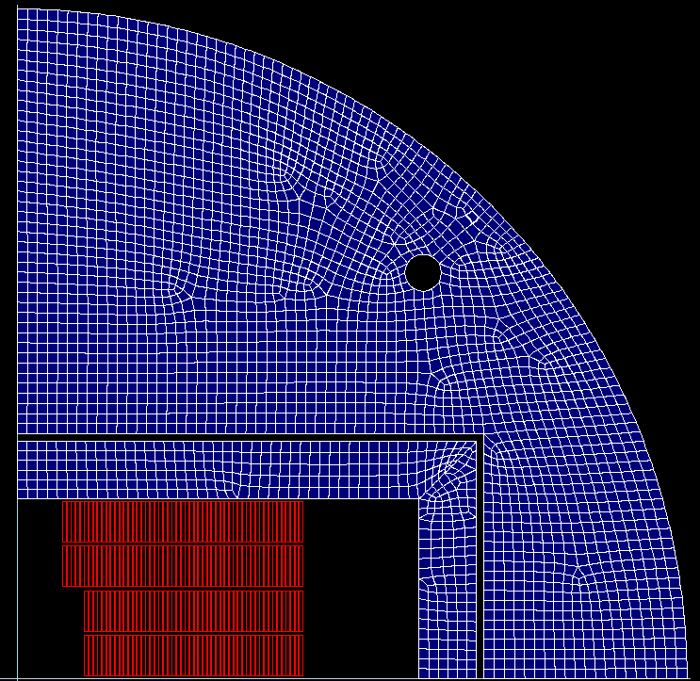
Design 1
RMM prototype cable
10 mm bore tube
2 double pancakes
210 turns
9.8 kA
16.0 T bore field
10 % margin
18.2 T short sample field at 4.2K

Slide 7
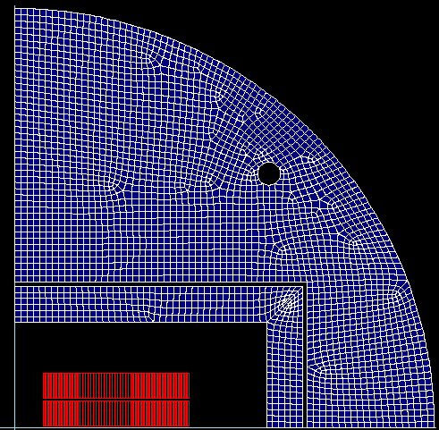
Design 1 - eRMC
RMM prototype cable
10 mm bore tube
1 double pancakes
110 turns
13.9 kA short sample current at 4.2 K
17.4 T short sample field at 4.2 K

Slide 8
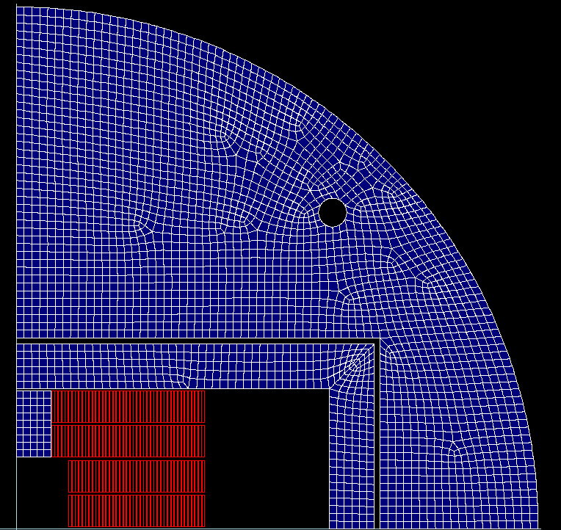
Design 2
RMM prototype cable
10 mm bore tube
2 double pancakes
170 turns
11.1 kA
16.0 T bore field
9 % margin
17.8 T short sample limit at 4.2K
→ 20 % gain in the # turns with an iron pole

Slide 9
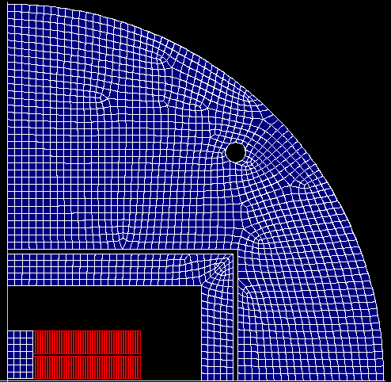
Design 2 - eRMC
RMM prototype cable
10 mm bore tube
1 double pancakes
90 turns
13.4 kA short sample current at 4.2 K
17.2 T short sample field at 4.2 K

Slide 10
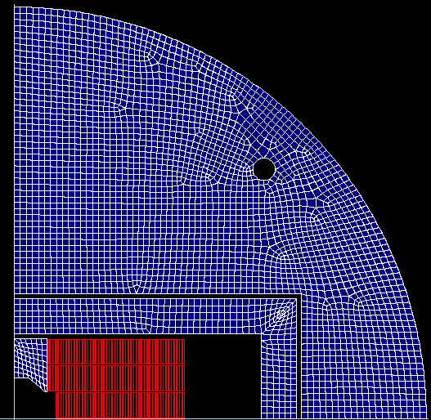
Design 3
RMM prototype cable
10 mm bore tube
3 pancakes
150 turns
11.0 kA
16 T bore field
10 % margin
17.8 T short sample limit at 4.2K

Slide 11
Load-lines comparison
10% margin

Slide 12
Design options using grading
High Field (HF) cable:
40 strands
1 mm diameter strands
Width = 21.32 mm
1:1 Cu:Sc ratio
78% packing factor
5% cabling degradation
Low Field (HF) cable:
19 strands
1 mm diameter strands
Width = 10.13 mm = 21.26/2
1:1.5 Cu:Sc ratio
78% packing factor
5% cabling degradation

Slide 13
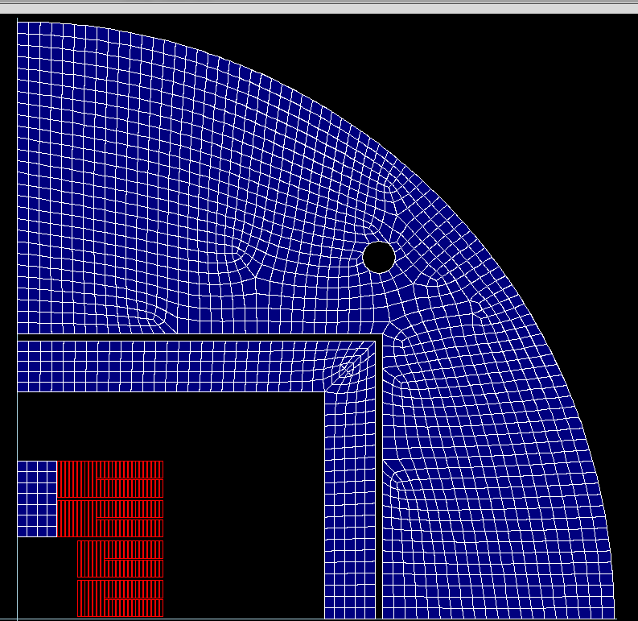
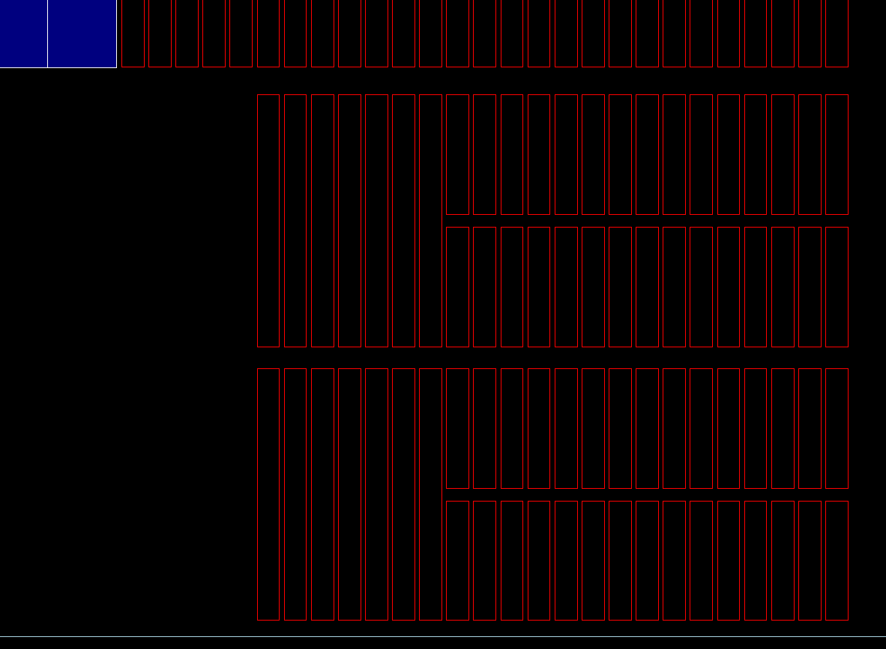
Design 4
grading
10 mm bore tube
2 double pancakes in the HF region + 2 4-pancakes in the LF region
34+128=162 turns
10.9 kA
16.0 T bore field
Margins: 10% (HF) – 14% (LF)
short sample limits at 4.2K: 17.8 T (HF) – 15.0 T (LF)

Slide 14
Load lines
LF load-line
15% margin
10% margin
HF load-line

Slide 15
Design options using grading
High Field (HF) cable:
29 strands
1 mm diameter strands
Width = 14.85 mm
1:1 Cu:Sc ratio
78% packing factor
5% cabling degradation
Low Field (LF) cable:
40 strands
0.7 mm diameter strands
Width = 14.85
1:1.2 Cu:Sc ratio
78% packing factor
5% cabling degradation

Slide 16
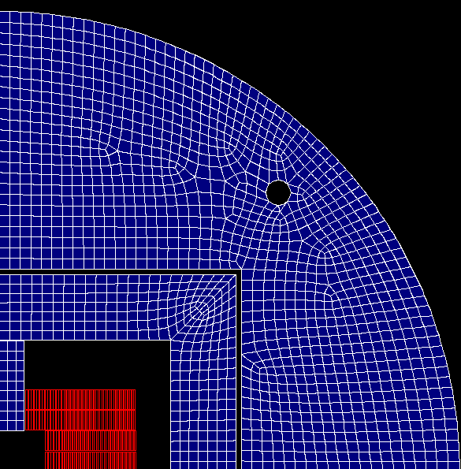
Design 5
grading
5mm bore tube
2 double
19+68 = 87 turns
8 kA
16.0 T bore field
Margins: 10% (HF) – 22% (LF)
short sample limits at 4.2K: 17.4 T (HF) – 15.7 T (LF)

Slide 17
Load Line

Slide 18
Protection

Slide 19
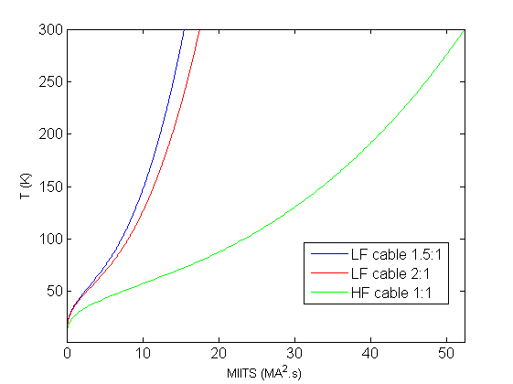
Protection
Protection very challenging!
What are the requirements for RMM?
Protection with quench heaters and/or CLIQ + dump?
 |  | Design 3 | Design 4 | Design 5
cu2sc | -- | 1 | 1/1.5 | 1/0.7
L_{d} | (mH/m) | 42 | 40 | 64
E | (kJ/m) | 2699 | 2500 | 2600
E_{d} | (MJ/m³) | 90.5 | 146 | 152
J_{cu} | (A/mm²) | 700 | 694/1217 | 702/953
J_{eng} | (A/mm²) | 350 | 347/730 | 351/520
Design 4
If we want to protect only with a dump:
 |  | Design 3 | Design 4 | Design 5
MIITs to reach 300K | -- | 58 | 58/17 | 28/16
Max. Voltage | (kV) | 1
R_{dump} for V_{max} | (kJ/m) | 91 | 92 | 125
Time for detection + validation + dump effective | (MJ/m³) | 25
MIITs discharge if "only dump" for 1 m length magnet | (A/mm²) | 59 | 55 | 35

Slide 20
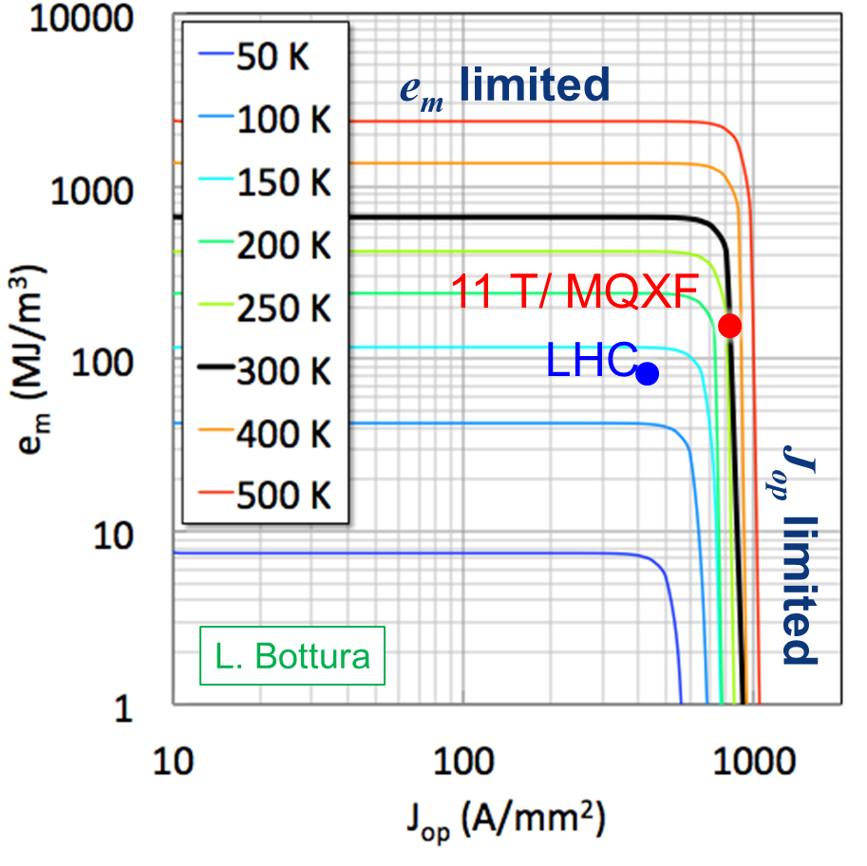
Protection
 |  | Design 3 | Design 4 | Design 5
cu2sc | -- | 1 | 1/1.5 | 1/0.7
L_{d} | (mH/m) | 42 | 40 | 64
E | (kJ/m) | 2699 | 2500 | 2600
E_{d} | (MJ/m³) | 90.5 | 146 | 152
J_{cu} | (A/mm²) | 700 | 694/1217 | 702/953
J_{eng} | (A/mm²) | 350 | 347/730 | 351/520
 | LHC MB dipole | DS-11T dipole | MQXF quadrupole
Field (T) /Gradient (T/m) | 8.3 | 11.2 | 132.5
Peak field in the conductor at I_{nom} (B_{p}), T | 8.6 | 11.6 | 11.4
Engineering current density (J_{eng}), A/mm² | 500 | 790 | 730
Stored energy at I_{nom,} MJ/m³ | 60 | 130 | 110
Differential inductance at I_{nom}, mH/m | 6.9 | 11.7 | 8.21
Magnetic length, m | 14.3 | 2 x 5.3 | 4x4.2/2x7.15
Temperature margin, K | 1.8-6.5 | 4.5-14.5 | 5.0-14.0

Slide 21
Where are we?
 |  | Design 3 | Design 4 | Design 5
w | (mm) | 96 | 69 | 69
B | (T) | 16 | 16 | 16
[E. Todesco]

Slide 22
Where are we?
 |  | Design 3 | Design 4 | Design 5
w | (mm) | 96 | 69 | 69
J_{overall} | (A/mm²) | 221 | 254/497 | 254/352
[E. Todesco]

Slide 23
Where are we?
 |  | Design 3 | Design 4 | Design 5
E_{d} | (J/mm³) | 0.090 | 0.146 | 0.152
J_{overall} | (A/mm²) | 221 | 254/497 | 254/352
[E. Todesco]

Slide 24
Summary
The “iron pole” solution is preferable, as the coil size can be reduced (for the case of no-grading by 20 %) keeping b3 saturation < 150 units.
Important decisions to be taken:
  Do we go for grading and “accelerator size” coil or known technology but big coil?
    If we go for grading:
      quench protection is a real issue! It will be difficult with the available strands to find a combination that provides enough margin in the load line and in terms of quench protection.
      3D magnetic analysis to start soon as it can have an impact on the 2D.
Next step:
  First iteration on mechanics for “Design 3” to define
    Minimum wall thickness of the bore
    Minimum outer magnet radius

Slide 25
Additional slides

Slide 26
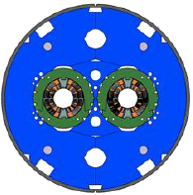
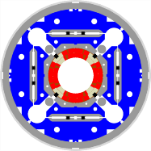
Protection – Reference for comparison
Main parameters for the high-field Nb₃Sn magnets for the LHC luminosity upgrade.
Comparing to the Main Bending LHC dipoles:
High stored energy density
(compact winding for cost reduction)
Low stabilizer fraction
(to achieve the desired margins)
Large temperature margin
(use Nb₃Sn as superconductor)
 | LHC MB dipole | DS-11T dipole | MQXF quadrupole
Field (T) /Gradient (T/m) | 8.3 | 11.2 | 132.5
Peak field in the conductor at I_{nom} (B_{p}), T | 8.6 | 11.6 | 11.4
Engineering current density (J_{eng}), A/mm² | 500 | 790 | 730
Stored energy at I_{nom,} MJ/m³ | 60 | 130 | 110
Differential inductance at I_{nom}, mH/m | 6.9 | 11.7 | 8.21
Magnetic length, m | 14.3 | 2 x 5.3 | 4x4.2/2x7.15
Temperature margin, K | 1.8-6.5 | 4.5-14.5 | 5.0-14.0

Slide 27
MIITs vs Tmax (Design 4)

Slide 28
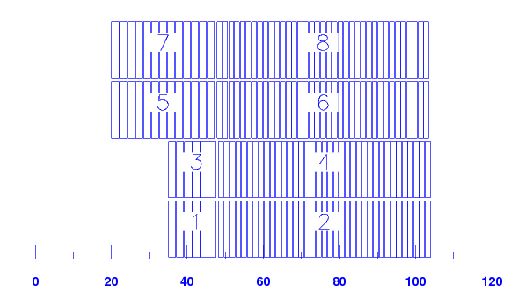
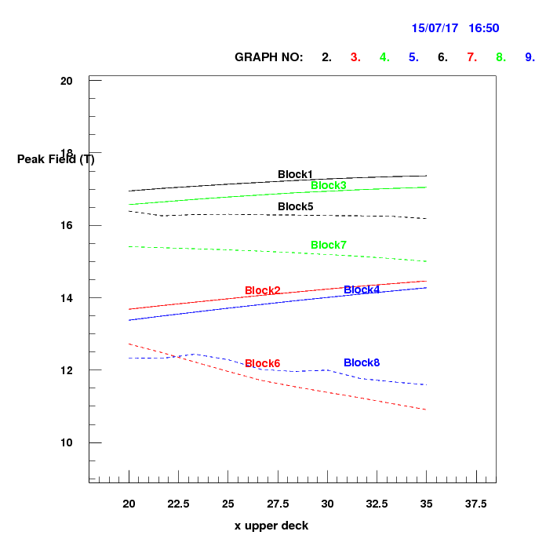
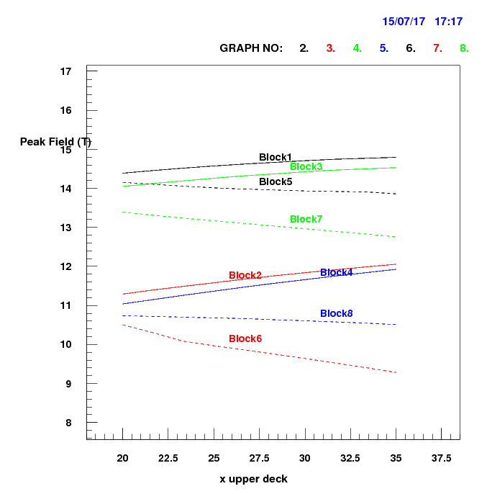
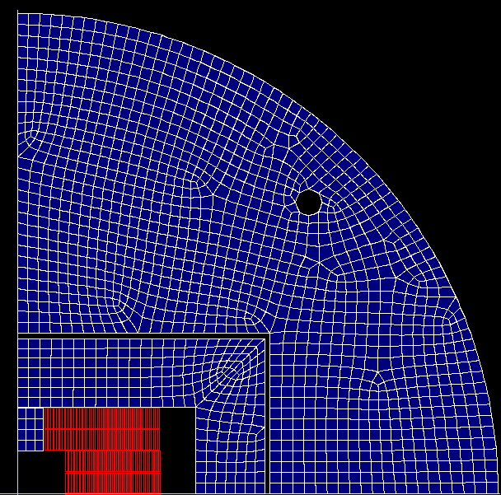
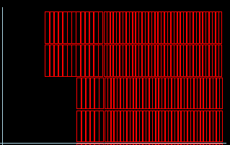
Longitudinal block position
Bp/Bo=0.997
Bp/Bo=0.957
Bp/Bo=1.03
Bp/Bo=1.09

