Slide 1
ERMC & RMM – Magnet Parameters
E. Rochepault, S. Izquierdo Bermudez – 13/09/2015

Slide 2
Design constraints
B_{o} = 16 T at 4.2 K with 10 % margin
Strand available or easy to procure
Winding should start January 2017 (cable should be ready for insulation two months before)
“Accelerator size”
Coil w~70 mm
Outer magnet diameter < 750-800 mm
Field Quality: b_{n} due to saturation < 10 units
Protected with dump + quench heaters (T_{max} < 350K )
Remark: Very difficult to satisfy all of them at the same time, we will need to set priorities!

Slide 3
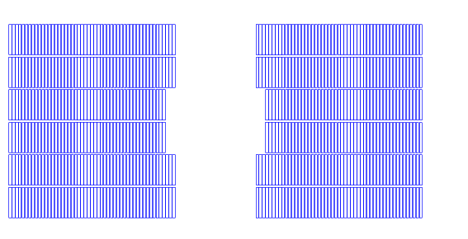
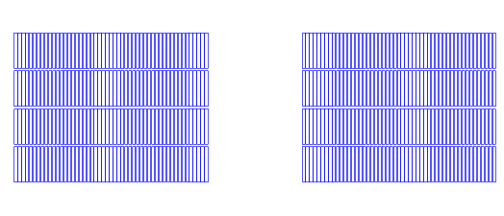
What we will try …
ERMC
RMM

Slide 4
Strand and cable parameters
Strand diameter:
Explored solutions: 1 mm – 1.1 mm
Proposal: 1 mm
J_{c}(12T,4.2K,wo self-field) = 3000 A/mm²
B_{c2}(12T,4.2K) = 25 T
Cu₂Sc ratio = 1.0-2.0
Can we go lower?
Cable packing factor ~ 80 %
Cable degradation = 5 %
Cable insulation thickness:
Explored solutions: 0.1 - 0.2 mm
Proposal: 0.150 mm

Slide 5
Strand diameter
Pros: In a block coil the magnet aperture and coil geometry are closely linked. Wider cable goes in the good direction for an efficient coil geometry, but it does not provide a significant improvement
Cons: Windability and Stability
FRESCA2 step back from 1.25 mm strand to 1 mm because the cable was declared “un-windable”
 |  | d=1.1 mm | d=1 mm
coil dimensions
number of conductors |  | 125 | 150
coil area (per aperture) | mm² | 29565 | 29843
coil area (per coil) | mm² | 14782 | 14922
w_{eq} | mm | 96.41 | 96.96
operation parameters
Inom | A | 13310 | 11000
Jsc | A/mm² | 700 | 700
Jcu | A/mm² | 700 | 700
Jeng | A/mm² | 350 | 350
Joverall | A/mm² | 225 | 221
No significant gain in terms of coil size

Slide 6
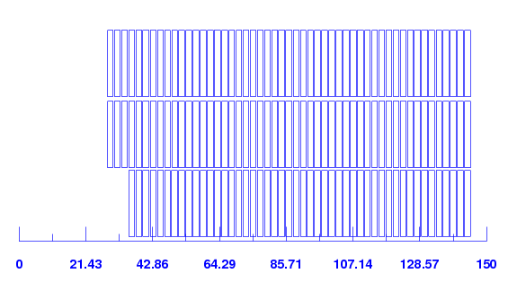
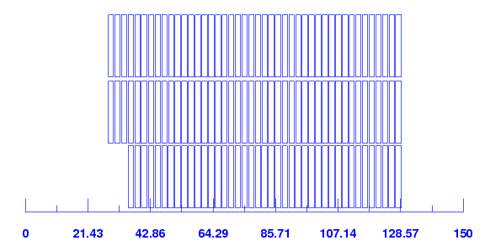
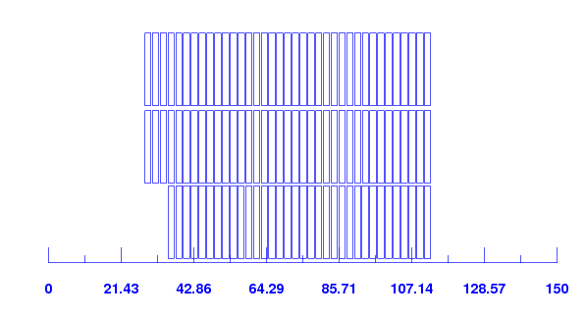
Copper to superconductor ratio
cu2sc |  | 1 | 0.8 | 0.6
number of conductors | -- | 150 | 129 | 108
coil area (per aperture) | mm² | 29843 | 25665 | 21487
coil area (per coil) | mm² | 14922 | 12833 | 10744
w_{eq} | mm | 96.96 | 88.49 | 79.33
operation parameters
I_{nom} | A | 11000 | 12200 | 13800
J_{sc} | A/mm² | 700 | 699 | 703
J_{cu} | A/mm² | 700 | 874 | 1171
J_{eng} | A/mm² | 350 | 388 | 439
J_{overall} | A/mm² | 221 | 245 | 277
Stored energy density | MJ/mm³ | 90.44 | 94.40 | 99.59
Differential inductance at Inom (per aperture) | mH/m | 42.07 | 30.67 | 21.14
Cu2sc = 1
Cu2sc = 0.8
Even if we reduce the copper to superconductor ratio to 0.6, we are still better in terms of protection than in MQXF and 11 T
Cu2sc = 0.6

Slide 7
Copper to superconductor ratio - Protection
 |  | cu2sc = 1 | cu2sc = 0.8 | cu2sc = 0.6 | MQXF | 11T
Insulated cable energy density | (J/mm³) | 0.0904 | 0.0944 | 0.0996 | 0.121 | 0.109
Insulated cable current density | (A/mm²) | 221 | 245 | 277 | 472 | 487
MIITS available | (MA²s) | 53.62 | 46.93 | 38.82 | 30.7 | 14.7
MIITS consumed decay | (MA²s) | 32.47 | 49.21 | 28.56 | 21.35 | 9.7
Time left to quench | (ms) | 175 | 119 | 54 | 34 | 35

Slide 8
Copper to superconductor ratio – Electromagnetic Forces
cu2sc |  | 1 | 0.8 | 0.6
number of conductors | -- | 150 | 129 | 108
coil area (per aperture) | mm² | 29843 | 25665 | 21487
coil area (per coil) | mm² | 14922 | 12833 | 10744
w_{eq} | mm | 96.96 | 88.49 | 79.33
operation parameters
F_{x} (per quadrant) at I_{nom} | kN/m | 8517 | 8289 | 8071
F_{y} (per quadrant) at I_{nom} | kN/m | -4519 | -4273 | -3980
F_{x}/CoilHeight at I_{nom} | MPa | 133 | 130 | 126
F_{y}/CoilWidth Midplane at I_{nom} | MPa | 41 | 46 | 52

Slide 9
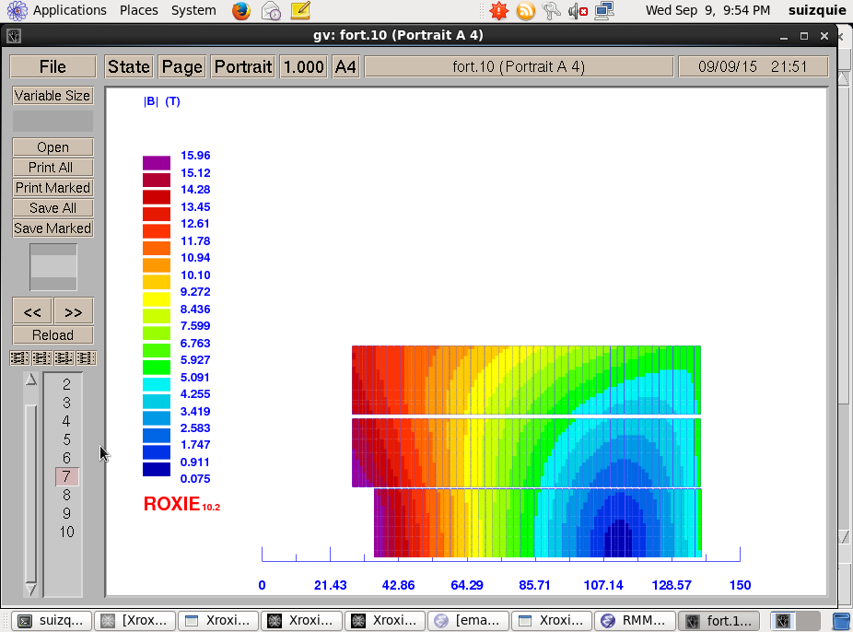
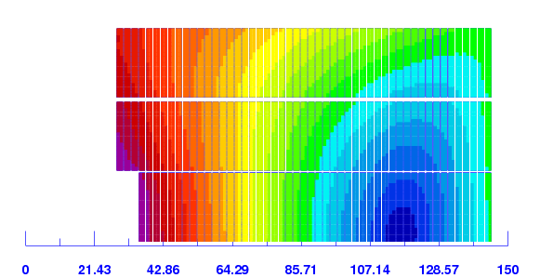
Insulation thickness
200 µm
150 µm
(cu2sc = 1) |  | 200 µm insulation | 150 µm insulation
coil dimensions
number of conductors |  | 147 | 150
coil area (per aperture) | mm² | 27841 | 29843
coil area (per coil) | mm² | 13920 | 14922
w_{eq} | mm | 92.97 | 96.96
operation parameters
Inom | A | 11000 | 11000
Jsc | A/mm² | 700 | 700
Jcu | A/mm² | 700 | 700
Jeng | A/mm² | 350 | 350
Joverall | A/mm² | 232 | 221
Nominal bore field/gradient at Inom | T | 15.95 | 15.95
Conductor peak field at Inom | T | 15.94 | 15.94

Slide 10
Insulation thickness
Conductor insulation for Hi-Lumi Magnets
11 T: 100 µm Mica-S2 glass
MQXF: 150 µm S2 glass
927 experience in terms of breakdown voltage for Nb3Sn coils:
SMC_3b#2 between 1.3 - 1.9kV
RMC_Cu between 2.6 - 2.9kV
MQXFS_001 around 3.5kV
MQXFS_101 around 6.25kV
11T#110 > 7kV (limit of the capacitor discharge generator)
For reference, MQXC#2 (NbTi) was tested to a maximum value of 5 kV
http://indico.cern.ch/event/395351/

Slide 11
Insulation
Proposal
Baseline insulation thickness 150 µm
Electrical robustness should be good enough, specially if we use Mica-S2 glass insulation
3 turns (out 150) less needed, to reach the same field (coil ~ 10 mm narrower)

Slide 12
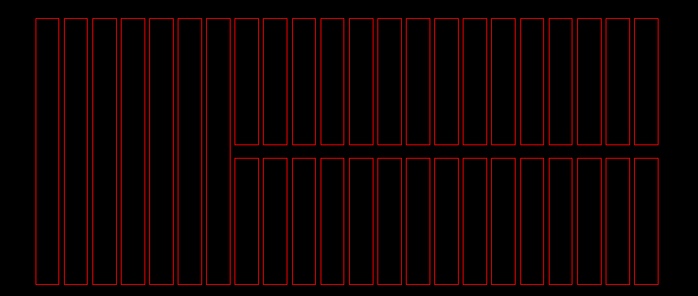
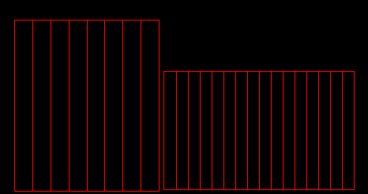
Cable geometry
Baseline parameters from EuroCirCol:
a “high-field” cable constituted of 40 wires that have a relatively large diameter (1-1.1 mm);
Cable w x t~ 21-23 x 1.82 mm
a “low field” cable constituted of 20 wires that have the same diameter as the wire used for the “high-field”. Non feasible to manufacture, some thinking needed.
A_{HF} /A_{LF} = 2
The low field cable will limit the design (see later with Etienne)
a “low field” cable constituted of 40 wires that have relatively small diameter (0.7 mm); Feasible to manufacture?
A_{HF} /A_{LF} = 2
Not very efficient

Slide 13
Cable parameters
Alternative solution # 1:
a “high-field” cable constituted of 40 wires that have a relatively large diameter (1-1.1 mm);
Cable w x t~ 21-23 x 1.8 mm
a “low field” cable constituted of Etienne? wires that have 0.7 mm diameter.
Cable w x t~ 21-23 x 1.4 mm
A_{HF} /A_{LF} = 1.3
Alternative solution # 2:
a “high-field” cable constituted of 29 wires that have 1.1 mm wire diameter;
Cable w x t~ 14.85 x 1.82 mm
a “low field” cable constituted of 40 wires that have 0.7 mm wire diameter ; (11 T)
Cable w x t~ 14.85 x 1.3 mm
A_{HF} /A_{LF} = 1.4

Slide 14
Feelings for grading with Alternative solution 1 or 2 (to discuss with Etienne)
If we want to have something that we can protect, we need to have cu2sc in the low field about 2.5; This will be ok if we are happy with 10 % margin in both low field and high field areas. Bernardo said that he wanted 20 % in the low field, but I think we can easily justify that the low field is in reality high field and that the load line is close to 11 T. We should plot 11 T load line together with LF/HF for the different designs
We should be able to get more or less the same coil size with the two grading levels
It seems it is going to be reasonable in terms of quench protection (see RMM_v12.data and RMM_v13.data). The designs are not exactly at 10 % margin, but we should be able to get something reasonable with more or less these numbers.
A solution with good field quality (without iron pole, close to RMM_v12.data and RMM_v13.data, further optimization of iron needed and refinement of the parameters to be at 10 % load line)
A solution with bad field quality (with iron pole, close to the ones Etienne is working in)

Slide 15
Feelings about grading
I didn’t find a solution that seems promising
We are really limited on the magnet design by low field cable
If we take cu2sc < 2, protection is even worse than in MQXF – 11T
If we take cu2sc > 2, to have 10 % margin in the low field, the current density in the low field is low, so it is getting less effective
Seems that a grading 2 to 1 is a bit too much

Slide 16
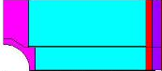
Size of the inner support structure
RMM First iteration:
conductor starts at x = 35 mm
35-50/2 = 10 mm
FRESCA2:
conductor starts at x = 58 mm
58-100/2 = 8 mm
HD2
conductor starts at x = 22.5 mm
22.5 – 36.2 = 6.5 mm
 |  | HD2 | FRESCA2* | RMM - no grading, 3 decks
I_{ss} 1.9 K | kA | 19.2 | 14.9 | 13.64
F_{x} per quadrant at I_{ss} 1.9 K | MN/m | 6.90 | 14.39 | 13.07
F_{y} per quadrant at I_{ss} 1.9 K | MN/m | -3.20 | -7.66 | -5.54
*FRESCA2 is designed to go to 15 T and not I_{ss} at 1.9 K (17 T)

Slide 17
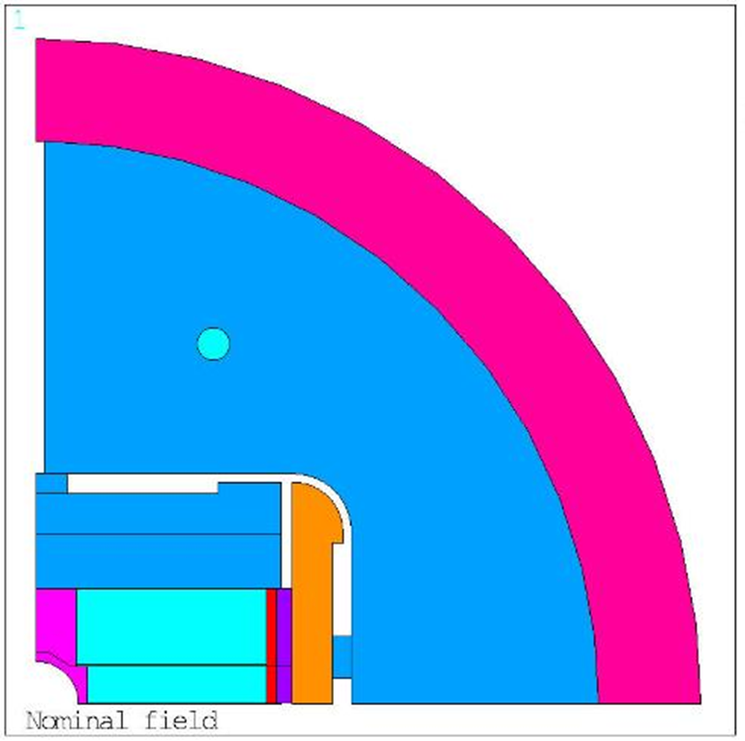
Overall magnet size
 |  | HD2 | FRESCA2* | RMM - no grading, 3 decks
I_{ss} 1.9 K | kA | 19.2 | 14.9 | 13.64
F_{x} per quadrant at I_{ss} 1.9 K | MN/m | 6.90 | 14.39 | 13.07
F_{y} per quadrant at I_{ss} 1.9 K | MN/m | -3.20 | -7.66 | -5.54
Outer Diameter | mm | 705 | 1003 | <750-780 (wish!)
Shell thickness | mm | 60 | 65 | 60-70
*FRESCA2 is designed to go to 15 T and not I_{ss} at 1.9 K (17 T)

Slide 18
Magnet Length?
For RMM, we should have a bit of straight section
Ends ~ 2 x 250 mm
Splice in case of grading ~ 150 mm
Layer jump ~ 250 mm
Straight section ~ 300 mm
TOTAL coil length ~ 1.2 m

Slide 19
Where are we?
Without grading ~ 100 mm
With grading ~ 70 mm
[E. Todesco]

Slide 20
Where are we?
Coil width:
Without grading ~ 100 mm
With grading ~ 70 mm
Overall current density:
J_{overall} ~ 220 A/mm²
J_{overall} ~ 250 A/mm² in the high field, 1.3 to 2 times higher in the LF
[E. Todesco]

Slide 21
Where are we?
J_{overall} ~ 220 – 250 A/mm2 in the high field (1.3 to 2 times higher in the LF in case of grading)
Energy density
Without grading : E_{d} ~ 0.09 J/mm³
With grading : E_{d} ~ 0.150 J/mm³
[E. Todesco]

