Slide 1
ERMC and RMM Magnet Design
S. Izquierdo Bermudez, J. C. Perez, R. Ortwein, E. Rochepault

Slide 2
Contents
Baseline design
Parametric study
  Margin on the load line
  Copper to superconductor ratio
  Strand diameter
  Insulation thickness
  Iron pole
Summary and next steps

Slide 3
Contents
Baseline design
Parametric study
  Margin on the load line
  Copper to superconductor ratio
  Strand diameter
  Insulation thickness
  Iron pole
  Size of the inner support structure
Summary and next steps

Slide 4
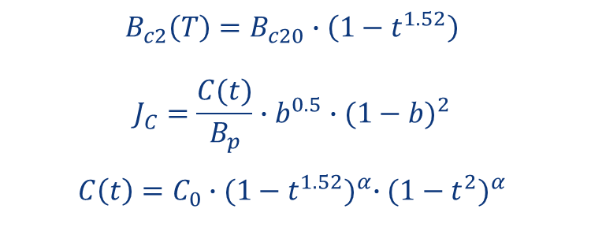
Strand
Strand diameter: 1 mm
Critical surface parametrization from EuroCircol, without self-field correction
Cu2SC ratio = 1.0
Critical current degradation due to cabling = 5 %
$$B_{c2}\left(T\right)=B_{c20}∙\left(1−t^{1.52}\right)$$
$$J_{C}=\frac{C(t)}{B_{p}}∙b^{0.5}∙{(1−b)}^{2}$$
$$C\left(t\right)=C_{0}∙{(1−t^{1.52})}^{α}∙{(1−t^{2})}^{α}$$
T_{c0} = 16 K, B_{c20} =28.8 T, α = 0.96, C₀ = 255230 A/mm² T

Slide 5
Cable and Insulation
FRESCA2 bare cable dimensions
Cable insulation thickness = 150 µm
  Can be either only S2-glass or S2-glass/Mica
  Experience in 927 in terms of electrical robustness:
      MQXF: 150 µm S2-glass
        MQXFS_001 ~ 3.5kV
        MQXFS_101 ~ 6.25kV
      11T: 150 µm S2-glass/Mica before HT, 100 µm S2-glass/Mica after HT
        11T#110: > 7kV (limit of the capacitor discharge generator)
 | Before HT | After HT
Bare width (mm) | 20.9 | 21.32
Bare thickness (mm) | 1.82 | 1.89
http://indico.cern.ch/event/395351/

Slide 6
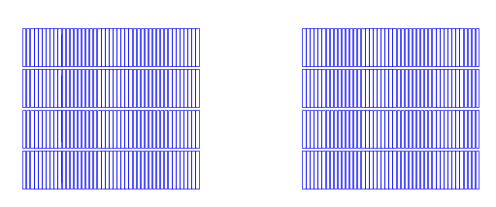
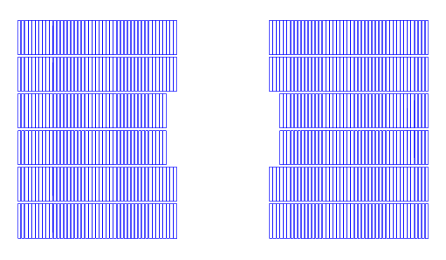
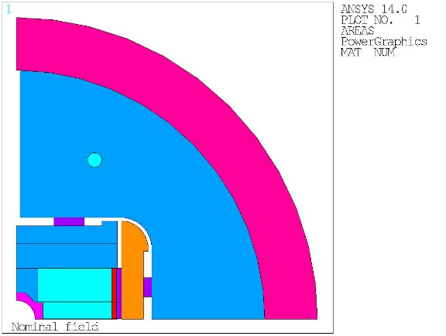
Coil cross section
Inter-Layer Insulation = 1.1 mm
  Other magnets:
    FRESCA2: 1.1 mm
    MQXF: 0.660 mm
    11T: 0.500 mm
Pole insulation = 0.550 mm
Same coils in ERMC and RMM
Size of the inner support structure:
10 mm is a conservative starting point:
FRESCA2 = 8 mm
HD2 = 6.5 mm
10 mm

Slide 7
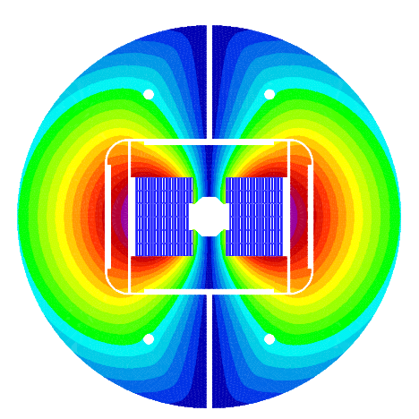
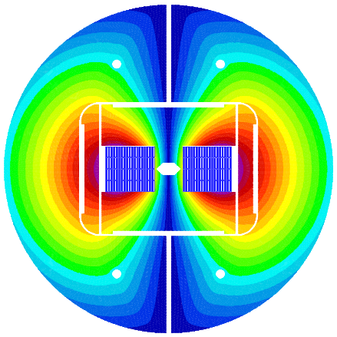
Magnet Cross Section
Outer diameter of the iron yoke = 660 mm
Same structure for ERMC and RMM
Aperture
  ERMC ~ 8 mm
  RMM = 50 mm

Slide 8
Load Line and Margin
Margin on the load line
  ERMC : 8 % for a coil peak field of 16 T at 4.2 K
  RMM : 10 % for a bore field of 16 T at 4.2 K

Slide 9
Operation Parameters
Operation Parameters
 |  | RMM | ERMC
Nominal current, I_{nom} | A | 11892 | 13805
SC current density, J_{sc} | A/mm² | 757 | 879
Cu current density, J_{cu} | A/mm² | 757 | 879
Cu + SC current density, J_{eng} | A/mm² | 379 | 439
Overall current density, J_{overall} | A/mm² | 251 | 292
Bore field at I_{nom} | T | 16.00 | 15.82
Conductor peak field at I_{nom} | T | 16.03 | 16.00
Short Sample Limits
 |  | RMM | ERMC
Short sample current I_{ss} at 4.2 K | A | 13195 | 14938
Coil peak field at 4.2 K, I_{ss} | T | 17.55 | 17.12
I_{nom}/I_{ss} at 4.2 K | % | 90 | 92
Short sample current Iss at 1.9 K | A | 14608 | 16556
Coil peak field at 1.9, Iss | T | 19.22 | 18.74
I_{nom}/I_{ss} at 4.2 K | % | 81 | 83

Slide 10
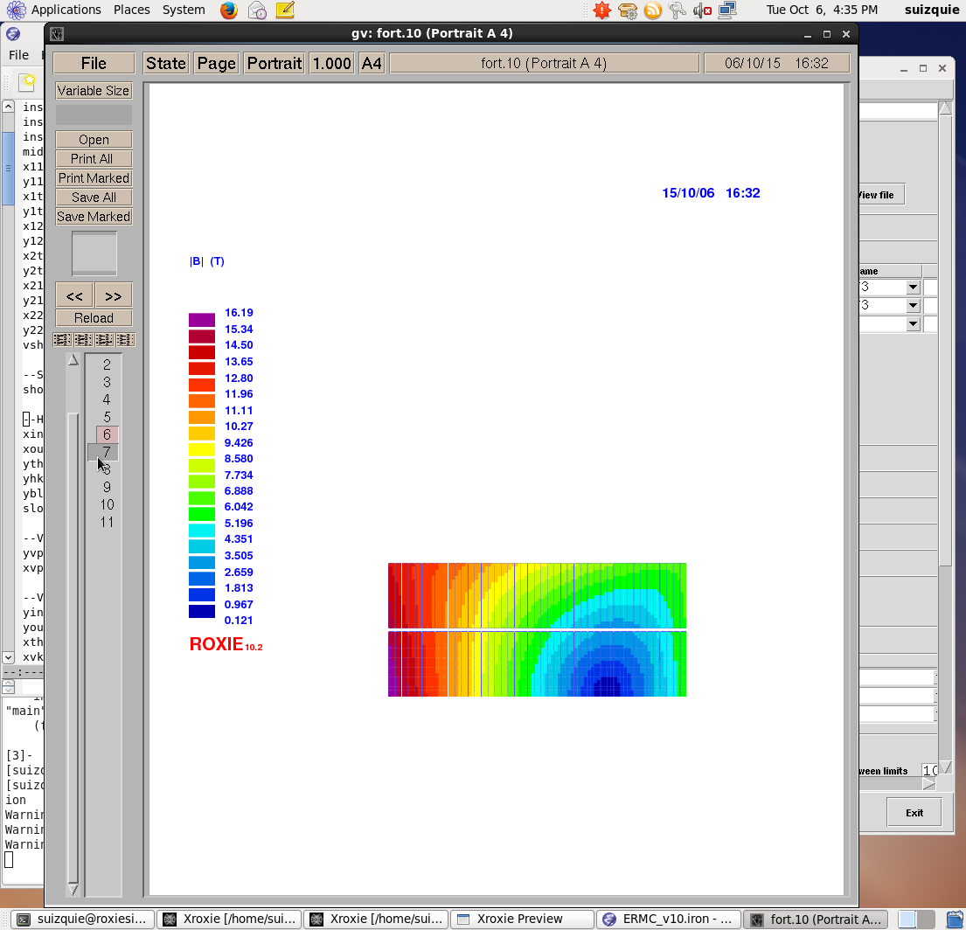
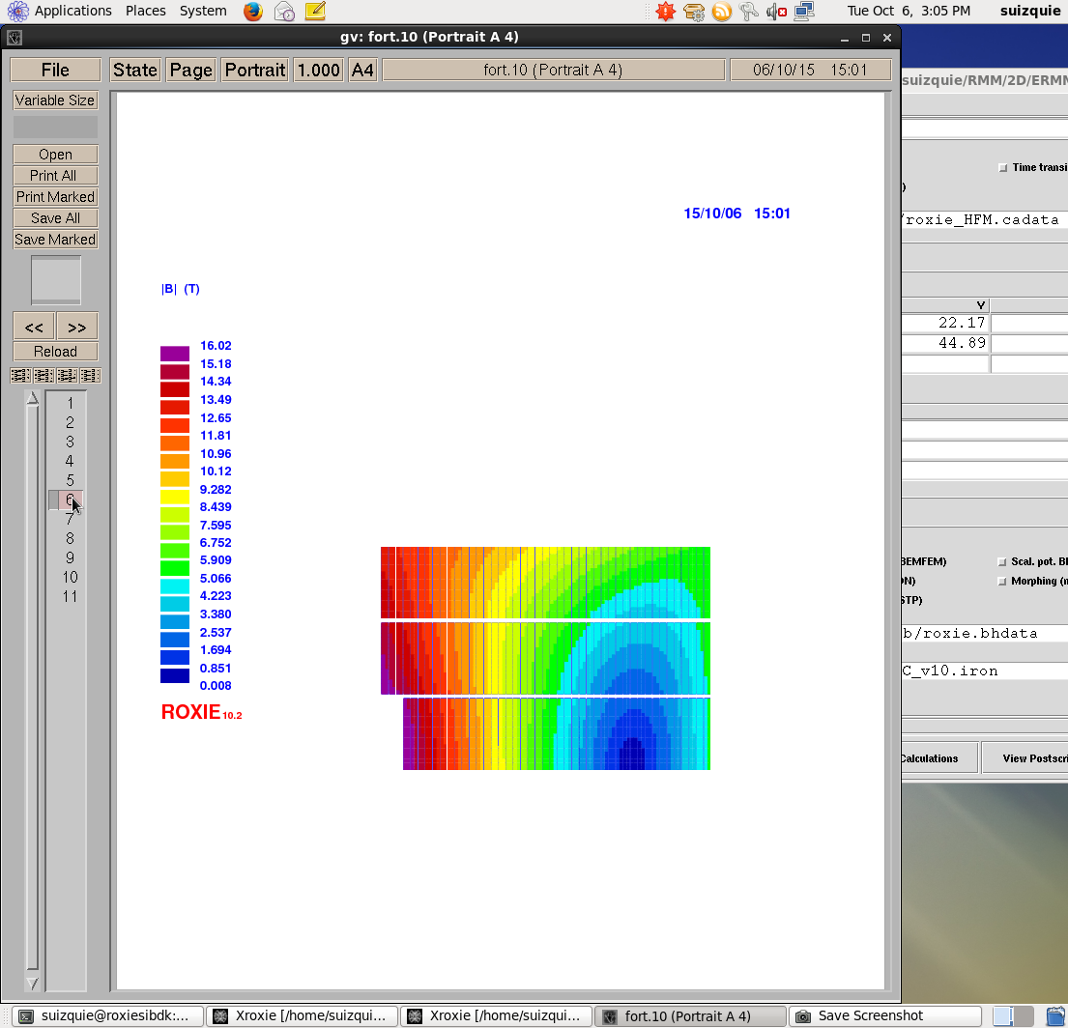
Coil Field at B₀ = 16 T
ERMC
  B_{p}/B_{o} = 1.097
RMM
  B_{p}/B_{o} = 1.002
98.5 mm
98.5 mm
45 turns
67.5 mm
45 turns
45 turns
45 turns
42 turns

Slide 11
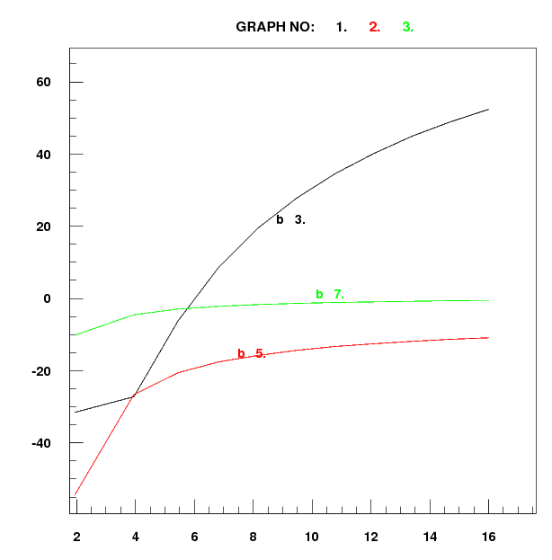
Field Quality
Rather large iron saturation effect due to the iron pole.
  100 units on b₃
  20 units on b₅
Can be slightly improved by further optimization on the iron shape.
See Parametric Study/Iron pole section for the high cost in terms of coil size of removing the iron pole.
bn (units)
Bo (T)

Slide 12
Electromagnetic Forces
 |  | 16 T | 18 T | 19.2 T (I_{ss} 1.9 K)
Fx (per quadrant) | kN/m | 8059 | 10250 | 11580
Fy (per quadrant) | kN/m | -4371 | -5848 | -6764
Fx/Coil Height | MPa | 124 | 158 | 179
Fy/Coil Width | MPa | -48 | -64 | -74
For reference, FRESCA2 @ 15 T
  Fx/Coil Height = 120 MPa
Design Constrains:
  Maximum outer diameter = 800 mm
  Structure should be OK up to 18 T

Slide 13
Mechanical design
DESIGN CRITERIA AS MQXF:
Pole-coil contact in pole-turns midpoint
p_{cont} ≥ 2 MPa
Max bladder pressure
< 50 MPa
Bladder should open the
interf=interf_{nom} + 100μm
All components σ ≤ R_{p 0.2}
For iron at 4.3K (brittle)
σ_{I} ≤ ~200 MPa
Material | R_{p 0.2} [MPa]
 | 293 K | 4.3 K
Al 7075 | 480 | 690
SS 316 LN | 286 | 930
NITRONIC 40 | 353 | 1240
MAGNETIL | 180 | 723
Ti 6Al 4V | 827 | 1654

Slide 14
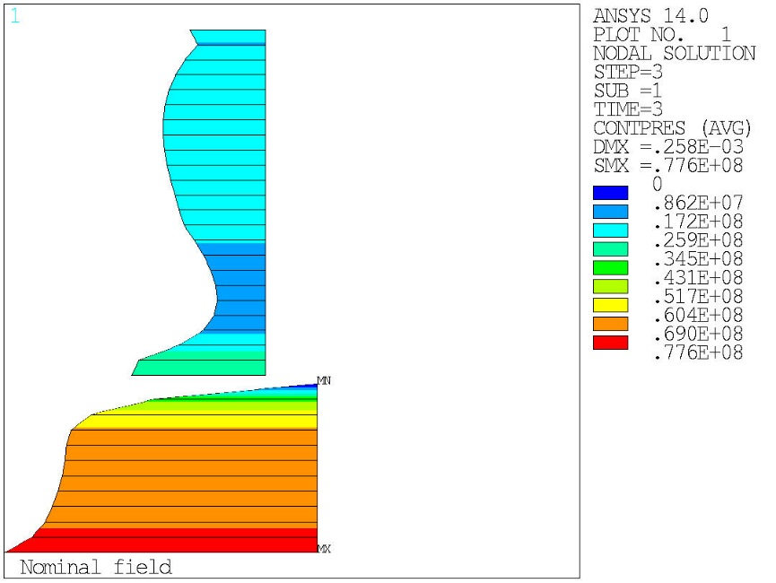
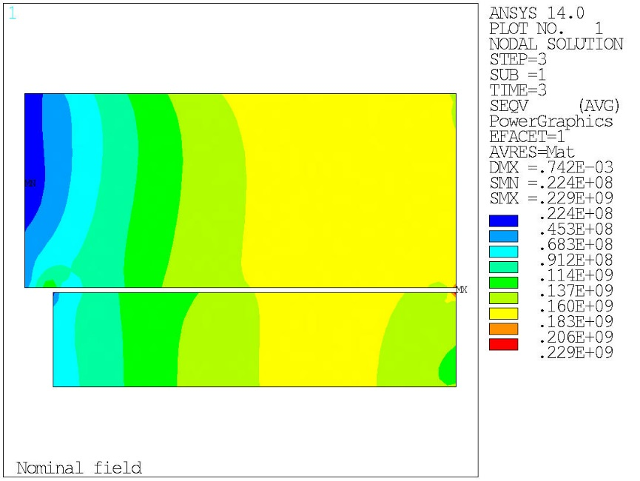
Mechanical design – 18 T
Shell thickness = 70 mm
Bladders pressure = 50 MPa
Position and dimension of the keys optimized to minimize the peak stress on the coil and have at contact pressure on the pole as uniform as possible.
Pole contact
20 MPa
60 MPa
Seq coil
180 MPa

Slide 15
Coil length
RMC coil dimensions
Proposal for ERMC-RMM
RMC does not half actual straight part, most of the central part is covered by the layer jump
241 mm
290 mm
820 mm
1200 mm
300 mm
600 mm
Top/Bottom coil: 2x45 turns
Middle coil: 2x42 turns
2x35 turns
Remark: For the “graded” solution, an option is to use the end region to do the splice. Options:
Have an structure that can accommodate 1.5 m coils even if the coils for the non-graded magnets will be 1.2 m.
For the graded solution, reduce the magnet straight section to < 100 mm

Slide 16
Cable unit length
ERMC coils |  |  |  | RMM middle pancake
Coil width | 290 | mm |  | Coil width | 290 | mm
Straigth part | 600 | mm |  | Straigth part | 600 | mm
Pole thickness | 30 | mm |  | Pole thickness | 60 | mm
Average winding radius | 160 | mm |  | Average winding radius | 175 | mm
Average winding path length | 2205 | mm |  | Average winding path length | 2300 | mm
Number of turns per double pancake | 90 |  |  | Number of turns per double pancake | 84
Total cable length per coil (no margin) | 198 | m |  | Total cable length per coil (no margin) | 193 | m
20% margin for possible design change | 238 | m |  | 20% margin for possible design change | 232 | m
Winding reserve | 25 | m |  | Winding reserve | 25 | m
Total required lenth/coil | 263 | m |  | Total required lenth/coil | 257 | m
Cable height | 21 | mm |  | Cable height | 21 | mm
Twist pitch | 100 | mm |  | Twist pitch | 100 | mm
Average length increase | 1.02 |  |  | Average length increase | 1.02
Number of strands per cable | 40 |  |  | Number of strands per cable | 40
Total required strand length/coil | 10.8 | km |  | Total required strand length/coil | 10.5 | km
To be cross-checked!
TOTAL required cable length/ERMC magnet | 526 | m
TOTAL required cable length/RMMC magnet | 783 | m
TOTAL required strand length/ERMC magnet | 21.5 | km
TOTAL required strand length/RMMC magnet | 32.0 | km

Slide 17
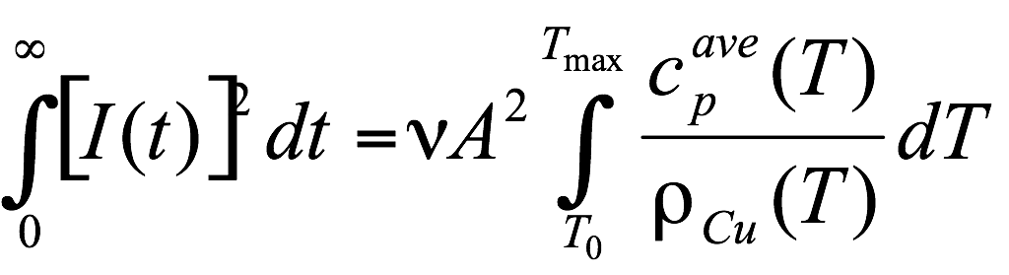
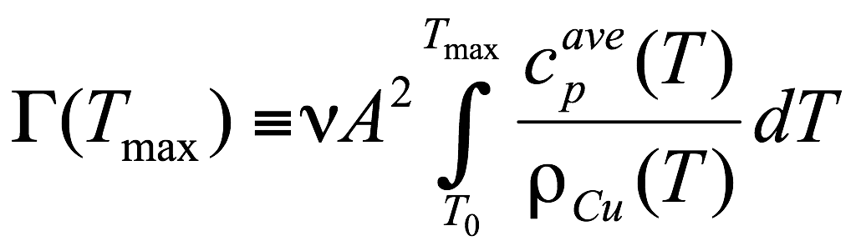
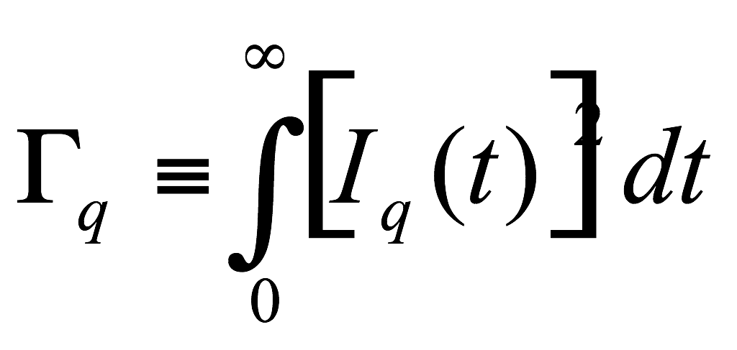
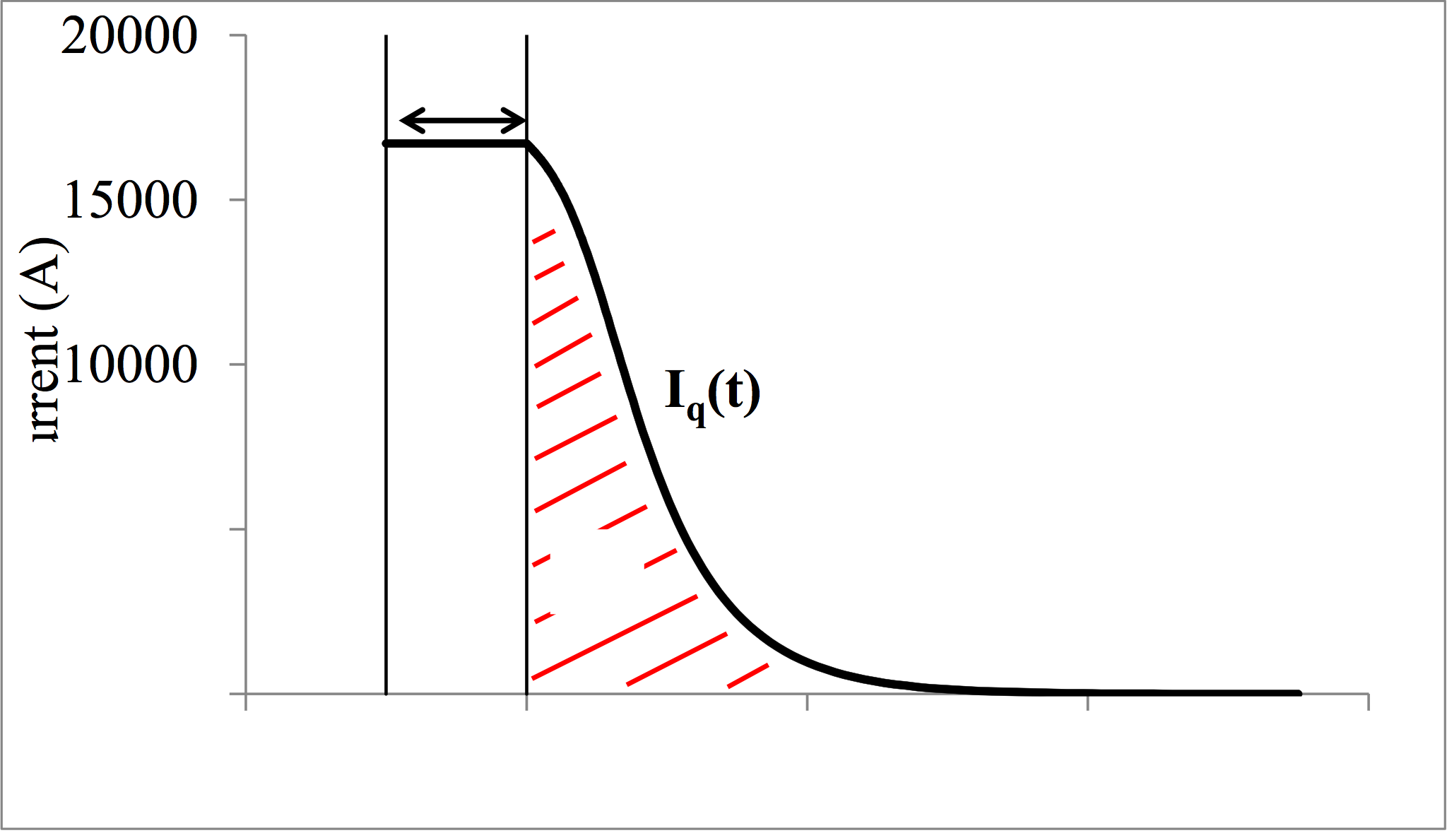
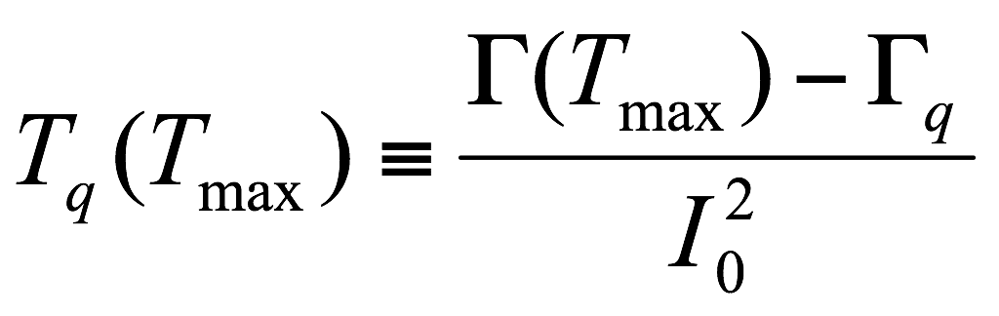
Protection
We use the concept of time margin to evaluate the margin in terms of quench protection and compare to other magnets:
Γ are the MIITs of the cable, the capital we can spend:
Γ_{q} are the MIITs of a quench where all magnet quenches at time = 0.
The time margin is the time we can stay at I0 to reach the capital margin

Slide 18
Protection
We have a lot of margin compared to Hi-Lumi LHC magnets (time margin ~ 35-40 ms) !!
Insulated cable energy density | (J/mm³) | 0.095
Insulated cable current density | (A/mm²) | 250
MIITS available | (MA²s) | 53
MIITS consumed decay | (MA²s) | 34
Time left to quench | (ms) | 133

Slide 19
Contents
Baseline design
Parametric study
  Margin on the load line
  Copper to superconductor ratio
  Strand diameter
  Insulation thickness
  Iron pole
Summary and next steps

Slide 20
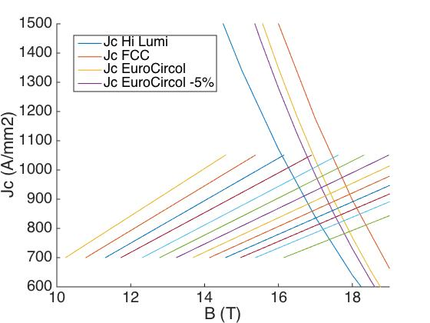
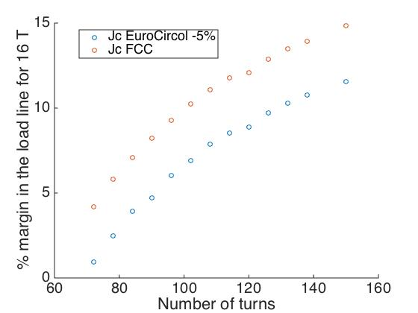
Margin on the load line
Number of turns need to reach 16 T @ 4.2 K with 10 % margin:
  132 turns assuming EuroCircol Critical Current Density and 5 % cabling degradation
  100 turns assuming minimum required for FCC
N = 72
N = 150

Slide 21
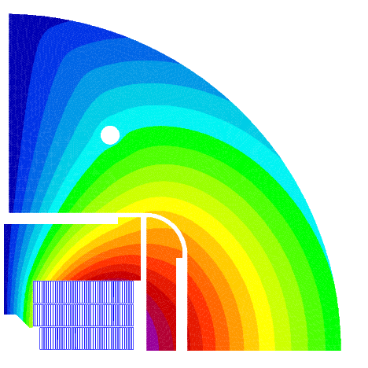
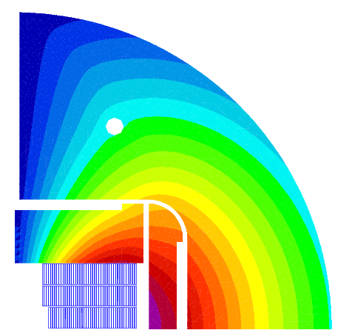
Iron pole
I_{nom} = 11862 A
B_{o} = 16.00 T
B_{p} = 16.03 T
I = 11862 A
B_{o} = 15.55 T
B_{p} = 15.99 T
To reach B_{o} = 16 T with 10 % margin at 4.2 K
  Additional number of turns = 24
  I_{nom} = 11016 A
  B_{o} = 15.55 T
  B_{p} = 15.99 T
For more efficient graded coils, the additional field given by the iron pole will be less critical

Slide 22
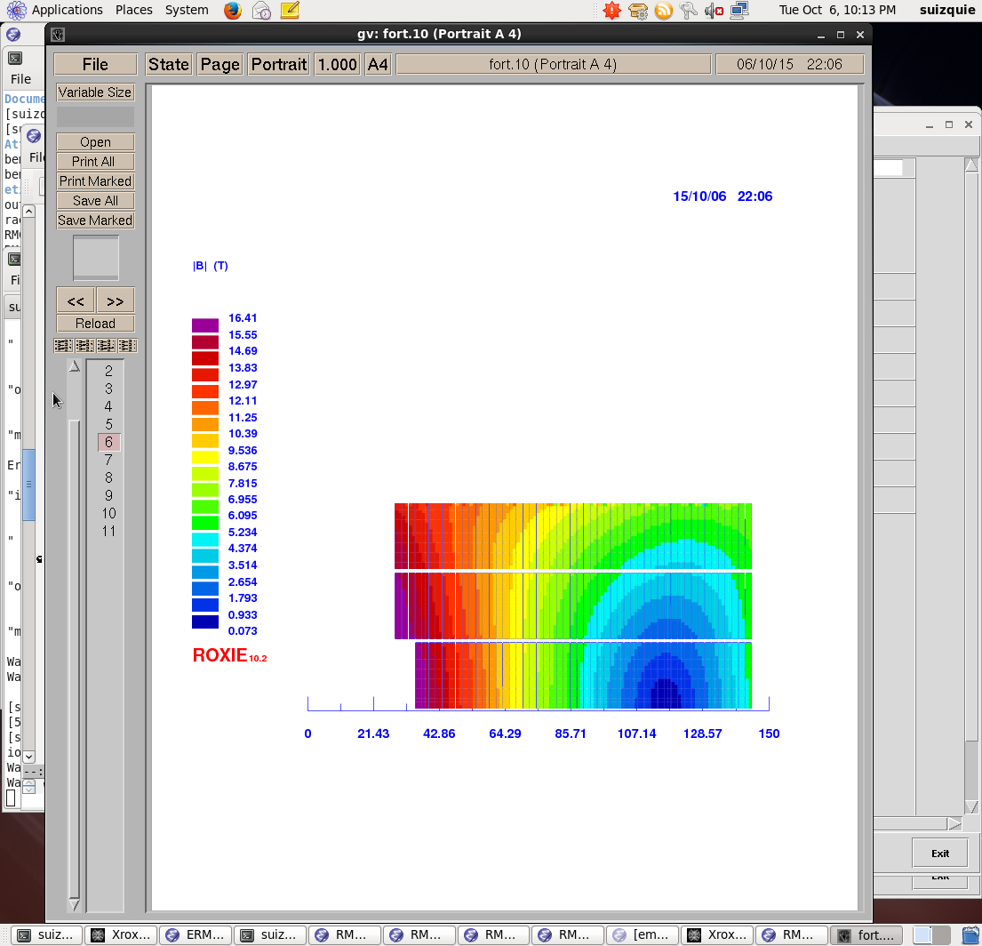
Iron Pole
45 turns
45 turns
With iron pole
42 turns
Without iron pole
53 turns
53 turns
50 turns

Slide 23
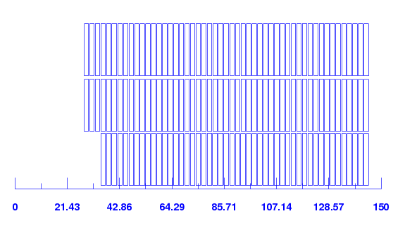
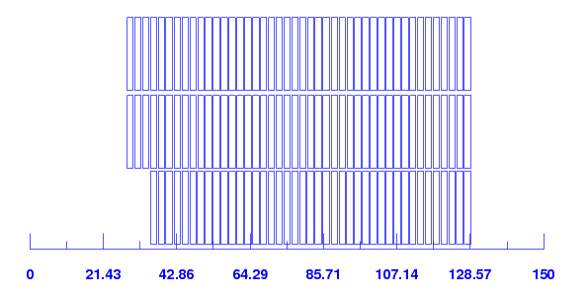
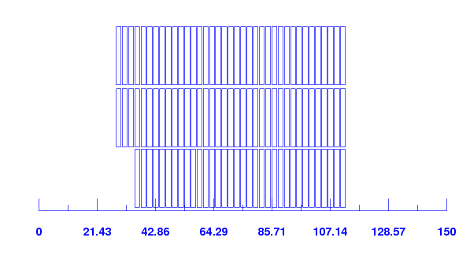
Copper to superconductor ratio
Copper to Supercondutor |  | 1 | 0.8 | 0.6
number of conductors | -- | 150 | 129 | 108
coil area (per aperture) | mm² | 29843 | 25665 | 21487
coil area (per coil) | mm² | 14922 | 12833 | 10744
w_{eq} | mm | 96.96 | 88.49 | 79.33
operation parameters
I_{nom} | A | 11000 | 12200 | 13800
J_{sc} | A/mm² | 700 | 699 | 703
J_{cu} | A/mm² | 700 | 874 | 1171
J_{eng} | A/mm² | 350 | 388 | 439
J_{overall} | A/mm² | 221 | 245 | 277
Stored energy density | MJ/mm³ | 90.44 | 94.40 | 99.59
Differential inductance at Inom (per aperture) | mH/m | 42.07 | 30.67 | 21.14
Cu2sc = 1
Cu2sc = 0.8
Remark:
The case cu2sc = 1 does not correspond to the “reference case”. Differences:
Conductor insulation thickness = 200 µm
Different critical surface
Cu2sc = 0.6
23

Slide 24
Copper to superconductor ratio
 |  | cu2sc = 1 | cu2sc = 0.8 | cu2sc = 0.6
Insulated cable energy density | (J/mm³) | 0.0904 | 0.0944 | 0.0996
Insulated cable current density | (A/mm²) | 221 | 245 | 277
MIITS available | (MA²s) | 53.62 | 46.93 | 38.82
MIITS consumed decay | (MA²s) | 32.47 | 49.21 | 28.56
Time left to quench | (ms) | 175 | 119 | 54
MQXF
(35 ms)
HD2
(48 ms)
11 T
(35 ms)
FrescaII
(200 ms)
TQ
(18 ms)
HQ
(25 ms)
HFD
(43 ms)
LHC MB (200-100 ms)
MQXC
(200-100 ms)

Slide 25
Strand diameter
cu2sc = 1
t_{ins} = 0.2 mm
Pros: In a block coil the magnet aperture and coil geometry are closely linked. Wider cable goes in the good direction for an efficient coil geometry, but it does not provide a significant improvement
Cons: Wind-ability and Stability
  FRESCA2 step back from 1.25 mm strand to 1 mm because the cable was declared “un-windable”
 |  | d=1.1 mm | d=1 mm
coil dimensions
number of conductors |  | 125 | 150
coil area (per aperture) | mm² | 29565 | 29843
coil area (per coil) | mm² | 14782 | 14922
w_{eq} | mm | 96.41 | 96.96
operation parameters
Inom | A | 13310 | 11000
Jsc | A/mm² | 700 | 700
Jcu | A/mm² | 700 | 700
Jeng | A/mm² | 350 | 350
Joverall | A/mm² | 225 | 221
No significant gain in terms of coil size

Slide 26
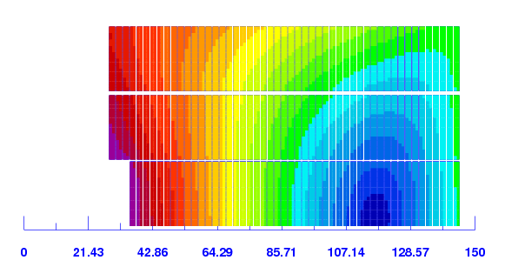
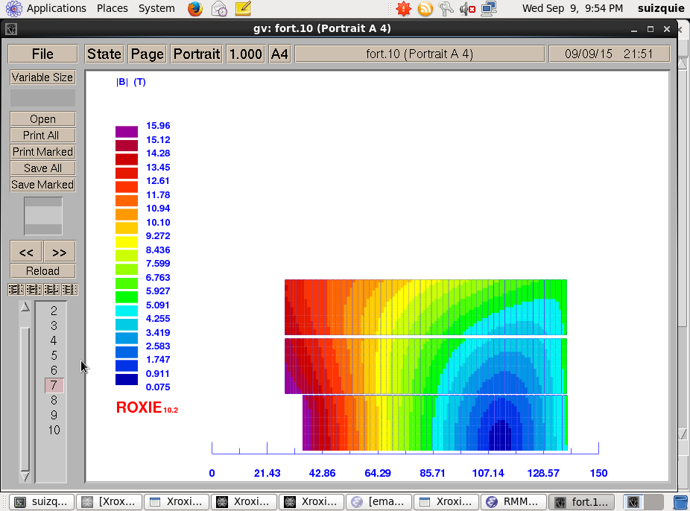
Insulation thickness
cu2sc = 1
d_{strand} = 1 mm
 |  | t=0.15 mm | t=0.2 mm
Coil dimensions
number of conductors |  | 147 | 150
coil area (per aperture) | mm² | 27841 | 29843
coil area (per coil) | mm² | 13920 | 14922
w_{eq} | mm | 92.97 | 96.96
Current density
I | A | 11000 | 11000
Jsc | A/mm² | 700 | 700
Jcu | A/mm² | 700 | 700
Jeng | A/mm² | 350 | 350
Joverall | A/mm² | 232 | 221
Interesting gain in terms of coil size

Slide 27
Contents
Baseline design
Parametric study
  Margin on the load line
  Copper to superconductor ratio
  Strand diameter
  Insulation thickness
  Iron pole
Summary and next steps

Slide 28
Summary and next steps
We have a baseline design for non-graded coil.
Next steps on the development of the non-graded magnet:
  Detailed mechanical design including assembly features and longitudinal loading
  CAD (we need a designer by mid-November)
Parallel development
  Graded design
    The most promising given the constrains on strand/cable is 4 decks using 15 mm cable, combining 0.7/1 mm strand
    Internal splices on Nb3Sn-Nb3Sn

Slide 29
Additional slides

Slide 30
ERMC – 4.2 K

Slide 31
ERMC – 1.9 K

Slide 32
RMM – 4.2 K

Slide 33
RMM – 1.9 K

