Slide 1
DT Group Meeting
Engineering Contributions to Atlas and Neutrino Platform
June 22, 2017
Andrea Catinaccio

Slide 2
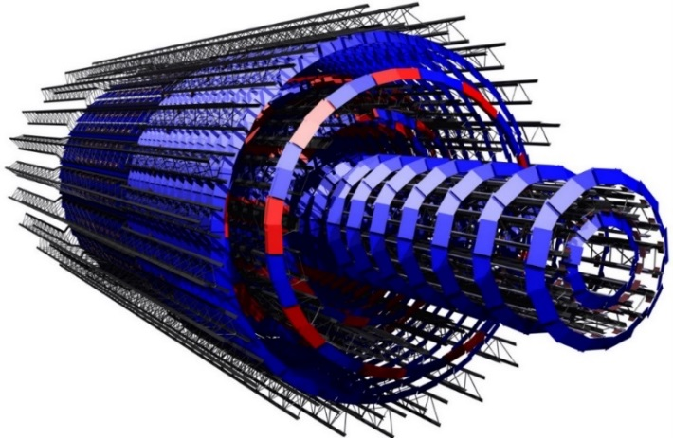
Outline
Two engineering projects:
  Atlas ITk Pixel Upgrade
  Neutrino Dune LBNF
Involving a number of DT resources today and in the future
Supported by WP agreements
Many other activities in EO
are summarised in annex
Atlas Pixel Upgrade
Neutrino LBNF Cryostat

Slide 3
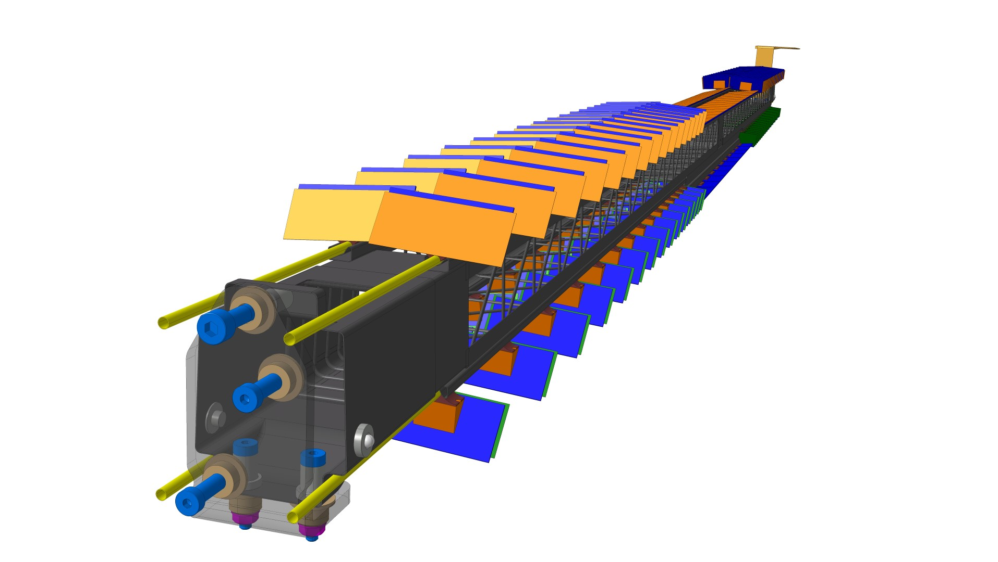
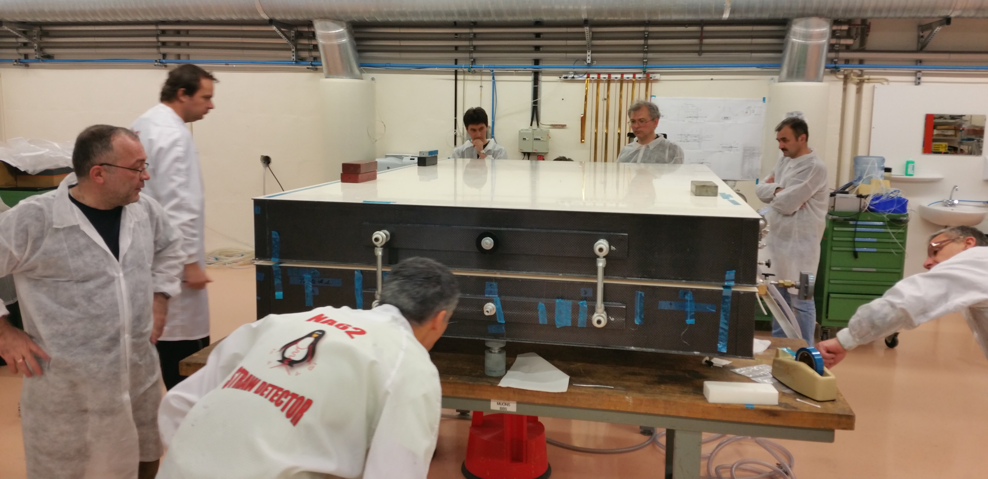
WP between the ATLAS and EP-DT: 2017-2021
https://edms5.cern.ch/document/1735463/1 updated on 16/5/17
Areas of collaboration for engineering activities (as well as M&O, Services)
.
Consolidation
New detector Projects
TRT, ID, IBL, nSQP, Muon Big Wheels, Atlas Alfa, Atlas AFP Roman Pots, Small wheels (Micromegas, Module 0 completed !)
Pixel Upgrade
CERN groups will contribute at 10% of the ITK Core
DT collaborates in the Development and Construction of the Pixel, plus common items and integration (EDMS 1569301)
Two phases:
Development towards TDR completion (2017 – 2018)
Detector construction phase (2019 – LS3)

Slide 4
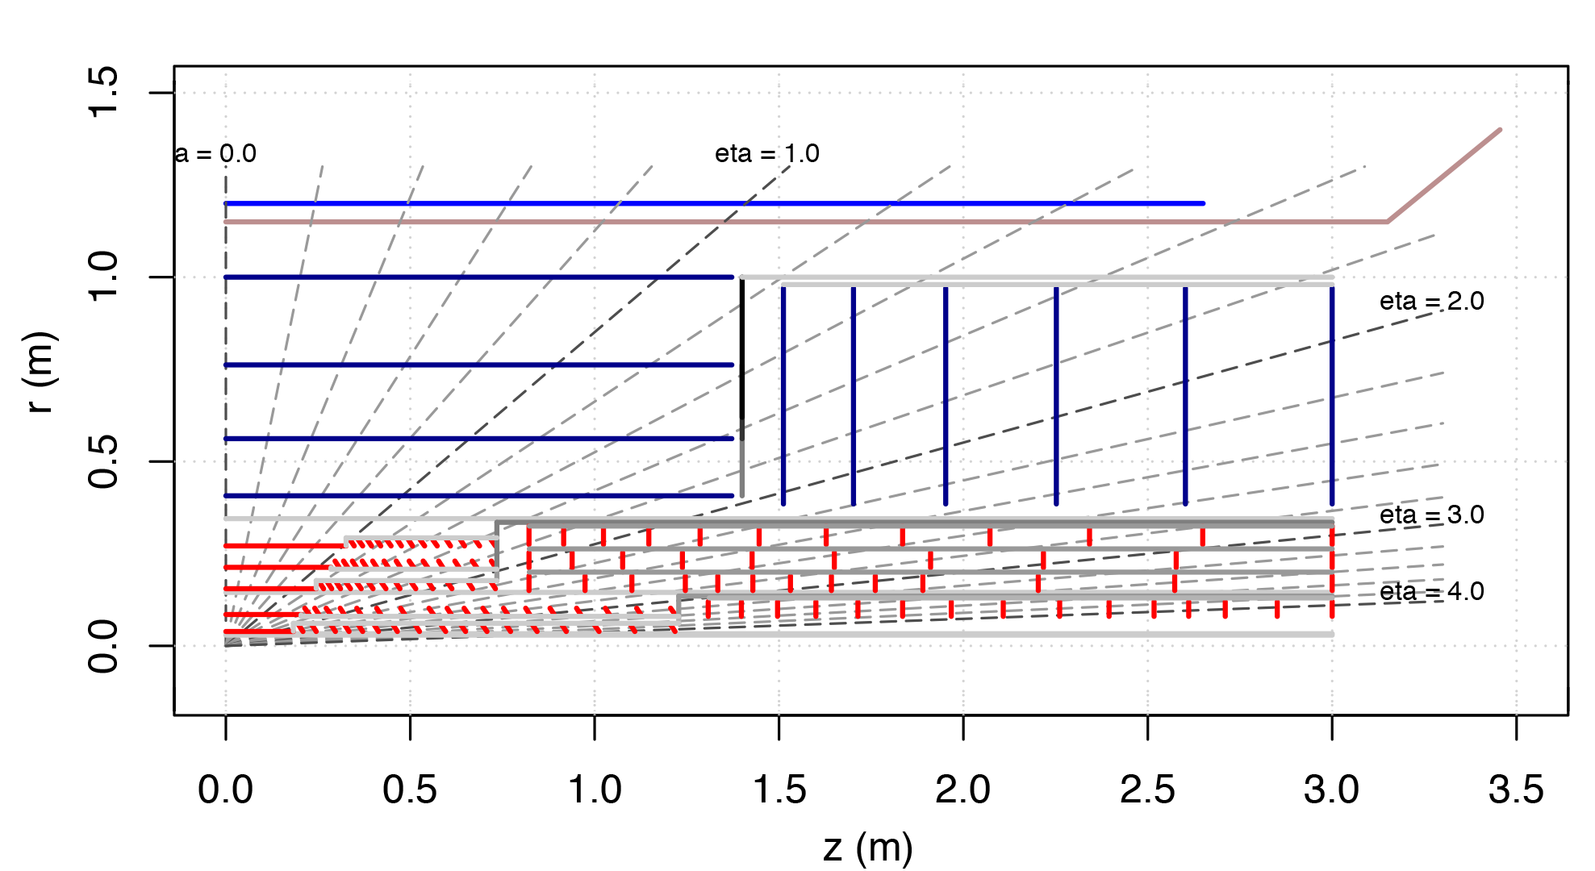
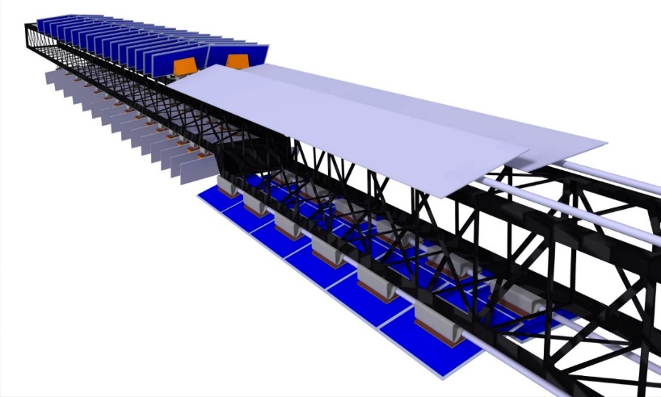
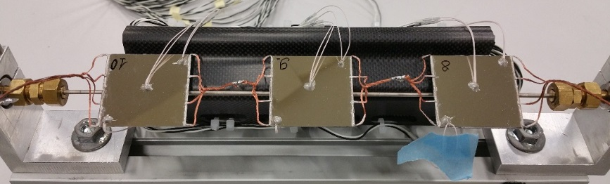
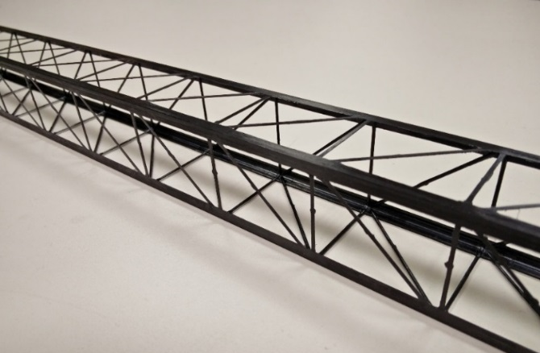
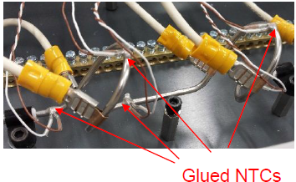
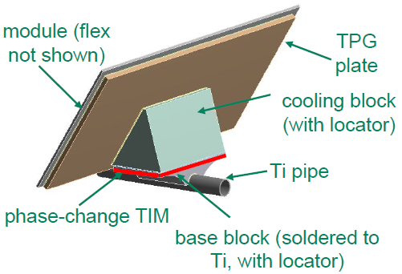
(1) R&D work towards TDR completion (2017 – 2018)
Development work:
  Mechanical design of a Pixel Barrel - inclined layout proposal
  C-composite structures, advanced materials, thermo-mechanical solutions, and global structures.
Tilted cell
Longeron
Barrel cell
Single cells and “triplets” have been manufactured and tested (TFM validation)
TRUSS Longeron
(“hybrid” construction)
~ 40g/m
“Looping” pipe concept

Slide 5
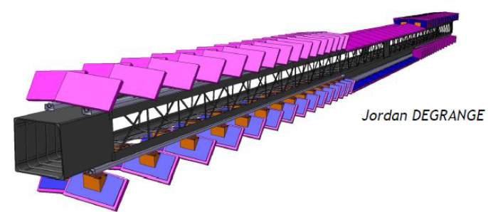
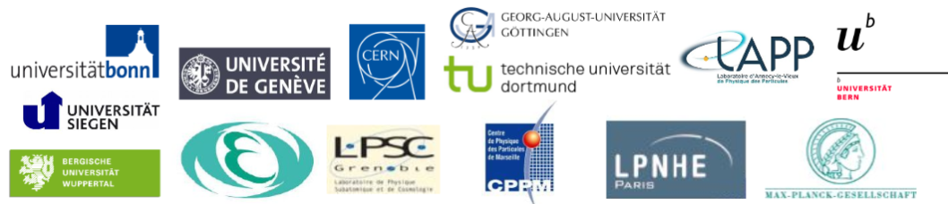
(1) R&D work towards TDR completion (2017 – 2018)
2. Construction of so-called “Pixel Demonstrator Programme” .
  A full-length active stave – thermo-mechanical and electrical validation at CERN
  DT with ADE: contribute and coordinate the collaboration work with several ATLAS institutes on the Pixel inclined solution
  ~ 200 modules on 4 lines
Two year programme launched at the end of 2016
  Engineering Prototypes (several)
  Loading, integration, re-workability and survey
  System test

Slide 6
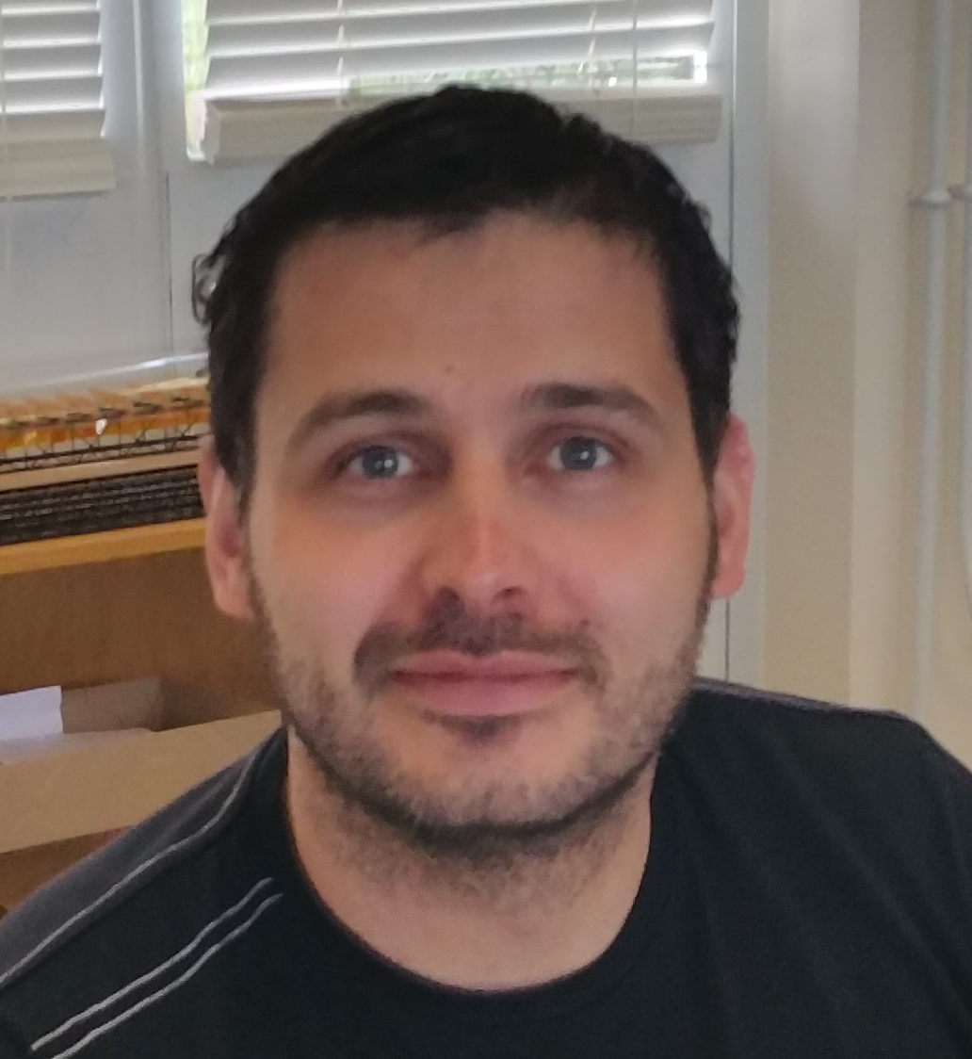
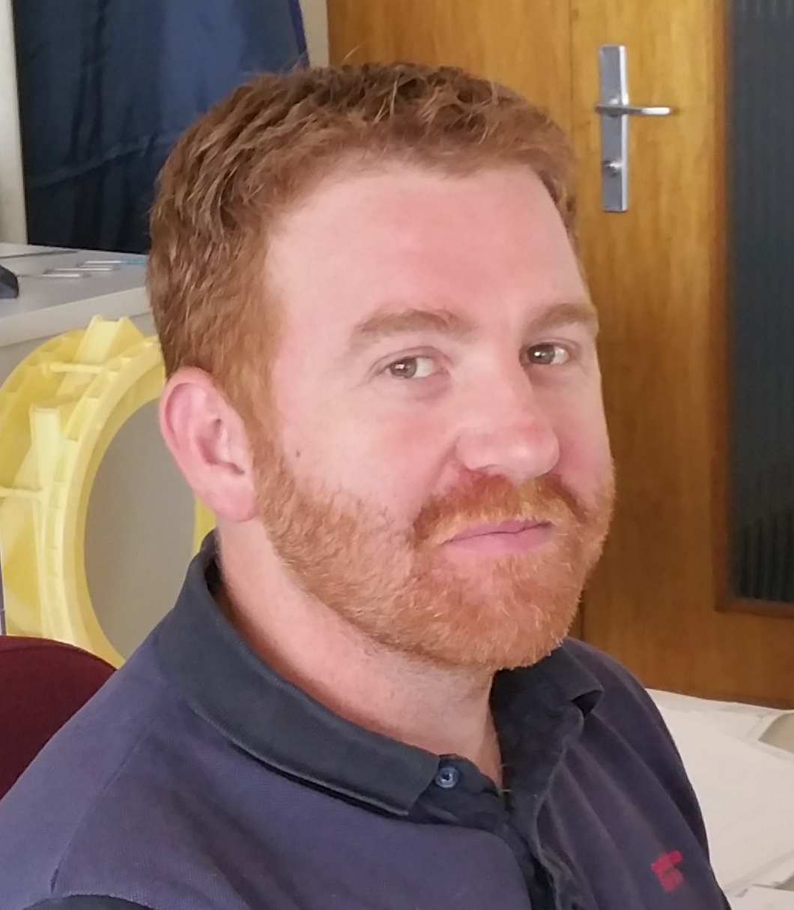
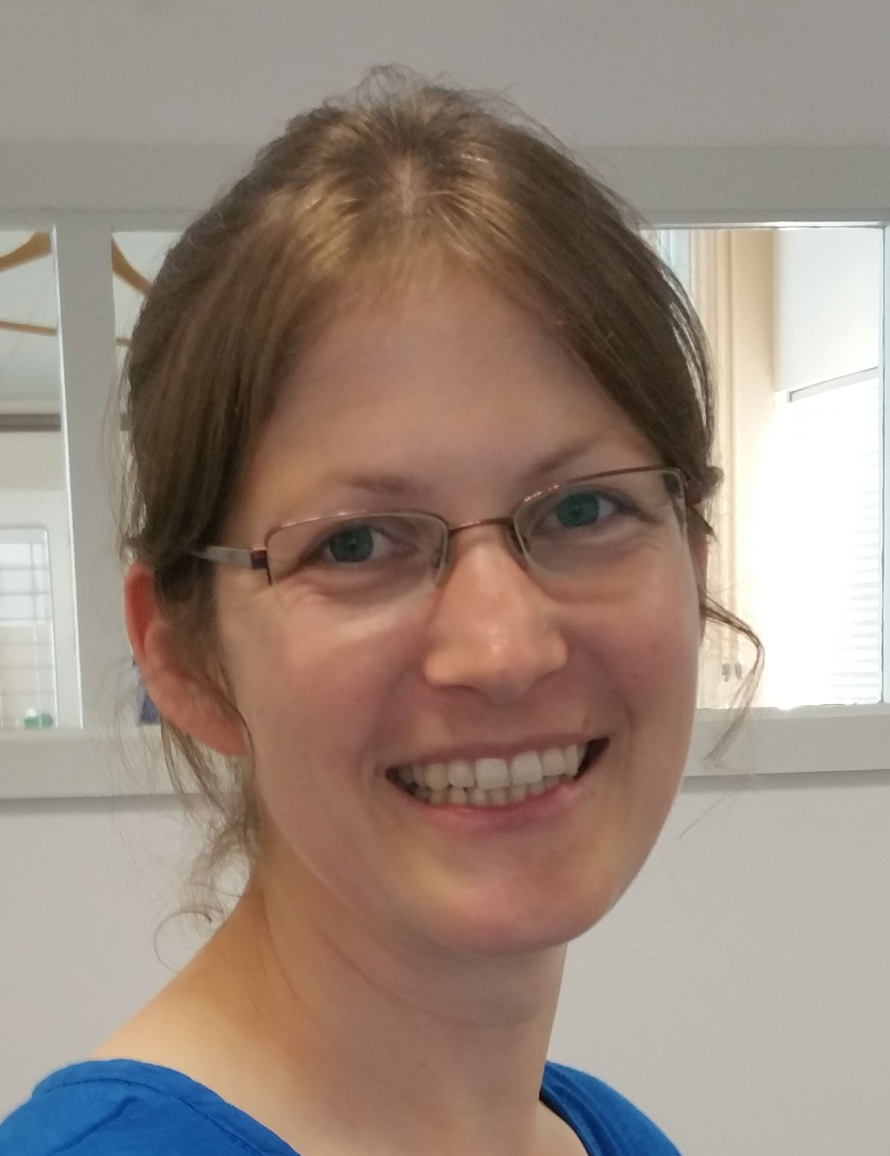
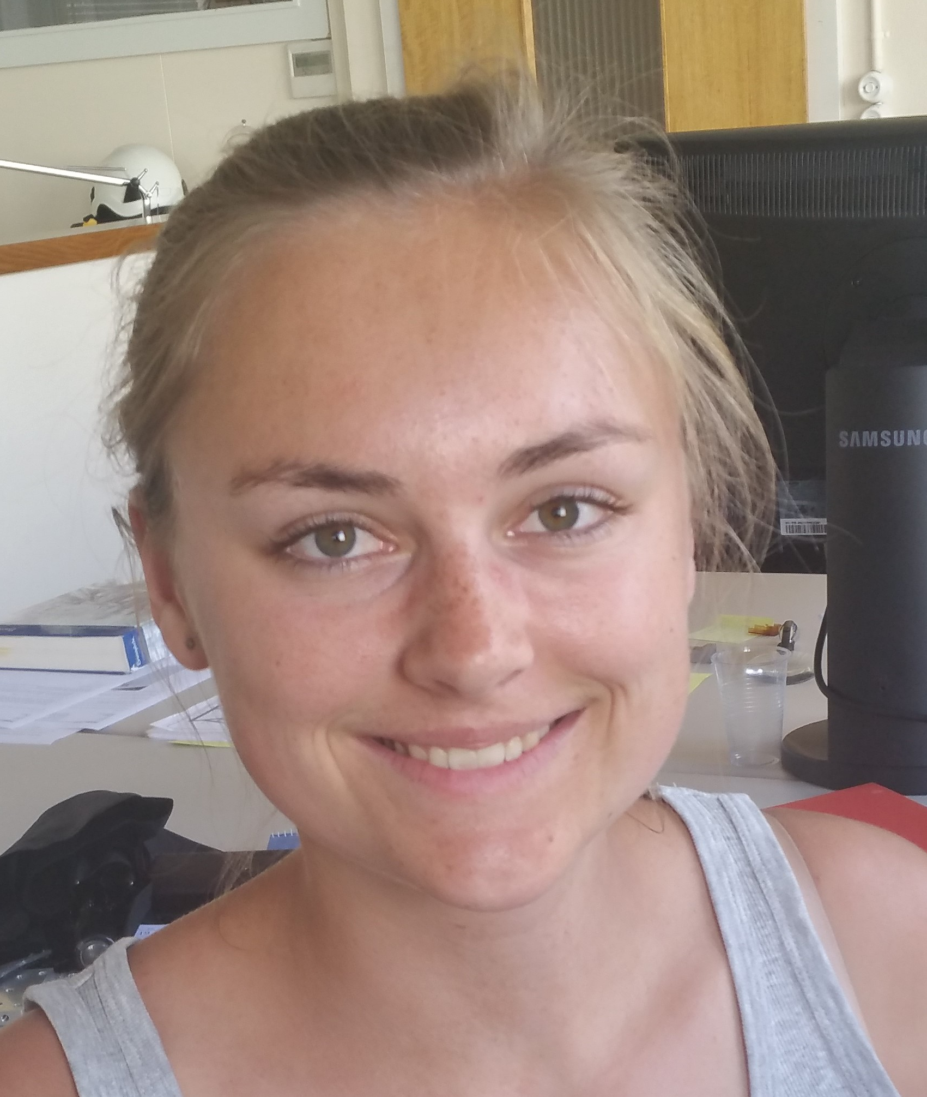
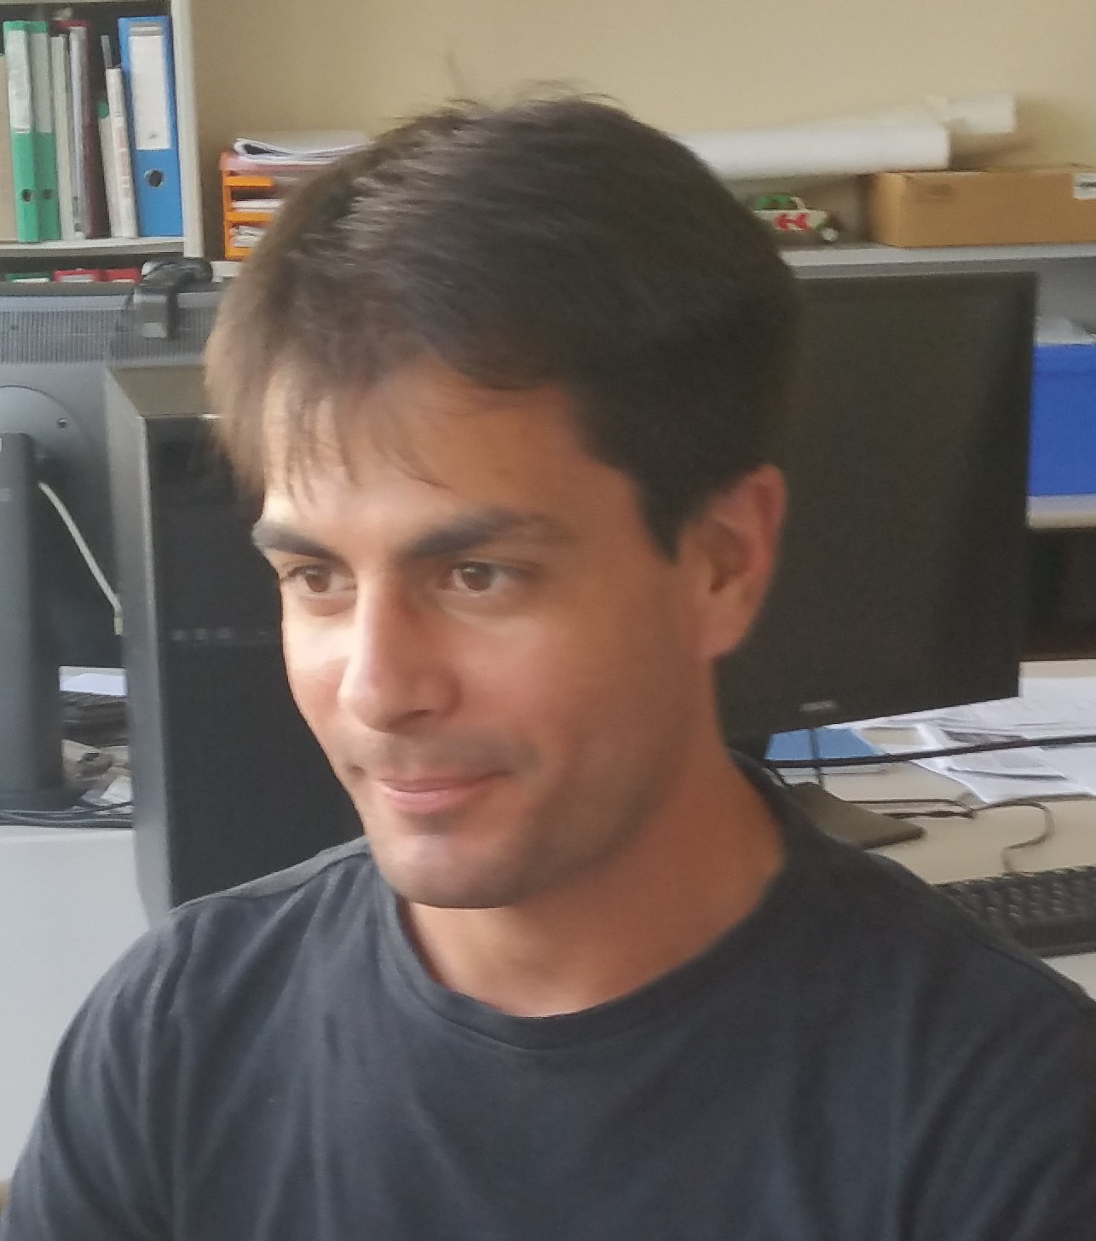
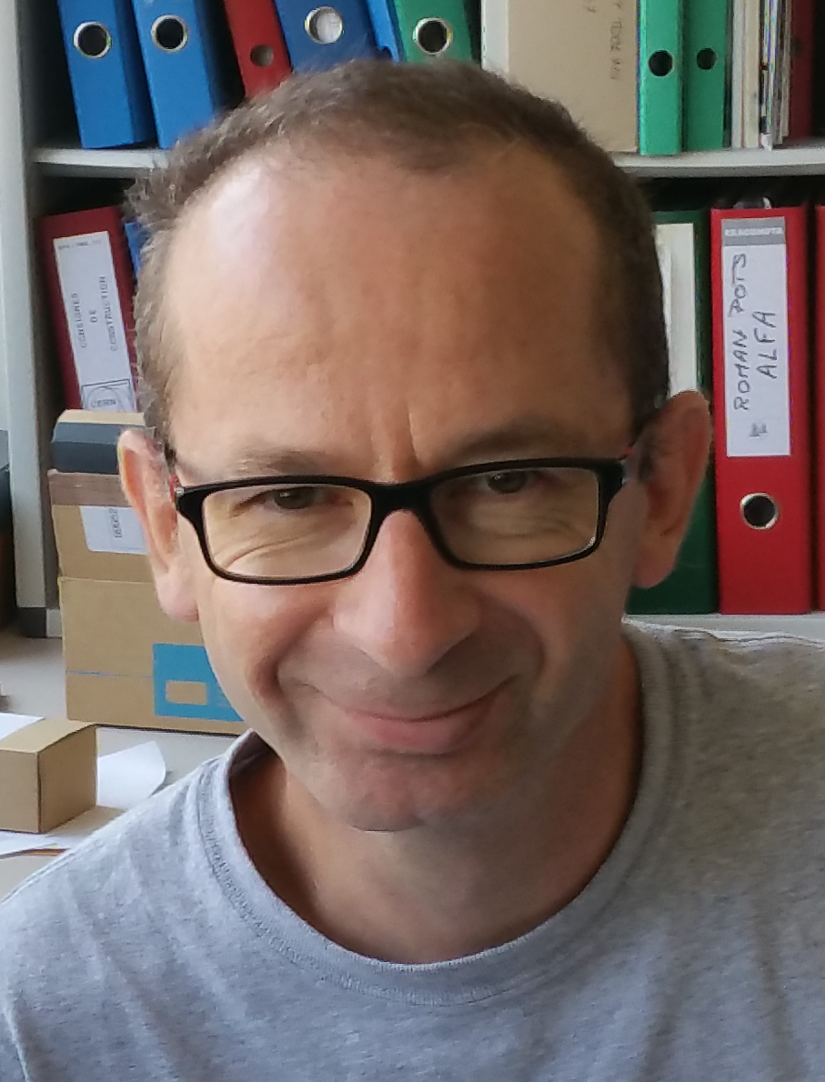
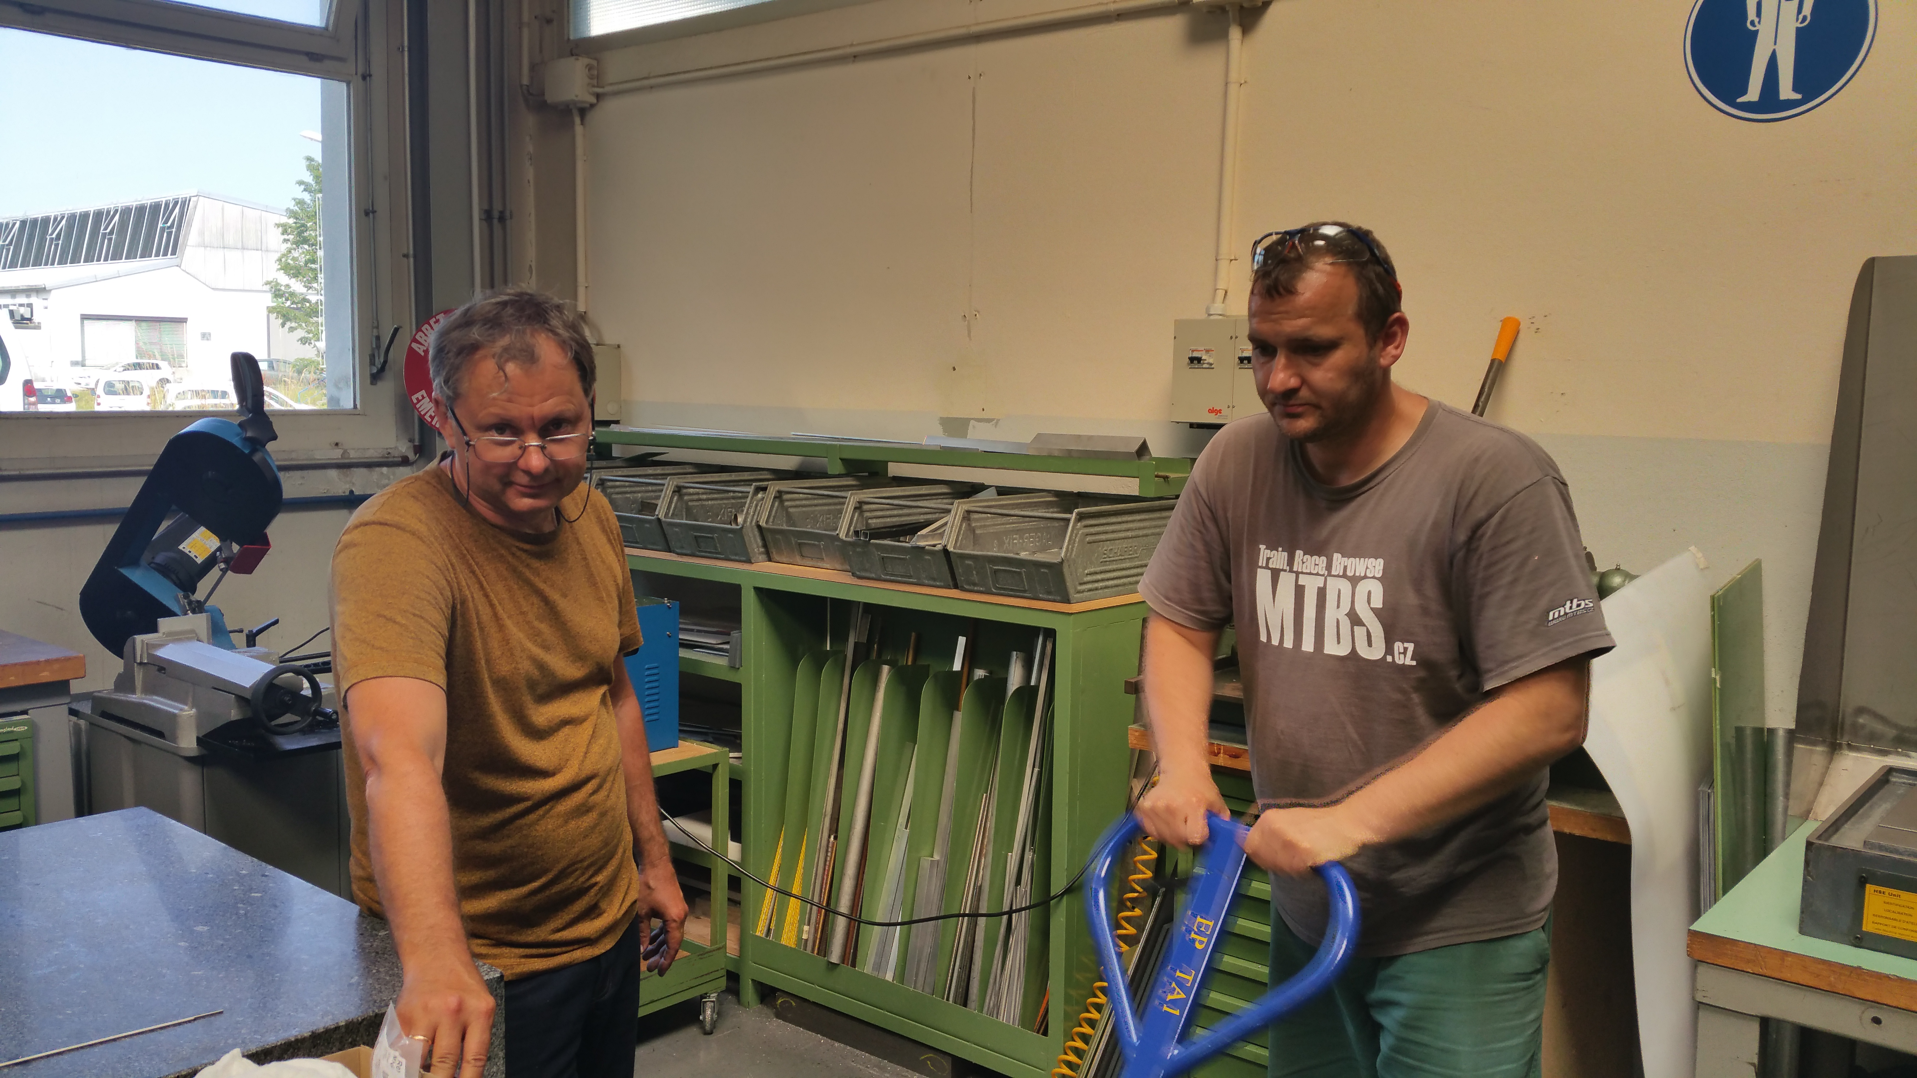
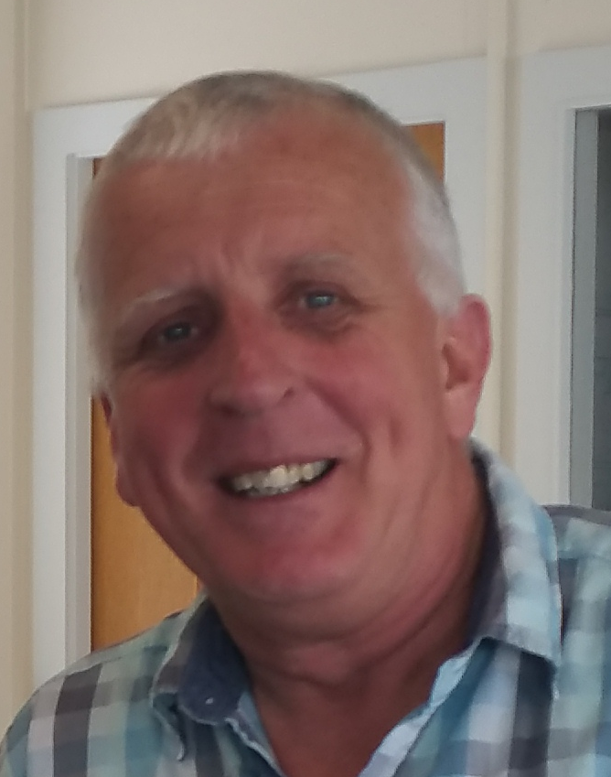
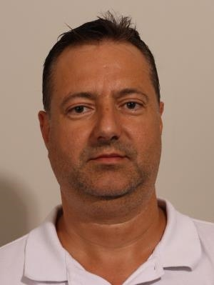
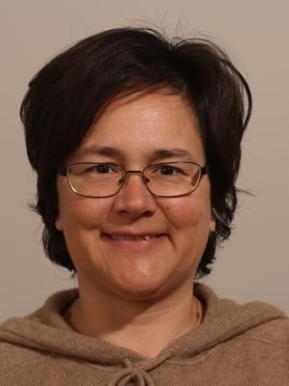
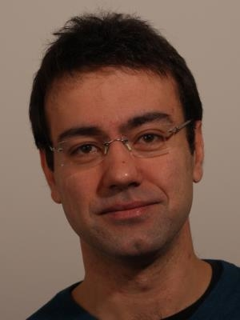
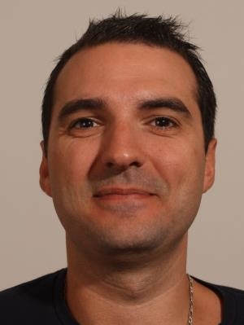
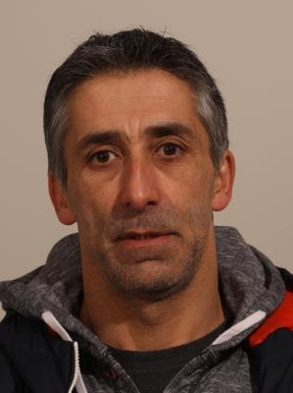
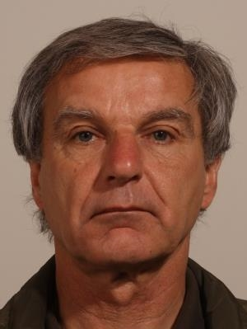
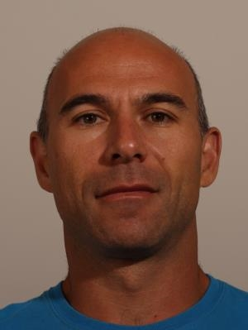
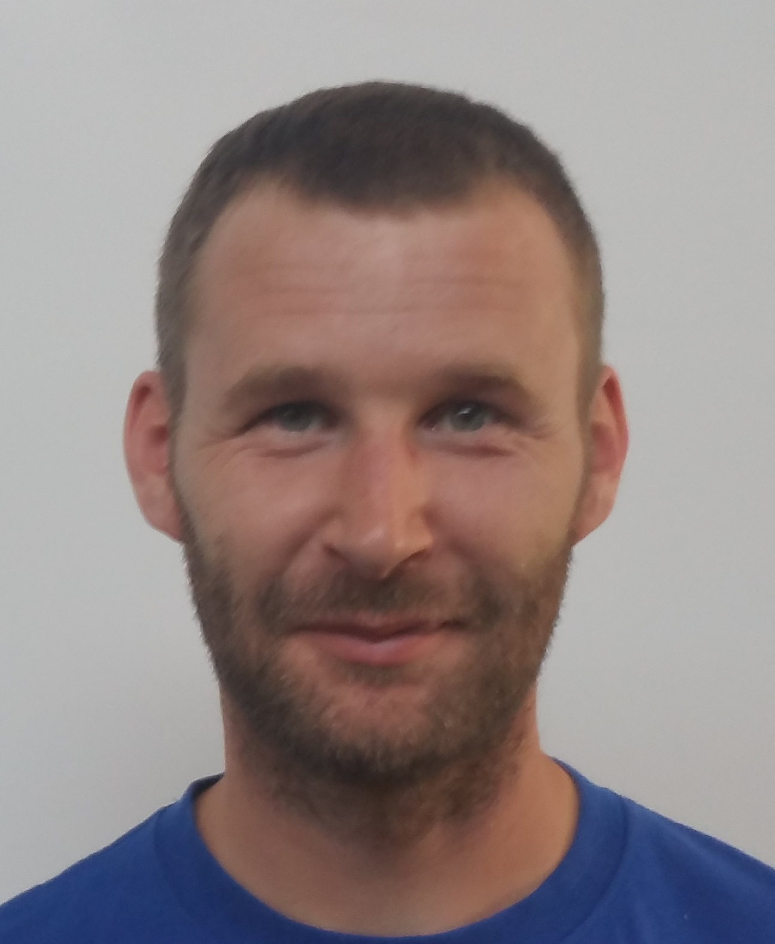
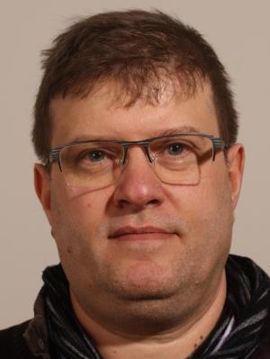
(1) R&D work Resources: a wide range of skills
 | Resources (FTE/y) 2017-2018 | Name where applicable
Engineers | 0.4 0.3 0.2 | D.Alvarez A.Catinaccio X.Pons
Technicians | 0.3 0.5 0.5 0.5 | F.Perez J.Bendotti M.Vergain N. Dixon
Designers | 0.7 | J. Degrange
Physicists | 1 | N.Pacifico
 | 4.4
DT Resources Estimated 4.4 FTE (but > 15 p. involved)
Active members are also : F. Boyer (composites), PA (Valery A.), ass tech. (Jan Mladek), FTEC (Ruben Gomez) and a Tech Student (Kari L. Ness), co-funded by ATLAS and DT
Important contributions from DT-EF and
rapidly increasing from DT-DI on DAQ

Slide 7
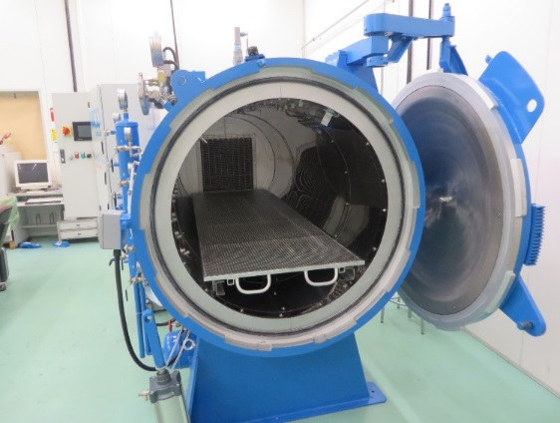
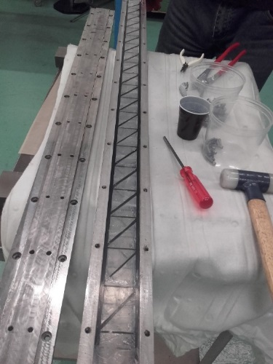
(2) Detector construction phase (2019 – LS3)
Focus on : one third of the pixel outer barrels construction
module, staves, loading, integration, testing, common items integration Tooling, CO₂ cooling system, Chip designs.
The composite lab is now prototyping and producing final CFRP components for most of CERN Experiments
DT allocates resources to contribute to the following tasks:
Carbon fiber final Staves and Support structures construction
Services integration
Loading with modules and QA
System tests & integration (mechanical integration of staves with support structures).
Autoclave 2.5m x 1 m
 | Resources (FTE/y) 2019 – LS3 | Name where applicable
Engineers | 0.7 0.4 0.3 | D.Alvarez A.Catinaccio X.Pons
Designers | 0.5 | J. Degrange
Technicians | 0.4 0.5 0.5 | F.Perez J.Bendotti N.Dixon
Physicists | 1 | N.Pacifico
 | 4.3
Estimate of additional resources needed:
Technicians Physicist Fellow | 1.6 0.5 1 | N.A. N.A. N.A.
Additional manpower needed
Key role of DT composite lab
Assembly space in 154 from demonstrator programme on.

Slide 8
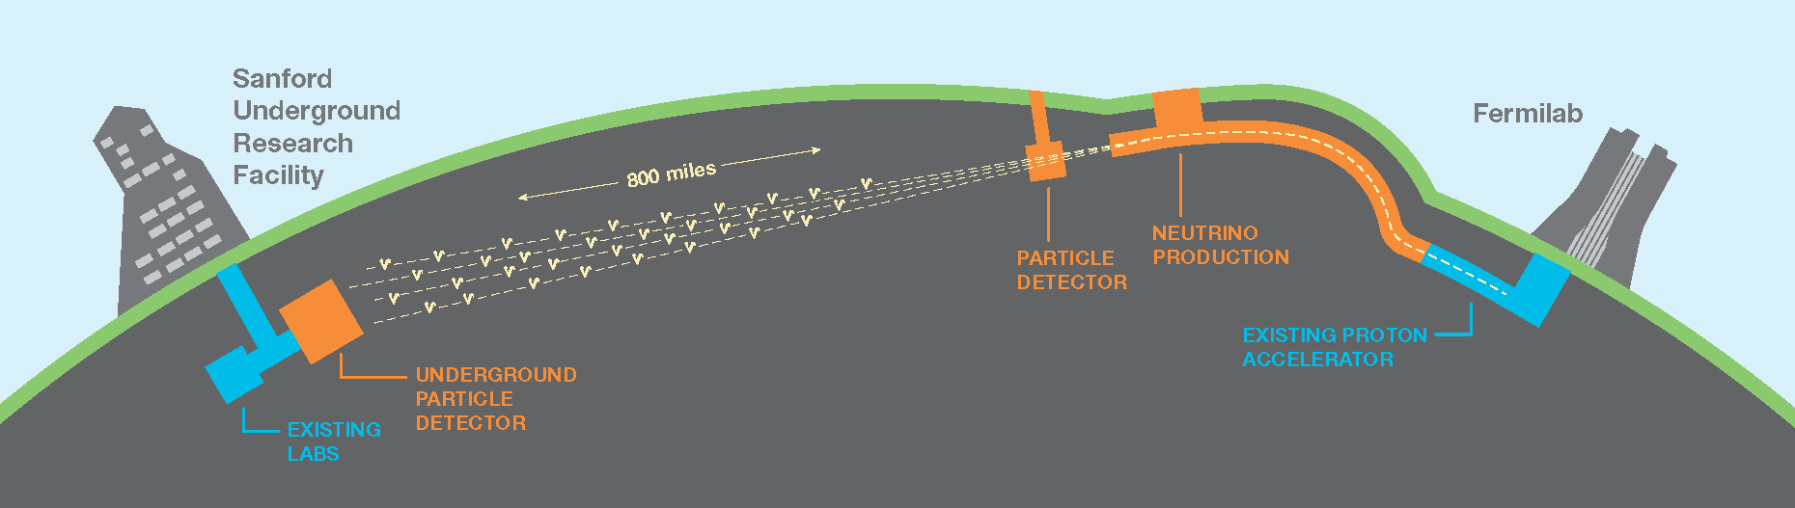
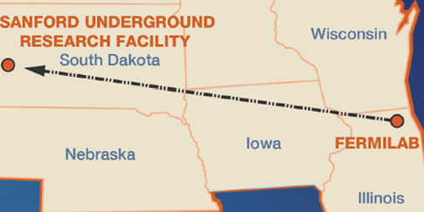
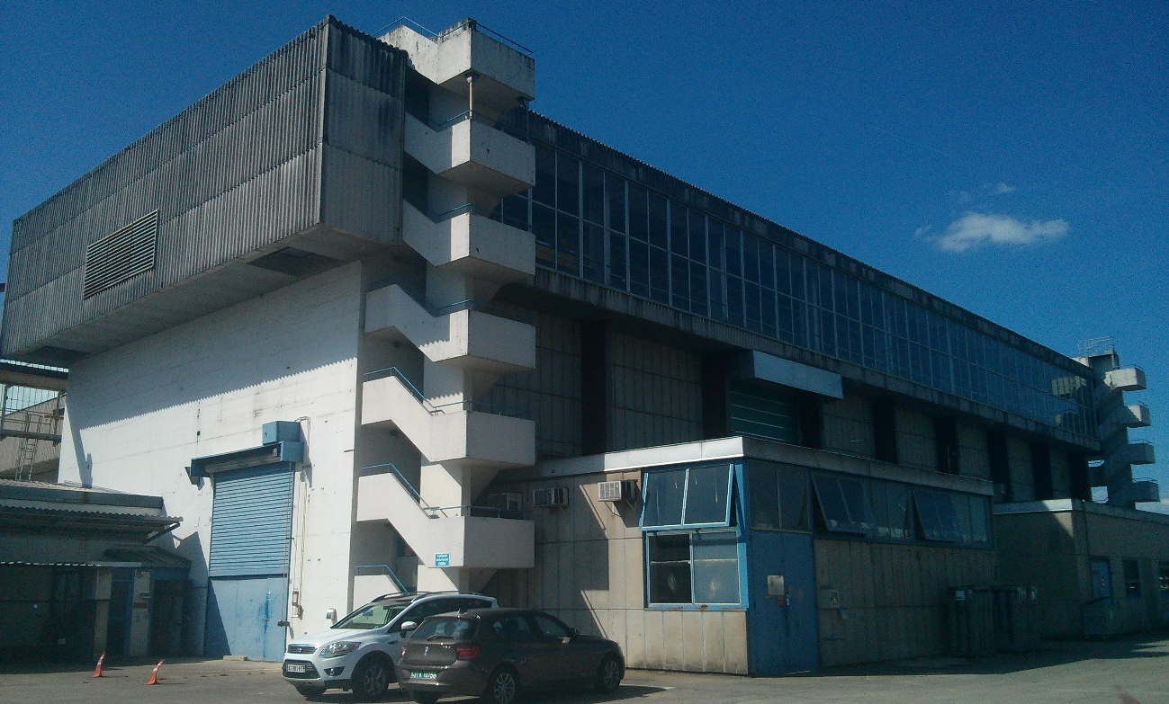
Neutrino LBNF: Overview
DUNE
(Deep Underground Neutrino Experiment)
LBNF: Long Baseline Neutrino Facility
  Far detector LAr TPC at SURF
  Near detector at Fermilab
~1300km
(http://www.dunescience.org)
1500m underground
Four LAr Cryostats (17kT LAr each)
Inner Dimensions:
L = 62m
W = 15.1m
H = 14m
Long Wall ~114MN
(11600 T)
Short Wall ~27.7MN
(2800 T)
Size similar to building 156

Slide 9
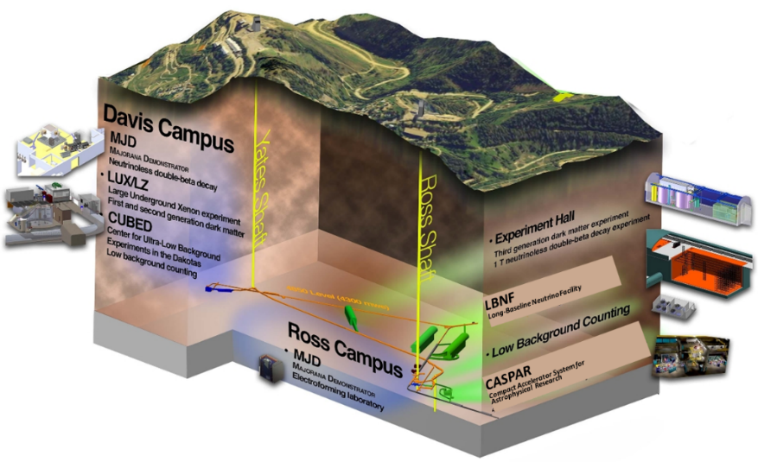
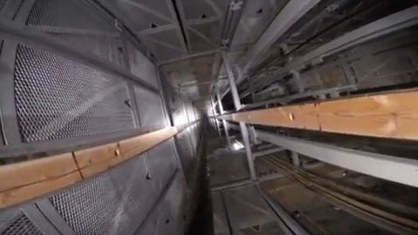
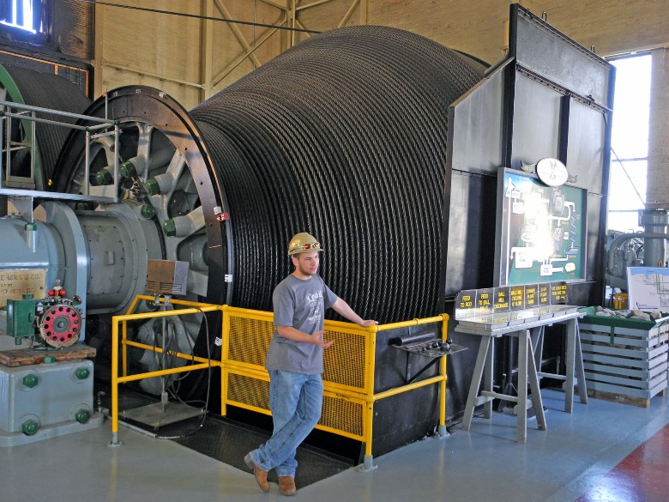
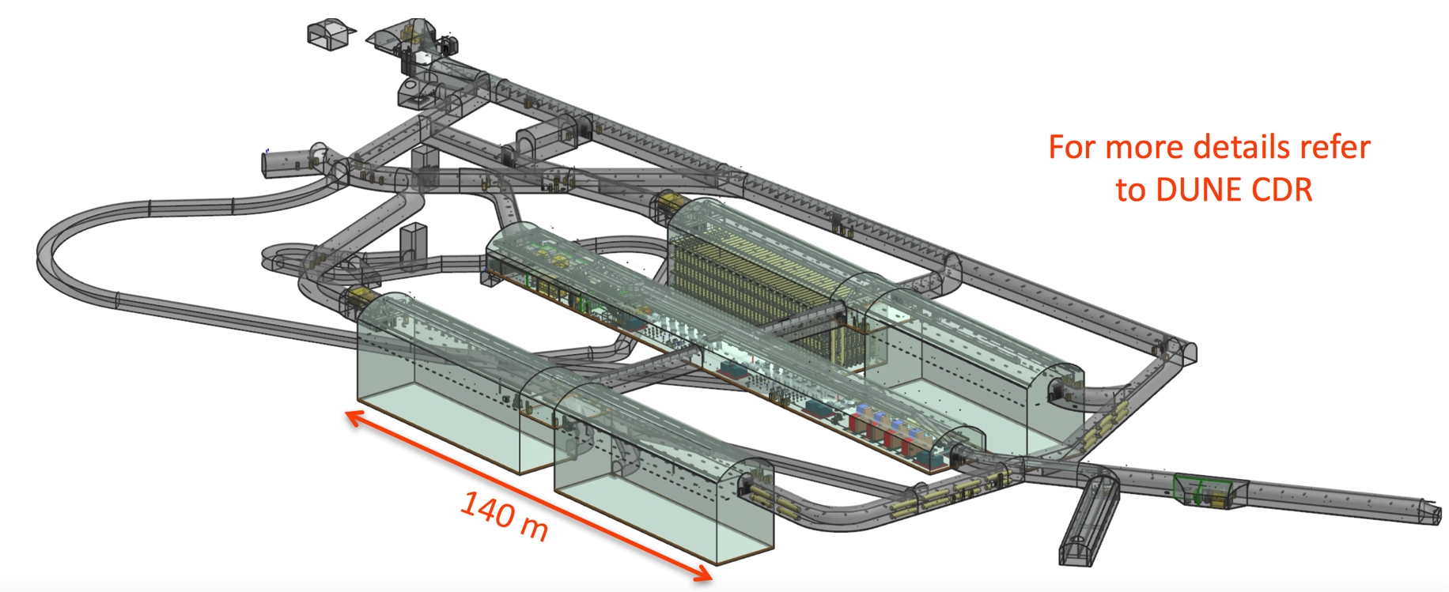
Some unusual constraints
Severe constraints imposed by shaft size and crane capacity
  Shaft dimensions (cage): 3.77 x 1.42 x 2.13 m (LxWxH)
  Crane capacity: expected max 9.5 ton.

Slide 10
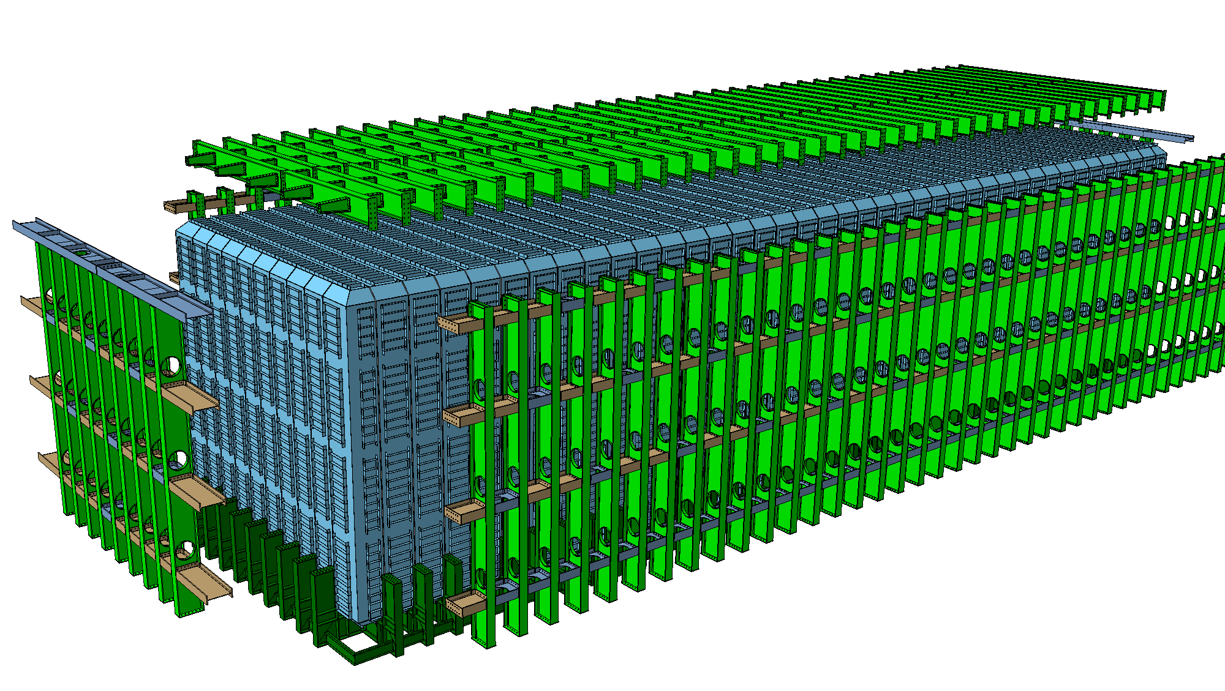
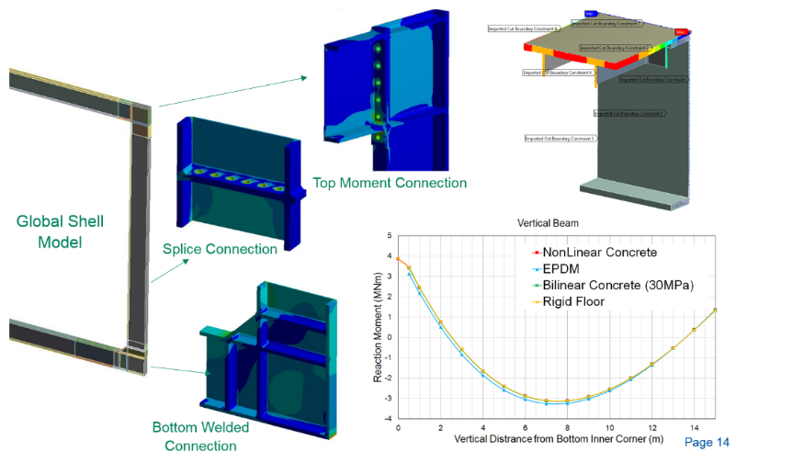
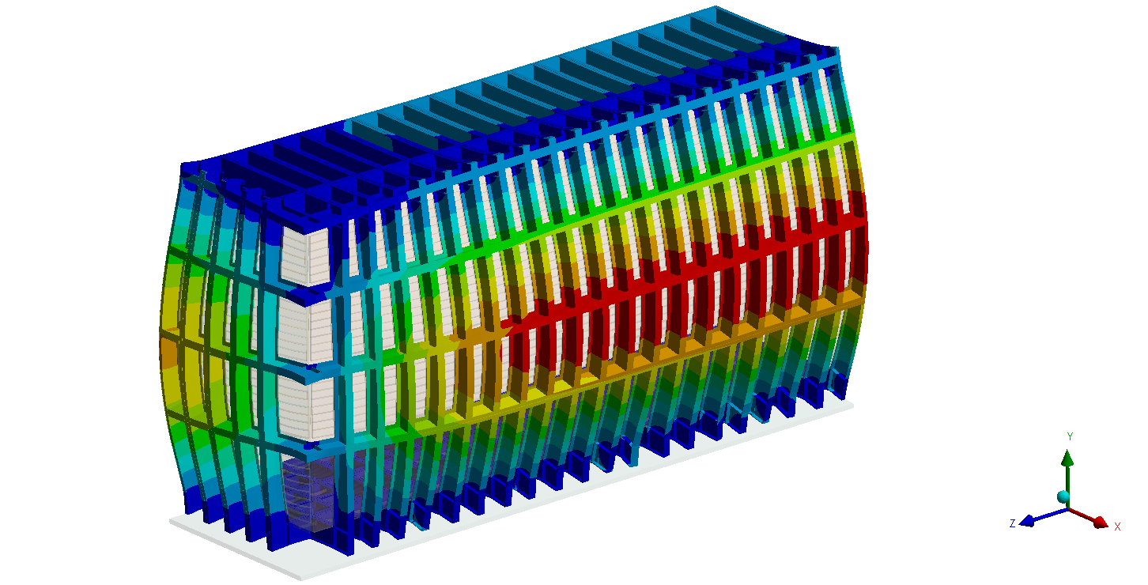
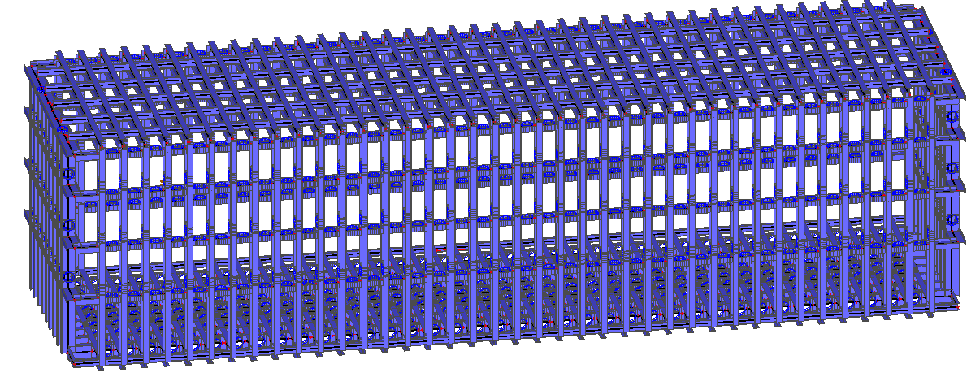

Re-design of the Cryostat Warm Structure
Since early 2015, 4 design revisions, 3 WP’s, 2 Reviews, next Final Design Review 22.08 with DOE.
  New roof design
New end wall
design
  New side wall belts.
  Tolerance compliant
  connections
MN m connections (6T@100m)
  New floor design
  New concept of inner warm membrane with
  stiffened panels and/or IPE 220 beams

Slide 11
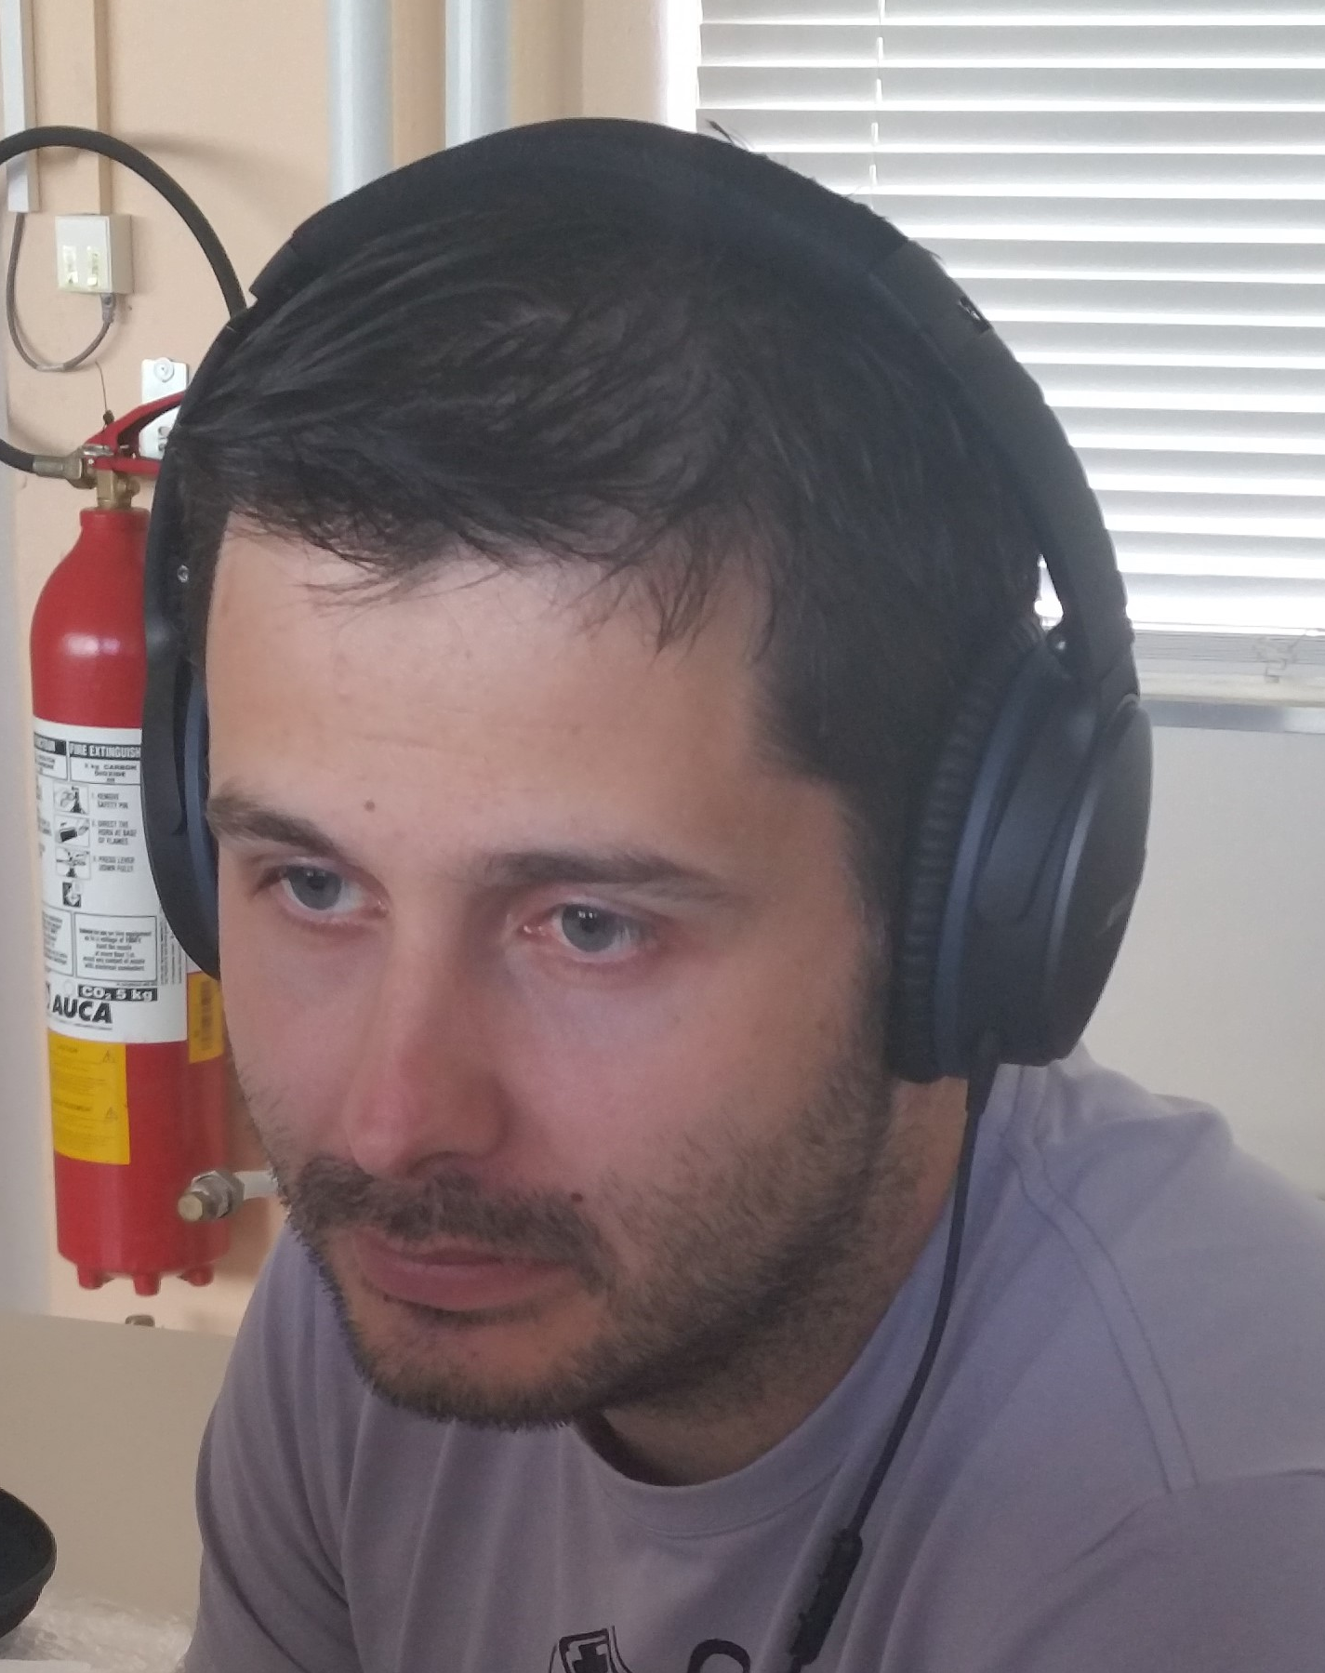
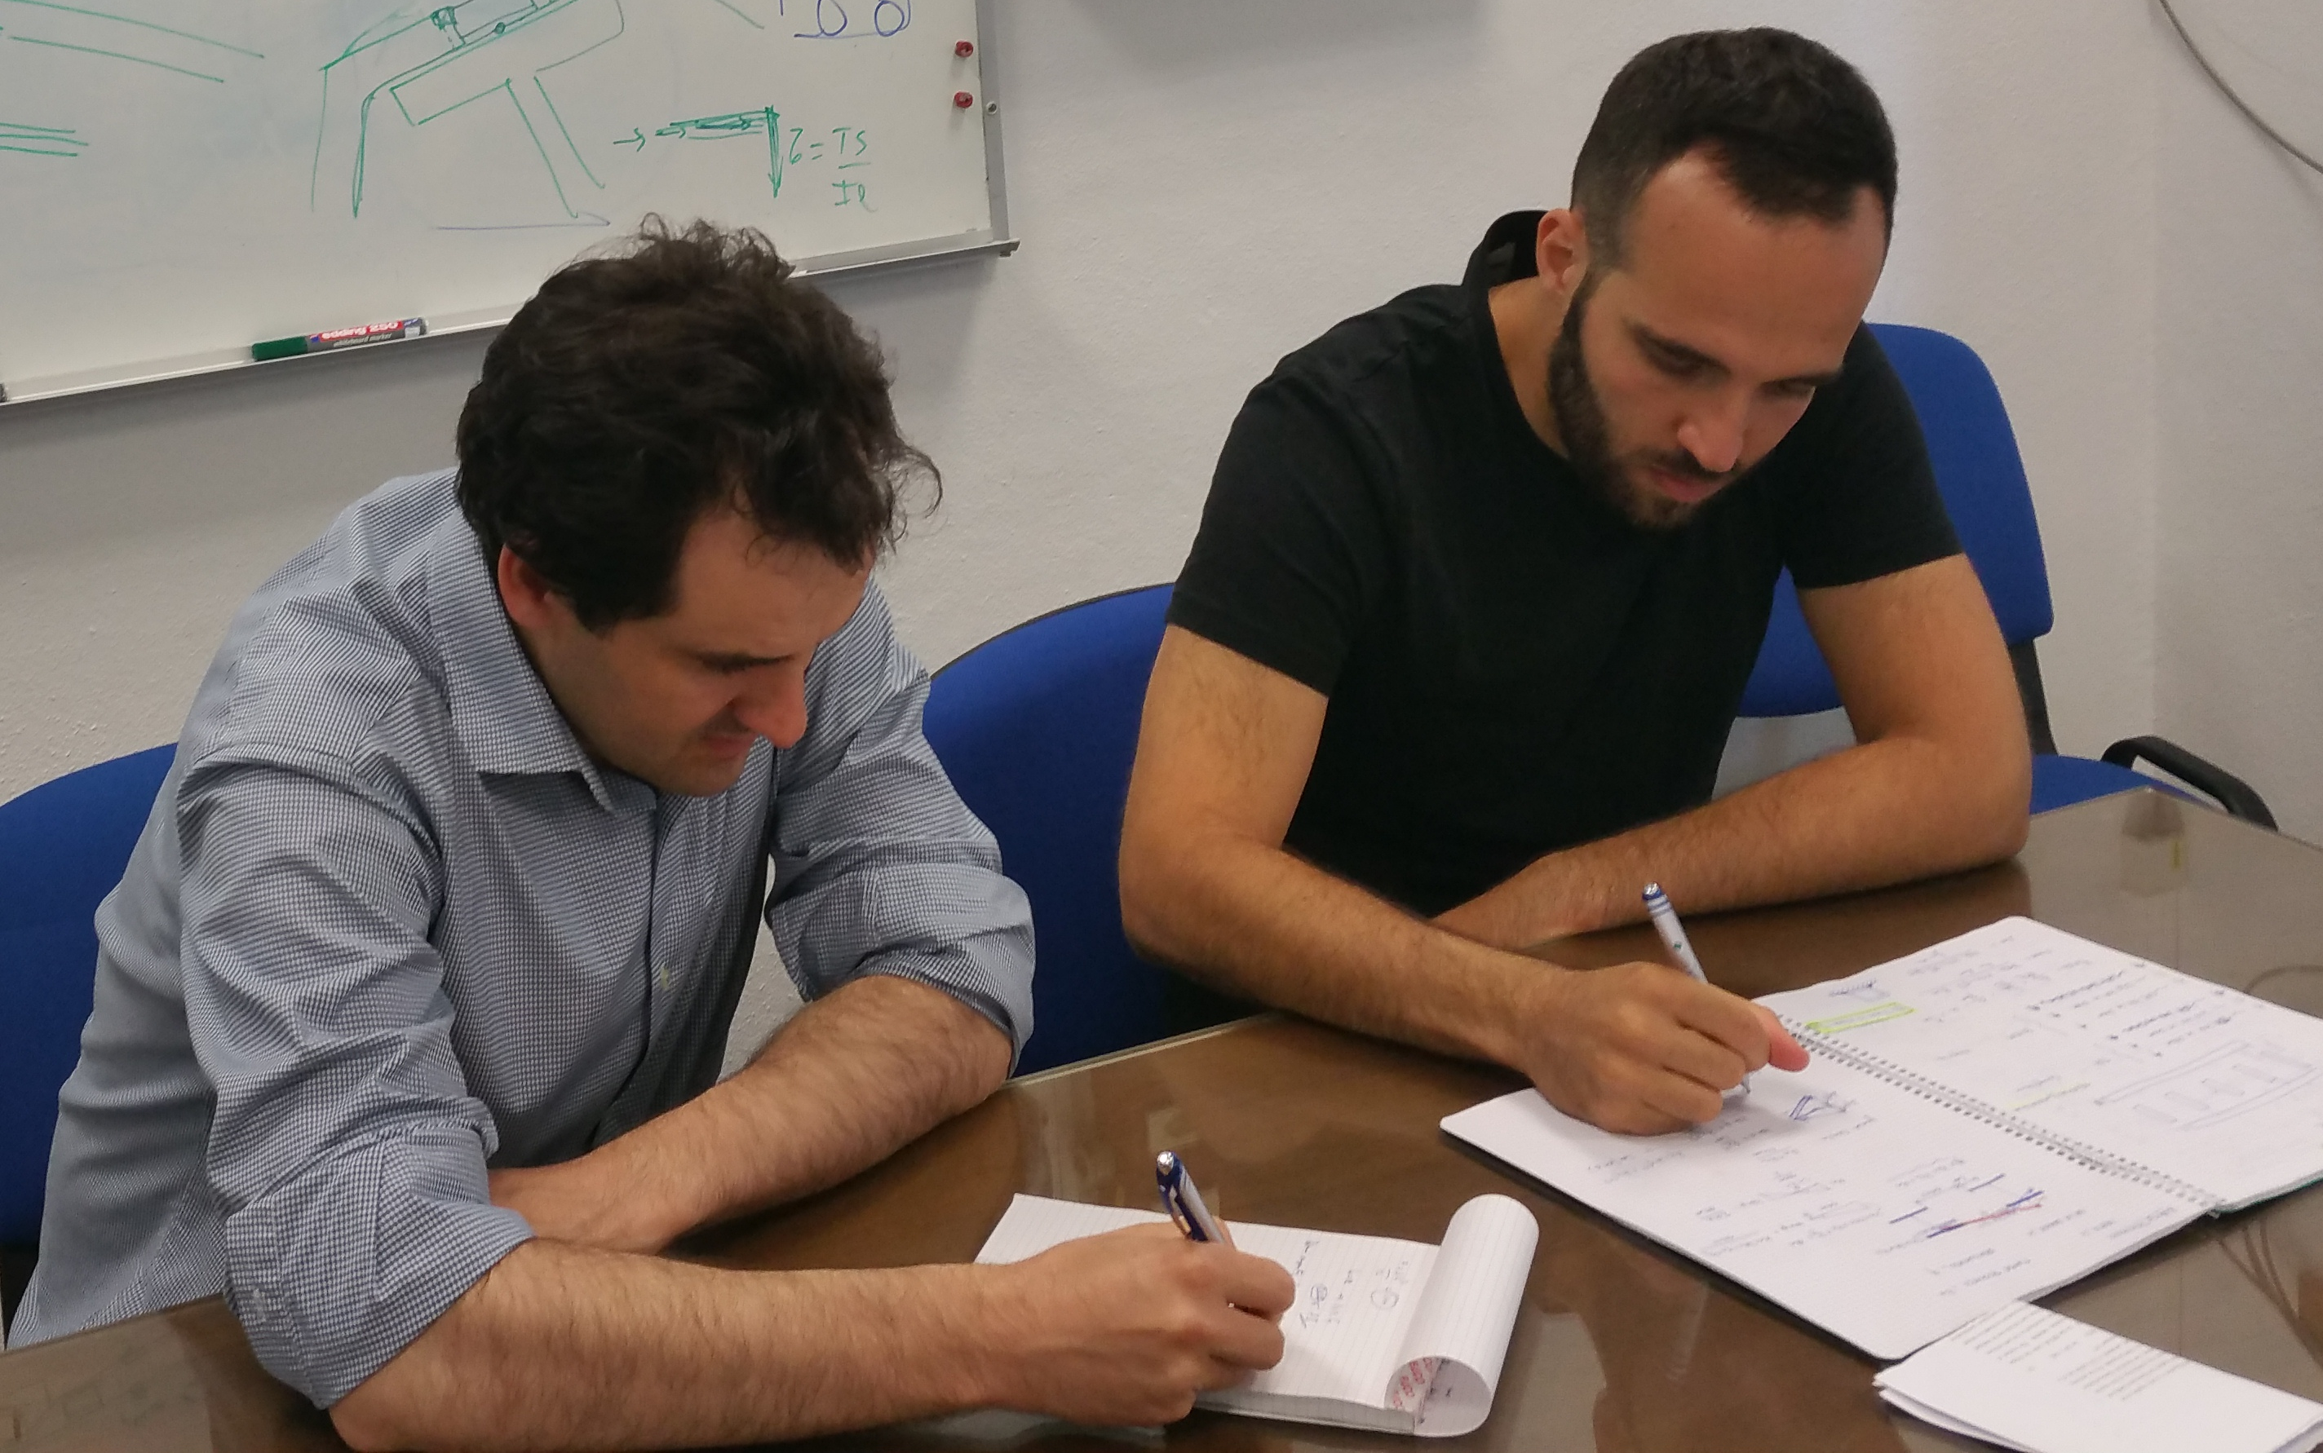
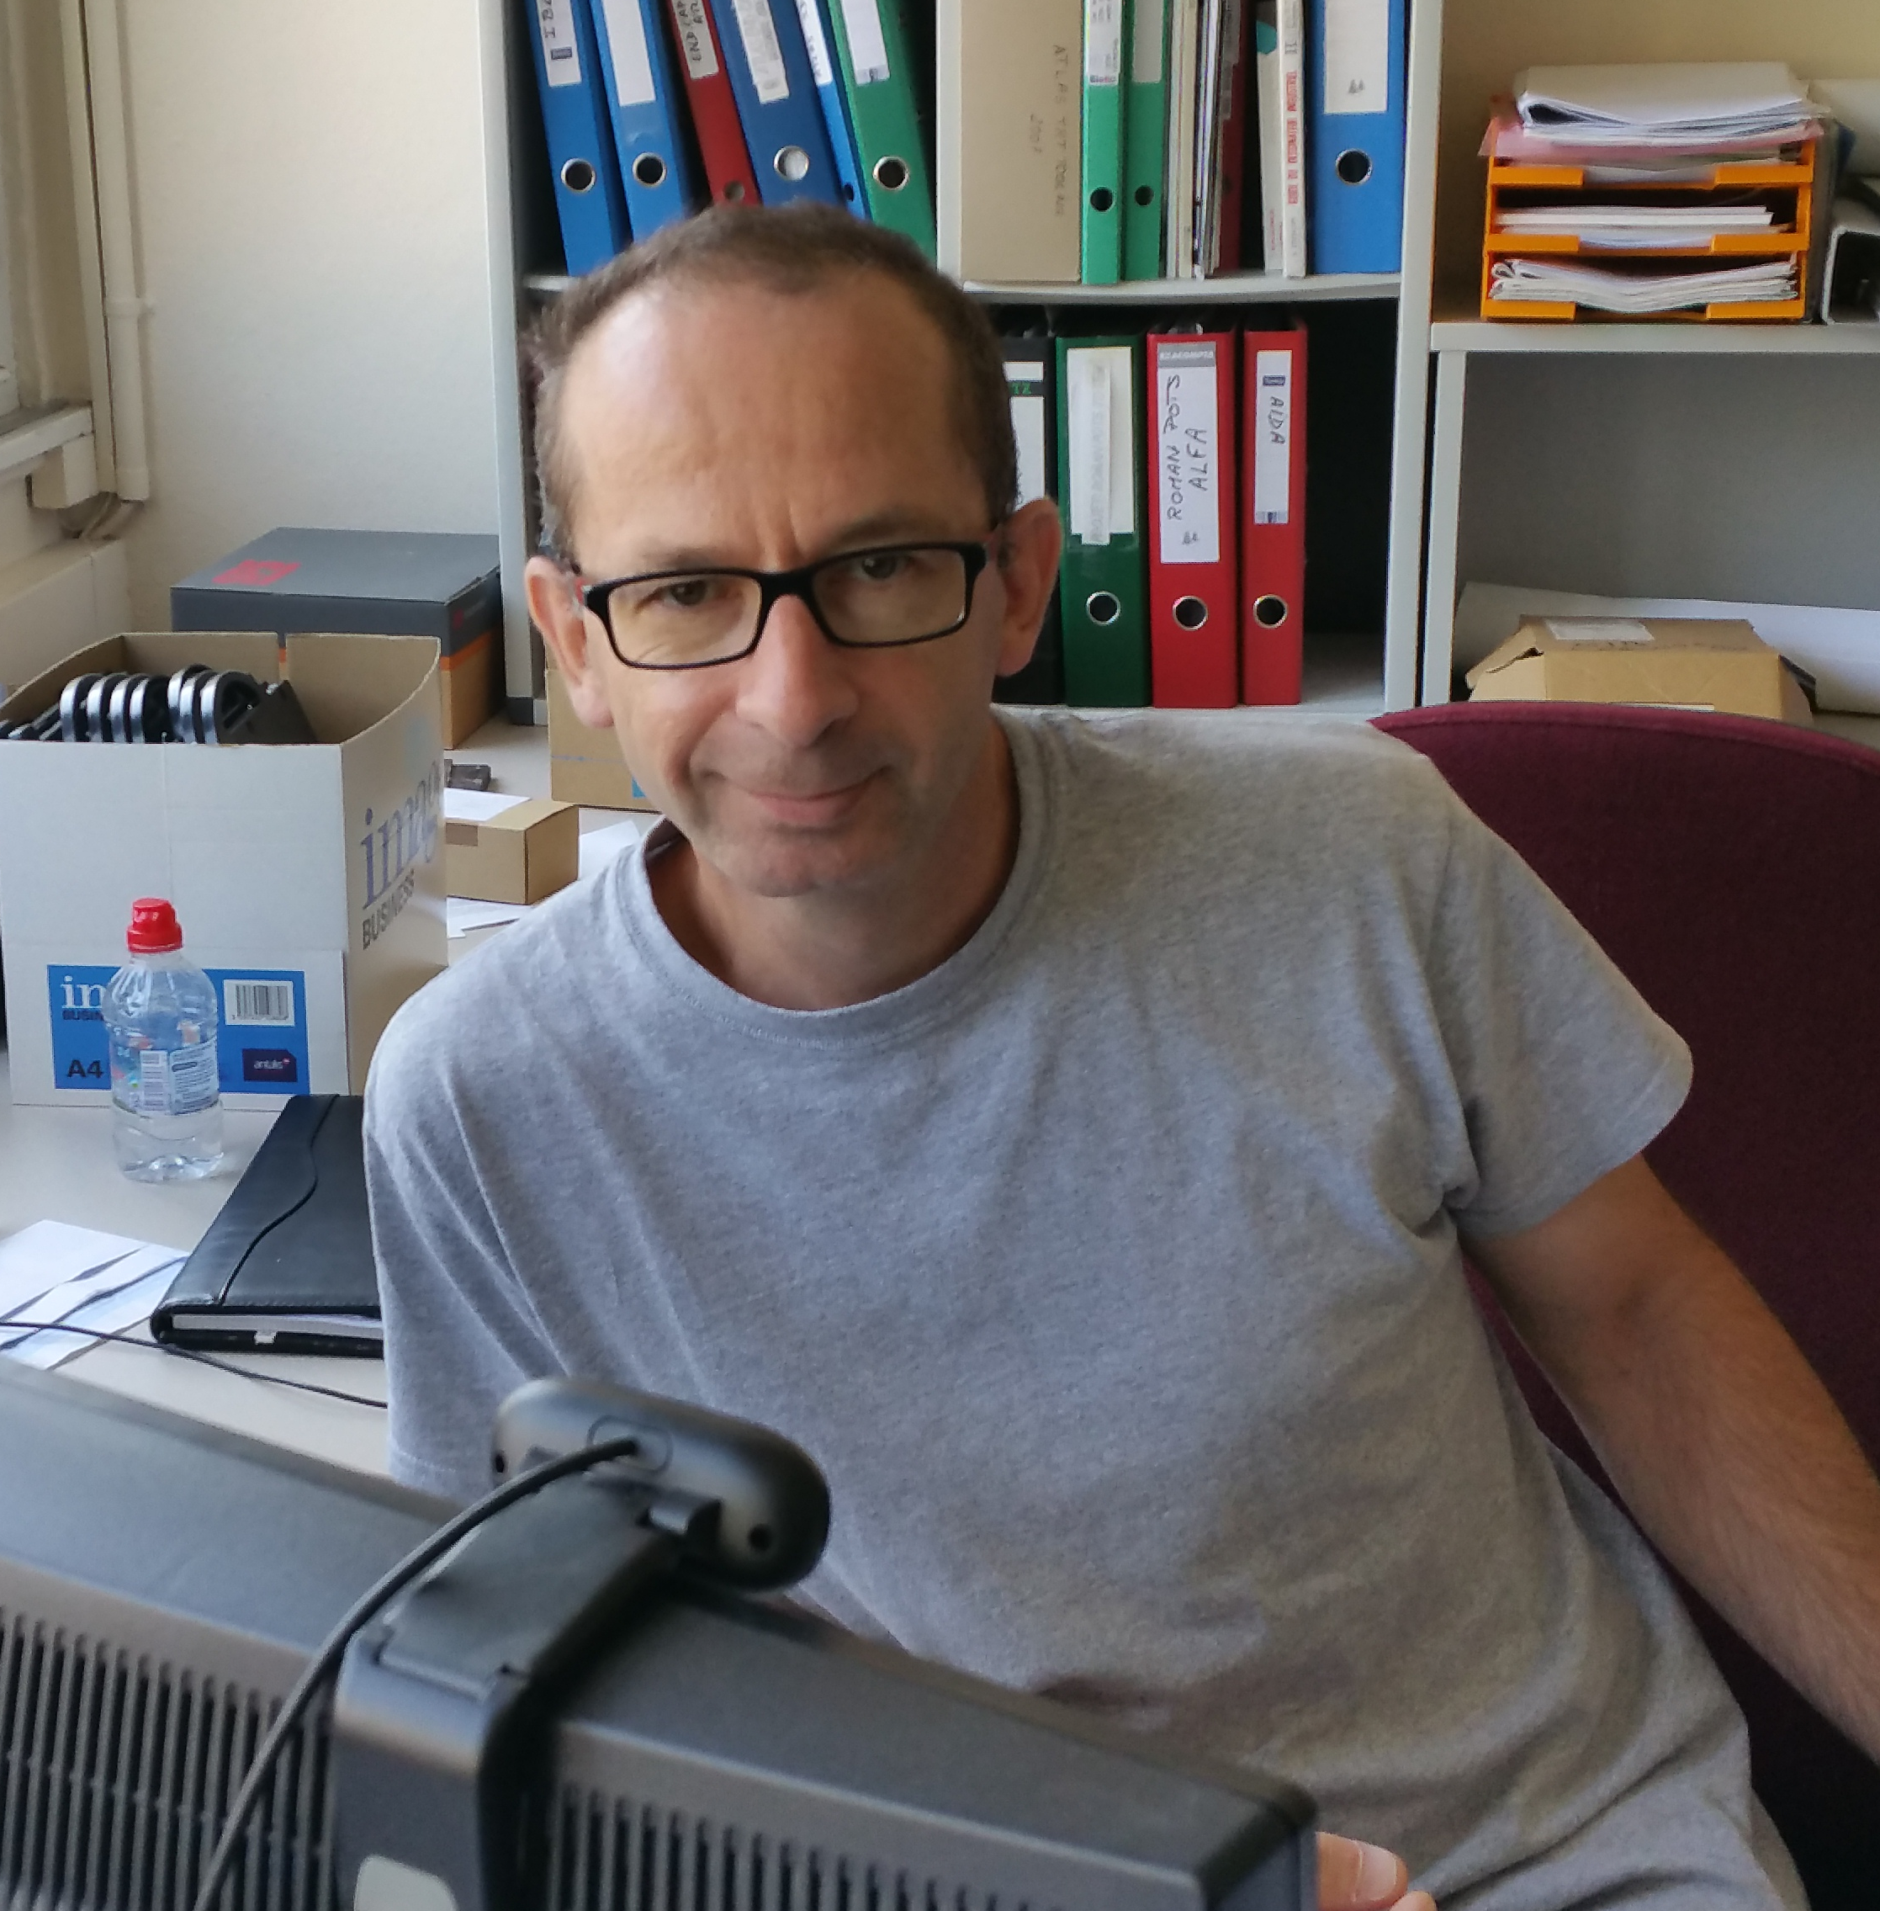
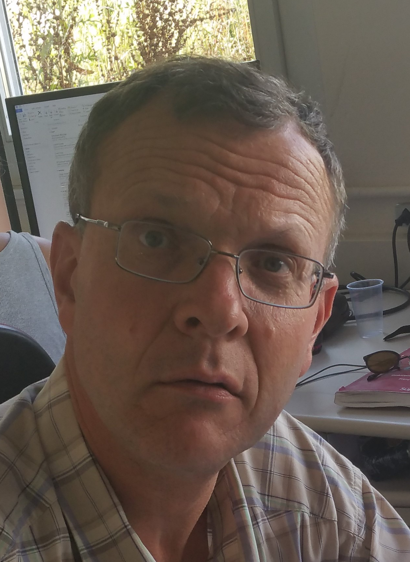
Very busy people & next Deliverables
Activity FTE/year | 2017 | 2018 | 2019 | 2020 | 2021
5.3, EP-DT-EO staff | 1.35 | 1.0
5.3, EP-DT-EO fellow | 1.0 | 1.0
5.4, EP-DI staff | 0.2 | 0.2 | 0.2 | 0.2 | 0.2
total | 2.55 | 2.2 | 0.2 | 0.2 | 0.2
Four design assessments of load-carrying structure
Analysis Models - Analytical & Numerical (>150 models)
Code Interpretation (EUROCODE 3 & ASME BPVC) (3000 pages)
3D CAD, Assembly (23 models)
Reports (>3300 pages)
Next EP-DT-EO deliverables
  CATIA 3D models and installation sequence (Ch. Bault)
  Final design and structural analysis, (J. Batista Lopes , D. Alvarez , L. D’Angelo)
  Definition of test components (ie full size connections) L. D’Angelo, plus structural calculations above).
  Design and coordination (A. Catinaccio)
  Next: hand over design to construction company in 2018

Slide 12
Thank You

Slide 13

List of agreed work packages
Available at: EP-DT EDMS:
WP between the ATLAS Experiment and EP-DT for the period 2017-2021 https://edms5.cern.ch/document/1735463/1 updated on 16/5/17
Workpage agreement Engineering support for the LBNF 10kT outer structure - 23-02-2015. Towards conceptual design review mid-June 2015 https://edms5.cern.ch/document/1505004/1 - Version 1
Further work after June 2015 review, described within the framework of a WP between the NP and EP-DT : Version2 https://edms.cern.ch/document/1579843/1
WP’s between the CERN Neutrino Platform and EP-DT 1735471 v.1: a link to WP’s as the LBNF cryostat engineering EP-WP-05 - Version3 and 4

Slide 14
Activity FTE/year | 2017 | 2018 | 2019 | 2020 | 2021
5.3, EP-DT-EO staff | 1.35 | 1.0
5.3, EP-DT-EO fellow | 1.0 | 1.0
5.4, EP-DI staff | 0.2 | 0.2 | 0.2 | 0.2 | 0.2
total | 2.55 | 2.2 | 0.2 | 0.2 | 0.2
EP-DT-EO deliverables:
  CATIA 3D models and installation sequence (Ch. Bault 40% FTE in EP-DT-EO for 2017, 2018)
  Final design and structural analysis, (J. Batista Lopes at 50% and D. Alvarez at 25%, Luca)
  Definition of test components (ie full size connections) (100% L. D’Angelo, for 2017 and 2018 also contributing to the structural calculations of the paragraph above).
  Design and coordination of these activities in 2017-2018: (20% of A. Catinaccio, and 5% in 2019 to 2021 if proven necessary ).

Slide 15
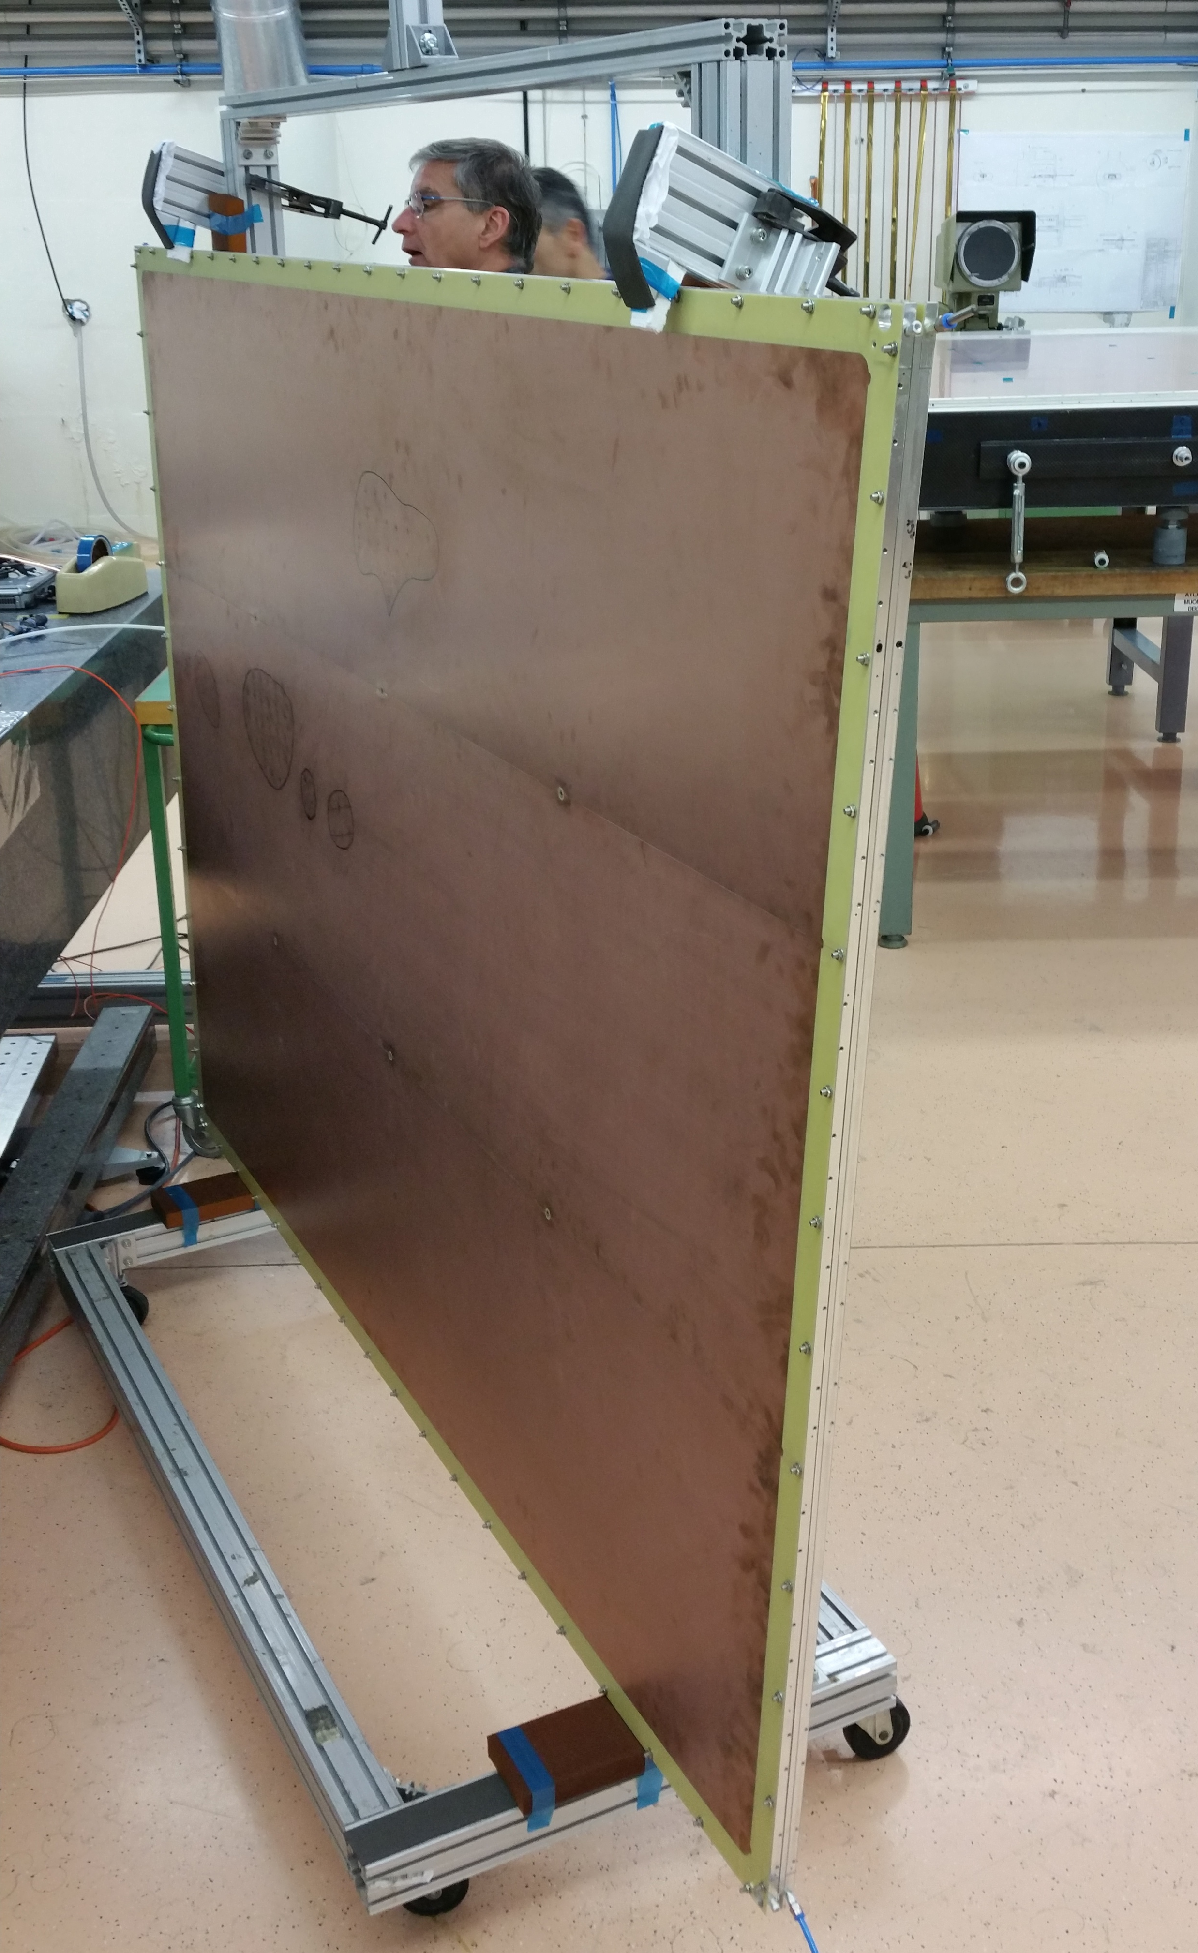
ATLAS New Small Wheel Micromegas Upgrade (LS2)
Motivation
  The only major detector upgrade in ATLAS for LS2
DT activities within the project
  Design one out of four module types (LM2) and construct module 0
  Develop tooling and assembly procedures for the series production. Train the assembly teams
  Consult and assist the collaboration on the industrial production of the PCBs (micromegas)
  Participate in the development of the resistive coating which is crucial for the success of the project
Notes:
In 2009, Still ATLAS, I joined the NSW muon upgrade, the only major upgrade for LS2….
It is a different technology and the Micromegas is a detector for future projects
Important to be present in order to stay in the front line.
Keep and develop the competences within the group. In general, the number of projects are limited.
Actvities Accelerated from 2014

Slide 16
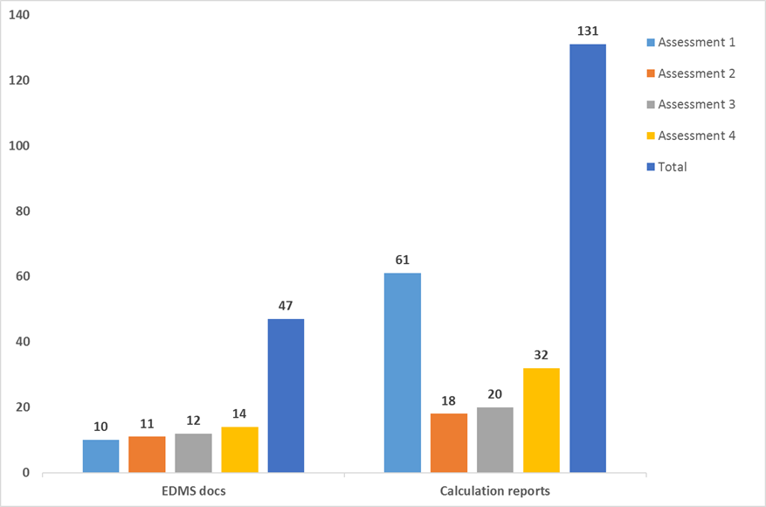
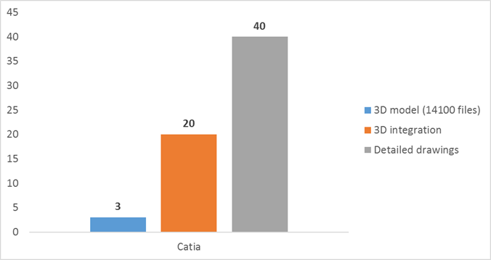
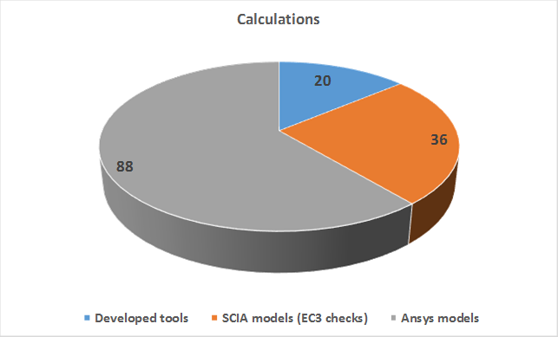
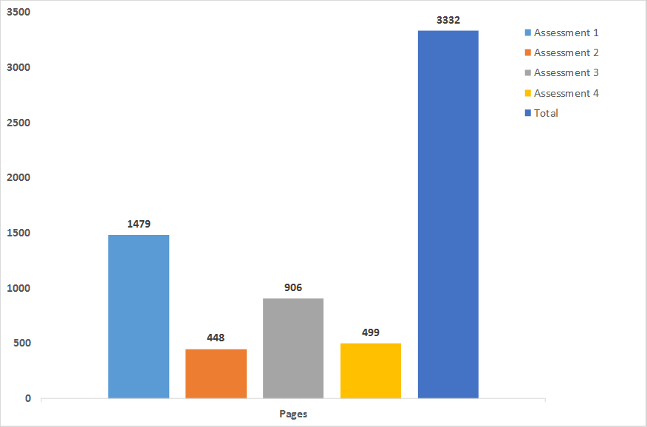
EP-DT-EO LBNF Contribution Summary

Slide 17






EO other Projects
Other examples of running projects/ activities (non exhaustive list):
CMS : Upgrade TOB, TIB Upgrade High granularity Si Calorimeter CMS HGCal wafer probe station setup Alice ITS upgrade ITS, TPC, installation LS2 TC integration LHCb upgrade (SciFi tracker), UT detector TC integration, infrastructure design and calculations NA62 (post installation support) GTK integration and micro-cooling Straw detector LCD: CLICdp Vertex, Integration studies HCAL, ILC collaboration Outer tracker support structure prototype Testbeam telescope COMPOSITE LAB Support to Gas Detector R&D lab Support to the Cooling Project (EP-DT-FS) Support to Micro-fabrication Support Catia / Smarteam
Integration: CMS OUTER TRACKER PHASE 2 UPGRADE
Alice ITS staves production, Beam pipe production, TC integration
Junction Box for LHCb
detectors: UT & Velo
Operation Lucasz Plant
modelling

