Slide 1
UT Integration
June 2, 2017

Slide 2
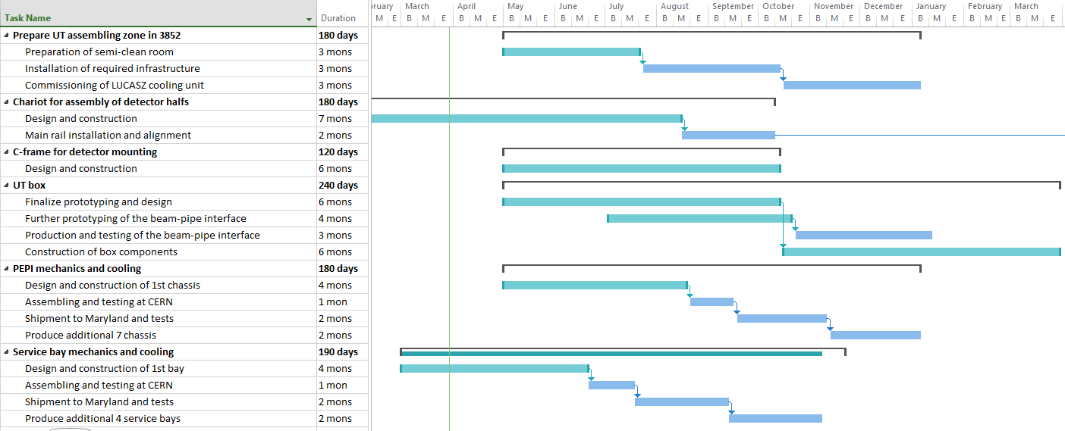
Preparatory work on infrastructure
1.
2.
3.
4.
5.
6.
Schedule as of March 30, 2017

Slide 3
1. Area for UT assembling
Outcome of previous discussions:
The area between 1-2 and A-B (7m x 7.6m, 3.5m high) is considered for UT
  It will be prepared as a semi-clean room for detector assembling, with slight overpressure, filters and an airlock to enter.
Additional space for UT will be made available (e.g. between 1-2 and B-C, or 2-3 A-B).
Also on top of 1-2 and A-B will be some space.
  Will be needed for the LUCASZ cooling plant
  Space will also be needed for material storage
  Control room space outside the clean room
Our zone will be available for us after the summer (September 2017)
Preparation of the zone is ongoing still

Slide 4
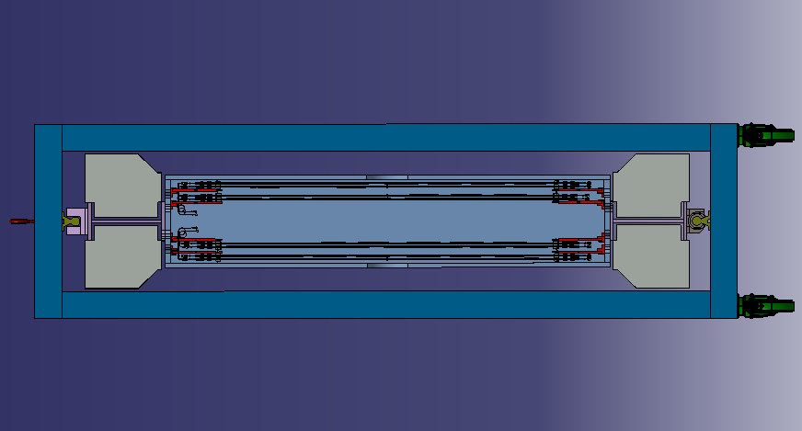
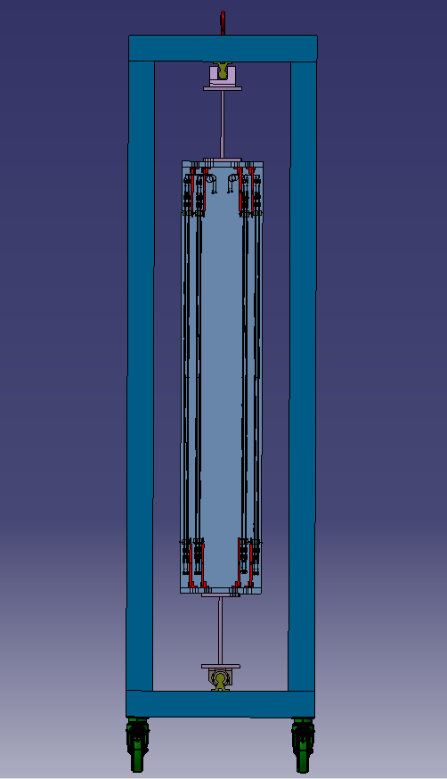
2. Cart for UT assembly
Dimensions have to be tuned.
We want to make sure the cart can be used on the surface and for installation in the detector.
Most likely, we need to foresee also a horizontal
position for the preparation of cabling in the PEPI
volume.

Slide 5
3. C-frame design
The C-frame design will following closely the present TT design
A critical issue is the precision on the inner surface, required for the detector box, the frames and the staves.
To be followed up by Joao and Michal
No news since the last meeting

Slide 6
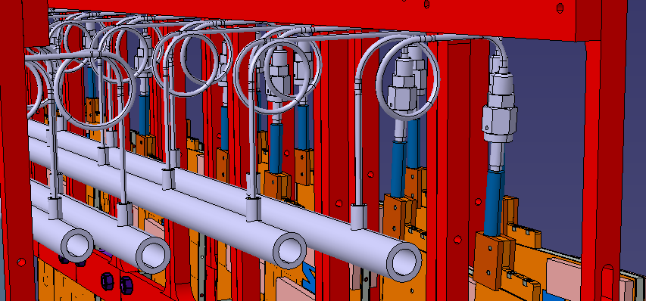
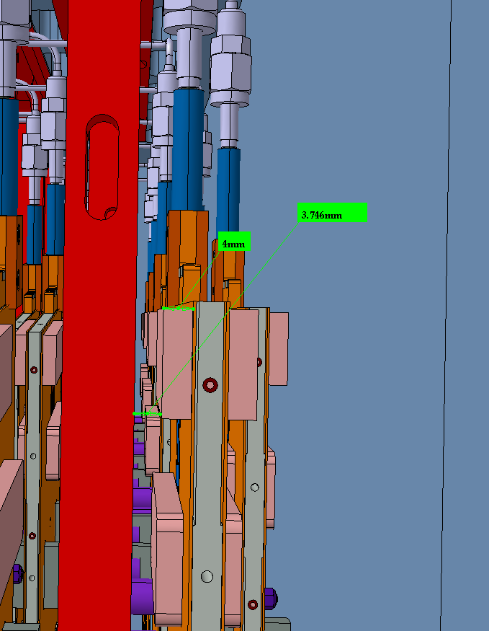
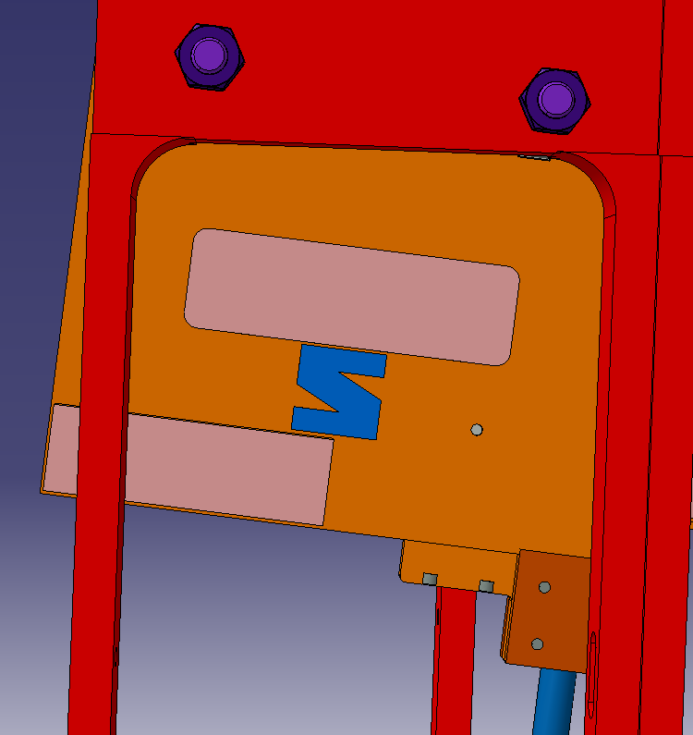
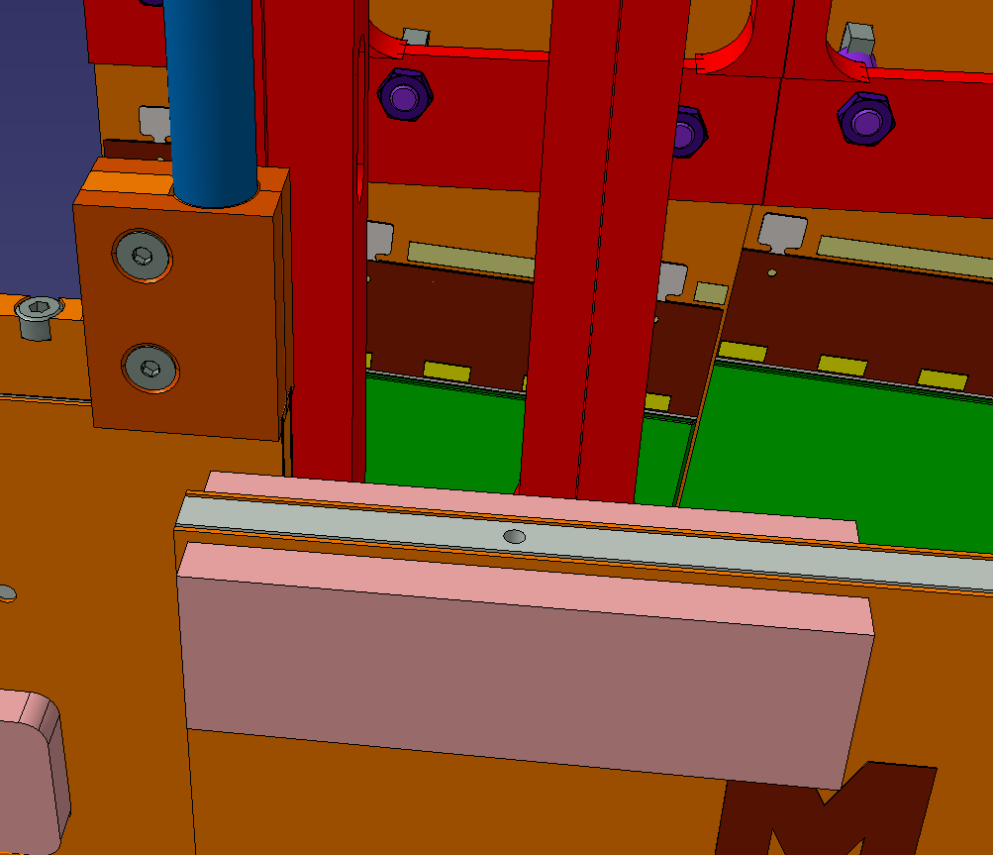
4. Integration in the UT box

Slide 7
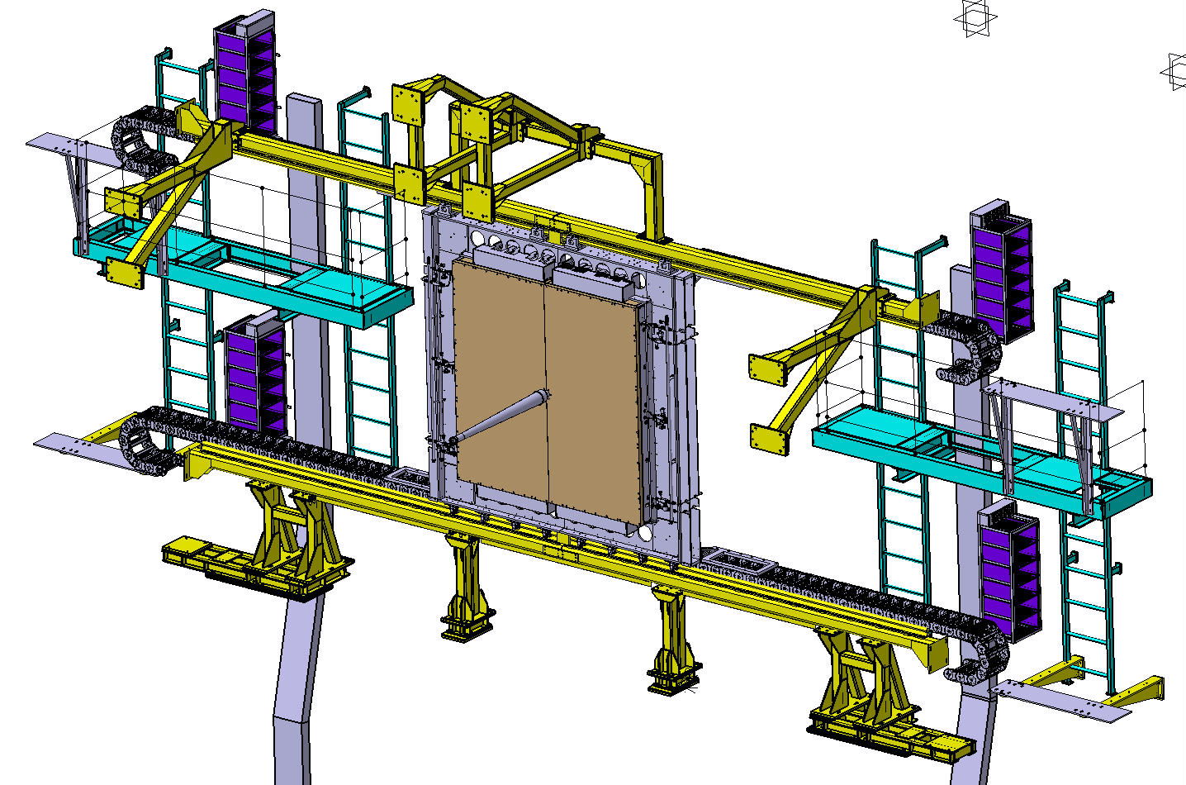
5. Service Bays
First iteration of the work on the mechanics and cooling for the service bays finished.
To be resumed when the work on the PEPI has reached a similar level.
View from the VELO downstream
2760mm
A-side
C-side

Slide 8
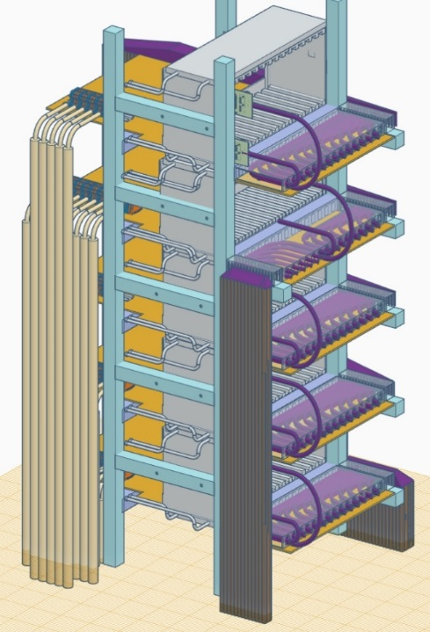
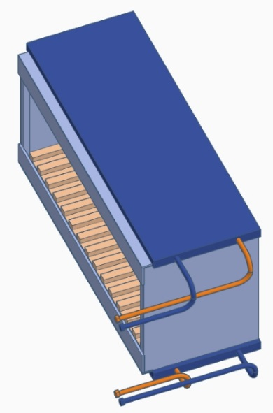
UT Service Bay cooling requirements
CERN, 24 April 2017
B. Schmidt(CERN), C. Abellan Beteta (UZH, Zurich) , P. Gorbounov (ITEP, Moscow)
4 Service Bay Chassis (SBC) with linear regulators
Each SBC will dissipate ~2.9 kW of heat, most of which has to be removed by indirect water cooling (NB: a small fraction of it, like 10-15%, will be dissipated by air convection, but this fraction is difficult to assess before the SBC mechanical design has been finalized: board spacing etc)
The SBC consists of 5 almost independent crates, each of which containing 14 boards cooled by conduction through the slots attached to the tubed cold plates
Earlier CFD calculations showed that ∆T between the cold plate and the hottest spot (regulator chip) on the board won’t exceed 7.4°C. The chip T should be, preferably, <40°C. Thus, the average cold plate temperature should be ≤ 33°C
cold plates
(~53 x 19 x 1.8 cm), with 3/8” pipes
SBC: 5 crates, total:2.9 kW
Crate: ~600 W

Slide 9
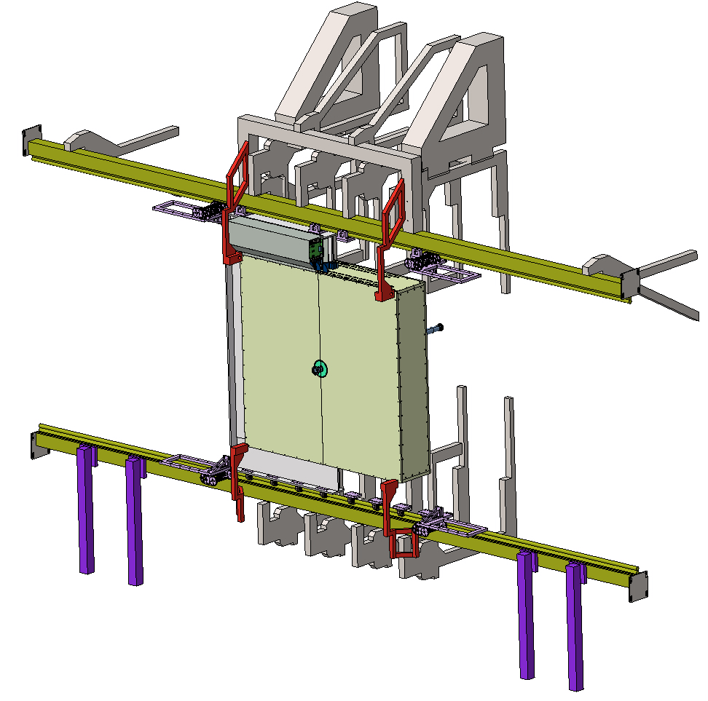
6. PEPI mechanics
Work on the PEPI mechanics and cooling is in full swing.
Done in close interaction with our Maryland colleagues.
Continue the discussion today
Might need a dedicated meeting with all people involved
2760mm

Slide 10
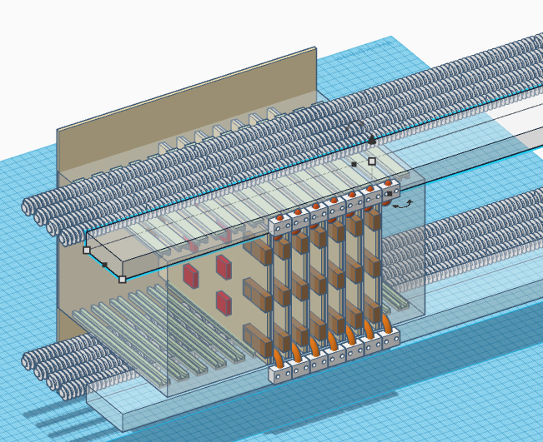
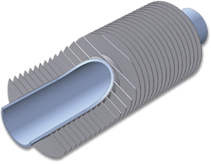
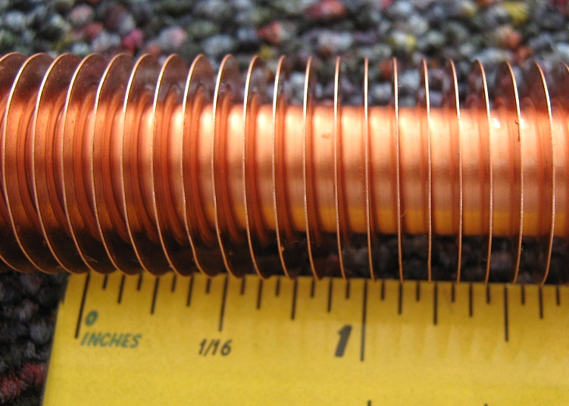
Finned tubes
Stainless steel tube with Alu or copper fins
Scalable solution (cut to length)
Best possible convective heat transfer

Slide 11
Conclusions
We are on track in relation to our commitments for UT integration
A few critical items need close attention
  Cabling in the PEPI volume
  HV connector on the staves
Will follow up on both today

Slide 12
Backup

Slide 13
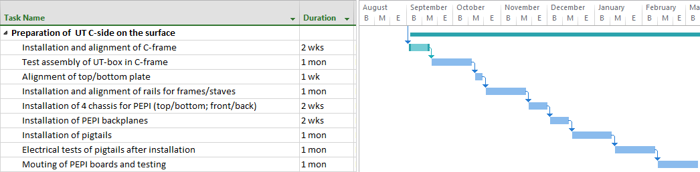
Preparatory work for stave mounting
2018 2019
Some tasks could be anticipated, if material arrives early enough

Slide 14
Some milestones assumed in the following
First batch of staves arrives at CERN February 2019
Second batch of staves arrives at CERN October 2019
C-side detector half ready for installation November 2019
A-side detector half ready for installation June 2020

