Slide 1
Design of magnetic elements close to the IR for FCC-ee
MDI meeting
M. Koratzinos
17/7/2017

Slide 2
Design of magnetic elements close to the IR
We finally have a design that meets all criteria
  Luminosity counter fits. First magnetic element at 1.25 m from the IP)
  Emittance blow-up is low (0.3pm for 2 Ips)
  There is no cross talk between FF quads
  FF quads sit at a very low field (well shielded from the detector solenoid field)

Slide 3
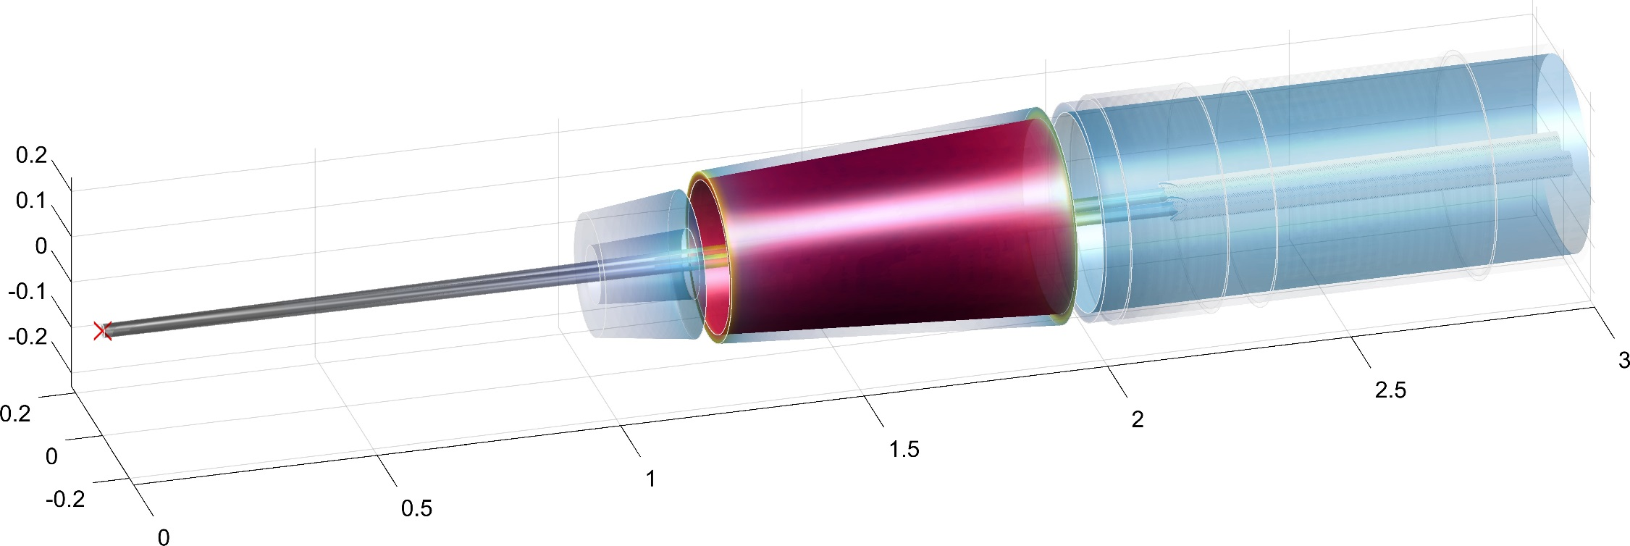
A pretty picture – feel free to use it in you representations
View of magnetic elements, beampipe and luminometer
Final focus quads
screening solenoid
Compensating solenoid
Luminosity counter
Beam pipes

Slide 4
Prior art
…what others have done before:
SuperKEKb is a good example
Some differences with our case:
  Asymmetric beams (we have same-energy beams)
  L* = 0.6 as opposed to 2.2m
  No space for compensating solenoid
  Vertical emittance ~10pm (SuperKEKb) as opposed to 1pm (FCC-ee)
A look at the SuperKEKb solution in some detail follows

Slide 5
53 degrees of freedom

Slide 6
Many corrector magnets

Slide 7
Many corrector magnets

Slide 8
No space for compensating solenoid
Zero (integrated) field in FCC-ee

Slide 9
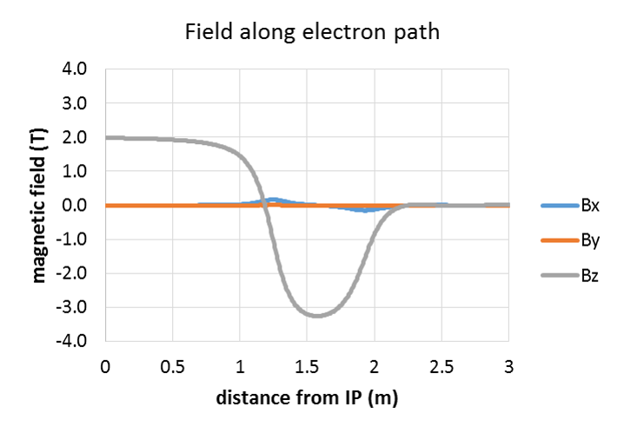
FCC-ee
L*

Slide 10
Final product

Slide 11
What can we do differently?
Use compensating solenoid – we have more space to fit one, but our emittance blow-up requirements are much more stringent
We have symmetric and same-energy beams: design near-perfect FF quads, and near-perfect crosstalk compensation
Use only very few corrector magnets
➔ all above can be satisfied if one uses a CCT magnet approach
A CCT magnet
  Can have no edge effects
  Can have excellent crosstalk compensation
  Any correctors fit as extra rings, taking only very little space

Slide 12
A slide explaining CCT technology
CCT technology is becoming popular due to the advent of modern manufacturing techniques (CNC machines, etc.)
CCT technology sacrifices ultimate field efficiency for field accuracy
Two layers with pre-defined and very accurately cut grooves for winding the conductor
Any multipole design (or a combination of) can be trivially implemented. This means that edge effects can be corrected, and cross-talk also.
Other advantages:
  mechanically stable (distance between conductors greatest where stresses are largest)
  Fast prototyping
  Cheaper than traditional designs

Slide 13
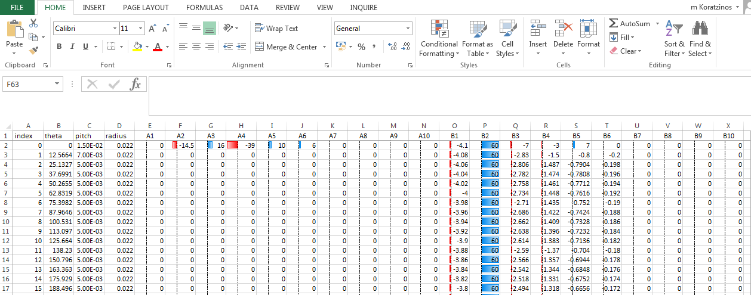
Customized CCT via the Field program
One can define all multipole components for every turn of the cable via an excel file

Slide 14
The problem
The FF quads sit in an area of rapidly varying optics functions.
This CCT design has excellent field quality when integrating over the whole length of the quadrupole. This is not sufficient.
Each side, when treated separately, should have excellent field quality.
The limit for multipoles has been loosely defined by Katsunobu to be less than 1 unit (10⁻⁴). And the smaller the better.

Slide 15
Solving this problem
The new option in the design of the CCT quadrupole can introduce the appropriate multipole components to cancel edge effects at the first few windings of the quadrupole, where they are needed.
Minimization done empirically, but a reduction of the multipole components at the edge by an order of magnitude has been demostrated.
Next slides: standalone FF magnet (one aperture). Correcting only one side (l.h.s.) and comparing with the other side

Slide 16
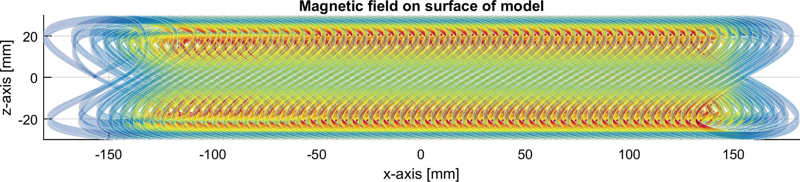
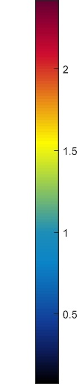
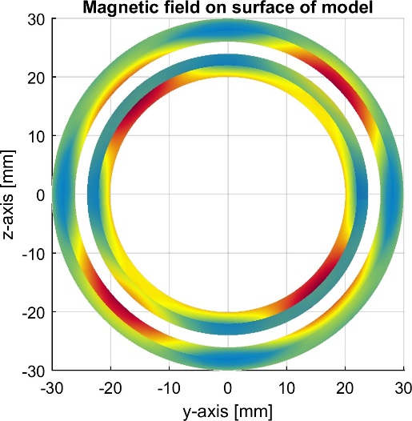
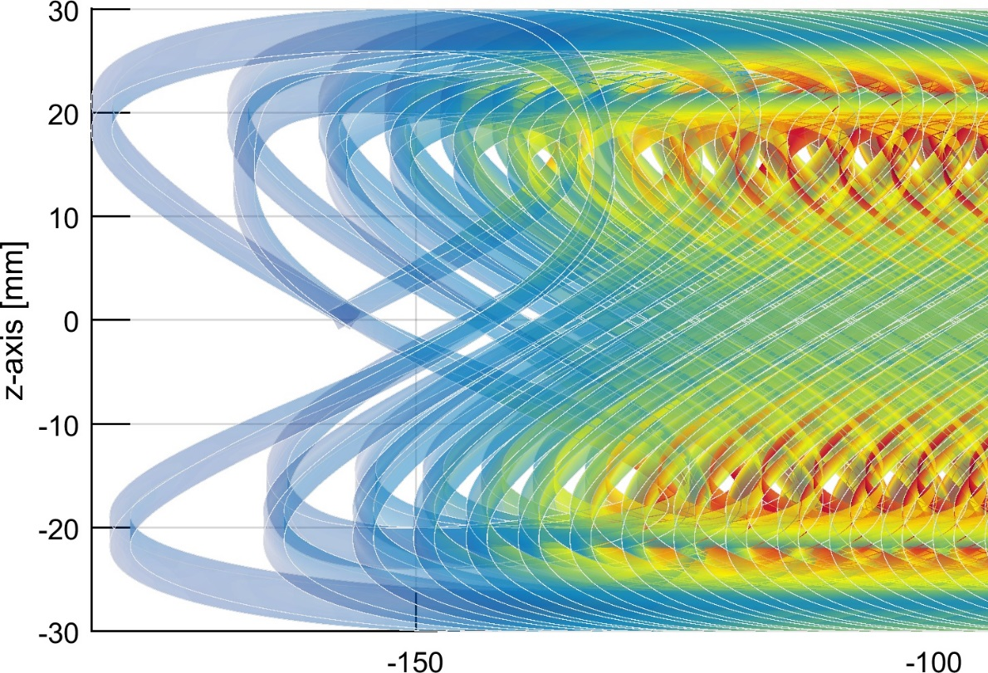
The FF quadrupole
The first two turns of the quadrupole contain, apart from the B2 component, all the necessary components to nullify the edge effects.
Only one side corrected (for demonstration)
Inner bore: 40mm diameter; 100T/m B2 field

Slide 17
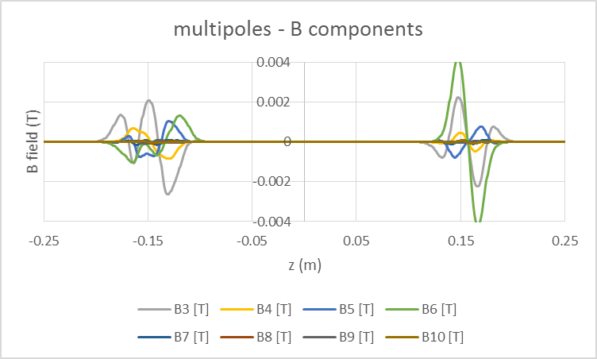
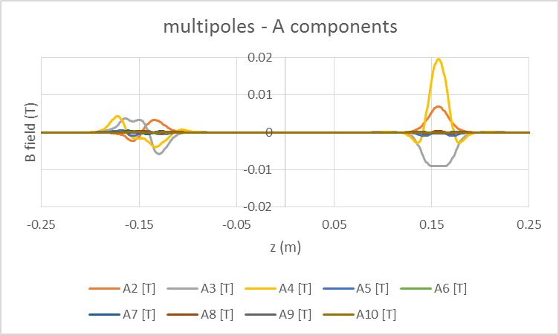
Multipoles – before and after
Multipoles at 2/3 aperture. (10mm radius)
Right: uncorrected edges. Note that in this configuration, the B components integrate to zero per side, but the A components integrate to zero only over the whole length of the magnet.
The B1, B2 and A1 components have been removed for clarity.
Left: the corrected side (see also next slides)
What matters is integrated multipoles (next slide)

Slide 18
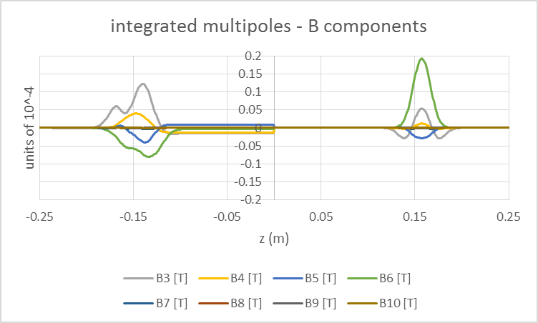
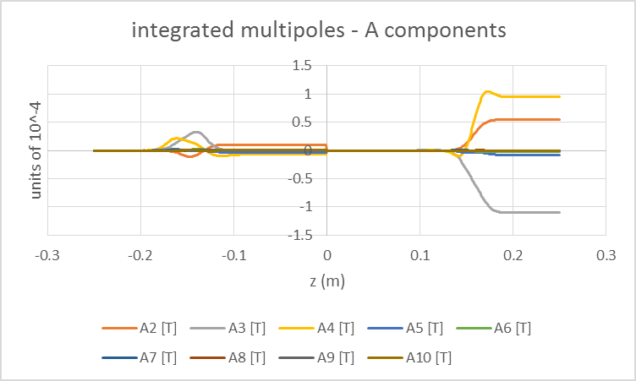
Integrated multipoles
corrected
uncorrected
Now normalised to the B2 component over the whole length of the quadrupole: we are at a radius of 10mm, so integrated B component is 3.2Tm (100T/m gradient, 3.2m long)
After correction: less than 0.1 unit. Before correction: A components as big as 1.1 units

Slide 19
Single magnet edge correction
“proof of principle” works beautifully; not clear where the limits of this method are. Multipoles can be kept to below 0.1 units (and can be reduced to an arbitrarily small number).
Correcting one component does not spoil other components; the process converges rather fast.
Multipole components added only to the first two turns of the cable
Next step: correct also crosstalk between adjacent apertures

Slide 20
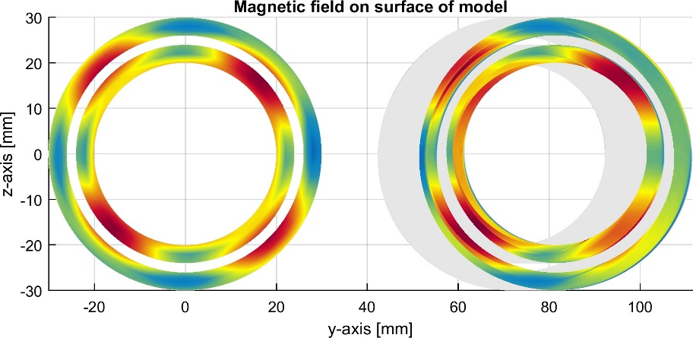
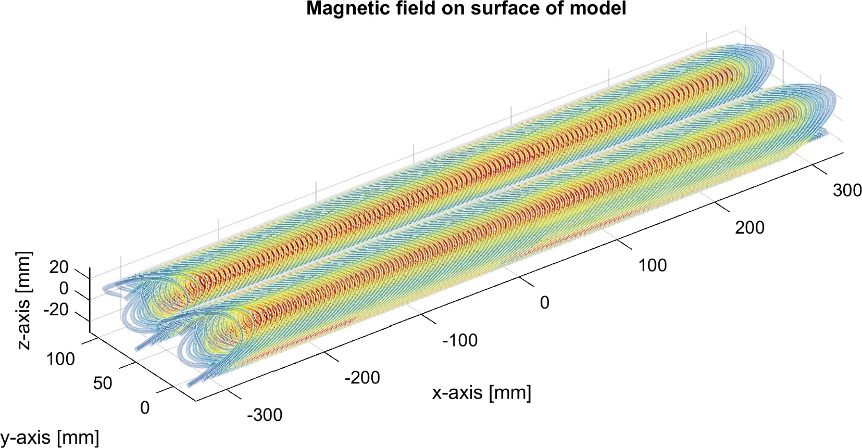
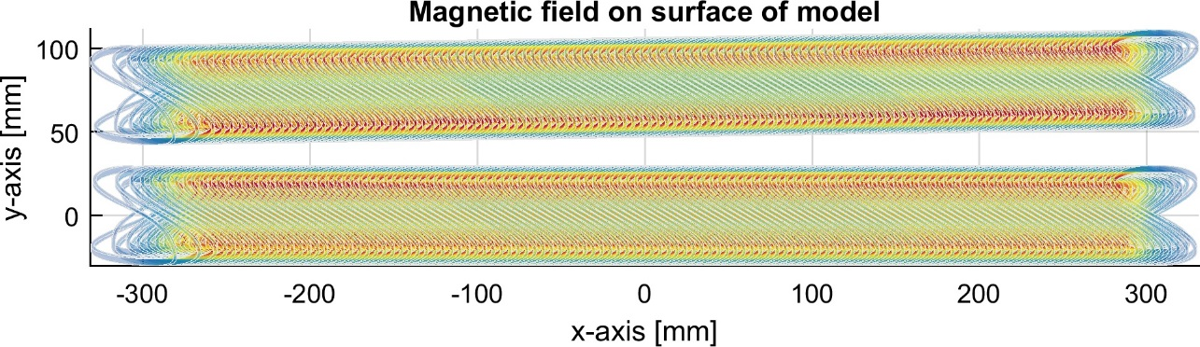
The problem (2): crosstalk compensation
This the part of the FF quadrupole closest to the IP, length = 720mm distance at tip: 66mm, angle 30mrad

Slide 21
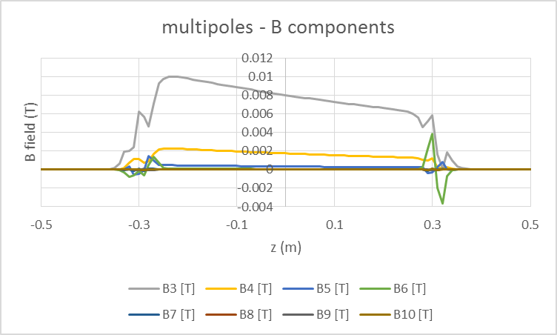
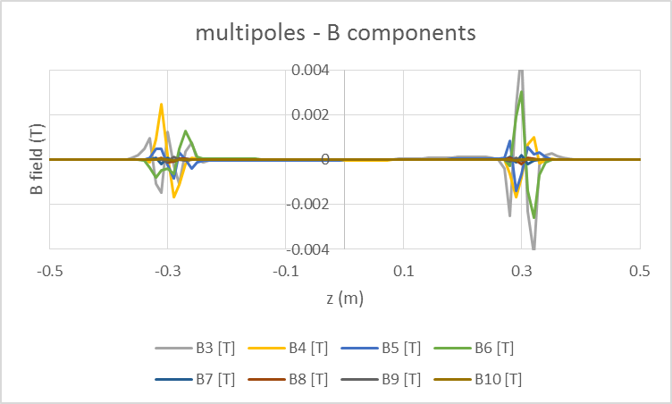
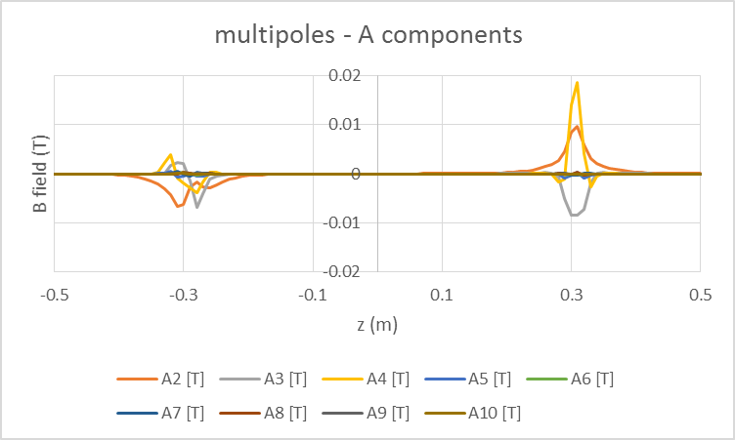
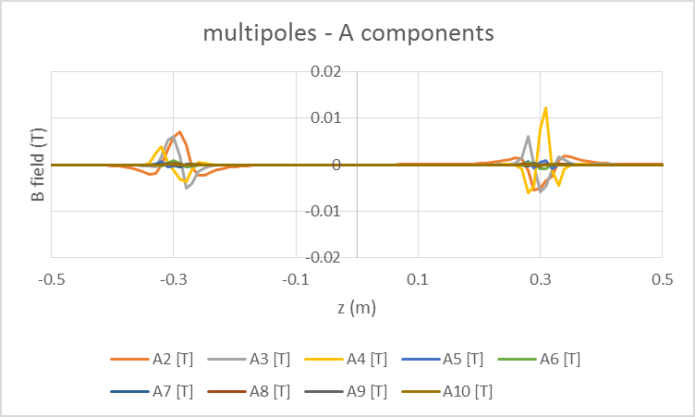
Multipoles – before and after
before
after
Before /after picture: note different scales

Slide 22
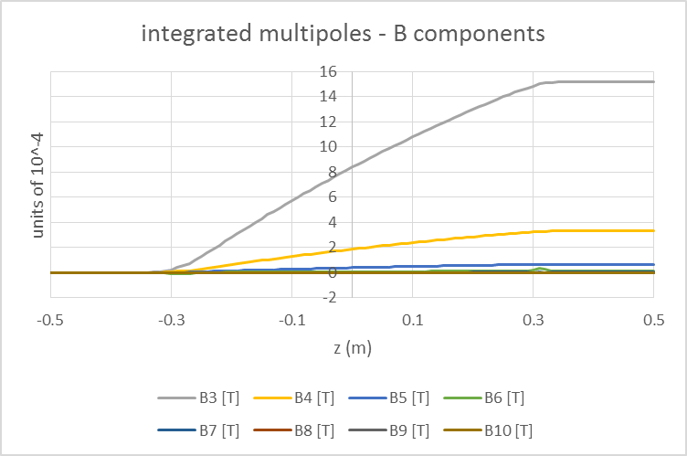
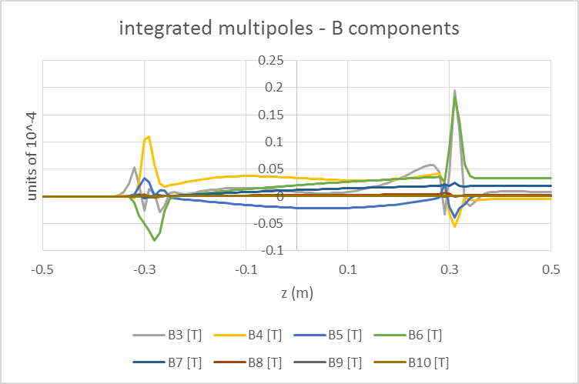
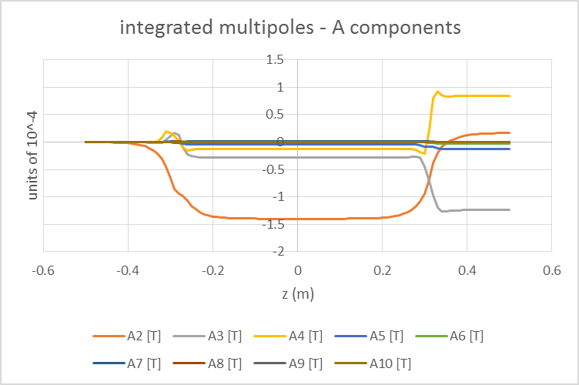
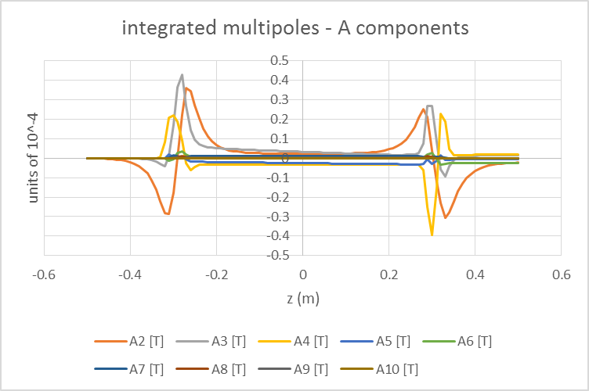
Integrated multipoles
before
after

Slide 23
Dual aperture crosstalk compensation
…also works beautifully.
The multipole components added are small (order of a few percent or less) and to the naked eye a compensated and uncompensated quad looks the same

Slide 24

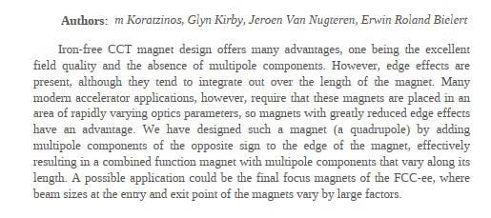

Conferences
MT25 – abstract submitted on edge correction
IPAC 2017 – paper on all IR elements
A novel method for greatly reduced edge effects design in CCT magnets

Slide 25
Conclusions
The magnetic element design close to the IR is of vital importance at FCC-ee and is a very difficult task.
We have a conceptual design that responds to all criteria: enough space for detector elements, including the luminometer, small vertical emittance blow-up, shielding of the FF quads from the main solenoid field of the detector, etc.
We have a benchmark, which is the SuperKEKb design. We aim to make something which is both simpler and more performant.
Regarding the FF quadrupole design, also a critical component, we have an excellent conceptual design using CCT technology with edge and crosstalk compensation.
We need to move from a conceptual design to a CDR-ready design that contains engineering design elements.
In view of the fact that this part is so crucial for FCC-ee, some prototyping effort should be made to make these ideas CDR material.

Slide 26
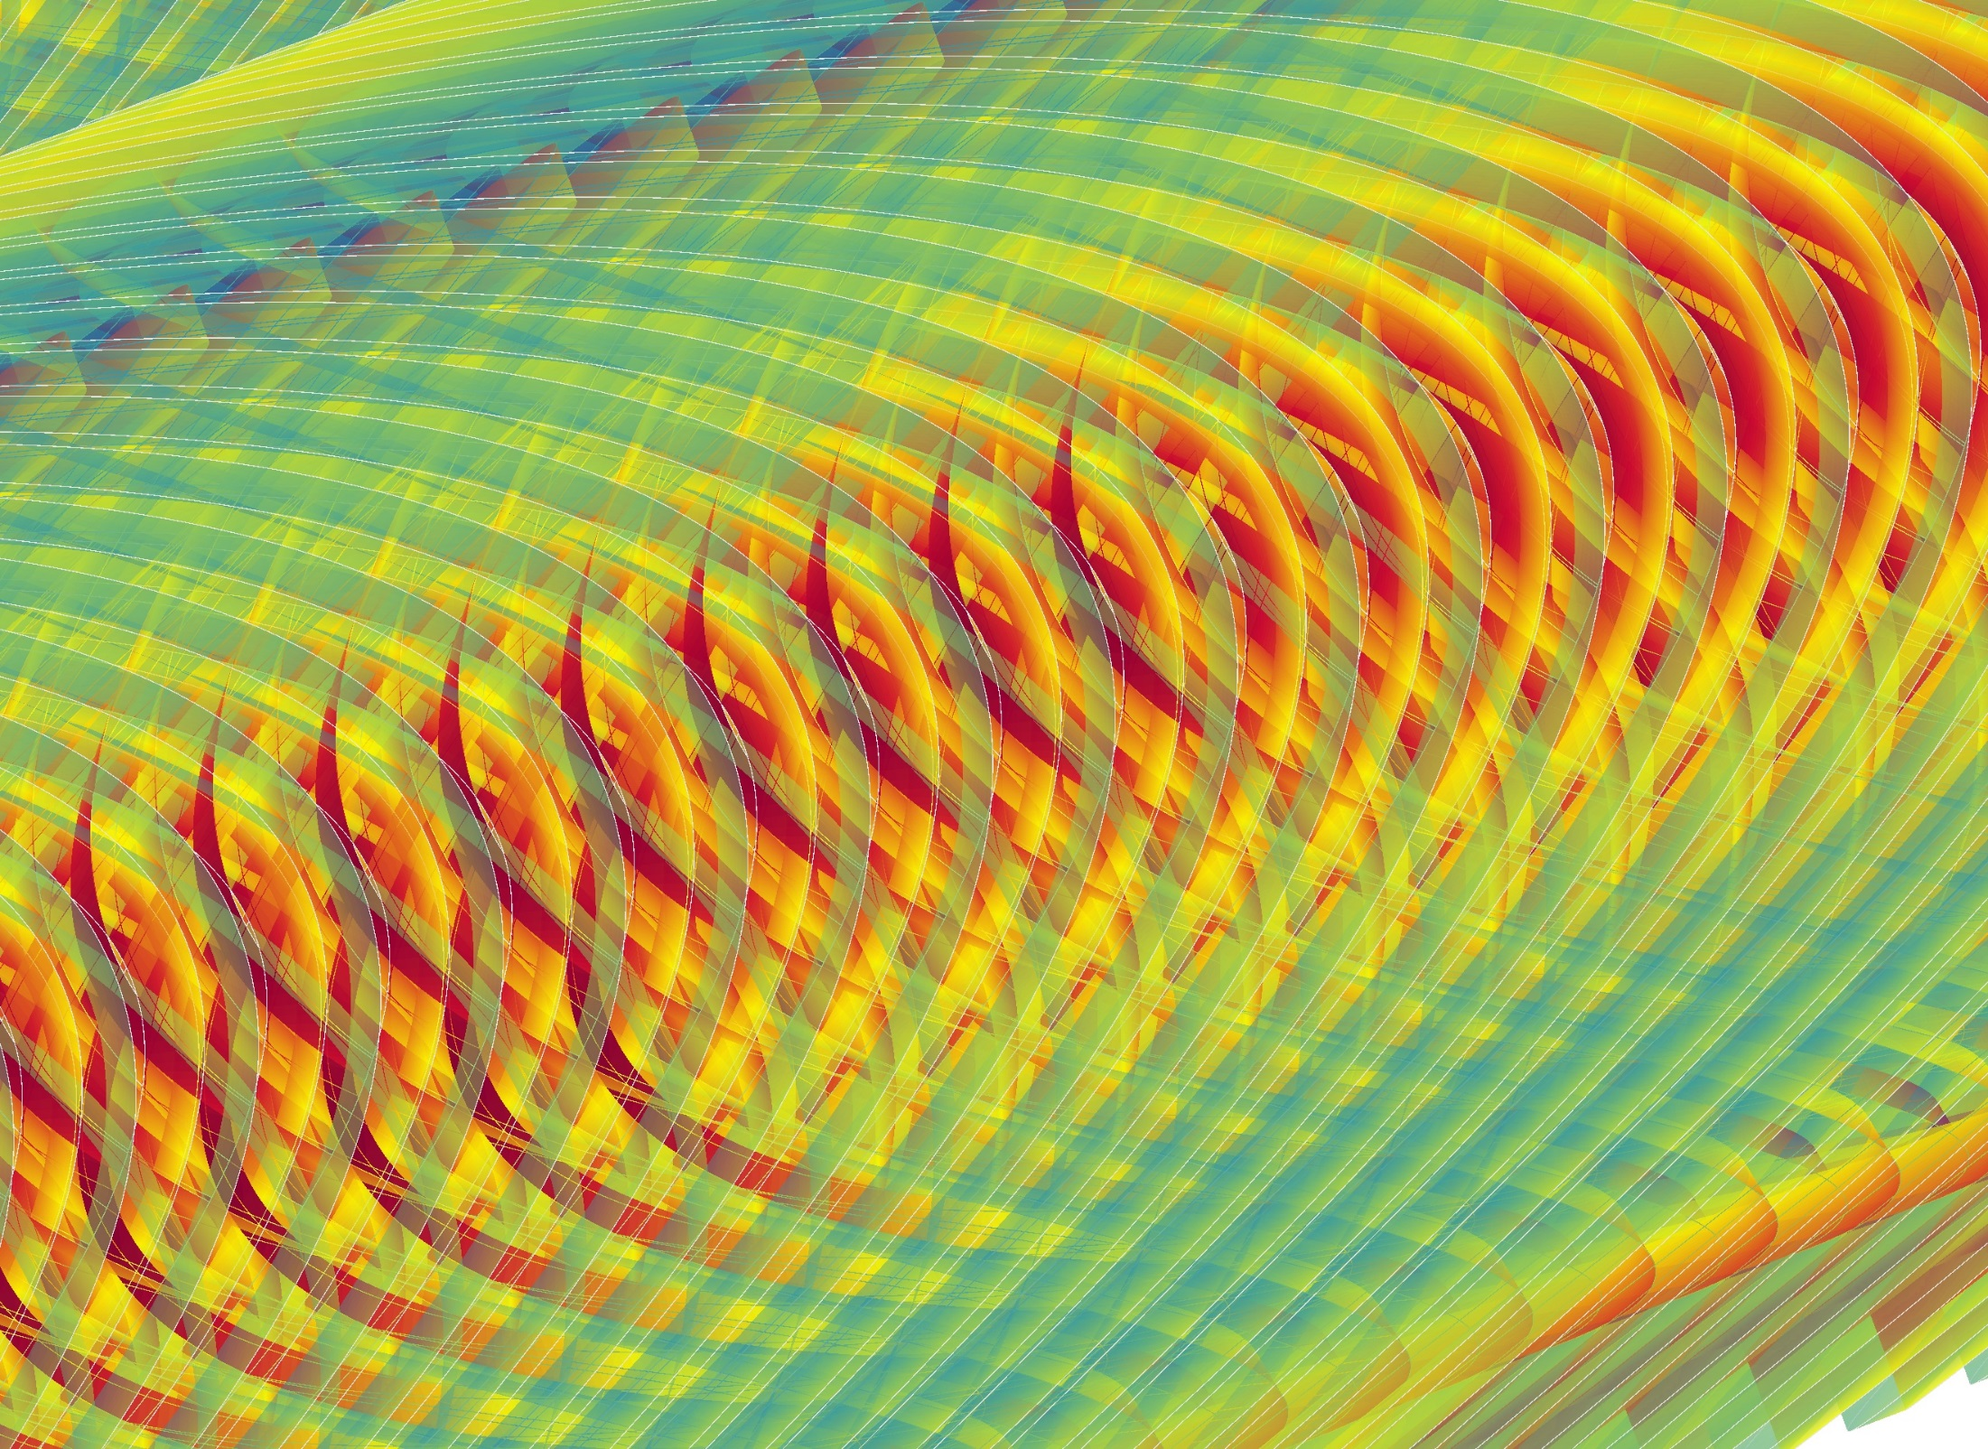
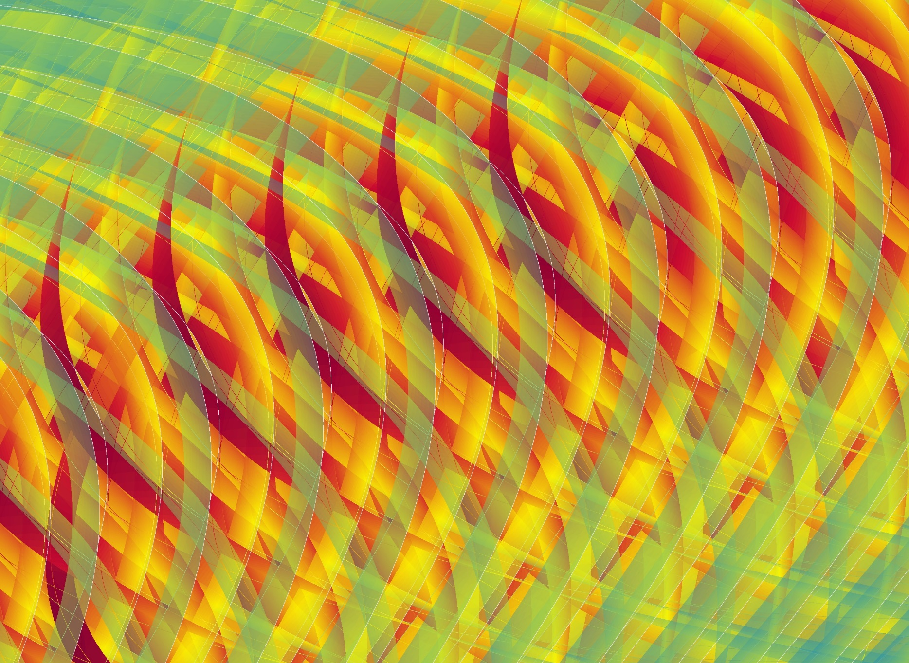
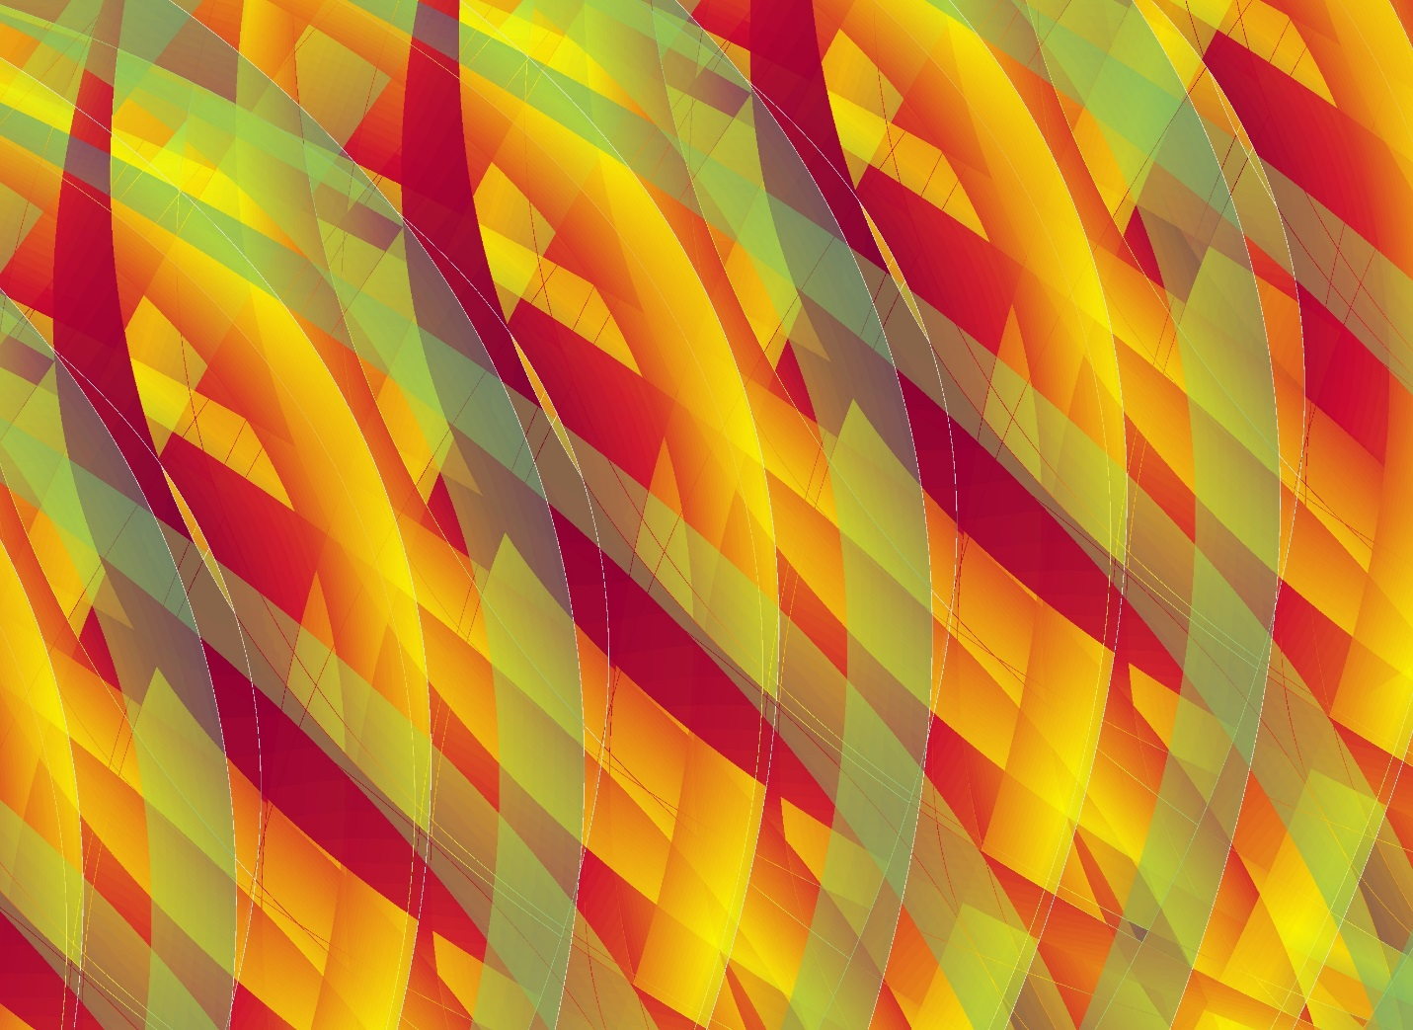
Thank you

