Slide 1
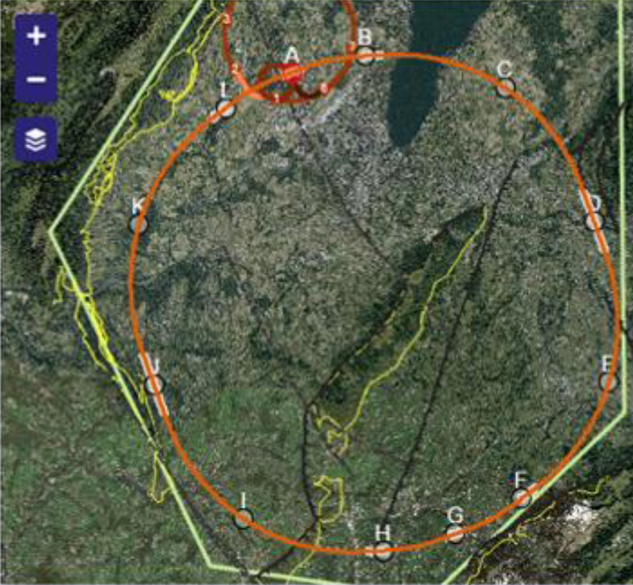
FCC-ee
Beam Polarization and Energy Calibration
EPOL group:
A Milanese CERN
K Oide CERN/KEK
T Tydecks CERN
J Wenninger CERN
F Zimmermann CERN
D Barber DESY
W Hillert DESY
E Gianfelice-Wendt FERMILAB
A Blondel GENEVA
M Koratzinos GENEVA
M Hildreth Notre-Dame (USA)
I Koop NOVOSIBIRSK
N Muchnoi NOVOSIBIRSK
A Bogomyagkov NOVOSIBIRSK

Slide 2
Baseline study:
-- transverse polarization for high precision measurements at Z and WW
-- polarization levels at : Z(91.2+-3), H(126), WW(161+-3) (E_{CM})
-- polarization wigglers
-- running scheme in physics ← main difference to LEP!
-- polarization improvement tools (harmonic corrections, others)
-- polarimeter design
-- depolarization and systematic errors on energy determination
-- from beam energy to center-of-mass energy
-- ancillary instrumentation : RF phases, beam orbit, energy spread etc…
different from LEP!
Beyond baseline
-- complementary monitoring (spectrometer, Moller scattering)
-- a word on longitudinal polarization possibilities
-- experiments require high polarization values
-- no compelling physics case

Slide 3
Some Bibliography
[1] | R. Assmann et al., “Calibration of centre-of-mass energies at LEP1,” Eur. Phys. J. C 6, 187-223 (1999).
[2] | L. Arnaudon et al., “Accurate Determination of the LEP Beam Energy by resonant depolarization,” Z. Phys. C 66, 45-62 (1995).
[3] | A.A. Sokolov, I.M.Ternov, “On Polarization and spin effects in the theory of synchrotron radiation,” Sov. Phys. Dokl. 8, 1203 (1964).
[4] | A. Blondel and J.M. Jowett, “Dedicated Wiglers for Polarization,” LEP note 606, CERN, 1988.
[5] | R. Assmann et al., “Spin dynamics in LEP with 40–100 GeV beams,” in AIP Conf. Proc. 570 , 169 , 2001.
[6] | G. Wilson, “Prospects for Center-of-Mass Energy Measurements at Future e⁺e⁻ Colliders” talk in TLEP7, 19 June 2014.
[7] | M. Koratzinos, “Transverse polarization for energy calibration at Z-peak”, arXiv:1501.06856 [physics.acc-ph]
[8] | M. Koratzinos, “Beam energy calibration: systematic uncertainties”, talk in TLEP8, 28 October 2014
[9] | M. Koratzinos, “FCC-ee: Energy Calibration Options”, FCC week 2015, Washington.
[10] | M. Koratzinos et al., “FCC-ee: Energy Calibration”, IPAC ’15
[11] | E. Gianfelice ‘Investigation of beam self-polarization in the future e+e− circular collider’ Phys.Rev.Accel.Beams 19 (2016) no.10, 101005 arXiv:1705.03003v1

Slide 4
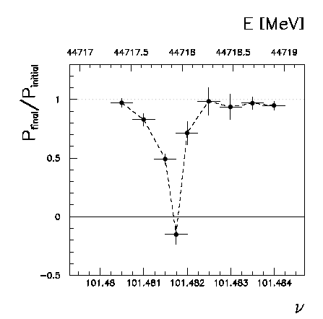
Beam polarization and E-calibration @ FCC-ee
Precise meast of E_{beam} by resonant depolarization
~100 keV each time the meast is made LEP→
At LEP transverse polarization was achieved routinely at Z peak.
instrumental in 10⁻³ measurement of the Z width in 1993
led to prediction of top quark mass (179+- 20 GeV) in Mar’94
Polarization in collisions was observed (40% at BBTS = 0.04 at Z energy)
At LEP beam energy spread destroyed polarization above 61 GeV
σ_{E} ∝ E²/√ρ ➔ At FCC-ee transverse polarization up to at least 81 GeV (WW threshold)
to go to higher energies requires spin rotators and siberian snake
FCC-ee: use ‘single’ bunches to measure the beam energy continuously
→no interpolation errors due to tides, ground motion or trains etc…
<< 100 keV beam energy calibration around Z peak and W pair threshold.
Δm_{Z} ~0.1 MeV, ΔΓ_{Z} ~0.1 MeV, Δm_{W} ~ 0.5 MeV

Slide 5
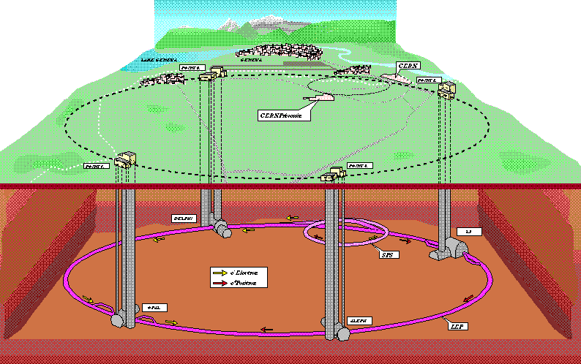
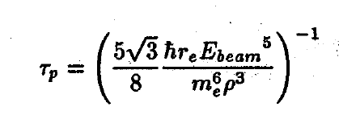
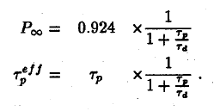
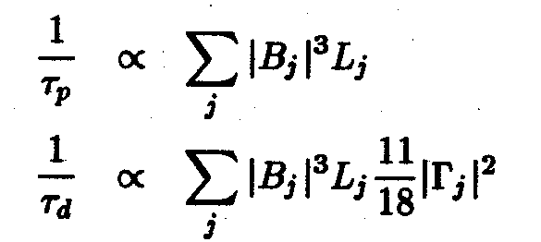

LEP (1989-2000) first observation of P⊥ in 1990
first resonant depolarization in 1991
=310 minutes
at 45.6 GeV in LEP
250 hours in FCC-eeZ!
14 hours at WW
orbit
imperfections
Spin tune at the Z peak : 103.5
The scan points 101.5 / 103.5 / 105.5 are perfect optimum for Z width meast
scan points at 100.5 and 106.5 are good for Δα_{QED} measurement
Spin tune for W threshold 180.5 -- 183.5

Slide 6
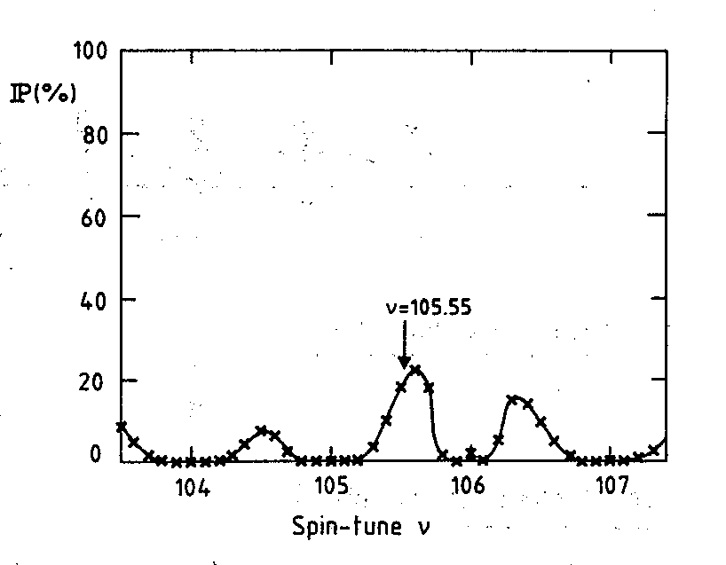
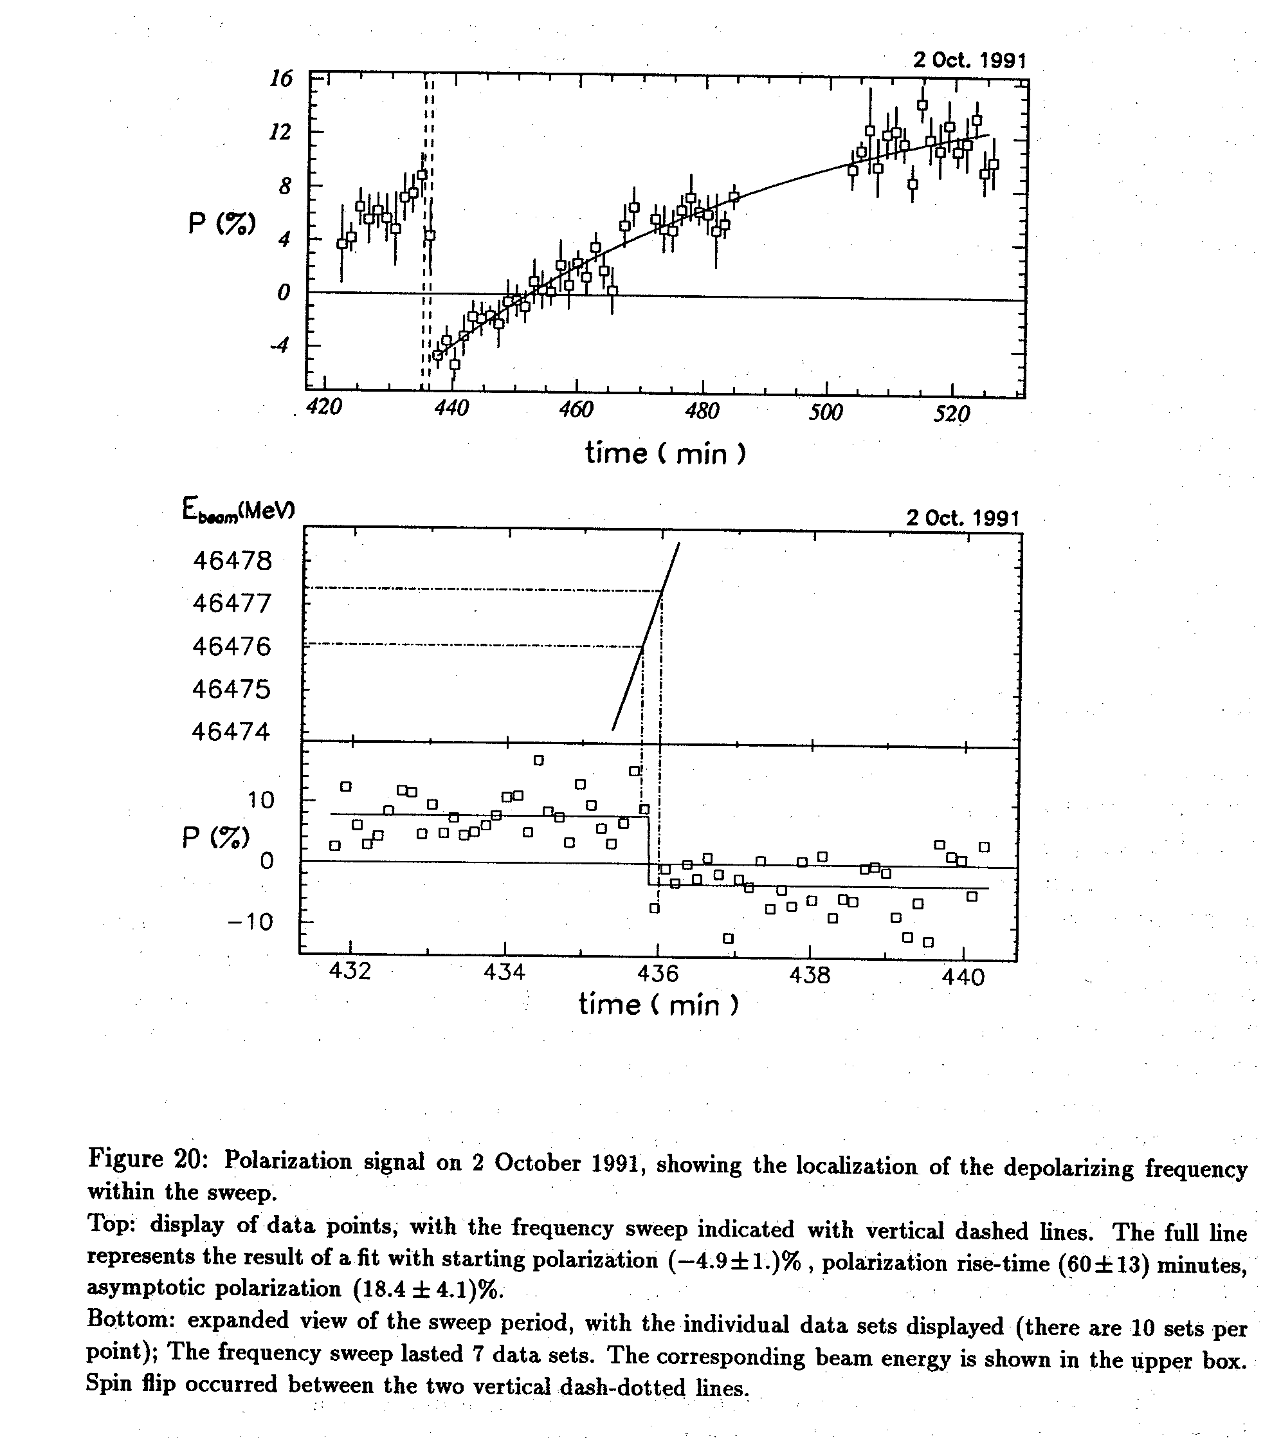
Self polarization @LEP :
expectations at LEP were O(5-20%)depending on imperfections (including estimate of energy spread effect) (Koutchouk, 1988)
10% level sufficient
for resonant depolarization
E_{beam}calibration at ±100keV
effective polarization time
is also 10% of polarization time

Slide 7
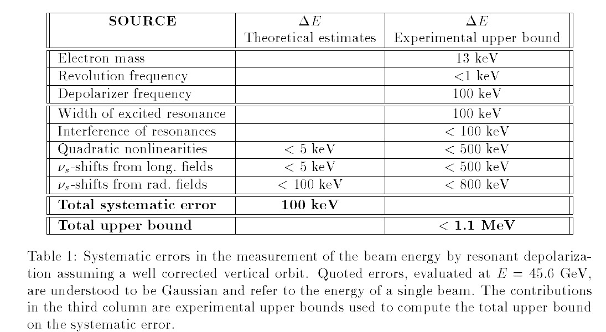
in 1995 we pushed the measurement
to «high precision» (100 keV)
spin tune

Slide 8
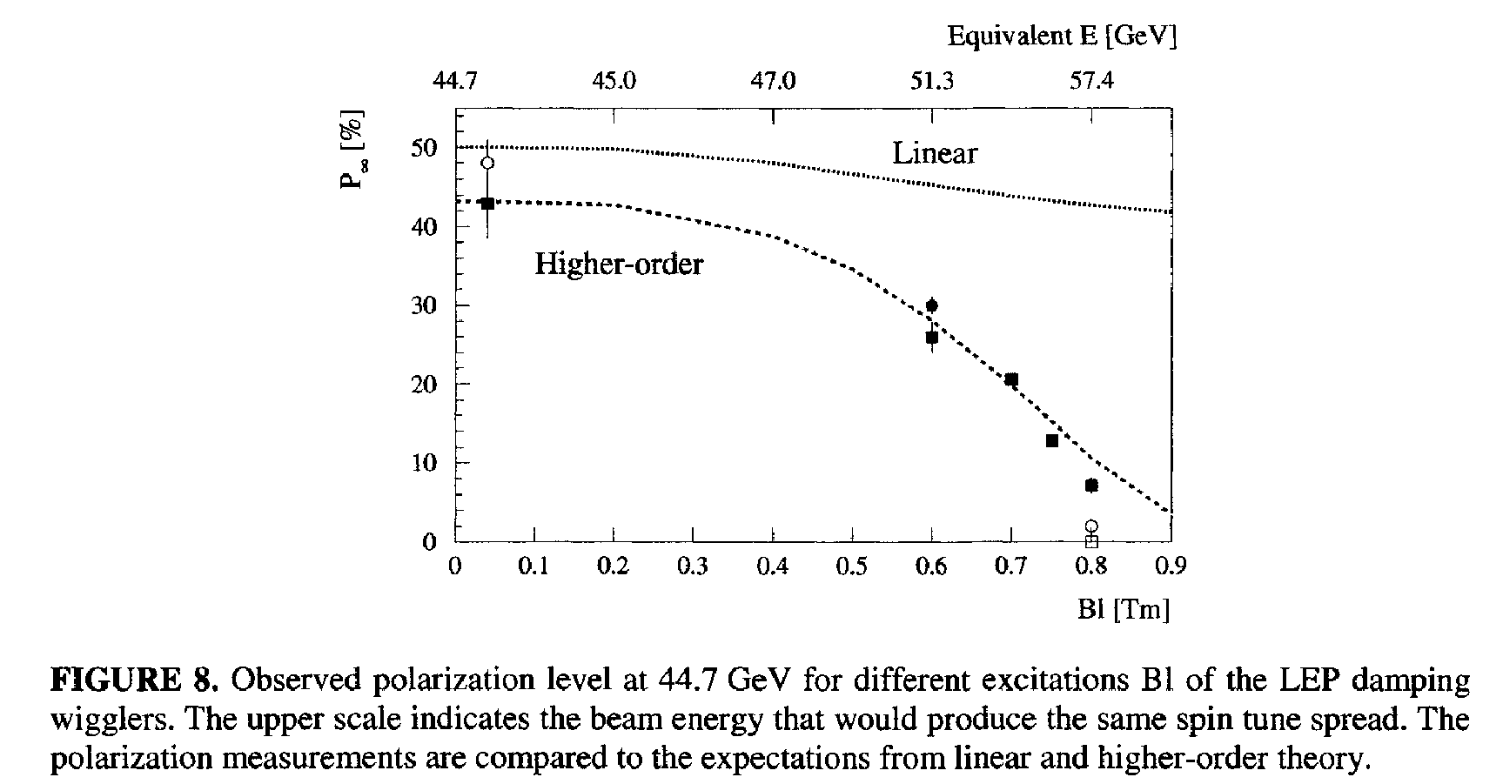
effect of energy spread on Polarization in a given machine was studied using the damping wigglers
Energy spread should not exceed ~55 MeV

Slide 9
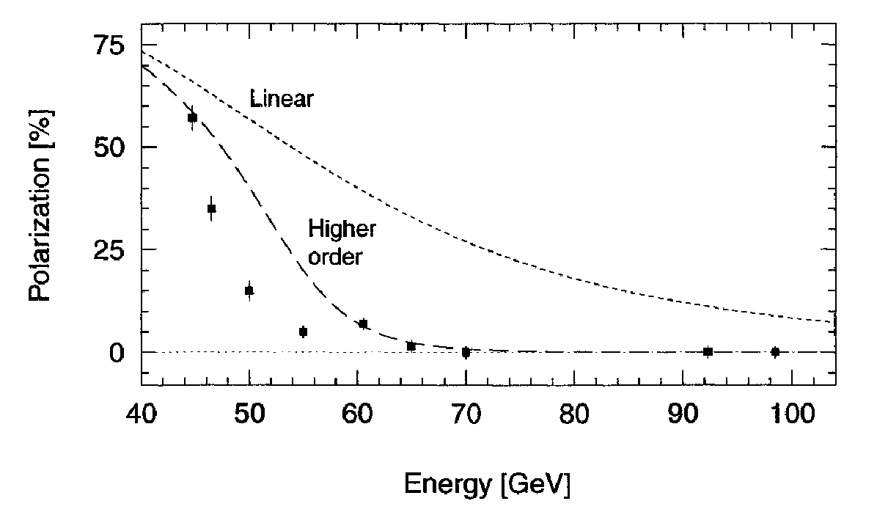
σ_{E} ∝ E_{b}² / √ρ
The good news is that polarization in LEP at 61 GeV corresponds to
polarization in FCC-ee at >80 GeV
➔ Good news for M_{W} measurement (see E. Gianfelice’s presentations)

Slide 10
These observations were consistent with the hypothesis that
energy spread drives the synchrotron resonances.
We were able to keep the polarization as long as σ_{E} < 56 MeV.
In a larger ring the energy spread is smaller ☺
But the polarization time is much longer
→ need to use wigglers within limit of energy spread.

Slide 11
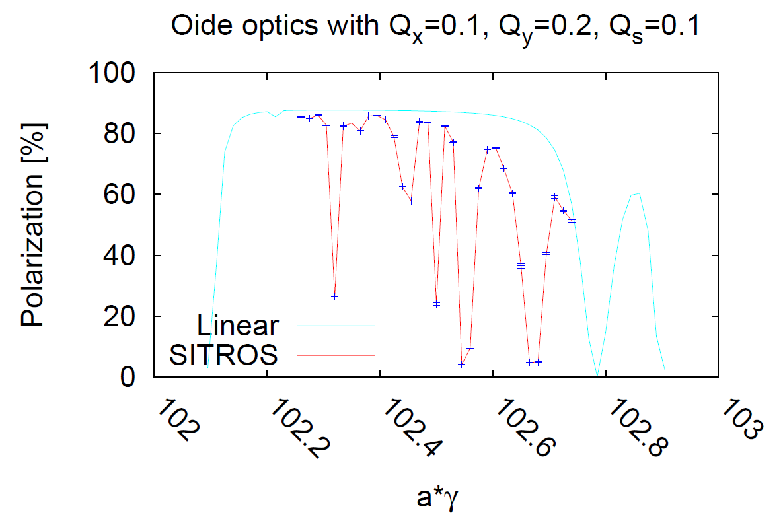
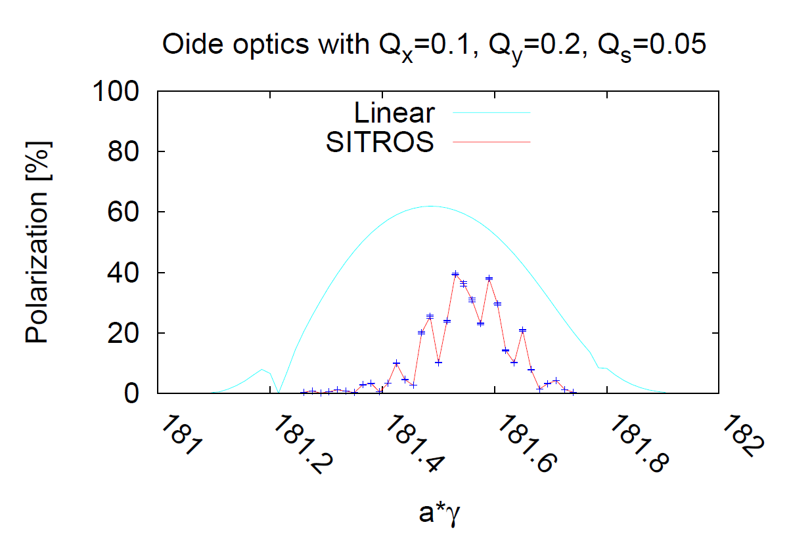
45 GeV
80 GeV
At the Z obtain excellent polarization level
but too slow for polarization in physics
need wiggler for Energy calibration
At the W expecation similar to LEP at Z
→ enough for energy calibration
Simulations by Eliana Gianfelice

Slide 12
Running mode
The process is e+/e- symmetric and independent
Inject 300 (out of 30,000 - 75,000 at the Z), 50 out of 5260 at the WW
non- colliding bunches in each beam (1%)
Use wigglers to achieve polarization of these bunches at a level of 9%, adequate for depolarization measurements – a 50-100 minute dead-time is introduced where no line shape physics can take place. Fills need to be long to compensate
Switch off wigglers and start line shape physics data taking with colliding bunches, which are continuously filled up (and therefore build up no polarization)
Perform a depolarization measurement every 10 minutes – 6 per hour.
When all non-colliding bunches will be exhausted, the new non-colliding bunches would have achieved a meaningful natural polarization.
Similar procedure at the Z and W energies, no wigglers are needed at the WW

Slide 13
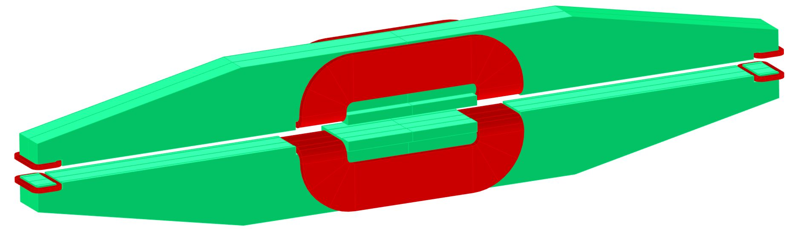
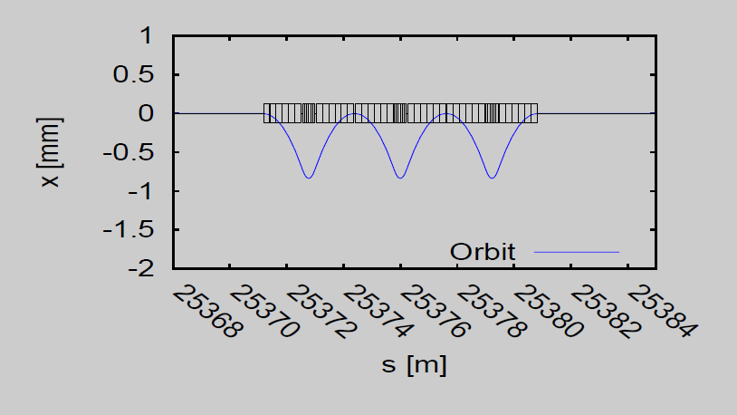
A first magnetic concept of the FCC-ee wigglers (A. Milanese)
narrower (200 mm) lateral poles
central main coils
mass ≈ 4 tons
beam
wider (300 mm) central pole
side trim coils
8 such magnets per beam with B=0.7T
will shorten life time to 25hrs at the
However smaller magnets in series →
lead to smaller horizontal excursion
smaller emittance blow-up
(Gianfelice)

Slide 14
Wigglers
Wigglers are essential since natural polarization time is long but have two undesired effects:
They increase the energy spread
They contribute to the SR power budget of your machine
Strategy is to use them is such a way that
  The energy spread is less than some manageable number (so that no resonances are encountered).
  Switch them on only where necessary and only on the monitoring bunches
Machine | Energy | No. of wigglers | B+ | Polarization time to 9% | Energy spread | Wiggler SR power
FCC-ee | 45 | 0 | 0 | 25 hours | 17MeV | 0
FCC-ee | 45 | 8 | 0.7T | 2.1 hours | 52MeV | 20MW*1%
FCC-ee | 45 | 1 | 1.35T | 2.4 hours | 52MeV | 9MW*1%
Lose ~2h at the beginning of (hopefully) very long fills – can reduce this if lower polarization levels could be distinguished by the polarimeter

Slide 15
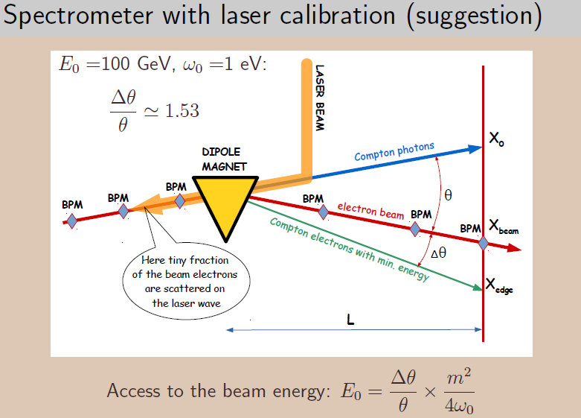
Other ideas for energy monitoring
Koop, Munchnoi

Slide 16
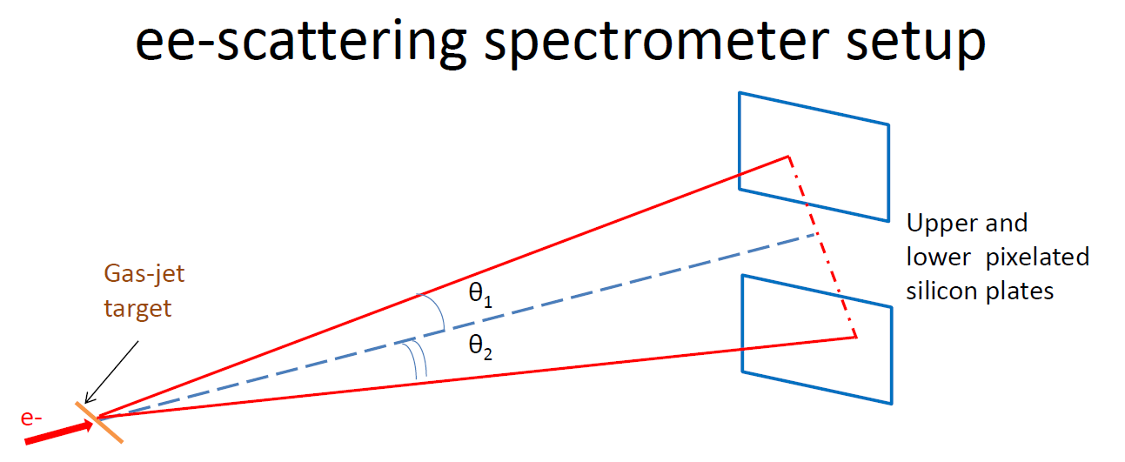
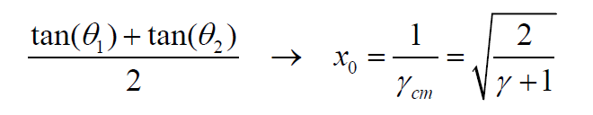
Other ideas for energy monitoring
Möller scattering spectrometer
min

Slide 17
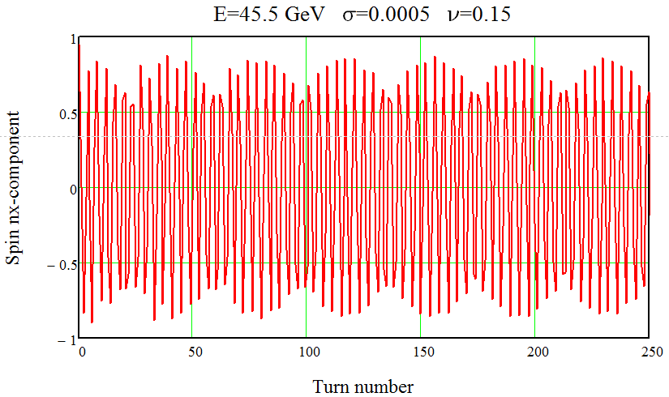
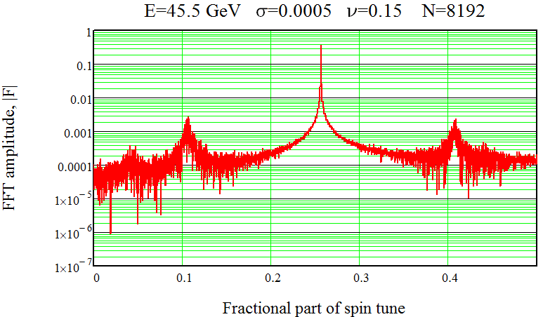
Injection of polarized e- or e+ beams → precession in horizontal plane (Koop)
Production of polarized electrons from a laser photocathode
Production of polarized positrons in a small energy damping ring
(1-2 GeV), with polarization time in the order of 10 min
Acceleration of polarized beams via linac, SPS , booster storage ring (100 km) using Siberian Snakes. → 8000T.m of SC solenoids
Injection of polarized bunches into the collider rings with the
horizontal spin orientation.
Measuring turn by turn free precession frequency using the
longitudinal Compton polarimeter.
beautiful! but
…. lots of hardware
3kHz
spin precession

Slide 18
Systematic Errors
theoretical estimates
design test experiments
A. Bogomyagkov
  Resonant depolarization errors
  Energy spread error (for Z width)
  IP specific correction (RF) errors
  Beam energy to E_{CM} errors
  energy difference of colliding
  and non-colliding bunches
  -- relationship between spin-tune
  and beam energy at IPs
cannot use the bunch length at IP
needs measurement of energy spread
(beam size at dispersive region,
bunch length measurements
requirements on RF distance to IR and phases
saw-tooth small at Z (17 MeV energy loss)
BPM must have differential position meast
capabilities
need dedicated simulation tools
e.g. spin tracking including FFT
(D. Barber)

Slide 19
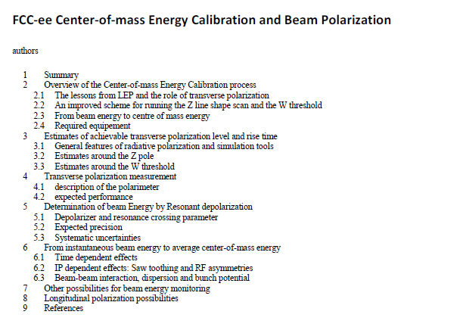

Slide 20
CONCLUSIONS
-- A beam Energy Calibration and Polarization (EPOL) was created 6 mo. ago
-- There is a straightforward baseline running mode for the Z and W (and H(126))
with continuous Energy Calibration on 1% non-colliding bunches
in order to aim at ±100 keV beam energy calibration
-- Polarization prospects for Z and WW are good, sufficient for the energy calibration,
Experiments can calibrate at higher energy with WW, γZ events (~±10 MeV)
this is sufficient for top and Higgs mass measurements
-- final word on precision requires much further work on systematic effects
-- a list of required hardware and instrumentation will be listed
if possible ensuring some redundancy
-- Computing tools for beam polarization (presently approximate)
will need to be developped

Slide 21
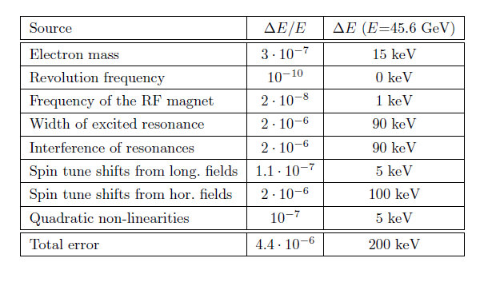
Resonant depolarization accuracy at FCCee – goal
Per beam, not ECM
Correlated/Z mass | Uncorrelated/ Z width
15keV | 0keV
0keV | 0keV
1keV | 0keV
1keV | 1keV
9keV | 9keV
5keV | 5keV
3keV | 1keV
5keV | 5keV
~20keV | ~12keV
~40keV | ~20keV
~45keV | ~23keV
IP specific errors
total
Statistical errors are divided by sqrt(10,000) - negligible
This is a first attempt at quantifying the errors and can be considered as a wish
The table should eventually also include effects that were negligible at the time of LEP

Slide 22
Energy spread
Total error at LEP was 1000keV translating to 200keV for the Z width
The method used at LEP (which was measuring the bunch length at the IP) cannot be used at the FCC-ee due to the crab waist scheme being used
another method should be used: for instance an SR camera at a place of large known dispersion (in the arcs)
Energy spread at the Z is 17MeV. We need a system that can measure this to 0.1% (not the accuracy of individual measurements, but the accuracy of the method) → 20keV per beam translating to 7keV for the Z width (numbers need to be checked)

Slide 23
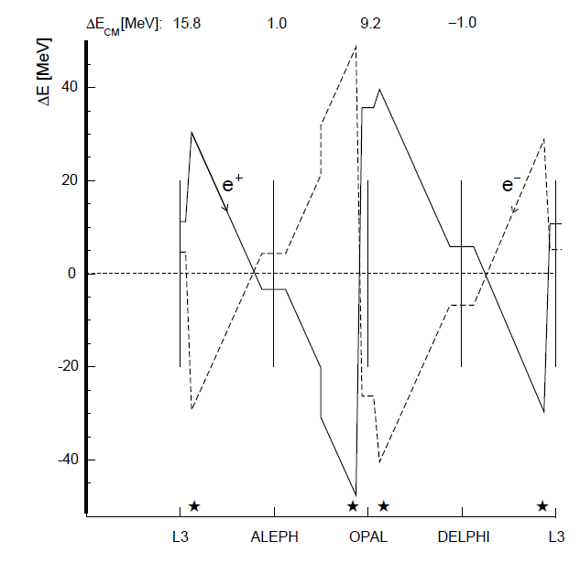
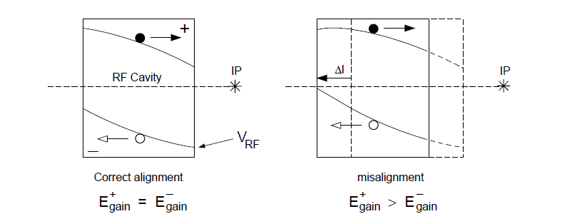
IP specific (RF) corrections
Errors arise due to cavity misalignments primarily:
At LEP cavity misalignment was assumed to be 1.4mm in 1995
Work is needed to reduce this error. For LEP the error was of the order of 500keV (leading to an error of 400/200keV for the mass/width of the Z. Need to reduce this error by (more than) a factor of 10!
This might be the dominant error at FCC-ee

Slide 24

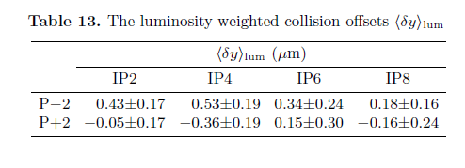
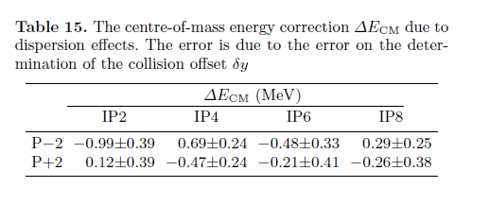
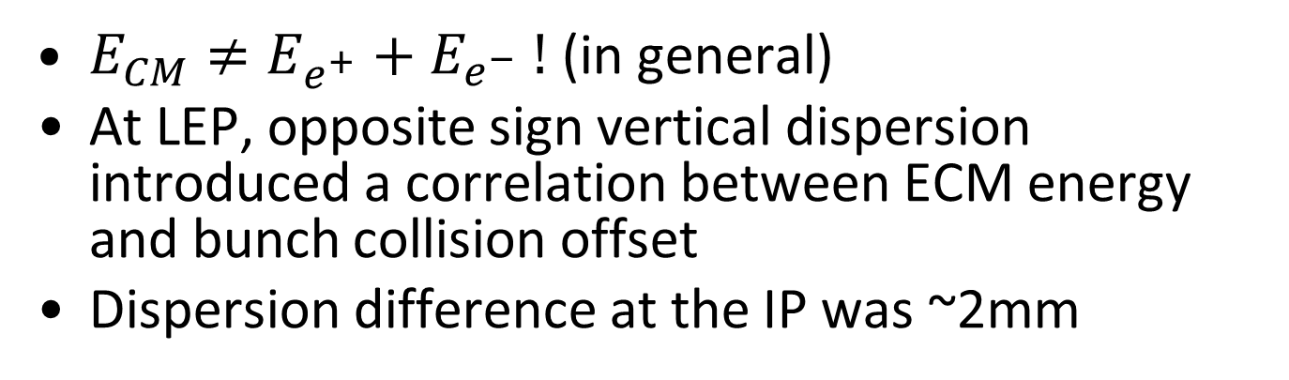
Beam energy to E_{CM}
$E_{CM}≠E_{e^{+}}{+ E}_{e^{−}}!$ (in general)
At LEP, opposite sign vertical dispersion introduced a correlation between ECM energy and bunch collision offset
Dispersion difference at the IP was ~2mm
Collision offsets were sub-micron!
To avoid the problem, we should run with zero OSVD!
LEP error (ECM) ~400keV

Slide 25
Non-colliding to colliding bunch energy difference
At FCC-ee we are obliged to routinely measure non-colliding bunches
These have a different tune shift and do not suffer from beamstrahlung
We should model any systematic average energy difference…
…but also measure this difference in a dedicated MD where we polarize all bunches, switch top-up injection off and then measure (quickly!) the difference in energy between colliding and non-colliding bunches

Slide 26

W physics
$$σ_{E}∝\frac{E^{2}}{\sqrt{ρ}}$$
In contrast to LEP, adequate polarization levels are expected to exist at the FCC-ee since the energy spread decreases in a larger ring (to be verified)
Analysis will be similar to the Z, and resulting error much smaller than what was achieved at LEP (that had to rely on large extrapolation)
The statistical error is expected to be 0.3MeV (which is much larger than what can be achieved at the Z), so we can be fairly confident that the systematic error due to the energy uncertainty will not be a limiting factor

Slide 27
Issues - summary
Hardware:
  Develop a performant polarimeter
    Need at least 2
    Aim to be able to perform a measurement with precision of <1% in one minute.
  Develop a beam size measuring device at a place of known dispersion for energy spread measurements
  Develop (polarization) wigglers
Software: full polarization simulation software analysis
RF system errors: investigate what positioning accuracy is needed, if it is achievable and how we can independently verify.
Model energy difference of colliding/ non-colliding bunches and perform a verification measurement
…

Slide 28
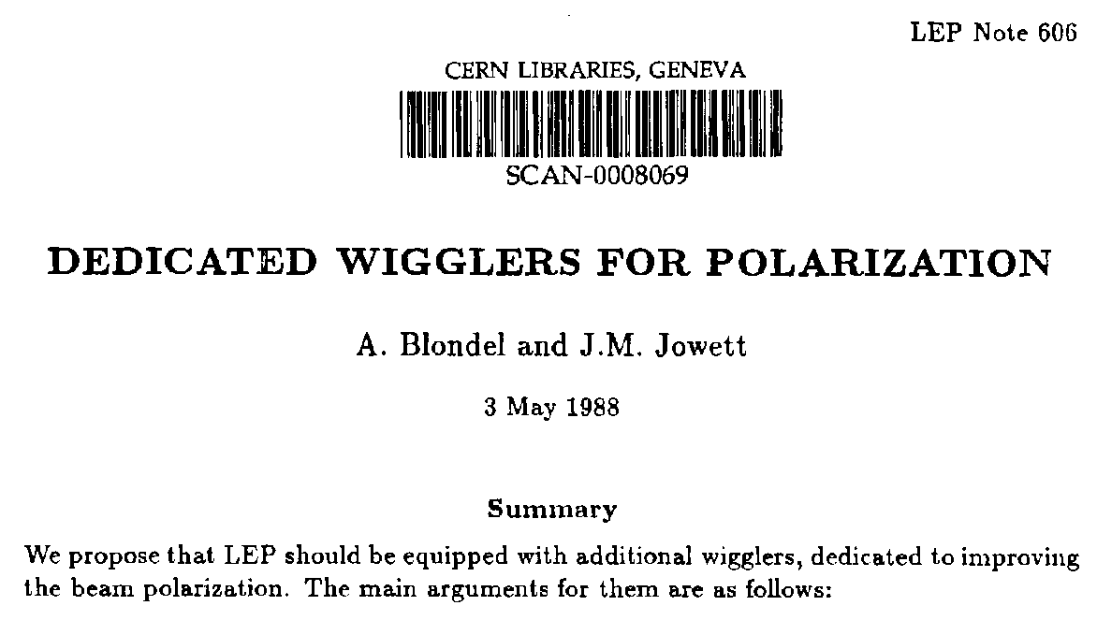
Use of polarization wigglers at TLEP

Slide 29
FOREWORD How the sausage was made...
In order to evaluate the effect of wigglers and top-up injection on TLEP polarization performance, I have generated two spread sheets
1. the first one calculates the energy pread and polarization time in TLEP assuming a bending radius of 10km for a circumference of 80km, and the presence of the 12 polarization wigglers that were built for LEP as calculated in LEP note 606 (Blondel/Jowett)
2. the second one folds the achived polarization performance with top up injection, given the luminosity life time and the regular injection of unpolarized particles.
The variable parameters are
-- B+ : field in the positive pole of the wigglers
-- beam energy
-- luminosity lifetime
-- and of course Jx but I have refrained to play with it. (one would want it as small as possible)

Slide 30
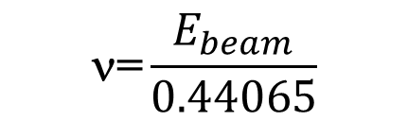
80 km machine!)
Energy spread (Jx=1) LEP TLEP
beam energy sigma(E) tau_P sigma(E) tau_P
45 GeV no wiggs 32 MeV 5.5 hrs 18 MeV 167 hrs
45 GeV wigglers 46 MeV 2.4 hrs 58 MeV 12 hrs
55 GeV no wiggs 48 MeV 1.96 hrs 26 MeV 61 hrs
61 GeV no wiggs 59 MeV 1.1 hrs 33 MeV 36 hrs
81 GeV 58 MeV 8.9 hr
➔ ☹ annoyingly: with wigglers at TLEP, the energy spread is larger than at LEP,
for a given polarization time.
consider somewhere between 48 and 58 MeV as maximum acceptable for
energy spread*). Take 52 MeV for the sake of discussion.
Note that wigglers make energy spread worse faster at TLEP (damping is less)
☺ There is no need for wigglers at 81 GeV.
*) The absolute value of energy spread corresponds to an absolute value of spin-tune spread
$$\text{=}\frac{E_{beam}}{0.44065}$$

Slide 31
Hypothetical scenario
Insert in TLEP the 12 Polarization wigglers that had been built for LEP (B-=B+/6.25)
Use formulae given in TLEP note 606 to determine as a function of B+ excitation
1. the energy pread σ_{E}
2. the polarization time τ_{P}
then set an uppper limit on energy spread ...
and see what polarization time we get
for 10% polarization the time is τ_{P} ^{eff} = 0.1 τ_{P}
for 52 MeV energy spread at TLEP Z we get τ_{P} = 15hrs or τ_{P} ^{eff} = 90 minutes
-- lose 90 minutes of running , then can depolarize one bunch every 10 minutes
if we have 9 ‘single bunches’ per beam. (will keep a few more to be sure)
Changing the wigglers (e.g. more, weaker) makes little difference
B-
B+
B-

Slide 32
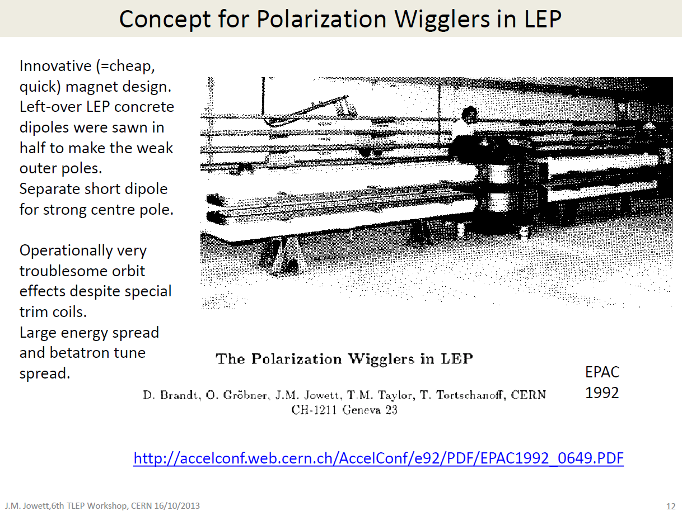
Jowett: were not easy to use (orbit distortions)
and should probably be better designed

Slide 33
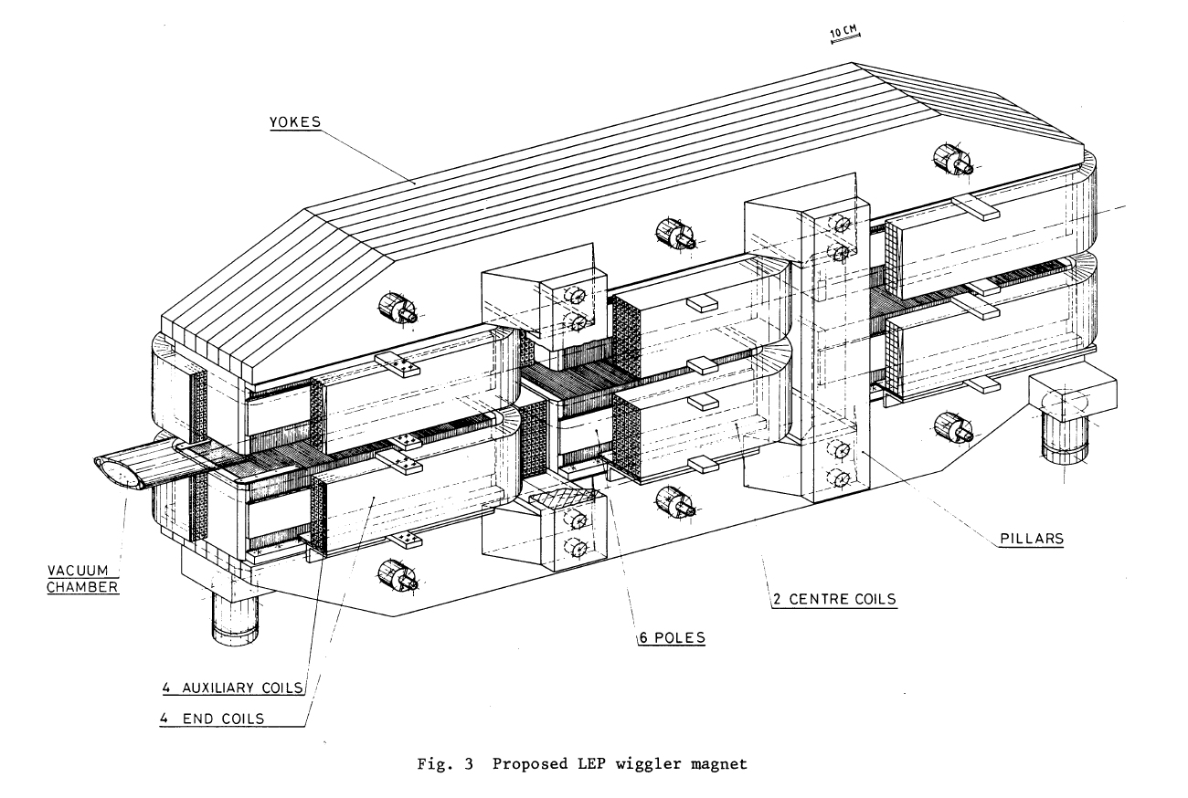
The LEP damping and emittance wigglers are a better model.

Slide 34
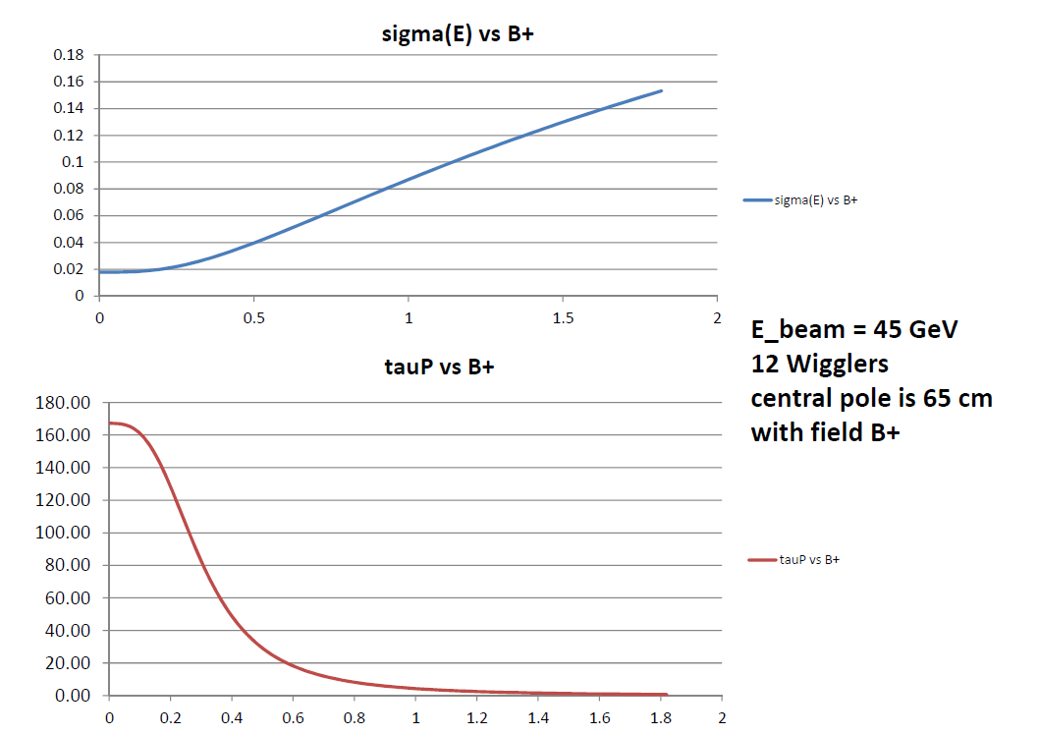
σ_{E}(GeV)
hrs
B_{Wiggler}(T)

Slide 35
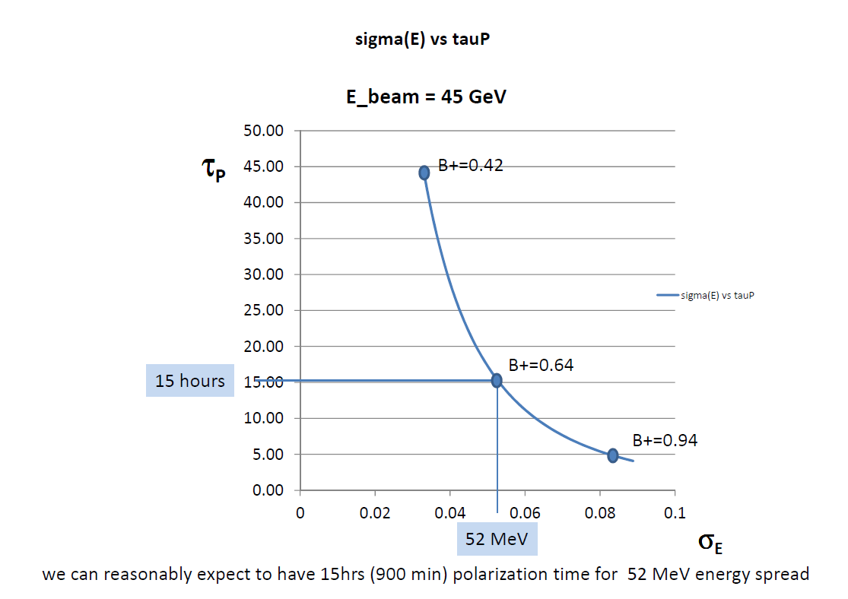
NB this was done
for 80km machine
itsa 25 hours for
the 100km FCC-ee

Slide 36
Synchroton radiation power in the wigglers
Synchrotron radiation power by particles of a given energy in a magnet of a given length
scales as the square of the magnetic field.
The energy loss per passage through a polarization wiggler was calculated in LEP note 606
(see next page). It is 3.22 MeV per wiggler or 38.6 MeV for the 12 wigglers.
At LEP the energy loss per particle per turn is 117 MeV/turn in the machine with no wiglers
and becomes 156 MeV per turn with the 12 wigglers at full field. From this it follows that
in the machine running at 45 GeV and wigglers at full field the radiation power
in the wigglers would have been 25% of the total power dissipated around LEP.
In TLEP now, the energy loss per turn in the ring is 36.3 MeV while, in the wigglers at 0.64T,
the energy loss in the wigglers is approx. a quarter of the above or 9.4 MeV.
The fraction of energy lost in the wigglers is then 9.4/(36.3+9.4) or 21%.
For a total SR power of 100MW, 21 MW go in the wigglers.
(if we use it on full current)

Slide 37
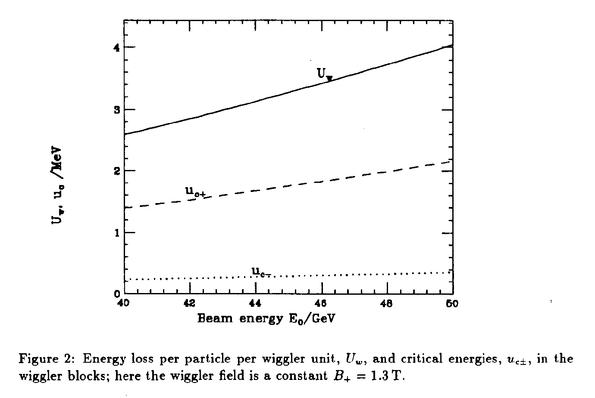
ENERGY LOSS PER PARTICLE PER WIGGLER
3.22MeV at 45 GeV

Slide 38
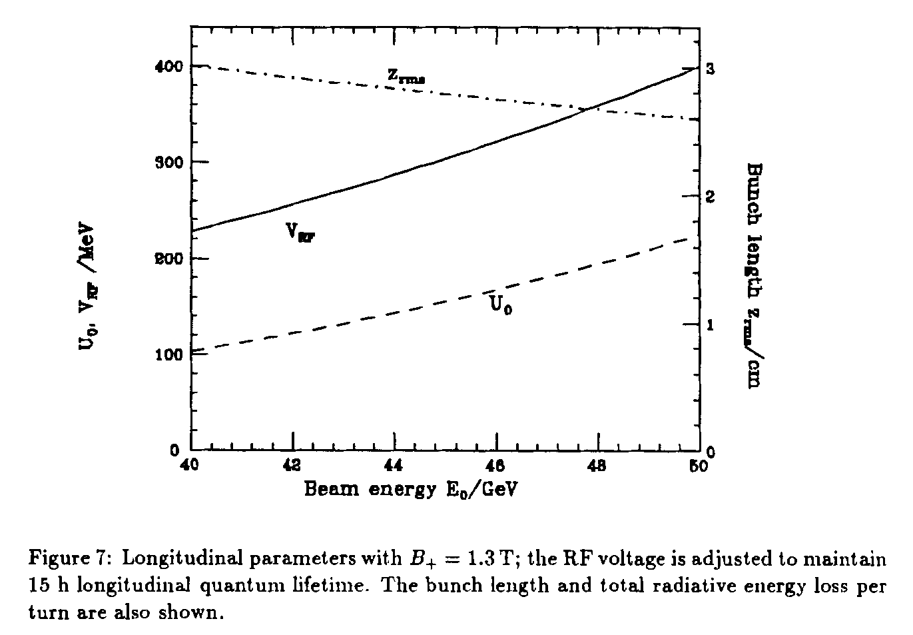
TOTAL ENERGY LOSS PER TURN PER PARTICLE WITH 12 WIGGLERS

Slide 39
Preliminary conclusions:
1. ☹ the wigglers increase energy spread in TLEP faster than in LEP
2. ☺ a workable point can be found for the ‘energy calibration mode’
at the Z pole or W threshold, assuming no better performance than in LEP for
depolarizing effects.
3. ☺ things should get better with lower emittance and lower vertical dispersion.
4. !!! A very careful design of the SR absorbers is required, as the SR power
in the wigglers is very large (20% of the total in the ring) !!!
5. reducing the luminosity for polarization runs can be envisaged,
since the statistical precision on m_{Z} and Γ_{Z} is very small (<10 keV) and probably
smaller than systematics.

Slide 40
A Sample of Essential Quantities:
X | Physics | Present precision |  | TLEP stat Syst Precision | TLEP key | Challenge
M_{Z} MeV/c2 | Input | 91187.5 ±2.1 | Z Line shape scan | 0.005 MeV <±0.1 MeV | E_cal | QED corrections
Γ_{Z} MeV/c2 | Δρ (T) (no Δα!) | 2495.2 ±2.3 | Z Line shape scan | 0.008 MeV <±0.1 MeV | E_cal | QED corrections
R_{l} | α_{s ,} δ_{b} | 20.767 ± 0.025 | Z Peak | 0.0001 ± 0.002 - 0.0002 | Statistics | QED corrections
N_{ν} | Unitarity of PMNS, sterile ν’s | 2.984 ±0.008 | Z Peak Z+γ(161 GeV) | 0.00008 ±0.004 0.001 | ->lumi meast Statistics | QED corrections to Bhabha scat.
R_{b} | δ_{b} | 0.21629 ±0.00066 | Z Peak | 0.000003 ±0.000020 - 60 | Statistics, small IP | Hemisphere correlations
A_{LR} | Δρ, ε_{3 ,}Δα (T, S ) | 0.1514 ±0.0022 | Z peak, polarized | ±0.000015 | 4 bunch scheme | Design experiment
M_{W} MeV/c2 | Δρ, ε_{3 ,} ε_{2,} Δα (T, S, U) | 80385 ± 15 | Threshold (161 GeV) | 0.3 MeV <1 MeV | E_cal & Statistics | QED corections
m_{top} MeV/c2 | Input | 173200 ± 900 | Threshold scan | 10 MeV | E_cal & Statistics | Theory limit at 100 MeV?

Slide 41
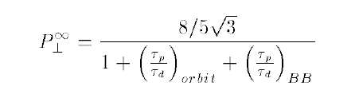
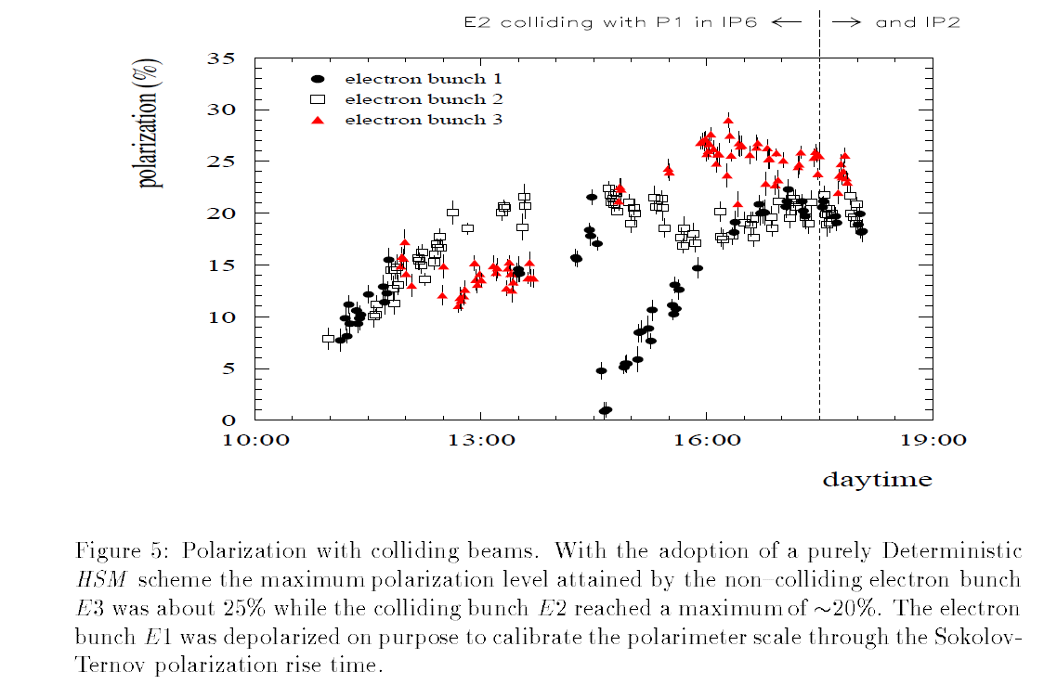
Polarization in collisions
CERN-SL-26-021
v = 101.5
11-1994
ξ_{y} = 0.04

Slide 42
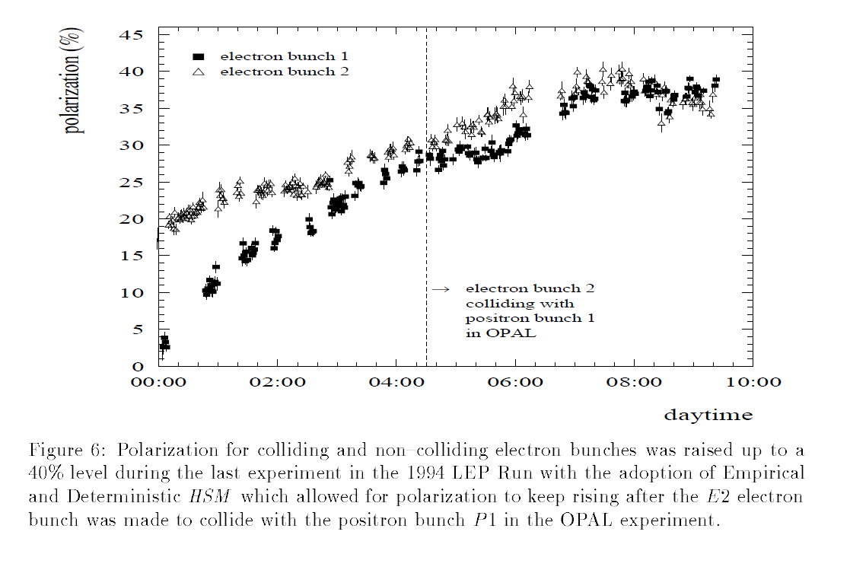

Slide 43
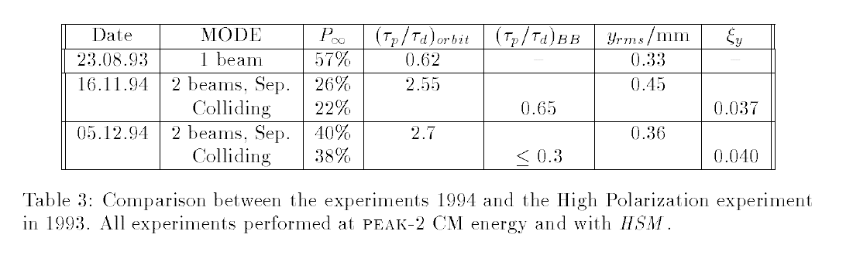
Beam beam depolarization is not very large. < 0.65
Alone, and for one exp. it would have limited the polarization to ~55%
Predictability is low.

Slide 44
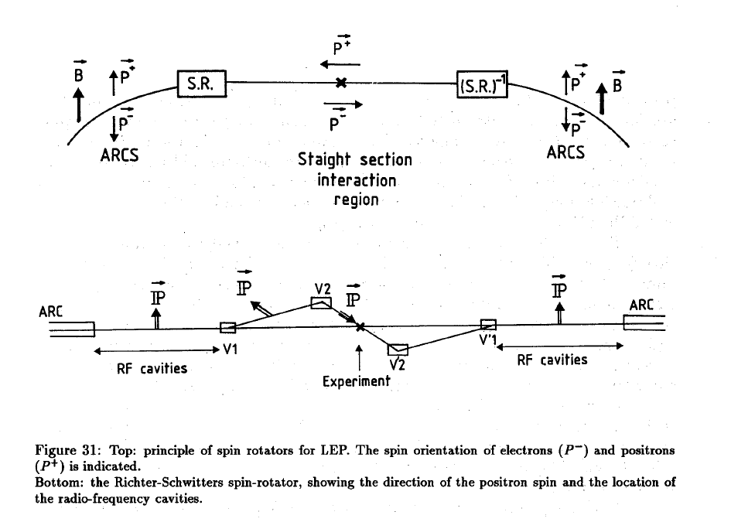
Longitudinal polarization at LEP?
scheme developed in 1988 see A.B. CERN-PPE-93-125

Slide 45
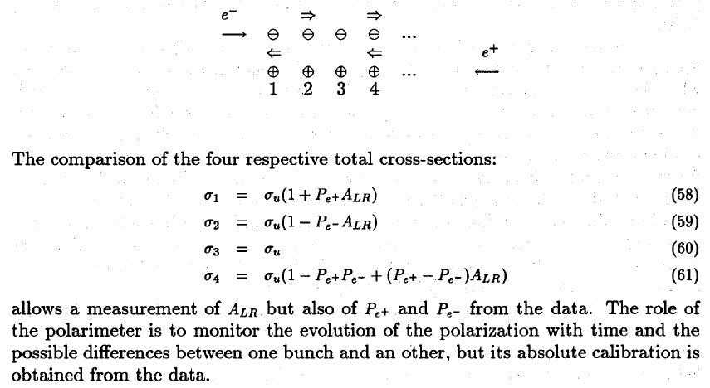
measuring the polarization asymmerty:
requires (continuous) depolarization of selected bunches
e+ and e- polarimeter
bb tune shift not too large. → probably at least factor 4 loss in Luminosity.
Did not happen under pressure from LEP2, then LHC

Slide 46
Longitudinal polarization operation:
Can we operate routinely with longitudinal polarization in collisions?
Polarization in collisions was observed in LEP
the following must be satisfied (in addition to spin rotators):
0. we have to take into account the top-off injection of non-polarized particles
1. random depolarization must be reduced wrt LEP by a factor 10 to go from 10% to 55% P
with life time of 15hrs=900 minutes (i.e with wigglers ON as before)
This is beyond what was achieved at LEP but there is hope that it can be done with
improved optics at TLEP, given better dispersion corrections (➔ simulation job to do)
2. luminosity lifetime must be reduced to 900 minutes as well. This means reducing
luminosity by a factor 10 down to 6 10^34/cm2/s/IP , or increase the number of bunches
(NB luminosity lifetime is sensitive to the momentum acceptance of the machine ➔ check!)
3. then the top up will reduce polarization further, to reach an equilibrium value of 44%
4. the effective polarization over a 12 hours stable run is then 39%

Slide 47
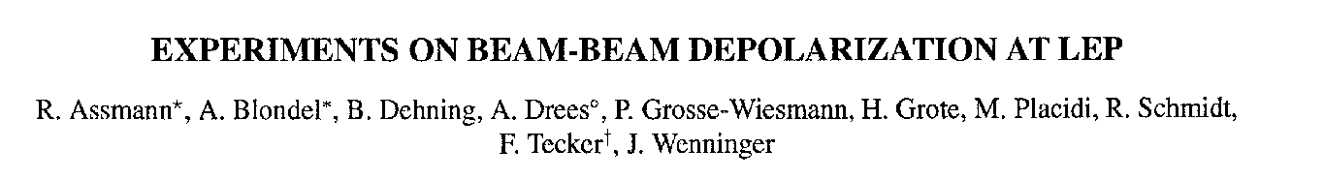
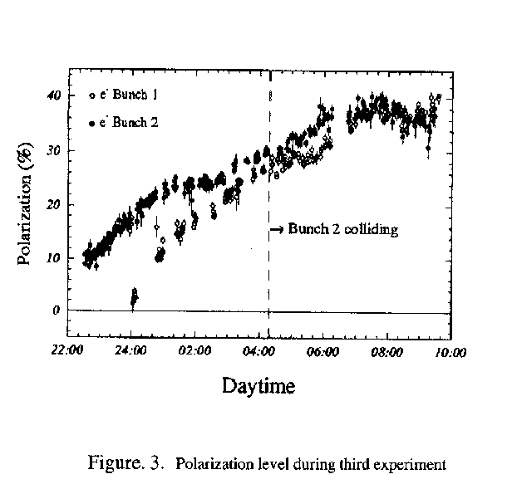
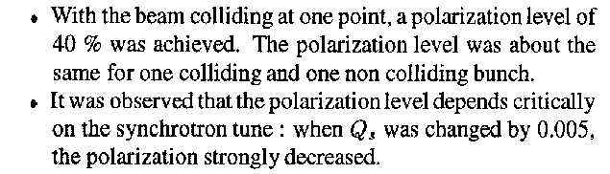
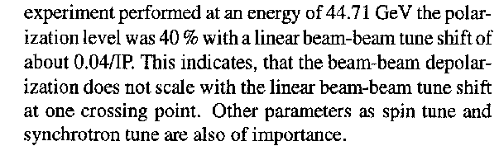
PAC 1995
LEP:
This was only tried 3 times!
Best result: P = 40% , ξ*_{y}= 0.04 , one IP
TLEP
Assuming 4 IP and ξ*_{y}= 0.01 ➔
reduce luminositiy somewhat, 10¹¹ Z @ P=40%

Slide 48
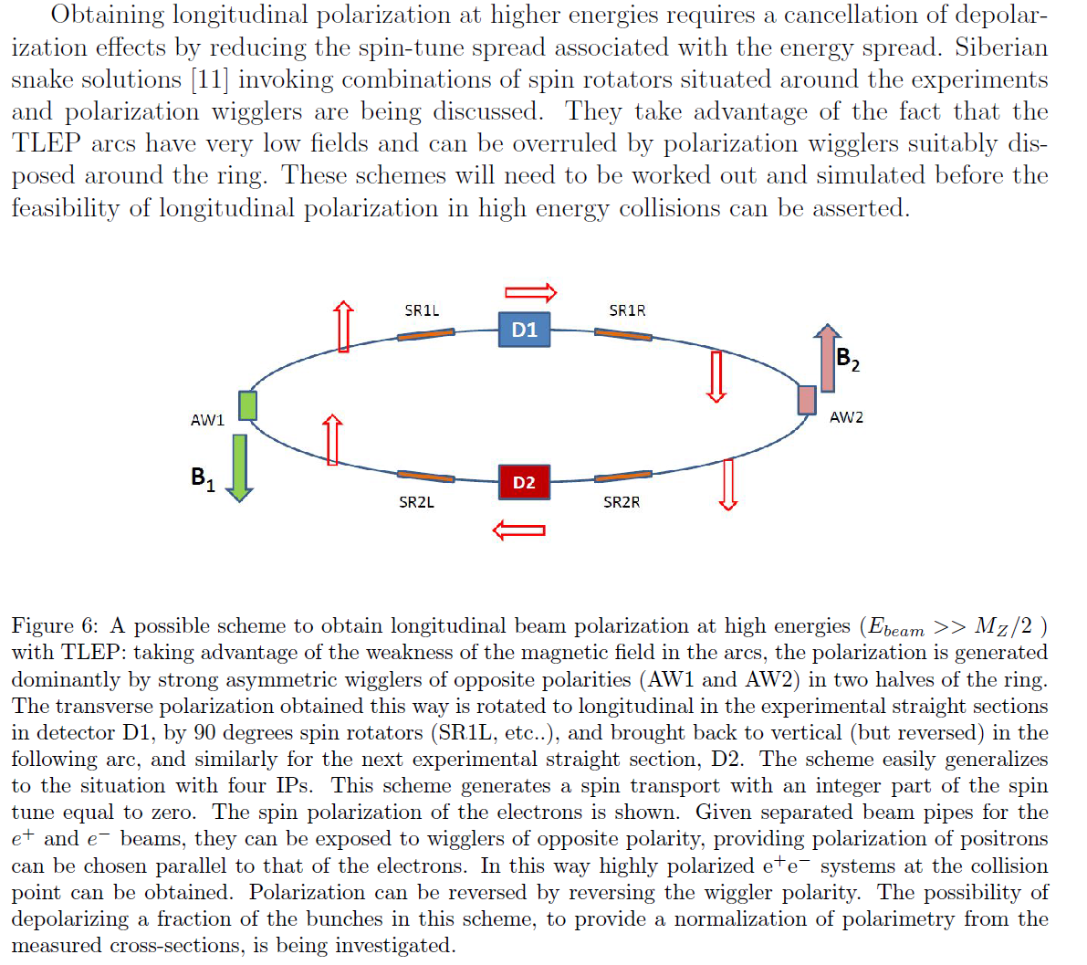
AB, U. Wienands)

Slide 49
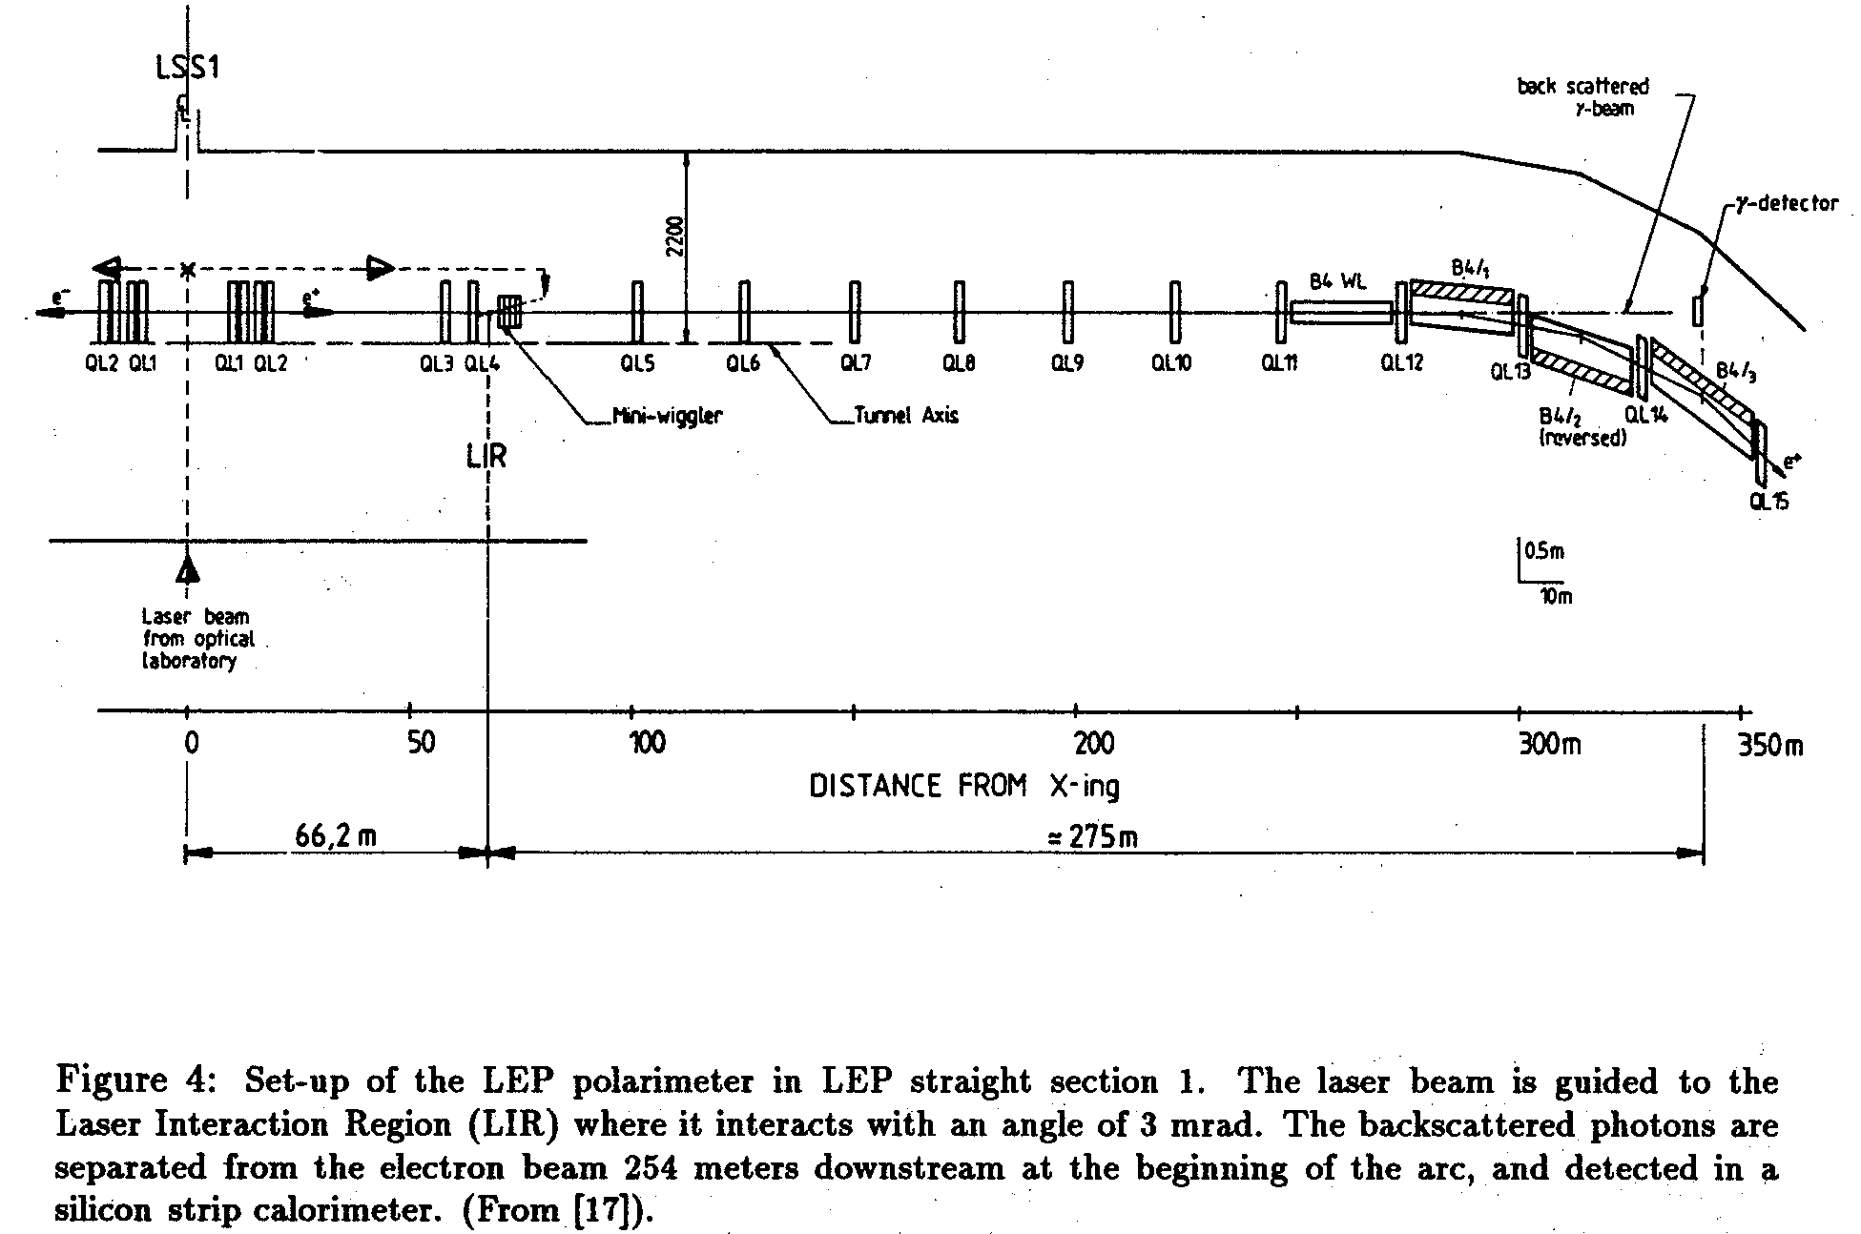
Polarization measurement with a back scattered
frequency doubled Nd-Yag laser (528 nm)

Slide 50
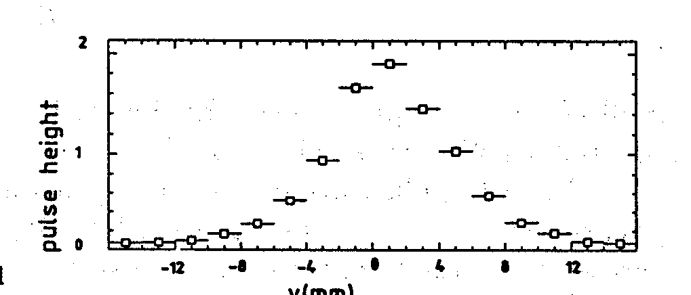
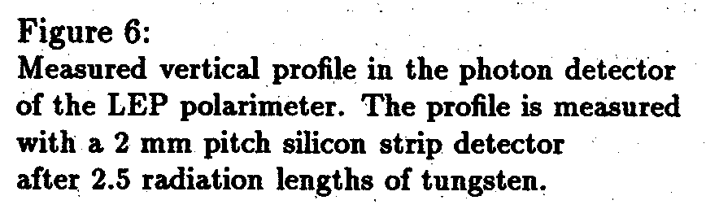

in FCC-ee emittances are much smaller and
profile should be narrower.
displacement upon inversion
of circular light is a measure of
the vertical polarization

Slide 51

Resonant depolarization, 1991
variation of Rf frequency
to eliminate half integer
ambiguity

Slide 52


depolarization by a static harmonic bump
and polarization rise.

