Slide 2


HIE-ISOLDE Beam Properties and Beam Commissioning
Jose Alberto Rodriguez
on behalf of BE-OP-ISO and the HIE-ISOLDE project team

Slide 3
Outline:
Introduction
Beam Properties
Beam Commissioning
First Beam to Users
Users/Machine Interface
Summary
J.A. Rodriguez – 79th ISOLDE Collaboration Committee Meeting – Jun. 27th 2017

Slide 4
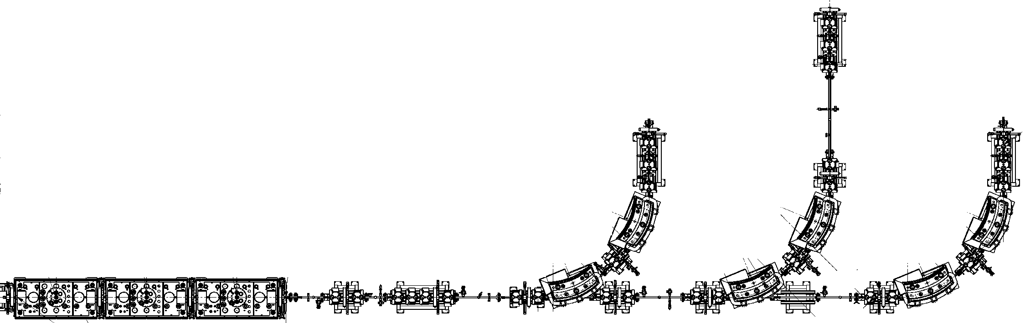
Introduction:
Phase 2A HIE-ISOLDE project:
Additional cryomodule (CM3)
Additional HEBT line (XT03)
Modification of the XT02 HEBT line
Phases of the HIE-ISOLDE project
Layout after Phase 2A
Phase | 1A | 1B | 2A | 2B
Completion in: | 2015 | 2016 | 2017 | 2018
# cryomodules | 1 | 2 | 3 | 4
# HEBT lines | 2 | 2 | 3 | 3
E_{max} [MeV/u] (A/q = 2.5) | 5.6 | 8.6 | 11.5 | 14.2
E_{max} [MeV/u] (A/q = 4.33) | 4.4 | 6.1 | 7.9 | 9.6
XT02 extension
(2017)
XT03
(2017)
End Tunnel
CM1
CM2
CM3 (2017)
J.A. Rodriguez – 79th ISOLDE Collaboration Committee Meeting – Jun. 27th 2017

Slide 5
Outline:
Introduction
Beam Properties
Beam Commissioning
First Beam to Users
Users/Machine Interface
Summary
J.A. Rodriguez – 79th ISOLDE Collaboration Committee Meeting – Jun. 27th 2017

Slide 6
Beam Properties: A/q
Before 2016:
Nominal minimum: A/q > 2.5
Nominal maximum: A/q < 4.5
Since 2016:
Nominal minimum: A/q > 2.5
Nominal maximum: A/q < 4.33
Several REX amplifiers not reliable at the power levels needed for beams with A/q = 4.5
Impact of the change in specs is limited (needs to be analyzed case by case):
  Some light beams are not possible (ex: ⁹Li²⁺)
  Charge breeding efficiency for some heavy beams could become lower (by a factor 2-4)
J.A. Rodriguez – 79th ISOLDE Collaboration Committee Meeting – Jun. 27th 2017

Slide 7
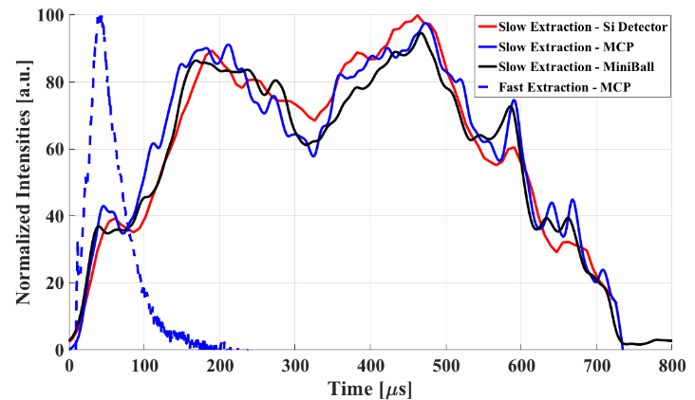
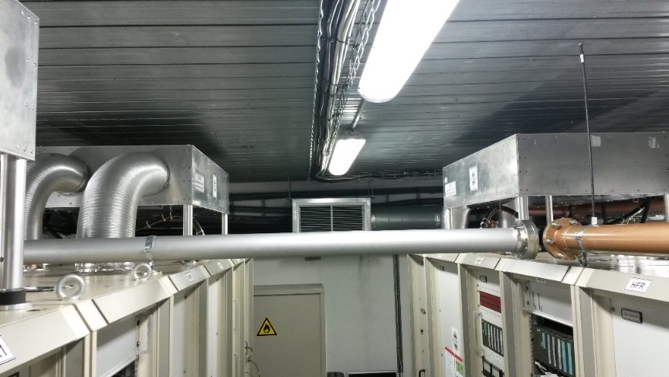
Beam Properties: Time Structure
In 2016:
Repetition rate: up to 50 Hz
RF Pulse length: up to 1 ms → Beam Pulse Length ~ 0.7 ms (with slow extraction)
Average power in 9gap < 2.5 kW
Expected for 2017:
Repetition rate: up to 50 Hz
RF Pulse length 2 ms → Beam Pulse Length ~ 1.7 ms
  Heat exchangers installed during the technical stop
  Bertronix was at CERN on wk. 7 and make the necessary modifications
Average power in 9gap < 2.5 kW
Spokesperson should inform OP if slow extraction is needed in advance (typically, a couple of hours are needed to set it up)
J.A. Rodriguez – 79th ISOLDE Collaboration Committee Meeting – Jun. 27th 2017

Slide 8
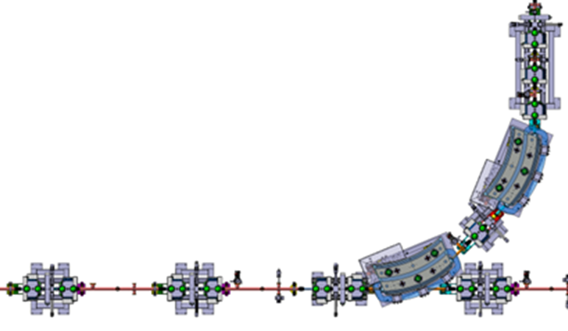
Beam Properties: Energy and Energy Spread
Highest beam energy for average gradients
Highest beam energy (assuming all cavities at 6MV/m) for different A/q
In 2016:
Two cryomodules installed
Dedicated energy measurement (~ 4 hours needed)
In 2017:
Three cryomodules installed
A new timing class for the time information of the Si detectors has been developed and commissioned
Dedicated energy measurement (~ 1 hour needed)
Energy spread optimization may be possible (needs to be requested in advance)
Silicon detector
1 mm vertical slits
All quads and steerers off
J.A. Rodriguez – 79th ISOLDE Collaboration Committee Meeting – Jun. 27th 2017

Slide 9
Outline:
Introduction
Beam Properties
Beam Commissioning
First Beam to Users
Users/Machine Interface
Summary
J.A. Rodriguez – 79th ISOLDE Collaboration Committee Meeting – Jun. 27th 2017

Slide 10
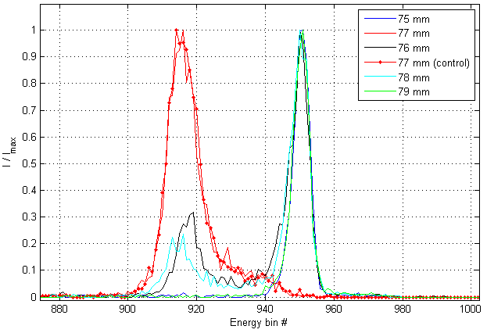
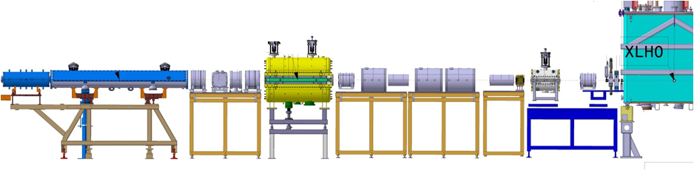
Beam Commissioning: Si detector at XLN2
Silicon detector at XLN2 used during the beam commissioning campaigns in 2016 and 2017
A 1 mm diameter collimator normally used in combination with the Si detector
Measurements with the collimator masking different areas of the detector carried out
Energy and energy spread with collimator at different locations
Signs of degradation of the Silicon detector at XLN2 observed:
  Energy spread artificially increased
  Offset in absolute energy measurement
XLN2 Diagnostics Box
RFQ
Triplet
Triplet
IHS
Triplet
Triplet
Doublet
7gap 2
7gap 3
Triplet
9gap
Triplet
Buncher
7gap 1
HV Steerer
Diagnostics
Diagnostics
J.A. Rodriguez – 79th ISOLDE Collaboration Committee Meeting – Jun. 27th 2017

Slide 11
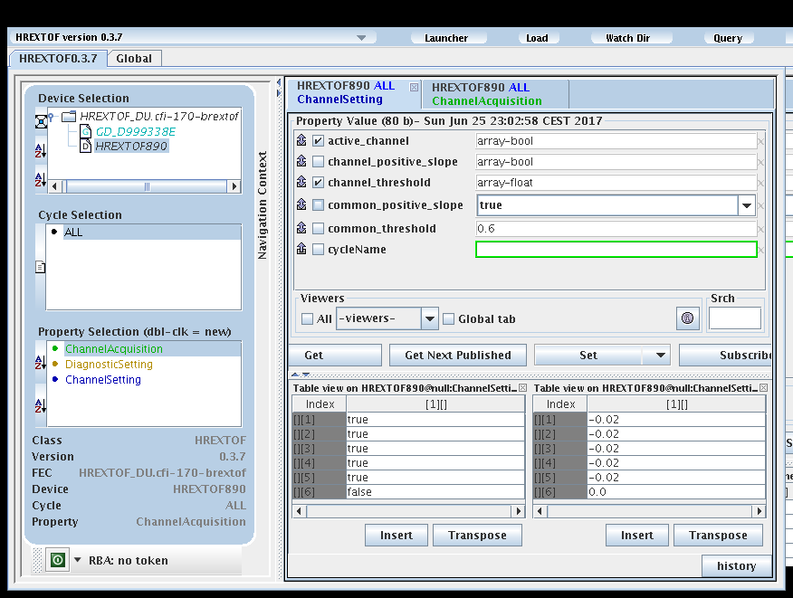
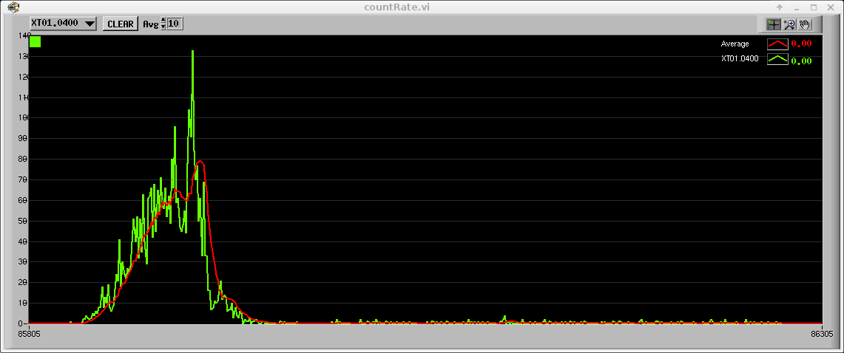
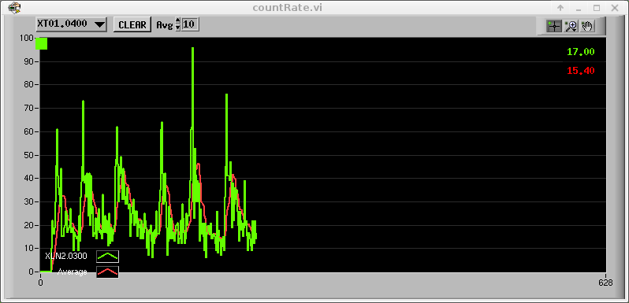
Beam Commissioning: Count Rate
New low-level controls (FESA class) Time Of Flight partially commissioned (channel settings and particle count rate)
Commissioning of the bunch time structure still pending
High-level application to use the Si detectors as very low current FC commissioned
Beam Intensity during a beam energy measurement
Measurement of the low-frequency jitter in energy of the beam
J.A. Rodriguez – 79th ISOLDE Collaboration Committee Meeting – Jun. 27th 2017

Slide 12
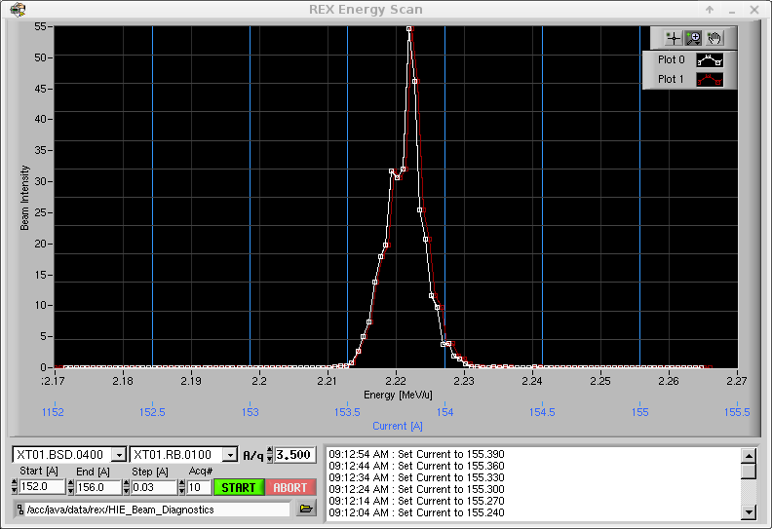
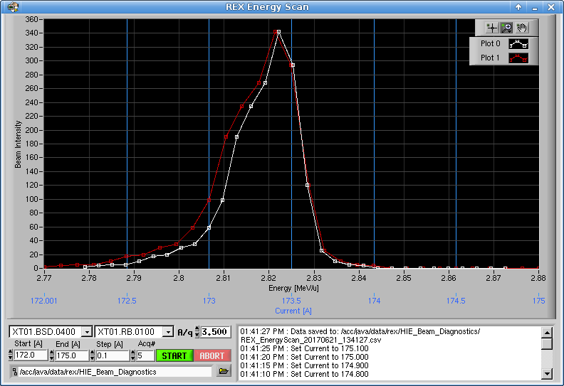
Beam Commissioning: Energy Scan
Energy and energy spread of the beam can be carried out using the count rate measured at the Silicon detector at XT01.0400 after the first dipole magnet
Energy Scan after set-up of 7gap3 was completed
Energy Scan after set-up of 9gap was completed
The method works very well
  Can be used for low-intensity beams
  Can be completed in ~ 1 hour
  However, as with all measurements with Si detectors, special attention is required to avoid damaging it
We will need to consider installing them in the
other two HEBT lines next year
1 mm vertical slits
Silicon detector
All quads and steerers off
J.A. Rodriguez – 79th ISOLDE Collaboration Committee Meeting – Jun. 27th 2017

Slide 13
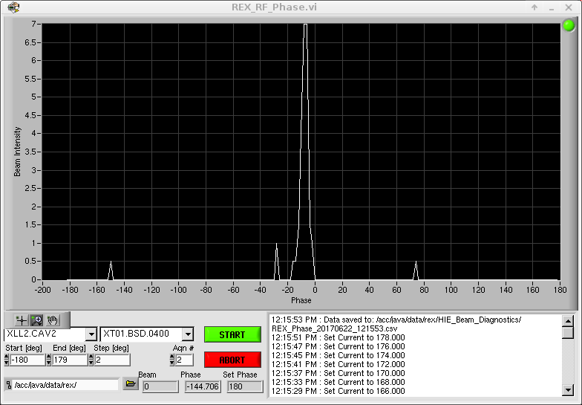
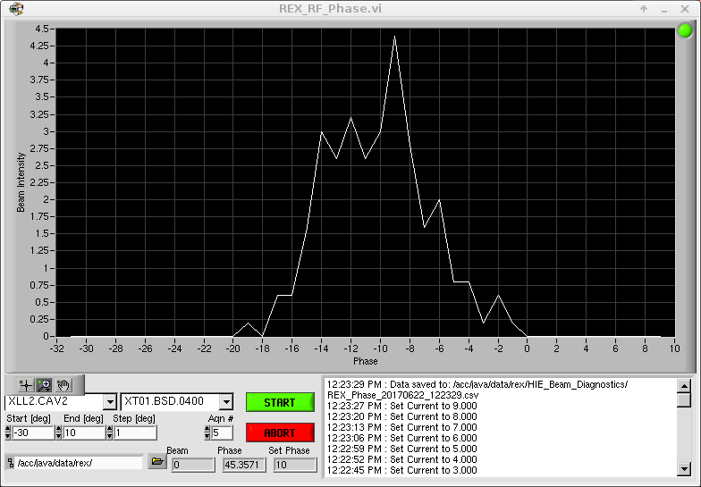
Beam Commissioning: Phase Scan
Phase Scan can be carried out using the count rate measured at the Silicon detector at XT01.0400 after the first dipole magnet
Rough Phase Scan to find the bunching zero-crossing of SRF02
Fine Phase Scan to find the bunching zero-crossing of SRF02
Unexpected behaviour observed:
  Occasionally not second zero-crossing
  Needed beam attenuation varies by several orders of magnitude from cavity to cavity
  Distance between zero-crossing phases not always 180 deg
Additional work needed to understand the
sources of the issues observed
1 mm vertical slits
Silicon detector
All quads and steerers off
J.A. Rodriguez – 79th ISOLDE Collaboration Committee Meeting – Jun. 27th 2017

Slide 14
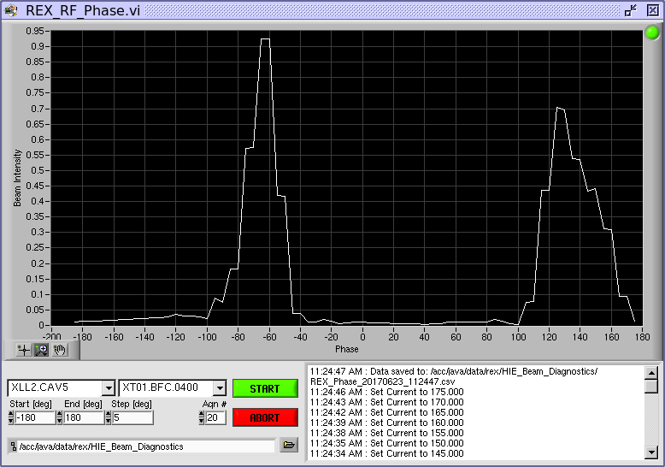
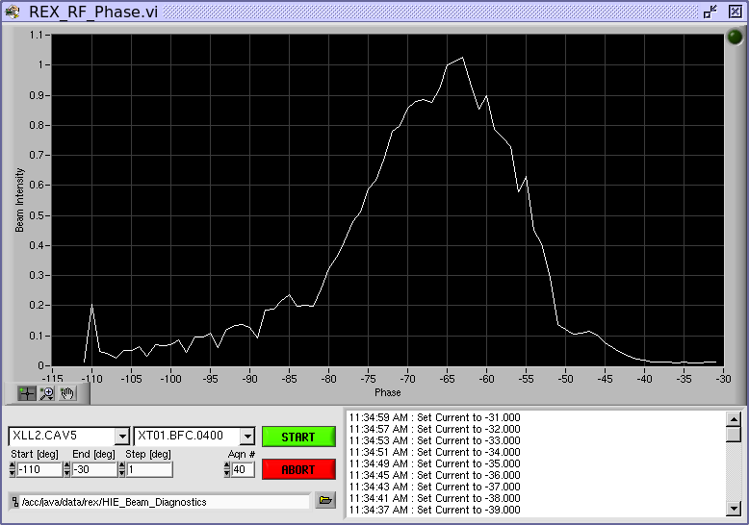
Beam Commissioning: Phase Scan
Phase Scan can also be carried out using the XT01.0400 FC after the first dipole magnet
  Due to the beam low current, focussing elements cannot be turned off and only one slit (10 mm) before the FC can be used
  Injection to the dipole on axis is not guaranteed
Rough Phase Scan to find the zero-crossings of SRF05
Fine Phase Scan to find the bunching zero-crossing of SRF05
Faraday Cup
Even though the measurements of the zero-crossing phases are less precise, they are a lot faster and less risky (Si detector can be damaged) → At this point, it is the preferred method to phase the cavities
10 mm vertical slit collimator
J.A. Rodriguez – 79th ISOLDE Collaboration Committee Meeting – Jun. 27th 2017

Slide 15
Beam Commissioning: Low Energy Beams
Tunes for beams with A/q = 3.5 to the end of XT01 after each REX RF structure was set-up
Precise energy measurement using the dipole for each tune
Transverse beam profiles at each diagnostics box measured (data not yet analysed)
Conclusions:
Low-energy beams can be transported without additional losses
Beam losses in HIE-ISOLDE (ie. XLN2 to end of XT01) negligible or at the very least small
Differences between different types of FC noticeable
J.A. Rodriguez – 79th ISOLDE Collaboration Committee Meeting – Jun. 27th 2017

Slide 16
Beam Commissioning: Plan
Week 26:
Phasing of cavities in CM2 and CM3 with ¹⁴N⁴⁺ (E_{final} = 6.6 MeV/u)
Scaling to A/q = 3.67 and 4.0
REX-TRAP and REX-EBIS synchronization with ³⁹K from the pilot ion source
Scaling to A/q = 3.9
Week 27-28:
Set-up for first RIB and Physics
Week 29:
Scaling to A/q = 4.33
Week 30-32:
Set-up and Physics
Week 33:
First beam to XT03
Commissioning of all diagnostics devices
Commissioning of the stripping foils
J.A. Rodriguez – 79th ISOLDE Collaboration Committee Meeting – Jun. 27th 2017

Slide 17
Outline:
Introduction
Beam Properties
Beam Commissioning
First Beam to Users
Users/Machine Interface
Summary
J.A. Rodriguez – 79th ISOLDE Collaboration Committee Meeting – Jun. 27th 2017

Slide 18
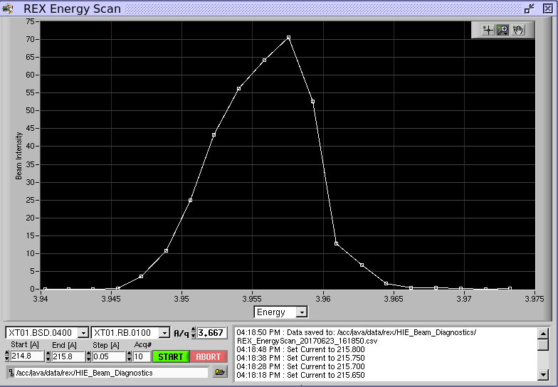
First Beam to Users:
²²Ne beam requested by Miniball users for testing and calibration last weekend
Ion | ²²Ne⁶⁺
A/q | 3.667
HEBT | XT01
Transmission | ~ 72 %
E | 3.955 MeV/u
dE_{FWHM} | 0.25 %
Length | ~ 60 hours
Rep. rate | 20 Hz
Both REX and the SRF cavities quite stable (1.5 trip/shift)
RF structure | REX |  | HIE
 | RFQ | 7GP3 | SRF02 | SRF04
# Trips | 1 | 3 | 2 | 8
Downtime [mins] | 15 | 0 | 10 | 40
Downtime [%] | 0.4 | 0 | 0.3 | 1.1
Cavity | Pf [kW]
RFQ | 32.8
Buncher | 1.45
IH | 38.0
7GP1 | 51.0
7GP2 | 50.2
7GP3 | 46.2
9GP | 61.5
Cavity | E [MV/m]
SRF01 | 4.14
SRF02 | 4.14
SRF03 | 4.14
SRF04 | 4.14
SRF05 | 3.22
However, note that 40% extra power will be needed at REX for beams with A/q = 4.33 and that the gradient of the SRF cavities was not pushed to 6 MV/m
J.A. Rodriguez – 79th ISOLDE Collaboration Committee Meeting – Jun. 27th 2017

Slide 19
Outline:
Introduction
Beam Properties
Beam Commissioning
First Beam to Users
Users/Machine Interface
Summary
J.A. Rodriguez – 79th ISOLDE Collaboration Committee Meeting – Jun. 27th 2017

Slide 20
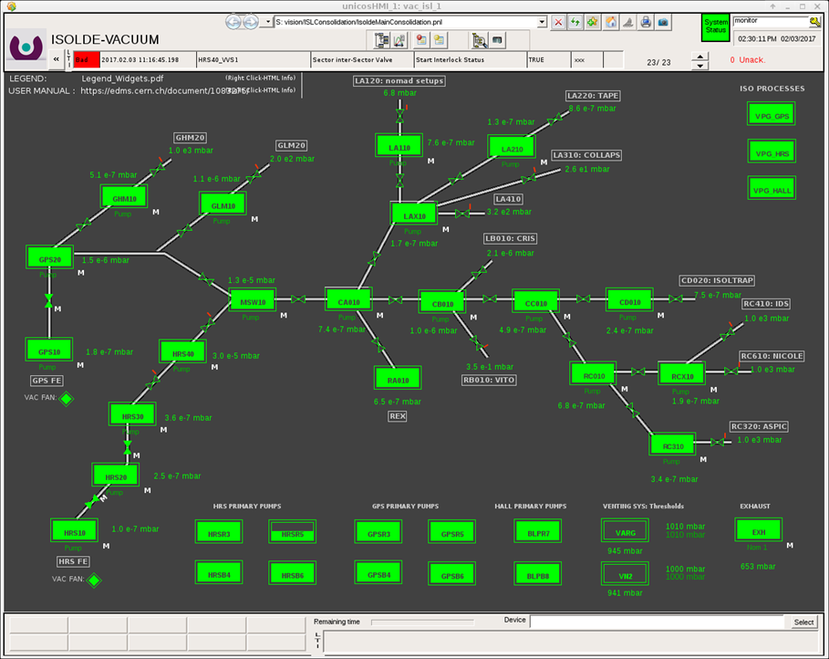
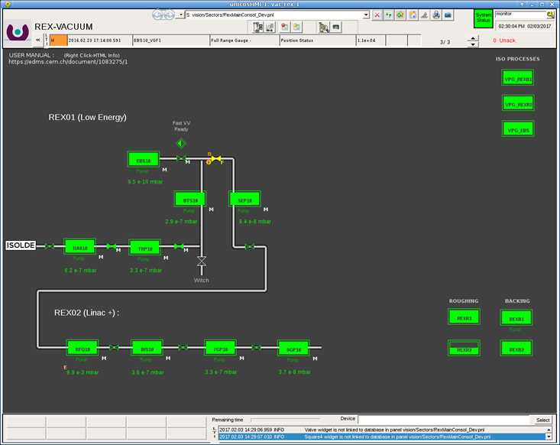
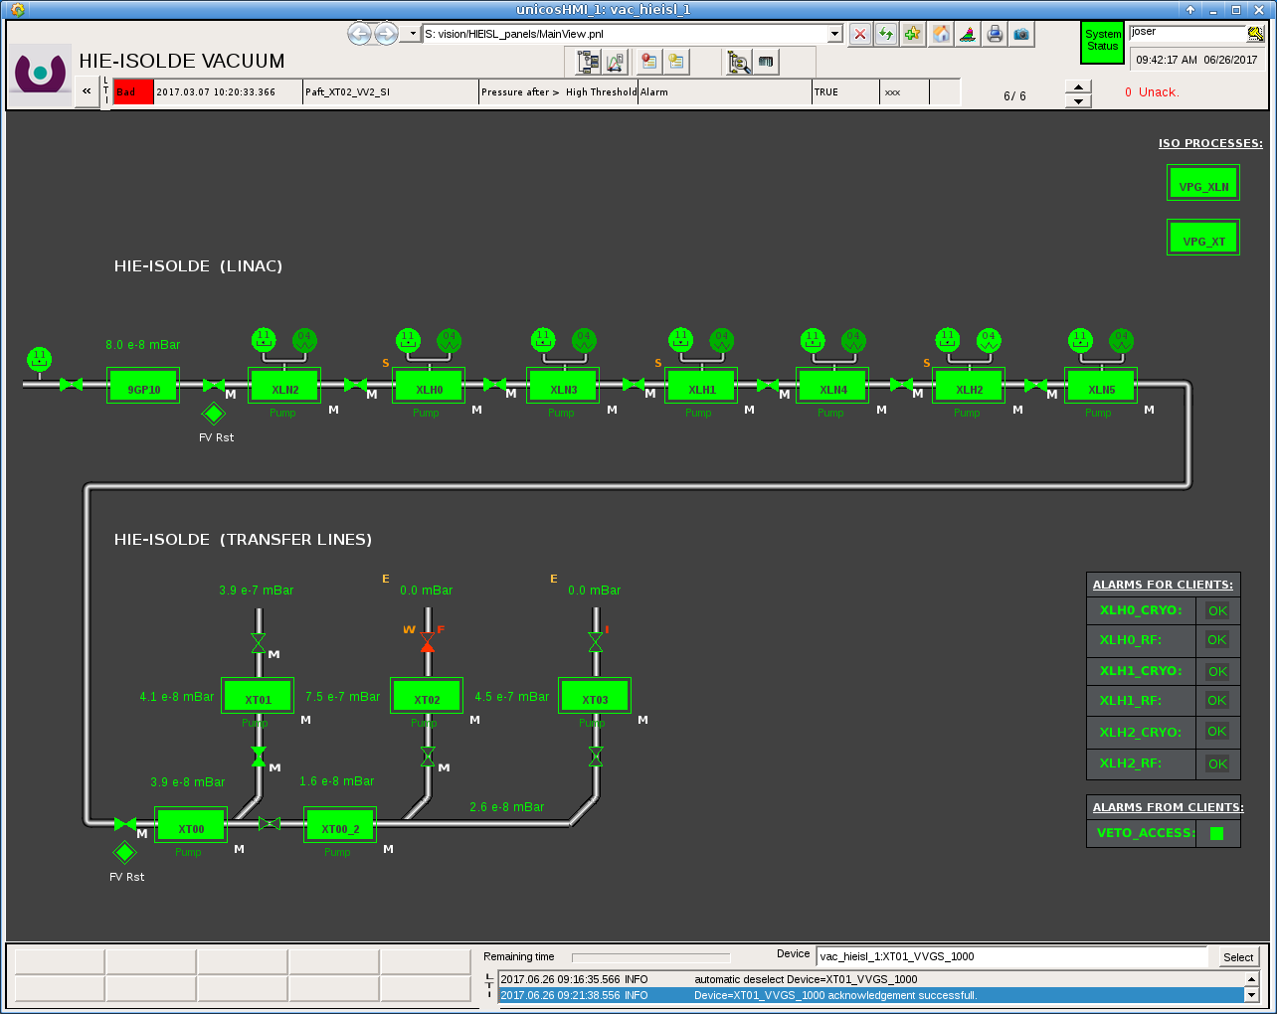
Users/Machine Interface:
Vacuum:
Vacuum in experimental station of 10⁻⁶ mbar required before beam is delivered
Valves between HEBT lines and the experimental station need to be closed before a mechanical intervention takes place on the experiment side
Users need to be granted access to open/close last valve in the HEBT line
(NICE usernames need to be provided at least a week in advance)
Visual sign with the status of the valve needs to be checked
Usernames:
ISOLDE low energy: isoop
REX: rexop
HIE-ISOLDE: user’s NICE
HIE-ISOLDE
ISOLDE low energy
REX
J.A. Rodriguez – 79th ISOLDE Collaboration Committee Meeting – Jun. 27th 2017

Slide 21
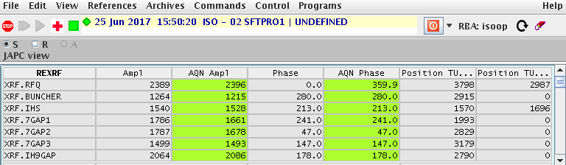
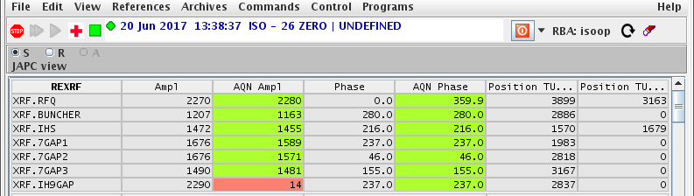
Users/Machine Interface:
REX RF:
All 7 RF Systems need to be working to reach energies higher than 2.8 MeV/u
Working Set: REX/HIE LINAC > Linac: RF
All REX RF systems ok
9GAP Structure down
REX RF amplifiers need to be restarted locally (amplifier room)
Users trained to restart RFQ, 7GAP1, 7GAP2 and 7GAP3. Procedure can be found in RF amplifier room
For the IHS, contact Engineer in Charge if standard procedure fails more than three times
Procedure for the 9GAP not standard. Generally, the Engineer in Charge will need to be contacted
J.A. Rodriguez – 79th ISOLDE Collaboration Committee Meeting – Jun. 27th 2017

Slide 22
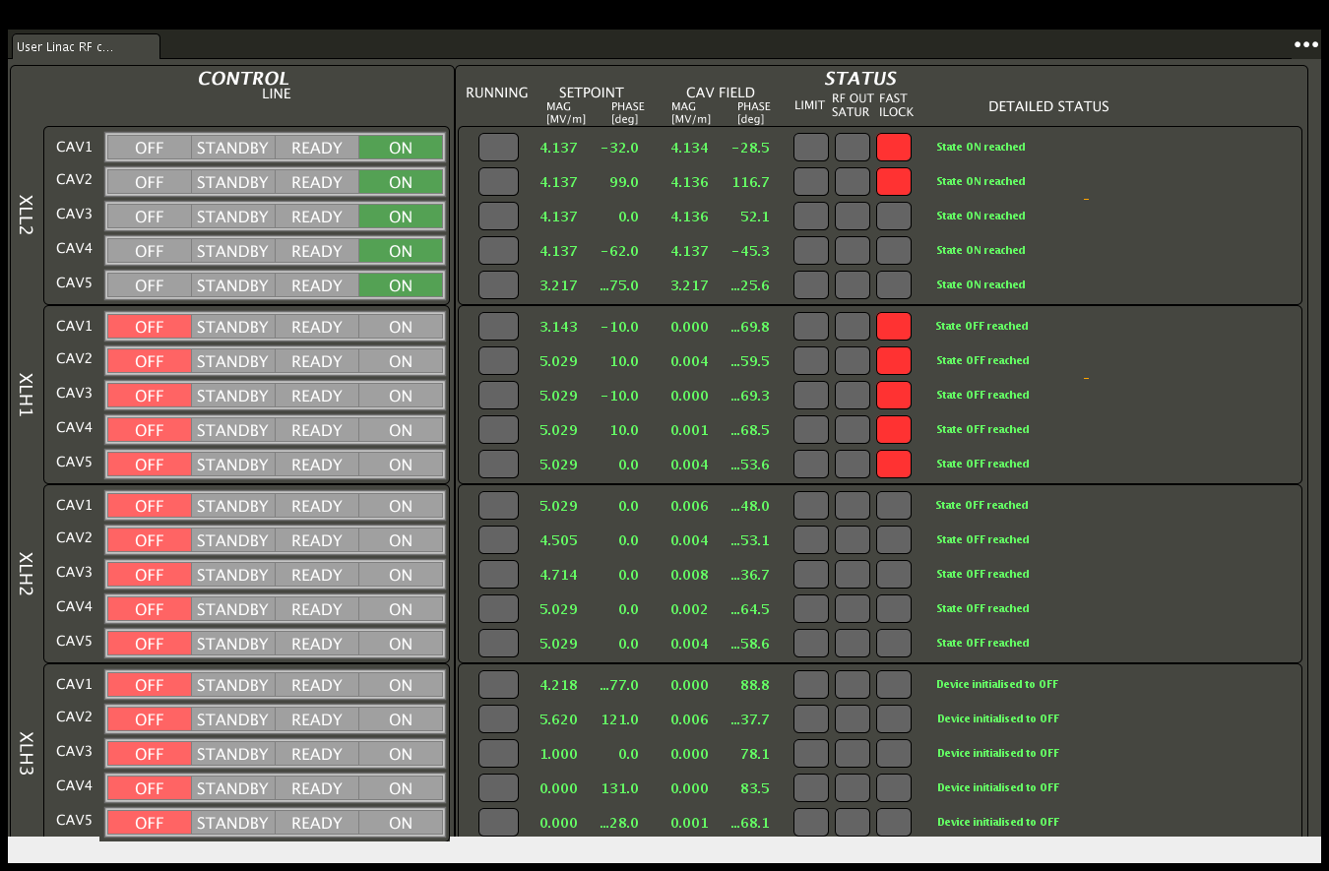
Users/Machine Interface:
HIE-ISOLDE RF:
Generally not all SRF cavities will be used for a given experiment (OFF = not used)
Those that trip (STANDBY or READY) need to be restarted by users (up to 3 times in a row)
It takes a couple of minutes to complete the start sequence after the ON button is pressed
Start sequence can be followed in Detail Status (message to logbook in restart not successful)
Cavity Status at STANDBY or at READY after a trip happens
Status information (particularly relevant during start sequence
All cavities in XLL2 (a.k.a. CM1) up and running in this example
Cavities in XLH1 and XLH2 available, but not used in this example
Cavity gradient
XLH3 (a.k.a. CM4) not available until 2018
J.A. Rodriguez – 79th ISOLDE Collaboration Committee Meeting – Jun. 27th 2017

Slide 23
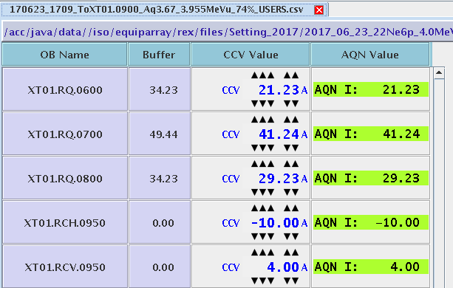
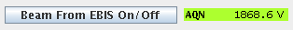
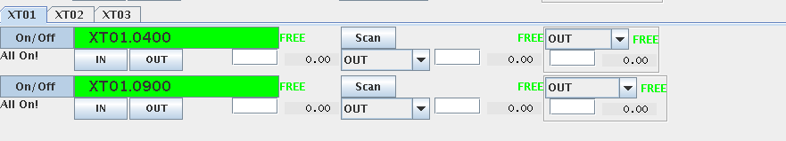
Users/Machine Interface:
Injection into Experimental Station:
Operations will only deliver beam to the last diagnostics box of the HEBT line
Users are responsible for injection into their experimental station
Equipment array to steer and/or focus the beam
Version for users of the diagnostics application
Beam stop will be included in diagnostics application
Contact OP to add your FCs and active collimators to the application
X-Y Steerer
Diagnostics box
Quadrupole Triplet
Beam stop controls
Faraday cup
Beam profile scanner
Collimators (20, 10, 5, 2 mm diameters)
FCs and active collimators in the experimental stations
J.A. Rodriguez – 79th ISOLDE Collaboration Committee Meeting – Jun. 27th 2017

Slide 24
Summary:
Beam Properties:
  2.5 < A/q < 4.33
  0.1 ms < Pulse Length < 1.7 ms (needs to be requested in advance)
  Repetition rate < 50 Hz
  Energy and Energy Spread will be measured for each experiment
Beam Commissioning:
  Low energy tunes to the end of XT01 prepared (80% transmission)
  Cavities in CM1 phased
  New low and high level controls tested:
    TOF FESA class
    Count Rate application
    Energy Scan application
    Phase Scan application
  Phasing of SRF cavities in CM2 and CM3 and scaling to A/q = 4 on-going
  Commissioning of XT03 on week 33
J.A. Rodriguez – 79th ISOLDE Collaboration Committee Meeting – Jun. 27th 2017

