Slide 1
Status & Planning of
HIE-ISOLDE Phase 2
Y. KADI & W. Venturini Delsolaro
for the HIE-ISOLDE Project Team
79th ISOLDE Collaboration Committee Meeting
CERN, 27 June 2017

Slide 2
OUTLINE
Phase2a Installation
Cavities for Phase 2
CM4 Assembly
CM4 Bunker Test
Schedule 2018
    Physics @ 10 MeV/u with 4 CMs
Summary

Slide 3
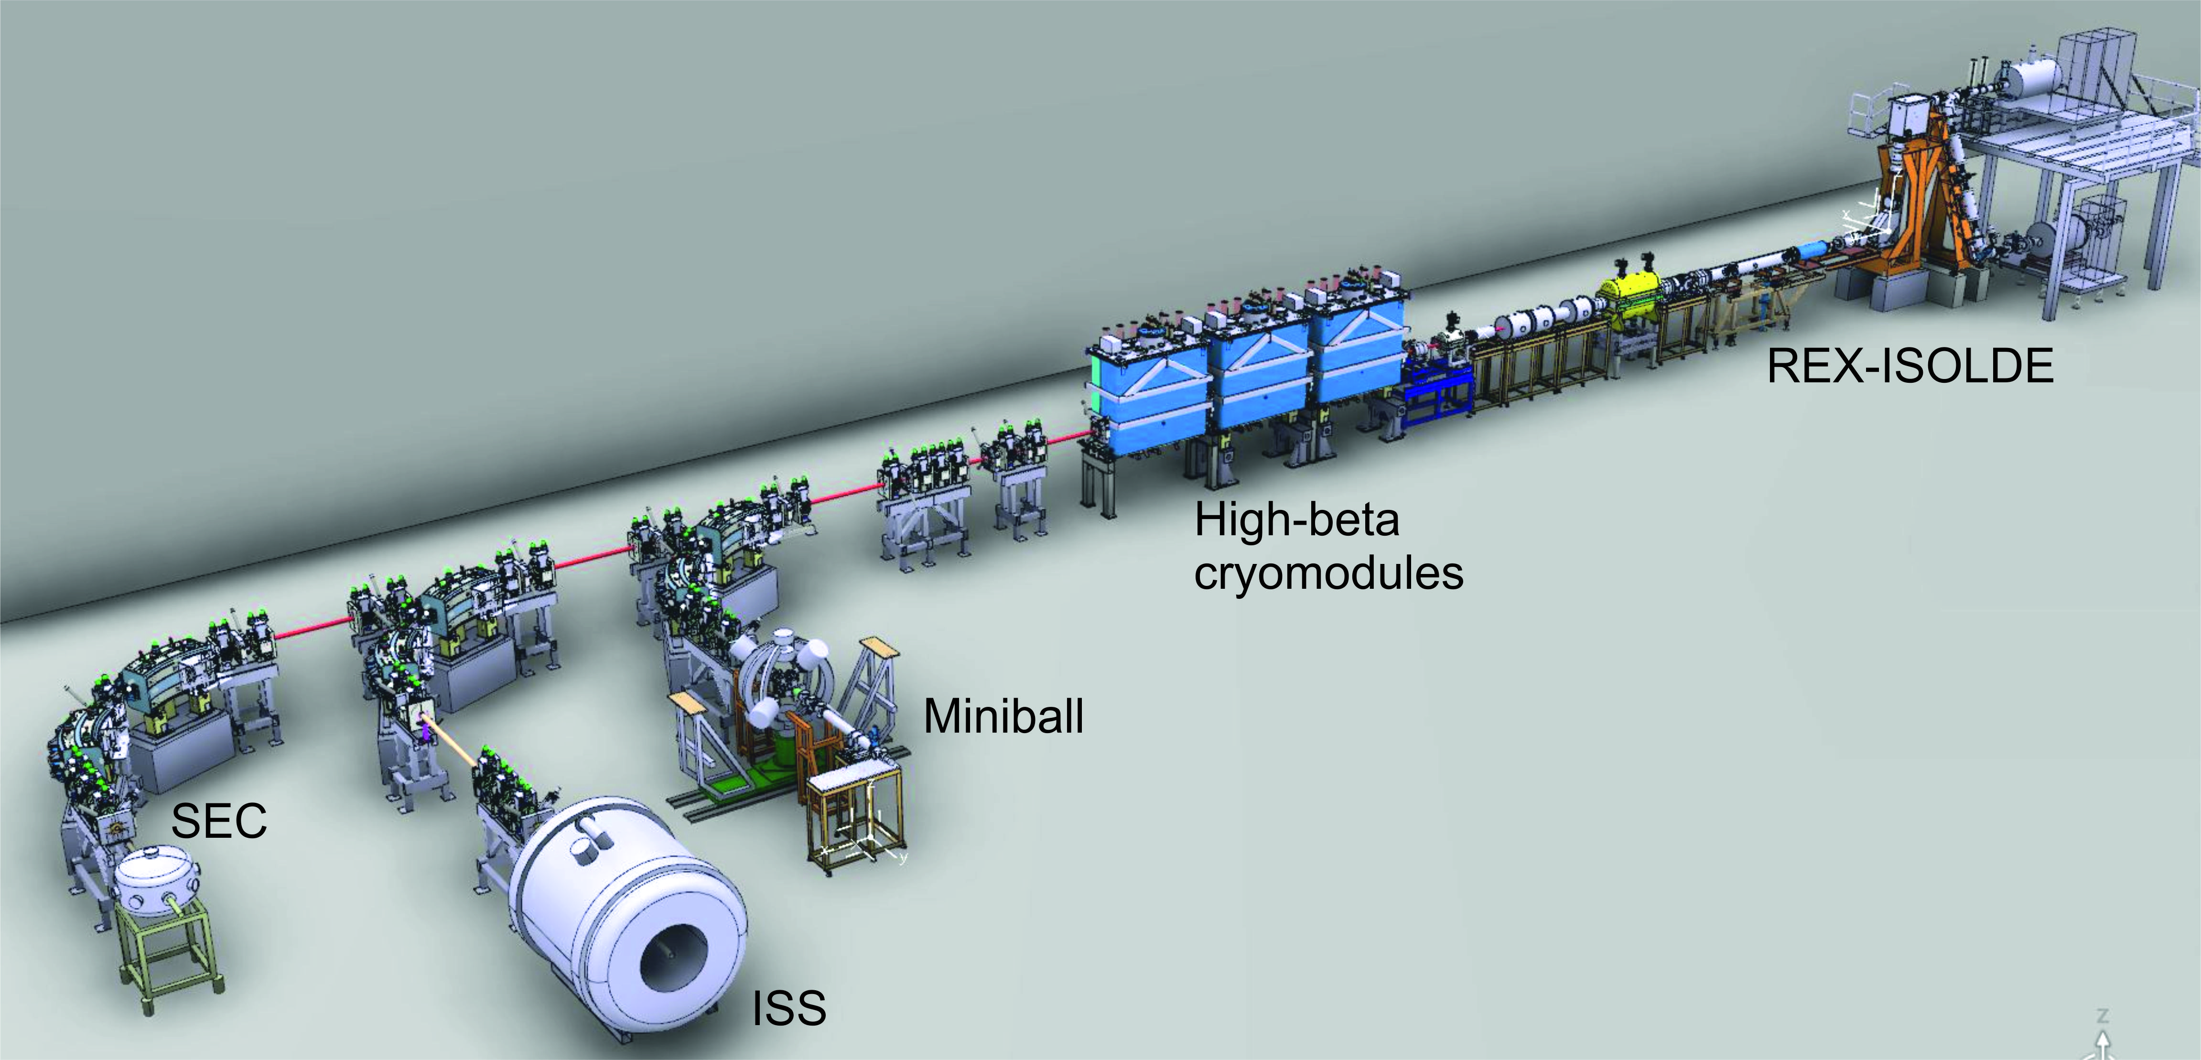
Phase 2a & 2017 Operation

Slide 4
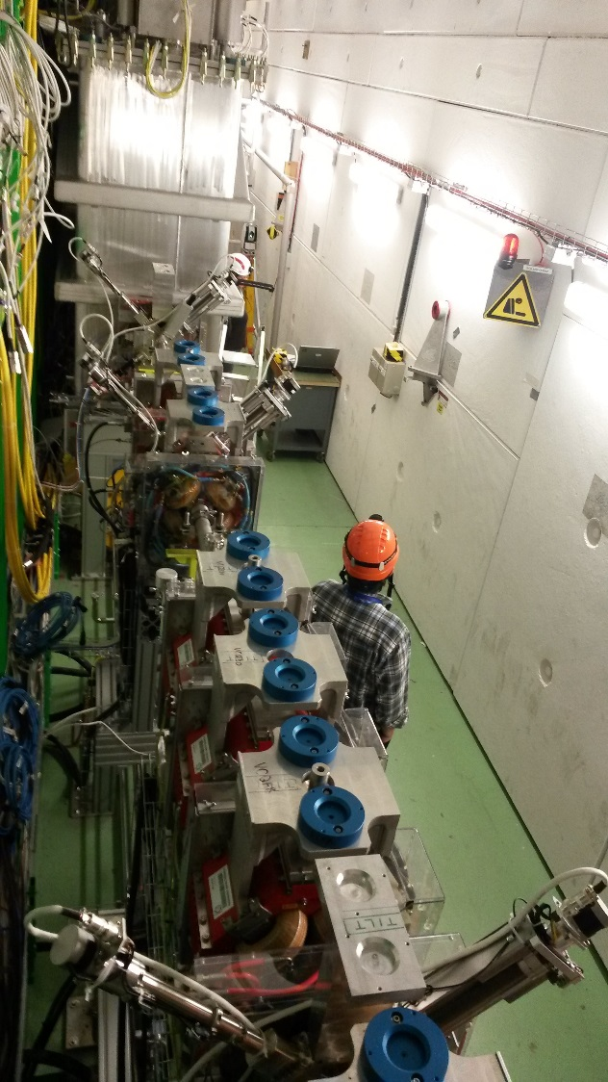
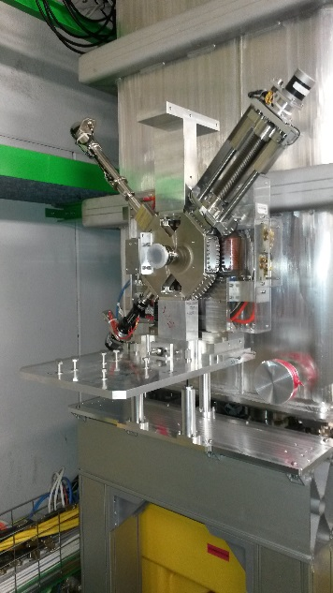
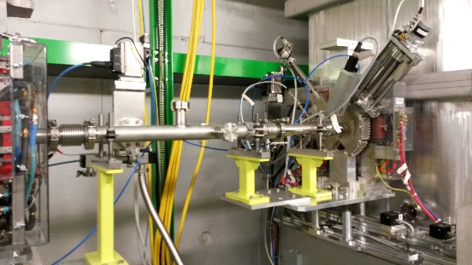
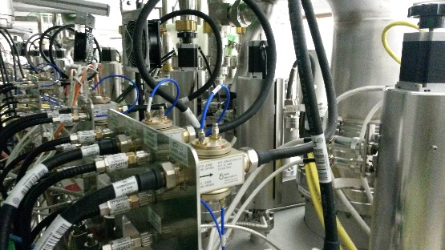
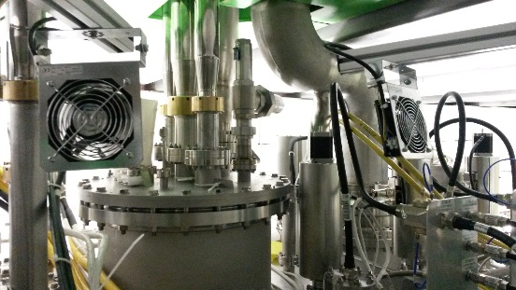
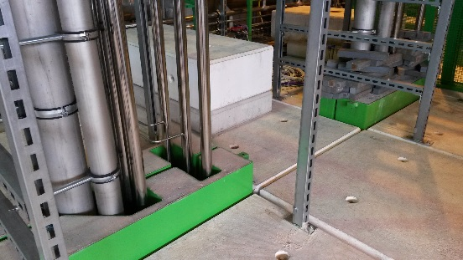
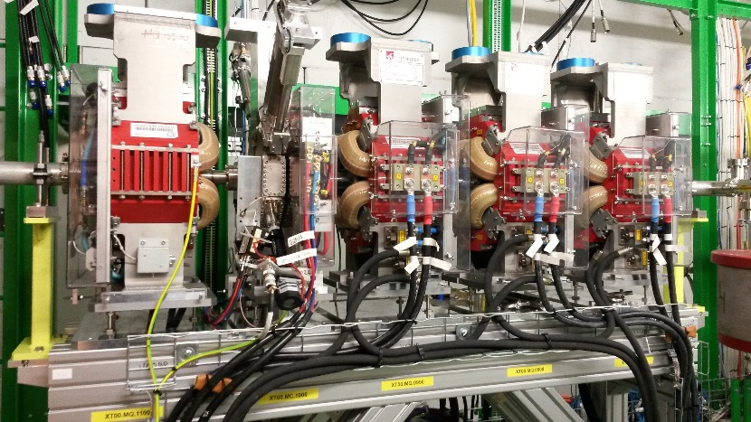
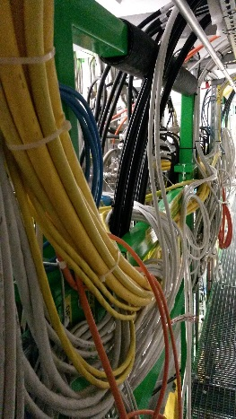
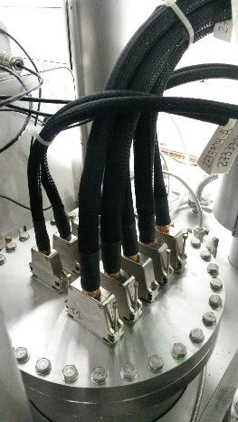
Final tunnel installation work
- XLN5 intertank sector in place and vacuum closed. BCAM cameras in place.
- All elements connected and aligned beginning of March.
- Cryo tubing on the top-plate and outside on the tunnel roof finished. CM cabling all done.
Tunnel closed on the 17th March ready for CM3 hardware commissioning.

Slide 5
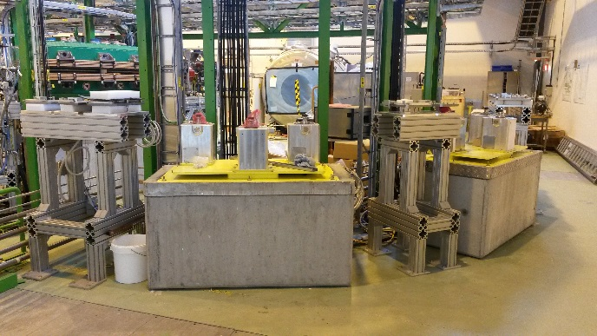
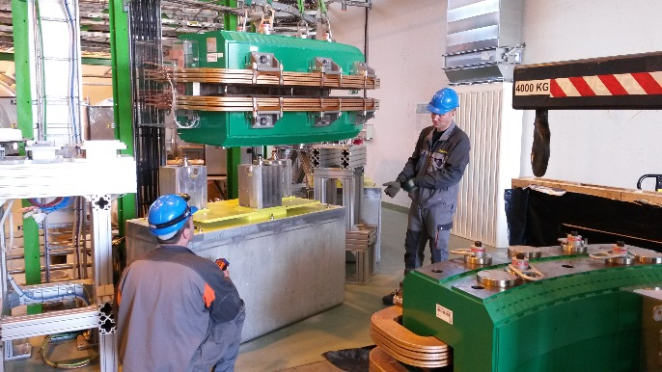
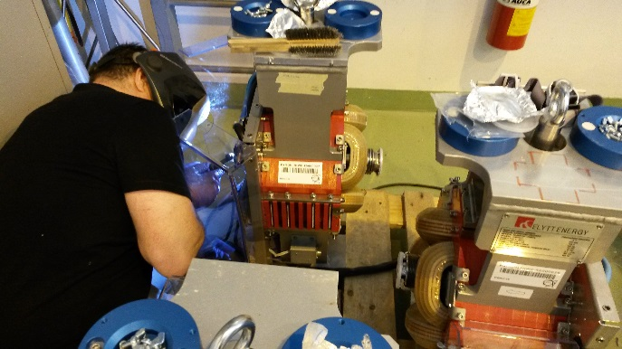
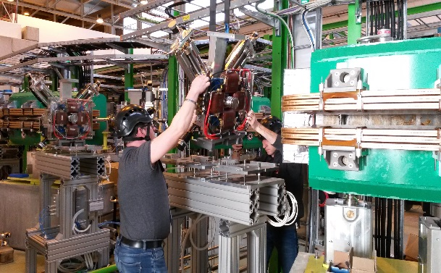
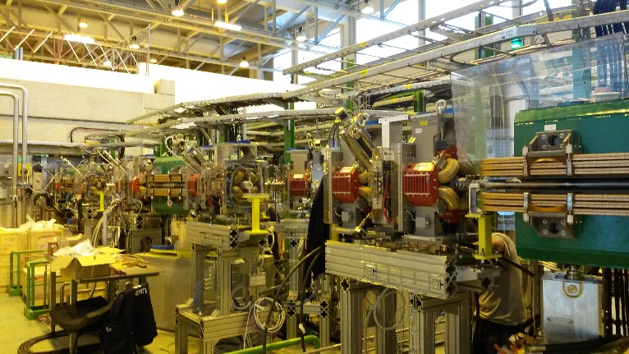
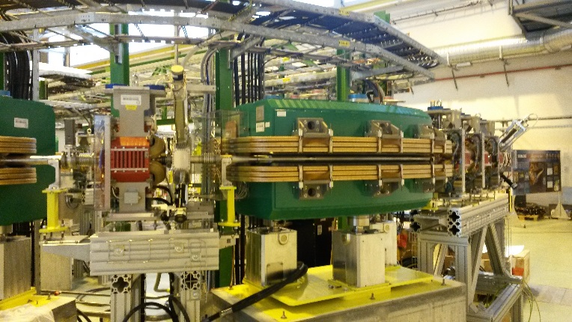
Installation XT00/03
February – May:
XT03 supports and tables in place and re-aligned immediately after the installation of ISS.
Installation of the dipoles followed by the Dbox units
Quadrupole vac chambers arrived with a delay: Welding in the hall to avoid more delay.
All elements aligned.
Vacuum connections, gauges and valves in place. Sectors leak tight.
All DC, water, interlocks and instrumentation connected.
Ready for Hardware Commissioning as of 8th May

Slide 6
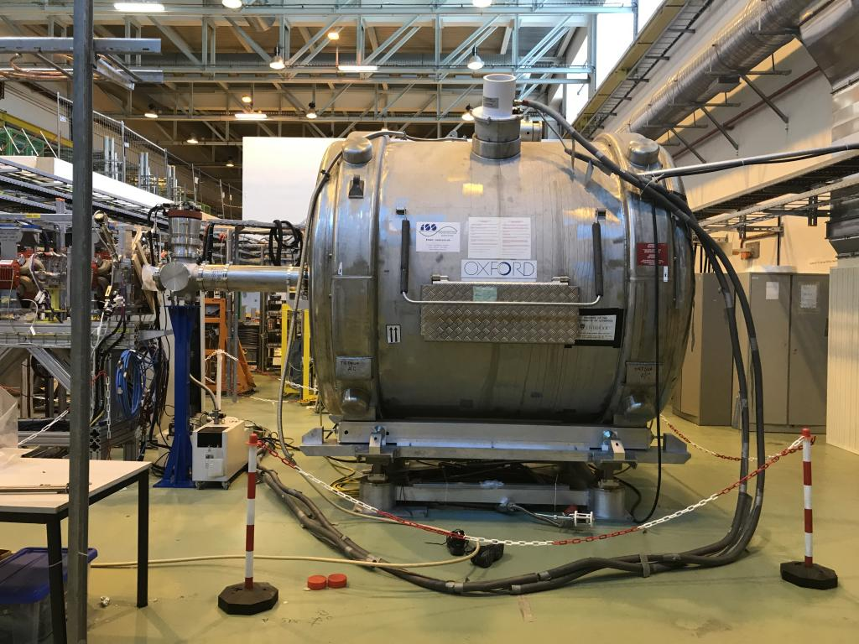
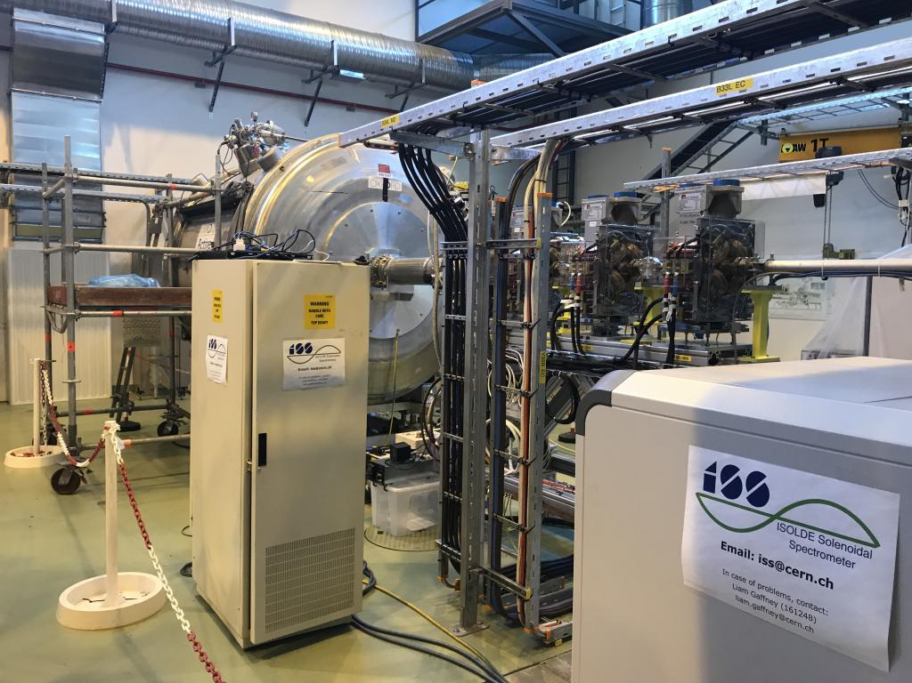
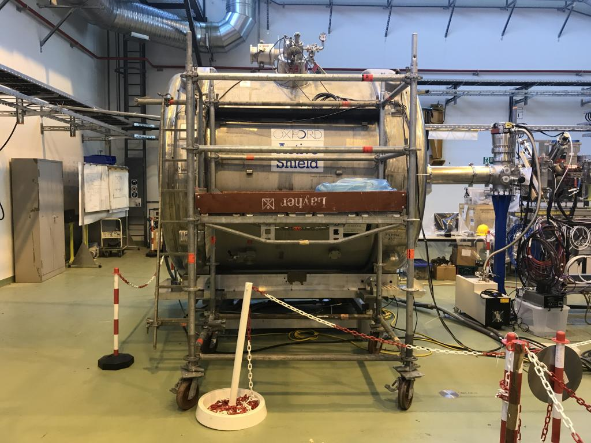
ISS connected to XT02

Slide 7
OUTLINE
Phase2a Installation
Cavities for Phase 2
CM4 Assembly
CM4 Bunker Test
Schedule 2018
    Physics @ 10 MeV/u with 4 CMs
Summary

Slide 8
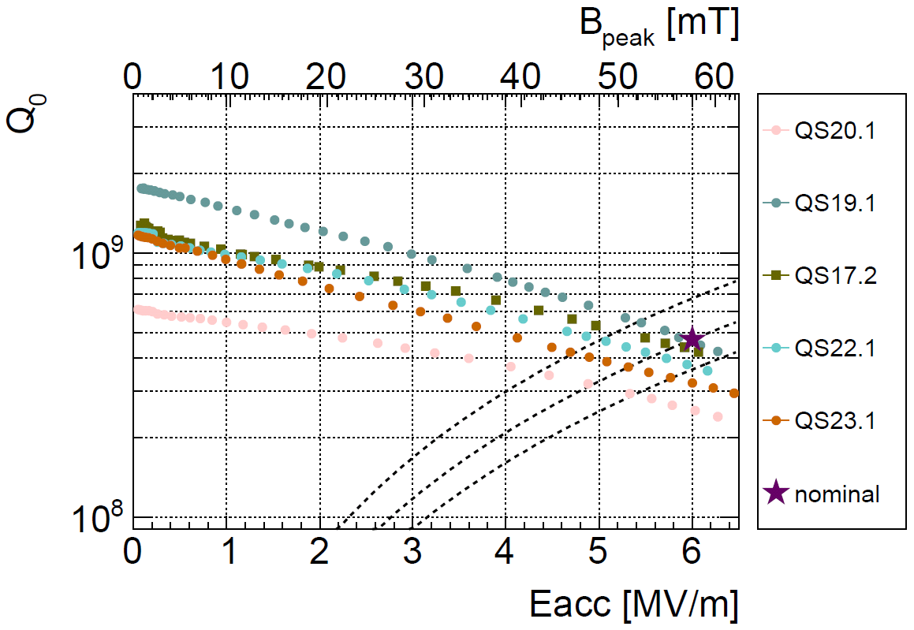
SRF Cavities for Phase 2
6 cavities in 6 months! (including QSS1 still to be tested)

Slide 9
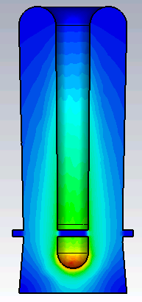
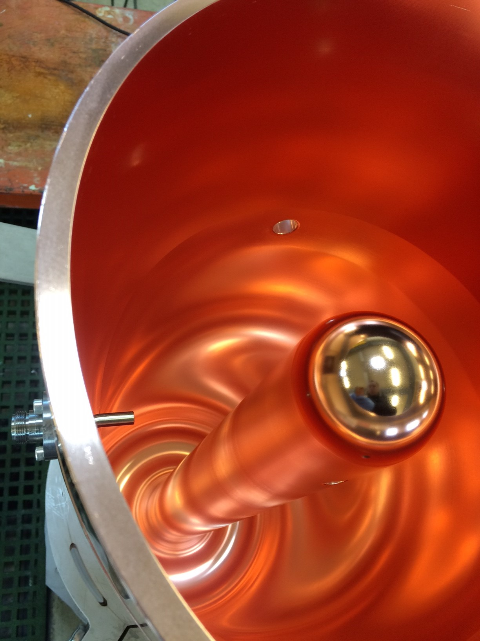
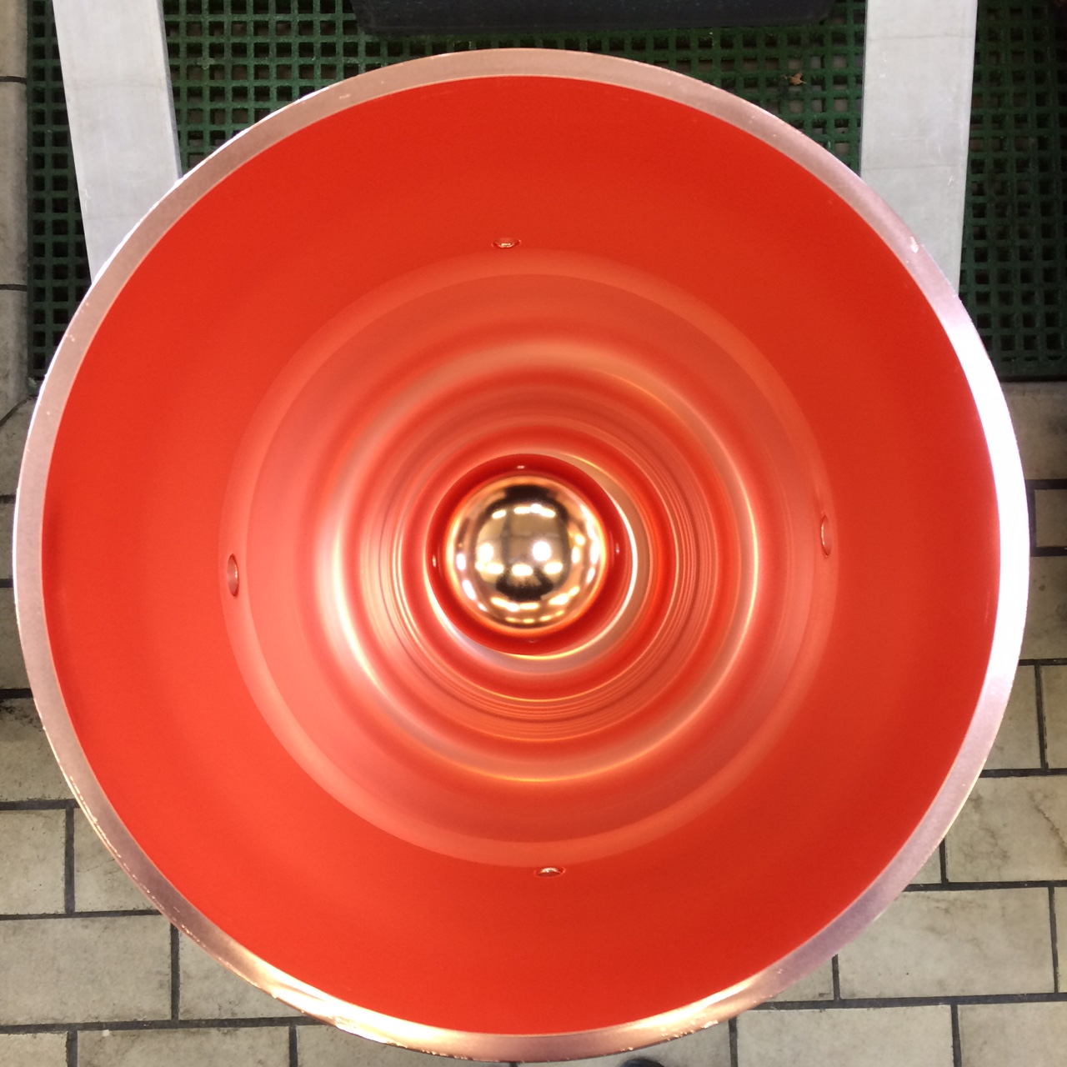
Status of seamless cavities
Design reviewed end April 2016
Full scale “prototype in July 2016: tolerances met → manufacturing method demonstrated
RF design optimized and beam dynamics simulated
Final design documented in EDMS
Order placed in industry for 2 cavities + 1 in option
First cavity (QSS1) delivered February, coated last week
QSS1 cold test next week
QSS2 delivered in April, blank assembly this week

Slide 10
CM4 Assembly
Same assembly team as for CM1 to CM3
Same duration as for CM3 :
  27 weeks in clean room
  + 2 weeks qualification tests outside of clean room
Planning is shifted by 7 weeks to ensure the best set of active elements:
  + 7 weeks to get solenoid #5 (preferred wrt solenoid #4)
  Window for cavity production for CM4 prolonged by 5 weeks
  CM4 assembly will pause in week 22
  Solenoid #5”
    Arrival at CERN: delayed from w18 to w27
    Ready for installation: w29
  5 cavities ready for the installation in w33
  CM4 finished and tested at warm: w42
SM18 cryo shut-down
Solenoid installation
cavity installation

Slide 11
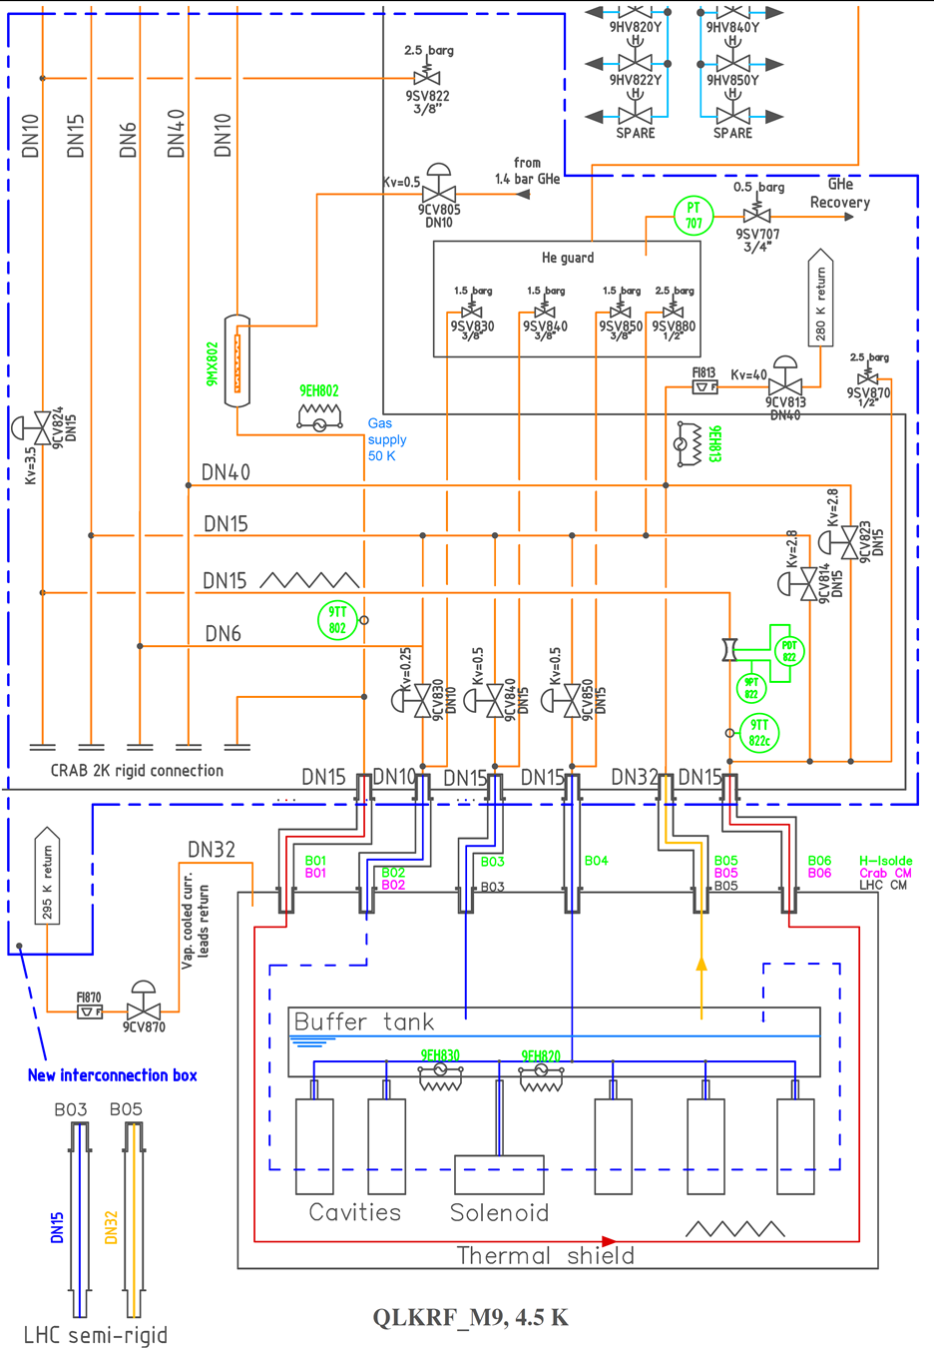
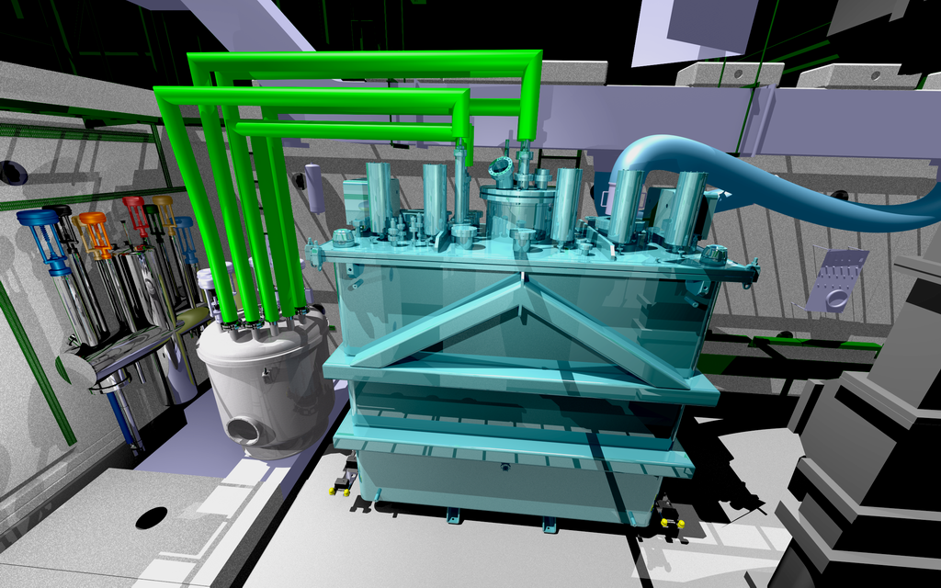
CM4 Bunker Test
Integration study still valid
Transport tools available
Cryogenics (valve box) installed
RF racks installed and cabled
Solenoid rack to be recovered from DANFISYK
Procedures will be adapted from those used for the linac (some tests can be skipped)
Space management: LHC cryomodule sitting in M9

Slide 12
CM4 Bunker Test Schedule

Slide 13
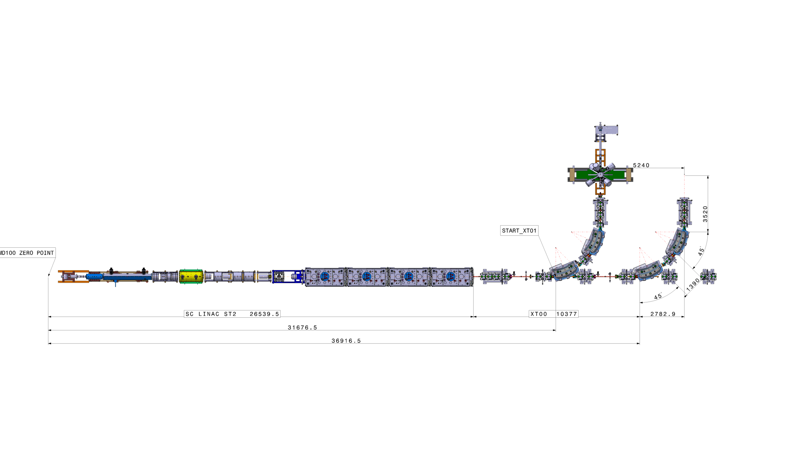
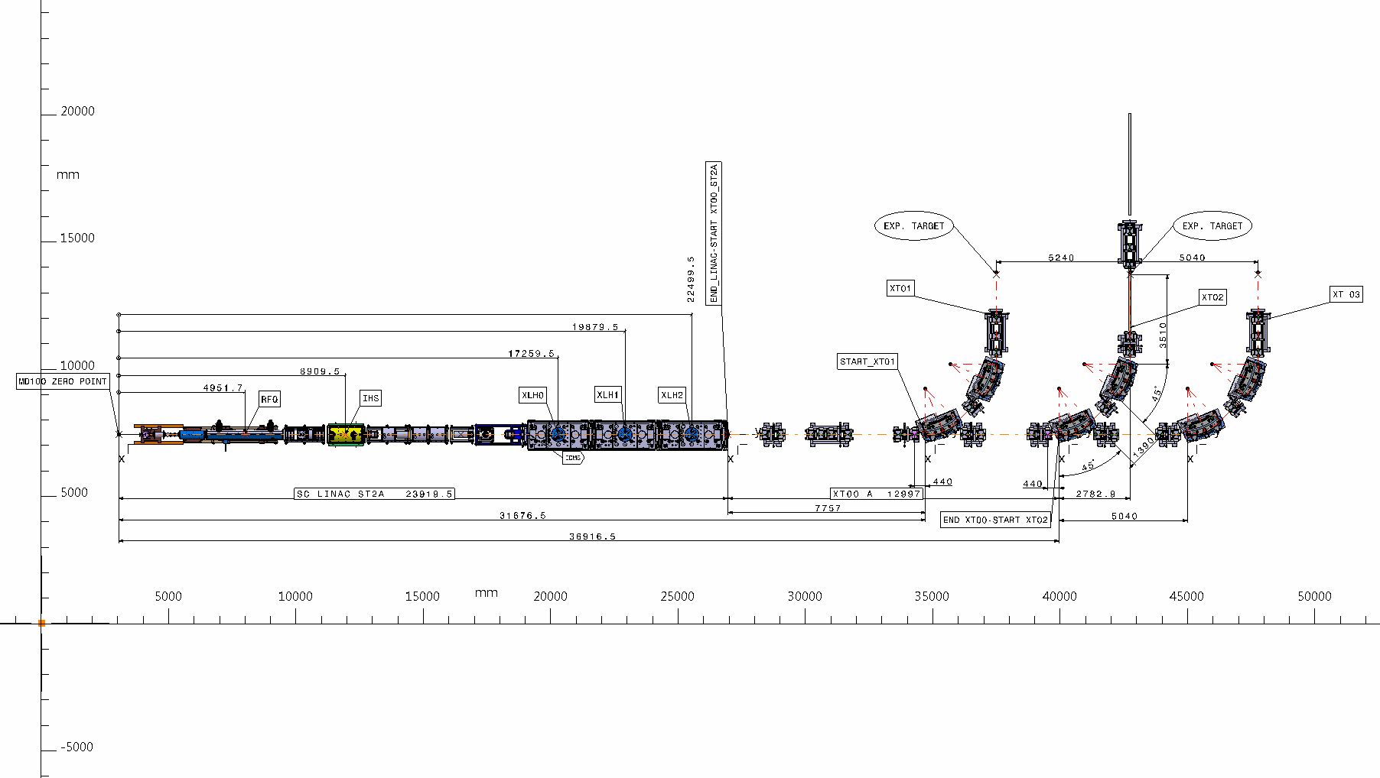
Phase 2B
Phase 2A

Slide 14
2018 Schedule

Slide 15
Overall Summary
CERN strategy on cavities for phase 2 being implemented
  Last RI cavity performance improved after change of weld parameters
  CERN produced cavities (QS22 and QS23) finished
  Production Seamless cavities also progressing well: to be tested week 27
CM4 Assembly
  Will use the best available cavities and solenoid
  Schedule adjusted, matching end of cryo-shutdown in SM18
  Bunker test is scheduled for the end of the year => Management decision solicited to go ahead or not, considering all facts
Spares
  Baseline: complete set of cavities (5xQS+ 1xQSS) and solenoids (1+coil)
  Possible future option: “hot spare”
  Infrastructures and know-how anyway to be preserved by CERN

Slide 16
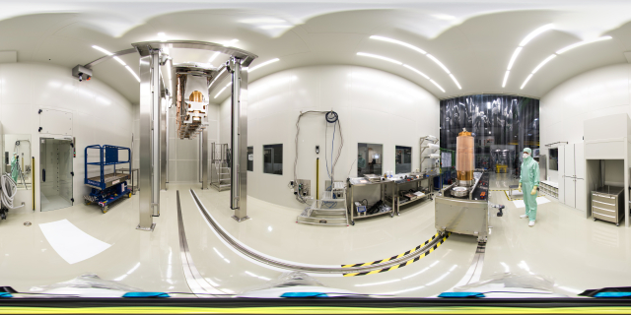
Thank you!

