Slide 1
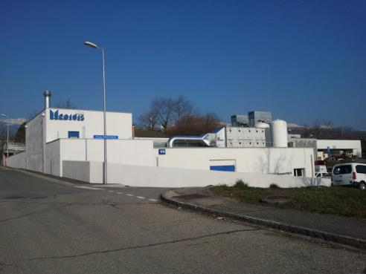

CERN-MEDICIS
Status and plans for 2017
Thierry Stora – ISCC 27th June 2017
Acknowledgements : S. Marzari, A. P. Bernardes, K. Kershaw, R. Catherall, J. Vollaire, S. Prodon, K. Johnston, U. Koster

Slide 2

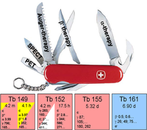
New radioisotopes in medicine
¹⁷⁷Lu
SPECT/CT
Sept 2015
C. Muller et al.
jnumed.112.107540v1
F. Bucchegger et al.

Slide 3
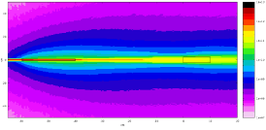
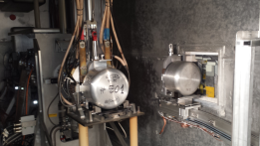
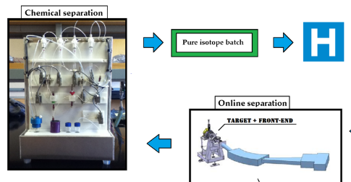
CERN-MEDICIS Principle:
Isotope production in the HRS beam dump and mass separation in the lab
spallation
1.4 GeV protons
fragmentation
fission
1000+ isotopes
of 70+
chemical elements

Slide 4
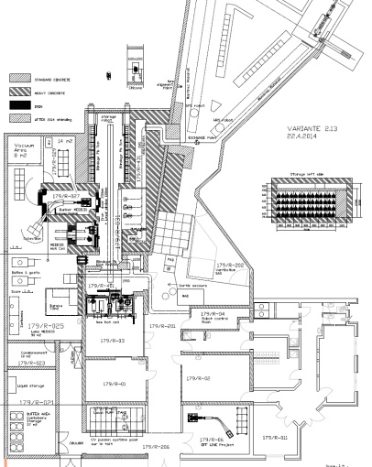
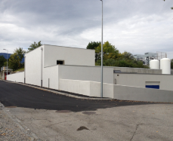
The facility today and the remaining Work Packages
Groundbreaking ceremony
3rd September 2013
MEDICIS
Target
Irradiation
Rail
Conveyor
System
Building reception
15th October 2014
MEDICIS
Laboratory
Installation of beamline and laboratory: ongoing
Commissioning & start-up end 2017 *
*Pending budget, management and safety clearance

Slide 5
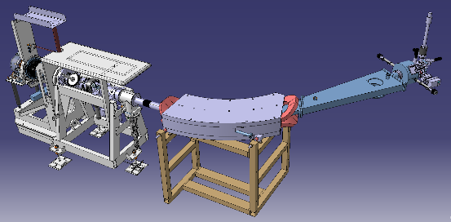
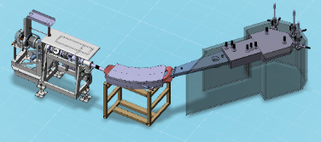
From the last project review : Phase I + Phase II EDMS 1572421
1 collection point
Standard target design
Standard beam instrument box
Laboratory with reduced equipment
Phase II
(3 collections, BI, target, lab)

Slide 6
Some milestones
Ventilation and cooling
Magnet from Leuven refurbished
Personal Protection System (PPS):
Commissioned last week
Remote handling : Robot + Rail Conveyor

Slide 7
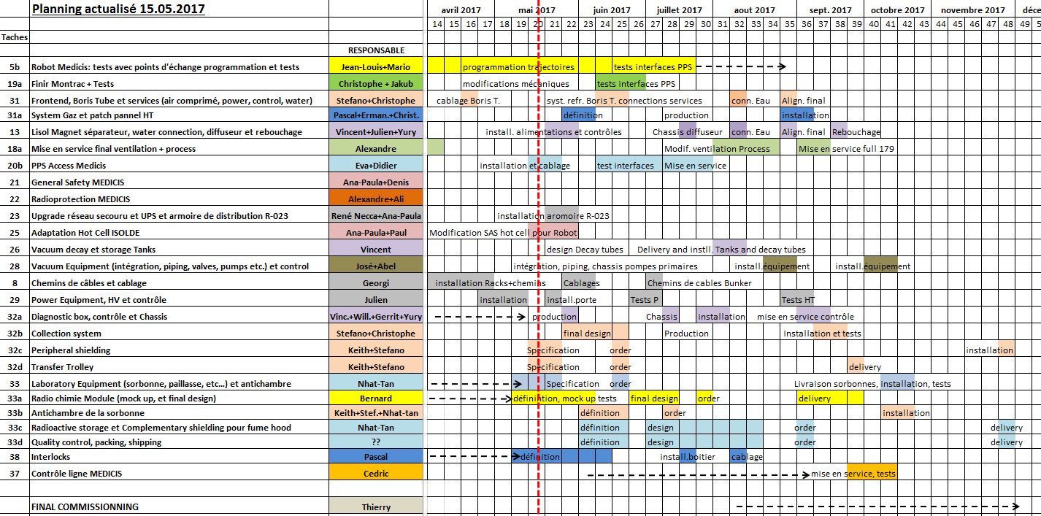
Detailled planning review

Slide 8
Tentative commissioning & operation planning
Starting-up:
    Stable commissioning in September
    Start with low isotope activities irradiated at CERN and at ILL (169Er) in October/November.
    Meeting soon to clarify Collab budget + start-up

Slide 9
Safety clearance
Descriptive and draft demonstrative parts of the safety file has been handed over and comments received.
Request to visit by OFSP, the Swiss authorities, for end of August/beginning of September.

Slide 10
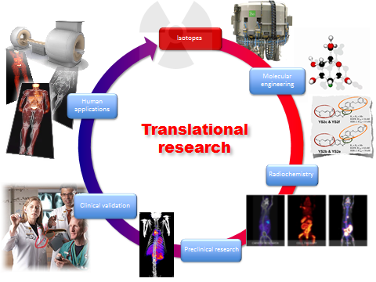
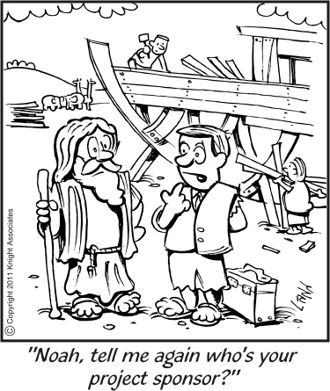

CERN-MEDICIS partners
Dr. Forni (Clin. Carouge, Geneve)
Prof. Morel, Prof. Buehler, Prof. Ratib* (HCUGE, Geneve)
Prof. R. Jolivet ( CERN/UNIGE, Geneve )
Prof. D. Hanahan (ISREC, EPFL, Lausanne)
Prof. J. Prior (CHUV, Lausanne)
Prof M. Huyse, prof. P. van Duppen, prof. T. Cocolios (KUL, Univ. Leuven)
Prof. S. Lahiri (SINP, Kolkata)
Prof. A. Goncalves, Prof. A. Raucho (CT2N, Lisbon)
Prof. F. Haddad (ARRONAX)
Dr. F. Bruchertseifer, Dr. A. Morgenstern (JRC-ITU, Karlsruhe)
Prof. S. Judge, Prof P. Regan, (National Physical Laboratory, Surrey)
Dr. N. Vd Meulen,Dr. C. Mueller (Paul Scherrer Institut, Villingen)
Dr. U. Koester (ILL, Grenoble)
Prof. Siem (Univ. Oslo)
Prof. Wendt (Univ. Mainz)
FABIS (if grant)
EANM (under discussion)
ISOLDE GL (ex-officio)

Slide 11
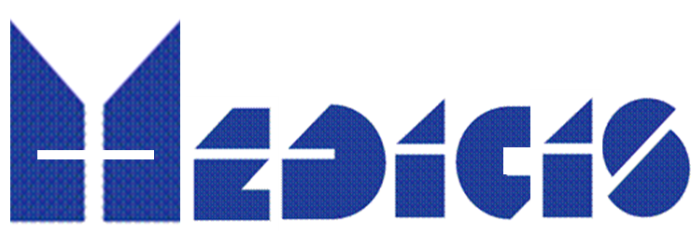
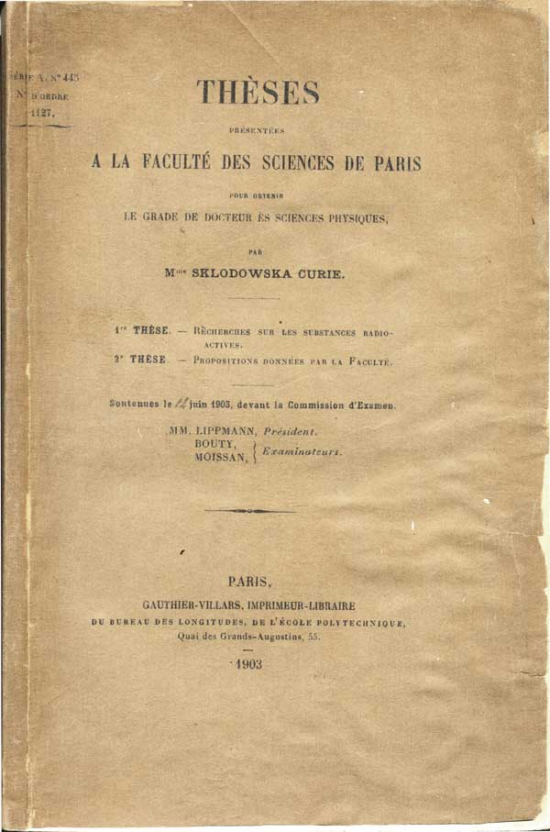
See you at 4pm for the visit
Thank you

Slide 12
RESERVE

Slide 13
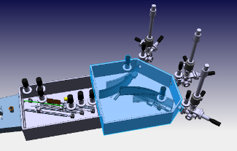
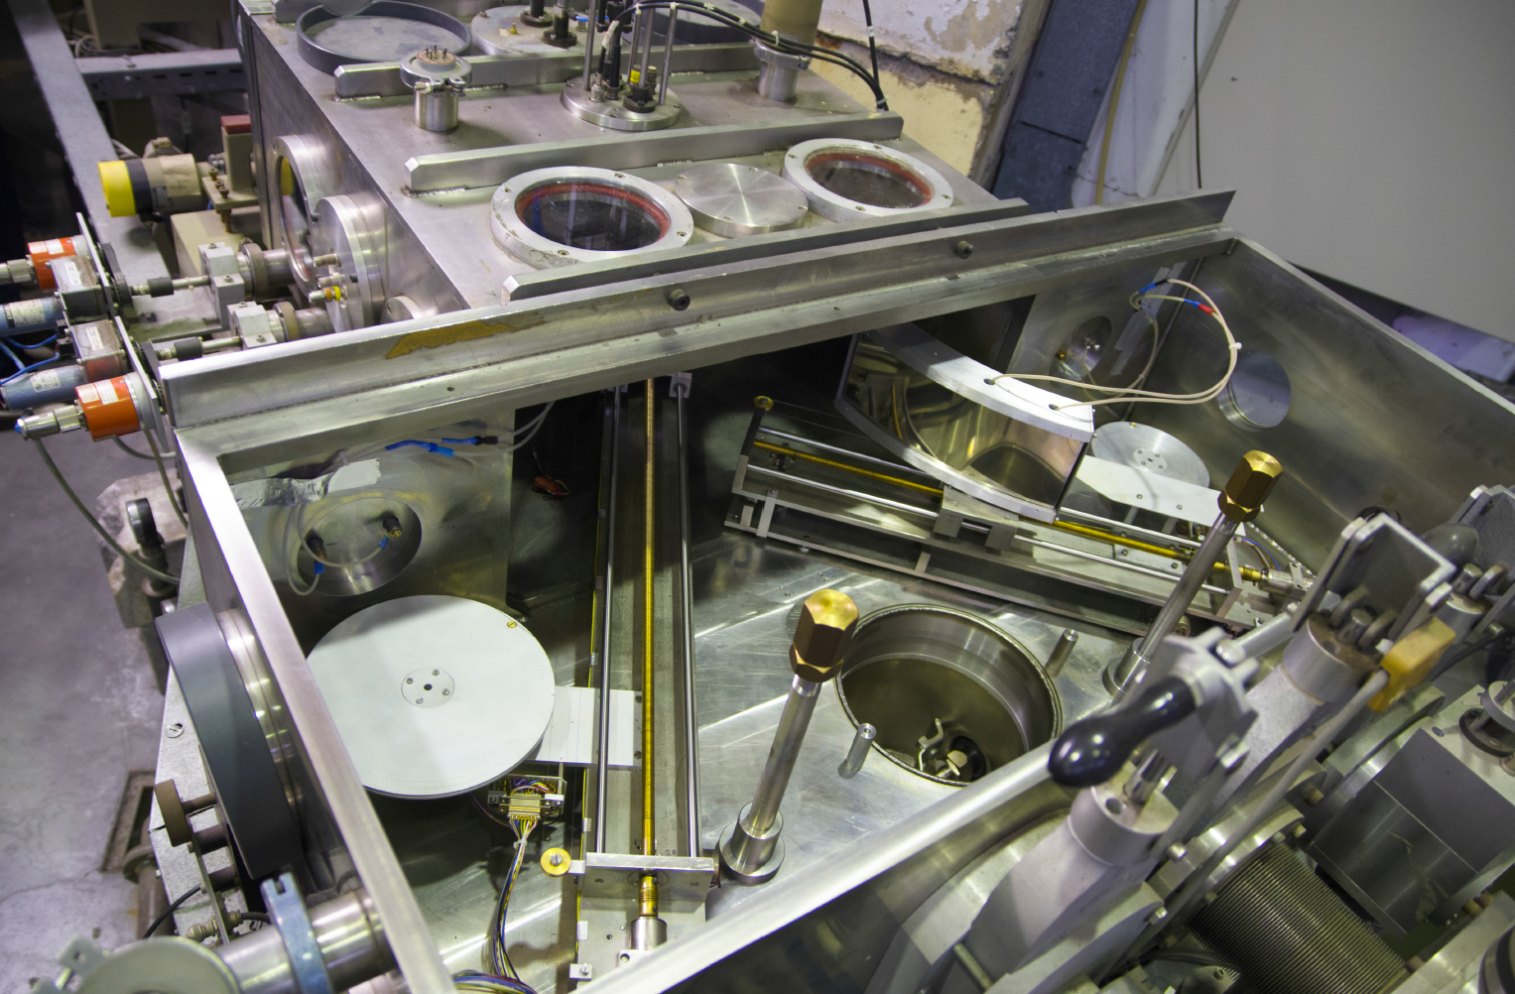
Phase II : New systems
3 collection points:
Electrostatic switchyard
Beam diagnotic box

Slide 14
Phase II : remaining work packages
Table edited from detailled discussions with WP holders
Included in Management Report EDMS 1572421
In circulation next week
Total: 0.6MCHF
Presently not available
Pending decision from ATS sector management

Slide 15
Phase I : Planning
Work Package/Planning | 16-I | 16-II | 16-III | 16-IV | 17-I | 17-II | 17-III | 17-IV
PHASE I
Ventilation |  |  |  | DSO t
Safety alarm systems
RP monitoring
Shielding, air locks
Access/interlock
Safety file |  |  | File | Review | Permit
Power converters |  |  |  | *
Cooling
Magnet
Target
Front End
Collection box
Beam Instr box |  | standard
Separator control
Vacuum
Lab equipment
Commissioning
Operation |  |  |  |  |  | Phase I
Table edited
from detailled discussions
with WP holders
Included in Management
Report EDMS 1572421
In circulation next week for
approval by GLs
* Synergy with ELENA project

