Slide 1
Laser Cooling of Ra ions for Atomic Parity Violation
CERN-INTC-2017-069
CERN, June 27, 2017
Lorenz Willmann

Slide 2
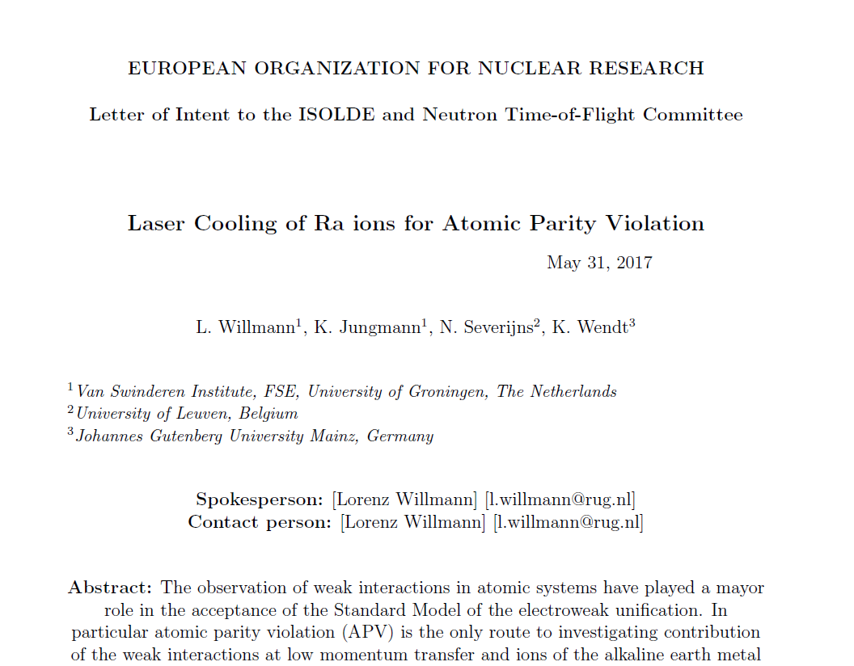
CERN-INTC-2017-069

Slide 3
The Weinberg Angle
Atomic Parity Violation

Slide 4
Atomic parity violation (APV)
sin²(θ_{W}) = (1 – (M_{W}/M_{Z})²) + rad. corrections + New Physics
Standard Model
Kumar, Marciano, Annu. Rev. of Nucl. Part. Sci. 63, 237 (2013)
Davoudiasl, Lee, Marciano, Phys. Rev. D 89, 095006 (2014); Phys. Rev. D 92, 055005 (2015)
Notes:
Atomic parity violation is the tiny effect of the weak interaction on the structure of an atomic system. The reason this is interesting is to test the electroweak part of the Standard Model
What is plotted here are measurements of the weak mixing angle or Weinberg angle (and actually sine squared of this value) which is a parameter of the SM. It’s value is not predicted, but as a running coupling constant, its behavior as a function of the energy scale at which it is probed is a prediction of the SM. Running all the way from measurements in high energy accelerator experiments down to the atomic energy scale.
Low-energy: currently only one measurement in atomic Cs, and the interpretation was complex
In addition: there is sensitivity to New Physics -> therefore another APV measurement: Ra+
We want to do better!

Slide 5


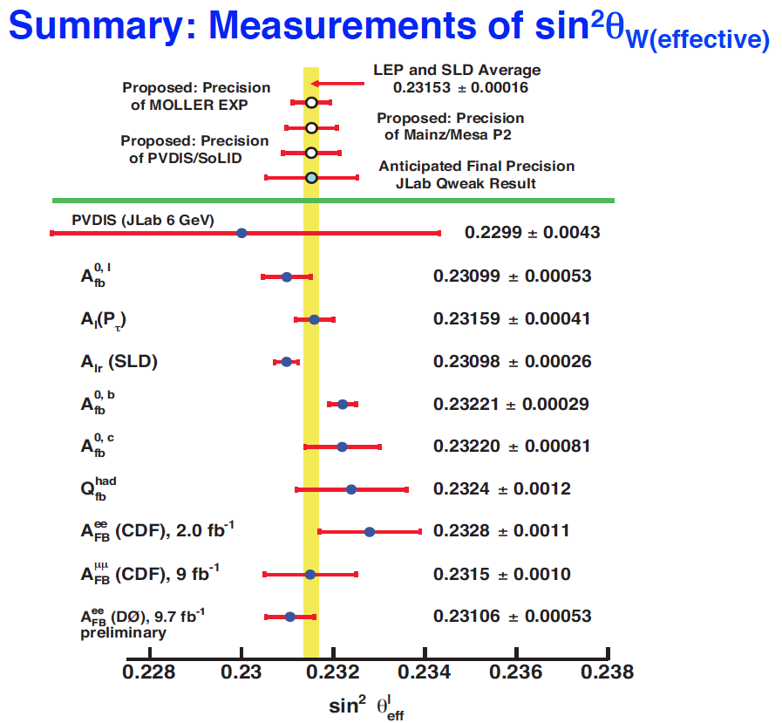
Ra⁺
Cs
F. Maas, PSI2016

Slide 6
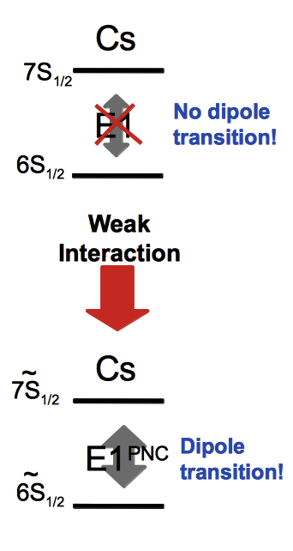
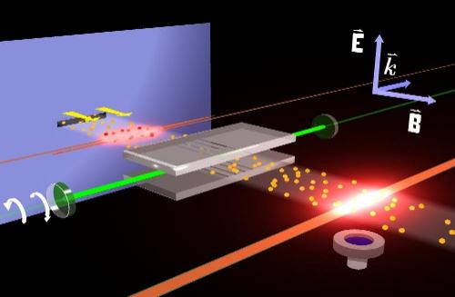
Cs Atomic Parity Violation
Stark induced forbidden transition
(C. Wieman et al. 1985-1996)

Slide 7
Single Ion APV
Experimental Method

Slide 8
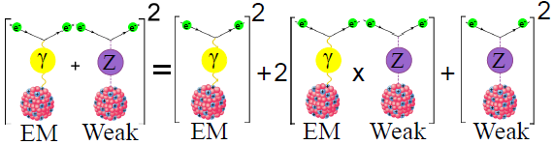
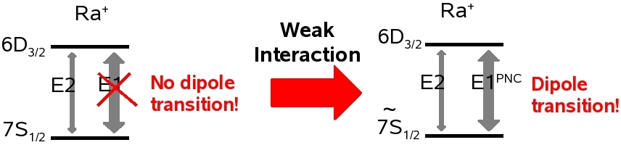

Weak Interaction in Atoms
Interference of EM and Weak interactions
E1_{PNC} = K_{r} Z³ Q_{w} = K_{r} Z³ (- N + Z (1-4sin² θ_{W}))
Heavy System
Measurement
Atomic Theory

Slide 9
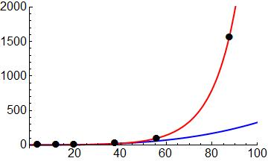
Scaling of the APV
K_{r} relativistic enhancement factor
increase faster than Z³ (Bouchiat & Bouchiat, 1974)
Z³K_{r}
Ra⁺ effects
larger by:
  20 (Ba⁺)
  50 (Cs)
Ra⁺
Enhancement
Z³
L.W. Wansbeek et al.,
Phys. Rev. A 78, 050501 (2008)
Ca⁺
Sr⁺
Ba⁺
Atomic Number
Relativistic coupled-cluster (CC) calculation of E1_{APV} in Ra⁺
E1_{APV} = 46.4(1.4) · 10⁻¹¹ iea₀ (−Q_{w}/N) (3% accuracy)
Other results:
45.9 · 10⁻¹¹ iea₀ (−Q_{w}/N) (R. Pal et al., Phys. Rev. A 79, 062505 (2009), Dzuba et al., Phys Rev. A 63, 062101 (2001).)

Slide 10
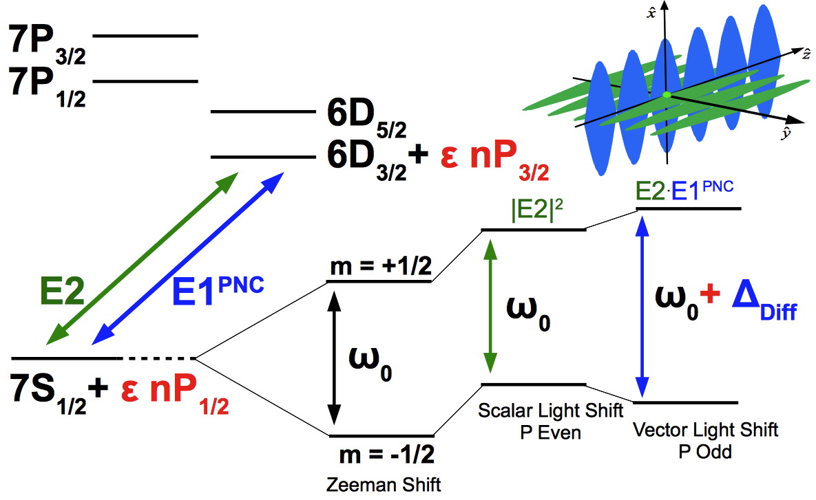
Experiment requires Trapping
Differential Light shift
Energy splittings
not to scale
N. Fortson, Phys. Rev. Lett. 70, 2383-2386 (1993)

Slide 11
Trapping Ra ion
Previous Work

Slide 12
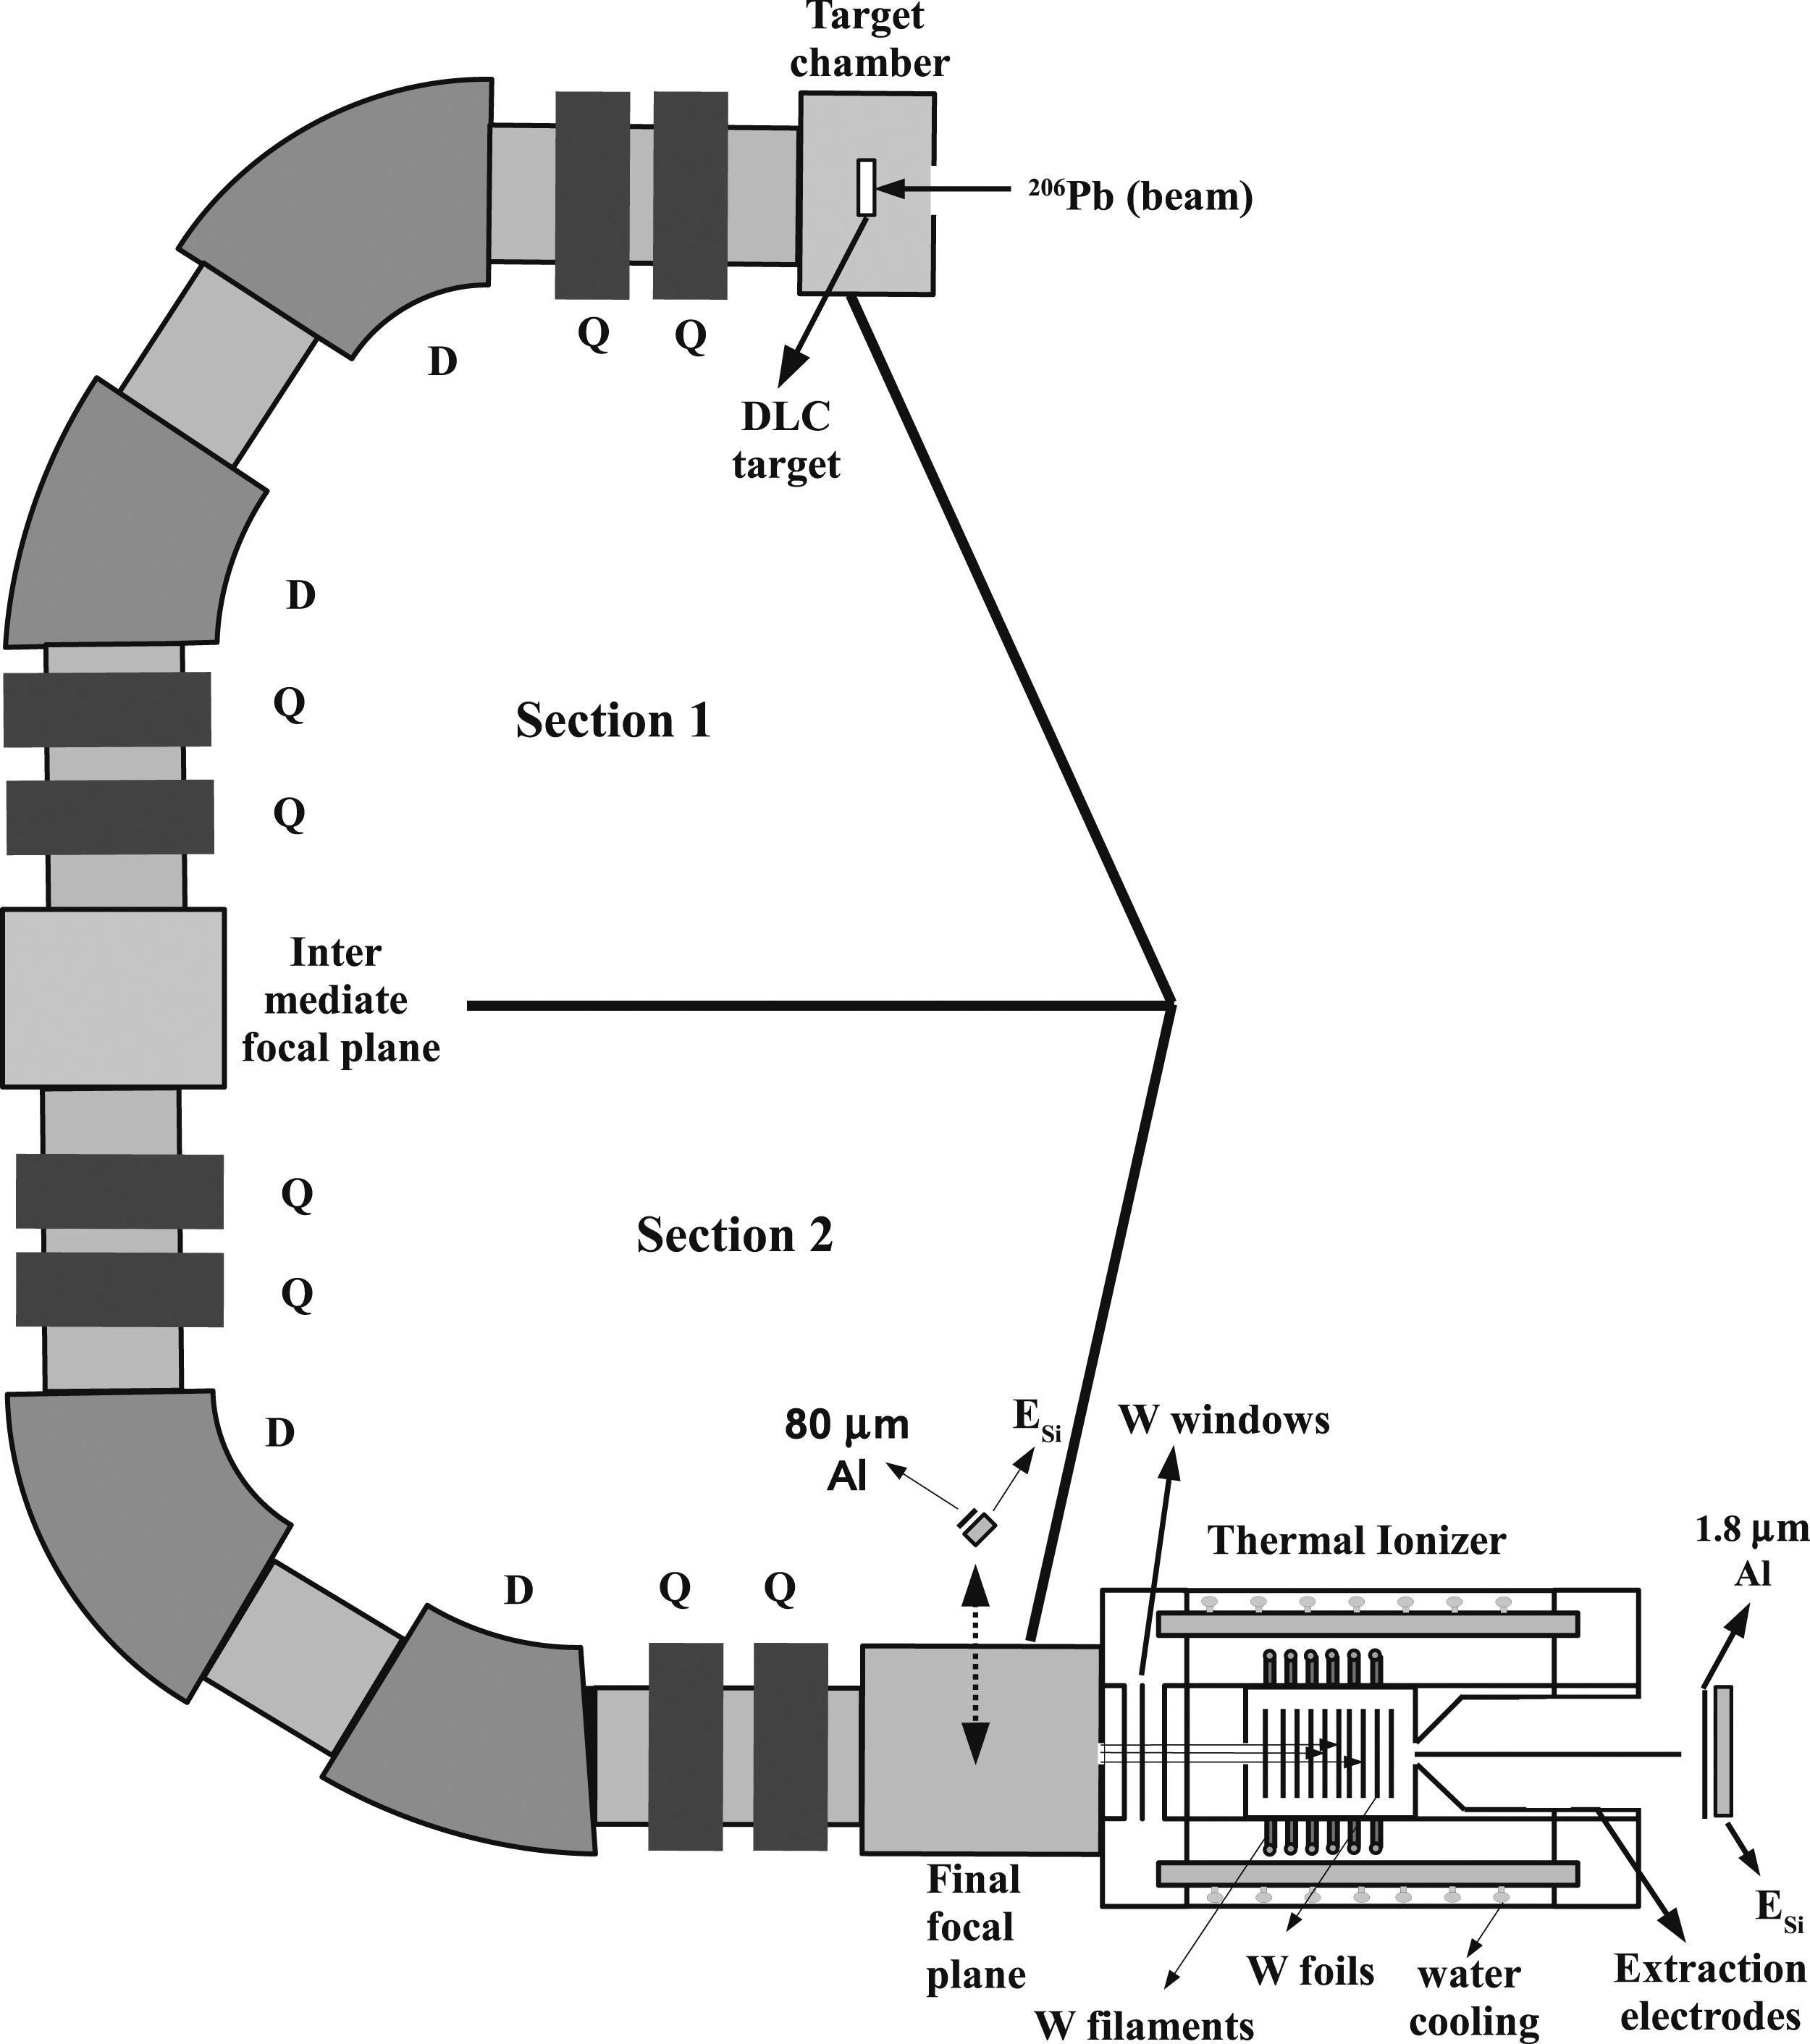

Radium Isotopes
²⁰⁶Pb + ¹²C ^{A}Ra + (218-A) n
²⁰⁶Pb beam
¹²C target
TRIμP separator
TRIμP@KVI
Thermal ionizer
ΔN <10
To RFQ (Paul trap)
Rate after TI
²²⁵Ra
extraction from ²²⁹Th source (ANL)
Long lived ²²⁹Th source in an oven (TRIμP)
Other Isotopes
Online production at accelerator facilities
e.g.
TRIμP ( flux > 10⁵/s) (until 2013)
ISOLDE ( flux < 10⁷/s)
Sources or fragmentation
Notes:
12
We produced radium isotopes using AGOR cyclotron. Etc. LIFETIME OF THE ISOTOPES PRODUCED

Slide 13
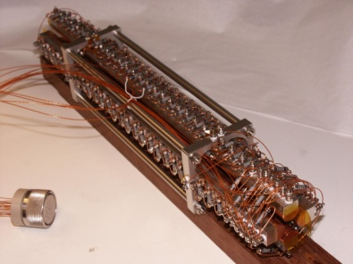
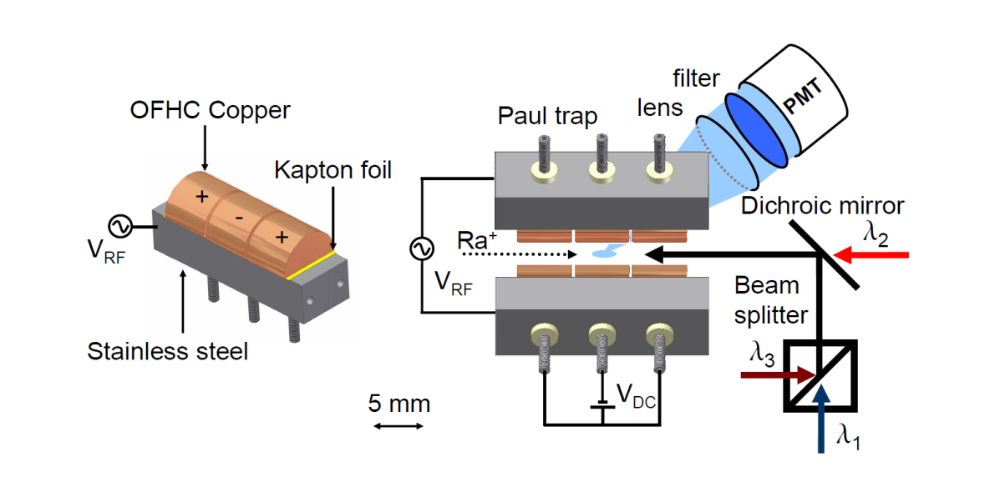
Trapped Ra⁺ Spectroscopy
Radiofrequency Quadrupole (RFQ)
7P_{3/2}
7P_{1/2}
708 nm
1079 nm
6D_{5/2}
6D_{3/2}
468 nm
7S_{1/2}
Level Scheme of Ra⁺

Slide 14
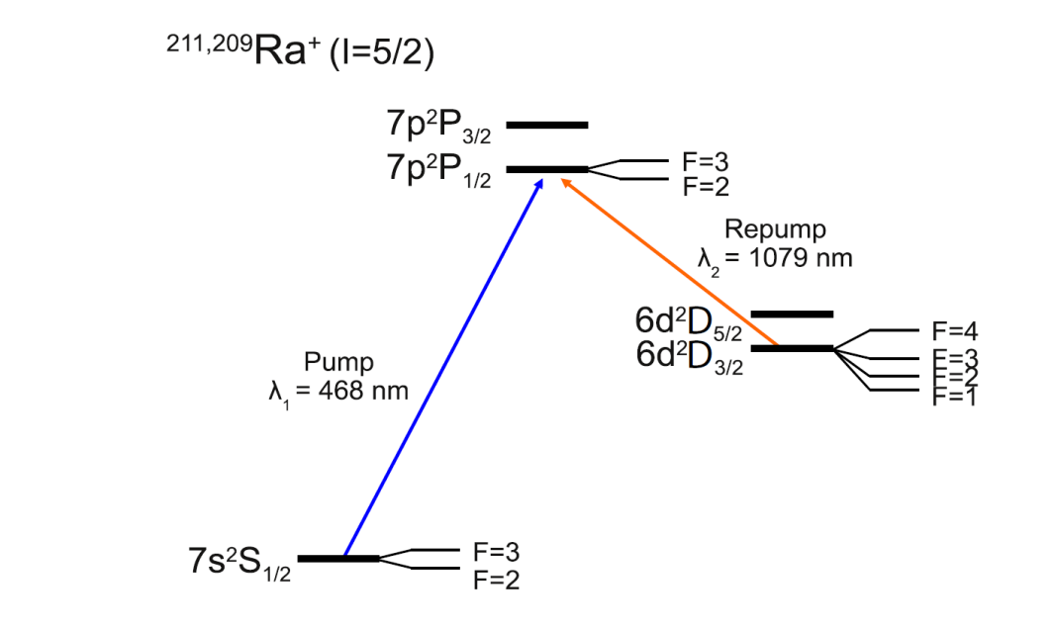
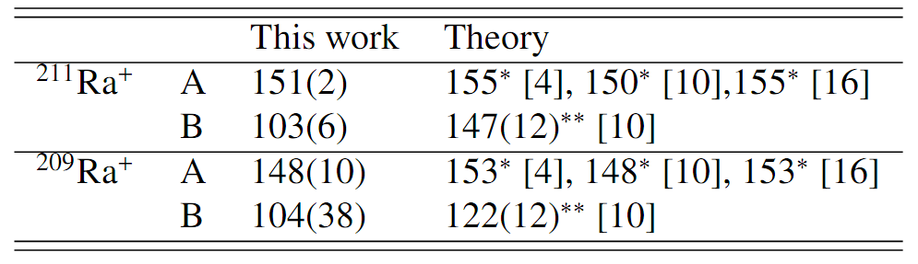
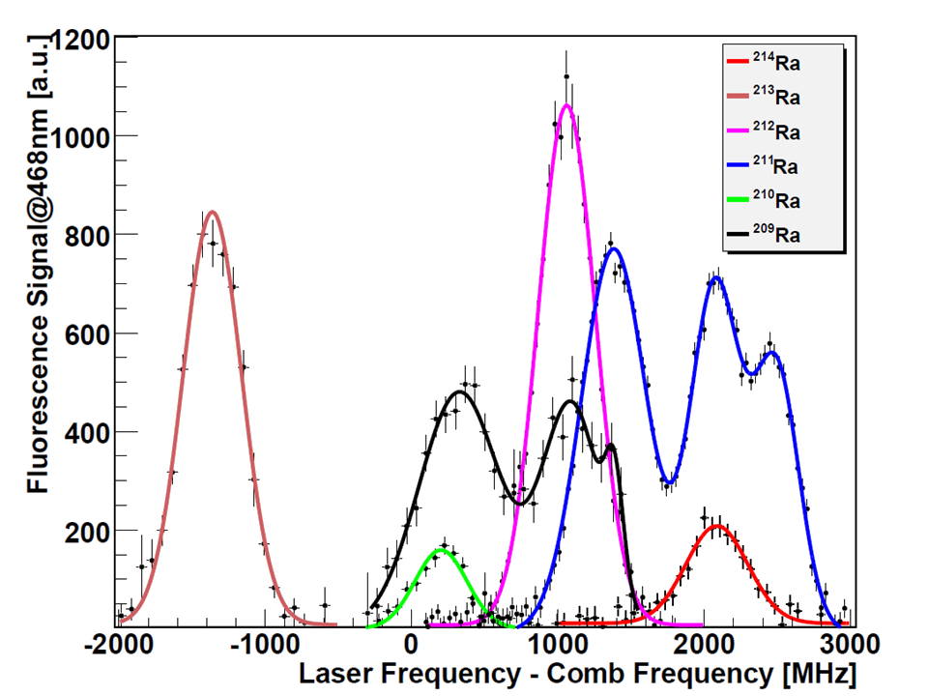
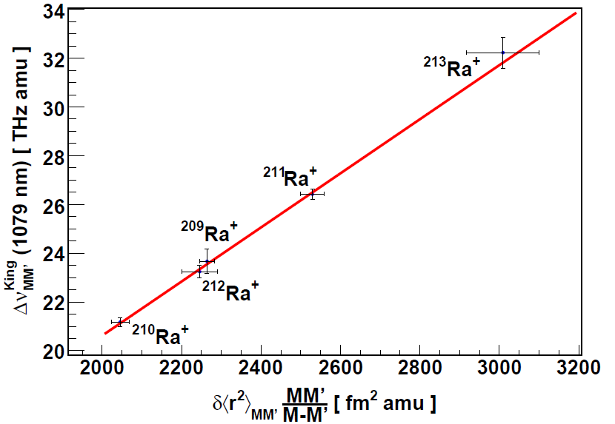
Hyperfine Structure of 6d ²D_{3/2} in Ra⁺
̴̴ 3,5 σ
Probe of atomic wave functions at the origin
Probe of atomic theory & size and shape of the nucleus
O. O Versolatao et. al., Phys. Lett. A375 (2011) 3130–3133
G. S. Giri et al. Phys. Rev. A 84, 020503(R) (2011)
[10] B.K. Sahoo et al. Phys. Rev. A, 76 (2007)
B.K. Sahoo et al. Phys. Rev. A, 79, 052512 (2009)

Slide 15
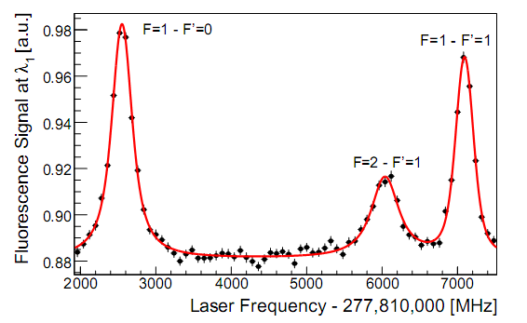
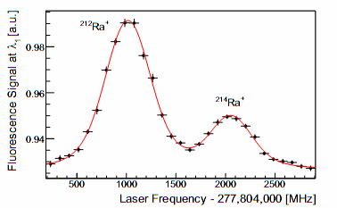
Summary Ra⁺ Measurements
Hyperfine Structure:
Atomic wave functions at the origin
Isotope Shifts:
Atomic theory & size and shape of the nucleus
State lifetime:
Probe of S-D E2 matrix element
agreement with atomic structure calculations at % level
Notes:
We used this system in Fall 2009 to perform measurements and extract hyperfine structures, isotopes shifts and even a lower bound of the lifetime of a meta-stable state in ra+.

Slide 16
Complementary Radium experiments
Atomic Properties

Slide 17
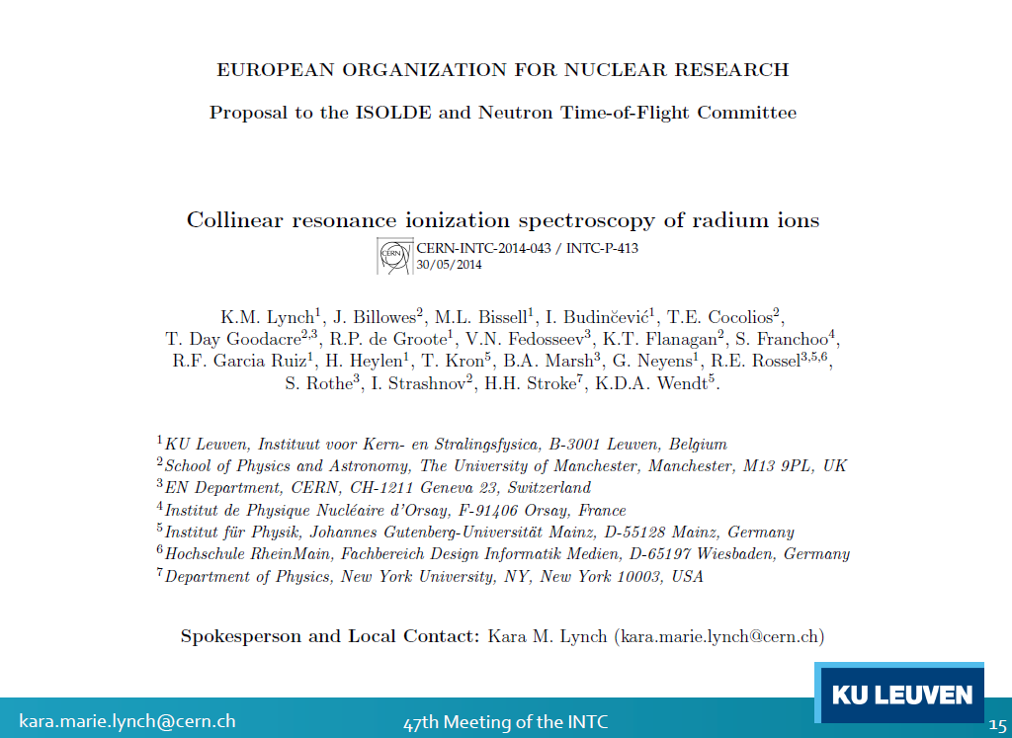
Activity at CERN/ISOLDE

Slide 18
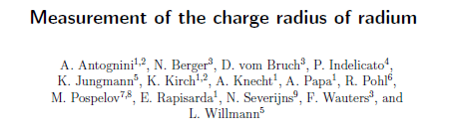
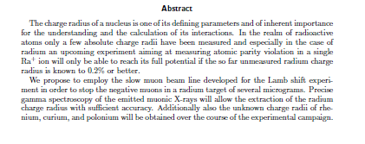
muX@PSI
Radium Charge Radium
Beamtime to improve sensitivity of muonic x-ray measurements this summer

Slide 19
Barium Ion
Ba⁺ Atomic Parity Violation

Slide 20
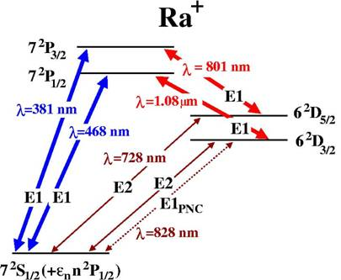
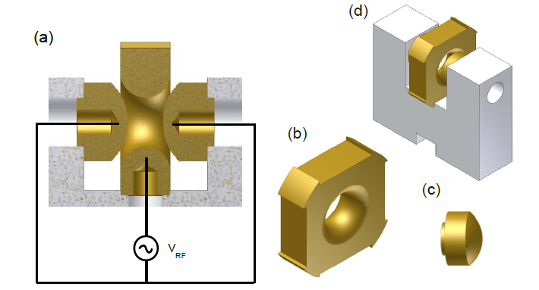
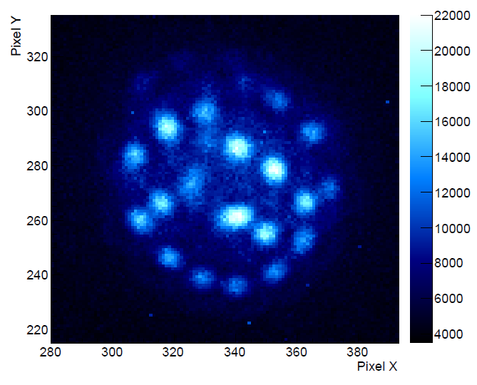
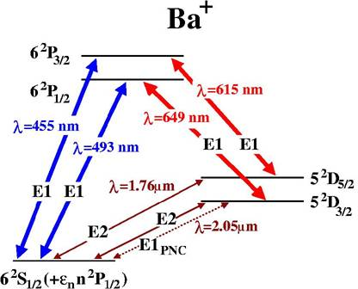
Hyperbolic Single Ion Trap
10µm

Slide 21
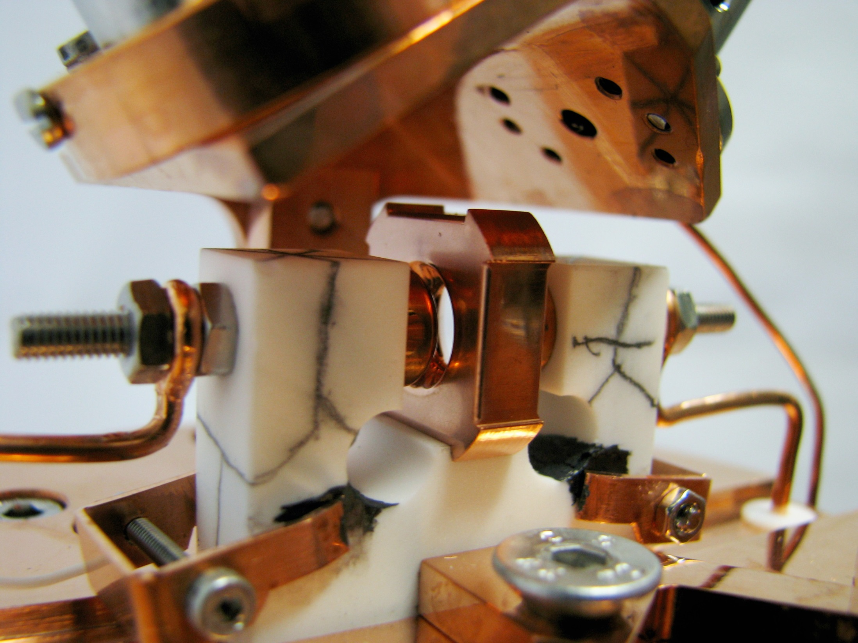
Hyperbolic Paul trap
5 mm
²P_{3/2}
²P_{1/2}
650 nm
494 nm
VRF
²D_{5/2}
¹³⁸Ba⁺
²D_{3/2}
²S_{1/2}
21
Notes:
21
Ion trap
21

Slide 22
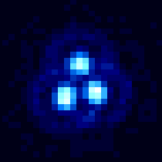
Detection
²P_{3/2}
²P_{1/2}
PMT
650 nm
494 nm
Lasers
²D_{5/2}
¹³⁸Ba⁺
²D_{3/2}
²S_{1/2}
650 nm laser frequency (MHz)
Ion trap
EMCCD

Slide 23
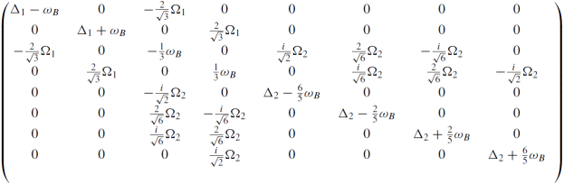
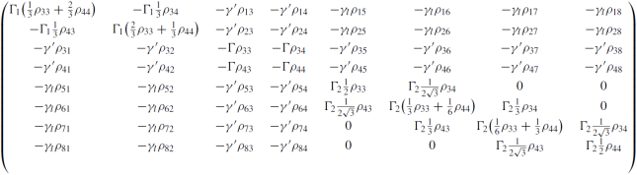
Importance of Line Shape
|²P_{1/2}⟩
Γ₁
Γ₂
|4⟩
Optical Bloch equation
3 level example
Δ₁
|3⟩
Δ₂
γ
γ
Ω₂
Ω₁
|8⟩
|7⟩
|²D_{3/2}⟩
|6⟩
|²S_{1/2}⟩
|2⟩
|5⟩
γ_{c}
|1⟩
Ba⁺
Ω₁, Ω₂
Rabi frequencies
(laser power)
Γ = Γ₁ + Γ₂
relaxation rate
γ = Γ/2
decoherence rate
Δ₁, Δ₂
laser detunings
γ_{c}
laser linewidth
Notes:
We use the optical Bloch equations
It uses the density matrix formalism and the time-dependence of the system is given by this Hamiltonian describing the interaction of the ion with the laser light and a damping matrix describing the decoherence effects.
I’m not going to go through all the math, but I just want to describe the ingredients going into this calculations:
Then there’s the spontaneous decay from the excited state which leads to relaxation of the populations, and the associated decoherence effect and finally the finite linewidth of the lasers also causes a decoherence effect.

Slide 24
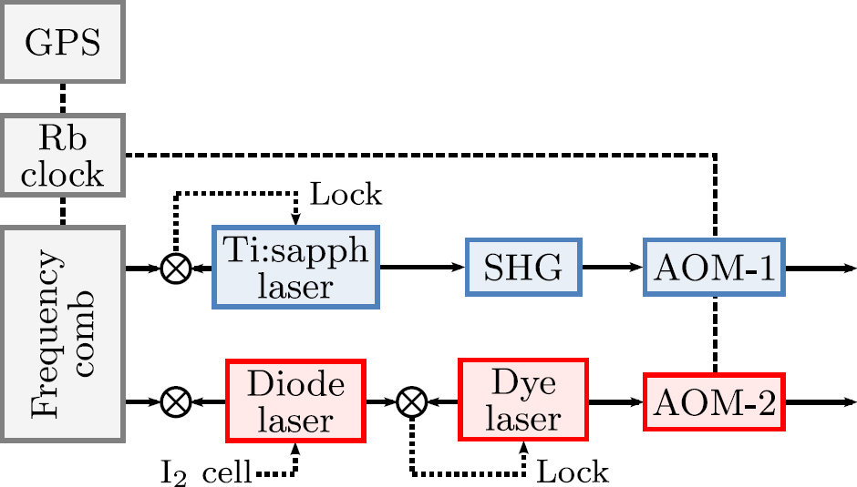
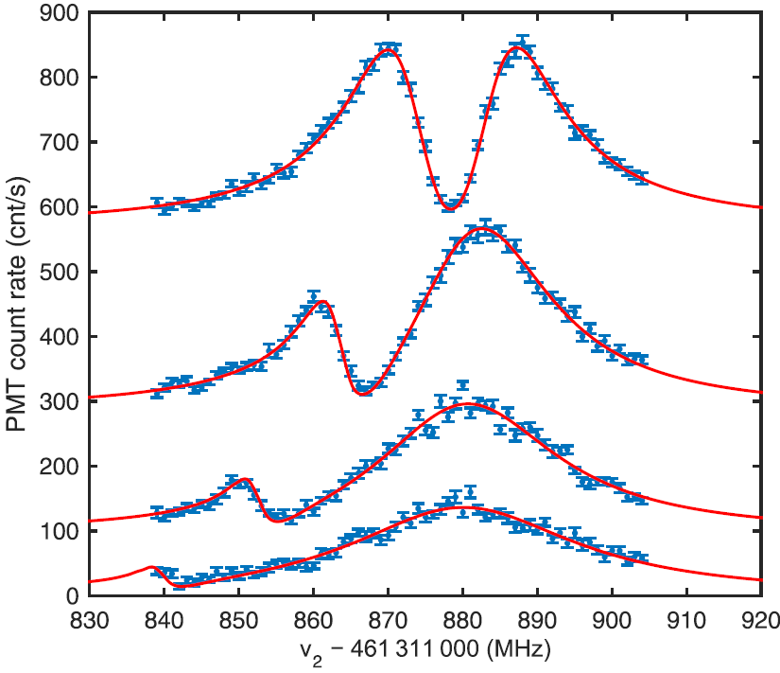
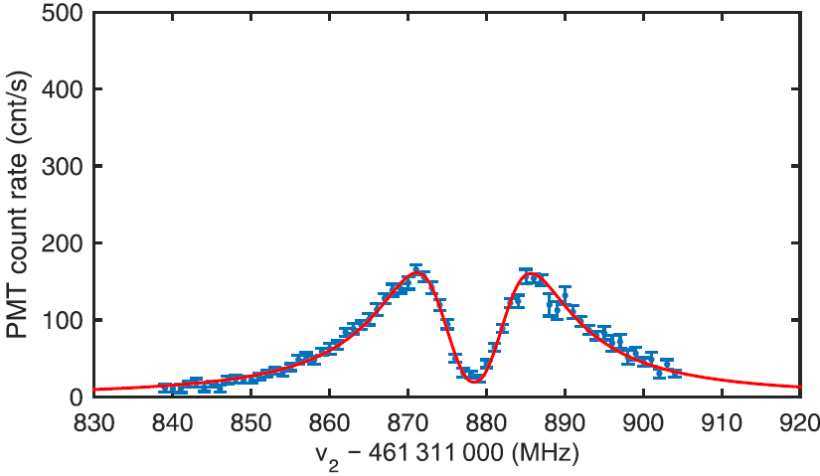
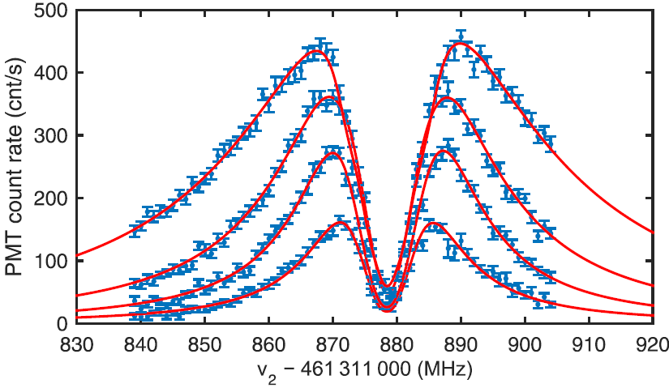
Transition frequencies
²P_{3/2}
Ba⁺
²P_{1/2}
650 nm
494 nm
²D_{5/2}
²D_{3/2}
494 nm
²S_{1/2}
494 nm laser detuning varied
650 nm
650 nm laser intensity varied
Frequency 650 nm laser − 461 311 000 MHz
Frequency 650 nm laser − 461 311 000 MHz
Fitted with optical Bloch equation model
Extract transition frequencies with 100 kHz accuracy
Dijck et al., Phys. Rev. A 91, 060501(R) (2015)
Notes:
We aim to extract transition frequencies, so we need to know

Slide 25
Transition frequencies
²P_{3/2}
Ba⁺
²P_{1/2}
650 nm
494 nm
²D_{5/2}
²D_{3/2}
494 nm
²S_{1/2}
Light shift?
650 nm
Correction in transition frequencies
for Ω₂ dependent shift consistent with
2° rotation of B-field
650 nm laser intensity varied
B-field
rotated 2°
879.5
879.0
One-photon peak
frequency (MHz)
878.5
Expected
461 311 878.0
0
1
2
3
4
5
Frequency 650 nm laser − 461 311 000 MHz
Power 650 nm laser (Ω₂ / Ω_{2,sat})
²
²
Fitted with optical Bloch equation model
Extract transition frequencies with 100 kHz accuracy
Dijck et al., Phys. Rev. A 91, 060501(R) (2015)
Notes:
We aim to extract transition frequencies, so we need to know

Slide 26
Summary
Atomic Parity Violation

Slide 27
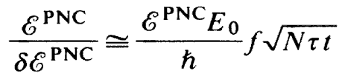

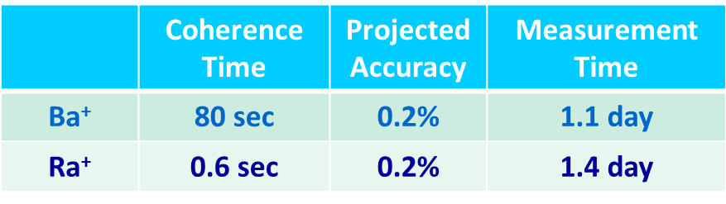
Accuracy of Single Ion Experiment
If coherence time can be fully exploited

Slide 28
Ratio measurement
Insensitivity of Ratio of measurements of E1_{APV} for isotopes to atomic structure.
V. A. Dzuba, V. V. Flambaum, and I. B. Khriplovich, Z. Phys. D, 1, 243 (1985)
Best case scenario:
For radium a wide range of isotopes is available

Slide 29



Laser Cooling of Ra ions for
Atomic Parity Violation
$${E1}_{APV}=k∙Q_{W}$$
Atomic Parity Violation:
Ba⁺
Ra⁺
Developing experimental setup
Atomic properties determination
Light shifts and Line shapes
Atomic Properties from online produced radium
Trapping and laser spectroscopy done at TRIμP
Activity on Ra⁺ colinear spectroscopy (ISOLDE)
Muonic Radium experiments for charge radius
Frequency 650 nm laser − 461 311 000 MHz
ISOLDE
Ion trapping permits access to many transitions
Laser cooling for precision
Availability of a large range of Ra isotopes
Lab with experience of precision lasers experiments at accelerators
Building up of a collaboration

