Slide 1
RF couplers for PIP-II
Sergey Kazakov
22 June 2017

Slide 2
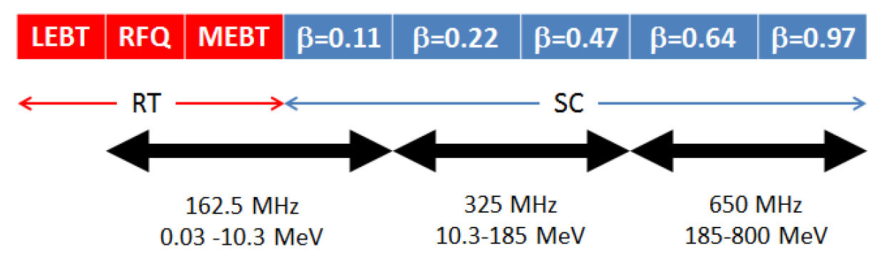
PIP-II linac technology map
Bunching cav.
HWR
SSR1
SSR2
LB650
HB650
Performance parameter
Linac beam Energy | 800 MeV
Linac Beam Current | 2 mA
Linac Pulse Length | 0.55 ms
Linac Pulse Repetition Rate | 20 Hz
Linac Upgrade Potectial | CW

Slide 3
PIP-II linac includes:
Room temperature cavities:
RFQ room temperature cavity.
Bunching cavity x 4.
5 types of SC cavities:
HWR x 8,
SSR1 x 16,
SSR2 x 35,
LB 650 x 33,
HB 650 x 24 elliptical cavities.
Each cavity requires a coupler.
Total number of couplers: 122 (RFQ uses 2 couplers).

Slide 4
Operating parameters of cavities determine the requirements to couplers:
(Requirements meets parameters of upgrade version of PIP-II with 5 mA current.)
RFQ coupler:
Frequency 162.5 MHz
Power 75 kW, CW
Buncher coupler:
Frequency 162.5 MHz
Power 3 kW, CW
HWR coupler:
Frequency 162.5 MHz
Power 10 kW, CW
SSR1 & SSR2 coupler:
Frequency 325 MHz
Power 30 kW, CW
LB & HB 650 coupler:
Frequency 650 MHz
Power 110 kW, CW
All couplers were designed and some prototypes were built and tested.

Slide 5
Principles of design:
Simplicity of vacuum part of coupler:
no moving parts, no bellows.
simple configuration – more reliable, easy to clean, less expansive.
Air cooling of antennas (no water) – Not so severe consequences in case of leak.
Ability to apply high voltage bias to suppress a multipactor.
Avoid a copper coating of stainless steel.
Based on this principles the RFQ, SSR1 & SSR2, LB & HB 650 couplers were design.
RFQ and SSR1 & SSR2 couplers were built and tested.

Slide 6
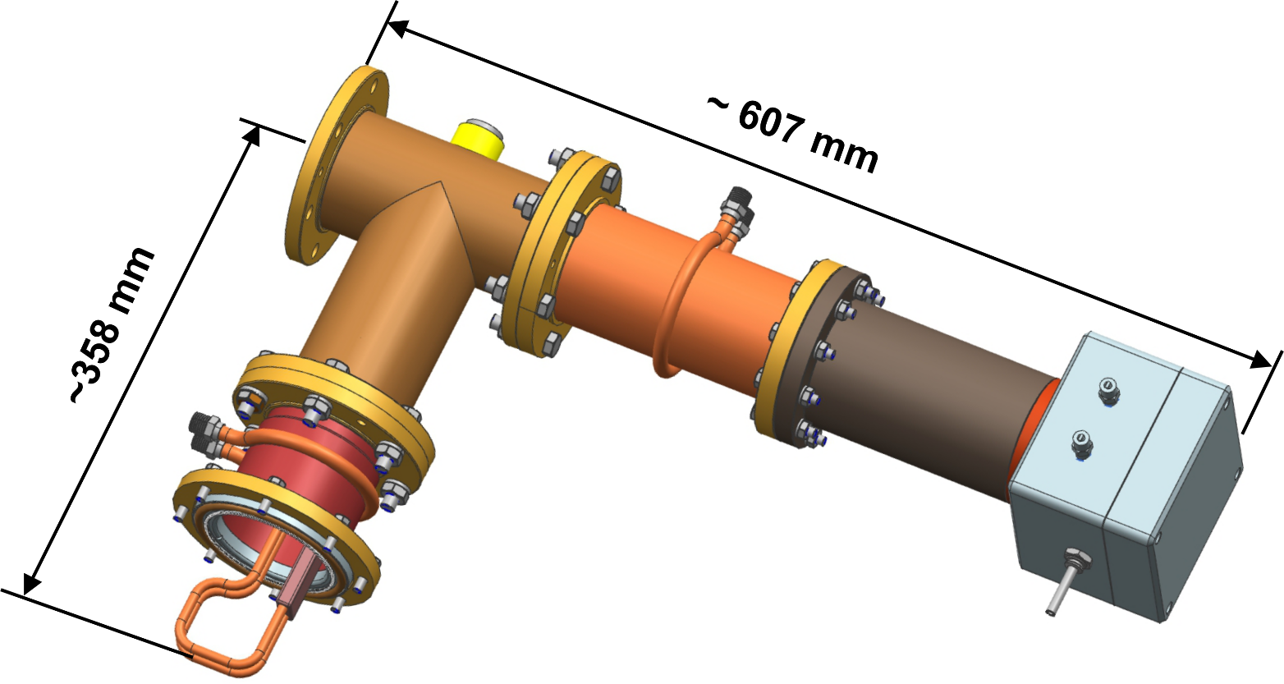
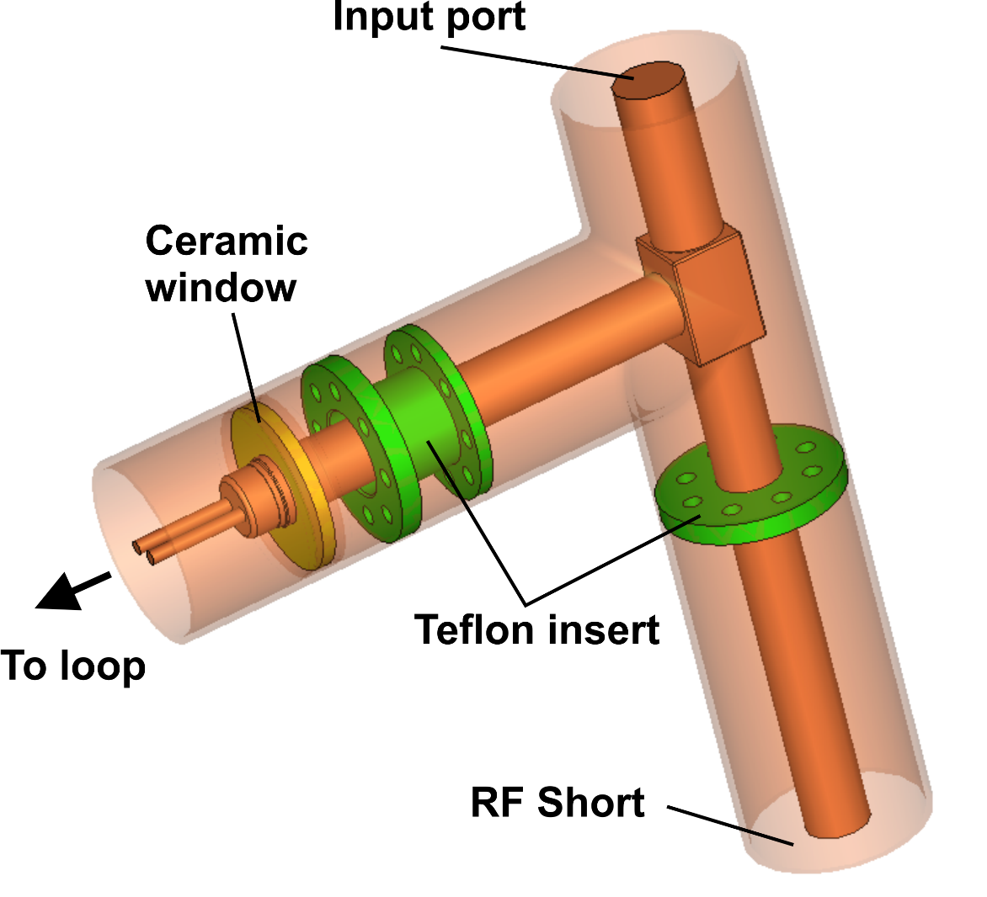
RFQ coupler:
Frequency 162.5 MHz
Power 75 kW, CW
Electrical configuration
Overall sizes

Slide 7
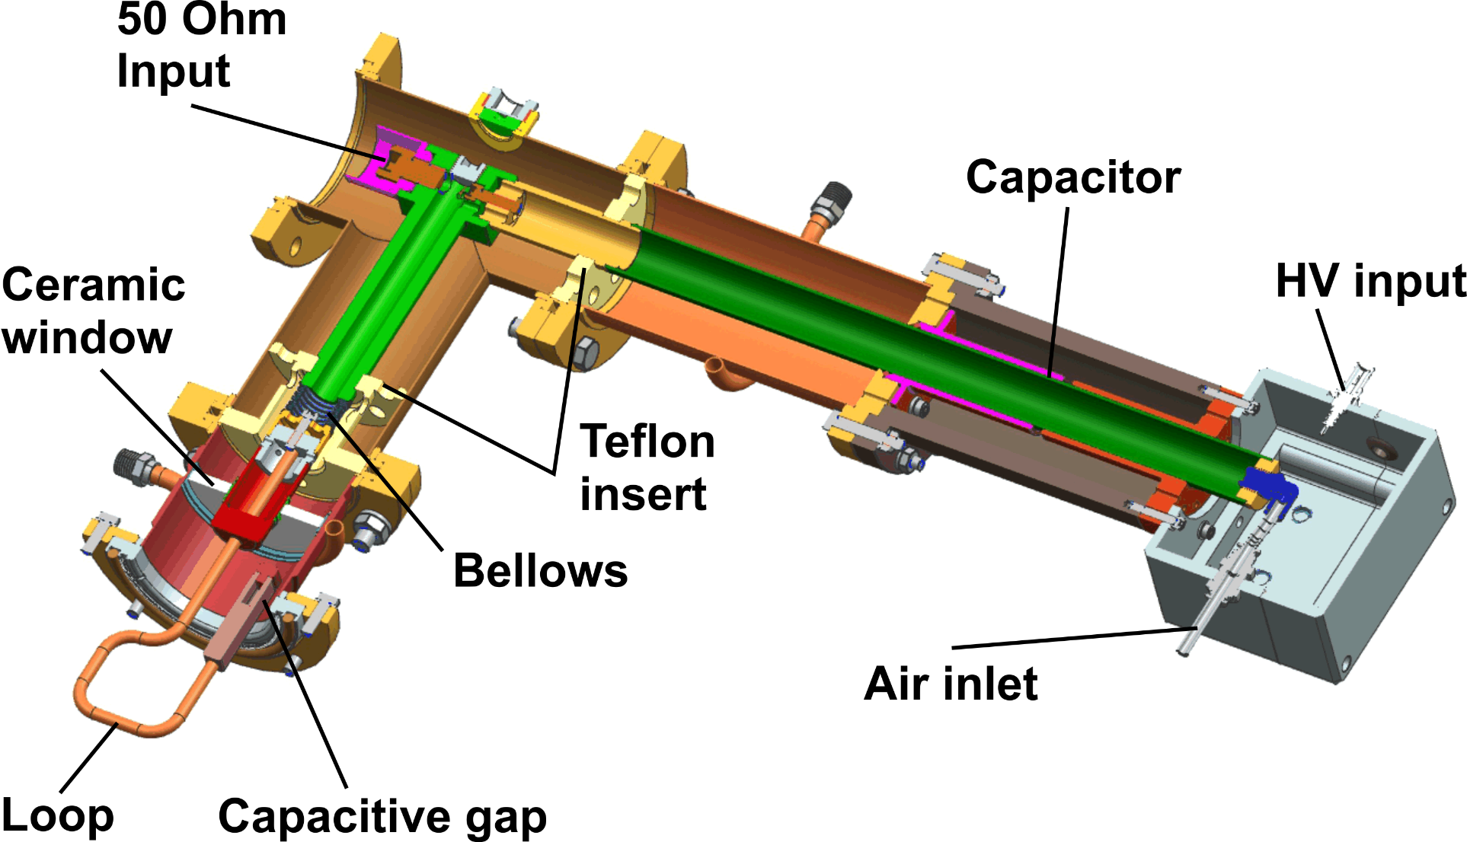
Some features of RFP coupler:
Not grounded loop (HV bias applicable)
Air cooling

Slide 8
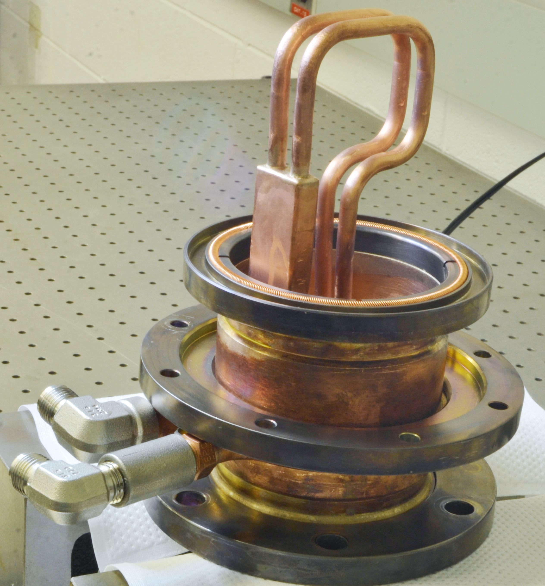
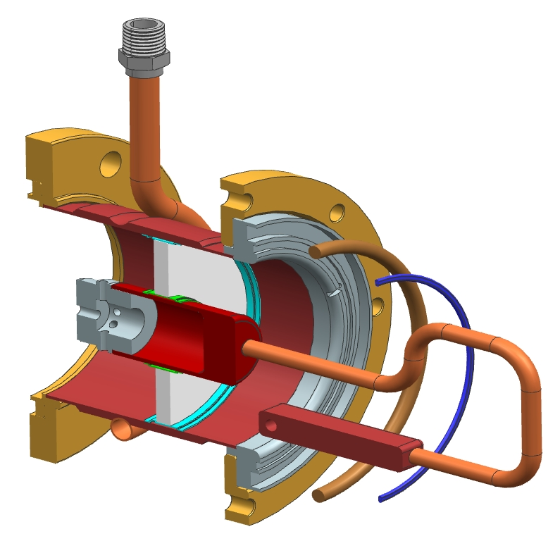
Ceramic window assembly:
Custom Rotatable
Flange SS316
3 1/8 Fixed coaxial flange
Viton O-ring
RF seal
Beryllium Copper C175 Alloy 10
(Bal Seal Spring )
Al2O3 ceramic disc
Copper sleeves
Copper 101 Tube OD .25”

Slide 9
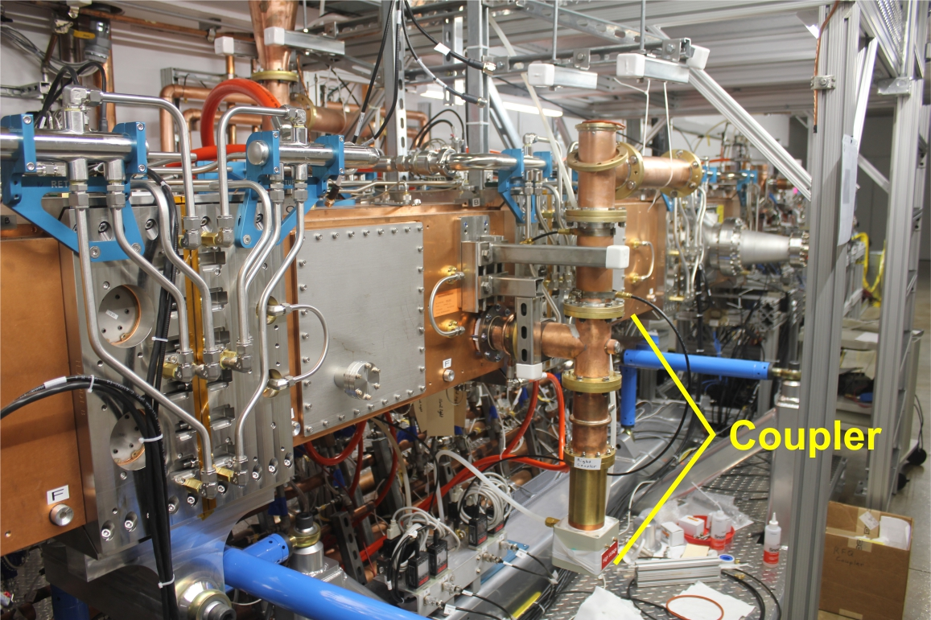
RFQ coupler connected to RFQ cavity:
DC block

Slide 10
Results of testing:
Two couplers with four ceramic window units were produced.
Couplers were tested at RFQ cavity up to 65 kW in pulse and CW modes.
CW mode integrated time was ~ 500 hours.
Two windows were broken. The reason is not clear enough.
The most probable reasons are not enough air cooling or/and
low quality of window brazing.
Remaining two windows are installed to RFQ cavity and operating in pulse mode now.

Slide 11
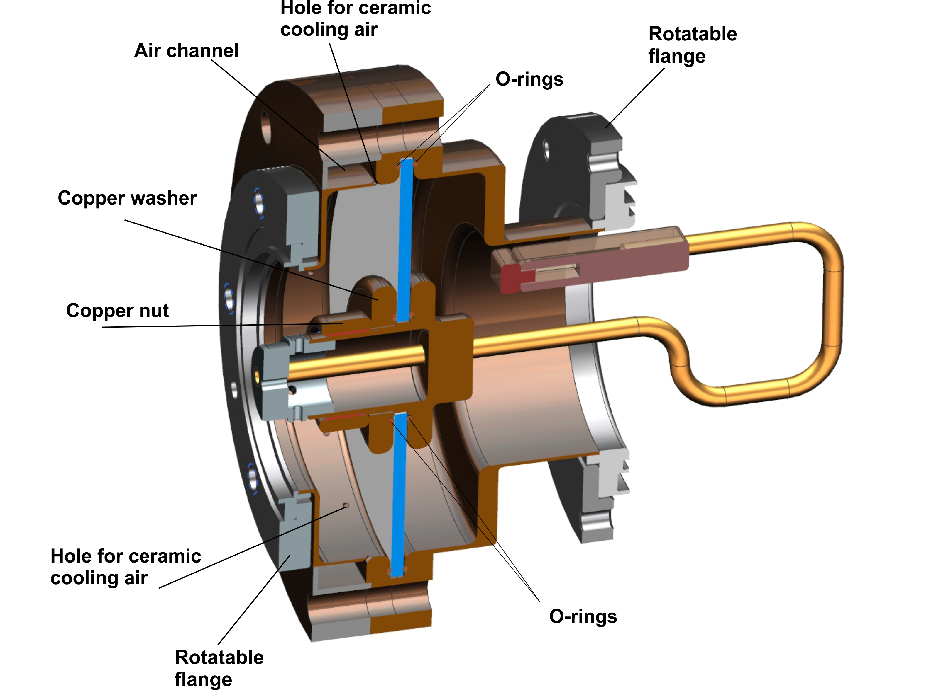
Backup RF windows:
We decided to design and build “backup” ceramic windows units with bigger and replaceable ceramics. Ceramic disk will be vacuum sealed by Viton rings or aluminum diamond seals. We expect that new window will be powerful enough. In case of broken window the ceramic disk can be change easily for new one.
Ceramic diameter 6’’ (was 3’’)
Ceramic thickness 4 mm (0.16’’)

Slide 12
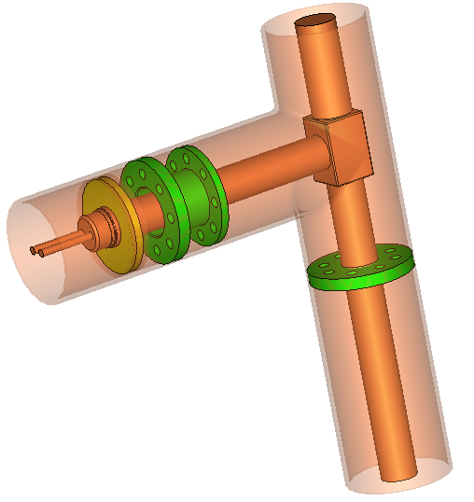
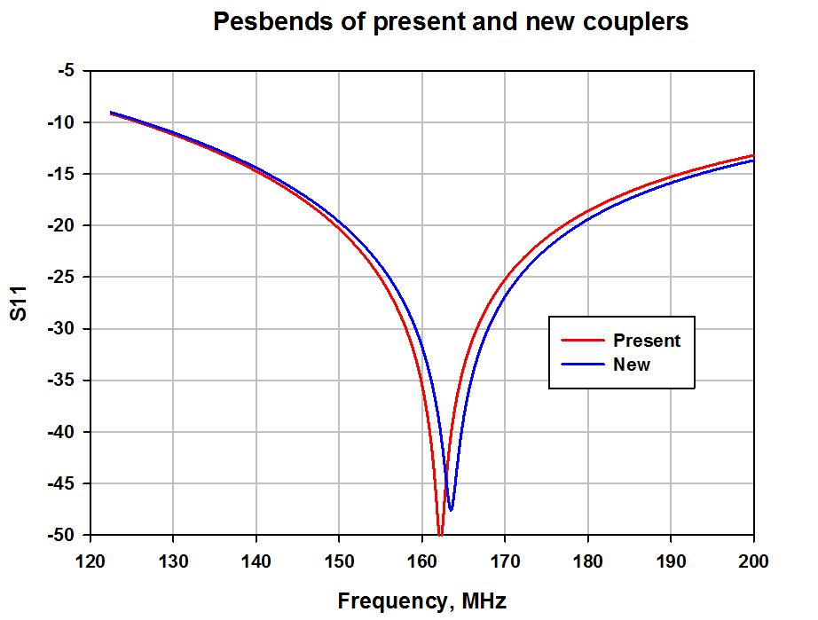
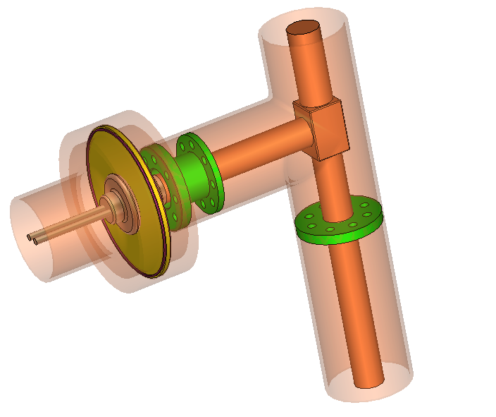
Window units are interchangeable.

Slide 13
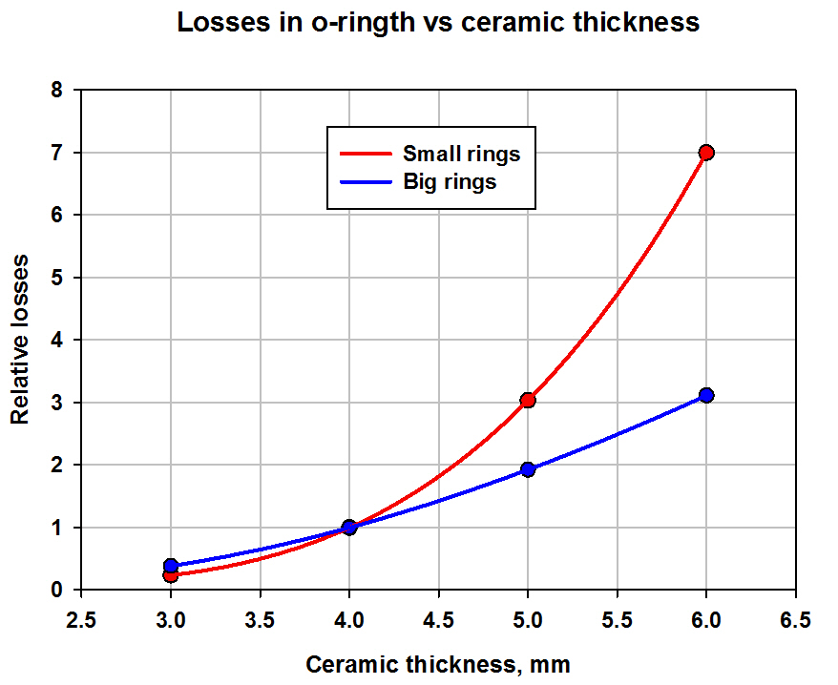
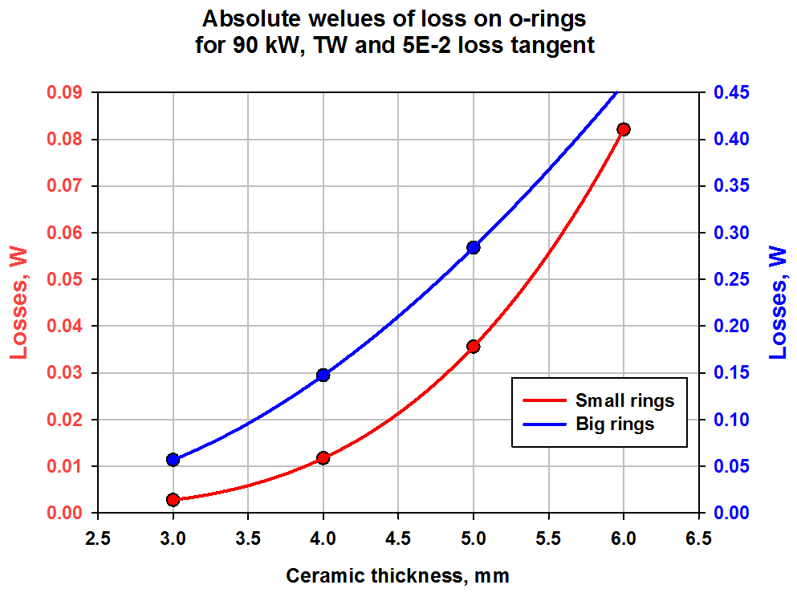
Relatively and absolute losses in Viton (rubber) rings.
Ceramic thickness was chosen 4 mm

Slide 14
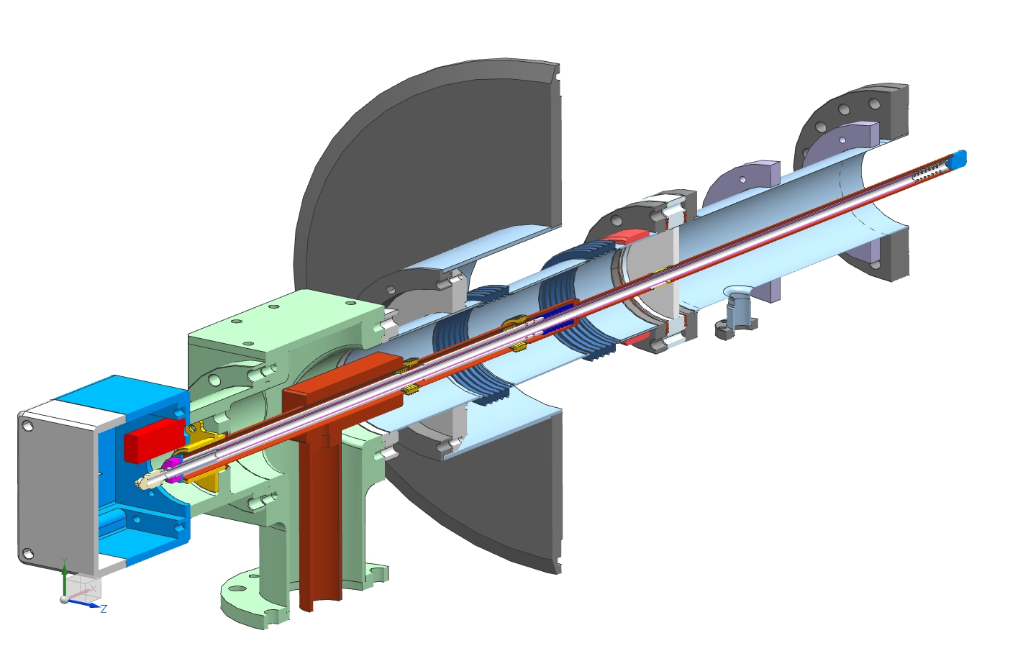
SSR1 & SSR2, 325 MHz coupler:
Design power:
30 kW, CW, full reflection
Antenna:
Copper 0.5’’, air cooled, HV bias.
RF Window:
Single, room temperature, alumina, OD 73mm (2.87’’),
ID 12.7mm (0.5’’), thick. 6mm (.236’’)
Outer conductor:
SS, ID 73mm (2.78’’), 0.4mm wall thickness, no Cu coating.
Cryomodule flange
Spring to compensate
thermal expansion
“5K” intercept
Impedance 105 Ohm
“80K” intercept
Ceramic window
Thermal properties of coupler:
Antenna
P, kW | “2K “, W | “5K”, W | “70K”, W
0 | 0.06 | 0.58 | 2.02
3 | 0.10 | 0.81 | 2.35
6 | 0.15 | 1.03 | 2.68
20 | 0.35 | 2.07 | 4.25
30 | 0.50 | 2.82 | 5.36
Matching bump
Arc detector
Cold flange
e-pickup port
Ni-Cu bellows
3’’x 0.0158’’
stainless steel tube
Heater
Air inlet
3-1/8’’ coaxial input

Slide 15
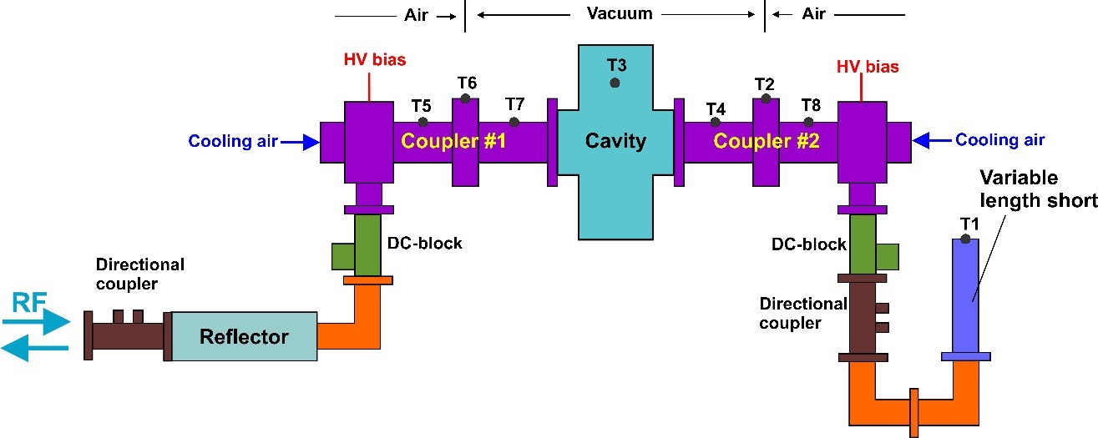
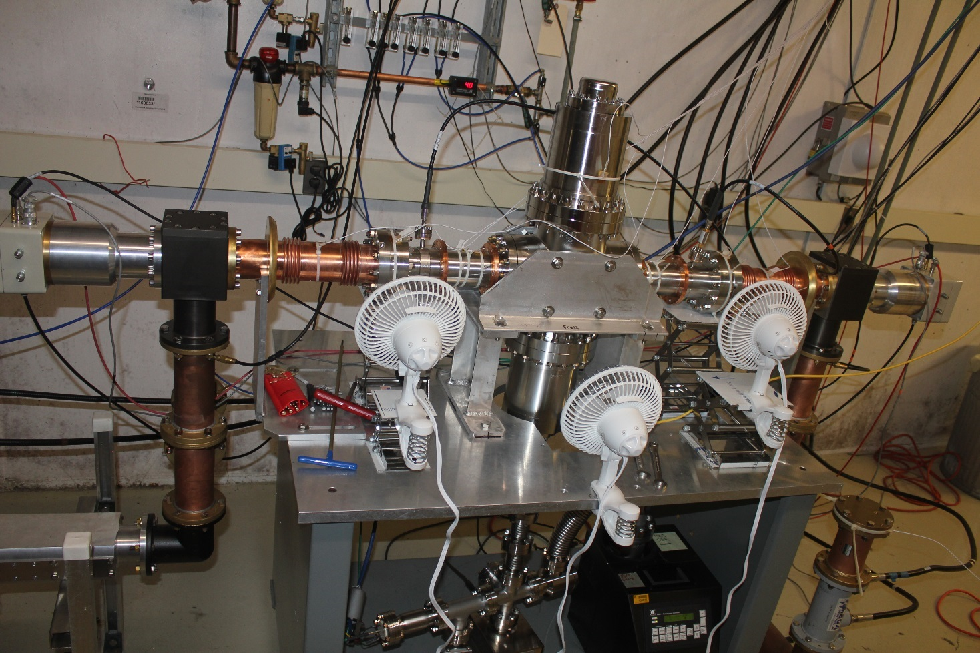
Results of testing, 325 MHz couplers:
Three prototypes were produced and tested in test stand at room temperature.
Pair of couplers were successfully tested up to 30 kW, CW, full reflection, 90 dgr. step reflection phase.
Then couplers were tested up to failure. Window was destroyed at 47 KW, CW, full reflection.
One prototype was successfully tested with SSR1 SC cavity in cryomodule up to 10 kW, CW. Coupler demonstrated designed thermal parameters.
10 couplers are under production.
Test stand of 325 MHz couplers

Slide 16
4 coupler produced by “Mega Ind.” were successfully tested at test stand up to 20 kW, CW, full reflection, 90 dgr step. 1.5 hour at each step.
Two coupler made of “Mega Ind.” were tested with cavity up to 10 kW, CW. One of them was tested twice. Last coupler (tested twice) got ‘mysteries’ leak. Leak happen after test in midnight without RF power during cavity warming up. But window is always warm, temperature of window T ~ room temperature. Small leak appeared In the middle of ceramic, no visible damages. We do not understand what happened.

Slide 17
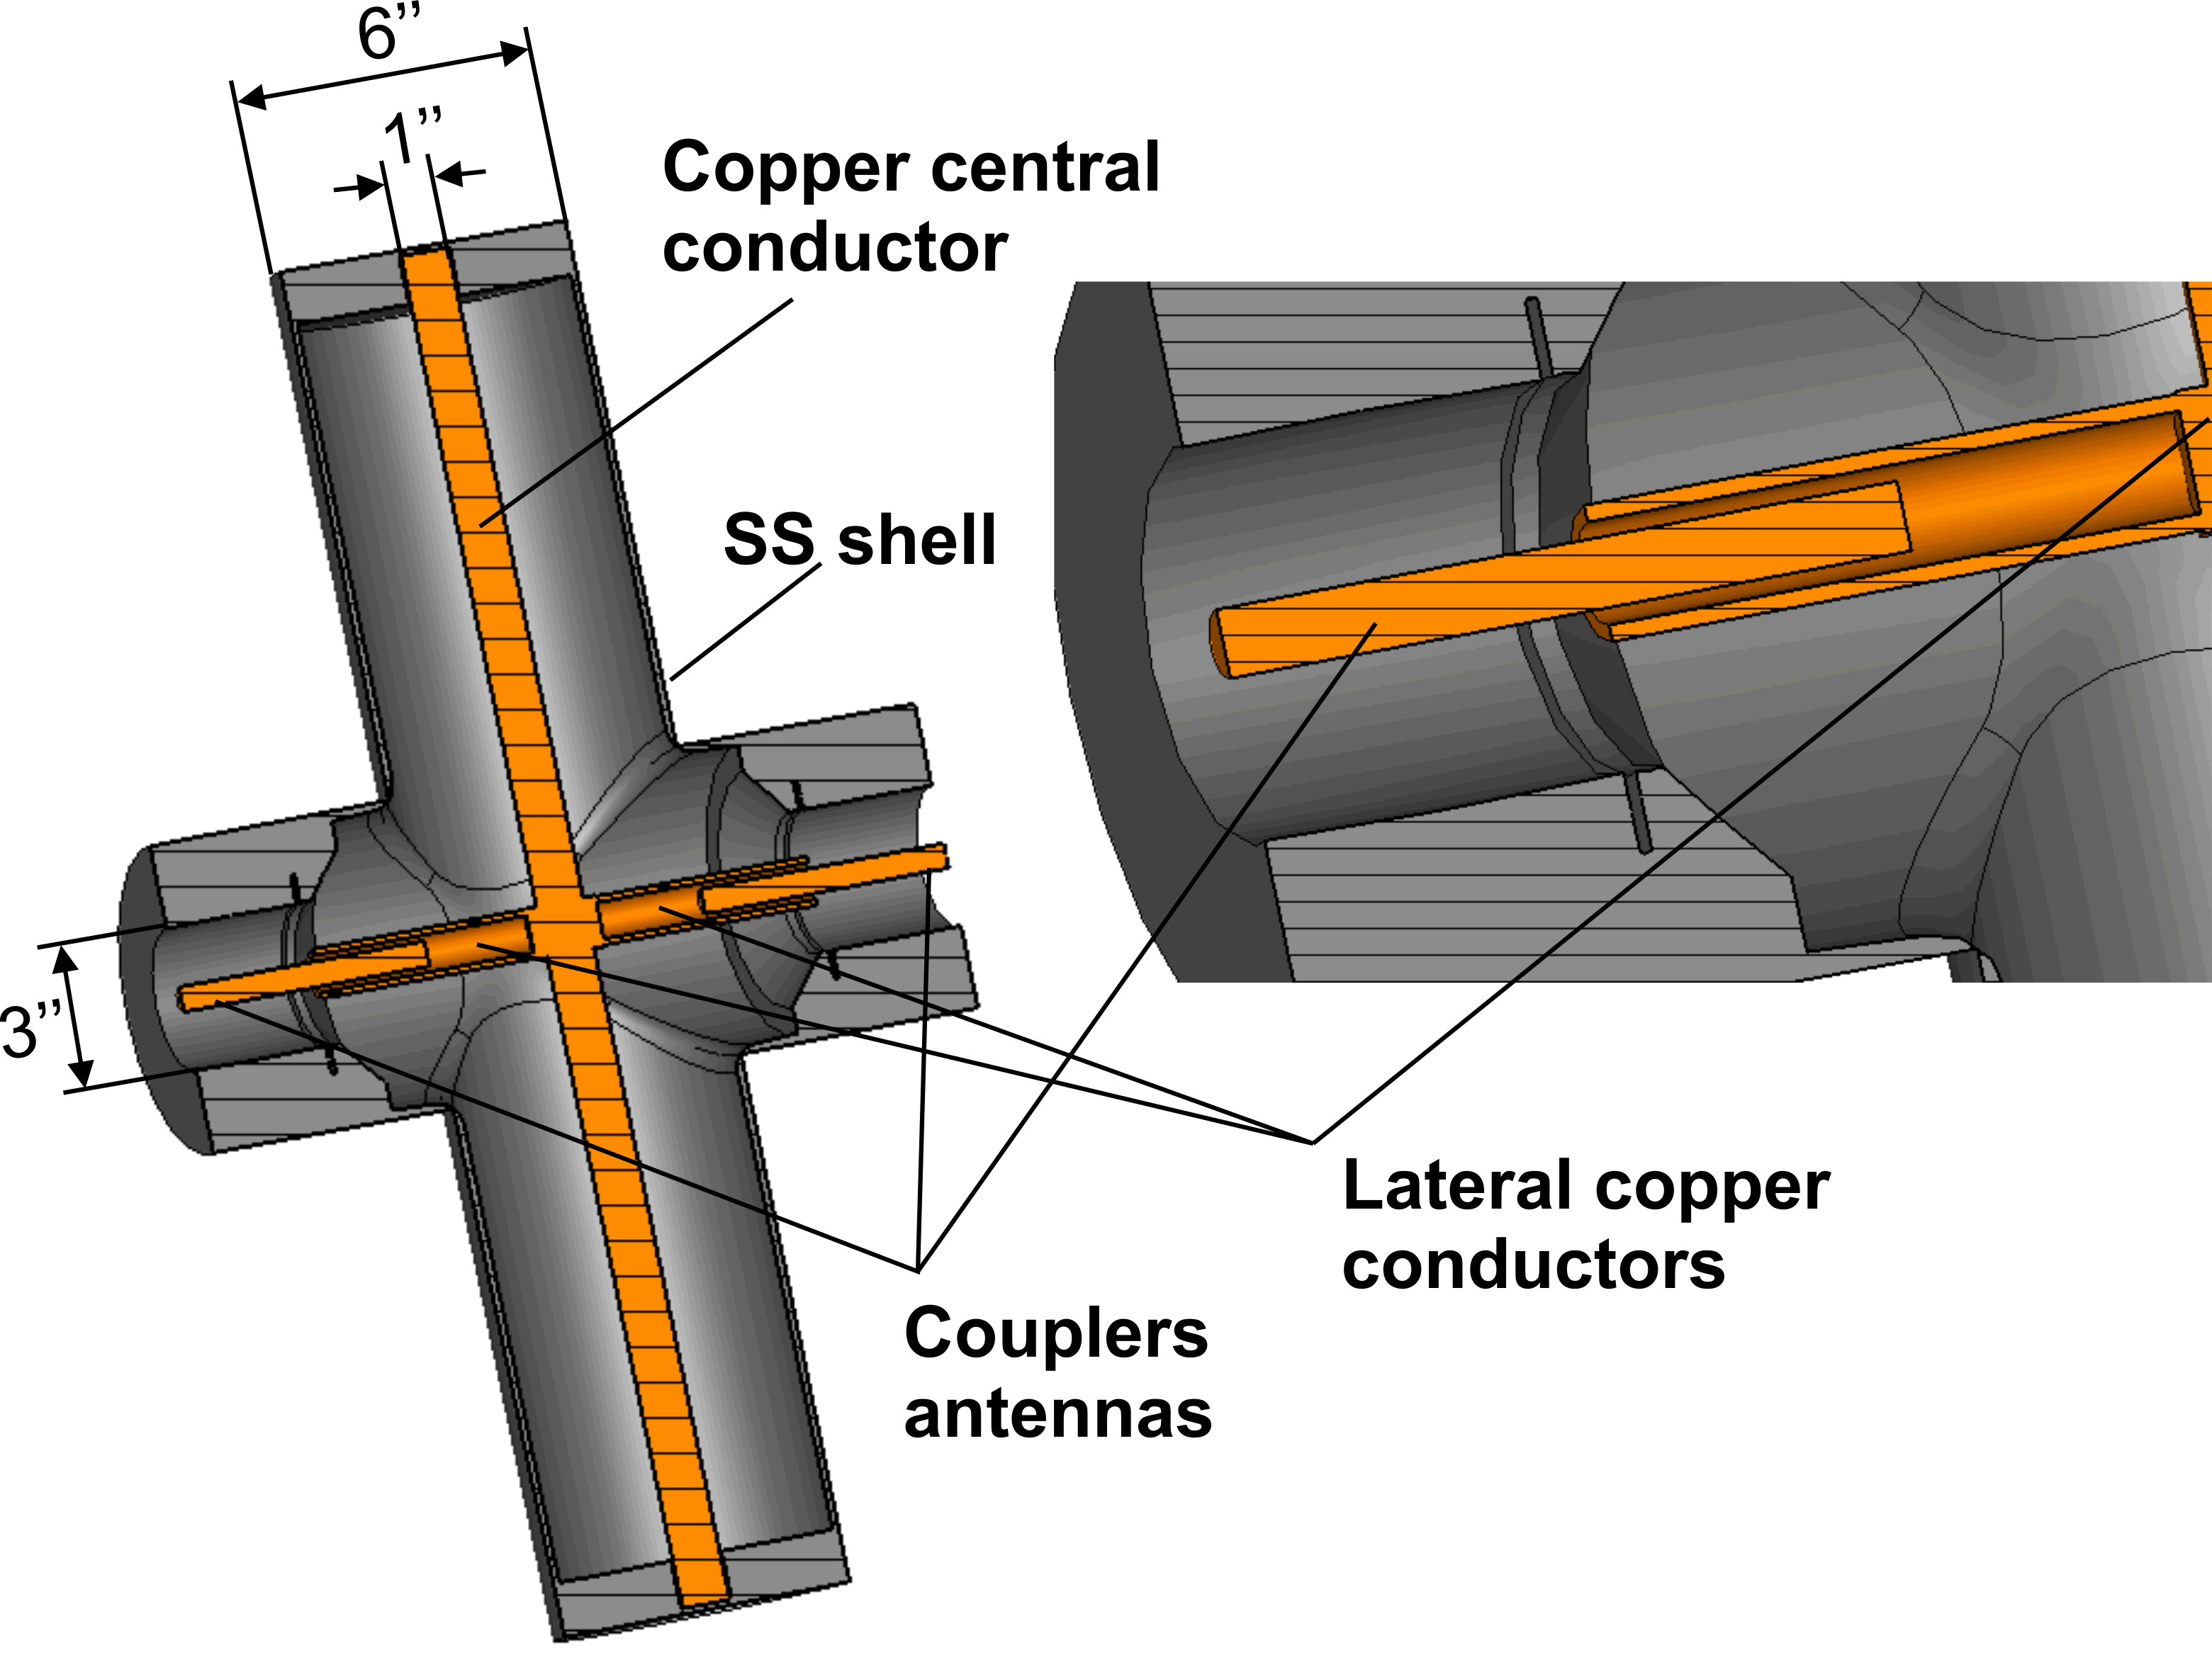
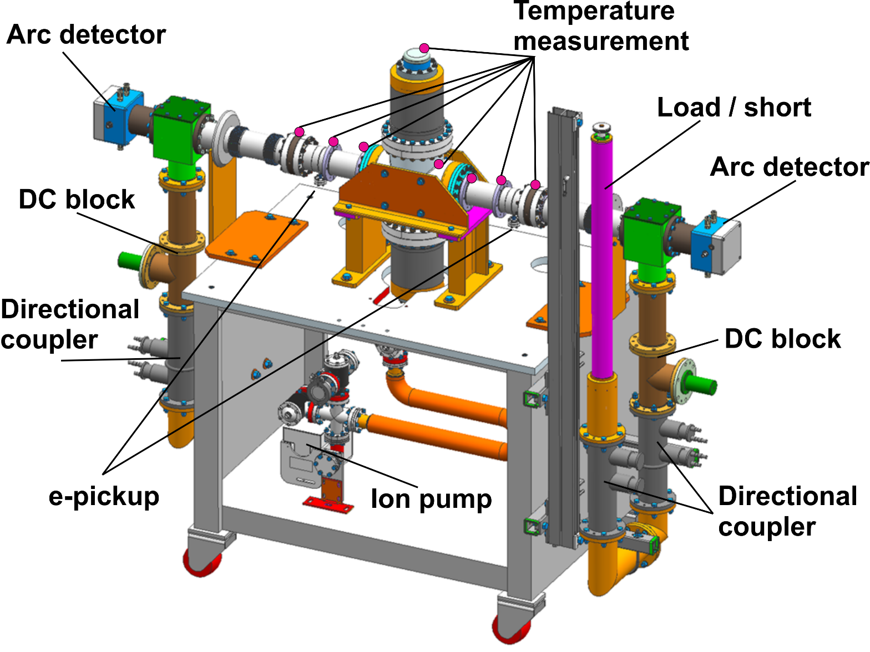
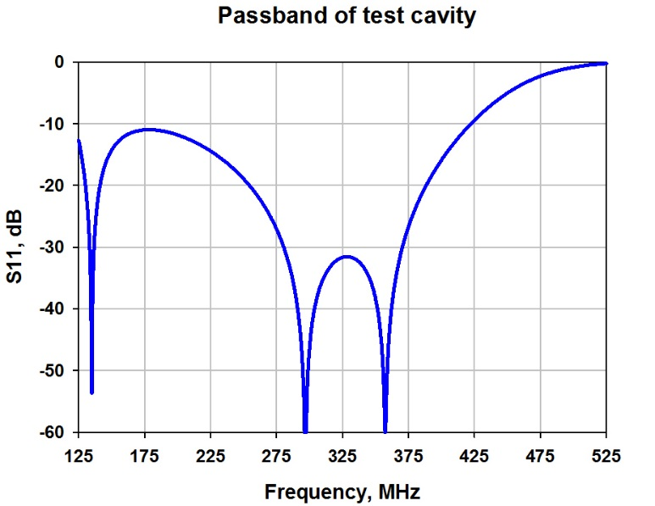
325 MHz coupler test stand
SS cavity under vacuum:
325 MHz coupler test stand configuration:
Size of the cavity was chosen big enough to avoid multipactor .

Slide 18
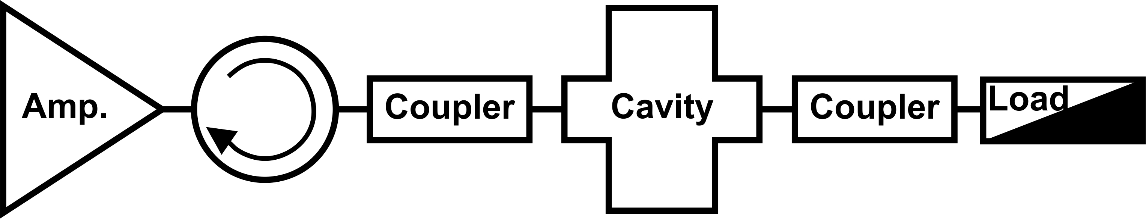
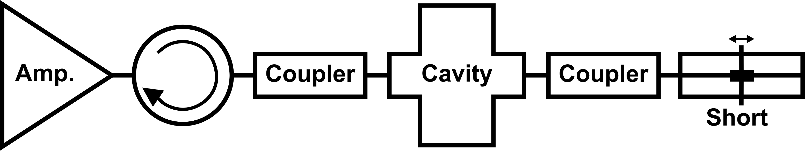
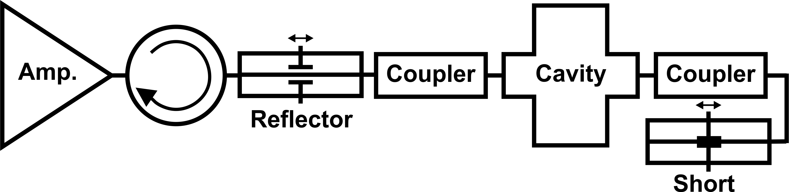

Slide 19
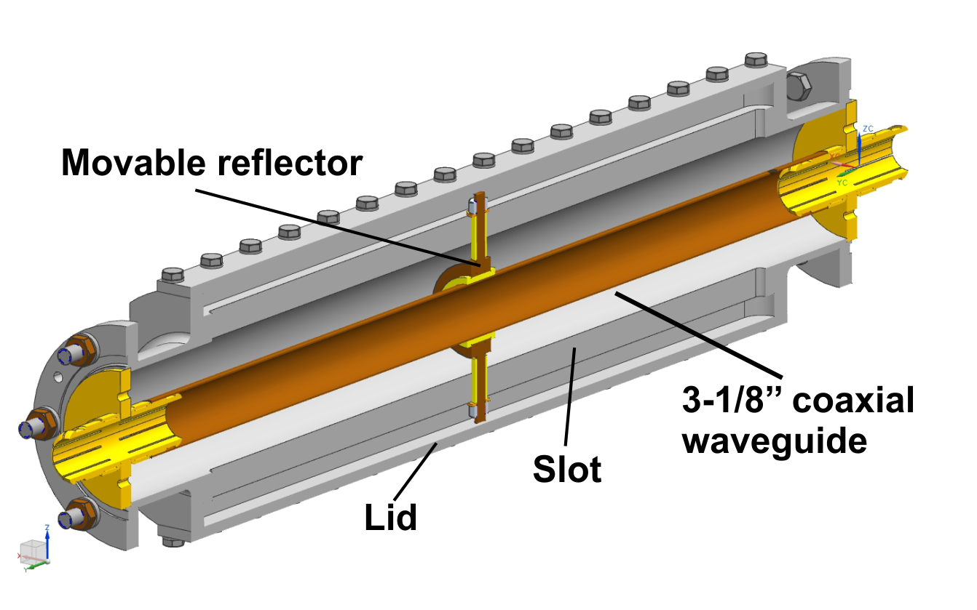
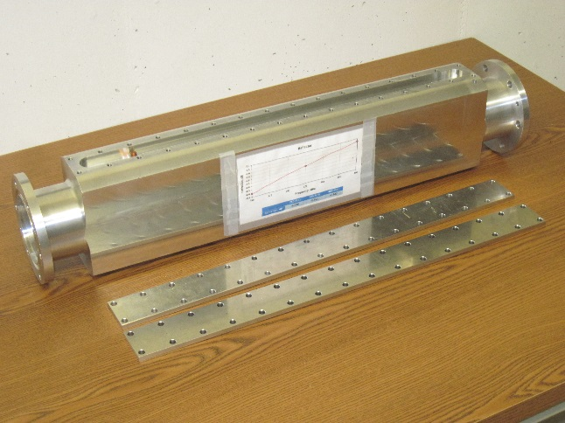
We test couplers in standing wave mode (full reflection). To increase testing power we use resonance. Resonance tined by movable reflector. Testing power can be 5 times higher then power of RF source.
RF source: SS, 10 kW, CW, 325 MHz.
Testing power: up to 50 kW, CW

Slide 20
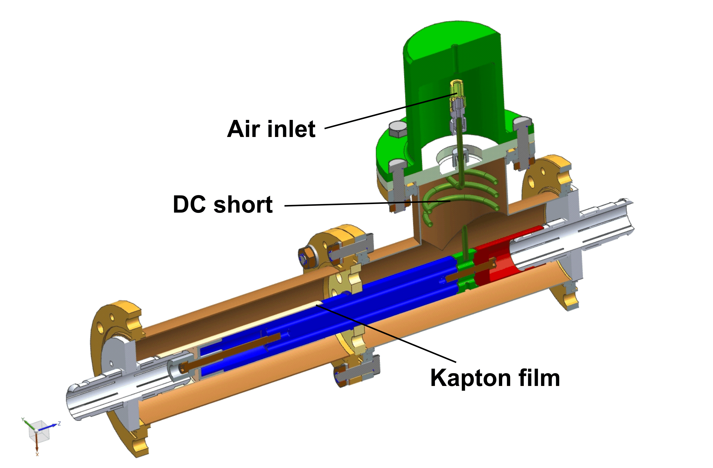
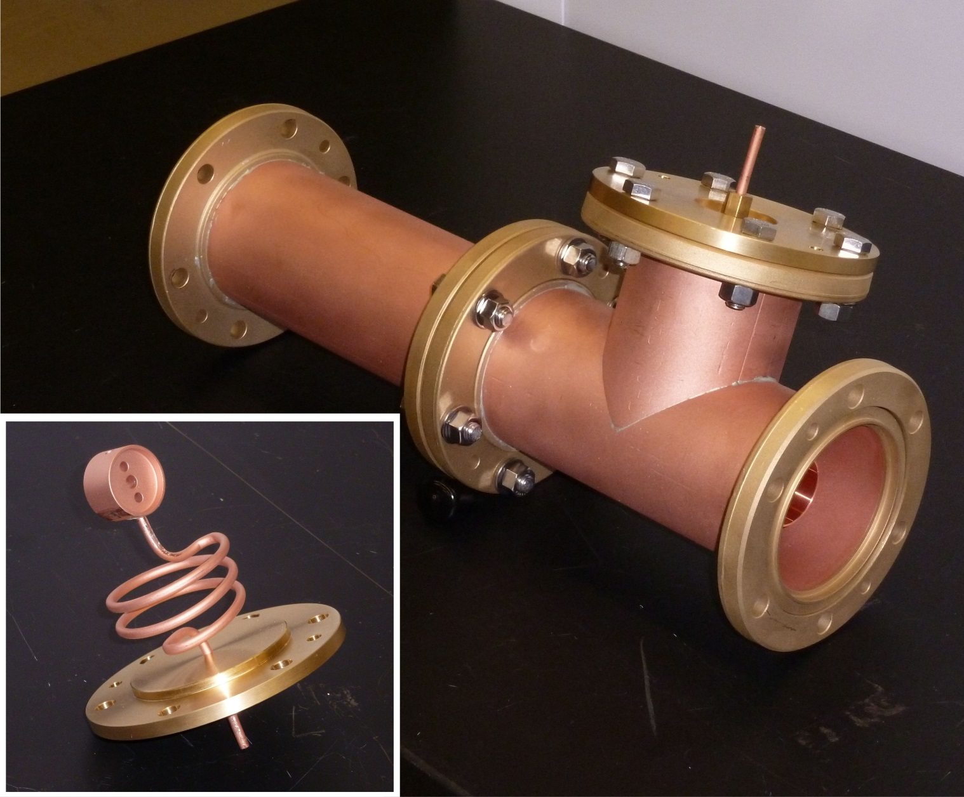
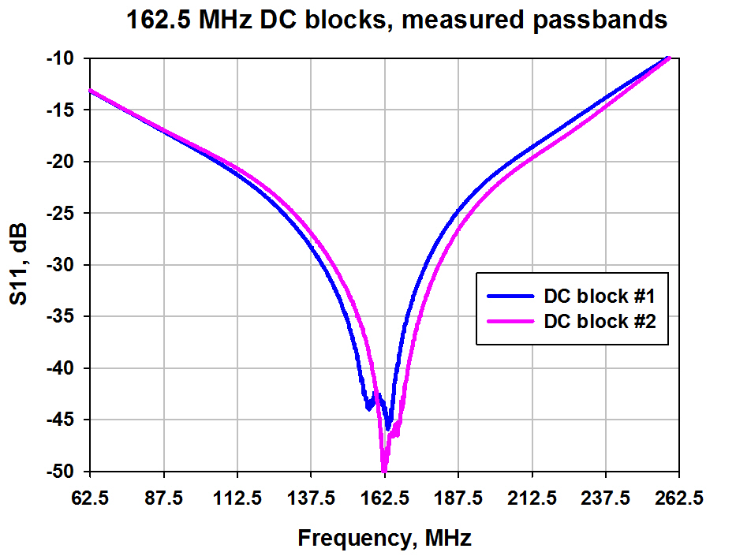
Multipcator in all couplers (different frequencies) is suppressed by HV bias.
To decouple and protect RF source against HV,
‘DC blocks’ installed between RF source and coupler.

Slide 21
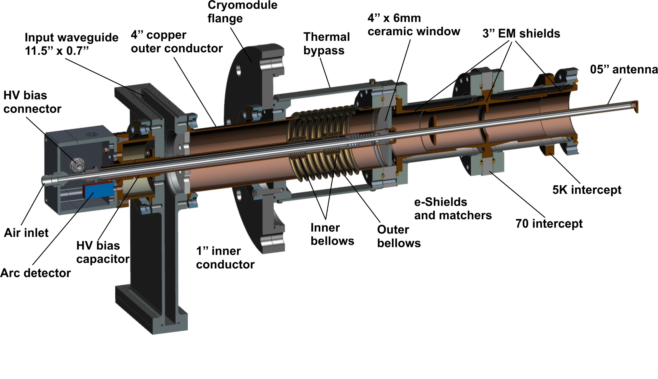
Structure of 650 MHz coupler, new design
Design power 100 kW, CW, TW
Window Al2O3, 102mm x 6mm
Outer conductor (vacuum) 72mm
Antenna D 12.7mm
Cooling Air
Multipactor HV bias

Slide 22
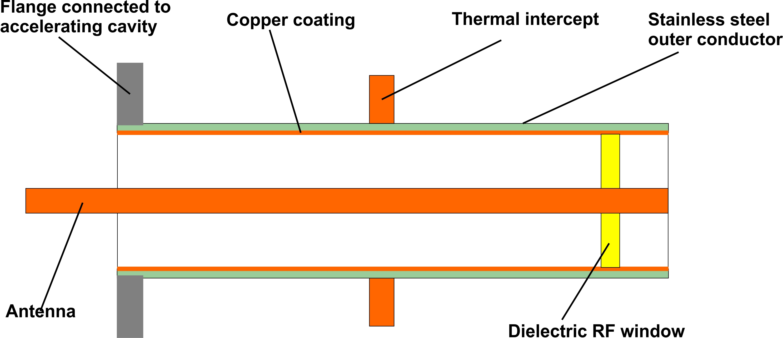
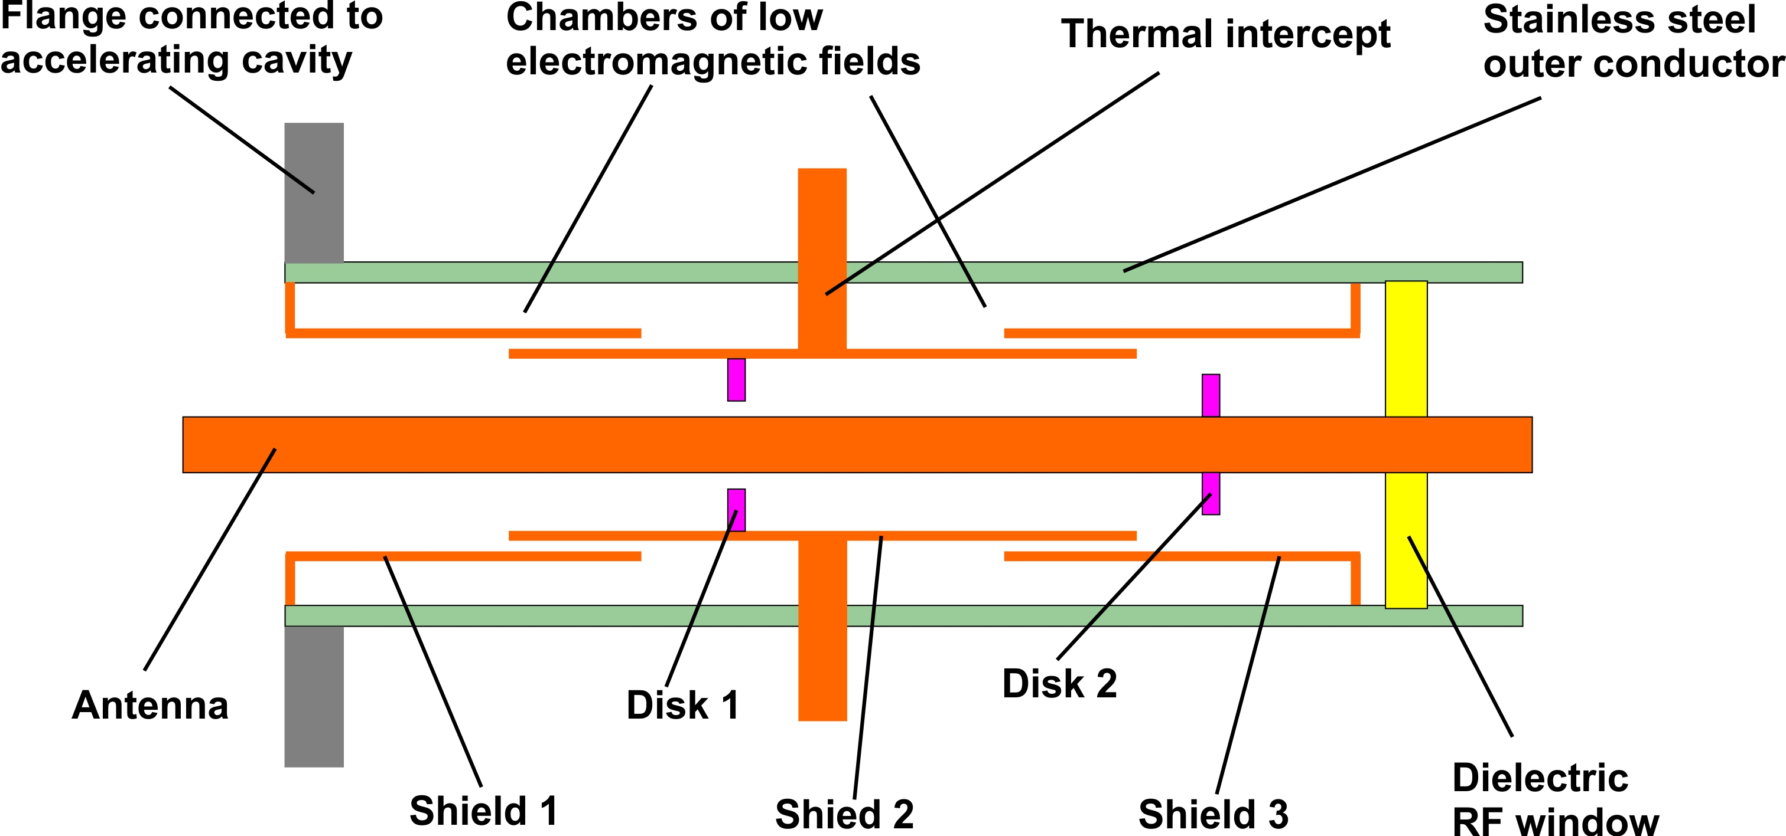
Conventional coupler
New approach

Slide 23
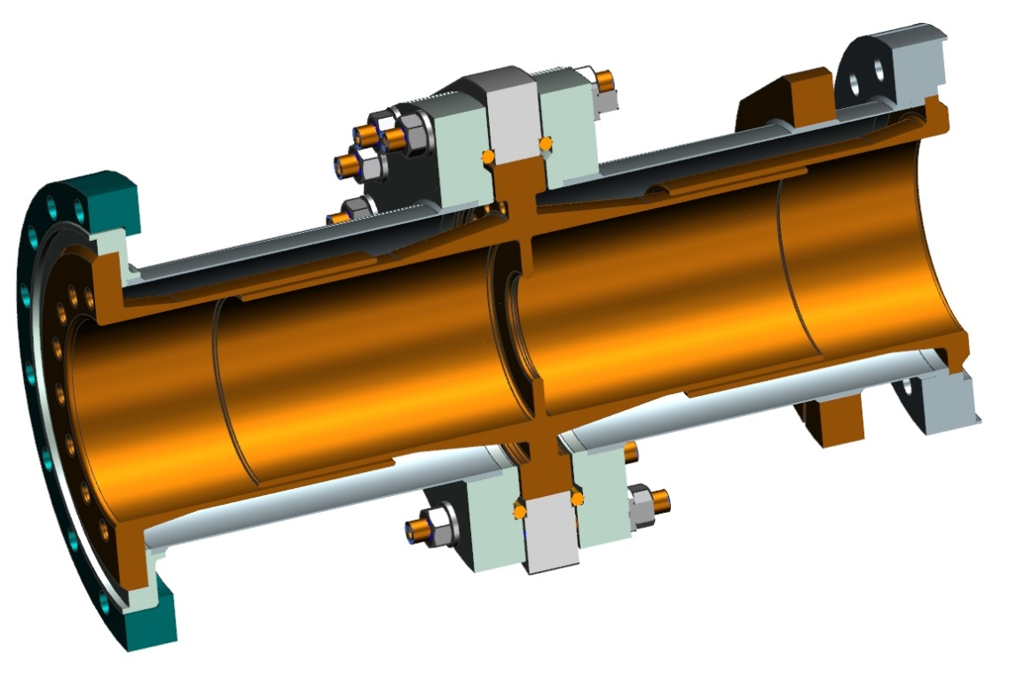
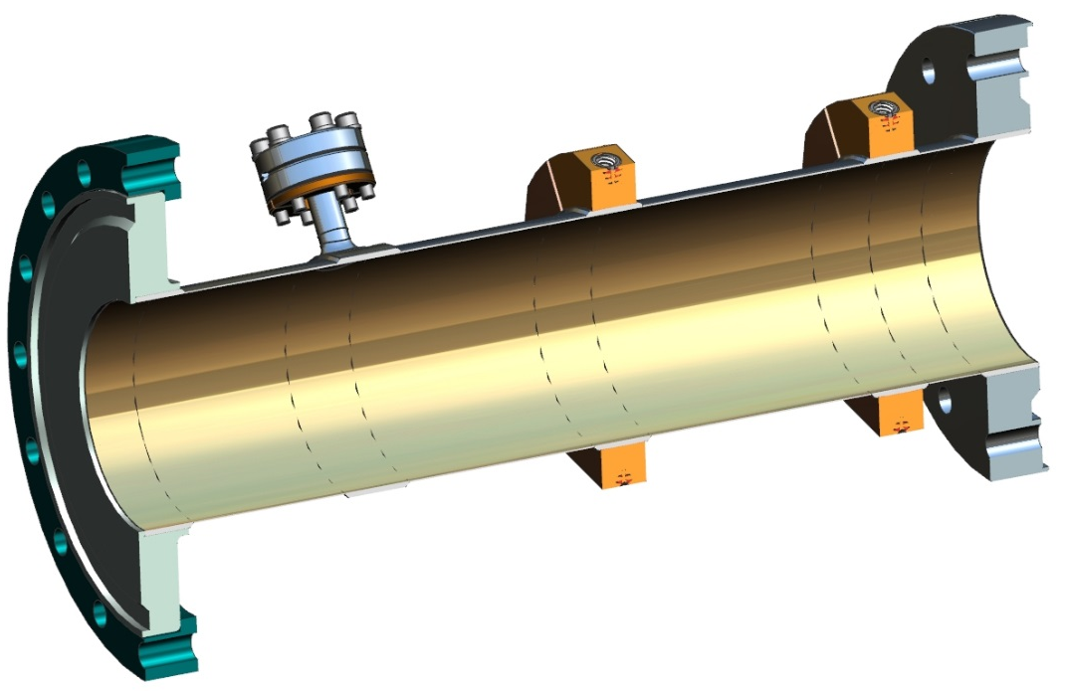
Two version of vacuum outer conductor were design:
New with electromagnetic copper shields
Conventional with copper coating
Outer conductors are interchangeable.
No copper coating
With copper coating

Slide 24
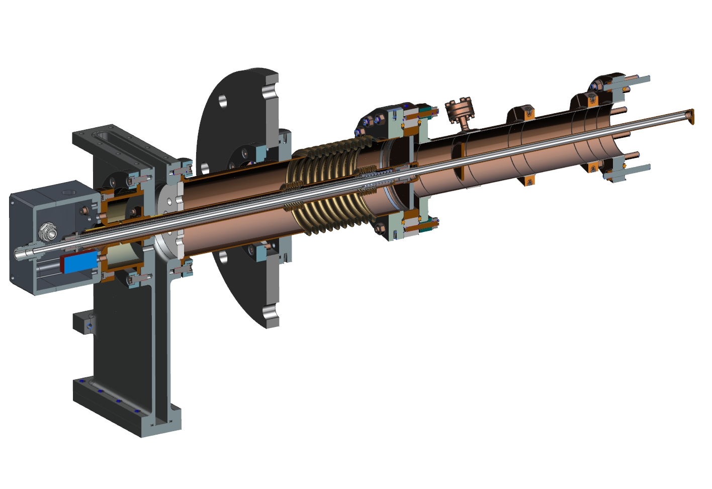
Configuration with ‘conventional’ outer conductor

Slide 25
Thermal properties of 650 MHz coupler
 | 2K, W | 5K, W | 70K, W | 293K, W | T window, K, min/max
New, 0 kW | 0.15 | 0.6 | 3.3 | -2.7 | 288/288
New, 100 kW | 0.55 | 0.93 | 6.2 | 21 | 334/347
Conv., 0 kW | 0.41 | 1.46 | 3.0 | -3.1 | 288/288
Conv., 100 kW | 0.97 | 4.1 | 11.4 | 20 | 331/344
Cryo-plant power consumption:
New = 0.55*960 + 0.93*220 + 6.2*20 ~ 857 W
Conv. = 0.97*960 + 4.1*220 + 11.4*20 ~ 2061 W
New configuration requires 2.4 times less power
of cryo-plant to compensate cryo-loading.
Two couplers are under production.

Slide 26
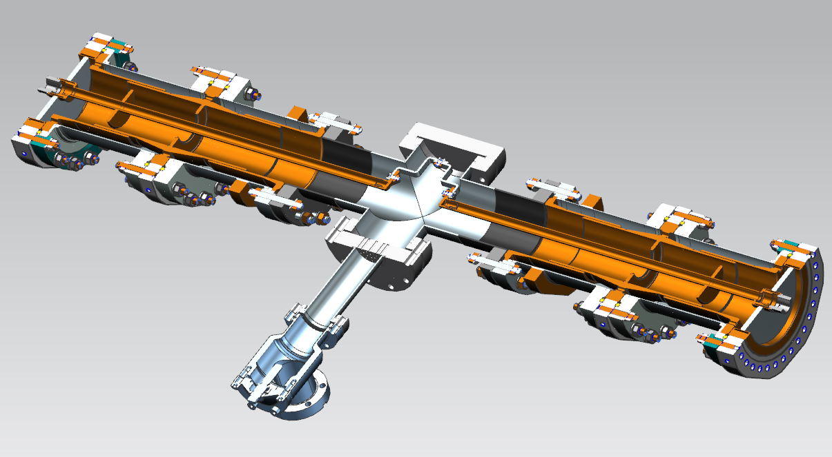
650 MHz coupler test stand is under design

Slide 27
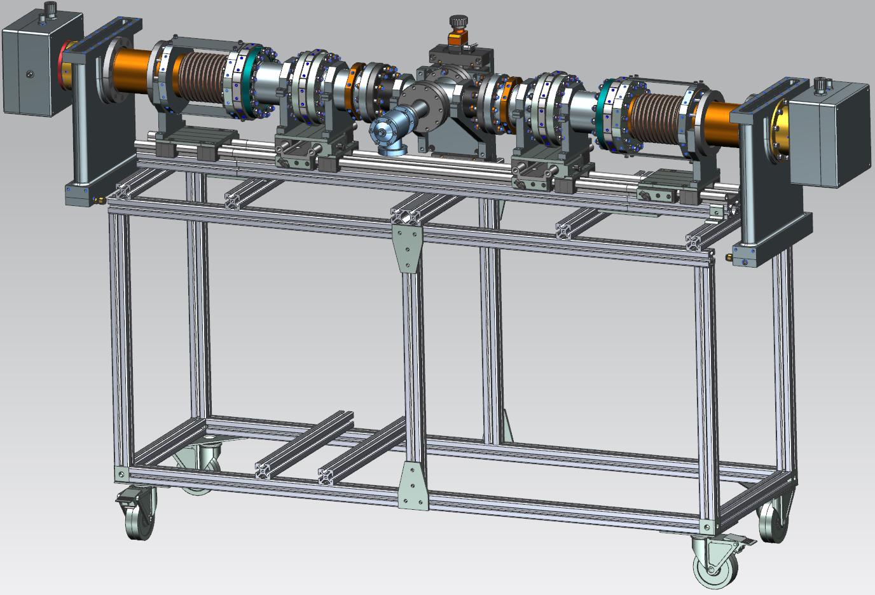
650 MHz coupler test stand

Slide 28
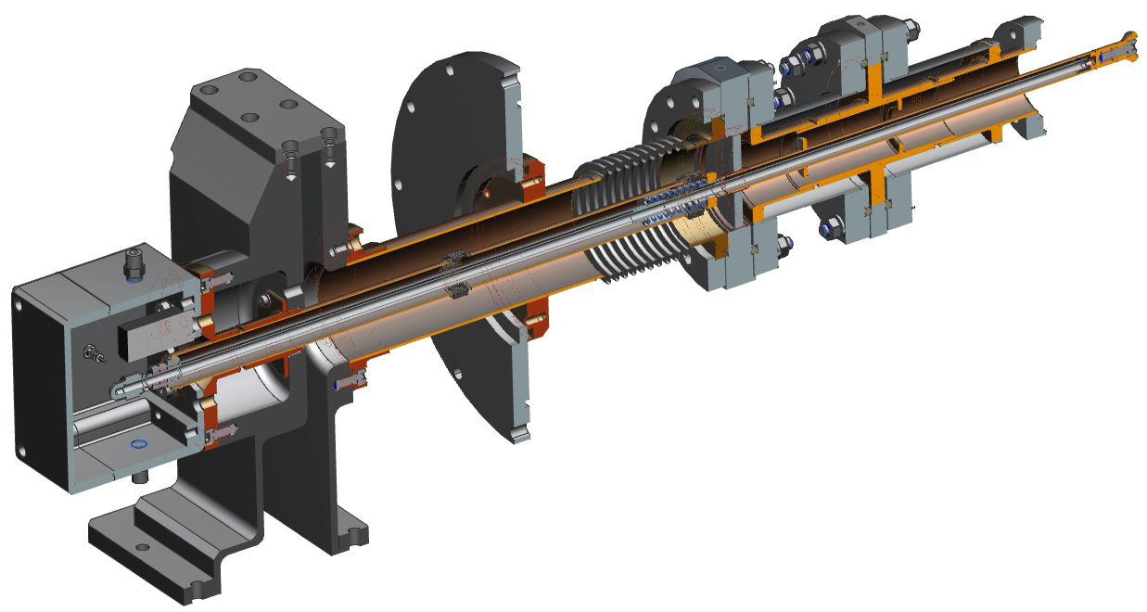
1.3 GHz coupler was designed for potential industrial SC accelerator.
Supposed cavity temperature is 4K (no 5K thermal intercept).
Coupler has TTF-III output flange.
Challenge: slots between screens should be ~ 0.5 mm to avoid multipactor in them. Special jigs will be used for assembling.

Slide 29
Two couplers were produced.
We suppose to test them before October.

Slide 30
Other projects.
Team of Illinois Accelerator Research Center (IARC) works for 650 MHz superconducting industrial accelerator. Each SC cavity will consume 250 kW, CW RF power. It will be accelerator with conducting cooling of accelerating structure (without liquid Helium). Available 4K commercial cryocoolers exist with a refrigeration power of 2 W at 4K temperature and several vendors are developing higher capacity units. It means that cryo-loading from coupler should extremely low, ~ 1W at 4K for ~ 250 kW transmitted power. We are working for design of this coupler.

Slide 31
Backup

Slide 32
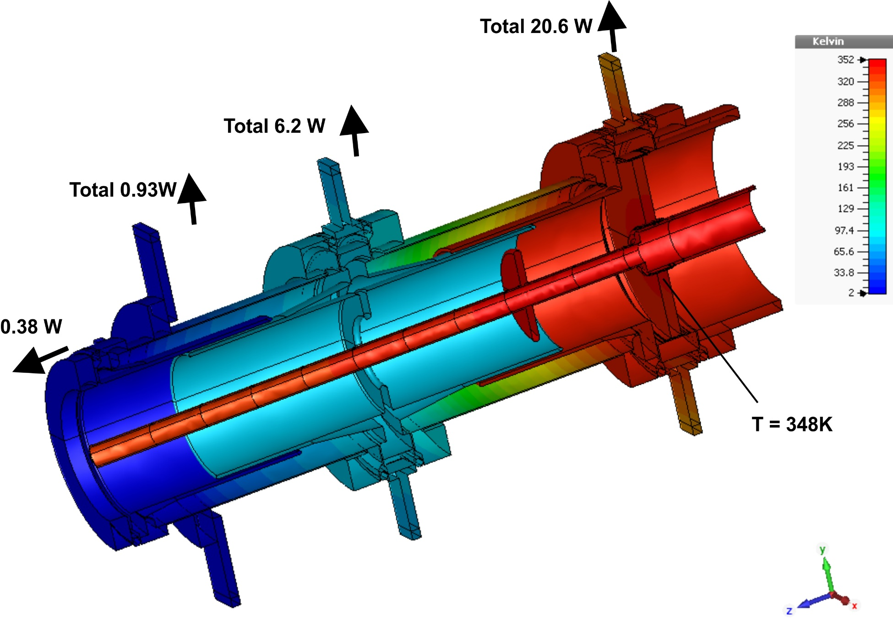
P = 100 kW, TW, Air = 3.0g/s
Loss in antenna = 77W +20W = 97W
ΔT_air ≈ 38C
T_tip ≈ 34C
P_rad = 0.17W

Slide 33
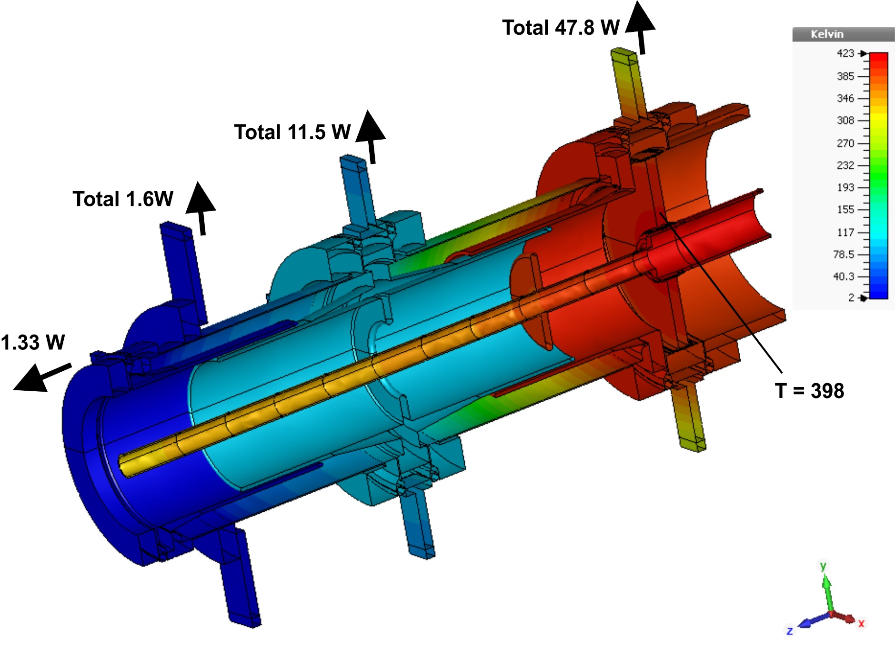
P = 300 kW, TW, Air = 5 g/s
Loss in antenna = 230W+58W = 288W
Δ_Tair ≈ 72C
T_tip ≈ 44C
P_rad = 0.19W

Slide 34
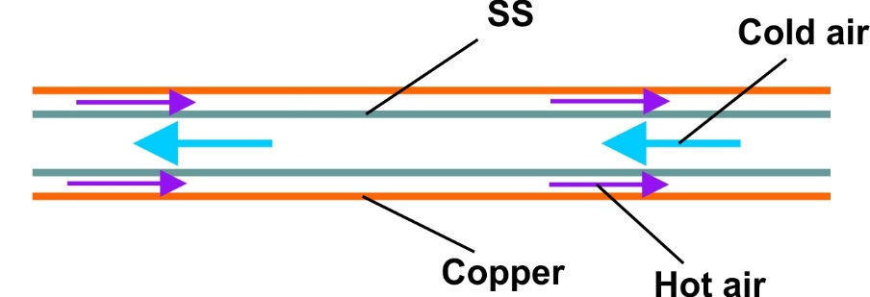
Air cooling of antenna
Pressure drops:
Inner pipe: OD 9.5 mm, ID 7.7 mm, Length ~ 1m
Antenna ID 10.9 mm, Length ~ 0.41 m
Pressure drop at inner pipe:
3 g/s: ΔP = 0.06 bar, V = 64 m/s
5 g/s: ΔP = 0.16 bar, V = 107 m/s
Pressure drop at antenna:
3 g/s: ΔP = 1.3 bar, V = 113 m/s, Convection ~ 550 W/(K*m2)
5 g/s: ΔP = 3.2 bar, V = 189 m/s, Convection ~ 830 W/(K*m2)
Inlet pressure ~ 2 bar for 3 g/s
~ 4 bar for 5 g/s

Slide 35
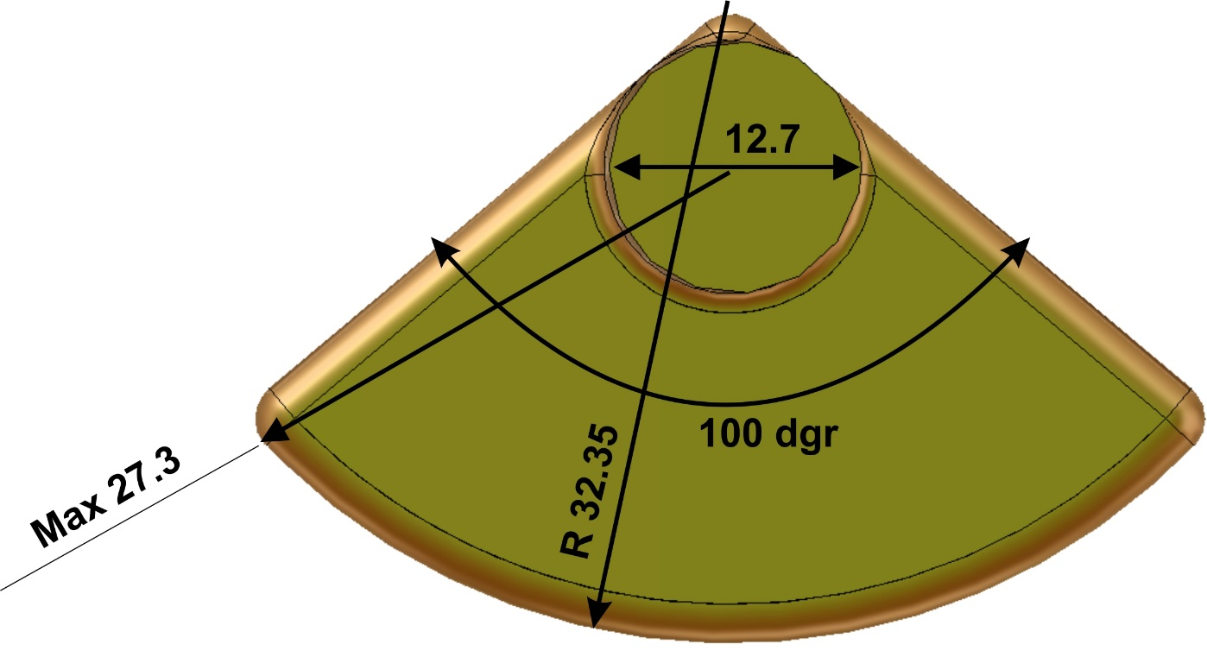
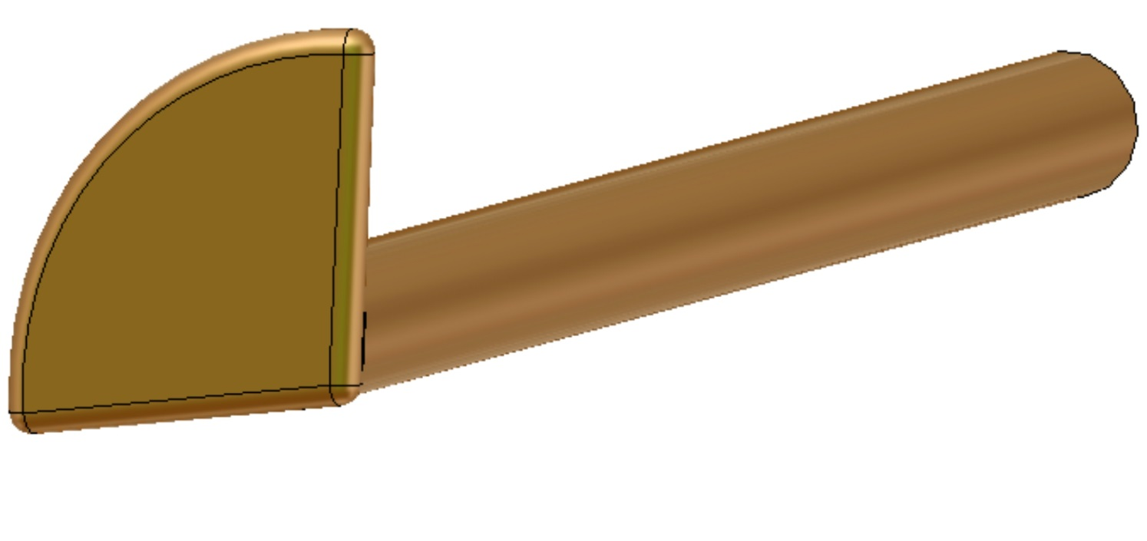
Antenna tip and coupling.
“Goose foot” shape improves a coupling and allows to change coupling by rotation of antenna

Slide 36
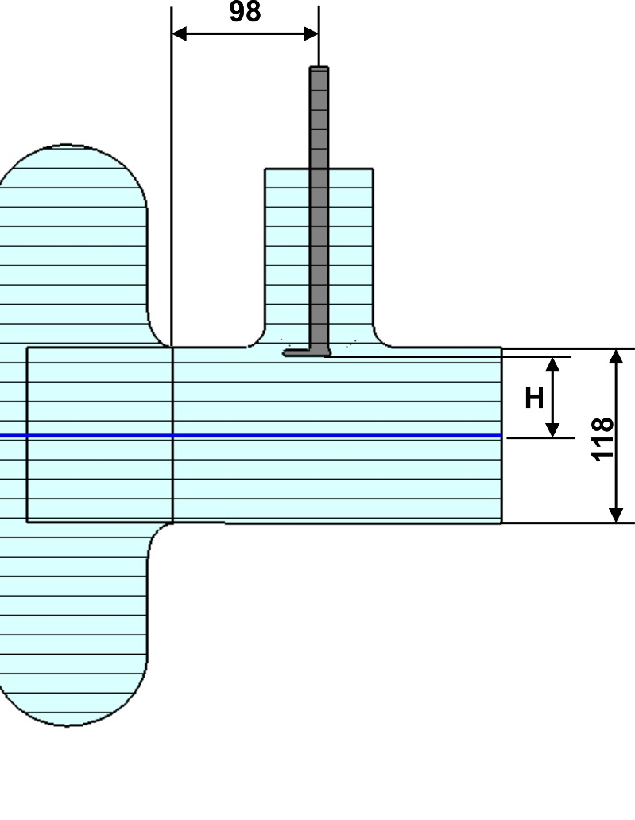
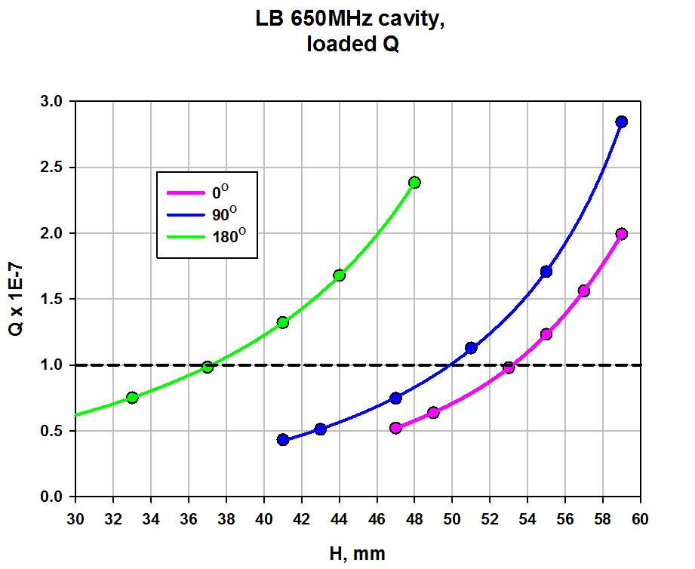
LB 650 MHz cavity coupling:

Slide 37
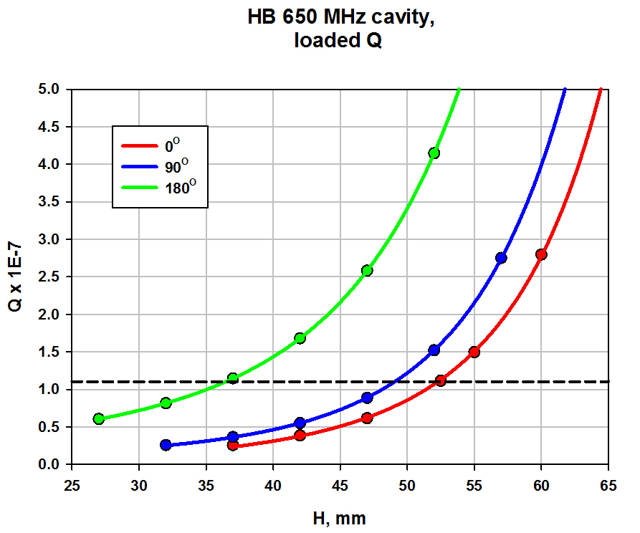
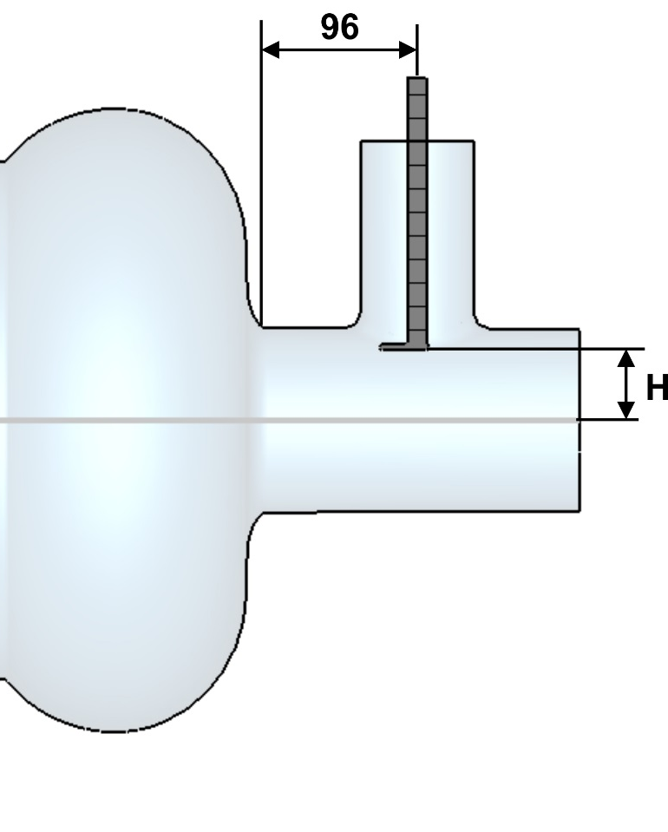
HB 650 MHz cavity coupling:

