Slide 1
World-Wide Fundamental Power Coupler meeting #3
eric.montesinos@cern.ch
Topics for discussion
Conclusion

Slide 2
















List of invitees for WWFPC#4 meeting in 2018
 | CERN | Eric Montesinos
 | KEK | Eiji Kako
 | DESY | Denis Kostin
 | KEK | Yasuchika Yamamoto
 | RIKEN | Kazutaka Ozeki
 | IHEP | Tong ming Huang
 | LAL | Walid Kaabi
 | IPNO | Emmanuel Rampnoux
 | BNL | Wencan Xu
 | IBS | Ilkyoung Shin
 | CEA | Guillaume Devanz
 | CEA | Christian Arcambal
 | Cornell | Vadim Veshcherevich
 | JLAB | Mircea Stirbet
 | ORNL | Yoon Kang
 | FNAL | Sergey Kazakov
 | SLAC | Chris Adolphsen

Slide 3
WWFPC#4 meeting date
Still hosted at CERN ?
Still yearly ?
Still June ?
Mandatory to be present the two days
No remote participation
Discussion oriented, no time limitation
Experts only
On invitation only (feel free to add to the list)

Slide 4
Topics for discussion
Design
Maximum power per coupler ?
Multi couplers per cavity ?
Ceramic
Sputtering: TiOx – TiN ?
Control of the process ? Qualification
New ceramic without treatment ? (KEK/CERN)
Gray deposit ?
How to qualify ?

Slide 5
Topics for discussion
Coating
Copper plating
How to make it correct ?
Common classification of defects
Acceptance criteria ?
Discoloration of ceramic
Is superficial oxidation or discoloration a problem ?
Before and after RF processing
To gray after RF conditioning at XFEL
To yellow due to multipacting ?
To brown after X-ray ?

Slide 6
Topics for discussion
Specific constraints for operation reasons
No brazing-welding-soldering between liquid coolant and vacuum (proven EBW should not be on the list)
No liquid cooled couplers
Do you have the same constraints ?
Do you have statistics linked to these constraints ?

Slide 7
Topics for discussion
Tests
TW? SW? TW & SW ?
Test boxes in 3D printing copper plated ? Acceptable or incompatible with cleanliness requirements ?
Arcing and air cooling
Is lower pressure creates arc ?
Is N2 worse than air ?
Do we need vacuum gauge for series production FPC ?
BNL, SNS, DESY do not use DC bias, prefer a good conditioning, afraid of gas accumulation (use multipacting simulation tool in order to make a multipacting free coupler)
Amplifiers for tests
Prototype processes versus series processes
What margin do we need between pre-series and series ?

Slide 8
Topics for discussion
Diagnostics
R&D and prototyping
Operation in accelerators
Statistics
How to list all couplers operated in accelerators ?
Degradation of characteristic over time of operation
How to share these information ? This meeting ? Mandatory in talks ?
Make pictures of work environments !

Slide 9
Topics for discussion
World Wide Program ?
How to organise it ?
Who can do what ?
Who want to do what ?

Slide 10
Al diamond seals for ceramic RF windows,
first experiments.
S. Kazakov, D. Plant
02/24/2017

Slide 11
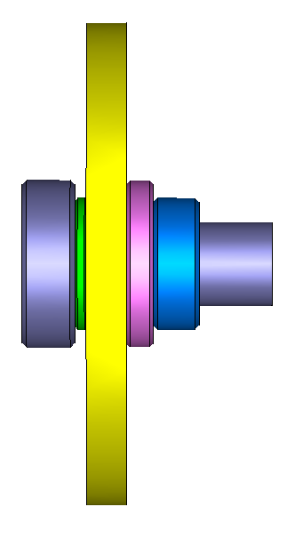
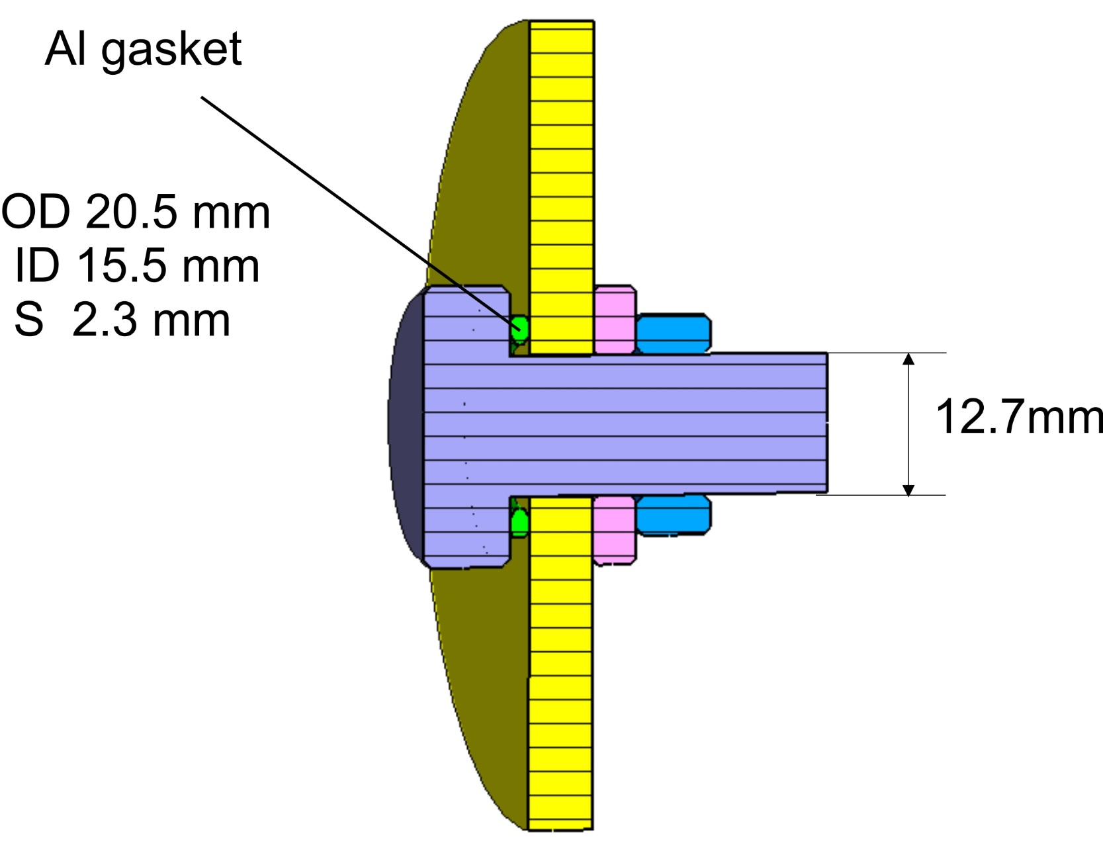
Geometry #1

Slide 12
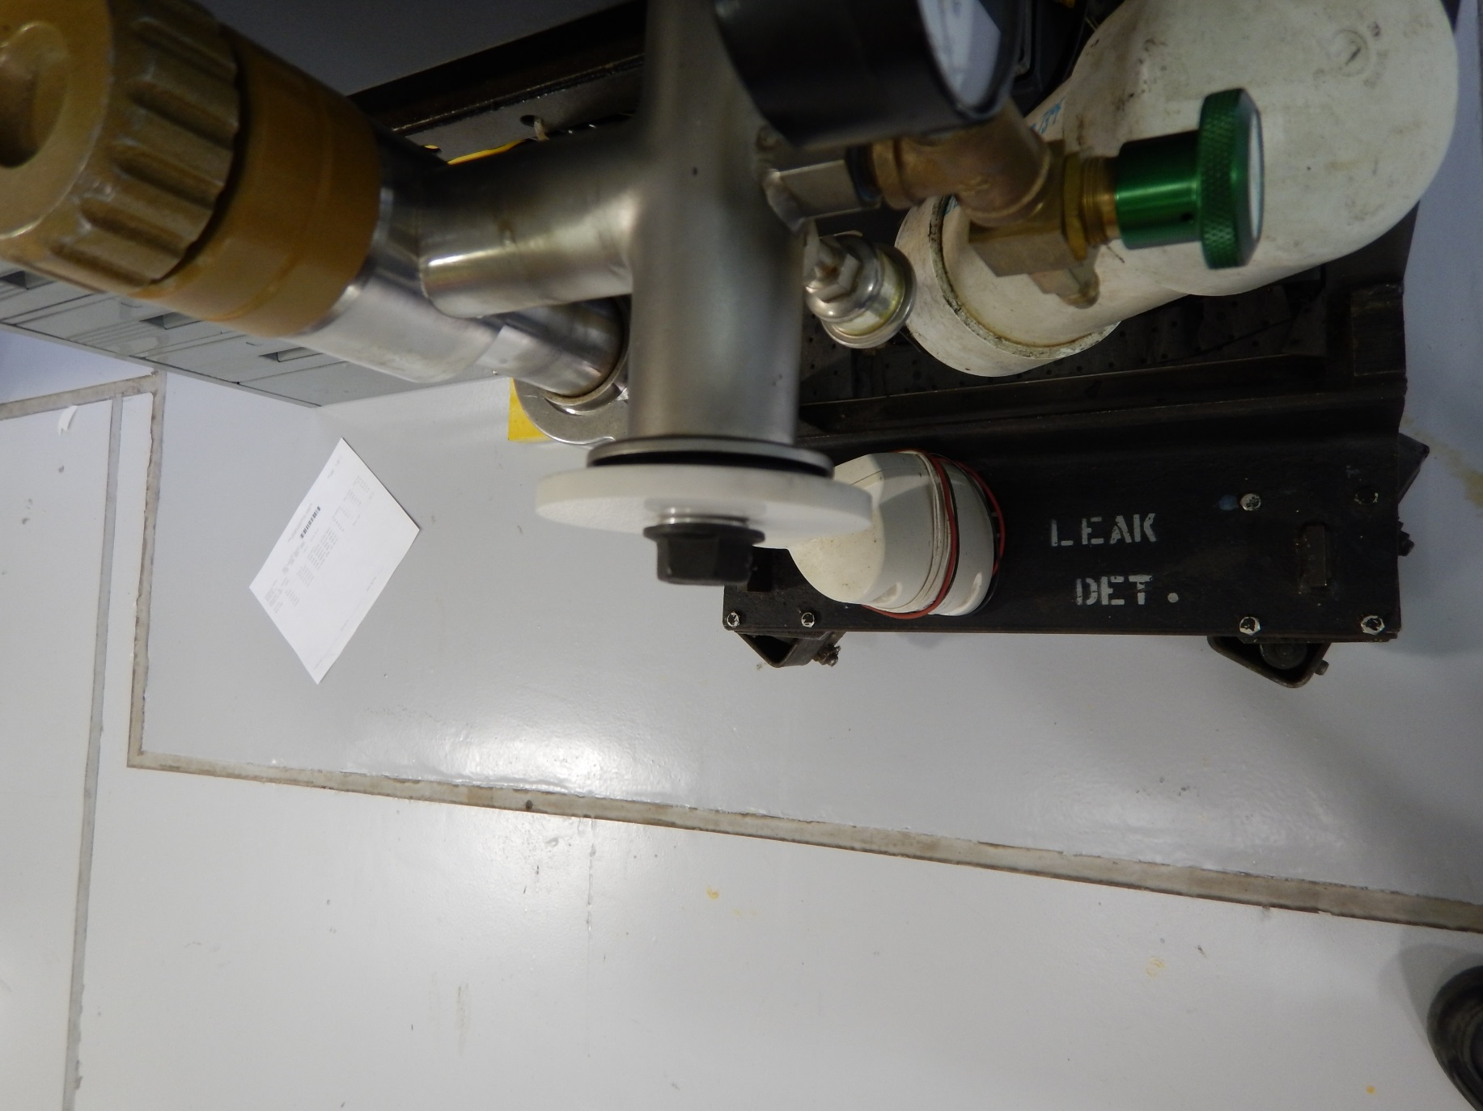

Slide 13
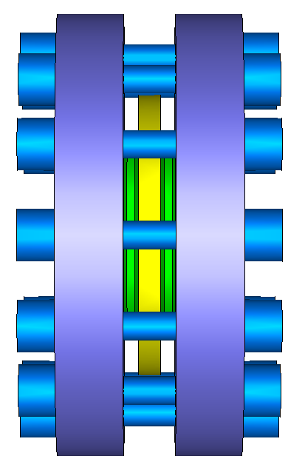
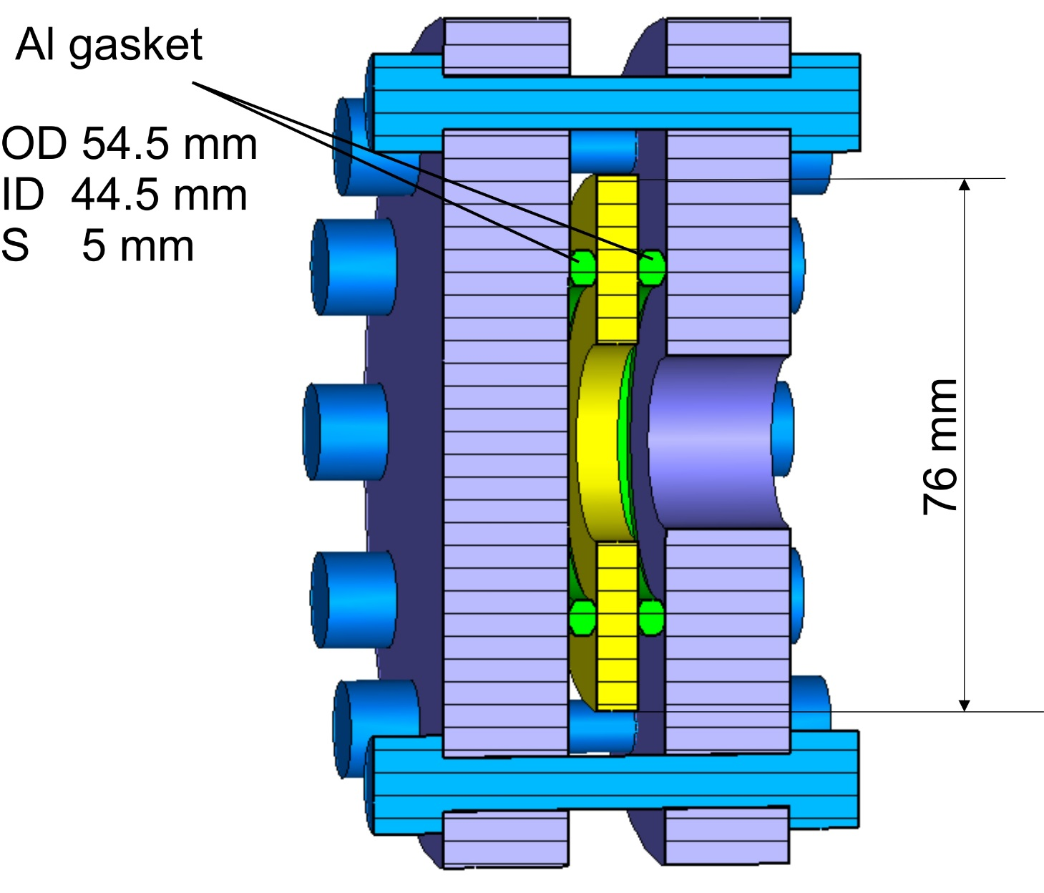
Geometry #2

Slide 14
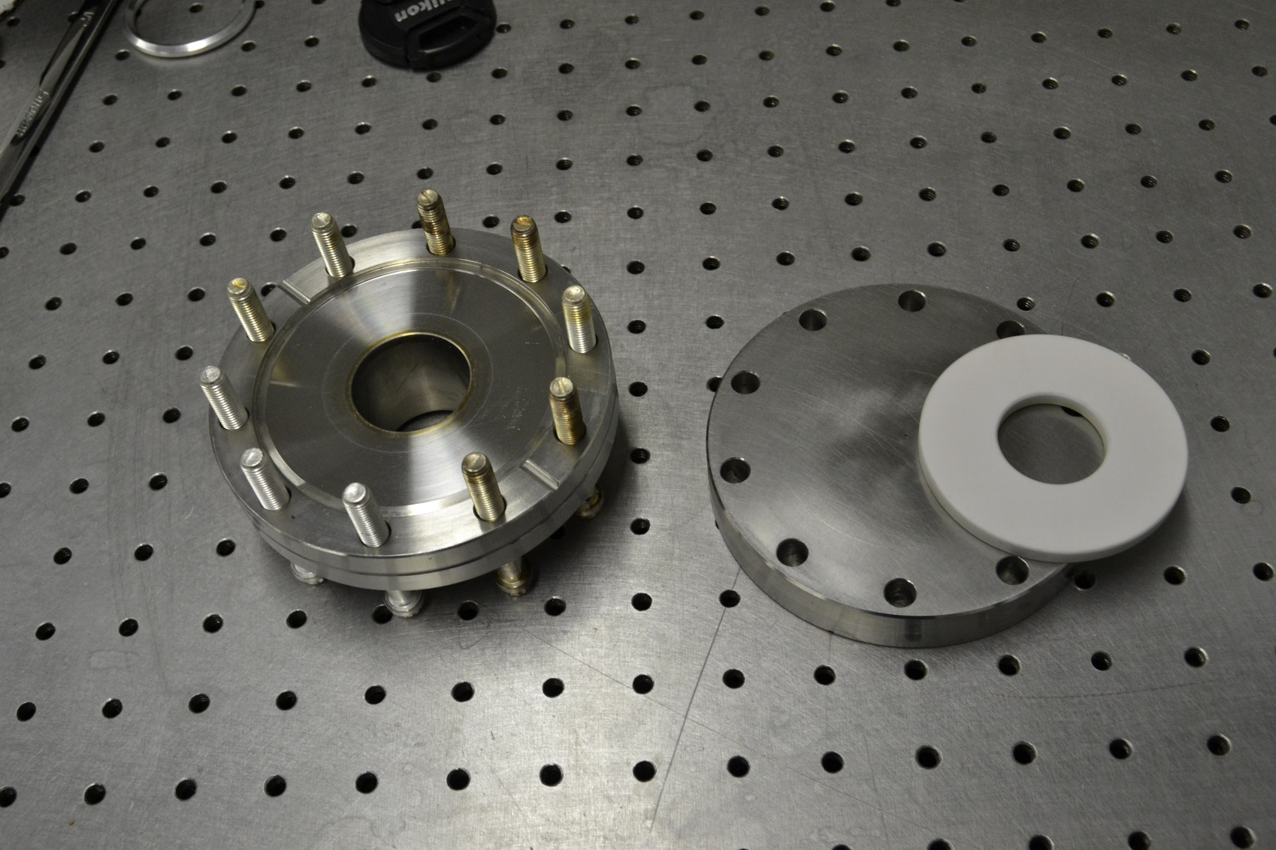
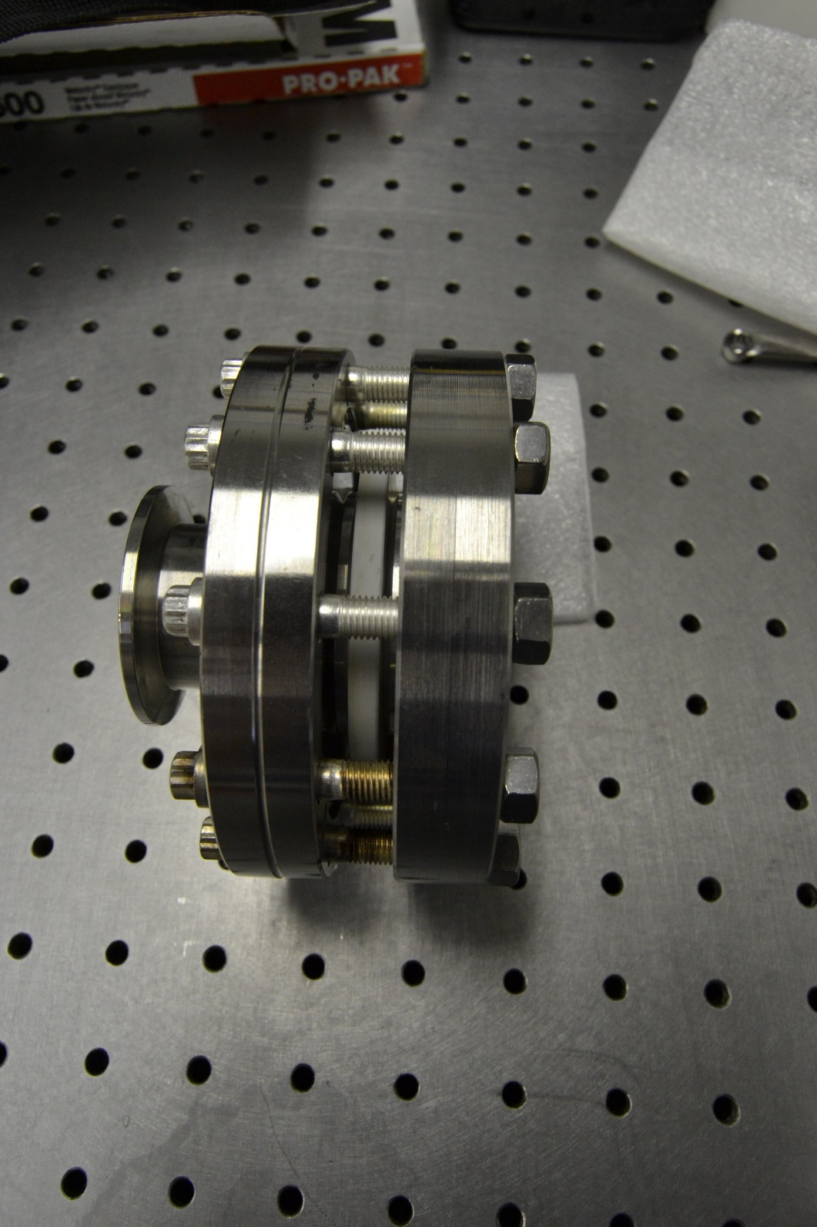

Slide 15
Geometry #1
Test 1:
(RT -> 0C -> RT -> 100C ->RT) x 10 times = OK (vacuum tight)
Test 2:
RT -> 70K -> RT = OK
RT -> 70K -> RT = Not OK
Bolt-nut were tightened.
Test 3:
RT -> 70K -> RT = OK
RT -> 70K -> RT = OK
RT -> 70K -> RT = ? (under the test)

Slide 16
Geometry #2
Test 1:
(RT -> 0C -> RT -> 100C ->RT) x 7 times = OK (vacuum tight)
Test 2:
RT -> 70K -> RT = Not OK
Bolts-nuts were tightened.
Test 3:
RT -> 70K -> RT = OK
RT -> 70K -> RT = OK
RT -> 70K -> RT = ? (under the test)
Conclusion:
Results are very promising. Window temperature operating range is 0 C < T < 100 C (not 70K)
Probably we can avoid a brazing of ceramics.

Slide 17
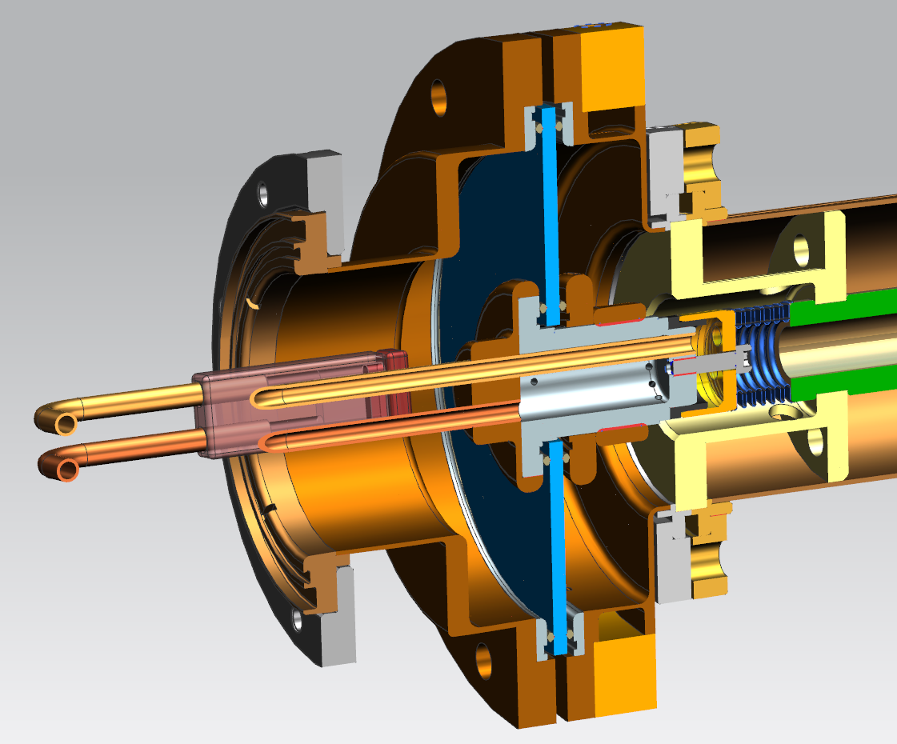

Slide 18
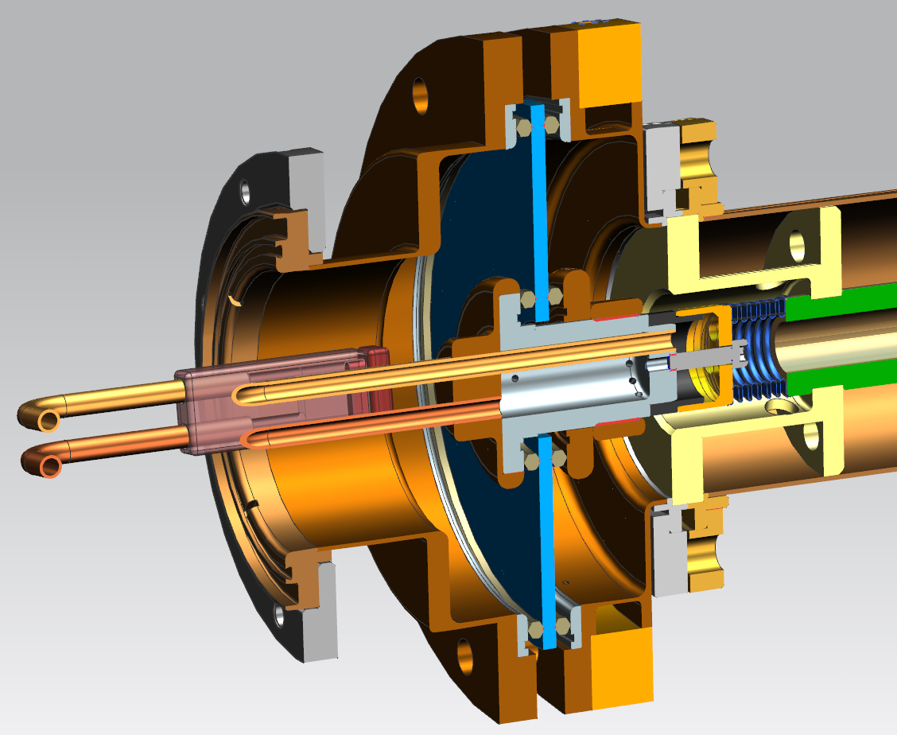

Slide 19
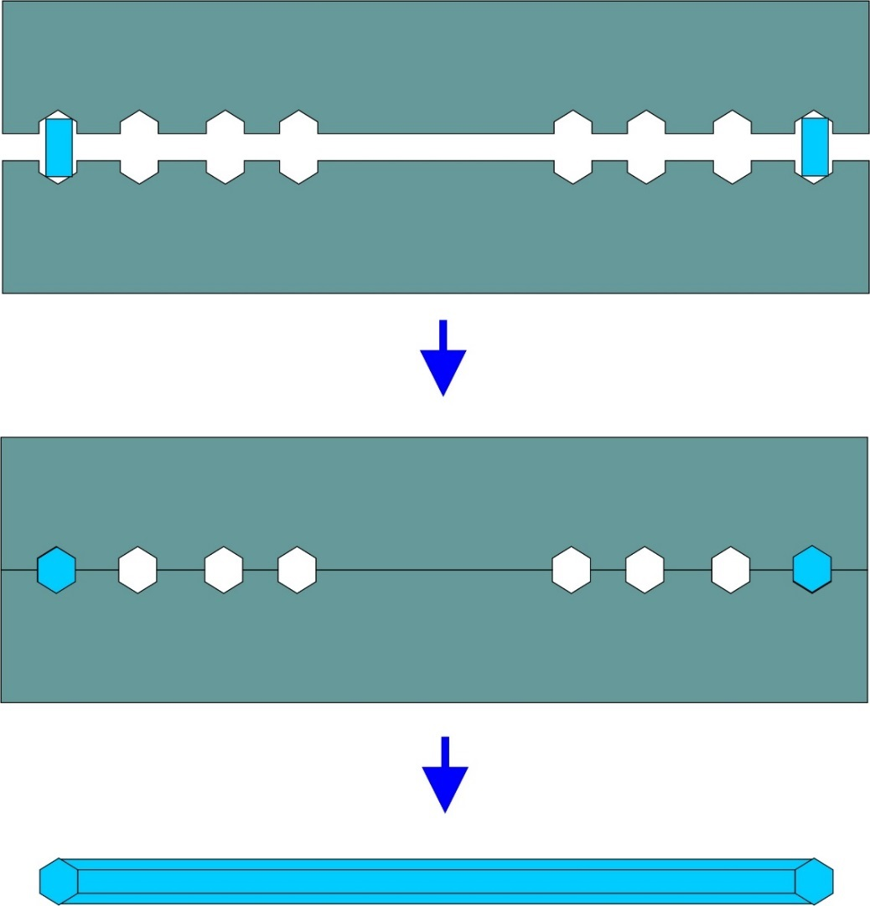
Now we buy the diamond Al seals from German company.
Price is ~$10 ~$20 per seal and 3 month delivery time.
We can try to produce seals by our self.
In this case we will have freedom in dimensions and,
perhaps, materials.
Probably the most simple and practical way is stamping.

Slide 20

Thank you again for being here today !

