Slide 1
Analysis of TCT losses during
2017 asynch dump tests
(work in progress)
R. Bruce
Many thanks to C. Bracco
Notes:
1
1

Slide 2
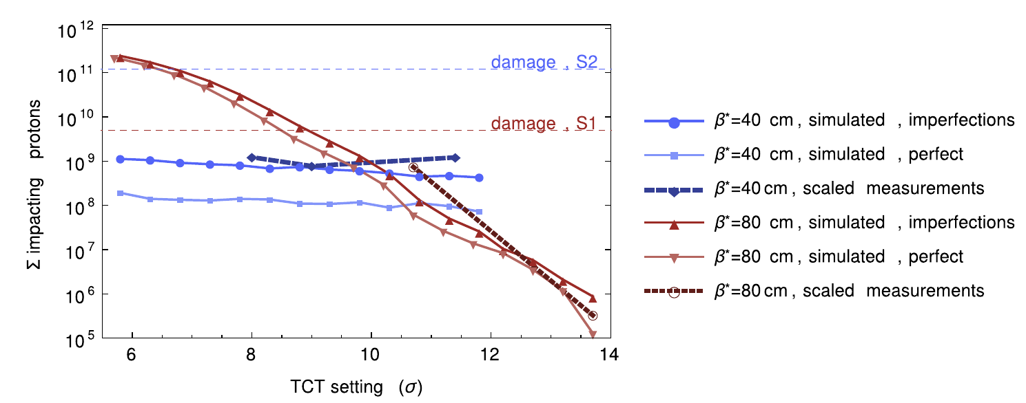
Introduction
In 2016, operated at β*=40 cm
  Prerequisite: improved MKD-TCT phase advance, so that TCTs can be operated at smaller retraction from TCDQ
  Did series of asynch dump test to verify assumptions
  Conclusion (measurements and simulations): TCT losses do not depend strongly on TCT setting with good phase, while they do with bad phase
NIM A 848 (2017) 19–30

Slide 3
Situation in 2017
Switched to ATS optics
Phase advance not as good as in 2016, but still acceptable for tight TCT settings (based on simulations)
Starting nevertheless at 40 cm, and tighter IR6/7 => 1 σ more margin TCDQ/TCT than in 2016
Proposed BPM and PC interlocks (see previous talks)
To check dependence of TCT losses on setting: as in 2016, did asynch dump tests with standard TCT settings as well as tighter TCTs

Slide 4
Asynch dump tests
Standard asynch dump test carried out in commissioning
Checked TCT losses in the following tests:
  Collision : 22/05/17 22:16:07.411
  End of squeeze : 23/05/17 03:48:28.524
  End of squeeze, tighter TCTs 7.5 σ : 23/05/17 06:22:37.945.
  End of squeeze, tighter TCTs 7.5 σ : 02/06/17 02:05:18.946
  Collision, tighter TCTs 7.5 σ : 03/06/17 22:49:12.753
Data good
Data not good –
dumped too early
Data good

Slide 5
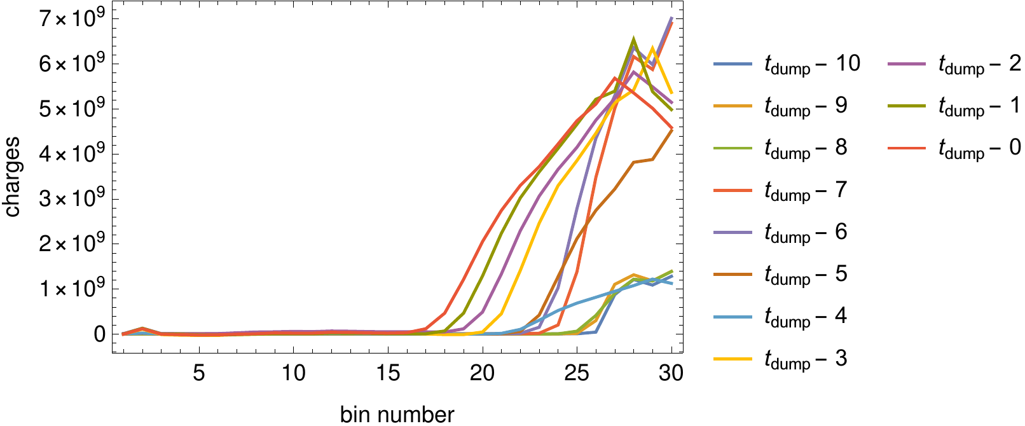
Data from early dump
Beam enters abort gap on side with high MKD kicks
If dump is triggered too early, not enough beam has propagated to the side of the abort gap with low MKD kicks
  Only particles at this side of the aboi gap can potentially make it to the TCTs
May 23
Low MKD kicks
High MKD kicks

Slide 6
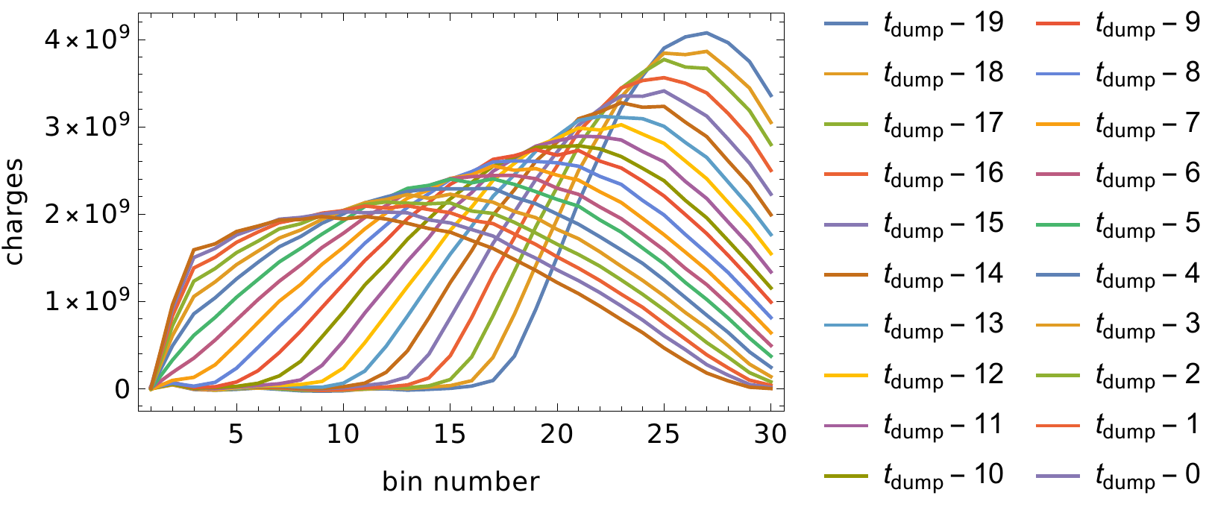
Data during “good” test
Example: B1 during latest test on 3/6
Low MKD kicks
High MKD kicks
June 6

Slide 7
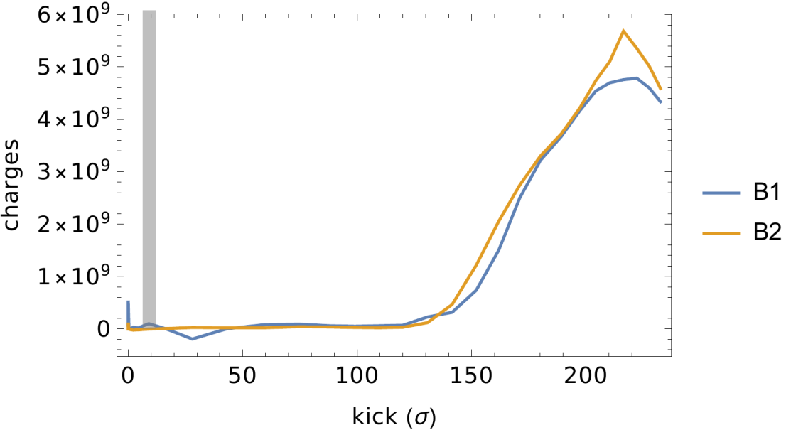
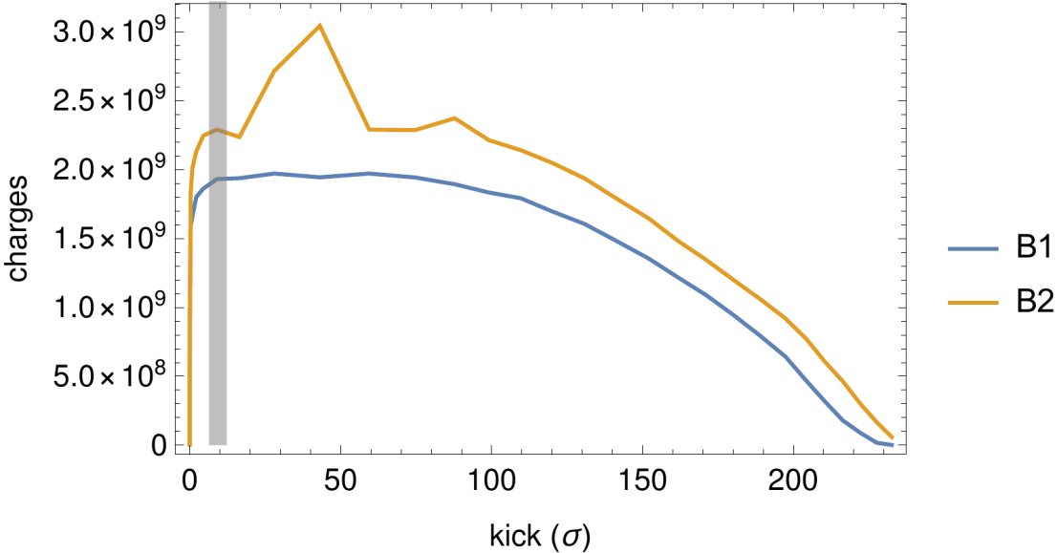
Abort gap at time of dump
Showing the abort gap population at time of dump, as function of kick in σ
May 23
June 6

Slide 8
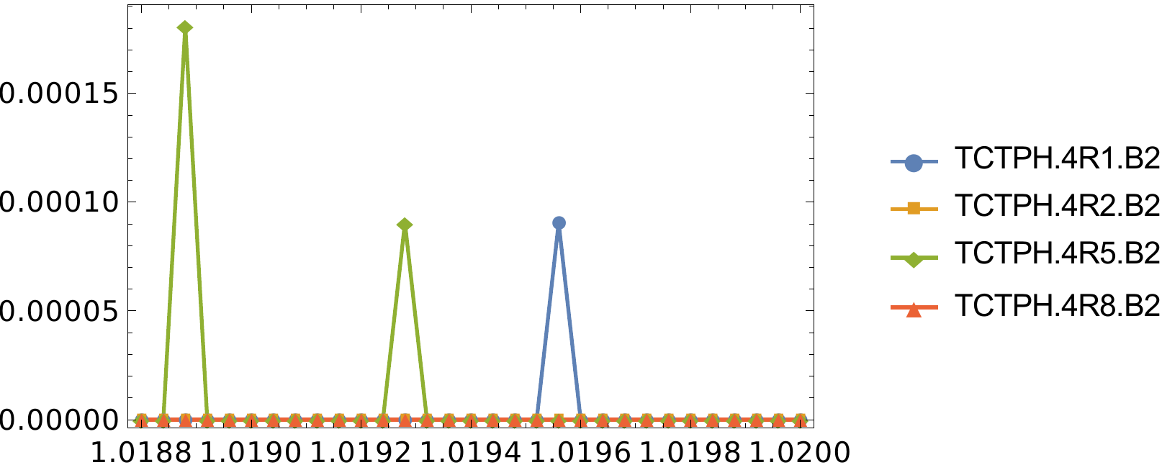
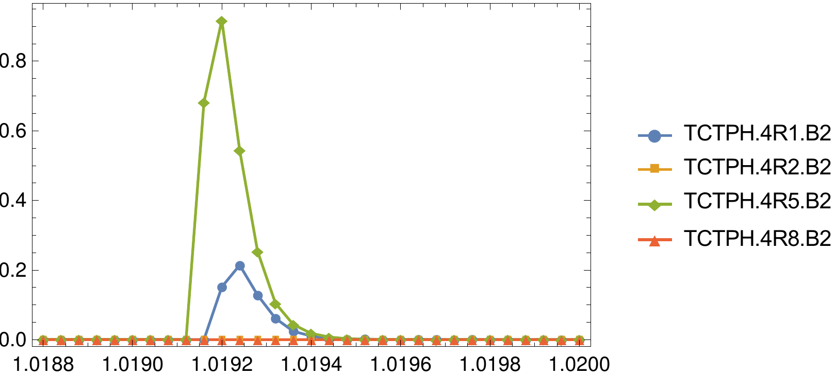
Losses on TCTs during dump
Showing BLM signals as function of time around the time of dump
If dump is triggered early, no real losses seen on TCTs as expected
May 23
June 6

Slide 9
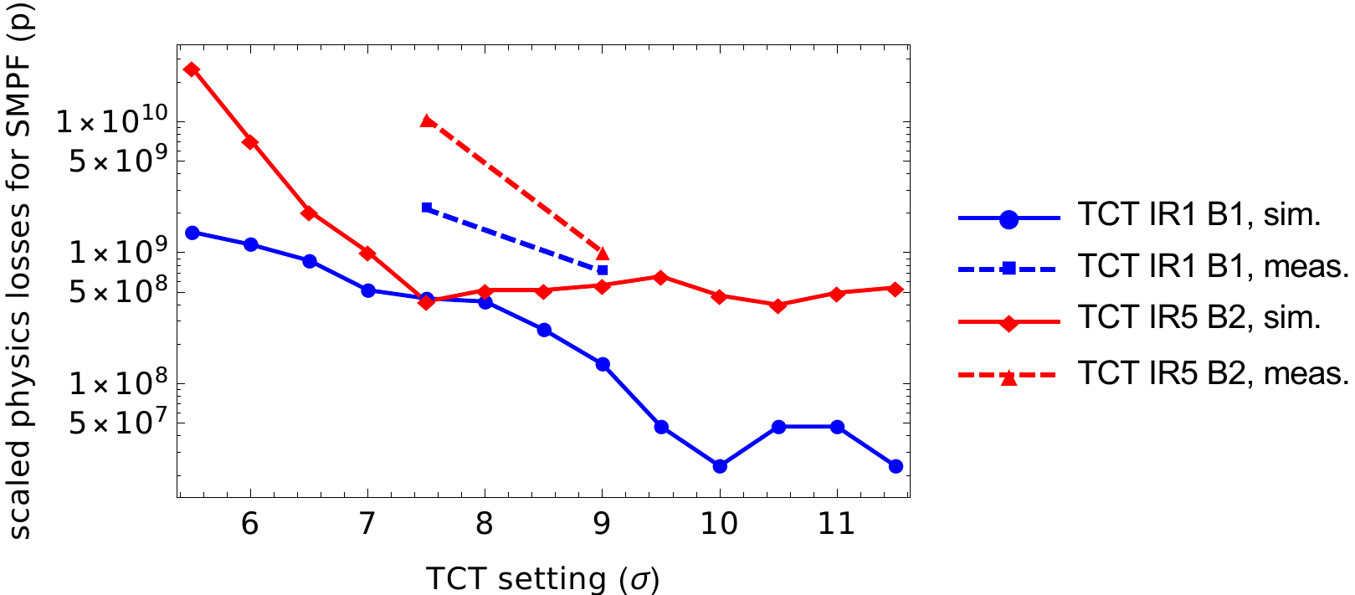
TCT losses as function of setting
Focusing now on the two “useful” tests (May 22 and June 6)
Showing the two highest TCTs: IR1 B1 and IR5 B2
First results: measurements and SixTrack simulations (perfect machine)
  1.2 mm IR6 bump on in both cases
  Scaled to full physics beam, type 2 single module pre-fire (kick data from M. Fraser)
Preliminary

Slide 10
Observations
1 order of magnitude difference between IR5 TCT losses at 9 σ and 7.5 σ
  From simulations, losses not expected to rise at 7.5 σ but at smaller settings
  Explained by imperfections? Further simulations to be done
Still, should be no issue for operation – the effective loss in margin from 40 cm OP configuration is around 4 σ
  But we should understand this for 30 cm
Asynch dump test done with RF off after 30 -40 s – beam is effectively off-momentum at time of dump.
  Momentum offset to be checked

Slide 11
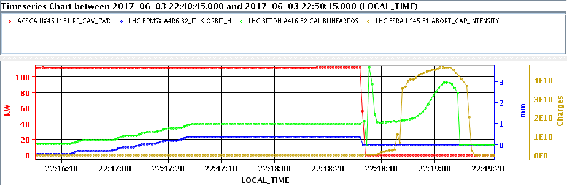
Orbit during asynch dump?
Standard BPMs seem to give zero readings after RF off
Collimator BPMs (linear positions) show significant excursion. How reliable are these data? Any ideas?
Do we have effectively a larger loss in margin due to additional orbit offsets? Would still be consistent with 2016 tests.

Slide 12
Summary
Work in progress – still some features to be understood
Several asynch dump tests performed during 2017 commissioning
Unfortunately, only two were triggered late enough to give useful data on TCT losses
TCT losses seem to rise more sharply at smaller settings than expected from simulations in IR5
  To be understood for 30 cm, but no worry for 40 cm operation
  Repeat simulations with imperfections
  Repeat simulations off-momentum
Could one think of an “on-momentum” asynch dump test in the future? Cogging to get some pilots to the left part of the abort gap? MD on closed bump from IR6?

Slide 13
Backup

Slide 14
