Slide 1


BPM interlock status and plans
Arek Gorzawski
S. Redaelli, J. Wenninger, R. Bruce, G. Azzopardi

Slide 2
Outline
Interlocking concept and motivation
Validation status
  Log file
  Result
Conclusions

Slide 3
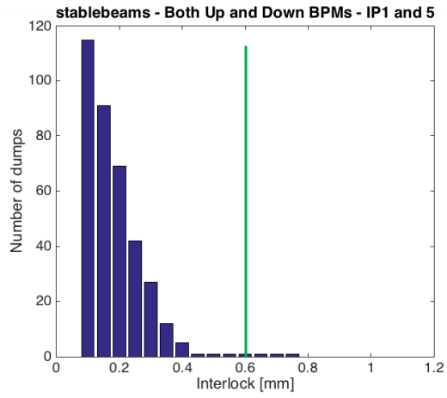
Motivation
SIS follows the collimator beam center measured from the embedded BPMs.
Following the TCT BPM performance analysis (A.Mereghetti et.al, Evian2016)
600 μm interlock limit was set (from 2016)
In addition to the analysis of orbit quality/stability, this new analysis of sis logs will also provide an assessment of the overall chain, addressing the complete implementation (status of acquisitions, etc) and the reliability.
Notes:
From summary on the evian (validation of the orbit reproducibility & performace analysis) -> trigger/interlock window
-> overall test (SIS system to log…)
In addition to the analysis of orbit quality/stability, this new analysis of sis logs will also provide an assessment of the overall chain, addressing the complete implementation (status of acquisitions, etc) and the reliability. in addition to the analysis of orbit quality/stability, this new analysis of sis logs will also provide an assessment of the overall chain, addressing the complete implementation (status of acquisitions, etc) and the reliability.

Slide 4
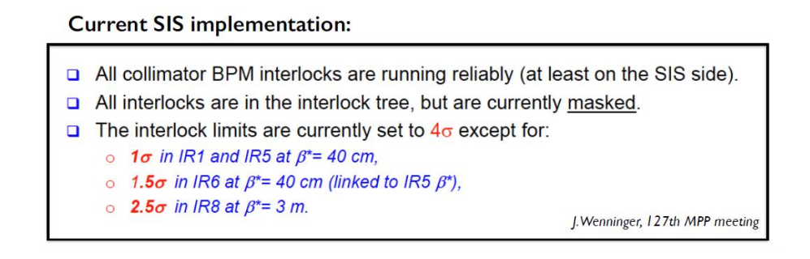
Motivation
The SIS produces the log file for EVERY interlocking case.
  How many (false?) dumps we would have, if in 2017 we use 2016 analysis result?
Analysing (and understanding) the log file will give the answer!

Slide 5
Outline
Interlocking concept and motivation
Validation status
  Log file
  Result
Conclusions

Slide 6
The SIS Log File
2017-05-25 22:49:43,004 [EventUpdaterThread-null-5] ERROR BpmCollimatorCenterValueConditionExtImpl adc97491-418b-11e7-843f-0f3eb12d931c =>
*** Collimator beam center [SISREF_TCTPV_4R2B2 / BPTUV_A4R2B2_ACQ - BPTDV_A4R2B2_ACQ] :
Beta @ collimator = 101.7 [m] for beta* = 10.00 [m] @ IR2
Beam sigma @ collimator = 0.232 [mm] with tolerance = 4.00 [sigma] @ E = 6499 [GeV] - emit = 3.5 [um]
Up BPM position = -1.123 [mm] - -121 [tol %] status = true
Down BPM position = -1.193 [mm] - -129 [tol %] status = true
Dump count =
2017-05-25 22:49:45,003 [EventUpdaterThread-null-5] ERROR BpmCollimatorCenterValueConditionExtImpl aefaa191-418b-11e7-843f-0f3eb12d931c =>
*** Collimator beam center [SISREF_TCTPH_4R8B2 / BPTUH_A4R8B2_ACQ - BPTDH_A4R8B2_ACQ] :
Beta @ collimator = 234.5 [m] for beta* = 3.00 [m] @ IR8
Beam sigma @ collimator = 0.352 [mm] with tolerance = 2.50 [sigma] @ E = 6499 [GeV] - emit = 3.5 [um]
Up BPM position = 2.899 [mm] - 329 [tol %] status = true
Down BPM position = 3.101 [mm] - 352 [tol %] status = true
Dump count =
2017-05-25 22:49:45,003 [EventUpdaterThread-null-5] ERROR BpmCollimatorCenterValueConditionExtImpl aefaa191-418b-11e7-843f-0f3eb12d931c =>
*** Collimator beam center [SISREF_TCTPV_4R2B2 / BPTUV_A4R2B2_ACQ - BPTDV_A4R2B2_ACQ] :
Beta @ collimator = 101.7 [m] for beta* = 10.00 [m] @ IR2
Beam sigma @ collimator = 0.232 [mm] with tolerance = 4.00 [sigma] @ E = 6499 [GeV] - emit = 3.5 [um]
Up BPM position = -1.123 [mm] - -121 [tol %] status = true
Down BPM position = -1.194 [mm] - -129 [tol %] status = true
Dump count =

Slide 7
The SIS Log File
The first file covered 25 May till 30 May
  ~6000 interlocking logs, but only the following channels:
    TCTPH_4L5B1 & TCTPV_4L5B1
    TCTPH_4L8B1 & TCTPV_4L8B1
    TCTPH_4R8B2
    TCTPV_4R2B2
First days of June (1 - 8)...
  ... another ~6000 interlocking entries
    ...TCT

Slide 8
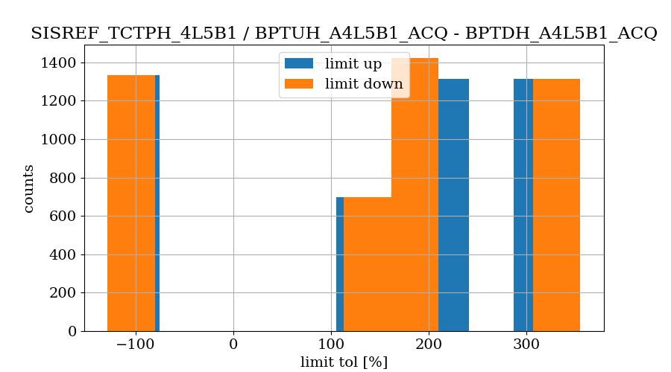
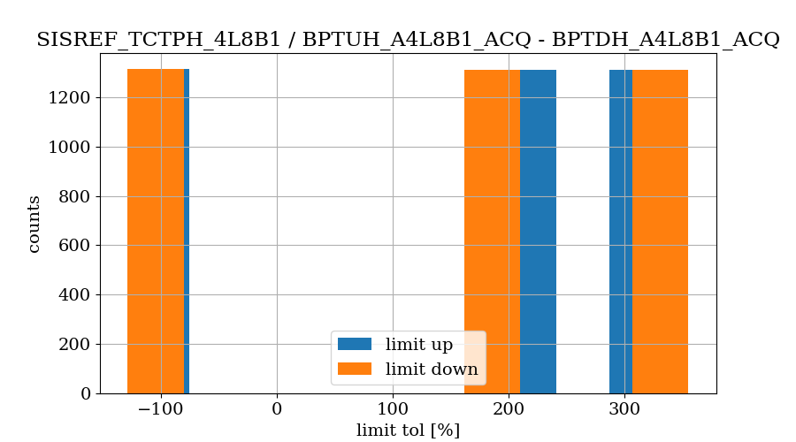
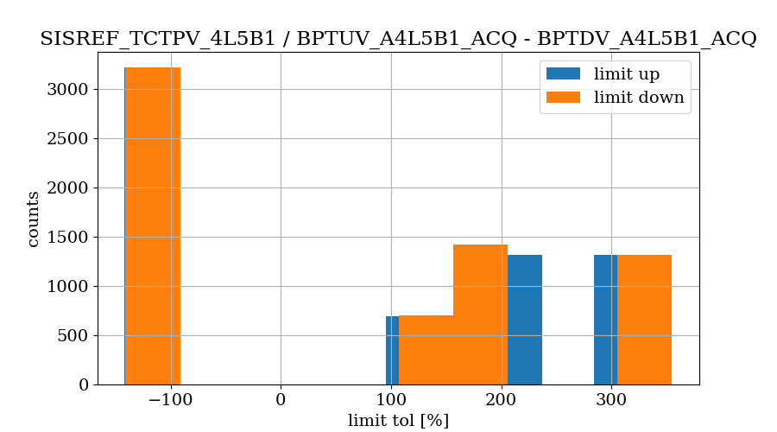
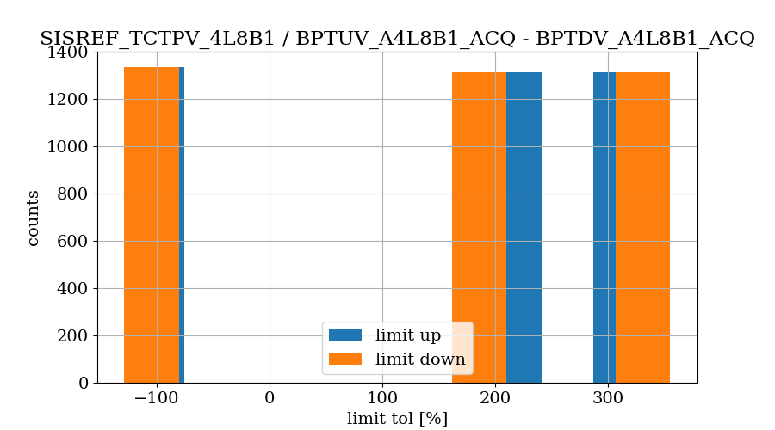
Parsing the file (examples)

Slide 9
Closer look at the interlocks
Looking at the time binning (one log file)
  clusters every 2s (?)
But all of these interlocks were recorded around specific beam commissioning activities:
  VdM scans in IP8
    25 May,
  30cm optics validation
    25 May, 4 June, etc.

Slide 10
Conclusions
Ready to perform the continuous monitoring
    With limits from the 2016 analysis
So far, no spurious (not identifiable) interlocks were found, all related to the beam commissioning
  Based on the correlation: amount and magnitude of the interlock wrt to the time when it happen
The tool is ready to monitor the log file
  Still an interaction with the logbook required to see the reason of interlocking
  Possible to add more criterias to check.
Notes:
Banal thing (as agreed on previous MPP) we perpared the tool, to identify , ready to perform continuous monitoring

