Slide 1
Loss of PP60A 08.05.2017
MPP Meeting
A. Antoine
I. Romera Ramirez
Thanks to
Jonas Arroyo Garcia (BE/ICS) for its feedback.

Slide 2
Outline
Introduction
PP60A lost on 08.05.2017
QPS_OK filtering method in details
Conclusions

Slide 3
Introduction
60A Power Permit implementation
No hardware interlocks for 60A orbit correctors
Protection guaranteed by Power Converters
Interlocks to avoid unnecessary quenches of magnets and current leads and to help operations
PC_PERMIT_60A derived from cryogenic and powering conditions and sent via GMT to EPC gateways
Courtesy of Ivan Romera Ramirez

Slide 4
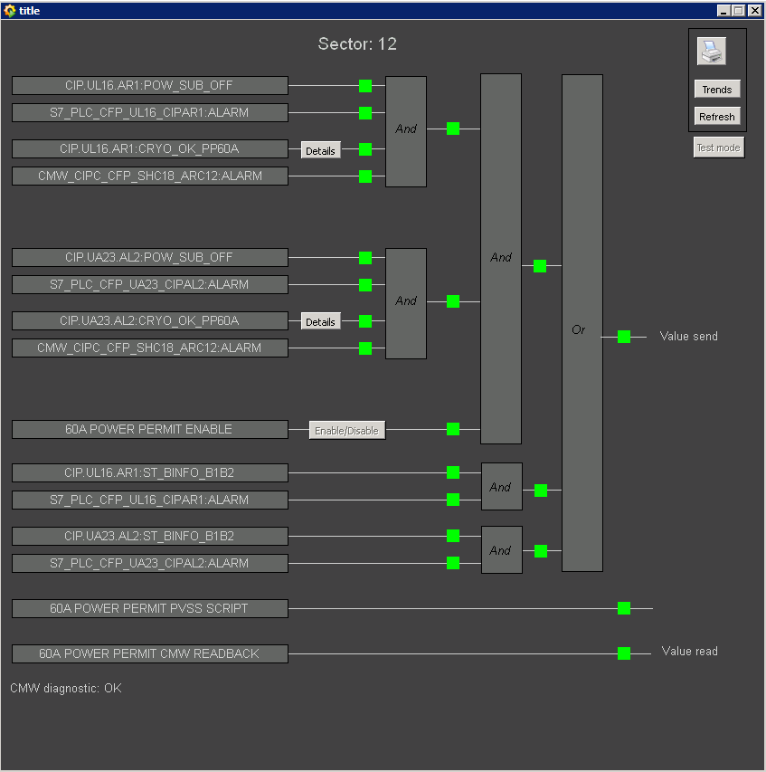
Introduction
Two operating modes
Power Permit Without beam
  Global Protection
  PLC communication alive
  Cryo PP60A
  CMW connection alive
Power Permit With Beam
  Beam_Info_B1B2
  PLC communication alive
In fact, PP60A logic from the PIC is always true when operation with beam !

Slide 5
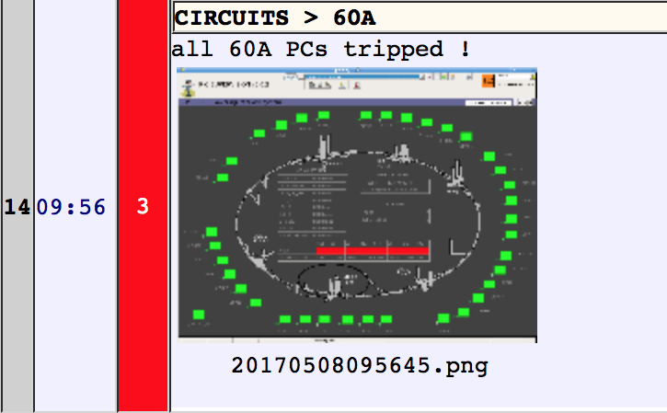
PP60A lost on 08.05.2017
Circumstances
First message (SMS/Mail) from PIC server on Tuesday 2nd Mai:
  F: pic.interlock@cern.ch S: pic_1 - Bad - Time synchro PM1_CMW_FE -> DS driver 30 - 05/02/2017 18:21:19 (milli:654)
  F: pic.interlock@cern.ch S: pic_1 – OK - Time synchro PM1_CMW_FE -> DS driver 30 - 05/02/2017 18:21:21 (milli:647)
The frequency of these messages increased exponentially over the 7 next days.
Initially, these messages were not considered important because they had no effect on the operation.
All PP60A lost on 08.05.2017.

Slide 6
PP60A lost on 08.05.2017
What happened (1)
New QPS_OK filtering method deployed during EYETS.
Overload of the WinCC server:
    CCC complained of:
      Slowdown of the PIC application.
      Unexpected and uncoherent behaviour of the PIC application.
WinCC server goes to emergency mode (automatic disconnection of services to save resources).
Messages appeared.
NO consequences for operation with beam.

Slide 7
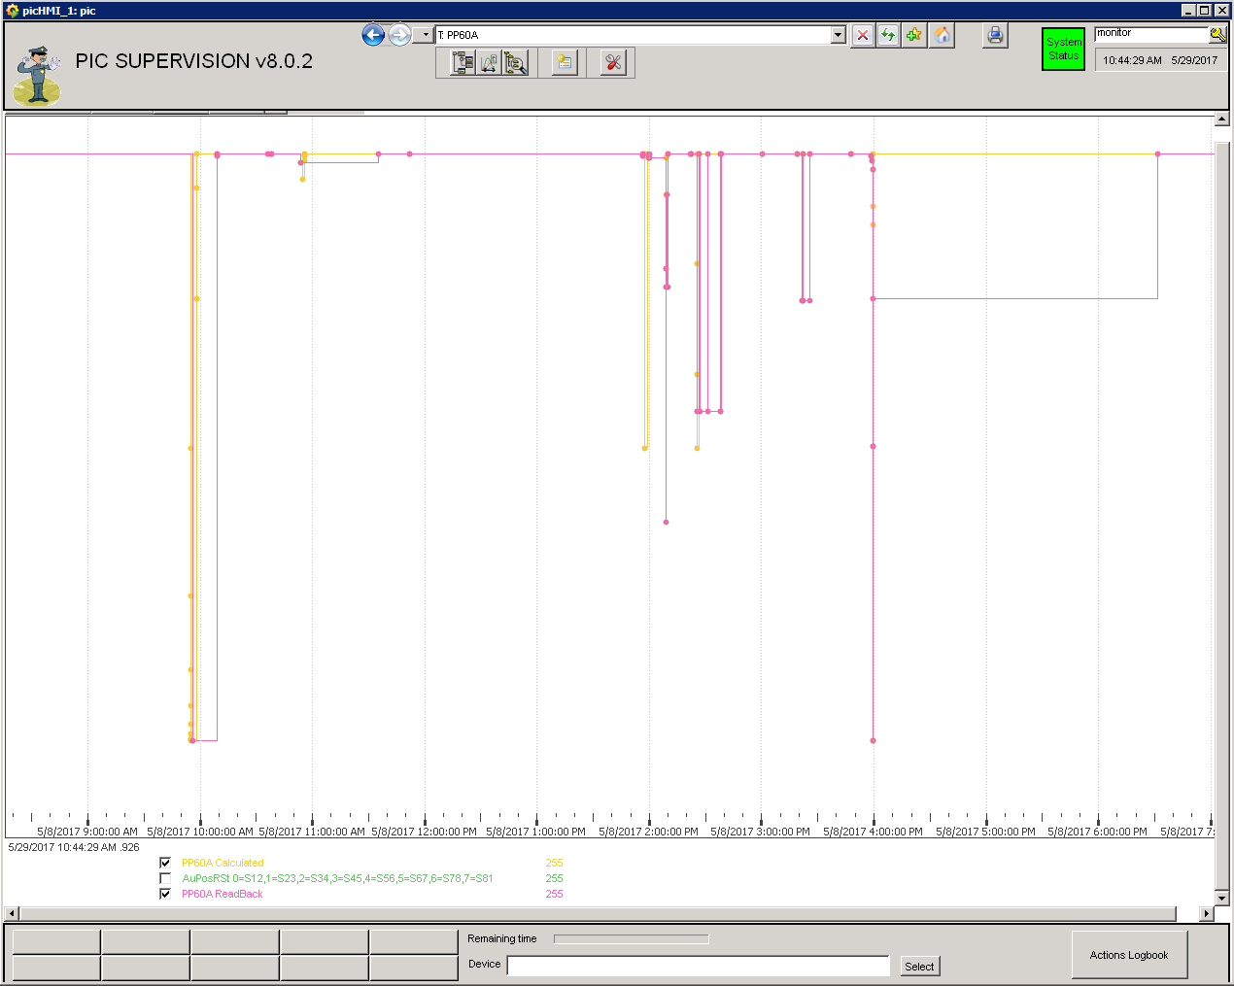
PP60A lost on 08.05.2017
What happened (2)
At 21.43 on 07.05.2017 the RQ5.LR3 circuit tripped:
  No beam
BE/ICS requested authorization to make an intervention on the WinCC.
The intervention:
  Shutdown of the WinCC No consequences
  Change of QPS_OK filtering polling time to 10 sec (Mitigation of WinCC overload).
  WinCC server restarted.

Slide 8
PP60A lost on 08.05.2017
What happened
At restart, WinCC is disconnected from CMW server.
Without Beam: All PP60A lost
Mitigation:
  Masking the CMW connection check for a time set at WinCC restart

Slide 9
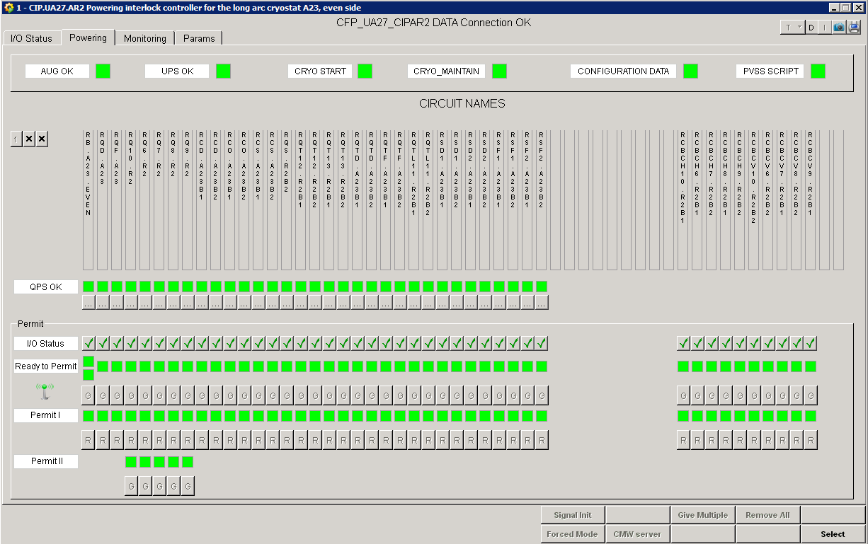
QPS_OK filtering method in details
QPS_OK is evaluated by WinCC scripts

Slide 10
QPS_OK filtering method in details
The reason of change is to fix the issues of:
  Sporadic missing QPS updates.
  Flooding of QPS_OK events.
< 2017 | From now on
Event based | Poling based
Low CPU load | High CPU load
Sensitive to missed QPS events | Immunity against missing QPS events

Slide 11
QPS_OK filtering method in details
Mitigation of WinCC Overload
Current mitigation:
  Polling time changed from 4 sec to 10 sec (with the agreement of Markus and Zinur ).
  The server load is now stable between 50-80%.
Future mitigation (to return to 4 sec of polling):
  Exchange of the server (hardware) with a more powerful one.
  Optimization of QPS code.
  Optimization of QPS_OK WinCC scripts (using C++ code to compute QPS signal avalanches).

Slide 12
Conclusion (1st)
PP60A lost on 08.05.2017
The PP60A lost was a consequence of a WinCC maintenance, which would have not occurred with beam.
WinCC maintenance in operation without beam can provoke the lost of all PP60A due to CMW disconnection.
WinCC overload had no effect when in operation with beam.
Improvement of QPS_OK filtering scripts and upgrade of the WinCC server (ongoing) are required.

Slide 13
Thank you for your attention

