Slide 1

BLM system:
Signal Drop at IP3 on 23/05/2017
Christos Zamantzas on behalf of the BLM team.

Slide 2
Issue: background
During the Loss Maps Validation several BLM signals drop to zero at DS of R3
The issue has been reported twice in Run 2:
  BIBML-990 on 2015/05/05
  BIBML-1344 on 2017/05/23
Issue known since Run 1:
  Several investigations and actions
  Cabling is not the same as in all other locations
  Cause never really understood

Slide 3
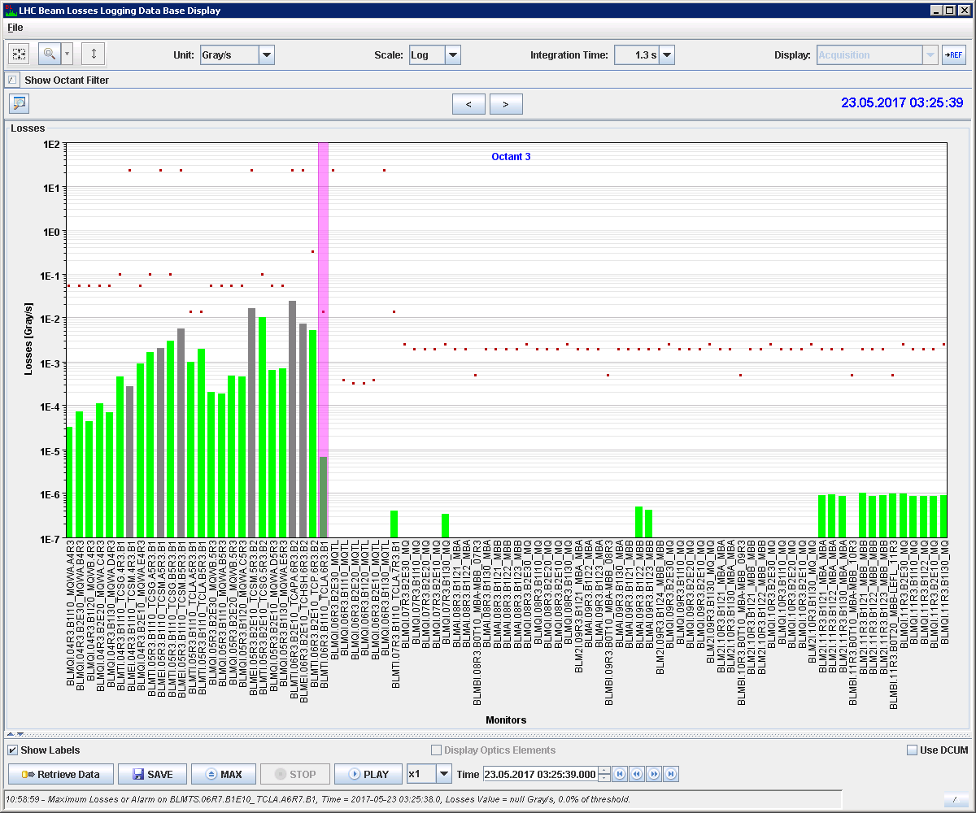
Issue: channels 6R3 – 10R3

Slide 4
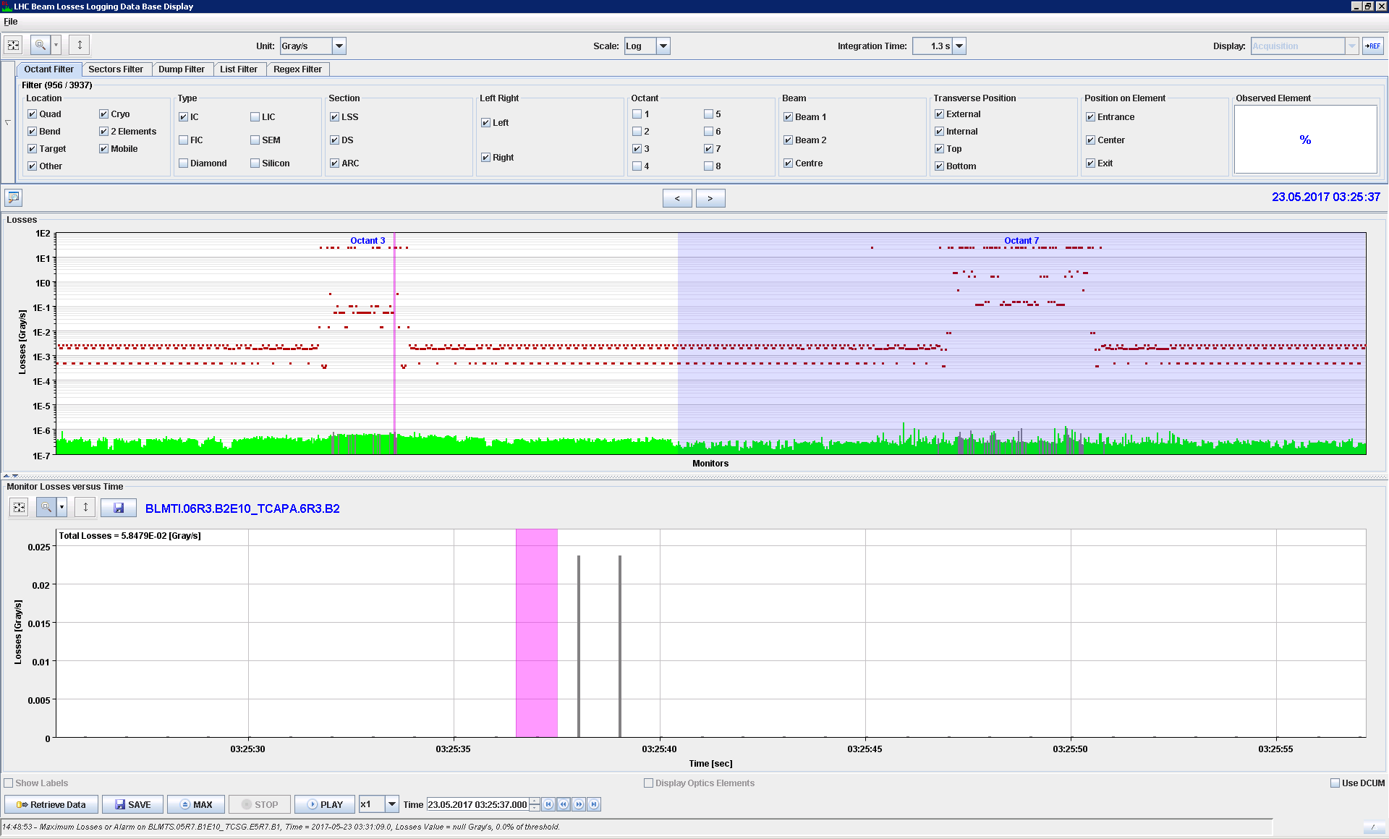
2017/05/23 03:25:37

Slide 5
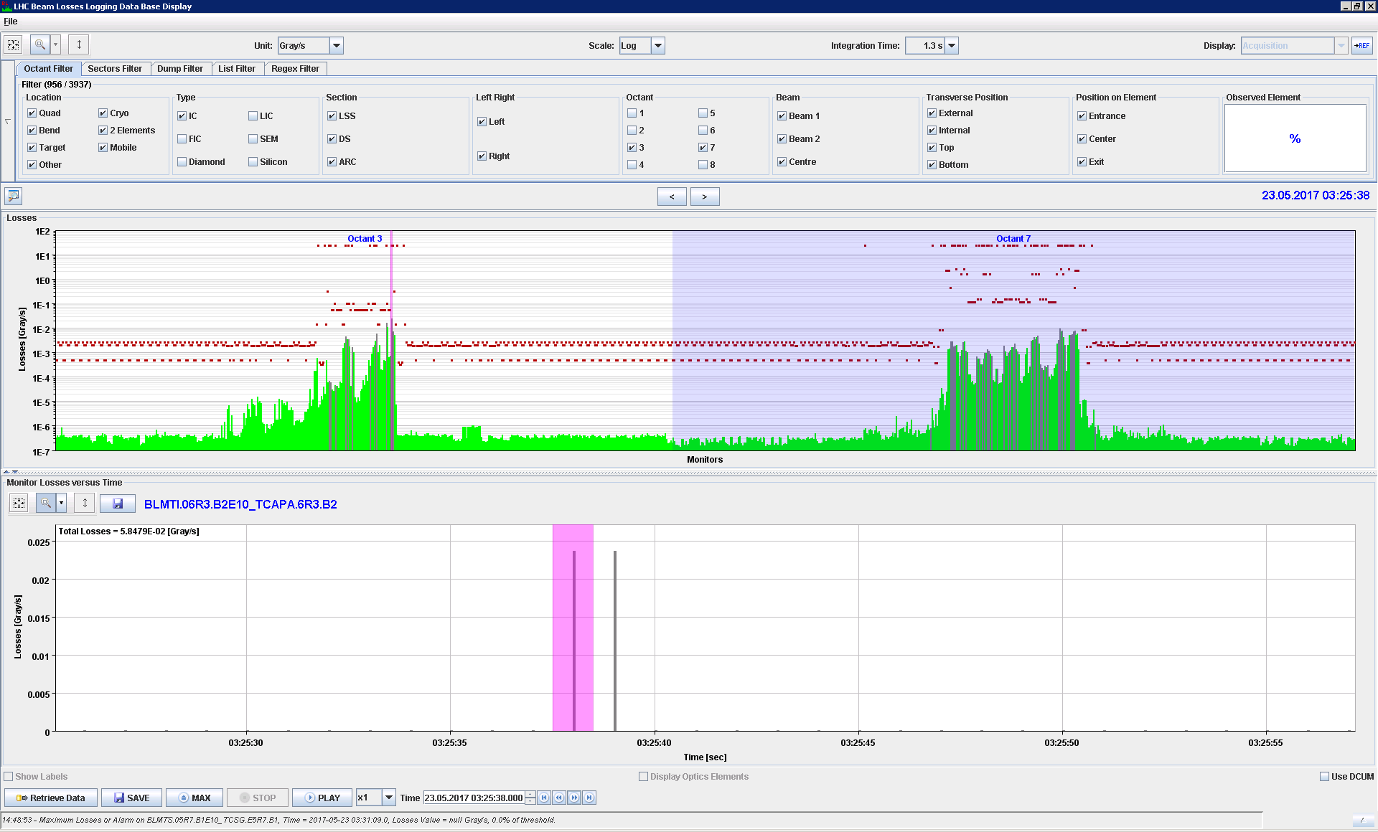
2017/05/23 03:25:38

Slide 6
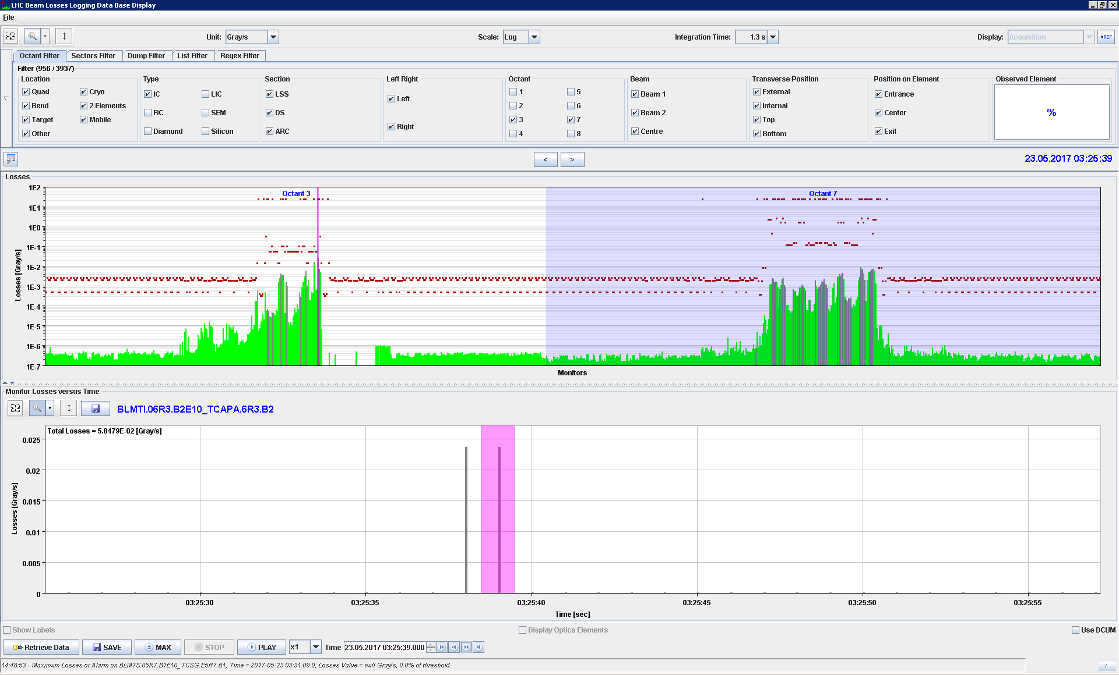
2017/05/23 03:25:39

Slide 7
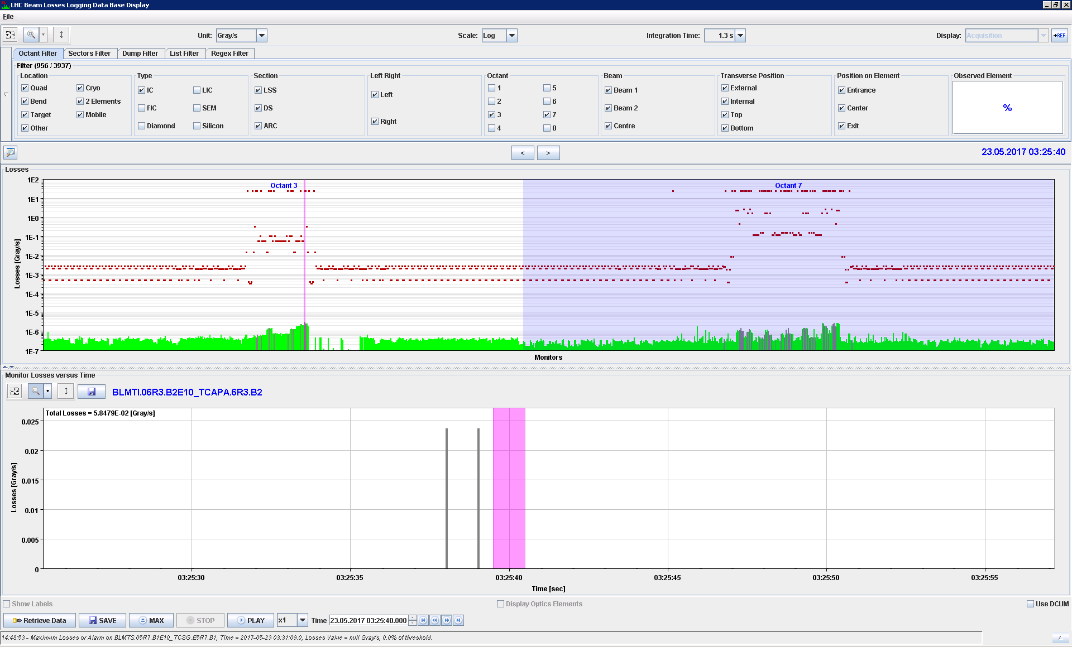
2017/05/23 03:25:40

Slide 8
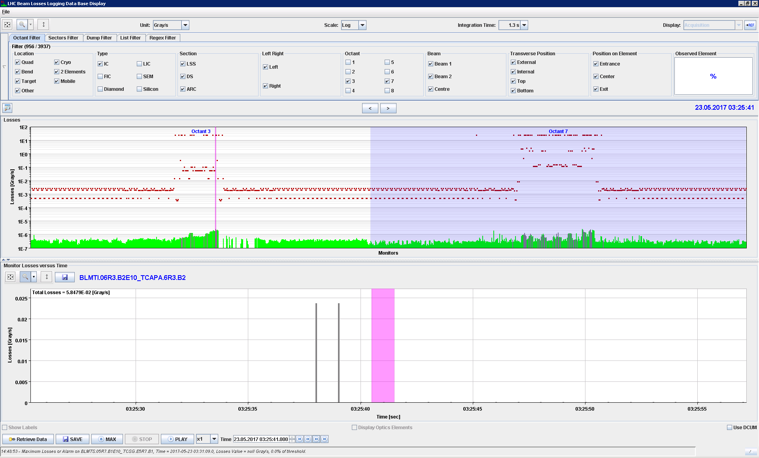
2017/05/23 03:25:41

Slide 9
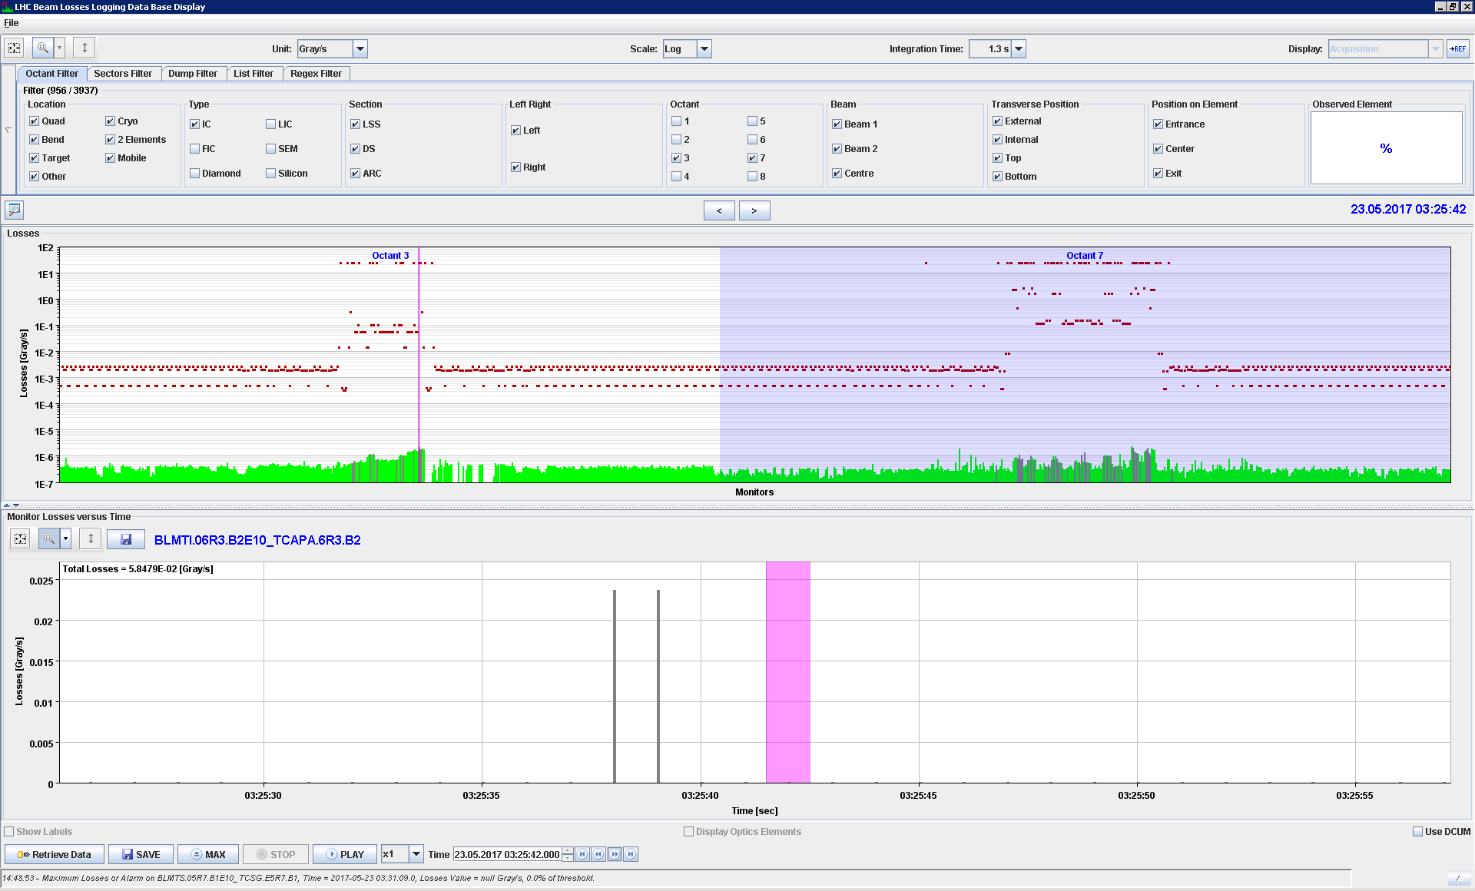
2017/05/23 03:25:42

Slide 10
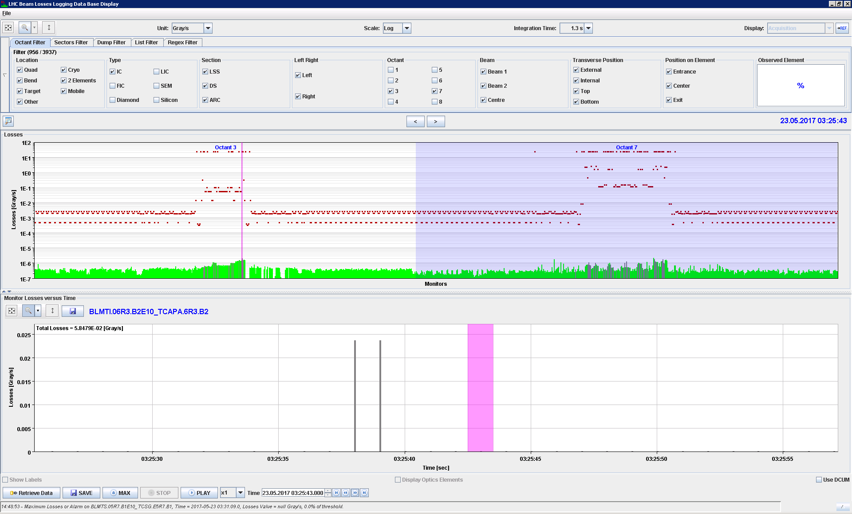
2017/05/23 03:25:43

Slide 11
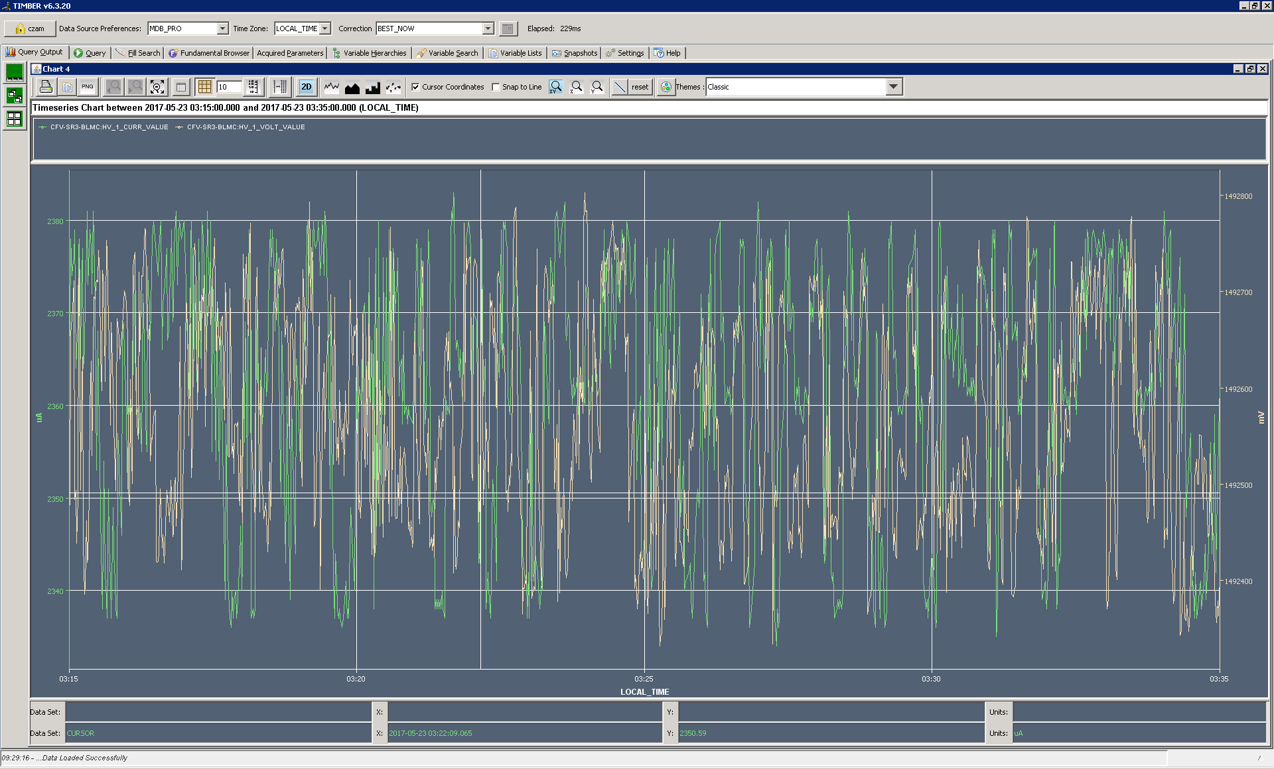
HV PSU: Current & Voltage

Slide 12
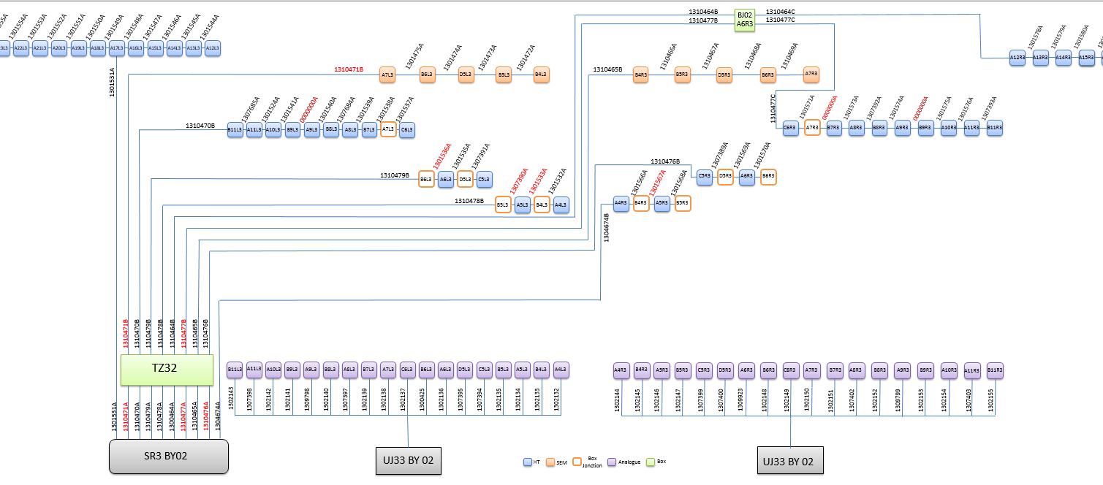
Installation
Specificities of the location
  HV cable is ~ 3km (all other locations < 200m)
  Very long signal cables (~ 800m)

Slide 13
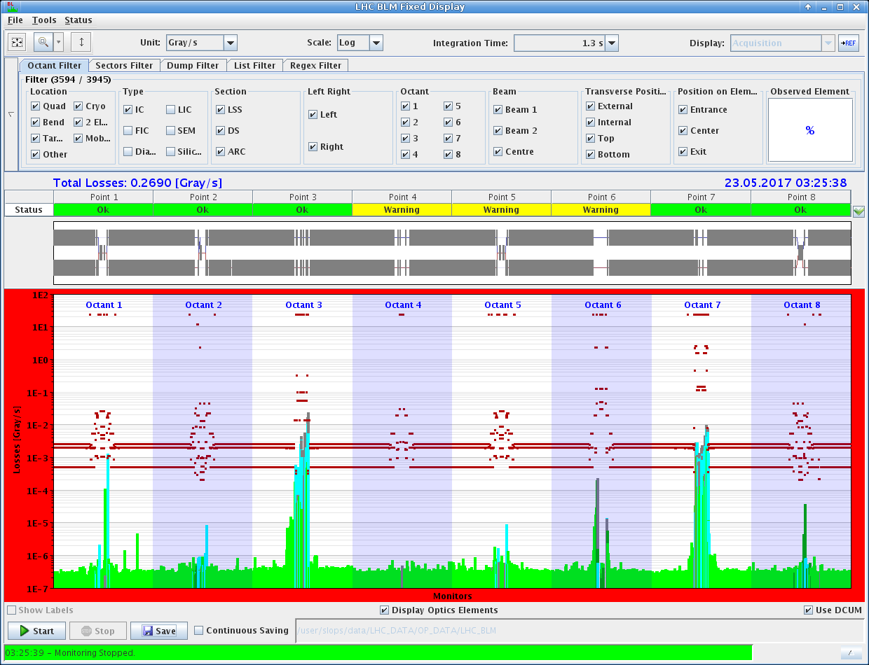
Protection
Due to the Loss Maps all MASKABLE BLM channels were masked
Otherwise a beam dump would have been issued from two other points already

Slide 14
Thank you

