Slide 1
Status of DOROS BPMs for SIS
G. Baud, M. Gasior, J. Olexa, M. Lasch

Slide 2
Requirements for SIS unmasking
Implementation of Post-Mortem in FESA
Reliable positions
Deployment of new FPGA code
  Currently validating for standard DOROS BPMs
Reset and check of boxes from LHC Sequencer
  Currently extracting Java code for Sequencer

Slide 3
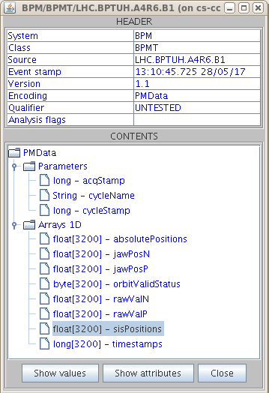
DOROS Post-Mortem data
History of data at 25 Hz
for 2+ min:
Jaw positions (p/n)
Raw data (p/n)
SIS positions
Absolute positions
OrbitValid flag

Slide 4
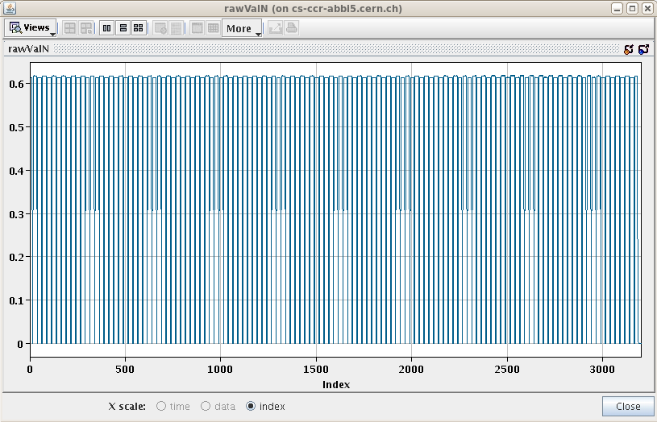
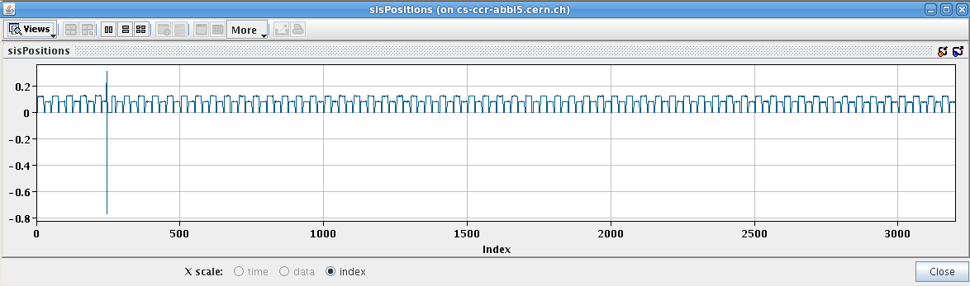
Post-Mortem
Should we add the 1 Hz data actually sent to SIS?

Slide 5
Position data not to use in SIS
Linear ONLY for centering
Corrected position (polynomial) currently not optimal:
  Too complicated (18 coeffs)
  Different for each BPM
  Not centered (offset when Δ/Σ=0)
  Lot of noise around center position
  (absolute error balanced over whole range)

Slide 6
Position data to use in SIS
Simpler polynomial correction to be validated soon
  2 coefficients : Pos = c10.Δ/Σ + c1.Δ/Σ.B
  Use same coefficients per BPM type
  Centered
  No wiggles/offset around center position
Offline analysis shows promising results

Slide 7
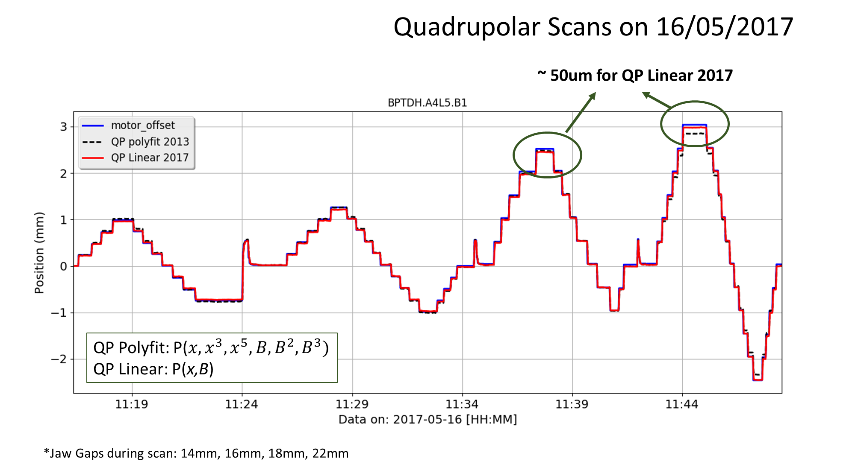
New “bilinear” position

Slide 8
DOROS Hardware
Was ready for 2017 start-up
So far, running “2016 FPGA code” to ensure reliable operation from 1st beam
New “2017 FPGA code” used in standard DOROS to be validated. Main new feature: HW post-mortem
Can now be loaded to collimator DOROS
  ~ 2 hours needed
  No data for 10 min

Slide 10
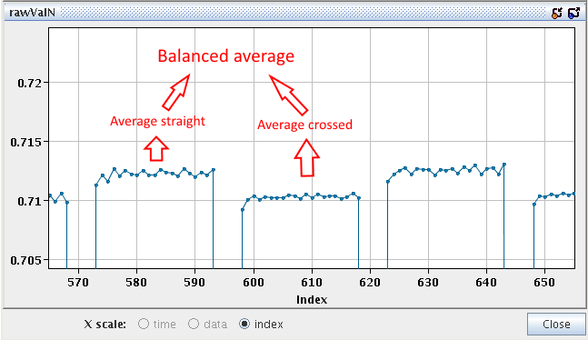
Auto-Calibration
Positions used by SIS are based on balanced averages of raw values

Slide 11
Story of the collimator beam position measurement
Until 2017 the BPM readings were used operationally only for jaw centring
  Beam position estimate according to the simplest approach with just one liner equation for all positions and all gaps
  Very reliable, used operationally from “the beginning” of the collimators with BPMs
  Only a rough approximation, however well sufficient for the automatic centring algorithm
  Guarantying monotonic convergence of the algorithm for all gaps and all beam positions
  (beam position is always underestimated)
  The approximation has never been meant for orbit measurements, as it gives large scale errors,
  changing with beam offset and jaw gaps
For beam position measurement there was foreseen a 2D polynomial, mapping the nonlinear BPM characteristic
  The polynomial covers large beam offsets and wide gap span
  It does not have any preference for the most important small beam offsets
  For coefficient evaluation it needs many points, requiring long beam measurements (more than an hour).
  During such time beam conditions are likely to change, limiting the accuracy of the measurements.
On the beginning of the 2017 run the 2D polynomial was calculated upon beam data for each collimator separately.
However, it was discovered that it is not accurate at all for small beam offsets.
Apostolos Sounas (BE-BI-QP) did (emergency) analysis showing that theoretical coefficients of this polynomial obtained from simulations give better results than the polynomials based upon beam data.
This may suggest that the scan measurements used for coefficient evaluation have very limited accuracy.
BI has proposed simplified approach with a linear equation with the slope depending linearly on the gap (“double-linear”).
Despite its simplicity, it still gives better results than the polynomial, as checked by Apostolos for small beam offsets.
  Only two coefficients, which (for the time being theoretically) can be evaluated from just two measurements
  (slope with the minimal gap, slope with the maximal gap)
  The Linear approach is very tolerant for measuring coefficients not exactly in the centre
  The smaller the beam offset, the smaller the error
  The collimator centres are indicated with no error, as the “linear centring equation”
  Before the final implementation the “double linear” equation should be checked carefully with beam

