Slide 1

Testing Quantum Calculations with Measurements on Radioactive Molecular Hydrogen Isotopologues
K.F. Lai
P. Czachorowski, M. Schlösser, M. Puchalski,
J. Komasa, K. Pachucki, W. Ubachs, and E. J. Salumbides

Slide 2
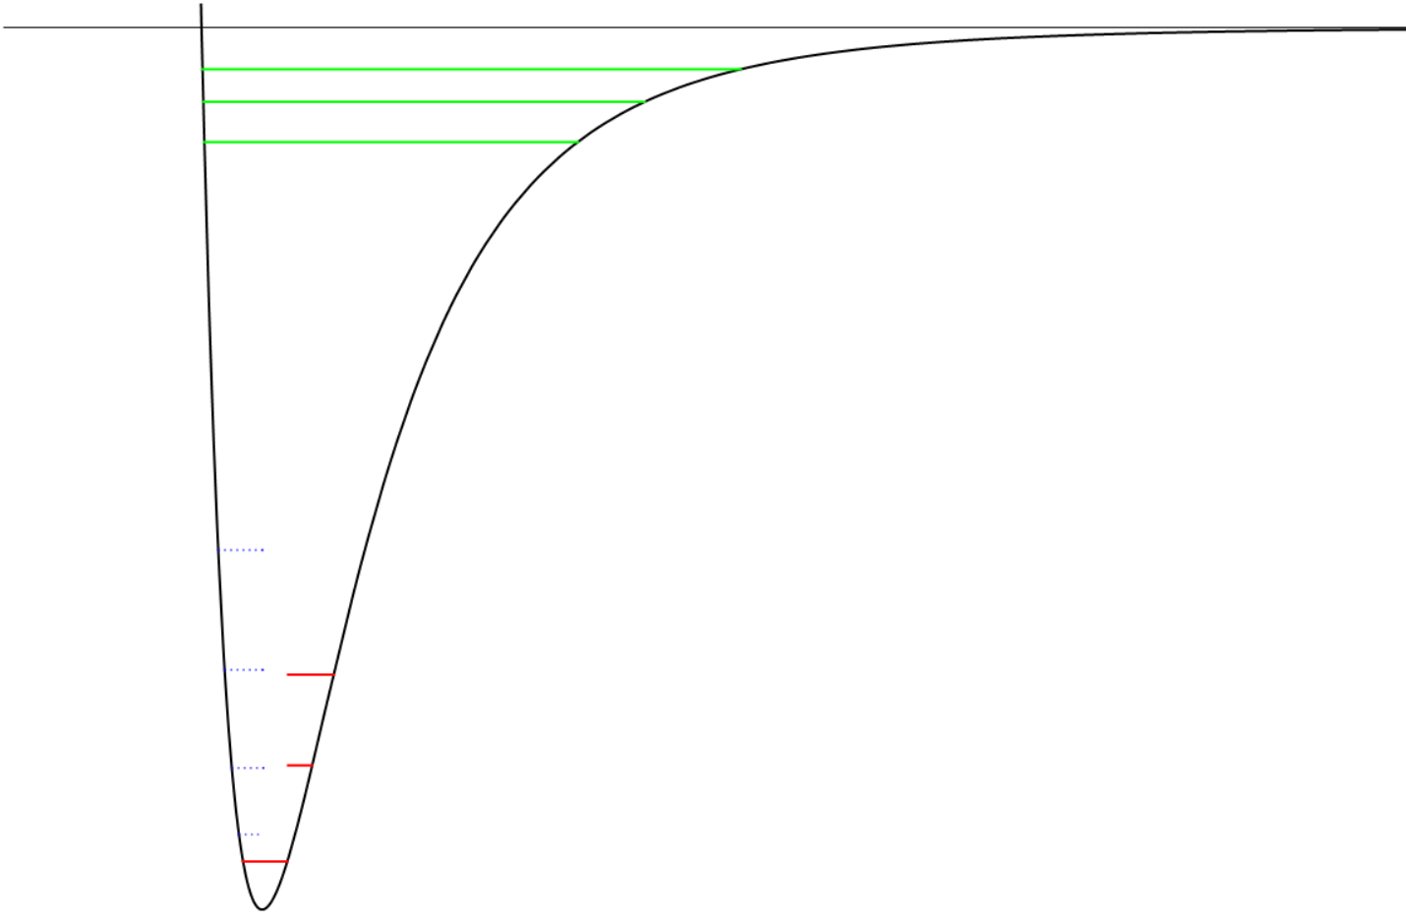
H₂ and Isotopologues as Benchmark Molecule
v = 10-12
Dissociation energy D₀(J=1) of H₂
C. Cheng et al. PRL 121, 013001 (2018)
H₂ High rotational state
v = 0, J = 0-16
E.J. Salumbides et al., PRL 107, 043005 (2011)
H₂ High vibrational state
v = 10-12
M.L. Niu et al. JCP 143, 081102 (2015)
Simplest neutral molecule
Internal nuclear motion
  Numerous transition available to test calculation
D₀
J = 16
J = 12
H₂ HD and D₂
Fundamental band (v = 1 ← 0)
G. D. Dickenson et al., PRL 110, 193601 (2013)
HD
First Overtone (v = 2 ← 0)
F.M.J. Cozijn et al., PRL 120, 153002 (2018)
v = 2
J = 8
v = 1
J = 4
v = 0

Slide 3
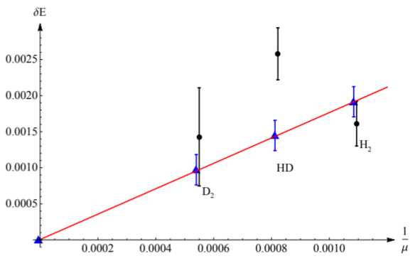
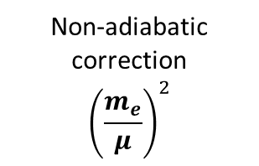
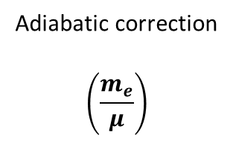

Heavier Tritiated Species
$$E_{level}=α^{2}E^{(2)}+α^{4}E^{(4)}+α^{5}E^{(5)}+…$$
$$E^{(2)}=E^{(2,0)}+E^{(2,1)}+E^{(2,2)}$$
Studies on heavier tritium-containing isotopologues doubles the no. candidates
Non-adiabatic contribution is smaller with larger reduced mass
Investigate g-u mixing contribution in HT and DT
BO energy
Adiabatic correction
$$\left(\frac{m_{e}}{μ}\right)$$
Non-adiabatic correction
$${\left(\frac{m_{e}}{μ}\right)}^{2}$$
Non-adiabatic correction to E⁽⁴⁾
H³He⁺ vs HT
N
P
P
N
P
P
N
P
T₂
DT
HT
M. Puchalski et al., PRL 121, 073001 (2018)

Slide 4
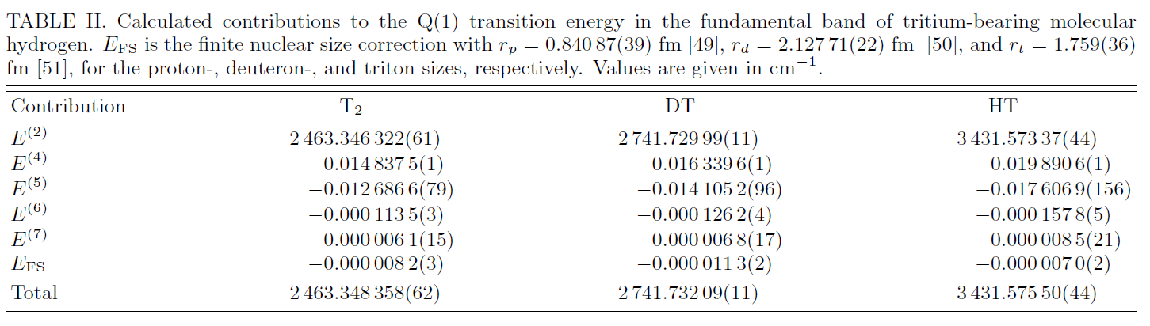
Calculation on tritiated species
NAPT calculation by P. Czachorowski
Uncertainty fundamental band v = 1← 0
~10⁻⁴ cm⁻¹ for DT and HT
6 x 10⁻⁵ cm⁻¹ for T₂
100-fold improvement to C. Schwartz et al. (1987)

Slide 5
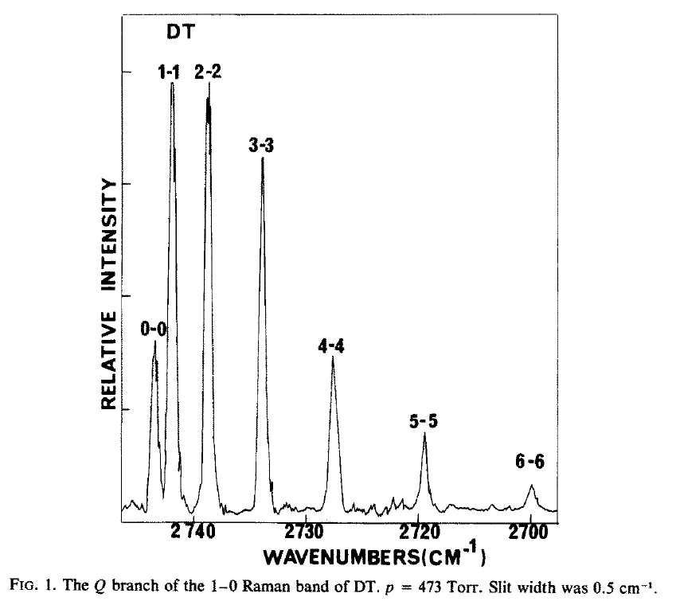
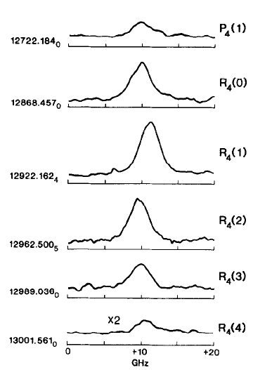
“Recent” experiment on tritiated species
Uncertainty of old measurement on vibrational transition
T₂ and DT
> 5 x 10⁻² cm⁻¹
HT
> 5 x 10⁻³ cm⁻¹
Latest calculation uncertainty
< 10⁻⁴ cm⁻¹
J.E. Barefield et al. J. Mol. Spectosc. 80, 233-236 (1980)
M.C. Chuang et al. J. Mol. Spectosc. 121, 380-400 (1987)

Slide 6
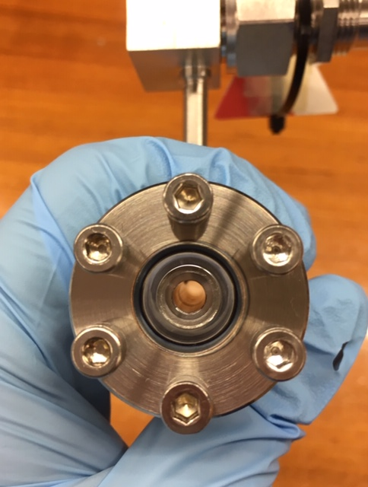

Experimental challenge
Beta decay of tritium
Half-life : 12.3 years
$$T → {}_{}^{3}{He^{+}} + e^{−} +\overline{ν_{e}}$$
Tritium sample from Tritium laboratory in KIT
Legal limit: <1 GBq radioactivity
~ 2.5 mbar T_{2,} or
~ 4 mbar DT,
(HT is preparing)
in 4 cm³ well-sealed gas cell
Limited methods for measurement
Not feasible for molecular beam experiment

Slide 7
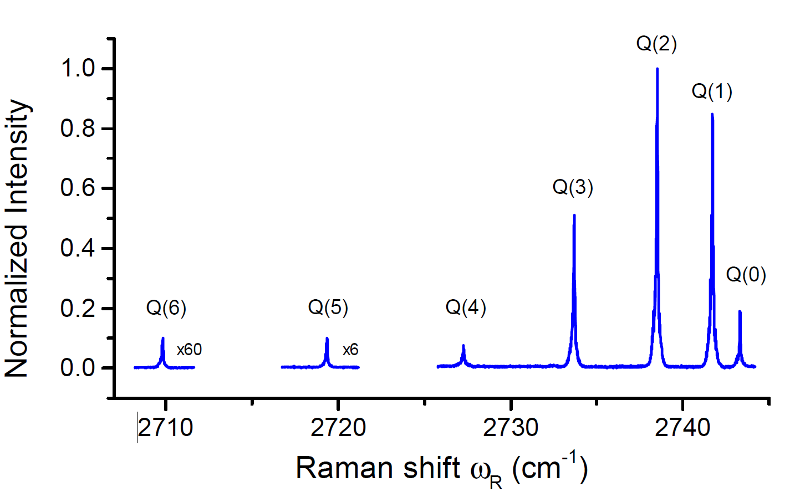
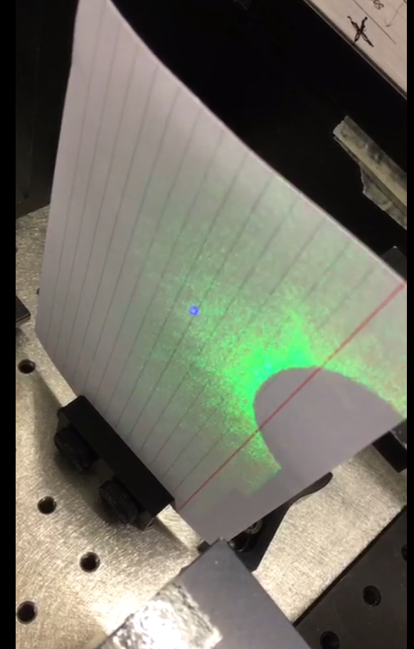
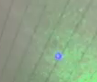

Coherent Anti-Stokes Raman Scattering
Virtual state
Advantage
Non-destructive and sensitive method
Anti-Stokes signal can be easily separated
Stokes
ω_{p}
ω_{s}
ω_{p}
ω_{as}
v = 1, J
Pump
Q-branch
ΔJ = 0
Pump
v = 0, J
Broadband CARS spectrum of
DT Q-branch
Anti-Stokes
$$ω_{as}=2ω_{p}−ω_{s}$$
$$ω_{R}=ω_{p}−ω_{s}$$
Visible blue light of Q(1) transition from 1 bar D₂

Slide 8
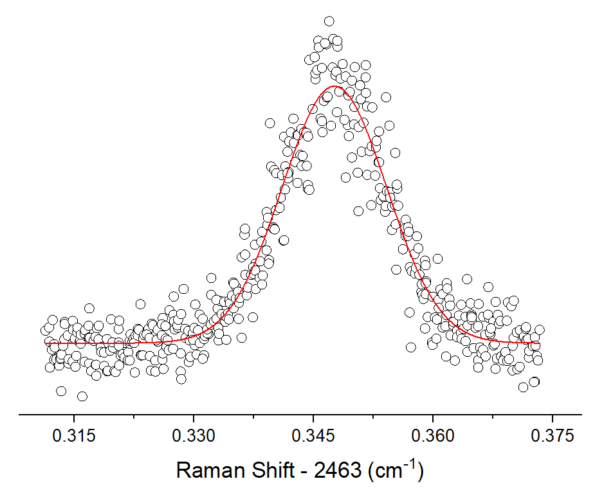

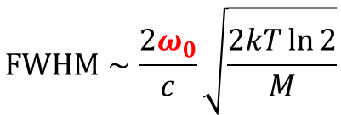
Doppler-limited measurement
Doppler-limited spectrum
Stokes
$$FWHM∼\frac{2ω_{0}}{c}\sqrt{\frac{2kT\ln{2}}{M}}$$
 | Q-branch Doppler Width @ Room temp
D₂ | 550 MHz
HT | 630 MHz
DT | 450 MHz
T₂ | 370 MHz
ω_{p}
ω_{s}
ω_{p}
ω_{as}
Pump
$$ω_{0}$$
Pump
Anti-Stokes
T₂ Q(1)
$$ω_{as}=2ω_{p}−ω_{s}$$
$$ω_{R}=ω_{p}−ω_{s}$$
450 MHz

Slide 9
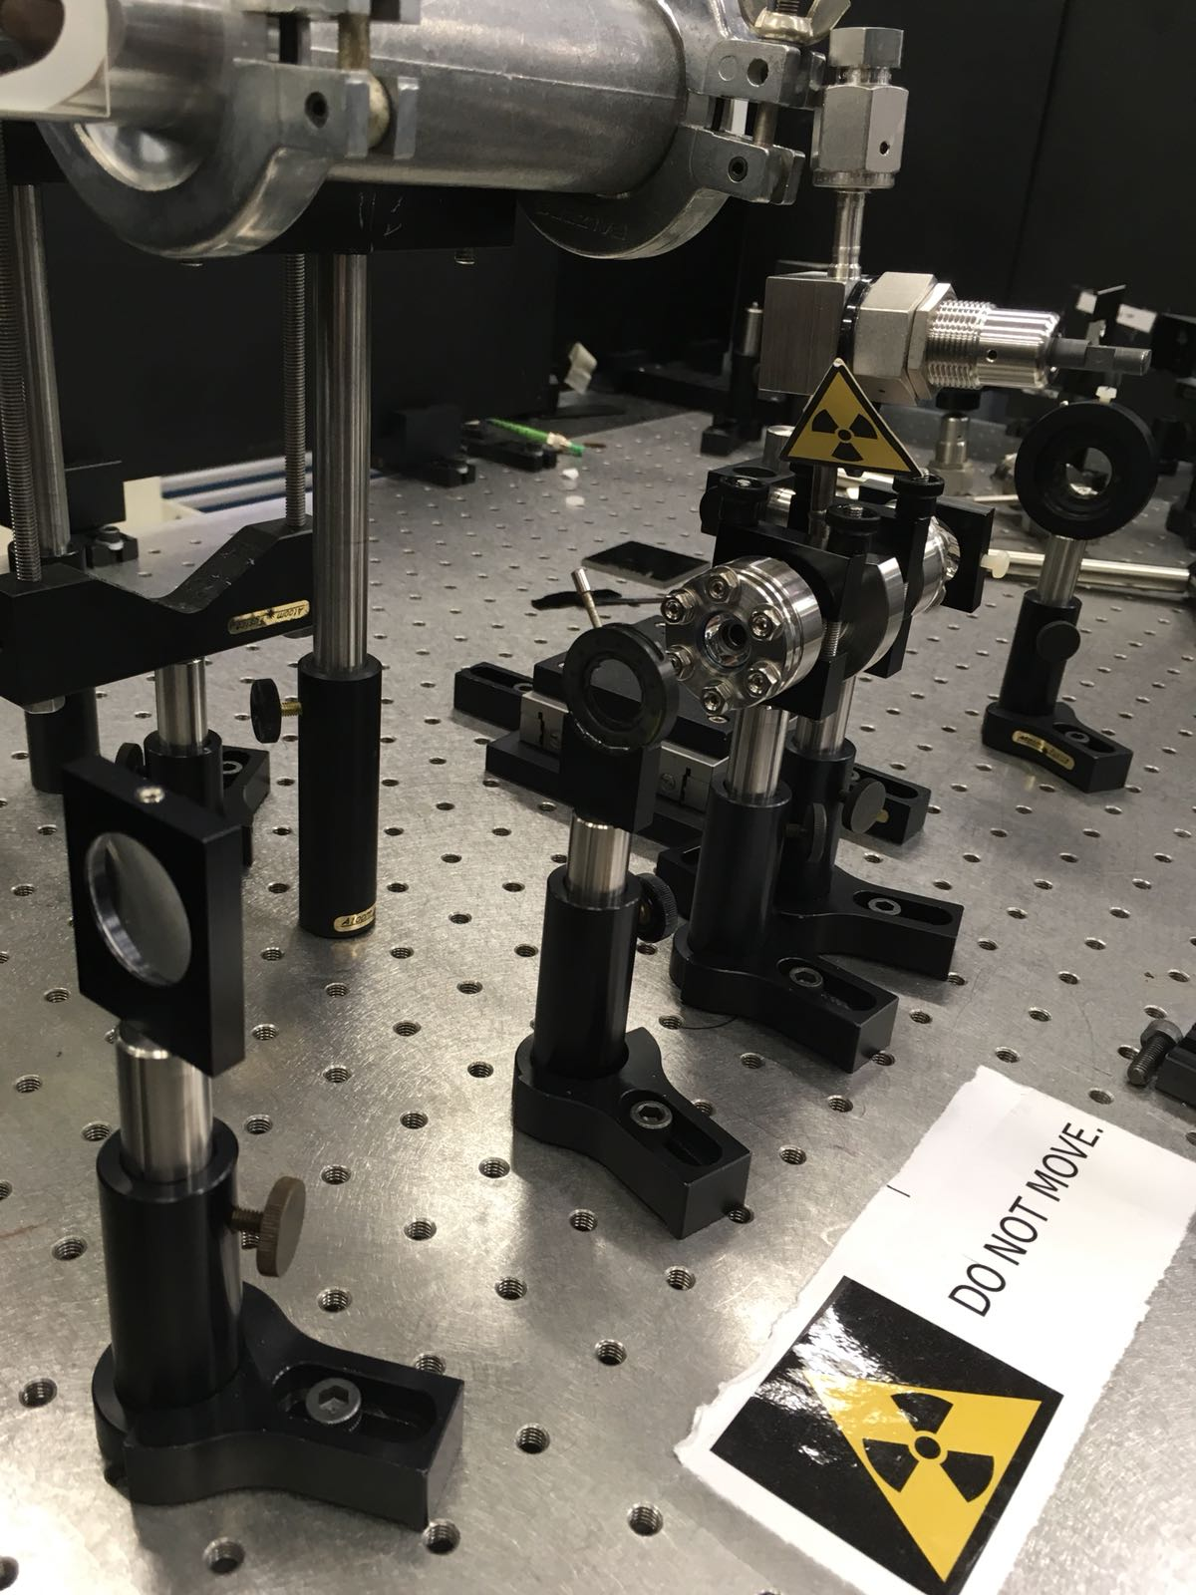




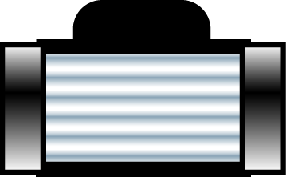



Experimental Setup
Wavemeter
Stokes
Virtual state
Seeded pulsed Nd-YAG (532nm)
ω_{p}
ω_{p}
ω_{s}
ω_{p}
ω_{as}
Gas cell
CW ring dye laser
Pulsed dye amplifier
v = 1, J’
ω_{s}
Pump
Lens 1
f = 20cm
Lens 2
f = 10cm
Pump
v = 0, J”
Anti-Stokes
Chirp analysis
ω_{as}
Freq. uncertainty:
6 MHz
I₂ saturation
Bandpass filter
PMT
Stabilized HeNe laser
Reference etalon
FSR ~ 150 MHz

Slide 10
Experimental Setup
Wavemeter
Stokes
Virtual state
Seeded pulsed Nd-YAG (532nm)
ω_{p}
ω_{p}
ω_{s}
ω_{p}
ω_{as}
Gas cell
CW ring dye laser
Pulsed dye amplifier
v = 1, J’
ω_{s}
Pump
610-620 nm
Lens 1
f = 20cm
Lens 2
f = 10cm
Pump
v = 0, J”
Anti-Stokes
Chirp analysis
cw light freq. uncertainty:
1 MHz
ω_{as}
Stokes cw-pulse freq. offset
~ 20 (5) MHz for DCM dye
~ -30 (5) MHz for Rh. 101 dye
I₂ saturation
Bandpass filter
PMT
Stabilized HeNe laser
Reference etalon
FSR ~ 150 MHz

Slide 11
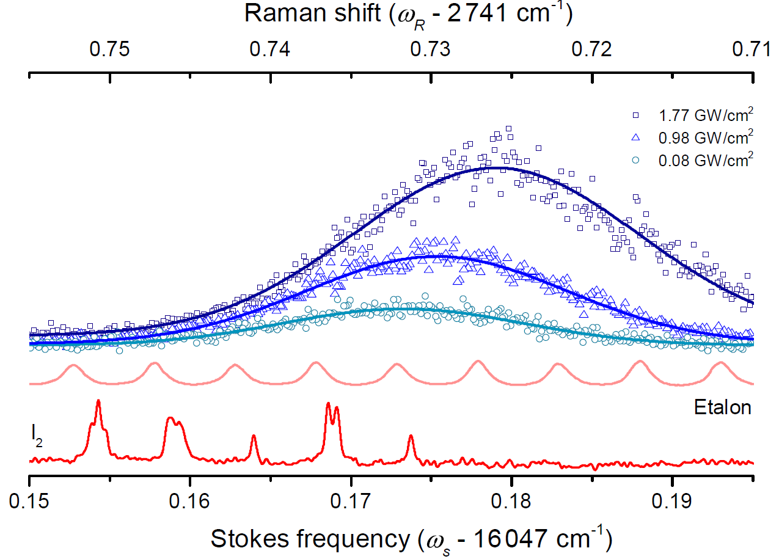

Experimental Setup
Wavemeter
Stokes
Virtual state
Seeded pulsed Nd-YAG (532nm)
ω_{p}
ω_{p}
ω_{s}
ω_{p}
ω_{as}
Gas cell
CW ring dye laser
Pulsed dye amplifier
v = 1, J
ω_{s}
Pump
Lens 1
f = 20cm
Lens 2
f = 10cm
Pump
v = 0, J
Anti-Stokes
Chirp analysis
ω_{as}
$$ω_{R}=ω_{p}−ω_{s}$$
I₂ saturation
Bandpass filter
PMT
Stabilized HeNe laser
Reference etalon
FSR ~ 150 MHz

Slide 12
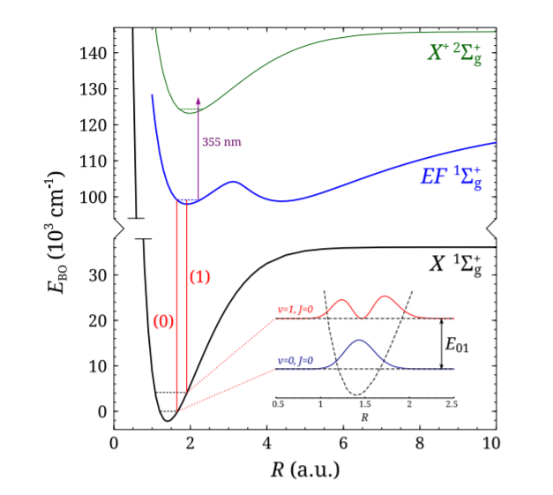
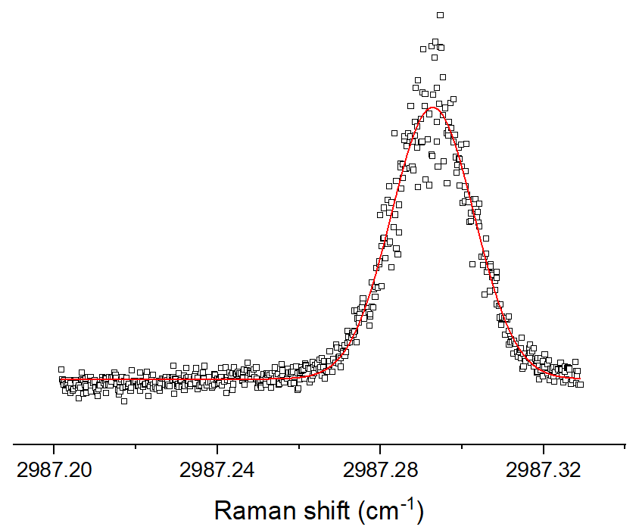
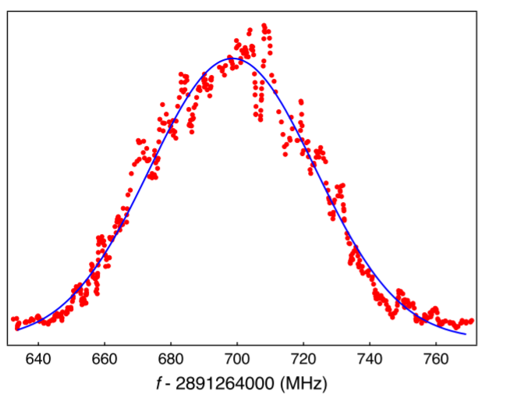
Benchmark: D₂ Q-branch
Fundamental band (v = 1 ← 0) with molecular beam setup
G. D. Dickenson et al., PRL 110, 193601 (2013)
Preparation of DT
D₂ + T₂ ➔ D₂ + DT + T₂
4 : 1
Ion Detection
D₂ Q(2)
~ 8 mbar in DT cell
60 MHz
700 MHz
Uncertainty D₂ Q-branch
4.5 MHz / 1.5 x 10⁻⁴ cm⁻¹

Slide 13
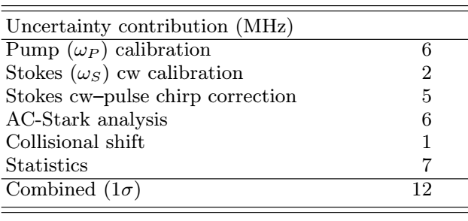
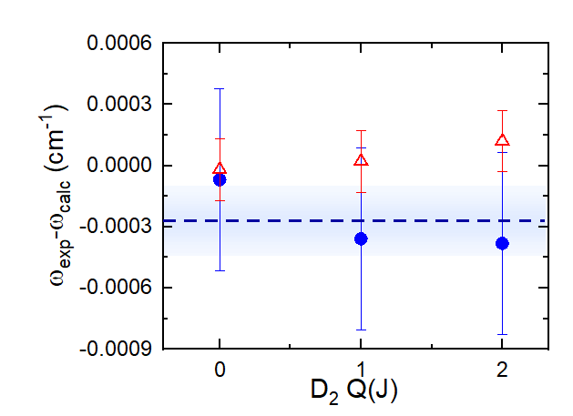
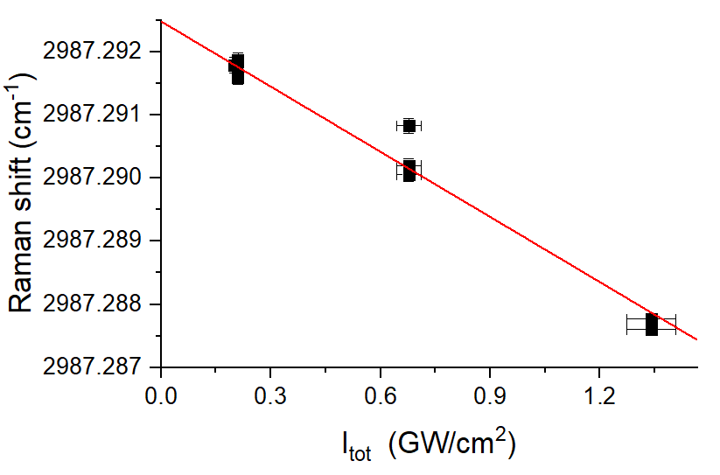
Benchmark: D₂ Q-branch
D₂ Q(2) ac-Stark analysis
Δ Molecular beam experiment
● This work

Slide 14
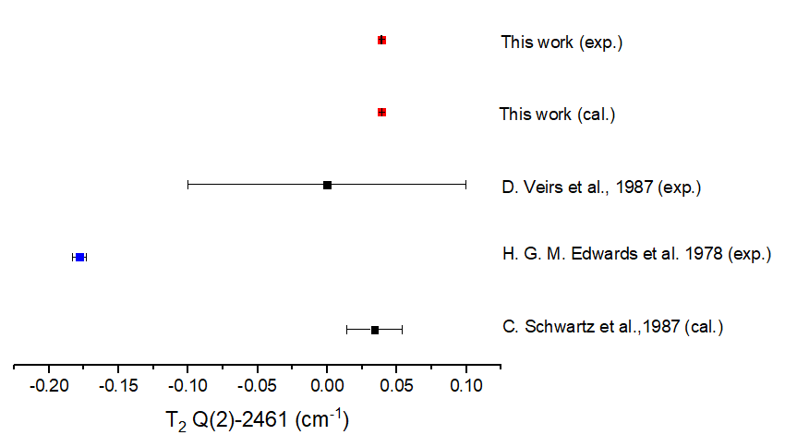
Comparison with old results

Slide 15
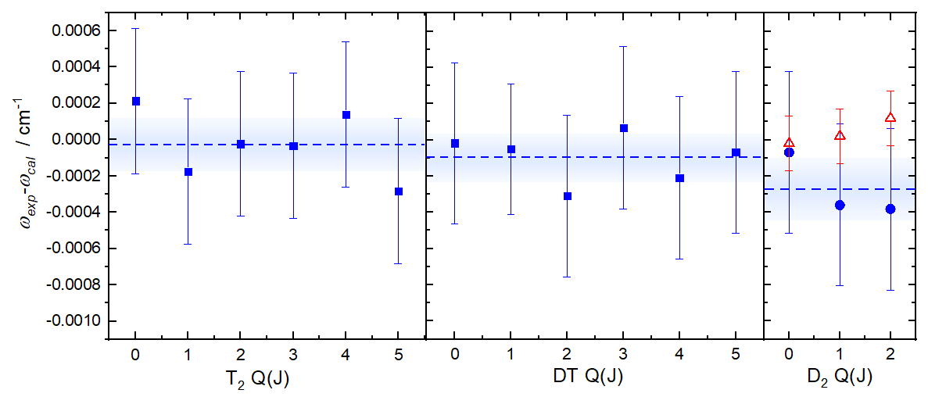
Comparison with calculation

Slide 16
Comparison with calculation
Mainly dominated non-adiabatic contribution of E⁽²⁾
Possible to do full calculation on E⁽²⁾
With uncertainty ~ 10⁻⁸ cm⁻¹
T₂ Q(1) uncertainty < 10⁻⁵ cm⁻¹
> 10-times less than our measurement uncertainty

Slide 17
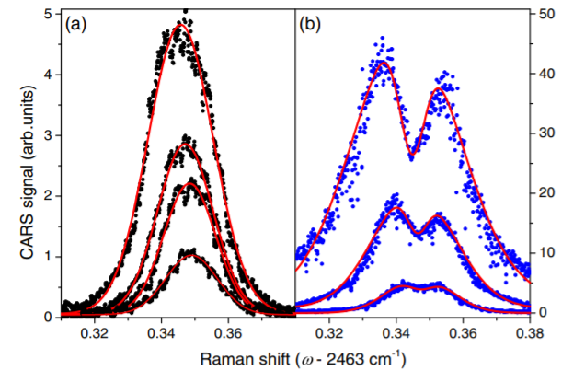
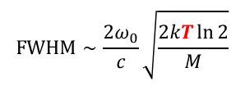
Doppler-limited measurement
Molecular beam CARS (not for tritiated species)
~100 MHz (laser bandwidth of current setup)
Cooling sample cell with pre-cooled air
300 K → ~ 100 K
450 MHz → ~250 MHz
Saturation CARS
 | Q-branch Doppler Width @ room temp
D₂ | 550 MHz
HT | 630 MHz
DT | 450 MHz
T₂ | 370 MHz
$$FWHM∼\frac{2ω_{0}}{c}\sqrt{\frac{2kT\ln{2}}{M}}$$
~ 300 MHz
T₂ Q(1)
450 MHz

Slide 18
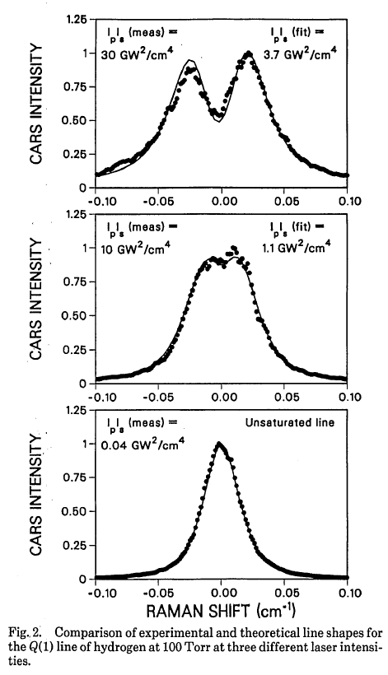
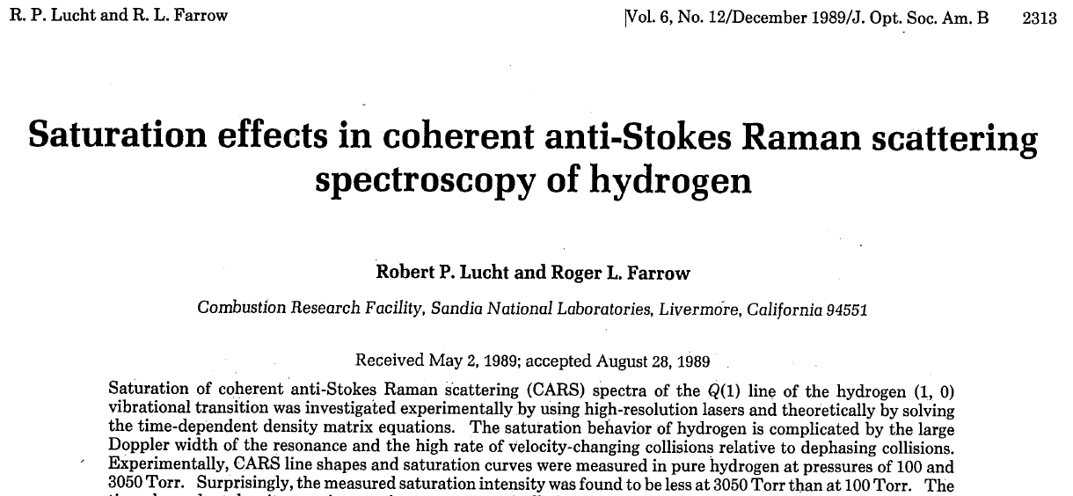
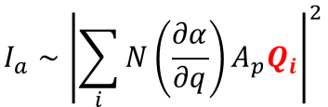
Saturation of CARS profile
Saturation in upper level
Interference coherence (Q_{i}) by different velocity classes
$$I_{a}∼{\left|\sum_{i}{N\left(\frac{∂α}{∂q}\right)A_{p}Q_{i}}\right|}^{2}$$

Slide 19
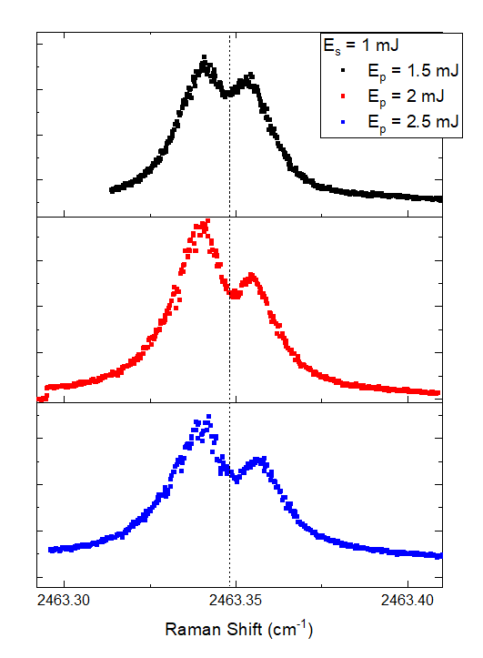
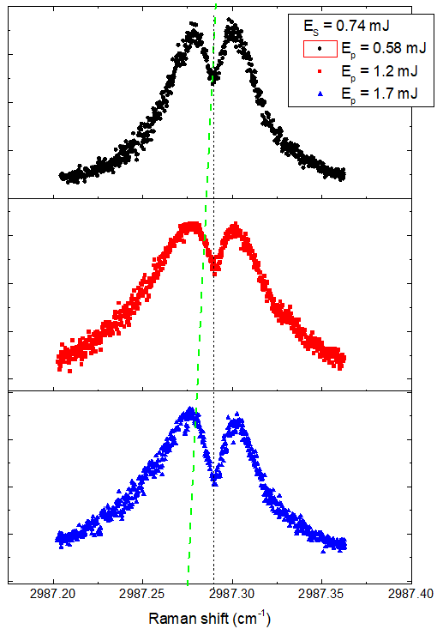
Saturation of CARS profile
T₂ Q(1)
D₂ Q(2)
Unexpected ac-stark shift
Doppler profile getting more asymmetric at high energy
Position of saturation dip is not centered at Doppler profile
Need full understanding about the saturated profile

Slide 20
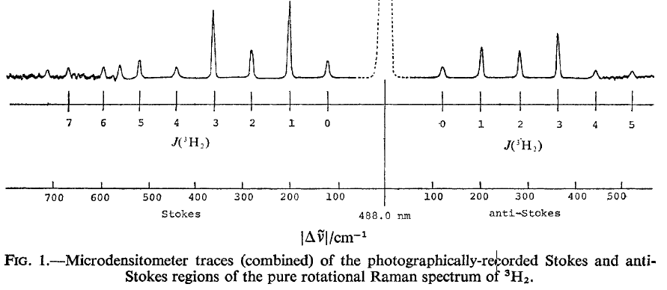



Pure Rotational Transition
Stokes
Virtual state
 | S(0) Doppler Width @ room temp | Expected linewidth
D₂ | 33 MHz | <100 MHz (depending on laser bandwidth)
HT | 44 MHz
DT | 27 MHz
T₂ | 22 MHz
ω_{p}
ω_{s}
ω_{p}
ω_{as}
v = 0, J+2
$$ω_{0}$$
Pump
S-branch
ΔJ = 2
Pump
v = 0, J
Anti-Stokes
$$ω_{as}=2ω_{p}−ω_{s}$$
T₂ S(0) $ω_{0}$ ~ 120 cm⁻¹
Requiring 2 laser sources working at similar freq.
+
Separate anti-Stokes for detection
H.G.M. Edwards et al. J. Chem. Sot. Faraday Trans. II 74, 1203-
1207 (1978).

Slide 21
Conclusion & Outlook
D₂ Q(0)-Q(2) show good agreement with molecular beam experiment
T₂ and DT Q(0)-Q(5) have been measured with 12 MHz uncertainty
All of them have good agreement with latest calculated value
Move on to last isotopologue HT

Slide 22
Acknowledgement
T. Madhu Trivikram, Meissa Diouf, Edcel Salumbides and Wim Ubachs
LaserLab, VU Amserdam
Rob Kortekass
Technical help

Slide 23
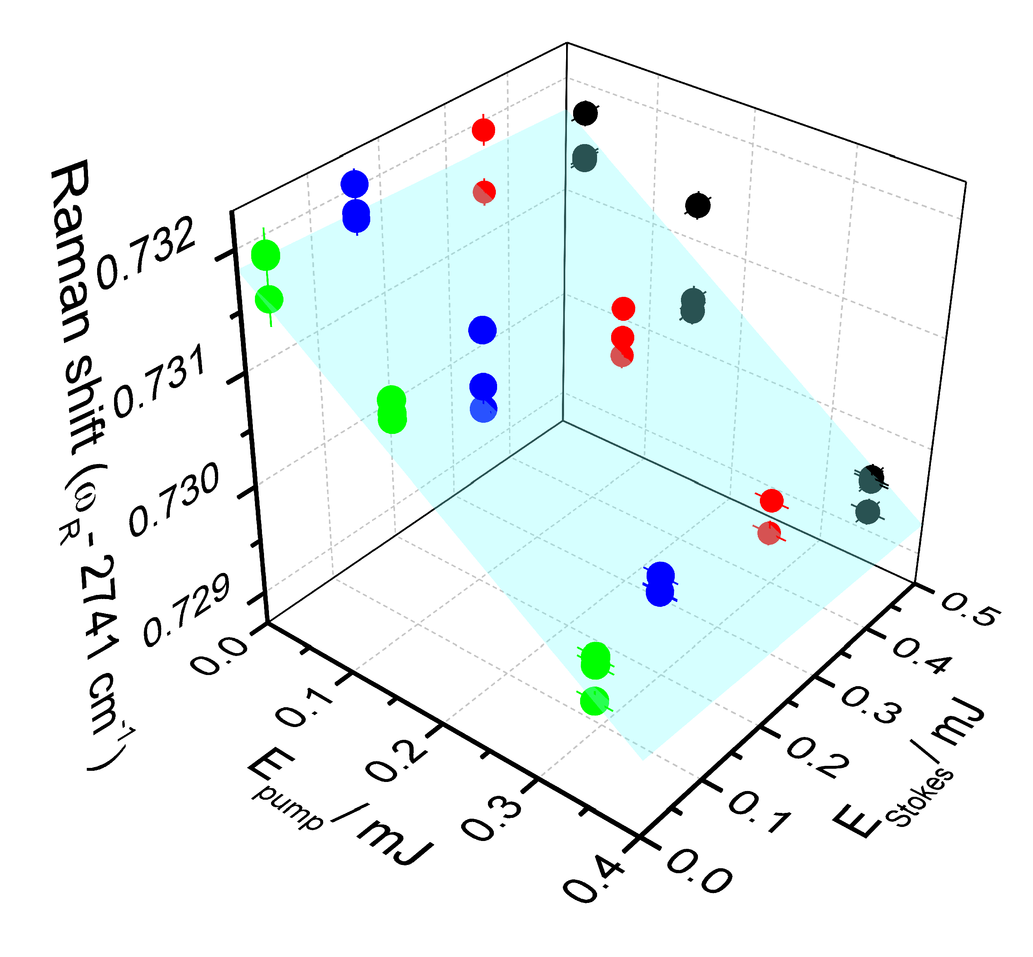
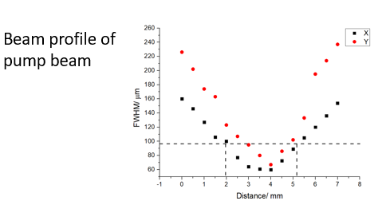
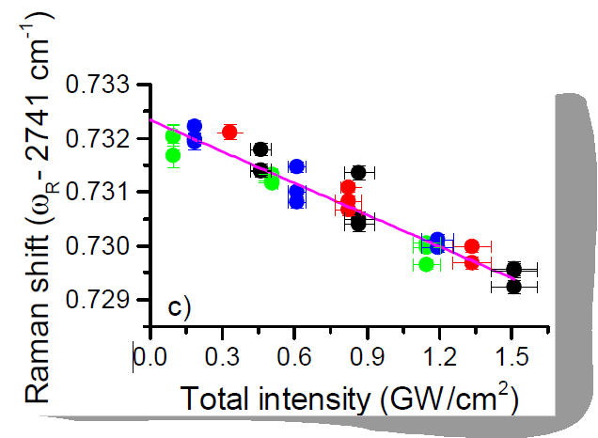
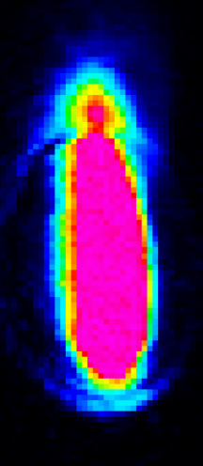

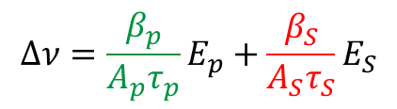
AC-Stark shift
$$Δν=\frac{β_{p}}{A_{p}τ_{p}}E_{p}+\frac{β_{S}}{A_{S}τ_{S}}E_{S}$$
$$β_{p}≅β_{S}$$
Doppler width

Slide 24
Comparison with calculation
Mean difference:
6 MHz/ 2 x 10⁻⁴ cm⁻¹

Slide 25
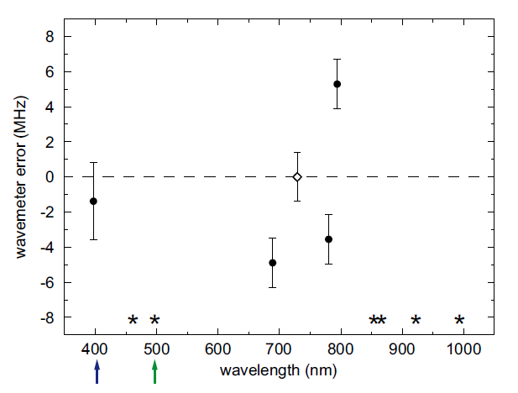
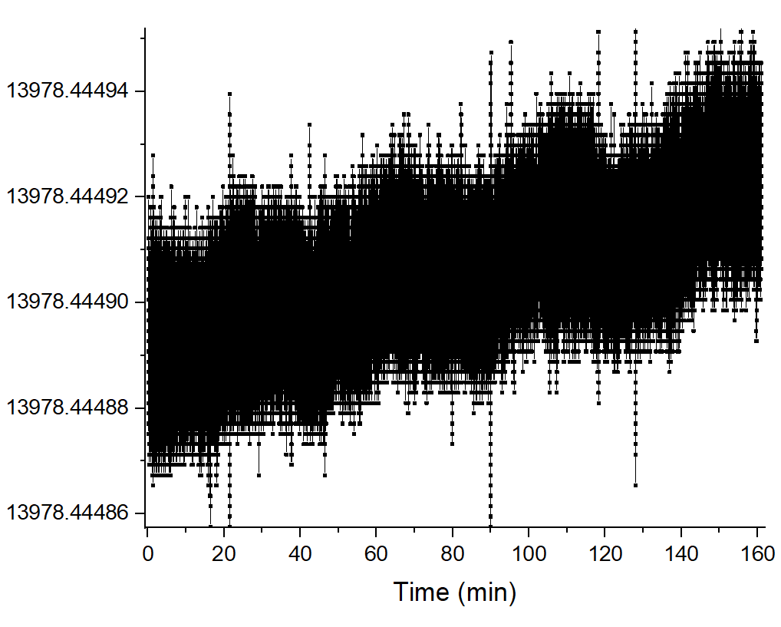
Pump Frequency Calibration
S. Stellmer et al. Phys. Rev. A 90, 022512 (2014)
High Finesse WS-U wavemeter
Drift rate:
0.1 MHz/ hr (from Stellmer)
0.3 MHz /hr (measured from comb-locked Ti-Sa)

Slide 26
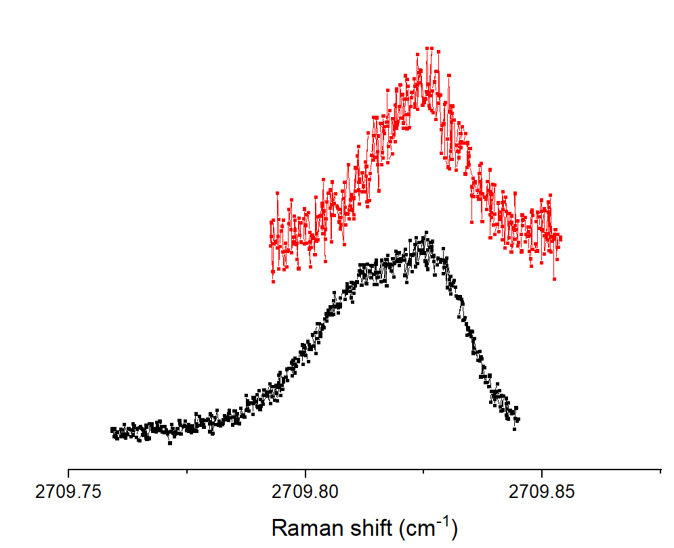
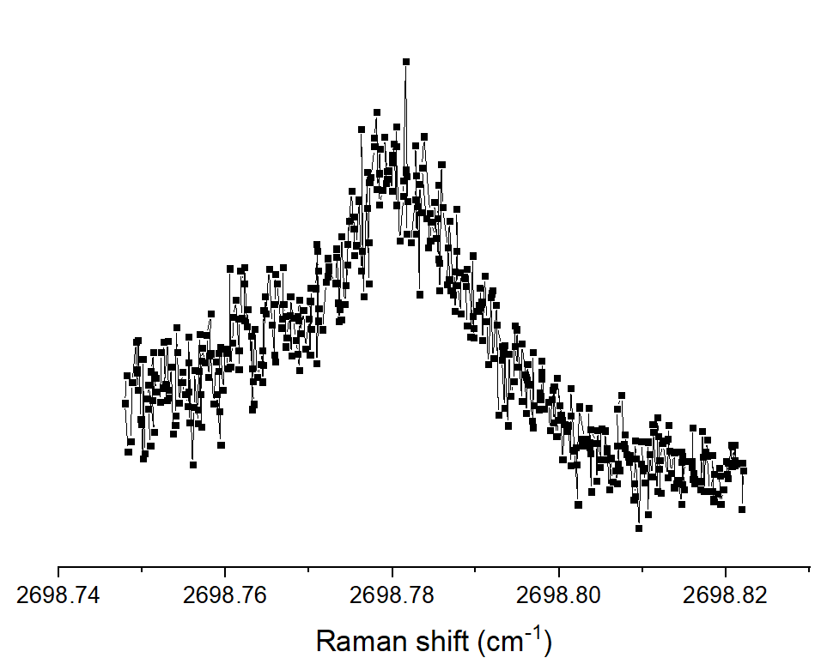
Other artefacts of CARS profile
DT Q(6) at different power
m_{J} splitting at high power
Non-resonant background interference
DT Q(7)

Slide 27
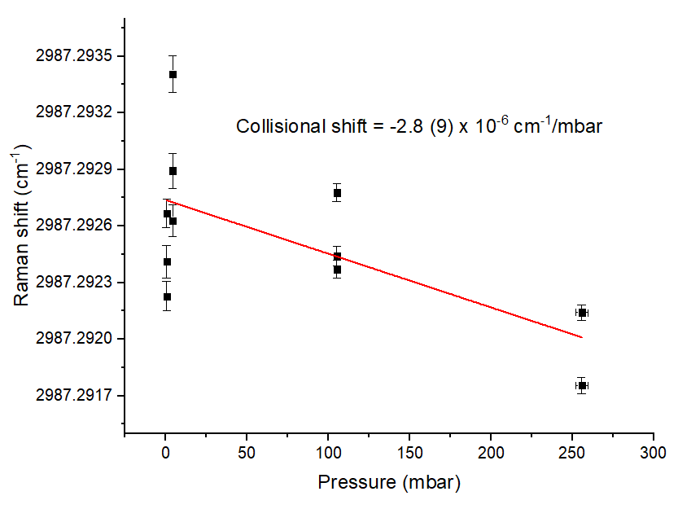
Collisional shift
Preliminary pressure studies on D₂ Q(2)
Collisional shift coefficient from literature
 | Q(0) | Q(1) | Q(2)
H₂ª | -2.28(6) | -3.38(5) | -2.05(6)
HD^{b} | -4.9(2) | -4.3(2) | -3.9(2)
D₂^{c} | -1.9(1) | -1.9(1) | -1.8(1)
Units in 10⁻⁶ cm⁻¹/mabr
ª Larry A. Rahn et al. Phys. Rev. A 41, 3698 (1990)
^{b} G.J. Rosasco et al. J. Chem. Phys. 90, 2115 (1989)
^{c} G.J. Rosasco et al. J. Chem. Phys. 94, 7625 (1991)
In DT cell,
D₂ pressure ~ 8 mbar
DT pressure ~ 4 mbar
Collisional shift ~ 3 x 10⁻⁵ cm⁻¹
In T₂ cell,
T₂ pressure ~ 2.5 mbar
Collisional shift < 1 x 10⁻⁶ cm⁻¹

Slide 28
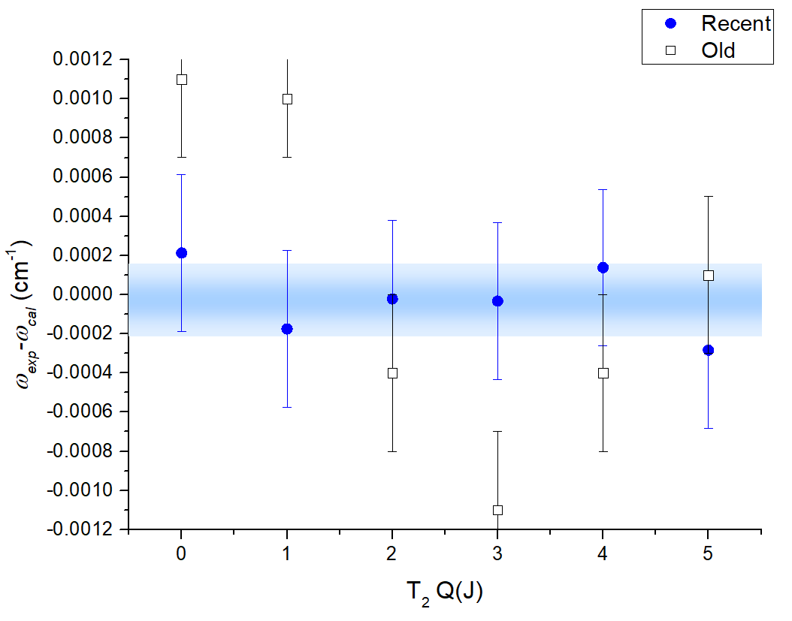
Revisit T₂ Q-branch

Slide 29
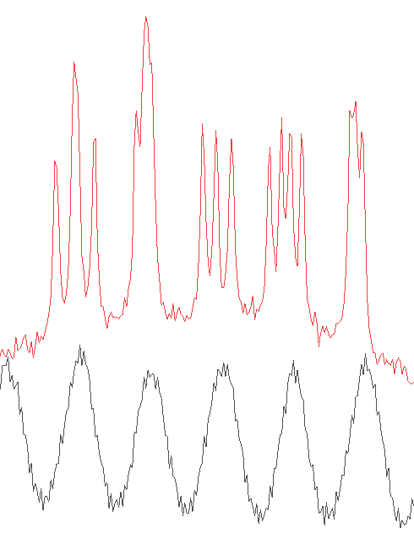
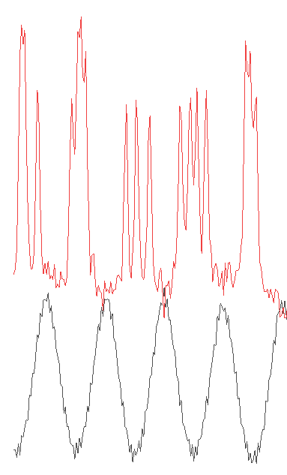
Biased Revisit of
T₂ Q-branch
Etalon FSR changed within same day
Q(3) ~42 FSR away from I₂ line
Q(0) ~20 FSR

