Slide 1




High-Precision Measurement of the Deuteron’s Atomic Mass
International Conference on Precision Physics and Fundamental Physical Constants
Sascha Rau

Slide 2
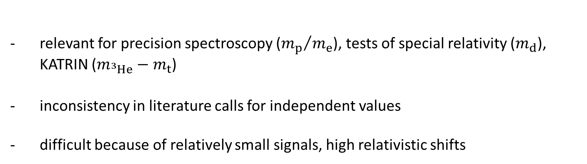
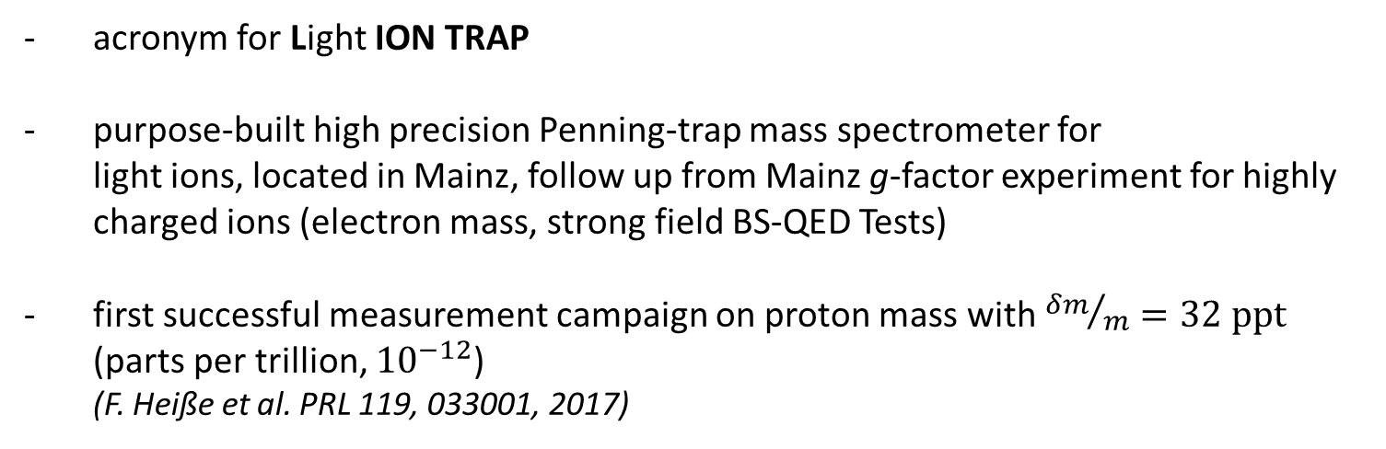
$$What is LIONTRAP?$$
acronym for Light ION TRAP
purpose-built high precision Penning-trap mass spectrometer for
light ions, located in Mainz, follow up from Mainz g-factor experiment for highly charged ions (electron mass, strong field BS-QED Tests)
first successful measurement campaign on proton mass with ${δm}/m=32 ppt$ (parts per trillion, ${10}^{−12}$)
(F. Heiße et al. PRL 119, 033001, 2017)
Why are mass measurements on light ions important?
relevant for precision spectroscopy (${m_{p}}/{m_{e}}$), tests of special relativity ($m_{d}$), KATRIN ($m_{{}_{ }^{3}{He}}−m_{t}$)
inconsistency in literature calls for independent values
difficult because of relatively small signals, high relativistic shifts

Slide 3
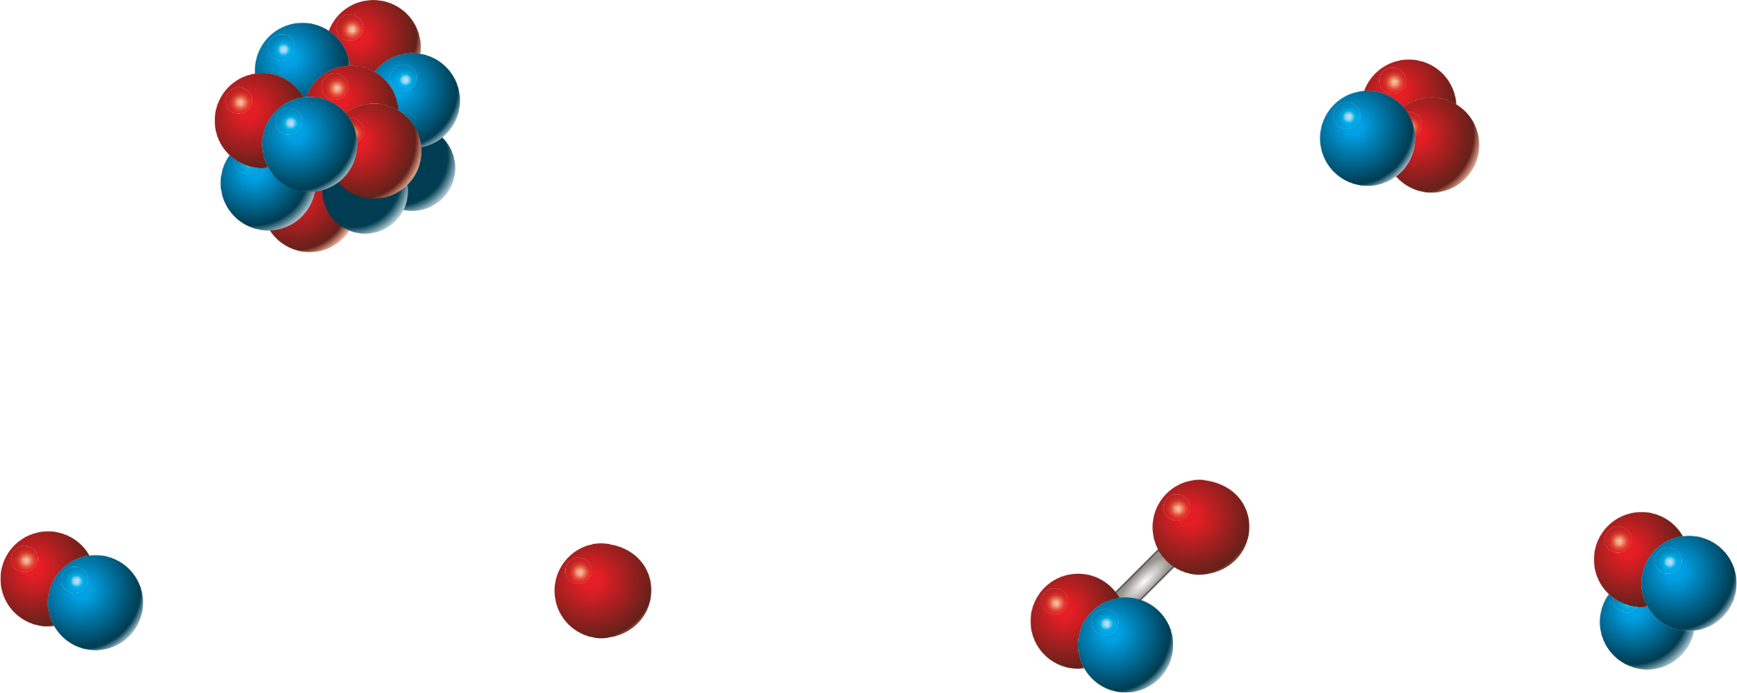
$$Puzzle of Light Atomic Masses$$
R.S. Van Dyck et al. @ UW
E. Myers et al. @ FSU
[2]
¹²C
?
³He
4.4 σ
790(180) pu
Deviation
[3]
[2]
?
?
?
[1]
[3]
D
H
HD
T
+ Binding Energy [4]
[3] E. Myers et al., PRL 114, 013003 (2015)
[1] R. S. Van Dyck Jr. et al., AIP Conf. Proc. 457, 101 (1999)
[4] Yan et al., PRA 67, 062504 (2003)
[2] S. L. Zafonte et al., Metrologia 52, 280 (2015)

Slide 4
$$Puzzle of Light Atomic Masses$$
R.S. Van Dyck et al. @ UW
E. Myers et al. @ FSU
[2]
¹²C
?
³He
3.5 σ
560(160) pu
Deviation
[3]
[2]
?
?
?
[1]
Our Measurement
[3]
D
H
HD
T
+ Binding Energy [4]
[3] E. Myers et al., PRL 114, 013003 (2015)
[1] F. Heiße et al., PRL 119, 033001 (2017)
[4] Yan et al., PRA 67, 062504 (2003)
[2] S. L. Zafonte et al., Metrologia 52, 280 (2015)
Notes:
-230 nu
056(16) nu

Slide 5
$$Puzzle of Light Atomic Masses$$
R.S. Van Dyck et al. @ UW
E. Myers et al. @ FSU
[2]
¹²C
?
³He
4.8 σ
490(97) pu
Deviation
New Measurement
[5]
[2]
?
?
?
[1]
Our Measurement
[3]
D
H
HD
T
+ Binding Energy [4]
[3] E. Myers et al., PRL 114, 013003 (2015)
[1] F. Heiße et al., PRL 119, 033001 (2017)
[4] Korobov et al., PRL. 118, 233001 (2017)
[2] S. L. Zafonte et al., Metrologia 52, 280 (2015)
[5] S. Hamzeloui et al, PRA 96, 060501 (2017)
Notes:
0.47(10) nu

Slide 6
Outline
Setup and Experimental Techniques
- a new ultra-harmonic trap
Proton’s Atomic Mass
F. Heiße et al., PRL 119, 033001 (2017)
Deuteron’s Atomic Mass

Slide 7
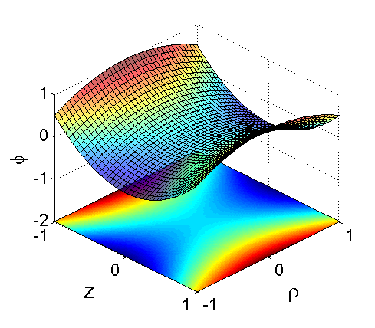
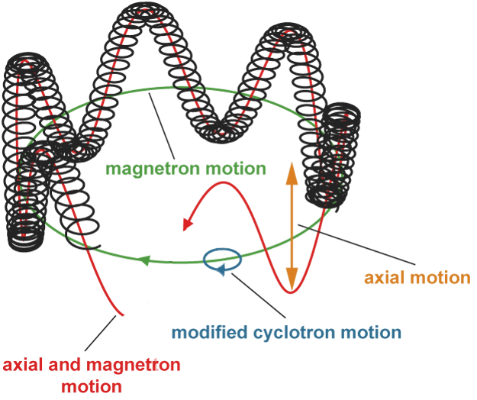
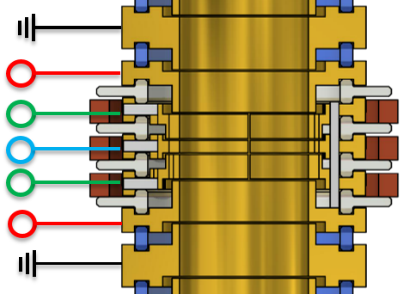
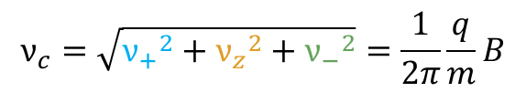


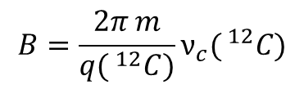
Experimental Approach
measurement of cyclotron frequency:
→ homogenous static magnetic field
$$ν_{C}=\frac{1}{2π}\frac{q}{m}B$$
→ electrostatic quadrupole potential for trapping
Penning trap:
B = 3.8 T
Deuteron:
$$ν_{+}\sim 28MHz$$
$$ν_{z}\sim 460kHz$$
$$ν_{−}\sim 4kHz$$
U_{UC2} ~ -8 V
U_{UC1} ~ -9 V
U_{R} ~ -10 V
U_{LC1} ~ -9 V
U_{LC2} ~ -8 V
d
1cm
$$B=\frac{2π m}{q( ^{12}C)}ν_{c}( ^{12}C)$$
cyclotron frequency via invariance theorem [1]:
$$ν_{c}=\sqrt{{ν_{+}}^{2}+{ν_{z}}^{2}+{ν_{−}}^{2}}=\frac{1}{2π}\frac{q}{m}B$$
[1] L.S. Brown & G. Gabrielse, PRA 25, 2423 (1982)

Slide 8
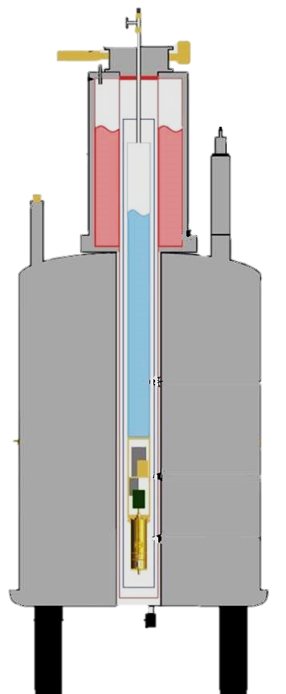
Setup
offline Experiment
liquid Helium temperature
hermetically sealed
trap chamber
in situ ion creation
using miniature
EBIT/S
Liquid Helium
(T = 4 K)
2.3 m
3.8 T
superconducting
Magnet
cryoelectronic
section
Trap chamber
p < 10⁻¹⁶ mbar
Notes:
-6:40

Slide 9
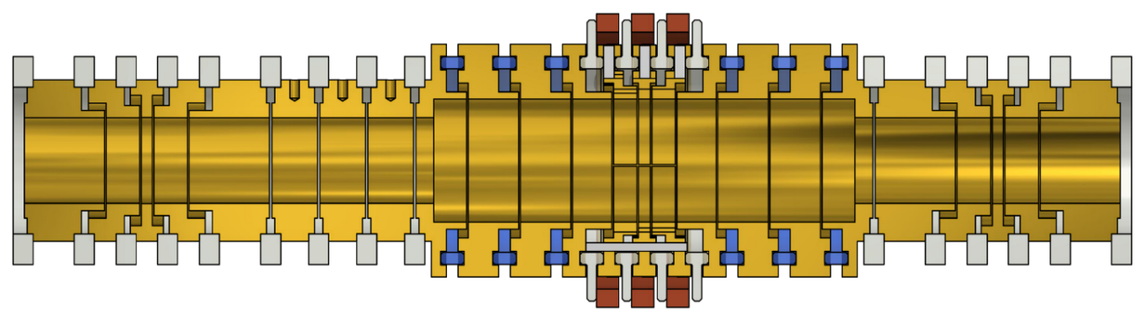
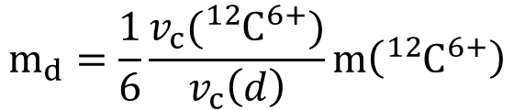
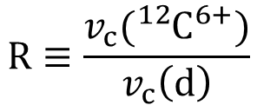

Measurement Procedure
$$m_{d}=\frac{1}{6}\frac{v_{c}({}_{ }^{12}{C^{6+}})}{v_{c}\left(d\right)}m\left({}_{ }^{12}{C^{6+}}\right)$$
$$d$$
¹²C⁶⁺
Storage
trap 2 (ST2)
Precision trap
(PT)
Storage
trap 1 (ST1)
both ions at the same time within the trap chamber
(I) v_{c}(d) in PT
$$R≡\frac{v_{c}({}_{ }^{12}{C^{6+}})}{v_{c}\left(d\right)}$$
(II) ν_{c}(¹²C⁶⁺) in PT
time between v₊ measurements optimized
  reduction of impact of magnetic field fluctuations compared to former measurements
Notes:
-6:40

Slide 10
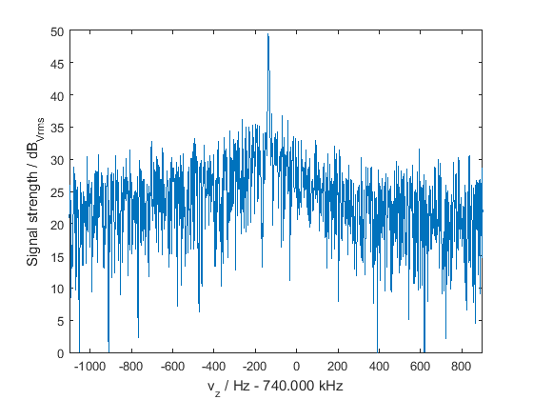
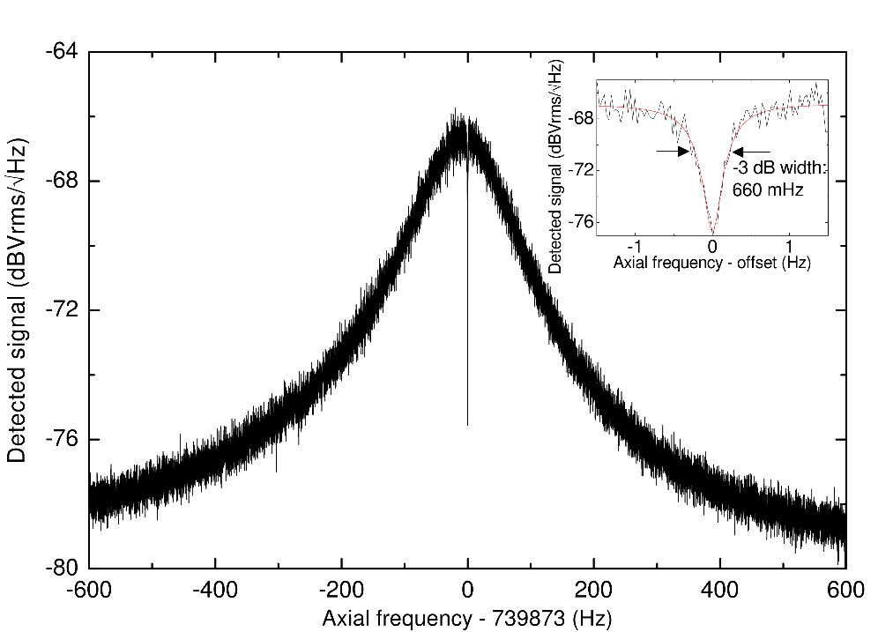

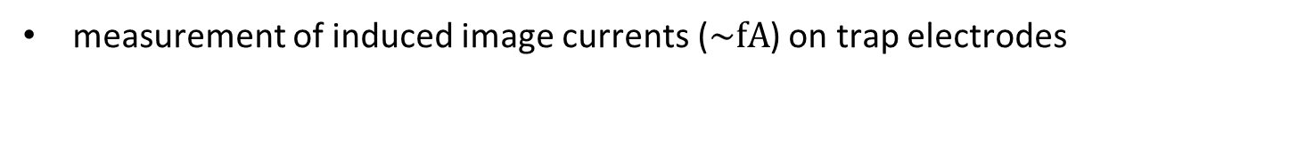
Eigenfrequency Detection
measurement of induced image currents ($\sim fA$) on trap electrodes
superconducting
tank circuit
ultra low noise
cryogenic amplifiers
A
fourier transformation
Signal (dB)

Slide 11
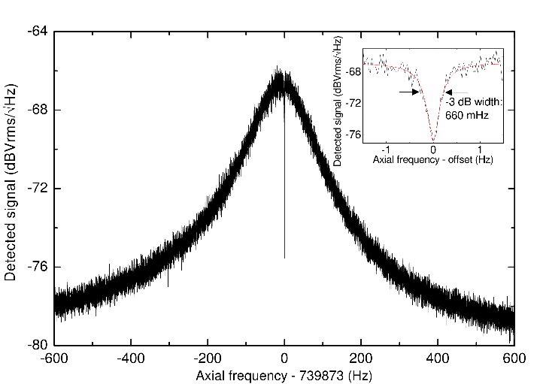

Eigenfrequency Measurement Techniques
1. Dip Signal
    v_{z} of thermalized ion (T_{z}=4.5 K) measured as narrow “dip”
  2. Double-Dip Signal:
    v₊, v₋ coupled to axial motion
    via rf-sideband coupling
740 000
    Advantages: - Thermal equilibrium during measurement
    → Small energy dependent systematic shifts
    Disadvantages: - → “slow” (3 min) → impact of field fluctuations
    - Lineshape dependent

Slide 12
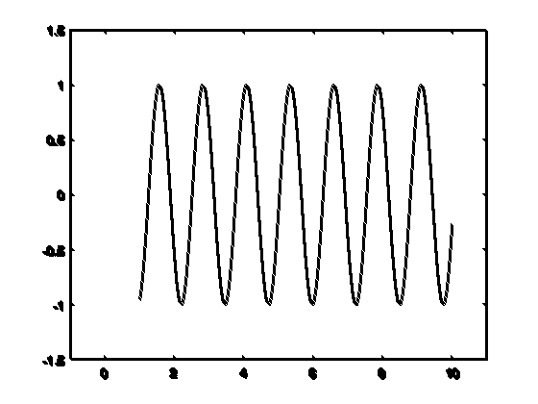



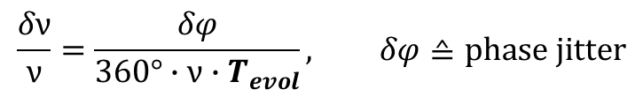
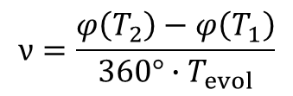
Phase-Sensitive Detection Method
A phase sensitive measurement scheme allows coherent detection.
The complex Fourier spectrum provides besides the peak position in the Fourier spectrum also the instantaneous phase of the ion.
Electrode
$$ν=\frac{φ\left(T_{2}\right)−φ\left(T_{1}\right)}{360°∙T_{evol}}$$
Dipolar excitation
$$φ(T_{1})$$
SNR_{peak}
$$φ(T_{2})$$
$$T_{evol}=T_{2}−T_{1}$$
    Advantages:
    -linear scaling with Measurement Time
    -no lineshape model needed
$$\frac{δν}{ν}=\frac{δφ}{360°∙ν∙T_{evol}}, δφ≙phase jitter$$

Slide 13

A New Ultra-Harmonic Trap
U
Ideal world:
$$U\left(z\right)=\frac{1}{2}U_{r}\left(C0+C2\frac{z2}{d_{char}^{2}}\right)$$
→ v_{z} independent of energy!
z
Real world:
U
→ v_{z} depends on energy!
z

Slide 14
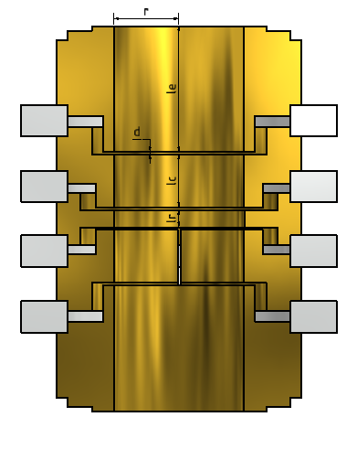
A New Ultra-Harmonic Trap
Real world:
$$U\left(z\right)=\frac{1}{2}U_{r}\left(C0+C2\frac{z2}{d_{char}^{2}}+C4\frac{z4}{d_{char}^{4}}+C6\frac{z6}{d_{char}^{6}}+C8\frac{z8}{d_{char}^{8}}+C10\frac{z10}{d_{char}^{10}}+…\right)=\frac{1}{2}U_{r}\sum_{i=0,2,…}^{∞}{C_{i}\frac{z^{i}}{d_{char}^{i}}}$$
So far:
Use one pair of correction
electrodes
Degrees of freedom: L_{R}, L_{C}, U_{C}
U_{C} ~ -9 V
U_{R} ~ -10 V
U_{C} ~ -9 V
Optimized parameters:
C₄=C₆=0 (compensated)

Slide 15

A New Ultra-Harmonic Trap
Real world:
$$U\left(z\right)=\frac{1}{2}U_{r}\left(C0+C2\frac{z2}{d_{char}^{2}}+C4\frac{z4}{d_{char}^{4}}+C6\frac{z6}{d_{char}^{6}}+C8\frac{z8}{d_{char}^{8}}+C10\frac{z10}{d_{char}^{10}}+…\right)=\frac{1}{2}U_{r}\sum_{i=0,2,…}^{∞}{C_{i}\frac{z^{i}}{d_{char}^{i}}}$$
New trap (additional pair of correction electrodes)
Degrees of freedom: L_{R}, L_{C1}, U_{C1,} L_{C2,} U_{C2}
Optimized parameters:
C₄=C₆=C₈=C₁₀=0
(doubly compensated)
U_{C2} ~ -8 V
U_{C1} ~ -9 V
U_{R} ~ -10 V
U_{C1} ~ -9 V
U_{C2} ~ -8 V
10mm
Notes:
1:50

Slide 16
A New Ultra-Harmonic Trap - Performance
Study shifts of axial freq. due to magnetron bursts:
$$\frac{∆ν_{z}}{ν_{z}}=−\frac{3}{2}\frac{C_{4}}{d_{char}^{2}C_{2}}r_{−}^{2}+\frac{15}{8}\frac{C_{6}}{d_{char}^{4}C_{2}}r_{−}^{4}−\frac{35}{8}\frac{C_{8}}{d_{char}^{6}C_{2}}r_{−}^{6}+…$$
MIT/FSU Trap (hyperbolic)
[S. Rainville Ph.D. Thesis]
Preliminary!
Our former bound-electron
g-factor experiment (m_{e})
F. Heiße et al., PRA, accepted
Notes:
1;50
Screw up your harmonic potential
Calcium\Measurement\2017_08_23\MT\Carbon\TR\20171002II\OptTRAuswertung.opj
Rainville Doktorarbeit S. 31
Vz=212kHz; Ci-Expansion identical except no C2!!!, dchar=5.49mm (our dchar: 5.107mm) dvz=0.7Hz at rm=1mm, so in our system: 0.7/212*515
Carl Sagan: The universe is not required to be in perfect harmony with human ambition
When you start running your experiment you do not end up with your optimized electric potential, due to machining errors and patch potentials, which are charged islands on the inner surfaces of the electrodes.

Slide 17
Outline
Setup and Experimental Techniques
- a new ultra-harmonic trap
Proton’s Atomic Mass
F. Heiße et al., PRL 119, 033001 (2017)
Deuteron’s Atomic Mass

Slide 18
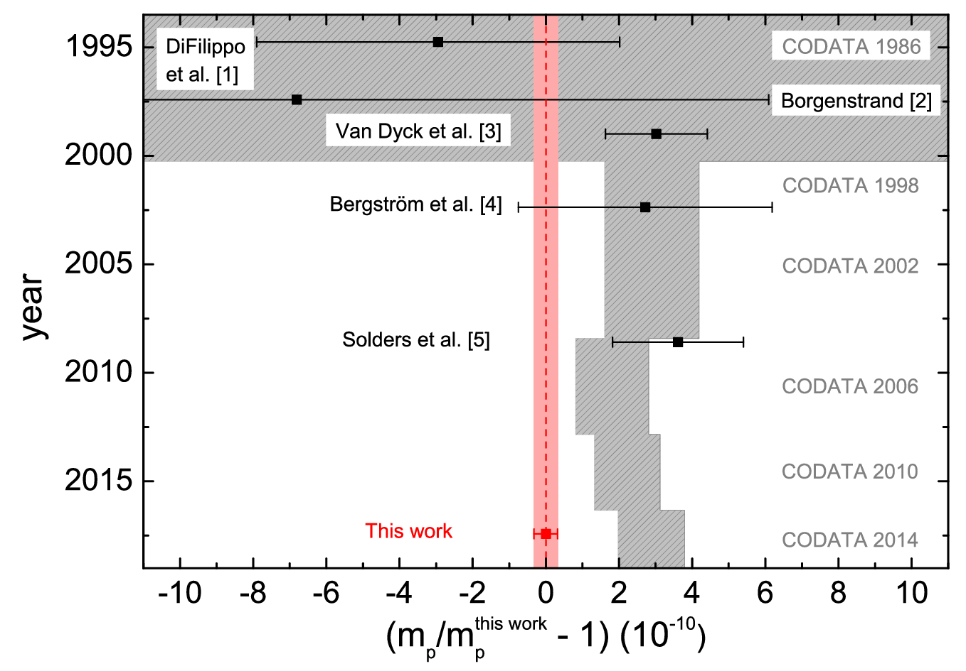
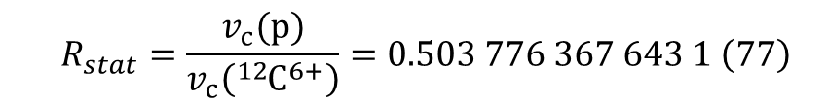
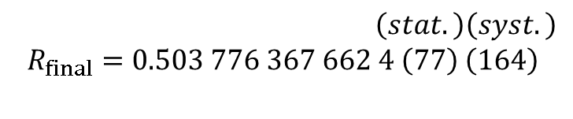

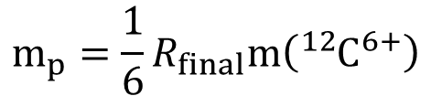
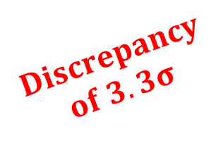
Results
$$m_{p}=\frac{1}{6}R_{final}m\left({}_{ }^{12}{C^{6+}}\right)$$
$$Discrepancy$$
$$of 3.3σ$$
(stat) (syst)
$$m_{p}=1.007 276 466 583 \left(15\right)\left(29\right) u$$
$$\frac{{δm}_{p}}{m_{p}}=3.2∙{10}^{−11}$$
→ Improvement by a factor of 3
[1] PRL 73, 1481 (1994). [2] Ph.D. thesis, Stockholm University (1997).
[3] AIP Conf. Proc. 457, 101 (1999). [4] Phys. Scr. 66, 201 (2002). [5] PRA 78, 2514 (2008).
[PRL 119, 033001 (2017)]
Notes:
0:55
2.2Sigma mit VanDyck

Slide 19
Results
[1] PRL 73, 1481 (1994). [2] AIP Conf. Proc. 457, 101 (1999).
[3] Phys. Scr. 66, 201 (2002). [4] PRA 78, 2514 (2008).
[5] PRL 119, 033001 (2017)
Notes:
0:55
2.2Sigma mit VanDyck

Slide 20
Proton/Electron Mass Ratio
[1]
[2]
[3]
[4]
[1] S. Alighanbari et al. Nat. Phys. 14, 555 (2018)
[2] M. Hori et al. Science 354, 610 (2016)
[3] F. Heiße et al., Phys. Rev. Lett. 119, 033001 (2017)
[4] S. Sturm et al. Nature 506, 467 (2014)

Slide 21
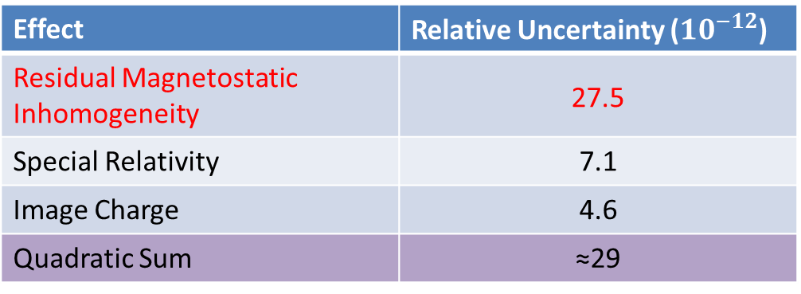


Systematic Uncertainties
Effect | Relative Uncertainty (${10}^{−12}$)
Residual Magnetostatic Inhomogeneity | 27.5
Special Relativity | 7.1
Image Charge | 4.6
Quadratic Sum | ≈29
Magnetic inhomogeneity:
B(z)=B₀+B₁z+B₂z²+…
<B>=B₀+B₂<z₀²>/2
$$3.8 T+{10}^{−9} T−$$
$$3.8 T−$$
B₂=-0.27(2)T/m²
B₁=0.92(1)mT/m
Superconducting
B1/B2-shim coils
$$≈100 μm$$
Notes:
Alle cs null, was ist mit den bs?

Slide 22
Outline
Setup and Experimental Techniques
- a new ultra-harmonic trap
Proton’s Atomic Mass
F. Heiße et al., PRL 119, 033001 (2017)
Deuteron’s Atomic Mass

Slide 23
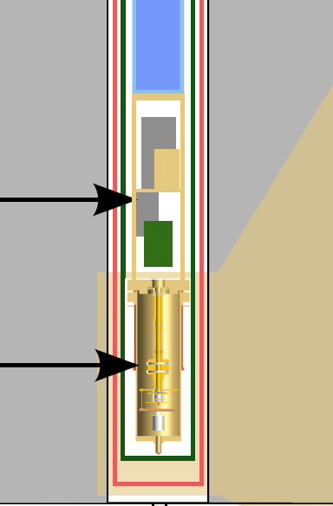
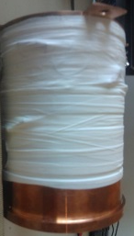
Solenoidal Superconducting B₂ Shim Coil
placed around trap chamber:
cryogenic
electronic
section
trap
chamber
Notes:
2:20
Wire Radius:
Acetylenflamme mit Schutzgas

Slide 24
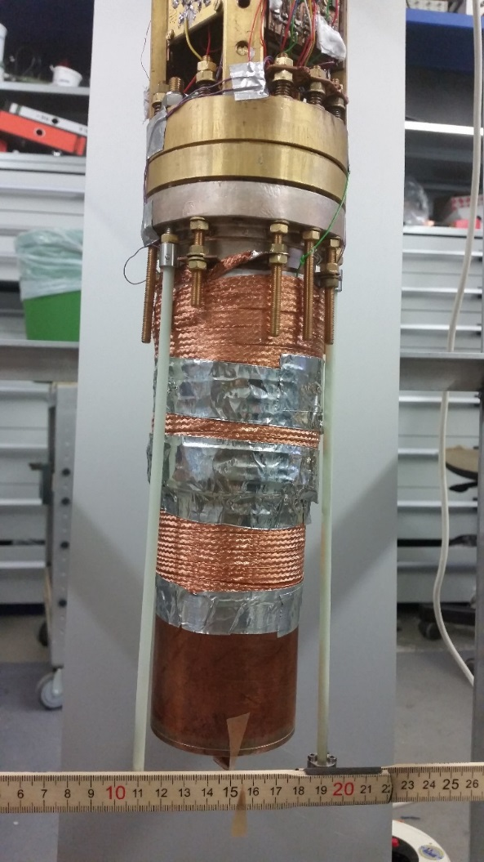
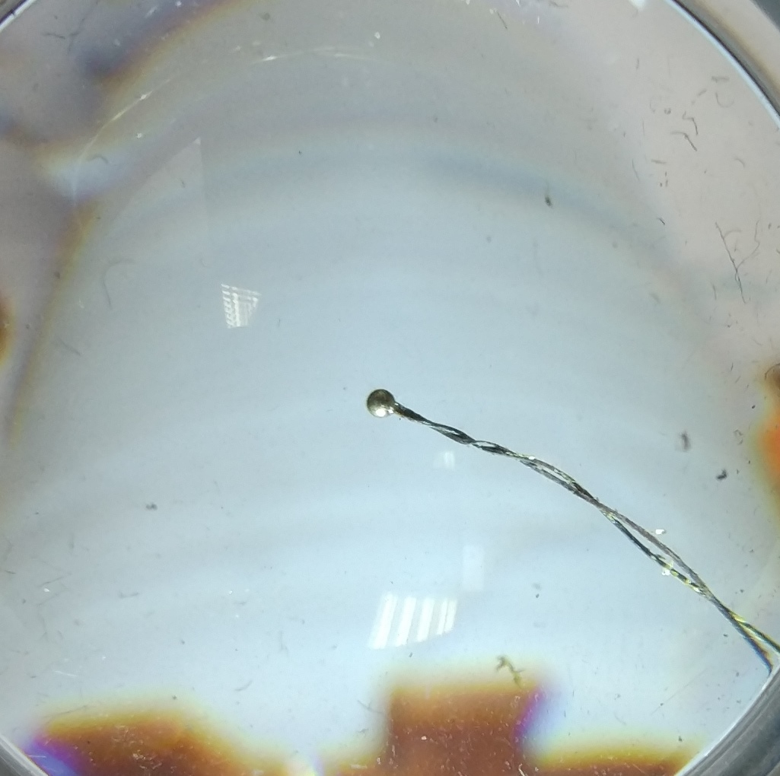
Solenoidal Superconducting B₂ Shim Coil
measurement in a testsetup
B @ 2mA
- Simulation
Superconducting Connection:
Closed B₂ shim coil
charged up to 180mA

Slide 25
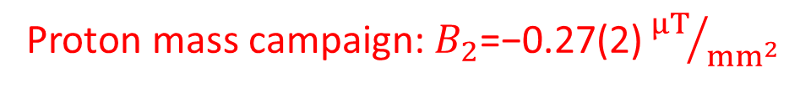
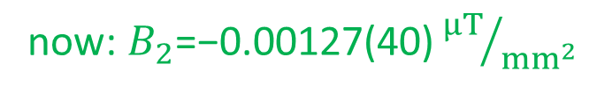



B₂ Shim Coil Performance
axial frequency shift as function of energy in $ν_{+}$-mode $\sim {r_{+}}^{2}$
$$∆ν_{z} (Hz)$$
$$r_{+}=1.1 mm$$
$${r_{+}}^{2} (m^{2})$$
⇒Factor 200 improvement
Proton mass campaign: $B_{2}\text{=}\text{−}\text{0.}\text{27}\text{(}\text{2}\text{)}{μT}/{mm^{2}}$
now: $B_{2}\text{=}\text{−}\text{0.00127(40)}{μT}/{mm^{2}}$
Notes:
2:20
Wire Radius:
Acetylenflamme mit Schutzgas

Slide 26
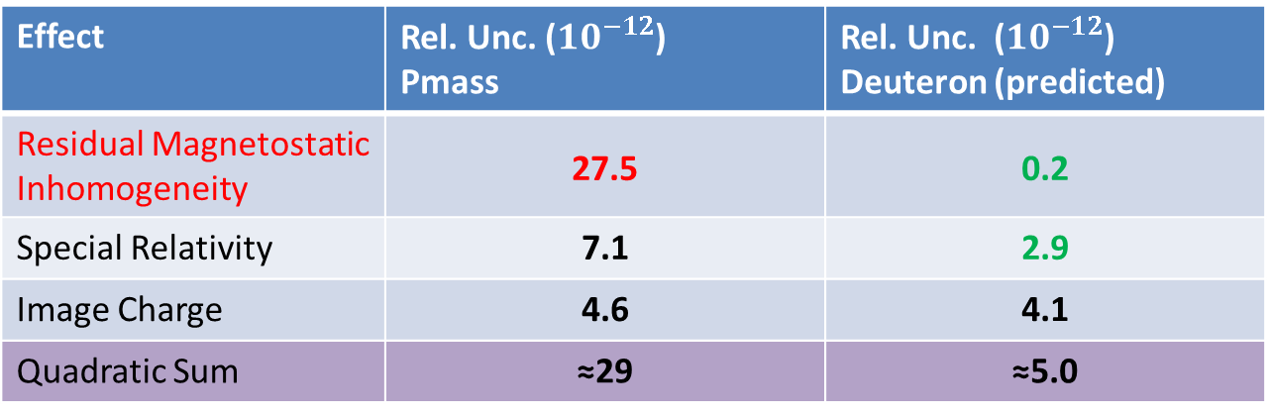
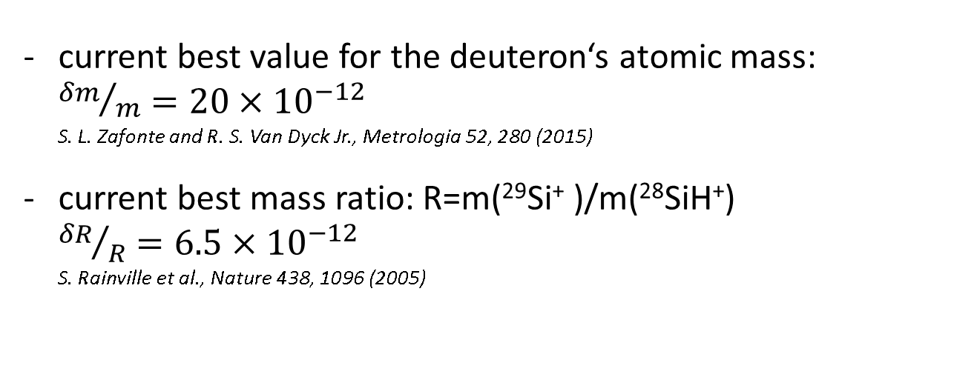
Estimated Error Budget Deuteron
Effect | Rel. Unc. (${10}^{−12}$) Pmass | Rel. Unc. (${10}^{−12}$) Deuteron (predicted)
Residual Magnetostatic Inhomogeneity | 27.5 | 0.2
Special Relativity | 7.1 | 2.9
Image Charge | 4.6 | 4.1
Quadratic Sum | ≈29 | ≈5.0
current best value for the deuteron‘s atomic mass: ${δm}/m=20×{10}^{−12}$
S. L. Zafonte and R. S. Van Dyck Jr., Metrologia 52, 280 (2015)
current best mass ratio: R=m(²⁹Si⁺ )/m(²⁸SiH⁺) ${δR}/R=6.5×{10}^{−12}$
S. Rainville et al., Nature 438, 1096 (2005)
Schuh et al., PRA, accepted
Notes:
2:20
Wire Radius:
Acetylenflamme mit Schutzgas

Slide 27

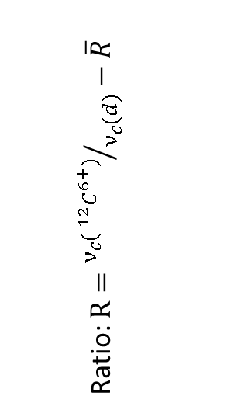
Preliminary Results
example run from 30.04.2019 to 02.05.2019
Ratio: $R={ν_{c}( ^{12}C^{6+})}/{ν_{c}(d)}−\overline{R}$
$$ν_{c}−\overline{ν_{c}} (Hz)$$

Slide 28
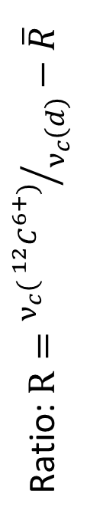
Preliminary Results
corrected for PnA Energy
!Preliminary!
Ratio: $R={ν_{c}( ^{12}C^{6+})}/{ν_{c}(d)}−\overline{R}$
previous best
measurement
run #
Zafonte and Van Dyck Jr., Metrologia 52, 280 (2015)

Slide 29
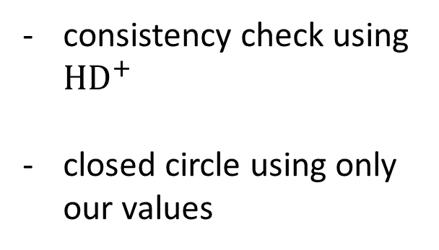

The mass of ${HD}^{+}$
consistency check using ${HD}^{+}$
closed circle using only our values
HD atomic & molecular Binding Energy:
Korobov et al., Phys. Rev. Lett. 118, 233001 (2017)

Slide 30
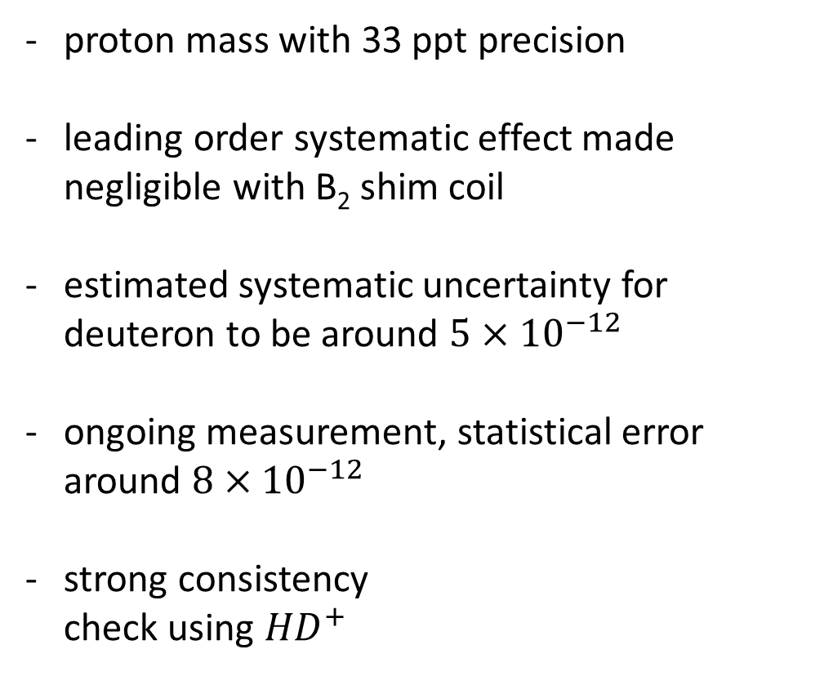
Summary
proton mass with 33 ppt precision
leading order systematic effect made negligible with B₂ shim coil
estimated systematic uncertainty for deuteron to be around $5×{10}^{−12}$
ongoing measurement, statistical error around $8×{10}^{−12}$
strong consistency
check using ${HD}^{+}$
!preliminary!

Slide 31



Acknowledgement
Collaboration: | Sascha Rau, Fabian Heiße^{1,2}, Florian Köhler-Langes¹, Wolfgang Quint², Sven Sturm¹ and Klaus Blaum¹
¹Division of Stored and Cooled Ions at MPIK, Heidelberg
²Atomic Physics Division at GSI Helmholtzzentrum, Darmstadt
Target: | Raphael Haas^{2,3,4}, Dennis Renisch^{3,4} and Christoph Düllmann^{2,3,4}
³Institut for nuclear chemistry at JGU, Mainz
⁴Helmholtz Institute Mainz
Funding:

Slide 32
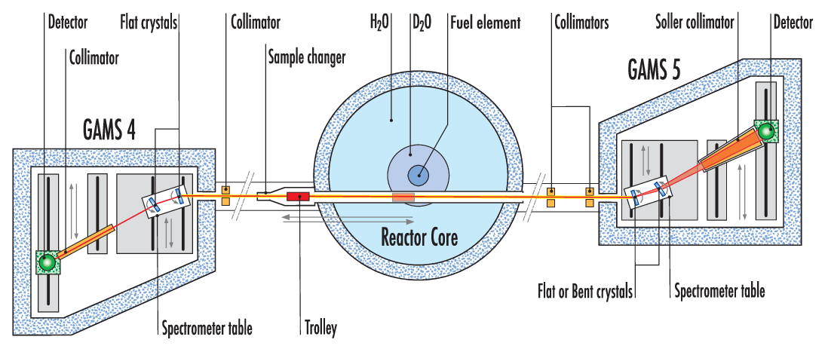
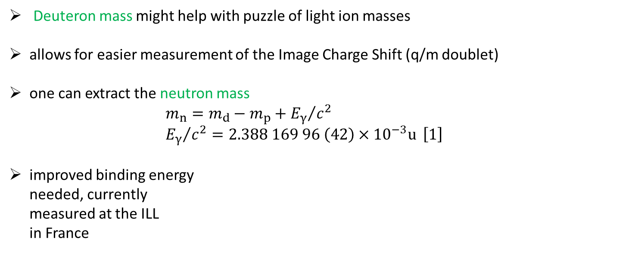
Why deuteron?
Deuteron mass might help with puzzle of light ion masses
allows for easier measurement of the Image Charge Shift (q/m doublet)
one can extract the neutron mass
$m_{n}=m_{d}−m_{p}+{E_{γ}}/{c^{2}}$
${E_{γ}}/{c^{2}=2.388 169 96 \left(42\right)×{10}^{−3}u} \left[1\right]$
improved binding energy
needed, currently
measured at the ILL
in France
p
n
[2]
[1] M.S. Dewey et al. Physical Review C 73, 044303 (2006)
[2] https://www.ill.eu/instruments-support/ „PN3-GAMS“
Notes:
2.2MeV, 4e-10 limit, graphite holders filled with Kapton plastic

Slide 33
Reference Trap
Reference trap
(RT)
Measurement trap
(MT)
²⁸Si¹³⁺
p
¹²C⁶⁺
Storage
trap 2 (ST2)
Storage
trap 1 (ST1)
Simultaneous comparison of cyclotron frequencies to reference ion
(I) v_{c}(²⁸Si¹³⁺) and v_{c}(p)
(II) v_{c}(²⁸Si¹³⁺) and ν_{c}(¹²C⁶⁺)
→ cancel impact of common mode magnetic field fluctuations

Slide 34
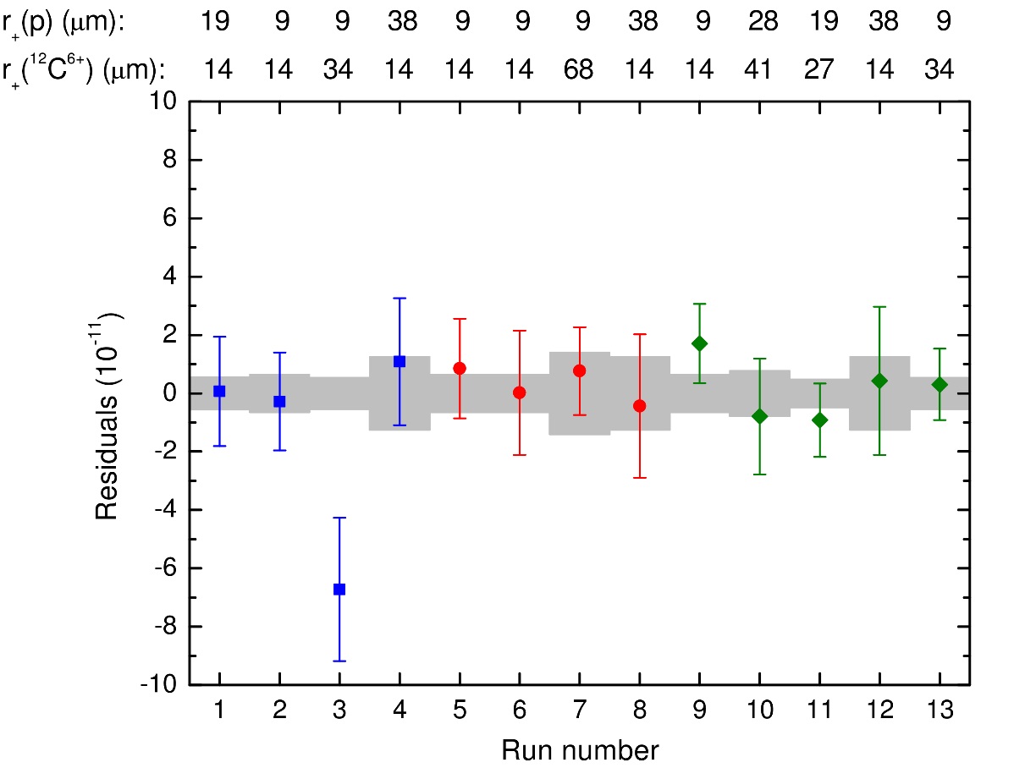
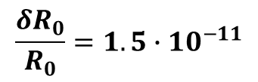
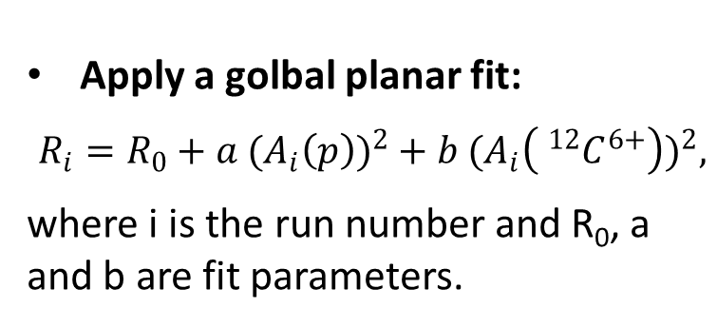
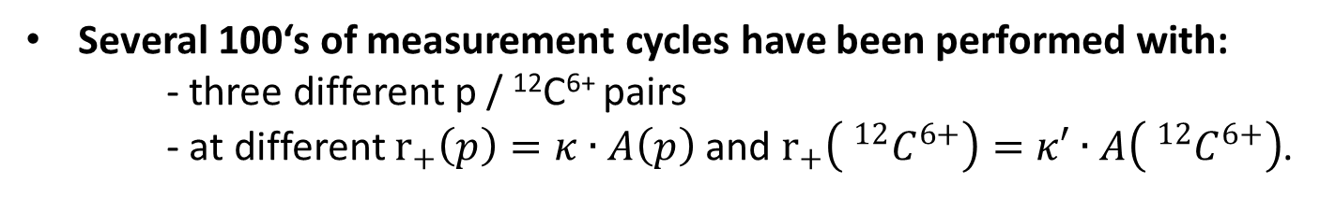
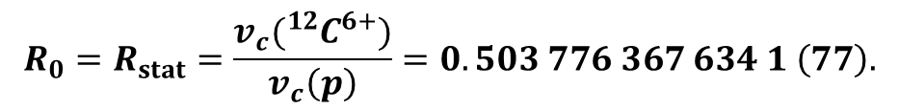
Data
Several 100‘s of measurement cycles have been performed with:
- three different p / ¹²C⁶⁺ pairs
- at different $r_{+}\left(p\right)=κ∙A\left(p\right)$ and $r_{+}\left( ^{12}C^{6+}\right)=κ′∙A\left( ^{12}C^{6+}\right)$.
Apply a golbal planar fit:
$$R_{i}=R_{0}+a{ (A_{i}\left(p\right))}^{2}+b{ (A_{i}\left( ^{12}C^{6+}\right))}^{2},$$
where i is the run number and R₀, a and b are fit parameters.
Extrapolated frequency ratio R₀:
$$R_{0}=R_{stat}=\frac{v_{c}({}_{ }^{12}{C^{6+}})}{v_{c}\left(p\right)}=0.503 776 367 634 1 \left(77\right).$$
i =
$$\frac{δR_{0}}{R_{0}}=1.5∙{10}^{−11}$$
Notes:
1:10
Prediction Interval of the Fit

Slide 35
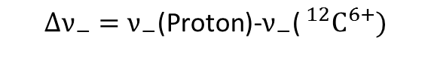
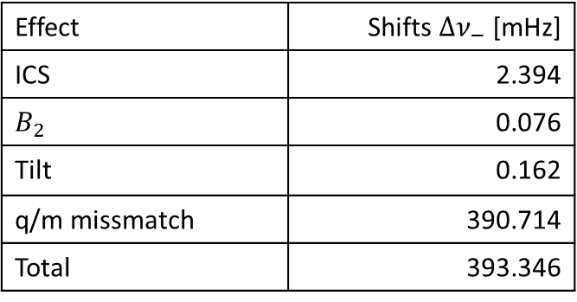
The Image Charge Shift
$$∆ν_{−}=ν_{−}\text{(}\text{Proton}\text{)−}ν_{−}\text{(} ^{12}C^{6+})$$
!!Preliminary!!
Effect | Shifts ${∆ν}_{−}$ [mHz]
ICS | 2.394
$$B_{2}$$ | 0.076
Tilt | 0.162
q/m missmatch | 390.714
Total | 393.346
BUT:
Tilt between magnetic and electric field (0.5 °)
Variations of this tilt are in the axial mode indistinguishable from voltage fluctuations
Fit gives δ (Δ v_) = 43 µHz with Red chi² = 2
⇒ confirmation limited to 5% level (120 µHz)

Slide 36






Improving axial stability
improve voltage stability by using a filter with a switchable time constant
use „freeze-out“ of silicon transistor (BF545) happening at $\sim 20 K$:
Characteristics:
0.5V voltage change
Conducting at: 13 mW for 20 s
Freezing out: 3 min
R_{cold} > 500 GΩ
small voltage change
leakage currents in the order of a few fA, resistance to ground $\sim {10}^{15}Ω$
transistors DC resistance at least in same magnitude, acts as very small capacity (17fF)

Slide 37

Improving axial stability
improve voltage stability by using a filter with a switchable time constant
use „freeze-out“ of silicon transistor (BF545) happening at $\sim 20 K$:
Characteristics:
Conducting at: 13 mW for 20 s
Freezing out: 3 min
R_{cold} > 500 GΩ
Fluctuations in angle lead to instabilities:
$$\overline{ν_{z}}≈ν_{z}\sqrt{1−\frac{3}{2}\sin^{2}θ} \\ θ=θ_{0}+δθ \\ δ\overline{ν_{z}}≈−\frac{3}{2}ν_{z}θ_{0}δθ$$
⇒ Mechanical Feedthrough to adjust angle to zero in situ

Slide 38


Mechanical Feedthrough

Slide 39


Target Preparation
use target printer to apply deuterated molecules (Thymidine-α,α,α,6-d₄) to surface of standard mEBIS target R. Haas et al., Nucl. Instr. Meth. Phys. Res. A 874
small number of particles,
while maintaining
vacuum conditions

Slide 40

Improved Statistics
implemented pressure and temperature stabilization
Allan deviation with consecutive $ν_{+}$measurements with a single deuteron promises statistics in the few ${10}^{−11}$ per cycle
!preliminary!
Notes:
2:20
Wire Radius:
Acetylenflamme mit Schutzgas

Slide 41

Pulse and Amplification – Method
    Phase sensitive detection method for v₊
Phase
detection
Rapid measurement time ( ~ 10 s instead of ~ 3 min for Double-Dip)
→ Reduction of impact of B-field fluctuations
Small radial kinetic energies during phase evolution
→ Small magnetic and relativistic shifts
S. Sturm et al., PRL 107, 143003 (2011)

