Slide 1


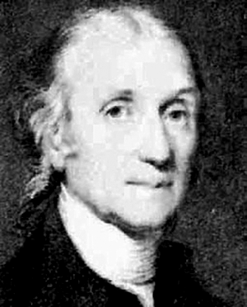
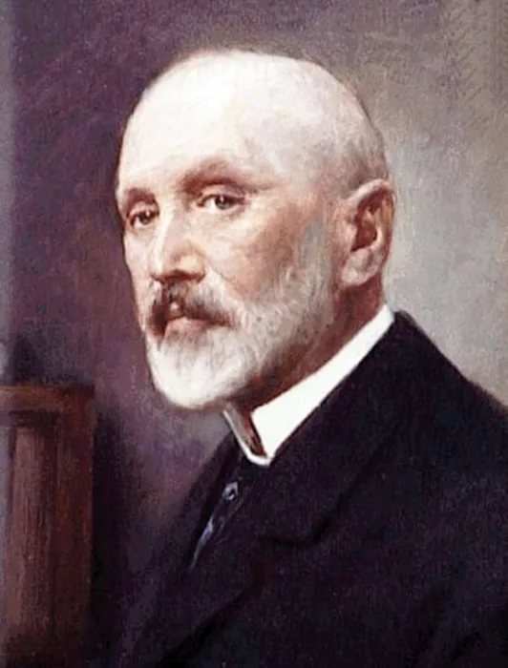
Newtonian Gravitation Constant: History of Measurement and New Results
Vadim Milyukov ^{1, 2}
Lomonosov MSU
Sun Yat sen University
FFK-2019
Tihany, Hungary
13 June 2019
Henry Cavendish (1731–1810),
Loránd Eötvös (1848-1919)

Slide 2
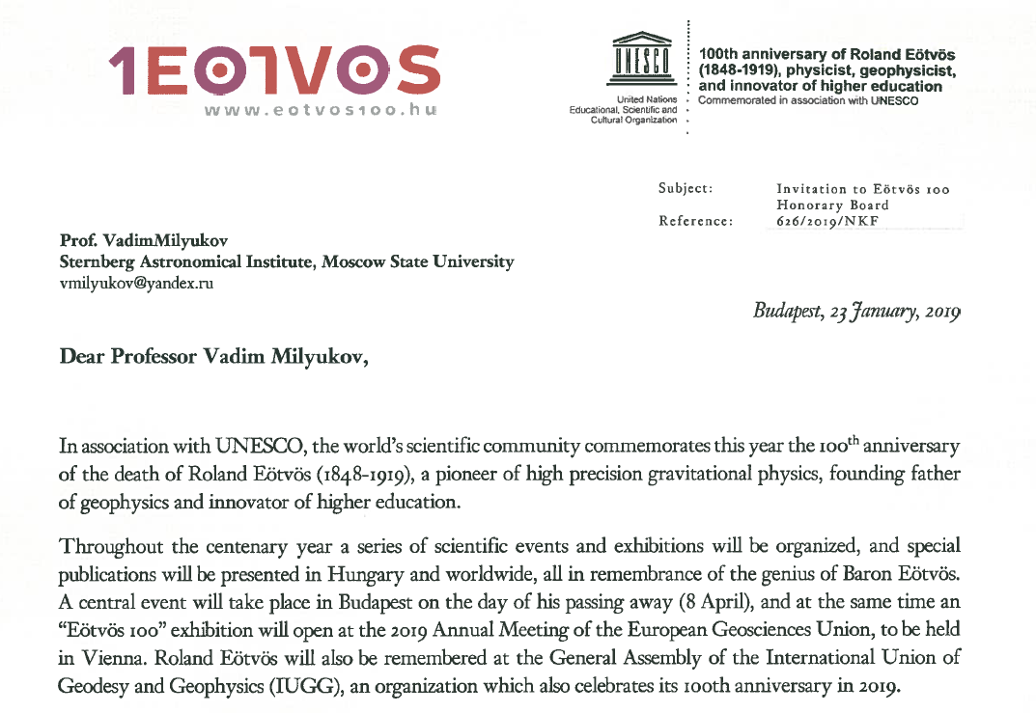

Slide 3
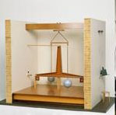
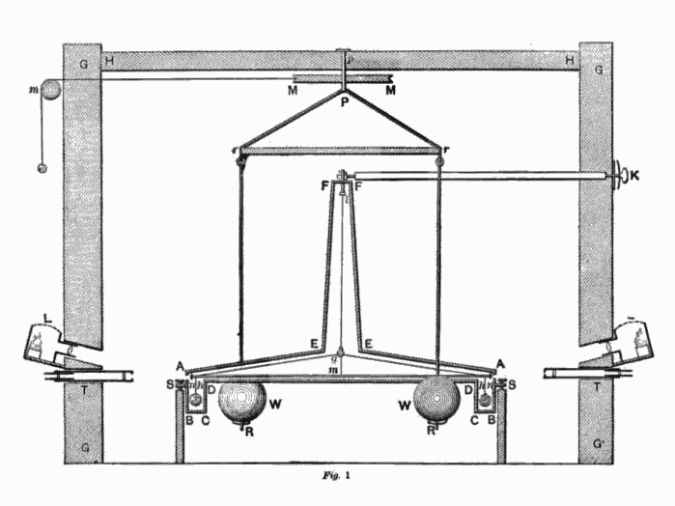

Cavendish experiment
1797-1798
1797-1798
Wooden rod 1,8 m
Spherical lead test masses 0.73 kg, D=51 mm
Spherical lead attracting masses 158 kg, D= 300 mm

Slide 4
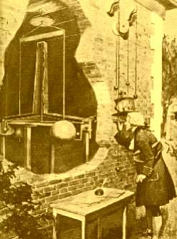
Cavendish experiment
Earth’s density:
σ=(5.448±0.033) gcm⁻³
Cavendish, H. Phil. Trans. R.Soc. B 88, 469–526 (1798).
First G value:
G=(6.67±0.07)×10⁻¹¹ m³kg⁻¹s⁻²
ΔG/G≈10⁴ ppm

Slide 5
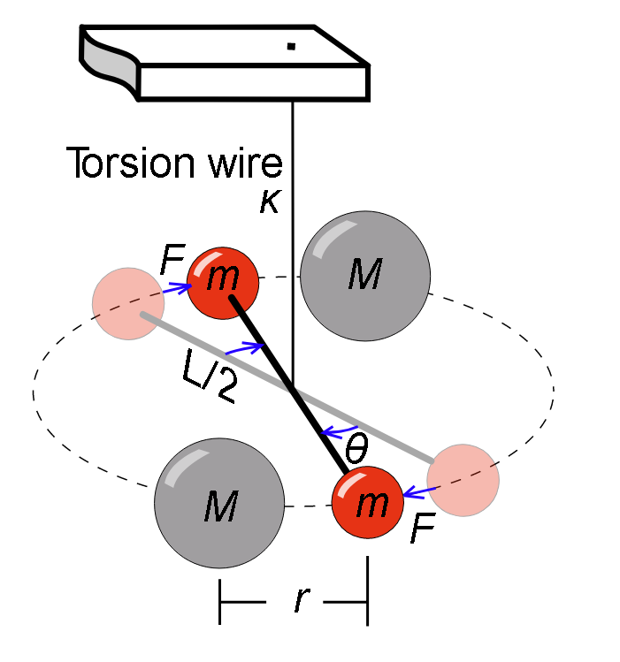
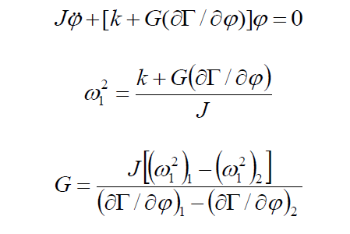
Time – of – swing method
Attracting mass
Test mass
To determine G by time-of swing method it is necessary to perform the following measurements:
frequencies of torsional oscillations at two different positions of the attracting masses M;
geometric dimensions and densities of the torsion balance;
geometric dimensions and density of the attracting mass M;
the mutual location of the torsion balance and test masses M.

Slide 6
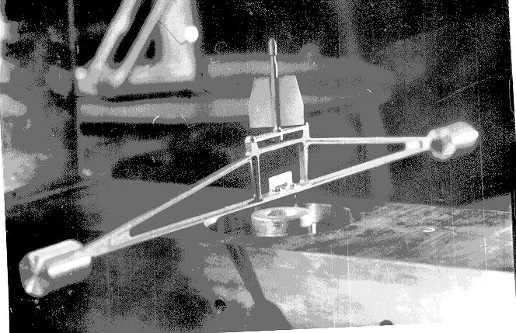
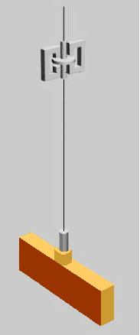
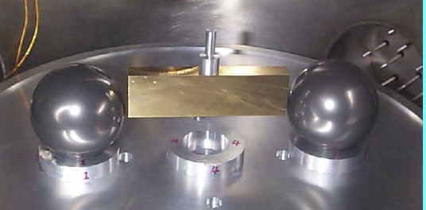
The torsion balances and time of swing method
No 1
No 2
Notes:
.

Slide 7
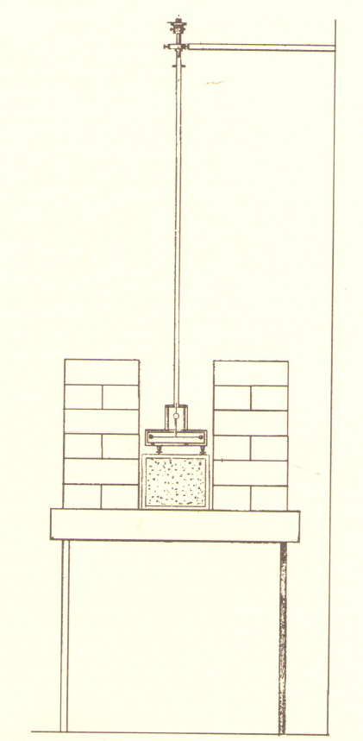

Eötvös experiment
The attracting masses: two lead parallelepipeds with a base of 30x30 cm and a height of 60 cm
Torsion wire
Period of oscillation in the longitudional position:
T1=641s;
Period of oscillation in the transversal position:
T2=860 s.
Attracting masses
Mirror
Eötvös G value:
G=(6.657±0.013)×10⁻¹¹ m³kg⁻¹s⁻²
ΔG/G=2×10³ ppm
Torsion balance
Lorand Eötvös. Annalen der Phys. und Chem., N.F., 59, 354-400 (1896)
Eötvös experiment, 1896

Slide 8
The most reliable measurements of the Newtonian gravitation constant (1 -2 stage)
Experiment: Author, year of publication, Place of experiment | Technique | G×10⁻¹¹ m³kg⁻¹s⁻²
H. Cavendish, 1798 Clapham, England | Torsion balance, static | 6.67÷0.07 ~10⁴ ppm
F. Reich, 1838, 1852 Freiburg, Germany | Torsion balance, dynamic | 6.64÷0.06
R. Eötvös, 1896 Budapest, Hungary | Torsion balance, dynamic | 6.657÷0.013
C. Braun, 1897 Marienstein, Austria | Torsion balance, static and dynamic | 6.649÷0.02
P.Heil, 1930 Washington, USA | Torsion balance, dynamic | 6.670÷0.005 ~10³ ppm
P.Heil, Chrzanowski, 1942 Washington, USA | Torsion balance, dynamic | 6.673÷0.005
R. Rose, H.Parker, K. Lowry, A. Kuhlhan, I. Beams, 1969 Charlotenscille, USA | Torsion balance, compensative | 6.674÷0.004
J. Renner, 1973 Budapest, Hungary | Torsion balance, dynamic | 6.670÷0.008

Slide 9
CODATA values of the gravitational constant
The Task Group on Fundamental Constants of the Committee on Data for Science and Technology (CODATA) was established in 1969 to periodically provide the scientific and technological communities with a self-consistent set of internationally recommended values of the basic constants and conversion factors of physics and chemistry based on all relevant data available at a given point in time.
CODATA - 1973 :
The recommended value of the Newtonian gravitation constant
G=(6.6720 ± 0.0041)×10⁻¹¹ m³kg⁻¹s⁻² (615 ppm)
was mainly based on the Heil and Chrzanowski results, obtained in 1942

Slide 10
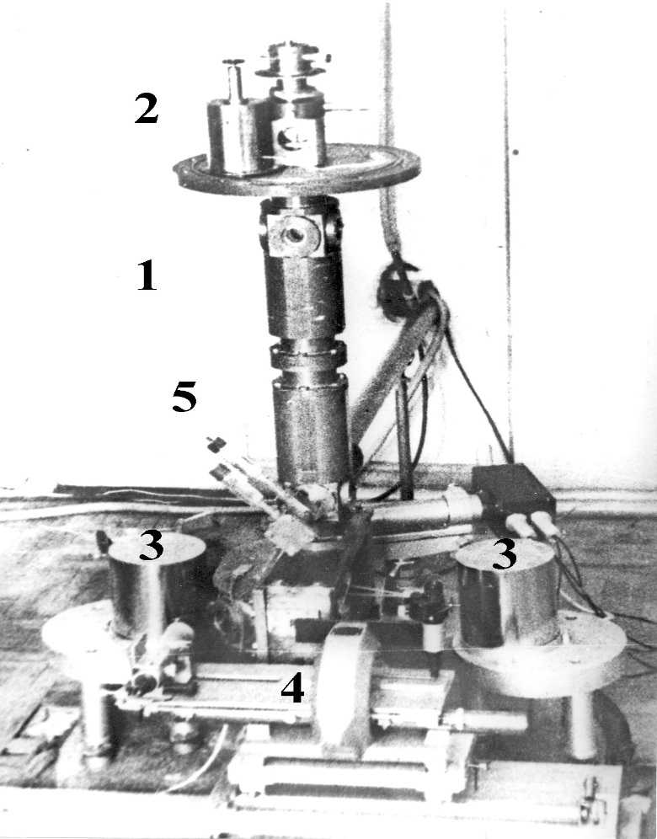
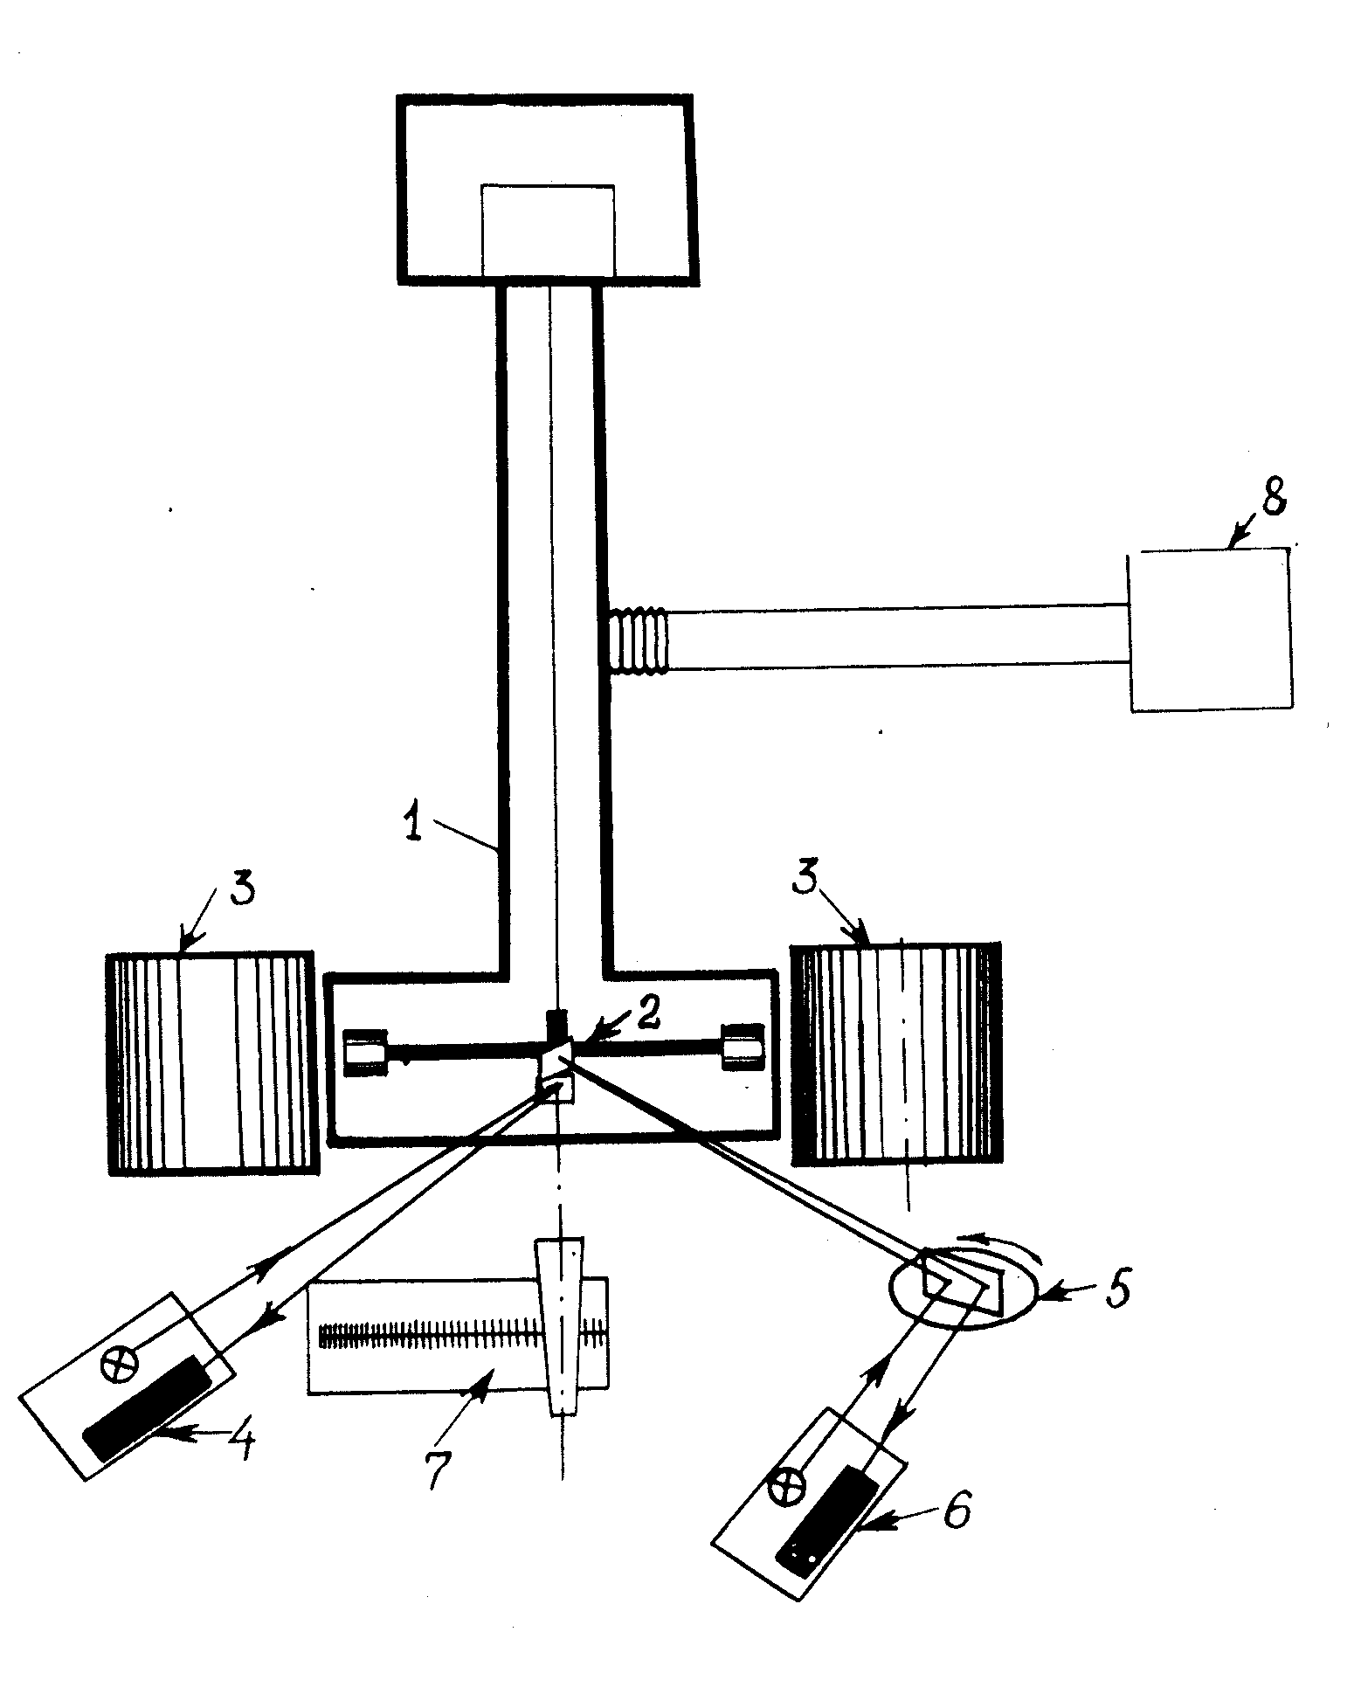
SAI MSU experiment (1975-1978)
General view and sketch of the SAI MSU experimental setup:
1 – housing of device; 2 – torsion balance; 3 – attracting masses; 4, 6 – optical readout systems; 5 – rotating mirror; 7 – device for linear measurements; 8 – vacuum pump.

Slide 11
The value of the Newtonian gravitational constant, obtained in the MSU experiment
Four series of the experiments:
1. March - May 1975,
2. March - June 1976,
3. January - March 1977
4. October 1977 – January 1978
G=(6.6745 ± 0.0008)×10⁻¹¹ m³kg⁻¹s⁻²
with relative standard uncertainties of 120 ppm
Сагитов М.У, Милюков В.К. и др. Новое определение кавендишевой гравитационной постоянной// Доклады АН СССР, 1979, т.245, № 3, с.567 -569 (Sov. Phys. Dokl. 245(1-6), 20-22 (1981))

Slide 12
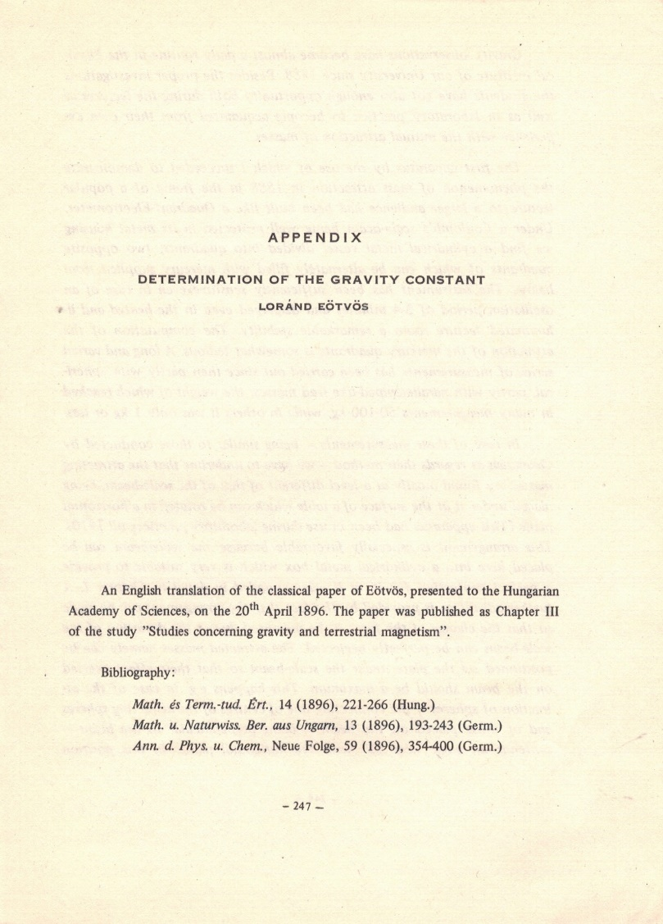
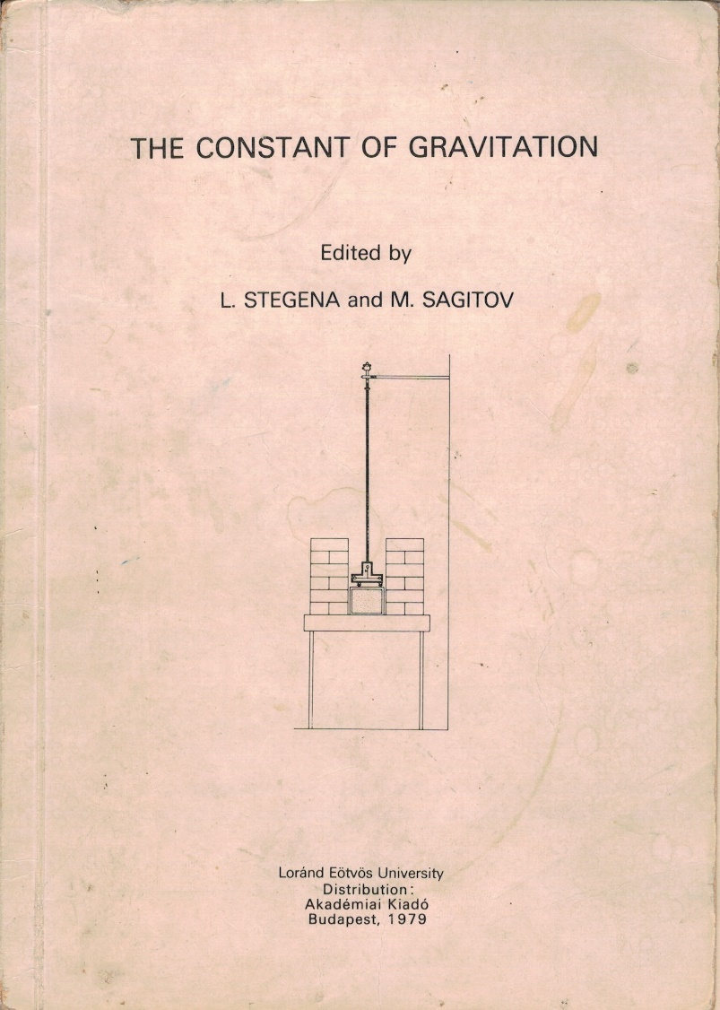
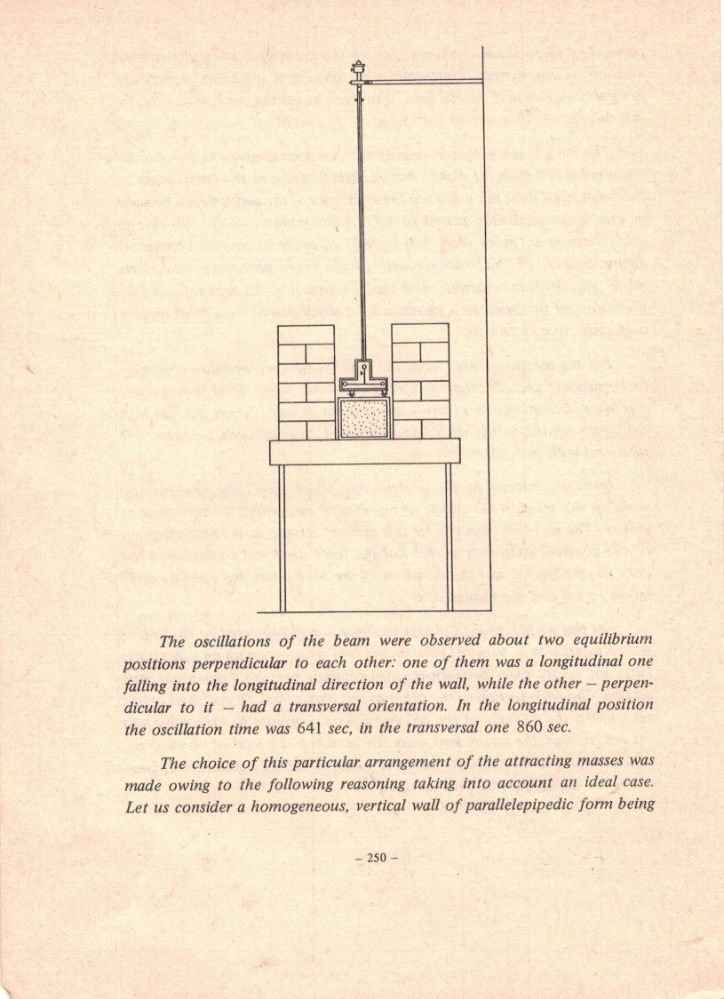
THE CONSTANT OF GRAVITATION (Result of the MSU experiment)

Slide 13
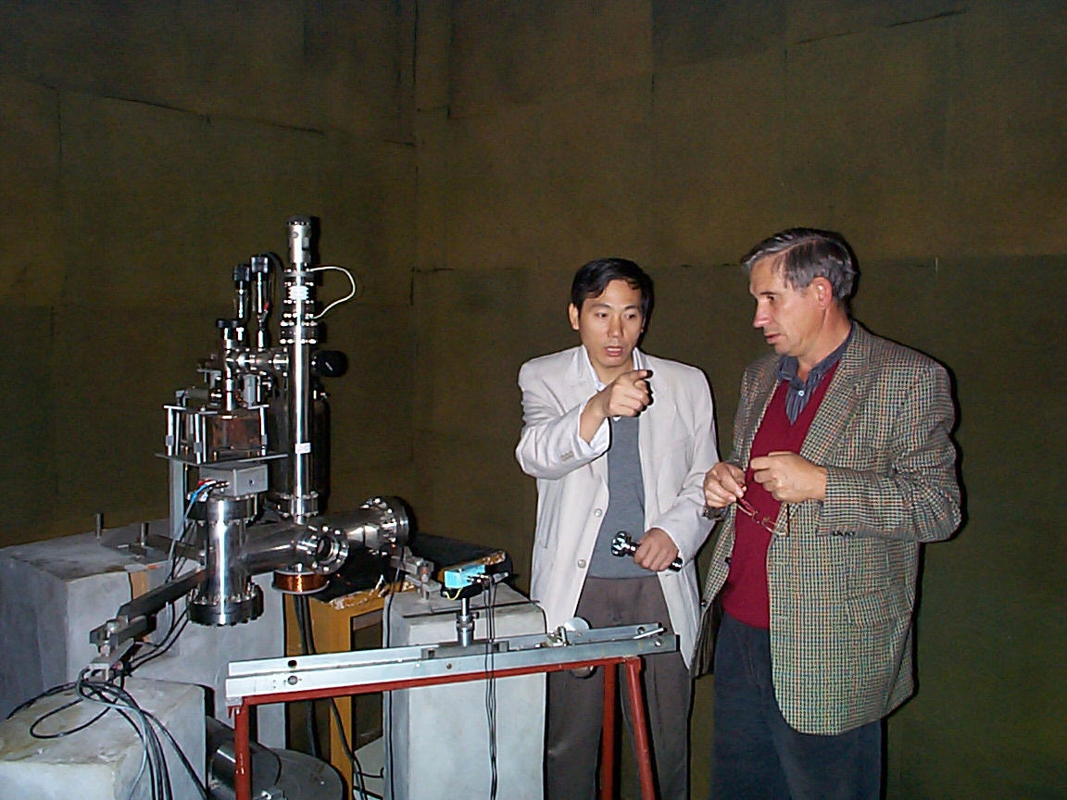
First HUST experiment (1998)
G=(6.6699 ± 0.0007)×10⁻¹¹ m³kg⁻¹s⁻²
with rel. unc.: 105 ppm
Luo, J. et al. Phys. Rev. D 59, 042001 (1998).

Slide 14
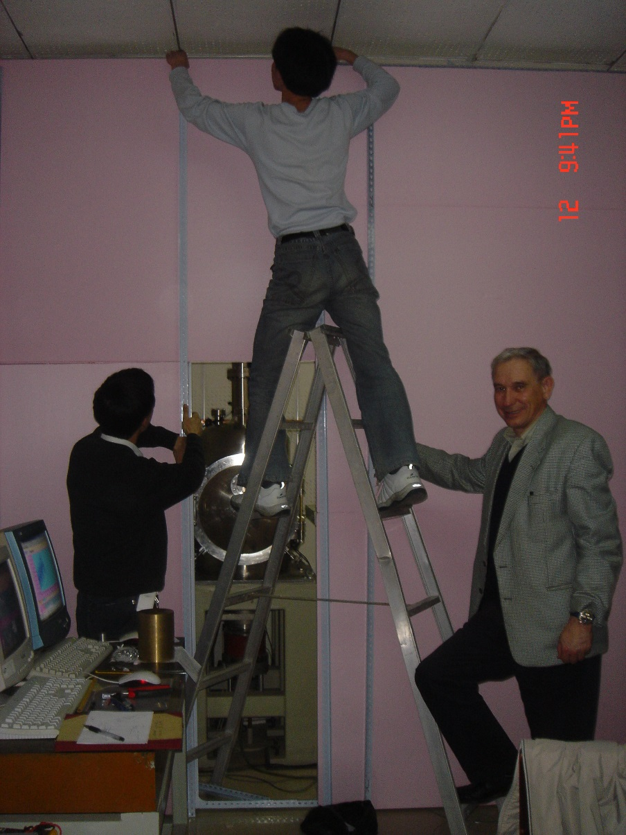
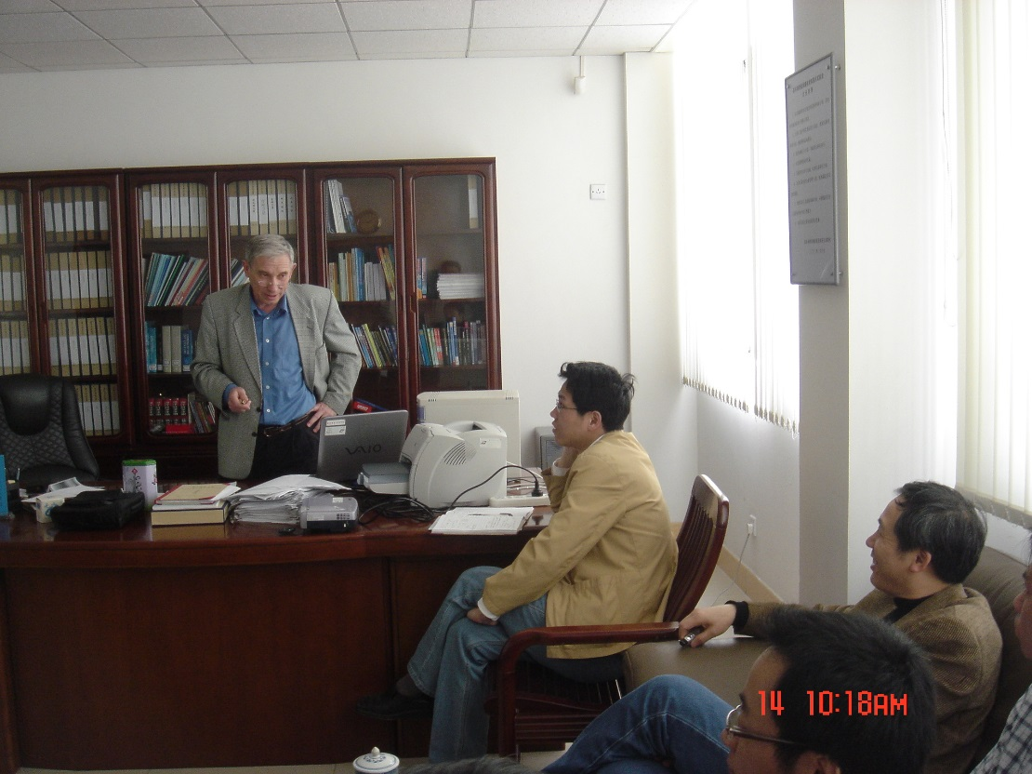
Second HUST experiment (2009)
G=(6.67349 ± 0.00018)×10⁻¹¹ m³kg⁻¹s⁻²
with rel. unc.: 26 ppm
Luo, J. et al. Phys. Rev. Lett. 102, 240801 (2009).

Slide 15
The most reliable measurements of the Newtonian gravitation constant (3 -4 stage)

Slide 16
4хх
[4]

Slide 17
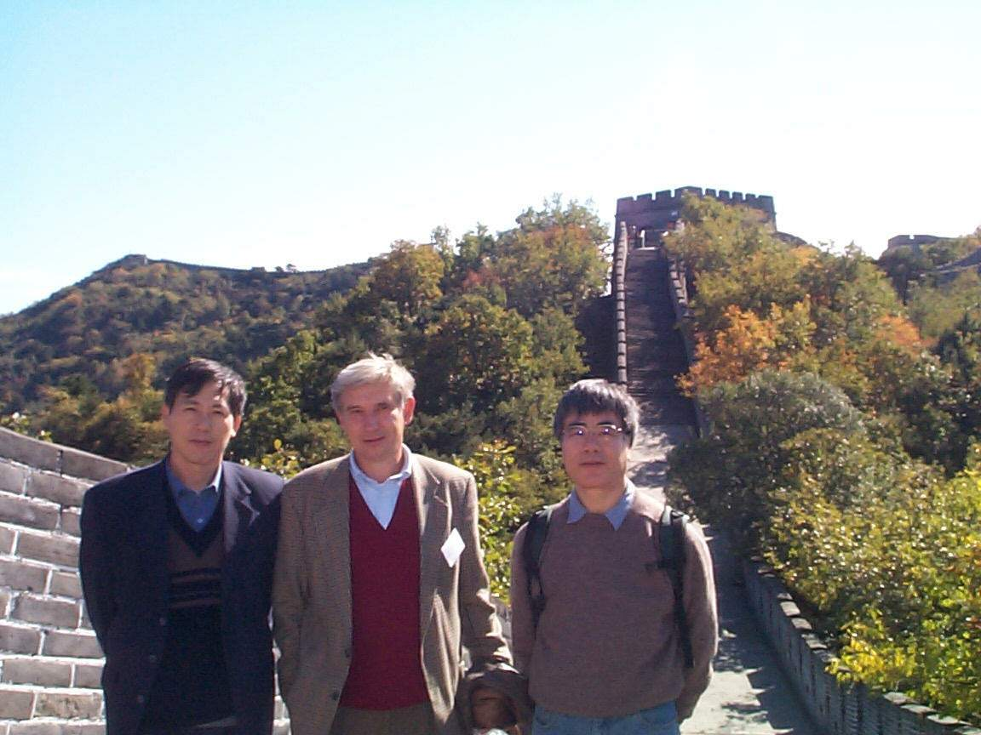

Effect of unelasticity of torsion fiber
(Kuroda effect)
Time- of –swing method
In ideal case K_{n} = k_{f} = const
In general case, spring constant k is a complex
value, and not only dissipation,
but also k depends on the frequency
For Q≈1700, ΔG/G ≈187 ppm;
For Q≈ 10⁵, ΔG/G ≈ 3 ppm

Slide 18
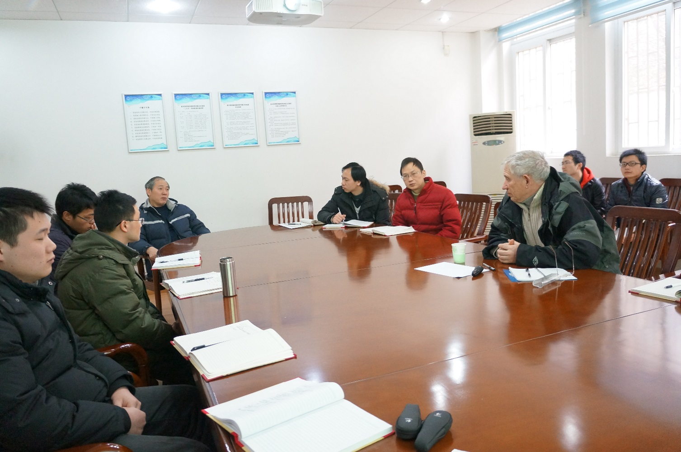
Ways to overcome Kuroda effect :
Torsional balance with high Q
The method of the experiment, in which the torsion wire is not twisted
Time-of-swing (TOS) method;
Angular-acceleration-feedback method (AAF)

Slide 19
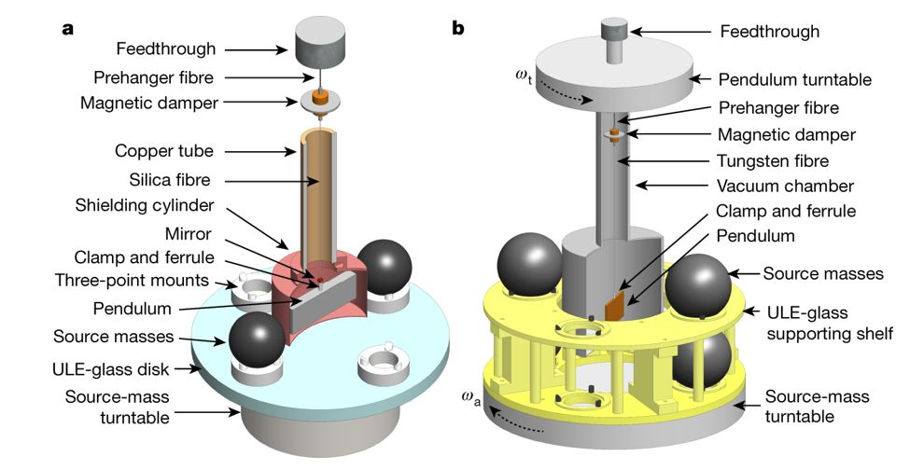
Ideology of TOS and AAF methods
See next presentations:
Qing Li, et al. Determination of G with time-of-swing method by using high Q silica fiber.
Chao Xue, et al. Determination of G with Angular-Acceleration-Feedback Methods

Slide 20
The most reliable measurements of the Newtonian gravitation constant ( stage 4)
Luo Jun, et al (TOS)
G=(6.674184(78)×10⁻¹¹ m³kg⁻¹s⁻²
with rel. unc.: 11.64 ppm
Luo Jun, et al (AAF)
G=(6.674484(78)×10⁻¹¹ m³kg⁻¹s⁻²
with rel. unc.: 11.61 ppm
Notes:
I will not dwell on the details of these experiments, this is the subject of my colleague's report. Such experiments were performed and the following results were obtained

Slide 21
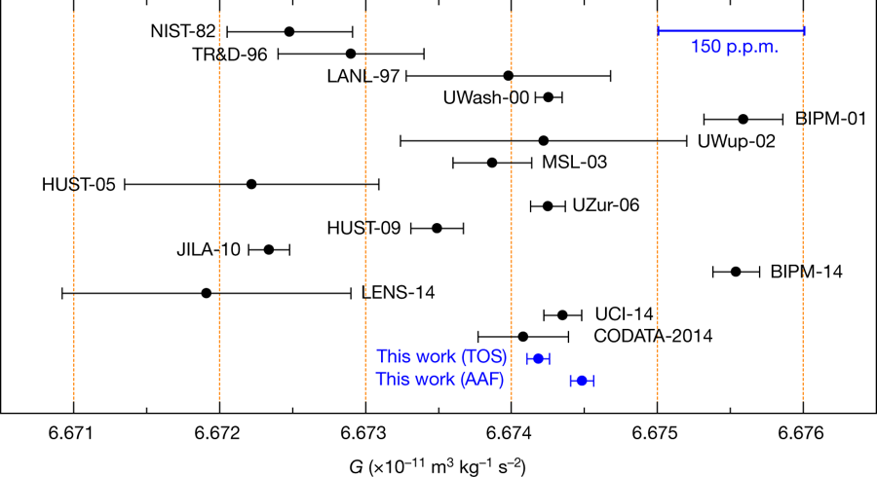
The most reliable measurements of the Newtonian gravitation constant
Luo Jun, et al (TOS)
G=(6.674184(78)×10⁻¹¹ m³kg⁻¹s⁻²
with rel. unc.: 11.64 ppm
Luo Jun, et al (AAF)
G=(6.674484(78)×10⁻¹¹ m³kg⁻¹s⁻²
with rel. unc.: 11.61 ppm
MSU-1979

Slide 22
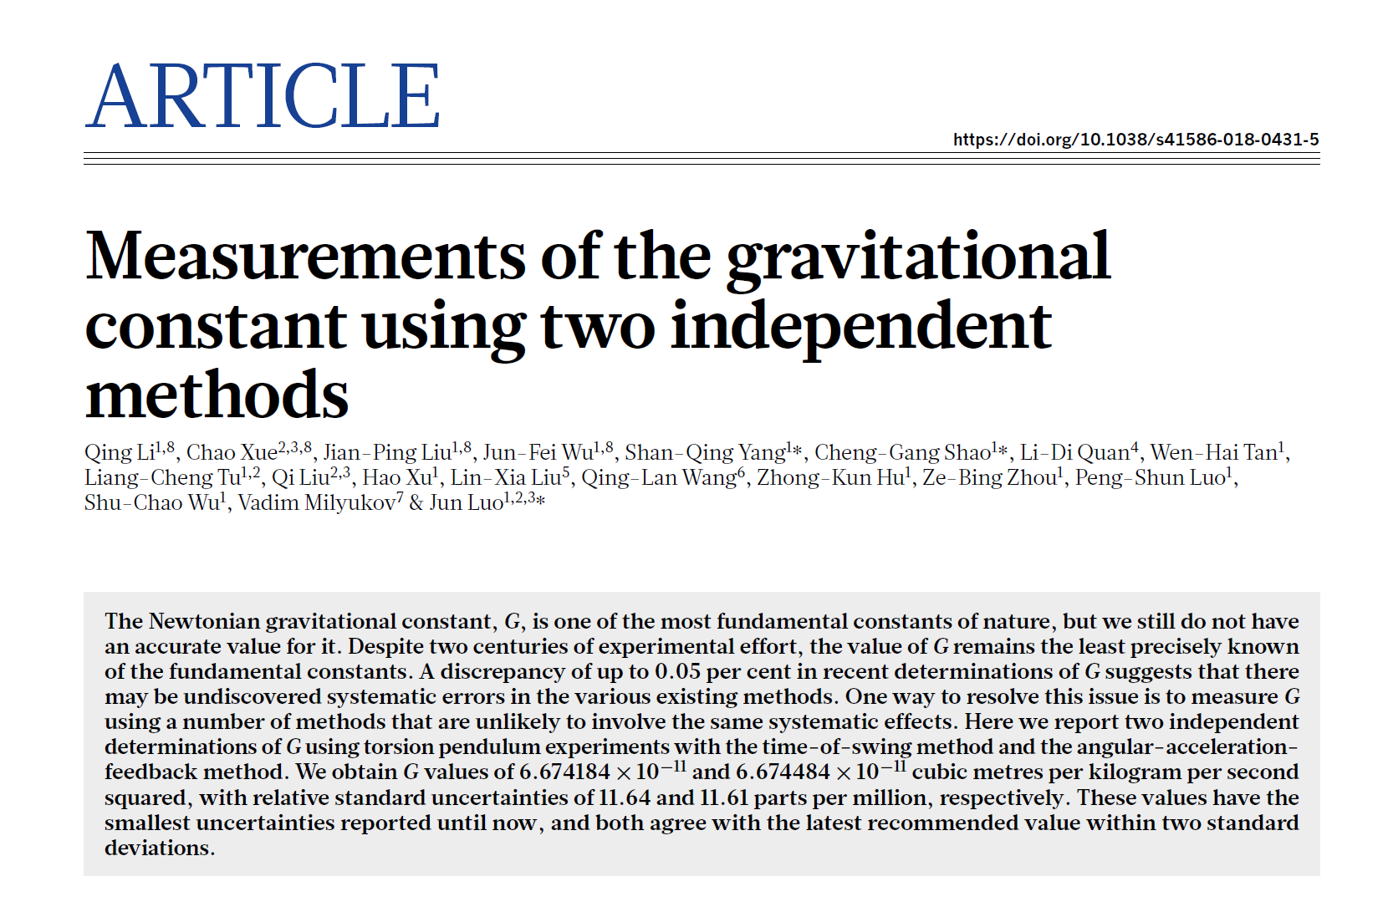
Nature volume 560, pages582–588 (2018)
doi.org/10.1038/s41586-018-0431-5

Slide 23
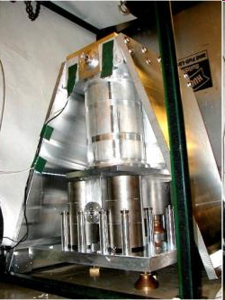
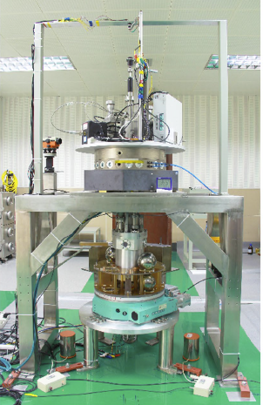
Conclusion
1798
Henry Gavendish : “The apparatus is very simple” (Philos. Trans. R. Soc. London, 88, 469, 1798)
2010
James Faller:
“Big G is the Mt. Everest of precision measurement science, and it should be climbed.” (Phys. Rev. Lett., 105, 2010)
2018
Stefan Schlaminger:
“Gravity measured with record precision”
562 (Nature, 560, 2018)

