Slide 1

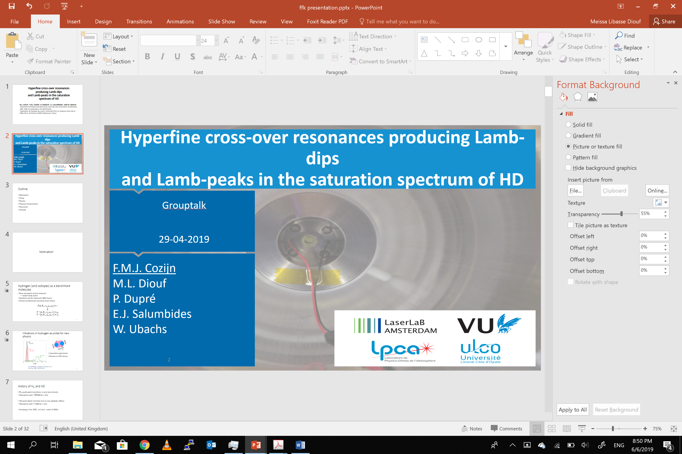
Hyperfine cross-over resonances producing Lamb-dips and Lamb-peaks in the saturation spectrum of HD
M.L. DIOUF¹, F.M.J. COZIJN¹, B. DARQUIÉ², E.J. SALUMBIDES¹, AND W. UBACHS¹
¹Department of Physics and Astronomy, LaserLaB, Vrije Universiteit, De Boelelaan 1081, 1081 HV Amsterdam, The Netherlands
²Laboratoire de Physique des Lasers, Université Paris 13, Sorbonne Paris Cité et CNRS, 99 av J B Clément, 93430 Villetaneuse, France

Slide 2
Motivation

Slide 3
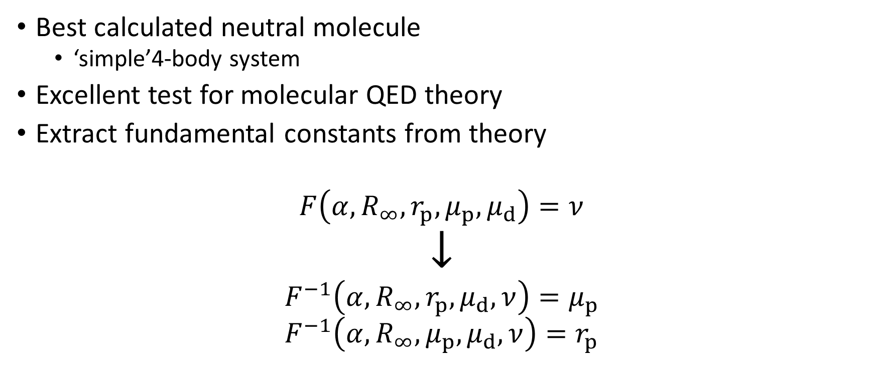
Hydrogen (and isotopes) as a benchmark molecules
Best calculated neutral molecule
  ‘simple’4-body system
Excellent test for molecular QED theory
Extract fundamental constants from theory
$$F\left(α,R_{∞},r_{p},μ_{p},μ_{d}\right)=ν$$
$$↓$$
$$F^{−1}\left(α,R_{∞},r_{p},μ_{d},ν\right)=μ_{p}$$
$$F^{−1}\left(α,R_{∞},μ_{p},μ_{d},ν\right)=r_{p}$$

Slide 4
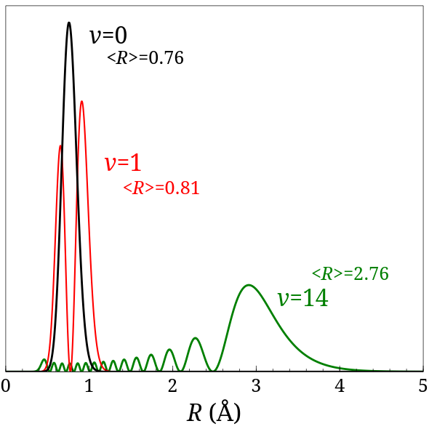
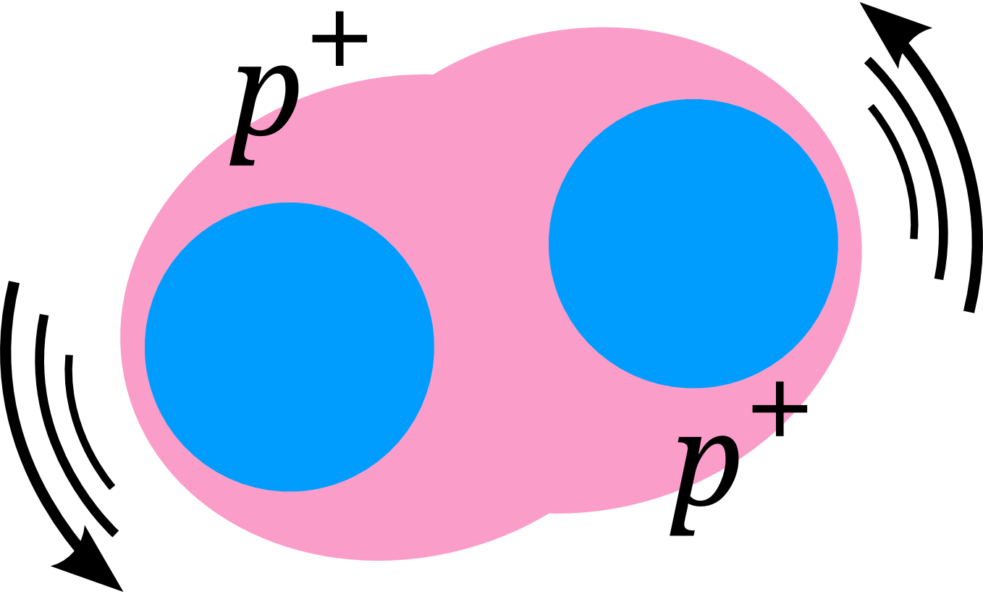
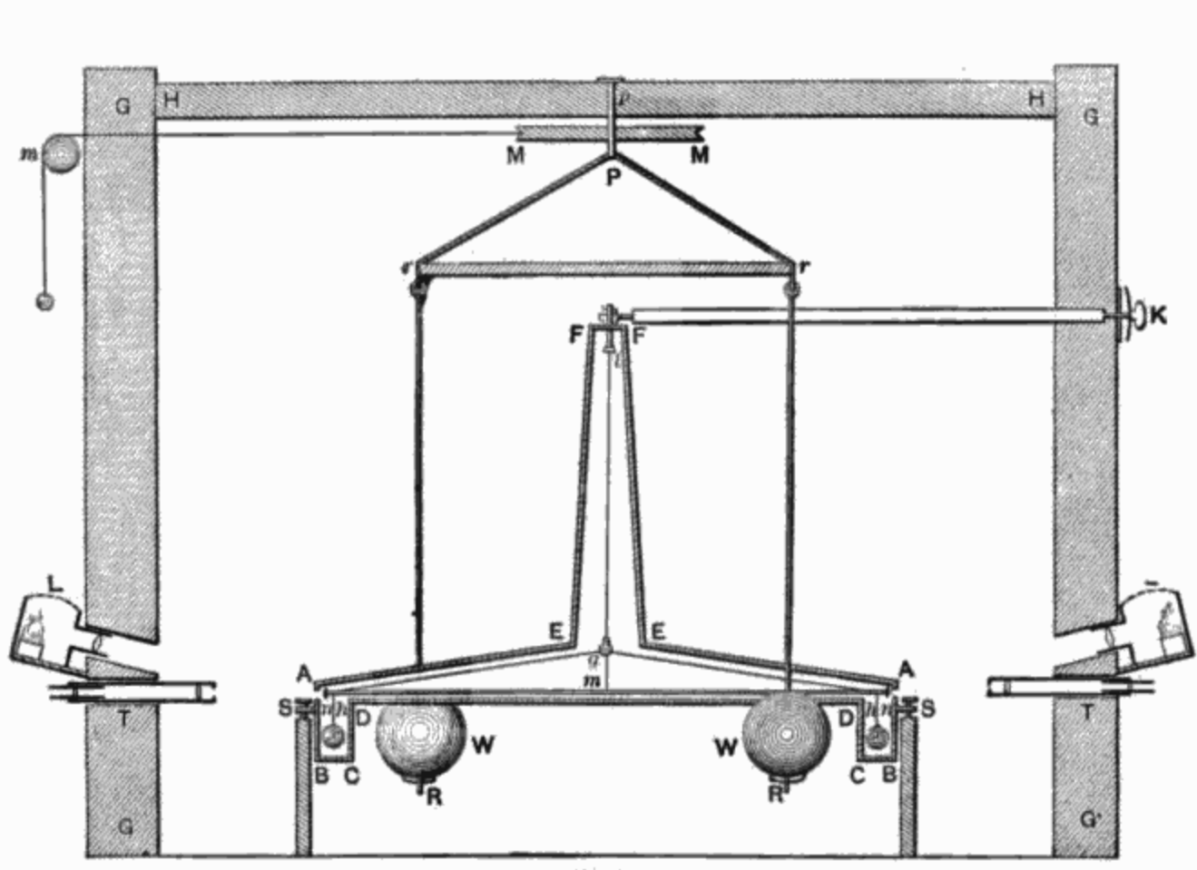

Vibrations in hydrogen as probe for new physics
$$r \sim Å$$
Cavendish experiment
Bounds on fifth forces
E.J.Salumbides, J. Komasa, K. Pachucki, et al.,
Phys. Rev. D 87, 112008 (2013)

Slide 5
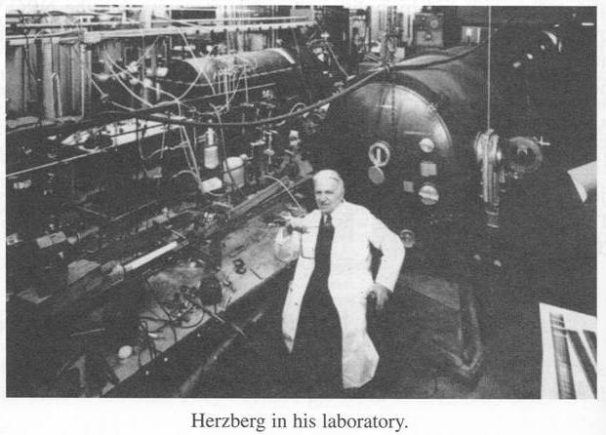

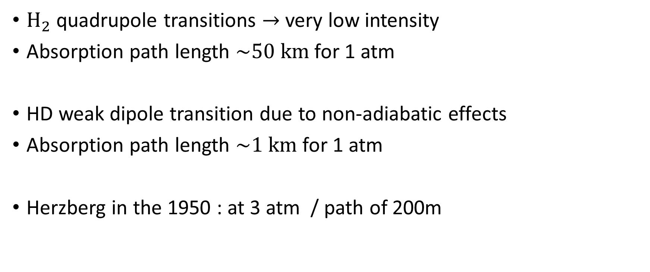
History of ${\text{H}}_{2}$ and HD
$H_{2}$quadrupole transitions $→$very low intensity
Absorption path length $\sim 50 km$ for 1 atm
HD weak dipole transition due to non-adiabatic effects
Absorption path length $\sim 1 km$ for 1 atm
Herzberg in the 1950 : at 3 atm / path of 200m

Slide 6
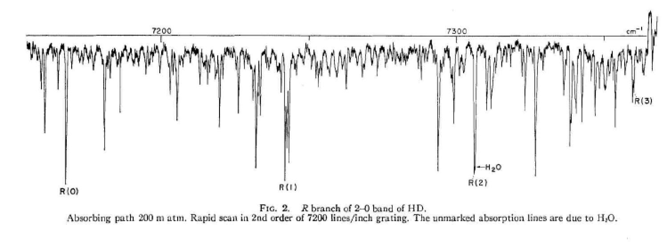
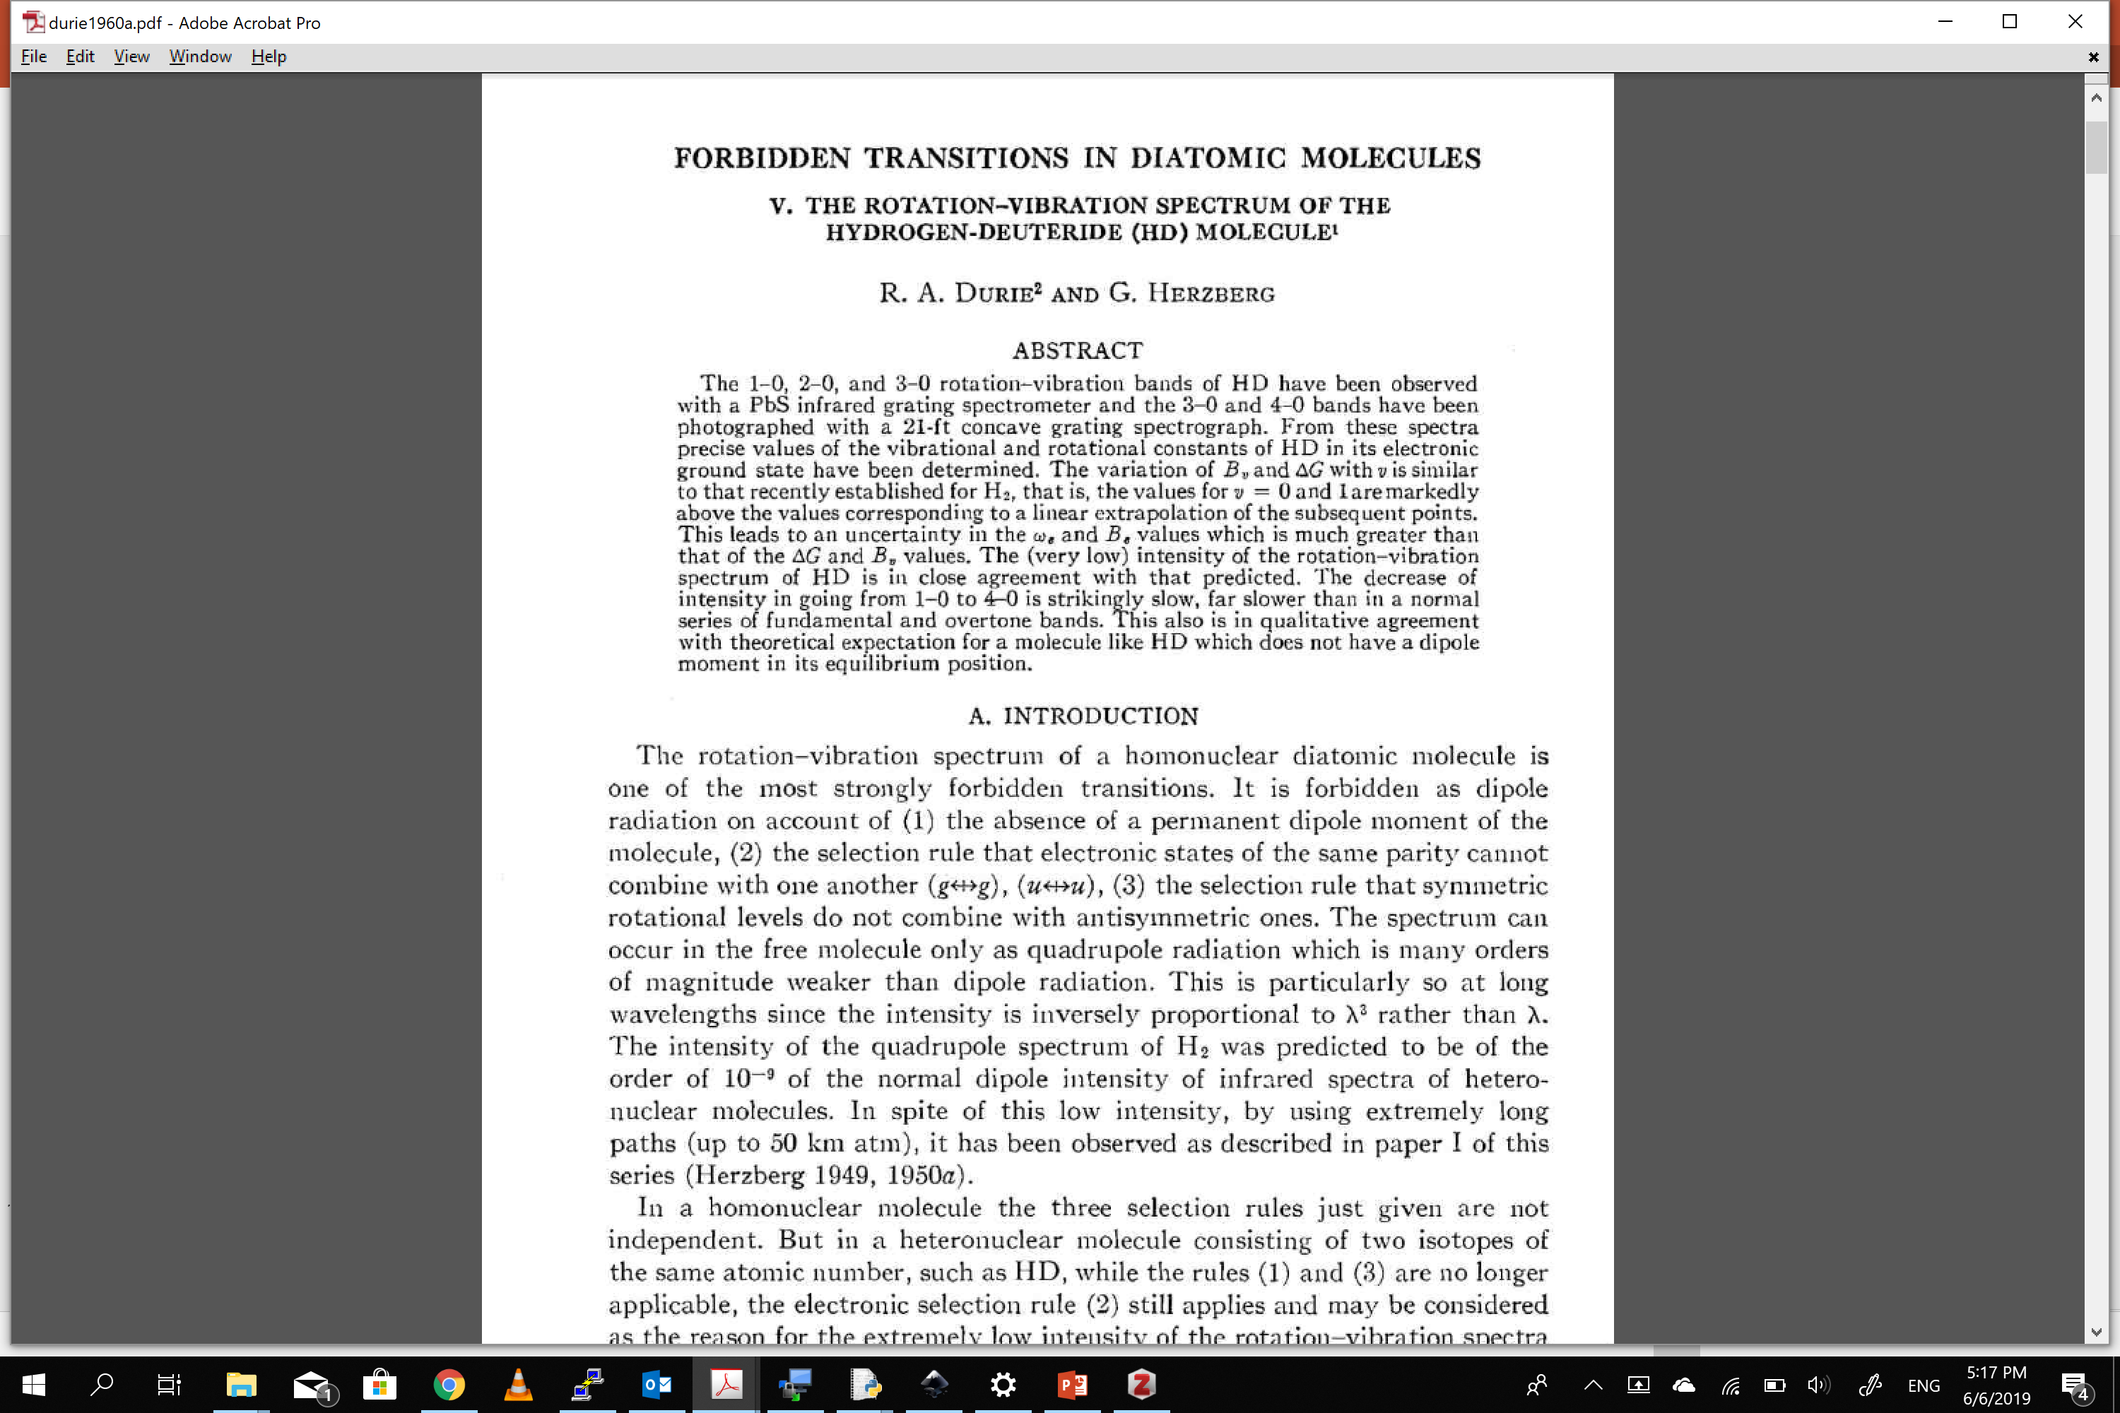

Slide 7
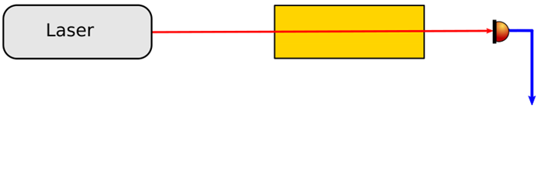
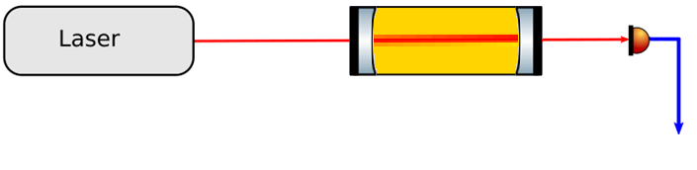
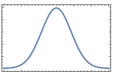
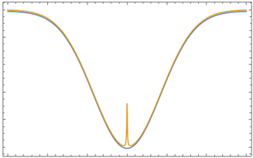
Direct excitation of first overtone band in HD
Doppler-broadened
1.5 GHz FWHM
Doppler-free
~ 300 kHz FWHM
Last years result
Cozijn et al., PRL 120, 153002 (2018)
Lamb-dip:
Saturation power is 10 kW
In our case : 100 W
v=2
R-branch (ΔJ=+1)
Dipole transitions
v=1
v=0

Slide 8
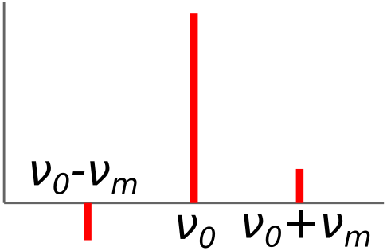
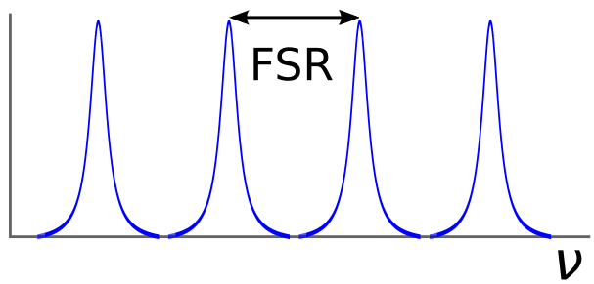
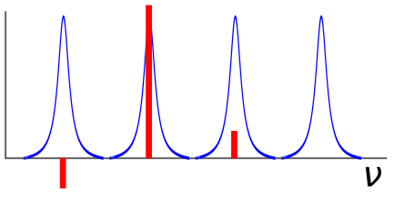
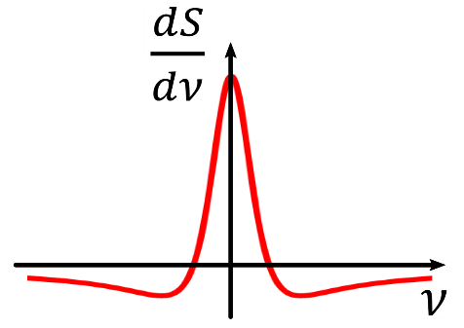
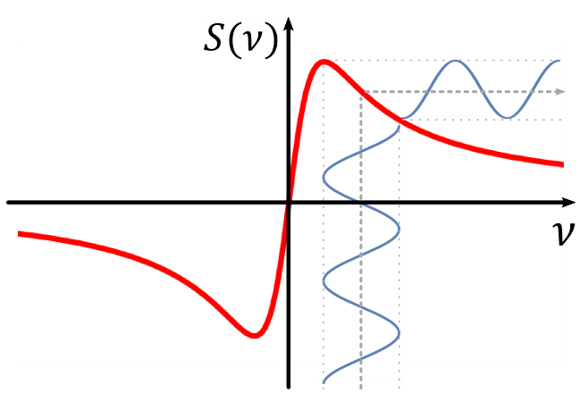
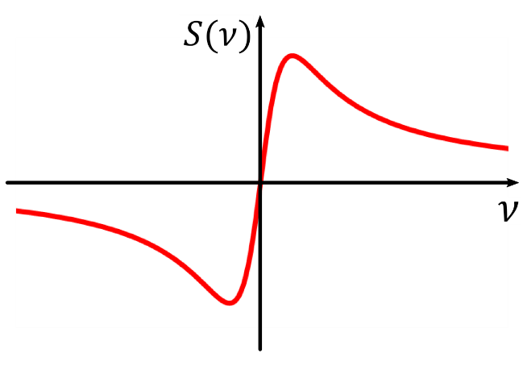
NICE-OHMS
Noise-Immune Cavity-Enhanced Optical Heterodyne Molecular Spectroscopy
Frequency Modulation Spectroscopy (FMS) in a cavity
Signals identical to FMS
  Dispersion measurement
  Additional wm-dither
+
=

Slide 9
Setup

Slide 10
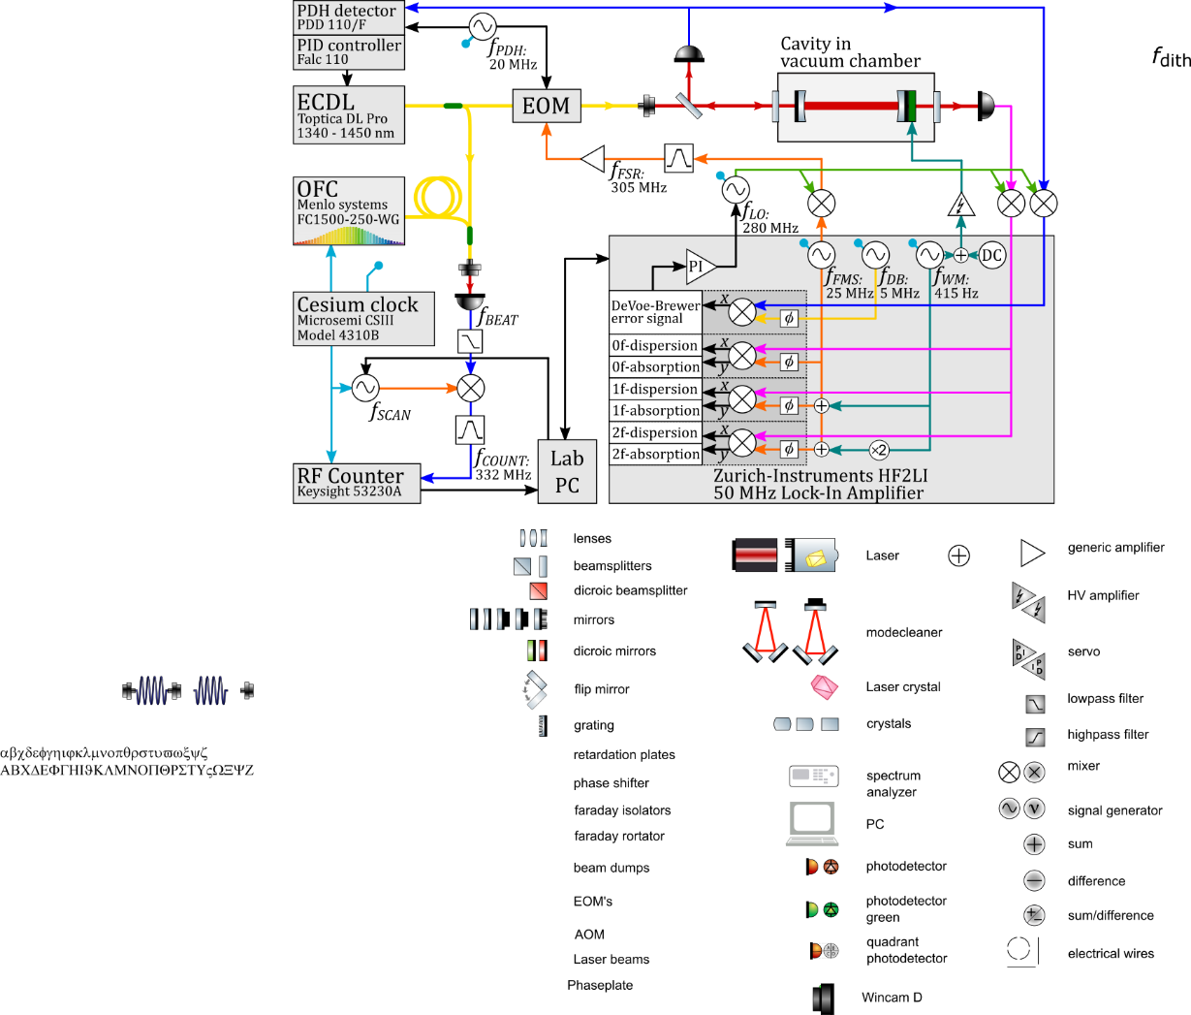

Finesse=150 000, $L_{eq}=46 km$

Slide 14
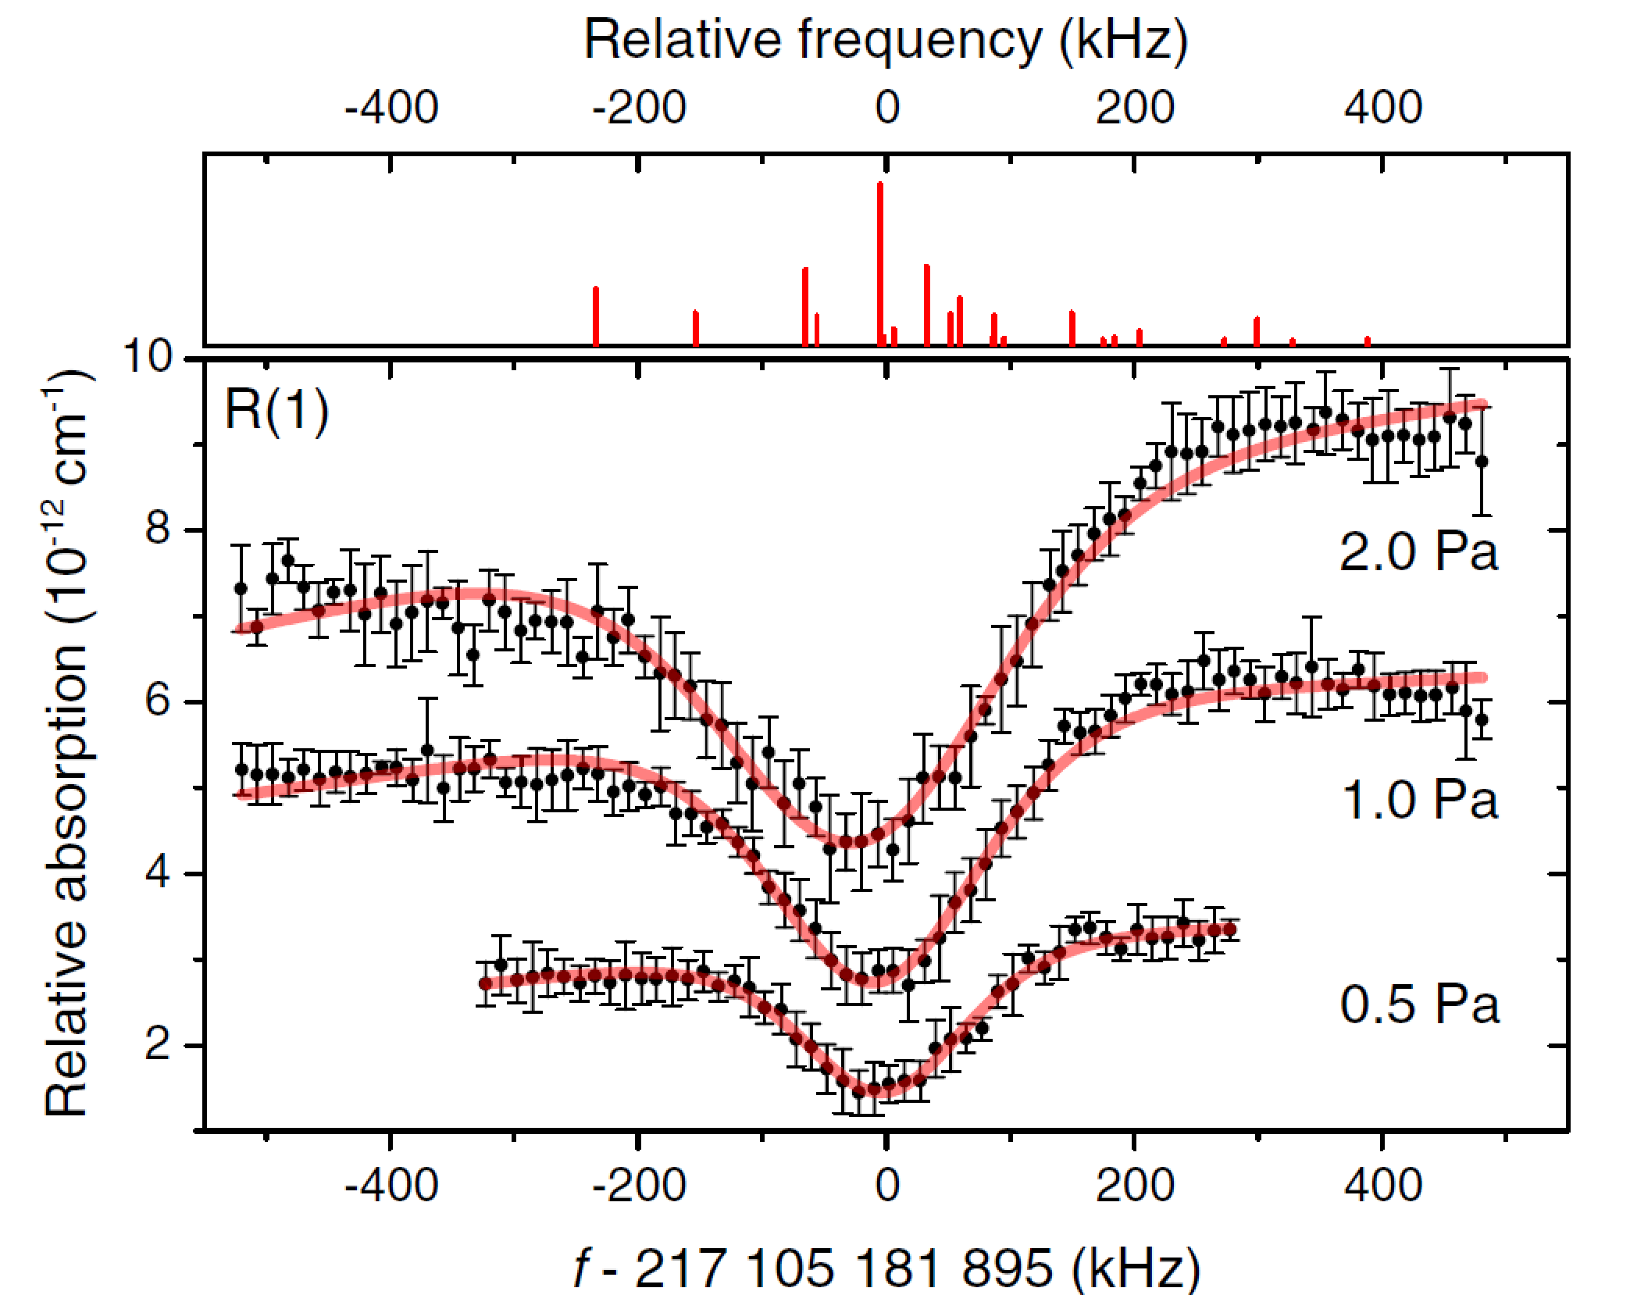
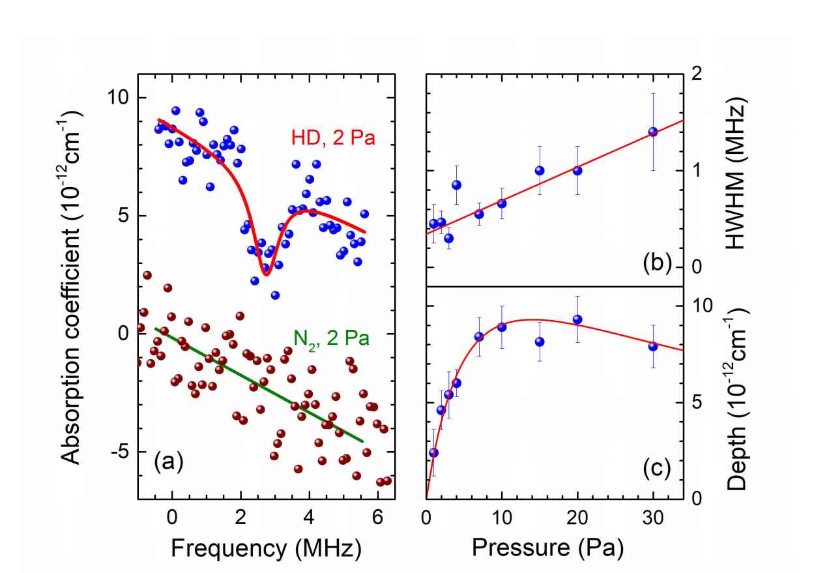

Experiments (2018) Amsterdam and HEFEI
$f_{0}=\text{217} \text{105} \text{182.79}$ MHz
Cozijn et al., PRL 120, 153002 (2018)
Amsterdam
Tao et al., PRL 120, 153001 (2018)
HEFEI

Slide 15
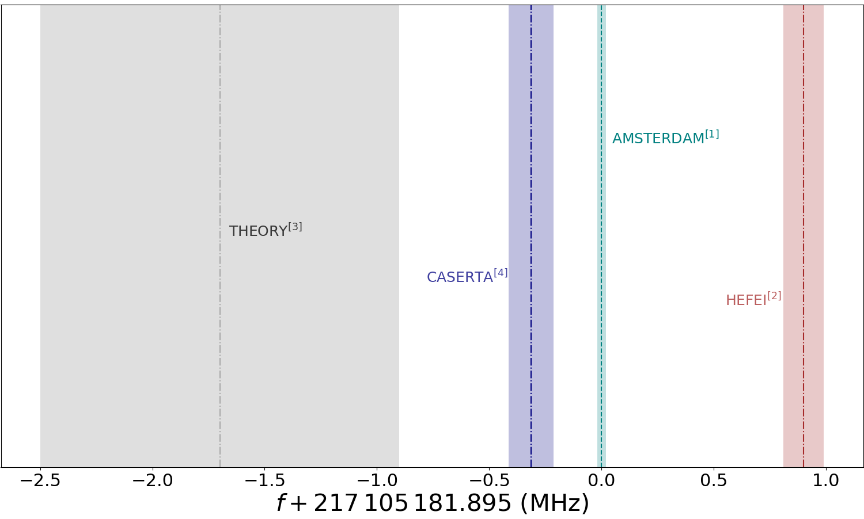
HD R(1) discrepancy
[1] Cozijn et al., PRL 120, 153002 (2018)
[2]Tao et al., PRL 120, 153001 (2018)
[3]Czachorowski et al., PRA 98, 052506 (2018)
[4] Fasci et al., PRA 98, 022516 (2018)

Slide 16
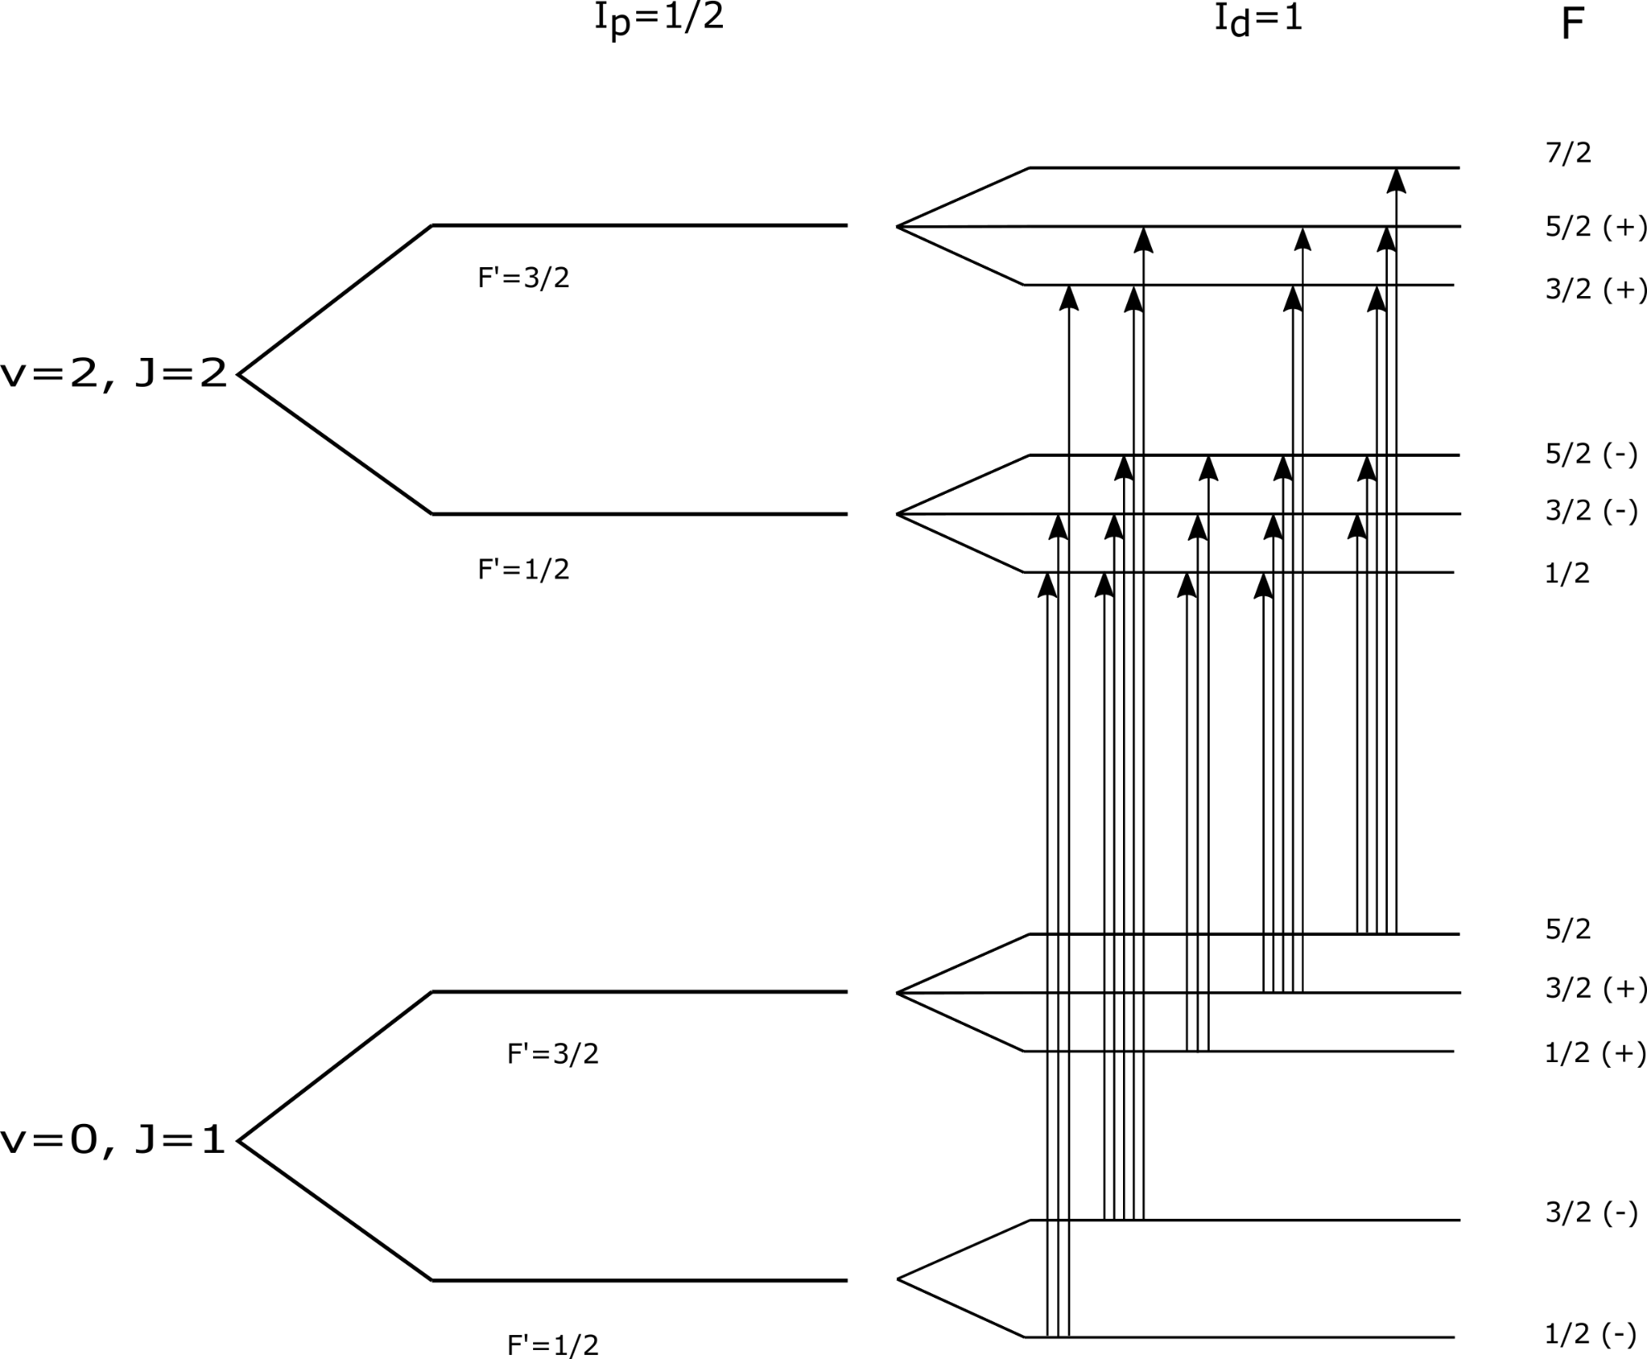

HD hyperfine levels
Interaction nuclear spins( d-p): $I_{d}=1,$ $I_{p}=1/2$
and rotational quantum number J
  v=0, J=1 $→$ 5 levels
  v=2, J=2 $→$ 6 levels
Allowed transitions $∆F=0,+/−1$ $→$ 21 transitions
N. F. Ramsey and H. R. Lewis, Phys. Rev. 108, 1246 (1957)

Slide 17
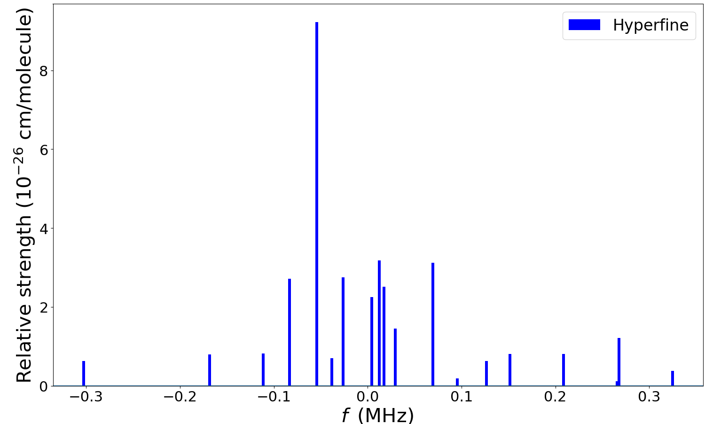
HD R(1) Hyperfine structure
P. Dupré and J. Gauss

Slide 18
Results

Slide 19
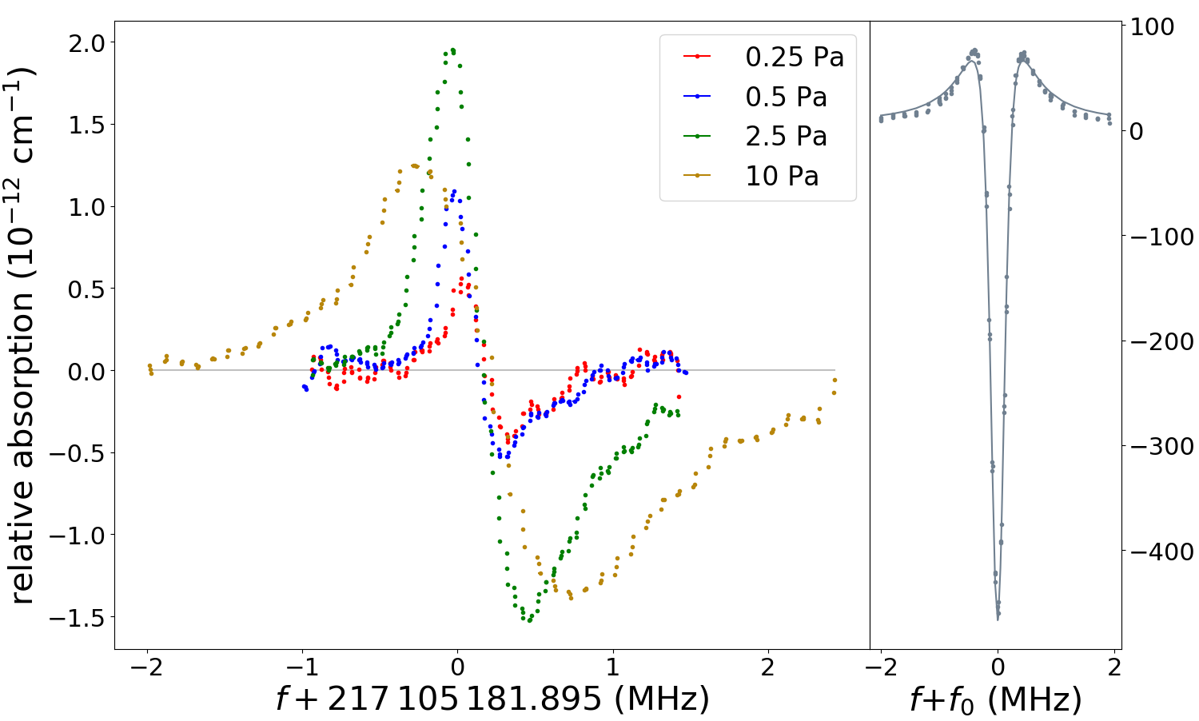

HD R(1)
$$C_{2}H_{2} R(9)$$

Slide 20
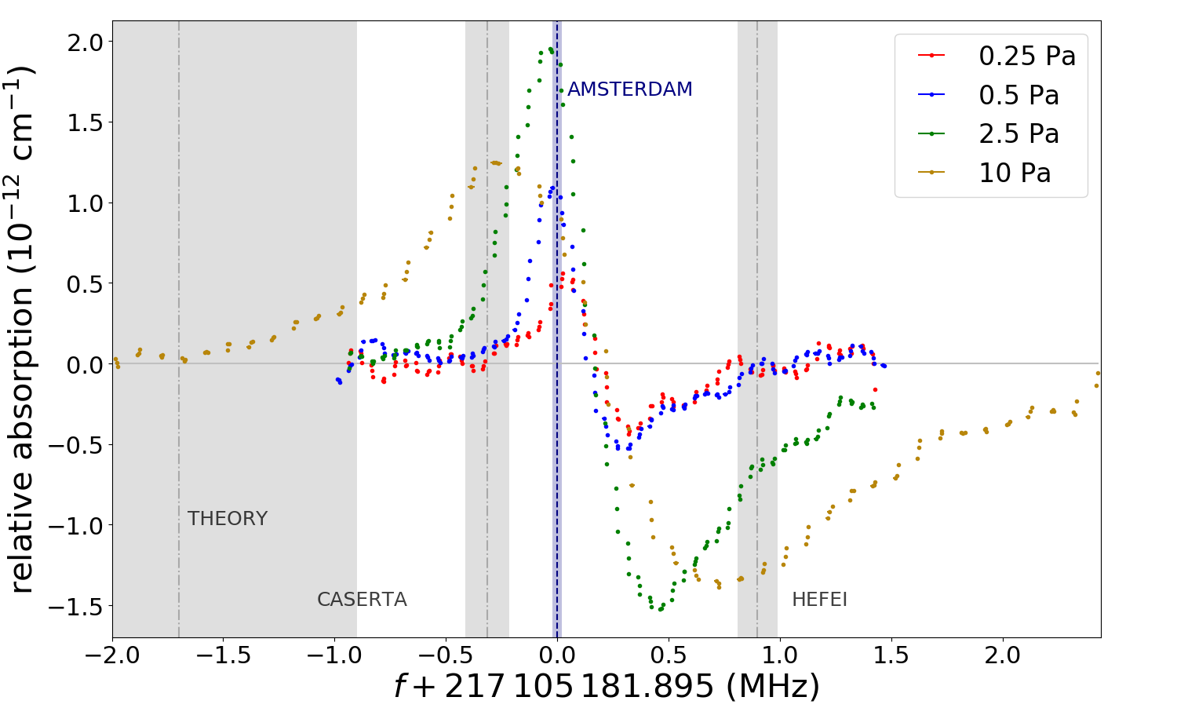

Slide 21
Interpretation

Slide 22
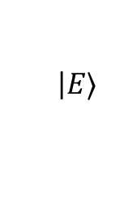
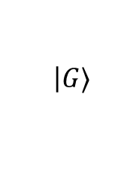
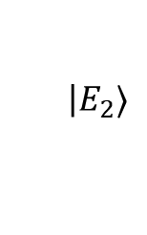
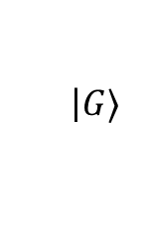
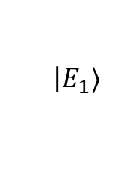
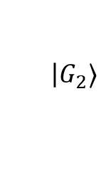
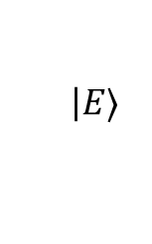
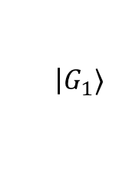
Crossovers in saturation spectroscopy
Doppler free Lamb-dip
Crossover resonances
V-scheme
‘dip-like’
Λ-scheme
‘peak-like’
$$\left|E_{2}⟩\right.$$
$$\left|E⟩\right.$$
$$\left|E⟩\right.$$
$$\left|E_{1}⟩\right.$$
$$\left|G_{2}⟩\right.$$
$$\left|G⟩\right.$$
$$\left|G⟩\right.$$
$$\left|G_{1}⟩\right.$$

Slide 23
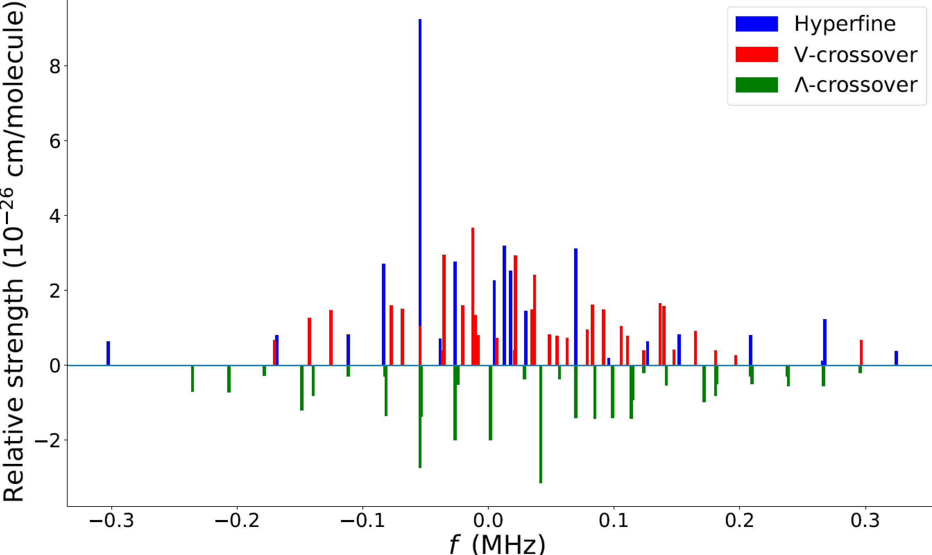
Crossovers effect
21 hyperfine transitions
36 V-crossovers
32 Λ-crossovers
Crossovers strength approximate

Slide 24
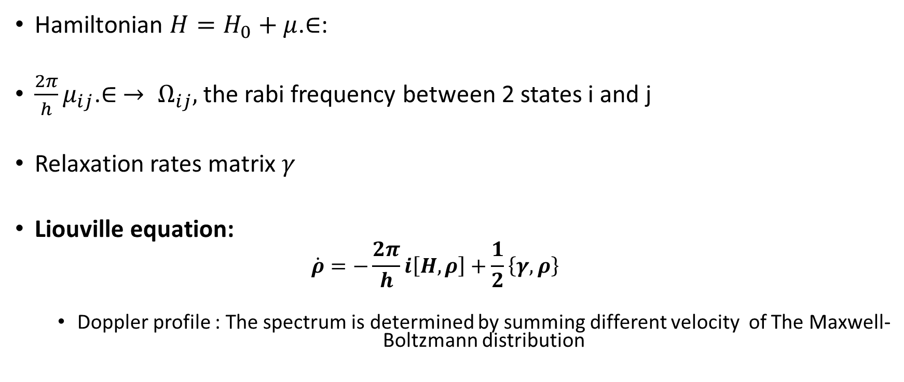
Density matrix simulation
Hamiltonian $H=H_{0}+μ$.$∈$:
$\frac{2π}{h}μ_{ij}$.$∈$ $→ Ω_{ij},$the rabi frequency between 2 states i and j
Relaxation rates matrix $γ$
Liouville equation:
  $$\dot{ρ}=−\frac{2π}{h}i\left[H,ρ\right]+\frac{1}{2}\left\{γ,ρ\right\}$$
  Doppler profile : The spectrum is determined by summing different velocity of The Maxwell-Boltzmann distribution

Slide 25

Simple Bloch equations
${\dot{ρ}}_{ii}=\sum_{j}{\frac{i}{\text{ħ}}\left({V_{ij}ρ}_{ij}−{V_{ji}ρ}_{ji}\right)+γ_{pop,ij}ρ_{jj}}$
${\dot{ρ}}_{jj}=\sum_{i}{−\frac{i}{\text{ħ}}\left({V_{ij}ρ}_{ij}−{V_{ji}ρ}_{ji}\right)−γ_{pop,ij}ρ_{jj}}$
${\dot{ρ}}_{ij}=\sum_{j}{(\frac{i}{\text{ħ}}V_{ij}\left(ρ_{jj}−ρ_{ii}\right))−(iΔ_{ii}}$+$γ_{coh,i,j}ρ_{ij}$)

Slide 26

Simple Bloch equations
${\dot{ρ}}_{ii} =\sum_{j}{\frac{i}{\text{ħ}}\left({V_{ij}ρ}_{ij}−{V_{ji}ρ}_{ji}\right)+γ_{pop,ij}ρ_{jj}}$
${\dot{ρ}}_{jj}=\sum_{i}{−\frac{i}{\text{ħ}}\left({V_{ij}ρ}_{ij}−{V_{ji}ρ}_{ji}\right)−γ_{pop,ij}ρ_{jj}}$
${\dot{ρ}}_{ij}=\sum_{j}{(\frac{i}{\text{ħ}}V_{ij}\left(ρ_{jj}−ρ_{ii}\right))−(iΔ_{ii}}$+$γ_{coh,i,j}ρ_{ij}$)

Slide 27

Simple Bloch equations
${\dot{ρ}}_{ii} =\sum_{j}{\frac{i}{\text{ħ}}\left({V_{ij}ρ}_{ij}−{V_{ji}ρ}_{ji}\right) +γ_{pop,ij}ρ_{jj}}$
${\dot{ρ}}_{jj}=\sum_{i}{−\frac{i}{\text{ħ}}\left({V_{ij}ρ}_{ij}−{V_{ji}ρ}_{ji}\right)−γ_{pop,ij}ρ_{jj}}$
${\dot{ρ}}_{ij}=\sum_{j}{\left(\frac{i}{\text{ħ}}V_{ij}\left(ρ_{jj}−ρ_{ii}\right)\right) −(iΔ_{ii}}$+$γ_{coh,i,j}ρ_{ij}$)

Slide 28

Simple Bloch equations
${\dot{ρ}}_{ii} =\sum_{j}{\frac{i}{\text{ħ}}\left({V_{ij}ρ}_{ij}−{V_{ji}ρ}_{ji}\right) +γ_{pop,ij}ρ_{jj}}$
${\dot{ρ}}_{jj}=\sum_{i}{−\frac{i}{\text{ħ}}\left({V_{ij}ρ}_{ij}−{V_{ji}ρ}_{ji}\right)−γ_{pop,ij}ρ_{jj}}$
${\dot{ρ}}_{ij}=\sum_{j}{(\frac{i}{\text{ħ}}V_{ij}\left(ρ_{jj}−ρ_{ii}\right))−(iΔ_{ii}}$+$γ_{coh,i,j}ρ_{ij}$)

Slide 29

Simple Bloch equations
${\dot{ρ}}_{ii} =\sum_{j}{\frac{i}{\text{ħ}}\left({V_{ij}ρ}_{ij}−{V_{ji}ρ}_{ji}\right) + γ_{pop,ij}ρ_{jj}}$
${\dot{ρ}}_{jj}=\sum_{i}{−\frac{i}{\text{ħ}}\left({V_{ij}ρ}_{ij}−{V_{ji}ρ}_{ji}\right)−γ_{pop,ij}ρ_{jj}}$
${\dot{ρ}}_{ij}=\sum_{j}{(\frac{i}{\text{ħ}}V_{ij}\left(ρ_{jj}−ρ_{ii}\right))−(iΔ_{ii}}$+$γ_{coh,i,j}ρ_{ij}$)

Slide 30
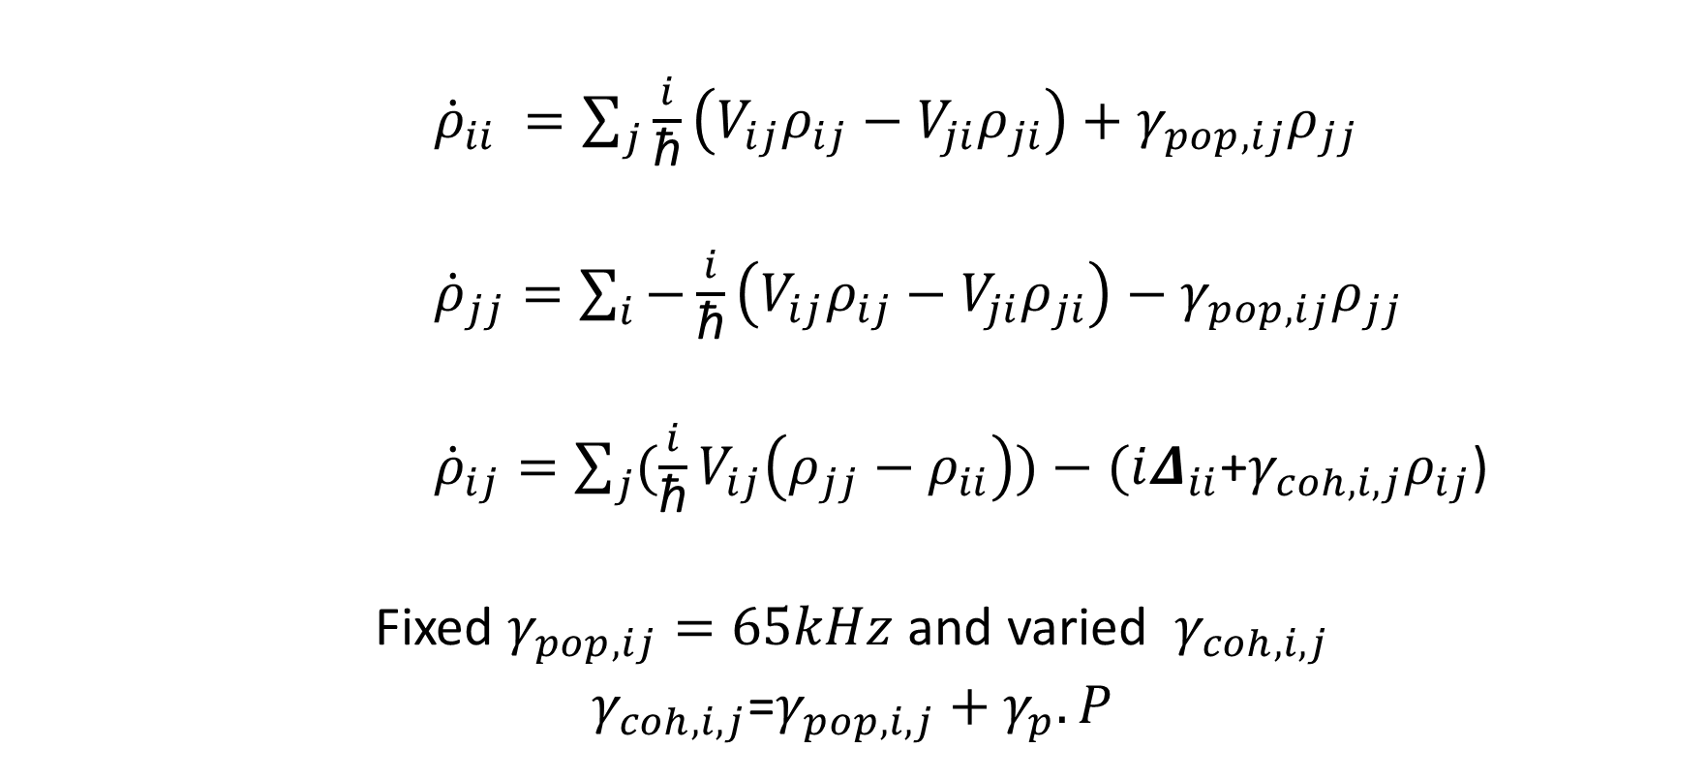
Simple Bloch equations
${\dot{ρ}}_{ii} =\sum_{j}{\frac{i}{\text{ħ}}\left({V_{ij}ρ}_{ij}−{V_{ji}ρ}_{ji}\right)+γ_{pop,ij}ρ_{jj}}$
${\dot{ρ}}_{jj}=\sum_{i}{−\frac{i}{\text{ħ}}\left({V_{ij}ρ}_{ij}−{V_{ji}ρ}_{ji}\right)−γ_{pop,ij}ρ_{jj}}$
${\dot{ρ}}_{ij}=\sum_{j}{(\frac{i}{\text{ħ}}V_{ij}\left(ρ_{jj}−ρ_{ii}\right))−(iΔ_{ii}}$+$γ_{coh,i,j}ρ_{ij}$)
Fixed $γ_{pop,ij}=65kHz$ and varied $γ_{coh,i,j}$
$γ_{coh,i,j}$=$γ_{pop,i,j}+γ_{p}.P$

Slide 31

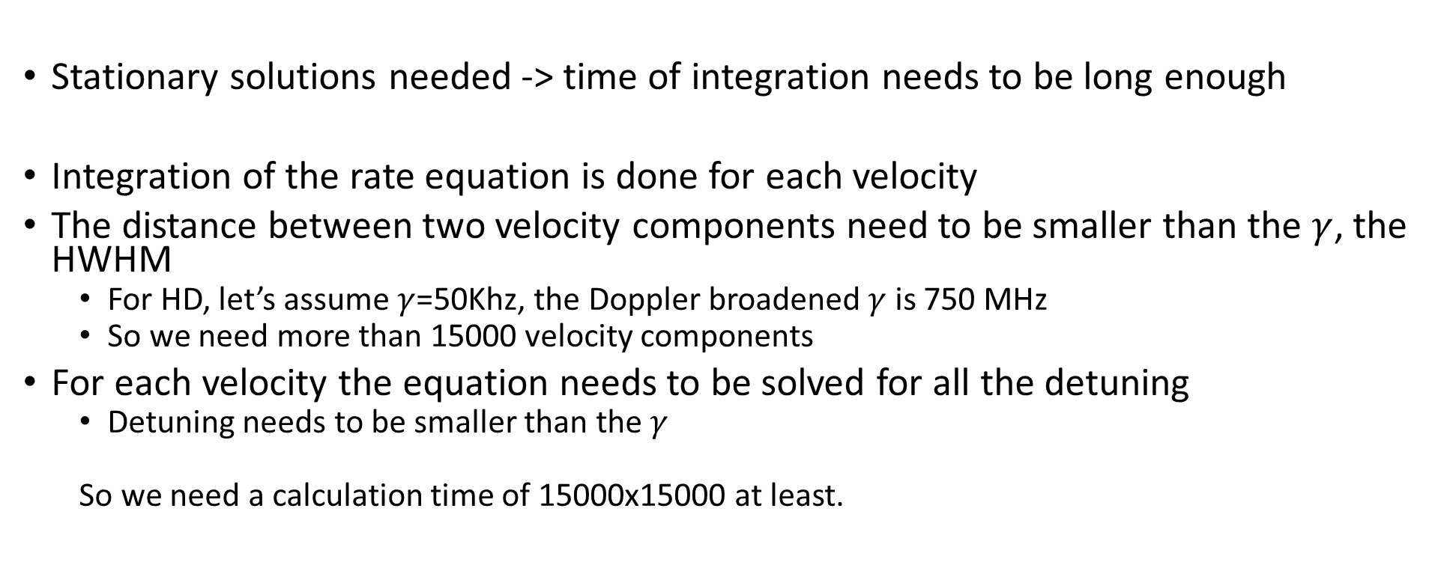
Why is a computer cluster needed ?
Stationary solutions needed -> time of integration needs to be long enough
Integration of the rate equation is done for each velocity
The distance between two velocity components need to be smaller than the $γ$, the HWHM
  For HD, let’s assume $γ$=50Khz, the Doppler broadened $γ$ is 750 MHz
  So we need more than 15000 velocity components
For each velocity the equation needs to be solved for all the detuning
  Detuning needs to be smaller than the $γ$
  So we need a calculation time of 15000x15000 at least.
Around 850 $μ_{s}$
Between 10 and 20 secs each

Slide 32
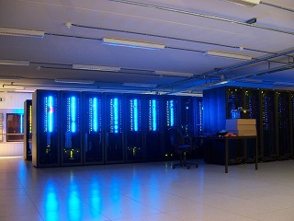
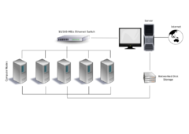
Lisa
Parallelization needed with the different Nodes
Normal pc task done in one Hour
In Lisa : 1 min done
1 whole spectrum done in 18 hours
More info on: https://userinfo.surfsara.nl/systems/lisa

Slide 33
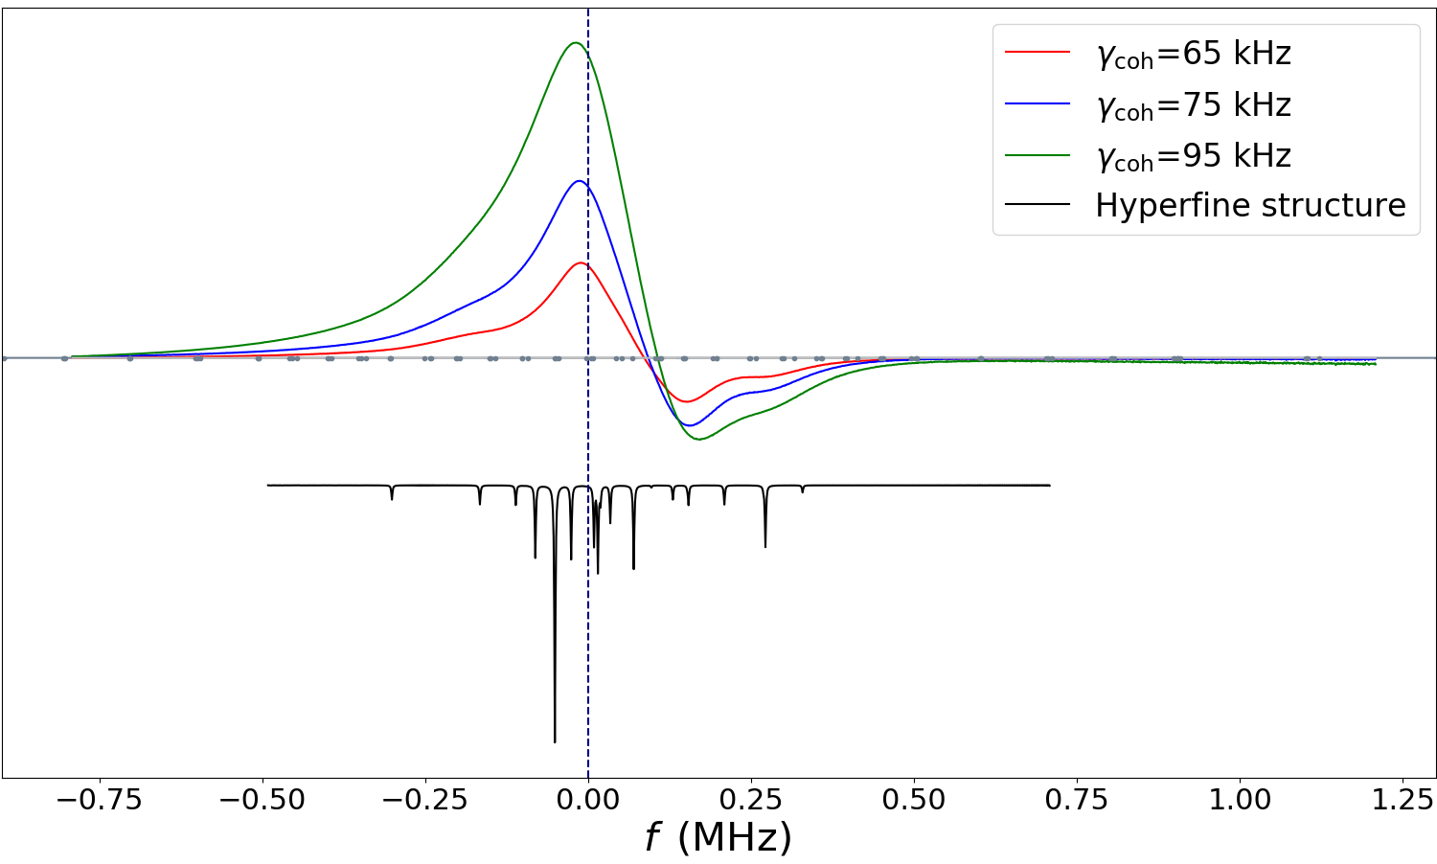
Calculation outcome

Slide 34
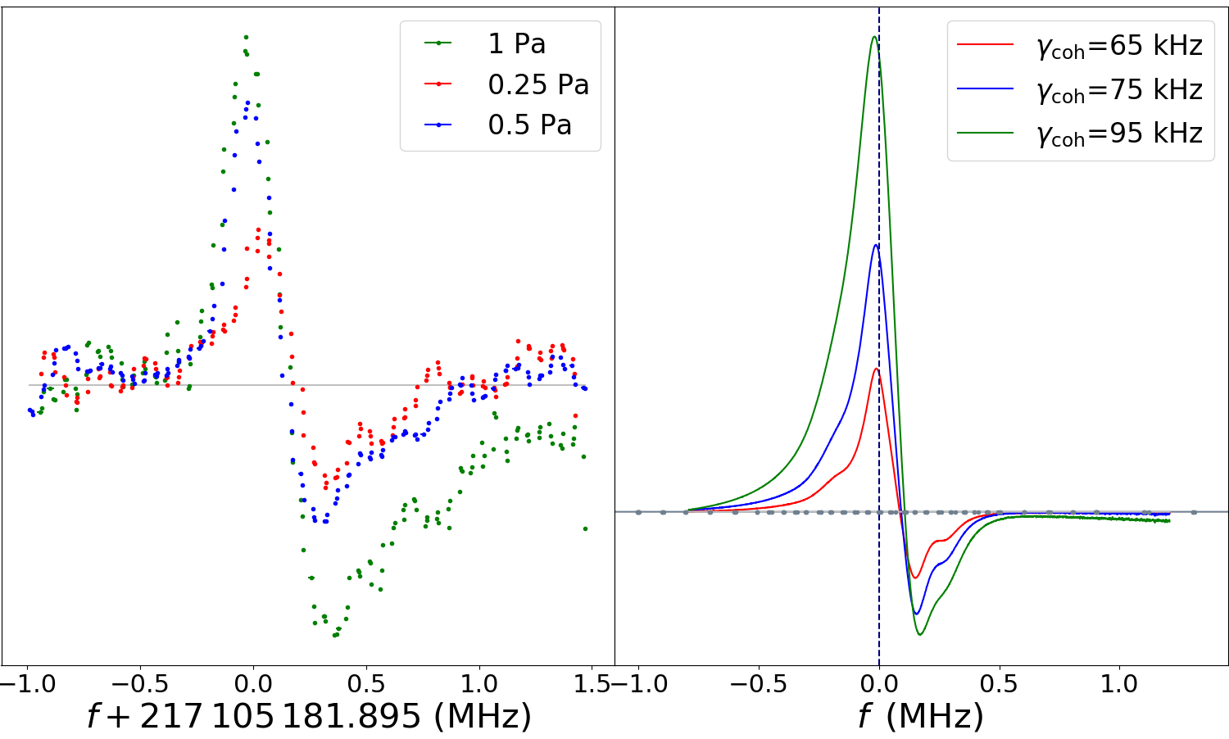

Slide 35
Remarks
The Lamb peak extrapolation 8kHz from the Hyperfineless center
Theory : 217 105 180.200 [900] MHz
Peak frequency:
217 105 181.895 [50] MHz

Slide 36
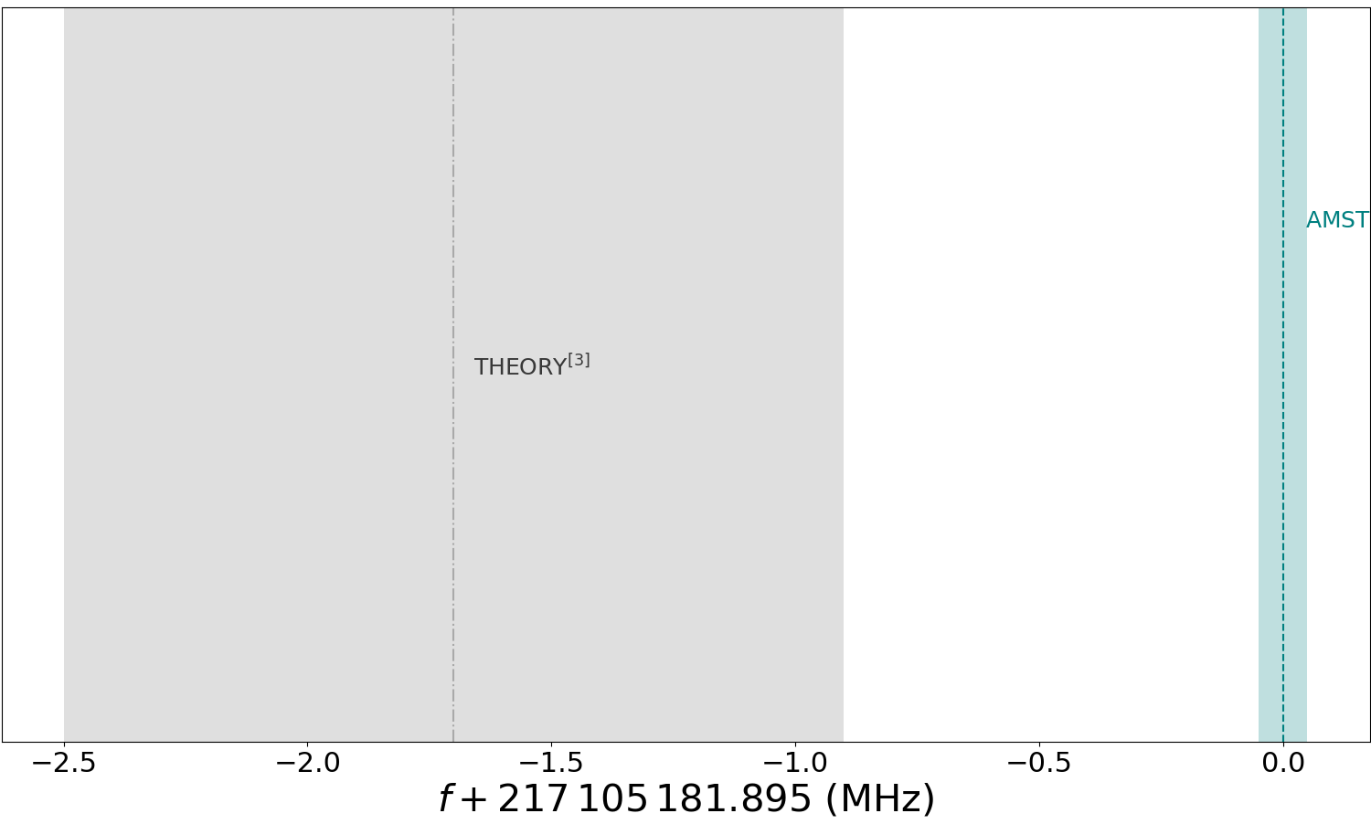

$2σ$

Slide 37
Conclusion
HD spectroscopy gives rise to a complicated line profile
Explanation of previous discrepancy
Complex hyperfine structure gives rise to crossover
Bloch equation can mimic that shape with certain parameters

Slide 38
Outlook
Improve the Bloch equation model
Cryogenic cooled cell is getting build
  Enhancement of population of the lower states
  Transit time longer
  R(0) (top of water line) can therefore be reached
R(0) hyperfine structure simpler

Slide 39



Acknowledgements
NICE-OHMS team
Frank Cozijn
Meissa Diouf
Edcel Salumbides
Wim Ubachs
Patrick Dupré
Benoit Darquié
Technician
Rob Kortekaas

Slide 40
Thank you

Slide 41

HD hyperfine levels
Interaction between nuclear spins( d-p): $I_{d}=1,$ $I_{p}=1/2$ and rotational quantum number J
  v=0, J=1 $→$ 5 levels F=($(−)1/2,(+)1/2$, $(+)$ $3/2,(−)3/2,5/2)$
  v=2, J=2 $→$ 6 levels F=($7/2,1/2$, $(+)3/2,(−)3/2,(+)5/2,(−)5/2)$
Allowed transitions $∆F=0,+/−1$ $→$ 21 transitions
N. F. Ramsey and H. R. Lewis, Phys. Rev. 108, 1246 (1957)

Slide 42


