Slide 1



Nonrelativistic ionization energy levels of a helium atom
D. Aznabayev, A. Bekbaev , V. Korobov
Balaton Limnological Research Institute of the Hungarian Academy of Sciences,
9-14 June 2019

Slide 2

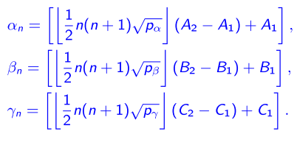
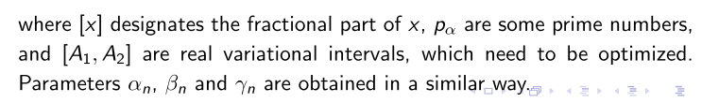
The nonliner parameters from are generated using the following simple formulas:
Variational Method
The wave function are taken in the form:

Slide 3
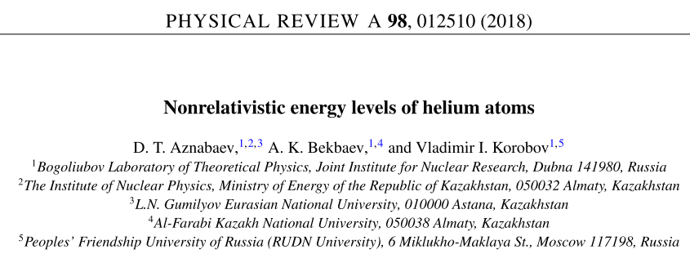
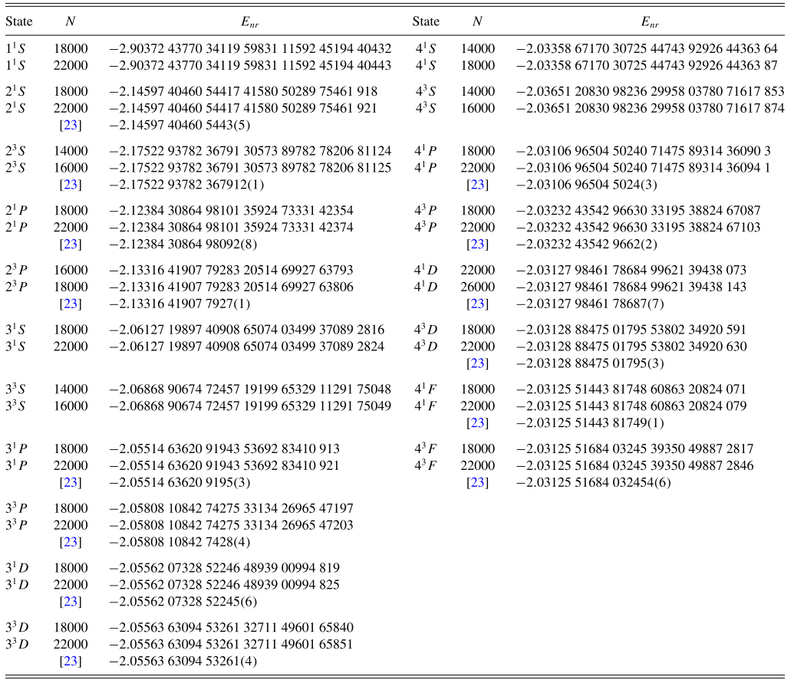
TABLE I. Convergence of the nonrelativistic energy of the ground state of a helium atom.
Basis (N) | Energy (in a.u.)
10000 | -2.90372 43770 34119 59831 11592 45193 9
14000 | -2.90372 43770 34119 59831 11592 45194 398
18000 | -2.90372 43770 34119 59831 11592 45194 40432
22000 | -2.90372 43770 34119 59831 11592 45194 40443
TABLE III. Nonrelativistic energies of the S, P, D, and F states of a helium atom. N is the number of basis functions. The two lines represent two consecutive calculations with the largest basis sets to show convergent digits. The third line presents calculations by Drake and Yan [23].
TABLE II. Comparison of nonrelativistic energies of the ground state of a helium atom.
Author (year) | Basis (N) | Energy (in a.u.)
Drake et al. (2002) | 2358 | −2.90372 43770 34119 598311
Korobov (2002) | 5200 | −2.90372 43770 34119 59831 1159
Schwartz (2006) | 24099 | −2.90372 43770 34119 59831 11592 45194 40444 66969 25310
Nakashima, Nakatsuji (2007) | 22709 | −2.90372 43770 34119 59831 11592 45194 40444 66969
This work | 22000 | −2.90372 43770 34119 59831 11592 45194 40443

Slide 4


