Slide 1



New States in Charmonium and
Bottomonium Families
Galina Pakhlova
International Conference on Precision Physics and Fundamental Physical Constants FFK-2019 Tihany, Hungary, 10-14 June 2019

Slide 2

Charmonium in the standard
quark model
c
c

Slide 3
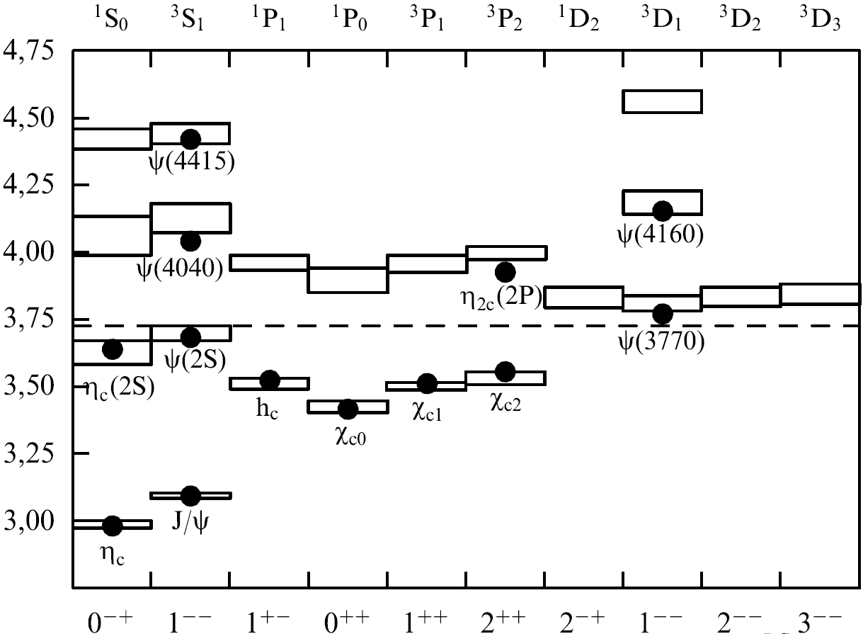

Charmonium in the standard quark model
c
c
X(4160)
(n+1)^{(2S+1)}L_{J}
n radial quantum number
S total spin of quark-antiquark
L relative orbital ang. mom.
  L = 0, 1, 2 ... corresponds to S, P, D...
J = S + L
P = (–1)^{L+1} parity
C = (–1)^{L+S} charge conj.
ψ₂(3823)
X(3940)
_
open charm threshold
ψ₃(3842)
DD
Below open charm threshold
all states are measured
S=0
S=1
S=0
S=1
J^{PC}
1974-1980 Discovery of 10 standard charmonium states
1980-2002 … nothing
2002-2019 Discovery of 7 new states that fit into charmonium table
Below open charm threshold a good agreement between theory and experiment

Slide 4

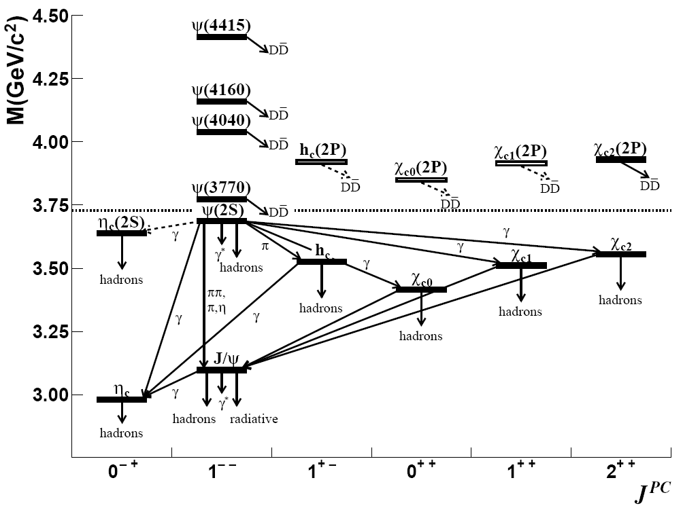
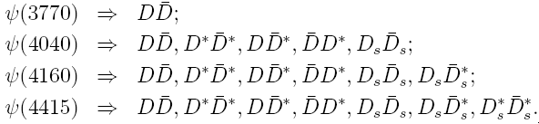
Charm factory BESIII
Symmetric e⁺e– collider
Energy scan 2.0 - 4.6 GeV
L ~ 10³³/cm²/s
Direct production of vector charmonium ψ states with J^{PC} = 1– –
Below open charm threshold
Above open charm threshold ψ states decay mainly to D meson pairs

Slide 5
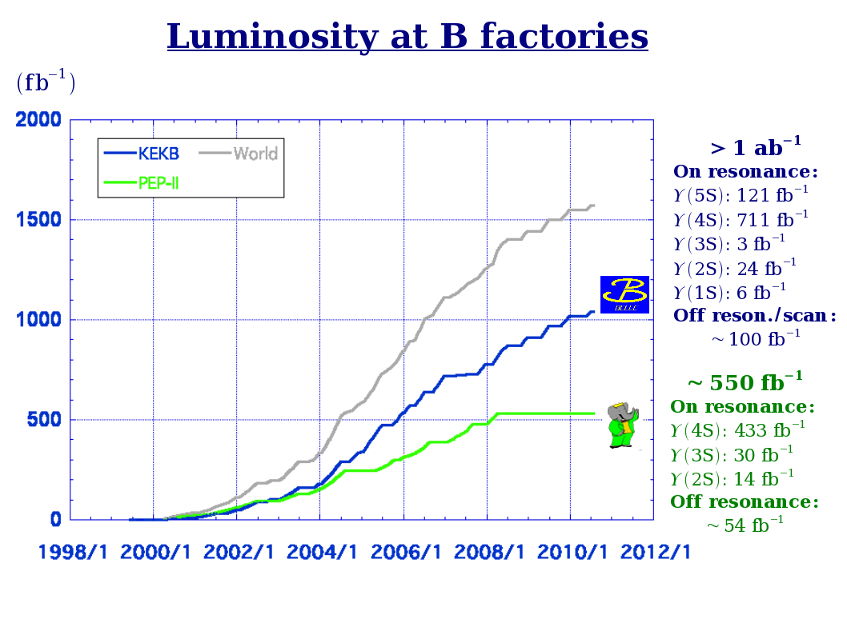
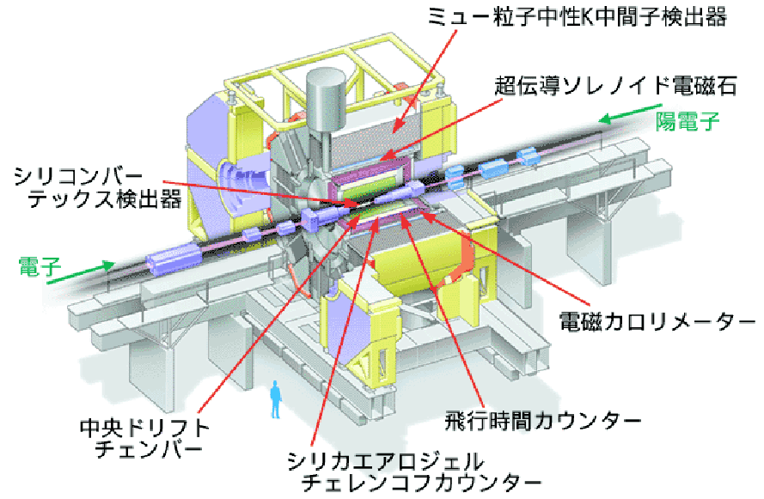

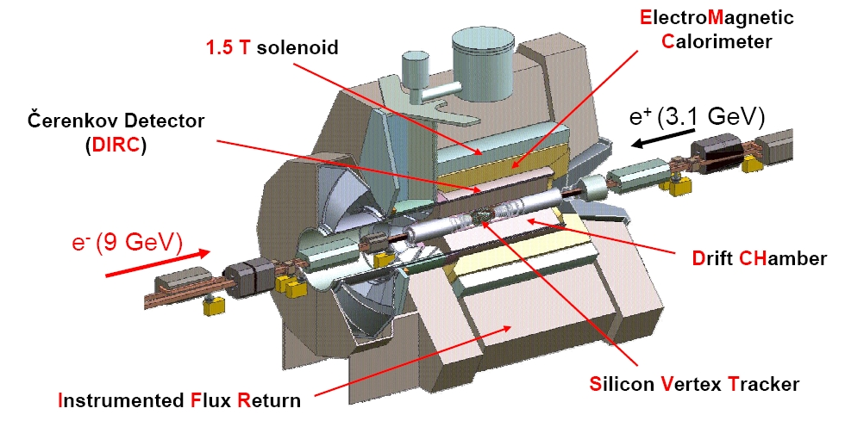
B factories Belle & BaBar
Asymmetric e⁺e– collider
Belle: 8 GeV (e–) × 3.5 GeV (e⁺)
designed luminosity: 10.0×10³³cm^{–2}s^{–1}
achieved 21.2×10³³cm^{–2}s^{–1}
>2 times larger!
BaBar completed data taking in April, 2008
Belle completed data taking in June, 2010
to start SuрerKEKB/Belle II upgrade
Notes:
5

Slide 6
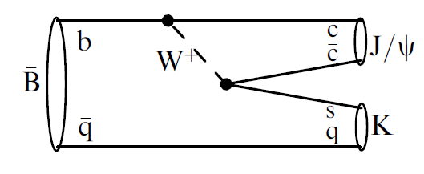
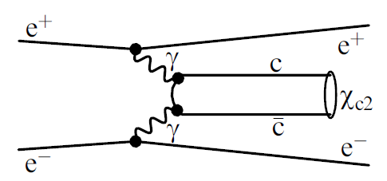
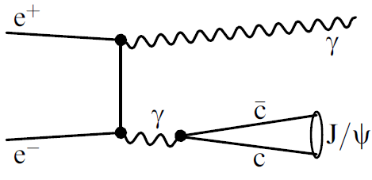
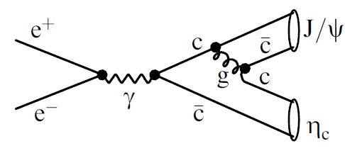
Charmonium production at B factories
B decays
γγ fusion
Any quantum numbers are possible, can be measured in angular analysis
J^{PC} = 0^{±+} , 2 ^{±+}
e⁺e⁻ annihilation with ISR
double charmonium production
J^{PC} = 1– –
Study of vector charmonium states from threshold in wide energy region
in association with J/ψ
only J^{PC} = 0^{±+} seen

Slide 7
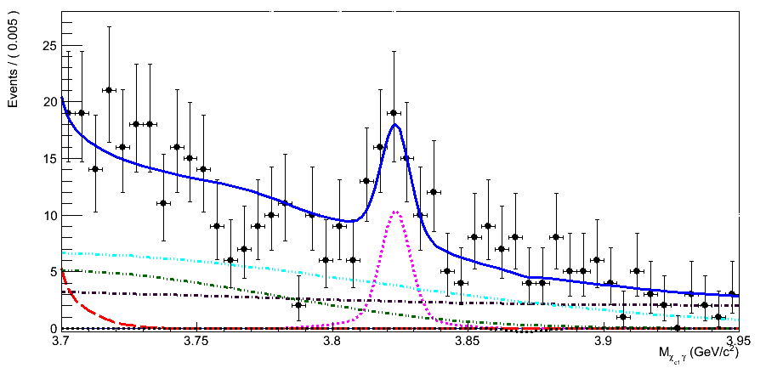

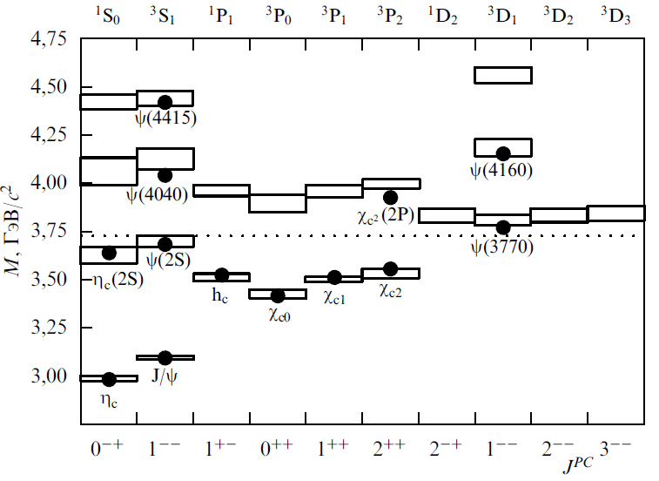
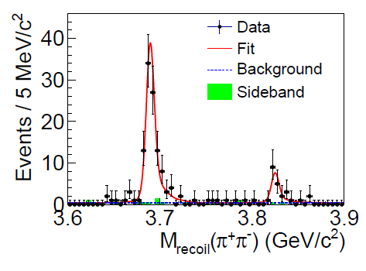
PRL 111, 032001 (2013)
X(3823) = ψ₂(1³D₂) PDG2018
B⁺ →χ_{c1} γ K⁺
X(3823)
X(3823)→χ_{c1}γ C = −
1⁻ ⁻ 1⁺ ⁻ 2⁻ ⁻ 3⁻ ⁻
ψ(3770) h_{c}(2P) ψ₂ ψ₃ → DD
4.2σ
711 fb⁻¹
decay to DD is forbidden due to unnatural spin-parity → small Γ
decay to χ_{c1}γ should be prominent (E1)
Γ(χ_{c1} γ ) ~ O(10KeV) is typical for charmonium
M (χ_{c1} γ), GeV
M = 3823.5 ± 2.8 MeV
Γ < 14 MeV @ 90%CL
e⁺e⁻ →π⁺π⁻X(3823)→π⁺π⁻γχ_{c1}
PRL115, 011803 (2015)
M = 3821.7 ± 1.3±0.7 MeV
Γ < 16 MeV @ 90%CL
ψ₂
X(3823)
γ
6.2σ
Notes:
7

Slide 8




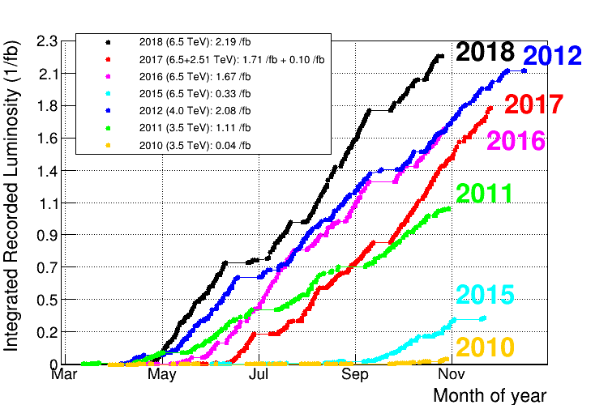
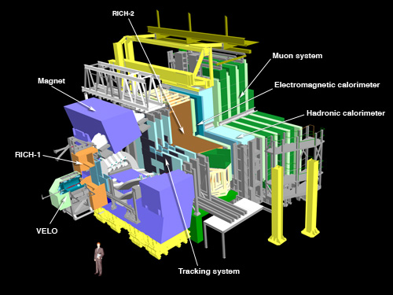

Tevatron
pp collider
E ~ 1.8 TeV: L ~ 4fb^{–1} / experiment
LHC
pp collider
Charmonium
Prompt production
Beauty hadrons decays
Charmonium
Prompt production
B meson decays

Slide 9
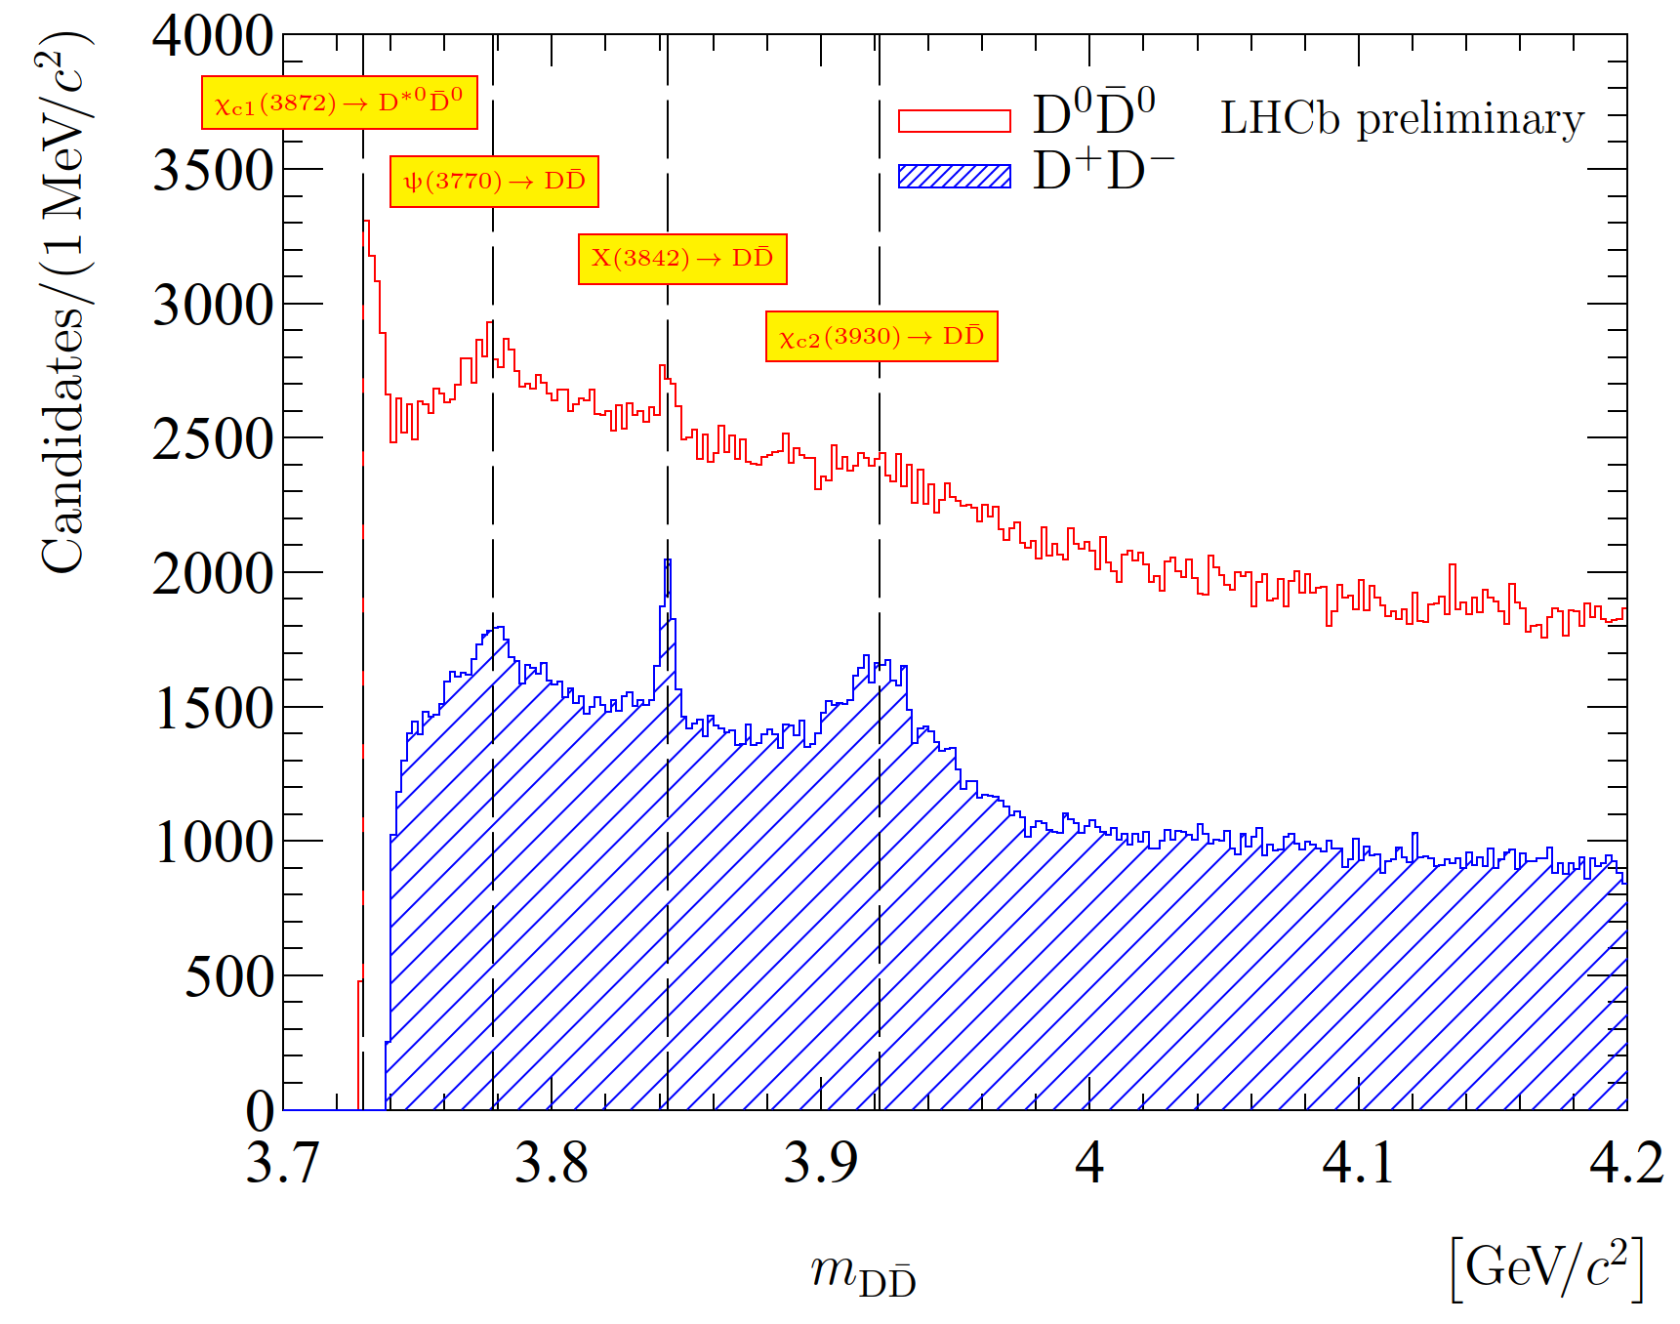
X(3842) = ψ₃(1³D₃)
NEW
X(3842) → DD
2⁻ ⁻ 3⁻ ⁻
ψ₂ ψ₃ → DD
Decay to DD should be prominent
Γ(DD ) ~ 1 MeV, due to small decay phase-space and L=3 centrifugal barrier!
Run 1&Run 2
9 fb⁻¹
New narrow state X(3842) at open charm threshold is observed
M = 3842.71 ± 0.16 ± 0.12 MeV
= 2.79 ± 0.51 ± 0.35 MeV
Consistent with expected 1³D₃ state ψ₃(1D) with J^{PC}=3⁻⁻
ψ₃
Notes:
9

Slide 10
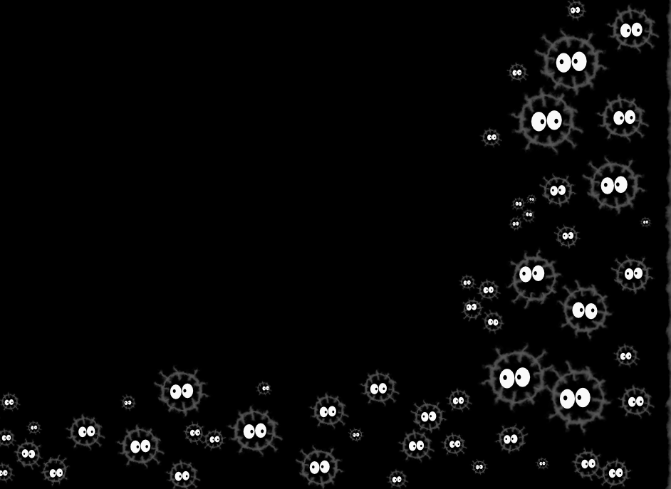
Exotic
Charmoniumlike
states

Slide 11
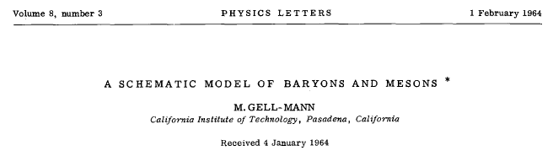
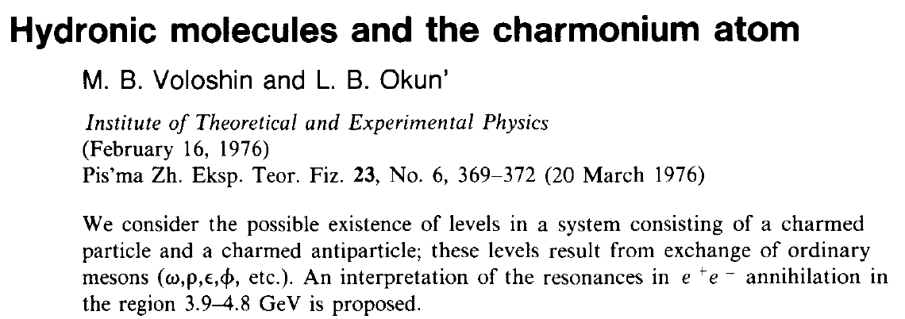
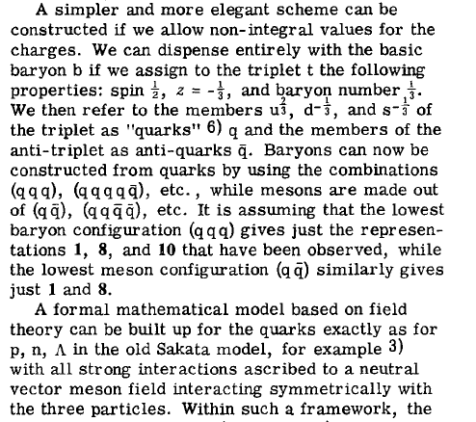
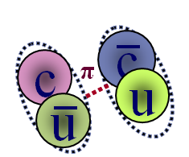
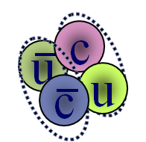
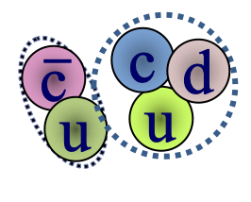
Multiquark states
February 1964
March 1976
November 1976
Molecular state
two loosely bound charm mesons
Tetraquark
tightly bound four-quark state
Pentaquark
tightly bound five-quark state
Notes:
Actually, existence of such exotic states have long been discussed, and were mentioned and discussed since the birth of original paper by Gell-Mann on the quark model.

Slide 12
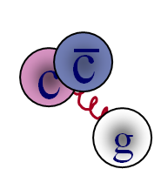
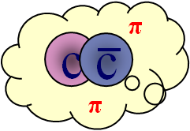
More charmoniumlike states
Charmonium hybrids
States with excited gluonic
degrees of freedom
c
c
&
something
Hadrocharmonium
Specific charmonium state “coated”
by excited light-hadron matter
Rescattering
Two D-mesons, produced closely, exchange quarks
Threshold effects
Virtual states at thresholds
Charmonium states with masses shifted by nearby D_{(s)}^{(*)}D_{(s)}^{(*)} thresholds

Slide 13
Charmoniumlike states
before PDG2018 naming scheme
X(4700)
Y(4660)
P_{C}⁺(4457)
X(4500)
Х(4630)
Y(4390)
Z(4430)⁺
P_{C}⁺(4440)
Y(4360)
Z(4250)⁺
P_{C}⁺(4312)
X(4160)
X(4274)
Y(4260)
X(4140)
Y(4230)
Z(4240)⁺
X(3915)
X(3872)
Z(4050)⁺
ψ₂(3823)
Z_{c}(4020)⁺
X(3940)
_
Z_{c}(3900)⁺
X*(3860)
ψ₃(3842)
DD
CHARGED!!!
S=0
S=1
S=0
S=1
J^{PC}
c
c
2002-2019
Discovery of two dozens exotic charmonium states
or charmoniumlike states
All of them above open charm threshold
&
something

Slide 14

X(3872)
as
χ_{c1}(3872) in PDG2018

Slide 15
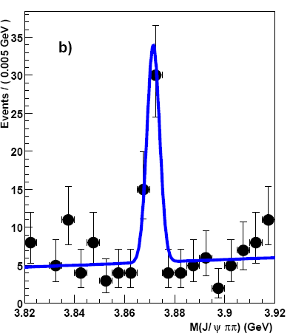
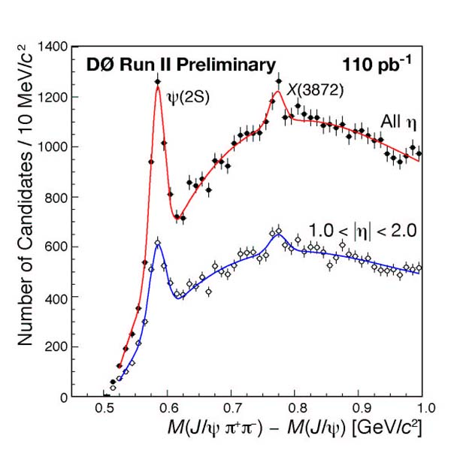

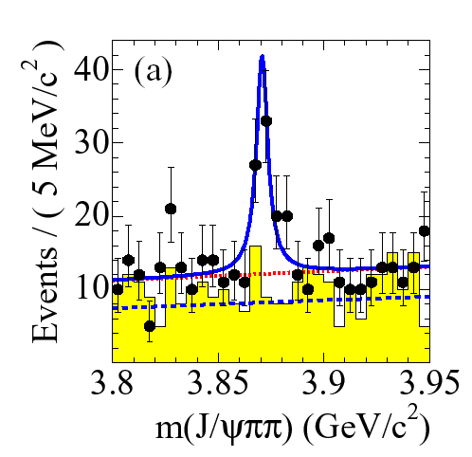
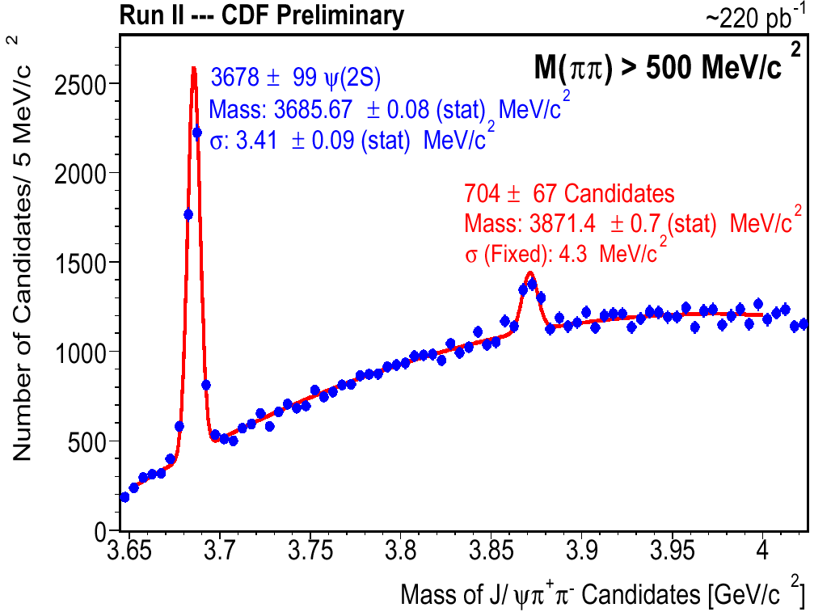
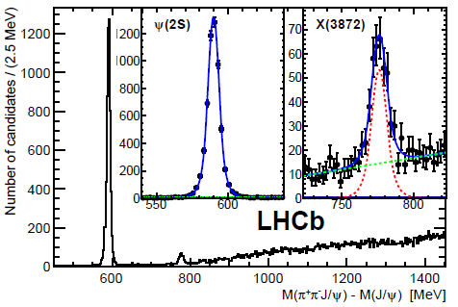

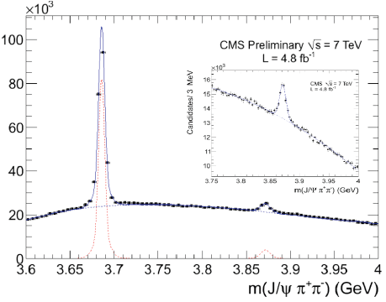

PRL91, 262001 (2003)
First observed by Belle
in B→K J/ψπ⁺π–
Belle top cited
1600+
PRD73, 011101 (2006)
10σ
PRL93, 162002 (2004)
M(J/ψππ)
EPJ C72 1972 (2012)
J^{PC} = 1⁺⁺
finally
established
PRL93, 072001 (2004)
Hadronic collisions:
produced mostly promptly; only
0.263±0.023±0.016
from B-decays (CMS)
JHEP 04, 154 (2013)
M_{X} close to D⁰D^{*0} threshold M = 3871.69± 0.17 MeV
not clear below or above: Δm = – 0.01 ± 0.18 MeV
Surprisingly narrow: Γ_{tot}< 1.2 MeV at 90% CL

Slide 16
ψ(2S)γ
X(3872) interpretation
J/ψω
J/ψγ
J/ψρ
D⁰D^{*0} molecular state: (the most popular today)
M_{X} ~ M_{D0} + M_{D*0} is not accidental
J^{PC}=1⁺⁺ (D⁰D^{*0} in S-wave)
DD* decay
Small rate for decay into J/ψγ is expected
too large X(3872) → ψ(2S)γ
too small binding energy: D⁰ and D^{*0} too far in space to be produced in high energy pp collisions
X(3872)
D⁰D^{*0}
Mixture of P-wave charmonium χ_{c1}(2P) and S-wave DD^{*0} molecule
Search for X(3872) partners decays Molecules with J^{PC} = 0⁺⁺, 1^{+–}, 2⁺⁺…
χ_{c1} γ χ_{c2} γ | Forbidden by C-parity conservation C-odd partners: tetraquark, molecule UL : < 1/4 from J/ψ π⁺π–
J/ψ η | C-odd partners: tetraquark UL : < 1/2 from J/ψ π⁺π–
η_{c} η η_{c} π⁰ η_{c} π⁺π– η_{c} ω | Search for other X-like molecular states UL : ~ J/ψ π⁺π
χ_{c1}(3872) PDG2018
X(4160)
X(3872)
ψ₂(3830)
X(3940)
_
DD
Notes:
16

Slide 17

Y family of exotic vector states

Slide 18
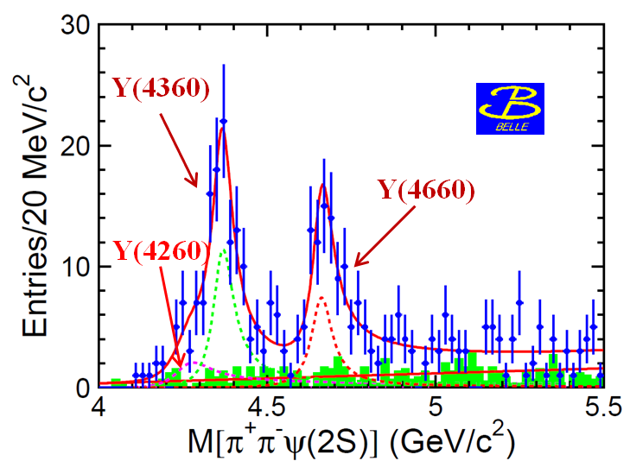
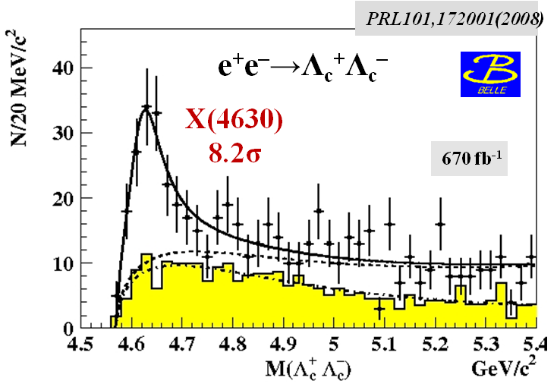
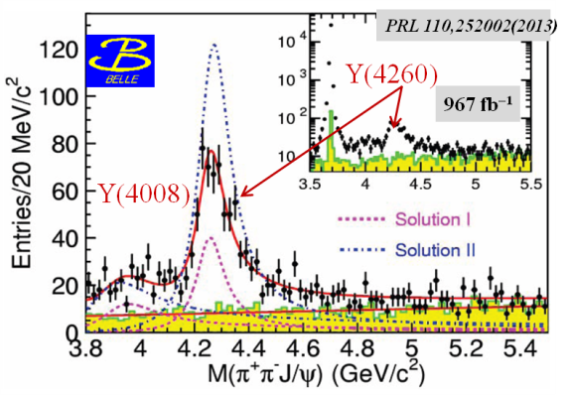
e⁺e⁻ →π⁺π⁻ψ(2S)
e⁺e⁻ →π⁺π⁻J/ψ
Y states at B factories via ISR
 | M(MeV) | Γ(MeV) | decay mode | experiment
Y(4260) | 4263⁺⁸₋₉ | 95±14 | J/ψππ | BaBar, Belle
Y(4360) | 4361±13 | 74±18 | ψ(2S)ππ | BaBar, Belle
X(4630) | 4634⁺⁹₋₁₁ | 92⁺⁴¹₋₃₂ | Λ_{с}⁺Λ_{с}⁻ | Belle
Y(4660) | 4664±12 | 48±15 | ψ(2S)ππ | BaBar, Belle
Y(4660)
X(4630)
π⁺π⁻
Y(4360)
Unlike conventional charmonium
No room for Y states among 1– – charmonium
3³S₁ = ψ(4040); 2³D₁ = ψ(4160) ; 4³S₁ = ψ(4415); masses of predicted 3³D₁ (4520); 5³S₁ (4760); 4³D₁(4810) are higher (lower)
Absence of open charm production
Anomalous large partial width
Γ(Y → J/ψππ) > 1 MeV
Only one decay channel per one Y state:
light charmonium + ππ
π⁺π⁻
Y(4260)
π⁺π⁻
π⁺π⁻
π
c
–
c
π

Slide 19
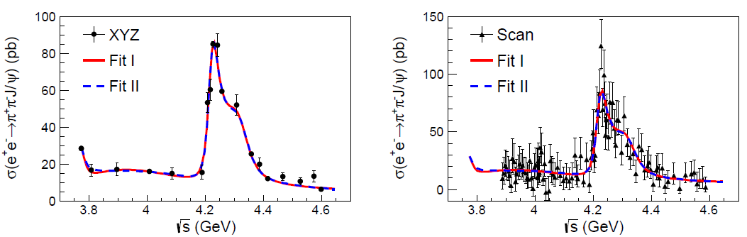
Precise measurements of e⁺e⁻ →π⁺π⁻ J/ψ
PRL118 092001 (2017)
e⁺e⁻ →π⁺π⁻ J/ψ cross section is inconsistent with a single pick of Y(4260)
Two peaks are favored over one peak by 7.6 σ
 | M, GeV/c² | Γ, MeV | Decay mode
Y(4220), BESIII | 4222.0±3.1±1.4 | 44.1±4.3±2.0 | π⁺π⁻ J/ψ
Y(4360), BESIII | 4320.0±10.4±7.0 | 101.4^{+25.3}_{−19.7}±10.2 | π⁺π⁻ J/ψ

Slide 20
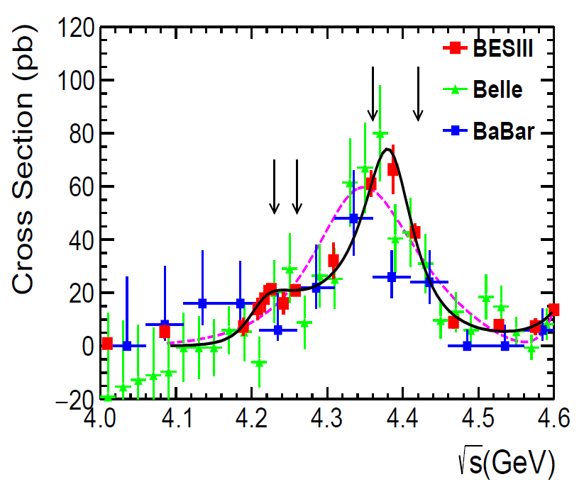
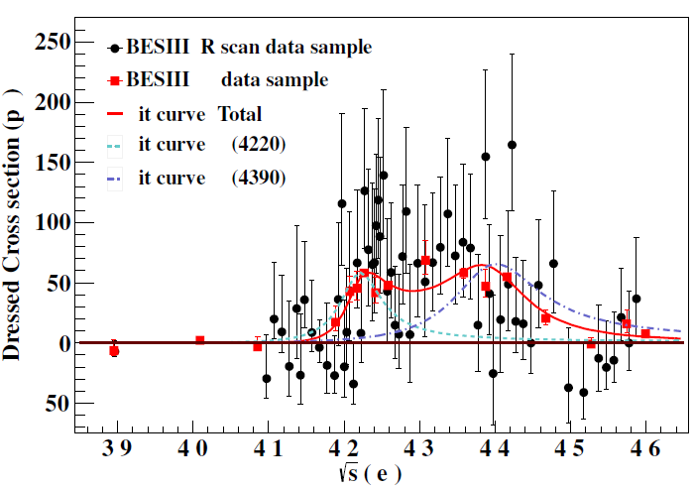
Precise measurements of e⁺e⁻ →π⁺π⁻ ψ(2S), π⁺π⁻ h_{c}
PRD96 032004 (2017)
PRL118 092002 (2017)
π⁺π⁻ h_{c}
π⁺π⁻ ψ(2S)
BESIII confirms lineshape in e⁺e⁻→π⁺π⁻ψ(2S)
 | M, GeV/c2 | Γ, MeV | Decay mode
Y(4220) | 4209.5±7.4±1.4 | 80.1±24.6±2.9 | π⁺π⁻ ψ(2S)
Y(4220) | 4218.4^{+5.5}_{−4.5}±0.9 | 66.0^{+12.3}_{−8.3}±0.4 | π⁺π⁻ h_{c}
Y(4390) | 4383.8±4.2±0.8 | 84.2±12.5±2.1 | π⁺π⁻ ψ(2S)
Y(4390) | 4391.5^{+6.3}_{−6.8}±0.9 | 139.5^{+16.2}_{−20.6}±0.6 | π⁺π⁻ h_{c}

Slide 21
e⁺e⁻→ D⁰D*–π⁺
PRL122, 102002 (2019)
Y(4390) or ψ(4415)?
Y(4220)
Two peaks are favored over one peak is greater 10 σ
 | M, GeV/c2 | Γ, MeV | Decay mode
Y(4220) | 4228.6±4.1±6.3 | 77.0±6.8±6.3 | D⁰D*–π⁺
ψ(4415)→ D⁰D₂(2460)⁰ → D⁰D–π⁺
ψ(4415)→ D⁰D₂(2460)⁰ → D⁰D*–π⁺

Slide 22
Vector states summary 2019
 | Open charm | J/ψπ⁺π⁻ | ψ(2S) π⁺π⁻ | h_{c}π⁺π⁻ | J/ψη | χ_{c0}ω | χ_{c2}ω
ψ(3770) | +
ψ(4040) | + |  |  |  | +
ψ(4160) | + |  |  |  | +
Y(4220) = ψ(4230) PDG 2018 Y(4260) = ψ(4260) PDG 2018 | DD*π - | + + |  | + |  | + |  | Same state?
Y(4390) = ψ(4390) PDG 2018 Y(4360) = ψ(4360) PDG 2018 | - | + | + + | + |  |  |  | Same state?
Y(4390)? | DD*π |  |  |  |  |  |  | ψ(4415)?
ψ(4415) | DDπ |  |  |  |  |  | +
Y(4630) = ψ(4660) PDG 2018 | Λ_{c}⁺Λ_{c}⁻ |  |  |  |  |  |  | Same state ψ(4660)?
Y(4660) = ψ(4660) PDG 2018 | - | + | +
Y family contains three ( five?) exotic vector states
Only one Few decay channels per one Y state
  hadrocharmonium is excluded!
Nature of Y states?
PDG naming 2018: Y states with J^{PC} = 1– – turn into ψ states

Slide 23

c
–
u
d
–
c
Z_{c}⁺
c
c
–
u
d
–
u
–
d
c
–
c
Charged charmoniumlike states

Slide 24
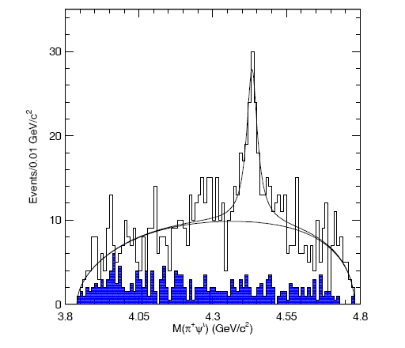
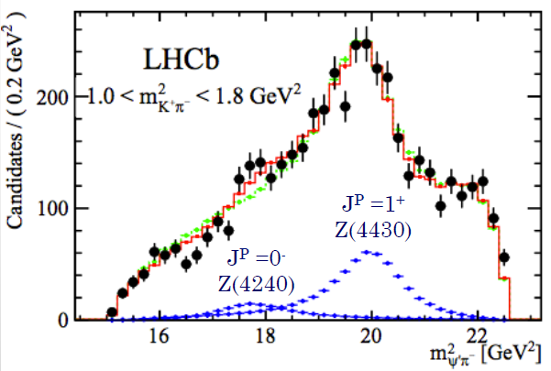

Charged Z_{c}⁺ states in B decays
PRL 100, 142001 (2008)
PRL 112, 222002(2014)
Z(4430)⁺→ψ(2S) π⁺
6.5 σ
LHCb: Parameters (including quantum numbers) are consistent with the Belle results
Another peak at 4240 MeV with significance ~5 σ
548 fb⁻¹
~5 σ
>14 σ
M(π⁺ψ(2S))
c
–
Belle: Z(4430)⁺ three different analysis, J^{P} = 1⁺
Discovery: fit to M(ψ(2S)π⁺) with K*(890)&K*(1430) veto
Dalitz analysis
Full amplitude analysis to obtain spin-parity
Mass values are the same, width depends on method
u
d
–
c
Z_{c}⁺ cannot be conventional charmonium
Four Z_{c}⁺ states found by Belle
 | PDG2018 | M(MeV) | Γ(MeV) | J^{PC} | decay mode | production mode | experiment
Z⁺(4050) | X(4050) | 4051⁺²⁴₋₄₀ | 82⁺⁵⁰₋₂₈ | ? | χ_{c1}π | B→KZ⁺ | Belle
Z⁺(4250) | X(4250) | 4248⁺¹⁹⁰₋₅₀ | 177⁺³²⁰₋₇₀ | ? | χ_{c1}π | B→KZ⁺ | Belle
Z⁺(4200) | Z_{c}⁺(4200) | 4196⁺³¹₋₂₉⁺¹⁷₋₁₃ | 370⁺¹⁰⁰₋₁₅₀ | 1⁺ | J/ψπ | B→KZ⁺ | Belle/LHCb
Z⁺(4430) | Z_{c}⁺(4430) | 4478⁺¹⁵₋₁₈ | 181±31 | 1⁺ | ψ(2S)π, J/ψπ | B→KZ⁺ | Belle/LHCb

Slide 25
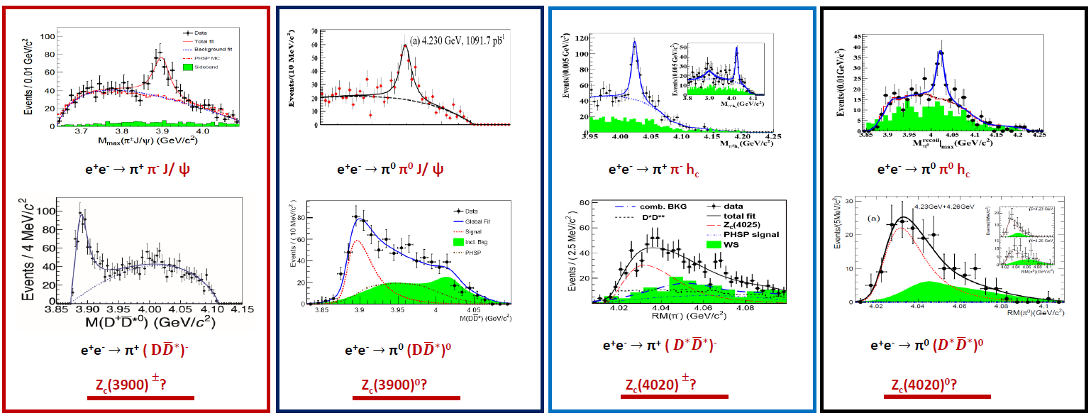
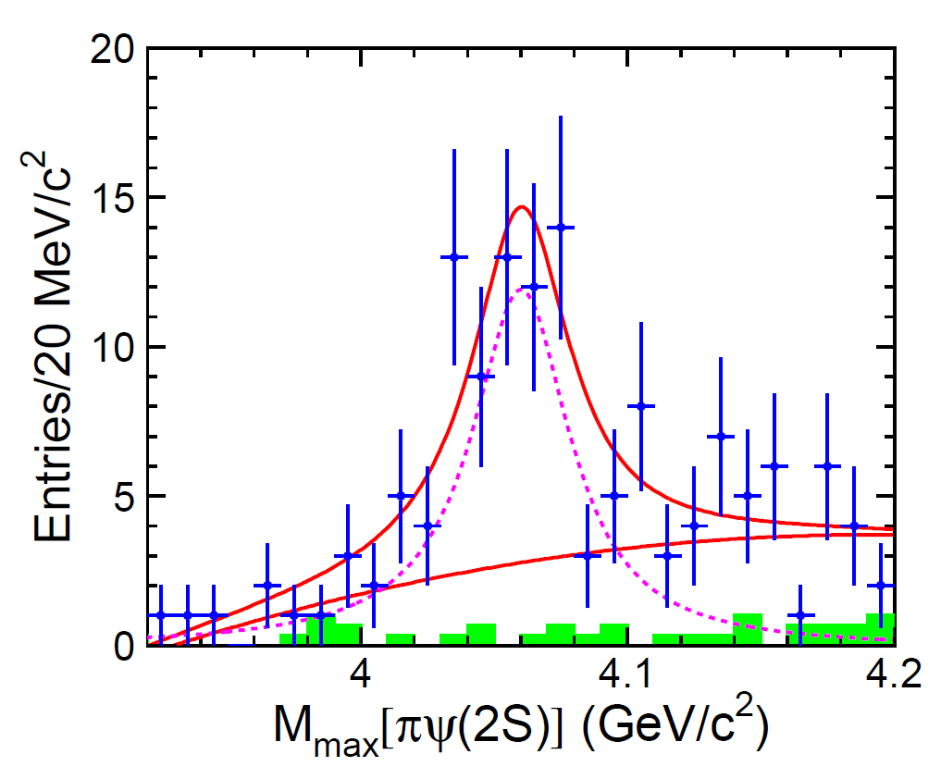
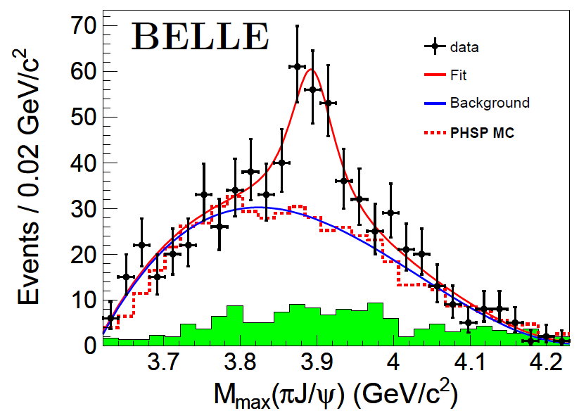

Z_{c} family in e⁺e⁻ annihilation
PRL 110, 252001 (2013)
PRL 115, 112003 (2015)
PRL 111, 242002 (2013)
PRL 113, 212002 (2014)
307±48
8σ
8.9σ
PRL 110, 252001 (2013)
PRL 115, 222002 (2015)
PRL 113, 132002 (2014)
PRL 115, 182002 (2015)
PRL 110, 252002 (2013)
PRD91, 112007(2015)
New signal in
Y(4360)→ π‒ Z(4050)⁺
M = 4054±3±1 MeV/c²
Γ = 45±11±6 MeV
BESIII
Z_{c}(4030)⁺
M = 4032.1±2.4 MeV/c²
Γ = 26.1±5.3 MeV
Z_{c}(3900)⁺
Z_{c}(4050)⁺?
5.2σ
3.5 σ
PRD96,032004(2017)
159±49

Slide 26
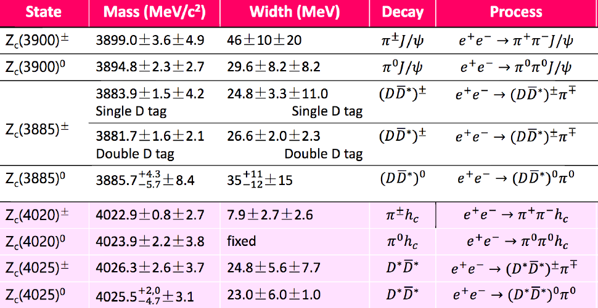
Z_{c} summary
Same states with different final states
Two isospin triplets: Z_{c}(3900)^{±/0} and Z_{c}(4200^{)±/0}
Amplitude analysis on Z_{c}(3900) : J^{P}=1⁺
Interpretation? Molecular states? Z_{c}(4050)⁺ = Z_{c}(4030)⁺?

Slide 27

Tetraquarks

Slide 28
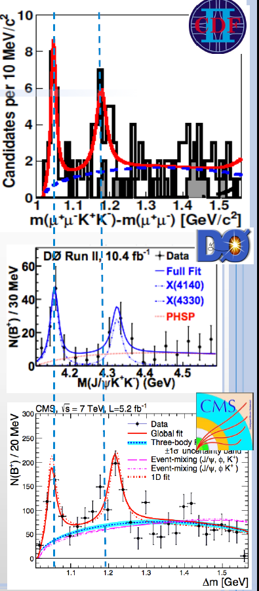
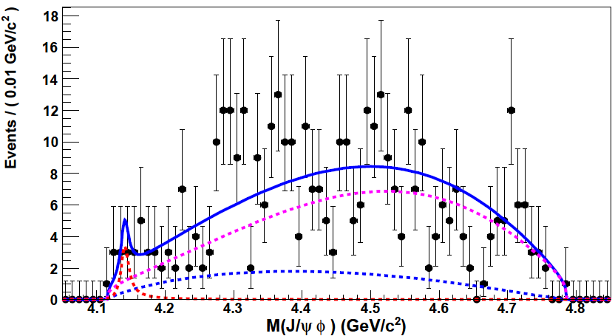
B⁺→J/ψϕK⁺
X(4140)→J/ψϕ
X(4140) & X(4274)
narrow peak at threshold and one more nearby

Slide 29
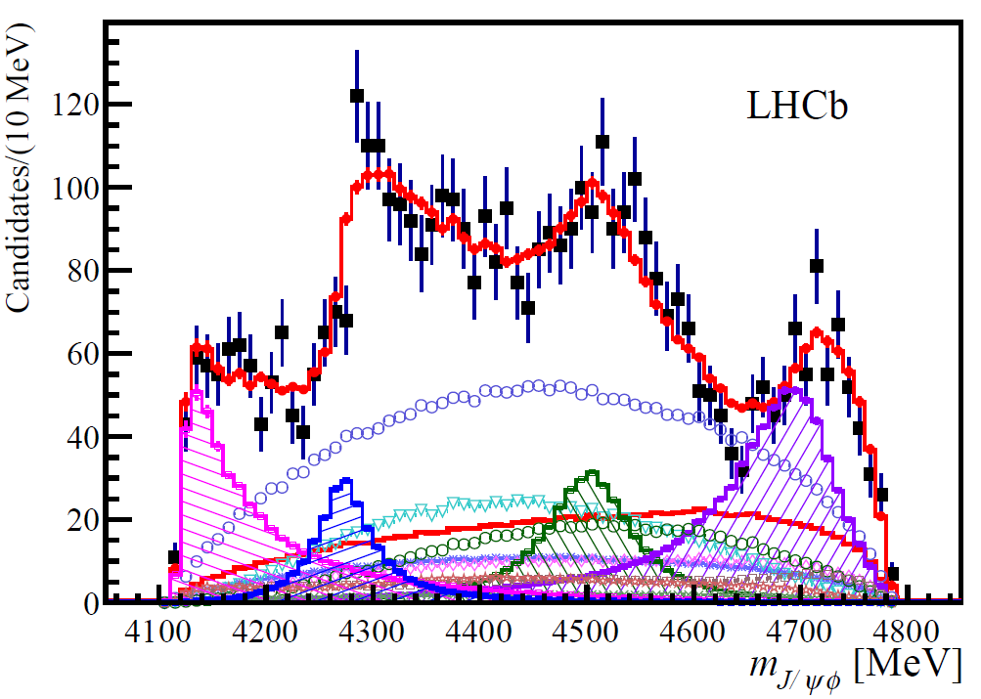
B⁺→J/ψϕK⁺ at LHCb
X(4700)
PRL 118, 022003 (2017)
X(4500)
X(4274)
X(4500)
X(4274)
X(4140)
1⁺⁺
0⁺⁺
X(4700)
X(4140)
Full amplitude analysis to obtain spin-parity
FOUR NEW STATES!!!
Theory:
X(4140) D_{s}D_{s}* cusp? tetraquark?
X(4274) tetraquark? X(4500) D_{s}*D_{s}* cusp? X(4700)?
 | M, GeV/c² | Γ, MeV | J^{PC}
X(4140), χ_{c1} (4140) PDG2018 | 4146.8±2.4 | 22⁺⁸₋₇ | 1⁺⁺
X(4274), χ_{c1} (4274) PDG2018 | 4274⁺⁸₋₇ | 49±12 | 1⁺⁺
X(4500), χ_{c0} (4500) PDG2018 | 4506⁺¹⁶₋₁₉ | 92±29 | 0⁺⁺
X(4700), χ_{c0} (4700) PDG2018 | 4704⁺¹⁷₋₂₆ | 120±50 | 0⁺⁺

Slide 30

Pentaquarks

Slide 31
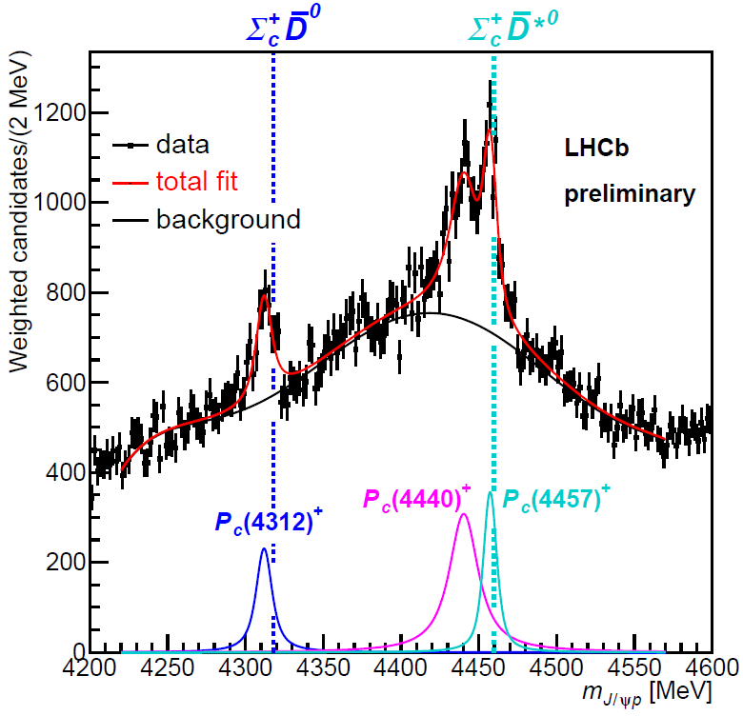
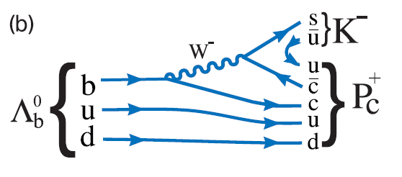
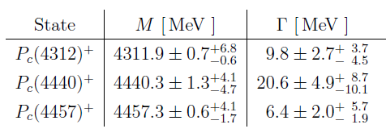
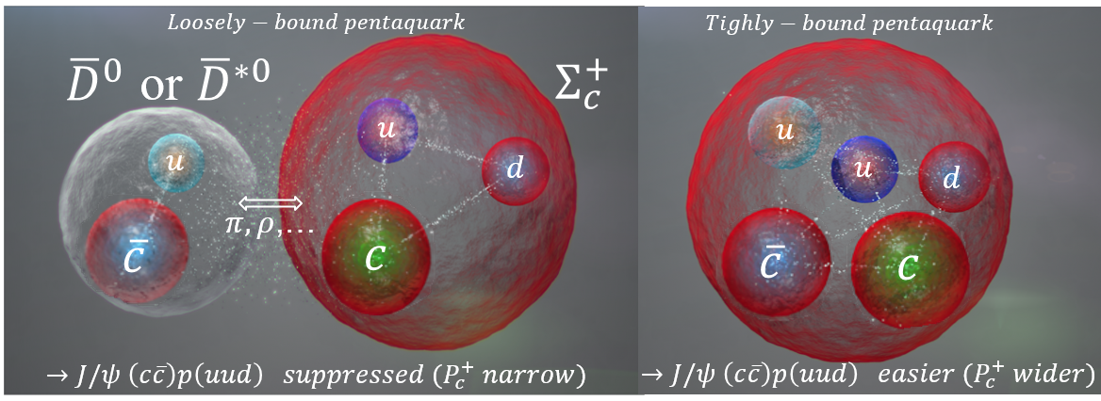
Λ_{b}→ P⁺_{c}K‒ → J/ψp K‒
NEW
” …the near-threshold masses and the narrow widths of P_{c}(4312)⁺, P_{c}(4440)⁺ and P_{c}(4457)⁺ favor “molecular” pentaquarks with meson-baryon substructure!
…we need to measure J^{P} to confirm molecular hypothesis, find isospin partners…”
Moriond QCD, Tomasz Skwarnicki, March 26, 2019

Slide 32

Bottomonium
b
b

Slide 33

Bottomonium in the standard quark model
b
b
n^{(2S+1)}L_{J}
n radial quantum number
S total spin of q-antiq
L relative orbital ang. mom.
L = 0, 1, 2 ... correspond to S, P, D
J = S + L
P = (–1)^{L+1} parity
C = (–1)^{L+S} charge conj.
2M_{B}
open bottom threshold
States below open bottom
threshold are narrow
The heaviest quarkonium provide a unique non-relativistic system
for QCD testing
Notes:
psi(2D) in Y(3S)→γpsi by Cleo

Slide 34





Vector bottomonium states
PRL54,381(1985)
Direct measurements at e⁺e– colliders from CUSB&ARGUS&CLEO to Belle & BaBar
ϒ(10860)
ϒ(1S)
J^{PC} = 1– –
The most accurate measurements of masses and widths of ϒ(nS) states
ϒ(2S)
ϒ(3S)
ϒ(4S)
ϒ(11020)
PDG:
ϒ(1S), ϒ(2S), ϒ(3S), ϒ(4S), but...ϒ(10860) and ϒ(11020) [Common names ϒ(5S), ϒ(6S)]
Study bottomonium states using transitions of ϒ(nS) states
ϒ(4S)→BB (B = B⁰ or B⁺)
“B physics” at B-factories
ϒ(nS)→γbb , n =2,3
ϒ(10860) →B^{(*)}B^{(*)}, B^{(*)}B^{(*)}π, BBππ, B_{s}^{(*)}B_{s}^{(*)}, ϒ(nS) ππ, ϒ(nS)X... etc
PRL102, 012001 (2009)
R_{b} = σ(e⁺e– →bb)/(e⁺e–→μ⁺μ– )
open bottom threshold
ϒ(11020)
ϒ(10860)

Slide 35




Observation of h_{b}(1P,2P)
PRL108,032001(2012)
ϒ(2S)
e⁺e⁻→ ϒ(5S) →X π⁺π–
h_{b}(2P)
ΔM_{HF}(1P) = 0.8 ± 1.1 MeV
ΔM_{HF}(2P) = 0.5 ± 1.2 MeV
consistent with zero, as expected
h_{b}(1P)
M_{miss}(π⁺π⁻)
π⁺π⁻
ϒ(5S) → h_{b}(nP) π⁺π–
ϒ(5S) → ϒ(2S) π⁺π–
2M_{B}
Due to spin flip to be suppressed as ~(Λ_{QCD}/m_{b} )²
π⁺π⁻
h_{b}(1P)
=
h_{b}(2P)
Large h_{b}(1P,2P) production rates! Unknown intermediate state?
CLEO
large e⁺e⁻→Y(4260)→h_{c}π⁺π–

Slide 36

Charged bottomoniumlike states

Slide 37


Resonant structure of ϒ(5S)→(bb)π⁺π–
ϒ(5S) →h_{b}(1P)π⁺π⁻
ϒ(5S) →h_{b}(2P)π⁺π⁻
no non-res.
contribution
phsp
phsp
Large h_{b}(1P,2P) production rates!
M(h_{b}(1P) π± )
PRD88, 052016 (2013)
M(h_{b}(2P) π± )
π⁻
Dalitz plot analysis
Two peaks are observed in all modes
2M_{B}
π⁻
Z_{b}(10650)⁺
Z_{b}(10610)⁺
π⁺π⁻
π⁺
The first exotic bottomoniumlike Z_{b}(10610)⁺ and Z_{b}(10650)⁺
states were discovered in h_{b}(1P)π⁺, h_{b}(2P)π⁺ final states
Z_{b}⁺ are multiquark states
spin flip
suppressed
π⁺
b
–
–
b
d
u

Slide 38



ϒ(5S)→ϒ(1S)π⁺π⁻
ϒ(5S) →ϒ(2S)π⁺π⁻
ϒ(5S) →ϒ(3S)π⁺π⁻
note different scales
PRL108, 232001 (2012)
Resonant structure of ϒ(5S)→(bb)π⁺π–
π⁻
2M_{B}
π⁻
Z_{b}(10650)⁺
Z_{b}(10610)⁺
π⁺
Dalitz plot analysis
Two peaks are observed in all modes
π⁺
π⁺
The first exotic bottomoniumlike Z_{b}(10610)⁺ & Z_{b}(10650)⁺ states were discovered in ϒ(1S)π⁺, ϒ(2S)π⁺, ϒ(3S)π⁺ final states
Z_{b}⁺ are multiquark states
b
–
–
b
d
u

Slide 39


Summary of Z_{b} parameters
Average over 5 channels
M₁= 10607.2±2.0 MeV
Γ₁ = 18.4±2.4 MeV
M₂ = 10652.2±1.5 MeV
Γ₂ = 11.5 ± 2.2 MeV
J^{P} = 1⁺
PRD91,072003(2015)
6D amplitude analysis
h_{b} production mechanism:
ϒ(5S) → h_{b}(1,2P) π⁺π– are not suppressed due to Z_{b} intermediate states!
Notes:
39

Slide 40


Resonant structure of ϒ(5S)→BB^{(*)}π
B^{(*)}
b
–
π
d
–
b
B
u
Phase space of Y(5S)→B^{(*)}B* is tiny
Relative motion B^{(*)}B* is small
Z_{b}(10610) → BB* dominantly
Z_{b}(10650) → B*B* dominantly
PRL108,122001(2012)
M_{Zb(10610)} – (M_{B}+M_{B*}) = +2.6 ± 2.1 MeV
M_{Zb(10650)} – 2M_{B*} = +1.8 ± 1.7 MeV
PRL116,212001(2016)
PRL117,142001(2016)
Favorable to the formation of
the molecular states
Select event in each peak
Z_{b}(10610)
J^{P} = 1⁺ :
B^{(*)}B* in S-wave
B
Z_{b}(10610) = | BB*⟩
Z_{b}(10650)
B^{(*)}
Z_{b}(10650) = | B*B*⟩
_

Slide 41

Bottomonium cross sections
e⁺e‒→Υ(nS)π⁺π‒
e⁺e‒→h_{b}(nP)π⁺π‒
n=1
Υ(5S)
Υ(6S)
n=1
Υ(5S)
Υ(6S)
X(10753)?
Υ(5S)
n=2
n=2
Υ(6S)
Υ(6S)
Υ(5S)
X(10753)?
PRL,142001(2016)
n=3
Υ(5S)
Cross sections of e⁺e‒→Υ(nS)π⁺π‒ (n=1,2,3):
Y(5S) and Y(6S) & New structure (6.7 σ)
M = 10752.7 ±5.9^{+0.1}_{−1.1} MeV/c²
Γ = 35.5^{+17.6}_{−11.3}^{+3.9}_{−3.3} MeV
Υ(6S)
arXiv 1905.05521
X(10753)?
Cross sections of e⁺e‒→h_{b}(nP)π⁺π‒ (n=1,2) & e⁺e‒→χ_{bJ}π⁺π‒ π⁰ :
Y(5S) and Y(6S) peaks only

Slide 42

Future
Super-B
&
c-τ
Factories

Slide 43




Mt. Tsukuba
KEKB & Belle upgrade SuperKEKB &Belle II
SuperKEKB
Belle II
7×4 GeV
~1 km in diameter
Belle II detector as upgrade of the Belle is capable to work at much higher background environment
SuperKEKB built inKEKB tunnel
is almost entirely new machine
×20 smaller beam focus at interaction region
twice higher beam current
×40 higher Luminosity
Better tracking
Better vertexing
Better particle identification
Better calorimeter resolution
First beam in 2016, physics data taking since March 25, 2019

Slide 44

Super Charm Tau Factory at BINP in Novosibirsk
Two rings, 800 m each
Crab waist
Collision energy from 2 GeV to 5 (6) GeV
Luminosity: 5·10³⁴ cm⁻²s⁻¹ at 2 GeV
and 10³⁵ cm⁻² s⁻¹ at 4 GeV
Longitudinally polarized electron beam at IP
The concept of the new collider is based on a new method to increase the luminosity, which was proposed by physicists from INFN (Italy) and developed by INFN and BINP experts
Detailed physics program is developed
Preliminary CDR was issued (in 2011) and updated in 2018
R&D for accelerator and detector is in progress, prototypes and key elements were designed and produced
Preliminary civil engineering and infrastructure design is completed
IT requirements are identified
Talk of P.V.Logachev, Director BINP at "Super c-tau factory workshop“, May 26-27 2018, Novosibirsk

Slide 45
To be done at Super-B & Super c-τ Factories
Huge luminosity and significantly improved detector parameters (better tracking, vertexing, particle identification, resolution) should allow to perform a lot of new measurements and studies inaccessible to previous experiments because of lack of statistics
Detailed physics programs are developed. They include:
Search for and precise measurements of all predicted quarkonium states above open charm (bottom) threshold
Energy scan in 3.7-5.0 GeV energy region at Super c-τ Factory. Precise measurements of σ( e⁺e⁻ →hadrons), including exclusive cross-sections to open charm final states
Search for new and precise study of known quarkoiniumlike states including angular & Dalitz & amplitude analyses

Slide 46

In conclusion

Slide 47
Dozens of quarkonium states and quarkoniumlike states named as XYZ states were discovered since 2002 by Belle & BaBar & BES & LHC experiments and this list continues to grow
  Particle Data Group 2018: instead of XYZ states new naming scheme of hadrons M. Tanabashi et al. (Particle Data Group), Phys. Rev. D 98, 030001 (2018).
Charmonium & Bottomonium tables below open charm & bottom thresholds are (almost) completed. Good agreement between theory and experiment!
Above open charm &bottom thresholds quarkonium physics is in deep crises! Observed states remain puzzling and can not be explained for many years!
BUT….
The mysterious behavior of exotic states motivates us to create new experiments and theoretical models
Super-B and Super-charm-tau factories have to shed light on unknown nature of quarkoniumlike states

