Slide 1

Test plan overview
A. Ballarino
Acknowledgements: V. Parma, M. Barberan, L. Tavian
A. Jacquemod, A. Perin, F. Dhalla, G. Willering, M. Bajko for the activity in the SM-18

Slide 2

Outline
Introduction
Master plan of WP6a
Key steps of validation
Strategy for the test series production
Conclusions

Slide 3
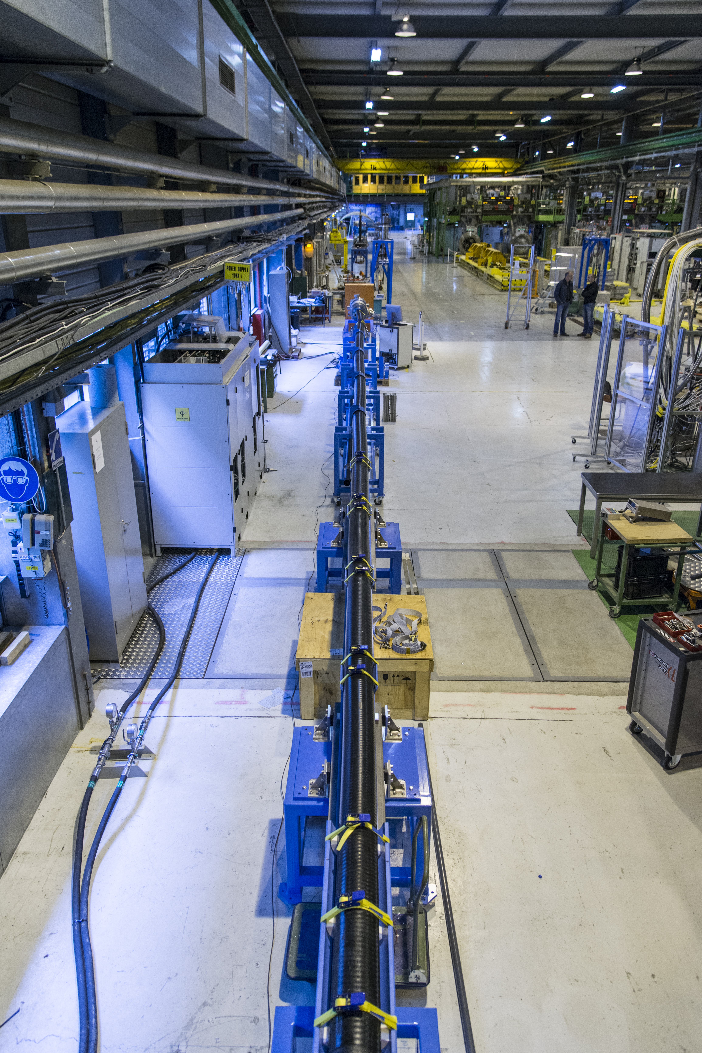
Introduction
Significant amount of measurements for validation of MgB₂ wires, MgB₂ cables, splices in nominal operating conditions and in LHe have been performed in the past
A dedicated test station has been designed and constructed for measurement of SC cabled and splices in nominal cryogenic conditions (operational from 2014 until 2016)

Slide 4
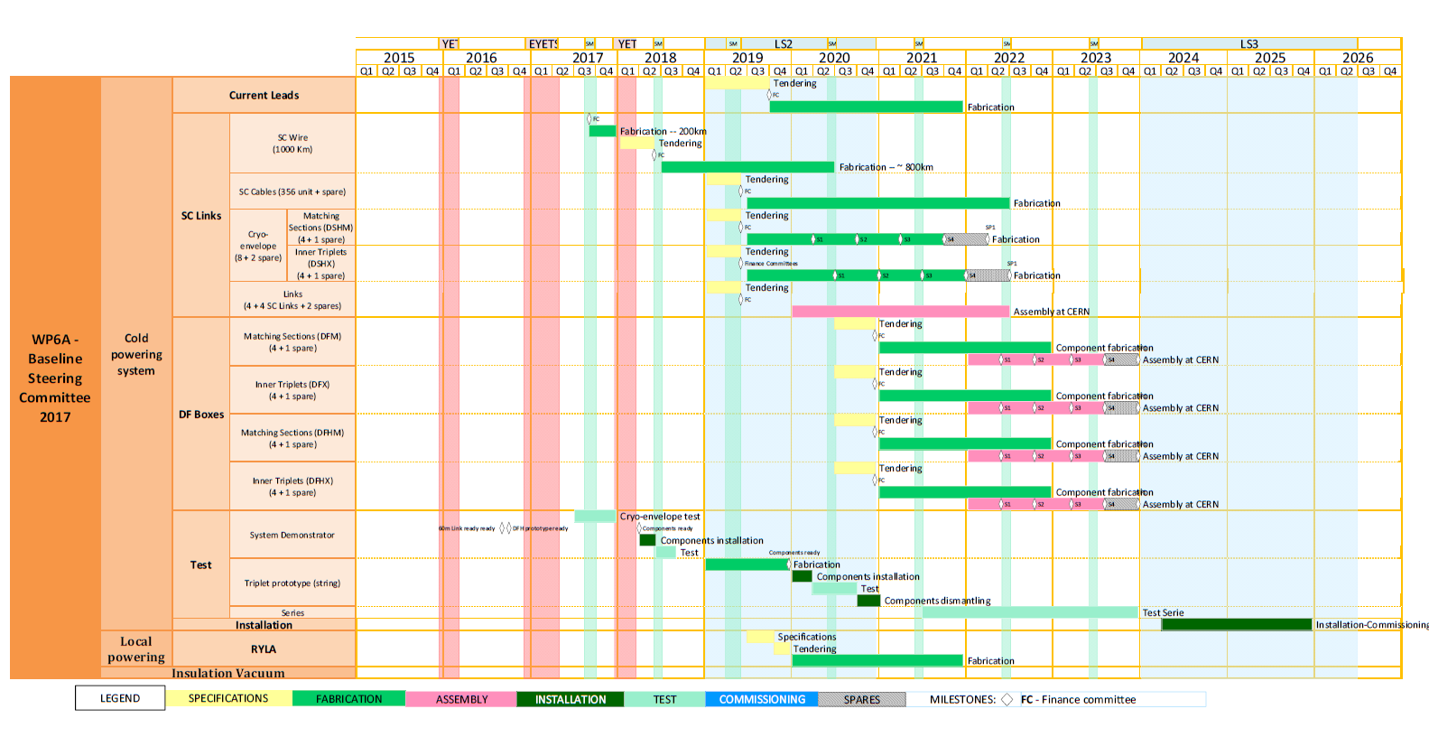
Test plan – 2017
Current Leads
SC Wire
SC Cable
SC Links
SC Link Cryostat (60 m long)
SC Link Cryostat + DFH + 2 Leads (18 kA)
SC Link Cryostat
Demonstrator
Prototype
DFH
A. Ballarino

Slide 5
SC Link Cryostat
Length of cryostat = 60 m
Cryostat with dummy copper cable inside, 60 m long, integrated inside. No electrical tests
Learning: integration of cable in cryostat (building 927), transport and installation of cryostat (from building 927 to SM-18)
Using existing feedbox in SM-18 for supply of GHe
Constructing a new test station equipped for:
Measurement of static load of cryostat
Measurement of pressure drop

Slide 6
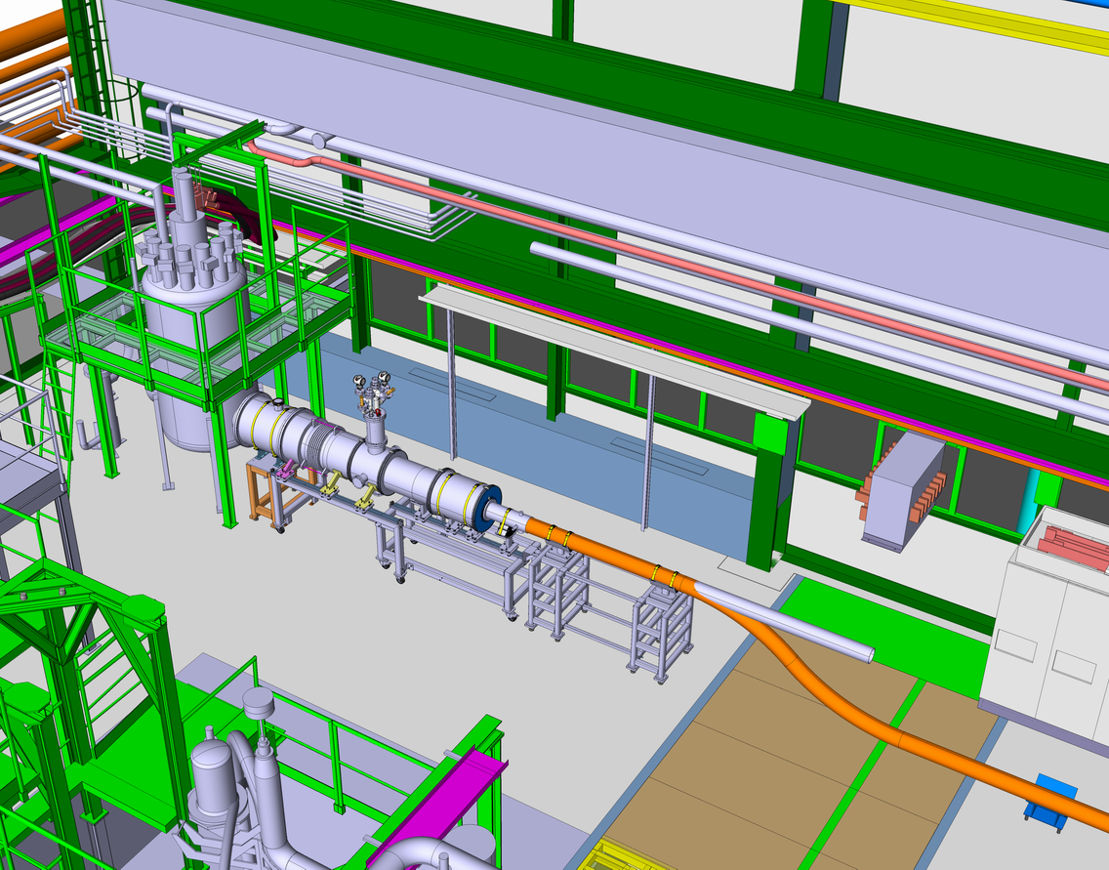
SC Link Cryostat

Slide 7
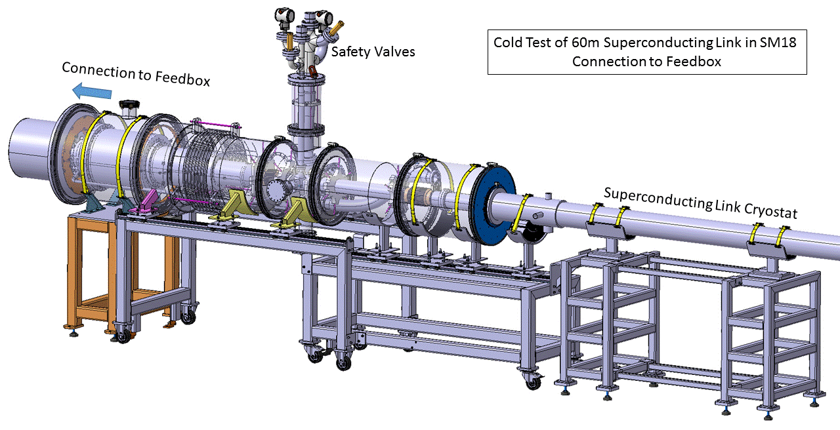
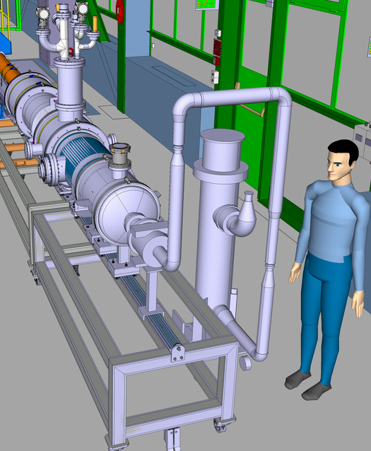
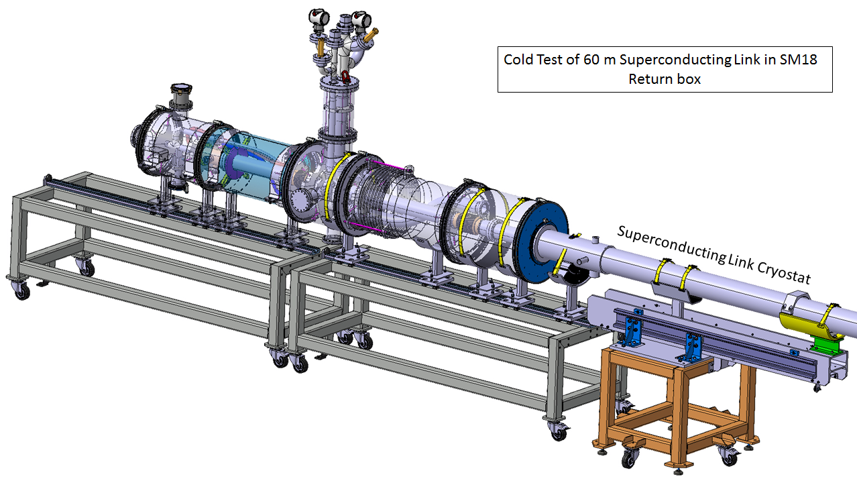
SC Link Cryostat

Slide 8
SC Link Cryostat with two 18 kA leads
Use installation for testing the 60 m long cryostat with a pair of 18 kA leads
Reduced size DFH constructed
Contract for cabling MgB₂ running at Tratos
Leads designed. To be assembled together with the Main Workshop. Critical raw material procured. Contract for manufacturing of components placed with external company (CECOM)

Slide 9
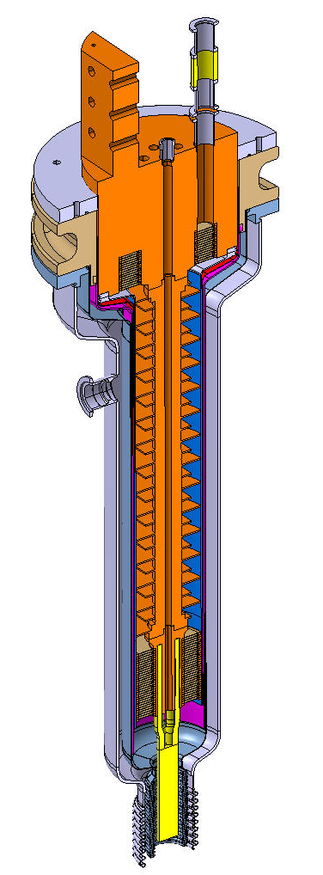
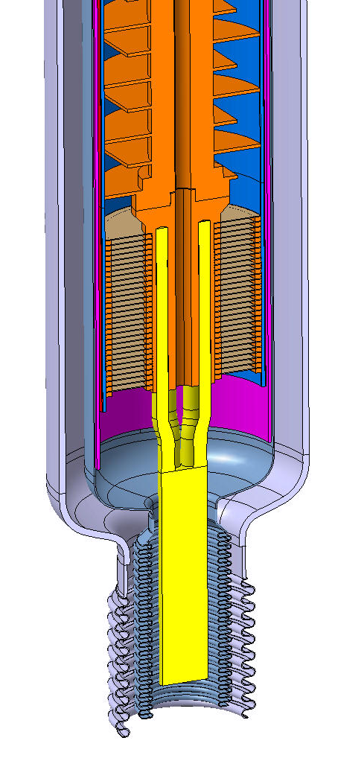
SC Link Cryostat with two 18 kA HTS leads

Slide 10
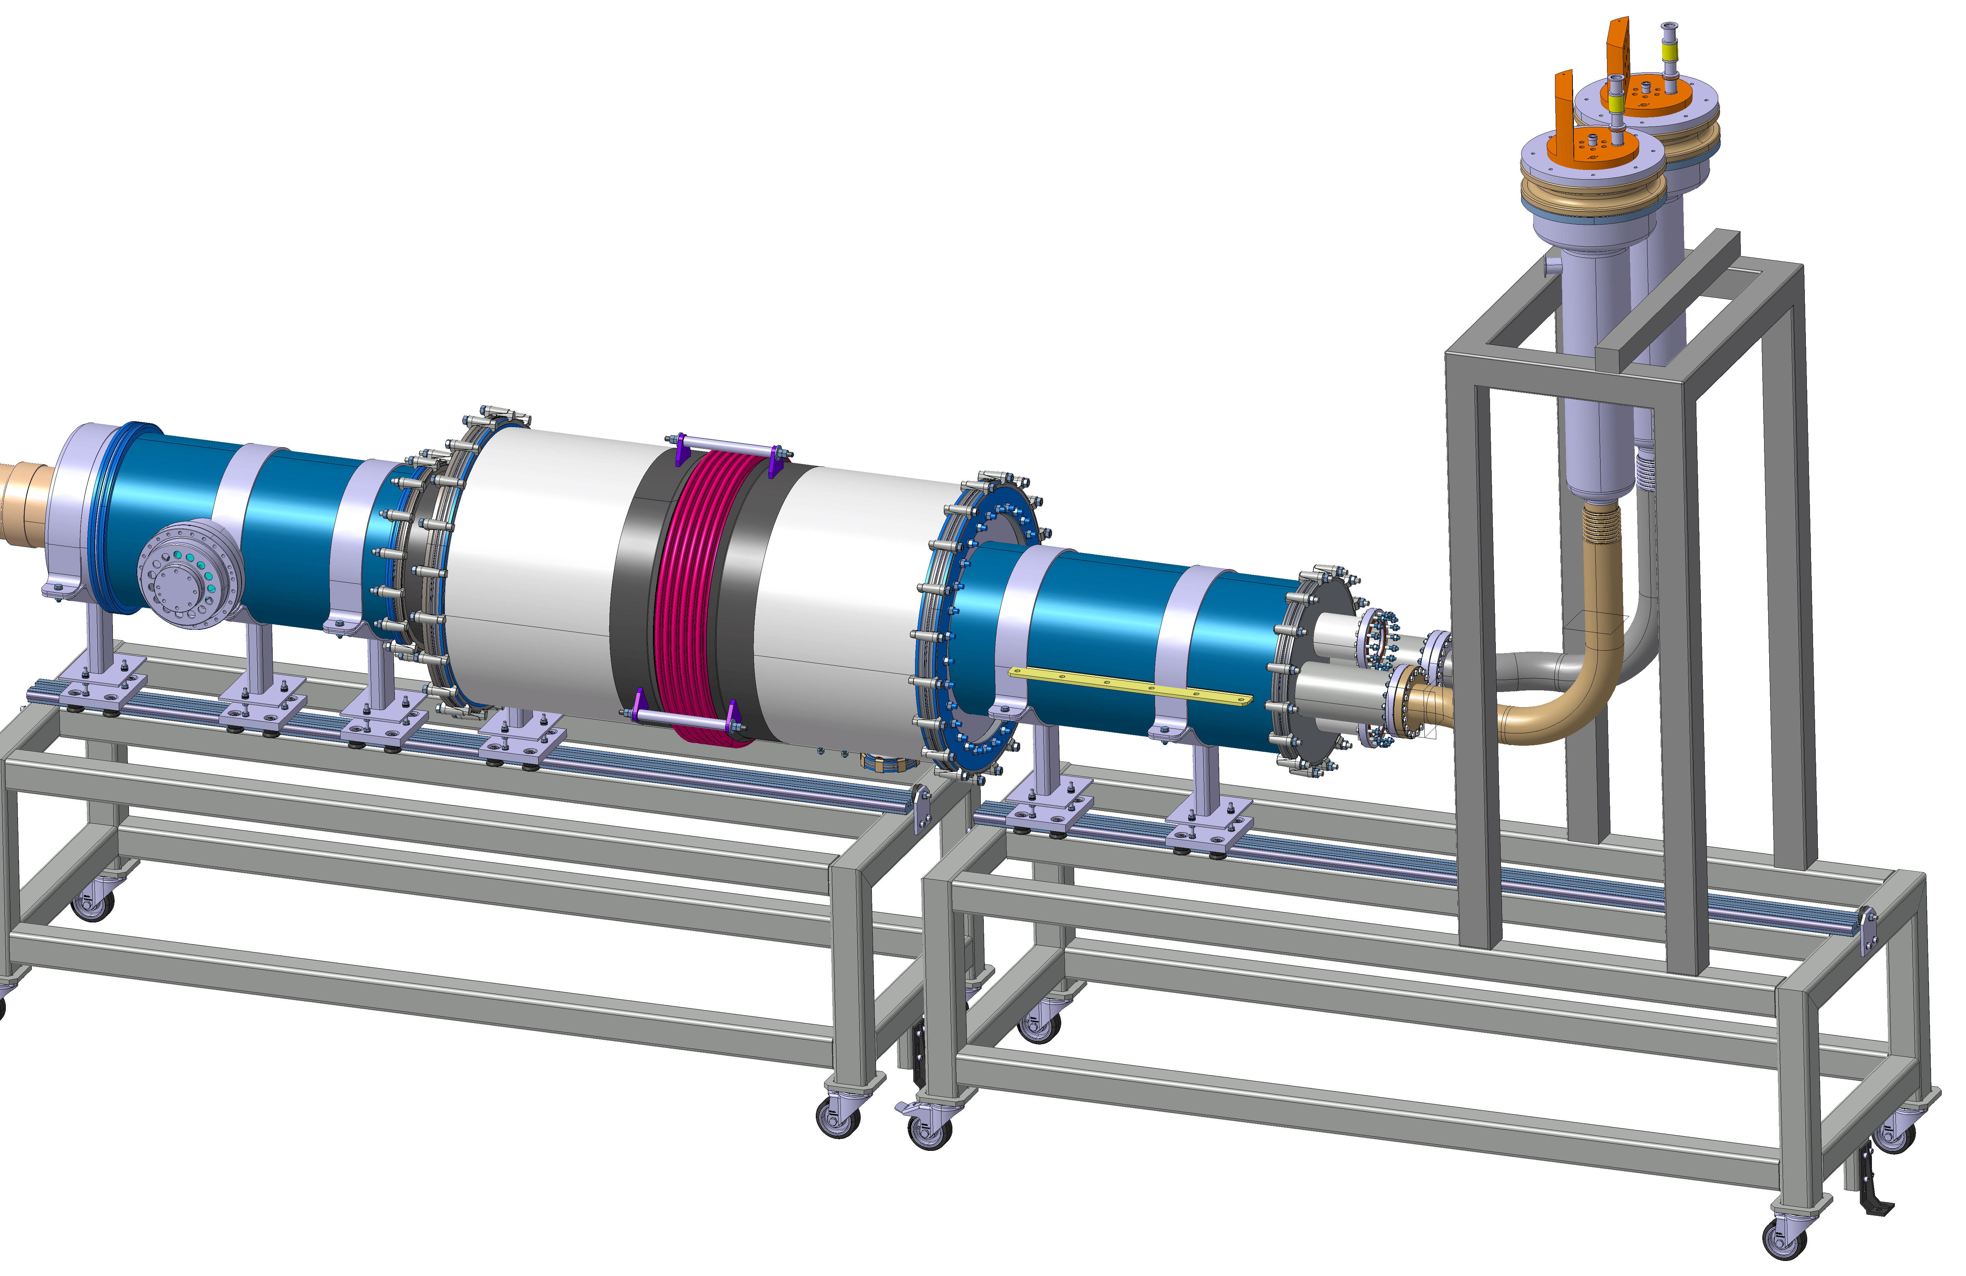
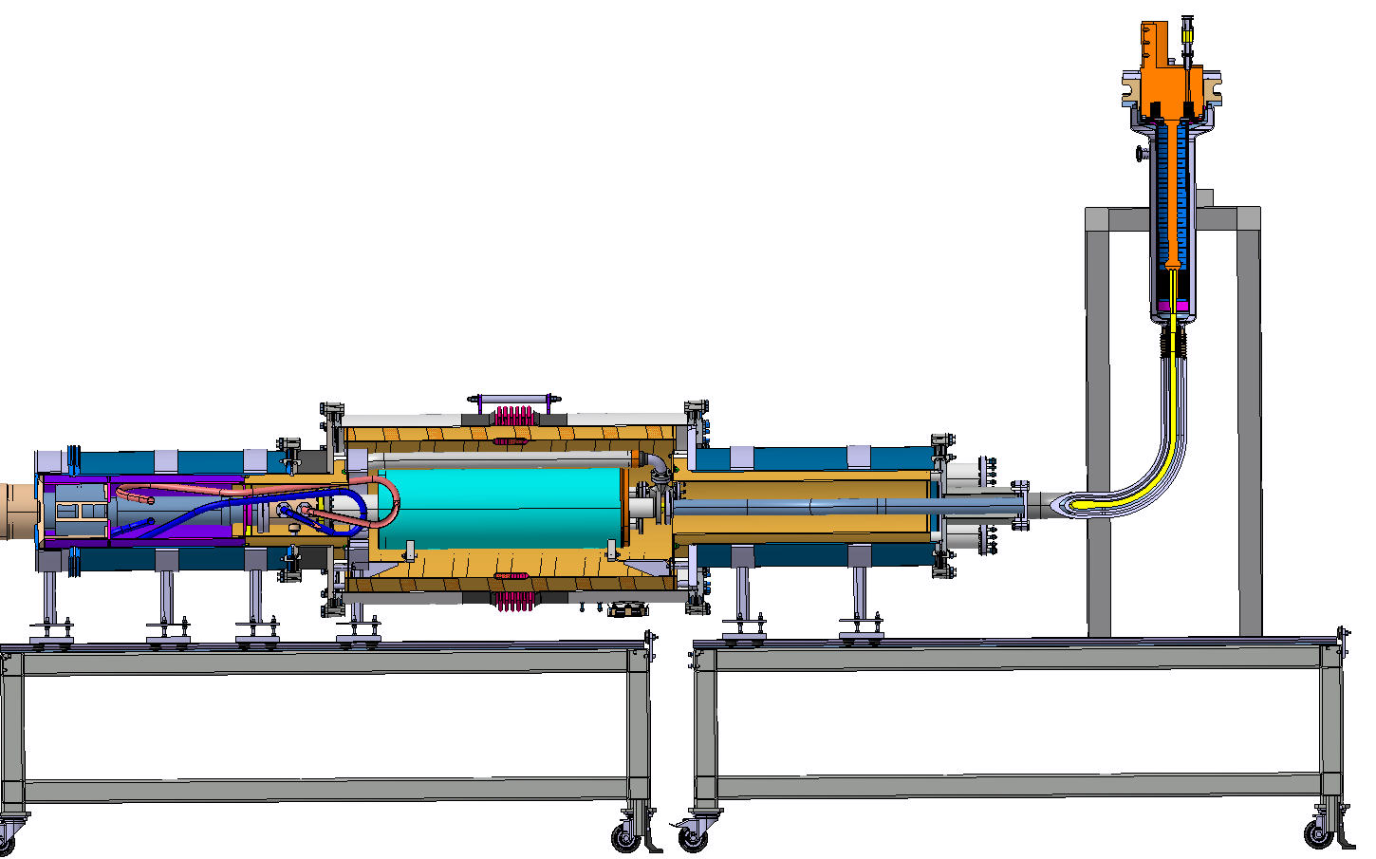
SC Link Cryostat with two 18 kA HTS leads
Feedbox side unchanged
RT Short at the level of the leads

Slide 11
Test plan
Current Leads
SC Wire
SC Cable
SC Links
SC Link Cryostat
SC Link Cryostat + DFH + 2 Leads (18 kA)
SC Link Cryostat
DFX + SC Link Cryostat + DFH + 2 Leads (18 kA)*
Demonstrator
DFX + SC Link Cryostat + DFH + All leads Triplets and D1
Prototype
DFH
String test
Removal from area for String
String installation
*One full size final cable assembly made in industry available

Slide 12
Test plan
Current Leads
SC Wire
SC Cable
SC Links
SC Link Cryostat
SC Link Cryostat + DFH + 2 Leads (18 kA)
SC Link Cryostat
DFX + SC Link Cryostat + DFH + 2 Leads (18 kA)
Demonstrator
DFX + SC Link Cryostat + DFH + All leads Triplets and D1
Prototype
DFH
String test
Removal from area for String
Test of series
String installation
*One full size final cable assembly made in industry available

Slide 13
Test plan
Test of series:
Measurement of all current leads (as for LHC)
Measurement of all Superconducting Links
Required a dedicated test station in the SM-18, where leads and link will be connected for being tested in nominal operating conditions and at maximum current (see presentation of M. Bajko)

Slide 14
Conclusions
Significant test activity has been performed
A plan/strategy for the future test programme has been established. It consists of intermediate steps for enabling validation of demonstrators, prototypes, sub-components, QPS and cryogenic control
A complete prototype system (DFX, DFH, Current Leads) will be used for the powering of the String. This prototype system will be fully tested before integration – and operation- in the String

Slide 15
Thanks for your attention !

