Slide 1
TE-MSC at Mid Term:
An Incomplete Snapshot and a Message
L. Bottura, 27 June 2017

Slide 2
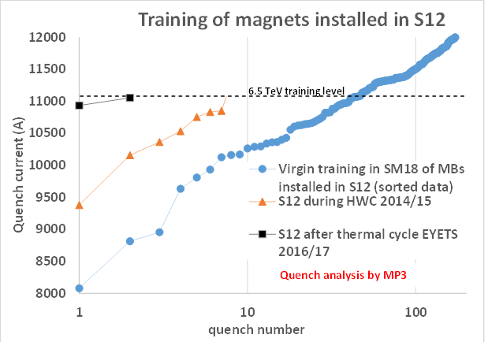
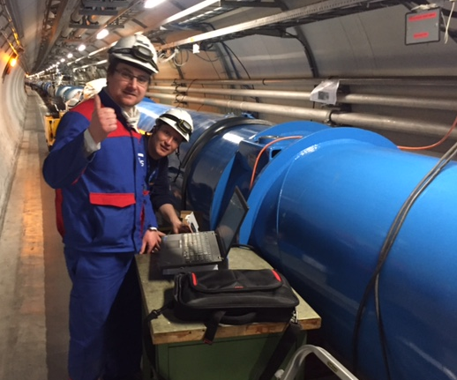
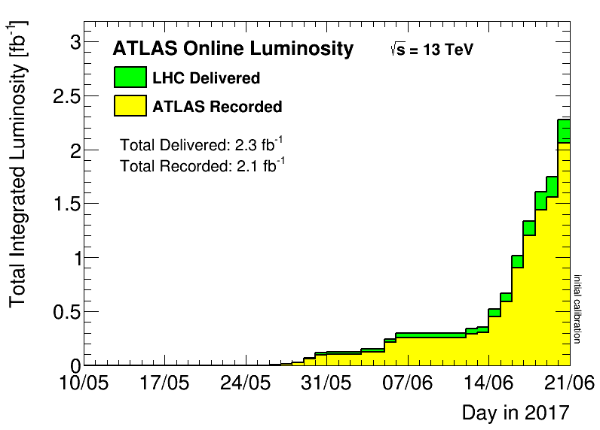

LHC is back
Is there a significant memory ?
A31L2 (MB1375) exchanged during EYETS 2016-2017
Extrapolate to 7 TeV:
550 quenches expected
There is hope (and desire) to increase the energy
Notes:
The call of physics is not yet clear. Whatever the question, the solution is more energy

Slide 3
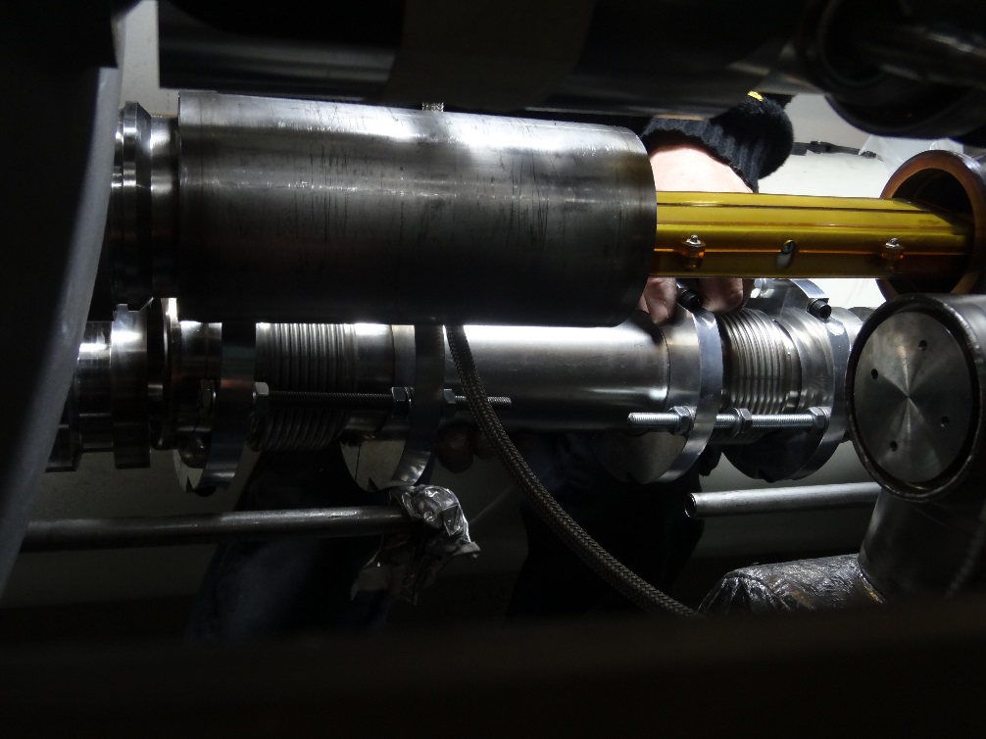
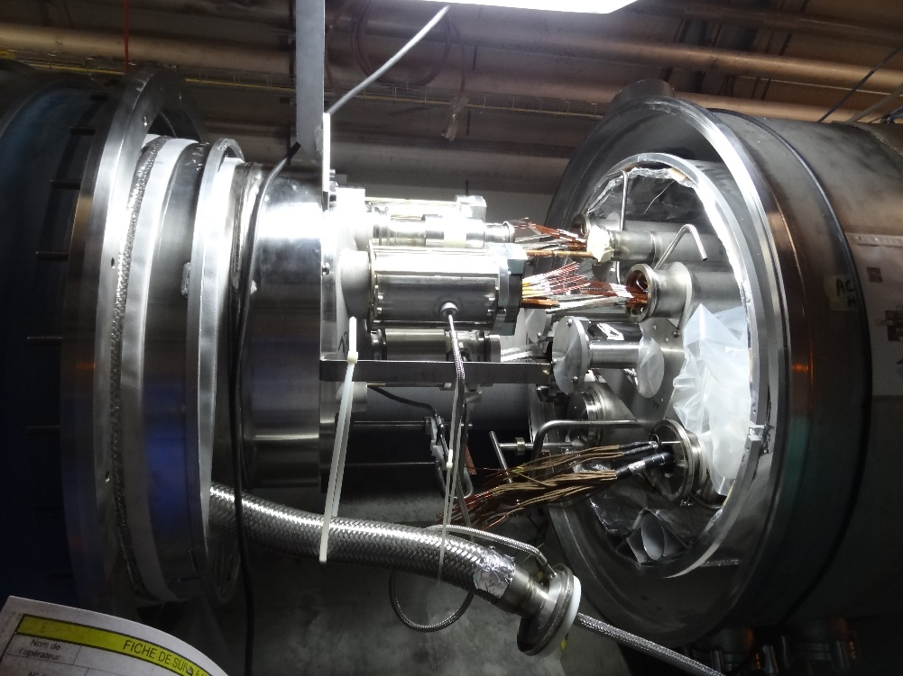
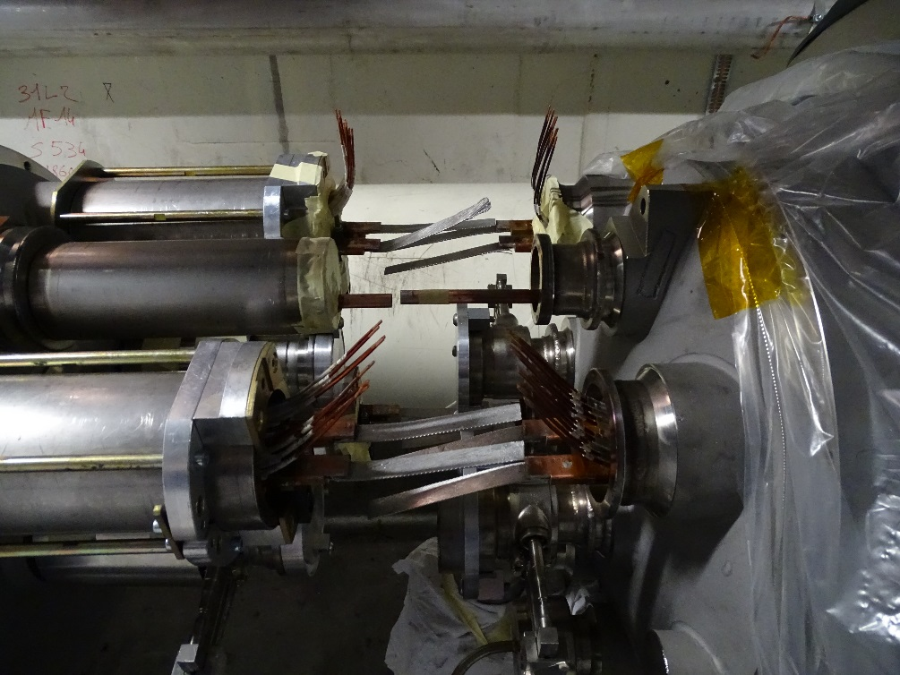
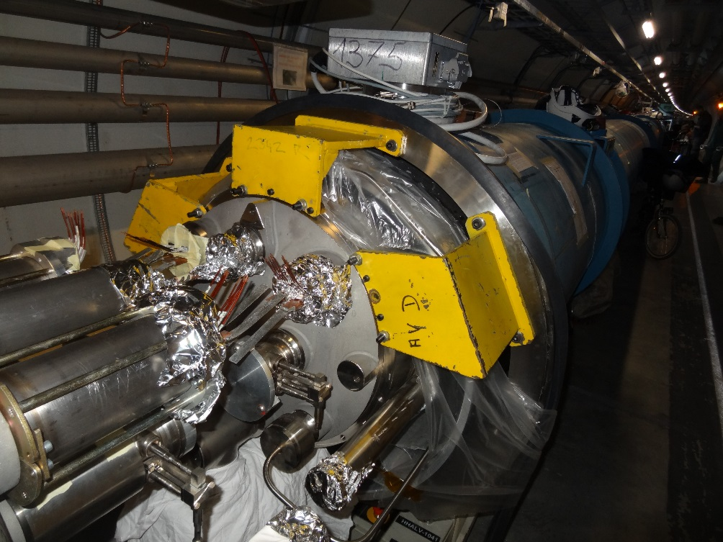
QBQI.31L2 : Line N removal
QBBI.A31L2 : line E cutting
QBBI.A31L2 : de-solder
QBBI.A31L2 : Ready for transport

Slide 4
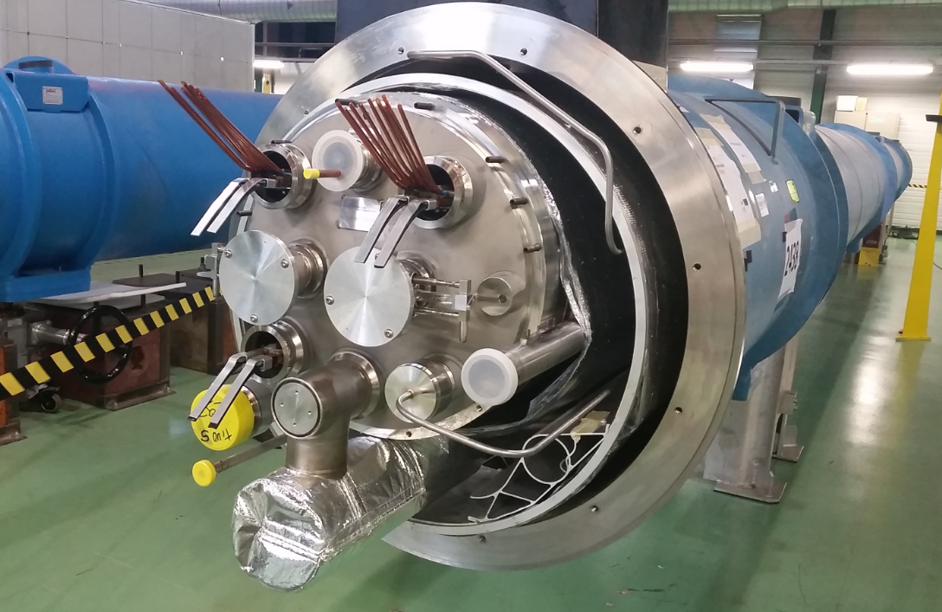
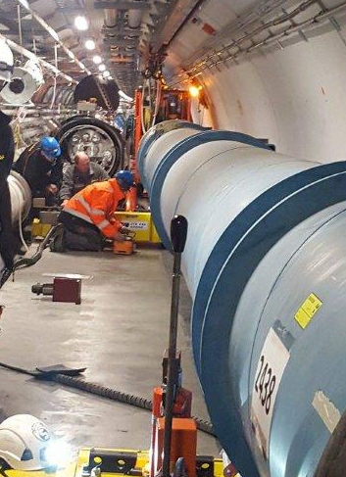
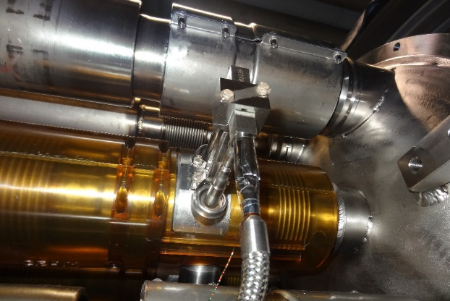
New A31L2 magnet installation
New A31L2 magnet ready in SMI2
New instrumentation
Notes:
Fond memories. We work to serve our accelerator complex, the first priority (after safety)

Slide 5
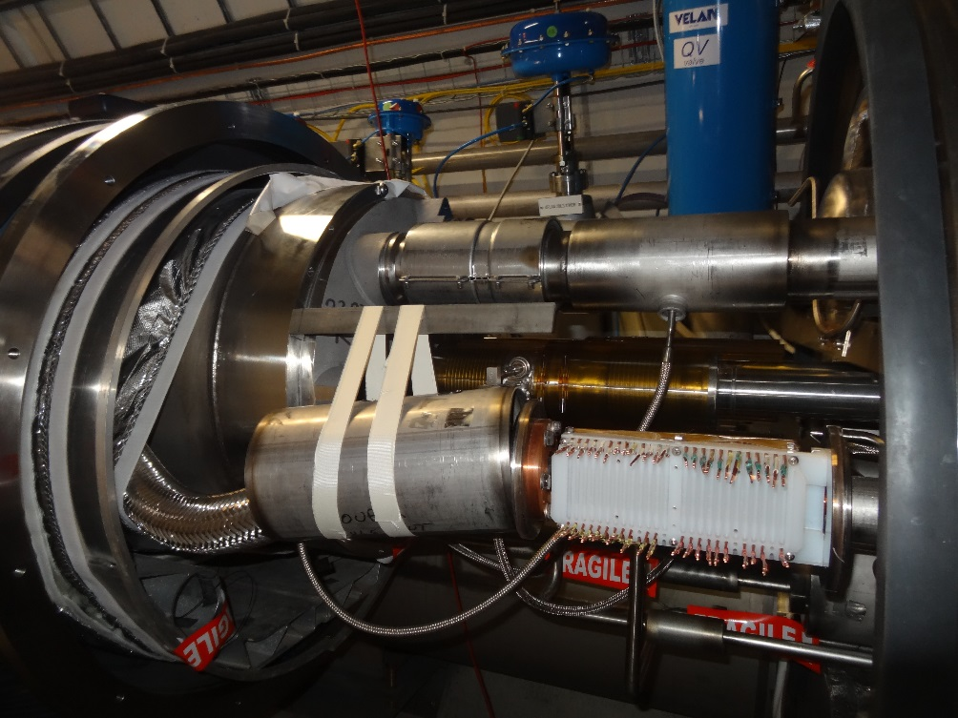
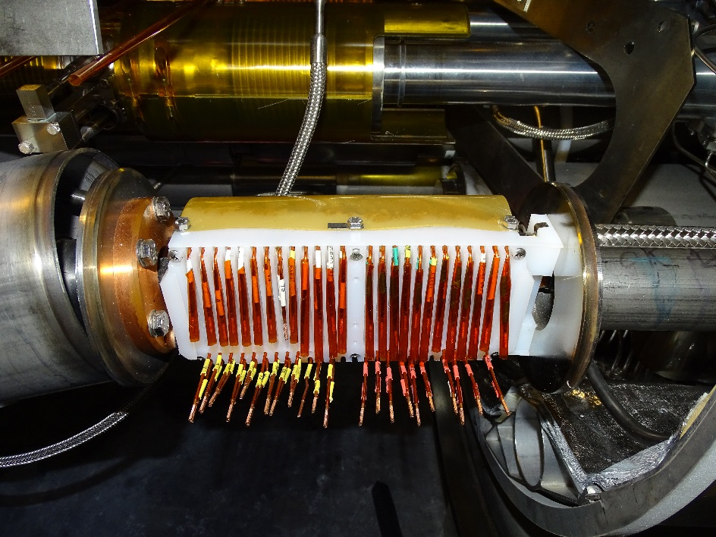
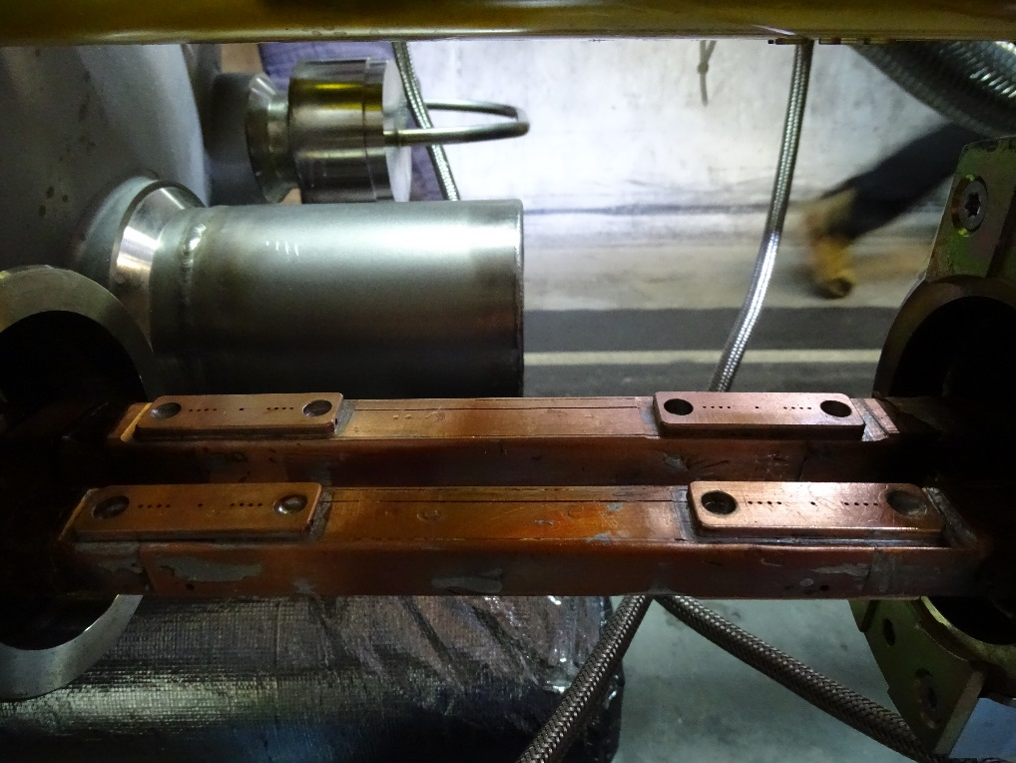
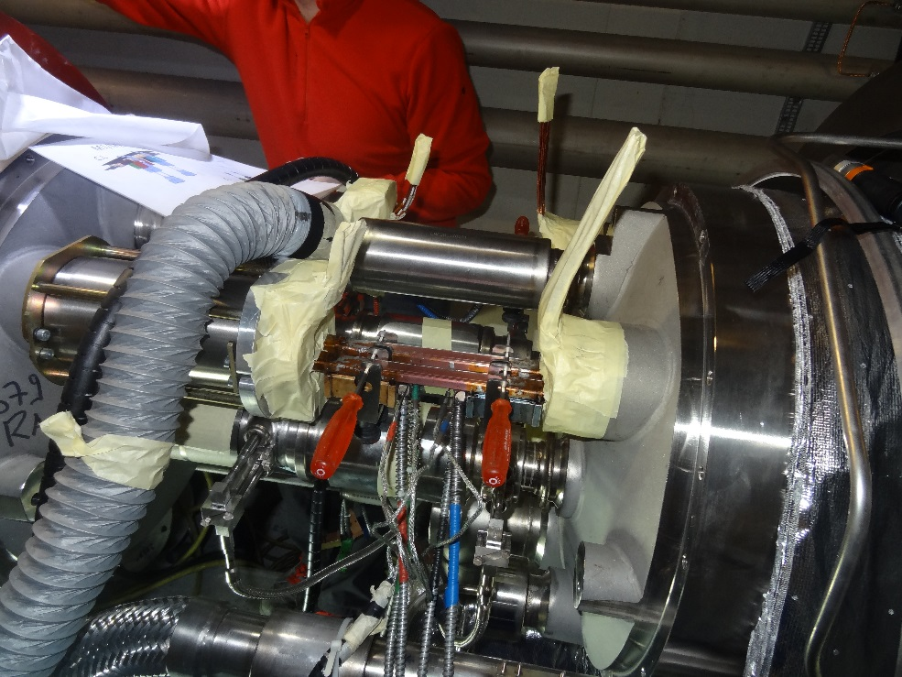
QBQI.30L2 : Line N assembly
QBQI.30L2 : N box
QBBI.A31L2 : shunt installation (M2)
QBBI.A31L2 : splice and shunts soldering (M3)

Slide 6
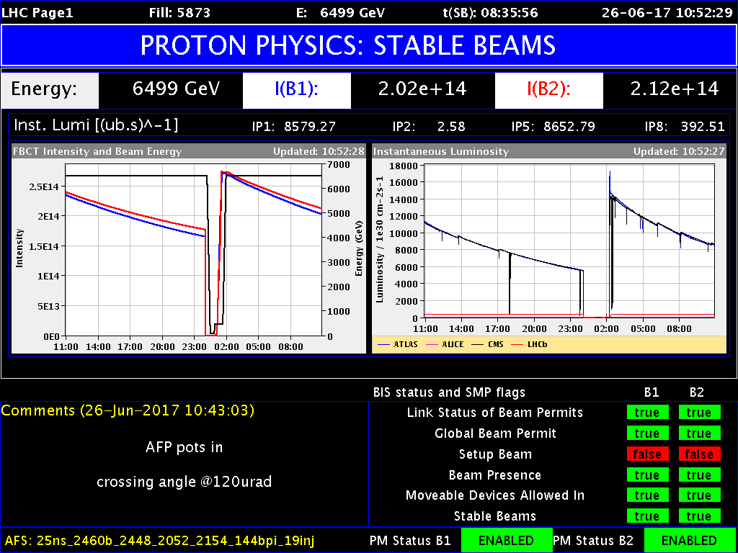

Slide 7
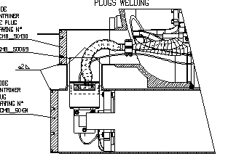
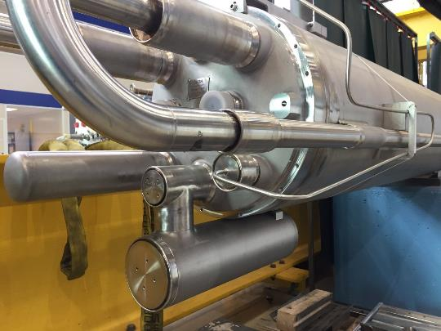
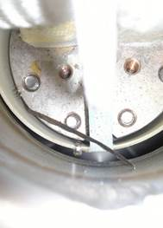
Dipole diodes
!?!

Slide 8
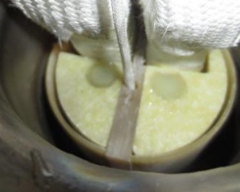
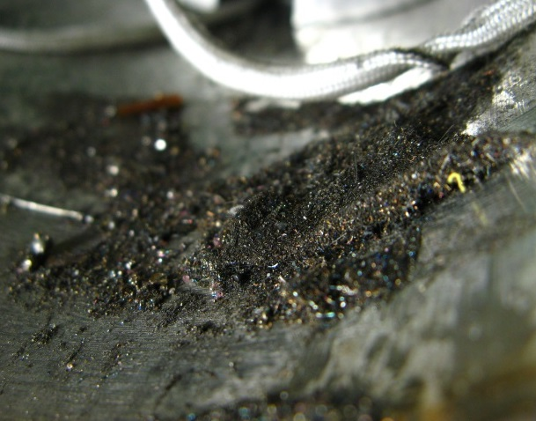

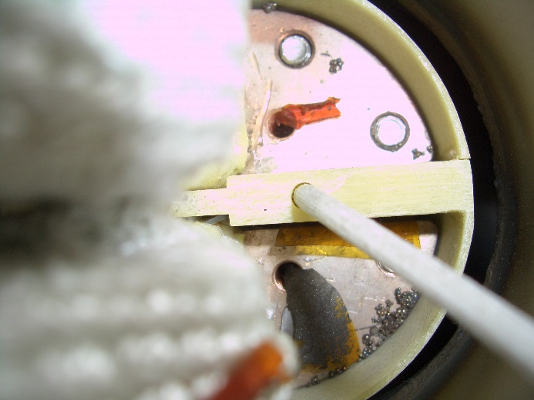
Dipole diodes
Cleaning of the diode boxes
Systematic reinforcement of the insulation and additional protection against debris

Slide 9
Simplified workflow
1. Open outer bellows and thermal shields
2. Give access to the diodes busbars (Mechanical cutting)
3. Clean the diode box and cold mass extremity
4. Consolidate electro-mechanical insulation
5. QA/QC of the consolidated insulation
6. Reclose cold mass volume (Welding)
7. Diode test
[ElQA]
8. Intermediate leak test
(Clam shell [TBC])
9. Reclose interconnections
10. Final leak test

Slide 10
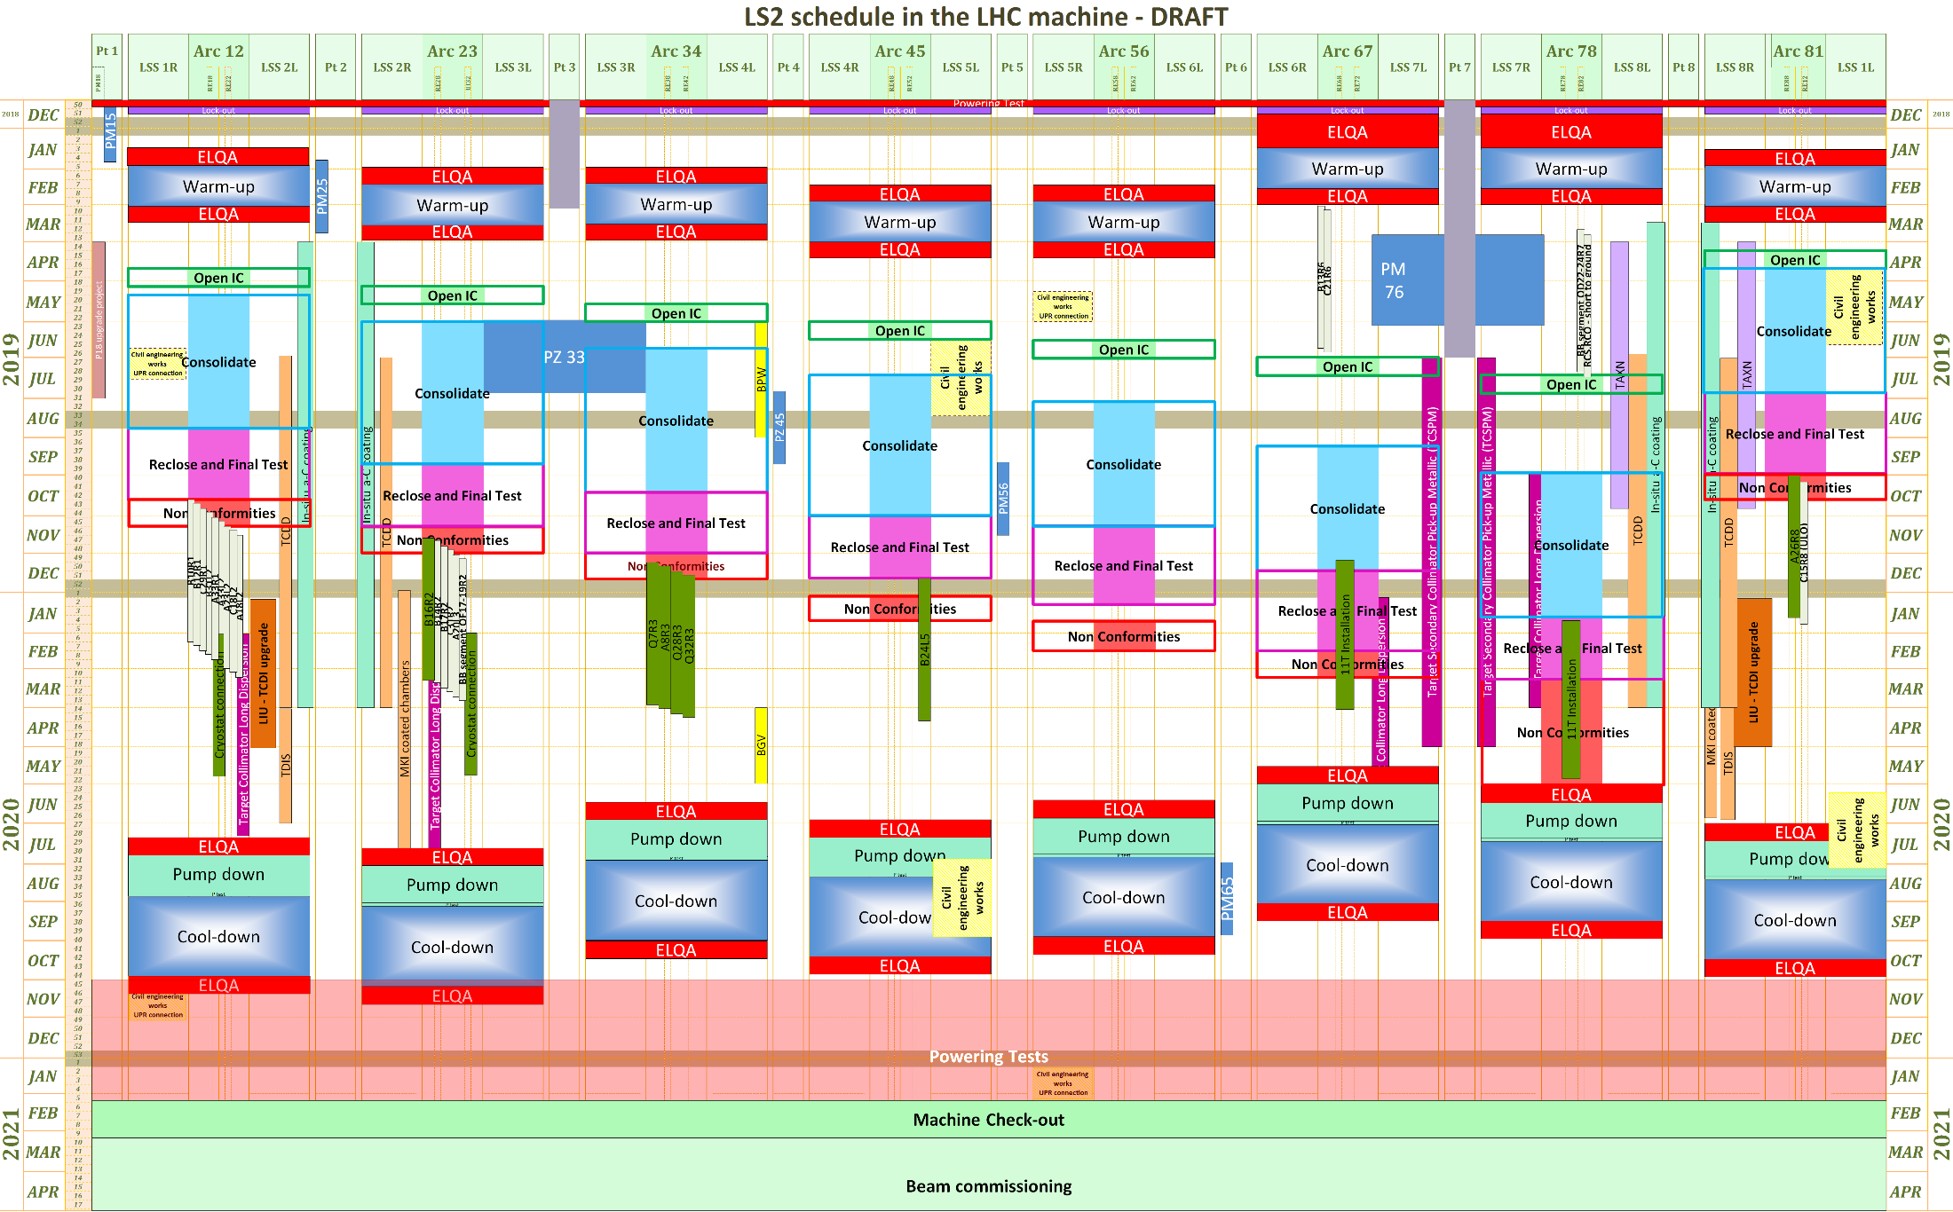
LS2: global overview
Courtesy M Bernardini

Slide 11
Long Shutdown 2
JM. Jimenez
J.Ph. Tock # 146
Consolidating LHC dipole diodes
Project Leader’s Office #8
Radiation protection
Safety, Access
General logistics
Pressure test
Link to visits, media
Coordination with
Survey, BLM, Instrumentation, Transport, planning, QPS, cryogenics, VSC, MPE, CRG, …
Test teams on a chain of IC
Reporting tools
Administrative support (Budget, human resources, scientific secretary)
2017-02-06
Defending LHC dipole diodes #3 – Indico 616383 J.Ph. Tock
11
Open/Close IC
#25
Diodes cons.
#20
Quality Assurance
# 26
Opening/ Closure of IC
W bellows & ther. shields
Cleaning
Consolidation
Experts
Electrical QC: # 12
-Welding QC: # 3
ICIT: : #6
QA manager support: #2
Audits: #2
Also contains replacement of cryomagnets and installation for High Lumi
Special interventions “SIT” #18
ELQA [TE-MPE]
#21
Leak Test [TE-VSC]
#15
Cutting&Welding [EN-MME]
#13
HL-LHC (CC/11T)
Cryomagnets exchange
PIMs
Specific issues
Heavy NCs
- Opening
- Rewelding
Continuity
HV test
Beam lines
Cryogenics lines
Insulation vacuum

Slide 12
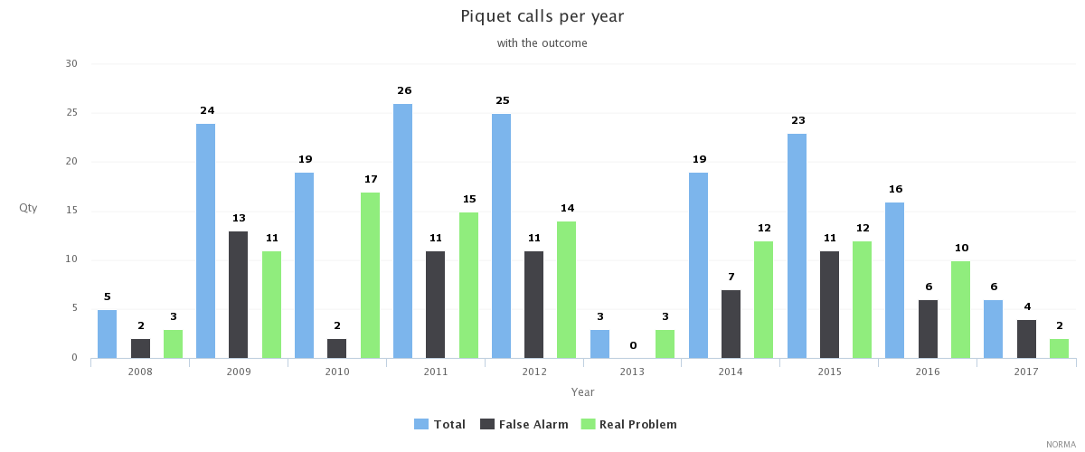
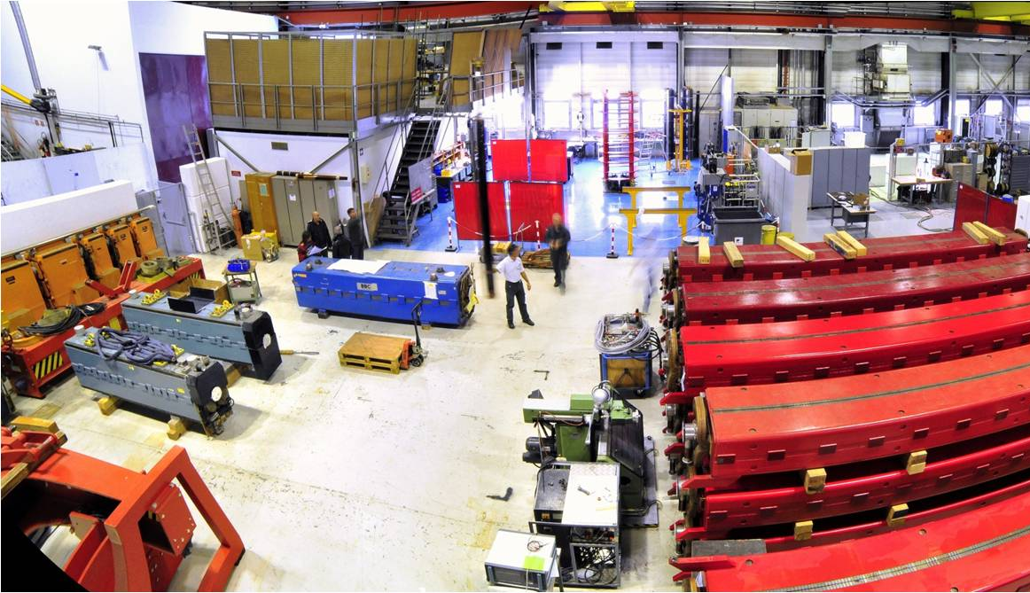
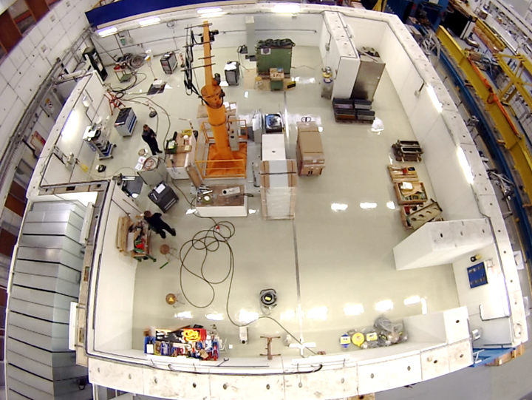
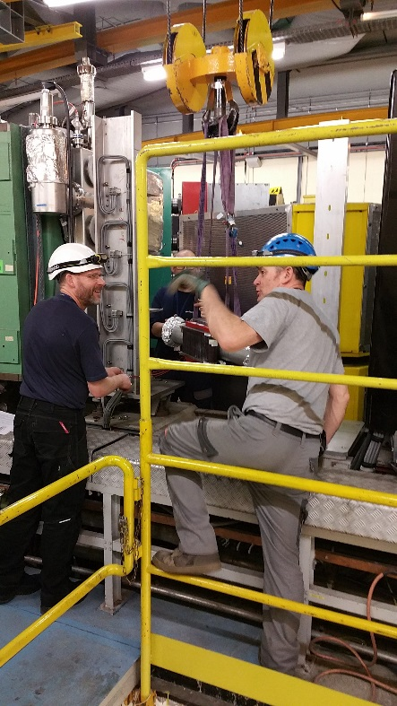
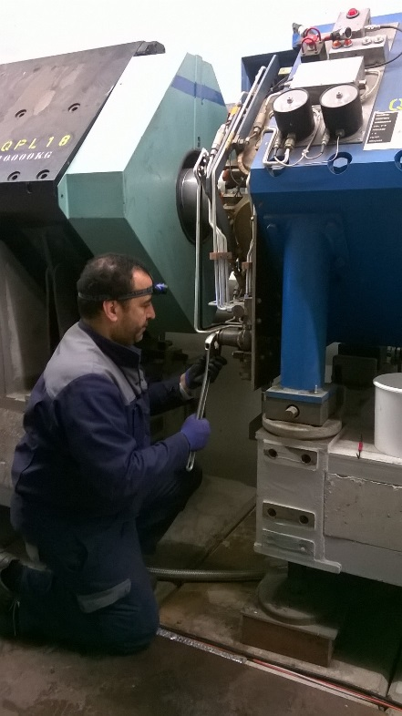
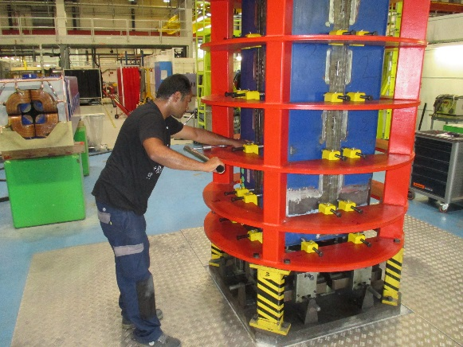
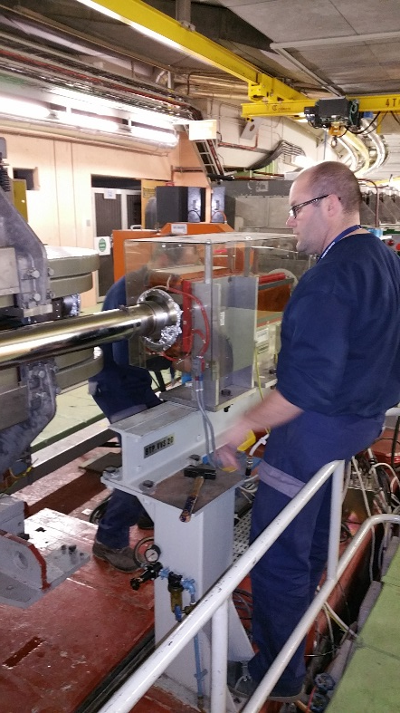
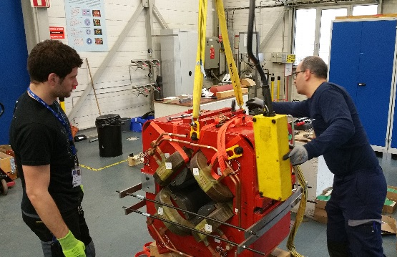
Reliable operation of the injectors
Effective strategy of preventive maintenance (inspections, diagnostics & consolidation)
and of corrective maintenance (inspections, piquet service, workshops)
Major problem is the lack of resources (2 technicians missing)

Slide 13
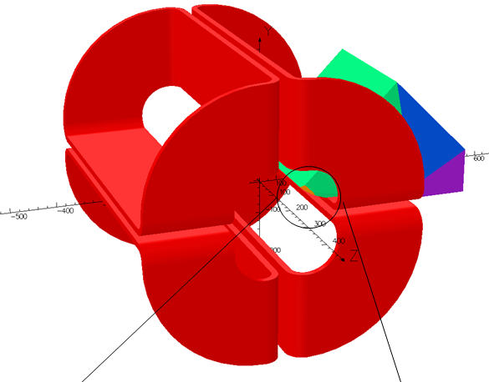
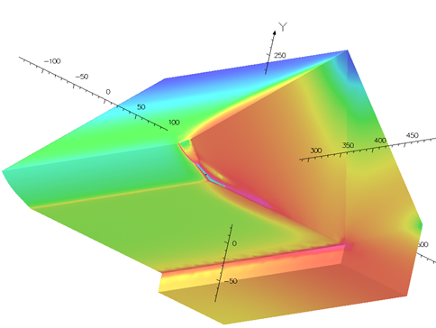
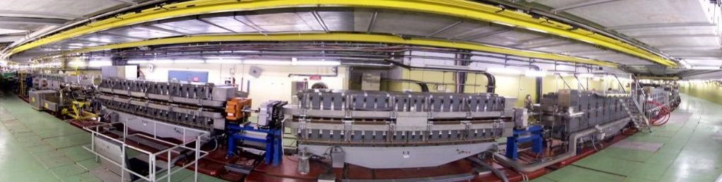
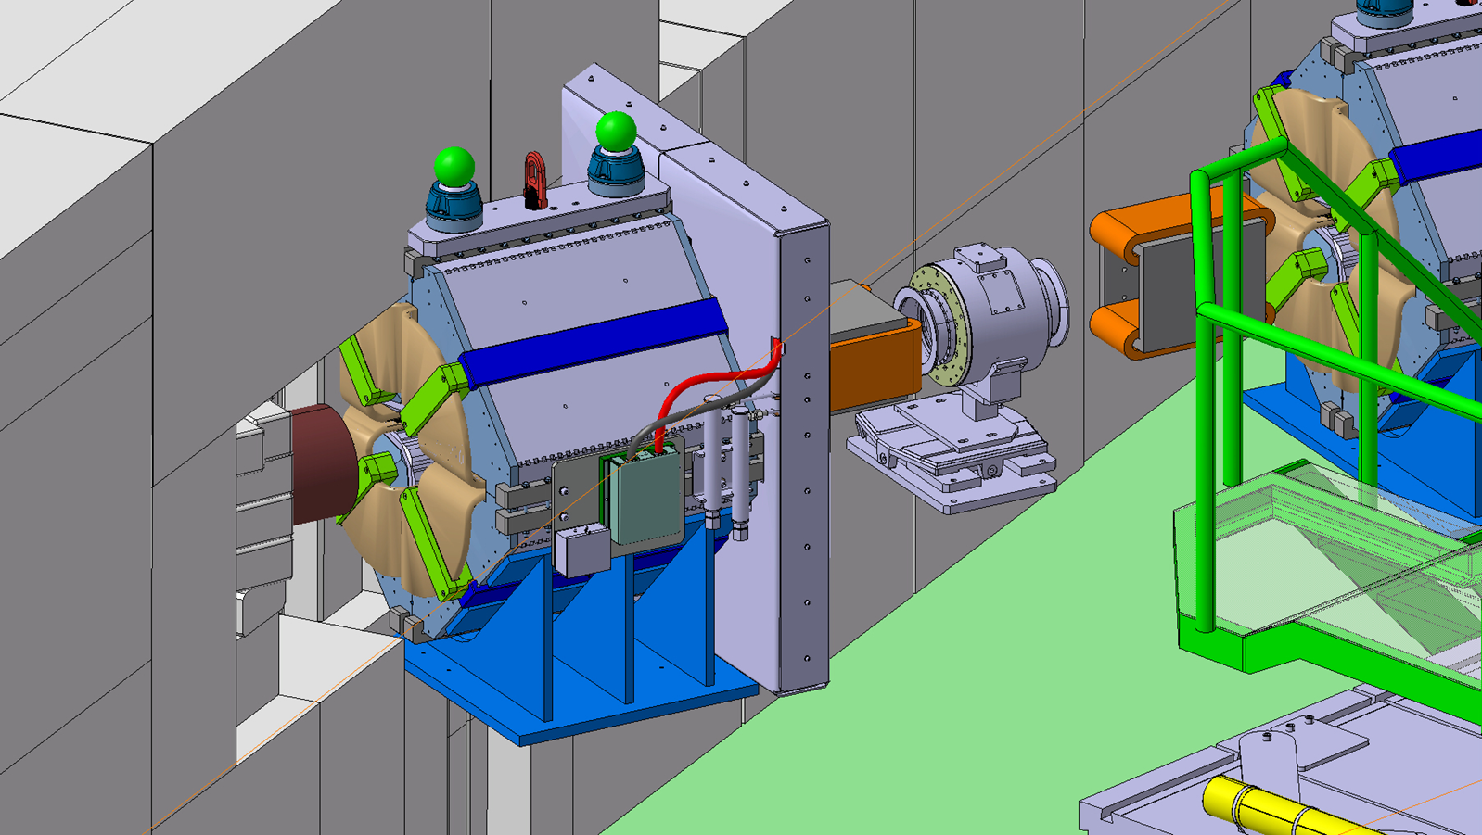
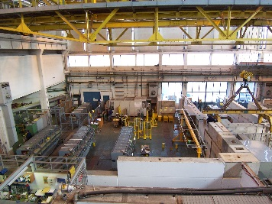
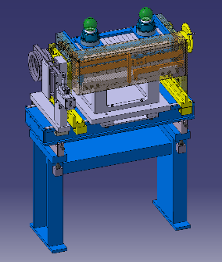
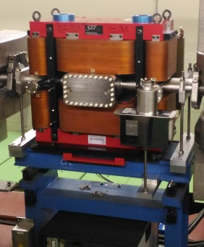
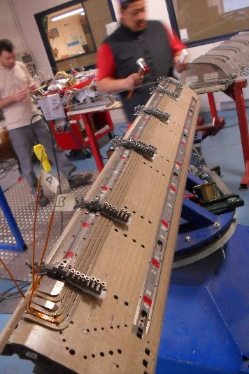
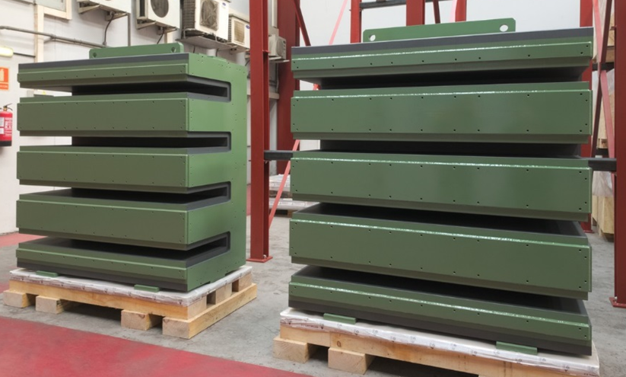
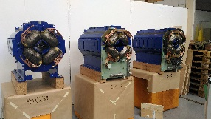
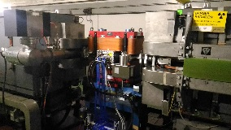
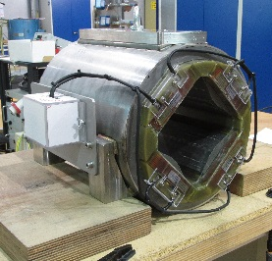
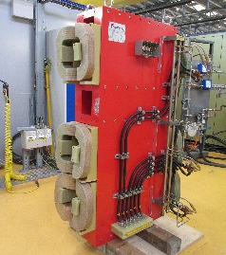
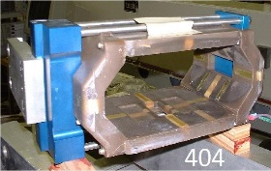
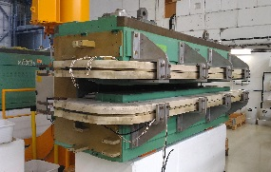
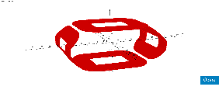
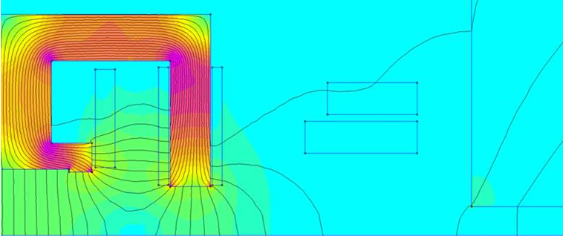
LIU advances well (LS2)
A considerable quantity of preparation work (new magnets, new coils, new PFWs)
Space to be found/consolidated to perform the work during LS2
Personnel resources to be found (agreements) to perform the work during LS2
PSB & TLs
PS & TLs

Slide 14
In summary, on Operation & Co.
The maintenance and consolidation of the accelerator complex remains our high-priority work
Though we can (and will) count on collaborators for much of the work, it is important to focus and maintain full control of the technical “details”
This work requires careful preparation, and will draw considerably on us during LS2

Slide 15
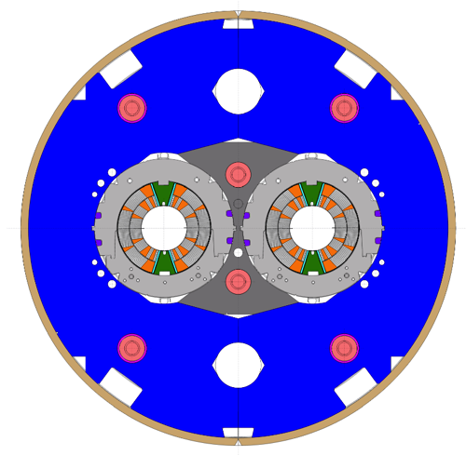
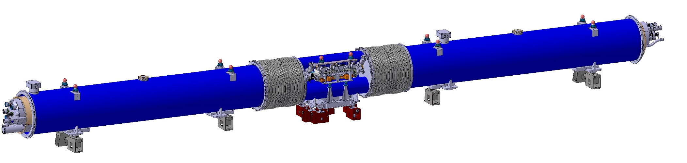
11T, the next major milestone
2x2+2 11 T dipoles to be installed in the LHC during LS2 (2019-2020)
Complete model program
Build and test the first prototype
Procure required components
Produce and test the collared coils, cold mass, cryomagnets

Slide 16
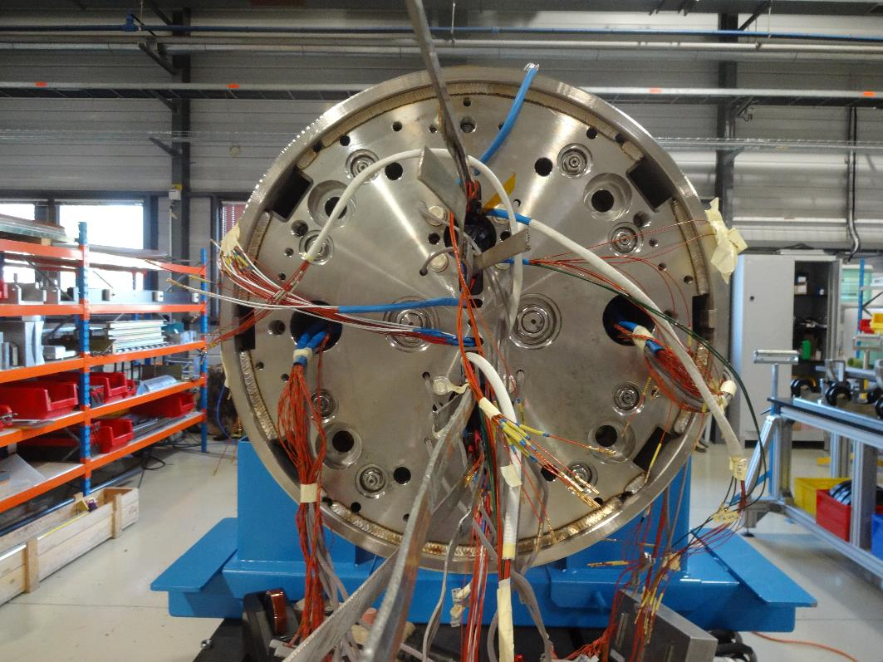


11T models
MBHDP102, second twin aperture model
In preparation for test, final validation of collaring procedure and coil performance (RRP)
Further model work is in support of the final magnet construction, and future technology (towards FCC)

Slide 17





11T prototype
First collared coil assembly !
All production steps have been completed (mock-up SC coils)
Production of prototype proceeding on a tight schedule
IT-4282/TE/HL-LHC dispatched to firms last week:
Provision of Services for the Manufacturing of Collared Coils for the 11 T Dipole Magnet of HL-LHC at CERN
Test planned early 2018

Slide 18




Layout - 11T Nb₃Sn collared coil production
Invitation to tender out !
A comment on the contribution of industry

Slide 19




QEP and QEN
Connection cryostat
Extremities with bus-bars
Warm by-pass for collimators
Review OK…

Slide 20


QEN prototype
Proto vacuum vessel and thermal shield delivered
Vacuum vessel series fabrication contract to be signed June 2017
Thermal shield series fabrication by EN/MME job being launched
… and now to production !

Slide 21



The rest of HL-LHC: QXF
MQXFS5
QXF entering final qualification phase…

Slide 22


The rest of HL-LHC: QXF
Copper coil impregnated
CR101 impregnated
CR102 in preparation for impregnation
CR103 just reacted
CR104 just started winding
8+2 Q2 magnets to be installed in the LHC during LS3 (2024-2026)
Prototype in construction
Industry, upcoming IT
… and preparation for production

Slide 23

Nb₃Sn production – 1/2

Slide 24
Nb₃Sn production – 2/2
Ic data : Good correlation, small systematic difference
  Initially CERN was measuring about 5 % lower values (due to different strain state)
  New sample mounting procedure implemented, now CERN measures about 2 % higher values (with improved reproducibility)
RRR data: good correlation, significant spread
A large effort, but important and systematic follow-up

Slide 25



The rest of HL-LHC: other magnets
D1: very significant improvement in training
Still requires some careful engineering (KEK)
D2: entering engineering phase for the short model construction
D1, D2, (Q4, Q5, Q10)

Slide 26




The rest of HL-LHC: other magnets
MCBXF: successful collaring test of short mock-up
Still much delicate work to do to have a full magnet built
HO correctors now in the hands of our colleagues at INFN
Novel CCT concept:
will it work as expected ?
MCBXF, MCBRD, HO, (MCBY)

Slide 27




MgB₂ SC Link for IR1/IR5
SC link cable manufacturing in EU industry

Slide 28



SC Link activities in Bdg. 927
Cryostat handling
Cryostat unspooling
Pulling bench with 60 m long cryostat and dummy cable

Slide 29
In summary, on HL-LHC
We have in front of us a period of critical demonstrations
  11T model and prototype (6 months)
  SC link and feedboxes (6…12 months)
  QXF prototype (12…18 months)
We are moving from the magnet model and prototyping phase into production (components procurement, industry contracts, quality and inspections)
Priority should be given to resolving the pending technical issues, and making sure we have enough margin (performance, resources, time)
The coming two years are a crucial point:
  for the new Nb₃Sn technology for accelerator magnets
  for the demonstration and engineering of SC links
  for the success of HL-LHC and of future projects that depend on it

Slide 30



FRESCA2 – training
Left
12.2 T
1
3401
1202
Left
1201
3402
2-6
Repaired splice
2-6
3401
Right
1202
1
1201
3402
Images by E. Rochepault

Slide 31




FRESCA2 – QH failure – 1/2
At the ramp following quench 6 the protection tripped. At 1 ms after heater discharge the heater circuit (QH7) showed anomalies
Heater currents
Heater resistance
40-70 cm
80-110 cm

Slide 32

FRESCA2 – QH failure – 2/2

Slide 33



FRESCA2 – reborn
Coil exchanged
Magnet re-assembled and ready for test
This is one of our battle-horses of the future

Slide 34

Test stations in SM-18 – 1/2
Total overhaul of powering in Cluster A
Tested at:
16.5KA for 8 hour (QXF nominal)
18KA for 1 hour (QXF ultimate)
20KA for 5 minutes
Preparation for HL-LHC series tests
Notes:
Prepare the test stations, but also the procedures, the MM equipment, and the teams

Slide 35




Test stations in SM-18 – 2/2
superleak
superleak
HFM test station
Cluster D test station
Last measurement 37.9 +/- 11.9 W

Slide 36




Eppur Si Muove ! (Et pourtant ça tourne !)
Training of MQXFS3 performed in the HFM test station
30 kA
20 kA
MQXFS_3 (RRP)
MQXFS_5 (PIT)

Slide 37




HIE-Isolde approaching completion !
Cavity of CM1 reconditioned successfully !
HIE-Isolde is a beautiful piece of technology and a working accelerator experiment, also (and much) thanks to the contribution of the group
Handing over now to operation and BE-RF
Notes:
We are focusing back to core mandate in the next years, and other projects outside of the mandate will be given lower priority

Slide 38




The HIE-Isolde solenoids
Danfysik Coil
OXINST Coil
Yoking
Cold Tests (in Test Vessel for coil training)
Test Station
Helium Vessel Assembly
Cold Tests (magnetic measurements, TF)
Completed Magnet
a
1
2
3
b
4
5
6
Whatever the project, Magnets R Us !
Notes:
Magnets are our core activity, we need to respond to magnet calls for all CERN accelerator complex. There is no shirking possible

Slide 39













Projects, studies, …

Slide 40
Diversity programs
East Area (energy management, re-organization of lines, safety, accessibility)
North Area (energy management, consolidation)
SHIP (Spectrometer magnet)
AD (permanent magnet quadrupole target area)
n-Tof EAR1 (permanent magnet cleaning dipole)
Completed: Elena, Awake protons, Awake electrons, Hie-Isolde, Sesame

Slide 41
In summary, projects and studies
This is a delicate balance:
  With no R&D there is no future, and traditionally we are a very strong motor of progress and innovation
  Some of the challenges of the coming years require focus and concentration of our efforts to fulfill the mission
A discussion is on-going (SLM) to see how to cope with our priority activities
A part of our program may need to be delayed or redirected to benefit the high priority work

Slide 42

By courtesy of M. Jimenez
TE Department Retreat
27-28 March 2017
P0
P1
P3
P2
P4/P5

Slide 43


E. Todesco
A. Devred
J. Axensalva
T. Bampton
I am aware that the pressure is high

Slide 44
Conclusions
This is a time of high demands
  LS2 and LIU, MB diodes, 11T dipoles and cryostats, cold powering, testing (and upgrades)
This is a time to focus on what is important
  Critical technical issues and organization to meet mandatory deadlines for LS2 and LS3
This is a time to build and make a difference
  LIU magnets, HL-LHC magnets
This is a time to enjoy

