Slide 1
Injection and Extraction
Masamitsu Aiba, PSI
CERN Accelerator School
26.02.2018
Zurich, Switzerland

Slide 2
Contents
Basics
  How to inject/extract beam
  Kicker
  Septum
  Filling pattern
Injection and extraction in future colliders
Hadron collider (LHC as an example)
  LHC injection
  LHC extraction
  From LHC to FCC-hh
Lepton collider
  Top-up injection
  FCC-ee
Some reference
* Linear collider is not mentioned in this lecture
but injection and extraction are relevant for
damping rings

Slide 3






Basics (1)
How to inject/extract beam into/from rings
  Ring accelerator has a closed orbit (No entrance/exit)
  Kicker is used to place the beam onto (or to temporarily open) the closed orbit
  Kicker is normally not strong enough, and Septum is then used
  Extraction is essentially a reversal process of injection
Extract
with kicker
& septum ☺
Inject…
w’
Inject!
with septum…
with kicker…
& kicker!
Accelerator
physics
w

Slide 4
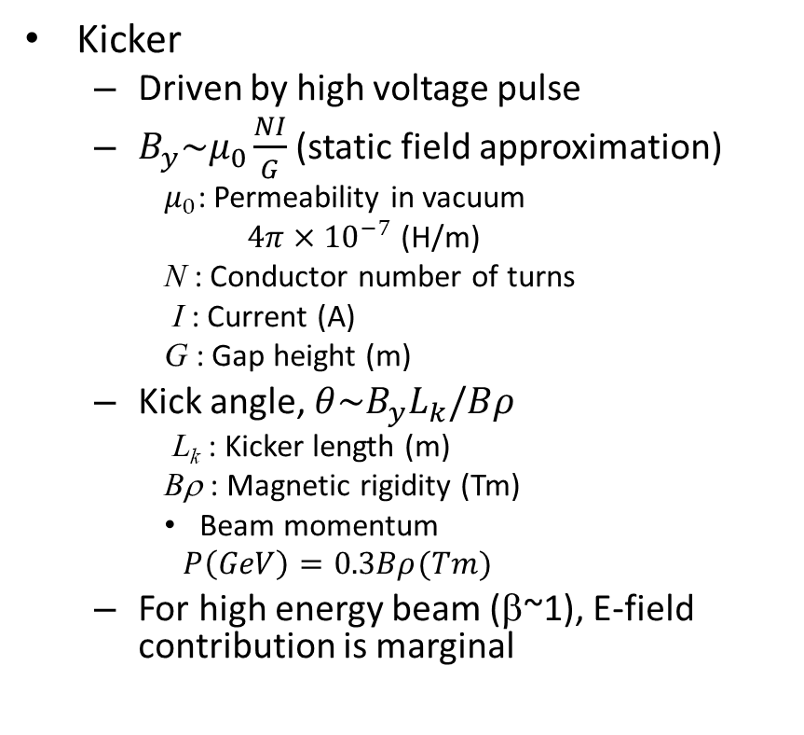
Basics (2)
Cross section of typical ferrite kicker
Kicker
  Driven by high voltage pulse
  $B_{y}\sim μ_{0}\frac{NI}{G}$ (static field approximation)
    $μ_{0}$: Permeability in vacuum
    $4π×{10}^{−7}$ (H/m)
    N : Conductor number of turns
    I : Current (A)
    G : Gap height (m)
  Kick angle, $θ\sim B_{y}L_{k}/Bρ$
    L_{k} : Kicker length (m)
    Bρ : Magnetic rigidity (Tm)
    Beam momentum
    $$P\left(GeV\right)=0.3Bρ(Tm)$$
  For high energy beam (β~1), E-field contribution is marginal
Ferrite
By
G
I
I
Beam
Return
HV conductor
“Good kicker”
B_{y}
Constant
Time
Short rise time
(Fall time is important for some cases)

Slide 5
Basics (3)
Septa
  B-field only inside the channel
  DC or Pulse magnet
  The equations in the last slide are valid to evaluate approx. septum deflection angle
  Lambertson septum
    Ver. separation and hor. deflection and vise versa
    Relatively strong deflection with thin septum wall
Cross section of
typical pulse septum
Cross section of
typical DC septum
Conductors
Conductors
By
I
I
By
I
I
Circulating
beam
Inj. or Ext. beam
Magnetic iron
Laminated steel
Typical Lambertson septum
Metal plate
“Good septum”
Conductors
B_{y}
Constant
I
By
I
Zero field
x
Thin septum wall
See more in the lecture by M. Paraliev, ‘Kicker and Septa’ on 5th March

Slide 6

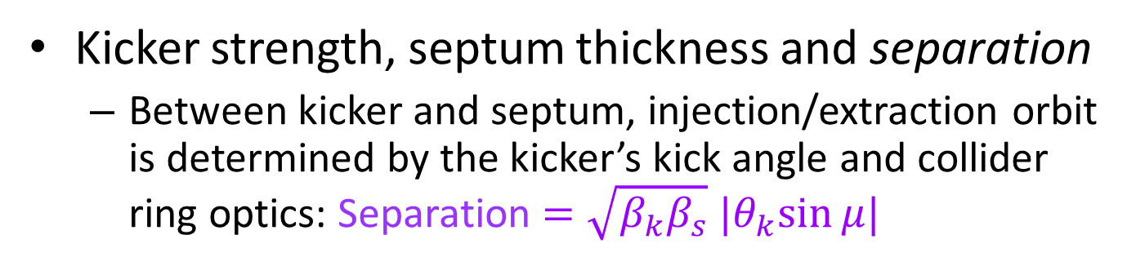
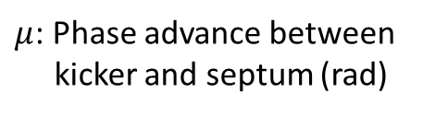

Basics (4)
Kicker strength, septum thickness and separation
  Between kicker and septum, injection/extraction orbit is determined by the kicker’s kick angle and collider ring optics: Separation $=\sqrt{β_{k}β_{s}} |θ_{k}sin⁡μ|$
$β_{k,s}$ : Beta function at kicker, septum (m)
$θ_{k}$ : Kick angle (rad)
Extraction
$μ$: Phase advance between
kicker and septum (rad)
Septum
Separation
Injection
Kicker
Collider ring
quadrupoles

Slide 7

Basics (5)
Filling pattern
  Injection
    In hadron colliders, several injections to fill the collider ring, normally not at one go; Much shorter booster circumference (for instance, SPS and LHC)
    Not all the rf buckets are filled because of finite kicker rise time → Gaps in filling pattern
    In lepton colliders, gap is not necessary (see later slides)
  Extraction
    One relatively long gap (aka abort gap) is required, for both hadron and lepton colliders, because of extraction kicker rise time
…
…
s

Slide 8
Injection and extraction in future circular colliders
Future collider’s beam features
  High energy to explore the energy frontier, and high beam current to achieve the luminosity goal
  →Large energy stored by the beam
  Small beam emittance to enhance the luminosity
  →High energy density
(Fundamental) Requirements
  Minimising beam losses due to injection and extraction
  → Highly stable and reliable injection/extraction system, taking
  into account fault cases
  Emittance preservation during injection for hadron colliders
  Top-up injection due to short beam lifetime for lepton colliders
  Emergency/Intentional extraction (aka. Beam dump/abort)

Slide 9
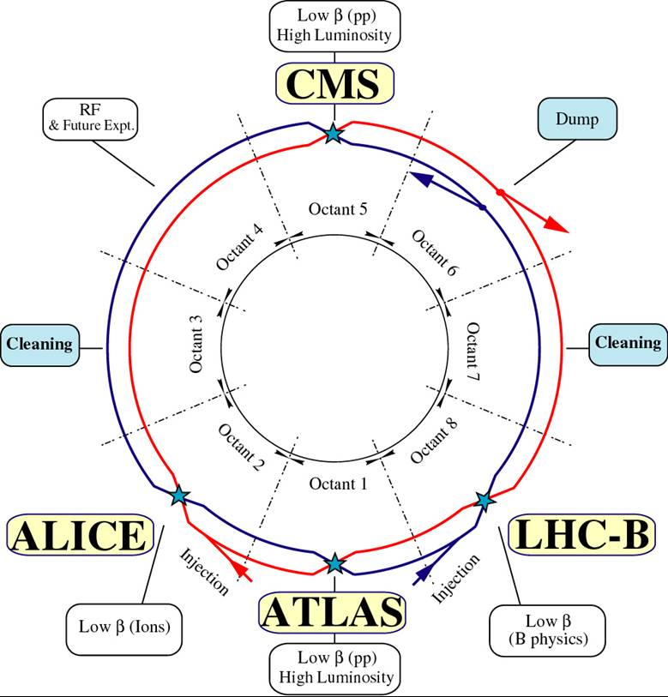
Hadron collider inj. & ext.
LHC as an example in the following slides
Image from https://lhc-machine-outreach.web.cern.ch/

Slide 10
Hadron collider injection (1)
LHC injection [2]
  Injection system integrated into IR2/8 matching section
  Lambertson septum, 12 mrad hor. bend with 5 magnet
  Kickers, 0.85 mrad ver. kick with 4 modules, rise time <~1 μs
  Diagnostics: 5 screens (per beam), ICT, BPMs and BLMs
  LHC full injection (two beams with >2000 bunches per beam) takes about 20 min
Beam
Stopper
Injection
Kicker
Injection
Septum
Figure taken from [1]

Slide 11
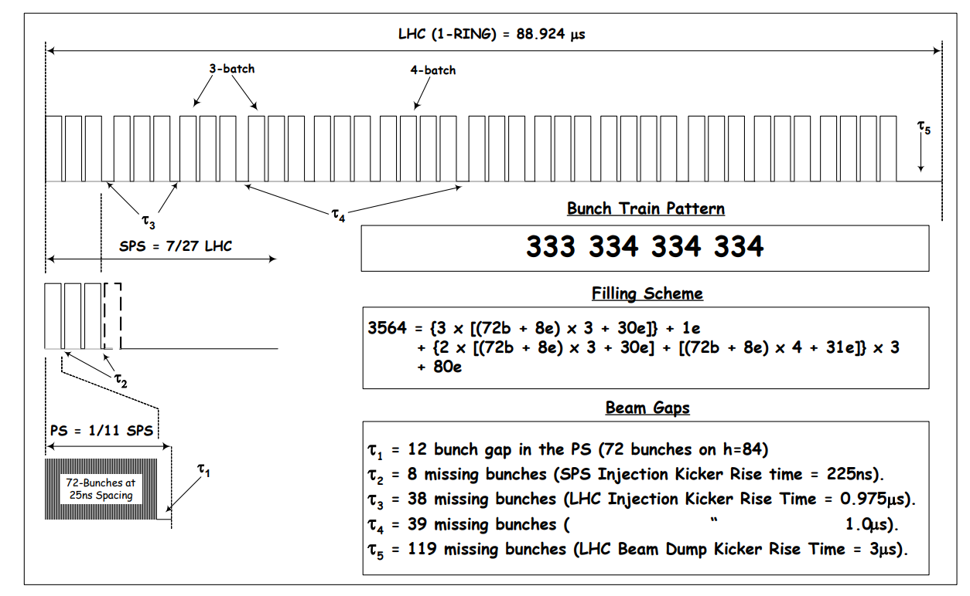
Hadron collider injection (2)
Typical LHC filling pattern
Figure taken from [3]

Slide 12
Hadron collider injection (3)
Possible failure/error and protection
  Beam stopper at a betatron phase advance of 90 deg from kicker, absorbing miskicked beams
  Beam stopper is inserted only during the injection (connected to interlock system)
  Collimators located at further downstream (n×180 +/-20 deg from Beam stopper) to cope with possible error in phase advance between the kicker and beam stopper
Injection beam in phase space (normalised coordinate)
@Kicker
@Beam
Stopper
Phase error
@Beam
Stopper
@Collimator1
@Collimator2

Slide 13
Hadron collider injection (4)
Emittance preservation [4]
(Remember the lecture by H. Schmickler last Friday)
  Source of injection beam betatron oscillation
    Injection beam angle and position offsets, constant over bunches
    Ripple in SPS extraction and LHC injection kicker pulse flat top, varying bunch by bunch
  Transverse damper, 0.5 μrad kick at 450 GeV, bunch-by-bunch capable with some limitation on the kick strength, is used to damp the injection beam oscillations
  Damping time (~4 ms) is not fully negligible relative to filamentation time (~67 ms). These numbers set the requirement on the SPS and LHC kickers to ±0.5% to limit the emittance growth to <2.5% specification
  Quadrupolar mismatch can be controlled through injection beamline quad tunings
Offset
measured
by BPM
w'
Correction
by damper
w'
w
w
Turn n @ BPM
Turn n+1 @ Damper

Slide 14
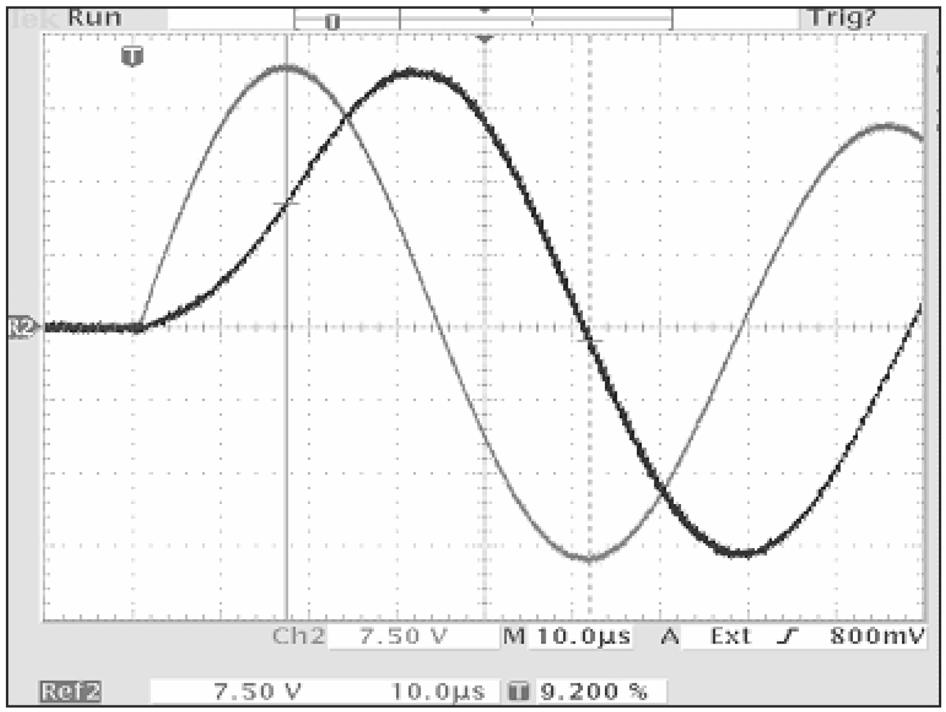
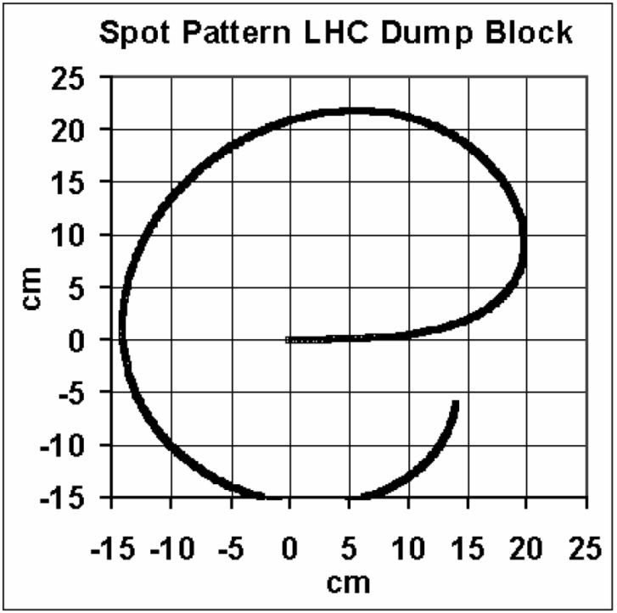


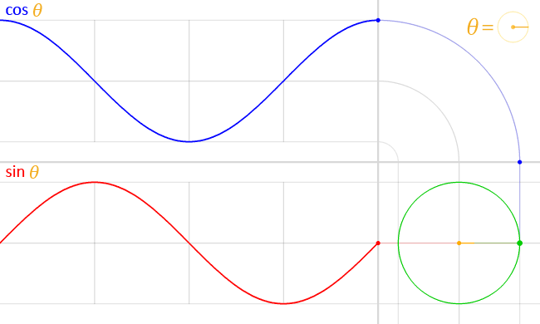



Hadron collider extraction (1)
  Extraction with Kicker+Septum+“Dilution kicker”
  Enormous energy stored in the beam, >300 MJ at 7 TeV
  It is necessary to reduce the energy deposit density on the beam dump block, otherwise the beam dump is damaged
  Dilution kicker = a series of horizontal and vertical kickers, excited by sinusoidal wave with 90 deg phase difference in H and V (sin and cos)
V kicker
H kicker
GIF animation taken from Wikipedia
Figures taken from [1]

Slide 15
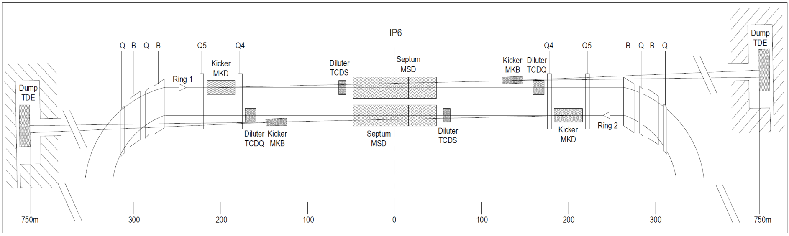
Hadron collider extraction (2)
LHC beam extraction
  Extraction system is installed into IR6 for both Beam 1 and 2
  Kicker: 0.27 mrad hor. kick with 15 modules, 3 μs rise time
  Lambertson septum: 2.4 mrad ver. Bend, 15 magnets
  Dilution kicker: ±0.14 mrad kicks in H/V
  Beam dump assembly at 750 m from Septum (Contained in an inert gas filled vessel to avoid fire)
  Absorbers in front of septum and Q4 to protect these components in case of failure
Extraction
Kicker
Extraction
Septum
Dilution
kicker
Beam dump
block
Absorber
Absorber
Figure taken from [1]

Slide 16
Hadron collider extraction (3)
Extraction system must be always ready
  During the acceleration, kickers and septa power supplies should follow the varying beam energy
Fail-safe design
  Whenever something wrong detected in the extraction system, the beam is extracted before the situation gets worse
  RF system failure, magnet quench, etc. trigger immediately beam dump
  Asynchronous dump: when one of 15 kickers faultily triggered, all the others are immediately triggered
  Extraction can be accomplished with a missing kicker out of 15 kickers
High reliability is ensured with
  Surveillance: checking the devices continuously
  Redundancy: important parts of the system are doubled
  Post checks: checking if the system worked properly after extraction
  Diagnostics: about 3000 beam loss monitors are installed

Slide 17
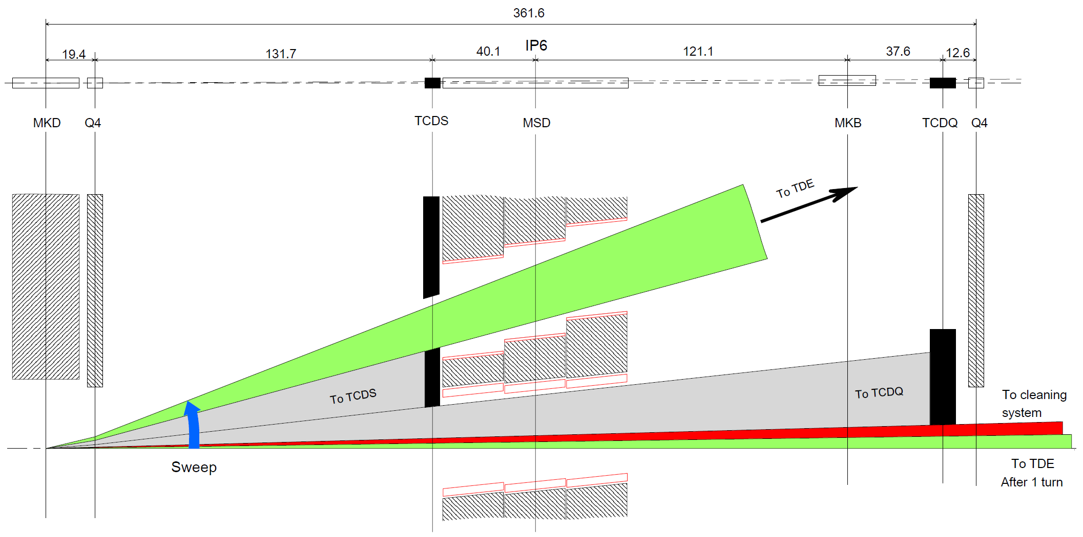
Hadron collider extraction (4)
Asynchronous dump…
…
…
s
Figure taken from [1]

Slide 18
Hadron collider extraction (5)
Abort gap cleaning [5,6]
  Particles leaking from rf buckets drift into the abort gap
  These particles are not conducted into the extraction septum channel since they are deflected with the rising edge of the extraction kicker (similarly to asynchronous damp)
  Cleaning using transverse damper system (LHC)
    Transverse damper is used conversely to excite betatron oscillation, bringing the particles to ring collimators
    Damper is excited at the betatron frequency
    Sweeping in the excitation frequency to increase the cleaning efficiency, taking into account (higher order) chromaticity and amplitude dependent tune
    Cleaning at the flat bottom after injection, and at flat top when AG population becomes high (5×10^9 at 6.5 TeV, 10% of Q4 quench level)
…
…

Slide 19
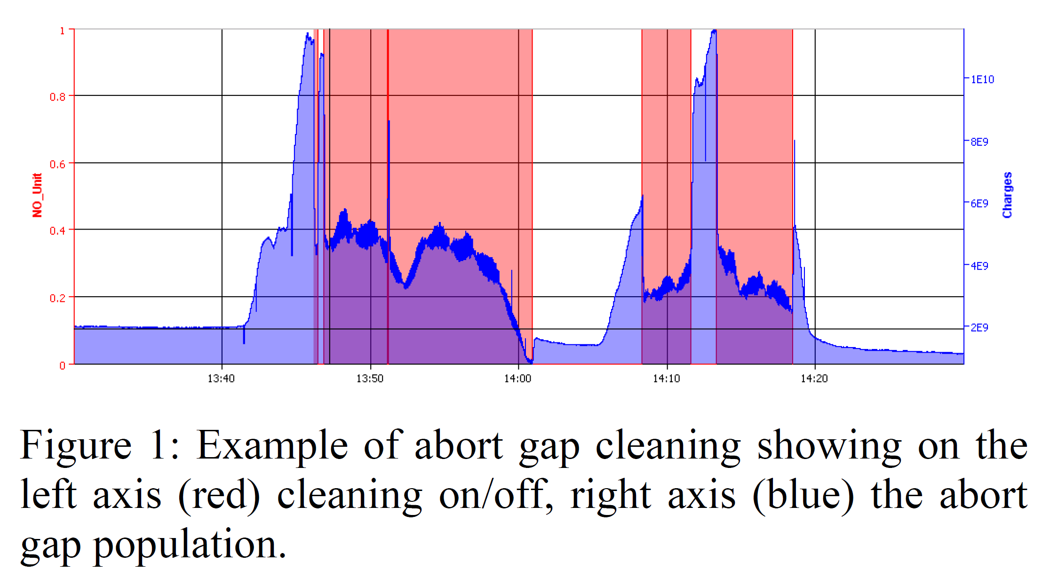
Hadron collider extraction (6)
Gap cleaning in operation
Figure taken from [5]

Slide 20
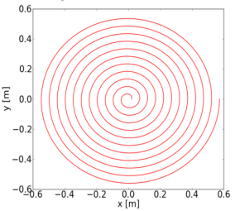
From LHC to FCC-hh
Injection [7]
  Energy stored in an injection bunch train is limited to a few MJ for machine protection reasons both in LHC and FCC-hh
  Number of bunches per injection will be significantly smaller in FCC-hh due to higher injection energy: 450 GeV vs. ~3 TeV (?)
  Many injections required, resulting in many gaps
  Shorter injection kicker rise time is then specified to achieve reasonable filling factor, <~300 ns (?)
Extraction [8]
  Energy stored in the beam is 8.5 GJ at flat top !
  One of kicker design concept under study is:
    Using a large number of kickers ~300
    Accidental triggering in one of kicker results in only a small betatron oscillation
    Asynchronous damp is then necessary only when multiple mis-triggering happens
  Due to the very high beam energy, superconducting septum is considered
  More dilution on the beam dump as shown in the figure
  Sacrificial absorbers…
Figure taken
from [8]

Slide 21
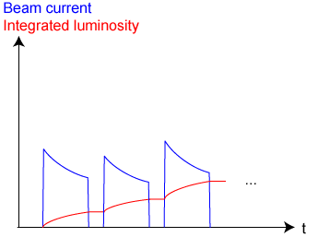
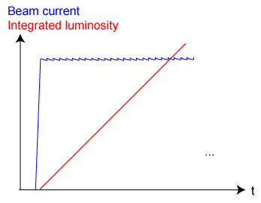
Lepton collider injection (1)
Top-up injection
  Injecting electrons/positrons atop of circulating beam to compensate for the beam current decrease during collision
  Maximising the integrated luminosity
  Stabilising the machine with constant heat load due to synchrotron radiation
Early time operation mode
Top-up operation

Slide 22




Lepton collider injection (2)
  Liouville’s theorem (for accelerator physics)
  “Under the influence of conservative forces the density of the particles in phase space stays constant” (Sentence from [9])
  This is true for charged particles moving in magnetic field
  For beam injection into rings, injection beam particles cannot overlap in phase space with the stored beam particles at the time of injection
B field
B field
x’
x’
x’
x
x
x
Top-up injection cannot continue as the entire phase space will be filled with particles!?

Slide 23
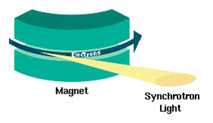

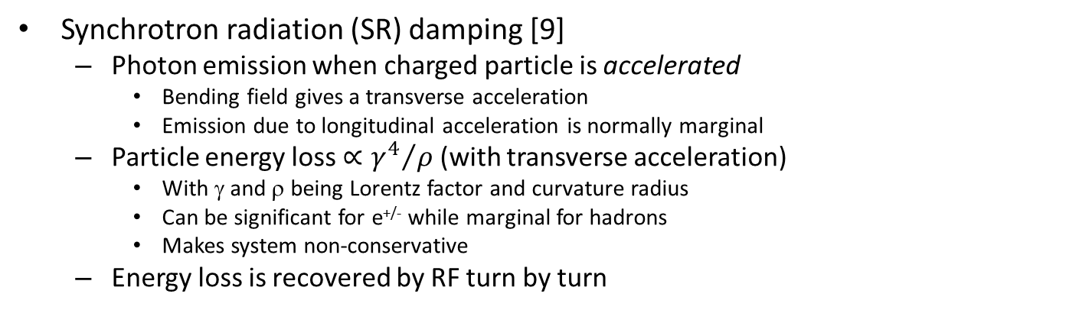
Lepton collider injection (3)
Synchrotron radiation (SR) damping [9]
  Photon emission when charged particle is accelerated
    Bending field gives a transverse acceleration
    Emission due to longitudinal acceleration is normally marginal
  Particle energy loss $∝{γ^{4}}/ρ$ (with transverse acceleration)
    With γ and ρ being Lorentz factor and curvature radius
    Can be significant for e^{+/-} while marginal for hadrons
    Makes system non-conservative
  Energy loss is recovered by RF turn by turn
Energy recovery by RF
SR [Figure taken from Wikipedia]
V_{RF}
Energy loss
per turn
Stored beam
Synchronous
phase
t

Slide 24
Lepton collider injection (4)
Radiation damping in transverse plane (Betatron oscillation)
  Longitudinal and transverse momenta loss due to SR while only longitudinal acceleration with RF
Radiation damping in longitudinal plane (Synchrotron oscillation)
  Energy loss due to SR is proportional to (1+δ)³, where δ is the fractional energy deviation (ΔE/E)
SR damping, longitudinal
SR damping, transverse
Initial Emission+Acceleration
Synchrotron oscillations
Initial Emission Acceleration
δ
x/y
s
s
(Arrow = Particle momentum)
(Area of ellipse = Longitudinal emittance)
Note: Emittance will not be zero because the synchrotron radiation excites betatron and synchrotron oscillation at the same time. Equilibrium emittances are determined such that the damping and excitations cancel each other.

Slide 25

Lepton collider injection (5)
Injection process (to be repeated!)
w'
Thanks to SR damping,
top-up injection can
continue unlimitedly!
w
Note: The initial injection errors, namely mismatch and centroid offset, are to be “forgotten” in e^{+/-} machines, while they have to be minimised in hadron machines.

Slide 26
Lepton collider injection (6)
Conventional top-up injection scheme
  Widely used in lepton colliders and light sources
  Septum + Kicker bump (a series of kickers)
  Gap for the kicker rise time is not required in top-up injection (Gaps may still be required to avoid ion instabilities)
x'
x'
x
x

Slide 27
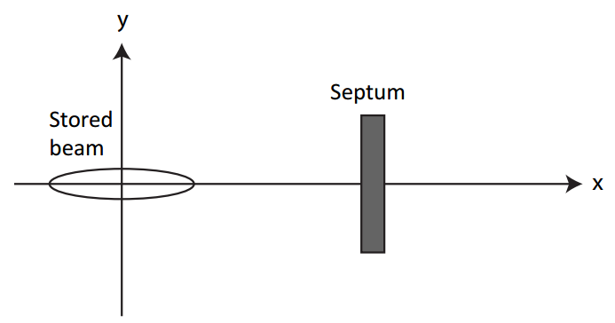
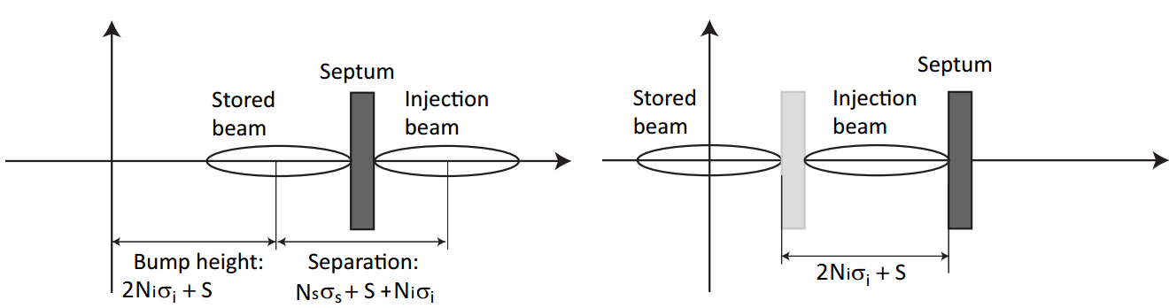
Lepton collider injection (7)
Parameters to be considered
  Stored and injection
  rms beam sizes: σ_{s}, σ_{i}
  Septum thickness: S
  Clearances in units of beam size:
  N_{s}, N_{i}
* Bump height is the minimum value required
Ring aperture required:
N_{s}σ_{s}+2N_{i}σ_{i}+S

Slide 28
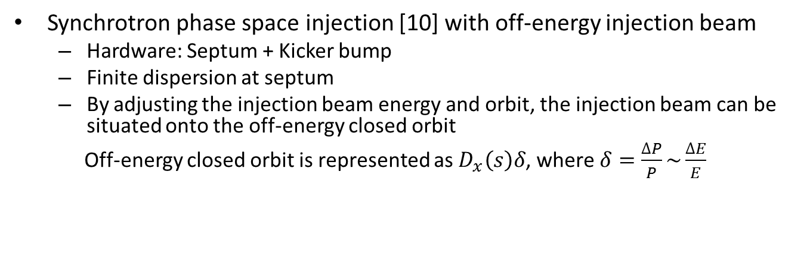

Lepton collider injection (8)
Synchrotron phase space injection [10] with off-energy injection beam
  Hardware: Septum + Kicker bump
  Finite dispersion at septum
  By adjusting the injection beam energy and orbit, the injection beam can be situated onto the off-energy closed orbit
  Off-energy closed orbit is represented as $D_{x}\left(s\right)δ$, where $δ=\frac{∆P}{P}\sim \frac{∆E}{E}$
  $$D_{x}δ$$
x'
x
Synchrotron
oscillation

Slide 29
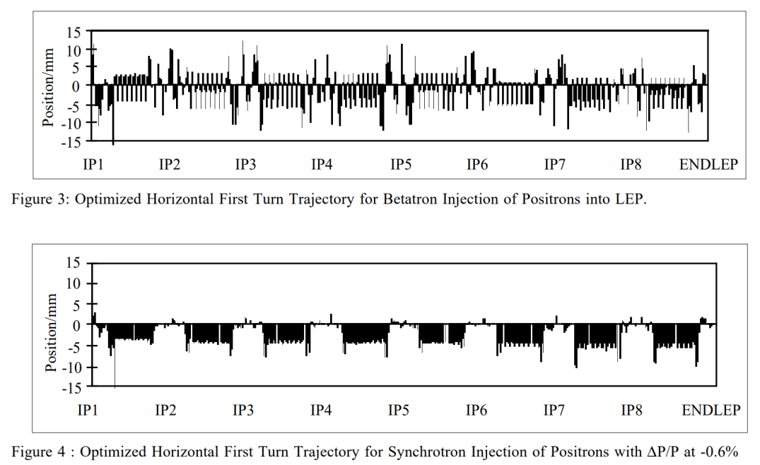
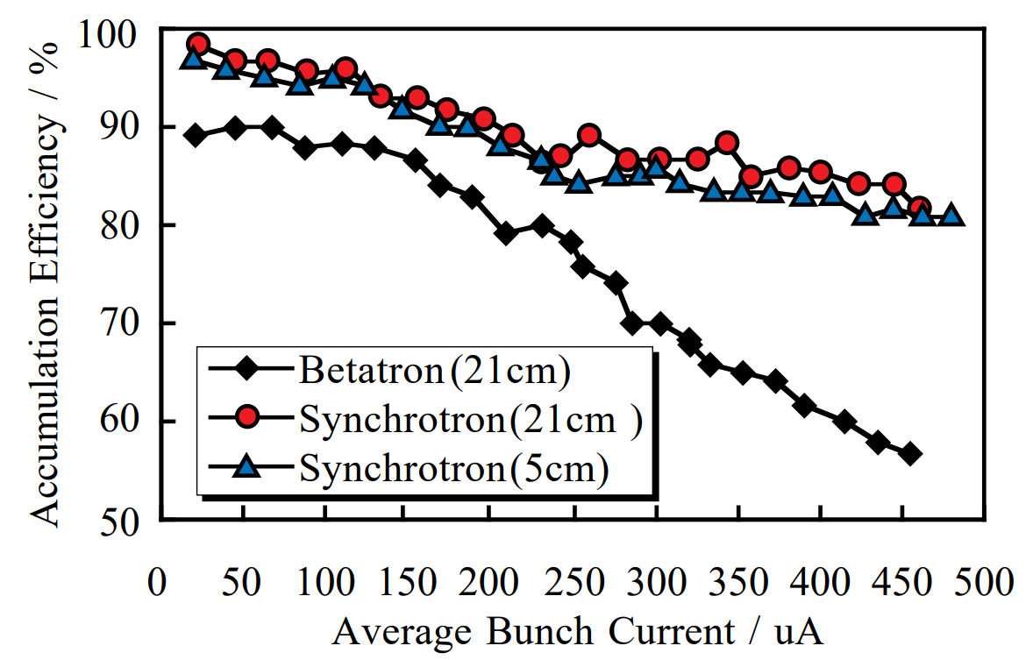
Lepton collider injection (9)
Synchrotron phase space injection at LEP
  Unwanted radiation dose to the physics detector during injection was reduced; Zero dispersion at detectors
  Higher injection efficiency than normal conventional injection was realised
Figures taken from [9]

Slide 30
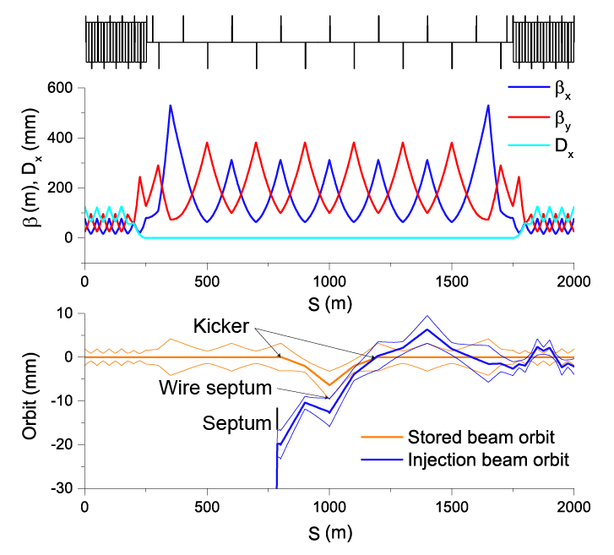
FCC-ee injection and extraction
Injection
  Main difficulty is injecting into limited dynamic aperture due to strongly squeezed β*
  Conventional injection (on- and off-energy) and multipole kicker injection [11] schemes are investigated and promising [12]
  One of possible designs:
    Conventional injection scheme
    Bump with two kickers with some quads
    in-between, enhancing bump height
    FODO optics with ~400 m beta function
    Wire septum is considered here.
    Can be normal septum with larger β function
    Modest kicker and septum specifications
Extraction
  Energy stored in the beam is ~20 MJ in Z operation mode (Beam energy of 45.6 GeV)
  20 MJ is “not much” compared to LHC/FCC-hh but well above damage threshold, requiring a careful beam dump design

Slide 31
Some references
[1] LHC Design Report http://cds.cern.ch/record/782076
[2] V. Mertens et al., “Beam commissioning of injection into the LHC”, Proc. of PAC’09, pp.1590-1592 (2009)
[3] R. Bailey and Paul Collier, “Standard filling schemes for various LHC operation modes”, LHC-Project-Note-323 (2003)
[4] G. Kotzian et al., “Emittance growth at LHC injection from SPS and LHC kicker ripple”, EPAC’04, pp.3629-3631 (2014)
[5] J. Uythoven et al., “Abort gap clearning for LC Run 2, IPAC’14, pp.138-140 (2014)
[6] W. Bartmann et al., “LHC abort gap clearning studies during luminosity operation”, IPSC’12, pp.496-498 (2012)
[7] T. Kramer et al., “Considerations for the injection and extraction kicker systems of a 100 TeV centre-of –mass FCC-hh collider”, Proc. of IPAC’16, pp.3901-3904
[8] T. Kramer et al., “Considerations for the beam dump system of a 100 TeV centre-of-mass FCC-hh collider”, Proc. of IPAC’15, pp.2132-2135 (2015)
[9] H. Wiedemann, “Particle Accelerator Physics I – Basic Principles and Linear Beam Dynamics”, Springer, ISBN 3-540-64672-X
[10] P. Collier, “Synchrotron Phase Space Injection into LEP”, Proc. of PAC’95, pp.551-553 (1995)
[11] H. Takaki et al., “Beam Injection with a Pulsed Sextupole Magnet in an Electron Storage Ring”, Phys. Rev. ST Accel. Beams, 13, 020705 (2010)
[12] M. Aiba et al., “Top-up injection schemes for future circular lepton collider”, Nucl. Instrum. and Method in Phys. Research A, 880, pp.98-106 (2018)
In these lectures:
- H. Schmickler, “Emittance preservation in hadron machines”
- M. Paraliev, “Kickers and septa”
- N. Mokhov, “Machine protection concepts”
- M. Seidel, “Collimators, dumps and masks”

Slide 32

Thank you for your attention!
Question?

