Slide 1


Low Level RF challenges / Timing systems
A. Gallo
INFN
Lab. Nazionali Frascati
Part 2

Slide 2
Lecture II Outline
MOTIVATIONS
  Why accelerators need synchronization, and at what precision level
DEFINITIONS AND BASICS
  Synchronization, Master Oscillator, Drift vs. Jitter
  Fourier and Laplace Transforms, Random processes, Phase noise in Oscillators
  Phase detectors, Phase Locked Loops
SYNCRONIZATION ARCHITECTURE AND PERFORMANCES
  Phase lock of synchronization clients (RF systems, Lasers, Diagnostics, ...)
  Residual absolute and relative phase jitter
  Reference distribution – actively stabilized links
BEAM ARRIVAL TIME FLUCTUATIONS
  Bunch arrival time measurement techniques
  Bunch arrival time downstream magnetic compressors
  Beam synchronization – general case
CONCLUSIONS AND REFERENCES

Slide 3
GENERAL DEFINITION
Every accelerator is built to produce some specific physical process.
One necessary condition for an efficient and stable machine operation is that some events have to happen at the same time (simultaneously for an observer in the laboratory frame) or in a rigidly defined temporal sequence, within a maximum allowed time error.
If the simultaneity or the time separation of the events fluctuates beyond the specifications, the performances of the machine are spoiled, and the quantity and quality of the accelerator products are compromised.
Clearly, the tolerances on the time fluctuations are different for different kind of accelerators. The smaller the tolerances, the tighter the level of synchronization required. In the last decade a new generation of accelerator projects such as FEL radiation sources or plasma wave based boosters has pushed the level of the synchronization specifications down to the fs scale.

Slide 4
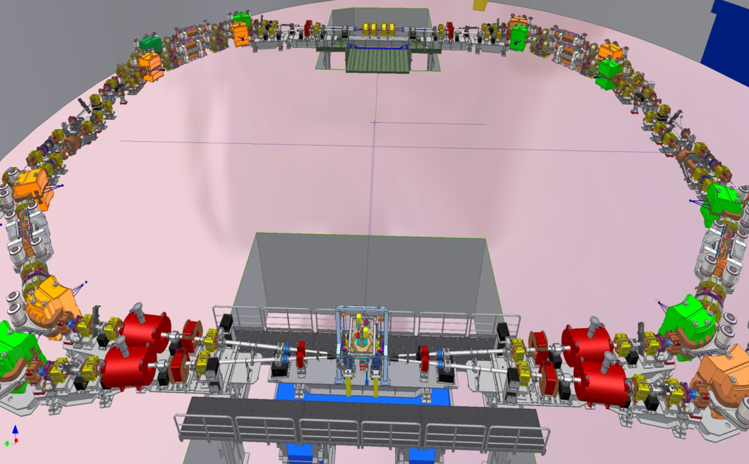
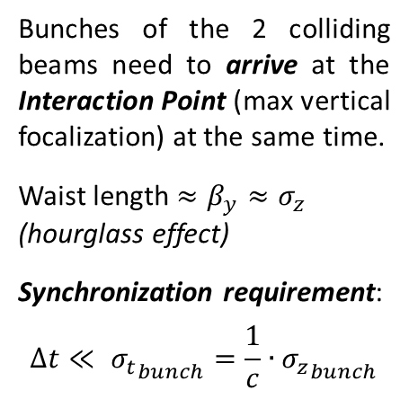

synchronization of
FLAT BEAM COLLIDERS
Bunches of the 2 colliding beams need to arrive at the Interaction Point (max vertical focalization) at the same time.
Waist length $≈β_{y}≈σ_{z}$ (hourglass effect)
Synchronization requirement:
$$∆t≪ {σ_{t}}_{bunch}=\frac{1}{c}{{∙σ}_{z}}_{bunch}$$
The Frascati Ф-factory DAФNE
CIRCULAR COLLIDERS:
$σ_{z}≈1 cm→$ $∆t<10 ps$
LINEAR COLLIDER (ILC):
$σ_{z}<1 mm→$ $∆t<1 ps$
IP
e⁻
e⁺
Synch. error !
RF Stability spec

Slide 5
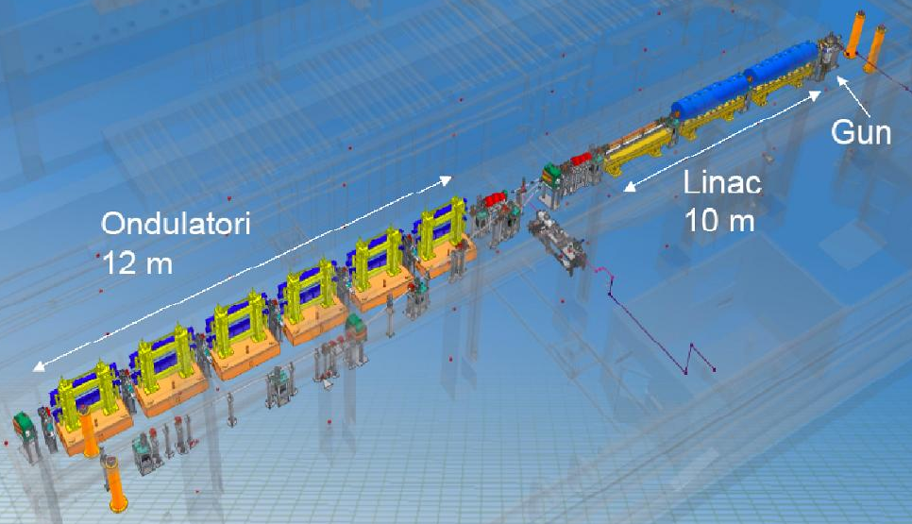
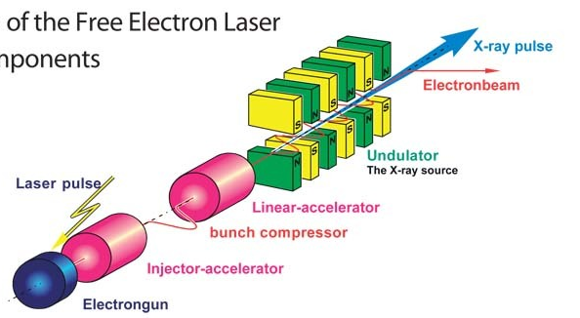
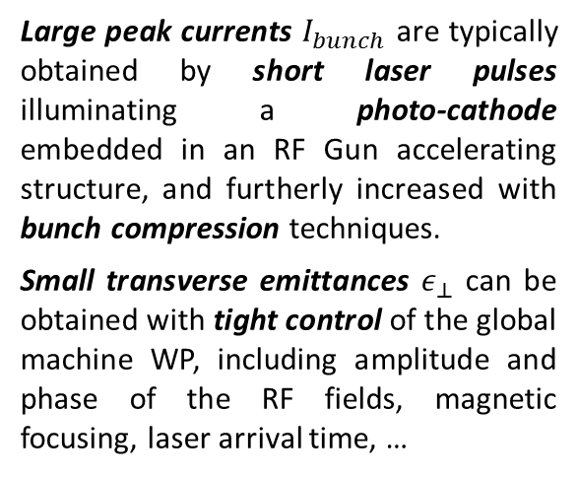
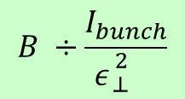
synchronization of
SASE FELs
SPARC Test Facility
INFN Frascati Labs
Free Electro Laser machines had a crucial role in pushing the accelerator synchronization requirements and techniques to a new frontier in the last ≈15 years.
The simplest FEL regime, the SASE (Self-Amplified Spontaneous Emission), requires high-brightness bunches, being:
$$B ÷\frac{I_{bunch}}{ε{}_{⊥}^{2}{}}$$
Large peak currents $I_{bunch}$ are typically obtained by short laser pulses illuminating a photo-cathode embedded in an RF Gun accelerating structure, and furtherly increased with bunch compression techniques.
Small transverse emittances $ε_{⊥}$ can be obtained with tight control of the global machine WP, including amplitude and phase of the RF fields, magnetic focusing, laser arrival time, …
Global Synchronization requirements: < 500 fs rms

Slide 6
synchronization of
Seeded FELs
In a simple SASE configuration the micro-bunching process, which is the base of the FEL radiation production, starts from noise. Characteristics such as radiation intensity and envelope profile can vary considerably from shot to shot.
A better control of the radiation properties resulting in more uniform and reproducible shot to shot pulse characteristics can be achieved in the “seeded” FEL configuration.
Undulator
To “trigger” and guide the avalanche process generating the exponentially-growing radiation intensity, the high brightness bunch is made to interact with a VUV short and intense pulse obtained by HHG (High Harmonic Generation) in gas driven by an IR pulse generated by a dedicated high power laser system (typically TiSa). The presence of the external radiation since the beginning of the micro-bunching process inside the magnetic undulators seeds and drives the FEL radiation growth in a steady, repeatable configuration. The electron bunch and the VUV pulse, both very short, must constantly overlap in space and time shot to shot.
Synchronization requirements (e- bunch vs TiSa IR pulse): < 100 fs rms

Slide 7
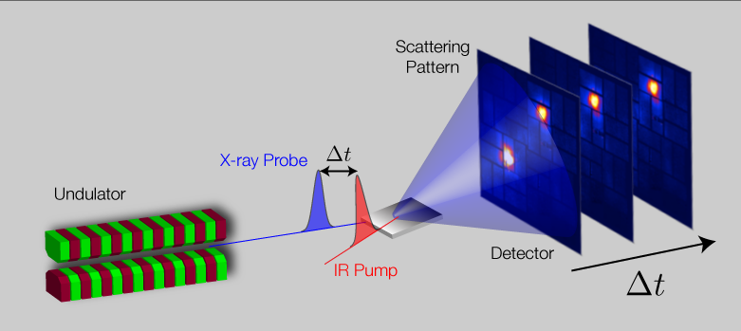
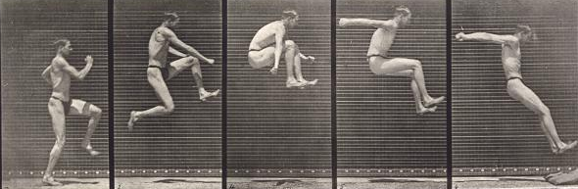
synchronization of
Pump-probe with FELs
Pump-probe technique is widely requested and applied by user experimentalists.
Physical / chemical processes are initialized by ultra-short laser pulses, then the system status is probed by FEL radiation.
The dynamics of the process under study is captured and stored in a “snapshots” record.
Pump laser and FEL pulses need to be synchronized at level of the time-resolution required by the experiments (down to ≈ 10 fs).
Pump Laser
≈ fs time scale
TiSa
Δt
Reconstruction of system dynamics
The relative delay between pump and probe pulses needs to be finely and precisely scanned with proper time-resolution.
≈ ms time scale
Synchronization requirements
(FEL vs Pump Laser pulses):
≈ 10 fs rms
Detail from Muybridge's Jumping,
running broad jump (1887)

Slide 8
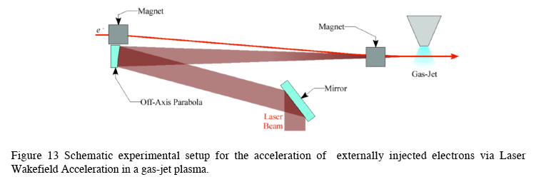
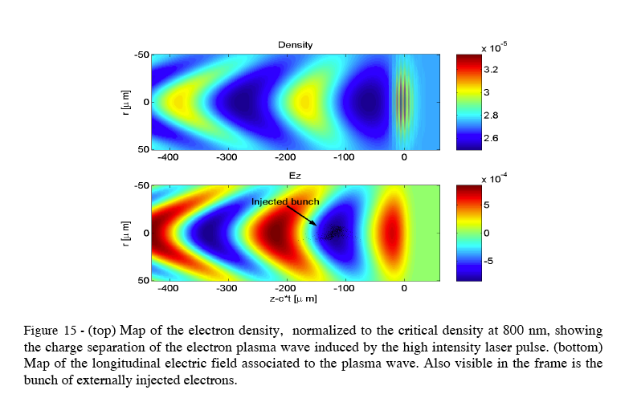
synchronization of
WLPA of injected bunches
Plasma acceleration is the new frontier in accelerator physics, to overcome the gradient limits of the RF technology in the way to compact, high energy machines.
Wakefield Laser-Plasma Acceleration (WLPA) is a technique using an extremely intense laser pulse on a gas jet to generate a plasma wave with large accelerating gradients ( many GV/m).
To produce good quality beams external bunches have to be injected in the plasma wave. The “accelerating buckets” in the plasma wave are typically few 100 μm long.
The injected bunches have to be very short to limit the energy spread after acceleration, and ideally need to be injected constantly in the same position of the plasma wave to avoid shot-to-shot energy fluctuations.
This requires synchronization at the level of a small fraction of the plasma wave period.
Synchronization requirements
(external bunch vs laser pulse):
< 10 fs rms

Slide 9
synchronization of different facilities
SUMMARY
Circular
colliders
Low-level RF, beam FBKs, ...
10 ps
Future Linear colliders
1 ps
LLRF systems, beam FBKs, ...
SASE FELs
Photocathode (PC) laser, LLRF, ...
Compton sources
Seeded FELs
100 fs
Seeding and PC lasers, LLRF, ...
+ Interaction laser
FELs
Pump-Probe
10 fs
FEL (*), Pump laser, ...
WLPA External injection
Injected beam (#), Power laser, ...
1 fs
Upcoming ...
...
sub fs
(#) depends on all RF and laser systems of the injector
(*) depends on beam (LLRFs + PC laser) and laser seed (if any)

Slide 10
SECTION I
GLOSSARY

Slide 11
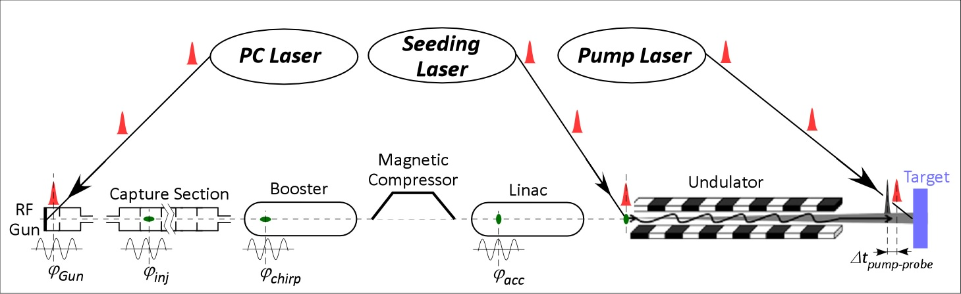
GLOSSARY:
SYNCHRONIZATION
Every accelerator is built to produce some specific physical processes (shots of bullet particles, nuclear and sub-nuclear reactions, synchrotron radiation, FEL radiation, Compton photons, ...).
It turns out that a necessary condition for an efficient and reproducible event production is the relative temporal alignment of all the accelerator sub-systems impacting the beam longitudinal phase-space and time-of-arrival (such as RF fields, PC laser system, ...), and of the beam bunches with any other system they have to interact with during and after the acceleration (such as RF fields, seeding lasers, pump lasers, interaction lasers, ...).
The synchronization system is the complex including all the hardware, the feedback processes and the control algorithms required to keep time-aligned the beam bunches and all the machine critical sub-systems within the facility specifications.
50 m ÷ some km

Slide 12
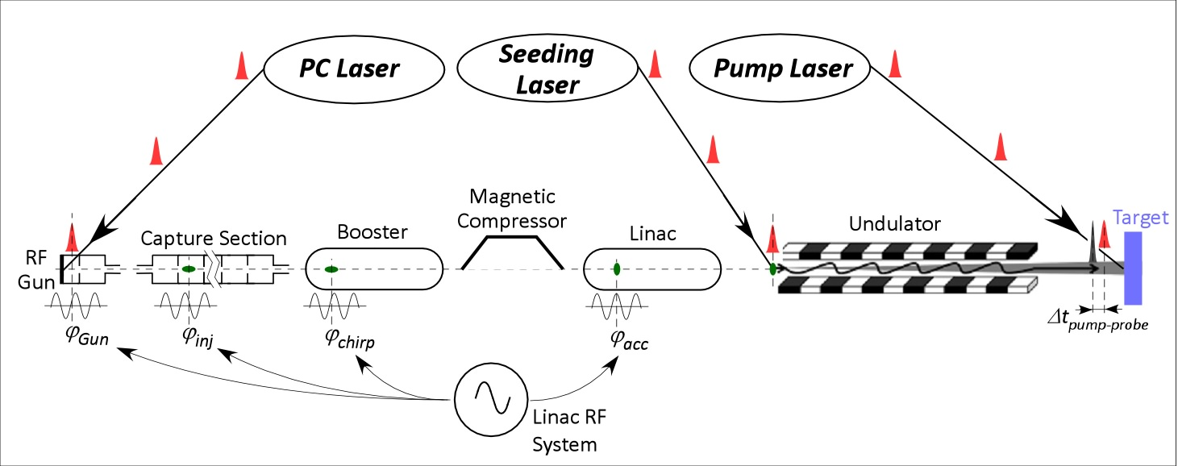

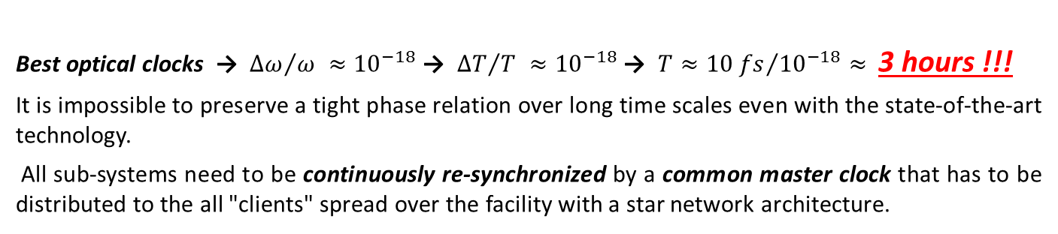
GLOSSARY:
MASTER OSCILLATOR
Naive approach: can each sub-system be synchronized to a local high-stability clock to have a good global synchronization of the whole facility ?
Facility
Master
Clock
Best optical clocks → ${∆ω}/{ω }≈{10}^{−18}$ → ${∆T}/{T }≈{10}^{−18}$ → $T≈{10 fs}/{{10}^{−18}}≈$ 3 hours !!!
It is impossible to preserve a tight phase relation over long time scales even with the state-of-the-art technology.
All sub-systems need to be continuously re-synchronized by a common master clock that has to be distributed to the all "clients" spread over the facility with a star network architecture.

Slide 13
GLOSSARY:
MASTER OSCILLATOR
Delay line
Delay line
Delay line
Delay line
Delay line
Delay line
Facility
Master
Clock
D L
D L
D L
Once the local oscillators have been locked to the reference, they can be shifted in time by means of delay lines of various types – translation stages with mirrors for lasers, trombone-lines or electrical phase shifters for RF signals. This allows setting, correcting, optimizing and changing the working point of the facility synchronization.
Delay lines can be placed either downstream the oscillators or on the reference signal on its path to the client oscillator. The function accomplished is exactly the same.
For simplicity, in most of the following sketches the presence of the delay line will be omitted

Slide 14
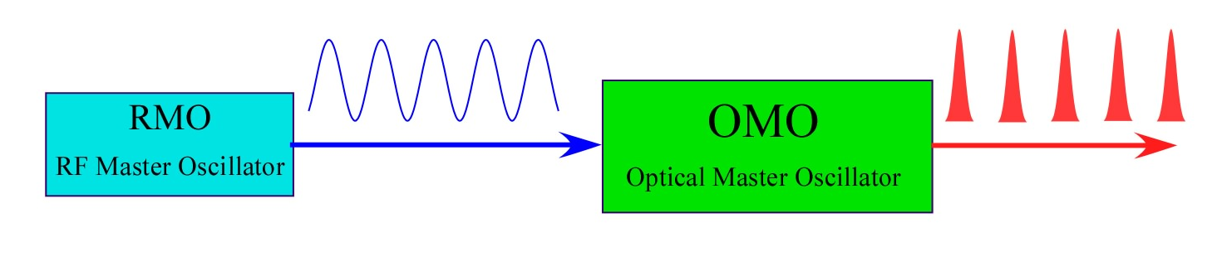
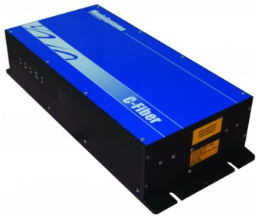
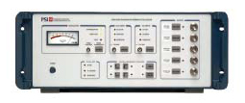
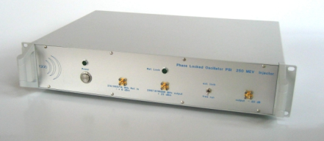
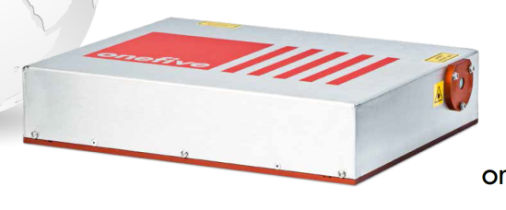
GLOSSARY:
MASTER OSCILLATOR
The Master Oscillator of a facility based on particle accelerators is typically a good(*), low phase noise μ-wave generator acting as timing reference for the machine sub-systems. It is often indicated as the RMO (RF Master Oscillator).
The timing reference signal can be distributed straightforwardly as a pure sine-wave voltage through coaxial cables, or firstly encoded in the repetition rate of a pulsed (mode-locked) laser (or sometimes in the amplitude modulation of a CW laser), and then distributed through optical-fiber links.
Optical fibers provide less signal attenuation and larger bandwidths, so optical technology is definitely preferred for synchronization reference distribution, at least for large facilities.
(*) the role of the phase purity of the reference will be discussed later

Slide 15
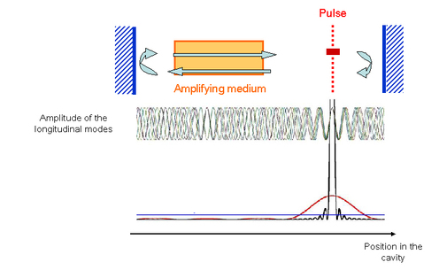
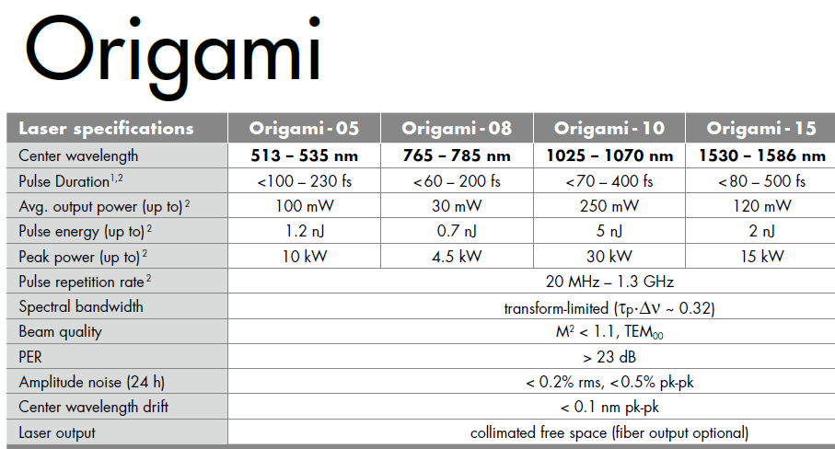
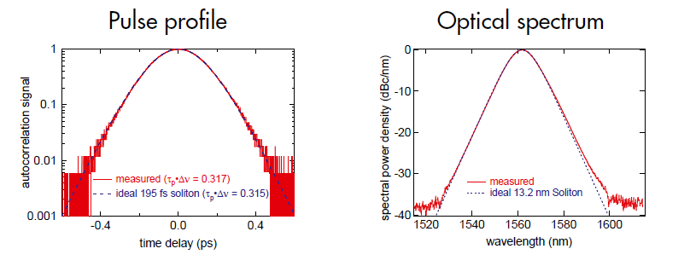

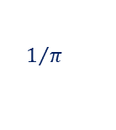
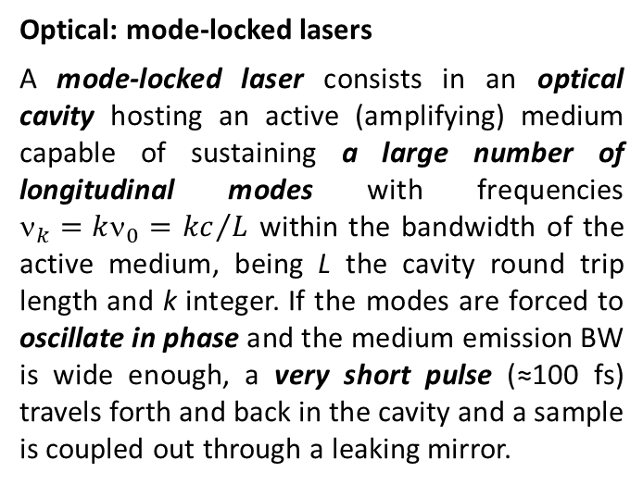
GLOSSARY:
OPTICAL MASTER OSCILLATOR
Optical: mode-locked lasers
A mode-locked laser consists in an optical cavity hosting an active (amplifying) medium capable of sustaining a large number of longitudinal modes with frequencies ${\text{n}}_{k}=k{\text{n}}_{0}=$ ${kc}/L$ within the bandwidth of the active medium, being L the cavity round trip length and k integer. If the modes are forced to oscillate in phase and the medium emission BW is wide enough, a very short pulse (≈100 fs) travels forth and back in the cavity and a sample is coupled out through a leaking mirror.
$$1/π$$
http://www.onefive.com/ds/Datasheet%20Origami%20LP.pdf

Slide 16
GLOSSARY:
JITTER vs. DRIFT
The synchronization error of a client with respect to the reference is identified as jitter or drift depending on the time scale of the involved phenomena.
Jitter = fast variations, caused by inherent residual lack of coherency between oscillators, even if they are locked at the best;
Drift = slow variations, mainly caused by modifications of the environment conditions, such as temperature (primarily) but also humidity, materials and components aging, …
Jitter
Drift
The boundary between the 2 categories is somehow arbitrary. For instance, synchronization errors due to mechanical vibrations can be classified in either category:
Acoustic waves → Jitter Infrasounds → Drift
For pulsed accelerators, where the beam is produced in the form of a sequence of bunch trains with a certain repetition rate (10 Hz ÷ 120 Hz typically), the rep. rate value itself can be taken as a reasonable definition of the boundary between jitters and drifts.
In this respect, drifts are phenomena significantly slower than rep. rate and will produced effects on the beam that can be monitored and corrected pulse-to-pulse.
On the contrary, jitters are faster than rep. rate and will result in a pulse-to-pulse chaotic scatter of the beam characteristics that has to be minimized but that can not be actively corrected.
Drift → Nasty
Jitter → Killer

Slide 17
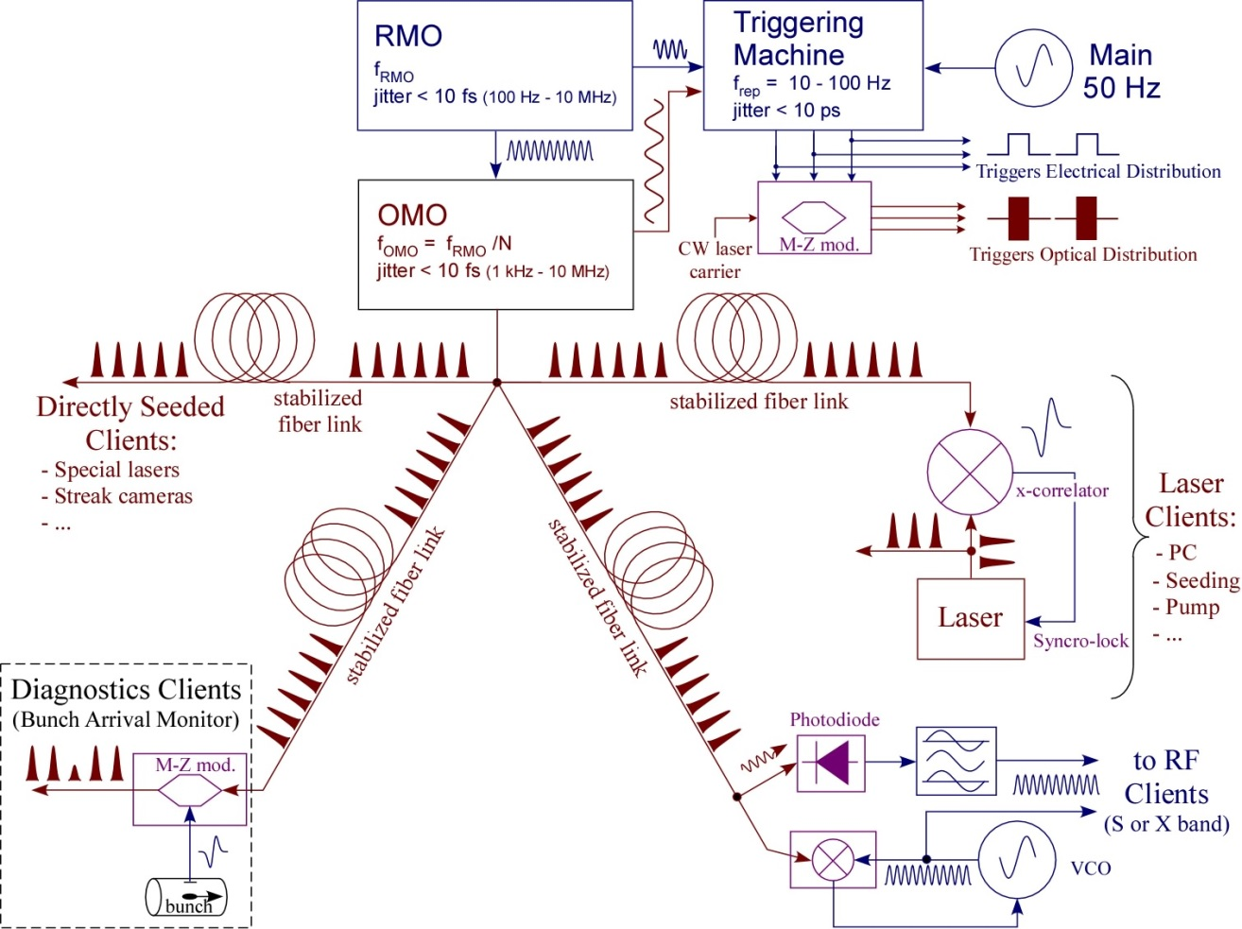
GLOSSARY:
SYNCRONIZATION SYSTEMS
Tasks of a Synchronization system:
Generate and transport the reference signal to any client local position with constant delay and minimal drifts;
Lock the client (laser, RF, ...) fundamental frequency to the reference with minimal residual jitter;
Monitor clients and beam, and apply delay corrections to compensate residual (out-of-loop) drifts.
Triggers
Digital signals still in the Timing business but the required precision is orders of magnitude less demanding.
Not covered in this lecture (but nevertheless an important aspect of machine operation).

Slide 18
SECTION II
BASICS
Fourier and Laplace Transforms
Random Processes
Phase Noise in Oscillators

Slide 19
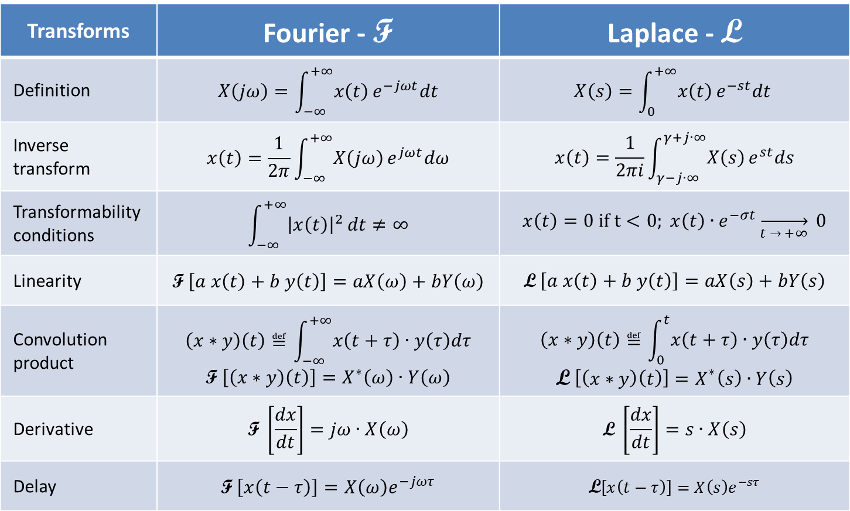
BASICS:
Fourier and Laplace Transforms
Transforms summary
Transforms | Fourier - F | Laplace - L
Definition | $$X\left(jω\right)=\int_{−∞}^{+∞}{x\left(t\right)}e^{−jωt}dt$$ | $$X\left(s\right)=\int_{0}^{+∞}{x\left(t\right)}e^{−st}dt$$
Inverse transform | $$x\left(t\right)=\frac{1}{2π}\int_{−∞}^{+∞}{X\left(jω\right)}e^{jωt}dω$$ | $$x\left(t\right)=\frac{1}{2πi}\int_{γ−j∙∞}^{γ+j∙∞}{X\left(s\right)}e^{st}ds$$
Transformability conditions | $$\int_{−∞}^{+∞}{{\left|x\left(t\right)\right|}^{2}}dt≠∞$$ | $$x\left(t\right)=0 if t<0; x\left(t\right)∙e^{−σt}\overset{→}{t → +∞} 0$$
Linearity | $$\text{F} \left[a x\left(t\right)+b y\left(t\right)\right]=aX\left(ω\right)+bY\left(ω\right)$$ | $$\text{L} \left[a x\left(t\right)+b y\left(t\right)\right]=aX\left(s\right)+bY\left(s\right)$$
Convolution product | $$\left(x∗y\right)\left(t\right)≝\int_{−∞}^{+∞}{x\left(t+τ\right)}∙y\left(τ\right)dτ$$ $$\text{F} \left[\left(x∗y\right)\left(t\right)\right]=X^{∗}\left(ω\right)∙Y\left(ω\right)$$ | $$\left(x∗y\right)\left(t\right)≝\int_{0}^{t}{x\left(t+τ\right)}∙y\left(τ\right)dτ$$ $$\text{L} \left[\left(x∗y\right)\left(t\right)\right]=X^{∗}\left(s\right)∙Y\left(s\right)$$
Derivative | $$\text{F} \left[\frac{dx}{dt}\right]=jω∙X\left(ω\right)$$ | $$\text{L} \left[\frac{dx}{dt}\right]=s∙X\left(s\right)$$
Delay | $$\text{F} \left[x\left(t−τ\right)\right]=X\left(ω\right)e^{−jωτ}$$ | $$\text{L}\left[x\left(t−τ\right)\right]=X\left(s\right)e^{−sτ}$$

Slide 20







BASICS:
Random Processes
Random process summary
Let’s consider a random variable $x\left(t\right)$ representing a physical observable quantity.
Stationary process: statistical properties invariant for a $t′$ time shift
Ergodic process: statistical properties can be estimated by a single process realization
Uncorrelation: if $x\left(t\right)$ and $y\left(t\right)$ are 2 random variables completely uncorrelated (statistically independent), then:
$$σ{}_{x+y}^{2 } =σ{}_{x}^{2}{ + σ}{}_{y}^{2} with σ{}_{x}^{2}{ ≝\overline{x^{2}}−{\overline{x}}^{2}}$$
$$x\left(t\right)→ x\left(t+t′\right)$$
Stationarity:
$\overline{x_{1}}≈\overline{x_{2}}≈\overline{x_{3}}$ $≈\overline{x}$
$σ_{x_{1}}≈$ $σ_{x_{2}}≈σ_{x_{3}}≈$ $σ_{x}$
$$x\left(t\right)$$
$\overline{x_{1}},$ $σ_{x_{1}}$
1
3
2
$\overline{x_{3}},$
$$σ_{x_{3}}$$
$\overline{x_{2}},$
$$σ_{x_{2}}$$

Slide 21
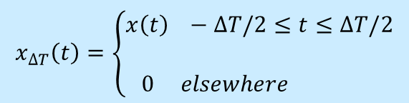
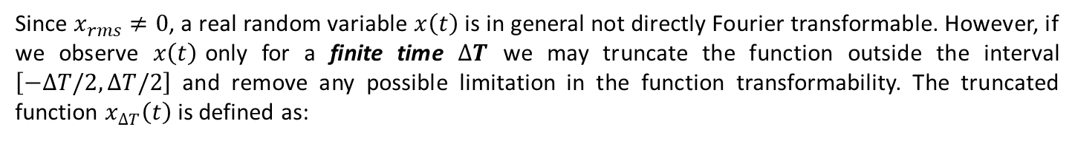
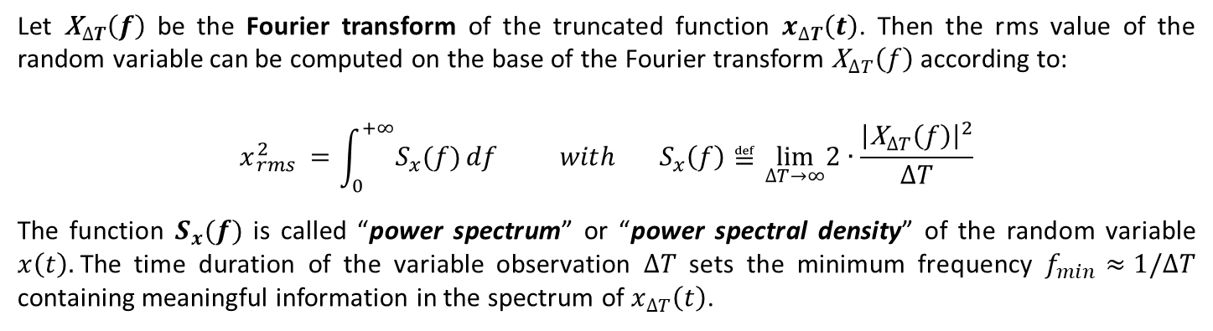
BASICS:
Random Processes
Power spectrum:
Since $x_{rms}≠0$, a real random variable $x\left(t\right)$ is in general not directly Fourier transformable. However, if we observe $x\left(t\right)$only for a finite time $∆T$ we may truncate the function outside the interval $\left[−∆T/2,∆T/2\right]$ and remove any possible limitation in the function transformability. The truncated function $x_{∆T}\left(t\right)$ is defined as:
$$x_{∆T}\left(t\right)=\left\{\begin{matrix}x\left(t\right) −∆T/2≤t≤∆T/2 \\ \\ 0 elsewhere \end{matrix}\right.$$
Let ${\text{X}}_{∆T}\left(f\right)$ be the Fourier transform of the truncated function $x_{∆T}\left(t\right)$. Then the rms value of the random variable can be computed on the base of the Fourier transform ${\text{X}}_{∆T}\left(f\right)$according to:
$$x{}_{rms}^{2 } =\int_{0}^{+∞}{S_{x}(f)}df{ with S}_{x}\left(f\right)≝\lim_{∆T→∞}2∙\frac{{\left|{\text{X}}_{∆T}\left(f\right)\right|}^{2}}{∆T}$$
The function $S_{x}(f)$ is called “power spectrum” or “power spectral density” of the random variable $x\left(t\right).$The time duration of the variable observation $∆T$ sets the minimum frequency $f_{min}≈1/∆T$ containing meaningful information in the spectrum of $x_{∆T}\left(t\right)$.

Slide 22






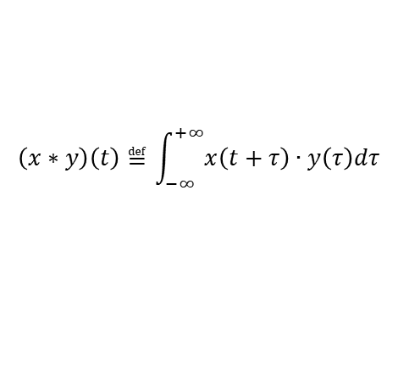








BASICS:
LTI Transfer Functions
Fourier and Laplace transforms are used to compute the response of Linear Time Invariant (LTI) systems:
convolution product
LTI
system
Green’s
function
$$\left(x∗y\right)\left(t\right)≝\int_{−∞}^{+∞}{x\left(t+τ\right)}∙y\left(τ\right)dτ$$
$$δ\left(t\right)$$
$$h\left(t\right)$$
time
domain
LTI
system
$$v_{in}\left(t\right)∗h\left(t\right)$$
Noise power
spectra
$$v_{in}\left(t\right)$$
$$S_{in}\left(ω\right)$$
$$e^{jωt}$$
LTI
system
$${H\left(jω\right)e}^{jωt}$$
Fourier
transform
LTI
system
$$V_{in}\left(jω\right)$$
LTI
system
$$V_{in}\left(jω\right)∙H\left(jω\right)$$
$$e^{st}$$
LTI
system
$${H\left(s\right)e}^{st}$$
$${\left|H\left(jω\right)\right|}^{2}∙S_{in}\left(ω\right)$$
Laplace
transform
$$V_{in}\left(s\right)$$
LTI
system
$$V_{in}\left(s\right)∙H\left(s\right)$$
LTI system
Transfer functions

Slide 23
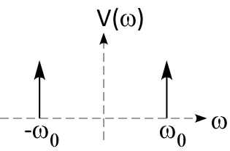
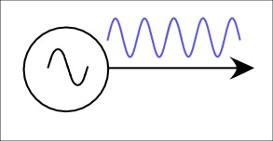
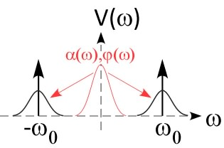
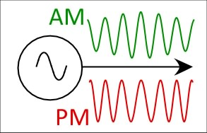
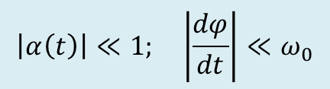

BASICS:
Phase Noise in Oscillators
The most important task of a Synchronization system is to lock firmly the phase of each client to the reference oscillator in order to minimize the residual jitter. The clients are basically VCOs (Voltage Controlled Oscillators), i.e. local oscillators (electrical for RF systems, optical for laser systems) whose fundamental frequency can be changed by applying a voltage to a control port.
Before discussing the lock schematics and performances, it is worth introducing some basic concepts on phase noise in real oscillators.
Ideal oscillator
Ideal Spectrum
$$V\left(t\right)=V_{0}∙cos\left(ω_{0}t+φ_{0}\right)$$
Real oscillator
Real Spectrum
$$V\left(t\right)=V_{0}∙\left[1+α\left(t\right)\right]∙cos\left[ω_{0}t+φ\left(t\right)\right]$$
In real oscillators the amplitude and phase will always fluctuate in time by a certain amount because of the unavoidable presence of noise. However, by common sense, a well behaving real oscillator has to satisfy the following conditions:
$$\left|α\left(t\right)\right|≪1; \left|\frac{dφ}{dt}\right|≪ω_{0}$$

Slide 24





BASICS:
Phase Noise in Oscillators
A real oscillator signal can be also represented in Cartesian Coordinates $\left(α,φ\right) → \left(v_{I},v_{Q}\right)$:
$$V\left(t\right)=V_{0}∙cos\left(ω_{0}t\right)+v_{I}\left(t\right)∙cos\left(ω_{0}t\right)−v_{Q}\left(t\right)∙sin\left(ω_{0}t\right)$$
$$if v_{I}\left(t\right),v_{Q}\left(t\right) ≪V_{0} α\left(t\right)={v_{I}\left(t\right)}/{V_{0}},_{}φ\left(t\right)={v_{Q}\left(t\right)}/{V_{0}}≪1$$
Real oscillator outputs are amplitude (AM) and phase (PM) modulated carrier signals. In general it turns out that close to the carrier frequency the contribution of the PM noise to the signal spectrum dominates the contribution of the AM noise. For this reason the lecture will be focused on phase noise. However, amplitude noise in RF systems directly reflects in energy modulation of the bunches, that may cause bunch arrival time jitter when beam travels through dispersive and bended paths (i.e. when R₅₆≠0 as in magnetic chicanes).
Let’s consider a real oscillator and neglect the AM component:
$$V\left(t\right)=V_{0}∙cos\left[ω_{0}t+φ\left(t\right)\right]=V_{0}∙cos\left[ω_{0}\left(t+τ\left(t\right)\right)\right] with τ\left(t\right)≡{φ\left(t\right)}/{ω_{0}}$$
The statistical properties of $φ\left(t\right)$ and $τ\left(t\right)$ qualify the oscillator, primarily the values of the standard deviations $σ_{φ }$and $σ_{τ}$ (or equivalently $φ_{rms }$and $τ_{rms}$ since we may assume a zero average value). As for every noise phenomena they can be computed through the phase noise power spectral density $S_{φ}\left(f\right)$of the random variable $φ\left(t\right)$.
$$α$$
$$v_{Q}$$
1111111111111
real phasor
$$φ$$
$$v_{I}$$
ideal phasor
Cartesian representation only holds for small PM depth

Slide 25

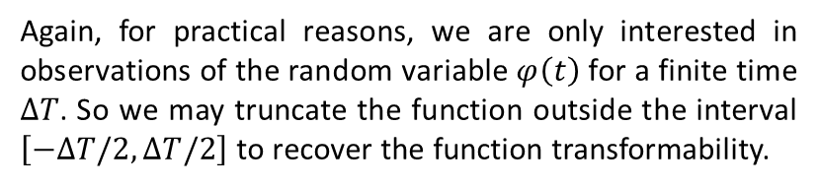
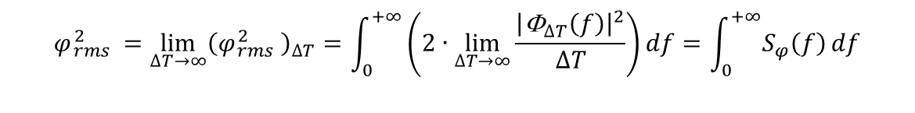
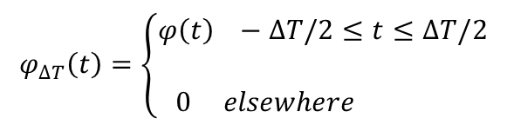
BASICS:
Phase Noise in Oscillators
Again, for practical reasons, we are only interested in observations of the random variable $φ\left(t\right)$ for a finite time $∆T$. So we may truncate the function outside the interval $\left[−∆T/2,∆T/2\right]$ to recover the function transformability.
$$φ_{∆T}\left(t\right)=\left\{\begin{matrix}φ\left(t\right) −∆T/2≤t≤∆T/2 \\ \\ 0 elsewhere \end{matrix}\right.$$
Let ${\text{F}}_{∆T}\left(f\right)$ be the Fourier transform of the truncated function $φ_{∆T}\left(t\right)$. We have:
$${\left(φ{}_{rms}^{2 } \right)}_{∆T}=\int_{f_{min}}^{+∞}{S_{φ}\left(f\right)}df with S_{φ}\left(f\right)≝2\frac{{\left|{\text{F}}_{∆T}\left(f\right)\right|}^{2}}{∆T}$$
$S_{φ}\left(f\right)$ is the phase noise power spectral density, whose dimensions are ${{rad}^{2}}/{Hz}$. Very often the single-sideband logarithmic scale $10∙Log\left|{S_{φ}\left(f\right)}/2\right|$ is used, whose units are ${dBc}/{Hz}$.
Again, the time duration of the variable observation $∆T$ sets the minimum frequency $f_{min}≈1/∆T$ containing meaningful information on the spectrum ${\text{F}}_{∆T}\left(f\right)$ of the phase noise $φ_{∆T}\left(t\right)$.
IMPORTANT:
we might still write
but we must be aware that $φ_{rms}$ in some case might diverge. This is physically possible since the power in the carrier does only depend on amplitude and not on phase. In these cases the rms value can only be specified for a given observation time $∆T$ or equivalently for a frequency range of integration $\left[f_{1},f_{2}\right]$.
$$φ{}_{rms}^{2 } =\lim_{∆T→∞}{{\left(φ{}_{rms}^{2 } \right)}_{∆T}}=\int_{0}^{+∞}{\left(2∙\lim_{∆T→∞}\frac{{\left|{\text{F}}_{∆T}\left(f\right)\right|}^{2}}{∆T}\right)}df=\int_{0}^{+∞}{S_{φ}\left(f\right)}df$$

Slide 26
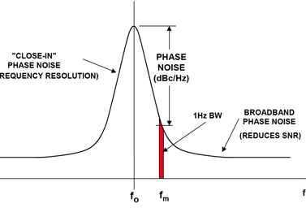
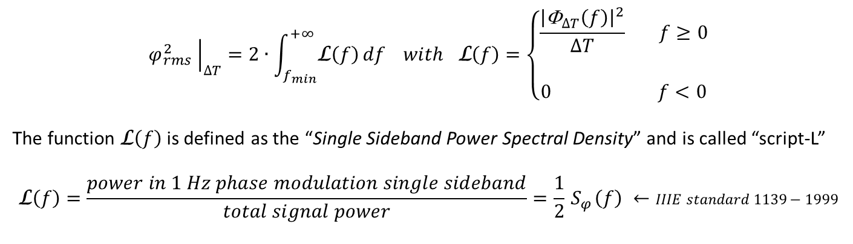
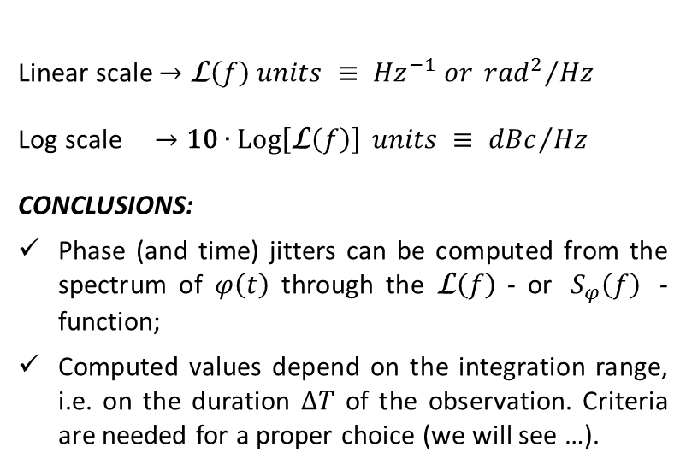
BASICS:
Phase Noise in Oscillators
$${\left.φ{}_{rms}^{2 } \right|}_{∆T}=2∙\int_{f_{min}}^{+∞}{\text{L}\left(f\right)}df with \text{L}\left(f\right)=\left\{\begin{matrix}\frac{{\left|{\text{F}}_{∆T}\left(f\right)\right|}^{2}}{∆T} f≥0 \\ \\ 0 f<0\end{matrix}\right.$$
The function $\text{L}\left(f\right)$ is defined as the “Single Sideband Power Spectral Density” and is called “script-L”
$$\text{L}\left(f\right)=\frac{power in 1 Hz phase modulation single sideband}{total signal power}=\frac{1}{2}{ S}_{φ}\left(f\right) ←IIIE standard 1139−1999$$
We have:
Linear scale $→\text{L}\left(f\right) units ≡ {Hz}^{−1} or {{rad}^{2}}/{Hz}$
Log scale $→\text{10}∙\operatorname{Log}\left[\text{L}\left(f\right)\right] units ≡ {dBc}/{Hz}$
CONCLUSIONS:
Phase (and time) jitters can be computed from the spectrum of $φ\left(t\right)$ through the $\text{L}\left(f\right)$ - or ${ S}_{φ}\left(f\right)$ - function;
Computed values depend on the integration range, i.e. on the duration $∆T$ of the observation. Criteria are needed for a proper choice (we will see …).
Attention:
this definition only apply at small PM depth, otherwise the spectrum will appear distorted
f

Slide 27
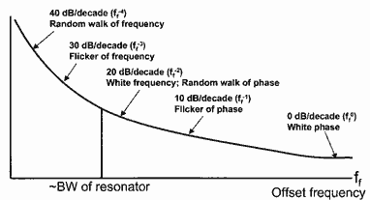
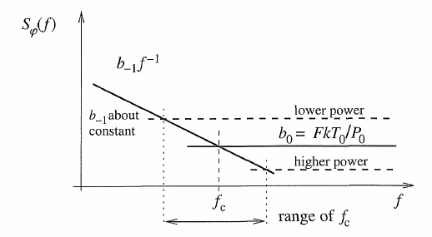

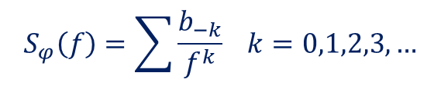



BASICS:
Phase Noise Nature and Spectra
Close-in
phase noise:
$${ S}_{φ}\left(f\right)=\sum{\frac{b_{−k}}{f^{k}}} k=0,1,2,3, …$$
Typical SSB PSD shape with
noise sources
$S_{FM}\left(f\right) \underset{→}{\begin{aligned}F or L \\ transforms\end{aligned} }S_{PM}\left(f\right)={S_{FM}\left(f\right)}/{f^{2}}$
 | Type | Origin | $$S_{φ}\left(f\right)$$
$$f^{0}$$ | White | Thermal noise of resistors | $$F∙kT/P_{0}$$
 | Shot | Current quantization | $$2q\overline{i}R/P_{0}$$
$$f^{−1}$$ | Flicker | Flicking PM | $$b_{−1}/f$$
$$f^{−2}$$ | White FM | Thermal FM noise | $$b{}_{0 }^{FM} ∙ \frac{1}{f^{2}}$$
 | Random walk | Brownian motion | $$b_{−2}/f^{2}$$
$$f^{−3}$$ | Flicker FM | Flicking FM | $$\frac{b{}_{−1 }^{FM} }{f} ∙ \frac{1}{f^{2}}$$
$$f^{−4}$$ | Random walk FM | Brownian motion → → FM | $$\frac{b{}_{−2 }^{FM} }{f^{2}} ∙ \frac{1}{f^{2}}$$
$$f^{−n}$$ | ... | high orders ...
$$F≝{{SNR}_{in}}/{{SNR}_{out}}$$
Corner frequency
$$\left[b_{−k}\right]={rad}^{2}{Hz}^{\left(k−1\right)}$$

Slide 28





BASICS:
Phase Noise Examples
Time jitter can be computed according to:
same time jitter → $S_{φ}\left(f\right) ÷ ω{}_{c}^{2}$
Phase noise spectral densities of different oscillators have to be compared at same carrier frequency $ω{}_{c}^{}$ or scaled as $ω{}_{c }^{−2}$ before comparison.
f ⁻² 20dB/decade
$$σ{}_{t}^{2} =\frac{σ{}_{φ}^{2 } }{ω{}_{c}^{2} }=\frac{1}{ω{}_{c}^{2} }\int_{f_{min}}^{+∞}{{ S}_{φ}\left(f\right)}df$$
f ⁻¹ 10dB/decade
Commercial frequency synthesizer
http://www.onefive.com/ds/Datasheet%20Origami%20LP.pdf
f_{c} = 2856 MHz
Spurious
60 fs
10 Hz ÷ 10 MHz
f ⁻³
f ⁰
f ⁻⁴
f ⁻²
f ⁻¹
f ⁻²
f ⁻¹
Low noise RMO
OMO – Mode-locked laser – f= 3024 MHz

Slide 29
SECTION III
BASICS
Phase Detectors
Phase Locked Loops

Slide 30

BASICS:
Phase Detectors – RF signals
Phase detection on RF signals
The Double Balanced Mixer is the most diffused RF device for frequency translation (up/down conversion) and detection of the relative phase between 2 RF signals (LO and RF ports). The LO voltage is differentially applied on a diode bridge switching on/off alternatively the D₁-D₂ and D₃-D₄ pairs, so that the voltage at IF is:

Slide 31



BASICS:
Phase Detectors – RF signals
Phase detection on RF signals
If f_{LO}= f_{RF} the IF signal has a DC component given by:
Passive
Cheap, Robust
Wideband
Sensitivity proportional to level, AM → PM not fully rejected
Noise figure F ≈ CL
Good sensitivity but lower wrt optical devices

Slide 32





BASICS:
Phase Detectors – RF vs. Optical
Time domain
Frequency domain
100fs
f_{rep}
Phase noise
Photo Detector
Bandwidth PD
T ≈ 5÷15 ns = 1/f_{rep}
Direct conversion with photo detector (PD)
Low phase noise
Temperature drifts ( 0.4ps/C°)
AM to PM conversion ( 0.5-4ps/mW )
f = n*f_{rep}
laser pulses
PD
BPF
~
~
~
f_{rep}
f = n*f_{rep}
Phase detection between RF and Laser –
Sagnac Loop Interferometer or BOM-PD
(Balanced Optical Microwave Phase Detector)
Recently (≈ 10 years) special devices to perform direct measurements of the relative phase between an RF voltage and a train of short laser pulses have been developed
balanced optical mixer to lock RF osc.
insensitive against laser fluctuation
Very low temperature drifts
Results: f=1.3GHz jitter & drift < 10 fs rms limited by detection!
Slide from H. Schlarb

Slide 33



BASICS: Phase Detectors
Optical vs. Optical
Balanced cross correlation of very short optical pulses ($σ_{t}≈200 fs$) provides an extremely sensitive measurement of the relative delay between 2 pulses.
$\frac{1}{λ_{3}}=\frac{1}{λ_{1}}$ + $\frac{1}{λ_{2}}$
SFG
Pass Band
V
Δt
Delay 1
Delay 2
SFG
Pass Band
The two pulses have orthogonal polarization and generate a shorter wavelength pulse proportional to their time overlap in each branch by means of non-linear crystal.
In a second branch the two polarizations experience a differential delay $∆T=T_{1}−T_{2}≈σ_{t}$. The amplitudes of the interaction radiation pulses are converted to voltages by photodiodes and their difference is taken as the detector output $V_{0}$.
If the initial time delay between the pulses is exactly ${∆T}/2$ then clearly $V_{0}≈0$ (balance), while it grows rapidly as soon as initial delay deviates.
Detection sensitivity up to 10 mV/fs achievable with ultra-short pulses!!!

Slide 34


BASICS: Phase Locked Loops for
Client Synchronization
What is peculiar in PLLs for clients of a stabilization system of a Particle Accelerator facility ?
Both the reference and client oscillators can be either RF VCOs or laser cavities. Phase detectors are chosen consequently;
Laser oscillators behave as VCOs by trimming the cavity length through a piezo controlled mirror.
  Limited modulation bandwidth (≈ few kHz typical);
  Limited dynamic range (Δf/f ≈ 10⁻⁶), overcome by adding motorized translational stages to enlarge the mirror positioning range;
  At frequencies beyond PLL bandwidth (f > 1 kHz) mode-locked lasers exhibit excellent low-phase noise spectrum.
RMO
σ_{t} ≈ 85 fs
10 Hz – 10 MHz
Laser:
PLL flat
σ_{t} ≈ 230 fs
PLL + 1 s=0 pole
σ_{t} ≈ 85 fs
PLL + 2 s=0 poles
σ_{t} ≈ 70 fs
SSB phase noise of a locked OMO for different loop filters

Slide 35


BASICS:
Phase Locked Loops
PLLs are a very general subject in RF electronics, used to synchronize oscillators to a common reference or to extract the carrier from a modulated signal (FM tuning). In our context PLLs are used to phase-lock the clients of the synchronization system to the master clock (RMO or OMO). The building blocks are:
A VCO, whose frequency range includes (D/N) f_{ref} ;
A phase detector, to compare the scaled VCO phase
to the reference;
A loop filter, which sets the lock bandwidth;
A prescalers or synthesizer ($N/D$ frequency multiplier, $N$
and $D$ integers) if different frequencies are required.
PLL transfer
function
VCO noise
freq-to-phase
conversion
loop
filter
VCO mod.
bandwidth
PLL linear model

Slide 36




BASICS:
Phase Locked Loops
Loop filters provide PLL stability, tailoring the frequency response, and set loop gain and cut-off frequency.
The output phase spectrum is locked to the reference if |H(jω)|>>1, while it returns similar to the free run VCO if |H(jω)|<1.
A flat-frequency response loop filter gives already a pure integrator loop transfer function thanks to a pole in the origin (f=0 ) provided by the dc frequency control of the VCO.
Loop filters properly designed can improve the PLL performance:
By furtherly increasing the low-frequency gain and remove phase err. offsets due to systematic VCO frequency errors, by means of extra poles in the origin (integrators) compensated by zeroes properly placed;
By enlarging the PLL BW through equalization of the frequency response of the VCO modulation port.
equalized
A very steep frequency response can be obtained (slope = 40 dB/decade) in stable conditions (see Nyquist plot).
unequalized
Equalization of the VCO modulation port frequency response allows increasing the loop gain.
Loop gain
Mod port
f [kHz]
Bode plot of the PLL loop gain
Nyquist locus

Slide 37
SECTION IV
Performances of
Synchronization Systems
Client Residual Jitter
Stabilized Reference Distribution

Slide 38




Performances of Synchronization Systems:
Residual Jitter of Clients
PC Laser
Seeding Laser
Pump Laser
Facility Master Clock
A client with a free-run phase noise $φ_{i_{0}}$ once being PLL locked to the reference with a loop gain $H_{i}\left(j2πf\right)$ will show a residual phase jitter $φ_{i}$and a phase noise power spectrum $S_{i}$according to:
$$φ_{i}=\frac{H_{i}}{1+H_{i}}φ_{ref}+\frac{1}{1+H_{i}}φ_{i_{0}}→ S_{i}\left(f\right)=\frac{{\left|H_{i}\right|}^{2}}{{\left|1+H_{i}\right|}^{2}}S_{ref}\left(f\right)+\frac{1}{{\left|1+H_{i}\right|}^{2}}S_{i_{0}}\left(f\right)$$
Client absolute residual time jitter
Incoherent noise contributions
$$σ{}_{t_{i}}^{2 } =\frac{1}{ω{}_{ref}^{2 } }\int_{f_{min}}^{+∞}{\frac{{\left|H_{i}\right|}^{2}S_{ref}\left(f\right)+S_{i_{0}}\left(f\right)}{{\left|1+H_{i}\right|}^{2}}}df$$

Slide 39








Performances of Synchronization Systems:
Residual Jitter of Clients
But we are finally interested in relative jitter between clients and reference $φ_{i−r}=φ_{i}−φ_{ref}$, and among different clients $φ_{i−j}=φ_{i}−φ_{j}$:
Facility
Master
Clock
Client # i
Client # j
$$φ_{i−r}=\frac{φ_{i_{0}}−φ_{ref}}{1+H_{i}} → S_{i−r}\left(f\right)=\frac{{S_{i_{0}}\left(f\right)+S}_{ref}\left(f\right)}{{\left|1+H_{i}\right|}^{2}}$$
$$φ_{i−r}$$
$$φ_{i−j}$$
$$σ{}_{t_{i−r}}^{2 } =\frac{1}{ω{}_{ref}^{2 } }\int_{f_{min}}^{+∞}{\frac{S_{ref}\left(f\right)+S_{i_{0}}\left(f\right)}{{\left|1+H_{i}\right|}^{2}}}df$$
Client residual relative time jitter
$$φ_{i−j}=\frac{φ_{i_{0}}−φ_{ref}}{1+H_{i}}−\frac{φ_{j_{0}}−φ_{ref}}{1+H_{j}}→ S_{i−j}\left(f\right)=\frac{S_{i_{0}}\left(f\right)}{{\left|1+H_{i}\right|}^{2}}+\frac{S_{j_{0}}\left(f\right)}{{\left|1+H_{j}\right|}^{2}}+{\left|\frac{H_{i}−H_{j}}{\left(1+H_{i}\right)\left(1+H_{j}\right)}\right|}^{2}S_{ref}\left(f\right)$$
If ${ H}_{i}≠H_{j}$ there is a direct contribution of the master clock phase noise $S_{ref}\left(f\right)$ to the relative jitter between clients i and j in the region between the cutoff frequencies of the 2 PLLs. That’s why a very low RMO phase noise is specified in a wide spectral region including the cut-off frequencies of all the client PLLs (0.1÷100 kHz typical).
$$σ{}_{t_{i−j}}^{2 } =\frac{1}{ω{}_{ref}^{2 } }\int_{f_{min}}^{+∞}{S_{i−j}\left(f\right)}df$$
Residual relative time jitter between clients i-j
f [Hz]

Slide 40

Performances of Synchronization Systems:
Drift of the reference distribution
Client jitters can be reduced by efficient PLLs locking to a local copy of the reference.
Reference distribution drifts need to be under control to preserve a good facility synchronization.
Depending on the facility size and specification the reference distribution can be:
PC Laser
Seeding Laser
Pump Laser
50 m ÷ 3 km !!!
RF system
Facility Master Clock
RF based, through coaxial cables Passive (mainly) / actively stabilized Cheap Large attenuation at high frequencies Sensitive to thermal variations (copper linear expansion ≈ 1.7 10⁻⁵/°C) Low-loss 3/8" coaxial cables very stable for ΔT<<1°C @ T₀≈ 24 °C | Optical based, through fiber links Pulsed (mainly), also CW AM modulated High sensitivity error detection (cross correlation, interferometry, ...) Small attenuation, large BW Expensive Active stabilization always needed (thermal sensitivety of fibers) Dispersion compensation always needed for pulsed distribution

Slide 41



Performances of Synchronization Systems:
Drift of the reference distribution
Around some optimal temperature $T_{opt}$cable physical elongation is compensated by dielectric constant variation. PPM relative delay variation is:
$${\left.\frac{∆τ}{τ}\right|}_{PPM}≈−{\left(\frac{T−T_{opt}}{T_{c}}\right)}^{2}$$
ELECTRICAL LENGTH CHANGE (PPM)
For a 3/8" cable (FSJ2): $T_{opt}≈24 °C, T_{c}≈2 °C$. Good enough?
$$L≈1 km → τ≈5 μs → {∆τ}/τ≈{5fs}/{5μs}≈{10}^{−3}PPMs ‼!$$
LONG DISTANCES ACTIVE LINK STABILIZATION REQUIRED !!!
RF distribution
standard
reflectometer
interferometer
SLAC
FLASH
E-XFEL
~
f ~ 100MHz …GHz
LO
~
MO
Pulsed Optical distribution
FERMI
FLASH
E-XFEL
SwissFEL
Δf ~ 5 THz
Mode locked
Laser
OXC
Sketches from H. Schlarb

Slide 42




Performances of Synchronization Systems:
Drift of the reference distribution
Active stabilized links are based on high resolution round trip time measurements and path length correction to stick at some stable reference value.
Pulsed optical distribution is especially suitable, because of low signal attenuation over long links and path length monitoring through very sensitive pulse cross-correlators. However, dispersion compensation of the link is crucial to keep the optical pulses very short ($≈100 fs$).
length correction applied to the
link ≈1 ps rms over 14 hours
residual link drift
≈6 fs rms over 14 hours
Courtesy of MenloSystems GmbH

Slide 43
SECTION V
Beam Synchronization
Bunch Arrival Monitors
Effects of Client Synchronization Errors on Bunch Arrival Time

Slide 44






Beam arrival time measurement:
RF Deflectors
The beam is streaked by a transverse RF cavity on a screen. The image is captured by a camera. Longitudinal charge distribution and centroid position can be measured.
Works typically on single bunch. Bunch trains can be eventually resolved with fast gated cameras;
Destructive (needs a screen ...)
Measure bunch wrt to RF (relative measurement)
with a spectrometer → long. phase space imaging -$\left(z,ε\right)→\left(y,x\right)$
$$τ_{res}=\frac{E/e}{ω_{RF}V_{⊥}}\sqrt{\frac{ε_{⊥}}{β{}_{⊥ }^{defl} }}$$
Achievable resolution down to ≈ 10 fs
Deflector screen

Slide 45



Beam arrival time measurement:
Electro-Optical BAM
45
A reference laser pulse train (typically taken from the facility OMO) is connected to the optical input of a Mach-Zehnder interferometric modulator (EOM). The short laser pulses are amplitude-modulated by a bipolar signal taken from a button BPM placed along the beam path and synchronized near to the voltage zero-crossing. The bunch arrival time jitter and drift is converted in amplitude modulation of the laser pulses and measured.
Works very well on bunch trains;
Non-intercepting;
Measure bunch wrt to a laser reference (OMO);
Demonstrated high
resolution
Sketches from
H. Schlarb and
F. Loehl
uncorrelated jitter
over 4300 shots:
8.4 fs (rms)
BAM 1 – 2 placed 60 m away along the beam path

Slide 46



Beam arrival time measurement:
Electro Optical Sampling
An electro-optic crystal is placed near the beam trajectory. In correspondence to the beam passage the crystal is illuminated with a short reference laser pulse transversally enlarged and linearly polarized. The bunch electric field induces bi-rifrengence in the crystal, so that while propagating the laser gains elliptical polarization. A polarized output filter delivers a signal proportional to the polarization rotation, i.e. to the beam longitudinal charge distribution.
Single shot, non-intercepting;
Provides charge distribution and centroid position;
Resolution $≈50 fs$ for the bunch duration, higher for centroid arrival time (1 pixel ≈ 10 fs).
beam ATJ vs. PC laser measured with EOS @SPARC_LAB
$$σ_{t}≈20 {fs}_{ rms}$$
over 330 shots

Slide 47




Beam arrival time:
Magnetic Compressor
Basics of magnetic bunch compression
sketch from Josef Frisch - SLAC
head
tail
Energy chirp h:
$$W_{0}=W_{in}+qV_{RF} cos\left(φ_{0}\right)$$
Final energy error of an accelerated particle starting with energy and phase errors $∆W_{in}$ and $∆φ$
$${∆W}_{o}={∆W}_{in}−qV_{RF} sin\left(φ_{0}\right) ∆φ={∆W}_{in}+h\frac{c}{ω_{RF}}W_{0} ∆φ$$
$$h≝\frac{{∆W}/{W_{0}}}{∆z}=\frac{ω_{RF}}{c}\frac{{∆W}/{W_{0}}}{∆φ}=\frac{−qV_{RF} sin\left(φ_{0}\right)}{W_{in}+qV_{RF} cos\left(φ_{0}\right)}\frac{ω_{RF}}{c}$$
with
chirp coefficient = relative energy deviation normalized to the particle z position

Slide 48




Beam arrival time:
Magnetic Compressor
Non-isochronous transfer line:
The bunch compression process is completed by making the chirped beam travel along a non-isochronous transfer line. Particles with different energies travel along paths of different lengths according to:
$$∆L=R_{56}\left({∆W_{0}}/{W_{0}}\right)$$
Path elongation normalized to the relative energy error
Overall, a particle entering the magnetic compressor with a time error ${∆t}_{in}$ and a relative energy error ${∆W_{in}}/{W_{in}}$ will leave it with time and relative energy errors ${∆W_{o}}/{W_{o}}$ and ${∆t}_{o}$ given by:
$${∆W_{0}}/{W_{0}}=hc ∆t_{in}+\frac{W_{in}}{W_{0}}{∆W_{in}}/{W_{in}}$$
$$∆t_{o}=∆t_{in}+\frac{∆L}{c}=∆t_{in}+\frac{R_{56}}{c}\left({∆W_{0}}/{W_{0}}\right)=\left(1+{h R}_{56}\right)∆t_{in}+\frac{R_{56}}{c}\frac{W_{in}}{W_{0}}\left({∆W_{in}}/{W_{in}}\right)$$
In the end if the compressor is tuned to get ${h∙R}_{56}≈−1$ it may easily noticed that the exit time of a particle is almost independent on the entering time. This mechanism describes the deformation (compression) of the longitudinal distribution of the particles in a bunch, but also the multi-shot dynamics of the bunch longitudinal centroid. The bunch arrival time downstream the compressor is weakly related to the upstream arrival time.

Slide 49




Beam arrival time:
Magnetic Compressor
Compressor longitudinal transfer matrices:
Previous results can be summarized in a matrix notation, according to:
$${\left(\begin{matrix}∆t \\ \\ {∆W}/W\end{matrix}\right)}_{o}=\left[\begin{matrix}1 & \frac{R_{56}}{c} \\ & \\ 0 & 1\end{matrix}\right]\left[\begin{matrix}1 & 0 \\ & \\ hc & \frac{W_{in}}{W_{0}}\end{matrix}\right]{\left(\begin{matrix}∆t \\ \\ {∆W}/W\end{matrix}\right)}_{in}=\left[\begin{matrix}1+hR_{56} & \frac{R_{56}}{c}\frac{W_{in}}{W_{0}} \\ & \\ hc & \frac{W_{in}}{W_{0}}\end{matrix}\right]{\left(\begin{matrix}∆t \\ \\ {∆W}/W\end{matrix}\right)}_{in}$$
$$\hat{B}$$
$$\hat{A}$$
$$\hat{C}=\hat{B}∙\hat{A}$$
total compressor stage
non-isochronous drift
chirping acceleration

Slide 50






Beam arrival time:
Magnetic Compressor
Effects of PM and AM in the compressor RF on final bunch energy and arrival time:
Let’s consider now the presence of phase ($∆φ_{o}=−ω_{RF}∆t_{RF}$) and amplitude (${∆V_{RF}}/{V_{RF}}$) errors in the RF section of the compressor. The resulting energy error of the beam entering in the non-isochronous drift is:
${∆W}_{o}=q{∆V}_{RF}cos\left(φ_{o}\right)−$ $qV_{RF}sin\left(φ_{o}\right)∆φ_{o}$
$$\frac{{∆W}_{o}}{W_{o}}=−hc∆t_{RF}+\frac{W_{o}−W_{in}}{W_{o}}\frac{{∆V}_{RF}}{V_{RF}}$$
The energy error will result in a time error downstream the drift through the transfer matrix $\hat{B}$.
$${\left(\begin{matrix}∆t \\ \\ {∆W}/W\end{matrix}\right)}_{o}=\left[\begin{matrix}1 & \frac{R_{56}}{c} \\ & \\ 0 & 1\end{matrix}\right]\left[\begin{matrix}0 & 0 \\ & \\ −hc & \frac{{W_{0}−W}_{in}}{W_{0}}\end{matrix}\right]\left(\begin{matrix}{∆t}_{RF} \\ \\ {{∆V}_{RF}}/{V_{RF}}\end{matrix}\right)=\left[\begin{matrix}−hR_{56} & \frac{R_{56}}{c}\frac{{W_{0}−W}_{in}}{W_{0}} \\ & \\ −hc & \frac{{W_{0}−W}_{in}}{W_{0}}\end{matrix}\right]\left(\begin{matrix}{∆t}_{RF} \\ \\ {{∆V}_{RF}}/{V_{RF}}\end{matrix}\right)$$
$$\hat{B}$$
$$\hat{N}$$
$$\hat{R}=\hat{B}∙\hat{N}$$
RF AM&PM conversion to bunch time and energy
non-isochronous drift
RF noise-to-energy

Slide 51













Beam arrival time:
Magnetic Compressor
BC block diagram:
$${∆t}_{in}$$
$${∆t}_{out}$$
To the first order the RF noise does not affect the bunch internal distribution, since RF amplitude and phase does not change significantly over a bunch time duration. It will more affect the bunch-to-bunch energy deviation and arrival time.
$${\left({∆W}/W\right)}_{in}$$
$${\left({∆W}/W\right)}_{out}$$
$$\hat{A}$$
$$\hat{B}$$
$$\hat{N}$$
$${∆t}_{RF}$$
$${∆V_{RF}}/{V_{RF}}$$
$${\left(\begin{matrix}∆t \\ \\ {∆W}/W\end{matrix}\right)}_{0}=\hat{B}\left[\hat{A}{\left(\begin{matrix}∆t \\ \\ {∆W}/W\end{matrix}\right)}_{in}+\hat{N}\left(\begin{matrix}{∆t}_{RF} \\ \\ {{∆V}_{RF}}/{V_{RF}}\end{matrix}\right)\right]$$
$$≈0$$
$$≈1$$
$$∆t_{0}=\left(1+{hR}_{56}\right)∆t_{in}−{hR}_{56}∆t_{RF}+\frac{R_{56}}{c}\frac{W_{in}}{W_{0}}{\left({∆W}/W\right)}_{in}+\frac{R_{56}}{c}\frac{{W_{0}−W}_{in}}{W_{0}}{\left({∆V_{RF}}/{V_{RF}}\right)}_{}$$
The bunch arrival time downstream the compressor is strongly related to the phase of the chirping RF. It is also affected by initial energy errors and RF amplitude variations.

Slide 52

Beam synchronization
How beam arrival time is affected by synchronization errors of the sub-systems?
PC laser
Seeding
laser
Pump
laser
R₅₆
LINAC END
Perfect
synchronization
the time (or phase) $T_{i}$ of all sub-systems properly set to provide required beam characteristics at the Linac end, where the bunch centroid arrives at time $T_{b}$.
Perturbations of subsystem phasing ${∆t}_{i}$ will produce a change ${∆t}_{b}$ of the beam arrival time.
First-order approximation:
$${∆t}_{b}=\sum_{i}{a_{i}}{∆t}_{i} =\sum_{i}{\frac{{∆t}_{i}}{c_{i}}} with \sum_{i}{a_{i}}=1$$
Compression
coefficients
Values of $a_{i}$ can be computed analytically, by simulations or even measured experimentally. They very much depends on the machine working point.

Slide 53



Beam synchronization
PC laser
Seeding
laser
Pump
laser
How beam arrival time is affected by synchronization errors of the sub-systems?
R₅₆
LINAC END
No compression: Beam captured by the GUN and accelerated on-crest
$$a_{PC}≈0.7 ;{ a}_{{RF}_{GUN}}≈0.3 ; others a_{i}≈0$$
Magnetic compression: Energy-time chirp imprinted by off-crest acceleration in the booster and exploited in magnetic chicane to compress the bunch
$$a_{{RF}_{boost}}≈1 ; \left|a_{PC}\right|≪1 ; others a_{i}≈0$$
Compression can be staged (few compressors acting at different energies). Bunch can be overcompressed (head and tail reversed, $a_{PC}<0$).
RF compression: a non fully relativistic bunch ($E_{0}≈few MEV$ at Gun exit) injected ahead the crest in an RF capture section slips back toward an equilibrium phase closer to the crest during acceleration, being also compressed in this process
$$a_{{RF}_{CS}}≈1 ; \left|a_{PC}\right|,\left|a_{{RF}_{GUN}}\right|≪1; others a_{i}≈0$$
The bunch gains also an Energy-time chirp. RF and magnetic compressions can be combined.
Particle distribution within the bunch and shot-to-shot centroid distribution behave similarly, but values of coefficients $a_{i}$ might be different since space charge affects the intra-bunch longitudinal dynamics.

Slide 54







Beam synchronization
PC laser
Seeding
laser
Pump
laser
Bunch Arrival Time Jitter
R₅₆
LINAC END
If we consider uncorrelated residual jitters of $∆t_{i}$ (measured wrt the facility reference clock), the bunch arrival time jitter $σ{}_{t_{b}}^{}$is given by:
$$σ{}_{t_{b}}^{2 } =\sum_{i}{a{}_{i}^{2} }σ{}_{t_{i}}^{2 }$$
while the jitter of the beam respect to a specific facility sub-system (such as the PC laser or the RF accelerating voltage of a certain group of cavities) $σ{}_{t_{b−j}}^{}$is:
$$σ{}_{t_{b−j}}^{2 } ={\left(a_{j}−1\right)}^{2}σ{}_{t_{j}}^{2 } +\sum_{i≠j}{a{}_{i}^{2} }σ{}_{t_{i}}^{2 }$$
EXAMPLE: PC laser jitter $σ_{t_{PC}}≈70 fs$, RF jitter $σ_{t_{RF}}≈30 fs$
No Compression: $a_{PC}≈0.65, a_{{RF}_{GUN}}≈0.35$
Magnetic Compression: $a_{PC}≈0.2, a_{{RF}_{boost}}≈0.8$
$$σ_{t_{b}}≈47 fs$$
$σ_{t_{b−PC}}≈27 fs;$ $σ_{t_{b−RF}}≈50fs$
$$σ_{t_{b}}≈28 fs$$
$σ_{t_{b−PC}}≈61 fs;$ $σ_{t_{b−RF}}≈15fs$

Slide 55
CONCLUSIONS
Timing and Synchronization has growth considerably in the last ~ 15 years as a Particle Accelerators specific discipline
It involves concepts and competences from various fields such as Electronics, RF, Laser, Optics, Control, Diagnostics, Beam dynamics, …
Understanding the real synchronization needs of a facility and proper specifications of the systems involved are crucial for successful and efficient operation (but also to avoid overspecification leading to extra-costs and unnecessary complexity ...)
Synchronization diagnostics (precise arrival time monitors) is fundamental to understand beam behavior and to provide input data for beam-based feedback systems correcting synchronization residual errors
Although stability down to the fs scale has been reached, many challenges still remain since requirements get tighter following the evolution of the accelerator technology. The battleground will move soon to the attosecond frontier … (see A. Ferran Pousa et al 2017 J. Phys.: Conf. Ser. 874 012032)

Slide 56
REFERENCES #1
F. Loehl, Timing and Synchronization, Accelerator Physics (Intermediate level) – Chios, Greece, 18 - 30 September 2011 – slides on web
H. Schlarb , Timing and Synchronization, Advanced Accelerator Physics Course – Trondheim, Norway, 18– 29 August 2013 - slides on web
M. Bellaveglia, Femtosecond synchronization system for advanced accelerator applications, IL NUOVO CIMENTO, Vol. 37 C, N. 4, 10.1393/ncc/i2014-11815-2
E. Rubiola, Phase Noise and Frequency Stability in Oscillators, Cambridge University Press
E. Rubiola, R. Boudot, Phase Noise in RF and Microwave Amplifiers, slides @ http://www.ieee-uffc.org/frequency-control/learning/pdf/Rubiola-Phase_Noise_in_RF_and_uwave_amplifiers.pdf
O. Svelto, Principles of Lasers, Springer
R.E. Collin, Foundation for microwave engineering, Mc Graw-Hill int. editions
H.Taub, D.L. Schilling, Principles of communication electronics, Mc Graw-Hill int. student edition
J. Kim et al. , Long-term stable microwave signal extraction from mode-locked lasers, 9 July 2007 / Vol. 15, No. 14 / OPTICS EXPRESS 8951
T. M. Hüning et al. , Observation of femtosecond bunch length using a transverse deflecting structure, Proc of the 27th International Free Electron Laser Conference (FEL 2005), page 538, 2005.
R. Schibli et al. , Attosecond active synchronization of passively mode-locked lasers by balanced cross correlation, Opt. Lett. 28, 947-949 (2003)
F. Loehl et al., Electron Bunch Timing with Femtosecond Precision in a Superconducting Free-Electron Laser, Phys. Rev. Lett. 104, 144801
I. Wilke et al. , Single-shot electron-beam bunch length measurements, Physical review letters, 88(12) 124801, 2002

Slide 57
REFERENCES #2
S. Schulz et al., An optical cross -correlator scheme to synchronize distributed laser systems at FLASH , THPC160, Proceedings of EPAC08, Genoa, Italy
M. K. Bock, Recent developments of the bunch arrival time monitor with femtosecond resolution at FLASH, WEOCMH02, Proceedings of IPAC’10, Kyoto, Japan
R. Pompili et al., Femtosecond timing-jitter between photo-cathode laser and ultra-short electron bunches by means of hybrid compression, New Journal of Physics, Volume 18, August 2016
http://www.onefive.com/ds/Datasheet%20Origami%20LP.pdf
E5052A signal source analyzer, http://www.keysight.com/en/pd-409739-pn-E5052A/signal-source-analyzer-10-mhz-to-7-265-or-110-ghz?cc=IT&lc=ita
Menlo Systems GMBH: http://www.menlosystems.com/products/?families=79
Andrew cables: http://www.commscope.com/catalog/wireless/product_details.aspx?id=1344
http://www.nist.gov/
http://www.thinksrs.com/index.htm
http://www.mrf.fi/
http://www.sciencedirect.com/science/article/pii/S0168583X13003844
http://spie.org/Publications/Proceedings/Paper/10.1117/12.2185103
A Ferran Pousa et al 2017 J. Phys.: Conf. Ser. 874 012032

