Slide 1

Kickers and Septa
M. Paraliev
Paul Scherrer Institute
SwissFEL
SLS
PROSCAN
HIPA
Accelerators at
Paul Scherrer Institute

Slide 2
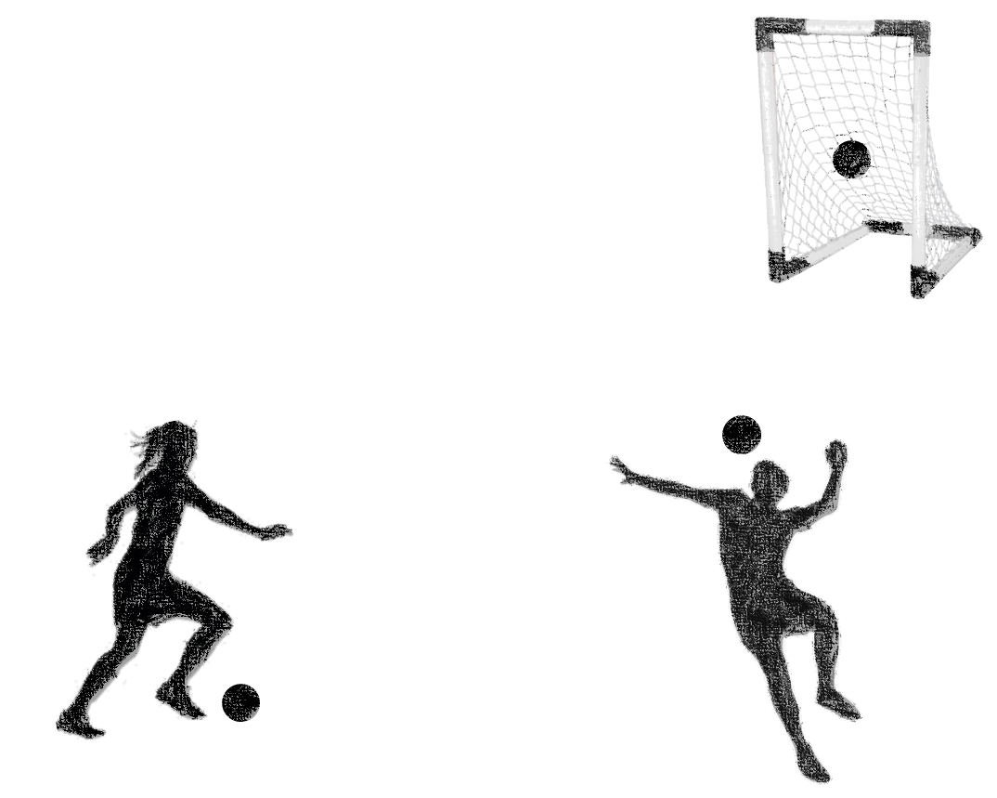
General picture – Single bunch extraction
Dynamic aperture
The Kicker element is fast but with limited deflection strength. It has to provide only small spatial separation needed at the septum.
Kickers are used to select a particular portion (bunch) of the beam or to switch it quickly.
Goooal!
Goooal!
Goooal!
Kicker
Septum
Large angle
The Septum element is slow or static but can provide strong deflection depending on the beam position.
Here, the small deflection provided by the kicker is “converted” to much larger trajectory change.
Small angle
+
+
+
+
+
+
+
+
+

Slide 3
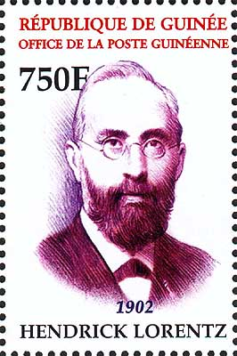

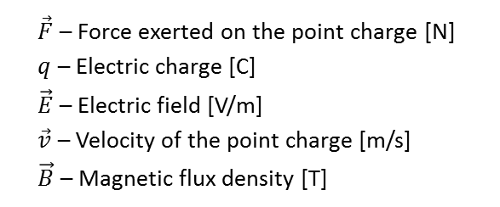
Deflecting charged particles
How do we deflect charged particles beams?
Electric, magnetic and “exotic” (e.g. bent crystals - plane channeling*)
Lorentz force** – the force exerted on a point charge by electromagnetic fields.
$$\vec{F}=q\vec{E}+q\vec{v}×\vec{B}$$
Electric
Magnetic
Hendrick Lorentz
1853 - 1928
$\vec{F}$ – Force exerted on the point charge [N]
$q$ – Electric charge [C]
$\vec{E}$ – Electric field [V/m]
$\vec{v}$ – Velocity of the point charge [m/s]
$\vec{B}$ – Magnetic flux density [T]
*Plane channeling of protons (> 10 GeV) in Si mono-crystals^{[26, 32]}
**First derivation is often attributed to Oliver Heaviside or James Maxwell
Often charged particles in accelerators move with relativistic speeds – relativistic dynamics should be applied.

Slide 4



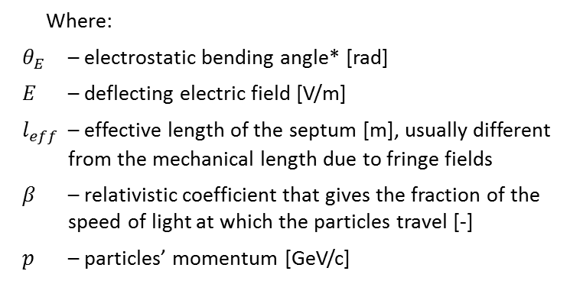


Electrostatic deflection
Deflecting force is collinear with the electric field – positive charges are deflected in the direction of the electric field lines, negative charges are deflected on the opposite direction.
Conventions:
Force on a positive point charge.
Electric field lines go from positive electrode to the negative one.
Opposite electric charges attract each other and like electric charges repel.
Electrostatic deflection angle $θ_{E}$ of particles with positive elementary charge ^{[19, 33]}
$$θ_{E}≈\frac{E{∙l}_{eff}}{{10}^{9}∙β∙p}$$
Positive charge is deflected to the left
Where:
$θ_{E}$ – electrostatic bending angle* [rad]
$E$ – deflecting electric field [V/m]
$l_{eff}$ – effective length of the septum [m], usually different from the mechanical length due to fringe fields
$β$ – relativistic coefficient that gives the fraction of the speed of light at which the particles travel [-]
$p$ – particles’ momentum [GeV/c]
Negative
Positive
_
$$\vec{F}$$
+
$$\vec{v}$$
$$\vec{E}$$
Positive charge moving into plane of page
*Small angle approximation: $tan\left(θ\right)≈θ$up to ~0.17 rad (~10°) error is <1%
Equation derivation – in “Additional material” at the end of the presentation.

Slide 5
Deflecting charged particles
How do we deflect charged particles beams?
Electric, magnetic and “exotic” (e.g. bent crystals - plane channeling*)
Lorentz force** – the force exerted on a point charge by electromagnetic fields.
$$\vec{F}=q\vec{E}+q\vec{v}×\vec{B}$$
Electric
Magnetic
Hendrick Lorentz
1853 - 1928
$\vec{F}$ – Force exerted on the point charge [N]
$q$ – Electric charge [C]
$\vec{E}$ – Electric field [V/m]
$\vec{v}$ – Velocity of the point charge [m/s]
$\vec{B}$ – Magnetic flux density [T]
*Plane channeling of protons (> 10 GeV) in Si mono-crystals^{[26, 32]}
**First derivation is often attributed to Oliver Heaviside or James Maxwell
Often charged particles in accelerators move with relativistic speeds – relativistic dynamics should be applied.

Slide 6





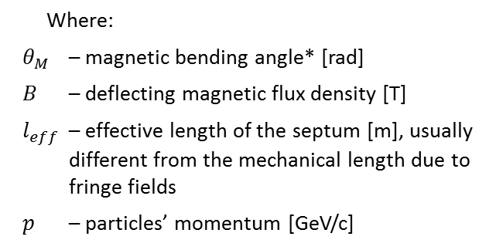




Magnetic deflection
$$\vec{v}$$
1
Deflecting force F is cross product of v and B
$$\vec{B}$$
Conventions:
Force on a positive point charge.
Magnetic field lines go from North pole to the South pole of the magnet.
Right hand rule: If the thumb points in the direction of motion and the index finger is in the direction of the magnetic field, the force goes in the direction of the middle finger.
Right hand rule
2
3
$$\vec{F}$$
Magnetic deflection angle $θ_{M}$ of particles with positive elementary charge ^{[15, 19, 33, 30]}
$$θ_{M}≈\frac{0.3∙B{∙l}_{eff}}{p}$$
Positive charge is deflected upwards
South
North
Where:
$θ_{M}$ – magnetic bending angle* [rad]
$B$ – deflecting magnetic flux density [T]
$l_{eff}$ – effective length of the septum [m], usually different from the mechanical length due to fringe fields
$p$ – particles’ momentum [GeV/c]
$$\vec{F}$$
S
N
$$\vec{v}$$
$$\vec{B}$$
Positive charge moving into plane of page
*Small angle approximation: $tan\left(θ\right)≈θ$up to ~0.17 rad (~10°) error is <1%
Equation derivation – in “Additional material” at the end of the presentation.

Slide 7
Deflecting charged particles
How do we deflect charged particles beams?
Electric, magnetic and “exotic” (e.g. bent crystals - plane channeling*)
Lorentz force** – the force exerted on a point charge by electromagnetic fields.
$$\vec{F}=q\vec{E}+q\vec{v}×\vec{B}$$
Electric
Magnetic
Hendrick Lorentz
1853 - 1928
$\vec{F}$ – Force exerted on the point charge [N]
$q$ – Electric charge [C]
$\vec{E}$ – Electric field [V/m]
$\vec{v}$ – Velocity of the point charge [m/s]
$\vec{B}$ – Magnetic flux density [T]
*Plane channeling of protons (> 10 GeV) in Si mono-crystals^{[26, 32]}
**First derivation is often attributed to Oliver Heaviside or James Maxwell
Often charged particles in accelerators move with relativistic speeds – relativistic dynamics should be applied.

Slide 8








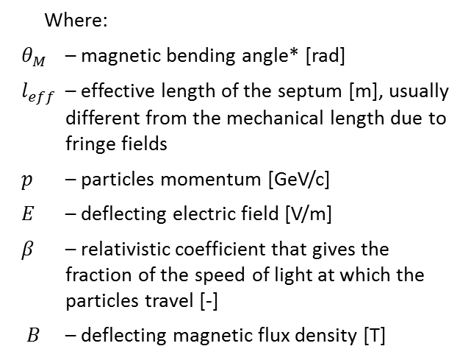

USPAS 2009 M Plum Injection and Extraction extraction
Electromagnetic deflection
If the current in upper conductor is flowing into the plane of page and the current in lower conductor is flowing out of the plane of page magnetic and electric force add-up.
Electromagnetic bending angle $θ_{EM}$ of particles with positive elementary charge ^{[10, 18]}
$$θ_{EM}≈\frac{l_{eff}}{p}\left( \frac{E}{{10}^{9}∙β}±0.3∙B\right)$$
Positive charge is deflected upwards
Negative
$I$
$I$
Where:
$θ_{M}$ – magnetic bending angle* [rad]
$l_{eff}$ – effective length of the septum [m], usually different from the mechanical length due to fringe fields
$p$ – particles momentum [GeV/c]
$E$ – deflecting electric field [V/m]
$β$ – relativistic coefficient that gives the fraction of the speed of light at which the particles travel [-]
$B$ – deflecting magnetic flux density [T]
South
North
$$\vec{E}$$
$$\vec{B}$$
$$\vec{F}$$
_
+
S
N
$$\vec{v}$$
$I$
$I$
Positive
*Small angle approximation: $tan\left(θ\right)≈θ$up to ~0.17 rad (~10°) error is <1%
Positive charge moving into plane of page

Slide 9

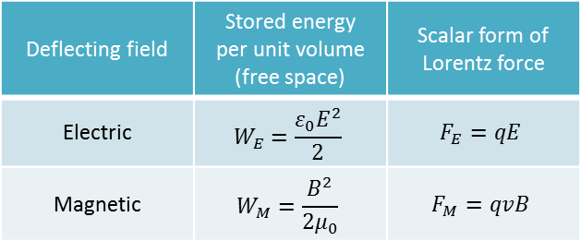
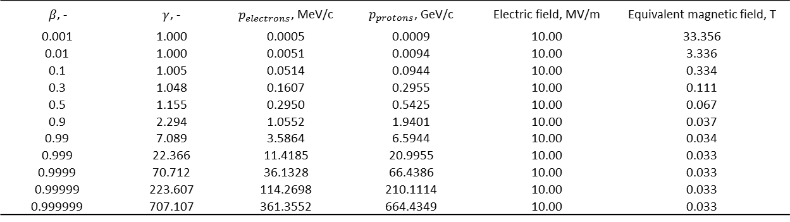



Electrostatic vs Magnetic deflection
Which one to use? How to compare?^{[22]} Duality of electromagnetism
Comparison using volumetric energy density
Deflecting field | Stored energy per unit volume (free space) | Scalar form of Lorentz force
Electric | $$W_{E}=\frac{ε_{0}E^{2}}{2}$$ | $$F_{E}=qE$$
Magnetic | $$W_{M}=\frac{B^{2}}{2μ_{0}}$$ | $$F_{M}=qvB$$
$$B\left[T\right]=\frac{3.3}{β}E[GV/m]$$
It is more practical to use magnetic field!
Too high electric field in vacuum could provoke electric breakdown. It is widely accepted that 10 MV/m is a practical limit^{[24]}.
Electric deflection could be beneficial for non-relativistic particles (e.g. low energy beams, heavy ions etc.)
For $W_{E}=W_{M}$ ($E=cB$) and relativistic particles ($v=c$)
$$F_{E}=qcB=F_{M}$$
Comparison between electric and magnetic deflection for beams with different momentum $p$
$β$, - | $γ$, - | $p_{electrons}$, MeV/c | $p_{protons}$, GeV/c | Electric field, MV/m | Equivalent magnetic field, T
0.001 | 1.000 | 0.0005 | 0.0009 | 10.00 | 33.356
0.01 | 1.000 | 0.0051 | 0.0094 | 10.00 | 3.336
0.1 | 1.005 | 0.0514 | 0.0944 | 10.00 | 0.334
0.3 | 1.048 | 0.1607 | 0.2955 | 10.00 | 0.111
0.5 | 1.155 | 0.2950 | 0.5425 | 10.00 | 0.067
0.9 | 2.294 | 1.0552 | 1.9401 | 10.00 | 0.037
0.99 | 7.089 | 3.5864 | 6.5944 | 10.00 | 0.034
0.999 | 22.366 | 11.4185 | 20.9955 | 10.00 | 0.033
0.9999 | 70.712 | 36.1328 | 66.4386 | 10.00 | 0.033
0.99999 | 223.607 | 114.2698 | 210.1114 | 10.00 | 0.033
0.999999 | 707.107 | 361.3552 | 664.4349 | 10.00 | 0.033
Non-relativistic
$$1 T→300 MV/m$$
Relativistic
Equation derivation – in “Additional material” at the end of the presentation.

Slide 10
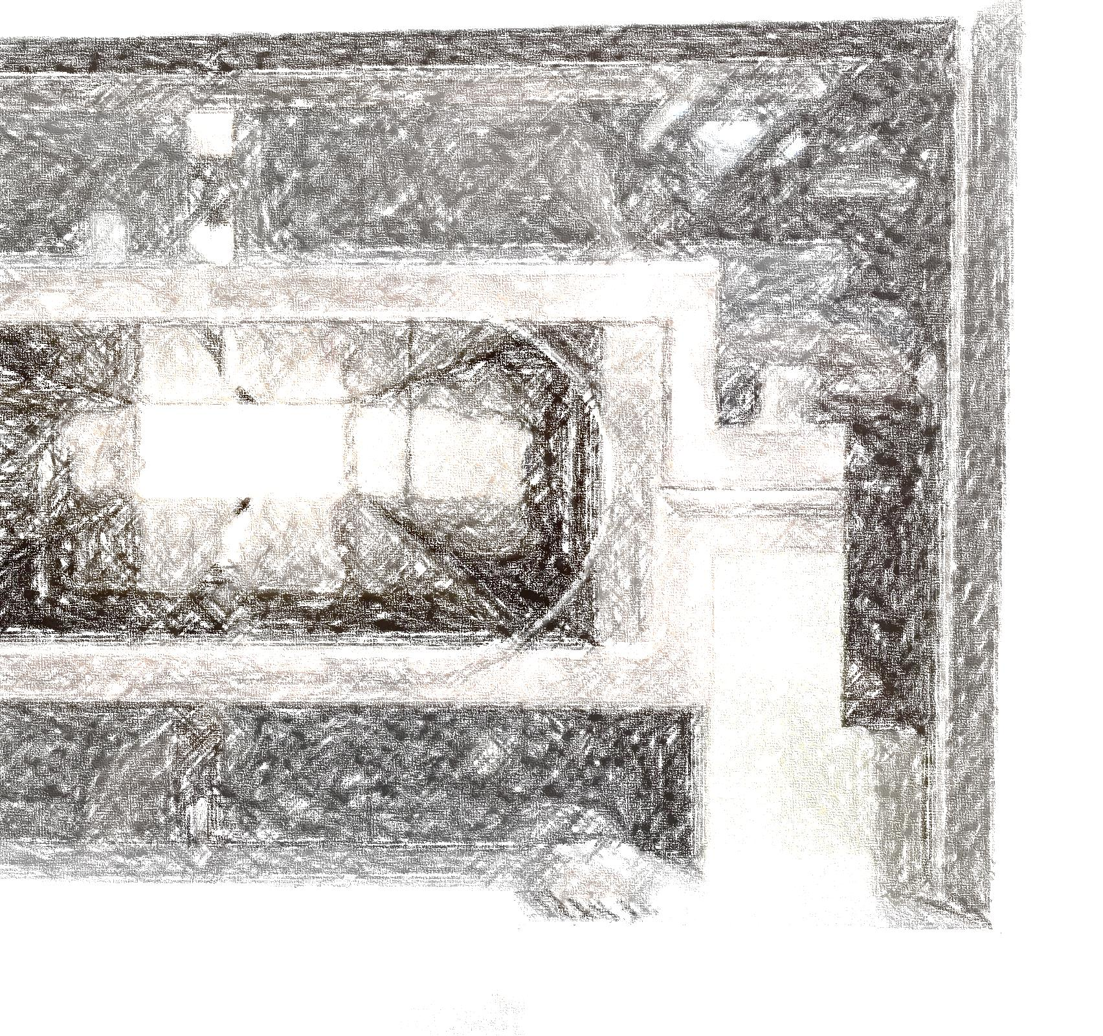
Kickers

Slide 11
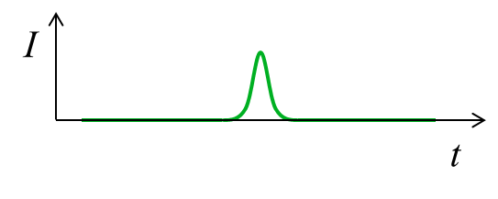
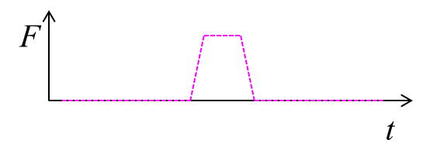
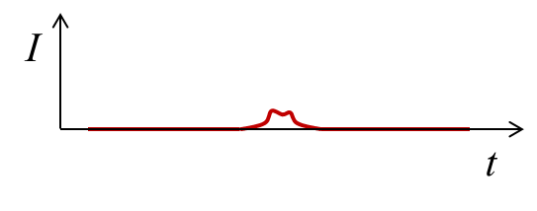
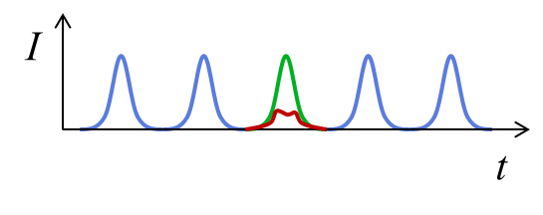
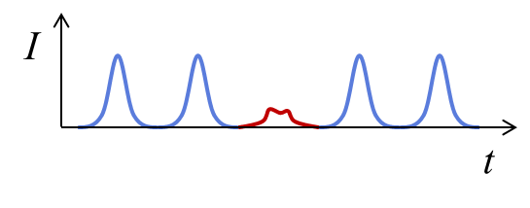
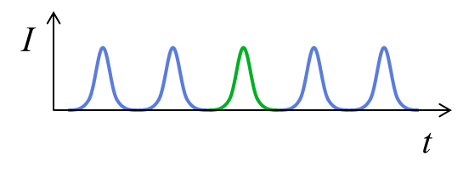
Kicker - function
A kicker is a fast acting (1 ns … 1 μs ) beam deflection element, usually providing relatively small deflection. It is used for beam injection, extraction, feedback, dilution and dump.
Example: “Swap-out” injection scheme
The kicker deflects only one bunch. Its field should rise and fall between bunches and should remain zero for the rest of the time, not to disturb the circulating beam.
New bunch
Replaced bunch
Kicker field
Septum wall
Septum wall
Injection septum
Bunches
Extraction septum
Obstacle
Obstacle
Kicker
Deteriorated bunch
Circulating beam before swap-out
Circulating beam after swap-out

Slide 12
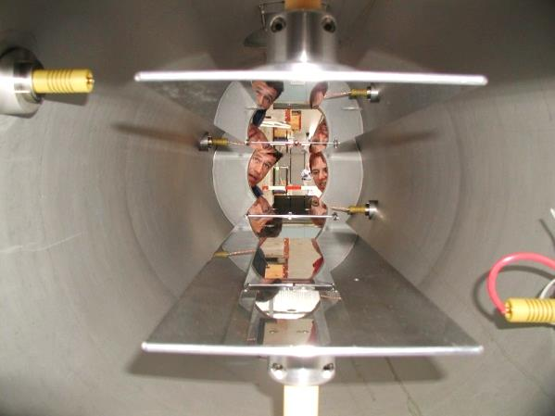
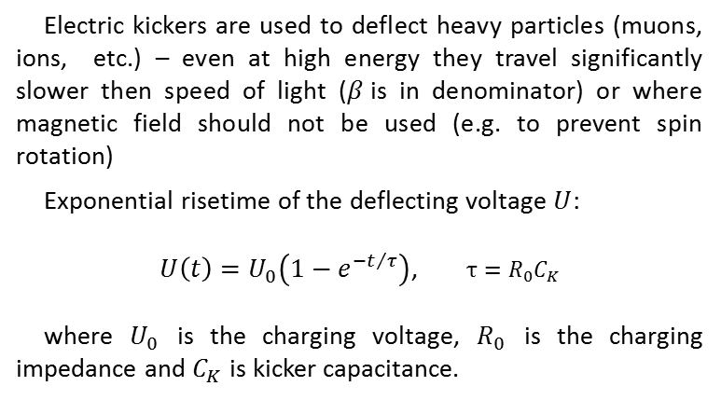




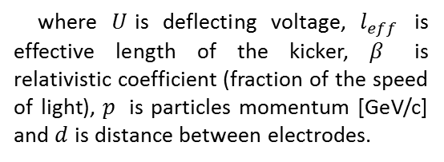
Lumped element electric kicker
Electrostatic deflection angle $θ_{M}$of particles with positive elementary charge :
Electric kickers are used to deflect heavy particles (muons, ions, etc.) – even at high energy they travel significantly slower then speed of light ($β$is in denominator) or where magnetic field should not be used (e.g. to prevent spin rotation)
Exponential risetime of the deflecting voltage $U$:
$U\left(t\right)=U_{0}\left(1−e^{−t/τ}\right)$, $τ=R_{0}C_{K}$
where $U_{0}$ is the charging voltage, $R_{0}$ is the charging impedance and $C_{K}$ is kicker capacitance.
$$θ_{E}≈\frac{U{∙l}_{eff}}{{10}^{9}∙β∙p∙d}$$
where $U$is deflecting voltage, $l_{eff}$ is effective length of the kicker, $β$ is relativistic coefficient (fraction of the speed of light), $p$ is particles momentum [GeV/c] and $d$ is distance between electrodes.
$$\vec{E}$$
Insulating supports
Electrodes
HV Feedthrough
Deflection direction
Beam
$$d$$
Courtesy of R. Carey
Lumped element electric kicker
Muon electric kicker for MuLan experiment (PSI) – voltage ±12 kV, field 0.16 MV/m, capacitance 74 pF, risetime 40 ns, minimum pulse length 160 ns^{[25, 17]}

Slide 13
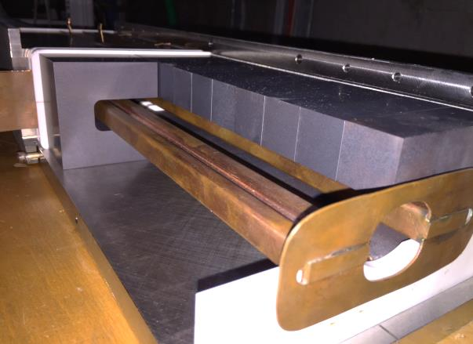

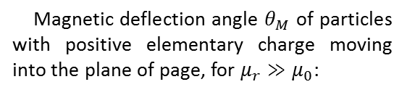


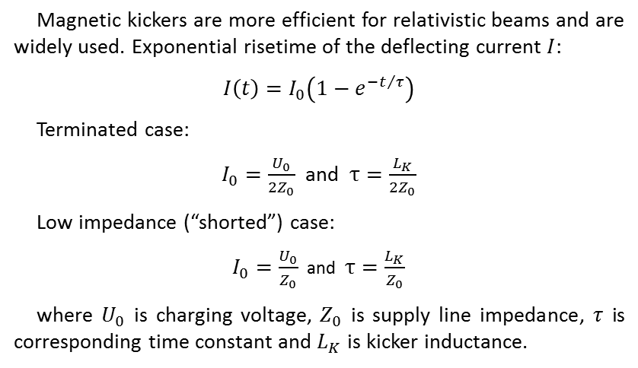
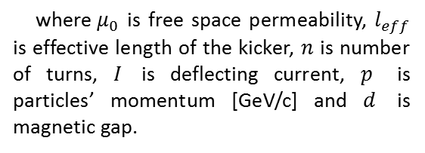

Lumped element magnetic kicker
Magnetic deflection angle $θ_{M}$ of particles with positive elementary charge moving into the plane of page, for $μ_{r}≫μ_{0}$:
Magnetic kickers are more efficient for relativistic beams and are widely used. Exponential risetime of the deflecting current $I$:
$I\left(t\right)=I_{0}\left(1−e^{−t/τ}\right)$
Terminated case:
$I_{0}=\frac{U_{0}}{{2Z}_{0}}$ and $τ=\frac{L_{K}}{{2Z}_{0}}$
Low impedance (“shorted”) case:
$I_{0}=\frac{U_{0}}{Z_{0}}$ and $τ=\frac{L_{K}}{Z_{0}}$
where $U_{0}$ is charging voltage, $Z_{0}$ is supply line impedance, $τ$ is corresponding time constant and $L_{K}$ is kicker inductance.
$$θ_{M}≈\frac{0.3∙μ_{0}{∙l}_{eff}∙n∙I}{p∙d}$$
where${ μ}_{0}$ is free space permeability, $l_{eff}$ is effective length of the kicker, $n$ is number of turns, $I$ is deflecting current, $p$ is particles’ momentum [GeV/c] and $d$ is magnetic gap.
Copper shield
Deflection direction
Copper shield position
$$μ_{r}$$
Ferrite
$$I$$
$$B_{m}$$
$$I$$
$$d$$
Conductor support (ceramics)
Conductor
Beam
SLS Extraction kicker (PSI) - Kicker inductance 1 μH, driving impedance 12.5 Ω, risetime 200 ns, pulse duration 1 μs, 22 kV, 1.7 kA^{[29]}
Lumped element magnetic kicker

Slide 14

















Transmission line kicker - topology
X
Electromagnetic deflection angle $θ_{EM}$ of particles with positive elementary charge:
$$\vec{B}$$
$$I$$
$$θ_{EM}=θ_{E}±θ_{M}≈\frac{l_{eff}}{p}\left(\frac{E}{{10}^{9}∙β∙d}±0.3∙B \right)$$
$${\vec{F}}_{E}$$
$$\vec{v}$$
Excitation
$$\vec{E}$$
Termination
$${\vec{F}}_{M}$$
For relativistic particles in free space (no dielectric or ferrite) the electric end magnetic component are roughly the same.
$$I$$
GND
Up-stream excitation – electric and magnetic force cancel out.
$$\vec{B}$$
$$I$$
$$d$$
$$I$$
$${\vec{F}}_{M}$$
$${\vec{F}}_{E}$$
$$\vec{v}$$
Termination
$$\vec{E}$$
Excitation
A
$$I$$
$$\vec{B}$$
$$\vec{E}$$
$$\vec{v}$$
Down-stream excitation – electric and magnetic force add up^{[18, 3, 14, 21]}
Stripline kicker
B
More on equivalence of electric and magnetic deflection – in “Additional material” at the end of the presentation.

Slide 15

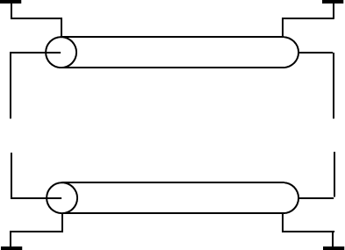
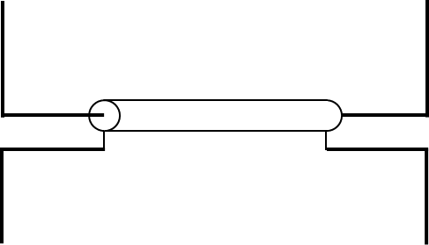
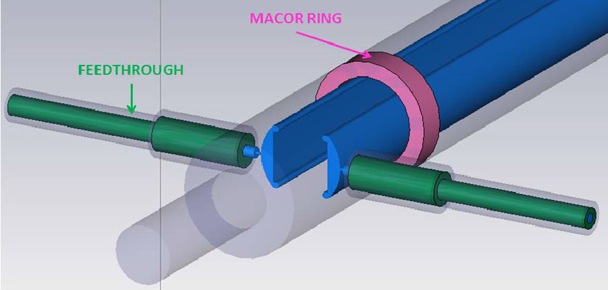
















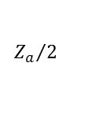










Transmission line kicker – even and odd mode
If transmission lines are matched there is no reflection, respectively no beam disturbance after the pulse finishes.
GND
GND
$$U_{A}$$
$$Z_{p}$$
$${Z_{odd}=Z}_{p}∥\frac{Z_{a}}{2}$$
$$Z_{p}$$
A
A
$$Z_{a}$$
$$∞$$
$$≡$$
$${Z_{a}}/2$$
$$Z_{a}$$
$$t$$
B
B
$$U_{B}$$
$$Z_{p}$$
$$Z_{p}$$
$${Z_{a}}/2$$
GND
GND
$${Z_{odd}=Z}_{p}∥\frac{Z_{a}}{2}$$
Placing the transmission line ($Z_{a}$) inside conducting pipe (GND) creates two more parasitic transmission lines ($Z_{p}$)
$$t$$
Odd (or differential) mode – used to kick the beam
Conductors
Support
GND
$$U_{A}$$
$$50 Ω$$
A
$${Z_{ev}=Z}_{p}$$
X
$$450 Ω$$
$$t$$
$$Z_{a_eff}=∞$$
B
$$U_{B}$$
$$\vec{v}$$
$$50 Ω$$
Feedthrough
GND
$${Z_{ev}=Z}_{p}$$
Courtesy of C. Aguilar
$$t$$
Termination and impedance components $Z_{a}=450 Ω$, $Z_{p}=50 Ω$, $Z_{ev}=50 Ω$ and $Z_{odd}=40.9 Ω$ ^{[14]}
Even (or common) mode – induced by the beam back into the kicker conductors.

Slide 16
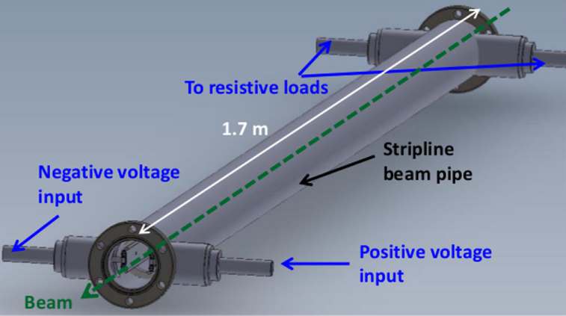
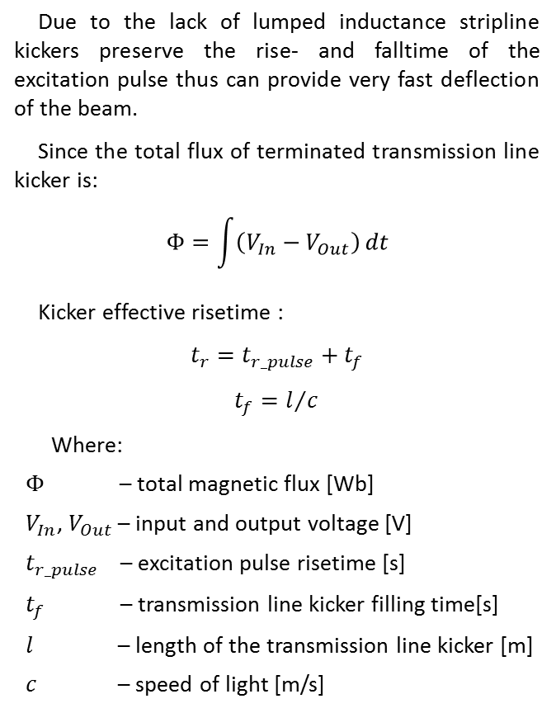
Stripline kicker
Due to the lack of lumped inductance stripline kickers preserve the rise- and falltime of the excitation pulse thus can provide very fast deflection of the beam.
Since the total flux of terminated transmission line kicker is:
$$Φ=\int{\left(V_{In}−V_{Out}\right)}dt$$
Kicker effective risetime :
$$t_{r}=t_{r_pulse}+t_{f}$$
$$t_{f}=l/c$$
Where:
$Φ$ – total magnetic flux [Wb]
$V_{In}$, $V_{Out}$ – input and output voltage [V]
$t_{r_pulse}$ – excitation pulse risetime [s]
$t_{f}$ – transmission line kicker filling time[s]
$l$ – length of the transmission line kicker [m]
$c$ – speed of light [m/s]
Stripline configuration of a transmission line kicker provides compact and simple design.
Shape of stripline structure and the feedthroughs should be carefully optimized for field homogeneity, impedance and discontinuity.
Special care should be taken to avoid electrical discontinuity (change of characteristic impedance) especially in the feedthroughs to avoid reflections.
For the same length, voltage and current the deflection of transmission line kicker could be up to 15 times weaker compared to lumped element kicker (but fast)^{[18]}
Courtesy of C. Aguilar
Model of extraction kicker for CLIC damping rings^{[14]}

Slide 17
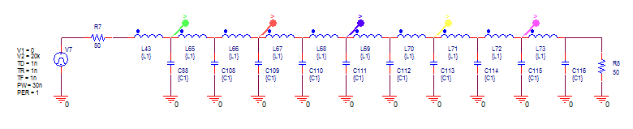
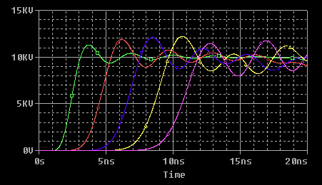
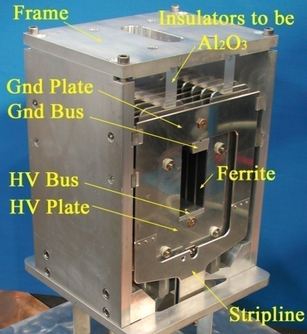
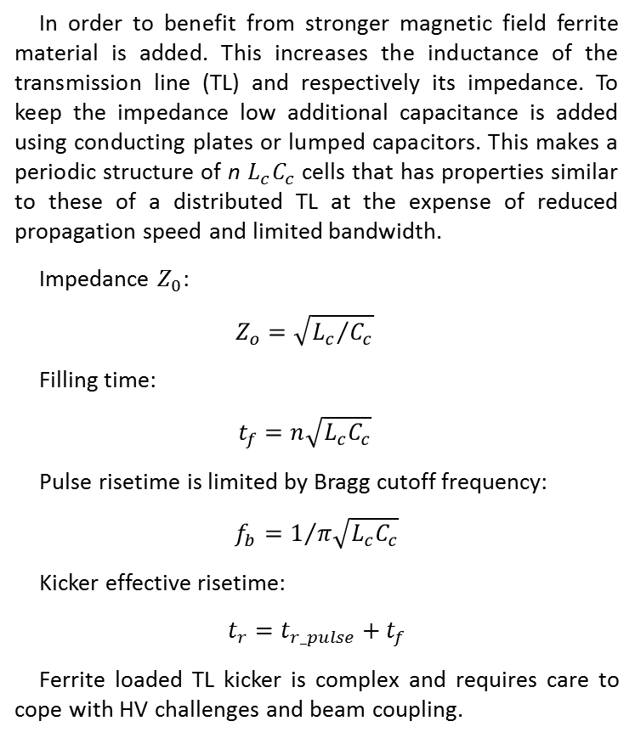
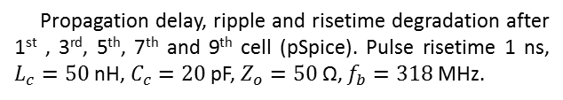
Ferrite loaded transmission line kicker
In order to benefit from stronger magnetic field ferrite material is added. This increases the inductance of the transmission line (TL) and respectively its impedance. To keep the impedance low additional capacitance is added using conducting plates or lumped capacitors. This makes a periodic structure of n $L_{c}C_{c}$ cells that has properties similar to these of a distributed TL at the expense of reduced propagation speed and limited bandwidth.
Impedance $Z_{0}$:
$$Z_{o}=\sqrt{{L_{c}}/{C_{c}}}$$
Filling time:
$$t_{f}=n\sqrt{L_{c}C_{c}}$$
Pulse risetime is limited by Bragg cutoff frequency:
$$f_{b}=1/{π\sqrt{L_{c}C_{c}}}$$
Kicker effective risetime:
$$t_{r}=t_{r_pulse}+t_{f}$$
Ferrite loaded TL kicker is complex and requires care to cope with HV challenges and beam coupling.
Propagation delay, ripple and risetime degradation after 1st , 3rd, 5th, 7th and 9th cell (pSpice). Pulse risetime 1 ns, $L_{c}=50$nH, $C_{c}=20$pF, $Z_{o}=50$Ω, $f_{b}=318$MHz.
Courtesy of M. Barnes
Prototype of TRIUMF Kicker Magnet ^{[20]}

Slide 18
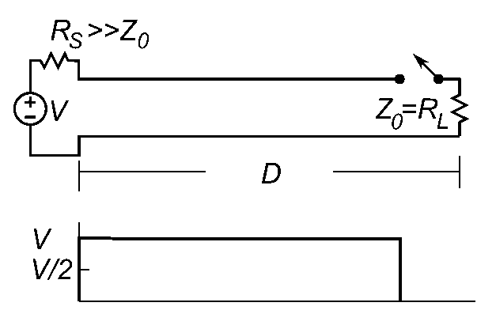
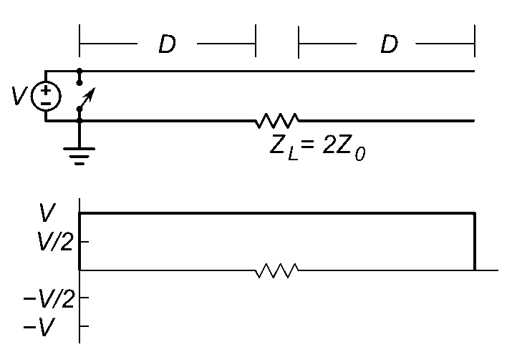
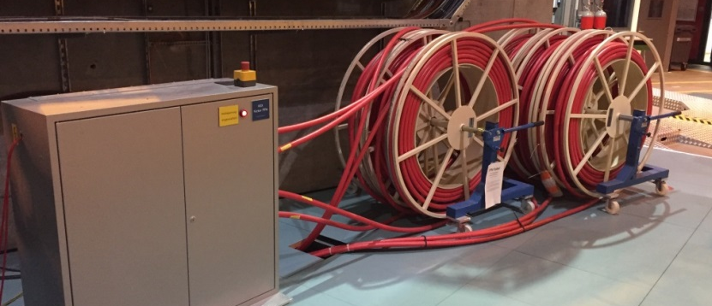

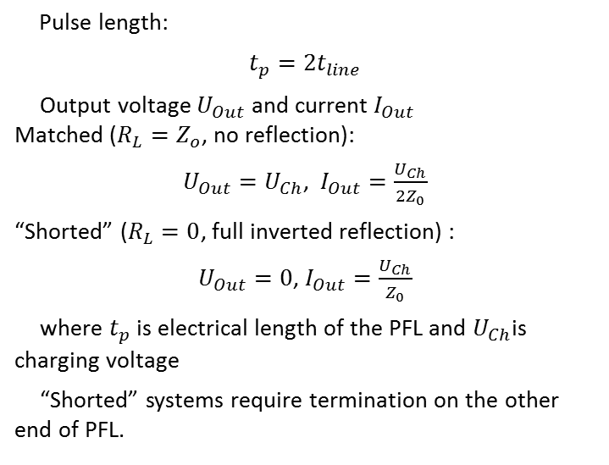



Pulse forming lines (PFL)
Pulse length:
$$t_{p}=2t_{line}$$
Output voltage $U_{Out}$ and current $I_{Out}$
Matched ($R_{L}=Z_{o}$, no reflection):
$U_{Out}=U_{Ch}$, $I_{Out}=\frac{U_{Ch}}{2Z_{0}}$
“Shorted” ($R_{L}=0$, full inverted reflection) :
$U_{Out}=0$, $I_{Out}=\frac{U_{Ch}}{Z_{0}}$
where $t_{p}$ is electrical length of the PFL and $U_{Ch}$is charging voltage
“Shorted” systems require termination on the other end of PFL.
$$U_{Ch}$$
$$U_{OUT}$$
Simple PFL configuration with matched load. Pulse amplitude is half of charging voltage and pulse duration is twice the electrical length of PFL.
$$U_{Ch}$$
$$U_{OUT}$$
Blumlein PFL configuration with matched load. Pulse amplitude is equal to charging voltage and pulse duration is equal to the electrical length of PFL
SLS Extraction kicker PFL (4 + 1x 50 Ω, 100 m, PSI) in “shorted” configuration and termination unit: $t_{p}=1$ μs, $Z_{0}=12.5$ Ω, $U_{Ch}=22$ kV, $I_{Out}=1.7$ kA^{[29]}

Slide 19
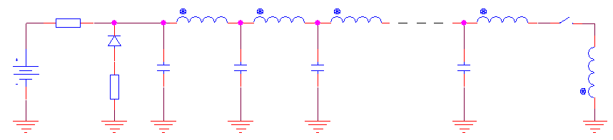
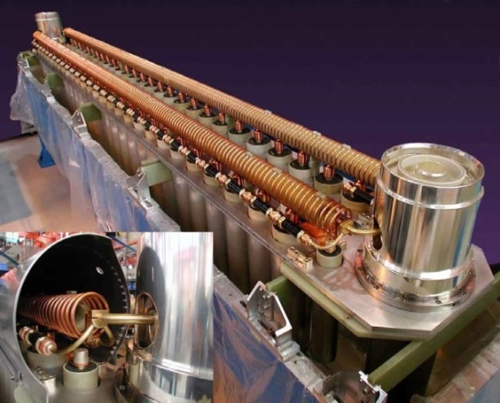



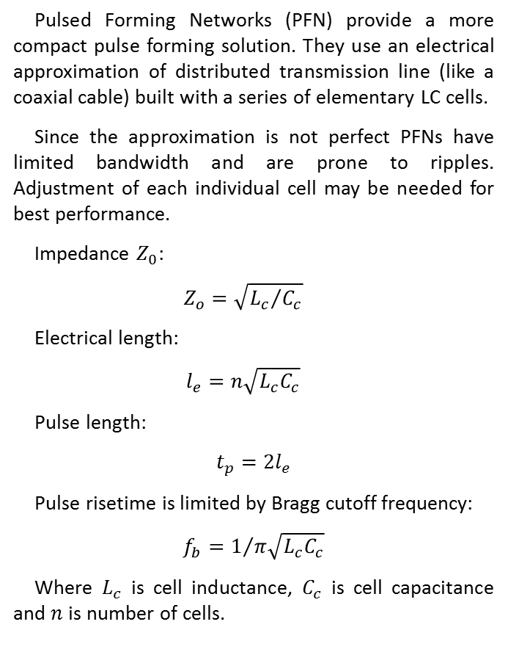



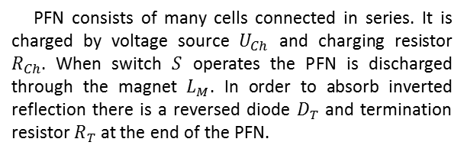

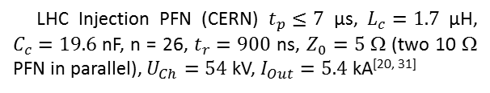




Pulse forming networks (PFN)
Pulsed Forming Networks (PFN) provide a more compact pulse forming solution. They use an electrical approximation of distributed transmission line (like a coaxial cable) built with a series of elementary LC cells.
Since the approximation is not perfect PFNs have limited bandwidth and are prone to ripples. Adjustment of each individual cell may be needed for best performance.
Impedance $Z_{0}$:
$$Z_{o}=\sqrt{{L_{c}}/{C_{c}}}$$
Electrical length:
$$l_{e}=n\sqrt{L_{c}C_{c}}$$
Pulse length:
$$t_{p}=2l_{e}$$
Pulse risetime is limited by Bragg cutoff frequency:
$$f_{b}=1/{π\sqrt{L_{c}C_{c}}}$$
Where $L_{c}$ is cell inductance, $C_{c}$ is cell capacitance and $n$ is number of cells.
$$R_{Ch}$$
$$L_{c}$$
$$L_{c}$$
$$L_{c}$$
$$L_{c}$$
$$S$$
$$U_{Ch}$$
$$D_{T}$$
$$C_{c}$$
$$C_{c}$$
$$C_{c}$$
$$C_{c}$$
$$L_{M}$$
$$R_{T}$$
cell
PFN consists of many cells connected in series. It is charged by voltage source $U_{Ch}$ and charging resistor $R_{Ch}$. When switch $S$ operates the PFN is discharged through the magnet $L_{M}$. In order to absorb inverted reflection there is a reversed diode $D_{T}$ and termination resistor $R_{T}$ at the end of the PFN.
Inductor
Thyratron socket
Capacitors
Shield
Courtesy of M. Barnes
LHC Injection PFN (CERN) $t_{p}≤7$ μs, $L_{c}=1.7$ μH, $C_{c}=19.6$ nF, n = 26, $t_{r}=900$ ns, $Z_{0}=5$ Ω (two 10 Ω PFN in parallel), $U_{Ch}=54$ kV, $I_{Out}=5.4$ kA^{[20, 31]}

Slide 20
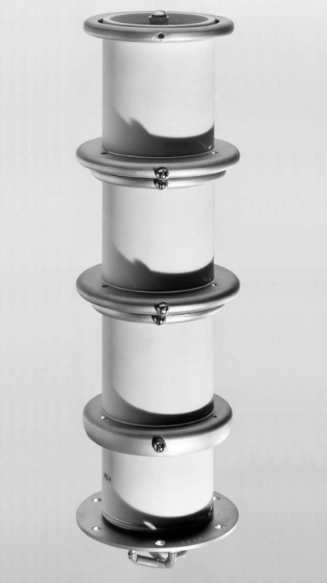
PFL/PFN switch
A PFL/PFN requires (at least) one closing switch able to operate reliably at the charging voltage and discharge current. Since voltages and currents are generally high the choice of the switches is limited to deuterium thyratrons and thyristor (in systems where slower turn-on is possible).
With the recent advancement of the semiconductors technology (especially the emergence of HV SiC MOSFETs) there is a continuous effort to develop reliable solid state replacement of the thyratrons.
Thyratrons switches:
Capable of switching HV and high currents (considering not only normal operation but breakdown or fault scenarios)
Fast turn-on (tens of nanoseconds) but no commanded turn-off possible
Adequate housing (cooling, low inductance, X-ray emission)
Measures against spontaneous turn-on (fast charging of PFL/PFN) or misfiring
Supporting circuits (cathode heater, reservoir heater and triggering, especially if the switch is in “floating” configuration)
Limited lifetime
Sensitive to reverse conduction (some models are capable of tolerating some reverse conduction)
Anode
Gradient grids
Grid 2
Cathode
Grid 1 and heaters’ terminals
E2V Three-Gap Deuterium-Filled Ceramic Thyratron CX1171, Blocking voltage 80 kV (peak 105 kV), Average current 2 A, Peak current 3 kA (single shot @0.1 Hz 10 kA), 30 ns risetime, time jitter 1..5 ns

Slide 21


PFL vs PFN
Pulse Forming Line (PFL)
Simple design
Short risetimes (switch or cable dispersion limited)
Short pulses (maximum pulse length defined by the electrical length of the cable)
Ripple-free (flat) pulses
Cable attenuation becomes problematic (pulses > 3 μs and droop < 1%)
Bulky: 1 μs pulse ~ 100 m of cable
Require high voltage and low-loss coaxial cable (often custom made) ^{[8]}
Pulse Forming Network (PFN)
Compact design
Low droop (long pulses > 3 μs)
Complex construction
More sells, better transmission line representation
Risetime limited (Bragg cut-off frequency)
Pulses are prone to ripples (degraded flat-top) - may require adjustments of each individual cell : difficult and time consuming
Require high voltage capacitors

Slide 22
Kickers recap
Fast acting beam deflecting element (electric, magnetic or combined)
Usually providing relatively small deflection
Essential part of beam injection and extraction systems, beam dump and dilution systems, feedback systems
Complex mechanical and electrical design, often a limiting factor for overall system performance
Parasitic coupling to the beam – unwanted energy exchange with the beam – goes in both directions: degrades beam quality / stability and could damage / disable the kicker element or its systems
Electric – fast but not efficient for highly relativistic beams
Magnetic – efficient but slow due to its lumped inductance
Transmission line (travelling wave ) kicker – fast, combines electric and magnetic deflection, limited by electrical impedance and electrical vacuum breakdown
Often crucial field time profile – fast rise- and fall- times, precise pulse duration, stringent tail-effect requirements etc.
Demanding power supply systems – high speed, high voltage and current switches, complex intermediate energy storage elements (PFL/PFN, HV capacitors)
Stringent reliability requirements – especially when part of safety and machine protection systems (emergency beam dump, beam dilution etc.)

Slide 23
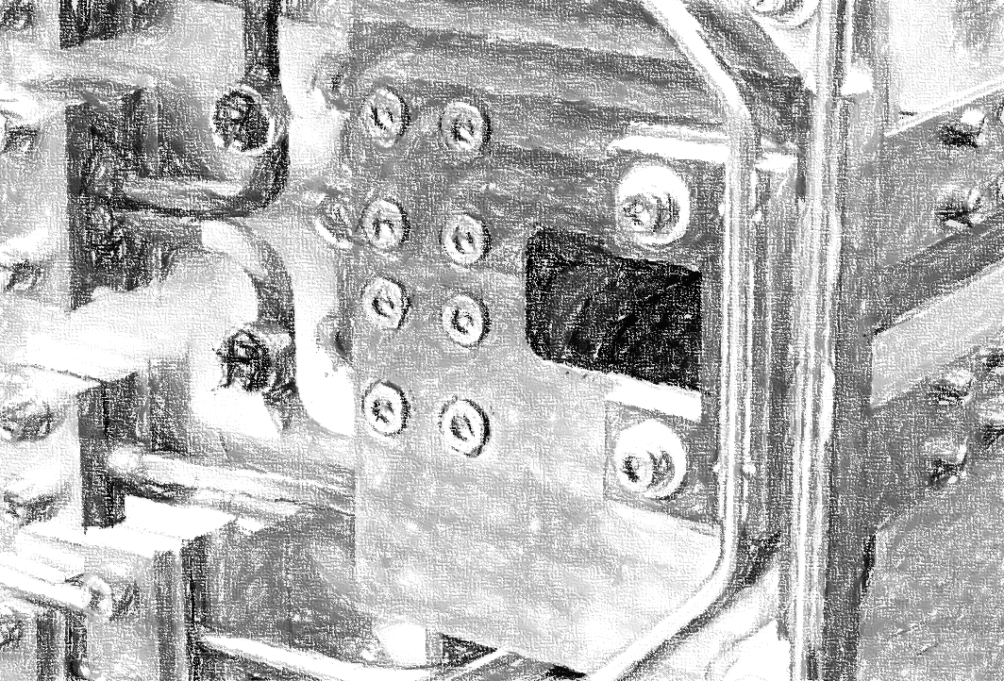
Septa

Slide 24
Septum - function
A septum is a selective beam deflection element, usually DC or slow pulse. It is used for beam injection, extraction and beam dump.
Example: “Swap-out on axis” injection scheme
Septa have abruptly changing deflection field depending on spatial position. Ideally, on one side of the septum wall there is zero deflecting field and on the other, there is strong homogeneous deflecting field. Usually septa provide the necessary additional deflection to the “kicked” beam to clear other machine components.
New bunch
Replaced bunch
Kicker field
Septum wall
Septum wall
Injection septum
Bunches
Extraction septum
Obstacle
Obstacle
Kicker
Deteriorated bunch
Circulating beam before swap-out
Circulating beam after swap-out

Slide 25
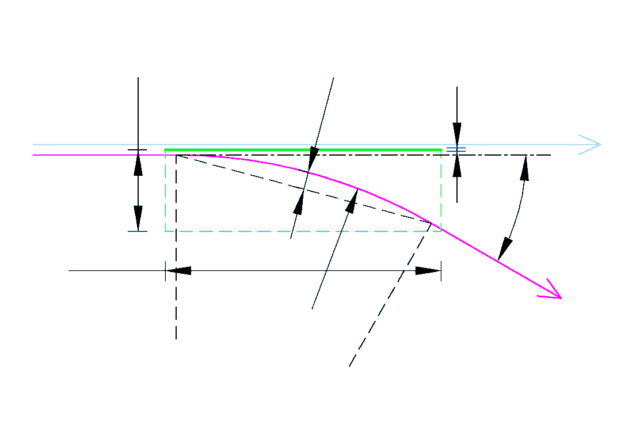






Basic concept and terminology
A septum shares a lot in common with dipole (bending) magnets
It has an abrupt field change between field and no-field region
𝜃 – Bending angle
𝑅 – Bending radius
𝑠 – Sagitta
𝑤 – Deflecting gap width
𝑡 – Septum thickness
𝑙 – Septum length
Septum
No-field region
$$w$$
$$s$$
$$t$$
Straight beam
$$θ$$
$$l$$
If deflecting gap does not follow the trajectory of the deflected beam (as shown here) the deflecting gap should be wide enough to accommodate the deflected beam trajectory.
$$R$$
Deflected beam
Deflecting field region
Schematic representation of a septum

Slide 26
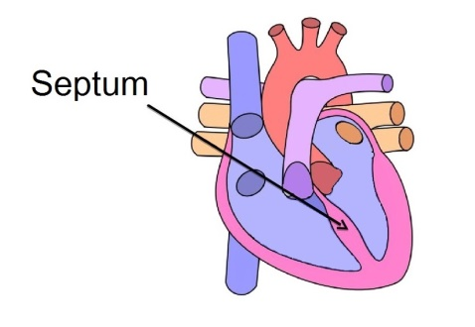
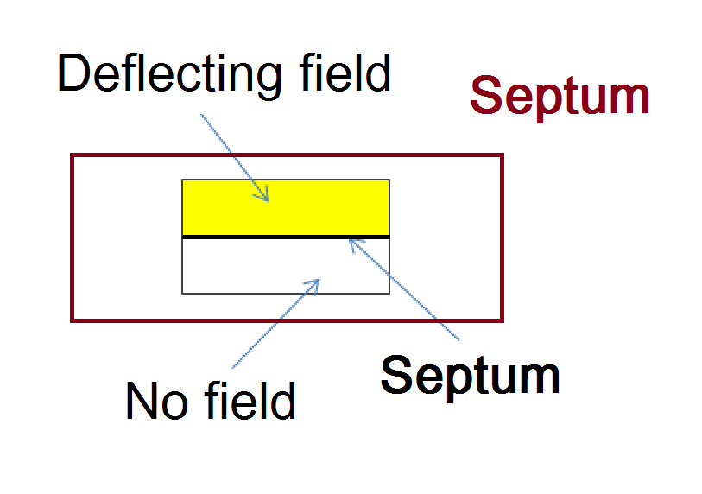
Septum
A septum (plural septa) is a partition, a wall, a barrier that separates two cavities or two chambers (biology, mechanics, part. physics, etc.).
Latin origin - saepio (sēpiō) - surround, enclose, fence in.
In particle accelerators, a septum separates two distinctive field regions in order to selectively deflect particle beams.
Used for injection and extraction of the beam
The septum separates the left and the right side of the heart (biology)
Often the device that embodies the septum is called septum as well (electrostatic septum, septum magnet, etc.)
Septums
Septa
Schematic representation of a septum device

Slide 27
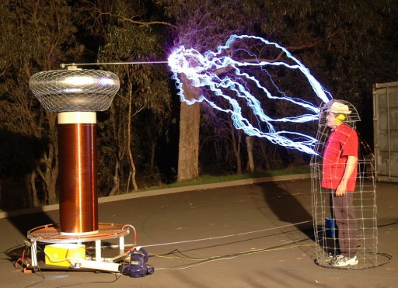




Electrostatic septum
Electric field is established between a HV electrode and a septum foil.
The extracted beam passes through the electric field region and it is deflected.
Using Faraday cage effect the foil and the foil support create a zero-filed region for the circulating beam that goes straight.
Electrostatic septa provide the smallest septum thickness.
Faraday cage used to protect a person while demonstrating discharges from Tesla transformer
Septum foil
Circulating beam
$$d$$
Deflected beam
Thin foil is used to minimize the interaction with beam (reduce beam losses and radiation levels)
Surface treatment of the HV exposed components for higher electric field
To utilize precise alignment with respect to the circulating beam often the septum is mounted on precision mover system
Care should be taken to ensure good vacuum conduction in order to maintain low background pressure
Often septa are the most irradiated devices in an accelerator. They get radioactively activated. Safety precautions should be taken when maintaining or discarding the devices
$$E=0$$
$$U$$
HV Feedthrough
$$E=\frac{U}{d}$$
α
y
HV Electrode
x
Vacuum
Positioning system
Foil support
Schematic view of electrostatic septum

Slide 28
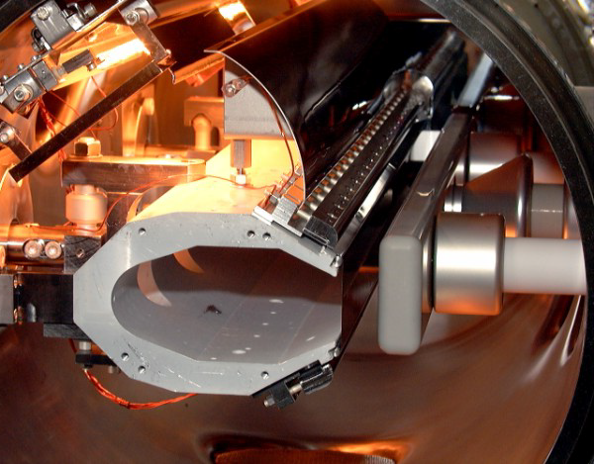

Foil electrostatic septum
In-situ bake-out lamp
Deflector
HV feedthrough
In-vacuum electrostatic foil (wire) septum gives the thinnest possible septum barrier.
Deflectors are used to improve the field homogeneity in the gap and to protect the HV elements from titanium sublimation pumps ^{[27]}
Holes in the septum support should ensure good vacuum conductivity, respectively low background pressure
HV conditioning to reach maximum electric field
Depending on required vacuum level provisions for in-situ bake-out should be implemented
Depending on the irradiation dose the insulating oil of the HV feedthroughs and the close HV cables have to be exchanged (radiation deterioration)
Maintenance - radioactive activation
Circulating beam
Septum foil
Septum support
Deflected beam
HV electrode
Courtesy of CERN Septa Section
PS “Septum 23” (CERN) – gap 17 mm, Septum thickness 100 μm, voltage up to 260 kV, electric field up to 15 MV/m ^{[27, 28]}

Slide 29
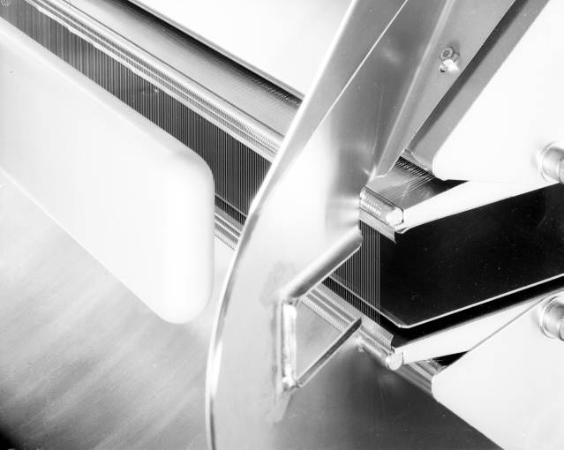
Wire electrostatic septum
The thin foil septum is substituted by array of thin wires for even lower interaction with beam
Ion trap
Deflector
HV electrode
An array of wires reduces the effective density of the septum, decreasing beam loss and radiation
High electric field possible
Field leakage in no-field region
Wires array increase the vacuum conductivity to the screened volume
Individual tensioner on each wire
Ionization of residual gas in the field-free region can provoke a HV breakdown. Care should be taken to remove ions from the volume
White array interaction with beam could cause excessive heating and consecutive destruction of the septum array. Proper protection mechanisms should be implemented to avoid damage.
Maintenance - radioactive activation
Circulating beam
Wire septum
Deflected beam
Courtesy of CERN Septa Section
SPS wire septum ZS (CERN) – gap 20 mm, septum wire diameter 50 – 100 μm, wire spacing 1.5 mm, voltage up to 220 kV, electric field up to 11 MV/m, Ion traps voltage: 3 to 6.5 kV ^{[23]}

Slide 30





Magnetic septum
The deflected beam goes through homogeneous magnetic field that is established between to magnetic poles. The circulating (straight) beam passes next to main magnetic circuit “seeing” as less as possible magnetic field. Often magnetic screening techniques are used to shield the straight beam.
Magnetic core
Septum
Circulating beam
$$B≈\frac{μ_{0}∙N∙I}{d}$$
Deflected beam
$$μ_{r}$$
Deflection
Follows from Hopkinson’s law (analogous to Ohm’s low), for $μ_{r}≫1$
Where:
B – magnetic flux density [T]
$μ_{0}$ – vacuum permeability [H/m]
$μ_{r}$ – core relative permeability [-]
$N$ – number of turns [-]
$I$ – current [A]
$d$ – gap [m]
$$I$$
$$B$$
$$d$$
$$I$$
$$B≈0$$
α
y
x
Positioning system
Return conductor
Vacuum chamber for “in-air” design
Vacuum or air

Slide 31
Types of magnetic septa
Classification according to magnetic field variation in time. Basically each type can be “in-vacuum” or “in-air design”
( )
Magnetic septa
DC and low frequency pulsed septa
Direct drive DC
Direct drive LF pulsed
Direct drive
Lambertson
Lambertson
Opposite field
Opposite field
Massless
Massless
Eddy current
Eddy current
Superconducting*
* Proposed design
Superconducting

Slide 32


Lambertson septum
Due to magnetic circuit symmetry the circulating beam area has very low leakage field.
Lambertson septum
Circulating beam
Septum
Thin septum possible
Low leakage field. To further reduce the leakage field a mu-metal screen could be added
More complex geometry
Poor vacuum conduction at circulating beam volume. NEG coating might be necessary.
DC or LF pulsed design
Deflection perpendicular to beam displacement
(In shown example:)
Kicker magnet is used to deflect the beam vertically (Down) and then the Lambertson septum deflects the beam horizontally (To the left)
$$μ_{r}$$
$$B_{m}$$
$$d$$
$$I$$
$$I$$
Deflection
Deflected beam
Lambertson septum

Slide 33

Lambertson septum - example
Design specifics of MSIA (LHC, CERN )^{[27, 16]}
Lambertson septum
Septum hole – zero-field region 1
(circulating LHC beam)
Zero-field region 2
(Counter rotating LHC beam)
Septum
“In-air” design
Two zero-field regions for circulating beam and for counter rotating beam
Mu metal chambers (thickness: 0.9 mm, 0.8 T saturation) for additional screening
Chamber is copper coated (0.4 mm) to improve beam impedance
Vacuum chamber is NEG coated
In-situ bake-out 200°C
Top yoke side (with zero-field regions) extends 175 mm on each side to screen the fringe fields
Transfer line from SPS
(deflected beam)

Slide 34


Lambertson septum - example
Construction and technical data of “in-air” Lambertson septum MSIA (LHC, CERN)
Lambertson septum
Straight beam 1
Septum
Straight beam 2
Vacuum: ${10}^{−7}$ mbar
Field length : 3650 mm
Gap height: 25 mm
Gap width: 230 mm
Beam momentum: 450 GeV/c
Deflection angle: 1.846 mrad
Septum thickness: 6 mm
Current: 950 A x 16 turns
Magnetic flux density: 0.76 T
Cooling water flow rate: 7.9 L/min
Dissipated power: 10.6 kW
Deflected beam
Courtesy of CERN Septa Section
Lambertson septum MSIA (LHC, CERN)^{[27,} ^{16]}

Slide 35






Eddy current septum
Eddy currents in the septum conductor cancel the changing magnetic field (eddy currents screening)
Eddy current septum
Circulating beam
Septum
Thin septum possible
Eddy currents dissipate power as well (edge cooling might be necessary)
Doesn’t work for DC magnets
Low leakage fields
Maximum of the leakage field appears after certain delay
More complex pulsed power supplies (short pulses)
Low inductance magnets (single turn)
Combined with thin mu-metal screening brings the ratio main field to leakage field to >1000:1
$$d_{s}$$
$$μ_{r}$$
$$B_{m}$$
$$d$$
$$I$$
$$I$$
$$μ_{0}$$
$$B≈0$$
Deflection
Eddy current septum
Deflected beam

Slide 36


AC magnetic field penetration
Eddy currents always flow in such direction that their magnetic field opposes the change of the magnetic field that produces them (Lenz's law)
Eddy current septum
Opposing magnetic field
Skin depth (field penetration) 𝛿 [m] – distance after the AC current is reduced 63%.
$$δ=\frac{1}{\sqrt{πfμ_{0}μ_{r}σ}}$$
Where:
$f$ – magnetic field frequency [Hz]
$μ_{0}$ – vacuum permeability [H/m]
$μ_{r}$ – relative permeability [-]
$σ$ – material conductivity [S/m]
High frequencies penetrate less
High conductivity materials screen better
Penetration in magnetic materials is smaller
Source of changing magnetic field
Eddy current
Conductive material
Illustration of magnetic field cancelation due to eddy currents in bulk conductor

Slide 37

Magnetic pulse waveform form
What is the best magnetic pulse waveform?
Eddy current septum
-100% / +80%
-100% / +0%
-100% / +50%
-100% / +80% / -10%
Courtesy of C. Gough

Slide 38


Eddy current septum - example
Construction and technical data of “in-vacuum” eddy current septum for SLS (PSI )^{[24]}
Eddy current septum
Septum support
Septum
Vacuum: ${10}^{−7}$ mbar
Field length : 600 mm
Gap height: 6 mm
Gap width: 20 mm
Beam momentum: 2.4 GeV/c
Deflection angle: 70 mrad
Septum thickness: 2.5 mm
Current: 4.3 kA (full sine 0.16 ms)
Magnetic flux density: 0.9 T
Eddy currents septum extends 50 mm on each side of the magnet to screen the fringe fields
Deflected beam
Straight beam

Slide 39


Eddy current septum - example
Leakage field measurements with and without mu-metal screen^{[24]}
Eddy current septum
Septum
Measured
Leakage field is reduced below 0.01%
Leakage field only varies by 2:1 over entire horizontal volume
With mu-metal screen, integral leakage dominated by screen end effect (integral leakage <1e-6 is possible)
Simulation
Mu-metal screen
Septum
Courtesy of C. Gough

Slide 40
Septa recap
Slow acting or DC beam deflecting element (electric or magnetic)
Usually providing large deflection
Essential part of beam injection, extraction and beam dump systems
Complex mechanical, thermal and vacuum design, often working close to materials’ damage threshold (mechanical, electrical, thermal).
Field homogeneity and beam impedance (injection/extraction septa)
Usually highest radiation point in the machine – gets radioactively activated. Materials degradation due to radiation (liquid and solid insulators degradation)
Electric – thinnest septum possible but not efficient for highly relativistic beams
Magnetic – efficient but at the cost of thicker septum
Has to accommodate the deflected beam trajectory (sagitta)
Low leakage field for the straight beam (in some cases leakage field could appear long after the main septum pulse due to slow field penetration through septum)
Interaction with adjacent magnetic elements (beam optics components, dipoles) due to large magnetic field leakage
Stringent reliability requirements – especially when part of safety and machine protection systems (emergency beam dump, beam dilution etc.)
Economics – dissipated power, supporting systems

Slide 41

Future colliders

Slide 42









Future colliders
Future colliders pose huge resources and technological challenges but they are the frontiers to the tomorrow’s science and physics in particular.
High Energy LHC
(HE-LHC)
Future Circular Collider (FCC)
Circular Electron Positron Collider (CepC)
Super Proton Proton Collider (SppC)
Fabiola Gianotti
CERN director general
Compact Linear Collider
(CLIC)
Earth Orbit Collider
(EOC) ☺
Earth Orbit Collider
(EOC) ☺
☺
Fabiola Gianotti ^{[13]}

Slide 43

Planed future colliders^{[1, 2, 6, 12]}
Parameter | LHC | HE-LHC | FCC | SppC | CLIC | CepC
Type | pp | pp | pp | pp | e-e+ | e-e+
Length, km | 27 | 27 | 100 | 54 | 48 | 54
Max beam energy, TeV | 7 | 14 | 50 | 35 | 1.5 | 0.12
Magnetic rigidity, T.km | 23 | 47 | 167 | 117 | 5 | 0.4
Stored energy / beam, MJ | 360 | 1300 | 8400 | 6400 | 0.280 | 0.350
Magnetic rigidity of charged particles beam:
$$BR≈3.3∙p$$
Where:
$BR$ – magnetic rigidity [T.m]
$B$ – magnetic flux density [T]
$R$ – bending radius [m]
$p$ – beam momentum [GeV/c]
High energy beams are difficult to deflect (due to high magnetic beam rigidity) and require high magnetic fields.
If HLC had to be built with 1 T magnets it would have had at least 23 km radius or would have required 144 km tunnel.
With 8.4 T (present design) bending radius is 2.74 km or minimum circumference (no straight sections ~17 km)

Slide 44



Challenges of future colliders
High beam energy - high magnetic rigidity, high magnetic fields are required
High beam intensity – (together with high energy) large amount of beam stored energy
High machine reliability – a failure in beam steering could be pretty destructive
High stability – to maintain a stable particle beam
FCC stored beam energy 8.4 GJ
≅
4.2x A320-200
@840 km/h
Different FCC dilution scenarios compared to the existing LHC one^{[7]}
Courtesy of W. Bartmann
Over 1 m length of SPS vacuum chamber destroyed after impact of 2 MJ proton beam (2004)^{[9]}
For comparison: energy of A320-200 (73000 kg) @ 840 km/h – 2 GJ
Courtesy of B. Goddard

Slide 45

Prepare for the future

Slide 46
Segmented beam dump kicker
FCC beam dump kicker ^{[11, 3, 7, 5]} :
Extremely high energy stored in the beam 8.4 GJ. Even fraction of a bunch can cause damage.
High magnetic rigidity 167 T.km (More than 7 times larger than the one of LHC)
Follow the beam energy
Fast reaction time
High reliability (solid state switches)
Possible solution: Segmented dump kicker:
  Number of devices: 300
  Current: 7.5 kA
  Voltage: 10 kV
  Magnet length: 300 mm
  Magnetic field: 0.25 T
  Rise time: 1 μs
Single spontaneous fire will cause very small deflection (~0.3%) - less than one sigma beam oscillation. Single failure will cause reduced kick by the same small amount – the beam still has to clear the septum.
Array of 300 elements (for illustrative purposes)

Slide 47





Solid state kicker drivers
CLIC Damping Ring Kickers drivers^{[34]}:
Pulse-to-pulse repeatability better than $1∙{10}^{−4}$
Pulse flatness (droop and ripple) less than ${2∙10}^{−4}$
High speed (rise/fall time) 100 ns
High reliability
  ±0.02%
  Pulse flat-top measurement at 6.3 kV with active compensation of droop and ripple^{[34]}
  Controlled decay pulse waveform with active amplitude modulation^{[34]}
Courtesy of J. Holma
Flat-top repeatability at low voltage (475 V) ±0.0004 % ( ±${4∙10}^{−6}$) measured with differential measurement method developed at PSI^{[34, 35]}
First full-scale, 20-layer, 12.5 kV CLIC DR extraction kicker inductive adder

Slide 48


Superconducting septum
FCC beam extraction/dump septum^{[4]}:
High magnetic field
Follow the beam energy (quasi-DC mode) - avoid excessive power consumption. Scaling in length LHC Lambertson technology (1 T) will require ~ 6 MW
Low leakage field in wide operating range
Homogeneous deflecting field
Possible solution: Superconducting septum:
  Septum thickness: 25 mm
  Field homogeneity: 0.5…1%
  Relative leakage field: $1.25∙{10}^{−4}$
  Magnetic field: 0 … 3 T
  If the magnet’s shield transits to superconducting state in zero-filed conditions it will act as a “perfect” magnetic screen. Any change of the external field will induce currents in the superconducting material that will prevent magnetic field penetration.
Courtesy of D. Barna
Schematic illustration of superconducting septum magnet.

Slide 49
Acknowledgments
Special thanks to
Chris Gough (PSI)
for providing very useful material
Special thanks to
Dr. Mike Barnes (CERN)
for providing very useful material
Thank you for your attention

Slide 50
Literature
[1] M. Mangano, “Physics at Future Circular Colliders”, Future Colliders for Fresh Physicists, CERN, Switzerland, 2017
[2] M. Dam, “Physics at Future Colliders 1“, Summer Student Lecture Programme Course, CERN, Switzerland, 2017
[3] M. Barnes, et al., “Kicker Systems -Part 2 -Hardware: Existing and Future”, Beam Injection, Extraction and Transfer, CAS 2018, Erice, Italy, 2017
[4] D. Barna, “High field septum magnet using a superconducting shield for the Future Circular Collider”, Phys. Rev. Accel. Beams 20, 2017
[5] T. Kramer, et al., “Considerations for the injection and extraction kicker systems of a 100 TeV centre-of-mass FCC-hh collider”, IPAC 2016, Busan, Korea, 2016
[6] F. Su, et al., “SPPC Parameter Choice and Lattice Design”, IPAC 2016, Busan, Korea, 2016
[7] W. Bartmann, et al., “FCC-hh Dump concepts”, The second Annual Meeting of the Future Circular Collider study, Rome, Italy, 2016
[8] J. Borburgh, “An introduction to HV cables”, Group meeting TE-ABT, CERN, Switzerland, 2016
[9] B. Goddard, “Surviving an Asynchronous Beam Dump?”, The second Annual Meeting of the Future Circular Collider study, Rome, Italy, 2016
[10] C. Aguilar, “Development of Stripline Kickers for Low Emittance Rings: Application to the Beam Extraction Kicker for CLIC Damping Rings”, PhD Thesis, Spain, 2015
[11] T. Kramer, et al., “ Considerations for the Beam Dump System of a 100 TeV Centre-of-mass FCC hh Collider”, IPAC 2015, Richmond, VA, USA, 2015
[12] R. Schmidt, “Concept & architecture of the machine protection systems for FCC”, First Annual Meeting of the Future Circular Collider study, USA, 2015
[13] F. Gianotti, “Physics opportunities at future high-energy colliders”, Invisibles15 Workshop, Madrid, Spain, 2015
[14] C. Aguilar, et al., “Stripline design for the extraction kicker of Compact Linear Collider damping rings”, Phys. Rev. ST Accel. Beams 17, 071003, 2014
[15] B. Holzer, "Introduction to Transverse Beam Dynamics", CAS-CERN Accelerator School, Slovakia, 2012
[16] A. Gabard, et al., "Radiation Hard Magnets at the Paul Scherrer Institute", IPAC 2012, pp 3518-3520, USA, 2012
[17] R. Carey, “The MuLan Experiment”, The 19th Particles and Nuclei International Conference, Cambridge, USA, 2011
[18] M. Plum, "Injection and extraction single, turn injection", USPAS Class on Injection and Extraction, USA, 2009
[19] M. Barnes, "Beam Transfer Devices Septa", CAS-CERN Accelerator School, Belgium, 2009
[20] M. Barnes, et al., "Injection and extraction magnets: kicker magnets”, CAS 2009: Specialised Course on Magnets, Bruges, Belgium, 2009
[21] A. Mikhailichenko, “Fast kicker”, Colliding Beam Notes 2009, Cornell University, USA, 2009
[22] M. Reiser, “Theory and Design of Charged Particle Beams”, Wiley, p. 18, 2008
[23] J. Wenninger, “Introduction to Slow Extraction to the North Targets", Training for operation, CERN, Switzerland, 2007
[24] C. Gough, "Minimizing Leakage Field from Eddy Current Septum Magnets", Presentation at SINAP 2005, 2005
[25] M. Barnes, “A 25-kV 75-kHz Kicker for Measurement of Muon Lifetime”, IEEE Transactions on Plasma Science, Vol. 32, Issue: 5, 2004
[26] A. Afonin, et al., "Proton Extraction from IHEP Accelerator Using Bent Crystals", Int. WS “Relativistic. Channeling and Related Coherent Phenomena”, Italy, 2004
[27] J. Borburgh, et al., "Final results on the CERN PS electrostatic septa consolidation program", PAC 2003, USA, 2003
[28] J. Borburgh, et al., "Consolidation project of the electrostatic septa in the CERN PS ring", PAC 2001, USA, 2001
[29] C. Gough, et al., "Septum and Kicker Systems for the SLS" PAC 2001, USA, 2001
[30] K. Wille, “The Physics of Particle Accelerators: An Introduction”, Oxford University Press, p. 148, 2000
[31] M. Barnes, “Design of the injection kicker magnet system for CERN's 14 TeV proton collider LHC”, IPPC 95, Albuquerque, USA, 1995
[32] S. Baker, et al., “First Operation with a Crystal Septum to Replace a Magnet in a Charged Particle Beam", NIM A234 (1985), pp 602-605, 1985
[33] C. Bovet, et al., "A selection of formulae and data useful for the design of A.G. synchrotrons", CERN, Switzerland, 1970
[34] J. Holma, “Inductive adders for the CLIC damping ring kickers”, First Topical Workshop on Injection and Injection systems, Berlin, Germany, 2017
[35] M. Paraliev, C. Gough, “Towards Sub-ppm Shot-to-shot Amplitude Stability of SwissFEL Resonant Kicker”, 2016 IEEE PMHVC, San Francisco, CA, USA, 2016

Slide 51











Additional material – Electrostatic deflection derivation
$$v$$
Derivation of electrostatic deflection of moving charged particle with velocity $v$, rest mass $m_{0}$ and elementary charge $q_{e}$, in electric field $E$ perpendicular to particle’s direction of travel. The electric force $F_{e}$ balances the centrifugal force $F_{c}$ and the particle travels on an arc trajectory with radius $R$.
Bending angle $θ$is found using bending radius $R$ and the length of the field $l$in the limits of small angle approximation $tan\left(θ\right)≈θ$
$$F_{c}$$
$$R$$
$$q$$
$$F_{e}$$
$$θ$$
$$E$$
$F_{e}=q_{e}E$, $F_{c}=\frac{{γm}_{0}v^{2}}{R}$, $p={γm}_{0}βc$, $v=βc$
and
$$p[\frac{kg.m}{s}]=\frac{{10}^{9}q_{e}}{c}p[\frac{GeV}{c}]$$
$$∴$$
$$R=\frac{{γm}_{0}v^{2}}{q_{e}E}=\frac{p[\frac{kg.m}{s}]βc}{q_{e}E}=\frac{{10}^{9}p[\frac{GeV}{c}]β}{E}$$
$$∴$$
$$θ≈\frac{l}{R}=\frac{El}{{10}^{9}.β.p[\frac{GeV}{c}]}$$
Where:
$F_{c}$ - centrifugal force [N]
$F_{e}$- electrostatic force [N]
$E$ - electric field [V/m]
$R$ - bending radius [m]
$q_{e}$ - particle charge (elementary charge) [C]
$m_{0}$ - particle’s rest mass [kg]
$p$ - beam momentum [kg.m/s] or [GeV/c]
$γ$ - relativistic gamma [-]
$β$ - relativistic beta [-]
$c$ - speed of light [m/s]
$l$ - length of the field [m]

Slide 52











Additional material – Magnetic deflection derivation
$$v$$
Derivation of magnetic deflection of moving charged particle with velocity $v$, rest mass $m_{0}$ and elementary charge $q_{e}$, in magnetic field $B$ going out of plane of paper. The magnetic force $F_{m}$ balances the centrifugal force $F_{c}$ and the particle travels on an arc trajectory with radius $R$.
Bending angle $θ$is found using bending radius $R$ and the length of the field $l$in the limits of small angle approximation $tan\left(θ\right)≈θ$
$$F_{c}$$
$$R$$
$$q$$
$$F_{m}$$
$$θ$$
$$B$$
$F_{m}=q_{e}vB$, $F_{c}=\frac{{γm}_{0}v^{2}}{R}$, $p={γm}_{0}βc$, $v=βc$
and
$$p[\frac{kg.m}{s}]=\frac{{10}^{9}q_{e}}{c}p[\frac{GeV}{c}]$$
$$∴$$
$$R=\frac{{γm}_{0}v}{q_{e}B}=\frac{p[\frac{kg.m}{s}]}{q_{e}B}=3.3\frac{p[\frac{GeV}{c}]}{B}$$
$$∴$$
$$θ≈\frac{l}{R}=\frac{0.3Bl}{p[\frac{GeV}{c}]}$$
Where:
$F_{c}$ - centrifugal force [N]
$F_{m}$- magnetic force [N]
$B$ - magnetic flux density [T]
$R$ - bending radius [m]
$q_{e}$ - particle charge (elementary charge) [C]
$m_{0}$ - particle’s rest mass [kg]
$p$ - beam momentum [kg.m/s] or [GeV/c]
$γ$ - relativistic gamma [-]
$β$ - relativistic beta [-]
$c$ - speed of light [m/s]
$l$ - length of the field [m]

Slide 53


Additional material – Equivalence of electrostatic and magnetic deflection
Comparing capabilities of electric and magnetic field with same volumetric energy density (in vacuum) to deflect relativistic charged particles
Electric field energy density $W_{E}=\frac{ε_{0}E^{2}}{2}$
Magnetic field energy density $W_{M}=\frac{B^{2}}{2μ_{0}}$
For $W_{E}=W_{M}$ and $c^{2}=\frac{1}{ε_{0}μ_{0}}$ $∴$
$\frac{ε_{0}E^{2}}{2}$ $=\frac{B^{2}}{2μ_{0}}$ or $E=cB$
Magnetic (Lorentz) deflection force $F_{m}=q_{e}vB$
Relativistic regime $v≅c$ $∴$
$$F_{m}=q_{e}vB≅q_{e}cB=q_{e}E$$
Electrostatic (Lorentz) deflection force $F_{e}=q_{e}E$
or
$$F_{e}≅F_{m}$$
Electric and magnetic field, with same energy density, have same effectiveness in deflecting relativistic charged particles.
Where:
$W_{E}$ - electric field energy density [J/m³]
$W_{M}$- magnetic field energy density [J/m³]
$ε_{0}$ - vacuum permittivity [F/m]
$μ_{0}$ - vacuum permeability [H/m]
$q_{e}$ - particle charge (elementary charge) [C]
$E$ - electric field [V/m]
$B$ - magnetic flux density [T]
$c$ - speed of light [m/s]
$F_{e}$ - electric force [N]
$F_{m}$ - magnetic force [N]

Slide 54








Additional material – Equivalence of electric and magnetic deflection for relativistic particles in constrained vacuum transmission line
Electrostatic deflection
$$θ_{E}≈ \frac{E∙l}{{10}^{9}∙β∙p}≈\frac{U∙l}{{10}^{9}∙β∙p∙d}$$
Magnetic deflection
$$θ_{M}≈\frac{0.3∙B∙l}{p}$$
In the middle of constrained transmission line: $\vec{B}≈const$ and crosses perpendicularly symmetry plane $A$, or total flux $Φ$ is:
$$Φ≈B∙d∙l$$
Assuming voltage step $U$, started at $t=0$ has just filed the line for time $t=l/c$, $β=1$ and $Φ\left(0\right)=0$:
$$U=\frac{∆Φ}{∆t}=\frac{Φ}{t}=B∙d∙c$$
$$θ_{E}≈ \frac{B∙d∙c∙l}{{10}^{9}∙β∙p∙d}=\frac{B∙3.{10}^{8}∙l}{{10}^{9}∙1∙p}=\frac{0.3∙B∙l}{p}$$
$$θ_{E}≈θ_{M}$$
$$l$$
$$I$$
$$\vec{E}$$
$$\vec{B}$$
$$d$$
$$A$$
Where:
$E$ - $\text{electric} \text{field}\text{ [}\text{V}\text{/}\text{m}\text{] }$
$l$ – transmission line length [m]
$β$ - relativistic factor ($β=1)$
$p$ - beam momentum [GeV/c]
$U$ – voltage between electrodes [V]
$d$ – distance between electrodes [m]
$B$ - magnetic flux density [T]
$Φ$ - total magnetic flux [Wb]
$c$ - speed of light ($c≈3.{10}^{8}$ m/s)

