Slide 1

Welcome to Vienna!
Markus Friedl
(HEPHY Vienna)

Slide 2

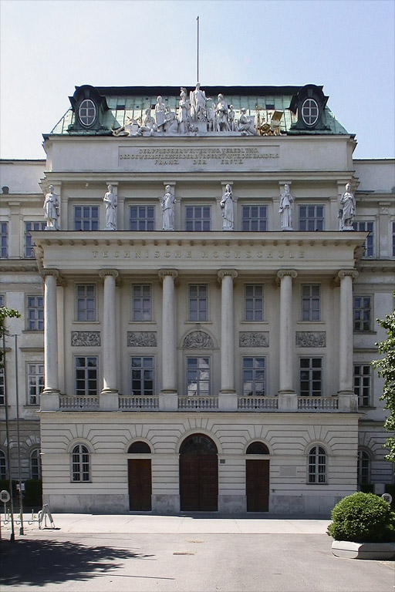
TU Vienna – University of Technology
Location
Founded in 1815
Large university: 29,000 students, 4,800 staff
8 faculties, including Electrical Engineering (where we are now)
53 different study courses offered

Slide 3
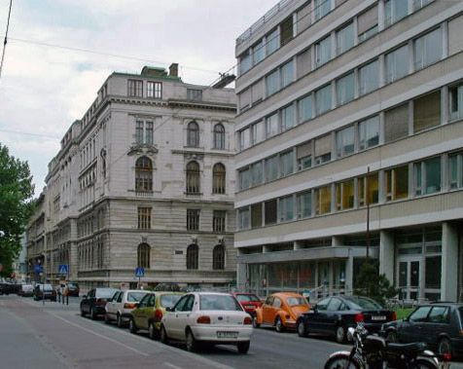
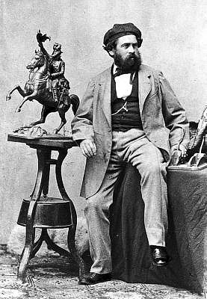
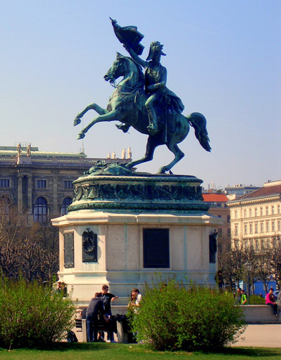
Address: Gusshausstraße
Location
“Gusshausstraße” means “street of the casting house”
1750-1850: canons were produced at Gusshausstraße 25
1850-1900: casting workshop for artists
Since 1903: Institute of Electrical Engineering (old building)

Slide 4
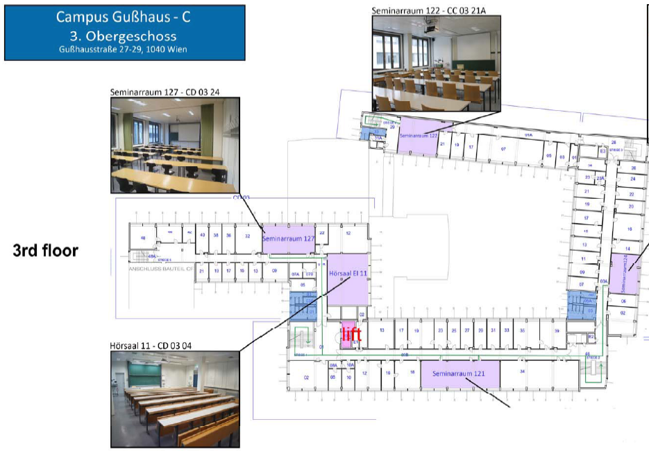
Location
Lectures and labs

Slide 5
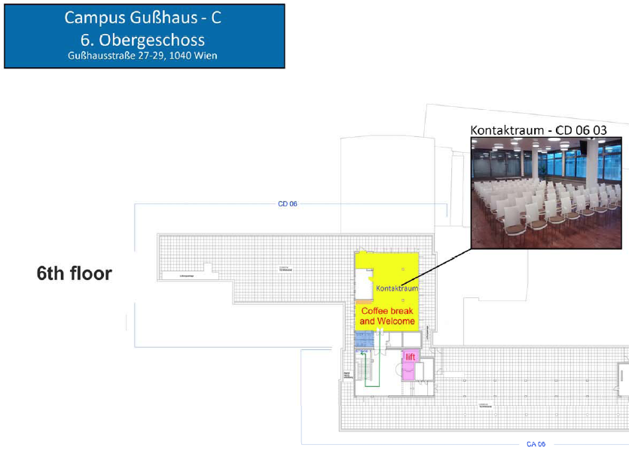
Location
Coffee and welcome

Slide 6
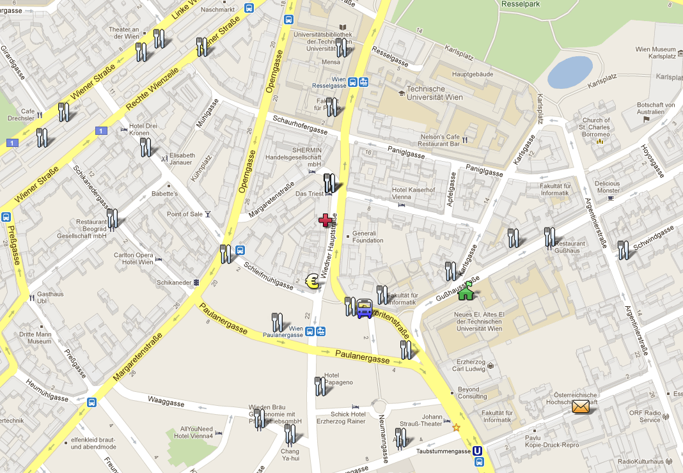
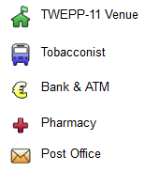
Neighborhood
Location
http://g.co/maps/re56e
Mensa
We are here
ISOTDAQ

Slide 7
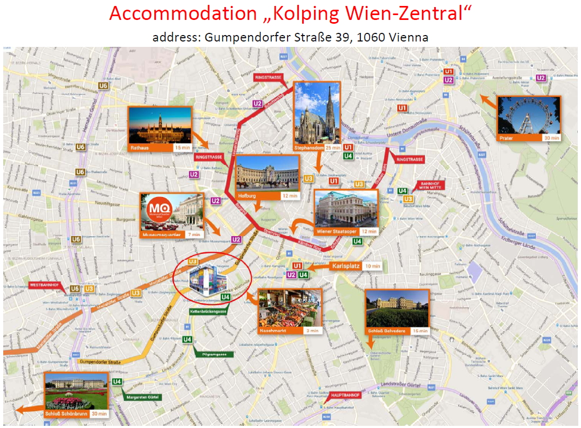
Location

Slide 8
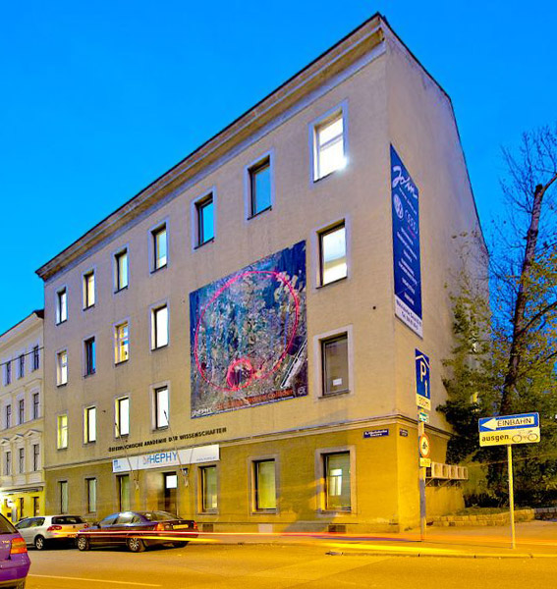

Local Organizer: HEPHY Vienna
Local Organization
Large institute of the Austrian Academy of Sciences
Located at Nikolsdorfer Gasse 18, 1050 Vienna
Staff & students: ~70

Slide 9
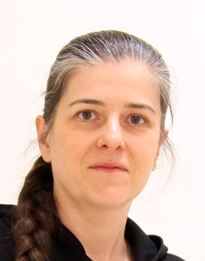
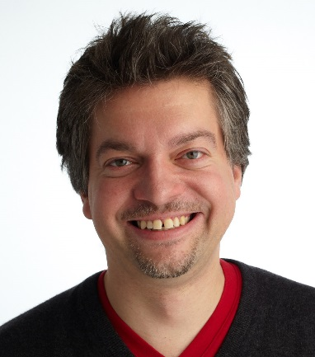
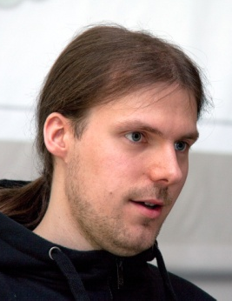
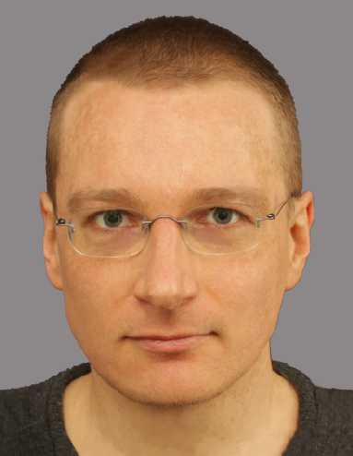
Local Organizing Committee
Local Organization
We are here to help you!

Slide 10
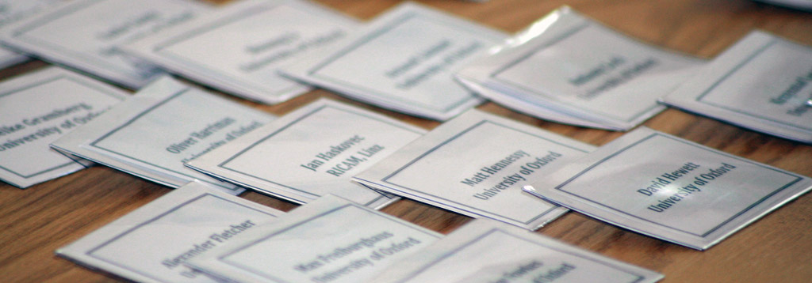
Registration Desk
Local Organization
Opening hours:
  Wed, 14 Feb (today): 7:30 – 18:30
  Thu, 15 Feb (tomorrow): 7:30 – 9:00
  Thu, 22 Feb (last day): 8:30 – 12:30

Slide 11
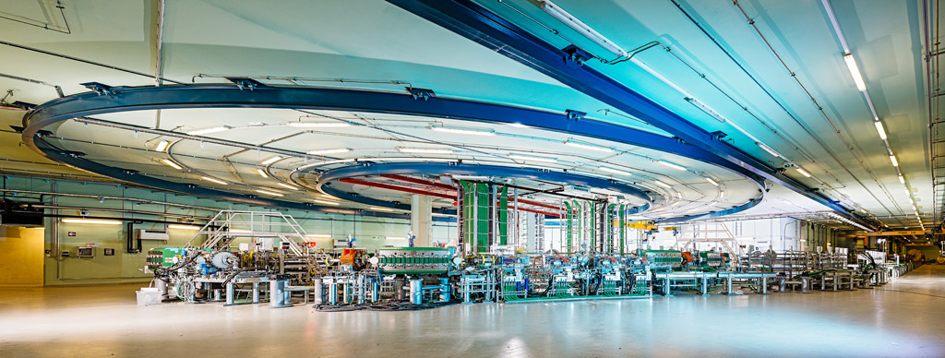
Schedule
Schedule
A typical day consists of
  Lectures in the morning
  Labs in the afternoon
Sunday: (optional) excursion to MedAustron, an ion-beam therapy center

Slide 12
Meals
Schedule
Breakfast: served in hostel
Lunch:
  You received vouchers for TU Mensa (canteen)
  Located in a different building (see your map)
  If you don’t need (some) vouchers, please return them to the organizers
Dinner:
  Up to yourself (except for social dinner)

Slide 13
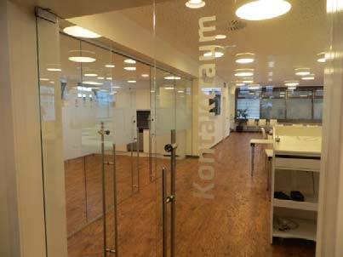
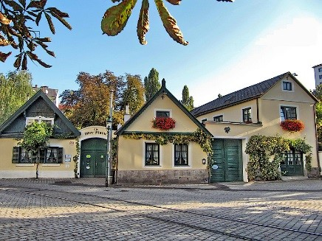
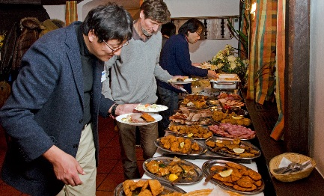
Social Events and Excursion
Schedule
Wednesday 14 February, 18:30:
Welcome Drink (Kontaktraum, 6th floor)
We’ll go up together after the last talk
Sunday 18 February, 10:00:
MedAustron (Wiener Neustadt)
Bus leaves in front of hostel
Monday 19 February, 19:30:
Conference Dinner (Heuriger)
Using trams to go there (see instructions)
You need to have a valid ticket
We’ll go together after the last lab

Slide 14
Internet Access
Practical Issues
WLAN
  Use „tunet“ (open)
  Open any website in browser and enter personalized access codes according to the sheet you received at registration
  Then you have full internet access (Web, SSH, Mail,…)
  Eduroam is also available

Slide 15
What is in Your Folder?
Practical Issues
Timetable
Lab groups and lab plan
Personal WLAN credentials
Useful maps
Scratchpad and pen
City map and leaflets
Invoice
Certificate of attendance
Name tag
Lunch vouchers

Slide 16
Public Transportation
Practical Issues
Sorry, but we do not provide tickets at the registration desk
Tickets are available from
  Tobacconists
  Vending machines in underground stations
Ticket types:
  Single trip (including changes) € 2.40
  4 strips (each valid for a single trip) € 9.60
  Various tickets valid for one or more days
Please consult ISOTDAQ website for additional information
Entering platform of underground requires punched ticket

Slide 17
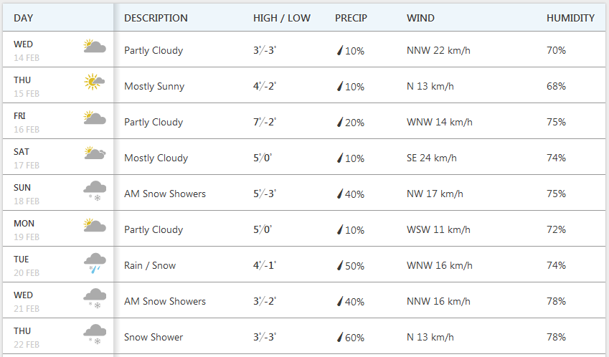
Weather Forecast
Finally…
Average winter weather: some sun, some rain, some snow…

Slide 18
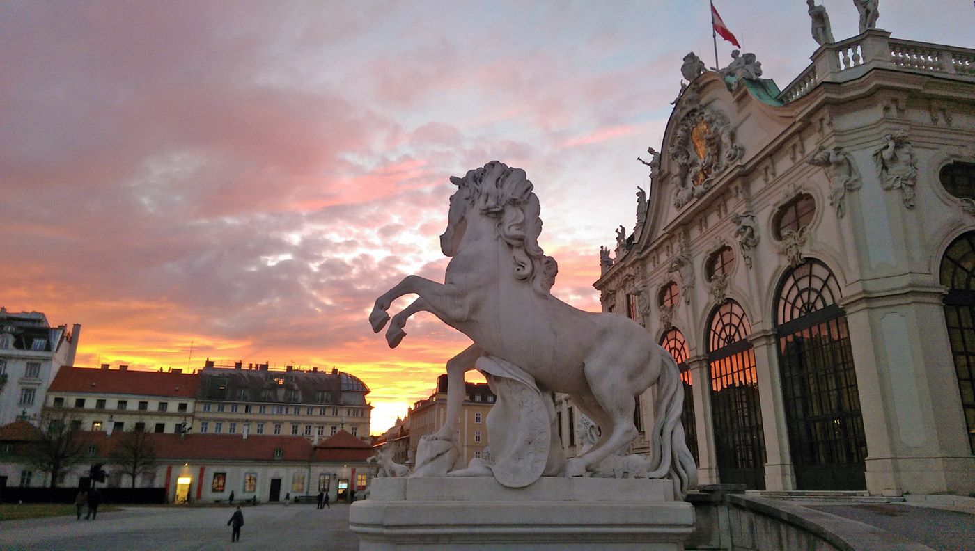
Enjoy ISOTDAQ 2018!

