Slide 1


XIV Workshop on Resistive Plate Chambers
and related detectors
Puerto Vallarta, Jalisco State, MEXICO
19-23 February 2018
Development of a new Front-End electronics
in Si and Si-Ge technology
for the Resistive Plate Chamber (RPC) detector
for high rate experiments
Authors
Luca Pizzimento & Roberto Cardarelli
Co-Authors
E. Alunno Camelia, A. Caltabiano, S. Bruno, A. Rocchi, L. Massa
luca.pizzimento@roma2.infn.it

Slide 2
Summary
RPC Rate Capability
The new Front End Electronics
Full-Custom Amplifier
Full-custom ASIC Discriminator
Test beam at the H8 beamline & experimental setup
Testbeam results
    Chambers efficiency ‘AND’ configuration
    Triplet efficiency (2 on 3)
    Average Cluster Size
    Time Resolution & time walk correction
Conclusion & Next to come

Slide 3
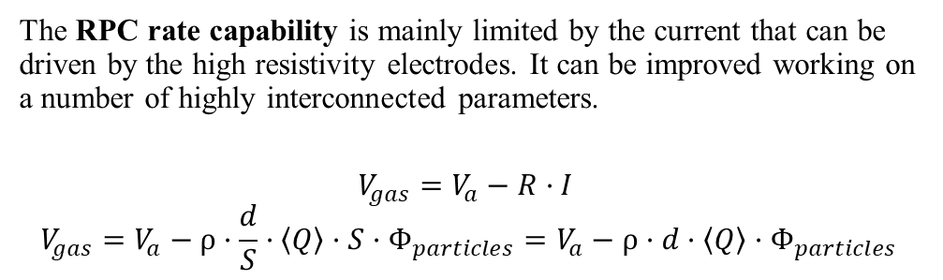
RPC rate capability and improvements for high rate experiments
The RPC rate capability is mainly limited by the current that can be driven by the high resistivity electrodes. It can be improved working on a number of highly interconnected parameters.
$$V_{gas}=V_{a}−R·I$$
$$V_{gas}=V_{a}−ρ·\frac{d}{S}·〈Q〉·S·Φ_{particles}=V_{a}−ρ·d·〈Q〉·Φ_{particles}$$
Reading strips X
Layers of graphite
High
Voltage
Insulating sheets
Gas Mixture
There are several possible ways to increase the detectable particle flux:
Decrease the electrode resistivity; large technological effort, with the risk of increasing its operating current, causing a possible ageing problems due to the more current driven.
Reduce the electrode thickness; similar effect obtained with the reduction of the resistivity.
Reduce the average charge per count Q. This method is the only one that permits to increase the rate capability while operating the detector at fixed current.
Polycarbonate spacers
Resistive
Electrodes
Reading strips Y
Foam
This last approach requires:
Very sensitive FE electronics with an excellent signal to noise ratio
High suppression of the noise induced inside the detector by the electronics and by external sources
Very careful optimization of the chamber structure as a Faraday cage.
Luca Pizzimento
3

Slide 4
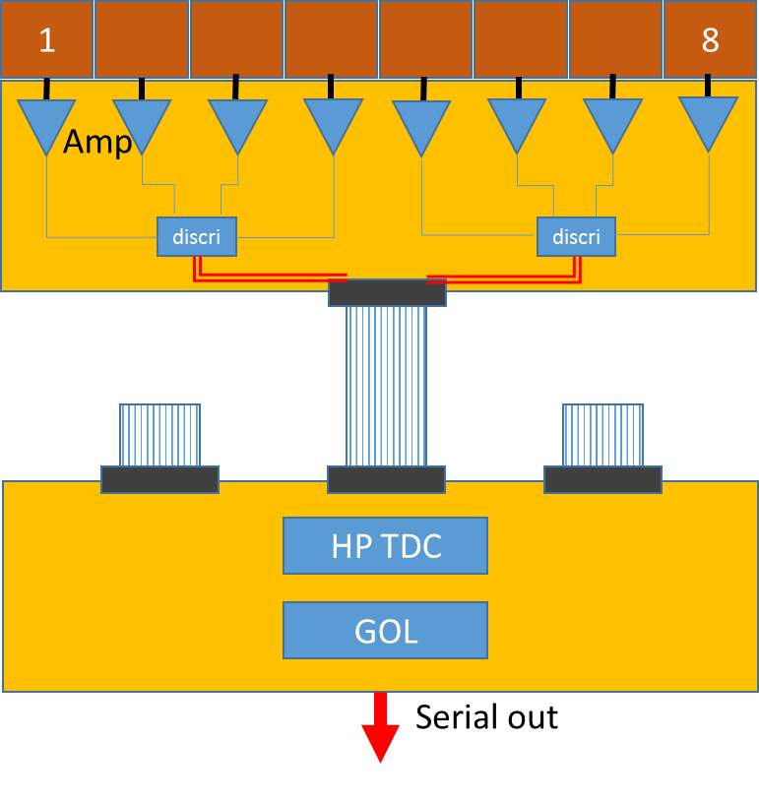
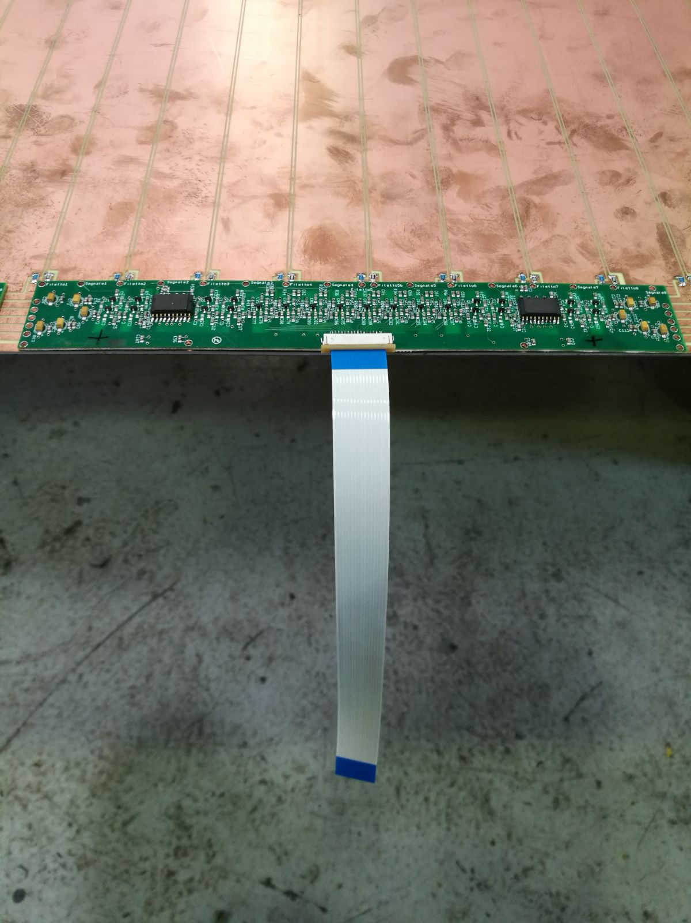
The new Front-End final design
8-channels Front-End Board composed by the new Amplifier, the full-custom ASIC Discriminator and the LVDS transmitter
Strips
Amplifiers
Discriminator
Discriminator
LVDS Transmitter
Amplifier Properties
Si standard component
Amplification factor: 2-4 mV/fC
Power Consumption: 3-5 V 1–2 mA
Bandwidth: 100 Mhz
Discriminator Properties
SiGe full custom
Power Consumption: 2-3 V 4-5 mA
Threshold: 0.5 mV
Bandwidth: 100 MHz

Slide 5
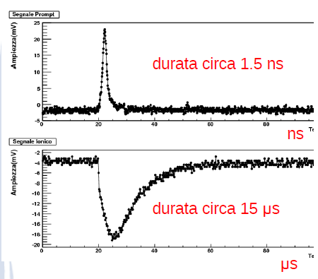
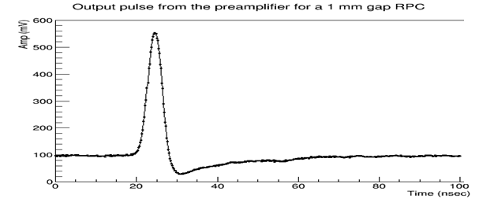
Full-Custom Amplifier
The Amplifier developed in Rome Tor Vergata for the RPCs is made in Silicon Bipolar Junction Transistor technology. The main feature of this new kind of amplifier is a fast charge integration with the possibility to match the input impedance to a transmission line. The working principle of this amplifier is shown in Figure 3. The performance of the silicon BJT amplifier are shown in the following table.
4000
Amp (a.u.)
Time (nsec)
Table 2: Performance of custom charge amplifier in Silicon BJT technology
With this amplifier it is possible to anticipate the efficiency curve of around 400 V respect to the previous ATLAS amplifier.
Figure 3: Operating principle of custom charge amplifier in Silicon technology

Slide 6
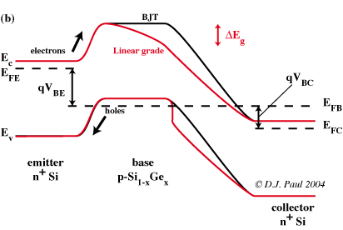
Full-Custom ASIC Discriminator
Pull up
System
The new full-custom Discriminator circuit dedicated to the RPCs for high rate environment is developed by using the Silicon-Germanium HJT technology.
The main idea behind this new discriminator is the limit amplifier. If the signal surpasses the threshold, it will be amplified until saturation giving as output a square wave.
Output
Input
The principle of SiGe heterojunction bipolar transistor (HJT) is to introduce a Silicon-Germanium impurity in the base of the transistor. The advantage of this device is that the band structure introduces a drift field for electrons into the base of the transistor, thus producing a ballistic effect that reduces the base transit time of the carriers injected in the collector. The net effect is to improve the transition frequency and to introduce a directionality in the charge transport allowing a much lower value of B-C capacitance; hence a much higher charge amplification can be achieved.
Voltage
V+
Without signal
V-
V+
With signal
V-
Time

Slide 7
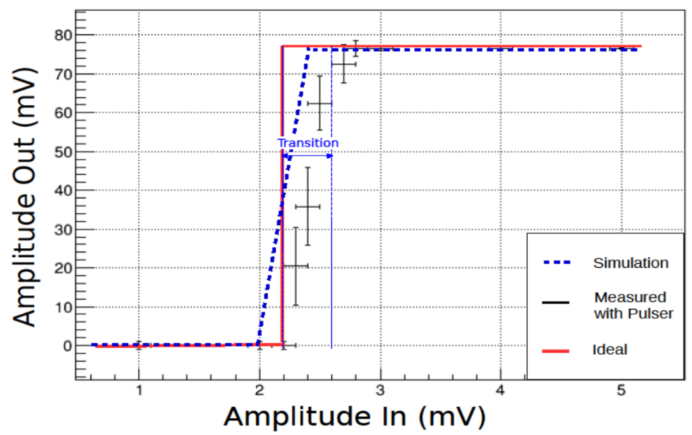
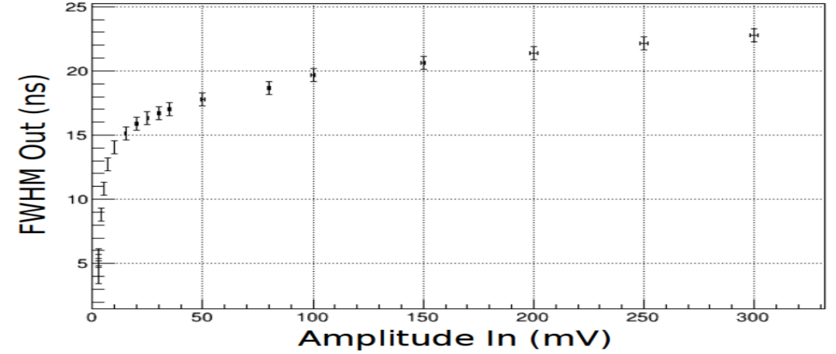
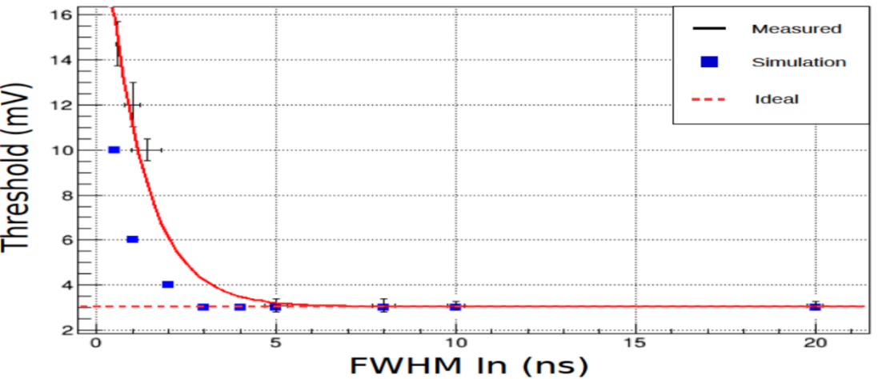
Full-Custom ASIC Discriminator
The main features are:
Optimal characteristic function with the possibility of an easy regulation of the threshold from a minimum value of few mV (see Fig. 4)
Very small transition region of around 300 μV, practically negligible when the discriminator is used within the RPC (see Fig 4).
Time-over-threshold measurement directly with the discriminator (see Fig 5).
Minimum pulse width of 3 ns ; for shorter signal the discriminator goes into a charge regime with a threshold in charge (see Fig 6).
Figure 4: Characteristic function of the discriminator in Si-Ge HJT technology
Figure 5: Dynamic of the time-over-threshold of the discriminator prototype in SiGe HJT technology.
Figure 6: Minimum pulse width of the new Si-Ge prototype with the simulated
and the ideal behavior of a discriminator compared

Slide 8
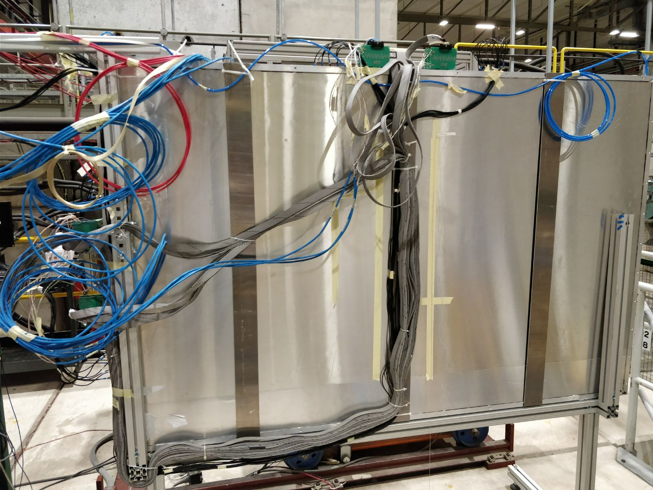
Testbeam at the H8 beamline
This Test beam was realized inside the North Area of CERN, precisely at the H8 beamline. The H8 beam is a secondary particle beam that provides hadrons, electrons or muons of energies between 10 and 400 GeV/c, as well as 450 GeV/c (primary) protons and up to 400 GeV/c per charge primary Pb ions. Only the muon beam was used for this test.
Measurement realized:
RPC overall test
  The aim of this test was to ensure that the whole system was working correctly
Parameters ”phase space’’ scans
  The aim of these scans is to find out all the possible electronics working points and their properties

Slide 9
Testbeam at H8 experimental setup
The RPCs chamber is composed by 3 mono-gap equipped with the new Front-End.
The gas gap is 1 mm thick and the electrodes are 1.2 mm thick each. The mixture used was 95% TFE, 4.7% I-C4H10, 0.3% SF6.
Gas gap
X,Y ReadOut Strips
Scintillators
The trigger system was composed by two scintillators of around 10cm x 10cm. The data acquisition was realized by using a CAEN TDC.
The low voltage system was realized in such a way to have the possibilities to regulate each parameter individually, allowing a deep parameters regulation for each Front-End board.
The Front-End board low voltages studied:
  Pull Up & Discriminator → The stability of the system
  Threshold & Amplifier → The effective threshold applied on the signals
Muon
beam
RPCs chamber

Slide 10
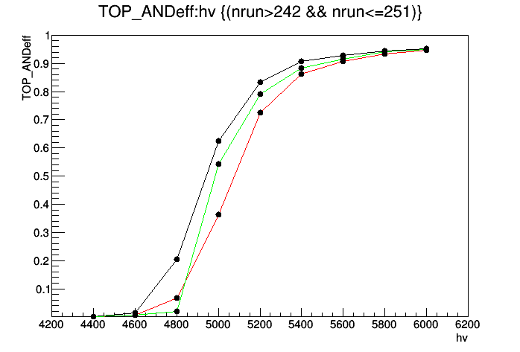
Experimental Results
Chambers efficiency in ‘’and’’ configuration
LV parameter
Efficiency
Vth = 1.6 V
Vpu = 0.4 V
Vamp= 1.5 V
Vdis = 2.5 V
Vtras= 3.5 V
Chamber
TOP
MID
BOT
HV (V)

Slide 11
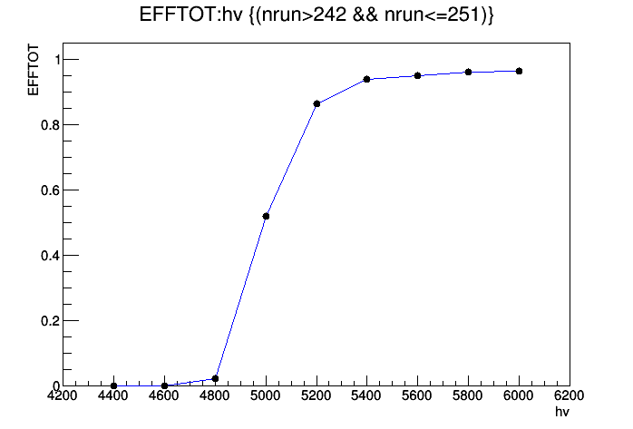
Experimental Results
Triplet efficiency 2 on 3
LV parameter
Efficiency
Efficiency
Vth = 1.6 V
Vpu = 0.4 V
Vamp= 1.5 V
Vdis = 2.5 V
Vtras= 3.5 V
HV (V)

Slide 12
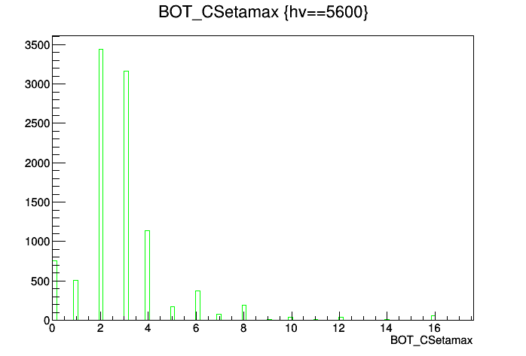
Experimental Results
Average Cluster Size of the chamber
CS

Slide 13
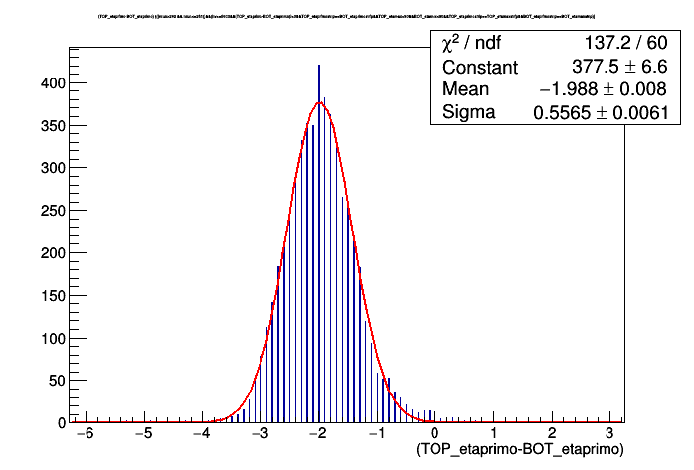
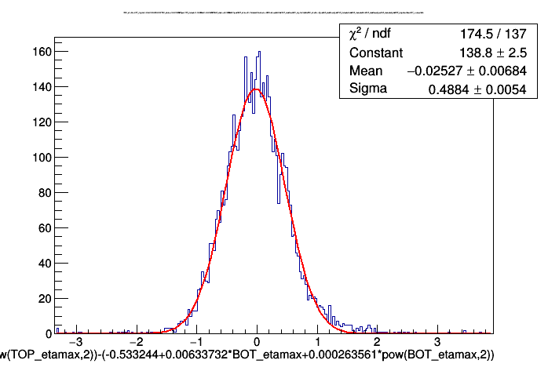


Time Resolution
Experimental Results
Time Resolution with time walk correction
$$\frac{0.5565}{\sqrt{2}}=\text{0.3935}$$
$$\frac{0.4884}{\sqrt{2}}=\text{0.3}\text{453}$$
T1-T0 (ns)
T1-T0 (ns)

Slide 14
Conclusions
The new Front-End developed achieved the following performances:
Minimum Threshold value of 1 mV of the amplified signal
Time-over-threshold measurement achievable directly with the FE
Along with 1mm gap RPC, a Time Resolution of around 350 ps
The developed Front-End, with the full-custom ASIC Discriminator in SiGe technology and the new Amplifier in Si technology, is able to detect signals of around 1 fC allowing the use of the RPC in high rate experiments

Slide 15
Thank you

Slide 16
Back up

Slide 17
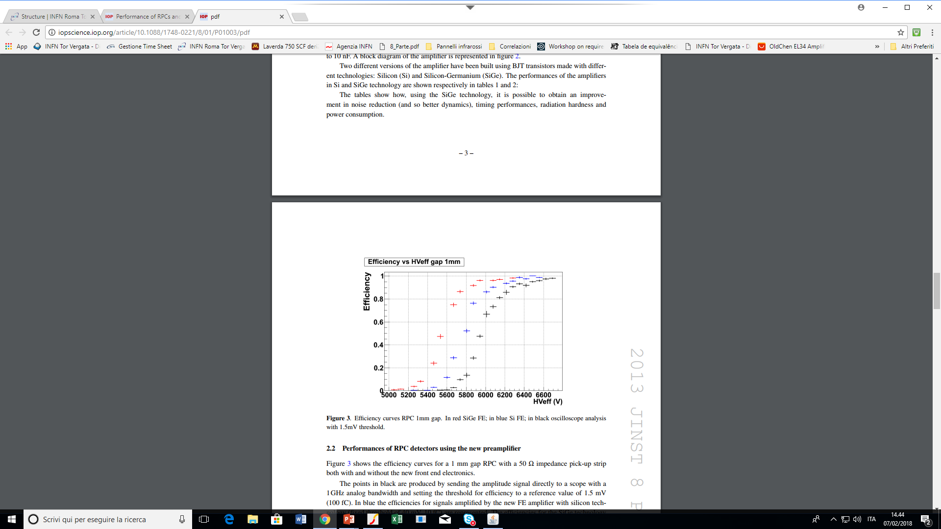
Full-Custom Amplifier

Slide 18
Rate Capability results
Absorption factor
No Source
100 = 1.2 kHz/cm^2
46 = 2.3 kHz/cm^2
15 = 3.9 kHz/cm^2
6.8 = 5.7 kHz/cm^2
2.2 =10.1kHz/cm^2

