Slide 1

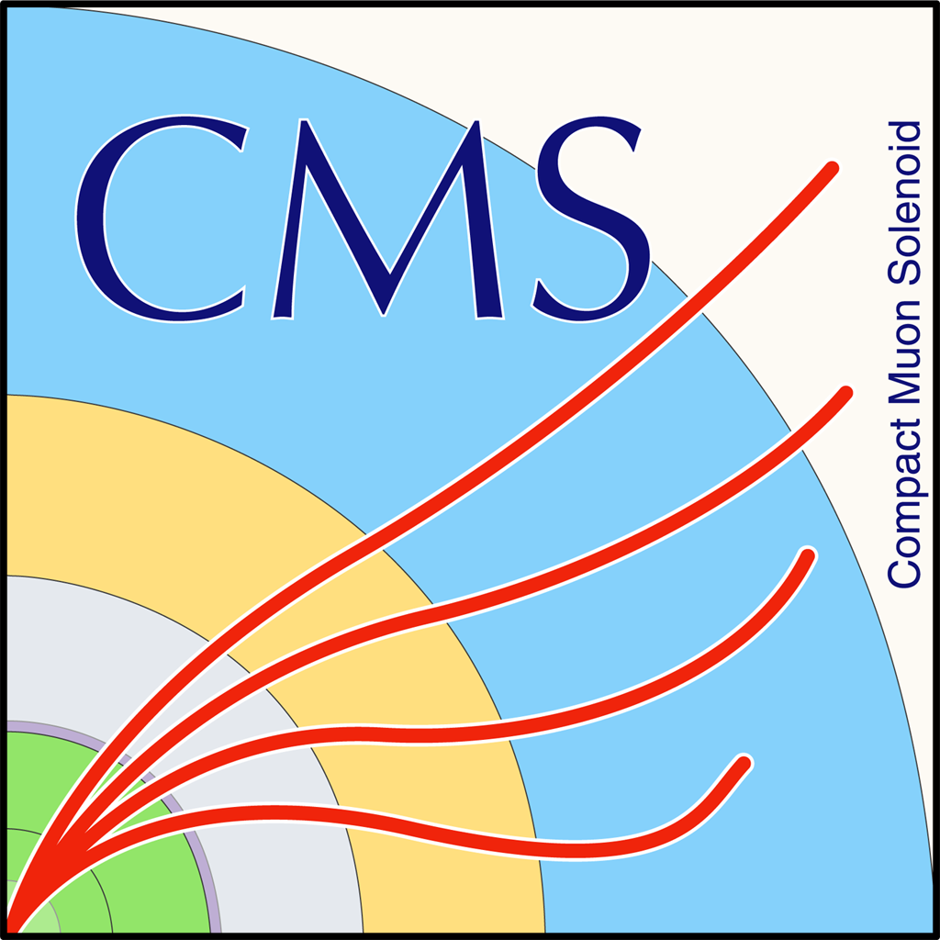

Fast timing measurement for CMS RPC Phase II upgrade
Christophe COMBARET, IPNL – CNRS IN2P3
On behalf of the CMS Muon Group
XIV Workshop on Resisitive Plate Chambers and Related Detectors

Slide 2
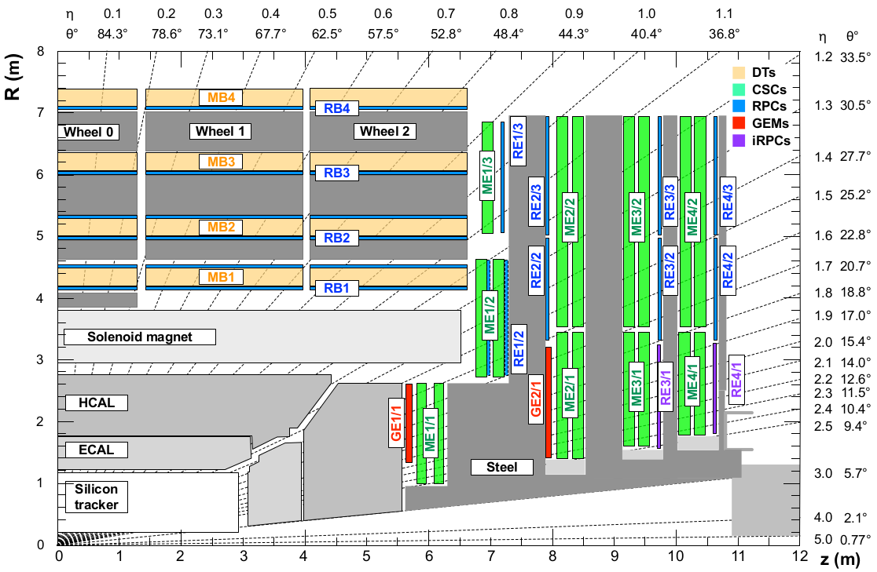
CMS muon upgrade at high eta
72 chambers to equip area with 1.8 < |η| < 2.4
Add track hits in muon reconstruction
Search for Heavy Stable Charge Particle
Proposed iRPC

Slide 3
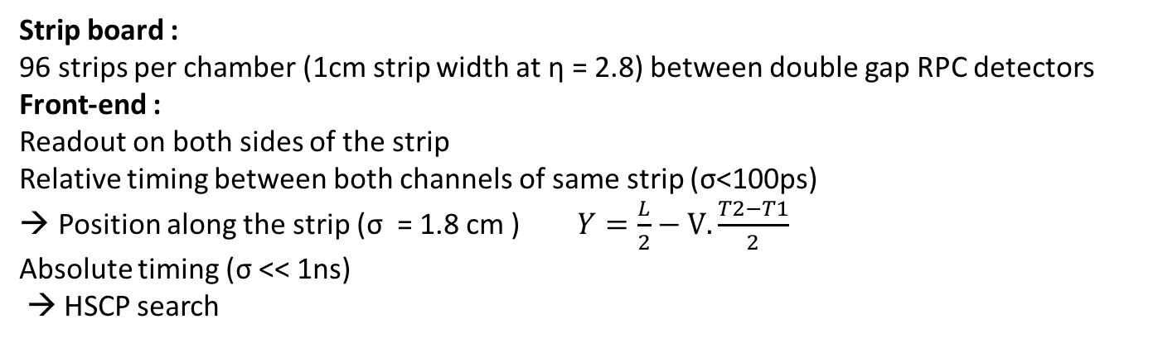
Proposed iRPC and front end electronics for RE3/1 and RE4/1
Strip board :
96 strips per chamber (1cm strip width at η = 2.8) between double gap RPC detectors
Front-end :
Readout on both sides of the strip
Relative timing between both channels of same strip (σ<100ps)
Position along the strip (σ = 1.8 cm ) $Y=\frac{L}{2}−V.\frac{T2−T1}{2}$
Absolute timing (σ << 1ns)
→ HSCP search
To
BE
Preampl.
+cmp.
TDC
GBT
Strip

Slide 4
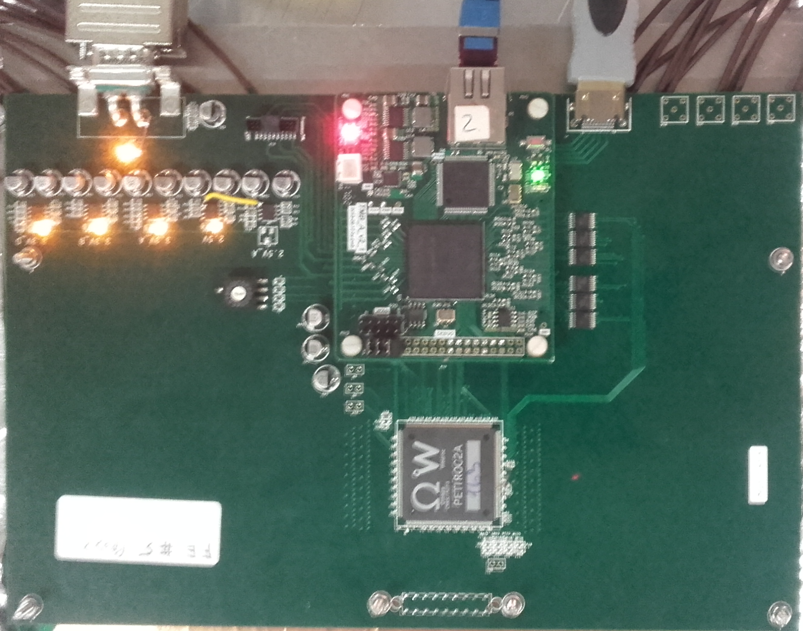
Global prototype measurement chain
Clock and Control Board
Requirements :
Fast preamp. : Petiroc ASIC
Precise TDC : Wave union TDC
Synchro. FPGA
Clk
Sync. cmds
Busy
Front-end board
ZDAQ acquisition software
cf. Laurent Mirabito’s talk
TCP-IP
FPGA
TDC
W5300
Tcp/Ip
32
Z matching network
Petiroc
TDC mezzanine
DAQ PC
iRPC top
HV
iRPC bottom
Gas system

Slide 5
Petiroc ASIC
Parameter | Value
Number of Channels | 32
Signal Polarity | positive or negative
Sensitivity | Voltage input amplifier, 200 Ohm matching
Timing Resolution | ~ 18 ps RMS on trigger output (4 photoelectrons injected)
Dynamic Range | 160 fC up to 400pC
Packaging & Dimension | TQFP 208 (28x28x1.4 mm) TFBGA 353 (12x12x1.2mm)
Power Consumption | 6 mW/channel
Inputs | 32 analogue inputs, No external component required Inputs DC level adjustable
Outputs | 32-channel trigger outputs ASIC level general trigger (OR of all channel) ASIC level second level general trigger (OR of all channels) Charge measurement (10 bits) Time measurement (10 bits)
Internal Programmable Features | Common trigger threshold adjustment and 6bit-DAC/channel Shaping time & gain of the charge shaper 32 x 8bit-input DAC over 1V span

Slide 6
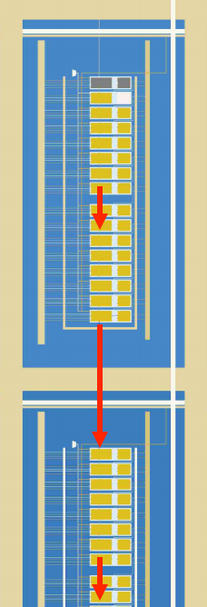
Wave union TDC
IN
Principle :
Input signal is propagated into a chain of identical delays (bins)
All delays output are latched on the system clock
Fine delay to clock edge is measured by position of last crossed delay element.
ΔT
T0
ΔT
T1
ΔT
LUT
T2
ΔT
T3
Implementation of carry chain TDC in FPGA :
Width of bins are different (Vcc and temperature). Typ. 60ps for Altera Cyclone II
Some ultra-wide bins (LAB boundary crossing). Typ. 165ps for Altera Cyclone II
Wave union TDC solves this problem by splitting the input signal in 2 edges and ensuring that in any case, at least one edge is not in the ultra-wide bin.
Details in : QI Ji, DENG Zhi, Liu Yi-nong. Nuclear Electronics &Detection Technology, 2011, 31(4): 378-381.

Slide 7
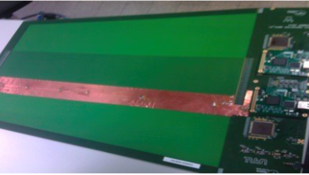
Small size Electronics prototype
- 32 x 50cm strips (3,5mm pitch ) and 32 off detector return lines (1mm wide)
- 2 iRPC chambers : 1.4/1.4 mm and 1.6/1.6 mm
- 2x Petiroc ASIC and 2x Wave union TDC mezzanine
DCC board
Clk and sync
50cm
TCP/IP
DAQ PC
Trigger
PMs
Top iRPC
Pcb with buried strips, readout on both sides
Bottom iRPC
Time resolution with 5pC injection

Slide 8
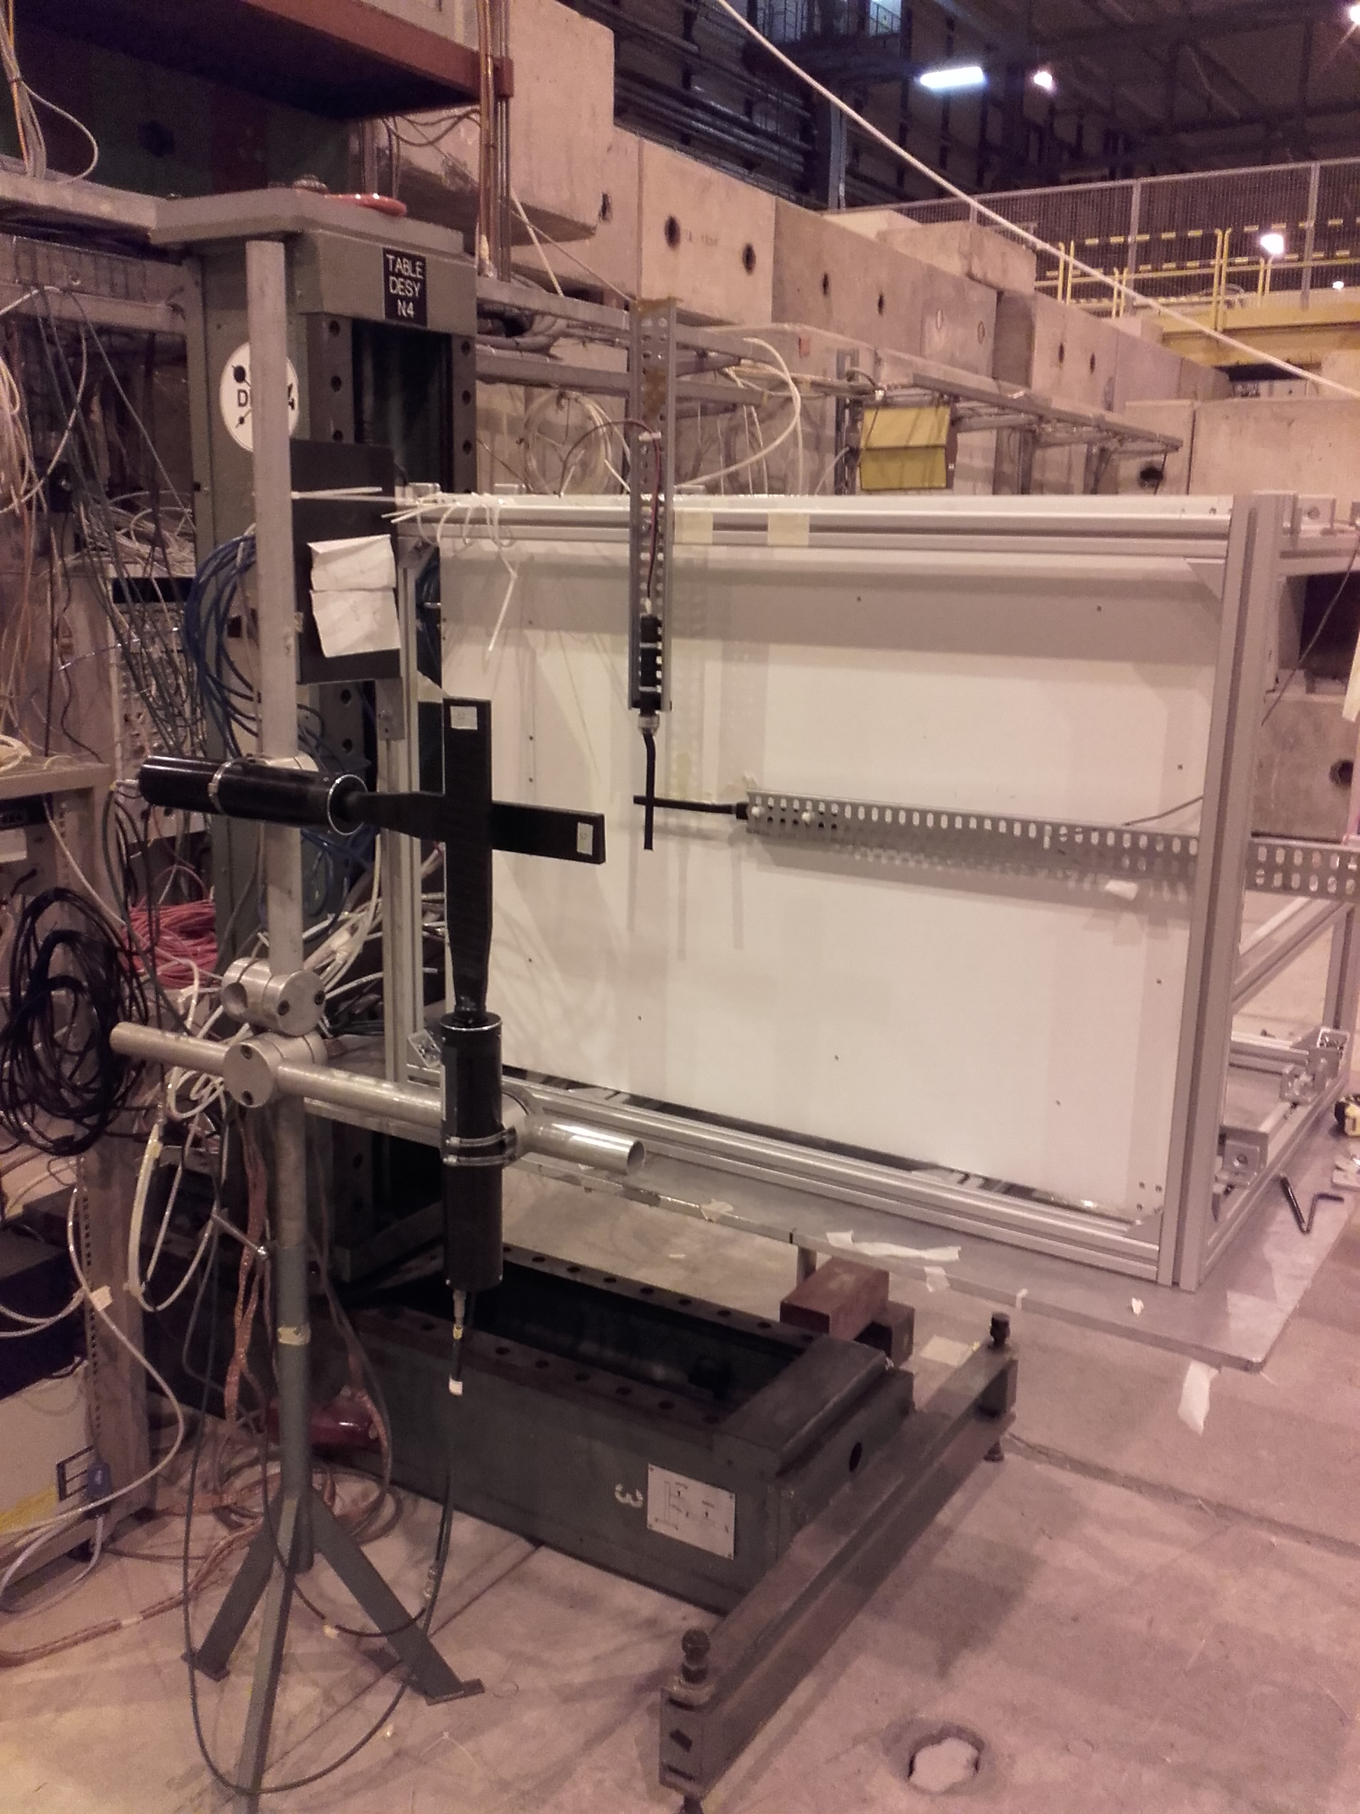
May 2017 beamtest at CERN (H4) : setup
H4 beam area
- Muon beam (150GeV)
- Tiny scintillators (1cm width)
- Scan studies were performed using moving tables (< 1mm resolution)

Slide 9
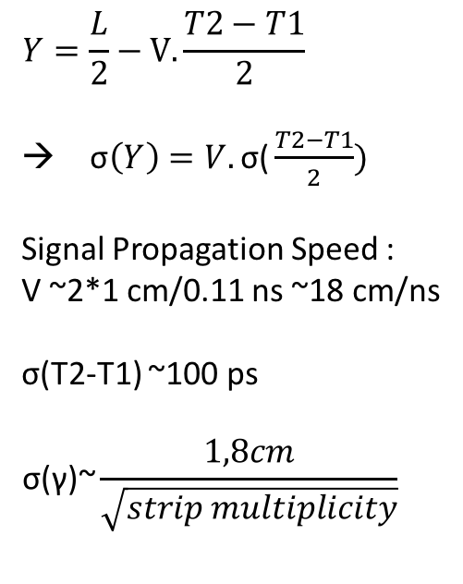
May 2017 beamtest at CERN (H4): Results
$$Y=\frac{L}{2}−V.\frac{T2−T1}{2}$$
→ σ$\left(Y\right)=V.\text{σ}\text{(}\frac{T2−T1}{2})$
Signal Propagation Speed :
V ~2*1 cm/0.11 ns ~18 cm/ns
σ(T2-T1) ~100 ps
$$\text{σ}\text{(}\text{γ}\text{)\sim }\frac{1,8cm}{\sqrt{strip multiplicity}}$$

Slide 10
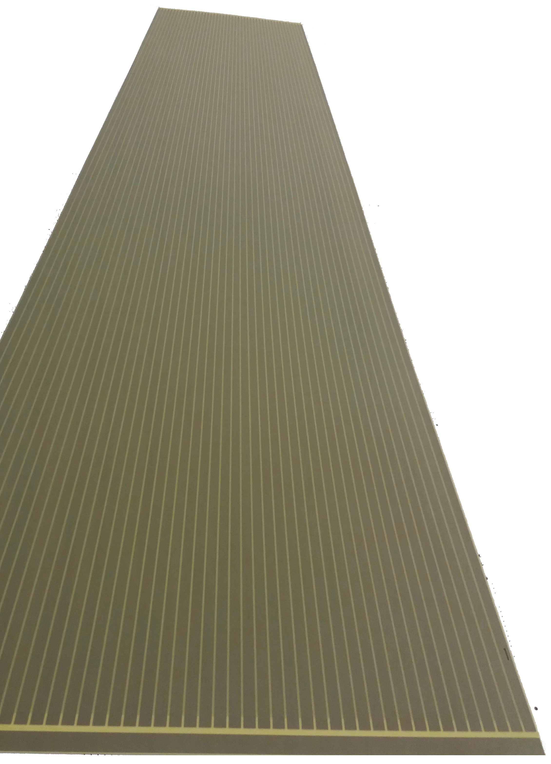

Real size strip PCB
GND area
Each strip PCB covers half of a cassette with 48 strips (1 cm each)
The strip, both gaps and cassette behave as a stripline where the cassette is the ground planes
Impedance of the strip is defined by :
              Where :
              R_{s} : Resistance
              L_{s} : Inductance
              G_{p} : Conductance
              C_{p} : Capacitance
1,6m
Side | Cp (pF) | Gp (S) | Ls (nH) | Rs (m | Zc (Ohm)
Wide | 244 | 934 | 482 | 467 | 43,5
Narrow | 244 | 934 | 487 | 461 | 44
Side | Cp (pF) | Gp (S) | Ls (nH) | Rs (m | Zc (Ohm)
Wide | 244 | 934 | 482 | 467 | 43,5
Narrow | 244 | 934 | 487 | 461 | 44
48 strips
$$Zc=\sqrt{\frac{Rs+j.Ls.ω}{Gp+j.Cp.ω}}$$
GND area

Slide 11
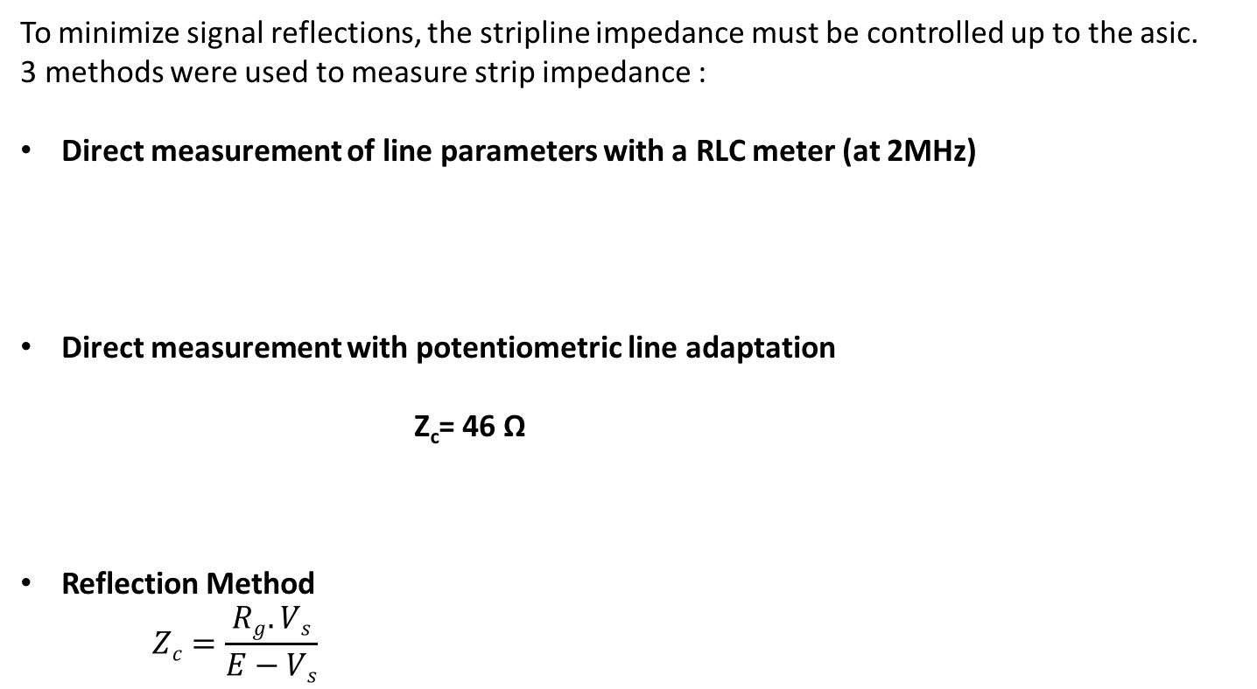
Real size PCB, Impedances and EMC
To minimize signal reflections, the stripline impedance must be controlled up to the asic.
3 methods were used to measure strip impedance :
Direct measurement of line parameters with a RLC meter (at 2MHz)
Direct measurement with potentiometric line adaptation
            Z_{c}= 46 Ω
Reflection Method
    $$Zc=\frac{Rg.Vs}{E−Vs}$$
Side | C_{p} (pF) | G_{p} (µS) | L_{s} (nH) | R_{s} (mΩ) | Z_{c} (Ω)
Wide | 244 | 934 | 482 | 467 | 43,5
Narrow | 244 | 934 | 487 | 461 | 44
R_{g}
Strip
E
R_{var}
Z_{c}=41Ω
R_{g}
Strip
E

Slide 12
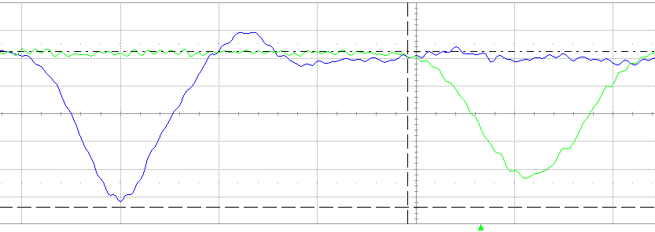
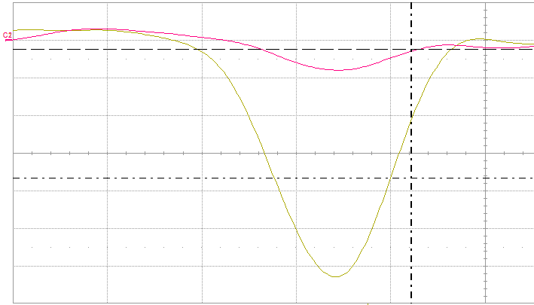
Calibrations (2) : injection on the PCB - principle
oscilloscope
Pulse generator
Agilent 81134A
A
50Ω coax.
50Ω coax.
B
1pF
50Ω
50Ω load
A’
50Ω load
Change is injected on one side (point A)
Charge is divided in two equal halves, each propagates in one direction of the strip
Cross talk is measured on adjacent strip
A’
A
B
A
A : 2mV/div
A’ : 2mV/div
Timebase : 2ns/div
A : 2mV/div
A’ : 2mV/div
Timebase : 2ns/div
Injected charges measured at both ends of the strip
Cross talk on two adjacent strips

Slide 13
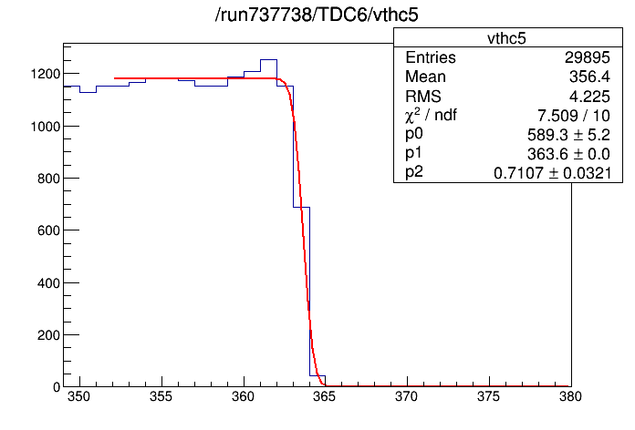
FE Calibrations : noise response, no injection
FE Calibration method :
With only one channel activated at once in the Petiroc ASIC :
  Threshold of comparator lowered step by step with short acquisition window
Alignment of all channels pedestal to the same value (individually saved in configuration database) . Erf fit function is used to compute pedestal value
Pedestal = 480 DAC

Slide 14
FE Calibrations : noise response, no injection
FE Calibration method :
With all Petiroc channels activated together :
    Threshold of comparator lowered step by step with short acquisition window (alignment check)
Turn On = 481
Channels alignment = 480

Slide 15
FE Calibrations : noise response, no injection
FE Calibration method :
With all channels activated together and strips connected to the FE board :
    Threshold of comparator lowered step by step with short acquisition window (alignment check and noise sources hunt)
Alignment = 480
Threshold =500
Turn On= 486

Slide 16
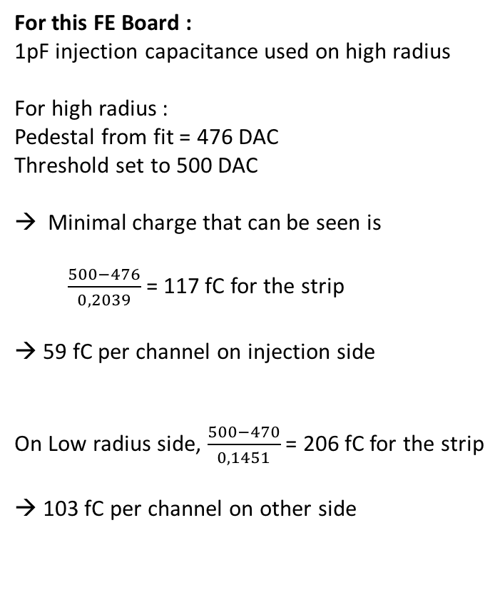
Calibrations (3) : injection on the PCB – results (for FE#2)
For this FE Board :
1pF injection capacitance used on high radius
For high radius :
Pedestal from fit = 476 DAC
Threshold set to 500 DAC
Minimal charge that can be seen is
  $\frac{500−476}{0,2039}$ = 117 fC for the strip
→ 59 fC per channel on injection side
  On Low radius side, $\frac{500−470}{0,1451}$ = 206 fC for the strip
  → 103 fC per channel on other side

Slide 17
Calibrations (4) : injection on the PCB – results (for FE#2)
170fC
230fC
230fC
❐ : injection side
○ : opposite side
Full efficiency on injection side : 170 fC (85 fC seen on each side)
Full efficiency on both sides : 230 fC (115 fC seen on each side), less than 200 ps resolution (3,6 cm)

Slide 18
Conclusions and prospects
Longitudinal position on the strip measured by difference of signals time arrival on both sides achieved with good resolution
Long Strip PCB behavior and impedance understood and under control
Wave union TDC used with Petiroc ASIC
Next steps and prospects :
FE board version 2 : 64 channels embedded in cyclone V GT FPGA
Petiroc3 ASIC (lower threshold and improved noise immunity)
Time over Threshold (ToT) to measure charge and correct time-walk effects
Integration in CMS central DAQ (GBT data link )

