Slide 1
Measurements of beam-induced photons for particle therapy
Kyong Sei Lee, Minho Kang, Youngmin Jo, and Sung Keun Park
Institute of Basic Science Laboratory and Dept. of Physics, Korea University
Sung Hwan Ahn and Youngyih Han
Samsung Proton Therapy Center

Slide 2
Contents
Motivation of R&Ds
Simulations for beam-induced secondary particles
MRPCs for gamma-ray measurements
Beam test for a 6-gap MRPC at KIRAMS
Beam test for a 4-gap MRPC at Samsung Proton Terapy Center
Conclusions and Milestones

Slide 3
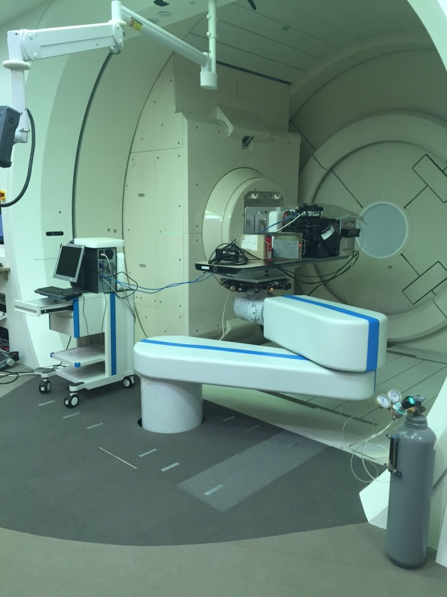
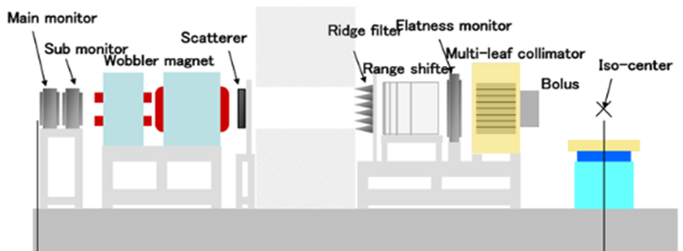
1. Motivation of R&Ds
On-line verification of beam activation in proton and carbon ion radiotherapies for quality assurance of hadron therapy treatments.
→ Verification by measuring prompt gammas
In-beam PET (positron emission tomography)
Measuring single-photon emission using collimators
Compton camera
Proton-beam Gantry at Samsung
Fixed carbon beam line at HIMAC
Detector

Slide 4
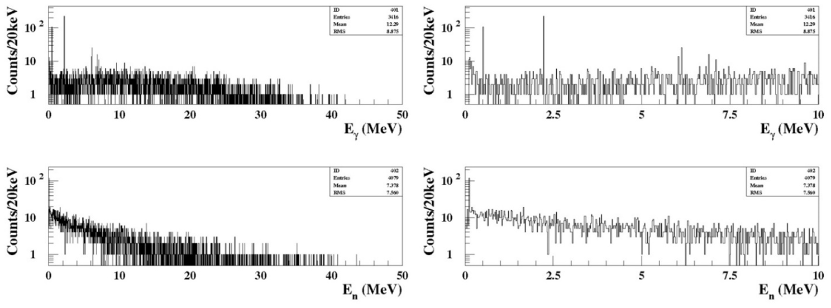
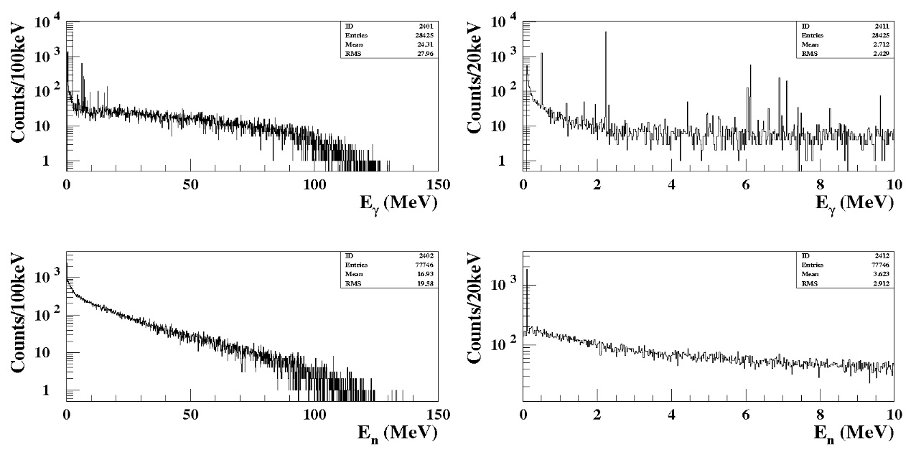
2. Simulations for beam-induced secondary particles
Using a GEANT4 program (2008 version), simulations for
44 MeV protons (0.5 M)
Prompt and delayed gammas of the excitation lines of nuclei, positron emission gammas, and bremsstrahlung occurred in a biological tissue
Neutrons emitted from biological tissue
Vertex positions, emission angles, energies of secondary particles
Gamma & neutrons per a proton
Gammas
Gammas
Neutrons
Neutrons
140 MeV protons (0.5 M)
Gammas
Gammas
Beam energy of proton | γ per proton | n per proton
44 MeV | 6.832×10⁻³ | 8.158×10⁻³
140 MeV | 5.670×10⁻² | 1.605×10⁻¹
190 MeV | 9.157×10⁻² | 3.537×10⁻¹
Neutrons
Neutrons

Slide 5
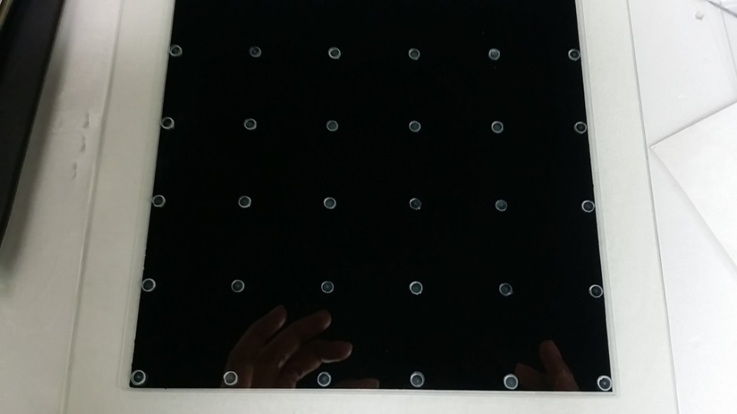
3. MRPCs for gamma-ray measurements
6-gap RPC
Thickness of a single gap = 0.36mm
Thickness/dia. of spacers = 0.35mm/4mm
Active area = 16 x 16 cm²
Thicknesses of glass
Outer electrode = 1.10 mm
Inner electrode = 0.45 mm
4-gap MRPC
Thickness of a single gap = 0.49mm
Thickness/dia. of spacers = 0.48mm/10mm
Active area = 16 x 16 cm²
Thicknesses of glass for all = 1.10 mm
γ
(-) HV
GND
x
y
GND
(-) HV

Slide 6
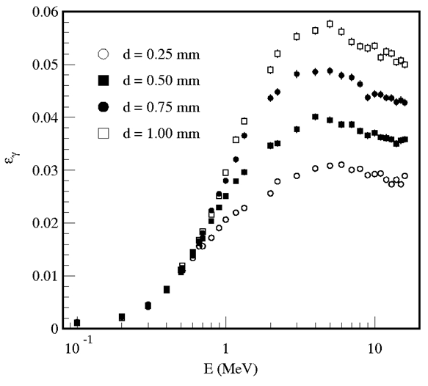
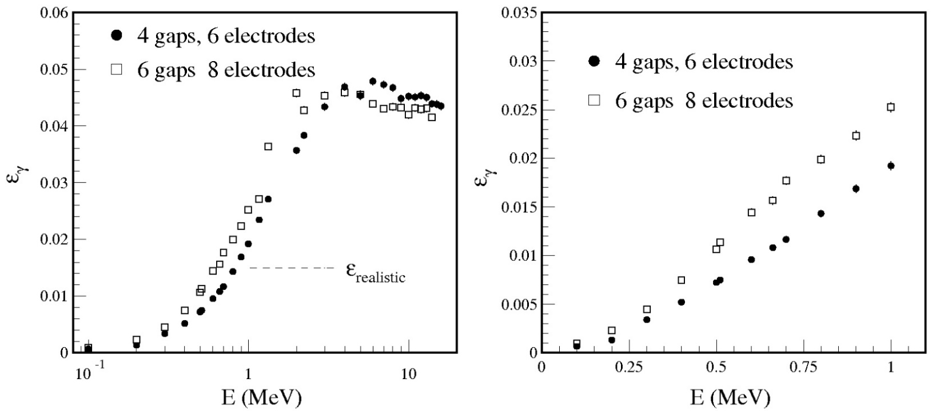
Estimation of Detector sensitivity (GEANT3)
8-glass six-gap MRPCs: Max. Q. E. via Compton scatterings = 0.058 at E_{γ} ~ 4 MeV for d = 1.25 mm
6-glass four-gap MRPCs with d=1.0 mm: Max. Q. E. for Compton scatterings = 0.048 at E_{γ} ~ 4 MeV
Realistic x-y matched sensitivity for E_{γ} > 1 MeV ~ 0.02
6-gap MRPC
6-gap MRPC
Inner glass: 0.45 mm
Outer glass: 1.1 mm
4-gap MRPC
1.1 mm for all glass

Slide 7
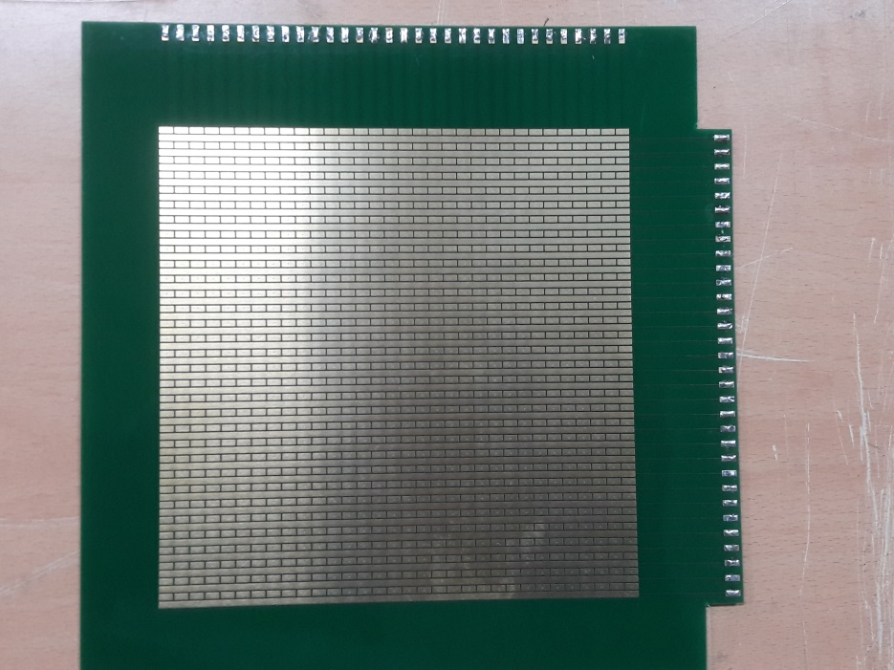
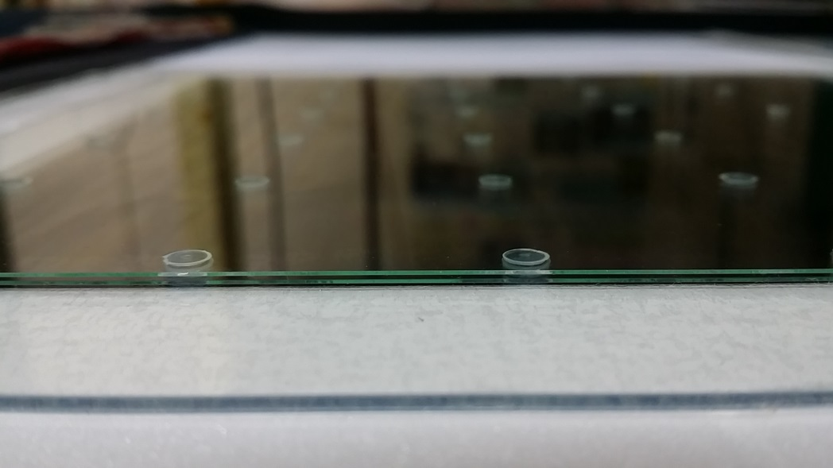
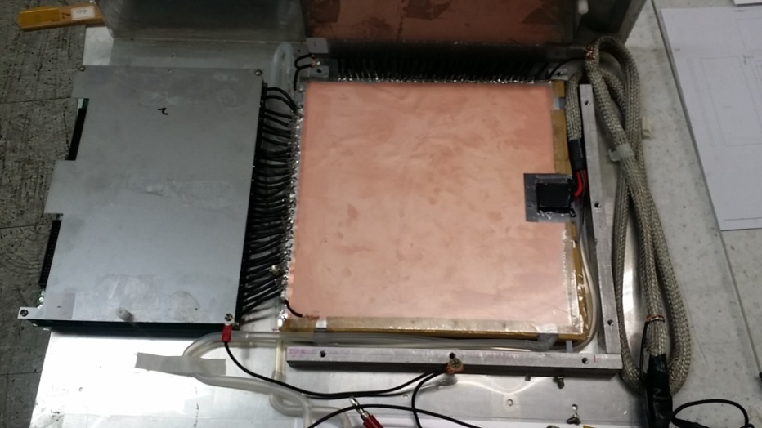
Readout strips
2-d strips for 2d imaging
Orthogonal x strips and y pads (connected by 0.1 mm traces)
Short strips → neglecting impedance matching
Pitch = 5 mm (strip & pad width = 2.0 mm)
Position resolution ~ 2 mm

Slide 8
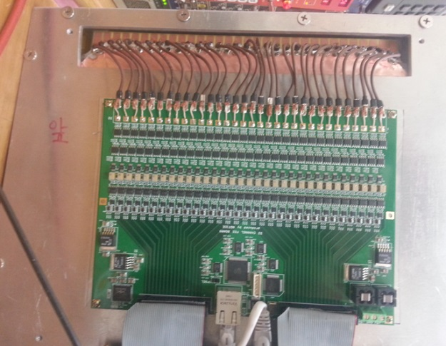
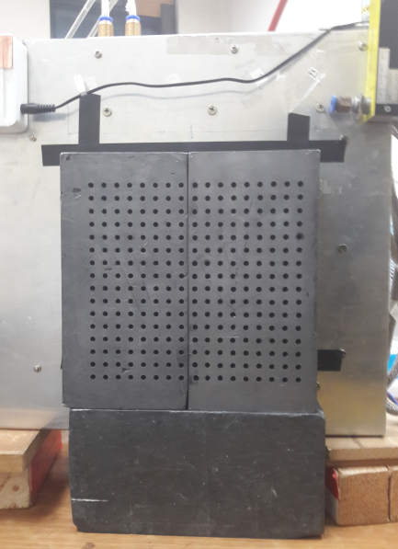
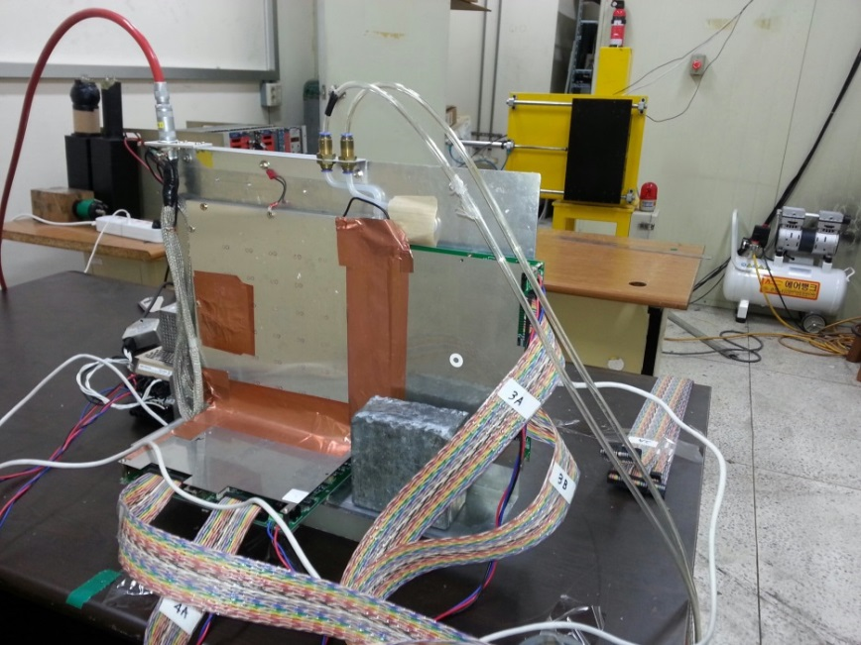
32-ch front-end electronics manufactured with commercial preamp chips (voltage sensitive)
Input impedance = 20 Ω
Gain = 200 mV/mV
Ethernet communication for FEBs
LVDS output pulse width = 70 ns (fixed)
RMS noise of board ~ 20 μV (~ 3 fC)
Time resolution ~ 100 ps for 1 pC signals
Threshold = 1.5 mV for a 6-gap MRPC
= 0.5 mV for a 4-gap MRPC
64-ch multi-hit TDC
250 Hz clock triggers with a 65-μs gate width
→ Ratio for measurement in time = 0.01625
FEBs
Colliators
Gas: 90% TFE + 10% iC₄H₁₀
Typical HV: ~ 9.1 kV for 6-gap MRPC
~ 7.0 kV for 4-gap MRPC
Typical strip multiplicity: 3 ~ 5

Slide 9
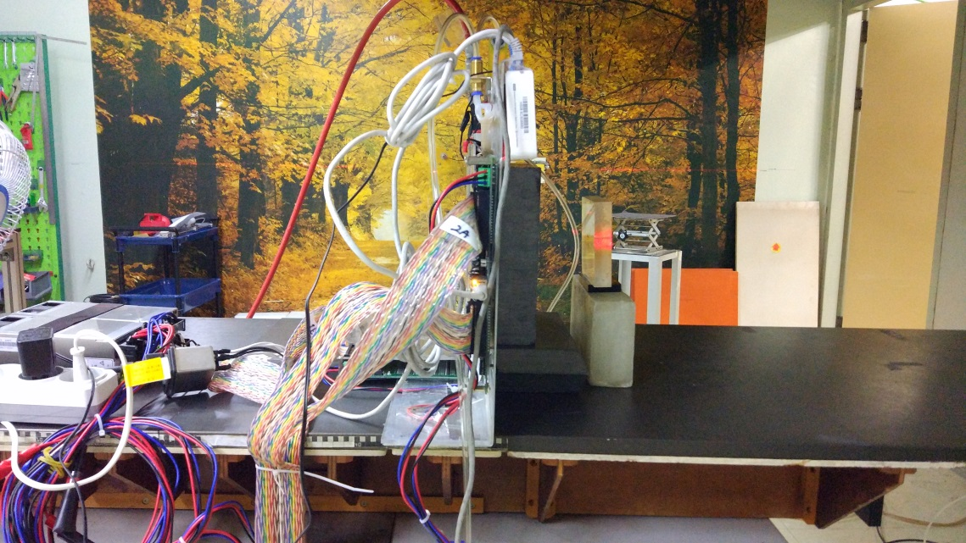
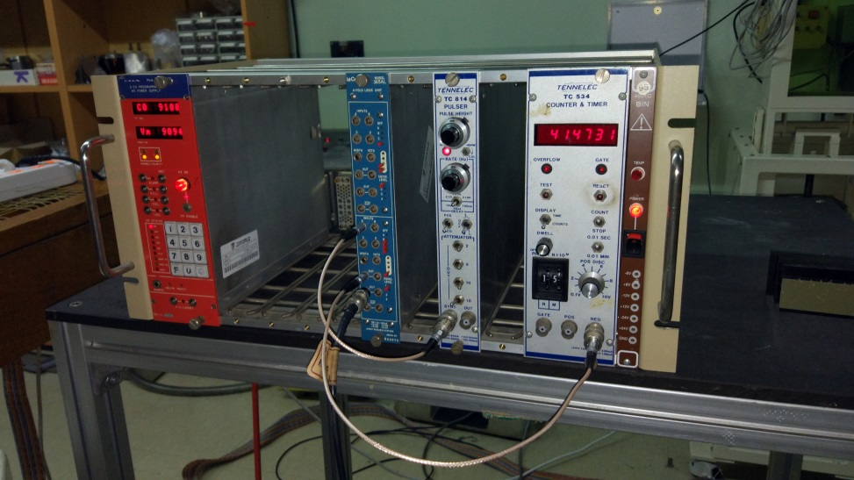
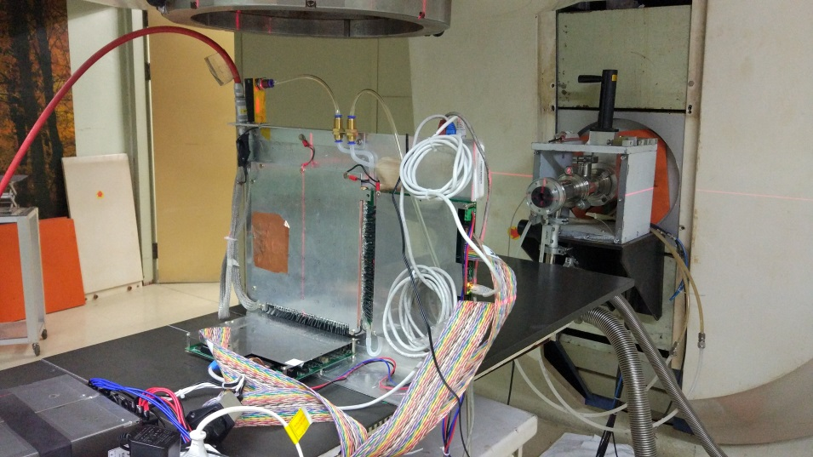
4. Beam test for a 6-gap MRPC at KIRAMS
Use 20-mm thick PMMA as a phantom
Installed detector 15 cm from the iso-center
Continuous-wave proton beams
Energy = 44 MeV
Average beam current = 10 nA
FWHM ~ 30 mm at 70 cm from
the vacuum beam exit
Collimators
5-cm thick lead bricks
4 mm holes with a 10x10 mm² 2D pitch

Slide 10
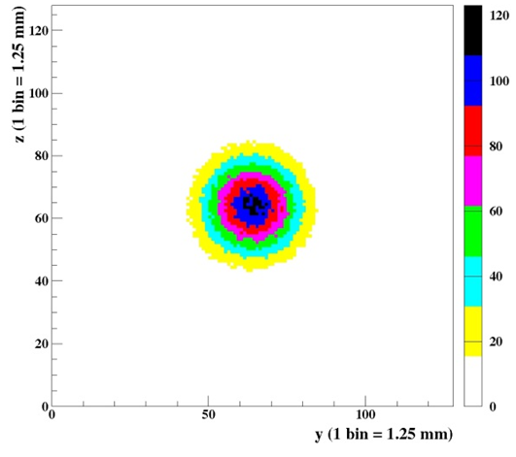
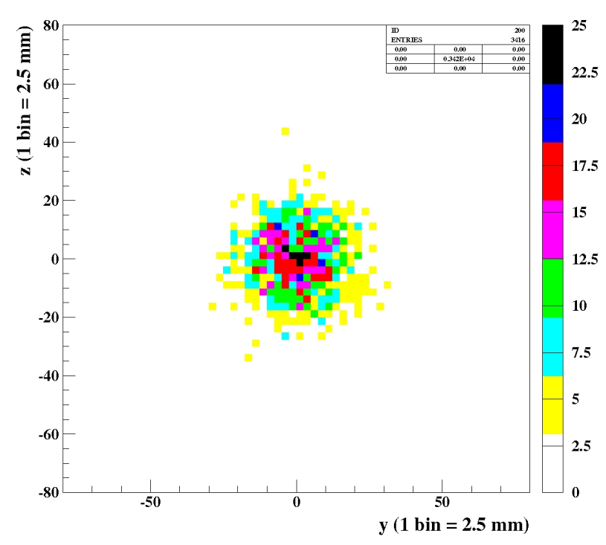
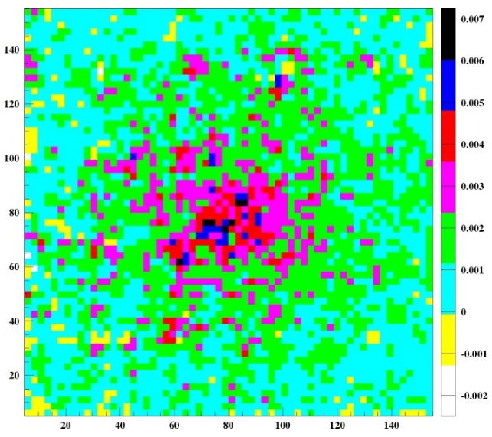
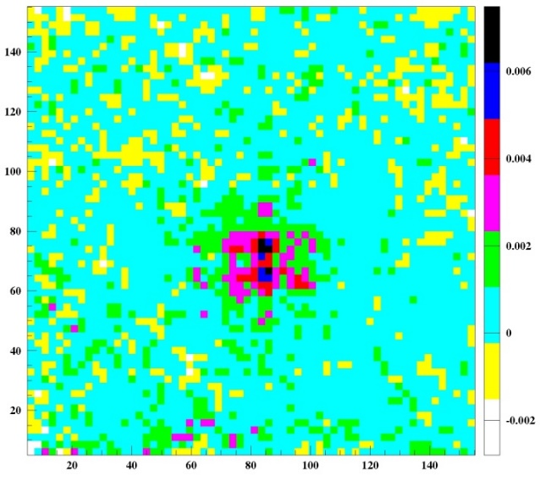
Simulated vertex distribution of γ on the horizontal plane
Beam-off condition
Delayed-decay gammas with finite half life times and positrons annihilated 511-KeV gammas (¹¹C, ¹³N, and ¹⁵O)
Measured gammas for 400 s after an irradiation on 20mm thick acryl for 400 s by applying 250-Hz clock pulses
TDC time window = 65 μs
→ DAQ efficiency ~ 1.6%
→ Actual measuring time = 6.5 s
@HV_{eff} = 9.1/9.3 kV
Using a single collimator layer,
# of effective gamma hits = 7,850
→ Low statistics due to the low DAQ
efficiency
** beam halo image of secondary Gammas induced by neutrons passing through the collimator holes and by activating the detector.
With double-layer collimators, # of effective gamma hits ~ 1,300
Simulated dose distribution in the horizontal plane
500 k protons,
dose (μSv) for color depth
500 k protons
10 nA, single collimator
10 nA, double collimator
y (mm)
y (mm)
x (mm)
x (mm)

Slide 11
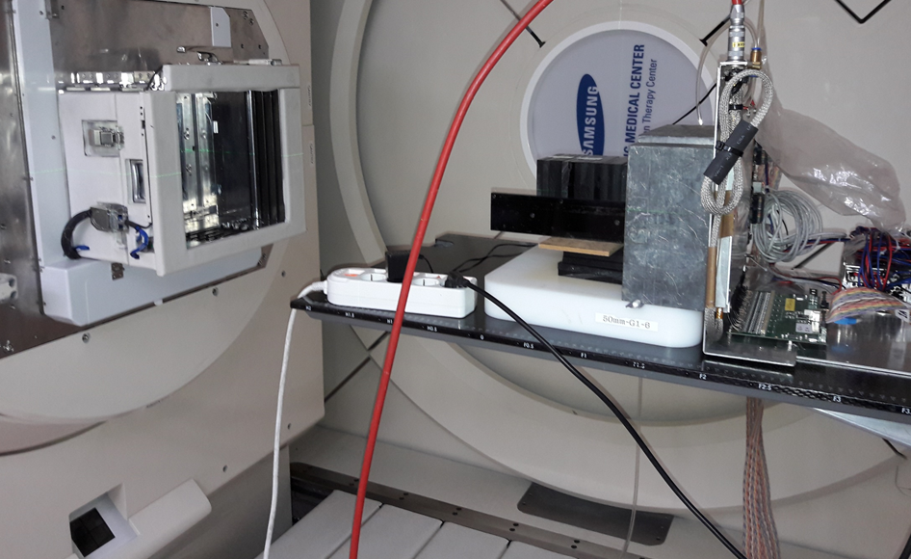
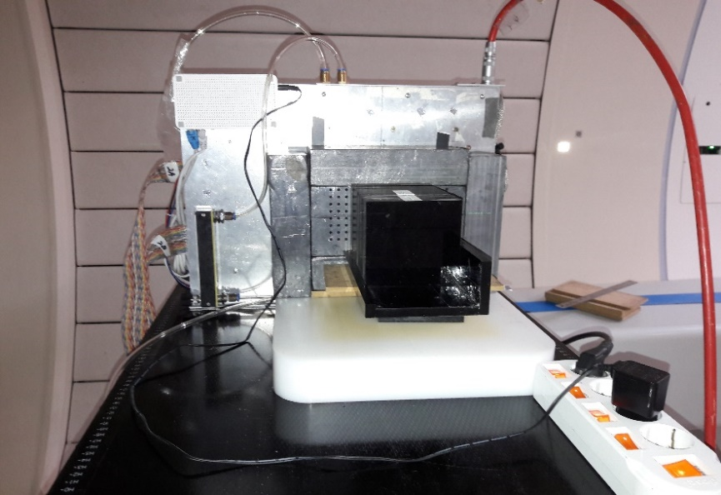
5. Beam test for a 4-gap MRPC at Samsung Proton Therapy Center
140 MeV 1 nA raster scan beam (medical cyclotron)
Raster-scan area = 5 cm x 5 cm
Image measured for 400 s
TDC window = 65 μs
Clock triger rate = 250 Hz
→ DAQ efficiency ~ 1.6%
→ Actual measuring time ~ 0.65 s
→ Even shorter because of
low duty factor of the beam
HV_{eff} = 6.9 & 7.0 kV
Case I:
For lateral distributions
Case II:
For depth distributions
5 cm x 5 cm raster scan beam
5 cm x 5 cm raster scan beam
10-mm thick acryl layers
10-mm thick acryl layers
22 cm
25 cm

Slide 12
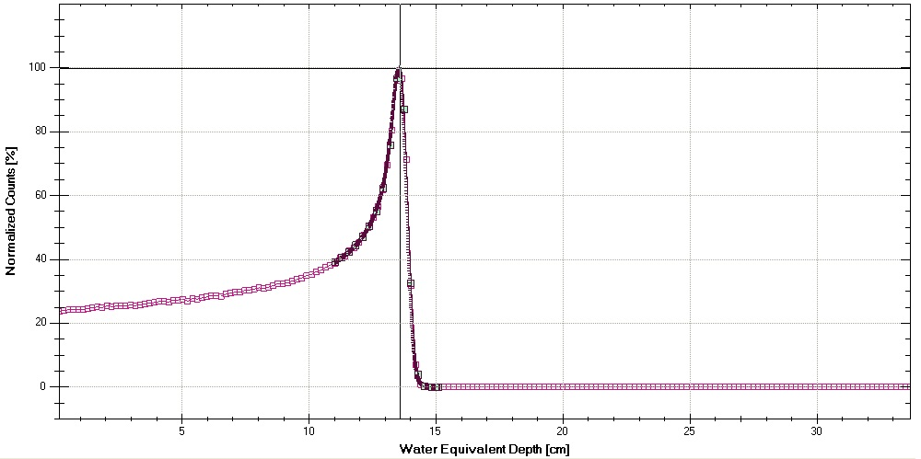
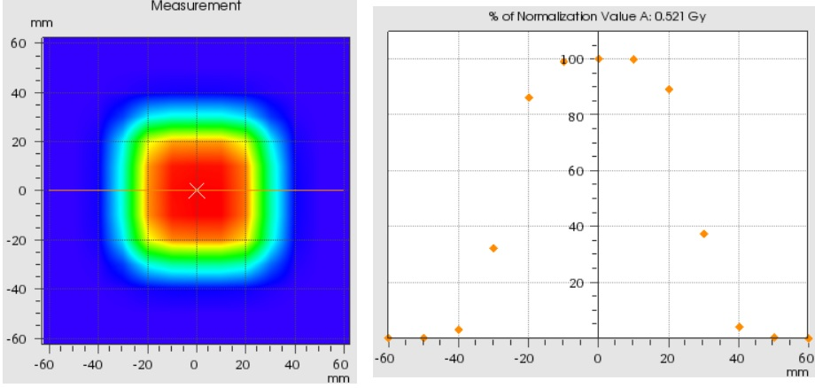
1-nA 140-MeV raster scan beam measured by an ionization chamber
(Model PTW Octavius 729 XDR)
Scan area = 5 cm x 5 cm
Bragg peak position = 136 mm
The scale for the measured dose is set to 1/10 of the actual value.

Slide 13
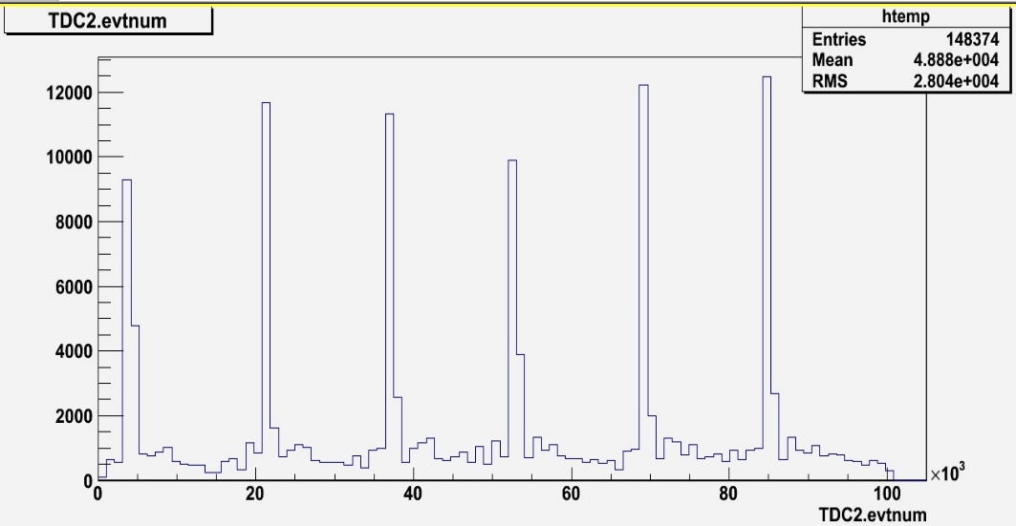
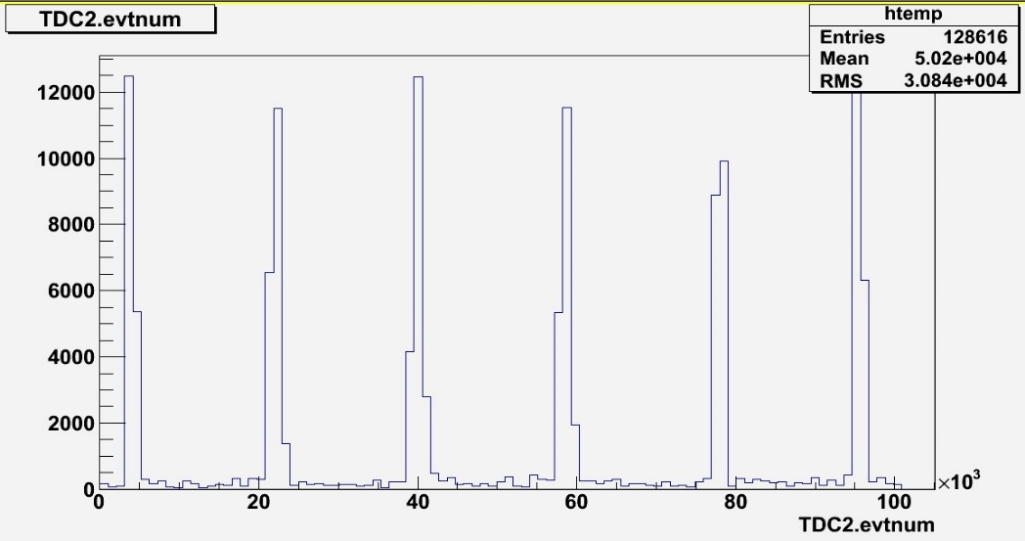
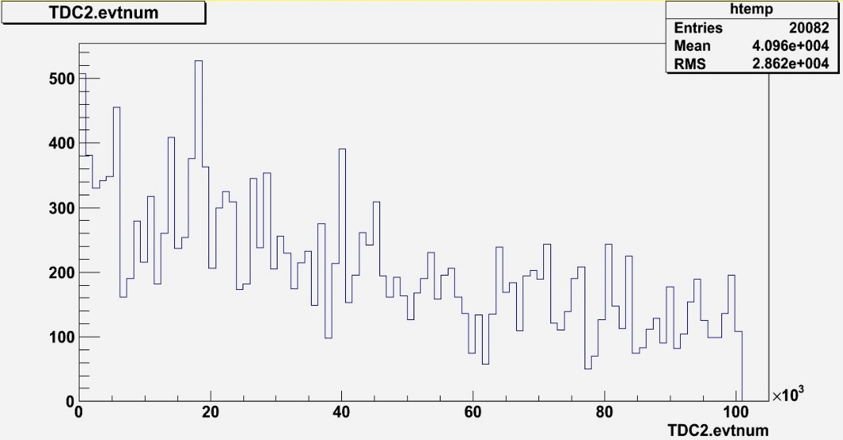
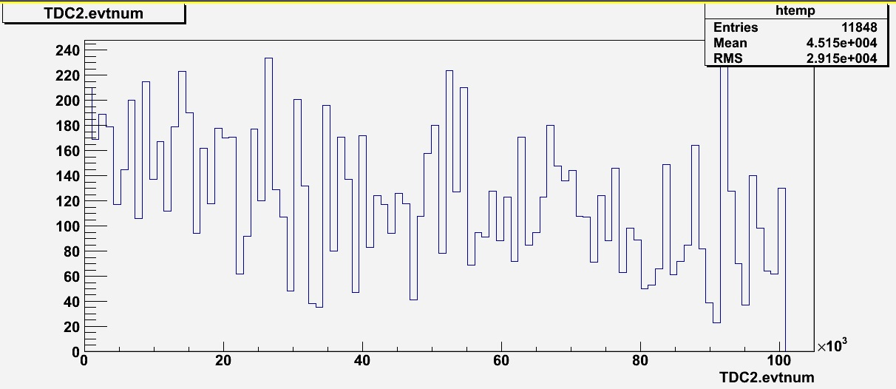
4-gap MRPC gamma (+neutron) hit data: Time profiles (TDC)
Duration of a raster scan = 6.6 s
6 raster scans in 400 s (actual irradiation time = 33.6 s → ~ 2 x 10¹¹ protons → ~ 10¹⁰ photons)
Case I: with beam
Case II: with beam
Case I: beam off
Case II: beam off
Delayed gammas by activation
Delayed gammas by activation

Slide 14
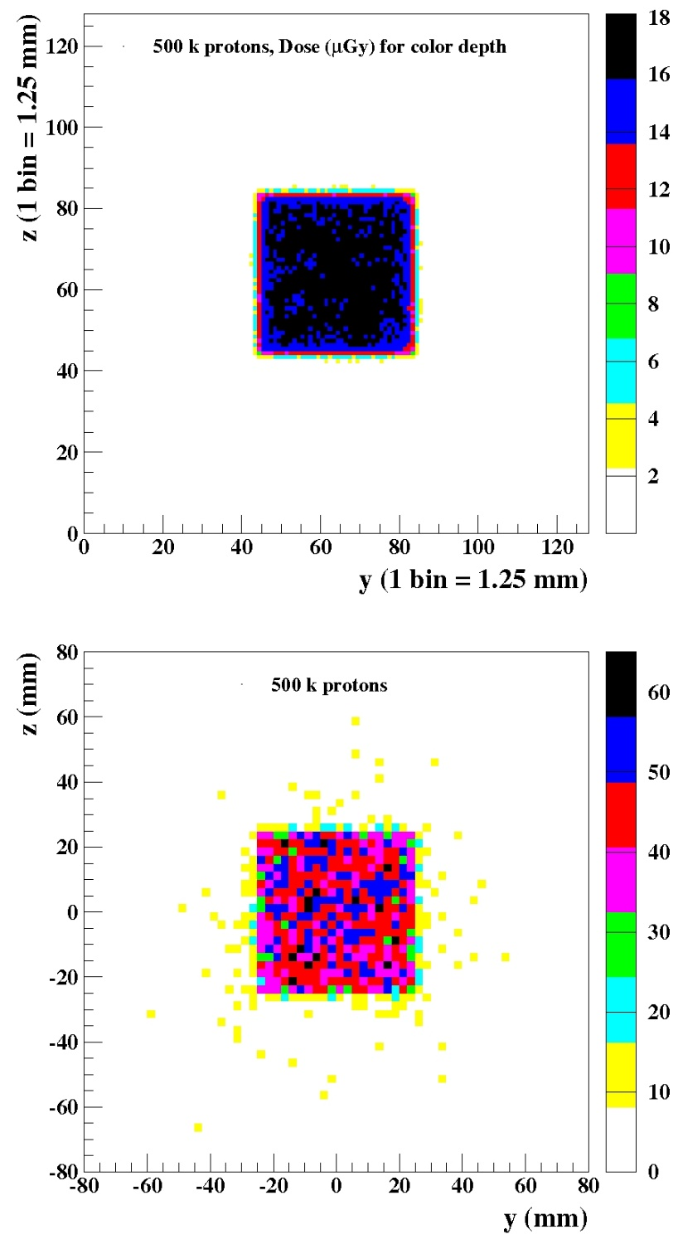
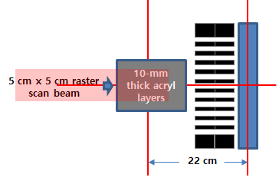
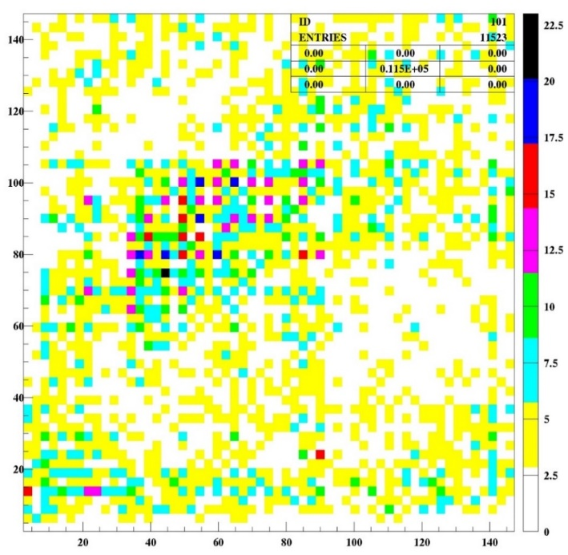
4-gap MRPC data with beam-on
Dose in tissue (GEANT4)
Case I: For lateral distributions
Using two-layer collimators
Image obtained with
C_{s,x} and C_{s,y} < 8
HV = 6.9 kV with beam
Specific gravity of acryl = 1.195
Gammas from tissue (GEANT4)
~ 30 k
The majority of background is due to neutron activation in the collimators and the detector

Slide 15
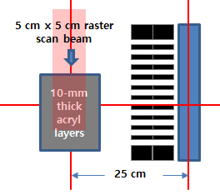
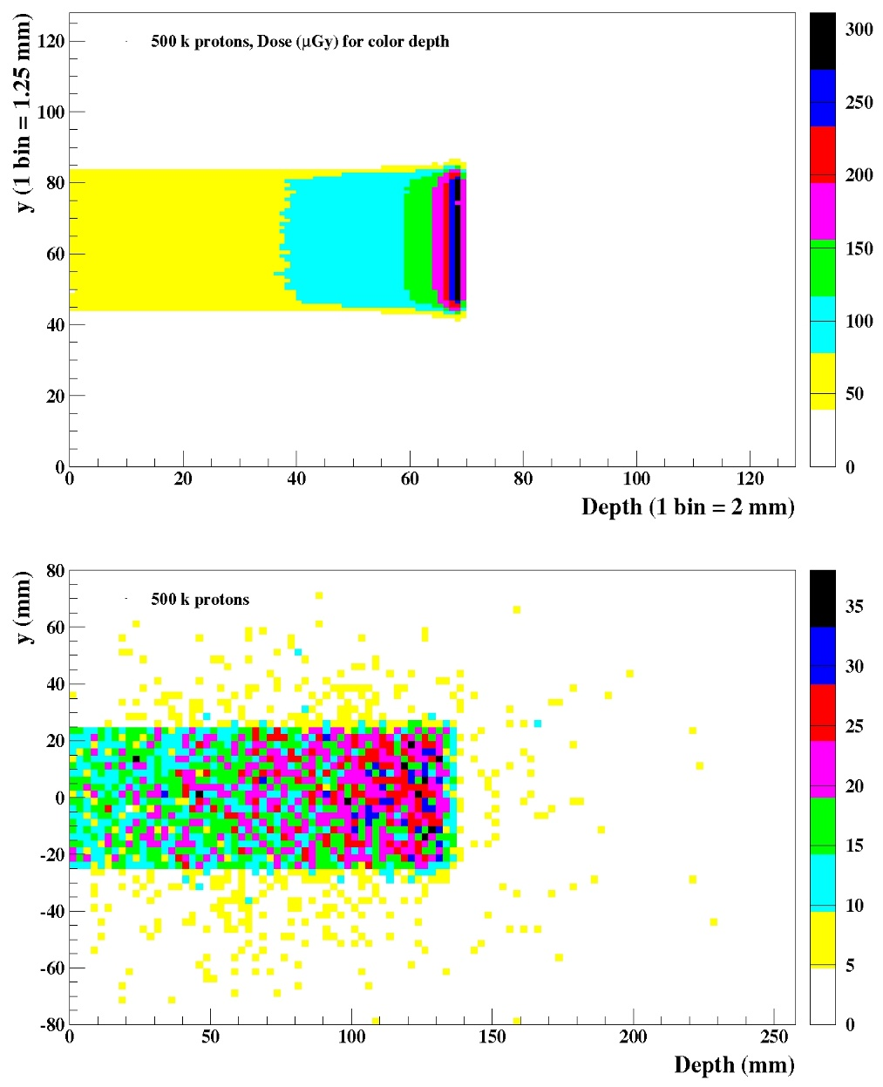
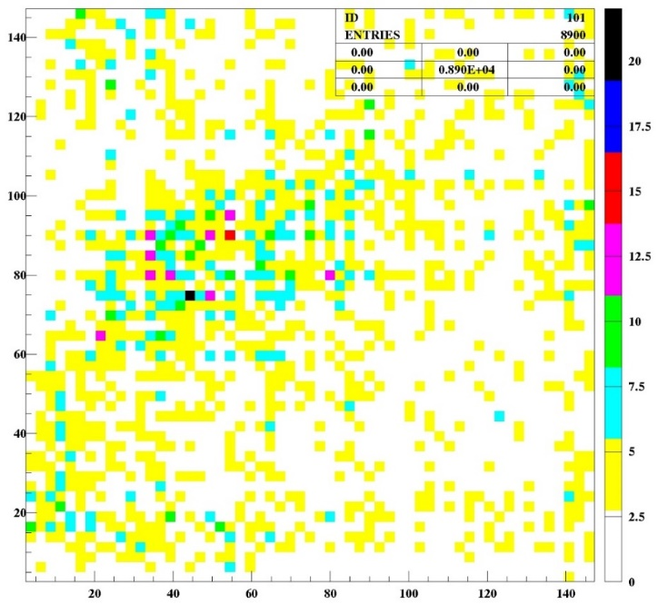
4-gap MRPC data with beam-on
Case II: For depth distributions
Using two-layer collimators
Image obtained
with C_{s,x} and C_{s,y} < 8
HV = 6.9 kV with beam
Dose in tissue (GEANT4)
Expected depth in acryl = 11 cm
Beam
Gammas from tissue (GEANT4)
~ 20 k
Beam
The majority of background is due to neutron activation in the collimators and the detector

Slide 16
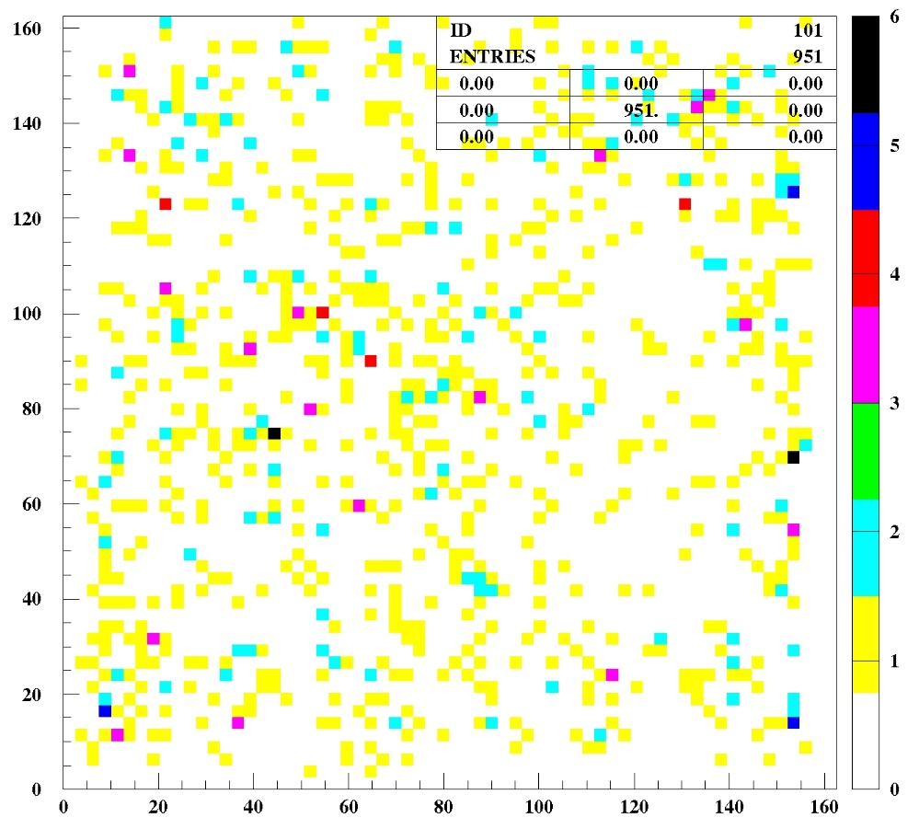
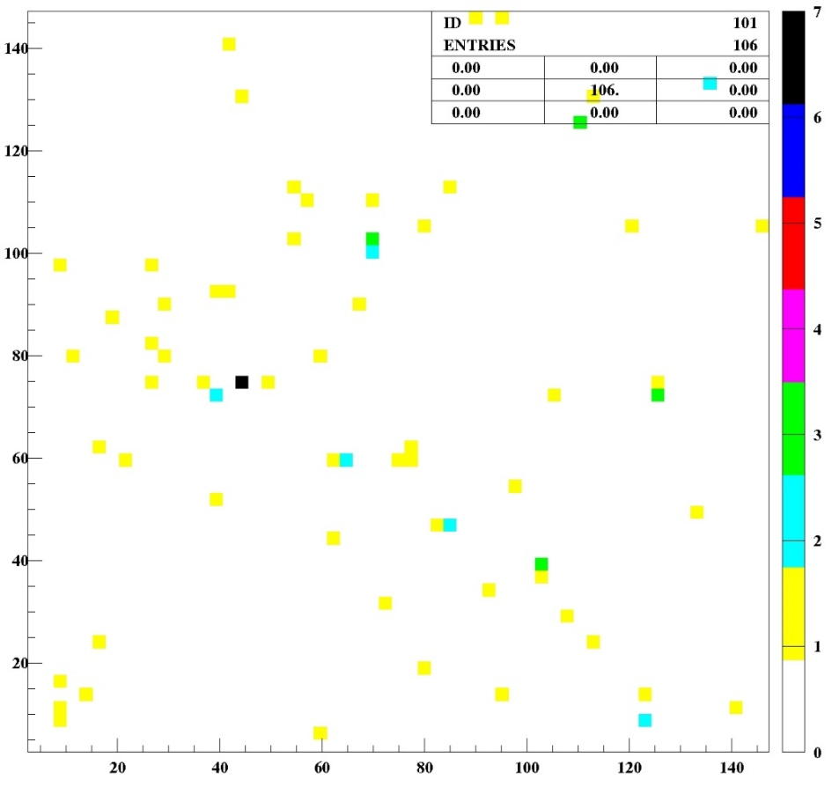
4-gap MRPC data (beam-off)
using two-layer collimators
Case I: For lateral distributions
Image obtained with C_{s,x} and C_{s,y} < 8
HV = 6.9 kV, beam off
Detector noise distribution
Image obtained with C_{s,x} and C_{s,y} < 8
HV = 6.9 kV
y (mm)
y (mm)
The majority of background is due to neutron activation in the collimators and the detector
x (mm)
x (mm)

Slide 17
6. Conclusions and Milestones
Conclusions: Have examined and proven the basic technology of MRPCs for proton-beam verifications
Simulations for prompt gammas to utilize all spectral lines of the beam driven excitations
Confirmed the detector sensitivities and the resolution for the 2D gamma images
Confirmed the imaging method for the radio active area induced by proton beams
6-gap MRPC using 10-nA 44-MeV protons at KIRAMS (beam-off condition)
4-gap MRPC using 1-nA 140-MeV protons at Samsung Proton Therapy Center (beam-on condition)
To be solved: Low statistics → should improve the high DAQ dead time (low DAQ efficiency in time)
To be solved: Neutron background problem → needs better neutron shielding for detectors
To be solved: Optimization of collimators (layer out, thickness, and neutron shielding)
Gas mixture (aging with Freon-base gas → other option: Ar + iC₄H₁₀)
Milestones: To enhance the statistics of data, need a dedicated trigger/data-transfer electronics
No DAQ dead time → the statistics will be 60 times larger!
Latching of all LVDS detector signals in a FPGA memory
Ethernet (or USB3) data transfer to DAQ PC
For a typical proton beam of energy ~ 140 MeV with the typical 6 raster scans
→ Expected statistics ~ 200 k gammas with beam-on
~ 10 ~ 20 k gammas even for the beam-off condition
When using collimators, MRPCs are the best for range-verification for particle therapy.

Slide 18
BACKUPS

Slide 19
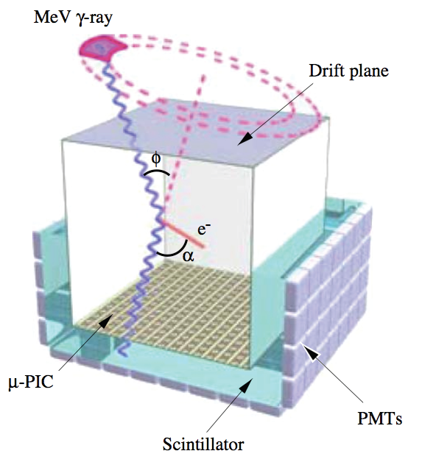
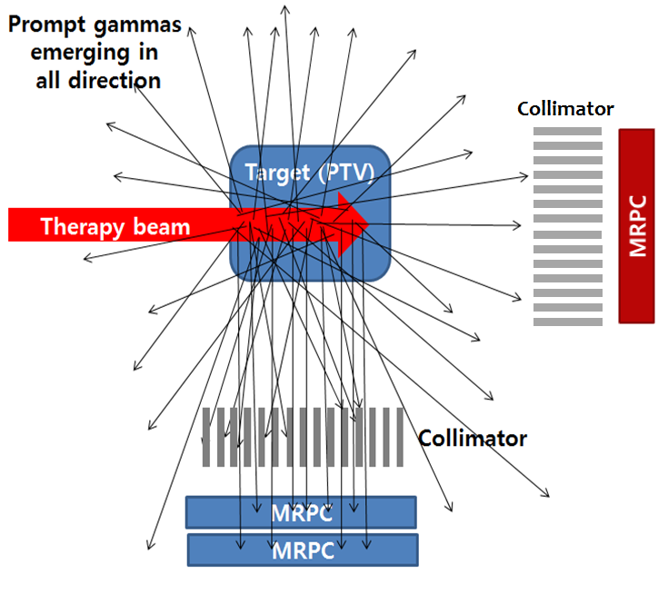
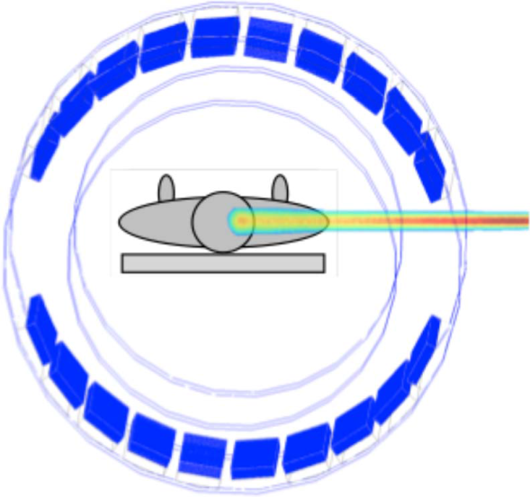
In-beam PET
Coincident measurement of 511-keV gammas emitted from only β decays of ¹¹C, ¹³N, ¹⁵O
Excellent resolution < 2 mm
(Converged vertex images)
Small field sizes
Expensive
Collimation for single γ
Measurement of prompt gammas emitted from all excitation lines (> 0.5 MeV)
Resolution < 5 mm
Very low tagging efficiency for 2D imaging
Large field sizes
Cheep
Compton camera
Tracking all gamma rays
→ Best efficiencies
Difficult tomographic process
Poor position resolution (diverged vertex images)
Small field size
Expensive

Slide 20
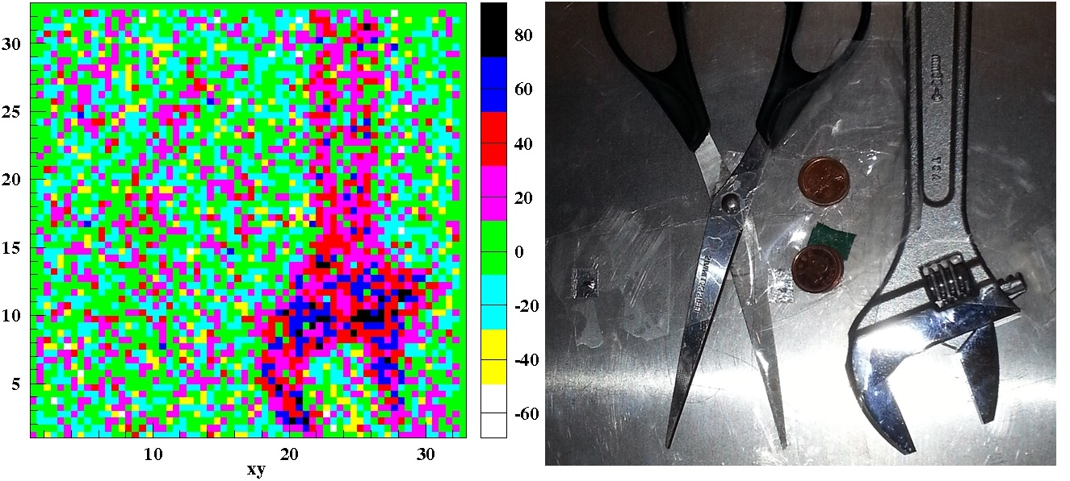
64 x 64 pixels 2D image obtained by
x(mean)-y(mean) matched data points
# of gamma hits per pixel ~ 170
Resolution ~ 2 mm
Spanner: stainless, 0.6 mm ~ 1.2 cm
Scissors: stainless, ~ 0.8 mm
Coins: brass, 1.0 ~ 2.0 mm
Half attenuation length of stainless for ¹³⁷Cs 661.7 keV gammas ~ 6 cm

Slide 21
Expected particle rates on the collimator (for ten minutes after beam off)
Beam energy of proton | γ signal rate on collimators
44 MeV | ~ 2 kHz cm⁻²
100 MeV | ~ 12 kHz cm⁻²
190 MeV | ~ 25 kHz cm⁻²
Expected detection rate (beam off condition)
Mean Q.E. for gammas at 8-stacked glass MRPC (6 gaps) ~ 0.02
Collimator efficiency ~ 0.02 (single) / 0.005 (double)
Beam energy of proton | γ detection rate on the detector
44 MeV | ~ 0.8 Hz cm⁻² / ~ 0.2 Hz cm⁻²
100 MeV | ~ 5 Hz cm⁻² / ~ 1.2 Hz cm⁻²
190 MeV | ~ 10 Hz cm⁻² / ~ 2.5 Hz cm⁻²
With a 44 MeV proton beam,
the actual rate (400 s after beam off)
= 4.7 Hz cm⁻² (single collimator)
~ 0.7 Hz cm⁻² (double collimator)
→ Larger than the expected rate by GEANT4
Collimator efficiency might be underestimated.
Neutron driven gamma backgrounds in the detector.

Slide 22
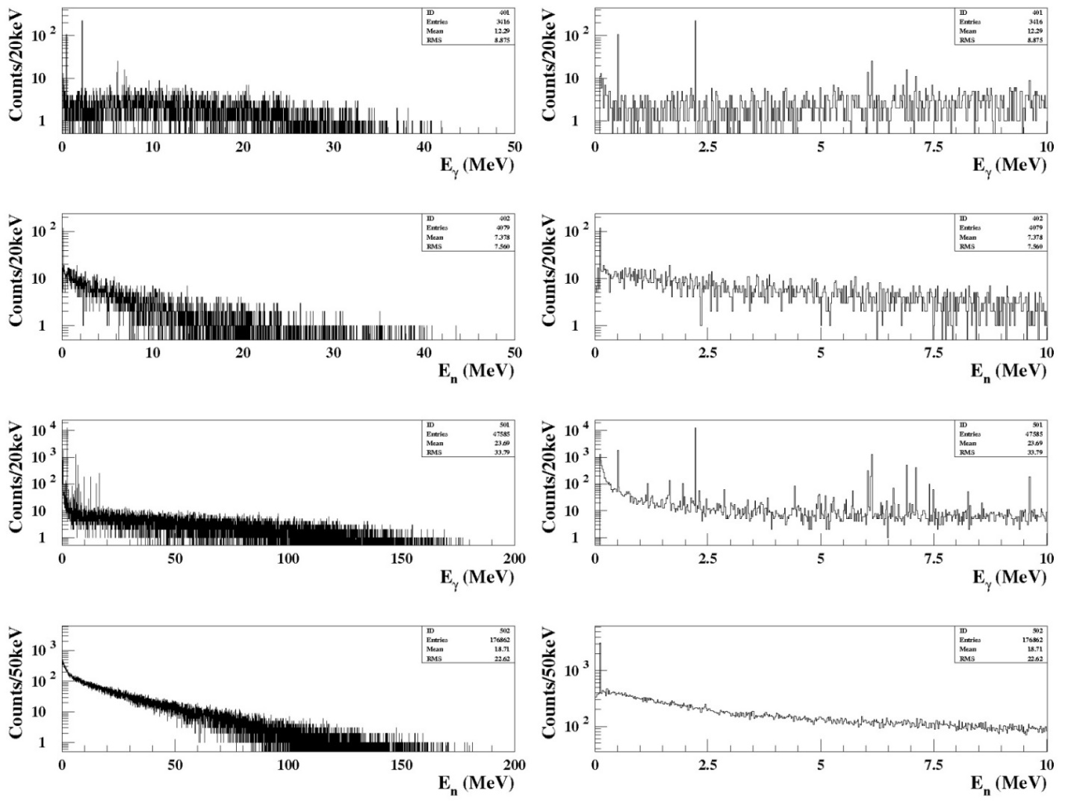
2. Simulations for beam-induced secondary particles
Using a GEANT4 program (2008 version), simulations for
44 MeV protons (0.5 M)
Prompt and delayed gammas of the excitation lines of nuclei and Bremsstrahlung occurred in a biological tissue
Neutrons emitted from biological tissue
Vertex positions, emission angles, energies
Gammas
Gammas
Neutrons
Neutrons
190 MeV protons (0.5 M)
Gammas
Gammas
Neutrons
Neutrons

Slide 23
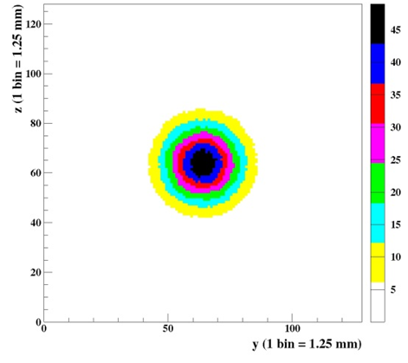
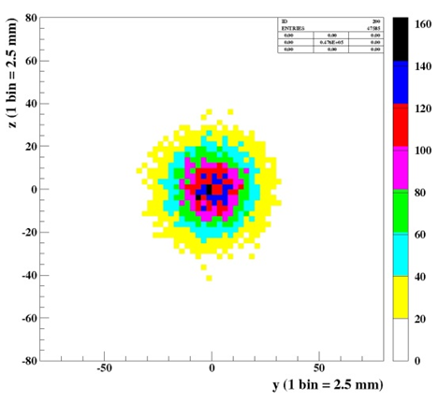
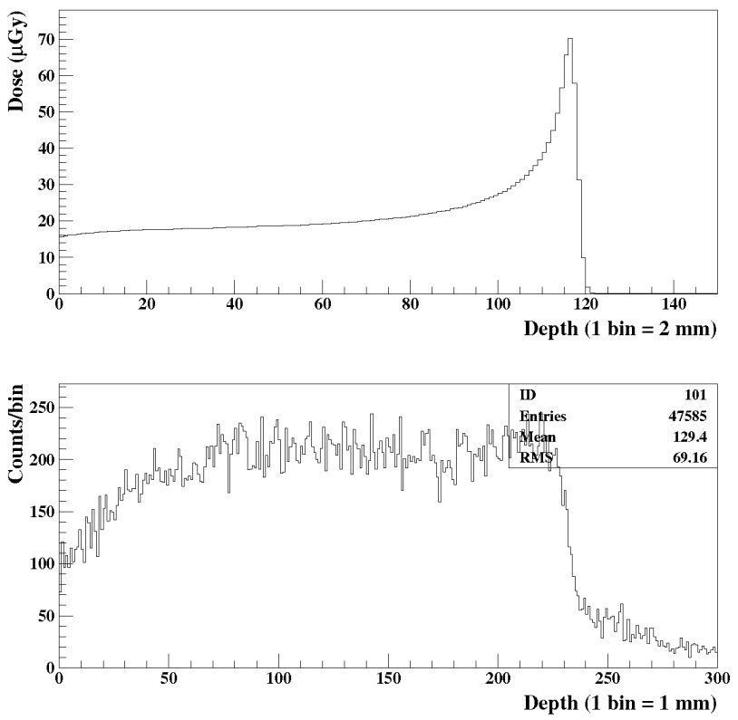
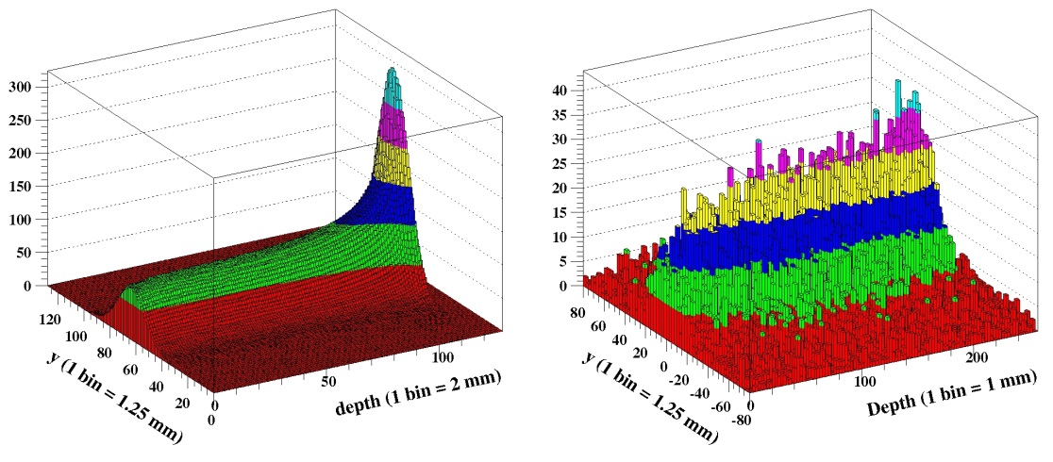
GEANT4 simulation for 190 MeV protons
FWHM = 3 cm
Phantom size (biological tissue)
= 30 cm x 16 cm x 16 cm
Dose distribution in the horizontal plane
Vertex distribution of γ on the horizontal plane
Dose distribution along the depth
Vertex distribution of γ

Slide 24
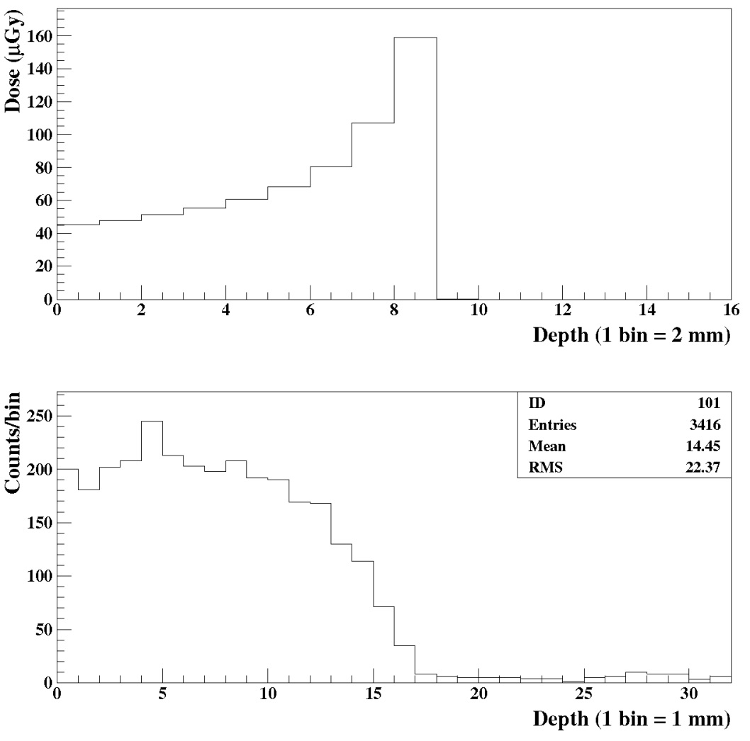
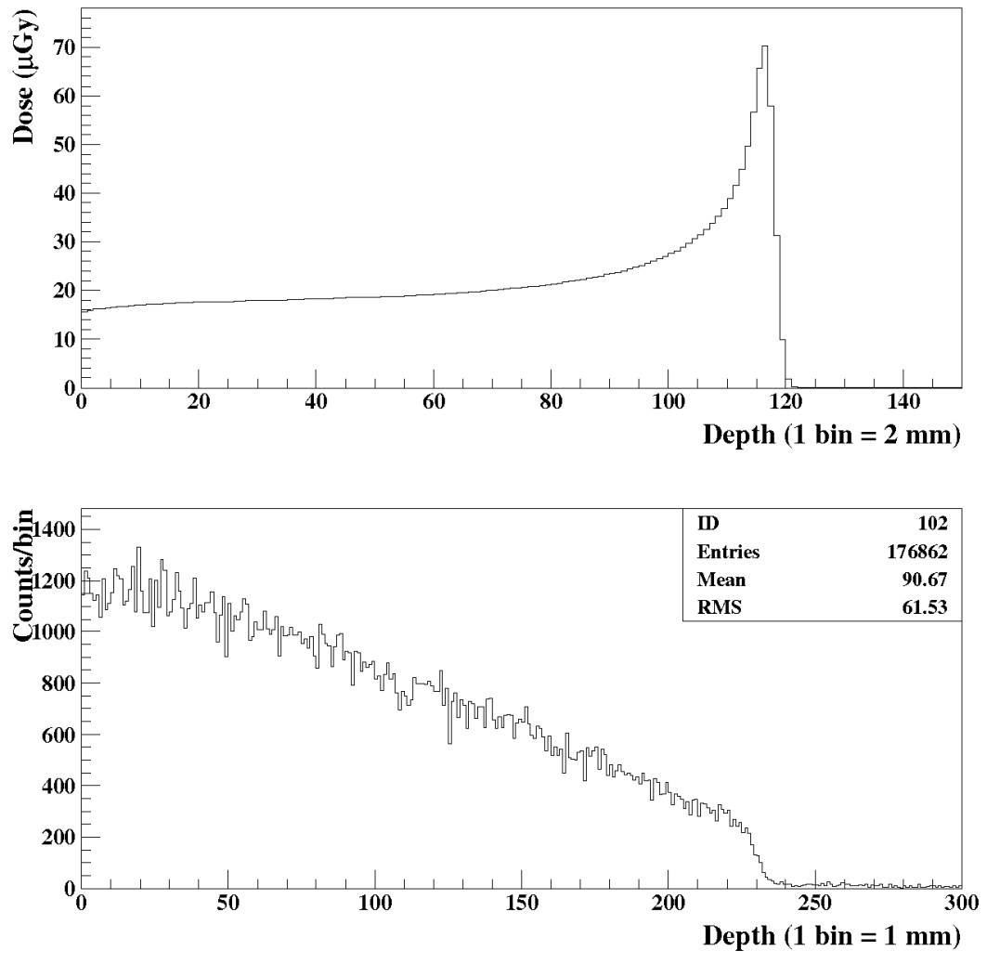
Dose distribution along the depth (44 MeV)
Dose distribution along the depth (190 MeV)
Vertex distribution of neutrons (44 MeV)
Vertex distribution of neutrons (190 MeV)

Slide 25
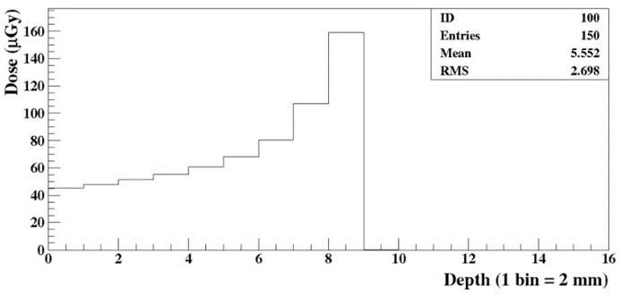
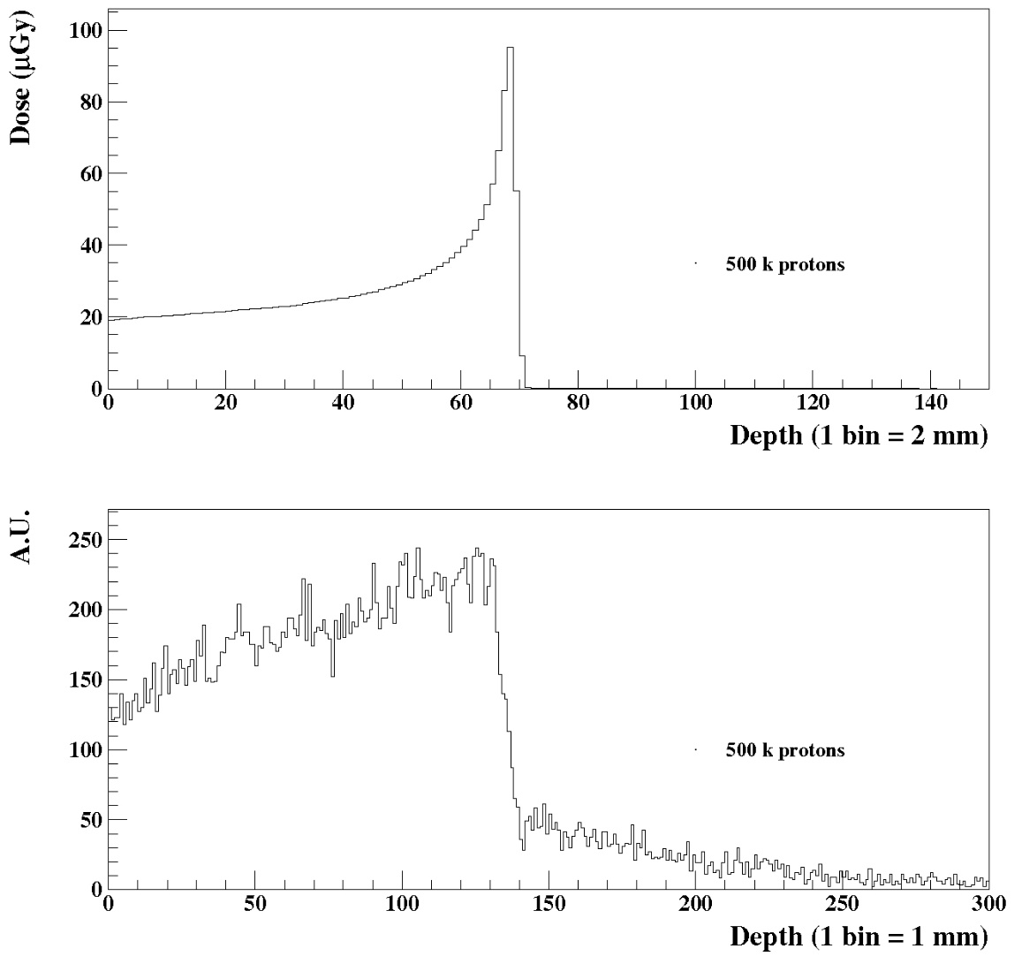
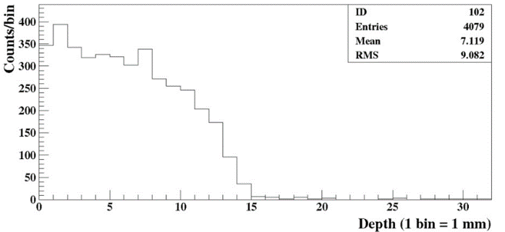

Dose distribution along the depth
44 MeV
Dose distribution along the depth
Vertex distribution of γ
140 MeV
44 MeV
Dose distribution along the depth
190 MeV
Vertex distribution of γ
140 MeV
Vertex distribution of γ
190 MeV

Slide 26

GEANT4: spatial and angle distributions

Slide 27


Test of 4-gap MRPC at 2.3 m from 5.0 GBq ¹³⁷Cs source (661.7 keV)

Slide 28



Responses to ¹³⁷Cs gammas
Channel distribution
x-y matched
Time profiles
Channel distribution
x strips
x strips
x strips
y strips
y strips
y strips

Slide 29

4-gap MRPC data with 140 MeV beam
Cluster size distribution for Case I
C_{s}
C_{s}
C_{s}
C_{s}

Slide 30

4-gap MRPC data
Case I: For lateral distributions in PMMA
HV = 6.9 kV
HV = 7.0 kV
x (mm)
y (mm)
x (mm)
y (mm)

Slide 31

Case II: For depth distributions in PMMA
HV = 7.0 kV
HV = 6.9 kV
x (mm)
y (mm)
x (mm)
y (mm)

Slide 32


2D response function for calibration (440 k γ) + random number generations of 500 times to smooth the response function image
Image of three of ~ 3 μCi ⁶⁰Co
y (mm)
y (mm)
x (mm)
x (mm)

Slide 33


Flood images through 4 cm x 4 cm window
Flood images (all)
y (mm)
y (mm)
x (mm)
x (mm)

Slide 34



GEANT4 simulation for 44 MeV protons (FWHM = 3 cm) for KIRAMS test
Phantom size (biological tissue) = 3 cm x 16 cm x 16 cm
Dose distribution along the depth
Vertex distribution of γ
Dose distribution in the horizontal plane
Vertex distribution of γ on the horizontal plane

Slide 35


Case I: For lateral distributions
Image obtained with C_{s,x} and C_{s,y} < 6
HV = 6.9 kV with beam
Case II: For depth distributions
Image obtained with C_{s,x} and C_{s,y} < 6
HV = 6.9 kV with beam
y (mm)
y (mm)
x (mm)
x (mm)

Slide 36


Case I: For lateral distributions
Image obtained with C_{s,x} and C_{s,y} < 6
HV = 7.0 kV with beam
Case II: For depth distributions
Image obtained with C_{s,x} and C_{s,y} < 6
HV = 7.0 kV with beam
y (mm)
y (mm)
x (mm)
x (mm)

Slide 37


Case I: For lateral distributions
Image obtained with C_{s,x} and C_{s,y} < 8
HV = 7.0 kV with beam
Case II: For depth distributions
Image obtained with C_{s,x} and C_{s,y} < 8
HV = 7.0 kV with beam
y (mm)
y (mm)
x (mm)
x (mm)

Slide 38


Image of 661.7 keV gammas @42 cm from a 5 GBq ¹³⁷Cs source
y (mm)
x (mm)

