Slide 1
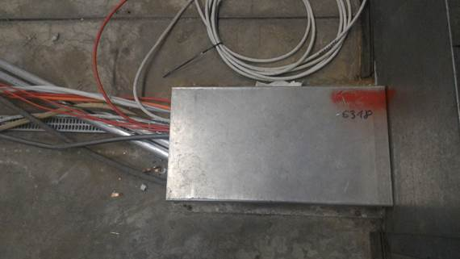
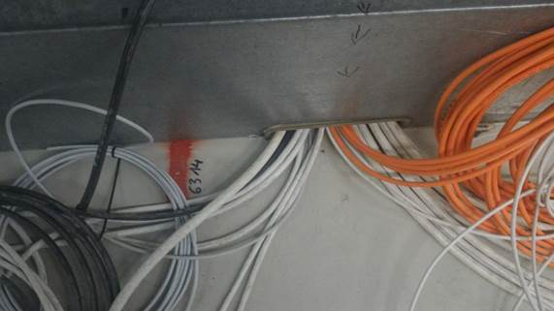
Proposition de routing des cables :
Avec 2 energy chains de part et d’autre de la table
Chaine amont (61734) : les fibres optiques, les cables de thermométrie de Sosin, les cables des cryogénistes)
Chaine aval (61744) : tous les autres et notamment les cables coaxiaux des RF
Re-routing des cables depuis l’actuelle fente dans le bus-bar, 6314m, jusqu’à la fente en aval, 6318m

Slide 2
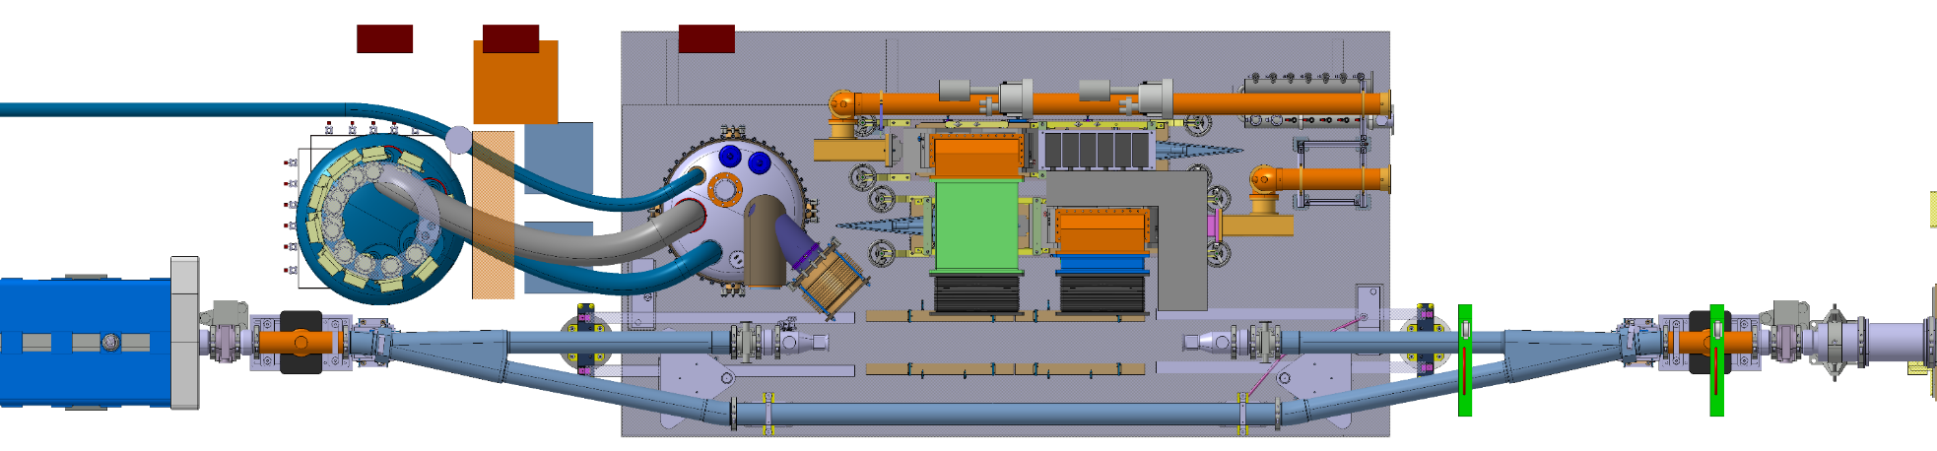
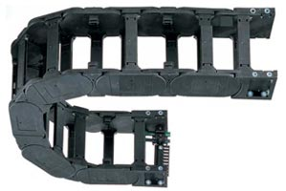
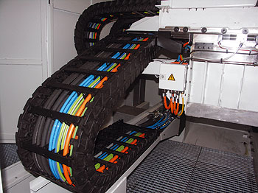
Energy chains

Slide 3
Integration
TUNNEL
New reheater
Mini-rack CRG substituting the crates
Phase separator LN2
Blowers may go on the ceiling
Mini-rack for interlocks (NE48 cables)
Patch panels for RF-Power and LLRF, flexwell cables (3/8’’ and 7/8’’)
BA6 SURFACE BUILDING
EN/EL should give us the dimension of the 2 switchboards

Slide 4
Questions EN/EL
1. UPS requests
3. Re-ALIM ?
ITEM | DESCRIPTION | V | kW
1 | RA4721 | 230 | 3.5
2 | POWER STRIP FIP CRATES | 230 | 3.0
3 | CRYO RACK RA10100=TA6 | 230 | 3.5
4 | QUR1HEM02-20401 | 230 | 6.0
5 | Cage Faraday | 400 | 1.5
6 | RF Controls | 230 | 1.0
 | 2 PLC
 | 2 Interlocks
 | 1 table interface
 | TOTAL |  | 18.5
Can’t this be reduced?
Better estimated ?
see Gerardo’s slide
Later, 4kW
4. PROGRESS on crab zone in the coming TS?
2. Additional DIC ?
Transfer Table
BE/ICS Oxygen Deficiency Detection and Alarm flashes
…

Slide 5
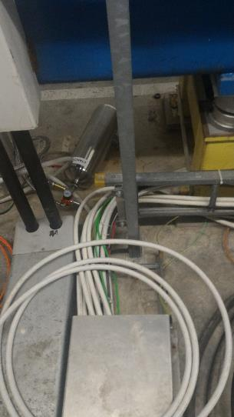
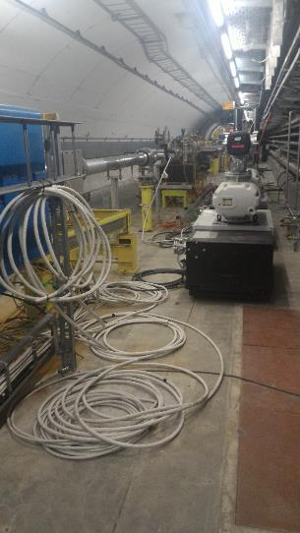
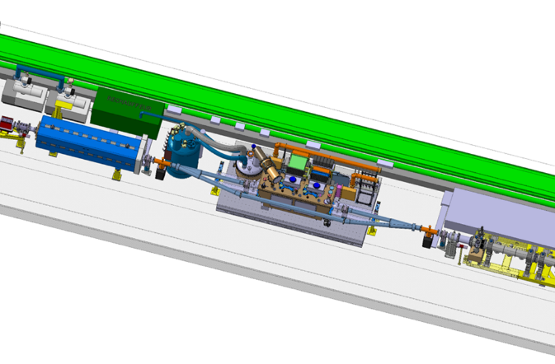
Cable routing

Slide 6
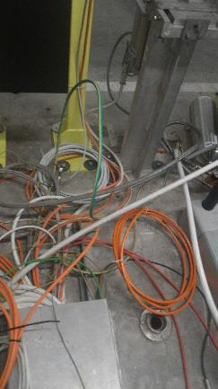
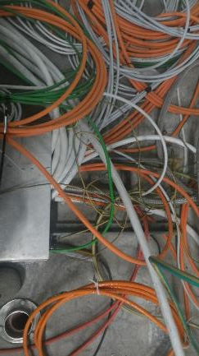
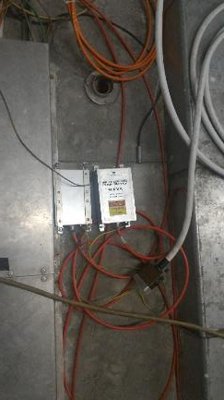
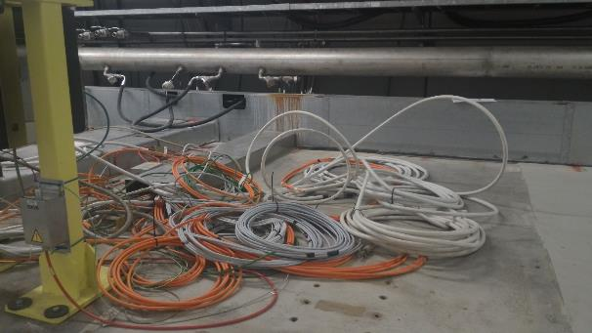
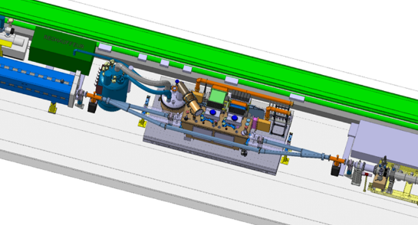
Cable routing

Slide 7
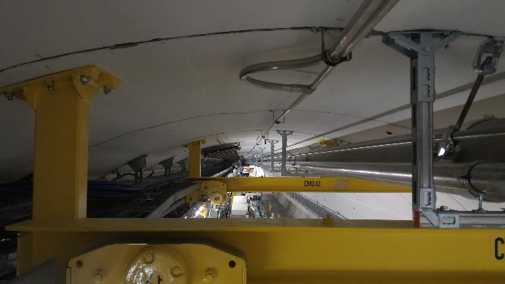
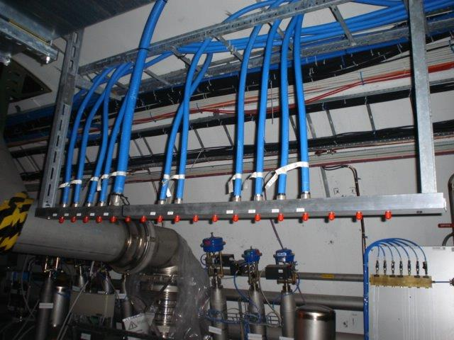
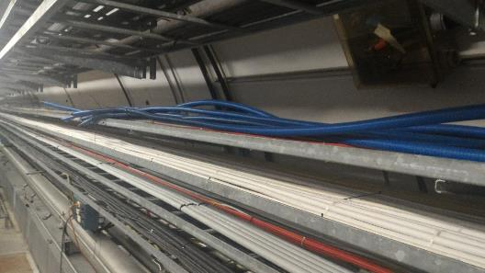
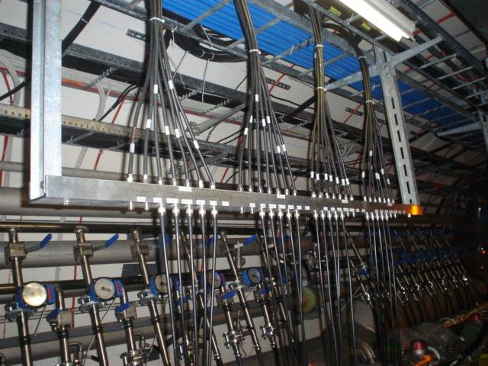
Cable routing – flexwell 7/8’’ and 3/8’’
LHC example

Slide 8
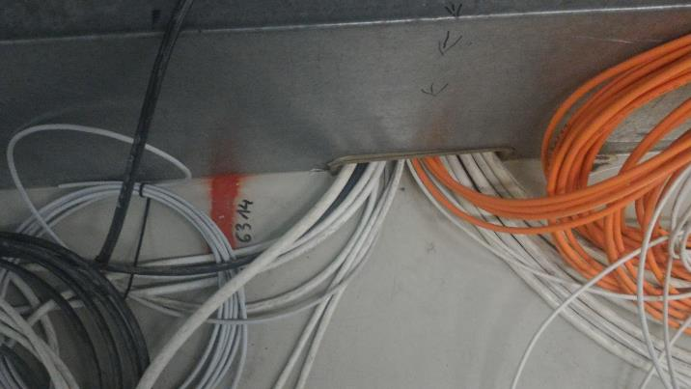
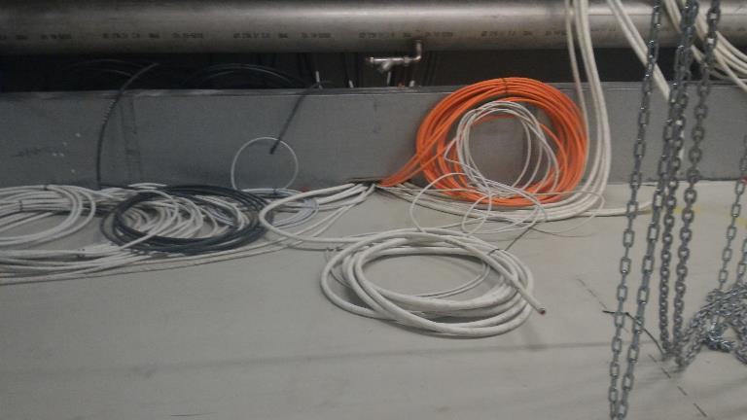
Cable routing
From behind the transfer table…
6314m

Slide 9
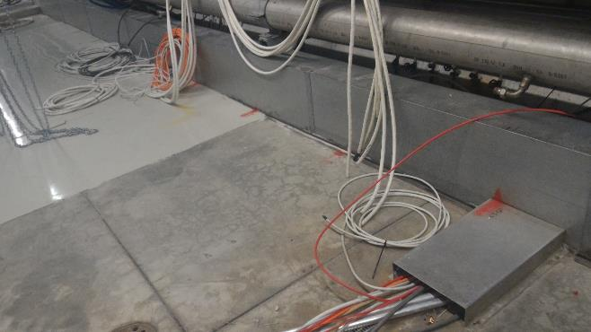
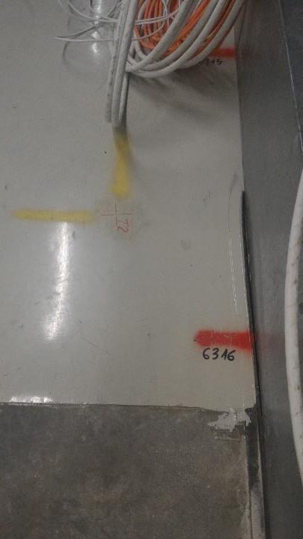
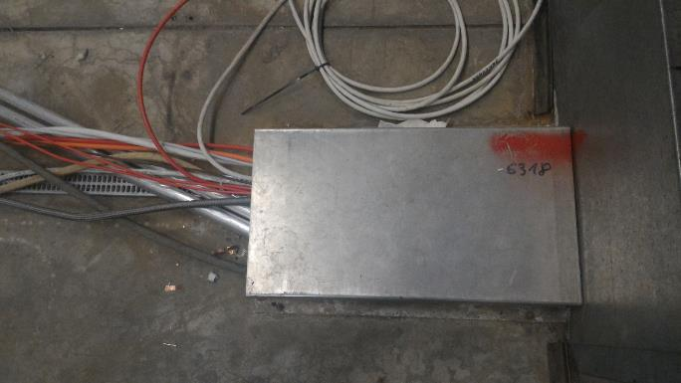
Cable routing
…to 4m more downstream
6314m
6318m

Slide 10
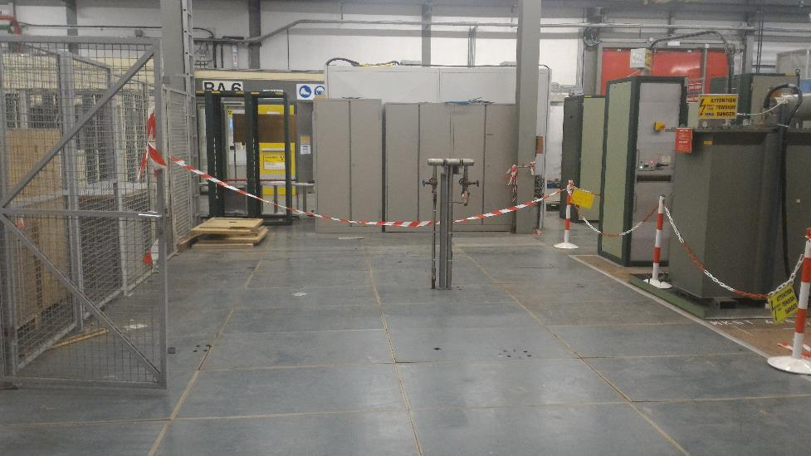
Activities TS#2
For the next TS, RF-Power foresees to install a load at the end of the RF Power lines, connect it to the lines and to water, to be able to test the emitters further on.
EN/EL: can you proceed to re-routing of the cables and cutting the flexwell, once the patch panel is installed?
EN/CV: is it possible to remove the unused water manifold (clarinette) during a 36h Technical Stop?
Others…?

