Slide 1
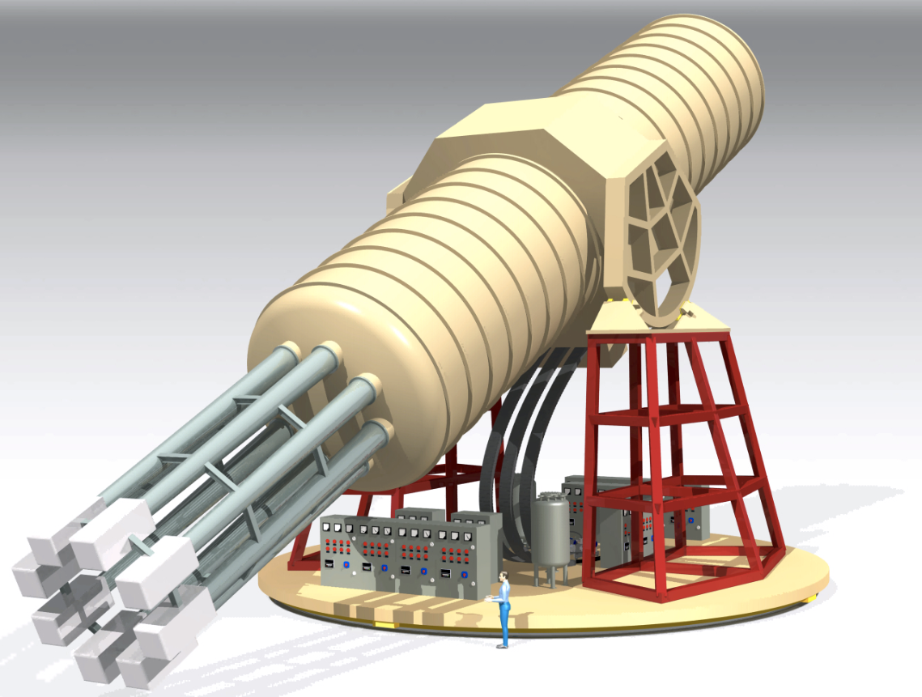
International AXion Observatory (IAXO) status and prospects
Igor G. Irastorza (U. Zaragoza) on behalf of the IAXO collaboration
Physics Beyond Colliders, CERN, November 21st 2017

Slide 2
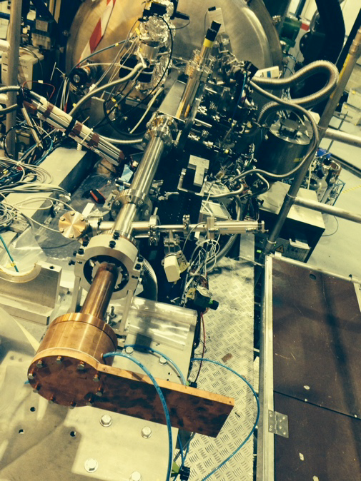
IAXO experiment reminder
Next generation “axion helioscope” after CAST
Purpose-built large-scale magnet
  >300 times larger B²L²A than CAST magnet
  Toroid geometry
  8 conversion bores of 60 cm Ø, ~20 m long
Detection systems (XRT+detectors)
  Scaled-up versions based on experience in CAST
  Low-background techniques for detectors
  Optics based on slumped-glass technique used in NuStar
~50% Sun-tracking time
Large magnetic volume available for additional “axion” physics (e.g. DM setups)
IAXO conceptual design
IAXO pathfinder system at CAST
In operation in 2014-15
Last CAST results published in Nature Physics last May
Nature Phys. 13 (2017) 584-590

Slide 3
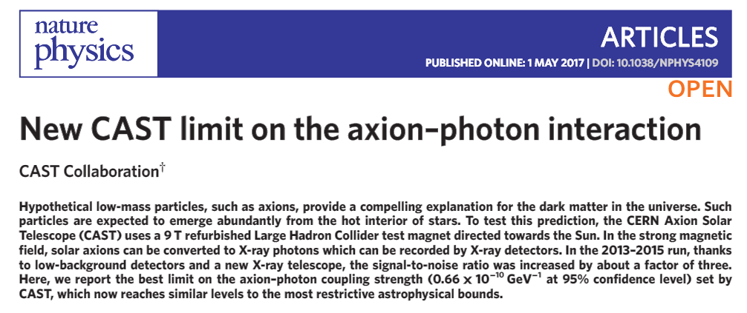
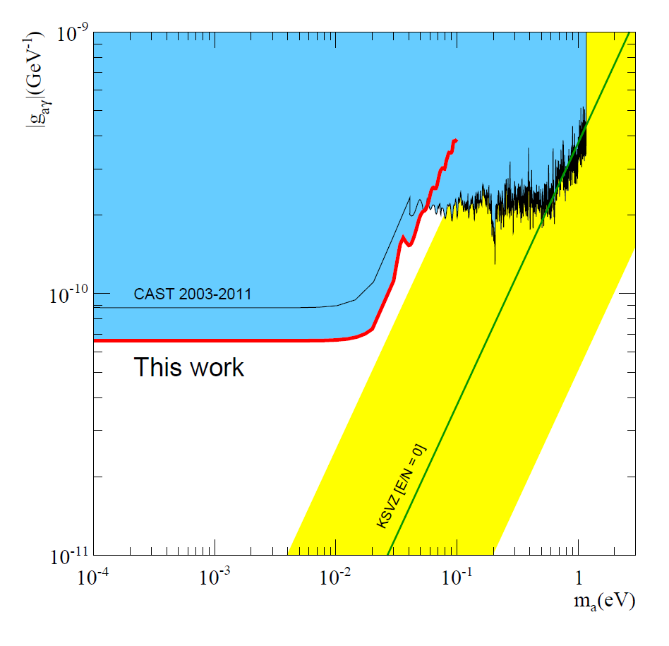

Last CAST limit
Enabled by the
IAXO pathfinder system
X-ray optics specifically built for axions
Low background Micromegas

Slide 4
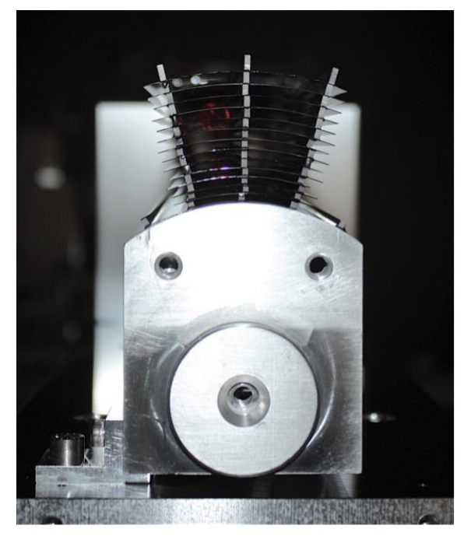
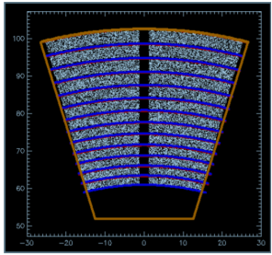
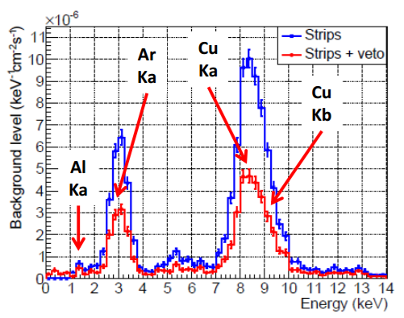
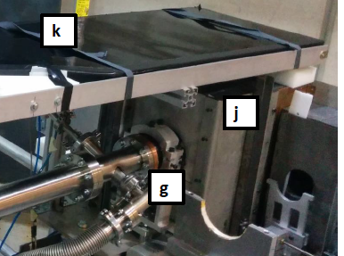
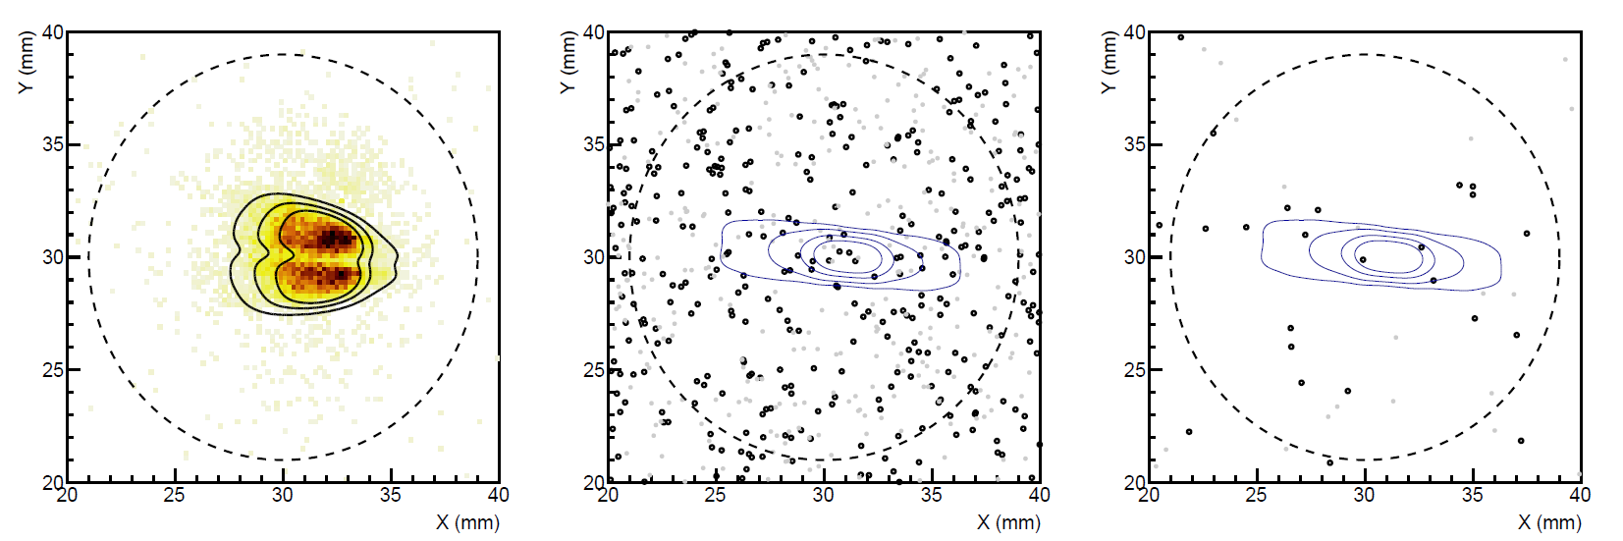
IAXO pathfinder system in CAST
Detector: JCAP12 (2015)
Physics: Nature Physics (10.1038/nphys4109)
Test MM detector + slumped-glass x-ray optics together
Best SNR than any other CAST detector ever!!
X-ray optics specifically built for axions
Background spectrum
Low background Micromegas at the focal point
5 mm
Best SNR of any previous detector
290 tracking hour acquired (6.5 months operation)
3 counts observed in RoI (1 expected)
Calibration data
“axion” data

Slide 5
IAXO most recent milestones
Collaboration formally established in the last collaboration meeting at DESY (last July):
  17 institutions to sign IAXO bylaws
  Management structure defined. Positions being elected.
  CB chair: K. Desch (Bonn)
  SP: I. G. Irastorza (Zaragoza)
  SC members: election ongoing
Near term goal: BabyIAXO → Full experiment “scaled-down IAXO”
  Test bench for magnet, optics and detectors. Risk reduction, but also opportunity to go beyond baseline FOM for IAXO (→ IAXO+)
  Intermediate scale, but representative of full IAXO dimensions
  Relevant physics outcome
Experimental site for IAXO: Strong interest from DESY
  BabyIAXO: DESY, INR (synergies with Russian initiative under discussion).
Magnet under design with CERN support. (Applied Fellow assigned)
Construction of BabyIAXO could happen in 2-3 years. MoU under preparation, collaboration addressing funding bodies.

Slide 6

IAXO collaboration
17 institutions from Germany, Spain, US, France, Russia, Croatia, S. Africa, CERN.
DESY (Germany)
U. Bonn (Germany)
U. Heidelberg (Germany)
St. Petersburg (Russia)
MIT (US)
U. Mainz (Germany)
CEA (France)
INR-Moscow (Russia)
LLNL (US)
CERN
RBI (croatia)
U. Barry (US)
INAF-Milano (Italy)
U. Zaragoza (Spain)
CNM (Spain)
U. Cape Town (S. Africa)
ICCUB (Spain)
Likely to grow in the future, more groups showing interest…
New partners welcome…

Slide 7
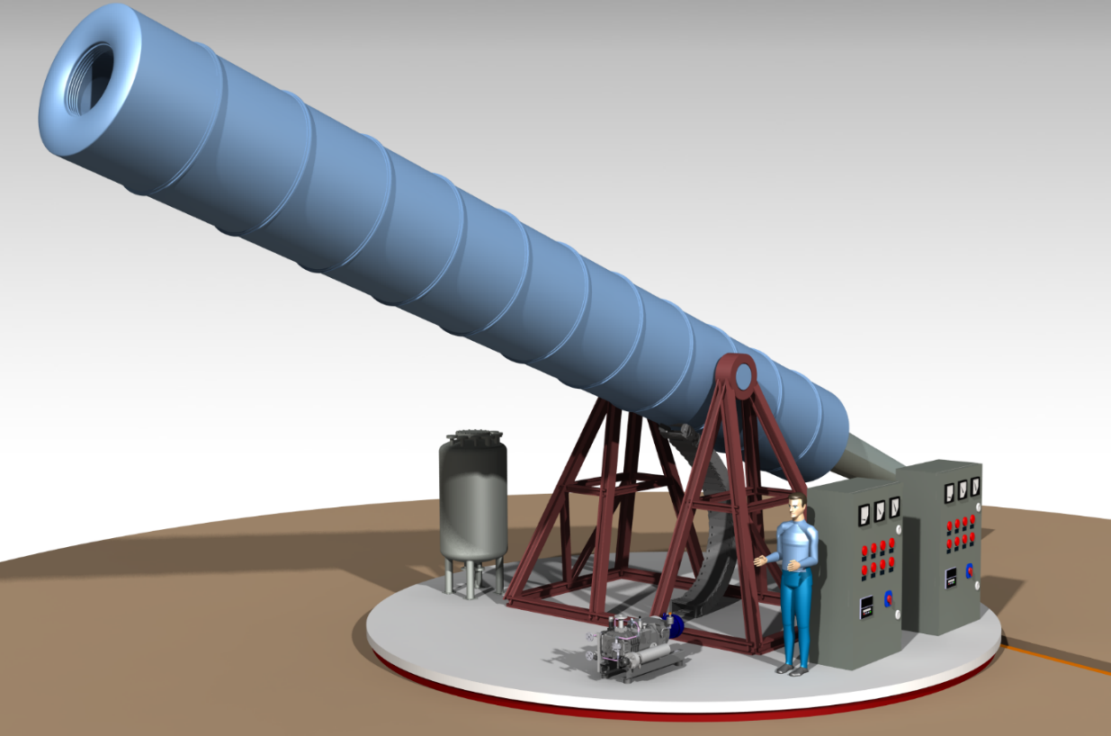
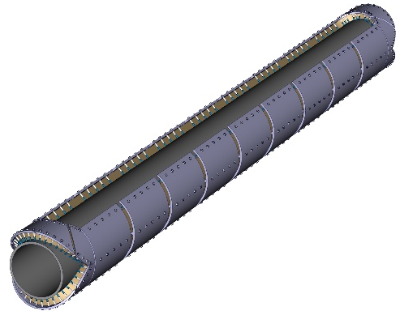
BabyIAXO
Conceptual design by CERN/ATLAS Magnet group (H. ten Kate)
Single bore magnet
Bore dimensions similar to full IAXO bores → detection line representative of final ones.
New magnet configuration (saddle dipole). Potential to go to higher B.
Test & improve all systems. Risk mitigation for full IAXO
Produce relevant physics
More staged access to funds
Move earlier to “experiment mode”
BabyIAXO CDR finished. Moving to Technical Design
Free bore [m] | 0.6
Magnetic length [m] | 10
Field in bore [T] | 2.5
Stored energy [MJ] | 27
Peak field [T] | 4.1
10x CAST MFOM
Saddle dipole configuration

Slide 8
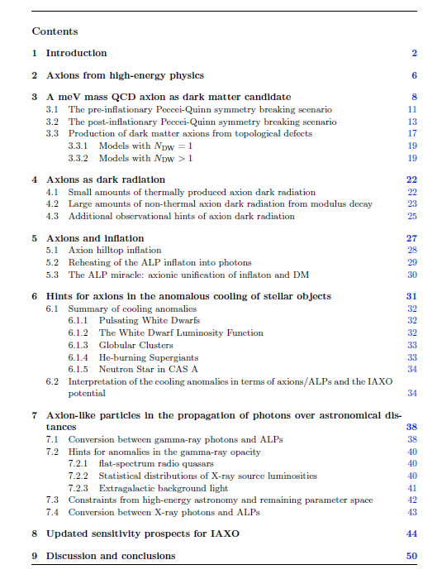
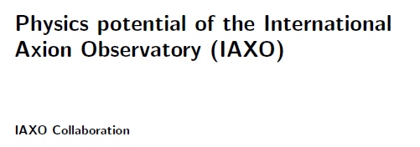
IAXO physics potential
(“white paper”)
Comprehensive review of IAXO physics case:
  Theory
  Cosmology
  Astro hints
  Updated IAXO sensitivity plots
Very advanced draft…
Many contributors from the theory/pheno community

Slide 9
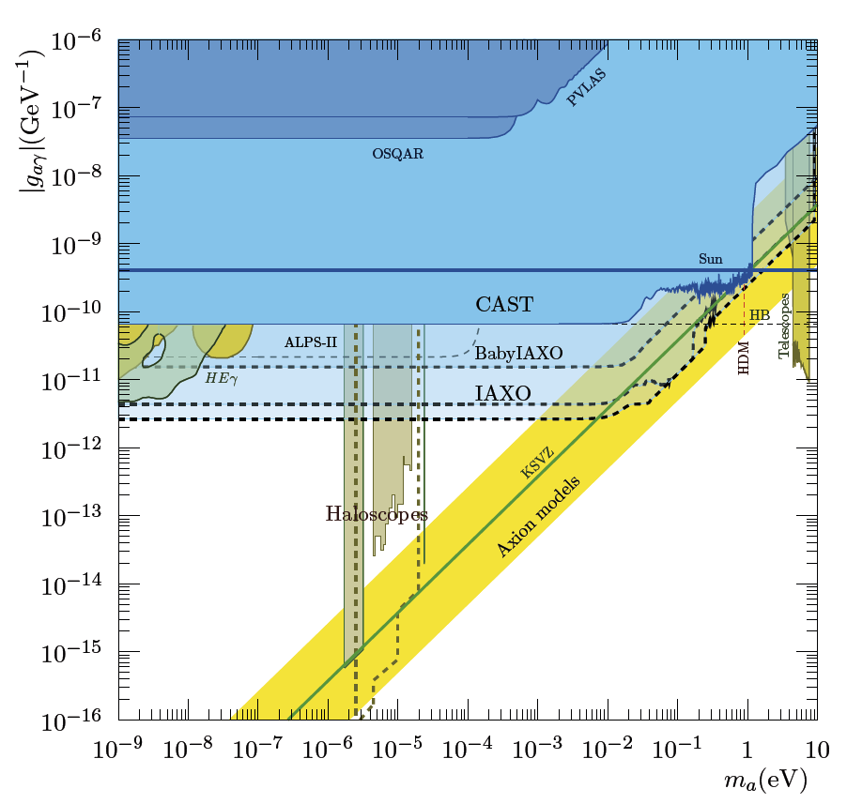
Updated IAXO sensitivity regions
babyIAXO prospects:
10xFOM magnet + optics and detector from conservative scenario of LoI
IAXO phase II: exposure rearranged to optimize sensitivity to DSFZ models
IAXO+: enhanced scenario with x4 higher MFOM with respect LoI

Slide 10
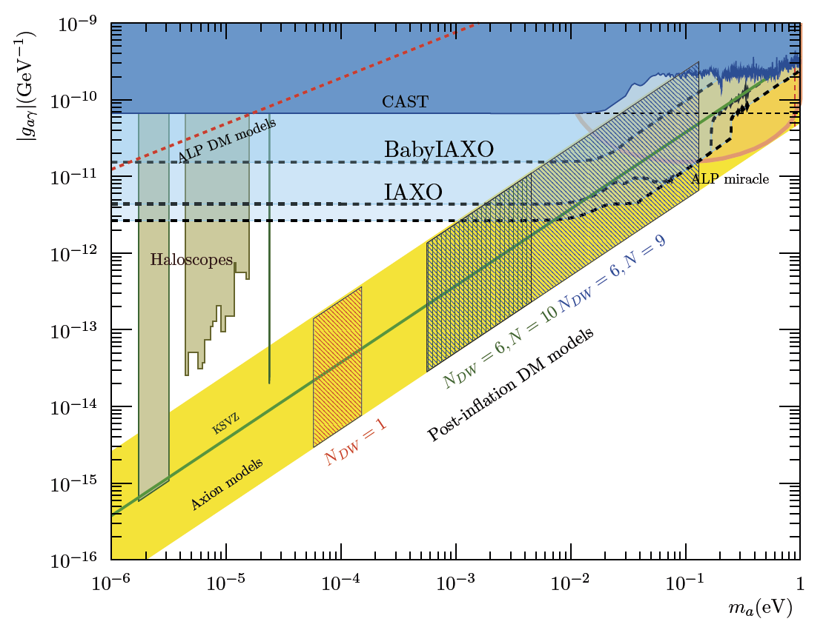
IAXO & meV axion cosmology
“ALP miracle” region
ALPs solving both
DM & inflation
Daido et al. 2017
arXiv:1710.11107
IAXO will explore viable
QCD axion DM models
Ringwald, Saikawa 2016
arXiv:1512.06436

Slide 11
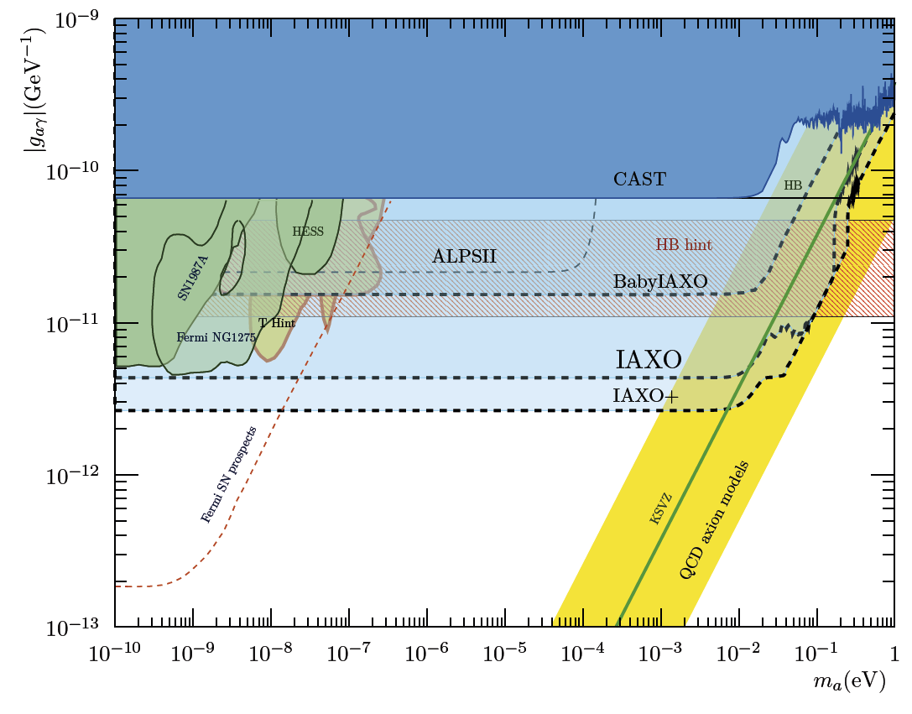
IAXO & astrophysics hints
… as well as a large fraction of the axion & ALP models invoked in the “stellar cooling anomaly”
But for this the g_{ae} is particularly interesting
IAXO will fully explore ALP models invoked to solve the “transparency hint”

Slide 12
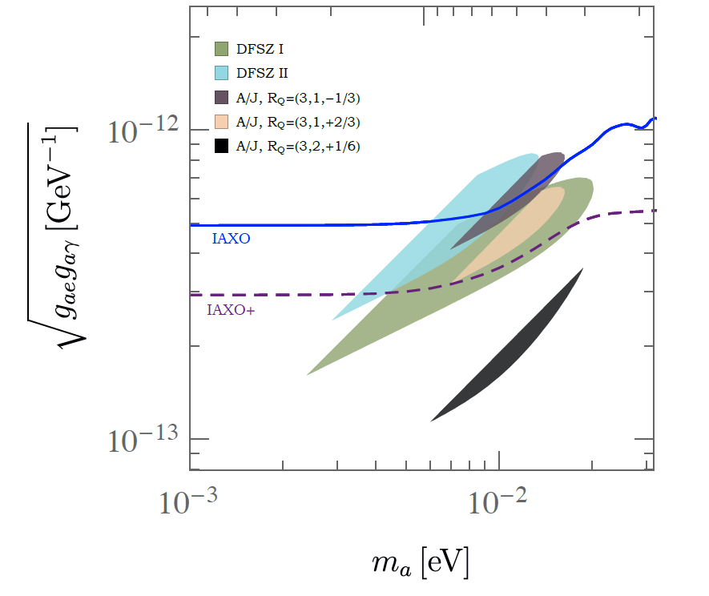
IAXO & stellar cooling
M. Giannotti et al.
JCAP 1710 (2017) 010
arXiv:1708.02111
Multiple stellar anomalies (HB, RG, WD, NS,..). Overall 3σ effect.
QCD axions with both gag & gae interactions simultaneously solve all anomalies.
  DFSZ models
  KSVZ axion-majoron
IAXO will explore most of the relevant models (especially with IAXO+)
Only experiment with such capability
Region of QCD axion models that solve the stellar anomaly (+ SN1987A constraint)
(if constraint not considered regions largely within IAXO reach – buffer gas)

Slide 13
IAXO physics reach summary
IAXO will improve the experimental “helioscope frontier” by more than 1 order of magnitude in sensitivity to g_{aγγ}
(= by more than 10000 in terms of signal to noise ratio)
IAXO will probe a large fraction of QCD axion models in the meV to eV mass band.
No other proposed technique can probe QCD axions in this region. ← Uniqueness of IAXO.
IAXO will fully probe the ALP region invoked to solve the transparency anomaly
IAXO will largely probe the axion region invoked to solve the stellar cooling anomaly
IAXO will partially explore viable QCD axion DM models, and largely probe the “ALP miracle” models solving both DM and inflation.
IAXO will probe a large unexplored ALP parameter space, also generically motivated dark radiation, string theory,…
All this, independent of the axion-as-DM hypothesis.
Large complementarity with other detection strategies

Slide 14
IAXO near-term milestones
Finish definition of management structures of the collaboration (next weeks)
Finish and release “physics potential” paper (next weeks).
Technical Design of BabyIAXO (next year – CERN support)
Site definition (next year)
  DESY: possible sites identified and “reserved”
  INR: candidate to host BabyIAXO - synnergies with TASTE proposal.
Build BabyIAXO (2-3 years). Collaboration addressing funding bodies
  MoU under preparation to cover BabyIAXO phase, especially magnet construction.
  Optics: aim is building full optics. Back-up plan with existing optics (first contacts with ESA Science Directorate already ongoing)
Full IAXO TDR with feedback from BabyIAXO phase

Slide 15
IAXO and CERN
[from PBC technology subgroup meetings]
IAXO crucially relies on CERN’s expertise on large-scale superconducting detector magnets. Both BabyIAXO and IAXO detector magnets are systems of a scale for which CERN’s expertise and infrastructure is almost unique.
The collaboration expects support and significant participation of CERN, in particular, but not exclusively, with knowledge and expert personnel to the Technical Design Report of magnets and related infrastructure, as well as the technical follow-up during construction, testing and commissioning, first of BabyIAXO and then for IAXO.
CAST is still active at CERN hosting a number of small-scale prototypes for testing novel concepts or performing R&D. There is potential in further using CAST infrastructure for providing feedback during the preparatory phase of IAXO, for example, to improve the insight on detector backgrounds

Slide 16
Conclusions
Important milestones regarding establishment of the collaboration
Near term planning better defined.
BabyIAXO → very appealing new experimental stage that can
  Enhance final FOM of experiment
  Catalyze near-term activities in the collaboration towards an intermediate experiment with relevant physics outcome
Physics case of IAXO getting sharpened by recent studies. Physics potential updated – new paper to be published soon
We remain at the disposal of the PBC committee to provide any information required for the final deliverable of the process

Slide 17
Backup slides…

Slide 18
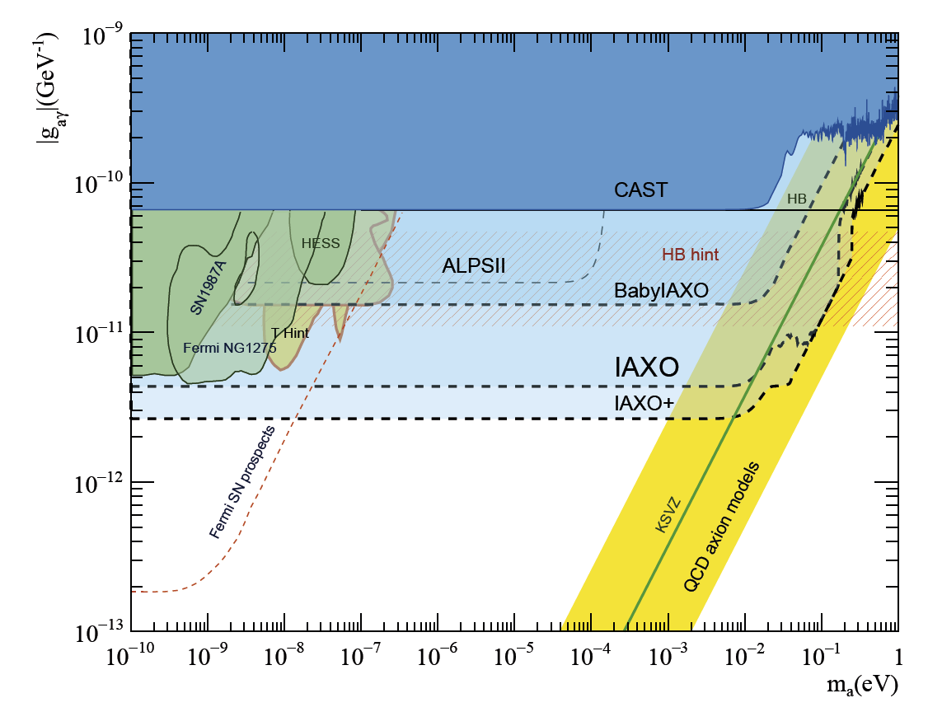

BabyIAXO & IAXO physics reach
“ALP miracle”
DM + inflation
Transparency ALP hints accesible to IAXO & ALPS-II
Anomalous stellar cooling hints
QCD axions at meV scale –
they are DM candidates

Slide 19
IAXO status of project
2011: First studies concluded (JCAP 1106:013,2011)
2013: Conceptual Design finished (arXiv:1401.3233) and LoI to CERN SPSC [CERN-SPSC-2013-022]
2014: Positive recommendations from SPSC.
2015-16: Transition phase towards TDR (technical design)
  Engaging funding agencies
  Community meetings in many countries
  Preparatory activities (IAXO pathfinder system at CAST)
  Preparation of collaboration bylaws and MoU to carry out TDR work.
  First discussions on experimental site options
  First dicussion on long-term plan to built full experiment
2017: Formal constitution of collaboration (expected for summer)
  “Founding” IAXO collaboration meeting to happen in July 2017, DESY

Slide 20



IAXO in the axion landscape
Source | Experiments | Model & Cosmology dependency | Technology
Relic axions | ADMX, ADMX-HF, Casper, CAPP, … | High | New ideas emerging, Active R&D going on,…
Lab axions | ALPS, OSQAR, fifth force exps,… | Very low
Solar axions | SUMICO, CAST, IAXO | Low | Ready for large scale experiment
Helioscopes → do not rely on the axion being the dominant DM component. Solar axion emission robust prediction
Helioscopes → No R&D needed. Technology mature enough for a large scale experiment (IAXO)
Large complementarity with other detection strategies

Slide 21
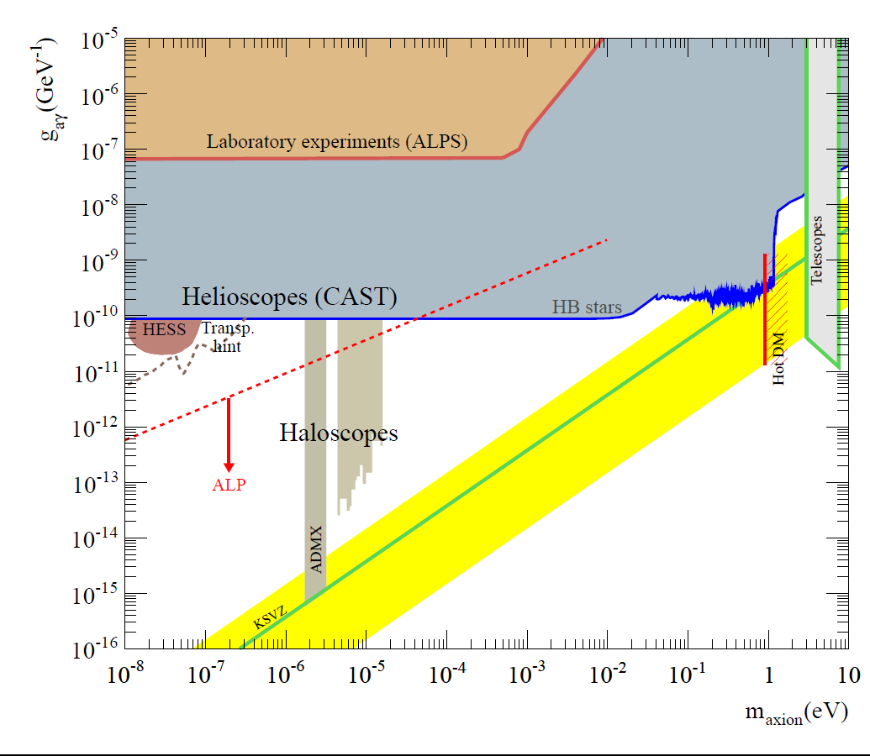
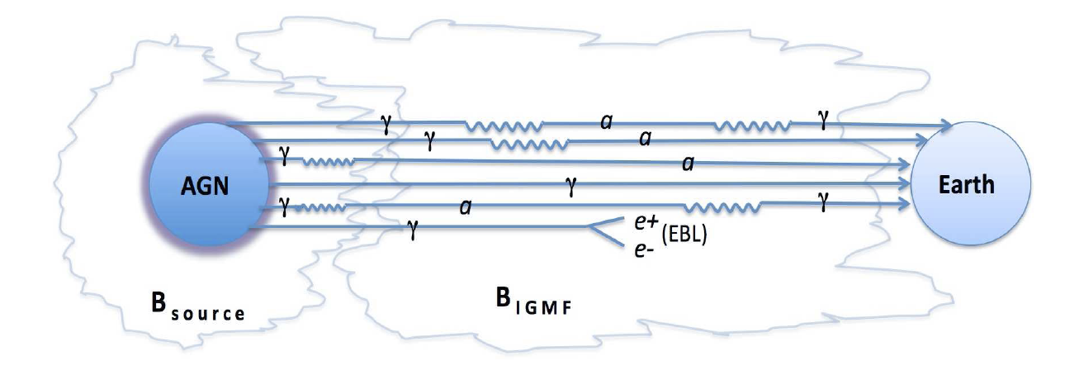
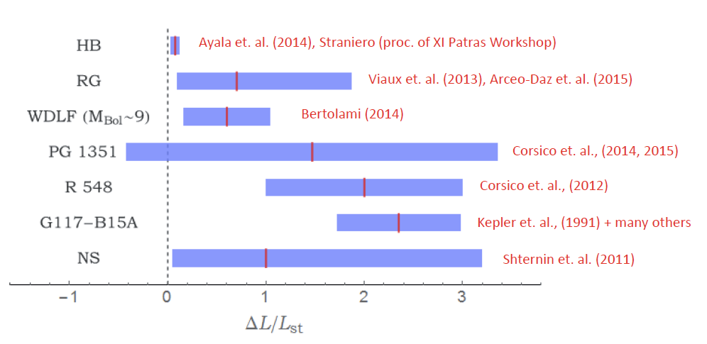
Axion/ALP parameter space
Transparency of the Universe
Stellar cooling hints

Slide 22
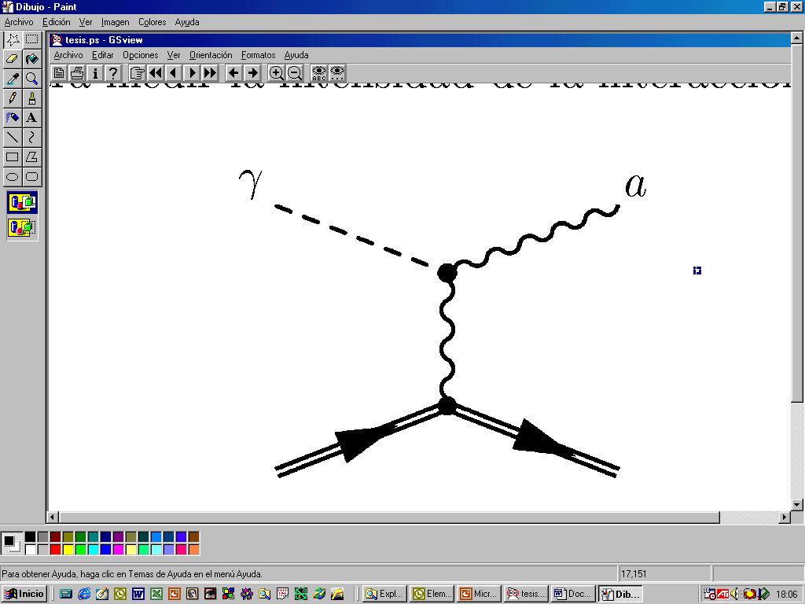
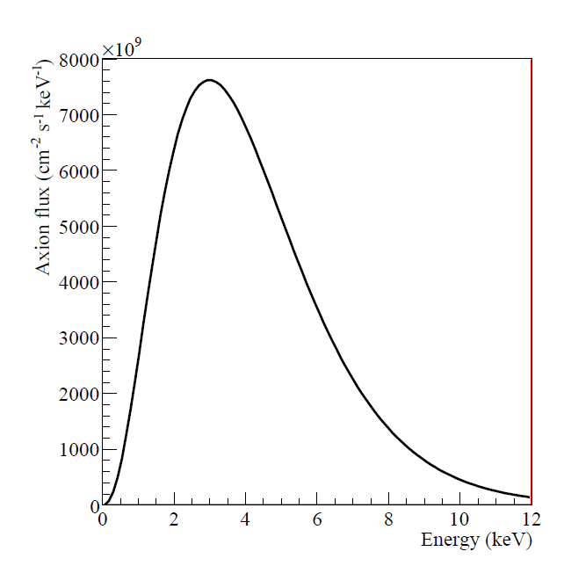
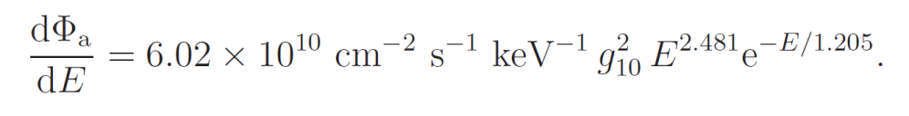
Solar Axions
Solar axions produced by photon-to-axion conversion of the solar plasma photons in the solar core
axions
“Primakoff” Solar axion flux at Earth
JCAP 04(2007)010

Slide 23
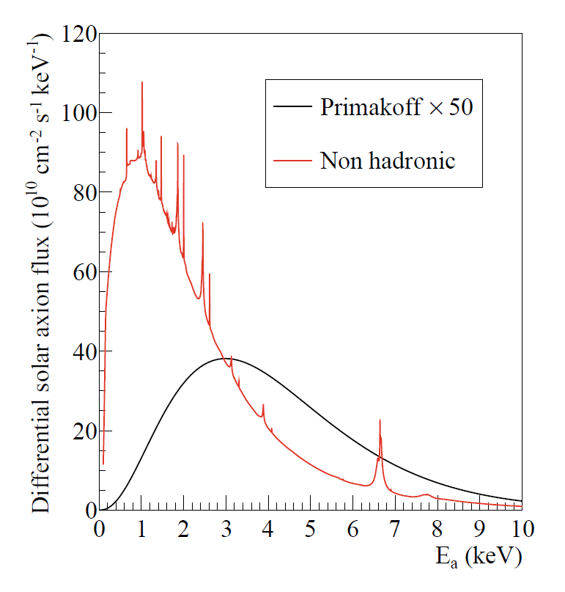
Solar Axions
Solar axions produced by photon-to-axion conversion of the solar plasma photons in the solar core
axions
Non-hadronic “ABC” Solar axion flux at Earth
JCAP 1312 008
* if the axion couples with the electron (g_{ae})
(non hadronic axion)

Slide 24
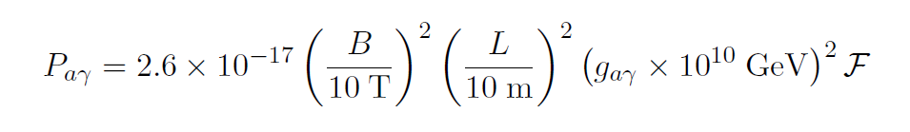
Helioscopes
Axion helioscope concept
P. Sikivie, 1983
+ K. van Bibber, G. Raffelt, et al. (1989)
(use of buffer gas)
axions
Transverse magnetic field (B)
L
X ray
detector
X ray

Slide 25
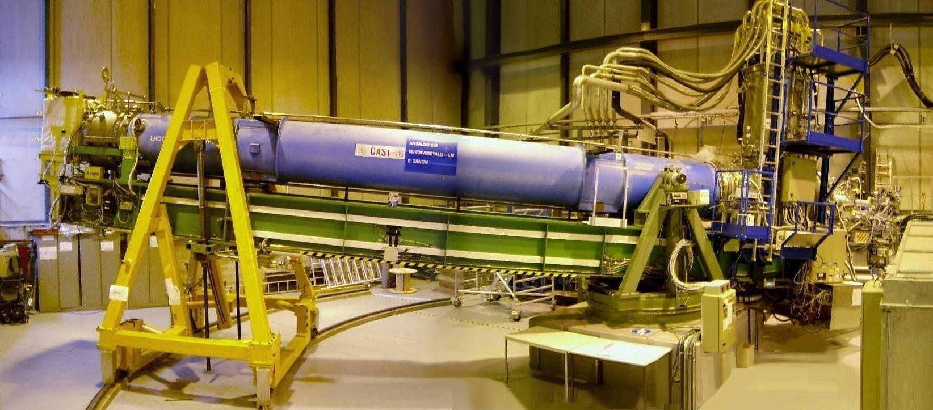
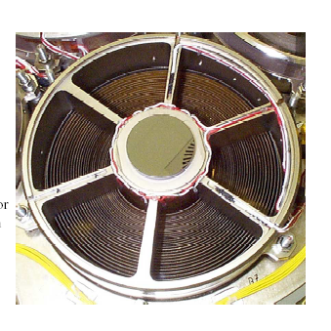
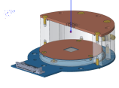
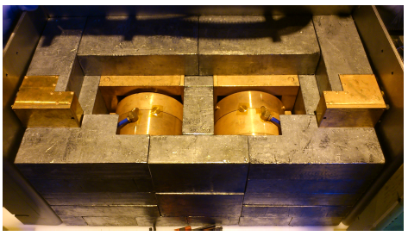
CAST experiment @ CERN
Decommissioned LHC test magnet (L=10m, B=9 T)
Moving platform ±8°V ±40°H (to allow up to 50 days / year of alignment)
4 magnet bores to look for X rays
2 X ray telescopes to increase signal/noise ratio.
Moving platform ±8°V ±40°H
LHC test magnet
2 low background Micromegas
1 Ingrid + XRT
1 Micromegas + XRT
25

Slide 26
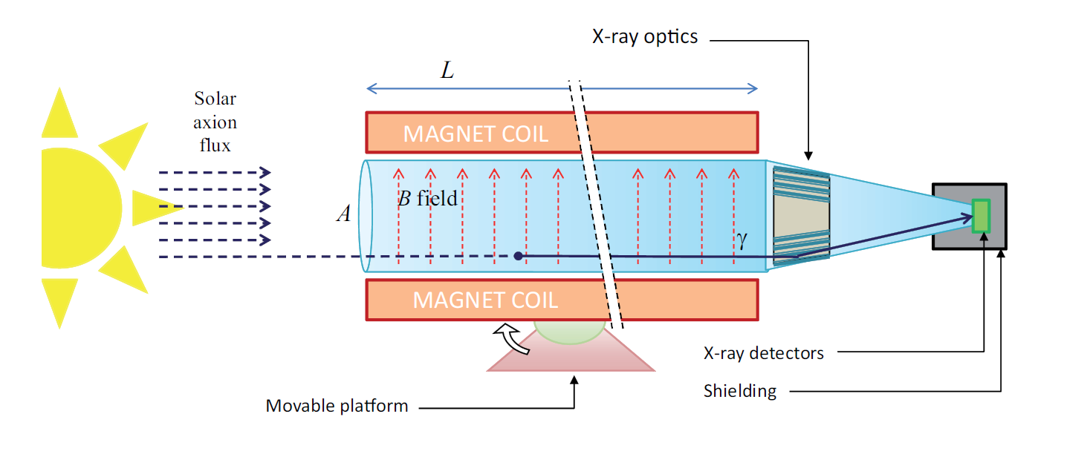
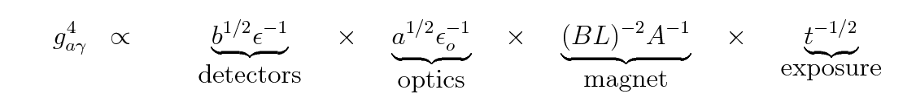
IAXO – Concept
Enhanced axion helioscope: JCAP 1106:013,2011
4+ orders of magnitude better SNR that CAST (JCAP 1106:013)

Slide 27
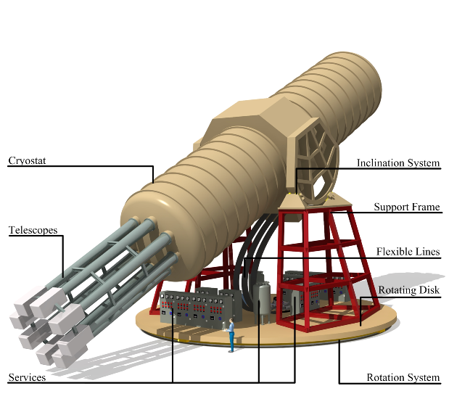
IAXO – Conceptual Design
Large toroidal 8-coil magnet L = ~20 m
8 bores: 600 mm diameter each
8 x-ray telescopes + 8 detection systems
Rotating platform with services

Slide 28
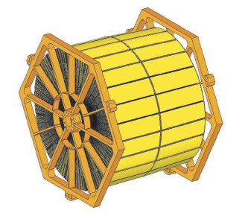
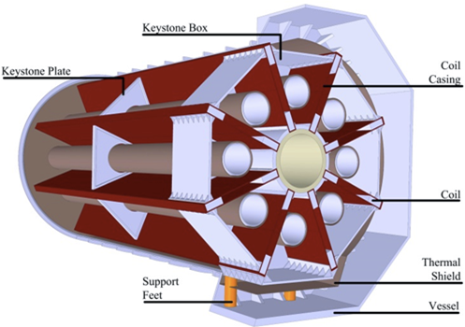
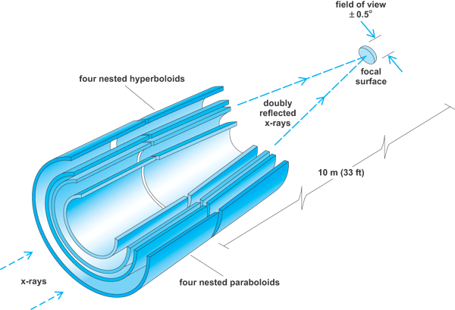
IAXO technologies – Baseline
IAXO telescopes
Slumped glass technology with multilayers
Cost-effective to cover large areas
Based on NuSTAR developments
Focal length ~5 m
60-70% efficiency
LLNL+UC+DTU
+ MIT + INAF
IAXO magnet
Superconducting “detector” magnet.
Toriodal geometry (8 coils)
Based on ATLAS toroid technical solutions.
CERN+CEA expertise
8 bores / 20 m long / 60 cm Ø per bore
Focal length
Baseline developed at:
IAXO Letter of Intent: CERN-SPSC-2013-022
IAXO Conceptual Design: JINST 9 (2014) T05002 (arXiv:1401.3233)

Slide 29
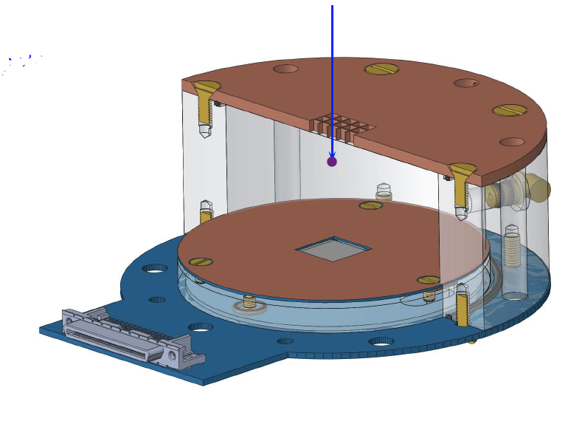
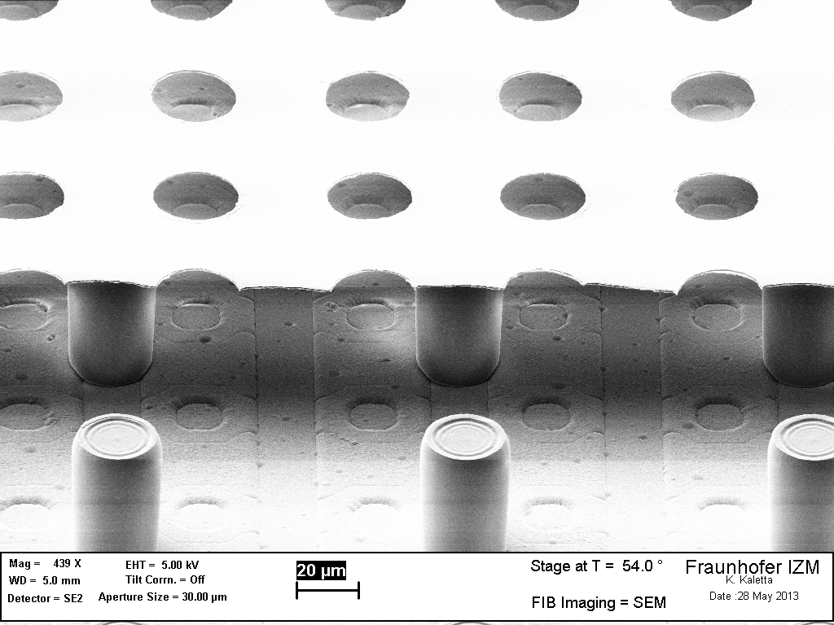
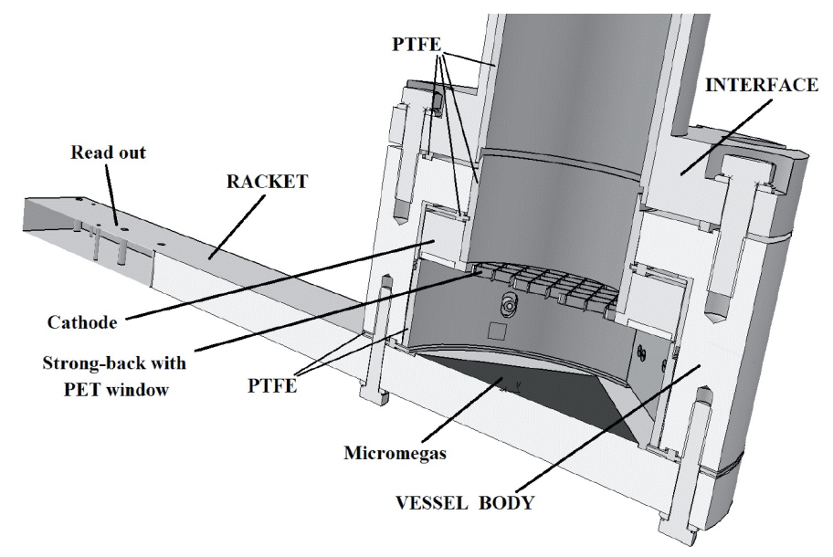
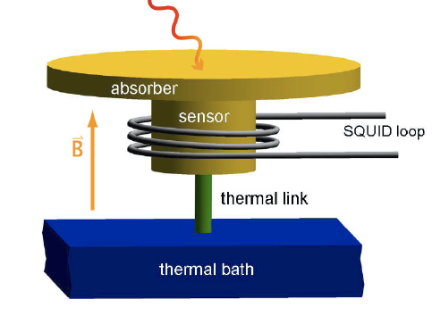
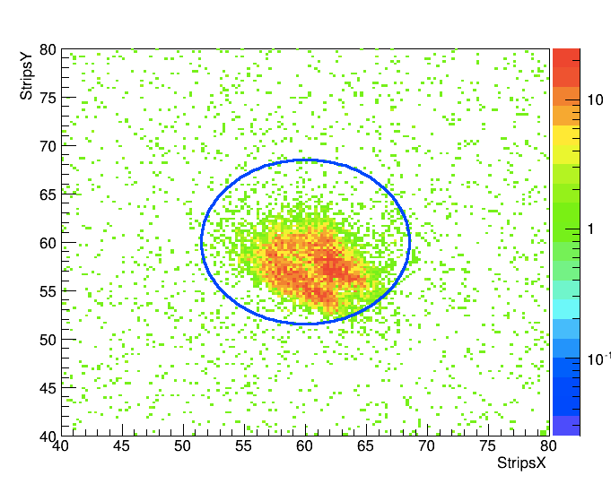
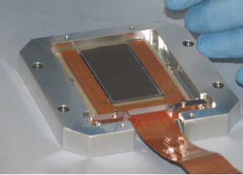
IAXO technologies – Baseline
IAXO detectors
Micromegas gaseous detectors
Radiopure components + shielding
Discrimination from event topology in gas
Long trajectory in CAST
Zaragoza + CEA + Bonn + others expertise
IAXO detectors
Ingrid detectors
Better threshold
U. Bonn
MMC (Magnetic Metallic Calorimeters)
TES (Transition Edge Sensors)
Very good E resolution & threshold
Heidelberg + CEA + CNSMS
Low noise CCDs
Optics+detector IAXO pathfinder system
(in operation in CAST during 2014-5)
Solar axion spectroscopy:
Axion-electron ABC spectrum
Axion mass determination
8.5 mm
Calibration photons (source 14 m away) focused onto the Micromegas

Slide 30
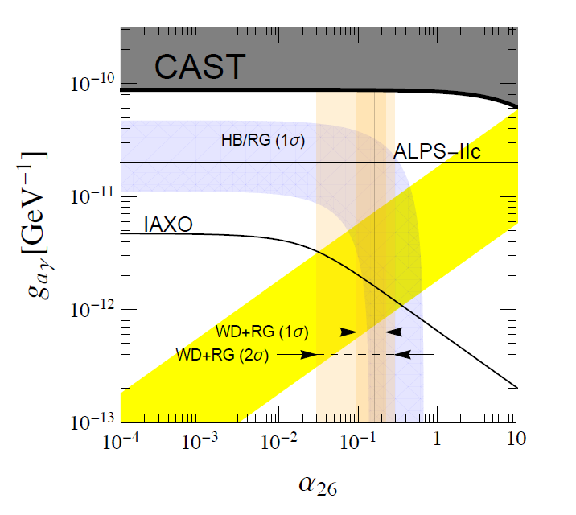
Axion-electron coupling
ABC-produced solar axions
Sensitive to g_{ae} values down to ~10⁻¹³
And more…
Dark Matter Axions (→ use of IAXO magnet with cavities / RF antennas)
ALPs from Dark Radiation
ALPs from nearby Supernova (connection with SNEWS) → MeV photon detector at the other end
…

Slide 31
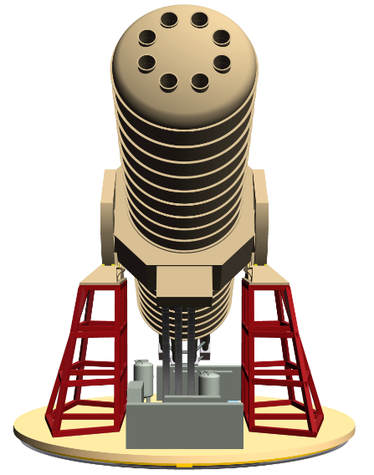
Conclusions
IAXO: best use of technologies (magnet, optics, detectors) and past trajectory of CAST at CERN
IAXO will probe deep into unexplored axion+ALP parameter space:
  QCD axions at the few meV scale → not at reach of any other technique
  ALPs at the g_{aγγ} ~10⁻¹² GeV⁻¹ scale
  ALPs at the g_{ae} ~10⁻¹³ scale
IAXO as a generic “axion/ALP facility”
First steps towards TDR after the positive recommendation from CERN SPSC.
Large community now endorsing the project.
Longer-term strategy towards construction under discussion. Site: CERN but also DESY or LNF
Looking forward to Study Group process

Slide 32
Why to search for axions?
Most compelling solution to the Strong CP problem of the SM
Axion-like particles (ALPs) predicted by many extensions of the SM (e.g. string theory)
Axions, like WIMPs, may solve the DM problem for free. (i.e. not ad hoc solution to DM)
Astrophysical hints for axion/ALPs?
  Transparency of the Universe to UHE gammas
  Anomalous cooling of different types of star
Relevant axion/ALP parameter space at reach of current and near-future experiments
Still too little experimental effort devoted to axions when compared to WIMPs

Slide 33
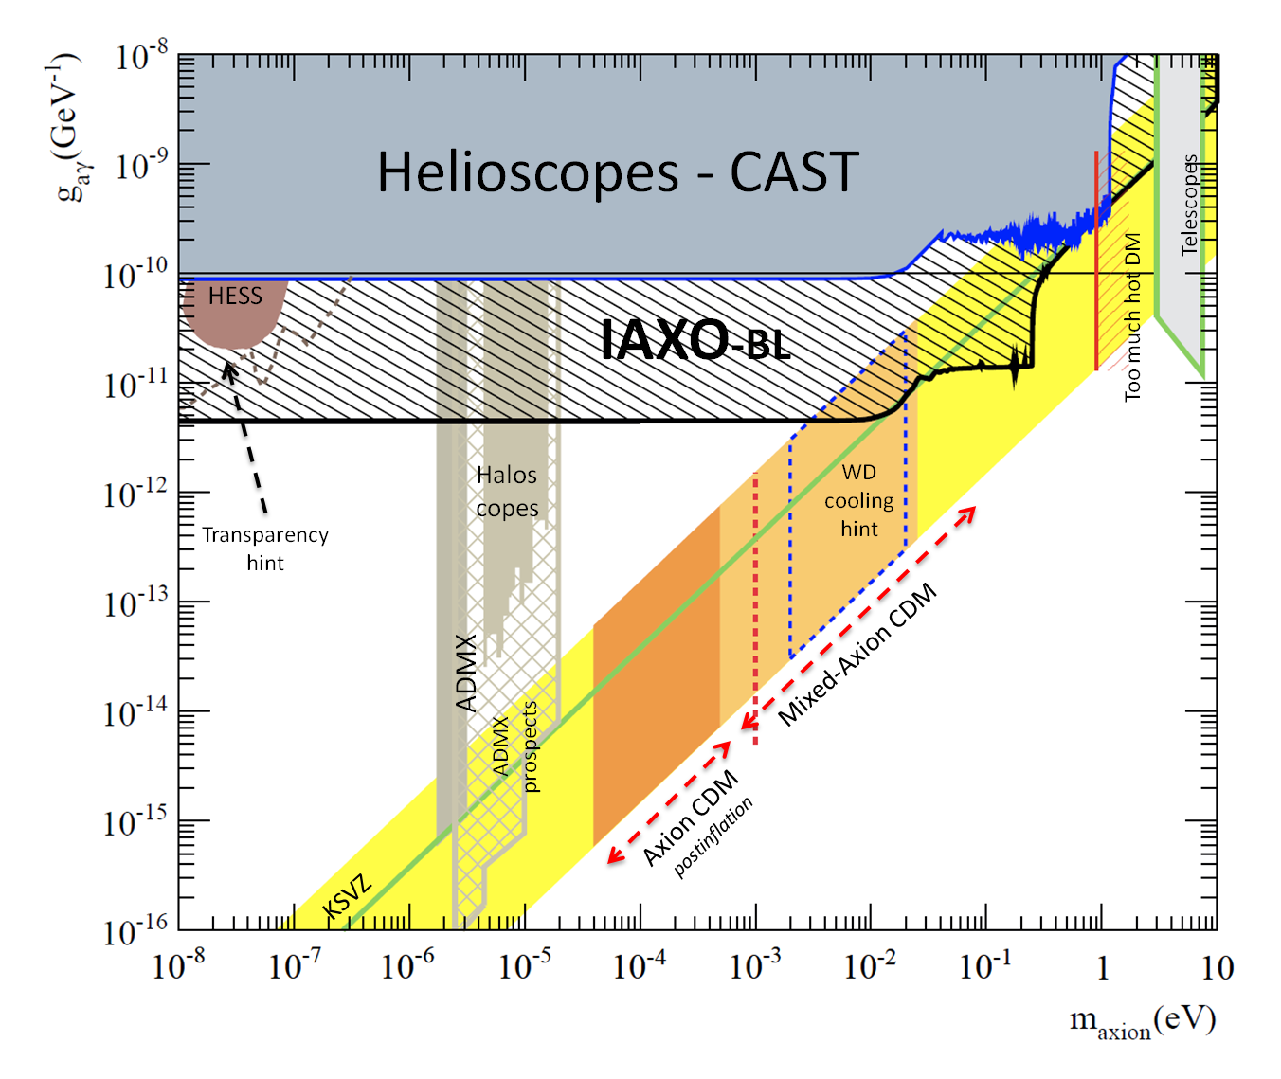
An ALP with g_{aγ}~ 10⁻¹¹⁻¹² GeV⁻¹
Well beyond current upper bounds on the g_{aγ} coupling (CAST & HB stars ~ 10⁻¹⁰ GeV⁻¹)
String theory ALPs
Invoked to explain the anomanlous transparency of the Universe to UHE gammas
Could explain some anomalous stellar cooling observations

Slide 34
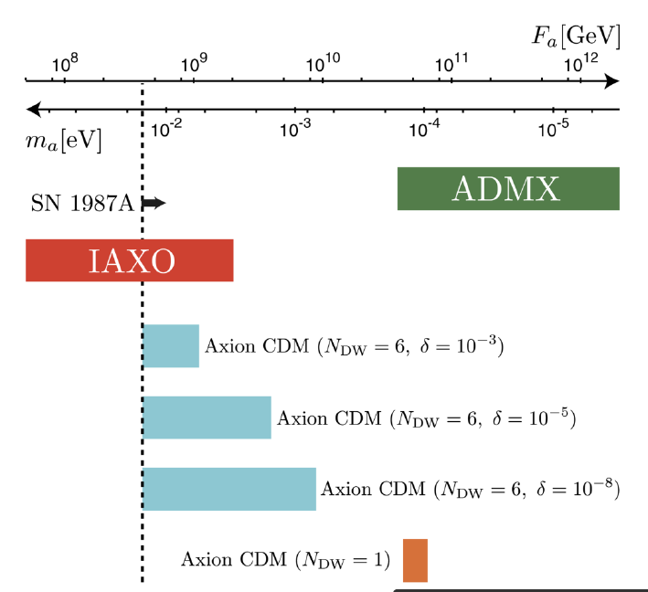
The multi-meV axion
Is compatible with all current axion bounds.
Is invoked in several anomalous stellar cooling scenarios
  Gianotti et al. JCAP1605 (2016) 057 [arXiv:1512.08108]
Can be the cold DM in some models
  with NDW>1 and bias term to break the discrete symmetry (Kawasaki et al. PRD91 (2015), Ringwald et al. arXiv:1512.06436)
  or it can be a subdominant DM component
Very hard to detect (→ IAXO!)
SN axion background
  Raffelt et al. PRD84 (11)

Slide 35
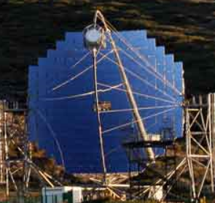
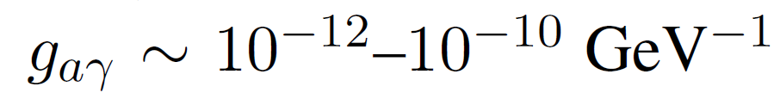


Astrophysical hints for axions
Gama ray telescopes like MAGIC or HESS observe HE photons from very distant sources…
ALP:

Slide 36
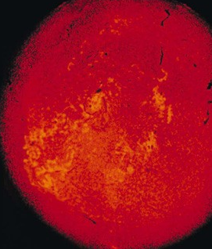
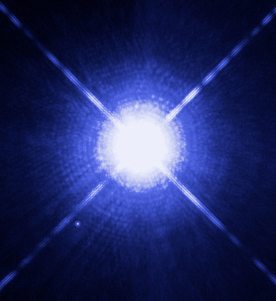

Astrophysical hints for axions (II)
Most stellar systems seem to cool down faster than expected.
Presence of axions/ALPs offer a good joint explanation (Giannotti et al. JCAP05(2016)057 [arXiv:1512.08108])
Parameters at reach of IAXO
Red Giants
White dwarfs
g_{aγ}
g_{ae}
Neutron star
CAS A

Slide 37



Buffer gas for higher masses
Coherence condition (qL << 1) is recovered for a narrow mass range around m_{γ}
axions
Transverse magnetic field (B)
Buffer gas
N_{e}: number of electrons/cm³
r: gas density (g/cm³)
L
X ray
detector
X ray

Slide 38

CAST results (solar axions)
2003 – 2004 | CAST phase I vacuum in the magnet bores
2006 | CAST phase II - ⁴He Run axion masses explored up to 0.39 eV (160 P-steps)
2007 | ³He Gas system implementation
2008 - 2011 | CAST phase II - ³He Run axion masses explored up to 1.17 eV bridging the dark matter limit
2012 | Revisit 4He Run with improved detecors
2013-2015 | Revisit vacuum phase with improved detectors Analisis ongoing. New result soon available
P
phase II-³He
phase II-⁴He
phase I

Slide 39
IAXO sensitivity prospects
Much larger QCD axion region explored
HB hint
Astrophysical hints for ALPs
NDW>1 Axion CDM

Slide 40
CERN SPSC recommendations
SPSC Draft minutes [Jan 2014]
The Committee recognises the physics motivation of an International Axion Observatory as described in the Letter of Intent SPSC-I-242, and considers that the proposed setup makes appropriate use of state-of-the-art technologies i.e. magnets, x-ray optics and low-background detectors.
The Committee encourages the collaboration to take the next steps towards a Technical Design Report.
The Committee recommends that, in the process of preparing the TDR, the possibility to extend the physics reach with additional detectors compared to the baseline goal should be investigated. The collaboration should be further strengthened.
Considering the required funding, the SPSC recommends that the R&D for the TDR should be pursuit within an MOU involving all interested parties.
This was endorsed by the Research Board in March2014
Minutes of the 206th CERN Research Board held on March2014:
https://cds.cern.ch/record/1695812/files/M-207.pdf

Slide 41
Mid term plans (+4 years) towards IAXO construction
Site:
  CERN is Plan A, but alternatives under consideration: it may affect funding strategies. Some preliminary interest from a number of institutions.
Magnet:
  Magnet construction → main resources challenge
  Plan A: Form international consortium, coordinated by CERN (+CEA?) to collectively support the magnet construction, by means of inkind contributions to the effort.
  Plan B: Large investment by host institution (IAXO being hosted outside CERN)
X-ray optics:
  Construction efforts distributed among groups pushing x-ray technologies for IAXO: US (LLNL, UC, MIT) + Europe (DTU, INAF-Milano)
Detectors:
  Efforts distributed among groups pushing each detector technology (actual decisions taken after TDR):
    Micromegas: Zaragoza, CEA
    Ingrid: Bonn
    CCD: FNAL?, LPNHE?
    MMCs/TES: Heidelberg, Orsay, CEA

Slide 42

IAXO costs
Comments/caveats:
Costs are for construction, and do not include operations and science support
Costs based on initial estimates that need to be confirmed at TDR
Labor for engineering, maintenance & operations not included
Estimates do not include contingencies

Slide 43

IAXO timeline
~18 months -> TDR + preparatory activities
~3.5 years construction
~2.5 years integration + commissioning

Slide 44

Additional IAXO physics cases direct detection or relic axions/ALPs
Promising as future pathways for IAXO beyond the helioscope baseline
First indications that IAXO could improve or complement current limits at various axion/ALP mass ranges…
Caution: preliminary studies still going on. Important know-how to be consolidated. Precise implementation in IAXO under study.
sensitivity prospects to be considered tentative
See J. Redondo, talk at Patras2014, CERN

