Slide 1
NA61 beyond 2020
Marek Gazdzicki
for NA61/SHINE
Frankfurt, Kielce

Slide 2
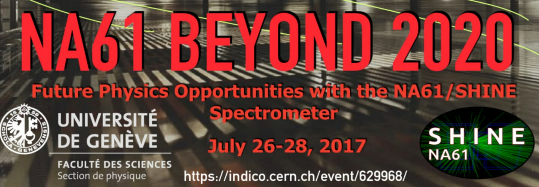
NA61/SHINE program for 2021-2024
Open charm production in heavy ion collisions
Measurements for physics of galactic cosmic rays
and neutrino experiments
  Many requests for new data
  Example: measurement of fragmentation cross sections
Based on the workshop:
https://indico.cern.ch/event/629968/timetable/

Slide 3
Measurement of open charm
Supporting letters from:
Helmut Satz (Bielefeld),
Mark Gorenstein (Kiev),
Wolfgang Cassing (Giessen)
https://indico.cern.ch/event/629968/timetable/

Slide 4
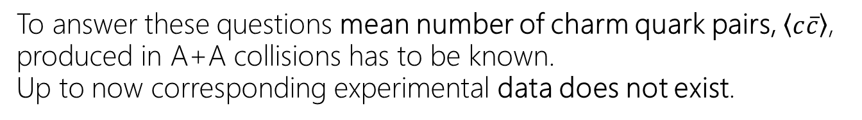
Questions that motivate open charm measurements at the CERN SPS:
What is the mechanism of open charm and 𝐽/𝜓 production?
How does the onset of deconfinement
impact open charm production?
How does the formation of quark gluon plasma
impact 𝐽/𝜓 production?
To answer these questions mean number of charm quark pairs, $\left\langle c\overline{c}\right\rangle$, produced in A+A collisions has to be known.
Up to now corresponding experimental data does not exist.

Slide 5
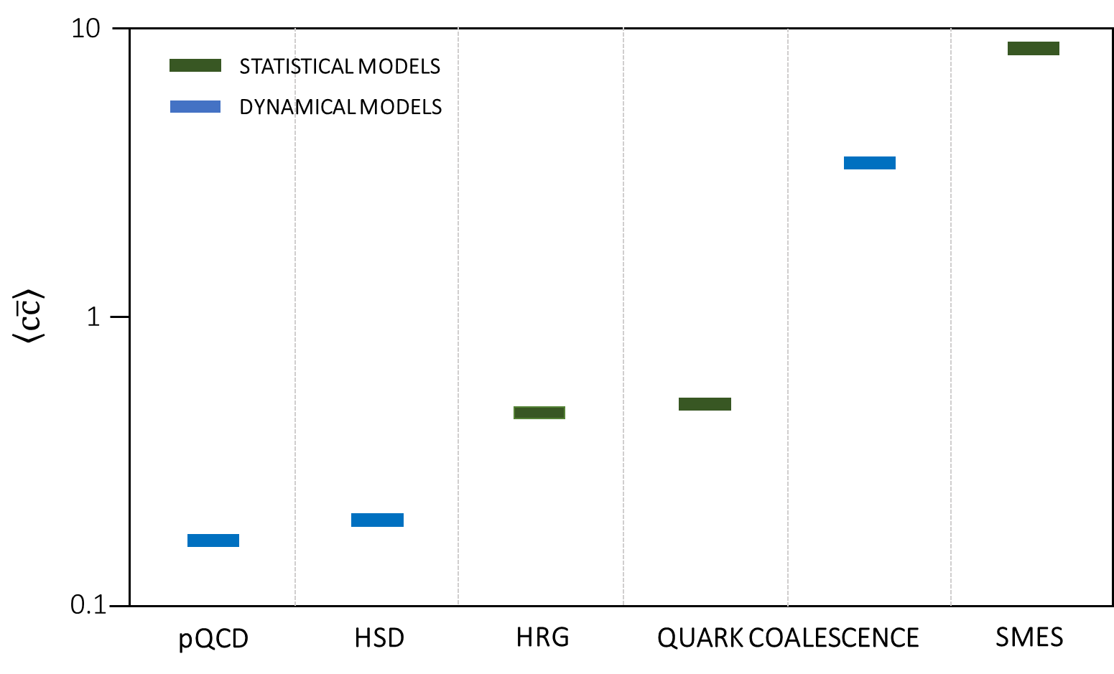
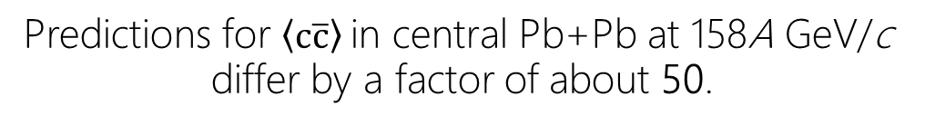
Models of open charm and 𝐽/𝜓 production
Predictions for $\left\langle c\overline{c}\right\rangle$in central Pb+Pb at 158A GeV/c
differ by a factor of about 50.
pQCD
Gavai et al. IJMP A 10 2999.
Braun-Munzinger, J. Stachel,
PL B 490, 196.
HSD
Linnyk, Bratkovskaya, Cassing, IJMP E17 1367
HRG, Quark Coalesc. Stat.
Gorenstein, Kostyuk, Stoecker, Greiner, PL B 509, 277.
Quark Coalesc. Dyn.
Levai, Biro, Csizmadia, Csorgo, Zimanyi, JP G 27, 703
SMES
Gazdzicki, Gorenstein, APP B30, 2705.

Slide 6
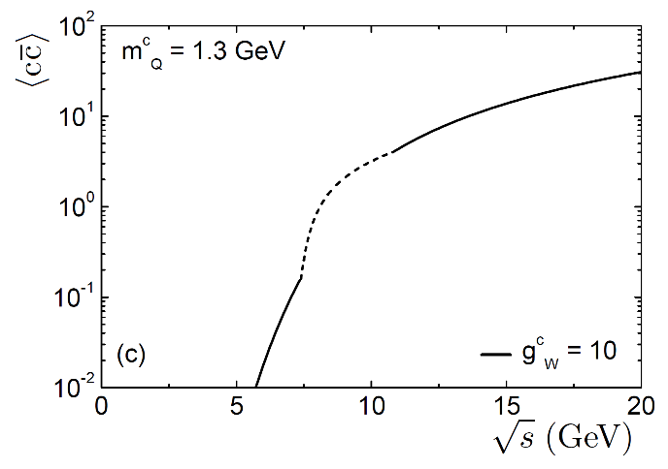
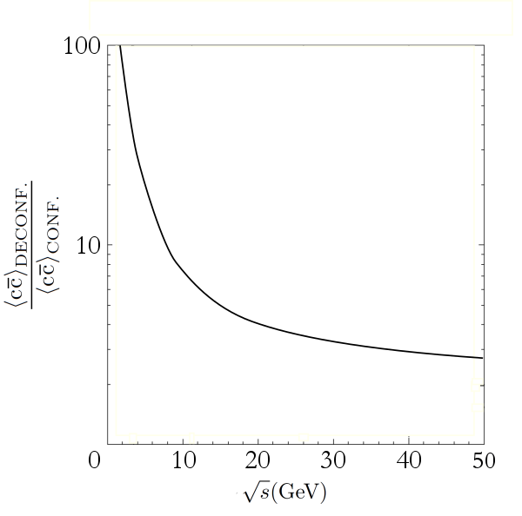
Open charm yield as the signal of deconfinement
$$confined matter → deconfined matter$$
$$D\overline{D} mesons → charm quarks$$
$$2m_{D} = 3.7 GeV → 2m_{c} = 2.6 GeV$$
$$g_{D}= 4 → g_{c}= 24$$
central Pb+Pb collisions
Statistical Model of the Early Stage
QCD-inspired calculations
[Poberezhnyuk, Gazdzicki, Gorenstein, ACTA PHYS POL B 9 48(2017)]
[Kostyuk, Gorenstein, Greiner,
PL B519 207]

Slide 7
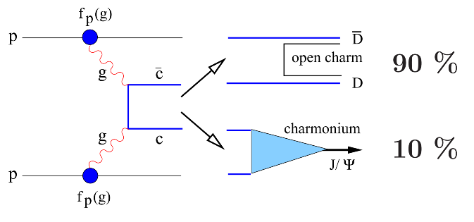

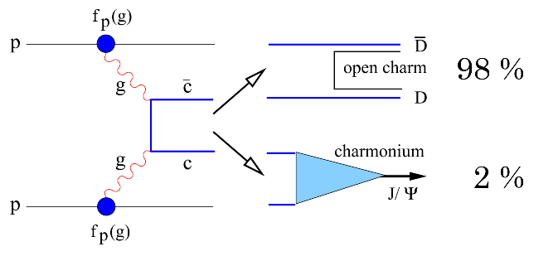




𝐽/𝜓 production as the signal of deconfinement
Open charm and $J/ψ$ production within Matsui-Satz model
[PL B178 416]
vacuum
medium
p
p
$$P\left(c\overline{c}→J/ψ\right)≡\frac{\left\langle J/ψ\right\rangle }{\left\langle c\overline{c}\right\rangle }≡\frac{σ_{J/ψ}}{σ_{c\overline{c}}}$$
$P_{vacuum}\left(c\overline{c}→J/ψ\right) >$ $P_{medium}\left(c\overline{c}→J/ψ\right)$
Medium reduces probability of $J/ψ$ production

Slide 8
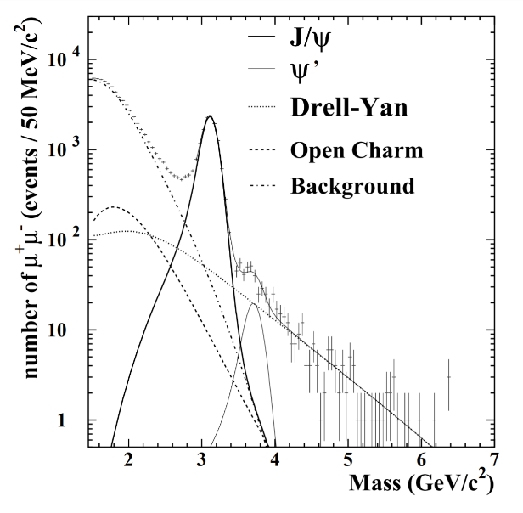
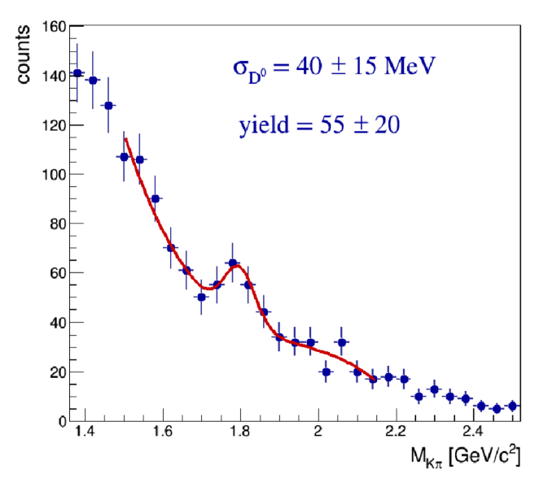
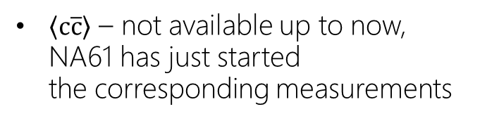
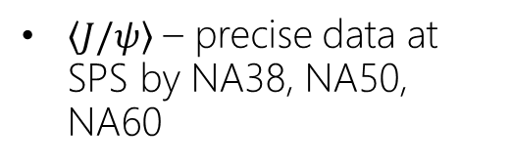
𝐽/𝜓 production as the signal of deconfinement
Calculation of $P(c\overline{c}→J/ψ)$ requires data on:
$\left\langle J/ψ\right\rangle$ – precise data at SPS by NA38, NA50, NA60
$\left\langle c\overline{c}\right\rangle$ – not available up to now,
NA61 has just started
the corresponding measurements
central Pb+Pb at 150-158A GeV/c
NA50
NA61
[NA50, arXiv:hep-ex/0412036v1]
[CERN-SPSC-2017-038]

Slide 9
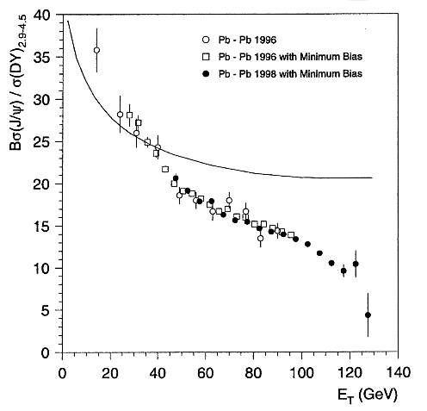
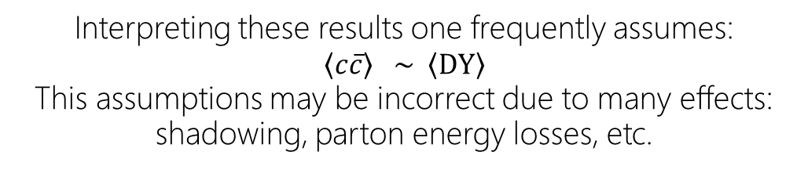
𝐽/𝜓 production at the CERN SPS
Data on $J/ψ$ production has been normalized by the Drell-Yan yield
[NA50, arXiv:hep-ex/0412036v1]
[NA50, PL B 477 28–36]
Interpreting these results one frequently assumes:
$$\left\langle c\overline{c}\right\rangle \sim \left\langle DY\right\rangle$$
This assumptions may be incorrect due to many effects:
shadowing, parton energy losses, etc.

Slide 10
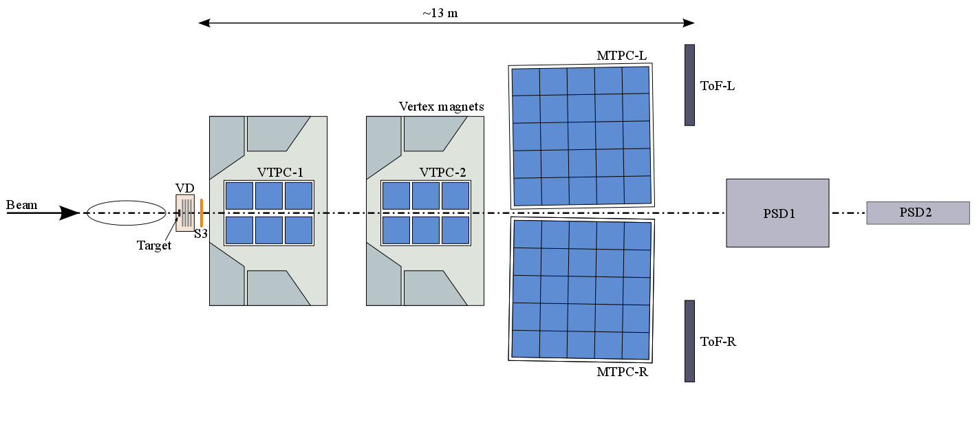
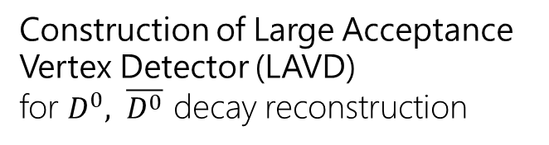
Upgrades of NA61/SHINE setup
Replacement of the TPC
read-out electronics
to increase data rate to 1 kHz
Construction of Large Acceptance Vertex Detector (LAVD)
for $D^{0}, \overline{D^{0}}$ decay reconstruction
New trigger and data acquisition system
Upgrade of Projectile Spectator Detector
New Time-of-Flight detectors

Slide 11
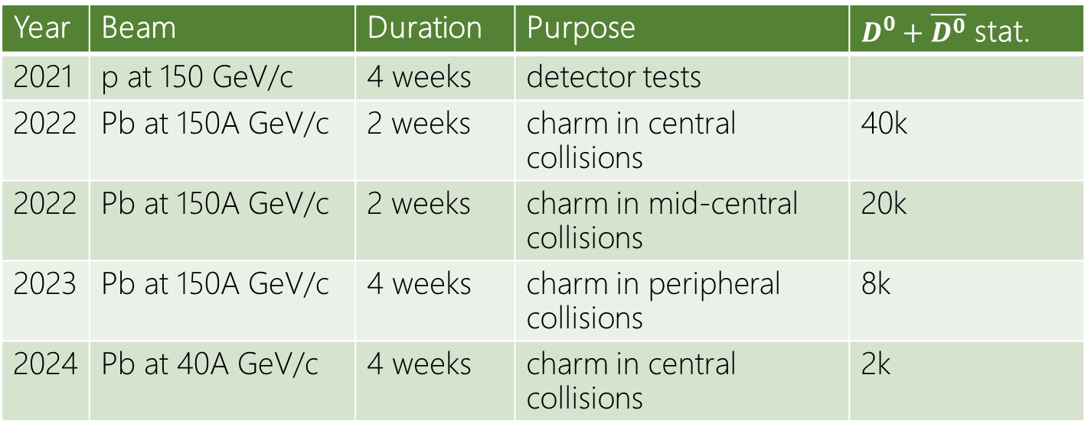
Beam request for 2021-2022
Year | Beam | Duration | Purpose | $D^{0}+\overline{D^{0}}$ stat.
2021 | p at 150 GeV/c | 4 weeks | detector tests
2022 | Pb at 150A GeV/c | 2 weeks | charm in central collisions | 40k
2022 | Pb at 150A GeV/c | 2 weeks | charm in mid-central collisions | 20k
2023 | Pb at 150A GeV/c | 4 weeks | charm in peripheral collisions | 8k
2024 | Pb at 40A GeV/c | 4 weeks | charm in central collisions | 2k

Slide 12
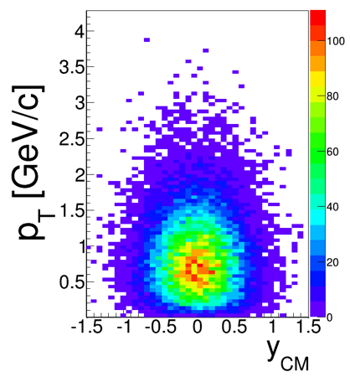
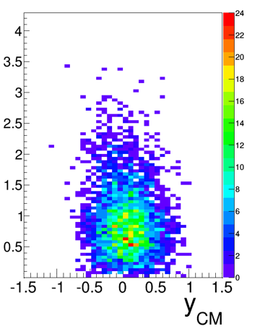
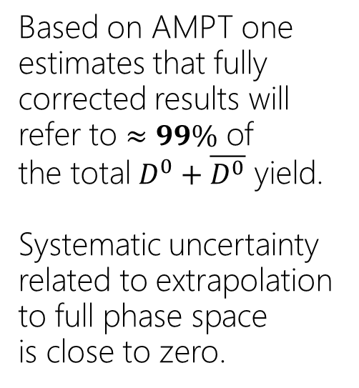
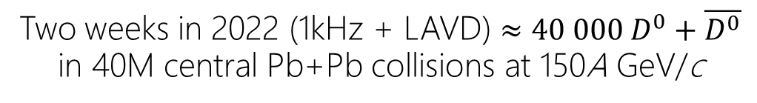
Performance for open charm measurements
Two weeks in 2022 (1kHz + LAVD) $≈40 000 D^{0}+\overline{D^{0}}$ in 40M central Pb+Pb collisions at 150A GeV/c
all generated
reconstructed
Based on AMPT one estimates that fully corrected results will refer to $≈99\%$ of
the total $D^{0}+\overline{D^{0}}$ yield.
Systematic uncertainty related to extrapolation to full phase space
is close to zero.
Total systematic uncertainty of $\left\langle c\overline{c}\right\rangle$ is expected to be about 10%.

Slide 13
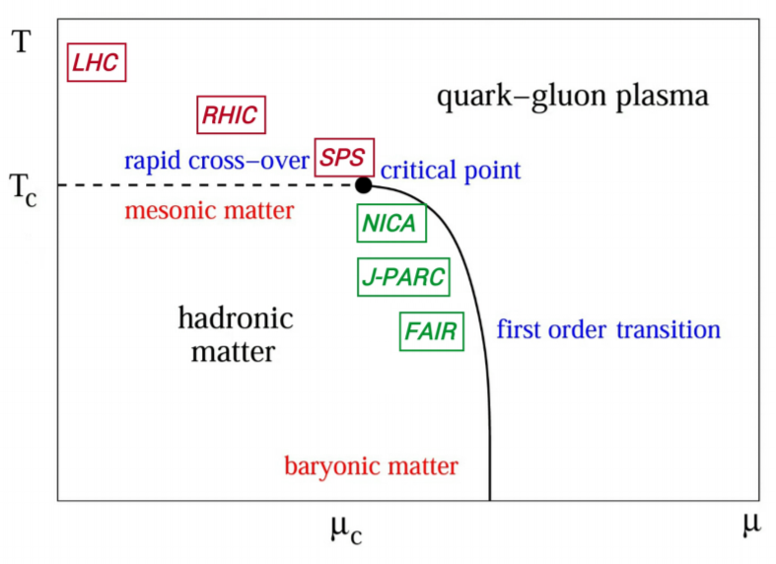
Uniqueness of NA61 open charm program
Landscape of present and future
heavy ion experiments
LHC and RHIC at high energies:
measurements in small phase space due to collider geometry
RHIC BES collider:
measurement not possible due to collider topology
RHIC BES fixed-target:
measurement require dedicated setup, not under consideration
NICA (< 80A GeV/c):
measurement during stage 2 under consideration
J-PARC (< 20A GeV/c):
maybe possible after 2025
FAIR (< 10A GeV/c):
not possible
Only NA61/SHINE is able to measure open charm production in heavy ion collisions in full phase space in the near future

Slide 14
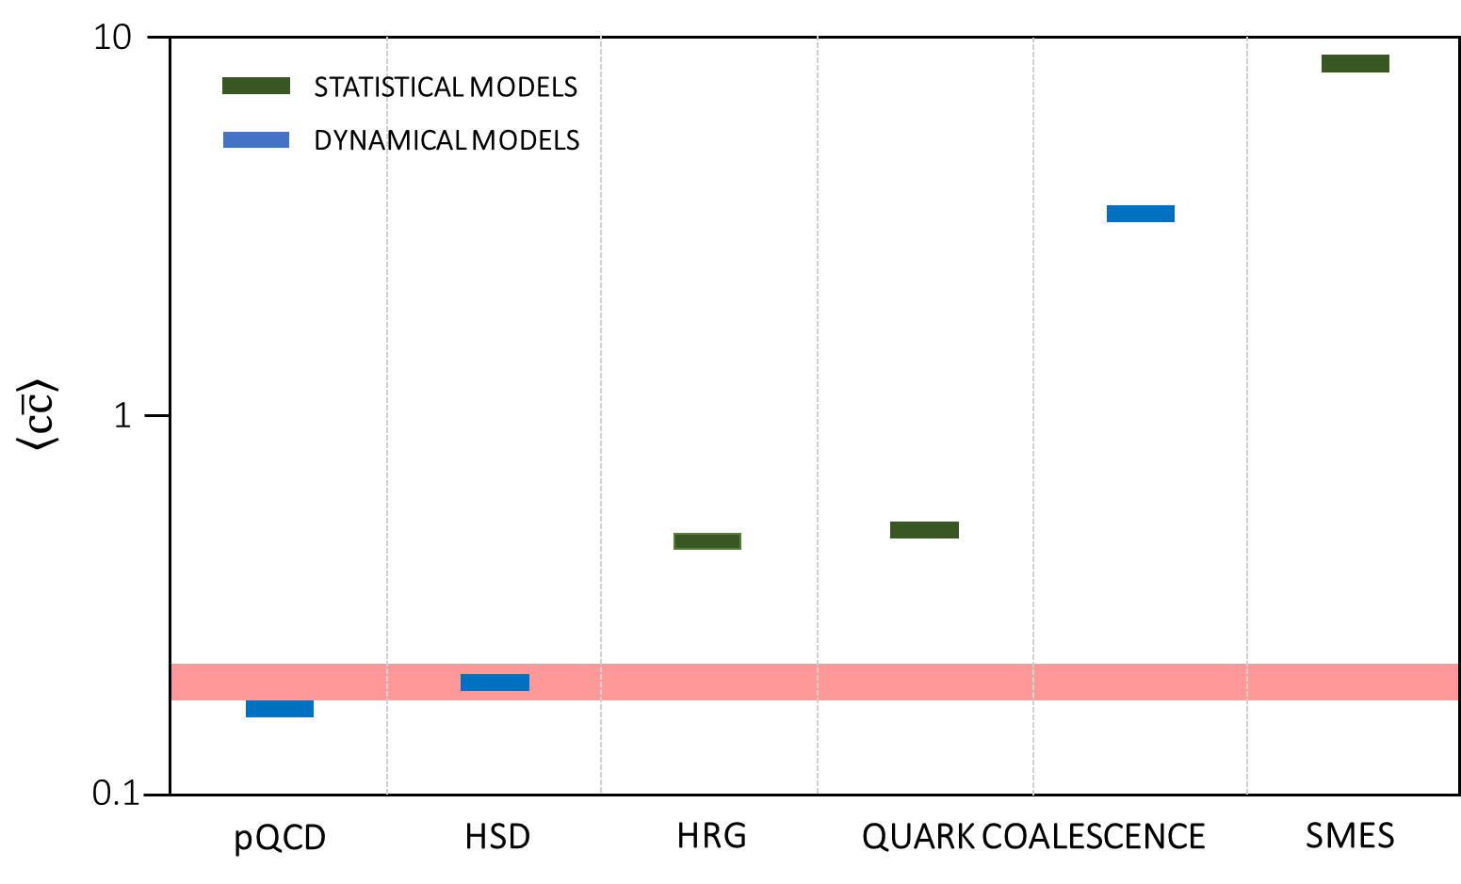
Impact of open charm measurements
accuracy of NA61++ result
assuming HSD yield

Slide 15
Impact of open charm measurements
accuracy of NA61++ result
assuming SMES yield

Slide 16
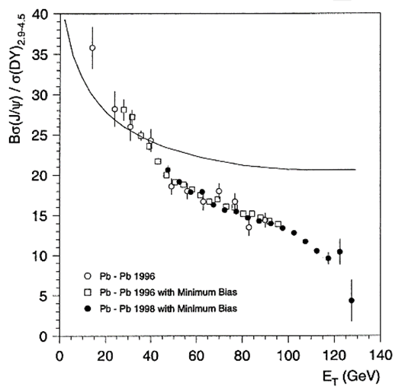
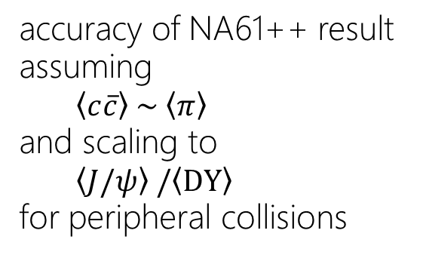
Impact of open charm measurements
accuracy of NA61++ result
assuming
$\left\langle c\overline{c}\right\rangle \sim \left\langle π\right\rangle$
and scaling to
$\left\langle J/ψ\right\rangle /\left\langle DY\right\rangle$
for peripheral collisions

Slide 17
Measurements for galactic cosmic rays and neutrino experiments

Slide 18
Many requests for new data
Neutrinos
NA61 ′ s measurements for T2K have been critical for T2K to reduce flux systematic errors by a factor of two, and further improvement is expected as the long target results are added into T2K′s flux model.
Many accelerator and atmospheric neutrino experiments expressed interest in thin-target measurements. These range from very low beam momenta to 120 GeV/c.
https://indico.cern.ch/event/629968/timetable/
Galactic cosmic rays
High precision data from cosmic-ray experiments require measurements of production of anti-nuclei and fragmentation cross-sections of light nuclei (see next slides).

Slide 19
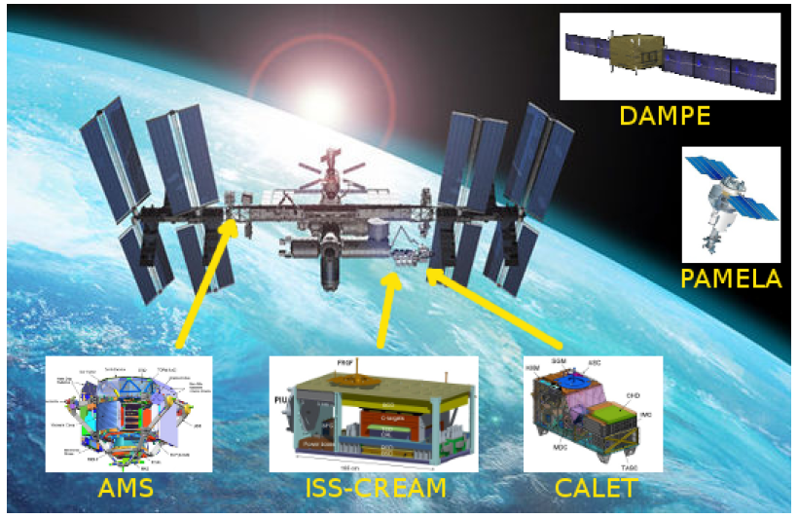
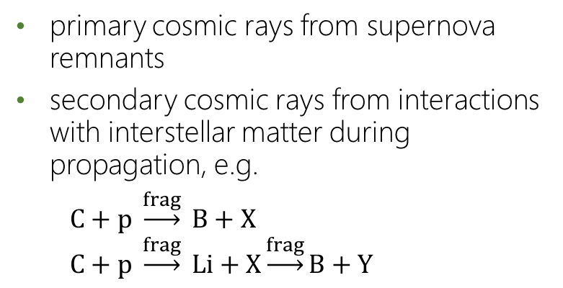
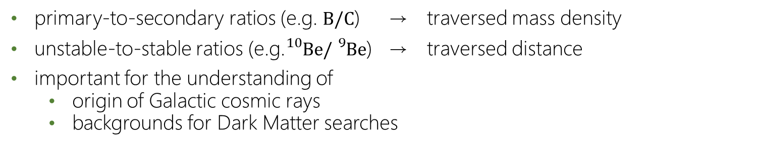
The History of Cosmic Rays in the Milky Way
cosmic ray experiments
primary cosmic rays from supernova remnants
secondary cosmic rays from interactions with interstellar matter during propagation, e.g.
$C+p \underset{→}{frag} B+X$
$C+p \underset{→}{frag} Li+X\underset{→}{frag}B+Y$
primary-to-secondary ratios (e.g. $B/C$) → traversed mass density
unstable-to-stable ratios (e.g.${}_{}^{10}{Be}/{}_{}^{9}{Be}$) → traversed distance
important for the understanding of
  origin of Galactic cosmic rays
  backgrounds for Dark Matter searches
understanding of cosmic-ray propagation limited by
uncertainties of fragmentation cross sections!

Slide 20
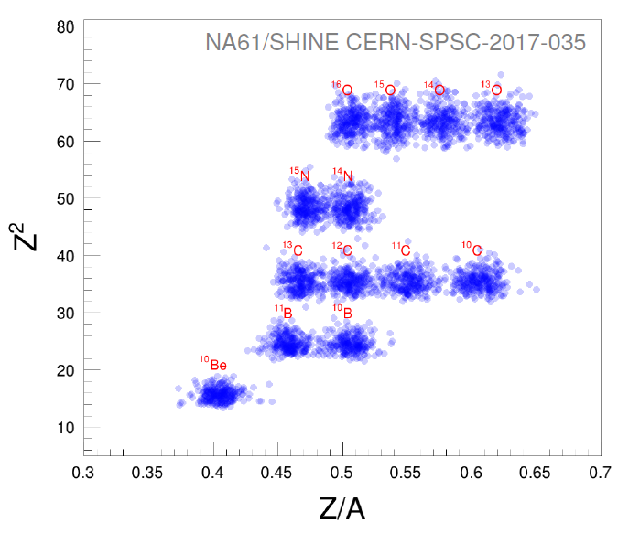
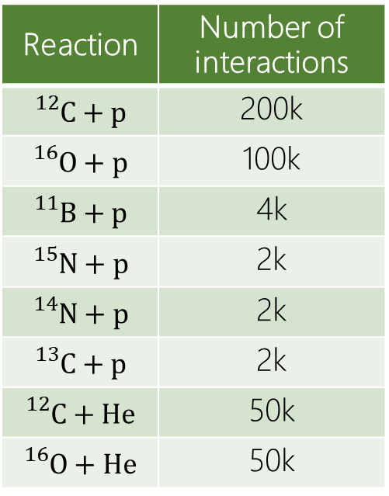
Measurement of Fragmentation Cross Sections
Request for two weeks of secondary light ion beams at 13A GeV/c in 2022
(produced from primary Pb beam at 14A GeV/c)
NA61 fragment identification
Reaction | Number of interactions
${}_{}^{12}C+p$ | 200k
${}_{}^{16}O+p$ | 100k
${}_{}^{11}B+p$ | 4k
${}_{}^{15}N+p$ | 2k
${}_{}^{14}N+p$ | 2k
${}_{}^{13}C+p$ | 2k
${}_{}^{12}C+He$ | 50k
${}_{}^{16}O+He$ | 50k

Slide 21
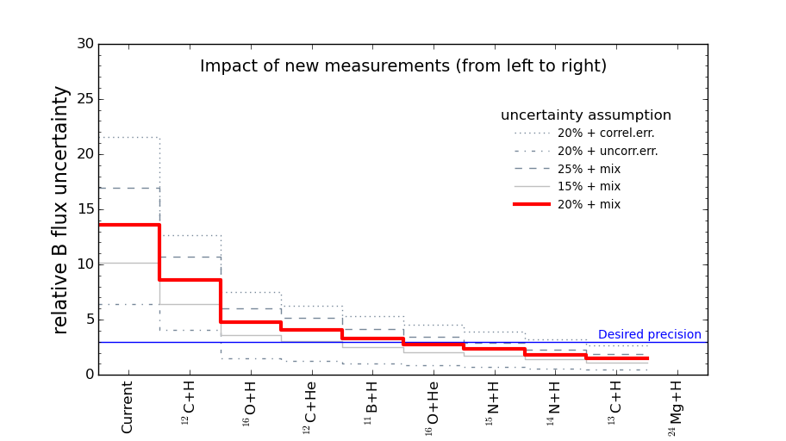
Impact of fragmentation measurement
Contributions from different reactions

Slide 22
NA61/SHINE program for 2021-2024
Open charm production in heavy ion collisions
Measurements for physics of galactic cosmic rays
and neutrino experiments
  Many requests for new data
  Example: measurement of fragmentation cross sections
Based on the workshop:
https://indico.cern.ch/event/629968/timetable/

Slide 23
Backup slides

Slide 24
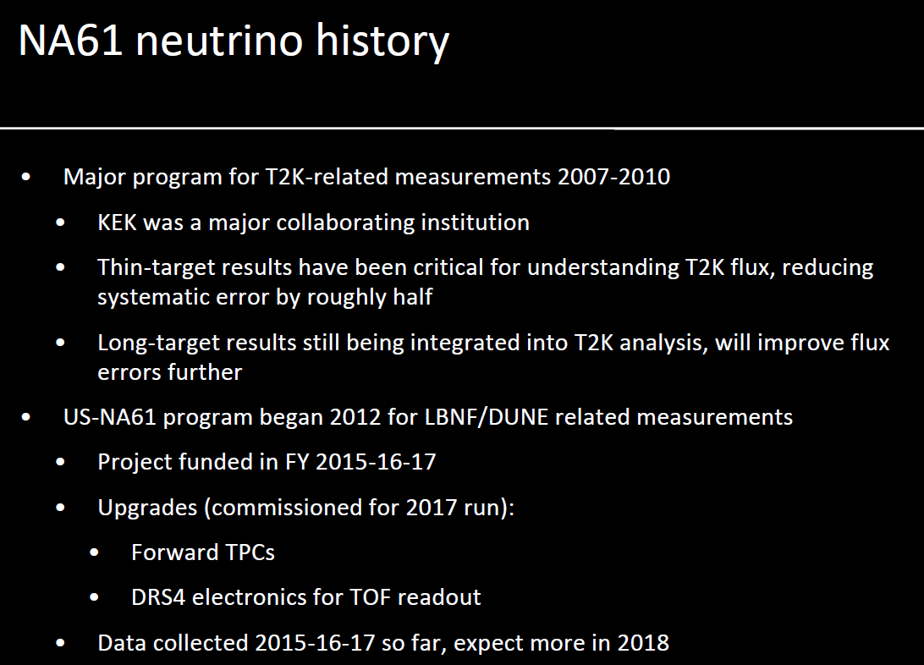

Slide 25
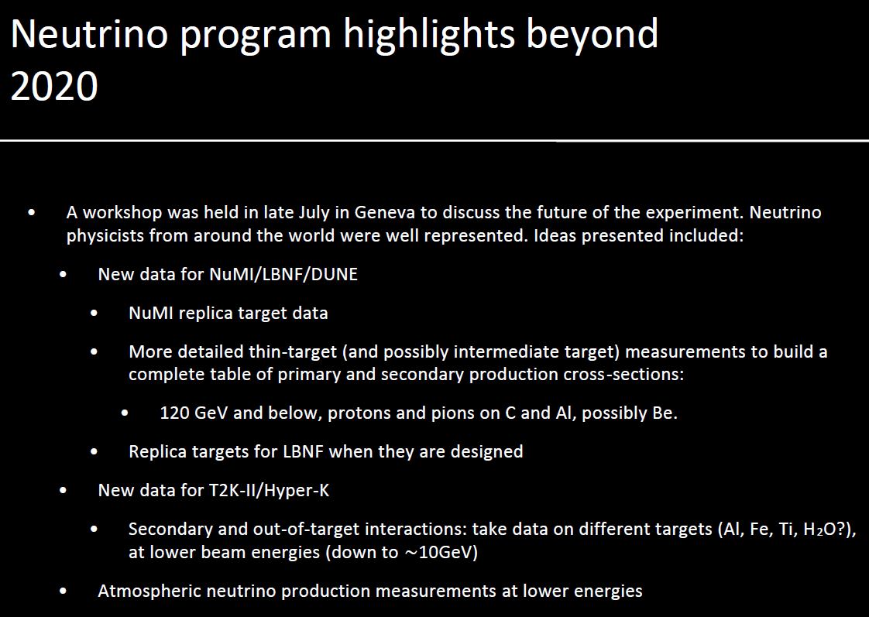

Slide 26
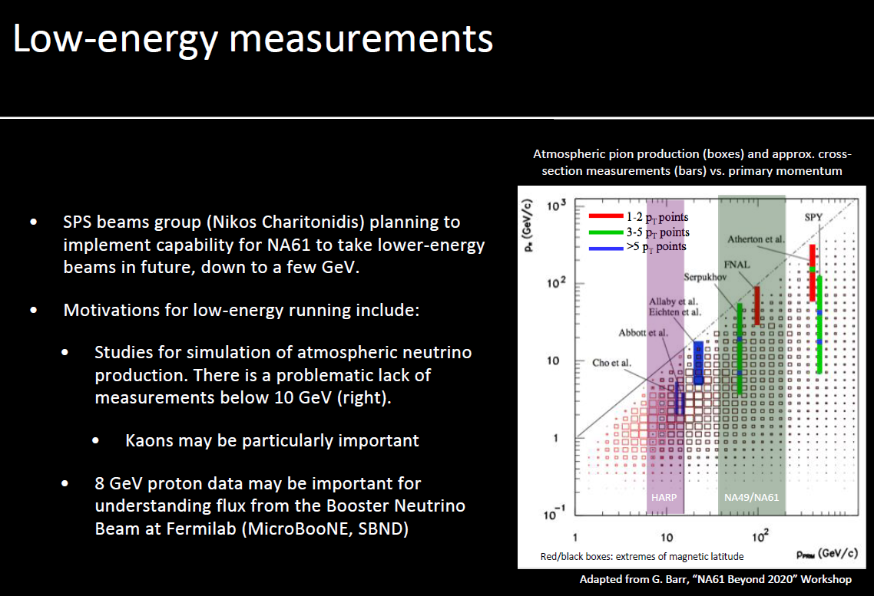

Slide 27
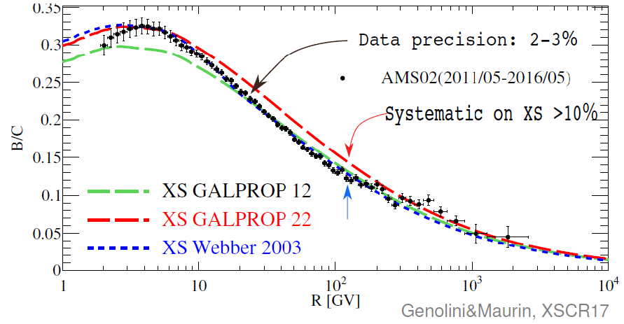
Interpretation of boron-to-carbon ratio
27

Slide 28
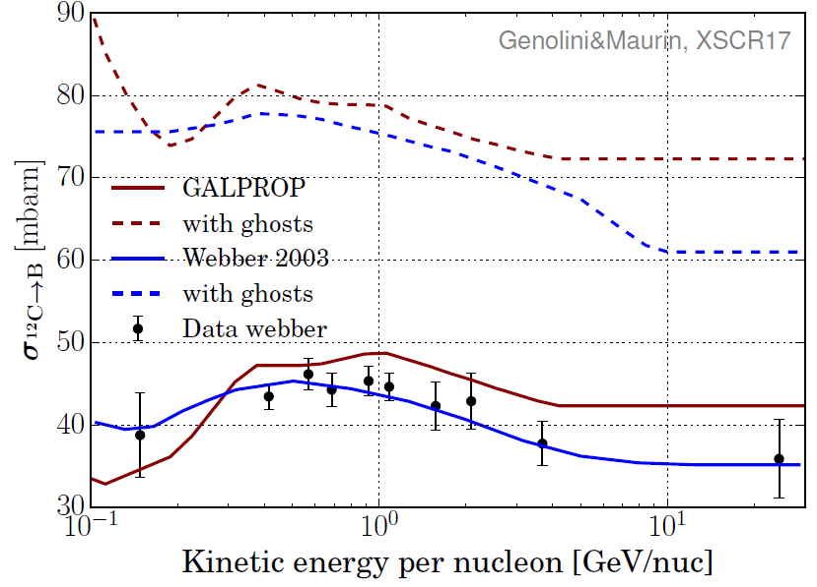
Current ¹²C+p → B + X cross sections
28

Slide 29
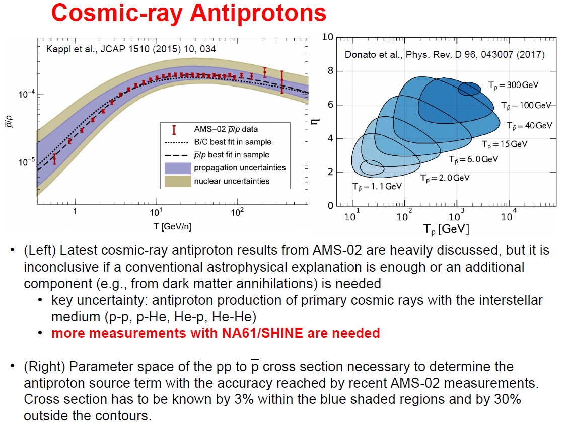

Slide 30
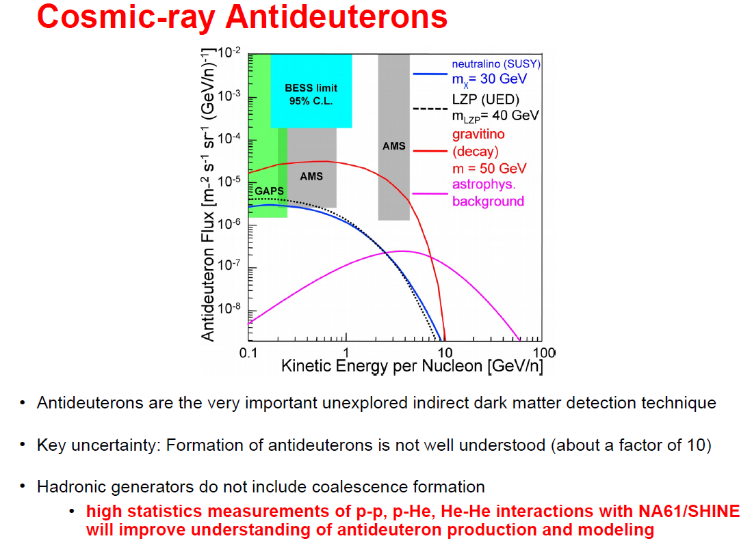

Slide 31
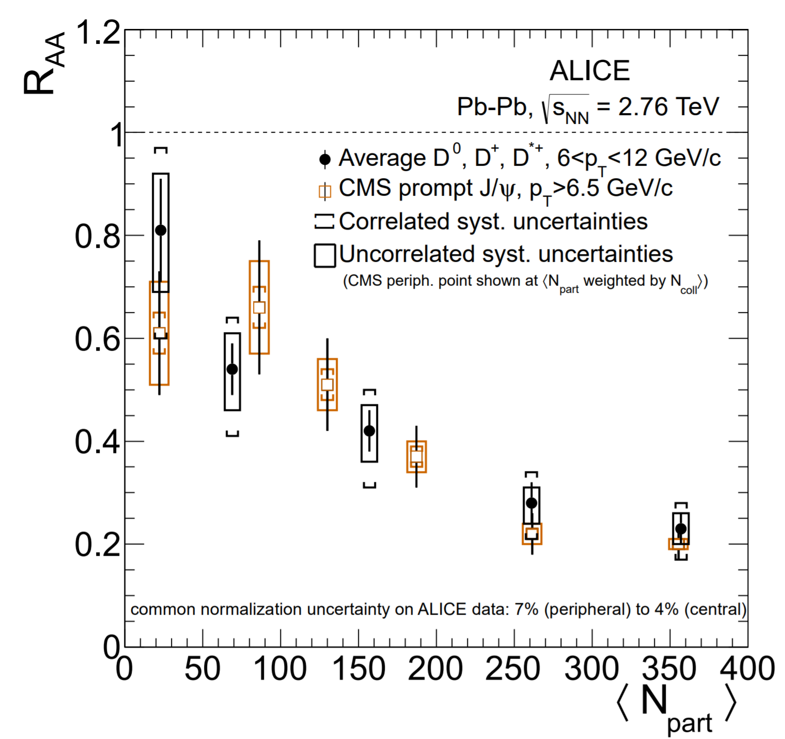
LHC open charm and $J/ψ$

Slide 32
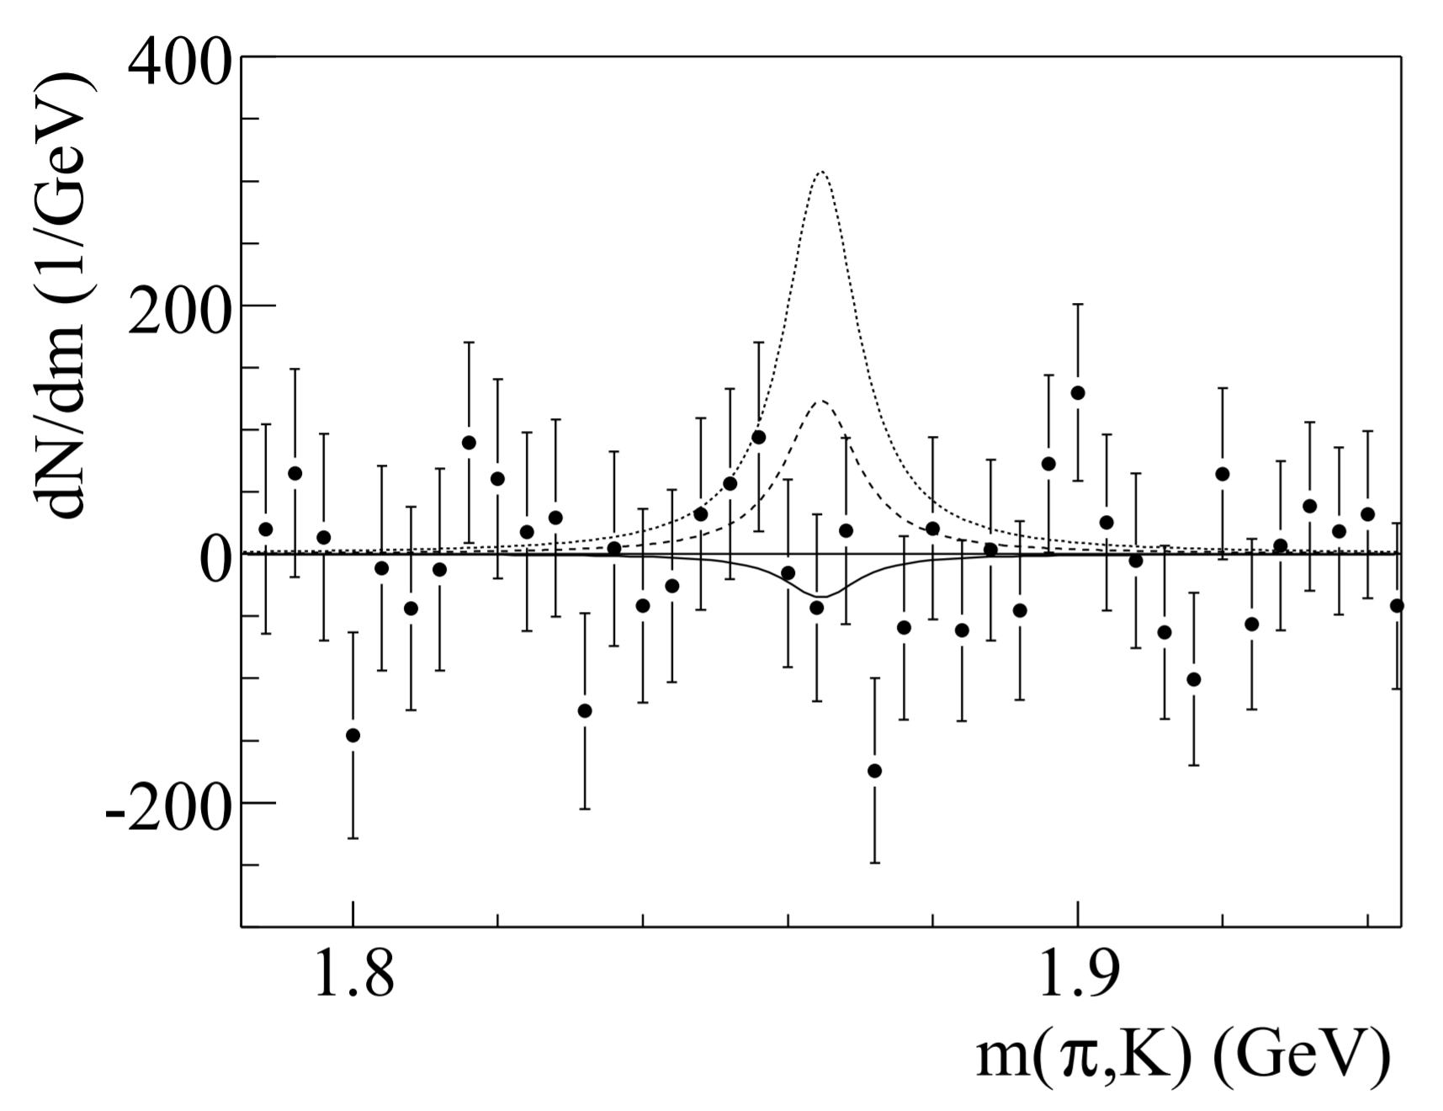
NA49 open charm upper limit

