Slide 1
Conventional Beams WG
L.Gatignon, on behalf of the CBWG
22 November 2017

Slide 2
Conventional Beams WG
Given the relatively long list of studies, we focus first on those leading to a possible short and medium time-scale implementation and with limited resources, as well as on those which seem to be the most advanced and competitive (based on the available input after the initial kickoff event and on a first feasibility analysis regarding the FT implementation).
Under consideration are at present:
NA62: proposal to operate in beam-dump mode
NA64++: High intensity e-, μ and hadron beams for dark particles searches
KLEVER: high intensity K_{L} beam (high flux, pencil beam, new target) for rare decays
COMPASS++: RF sep. beams for hadron structure and spectroscopy, also μp FF
Mu-e: 150 GeV μ beams for high precision hadron vacuum polarisation for g_{μ}
DIRAC++: DIRAC@SPS for high statistic mesonic atoms
NA60++: Heavy ion beams for dimuon physics
NA61++: Higher intensity ion beam for charm studies

Slide 3
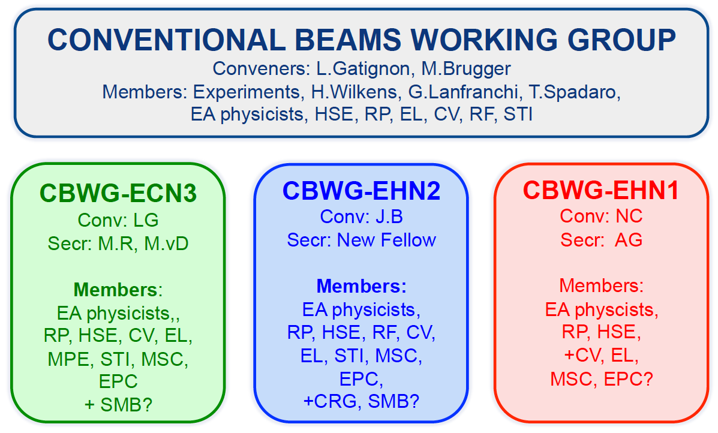
CBWG Organisation

Slide 4
Simulation for NA62-beamdump: G4-beamline
M.Rosenthal / EN-EA

Slide 5
M.Rosenthal / EN-EA

Slide 6
M.Rosenthal / EN-EA

Slide 7
M.Rosenthal / EN-EA

Slide 8
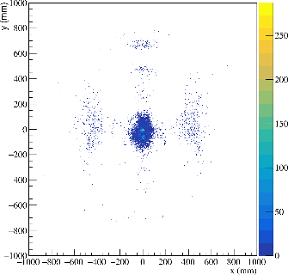
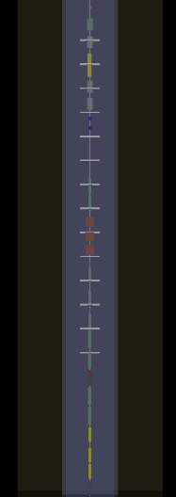
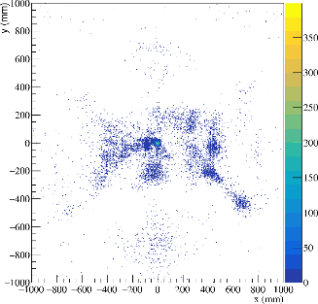
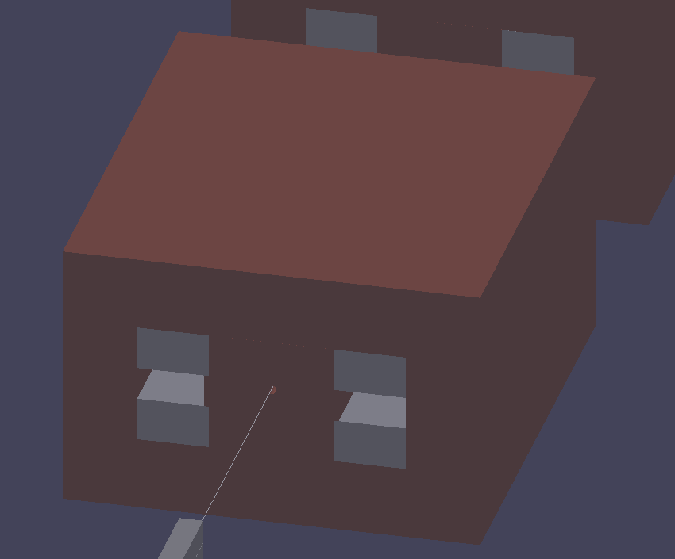
Triggering distribution default configuration
z = 30 m
z = 50 m
Centralized spot before BEND3
  Not deflected in hole
  Remove iron core?
Courtesy: M. Rosenthal / EN-EA

Slide 9
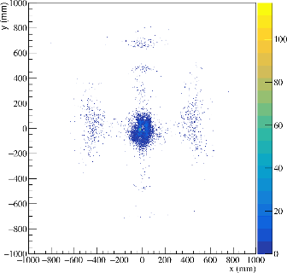
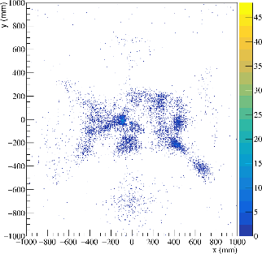
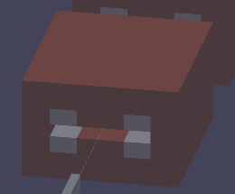
Triggering distribution MBPL configuration
z = 30 m
z = 50 m
Centralized spot before BEND3
  Not deflected in hole
  Remove iron core?
With MBPLs central spot
disappears from triggering muons
Courtesy: M. Rosenthal / EN-EA

Slide 10
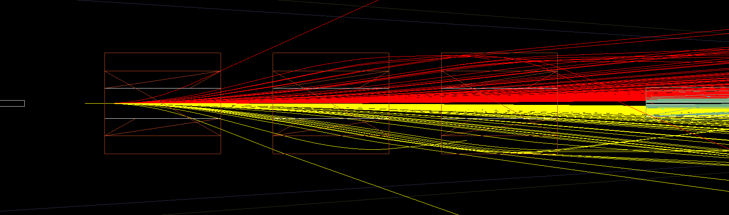

Muon trajectories in MBPLs for pencil beam
Optimization of number of MBPLs and field strength
First considerations:
  Simulate momenta up to 400 GeV/c, start tracking in front of MBPLs
  Momenta below 20 GeV/c are partially caught in return yokes of 3 MBPLs
  High momenta require large field strength to be deflected sufficiently
    Optimization on-going
$$μ^{+}$$
$$μ^{−}$$
Courtesy: M. Rosenthal / EN-EA

Slide 11
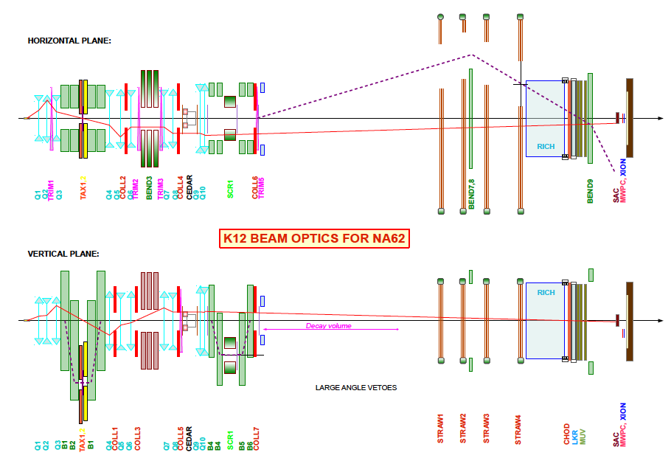
FOR SHORT RUNS WITH EXISTING LAYOUT

Slide 12
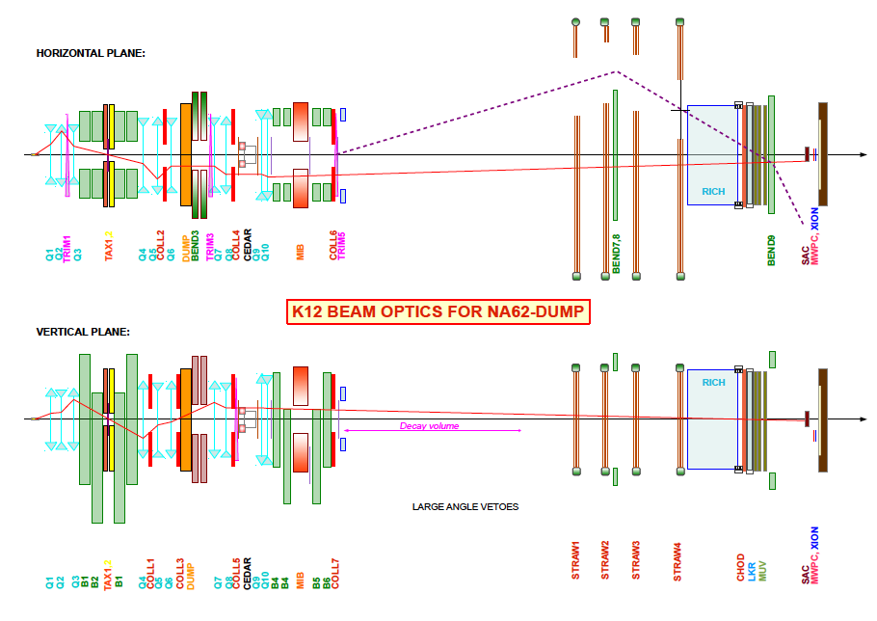
FOR 1-YEAR RUN

Slide 13
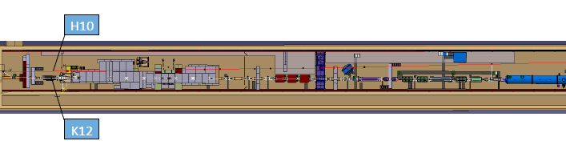
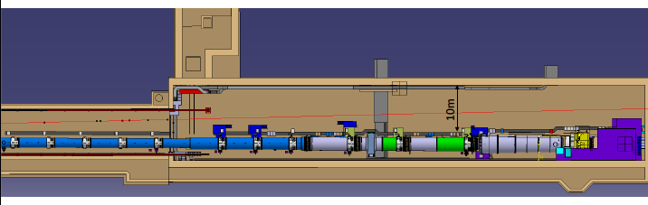
Difficulties to add beam line in ECN3 e.g. for DIRAC++ or NA60++
S.Girod / EN-EA

Slide 14
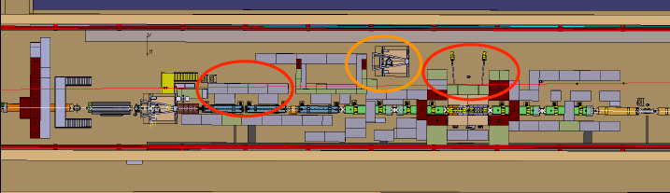
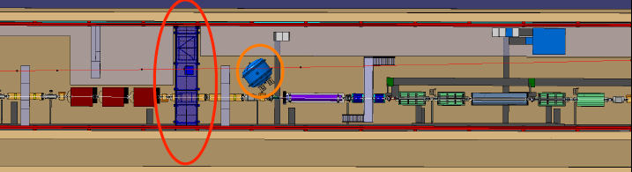
E.g. beam front end
All this requires detailed simulations!

Slide 15
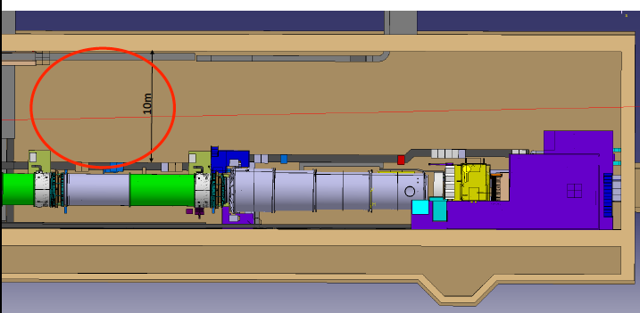
Or on the detector side…..

Slide 16
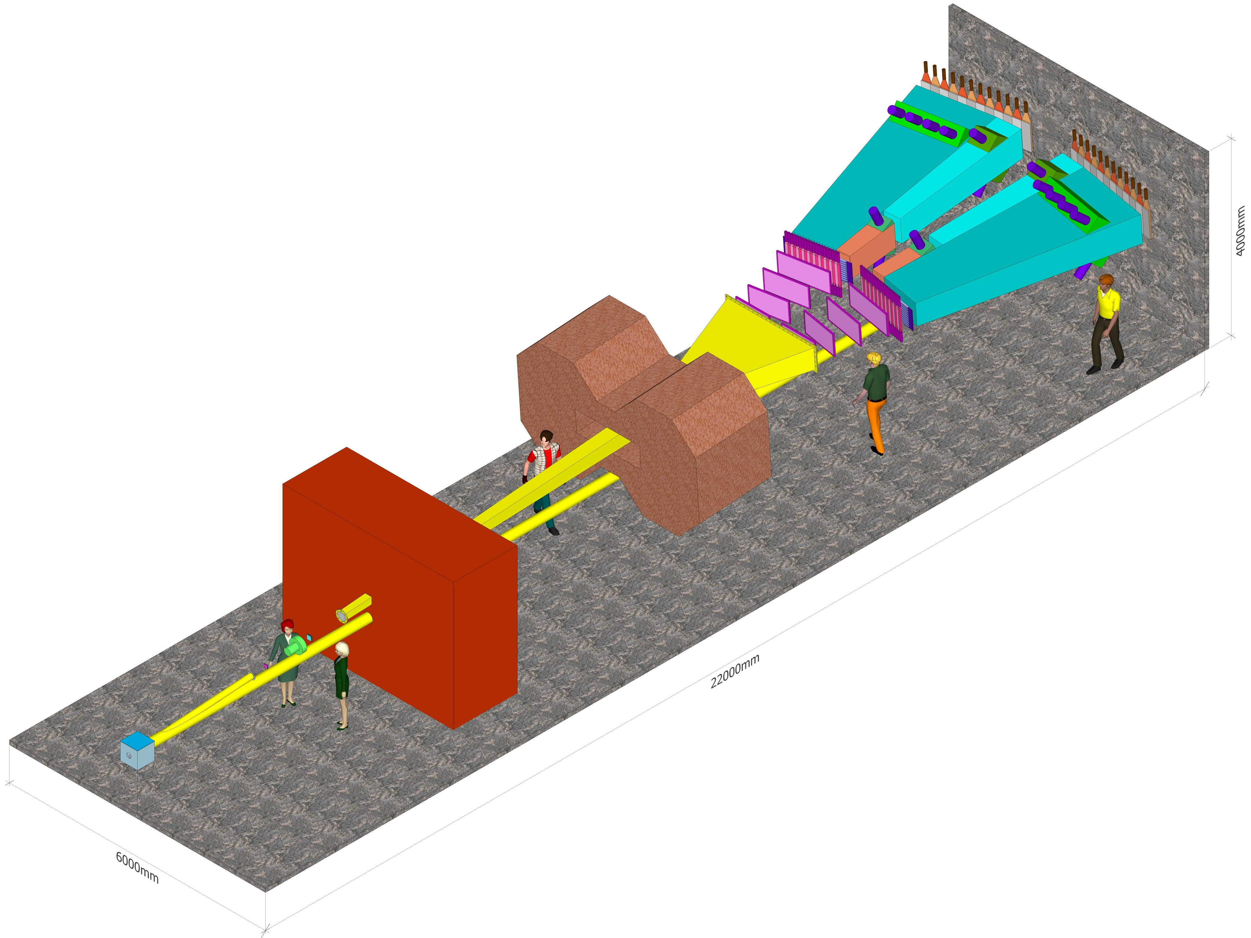
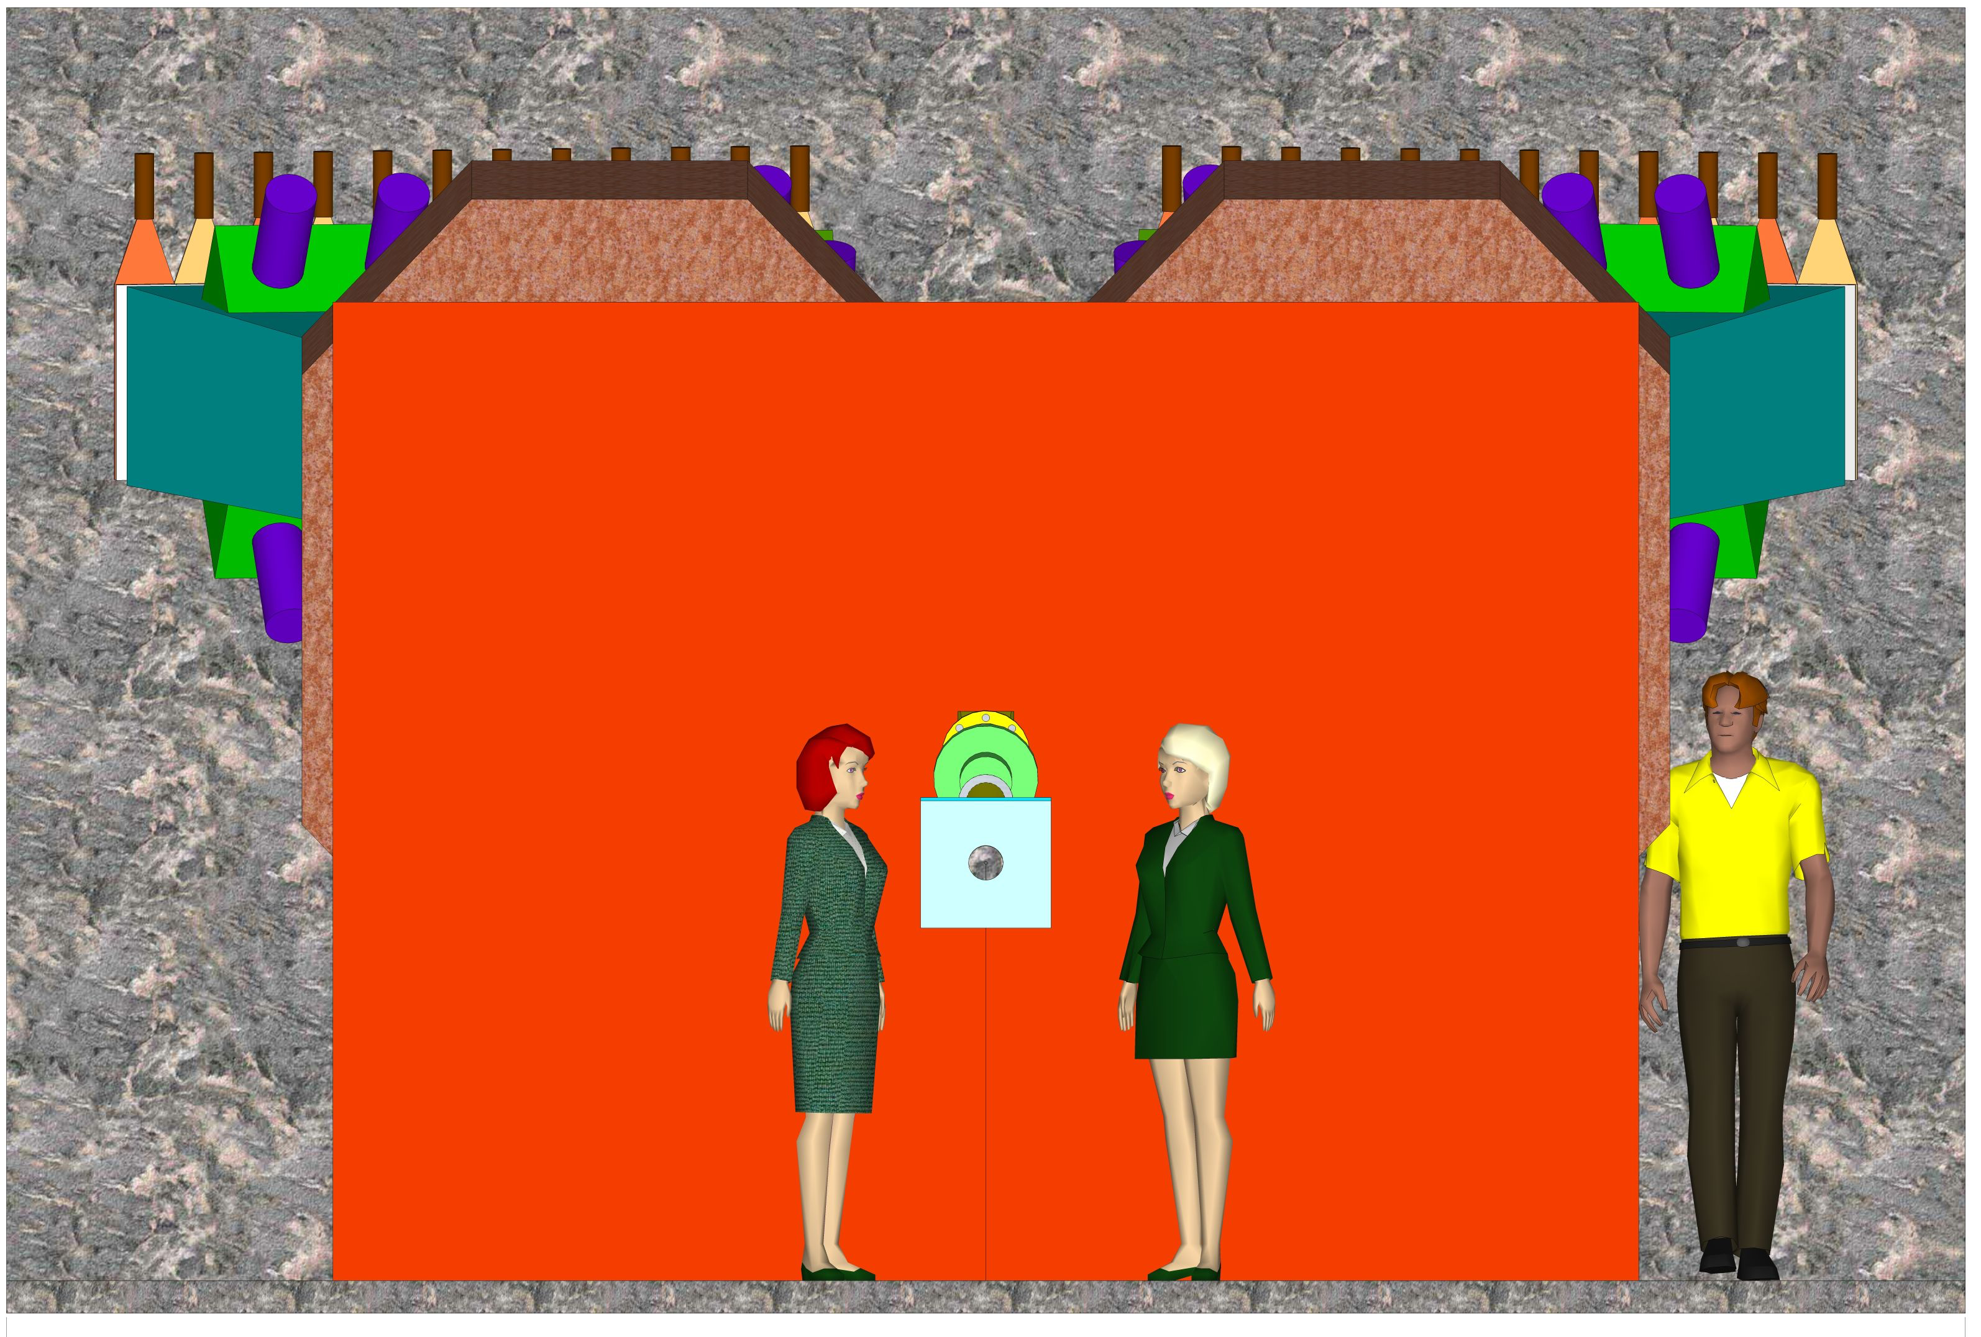
E.g. adaptations for DIRAC⁺⁺ layout
6 m wide
V.Yazkov / DIRAC.

Slide 17
Start of FLUKA studies for KLEVER
After a learning phase, tools have been developed to start work for KLEVER
starting with particle production studies and benchmarking.
E.g.:
Particle production
in KLEVER Target
In preparation for
studies of target
material and
production angle
dependence
Note: Kº ~(K⁺ + 3 K⁻)/4
M.van Dijk, M.Rosenthal

Slide 18
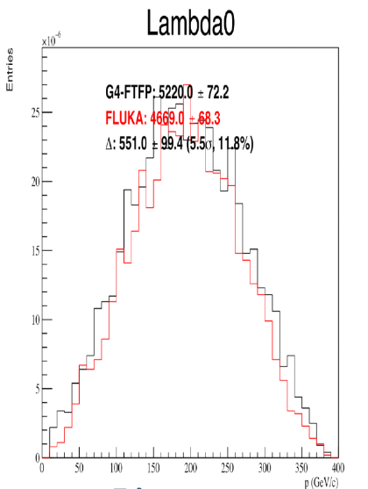
Potential background
On-going effort to
minimise background
from neutrons and Λ^{ο}
Maarten van Dijk

Slide 19
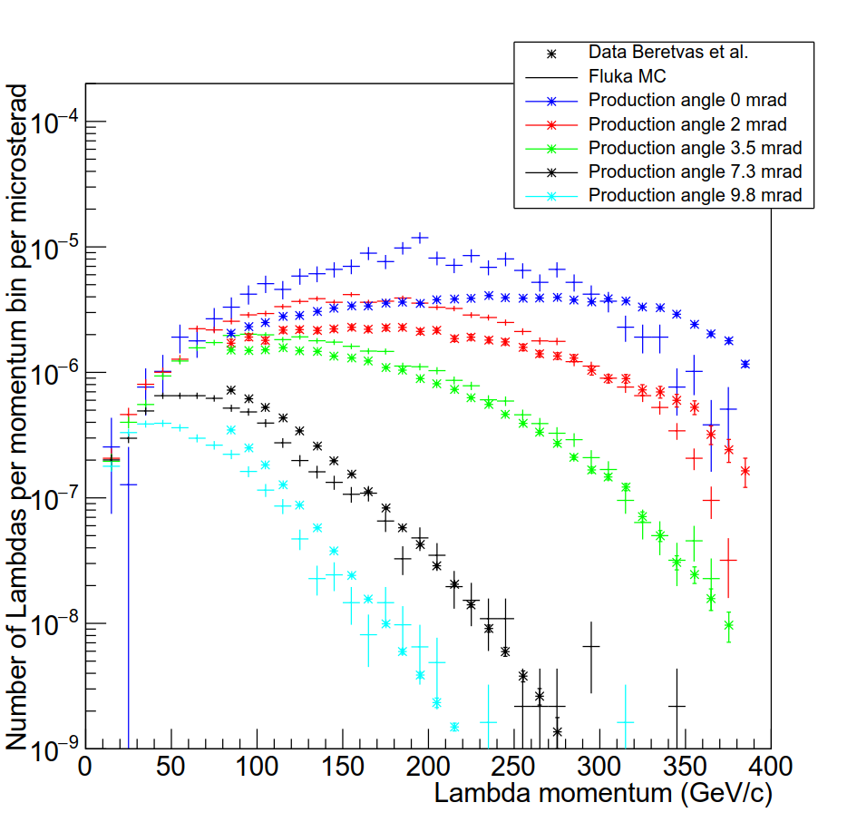
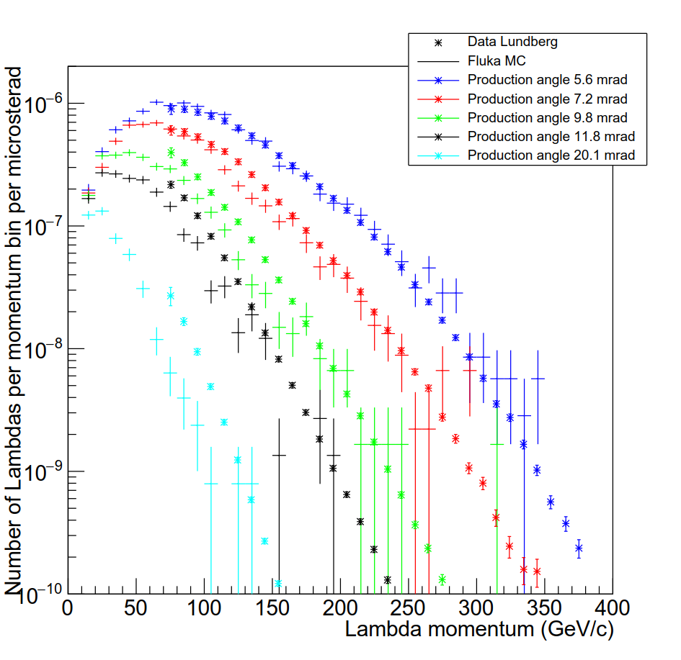
FLUKA Benchmarking for Λ production
Now background studies from e.g. Λ as a function of production angle can start,
followed by more detailed studies for the configuration finally chosen.
M.Van Dijk / EN-EA

Slide 20
Intensity increase for KLEVER
There are a number of intensity limitations for beams into TCC8 and ECN3 that need to be quantified and improvement to be studied. These include:
Maximum proton intensity in SPS, proton sharing, duty cycle, BDF, etc
→ BDF studies,Proton production WG
Losses at extraction, on the splitters and on the way to the targets
→ SLAWG
Spill structure even more important at higher intensity
→ Work with experiments to improve feedback to CCC
Beam attenuation in T4 (or T6)
Equipment reliability and survival (splitters, targets, TAX, etc)
Machine and equipment protection
Radiation protection constraints (ventilation, environment, muons, etc)

Slide 21
T10 intensity for KLEVER
2 10¹³ ppp on T10 requires many more on T4. Survival of targets?
E.g. with 100 mm target need more than 3 10¹³ ppp on T4
Would also produce high radiation levels in BA80 and for cooling water
A short T4 target is penalising for electron content in H6, H8
A longer target would be better in this respect, but radiation issues
harder to control
A by-pass beam at T4
has been suggested:
Most of beam can be transmitted
directly (no scattering in T4) to T10
and possibly longer target in T4
Optics in transfer line and P42 to be worked out
In general more instrumentation is needed to
improve transmission and reduce losses everywhere

Slide 22
Ventilation in TCC8 and ECN3
The present solution (cost driven) provides only little margin for nominal intensity on T10, i.e. 3 10¹² ppp (according to FLUKA calculations)
Higher intensity (as requested by KLEVER) would normally require under-pressure in TCC8 and transfer tunnel Not easily possible with present tunnel construction (leaking in many places, would require lots of CE work – cost?)
Need to physically separate ventilation units for TCC8 and ECN3 to avoid leakage of active TCC8 air into the ECN3 units.
Requires moderately large new surface building,
Also other RP aspects need to be considered.
Studies involve RP, CV and SMB and are now kicked off following a year
of data-taking by NA62 at 60% of nominal intensity on the T10 target.
Looking forward to first outcome of RP analysis of measurements soon.

Slide 23
EHN2 Working Group
Identified work packages by beam type and physics proposal
    WP1: Muon beams post 2020
    WP2: Hadron and Electron beams post 2020
    WP3: RF-separated beams
    WP4: Beam Particle Identification (dedicated meetings / WP leader S.Mathot/EN-MME)
Roadmap: Identify necessary studies for WP proposals (Beam Design / Optics, Integration of Set-ups in EHN2, Backgrounds for Physics, Radiation Protection, Safety) and prepare input to PBC Conceptual Design Report (2018)
Dedicated meetings for possible 2018 tests in EHN2 (mostly WP1)

Slide 24
Muon beams in EHN2
Options to be studied for location of NA64 mu program and mu-e scattering proposal set-ups
3 locations in EHN2 identified that would be compatible with the current COMPASS set-ups
  Option 1
    Pro: rather easy to install, no further cabling for MBPL necessary, best electron beam quality
    Con: limited space, not compatible with COMPASS running at the same time
12.8 m
J.Bernhard

Slide 25
Muon beams in EHN2
  Option 2
    Pro: might be compatible with COMPASS running at the same time (PT in garage position, small angle spectrometer available with SM2, muon ID, calorimetry)
    Con: limited space, cabling and space for MBPL (maybe remove Quad36 and use Bend9?)
10.8 m
J.Bernhard

Slide 26
Muon beams in EHN2
  Option 3
    Pro: compatible with COMPASS running at the same time (able to use full COMPASS set-up)
    Con: expensive cabling for MBPL, safety aspects (lock ABS in, no hadron beams), electron beam would have to pass additional 60m of air + COMPASS target and detectors, would need to ensure safety with electron beam operation (e.g. limit Bends 5 and 6)
14.9 m
J.Bernhard

Slide 27
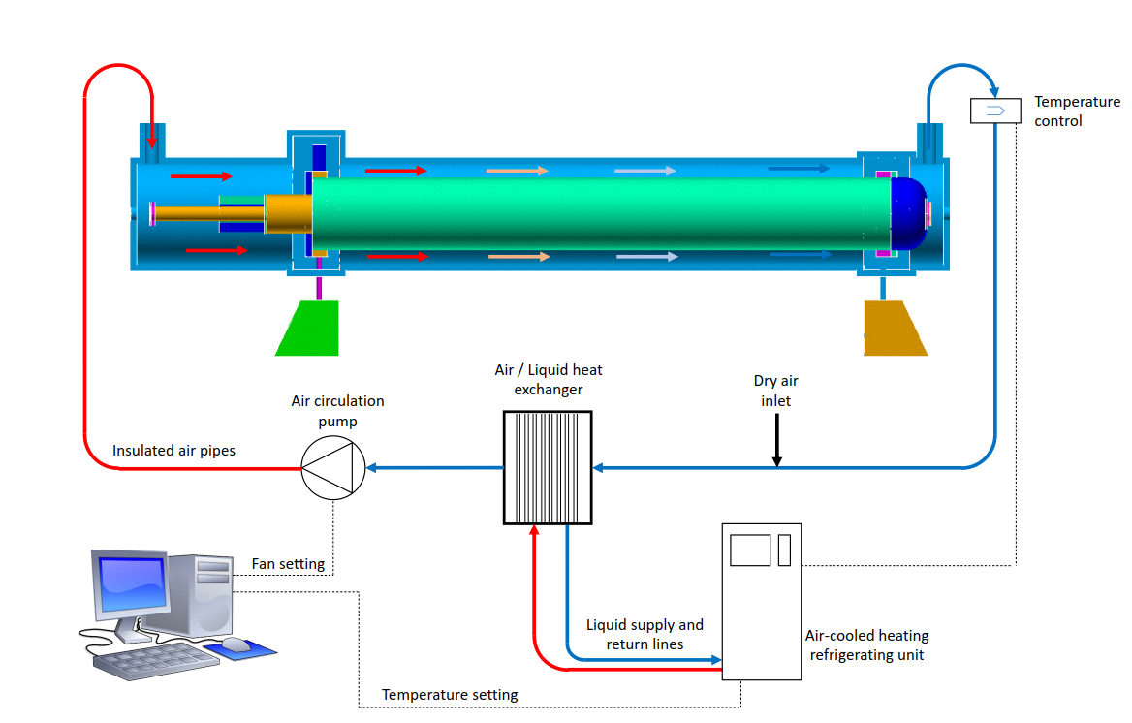
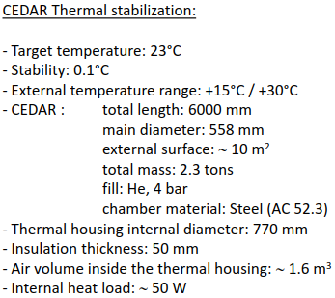
CEDAR Upgrade
CEDAR upgrade for better rate and thermal stability, goal: project ready for 03/2018
  New PMTs, gain monitor, and read-out (COMPASS)
  New thermalisation (EN-EA / MME / CV)
S. Mathot is project leader for CERN, M. Ziembicki coordinates Front-end for COMPASS, BE-BI will check compatibility and use this as a pilot project
S.Mathot

Slide 28
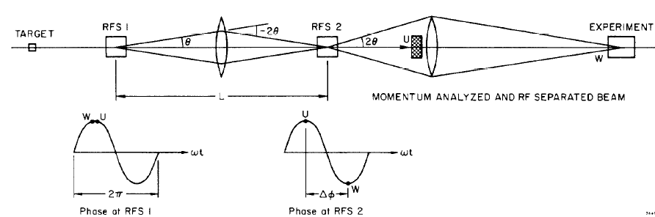
RF-separated Beams
Note: Preliminary considerations, guided by initial studies for NA62 and CKM studies by J.Doornbos/TRIUMF, Panofsky-Schnell-System with two cavities (CERN 68-29):
for K^{+/-}
for pbar
Selection of particle species by selection of phase difference
ΔΦ = 2π (L f / c) (β₁⁻¹ – β₂⁻¹)
Estimated flux (100 GeV/c): 8 10⁷ pbar/pulse (for current RP limit in EHN2: 5 10⁷ pbar/pulse), K⁺ case: flux about 75%

Slide 29
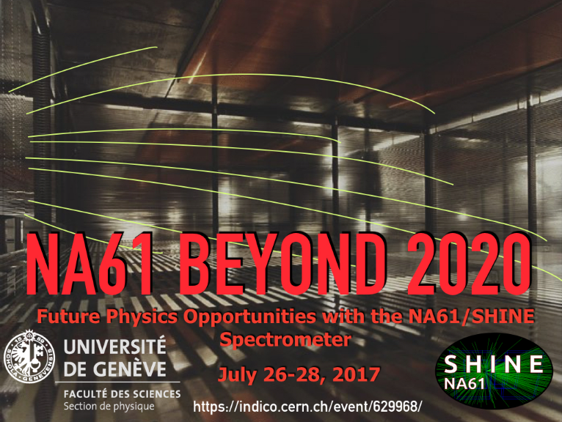
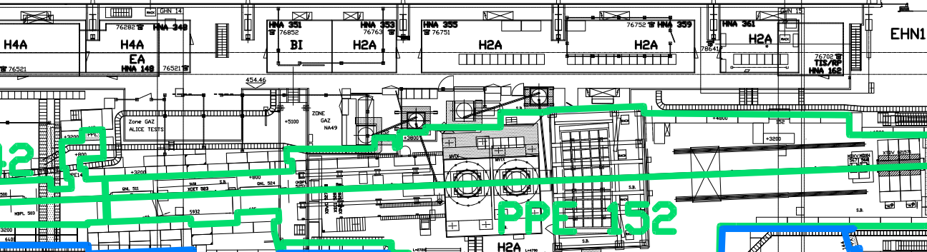
NA61 Higher Intensity
As expressed during the workshop “NA61 Beyond 2020”, higher intensities are necessary for improving the open charm and multi-strange hadron measurements.
→ 2 10⁶ ions per spill !
A radiation mapping during the 2017 ion run revealed that extra shielding will be needed around the calorimeter in PPE152 and a possible re-arrangement of the zone.
→ FLUKA simulations needed for the optimization of the shielding and the optimal positioning of the door in collaboration with HSE/RP
Green line: current PPE152
zone limits.
CAL
N.Charitonidis

Slide 30
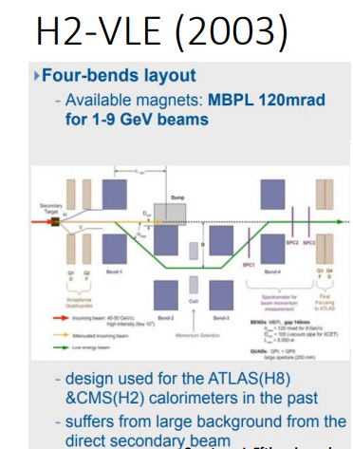
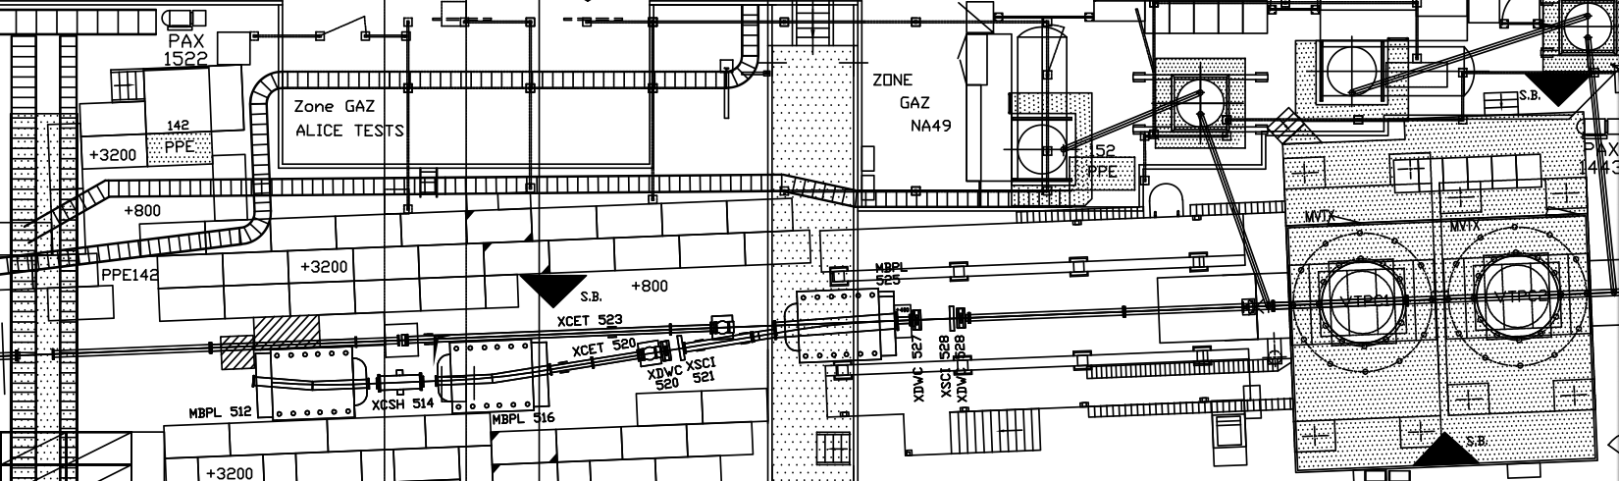
Low Energy Beams for NA61++
Increasing interest for beams < 10 GeV/c
To be studied: 4-bends layout at PPE132 (already implemented in the past)
A similar layout could be envisaged for NA61++
Background and proton content the biggest challenges, along with the magnets’ availability
NA61
VLE part ?

Slide 31
Yet to come
Continue the on-going studies
Prepare for 2018 test beam requests
Optimisation of NA62 beam dump for long run
Detailed studies for KLEVER beam using FLUKA and/or G4-beamline
RF separated beam for COMPASS
User requirements being updated by COMPASS.
Feasibility, and cost estimates to be worked out in detail
(including technical, RP and safety aspects).
Possibly new projects?
Thanks to the colleagues in the EA group and
in the Conventional Beams working group

Slide 33
COMPASS RF separated beam for K±

Slide 35
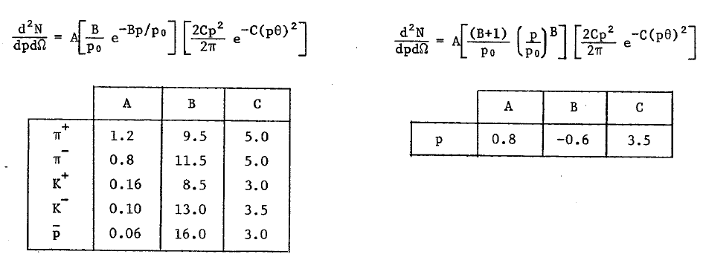
Particle Production
Atherton parameterisation (CERN 80-07):
with primary momentum p₀ and production angle θ
Flux per solid angle [steradian], per interacting proton, and per dp [GeV/c]
θ = 0 mrad

Slide 38
COMPASS RF separated beam for pbar

Slide 39
NA64 schedule

Slide 40
Mu-e

Slide 45
COMPASS DY Shielding studies (H.Vincke)

