Slide 1
The CERN Neutrino Platform
CERN, 1st August 2017
Marzio Nessi, CERN & University of Geneva

Slide 2
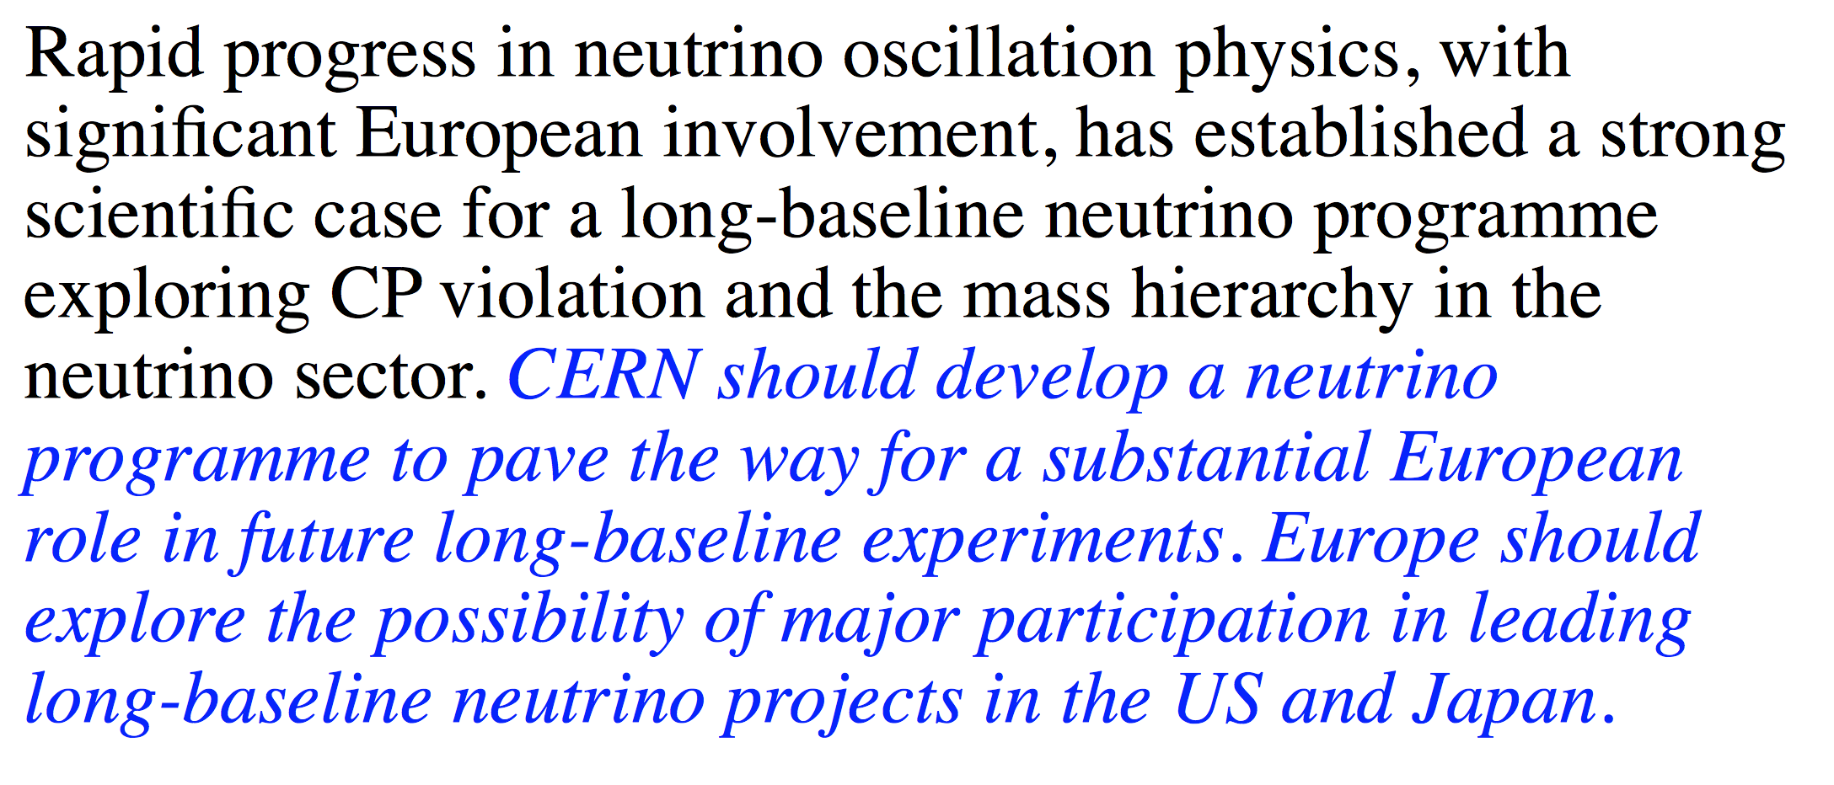
2013 European strategy

Slide 3
2013 European strategy
LBNE in the US with a detector on the surface (10KT), MINOS operational
Short and Long baseline in Europe under evaluation
Several non-accelerator based experiments producing important results (Daya Bay,..)
Very succefull T2K experiment taking good data and thinking about the future
Evident need, at least in Europe, to give coherence and support to a fragmented community

Slide 4
CERN ν Platform Initial Mandate (2015)
Assist the various groups in their R&D phase (detectors and components) in the short and medium term and give coherence to a fragmented European Neutrino Community
Provide the ν community with a test beam infrastructure (charged particles)
Bring R&D to the level of technology demonstrators in view of major construction activities
Continue R&D on ν beam, as a possible basis for further collaborations
Support the short baseline activities (infrastructure & detectors)
Support the long baselines activities (infrastructure & detectors)
Be a partner in the physics exploitation

Slide 5
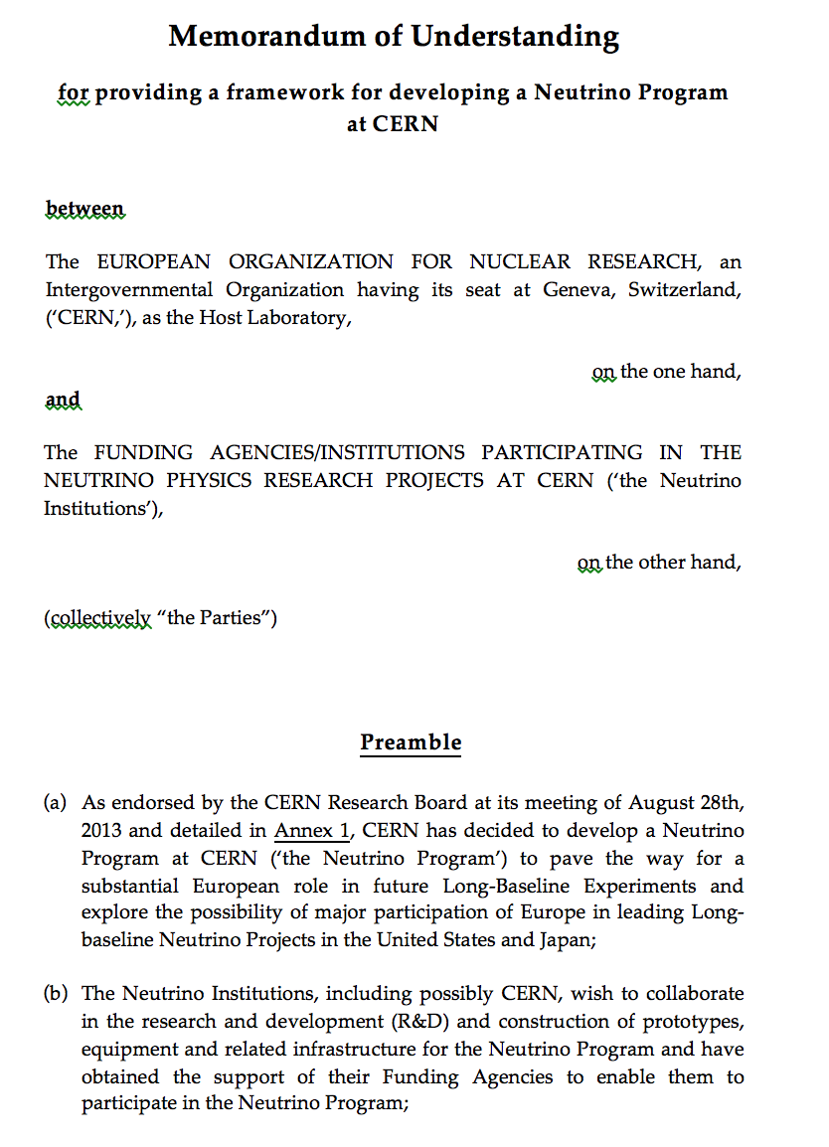
We react on demands from the community : MOU framework
https://edms.cern.ch/document/1353815
~ 60 EU institutions
As of Today we have 6 MOU addenda active !!
& cooperation agreements with US-DOE and JINR
SPSC committee as an entry point

Slide 6
We react on demands from the community : MOU frame
- 6 Projects presented to the SPSC and approved:
NP01: WA104, ICARUS as far detector for the US SBN
NP02: protoDUNE WA105, demonstrator + engineering prototype for a double ph. TPC
NP03: PLAFOND, an generic R&D framework
NP04: ProtoDUNE, engineering prototype for a single phase TPC
NP05: Baby Mind, a muon spectrometer for the WAGASCI experiment at T2K
Argon Cube : a modular TPC R&D
- A few Projects in the pipeline : T2K near detector, DUNE near detector, HPgas TPC, ENUBET, ….
- COOPERATION PROTOCOL with the US Neutrino Program (Neutrino Protocol signed in 2015, Addendum 1 just signed in 2017)

Slide 7
How to continue and formalize new projects?
The SPSC committee will open a call for proposal of new Neutrino experiments in October 2017
After an analysis, there will be a recommendation to the CERN Research Board, for an approval and for further project details
The timing for the approval will depend on the required CERN resources
R&D on small projects or R&D projects preparation, if fitting in the Neutrino Platform existing possibilities, should go ahead without much delays. Best prepare the field with direct discussion with us.
For the ND280-II upgrade project we need to have soon a clarification discussion with the CERN Directorate. EOI submitted, status not fully clear.
In the mean time we have launched a generic ND preparation activity (see Stefania Bordoni next talk)

Slide 8
Our Strategy
Act on direct requests from the community
Support in an effective way new inedit R&D proposals (hardware and software)
Try to bring in synergies between Neutrino community and the LHC community on specific technologies (DAQ, computing, electronics, …)
Host at CERN specialized researchers to make these projects more effective in the initial stage
Support large new projects with the necessary infrastructure, which just a big lab can offer
Offer to the community the collaborative experience and models, developed for the LHC

Slide 9
LAr TPC (time projection chambers) technology emerged as the solution to be adopted in both, Short and Long baselines, in the US facilities
The technology for near detectors is more vague (both in US and Japan):
  Atmospheric or pressure TPCs
  Modular liquid argon TPCs
  Various trackers, calorimeters and muon spectrometers
All solutions need R&D (hardware & software) and an approach in steps, given the size and the complexity

Slide 10
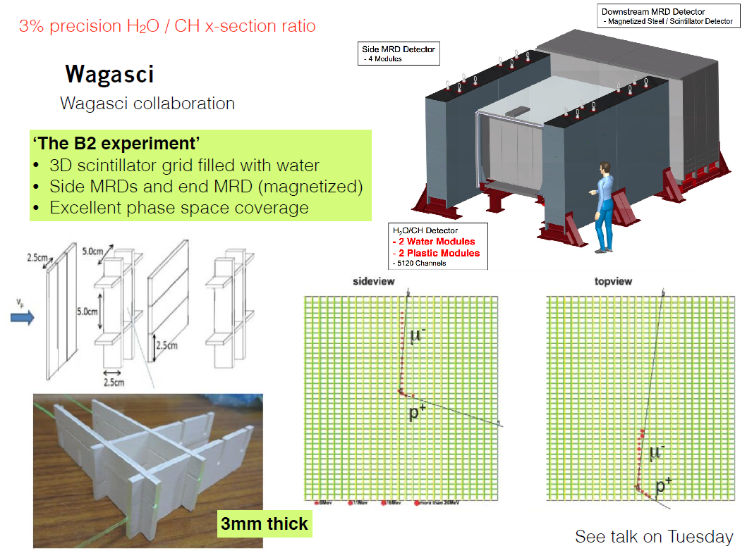
Wagasci experiment (P59) at JPARK
-- 3% precision H2O/C_{n}H_{n} cross-section ratio
-- Study of ν_{μ} energy reconstruction
-- wide angle θ coverage
-- complementary to ND280
novel fine grain target

Slide 11
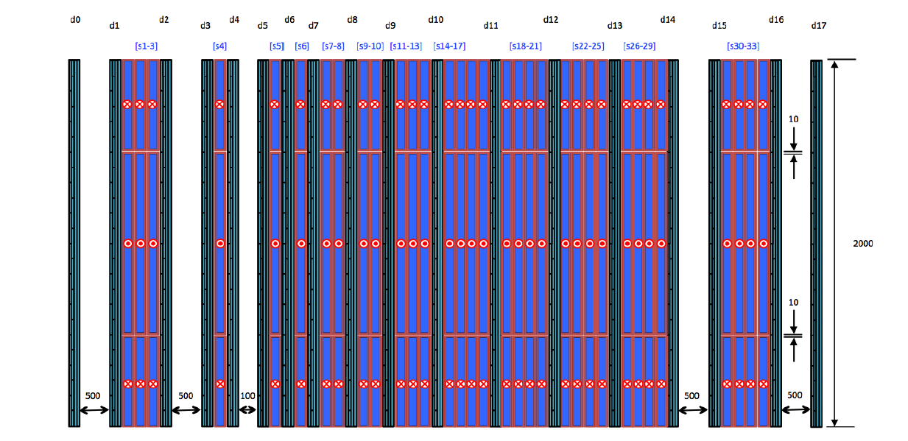
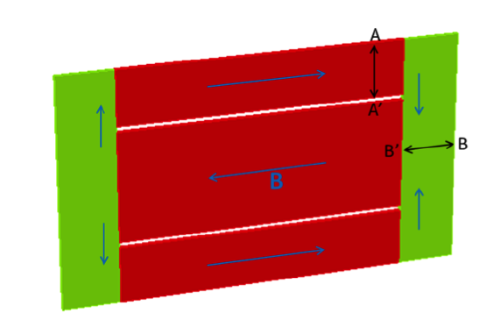
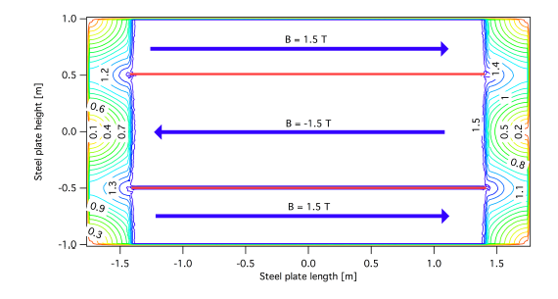
Baby-MIND LAYOUT
Magnet module thickness:
50 mm (30 mm Fe)
Detector module thickness:
38 mm (31 mm CH).
ν

Slide 12
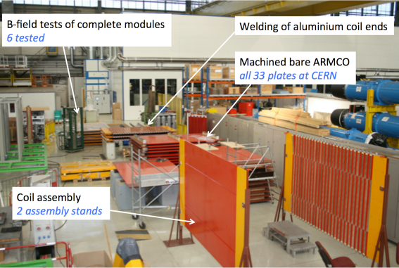
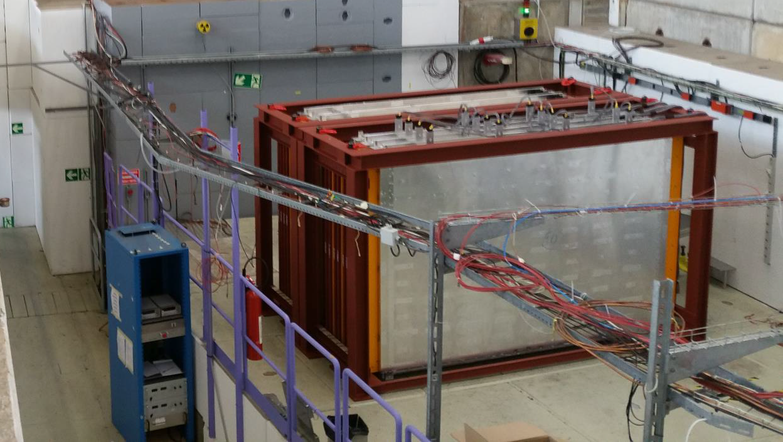
Wagasci/Baby-MIND Status and plans(II)
Baby-MIND
All magnetic and detector modules assembled
Full detector designed as 4 blocks
First tested in T9 test beam at CERN in May17
Full detector assembled and tested June-July’17
Ship to Japan in by Nov’17
Installation in B2 starting in Sep’17
Commissioning Oct’17-Mar’18
➔Start full data taking WAGASCI+ BabyMIND Apr’18
assembly of magnet modules at CERN
NOW
transport of first 20ton module in Apr’17
taking data at CERN in T9

Slide 13
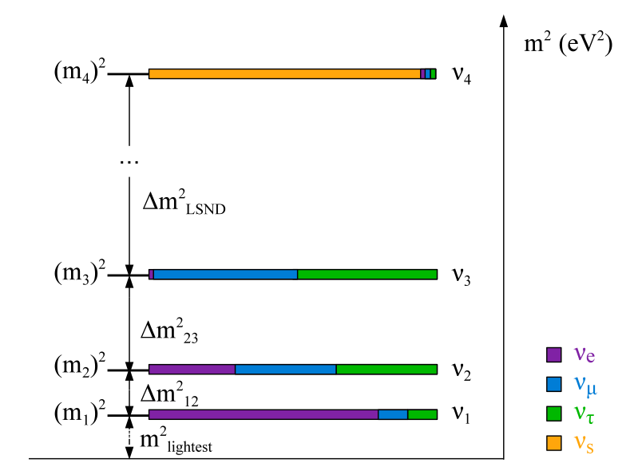
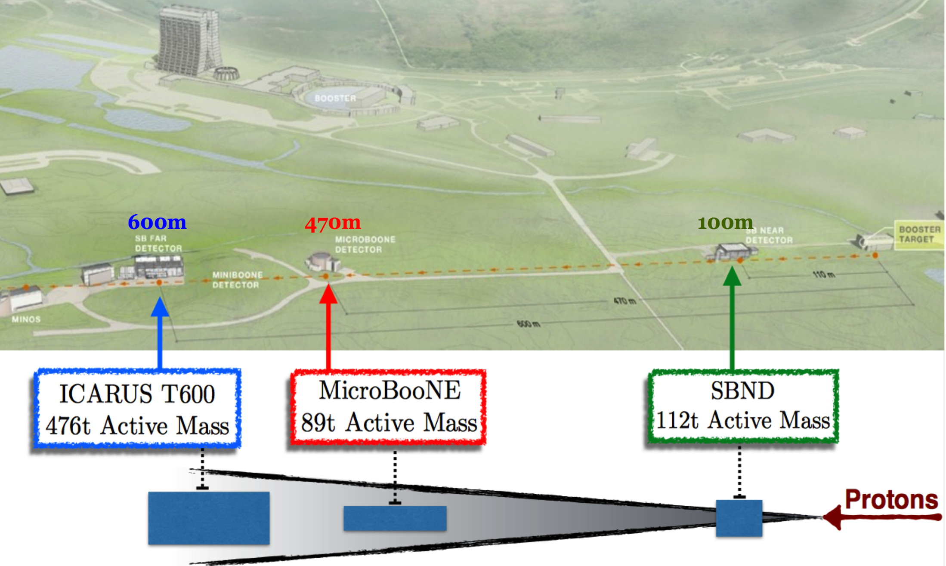
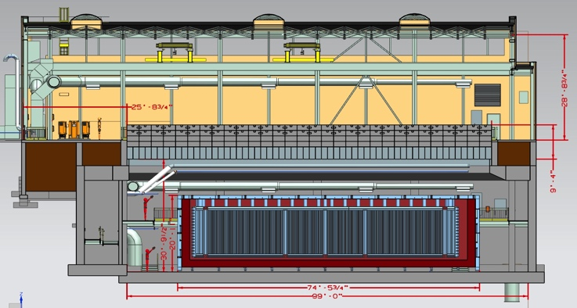
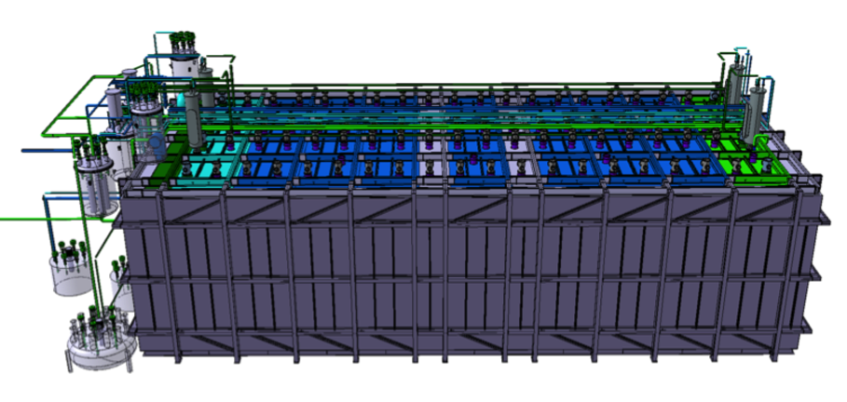
SBL @ FNAL
  A Multi-detector program will address the unexplained anomalies which together could be hinting at new physics (steriles?)
ICARUS T600
476t Active Mass
MicroBooNE
89t Active Mass
SBND
112t Active Mass

Slide 14
SBL @ FNAL
2015 ICARUS moved from Gran Sasso INFN Laboratory to CERN
@CERN detector reshaped, new cryostats
2017 ICARUS moving to FNAL
2017-early 2018 installation at FNAL
2018 commissioning
mid 2018 operation (far detector, ICARUS)
2019 near detector installation and commissioning

Slide 15
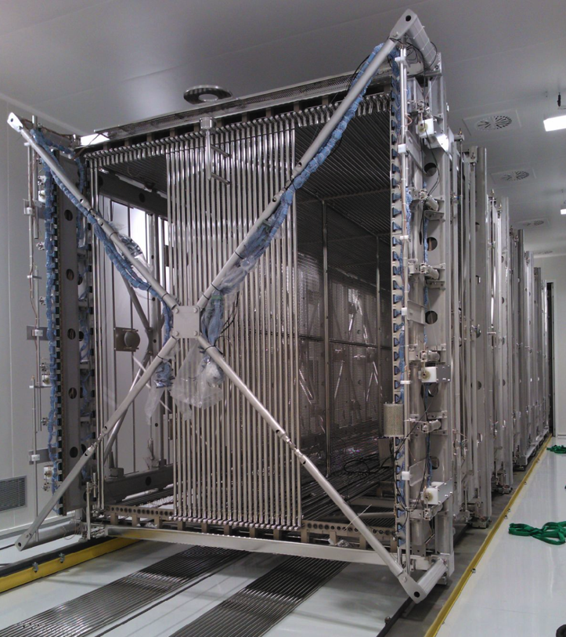
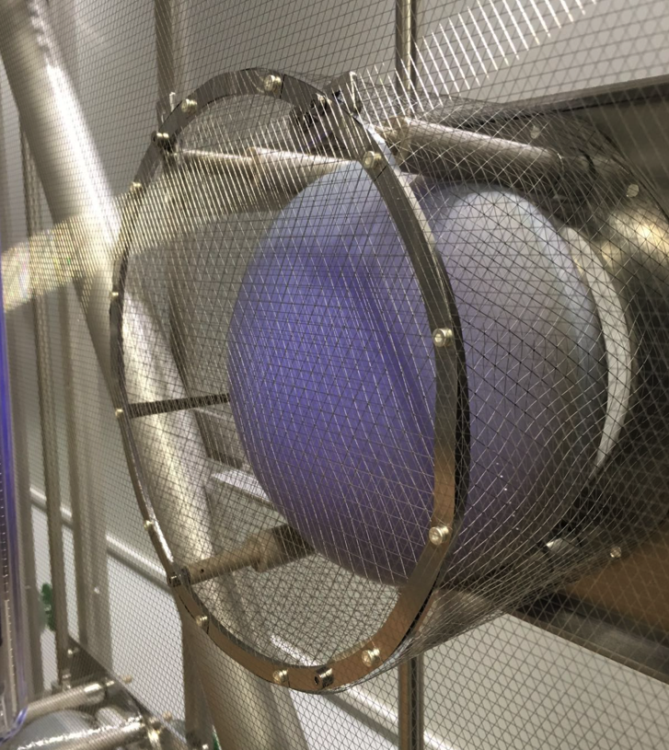
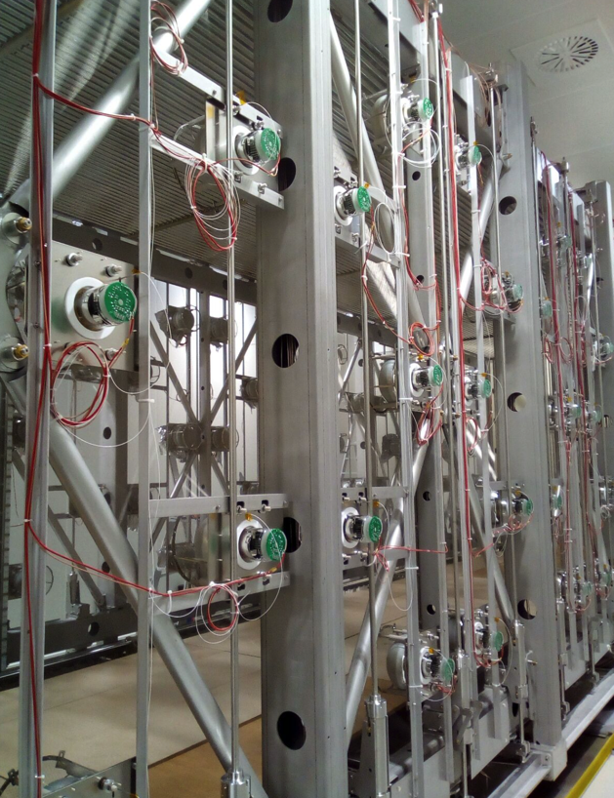
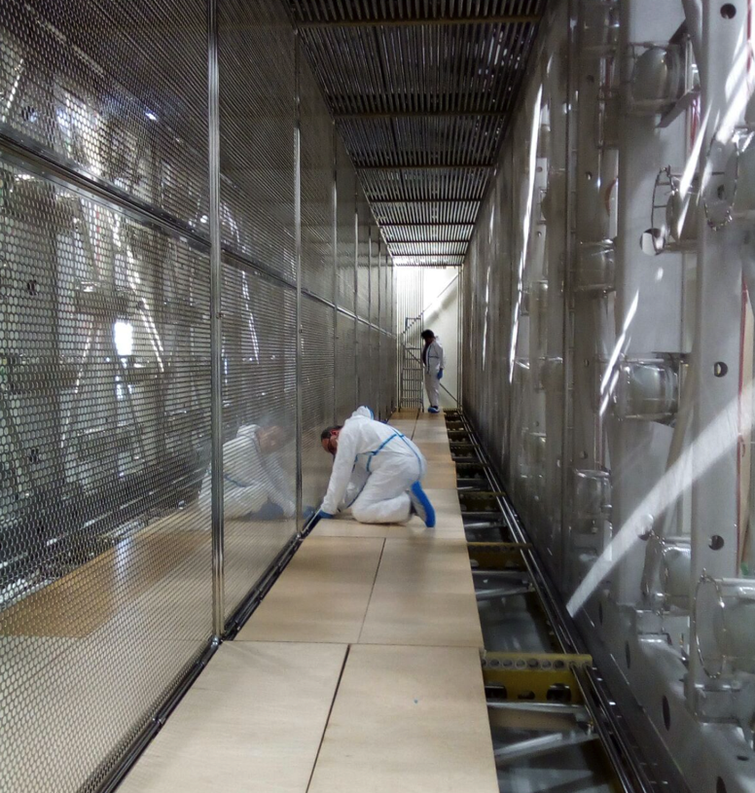
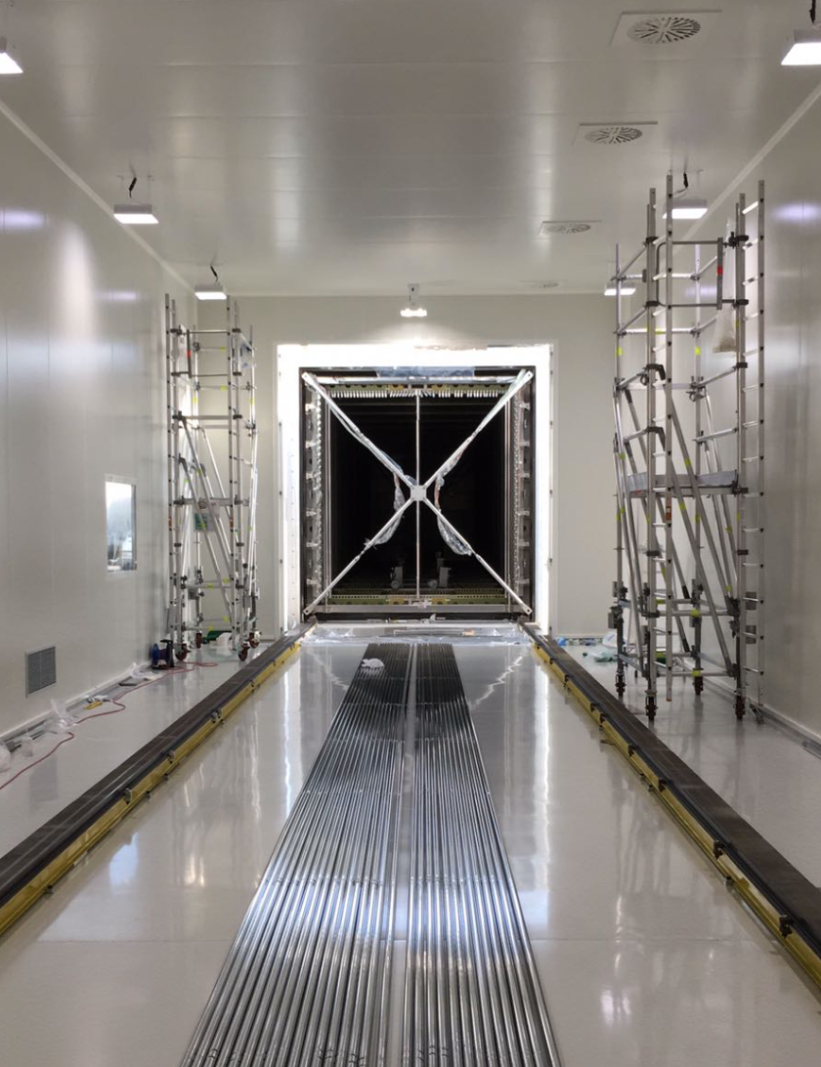
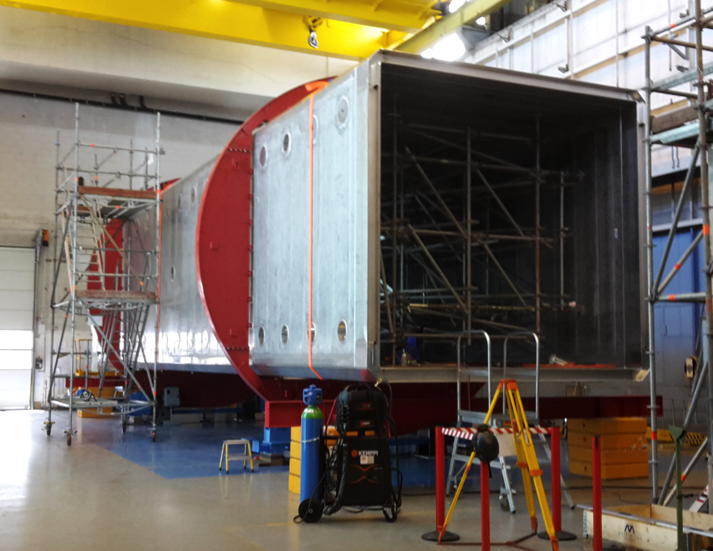
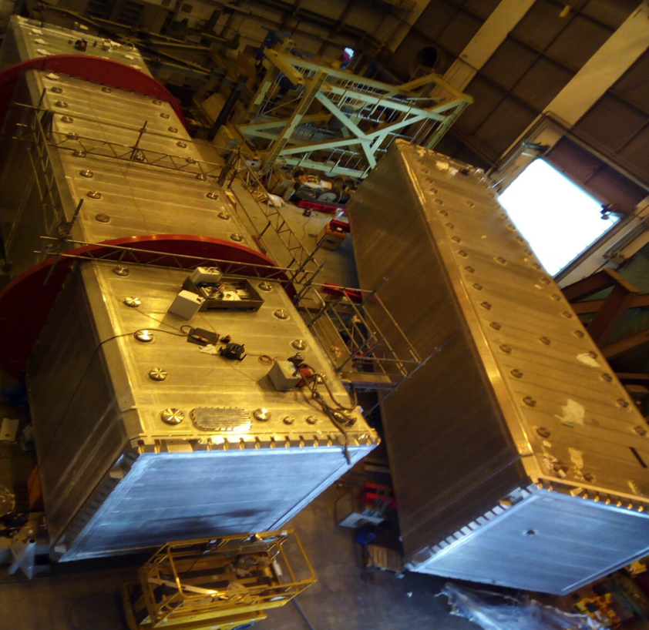
– new PMTs – new cabling - rework on cathodes – new cryostats – new electronics - ……

Slide 16
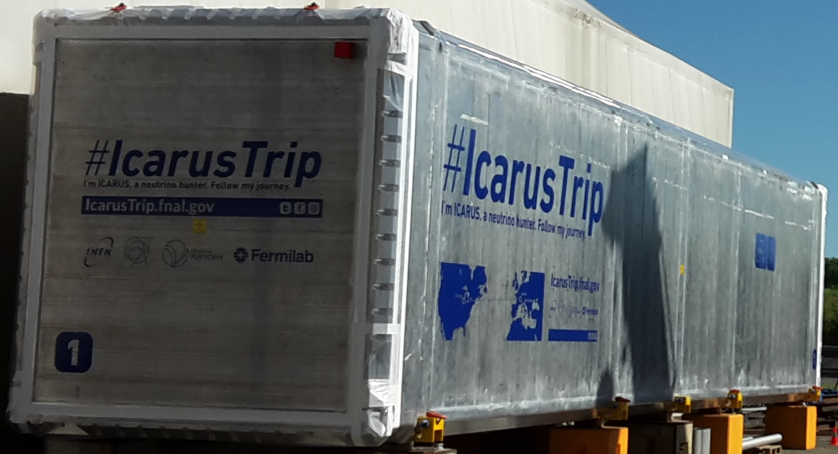
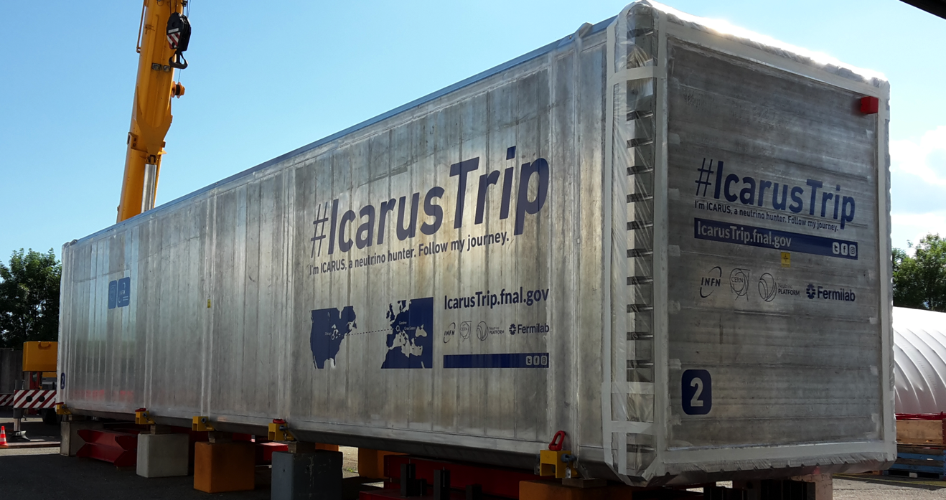
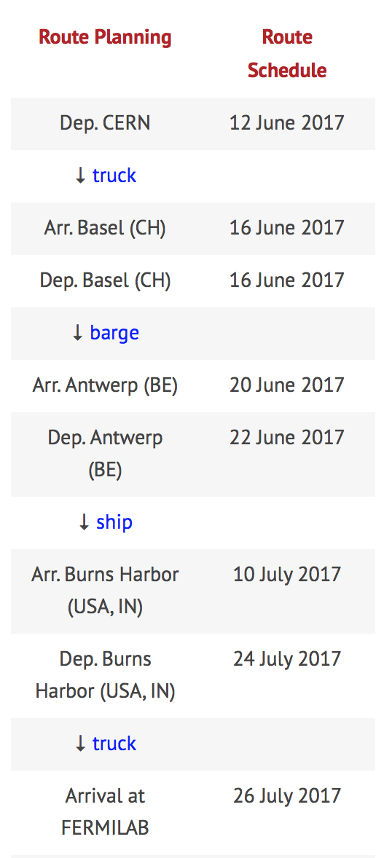
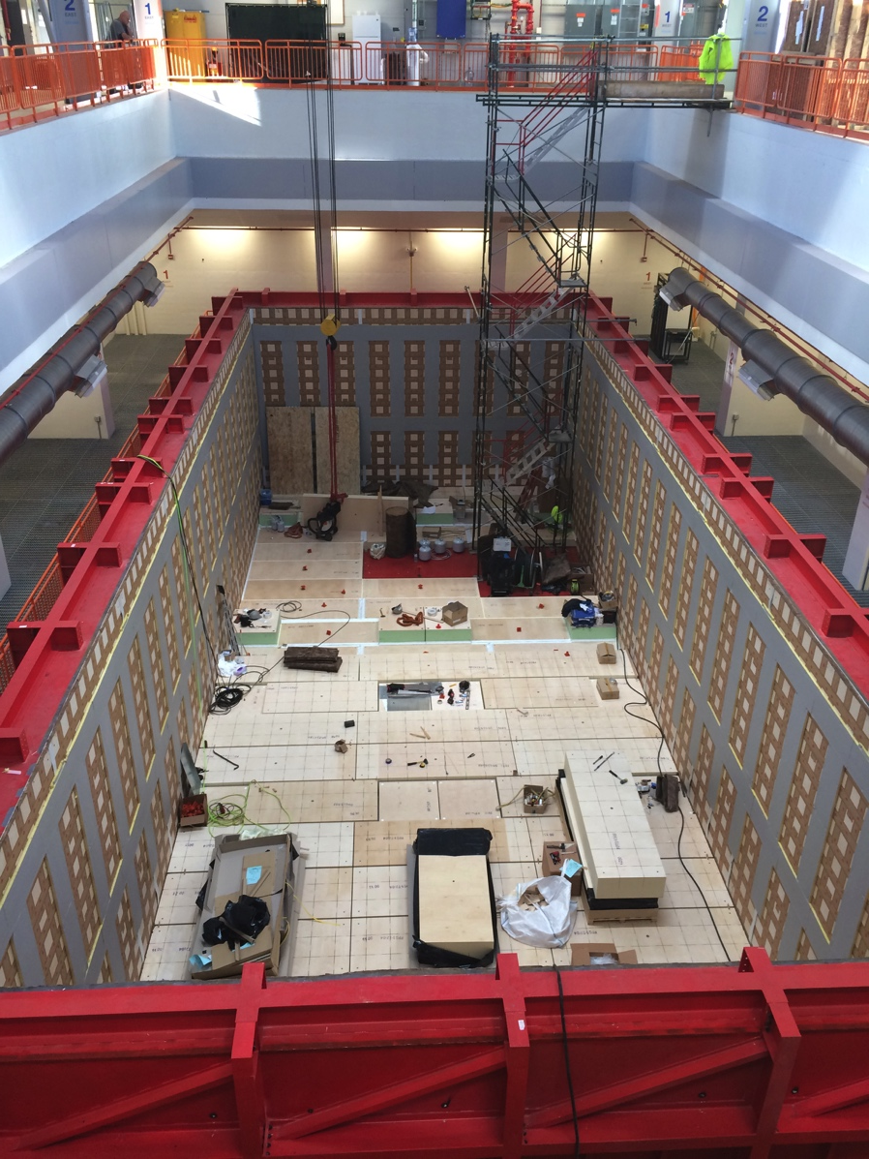
http://cenf-wa104.web.cern.ch/wa104org/icarus-transportation-cern-fnal

Slide 17
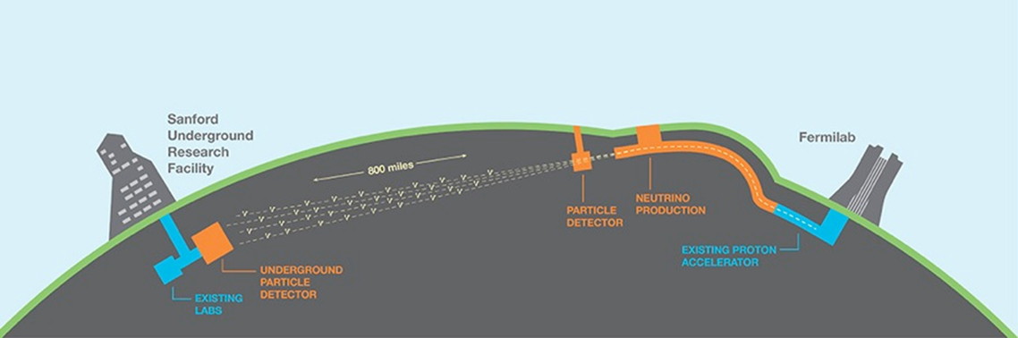
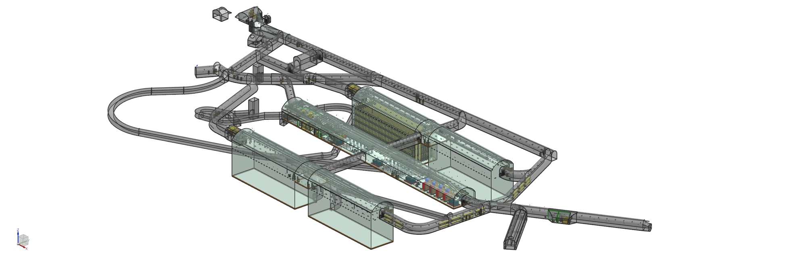
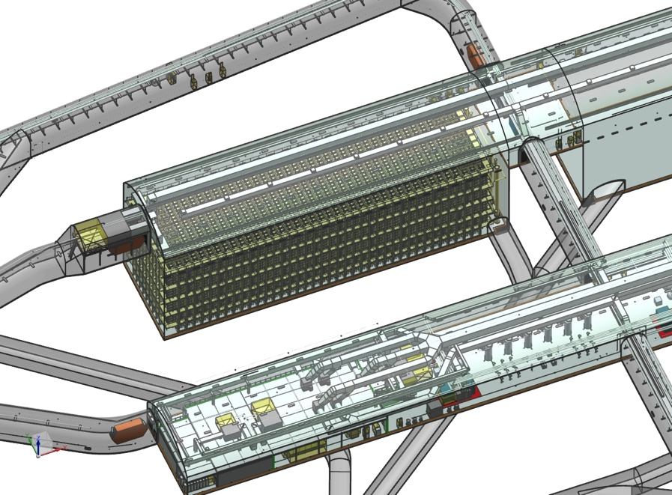
LBNF / DUNE : high intensity facility
FAR detector : ~40KT LAr eff. Mass
NEAR detector : ?

Slide 18
DUNE : physics Int. Collaboration
Near Detector(s ?) : R&D just starting
FAR Detectors : 2 possible technologies based on LAr : single phase (ICARUS like), double phase (new)
Large computing activities and physics preparation (pattern recognition, trigger, systematics, …)

Slide 19
LBNF Plans
Begin execution by DOE/FNAL of Sanford Lab “Reliability Projects” such as Ross Shaft refurbishment, to reduce risk during main excavation operations
Complete Preexcavation final design for Far Site conventional facilities
Execute Lease for LBNF exclusive use areas at Sanford Lab
Award CM/GC contract June 2017
Hold groundbreaking summer 2017 (scheduled on 21 July 2017)
Start construction activities at Sanford Lab in summer 2017
Start final design for cavern and drift excavation and surface facilities in summer 2017
Reach decision on optimized beamline preliminary design features in 2017
Complete underground and surface rock handling systems in 2018
Initiate major cavern excavation construction work in 2019
Complete first cryostat and cryo systems construction to enable detector install to begin in 2022, with commissioning in 2025
Produce neutrino beam in 2026

Slide 20
KEY ISSUE : CRYOSTATS
LAr technology requires very special cryostats and cryogenics
  Large volume (~20 Ktons/cryostat)
  Installation underground with a difficult access
  Modular construction technique
  High purity requirements (ppb)
  Very high temperature and liquid stability
→ LNG transport technique

Slide 21
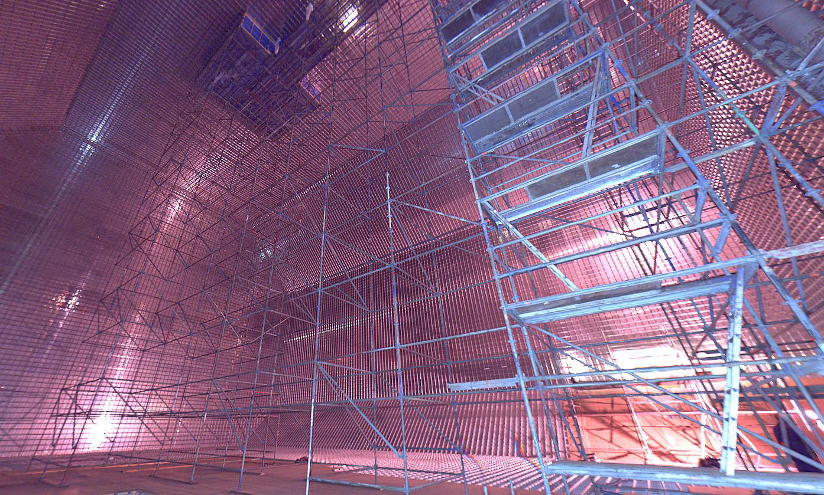
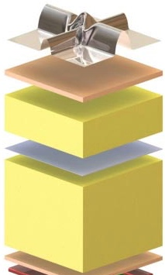
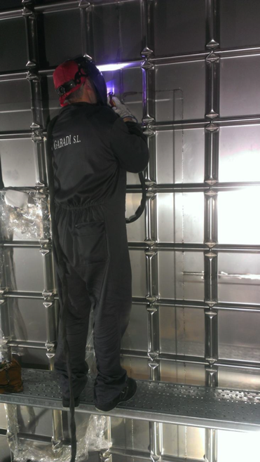
Membrane cryostats (LNG industry technology)
secondary membrane : composite laminated material (secondary containment)
Insulation : reinforced polyurethane foam (5-6 W/m²)
SS 1.2 mm primary membrane in contact with the liquid (primary containment)

Slide 22
Demonstrator and Prototypes
Cryostats and Cryogenics need to be demonstrated and the techniques acquired
Single phase LAr detectors have to be extrapolated to the new scale (x 100), starting from the ICARUS and MicroBooNE experience. Cold electronics and automatic data reconstruction are the next challenges
Double phase LAr detectors have to be proven as concept and then extrapolated to the new scale

Slide 23
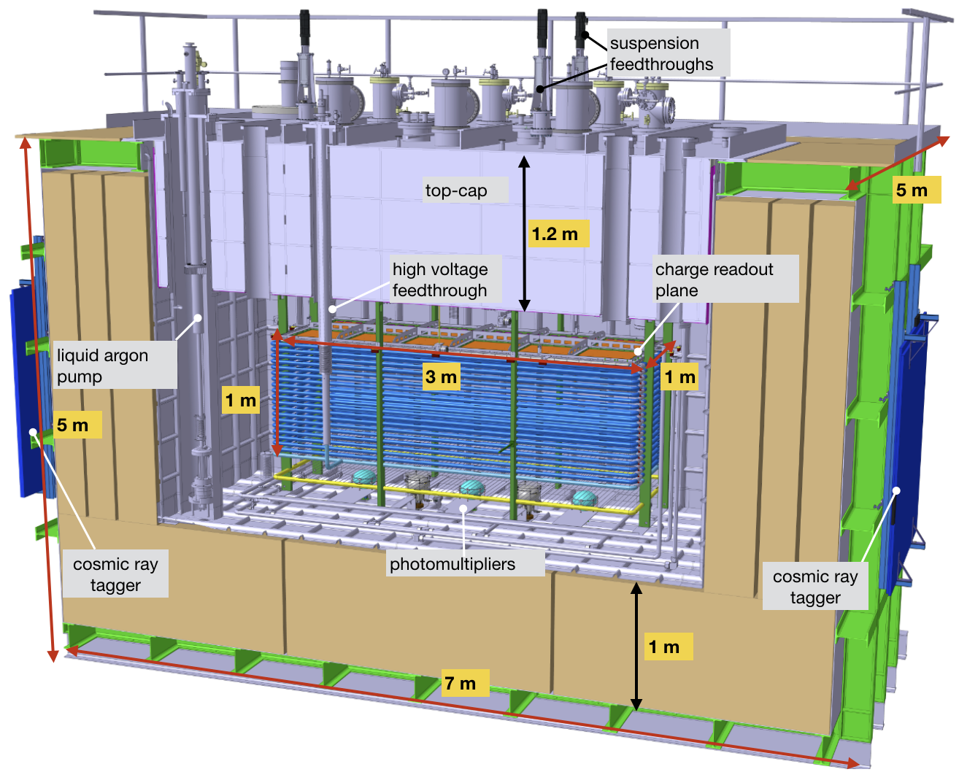
DOUBLE PHASE Demonstrator (WA105/NP02)
LNG and cryogenics first lesson!
LAr TPC double phase demonstrator
The 3x1x1 m³ dual phase LAr TPC

Slide 24
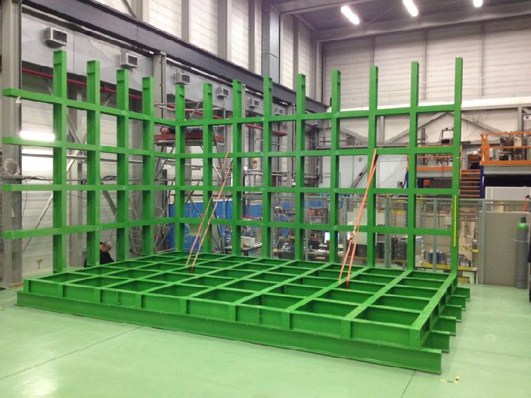
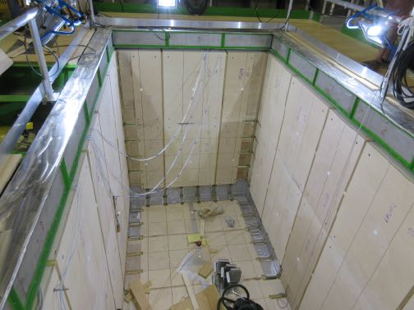
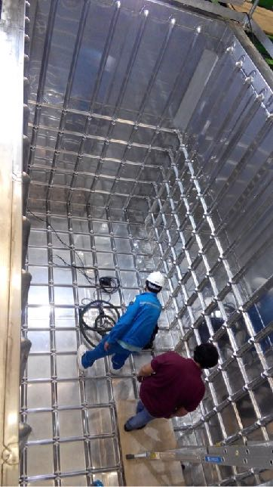
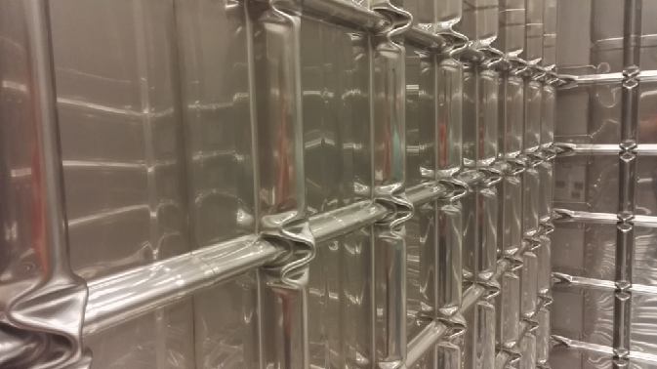
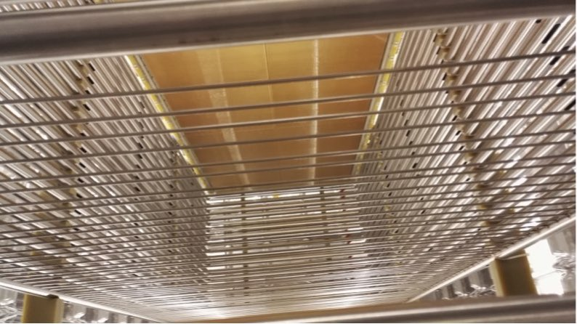
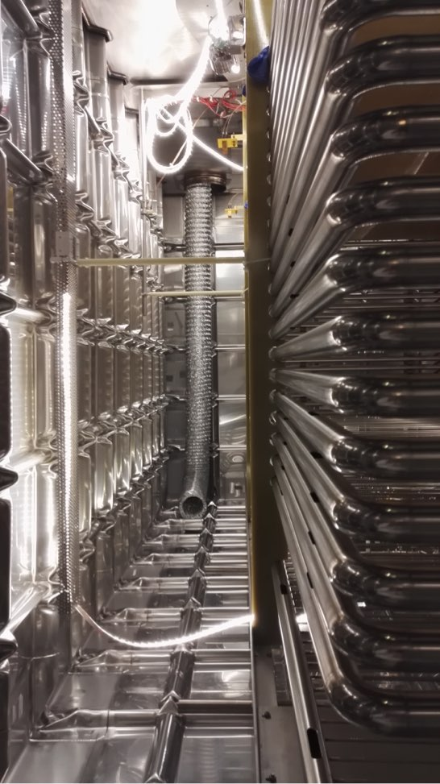
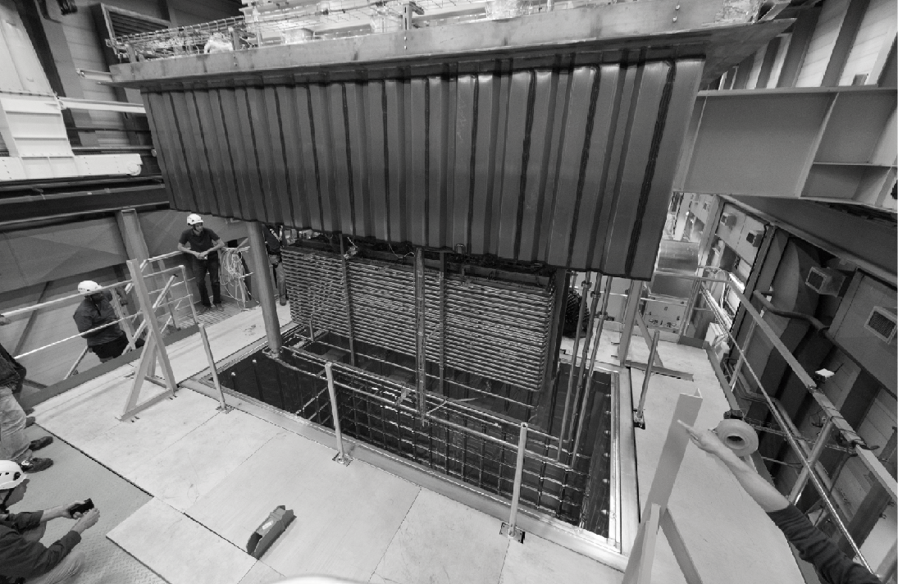
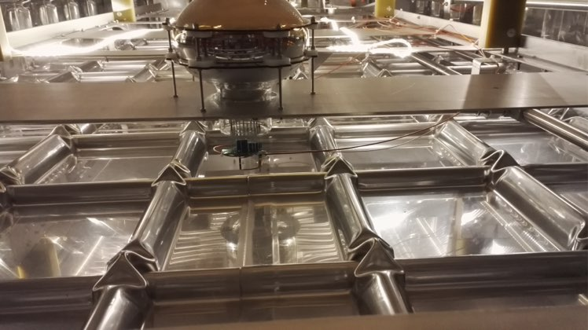
2015-16. 3x1x1 DP first membrane cryostat at CERN
2015
2016. 3x1x1 DP detector installation

Slide 25
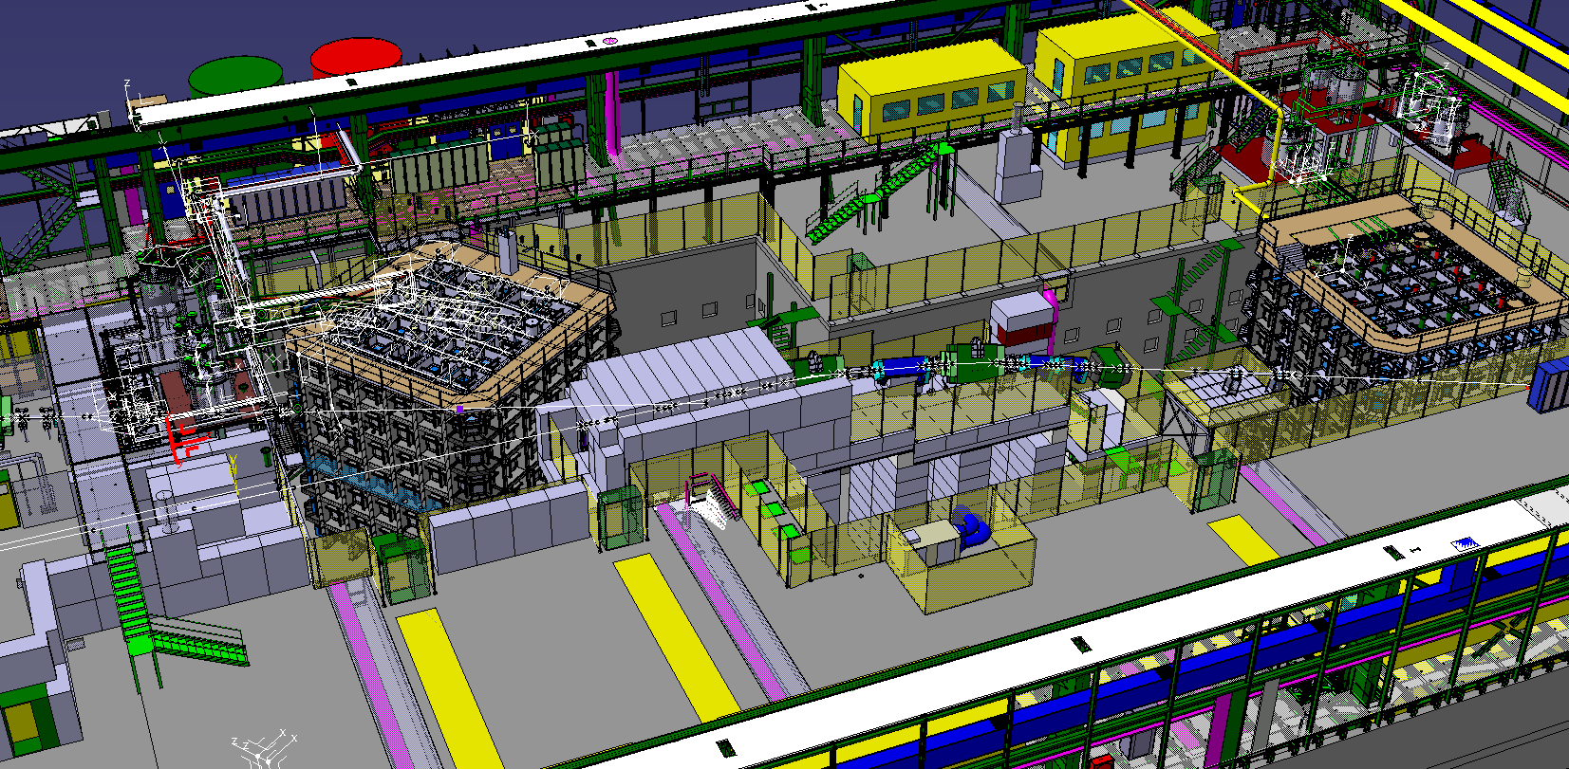
Next step : ~800 ton LAr prototypes
External cryogenics
NP04 proximity cryogenics
SPS : new EHN1-1 experimental area
NP02 proximity racks
DAQ & computing rooms
NP04 SP
NP02 DP
H2 beam line
H4 beam line
NP04 proximity racks
NP02 proximity cryogenics

Slide 26
protoDUNE strategy
Modular structure that will be repeated many times inside DUNE
ProtoDUNE prototypes as DUNE module 0, as basis for the final detector construction and assembly
Full engineering done as a basis for the final production (PRRs), both for detectors and cryostat/cryogenics
Check detector response with cosmics (DCS, DAQ, Computing, Reconstruction, …)
Calibrate with charged beam the response to leptons and hadrons
Very ambitious program :
- detectors cooled by April 2018
- in beam in 2018 before LS2 shutdown

Slide 27
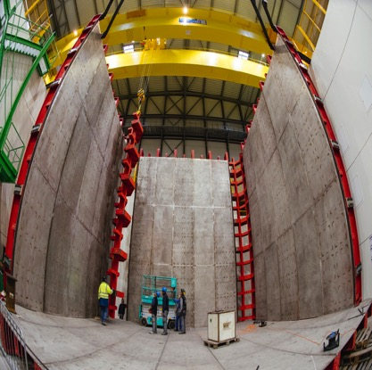
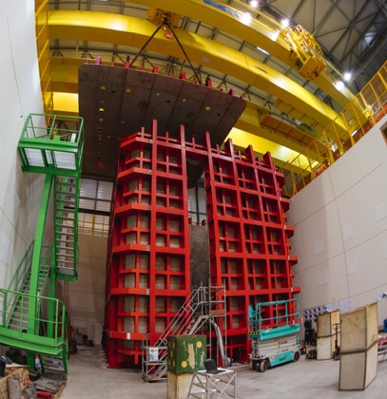
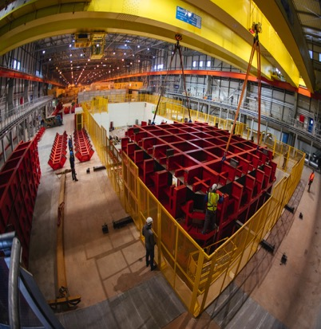
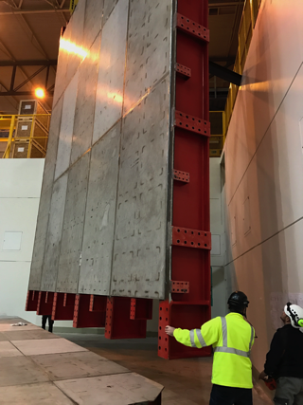
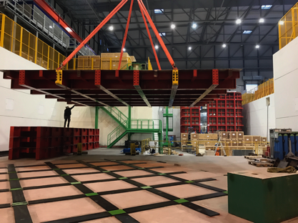
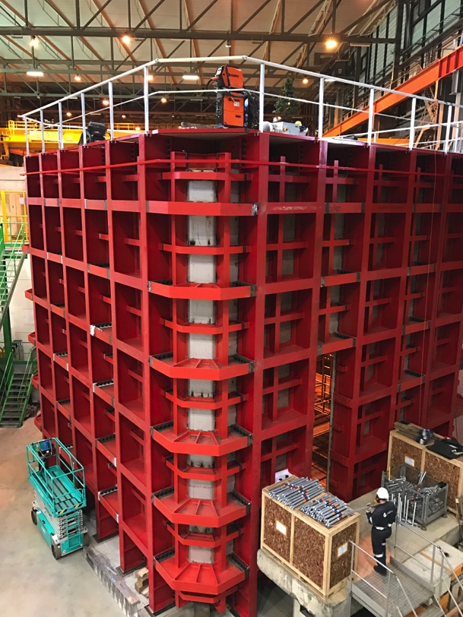
2016-2017 : ProtoDUNEs ~800 ton LAr cryostats
NP04: single phase
NP02: double phase

Slide 28
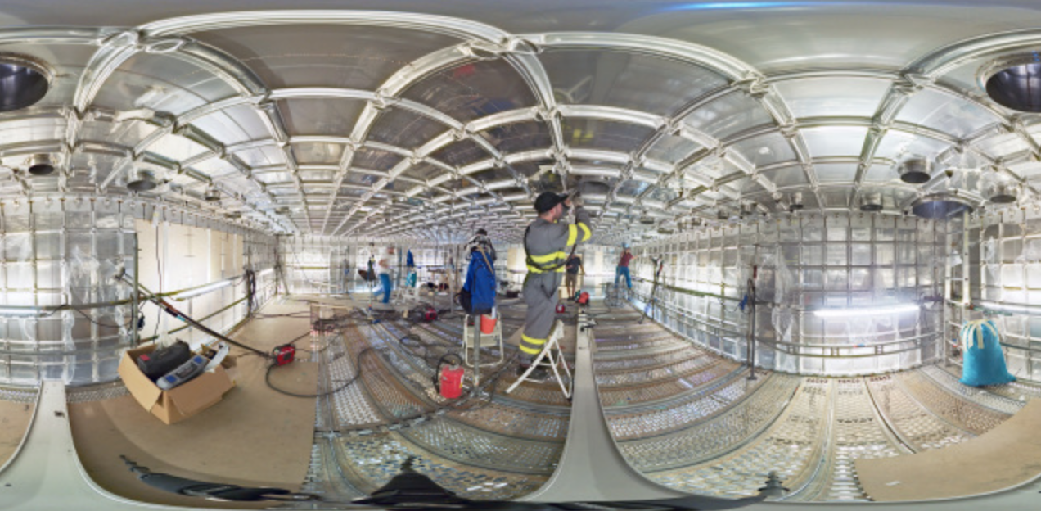
2016-2017 : ProtoDUNEs ~800 Lar tons cold cryostats

Slide 29
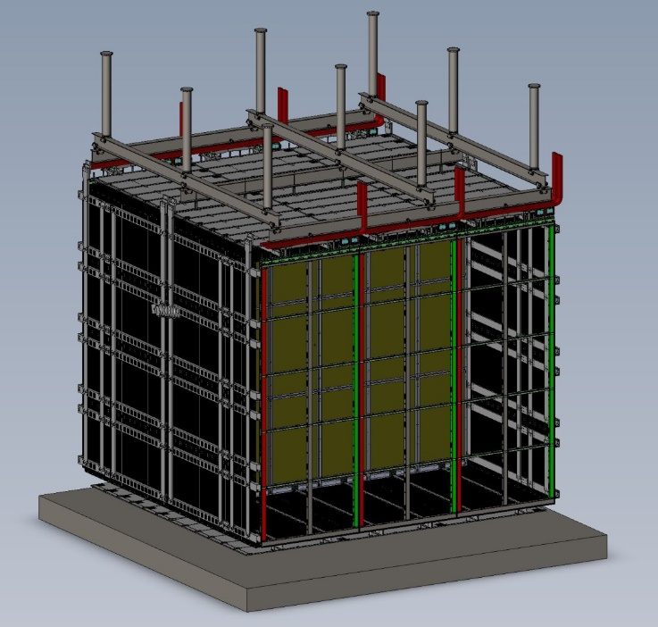
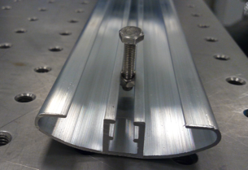
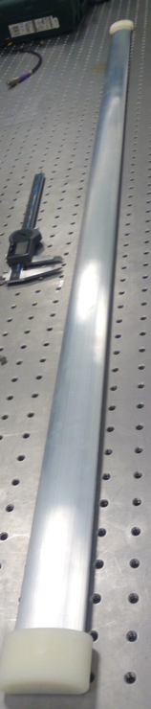
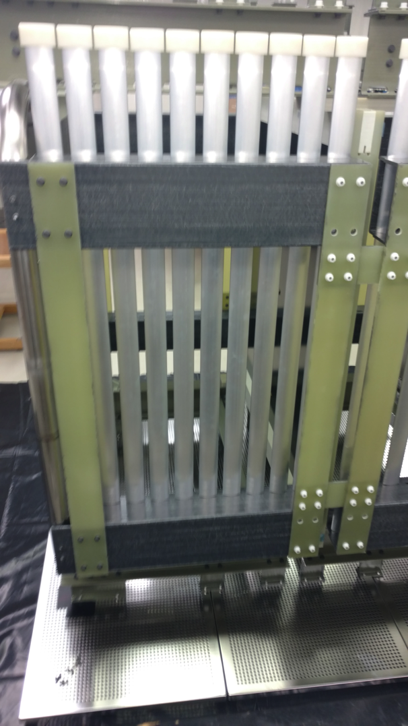
SP detector components
Support system
Cathode plane
Field cage
Field cage made out of Al extruded profiles
29

Slide 30

Resistive Cathode Concept
With a conventional metallic cathode assembly, in the DUNE LAr-TPC layout, several tens of J of energy on each interior cathode are stored when energized to -180kV.
In the event of a discharge from a cathode edge to the facing cryostat wall, there is a risk of physical damage to either the cathode or the membrane. The voltage on an all-metal cathode will also collapse very quickly (ns), injecting high current into the cold electronics, risking damage to the front end ASICs.
To minimize these risks, it has been proposed to use a cathode made out of insulating material with a resistive coating in the MΩ to GΩ/square range. This will greatly reduce the peak power transfer to the cryostat and peak current injection into the front-end ASICs in a HV discharge.

Slide 31


Protego Inline Safety Valve
Insulation
Detector
Condenser
LAr Filters
Steel Support Structure
LAr Filters Regeneration
(NP-02/NP-04)
LAr
Primary Membrane
Internal Piping
LN2 storage tank
(NP-02/NP-04)
LAr Phase sep.
LN2 Phase sep.
LAr storage tank
(NP-02/NP-04)
LAr circulation pumps

Slide 32
BIG data … DAQ, event reconstruction
Detector Infrastructure
Detector Front-End
Clock Distribution
Data
Trigger Distribution
FELIX
New DAQ in synergy with LHC upgrade developments (ATLAS FELIX=Front End LIink eXchange)
Commands
& settings
Status
Detector Busy
Commands
& settings
DAQ Data Handler
Status
DAQ Event Builder
Optional data reduction
Online Processing
Detector Control System
DAQ Storage System
Permanent Storage
Including Tier0 dedicated infrastructure

Slide 33




… and online processing farm
Online computing farm
First DAQ racks

Slide 34

LBNF cryostats design, first cryostat financed by CERN
18.94m
65.84m
~ 13’000 m³ of cold cryostat volume
39 frames (1.6m)
8 frames (1.6m)
17.84m
LAr = 17’432 tons (95% liquid)

Slide 35




LBNF LAr proximity cryogenics design
7.7 m
2.3 m
35 m
Protego Inline Safety Valve
Insulation
Detector
Protego Inline Safety Valve
Insulation
Detector
12 m
Steel Support Structure
Steel Support Structure
LAr
Primary Membrane
Primary Membrane
Internal Piping
Internal Piping
NB: External cryogenics designed by FNAL
Valve Actuator
Valve Body
Valve Actuator
Valve Body

Slide 36
Summary:
CERN offers a platform for Neutrino detectors R&D and later construction. CERN is supporting this platform in an active way both for the infrastructure and for the detectors construction, installation and commissioning
A large neutrino test area (EHN1-1 extension) with charged beams capabilities has been constructed and is being made operational
We will assist the EU neutrino community in their long term common plans. We are reacting on demands from the community, in particular for many R&D aspects. Entry point for medium/large projects: CERN SPCS
In the short term, the CERN Platform is helping in getting a Short Baseline operational at FNAL with an agreed physics program … and later a Long Baseline. Near detectors are now appearing as new R&D projects.

