Slide 2
Status of the PSB SEM grids for injection matching
Jocelyn TAN, BE-BI
On behalf of C. Vuitton, G.J. Focker, F. Roncarolo, R. Veness, B. Riffaud
J Tan, 20th June 2017

Slide 3
Outline
Motivations
Specifications
Status
Summary

Slide 4
Motivations
Why? Measure the transverse matching and the emittance of the beam injected from Linac4
How? see Engineering specification: Inject ½ PSB turn (ie ~500ns long pulse) and acquire up to 20-30 circulating profiles of the circulating beam with a SEM.
When? Installation during YETS17-18 for beam commissioning in 2018.

Slide 5
Dedicated operation mode
Beam parameters
A pair of monitors (H+V) in one ring is sufficient: ring3.
Permament implementation for setting up new beams and MDs.
Protection of fragile wires
  Not PPM for reliability reasons
  External condition interlock to prevent injection of more than 1 turn while the monitor is in.
Beam dumped after ~100 turns: set BT line for extraction at 160MeV.
Beam kinetic energy | 160 MeV
Beam intensity | 5x10⁹ to 2x10¹¹ protons
Beam pulse length | 50 to 500 ns
ε_{rms} of incoming beam | 0.5 μm
Beam size (H/V) | 1.1 to 2.4 mm (rms)
Beam size resolution | <2%

Slide 6
Scattering angles and energy loss with graphite
Compact monitor
Grid size : 25.2 mm
64 graphite wires
Density ρ | radiation length X₀ | wire spacing w | wire radius r
2.265 g/cm² | 18.8 cm | 0.4 mm | 17 μm
  Average values for average (effective) thickness d = r² π/w = 2.1 μm
  Rms scattering angle
  With logarithmic correction : ϑ = 0.09 mrad
  Energy loss corresponding to
  Blow-up (phys. rms emittance) due to interaction with monitor: 0.06 μm/turn
    ⇒ Blow-up per turn due to monitor almost one order of magnitude lower than the expected emittance of 0.5 μm (rms)
    ⇒ Measurement can be envisaged
    Remarks:
    Expect significant tails, which may lead difficulties with profiles widths estimates (systematic errors)
    Thick frame ( ±15 mm ) for stopping scattered protons
w
wire spacing 0.4 mm
Diametre ∅= 33 μm

Slide 7
Other considerations
Electronics: still under development
Beam interaction : ~ 10 μA max in the graphite wire
Tungsten would yield ~3x larger signal but proton scattering is also larger
Amplifier Type Linear, Integrator in he ADC module
Input impedance 93 Ω
Bandwidth >5MHz
Sampling rate 1 MHz
Cable length the shorter the better (max ~25 m)
2018: Commissioning with a prototype
Concerns on ageing
Sensibility of central wires seeing more beam reduced w.r.t. outer wires
Cabling: plan #10071
Budget charged by EN/EL in 2016
ECR
It will be done when the integration work is complete.
10 μA max

Slide 8
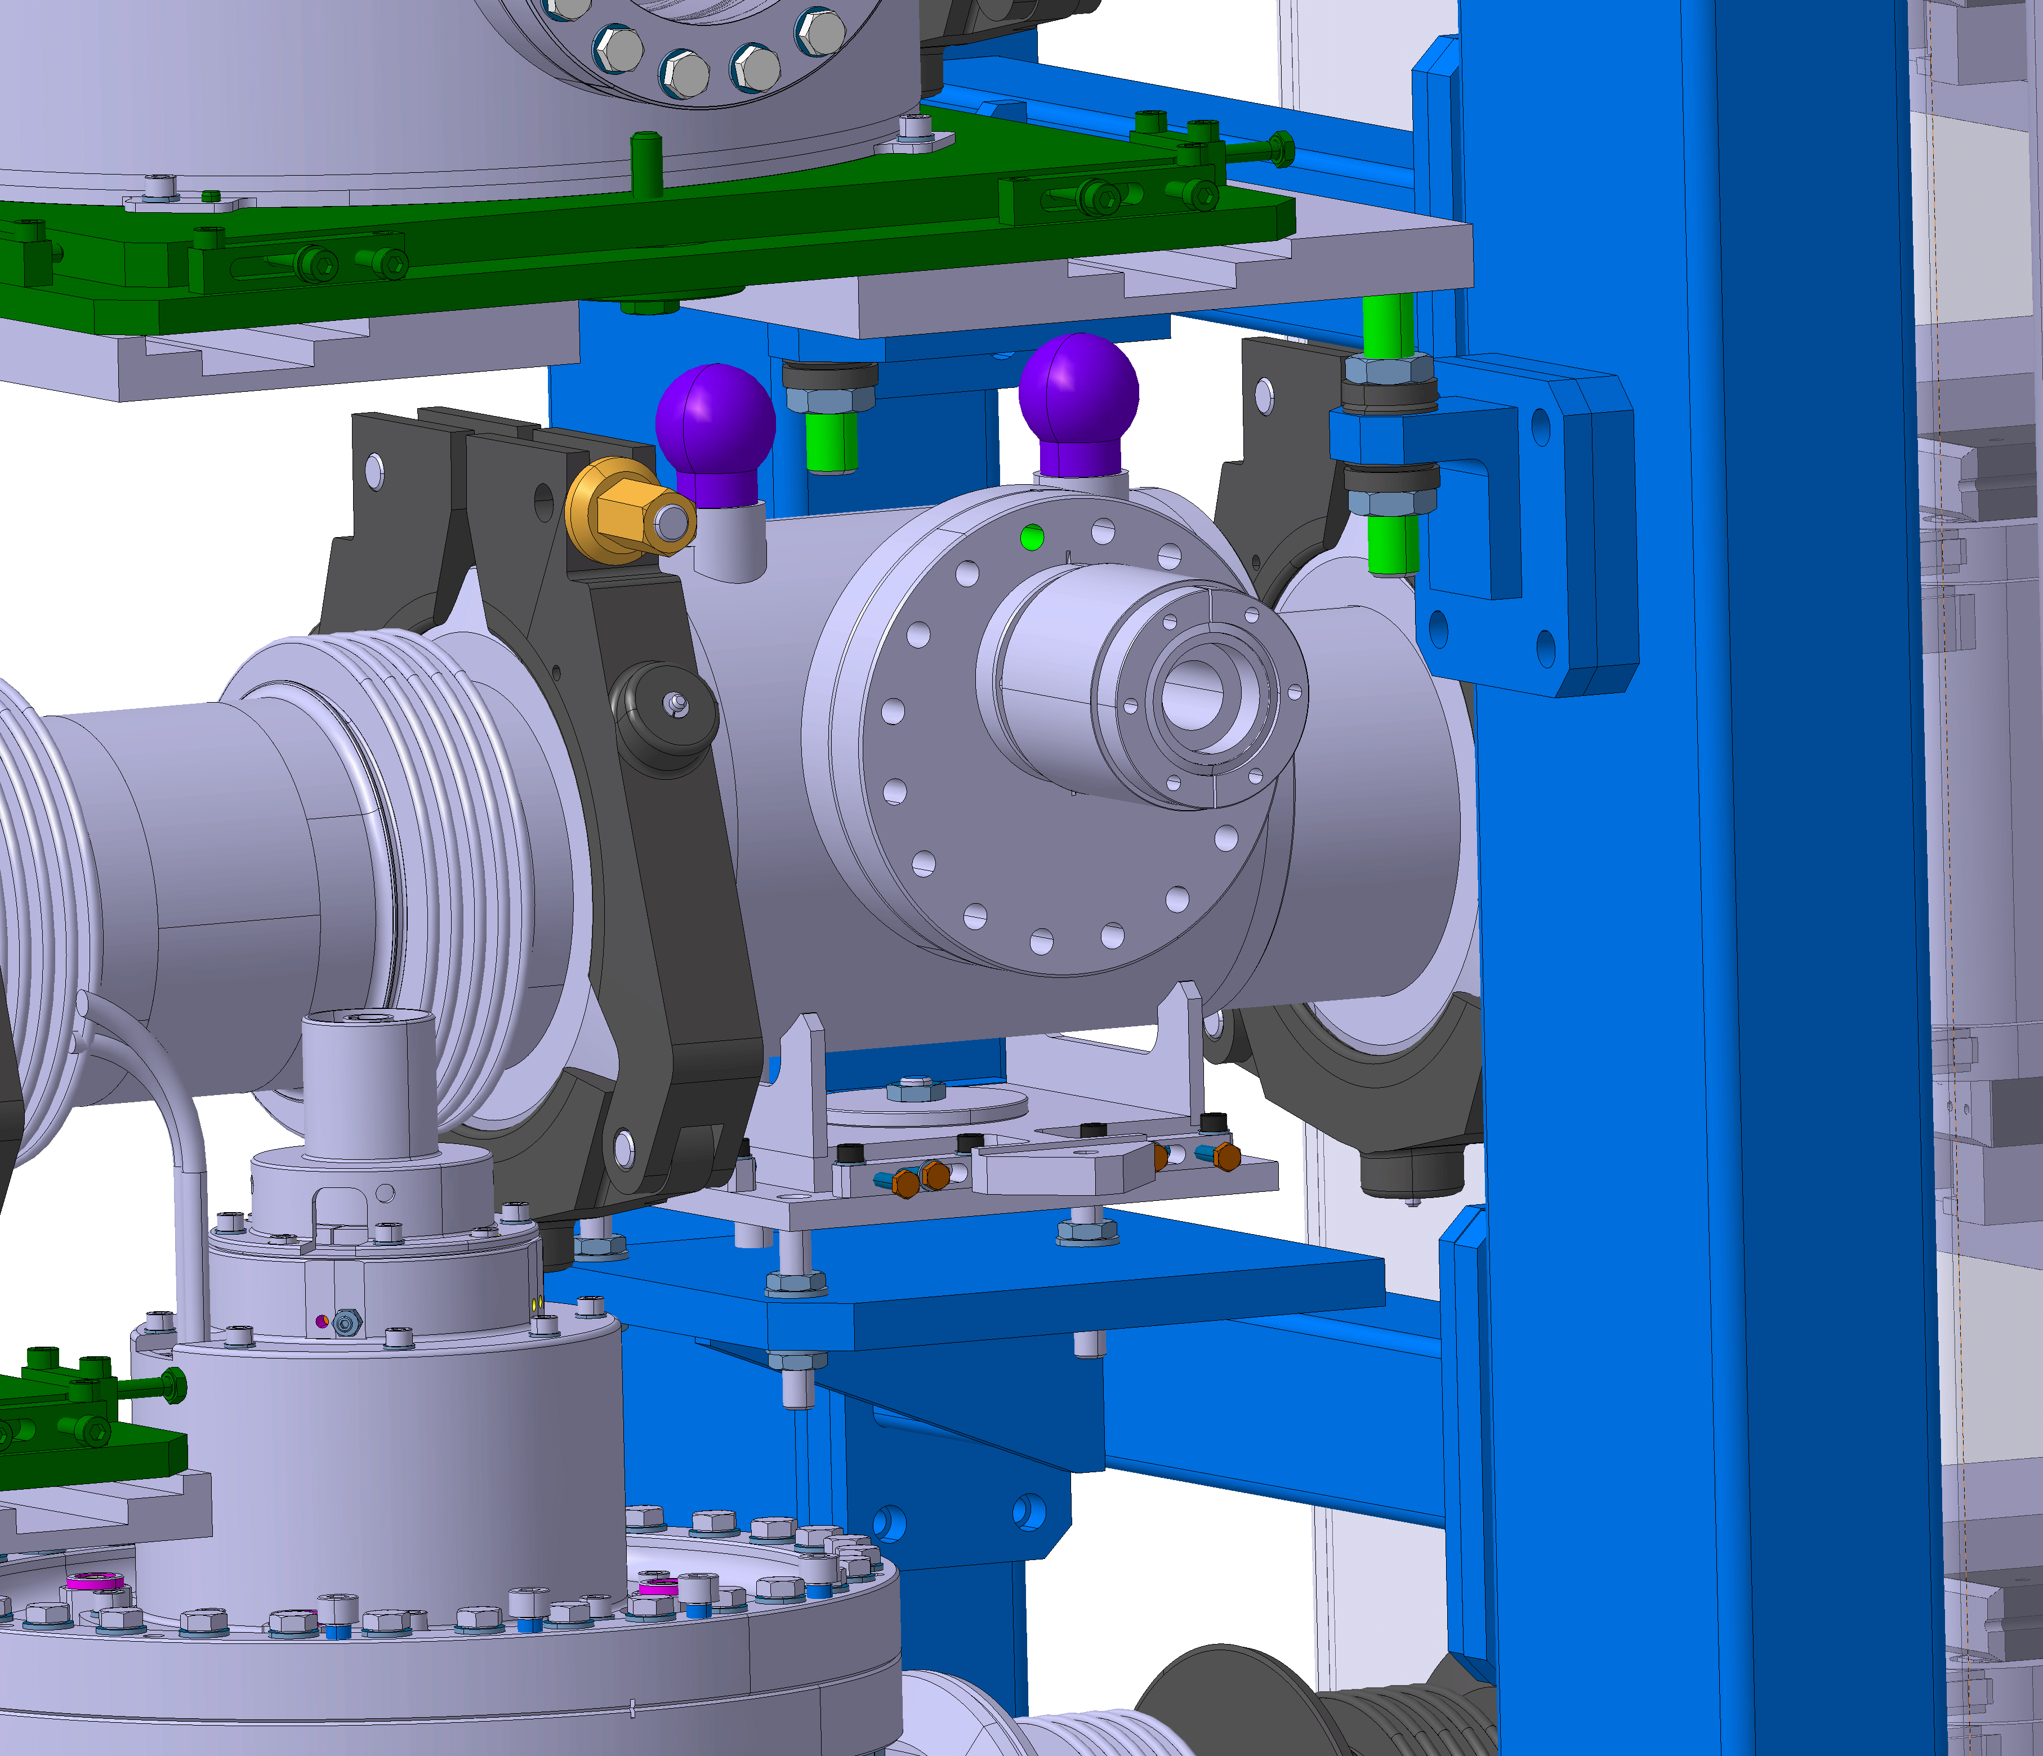
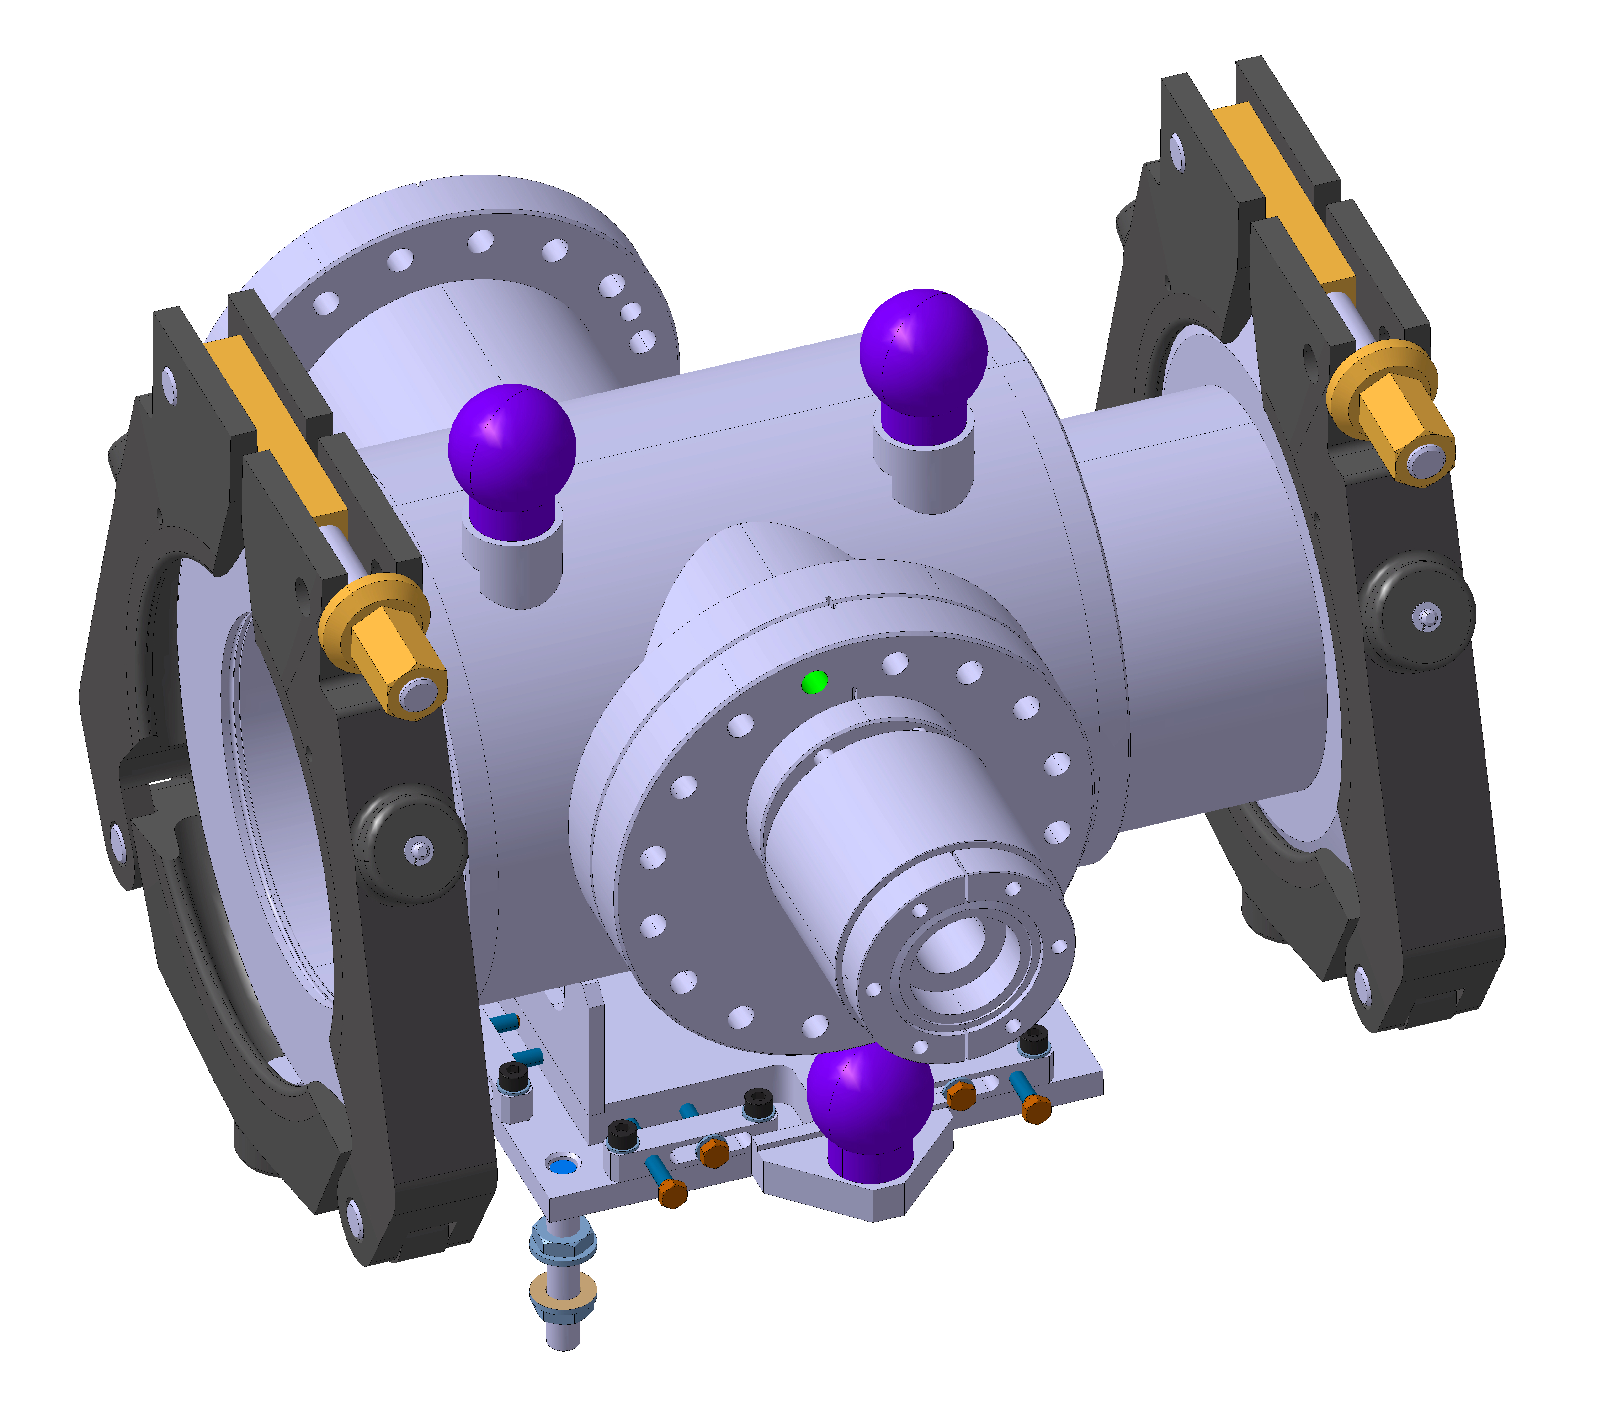
Mechanics: integration in 4L1
YETS17-18 : installation on a temporary support structure
LS2: The final support system (in blue) will be installed with the series of wire scanners
Courtesy: B. Riffaud

Slide 9
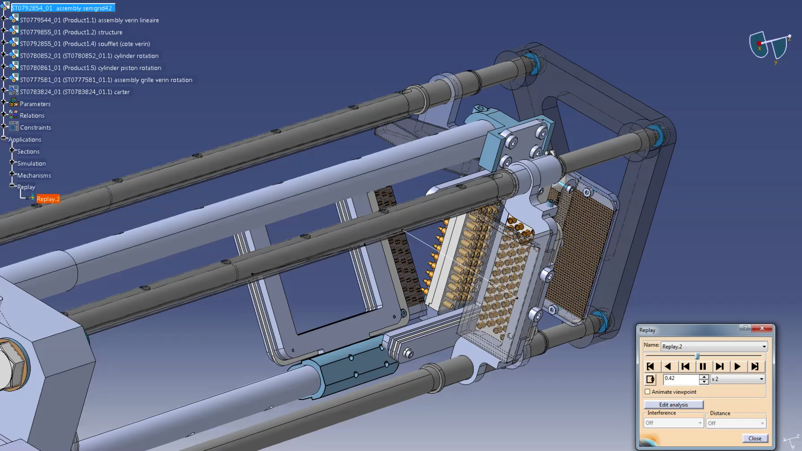
Mechanics: grids actuation
No bellow
Actuation by magnetic motors:
  translation for H plane
  rotation for V plane
Animation example below: PS SEM grid
Wiring in vacuum: use of extruded kapton
First tests of grid assembly: end of June
V
H
PS SEM grid
Courtesy: C. Vuitton

Slide 10
Planning and budget
Tight mechanic production schedule
It should be supported as a priority in MME by the LIU project
2016
Cabling+electronics 57 kCHF
2017: 65% commited
Design office 15 kCHF
Acq chain+actuations 45 kCHF
Monitor production 20 kCHF
2018
Installation 4 kCHF

Slide 11
Summary
Mechanical design nearly completed
No below for enhanced reliability
Monitor should be installed in YETS 17-18, but…
We need LIU support to set Tank production as high priority for EN-MME in Q3-2017
Beam commissioning will likely take place with a prototype board.

