Slide 1
Nepal and CERN
how far we’ve come
(and how much further we have to go)
Abha Eli Phoboo

Slide 2
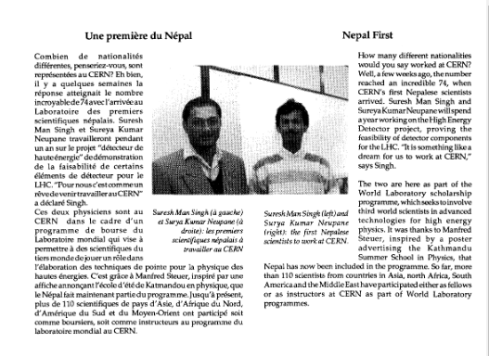

1994: this is where the story starts
Suresh Man Singh and Sureya Kumar Neupane, first Nepalis at CERN,
under the World Laboratory scholarship programme

Slide 3
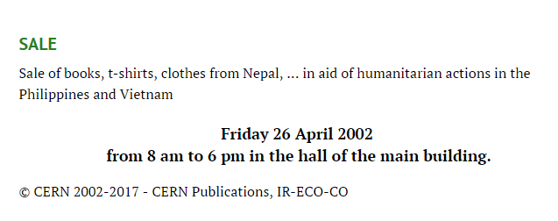
2002: and meanders

Slide 4
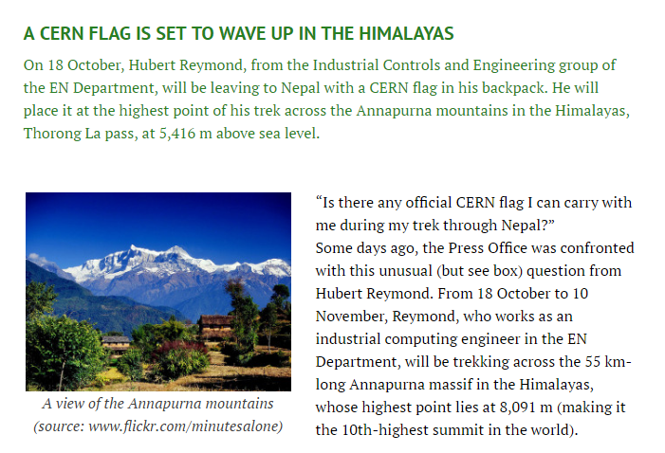
2010: for a while

Slide 5
In between years
Nepalis conduct research at CERN or with data collected at CERN via member states and studying or working at institutions with formal relationships
CERN releases Invenio in 2011, an open software library management package that becomes the basis of HIMALDOC, a digital library platform maintained by ICIMOD in Nepal for knowledge exchange on sustainable mountain development

Slide 6
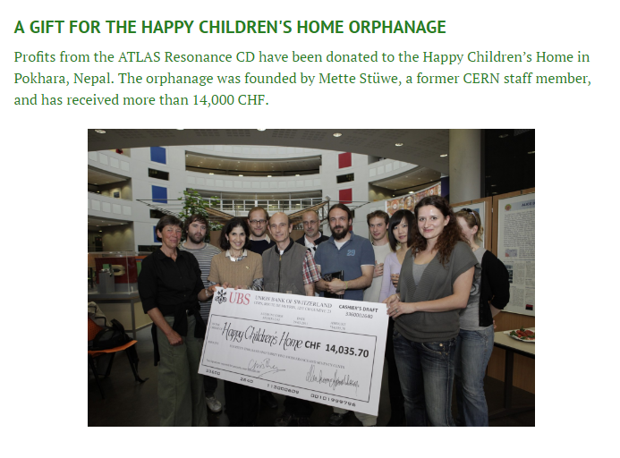
2011

Slide 7
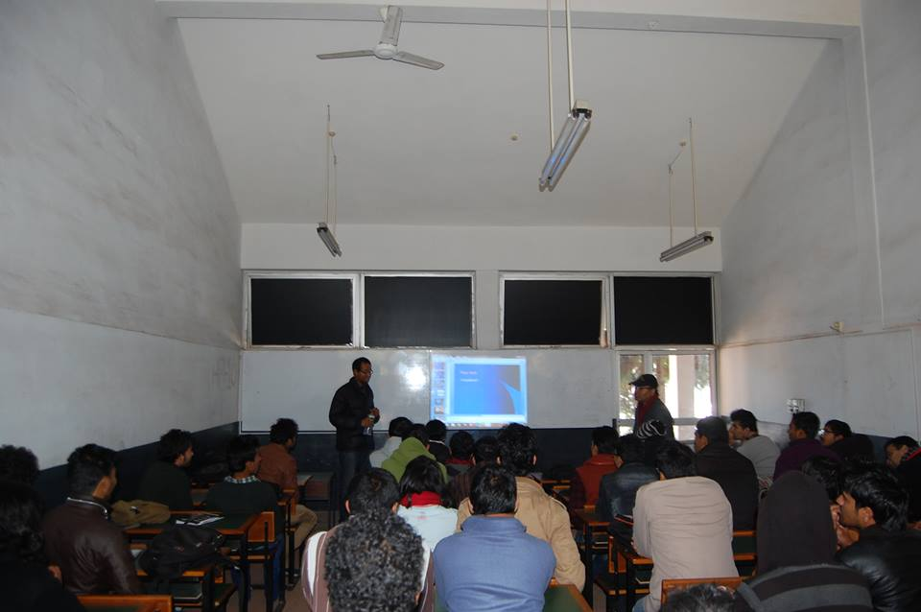
2013
A student from Tribhuvan University attends the CERN Summer program. Ishan Pokhrel
Pilot testing : The first International High Energy Particle Physics Masterclass in Nepal takes place in December at Kathmandu University.

Slide 8
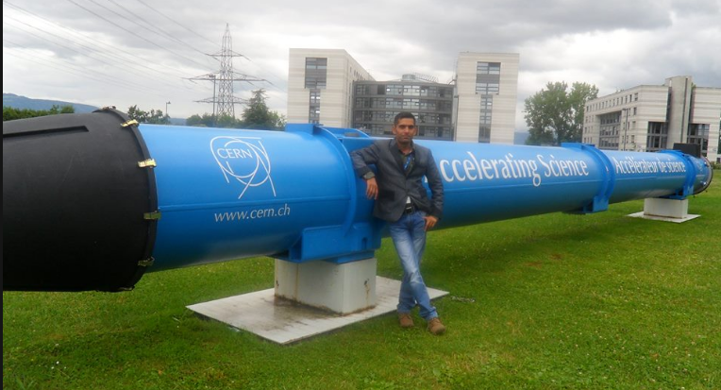
2014
Bishnu Lamsal, the first high school science teacher from Nepal attends the CERN High School Teachers Training program. Now he is inspiring the next generation of scientists.

Slide 9
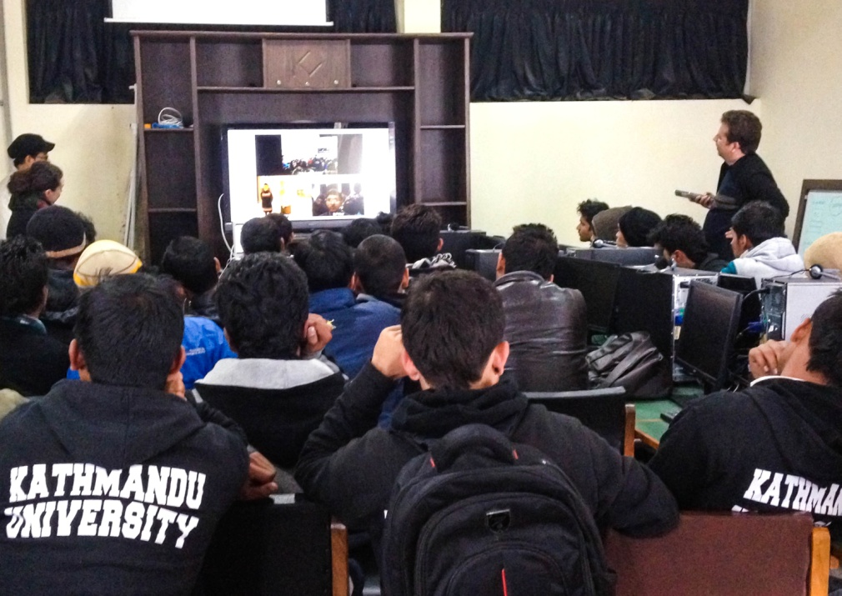
2015
Particle Physics Masterclass hosted by Kathmandu University and 16 schools in India, in partnership with KU, CERN and ICTP. Ended with a virtual visit where the students in India and Nepal could talk directly to experts at CERN’s ATLAS Control Room.

Slide 10
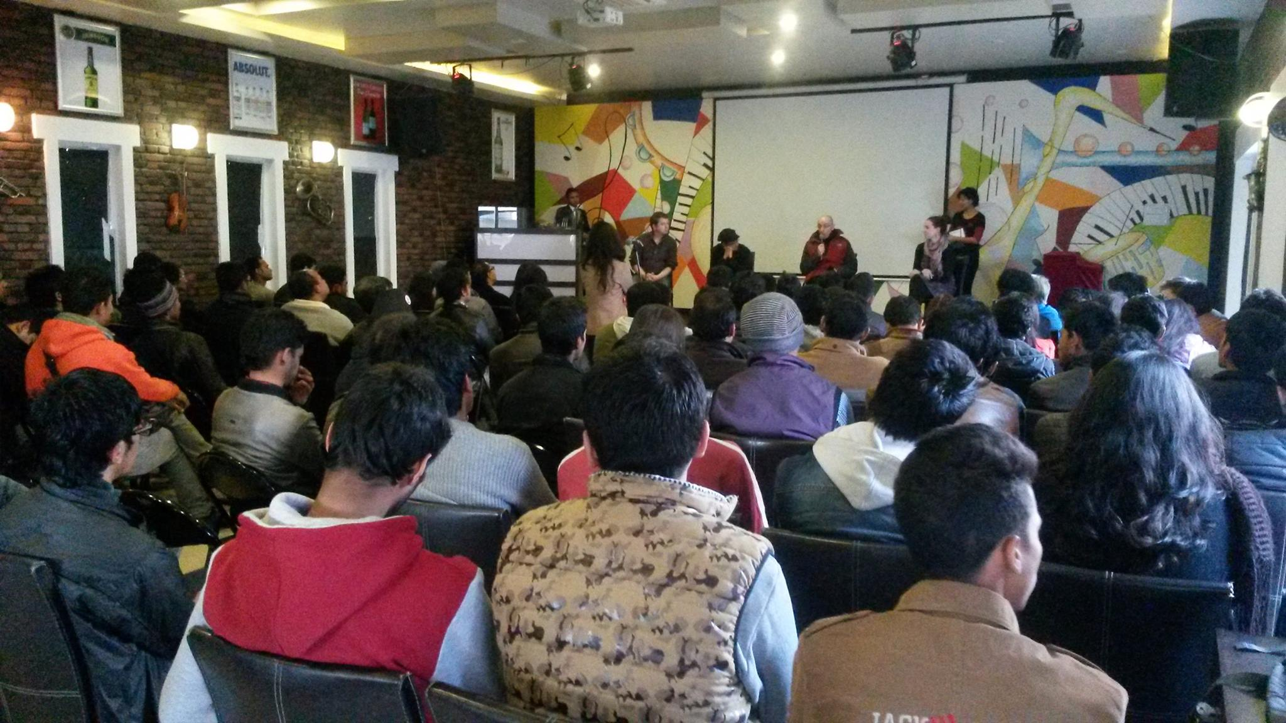
Public screening of Particle Fever
followed by Q&A with CERN physicists. 200+ people attended with 200+ on the waiting list.
Mark Levinson had a special message for the audience in Nepal

Slide 11
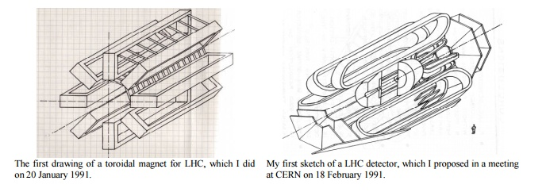
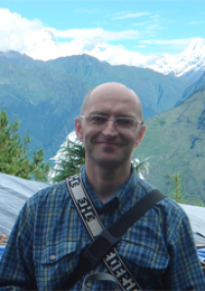
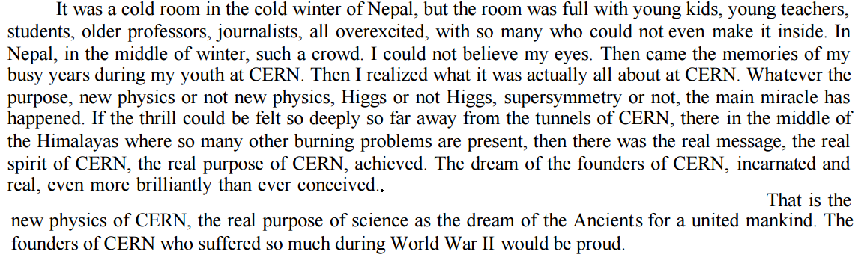
Full circle
Frederic Perrier, http://www.ipgp.fr/sites/default/files/cern_spirit_210115_1.pdf

Slide 12
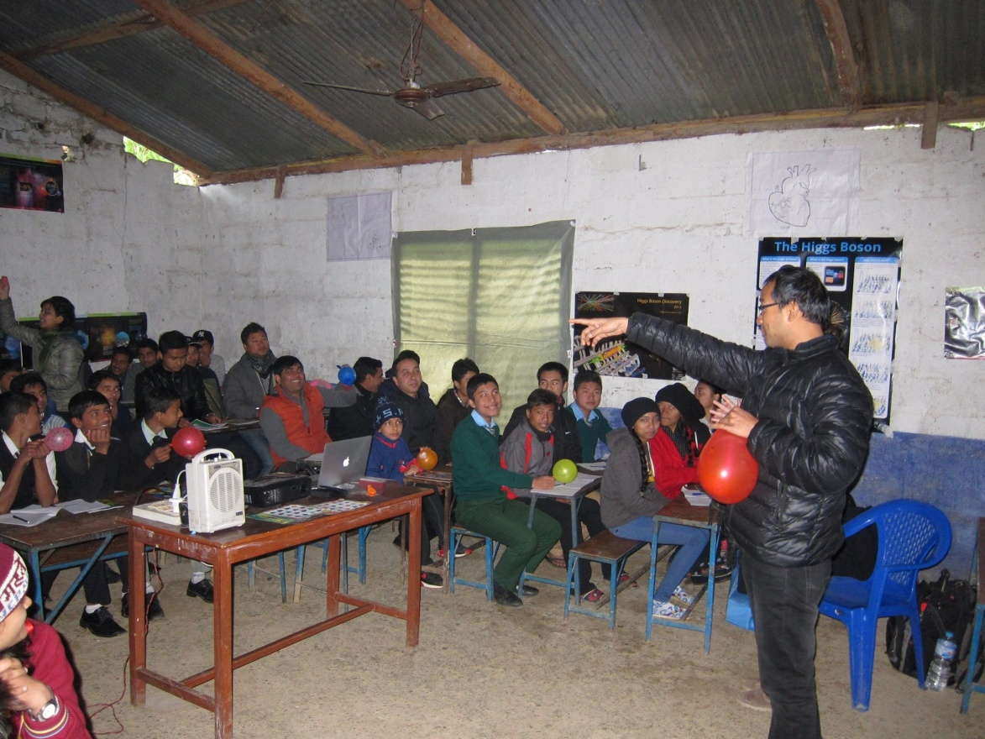
Education & Outreach sessions
Students at Nawa Asha Griha in Kathmandu, Happy Children’s Home in Pokhara
With Bishnu Lamsal, organized an Outreach Session with 11 high schools in Syangja, ~200 km southwest of Kathmandu

Slide 13
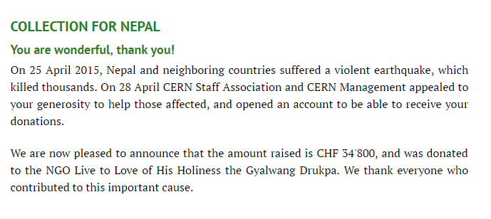
From CERN with love

Slide 14
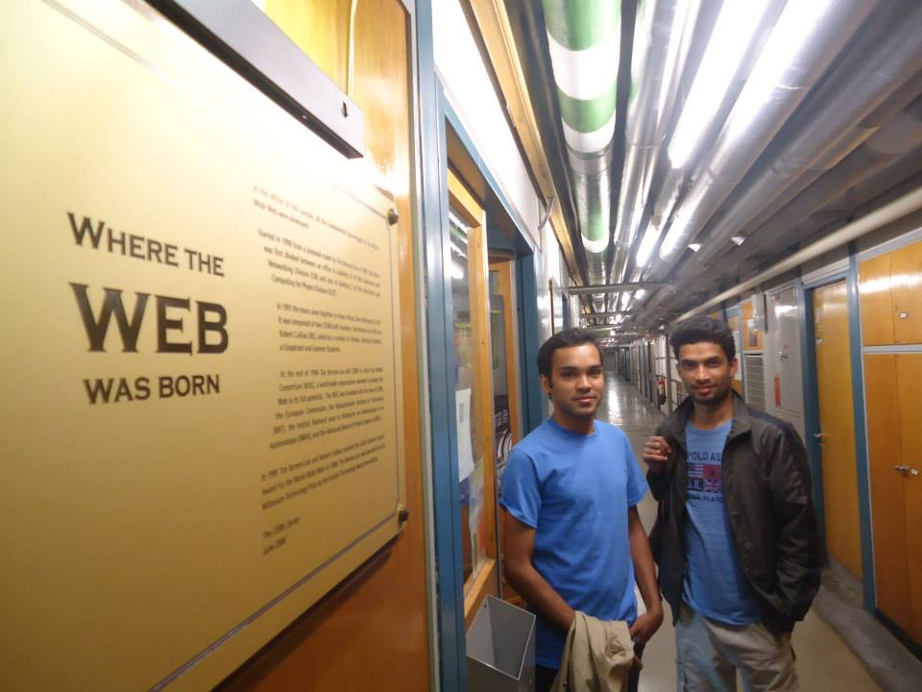
Summer students
Of the students from the Masterclass in 2014, Santosh Parajuli came to CERN as a summer student in 2015 and Yadav Kandel went to ICTP (and visited briefly for a CERN tour)

Slide 15
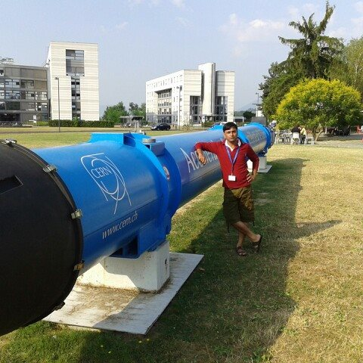
Reaching out to schools
Kamlesh Chaudhary, science teacher and principal of Kamala High School, Sindhuli, came to CERN for the High School Teachers Training program in 2015.

Slide 16
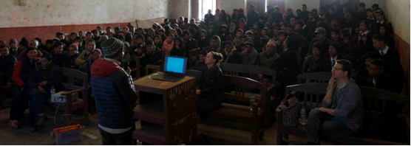
2016
Held an Outreach Session for 120 students and 30 teachers, staff and townsfolk
Students were highly enthusiastic and asked brilliant questions. As always, lots of fun interacting with the students and teachers

Slide 17
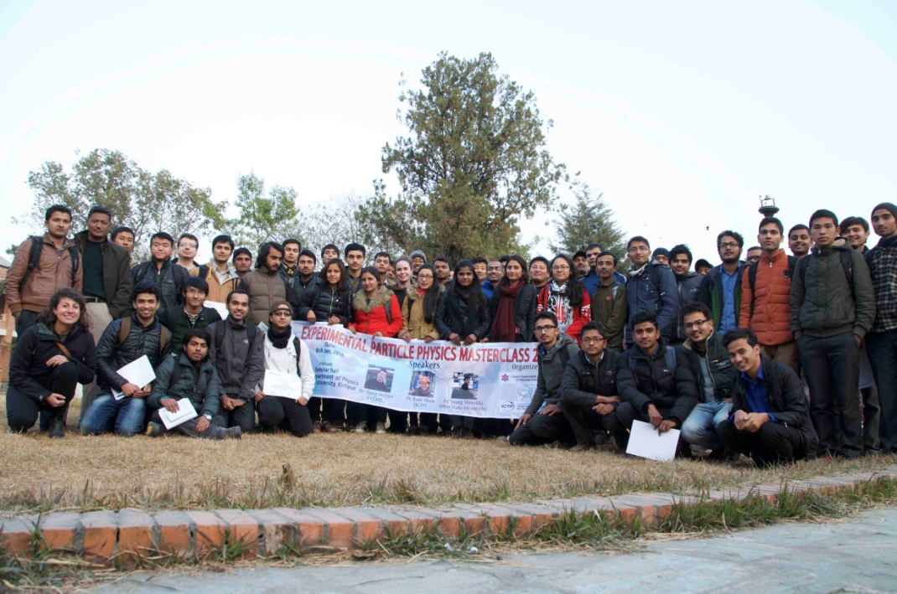
Back to basics
Particle physics Masterclass in Tribhuvan University, in partnership with CERN, KU and ICTP
Impact 300+ students in Kathmandu and Sindhuli
Summer student, Mahesh Thakuri, attends the CERN Summer Student program.

Slide 18
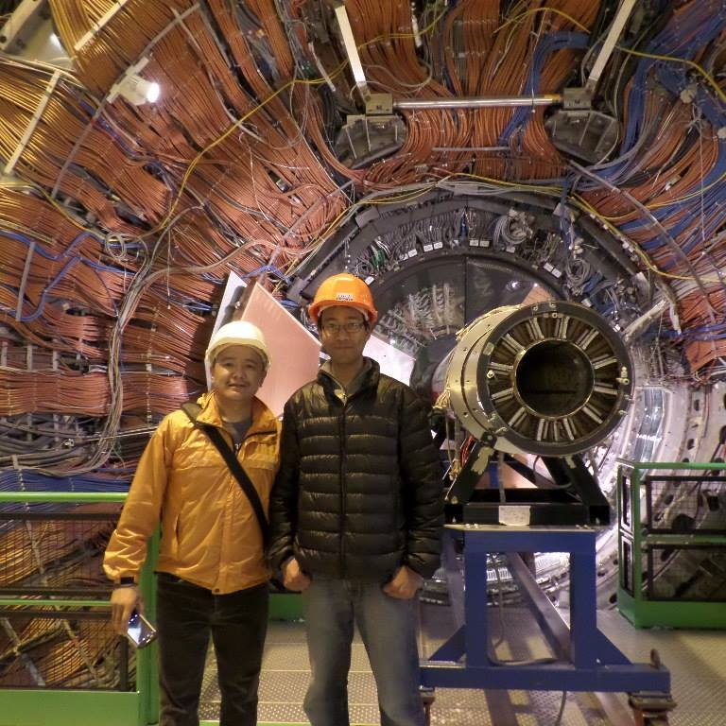
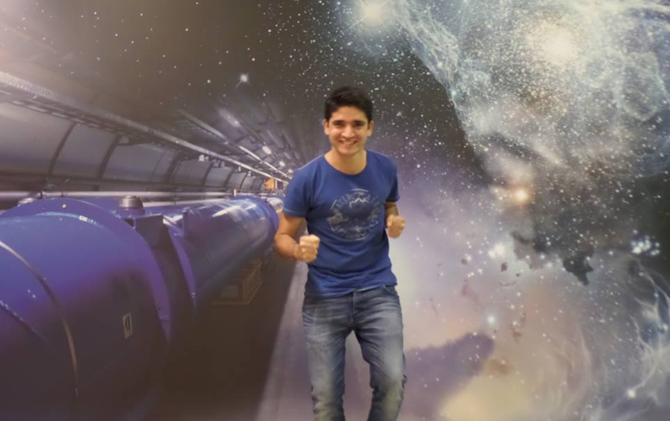
Nepalis at CERN
Work as engineers, technicians, communication professional, and physicists, via CERN member states and institutions with professional relationships

Slide 19
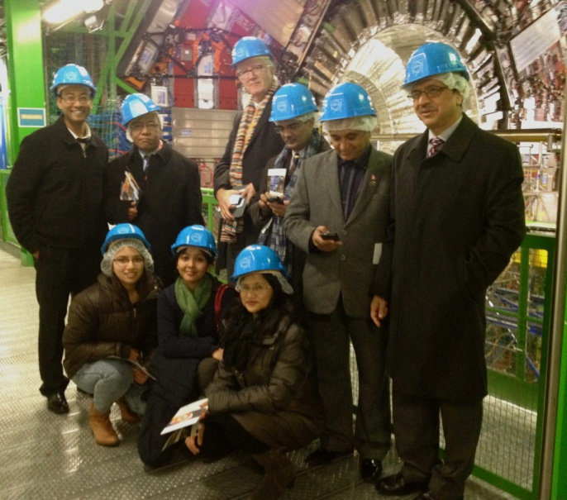
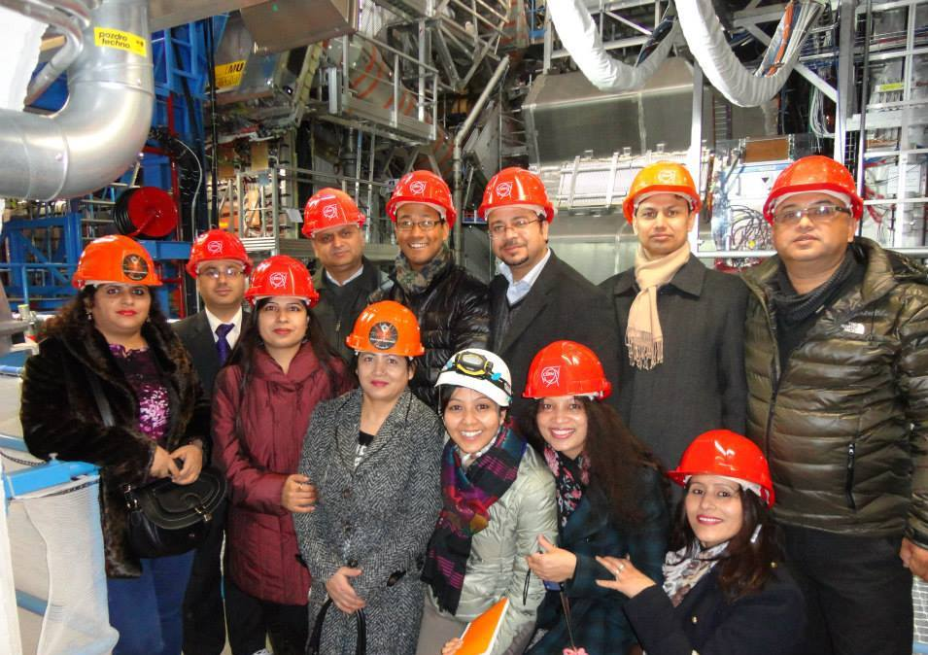
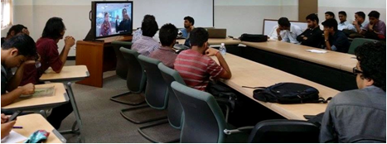
In-betweens
(clockwise) Minister of Health Visits CERN with the Ambassador in Geneva. Visitors from the Mission in Geneva. Ministry of Science organizes a virtual visit to ATLAS on National Science Day.

Slide 20
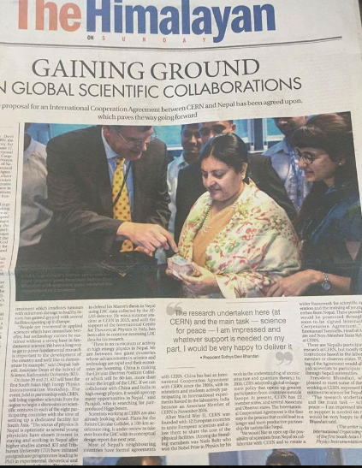
2017
Genuine interest from the government, with the president visiting CERN just last week
International Cooperation Agreement between CERN and Nepal unanimously agreed upon by the CERN Council, to be signed later this year

Slide 21
and here we are
at the first SAHEPI
More than 70 people registered to attend! (We had planned for 35)
Want to understand the expertise and need in South Asia, to connect and make potential future collaboration possible
Become an active partner in scientific pursuits, especially in the region, and facilitate the establishment of a dedicated scientific facility

Slide 22
Thank you!

