Slide 1
ARIES WP2 Task 2.2 kick-off
Coordination, support and enhancement of communication/outreach activities for accelerators in Europe
Jennifer Toes (CERN), Wed 14th June 2017

Slide 2
Meeting objectives
Provide overview of ARIES communication and outreach activities already established
Gather experience for:
  Future ARIES communication/outreach activities
  How to implement Deliverable 2.2 report on European accelerator comms/outreach
Discuss D2.2
  Parameters
  Timelines
  Responsibilities

Slide 3

Overview of Task 2.2
Objectives:
  Internal and external communications
  Project website
  Intranet
  Newsletter
  Monitoring of comms/outreach activities
  Disseminate best practice for comms/outreach activities via network meetings/workshops
  Identify actions for improving comms/outreach with the project
Milestones & Deliverables:
MS10: Project website launched (M6, Oct 2017)
D2.2: Final report on coordination of communication/outreach activities (M37, May 2020)
  Report documenting ongoing and proposed communication/outreach activities and identifying any required additional resources to support proposed initiatives.

Slide 4
Communication products
Project branding
  Logo
  Colour scheme
  Website banner
  Presentation templates
Mailing lists
Website
Intranet
Newsletter (Accelerating News)
ARIES factsheet
Annual briefings (for Annual Meetings)
Posters (for meetings, outreach)
Videos
Social media

Slide 5


Project branding
Project branding
  Logo
  Colour scheme
  Website banner
  Presentation templates
Mailing lists
Website
Intranet
Newsletter (Accelerating News)
ARIES factsheet
Annual briefings (for Annual Meetings)
Posters (for meetings, outreach)
Videos
Social media

Slide 6

Mailing lists
Project branding
  Logo
  Colour scheme
  Website banner
  Presentation templates
Mailing lists
Website
Intranet
Newsletter (Accelerating News)
ARIES factsheet
Annual briefings (for Annual Meetings)
Posters (for meetings, outreach)
Videos
Social media
WP mailing lists created, Task lists to be established as needed
E.g: ARIES-WP2-MEMBERS@cern.ch

Slide 7
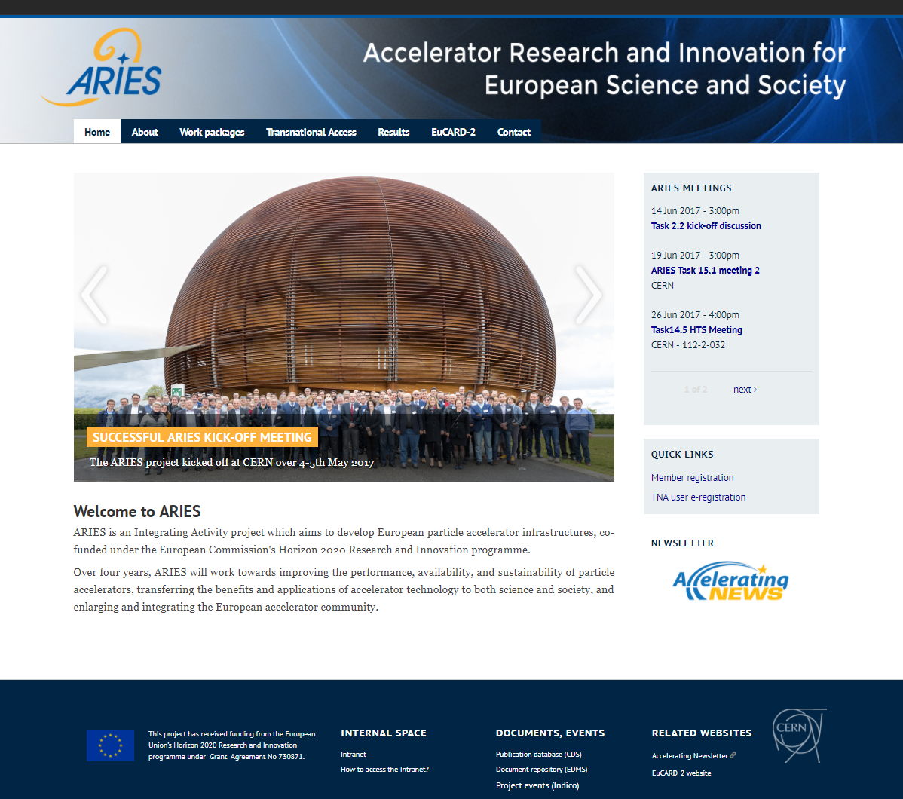
Website and intranet
Project branding
  Logo
  Colour scheme
  Website banner
  Presentation templates
Mailing lists
Website
Intranet
Newsletter (Accelerating News)
ARIES factsheet
Annual briefings (for Annual Meetings)
Posters (for meetings, outreach)
Videos
Social media
Website created, intranet in development.

Slide 8

Newsletter
Project branding
  Logo
  Colour scheme
  Website banner
  Presentation templates
Mailing lists
Website
Intranet
Newsletter (Accelerating News)
ARIES factsheet
Annual briefings (for Annual Meetings)
Posters (for meetings, outreach)
Videos
Social media
Accelerating News already exists, ARIES members added to subscriber list.

Slide 9
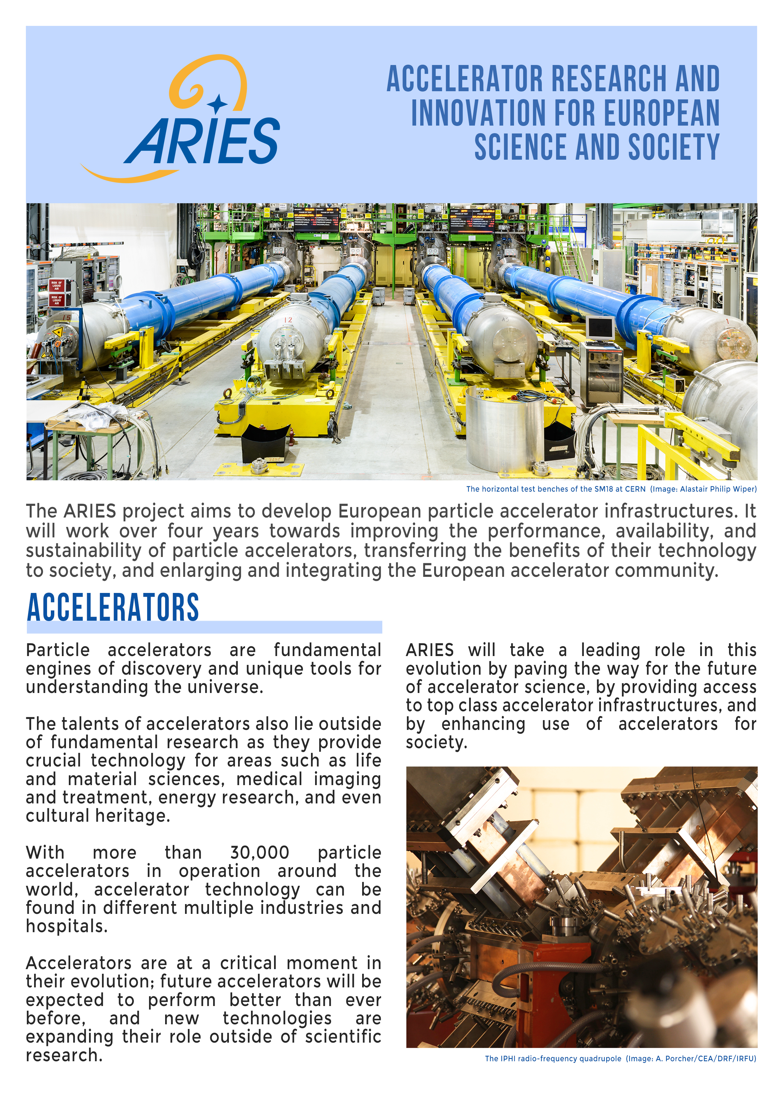
Factsheet
Project branding
  Logo
  Colour scheme
  Website banner
  Presentation templates
Mailing lists
Website
Intranet
Newsletter (Accelerating News)
ARIES factsheet
Annual briefings (for Annual Meetings)
Posters (for meetings, outreach)
Videos
Social media
Distributed at kick-off meeting, available online. Currently being translated into Polish. Other languages upon request.

Slide 10

Posters & briefings
Project branding
  Logo
  Colour scheme
  Website banner
  Presentation templates
Mailing lists
Website
Intranet
Newsletter (Accelerating News)
ARIES factsheet
Annual briefings
Posters
Videos
Social media
Poster for kick-off, future as needed. Annual briefings for Annual Meeting

Slide 11
Videos
Project branding
  Logo
  Colour scheme
  Website banner
  Presentation templates
Mailing lists
Website
Intranet
Newsletter (Accelerating News)
ARIES factsheet
Annual briefings
Posters
Videos
Social media
Two videos planned -> in early development stages

Slide 12



Social Media
Project branding
  Logo
  Colour scheme
  Website banner
  Presentation templates
Mailing lists
Website
Intranet
Newsletter (Accelerating News)
ARIES factsheet
Annual briefings
Posters
Videos
Social media
Social media plan proposed to Steering Committee
To vote on in Sept 2017
?

Slide 13
Communication products
Project branding
  Logo
  Colour scheme
  Website banner
  Presentation templates
Mailing lists
Website
Intranet
Newsletter (Accelerating News)
ARIES factsheet
Annual briefings
Posters
Videos
Social media
Already well advanced in most products, some require ongoing effort, others (ie, the social media and briefings) require future initiatives
?

Slide 14
Additional products/actions to consider
Branded “goodies” (ie, pens, notepads etc) for distribution at meetings, both internal and external
Leaflets for conferences with recent highlights of the project, advertising the TA facilities, PoC fund etc.
Contributing articles to external newsletters (of partner institutes or relevant organisational bodies)
Make use of external social media channels: CERN, LHC experiment, and institutional
Provision of talks/seminars
Attendance to science festivals
Additional actions to be discussed by Task 2.2 members

Slide 15
Further objectives
Monitor communications/outreach activities
  Formally: for D2.2 report
  Informally: for internal ARIES use
Disseminate best practice in comms/outreach
  Via network and meetings/workshops
    How?
Identify areas for improving comms/outreach
  To be defined

Slide 16
Monitoring ARIES comms/outreach
Internal activities usually monitored after the fact, via periodic reporting. How can we be more pro-active?
Formal approach
Survey
Create database of PR contacts at institutes, reach out to contacts on a regular basis
Informal approach
Page on website or email address to submit activities
Ask WP leaders to report upcoming comms/outreach work at Steering Committee meetings
Regular meetings of Task 2.2 for updates on activities or events they are aware of + dissemination to ARIES members

Slide 17
Deliverable 2.2
D2.2: Final report on coordination of communication/outreach activities
Deadline: Month 37, May 2020
Description: Report documenting ongoing and proposed communication/outreach activities and identifying any required additional resources to support proposed initiatives
Action plan:
Experience gathering meeting to discuss path forwards
Create plan, establish timeline, assign responsibilities
Identify parameters to be included in survey (ie, fields, contacts etc)
Create and circulate survey
Gather responses for assigned time
Analysis of responses
Create report

Slide 18
Timeline
May 2020 → Final report to be submitted to the EC
March 2020 → Draft circulated to ARIES management
Jan–Mar 2020 → Report writing
Until Jan 2020 → Survey open for responses
Before July 2019, at least
  Draft survey
  Discuss survey, to establish:
    Parameters / content
    Fields/institutes to survey
    Dissemination channels

Slide 19
Organisation
Groups to define:
  How to disseminate? (ie, which audiences to target, but also channels for disseminating the survey widely)
  Content of the survey
  Tools for implementing the survey

Slide 20
Survey audiences
Audiences to consider:
  Universities
  Scientific and technical institutes
  Learned societies (with scientific scope)
  Industry
  Science festivals
  Museums
Must define specific institutes & identification of ideal contacts, as well as additional channels to disseminate to a wider audience than just ARIES members.

Slide 21
Survey content
Organisations working on communication and outreach activities related to accelerator science in Europe
Type of communication and outreach
  Events – talks, seminars, accelerator schools
  Exhibitions
  Policy reports or briefings
  Educational materials, school and university
  Audiovisual materials
Tools used to conduct communication and outreach
Motivations
Observations
Activities that can’t be carried out and why
Future directions

Slide 22
Survey implementation
Once content defined and audiences/contacts established, the survey must be implemented
Where to be hosted?
  ARIES website?
Technical tools for hosting
  Drupal (CERN website content management system) survey plug in?
  Google Forms?
Monitoring
  Reminder emails / phone calls to specific institutes
  Reminder emails, posts, articles for general audiences

Slide 23
Actions
Set up meeting schedule to monitor progress
  Would suggest next meeting in September 2017?
Establish group to define the audiences
Establish group to define the content and parameters
Establish group to define implementation
Define feasible timeline for survey and resulting report

Slide 24
Thank you for your attention!

