Slide 1
Review of Expected Crab Cavity Heat Loads Due to Impedance
Sergey Antipov, Nicolo Biancacci, Benoit Salvant,
Francesco giordano, and Elias Metral
13.06.17

Slide 2
Some HOMs close to a multiple of the bunch spacing frequency might cause massive heat load
Example: DQW design (update of 10.2016)
Shunt impedance (Ω) | Quality factor | HOM Frequency (Hz)
9.34E+07 | 2.17E+10 | 4E+08
2.13E+04 | 1.60E+03 | 5.64E+08
0.005098 | 1.05E+03 | 5.69E+08
5.401713 | 1.04E+03 | 5.69E+08
1.15E+05 | 2.63E+03 | 5.86E+08
0.206092 | 6.71E+03 | 6.81E+08
417.1959 | 2.34E+03 | 6.82E+08
6.313443 | 1.06E+03 | 6.83E+08
0.205469 | 5.37E+00 | 8.53E+08
0.662133 | 5.39E+00 | 8.54E+08
3.30E-07 | 7.95E-01 | 8.6E+08
0.002906 | 6.09E+02 | 9.28E+08
1.14E+04 | 1.17E+03 | 9.6E+08
2209.216 | 2.62E+05 | 1.04E+09
55.08195 | 7.83E+02 | 1.07E+09
High R + close to a beam harmonic

Slide 3
Why is this not an issue in normal RF cavities?
The main mode is transverse, not longitudinal
  The HOMs are lower in frequency
The crab cavities sit in the places with high β
  Low Q of the HOMs is needed to ensure transverse stability
See also:
  N. Biancacci et al., Effect of tail cut and tail population on octupole stability threshold in the HL-LHC, HSC Meeting, 05.10.15
  E. Metral, Impedance update (other components than Crab Cavities), Joint LARP CM26/Hi-Lumi Meeting, SLAC, 19.05.16
  E. Metral et al., CC: Impedance status, International Review of the Crab Cavity Performance for Hi-Lumi, CERN, 05.04.17

Slide 4
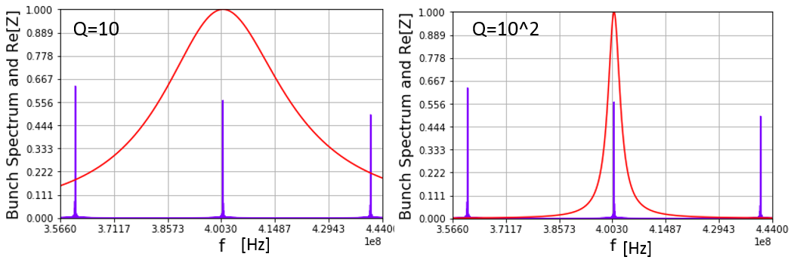
Simulation procedure
Take the actual beam spectrum
Sum the contributions of all the HOMs
N. Biancacci’s code:
  Adding an extra ±3 MHz spread to the HOM frequencies to account for manufacturing uncertainties
  Equidistant Gaussian bunches
B. Salvant’s code:
  Actual filling pattern
  Gaussian or cos² distribution
Courtesy F. Giordano
p per bunch
No. bunches

Slide 5
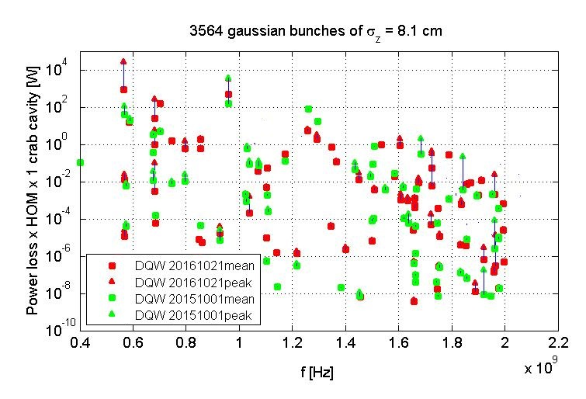
Double Quarter Wave: Total heat load has increased
2.2x10¹¹ ppb
25 ns spacing
In reality, not all the buckets are filled
The power loss will be lower

Slide 6
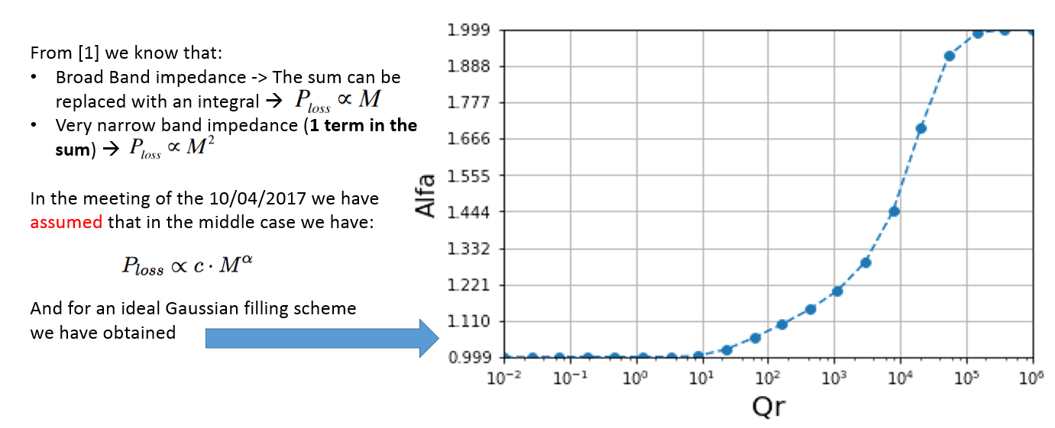
The sidebands of the beam spectrum significantly affect the power loss. It is quadratic with the number of bunches only if only the main line contributes
If is true,
in the LHC α is almost never equal to 2.
F. Giordano, B. Salvant, Update on power loss for resonator impedance with various filling schemes, APB HSC Meeting, 08.05.17

Slide 7
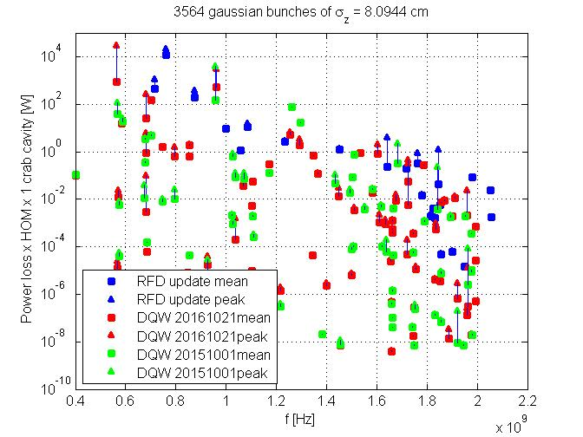
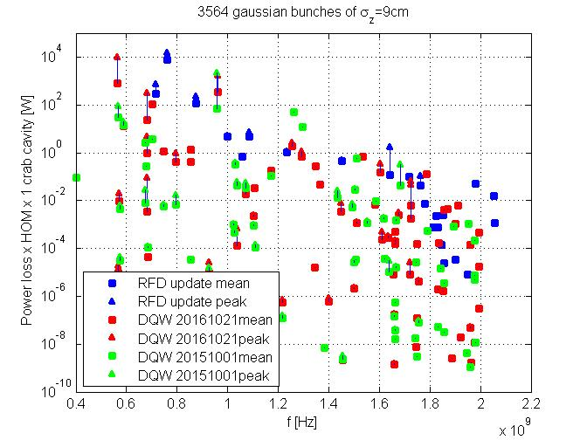
Going to 9 cm rms bunch length decreases the peak power loss
The effect is more prominent at 1 GHz and higher
8.1 cm rms bunch length
9.0 cm rms bunch length

Slide 8
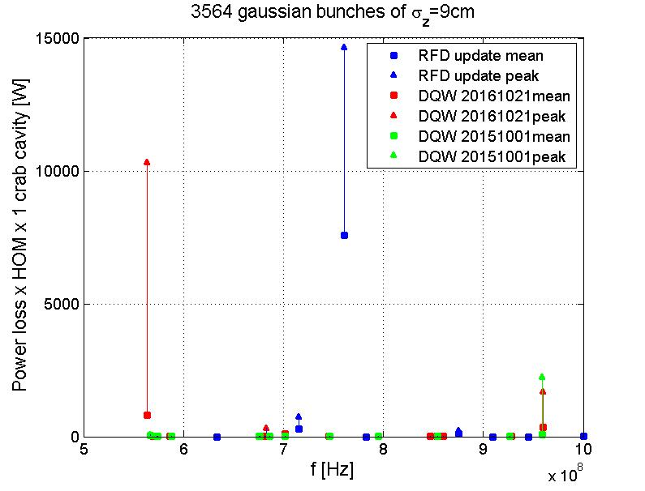
The most dangerous modes
760 MHz
The recipe of high loss:
High R 28 kΩ
Low Q 300
Close f 761 MHz
560 MHz
960 MHz
We need the HOMs to have low Q to ensure the transverse stability

Slide 9
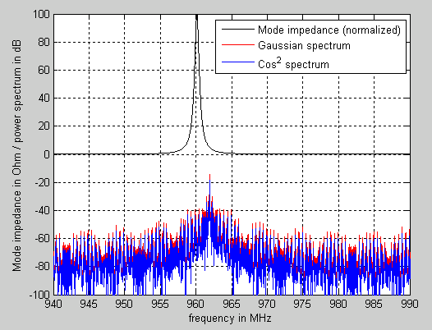
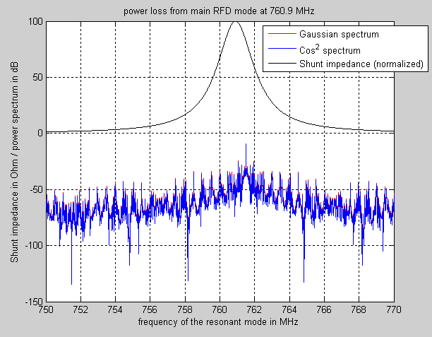
Intersection of the mode line with the peak in beam spectrum leads to kW-scale power losses
DQW
RFD
For a more realistic cos² spectrum the losses are lower. Up to a factor of 2 for a 1 GHz mode in DQW

Slide 10
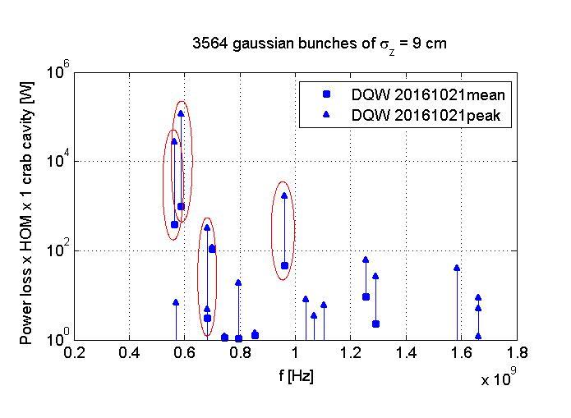
Need to look at all potentially dangerous modes
Adding a ±25 MHz spread to HOM frequencies
The modes may shift significantly during the tuning
  As far as 50 MHz
  No way of controlling the individual frequencies
To be safe, one might need to take into account all potentially dangerous modes
  Not only the ones that are close to beam harmonics at the moment
The modes with peak power loss > 100 W are highlighted

Slide 11
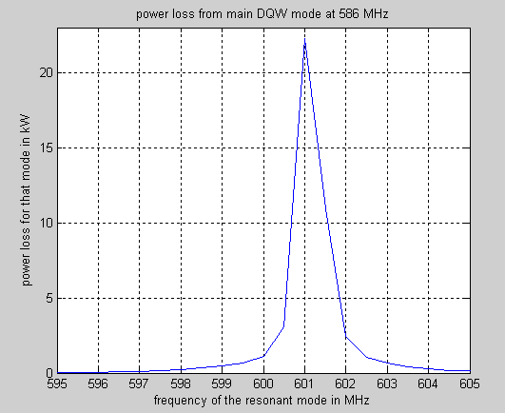
DQW: Stay at least 2 MHz away from the critical HOMs
Intensity | 2.2x10¹¹ ppb
No. bunches | 2748
Bunch distribution | Cos²
Mode frequencies | 586 MHz
Q-factor | 2600
Shunt imp. | 115 kΩ
500 W level

Slide 12
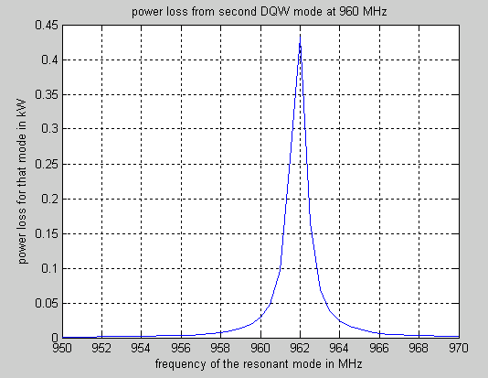
DQW: Stay at least 2 MHz away from the critical HOMs
Intensity | 2.2x10¹¹ ppb
No. bunches | 2748
Bunch distribution | Cos²
Mode frequencies | 960 MHz
Q-factor | 1100
Shunt imp. | 11 kΩ
Can significantly reduce the losses from the
2nd potentially dangerous mode

Slide 13
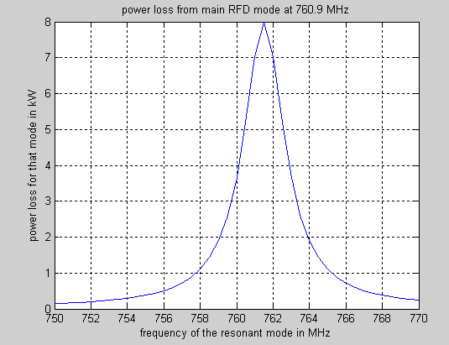
RFD: Stay at least 5 MHz away from the critical HOM
Intensity | 2.2x10¹¹ ppb
No. bunches | 2748
Bunch distribution | Cos²
Mode frequency | 760 MHz
Q-factor | 290
Shunt imp. | 28.7 kΩ
500 W level

Slide 14
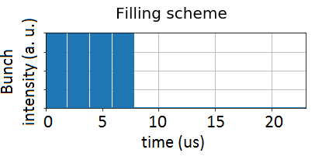
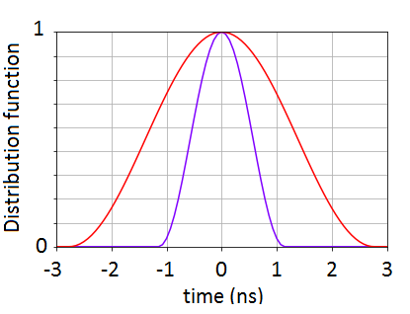
What can be measured at SPS?
Cos² bunch profile
injection
extraction
Intensity | 1.35x10¹¹ ppb
No. bunches | 288
Bunch length, extraction | 1.65 ns
Bunch length, injection | 4.0 ns

Slide 15
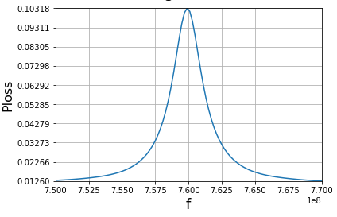
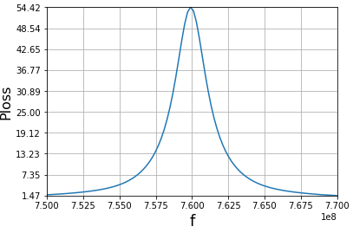
RFD: up to 50 W at extraction
Injection, 4.0 ns bunch length
Extraction, 1.6 ns bunch length
0.10
0
54.4
0
Power loss (W)
Power loss (W)
Power loss (W)
760 770
frequency (MHz)
760 770
frequency (MHz)

Slide 16
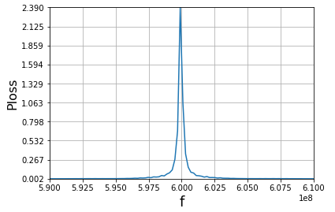
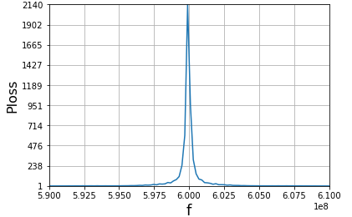
DQW: up to 2 kW, very narrow peak
Injection, 4.0 ns bunch length
Extraction, 1.6 ns bunch length
2.4
0
2140
0
Power loss (W)
Power loss (W)
0.3 MHz
590 600 610
frequency (MHz)
590 600 610
frequency (MHz)

Slide 17
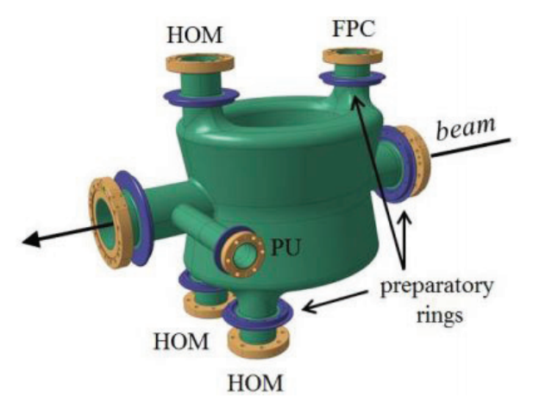
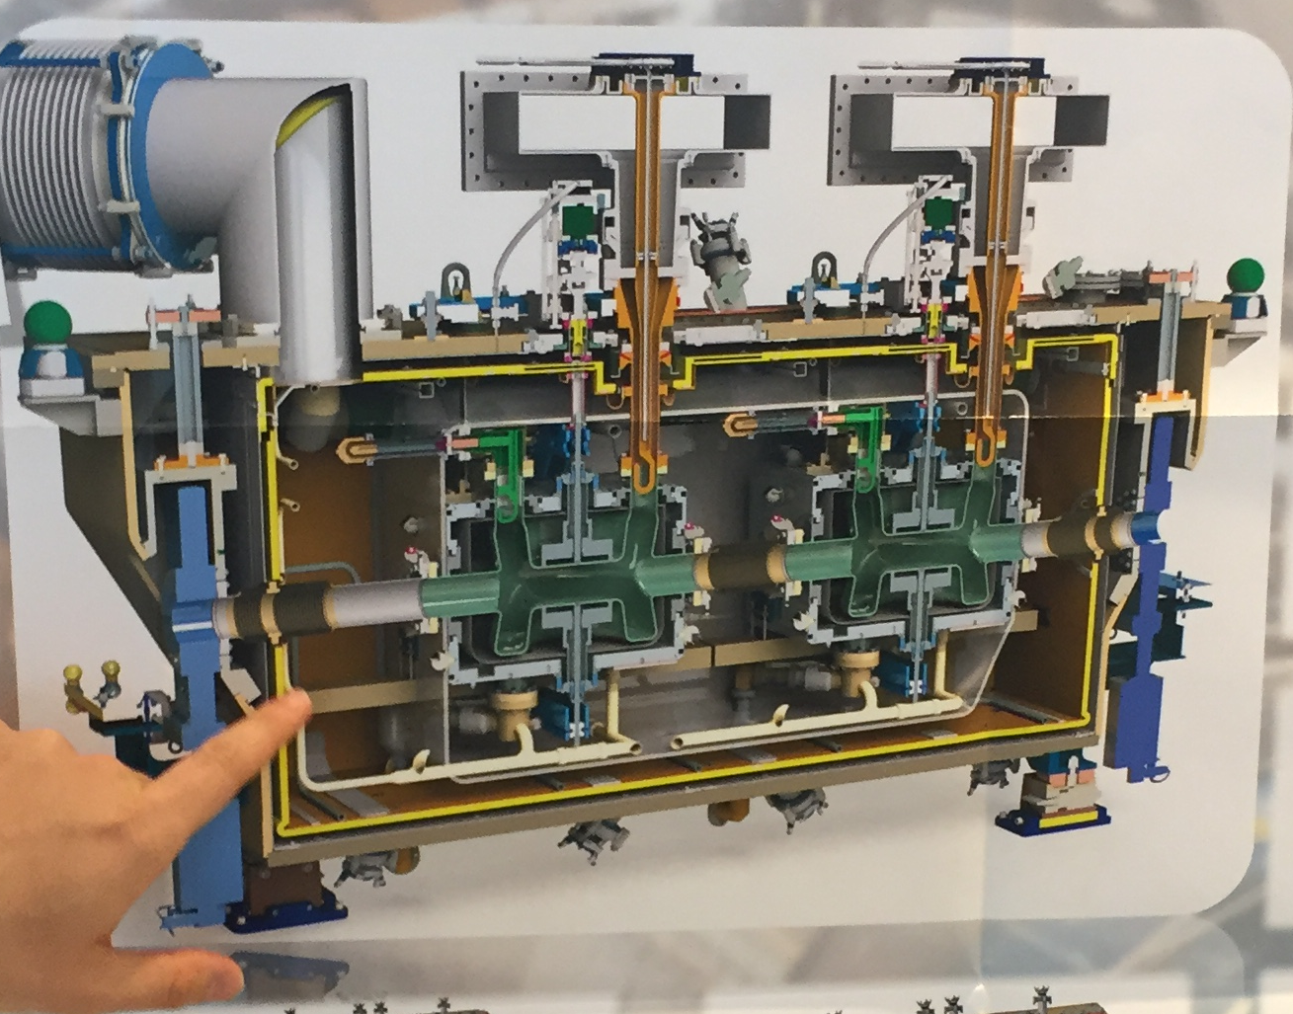
DQW: HOM damping system is designed to take up to 1 kW
The coaxial line can transport up to 1 kW
of HOM power load out of the cavity
DQW has several HOM couples
J. A. Mitchel et al., IPAC’16, Busan, Korea
Thermal breakdown might be an issue
A dedicated breakdown test is foreseen

Slide 18
Summary
If a high-impedance HOM is close to a beam spectrum line, it may lead to a high power loss
  kW-scale losses!
HOM lines can be quite broad (low-Q), making it challenging to avoid
Would like to have at least 2-5 MHz from the harmonics of 40.08 MHz to keep the beam induced heating below 500 W
  How feasible it actually is?
As measurement in SPS might reveal some information
  Substantial power loss
  Tens of Watts can be achieved at extraction
  May be hard to tune on certain lines

