Slide 1
Planning and Installation
LIU Project Team meeting

Slide 2
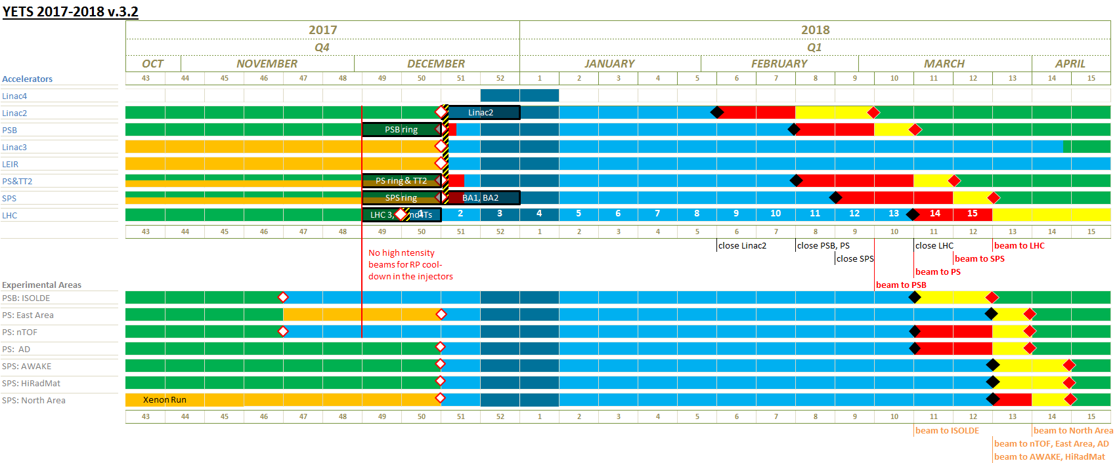
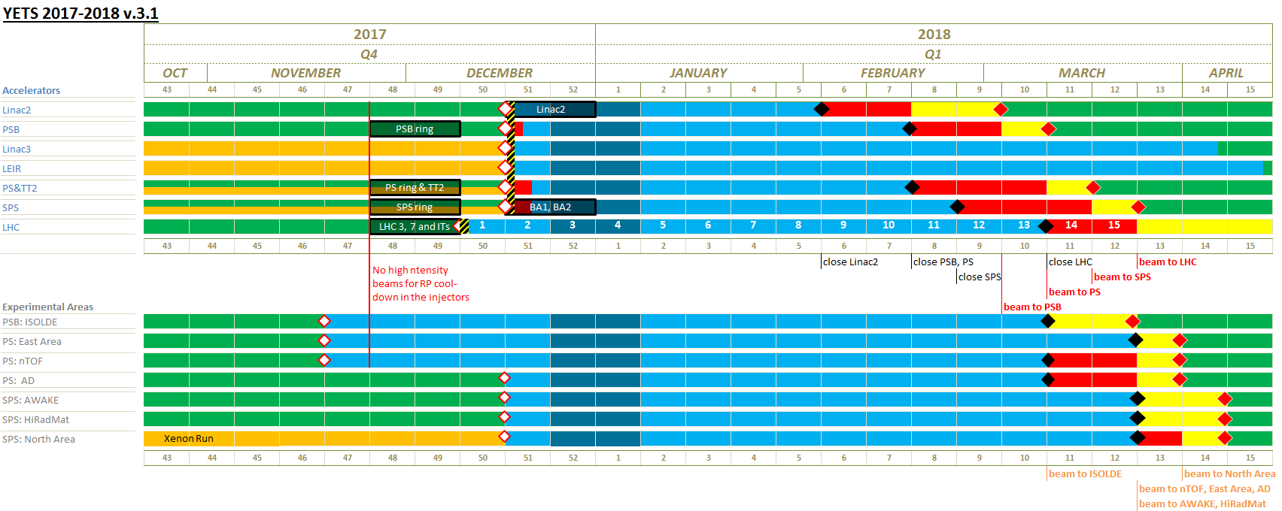
YETS 2017-2018 schedule
Presented at IEFC 7th and LMC 12th April
EDMS document sent for approval on 27th April
→ Presentation to IEFC on Friday 07th July
Results
Linac4 schedule under discussion
Possibility to run 2 weeks more for the high-intensity
Ion run in the east area
Cryo cool-down of
HL-LHC Crab cavity
Activity/maintenance affecting all facilities must be scheduled during this period (i.e. electrical cut, cooling maintenance, controls etc…)

Slide 3
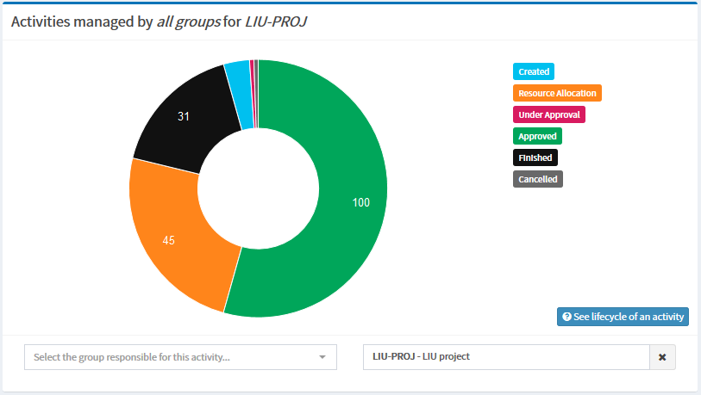
PLAN version 2 timeline
45 jours
Initialization
30/1/2017 - 31/3/2017
5 jours
Prioritization
1/4/2017 - 8/4/2017
55 jours
Resource allocation
9/4/2017 - 23/6/2017
15 jours
Final approval
24/6/2017 - 15/7/2017
2017
janvier
février
mars
avril
mai
juin
juillet
2017
Today
New dates

Slide 4
PLAN
Contribution Resources Requests not yet approved

Slide 5
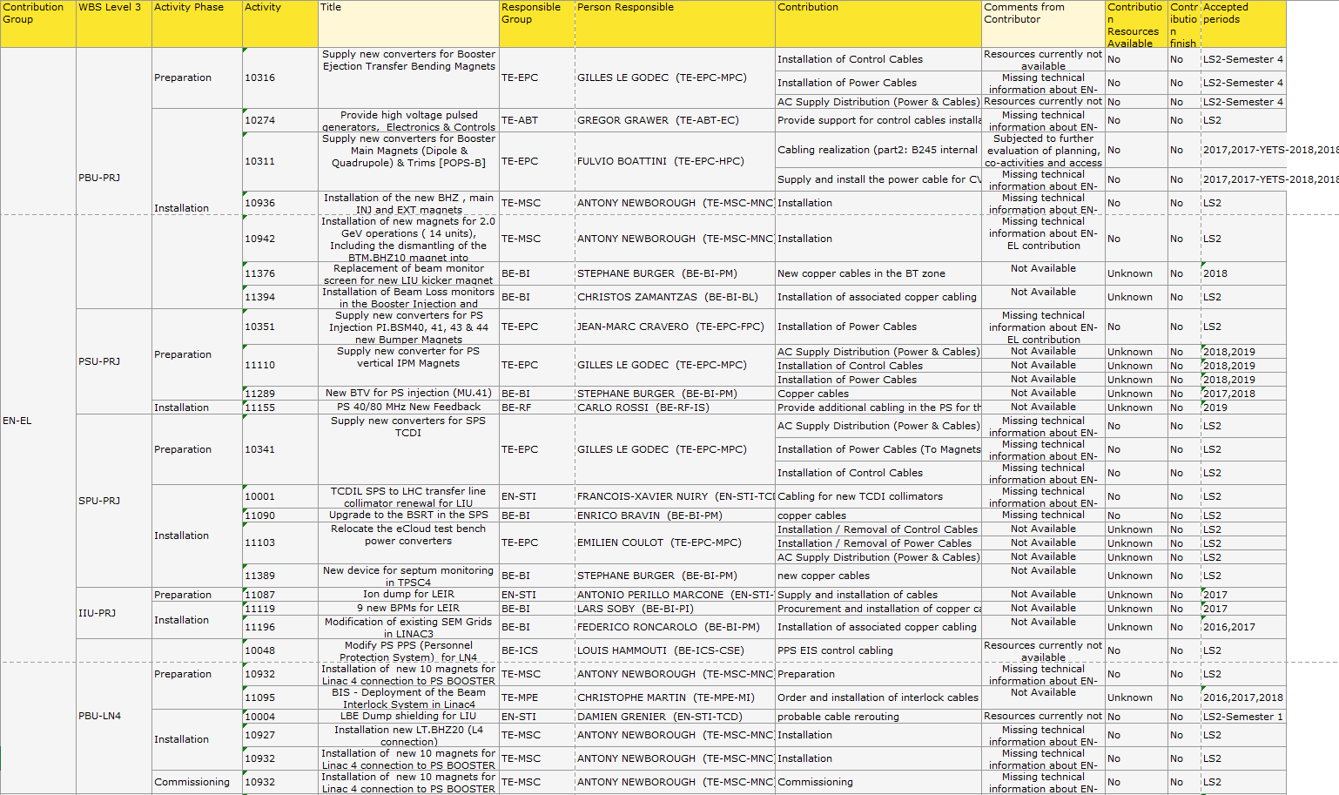
PLAN
Contribution Resources Requests not yet approved

Slide 6
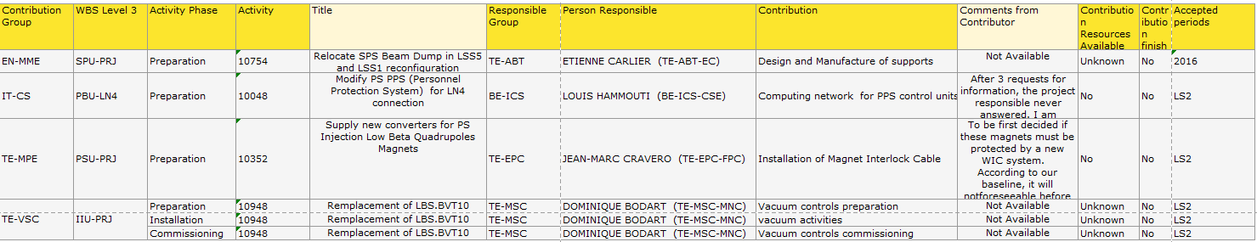
PLAN
Contribution Resources Requests not yet approved

Slide 7
Facility LINAC and LEIR YETS 2017-2018
Project | Title | PLAN | Location | Group | Contact | Technical Specification | SRR | SRR status | ECR | ECR status | Integration | Installation status
LIU | 2 new BPMs | 11119 | EI line | BE-BI | Lars Soby |  | N/A | N/A | LEI-BPM-EC-0001 | RELEASED | COMPLETED | to be RELEASED
LIU | 5 new BPMs | 11119 | ETL line | BE-BI | Lars Soby |  | N/A | N/A | To be prepared by Lars |  | COMPLETED
LIU | LINAC3 Faraday Cups Upgrade | 11197 | ITF line | BE-BI | Federico Roncarolo | L3-B-ES-0001 | N/A | N/A |  | Needed? | N/A
LIU | SEM grids ITL-ITM: request for new wire layout | 11196 | ITL line ITM line | BE-BI | Federico Roncarolo | L3-B-ES-0001 | N/A | N/A | L3-BCFAB-EC-0001 | L3-BCFAB-EC-0001 ECR is RELEASED! | N/A
LIU | New LEIR beam dump | 11087 |  | EN-STI | Antonio Perillo Marcone |  | LEI-LJ-EC-0001 | RELEASED | LEI-TD-EC-0001 | Should be ready in next 2 wks | COMPLETED | LIU-PLI

Slide 8
Facility Booster YETS 2017-2018
Project | Title | PLAN | Location | Group | Contact | SRR | SRR status | ECR | ECR status | Integration | SMARTEAM Ref Integration | Differential Drawing | Installation status
LIU | 4 New Tune pick-ups in 3L1 | 10600 | period 3 L1 | BE-BI | Marek Gasior | N/A | N/A | PSB-BPMTA-EC-0001 | RELEASED | Completed |  | PSBLJ_UI0016 | postponed to YETS 2017-2018
LIU | New SEMGrid in sector 4 | 10071 | period 4 L1 ring 3 | BE-BI | Christophe Vuitton | PSB-LJ-EC-0004 | RELEASED |  |  | On going to MME Waiting 3D
LIU | Installation of resistors |  |  | TE-MSC | Antony Newborough | N/A | N/A | N/A | N/A | N/A | N/A | N/A
LIU | Installation of Upgraded PSB Recombination Septum BT.SMV20 | 10216 | BT line | TE-ABT | Michael Hourican | N/A | N/A | PSB-MSMID-EC-0001 | RELEASED | Completed

Slide 9
Facility PS YETS 2017-2018
Project | Title | PLAN | Facility | Location | Group | Contact | Technical Specification | SRR | SRR status | ECR | Integration | Differential Drawing
LIU | New Fast BWS prototype in SS54 | 10434 | PS | SS54 | BE-BI | Ana Guerrero |  | N/A | N/A | On going | Close to completion. | Le plan differentiel est en controle, mais c’est OK

Slide 10
Facility SPS YETS 2017-2018
Project | Title | PLAN | Facility | Location | Group | Contact | Installation period | Technical Specification | SRR | SRR status | ECR | ECR status | Integration | SMARTEAM Ref Integration | Differential Drawing | Installation status
LIU | New RF power feeder line in SPS point 3 shaft | 10836 | SPS | BA3 | BE-RF | Eric Montesinos | YETS 2017-2018 |  | N/A | N/A | SPS-LJ-EC-0005 | IN WORK | Started
LIU | ZS improvements (change 1 ZS) | 10334 | SPS | LSS2 | TE-ABT | Bruno Balhan | YETS 2017-2018 |  | N/A | N/A
LIU | MKE improvements | 0 | SPS | LSS6 | TE-ABT | Laurent Ducimetière | YETS 2017-2018 |  | N/A | N/A | N/A | N/A | N/A | N/A | N/A
LIU | New vacuum valves (x2) |  | SPS |  | TE-VSC | Jose Antonio Ferreira Somoza | YETS 2017-2018 |  | N/A | N/A
LIU | aC coating and flange impedance reduction | 0 | SPS |  | TE-VSC | Paul Cruikshank | YETS 2017-2018 |  | N/A | N/A |  |  | N/A | N/A | N/A

