Slide 1

BGC as profile diagnostics for Electron Lenses in HL-LHC (Halo Depletion and Beam-Beam Long Range Compensation)
A. Rossi (CERN), D. Perini, S. Redaelli, G. Stancari et al.
Beam Gas Curtain Instrument Review – Cockcroft Institute – 27-28 June 2017

Slide 2
Outline
Hollow Electron Lens motivations and principles
HEL current design
BGC requirements for HEL
Long-Range Beam-Beam effect and ‘wire’ compensation
LRBB compensation with electron lens
Current design status
BGC requirements for LRBB
TIMELINE

Slide 3
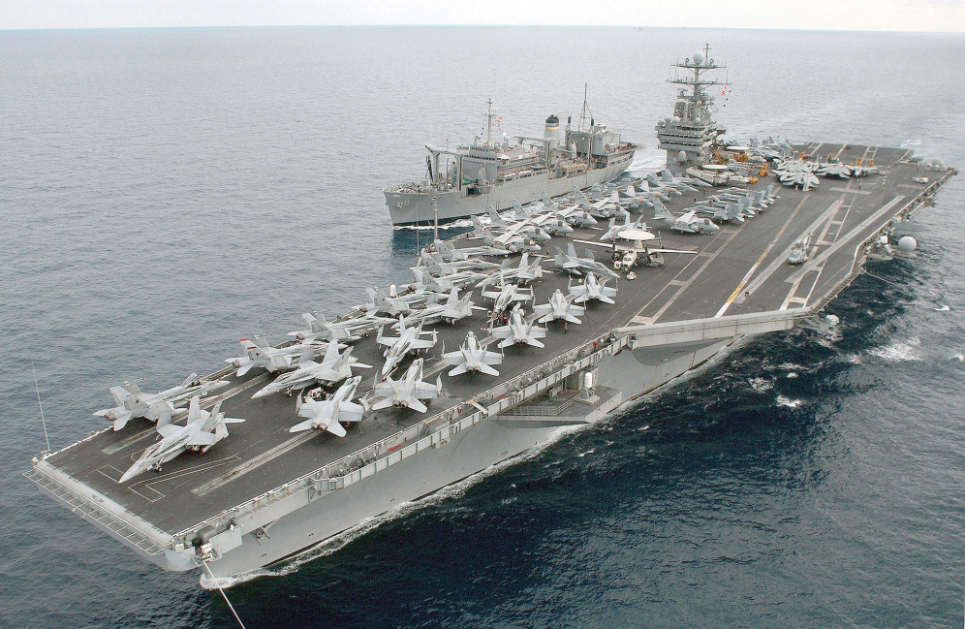
LHC collimation challenge
Large Hadron Collider: 27 km ring, designed to collide 7 TeV proton beams
Huge stored beam energy per beam : 362 MJ for nominal configuration, 675 MJ for planned upgrade HL-LHC
Beams could be highly destructive if not controlled well => collimation plays an essential role to prevent dangerous losses
v = 7 knots
675 MJ = kinetic energy of
USS Harry S. Truman
cruising at 7 knots
Courtesy of
A. Bertarelli

Slide 4
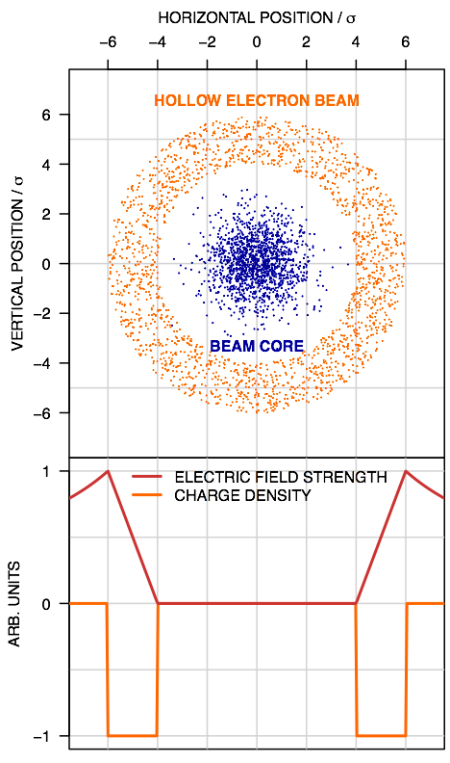

Principle of hollow e-lens
Main beam travelling inside a hollow electron beam over a short distance (~3m), can act on the halo particles at transverse amplitudes below primary collimators
Halo particles kicked to higher amplitudes by electromagnetic field of electron beam (slow process)
Axisymmetric electron beam hollow =>
core not affected (in field-free region)
+ no effects on impedance
1.23mm
Courtesy of
G. Stancari
1σ≈3.06µm
A. Rossi et al, Beam Gas Curtain Instrument Review – Cockcroft Institute – 27-28 June 2017

Slide 5
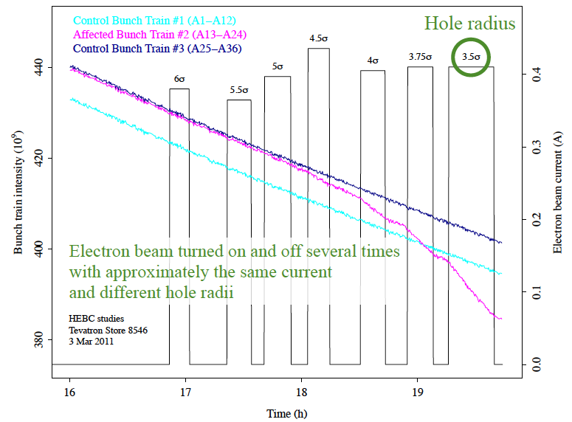
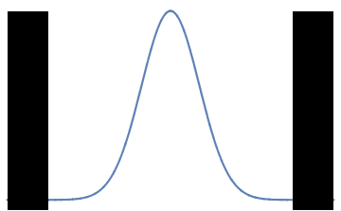
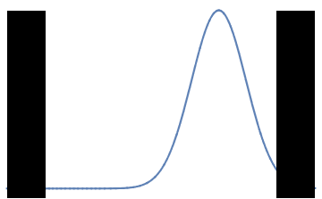
Review of the need for hollow e-lenses for the HL-LHC (CERN, 6-7 October 2016)
https://indico.cern.ch/event/567839/
Successfully demonstrated at
Tevatron (Stancari et al.)
Review conclusions:
  A hollow e-lens will mitigate CC
  failures (large betatron oscillations)
  if < 1 to 2 σ
  HL-LHC less sensitive to transients
  due to small variations of orbit, tune
  and other parameters
  Implement active beam halo
  control using a hollow e-lens
collimator
collimator
Orbit shift
collimator
collimator
Stancari et al., Phys. Rev. Lett. 107, 084802 (2011)
See also
Shiltsev, BEAM06, CERN-2007-002
Shiltsev et al., EPAC08
Shiltsev et al., Phys. Rev. STAB11, 103501 (2008)

Slide 6
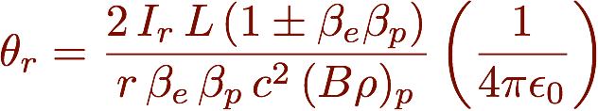
Required parameters
Kick given by electron lens + counter, − co-propagating
Keeping the Tevatron hardware, kicks given to protons would be factor ~7 less from magnetic rigidity
  Increase electron current to compensate (or length – less attractive)
Halo removal rate depends not only on kick but also on lattice non-linearities
  Simulations (LifeTrack and SixTrack) demonstrate desired halo depletion with 5A current and stochastic excitation mode
10kV to transport through the e-lens structure
A. Valishev, FERMILAB-TM-2584-AP (2014)
A. Rossi et al, Beam Gas Curtain Instrument Review – Cockcroft Institute – 27-28 June 2017

Slide 7
Instrumentation
Need to monitor position of electron beam and proton beam
  Requirement: ~ 30 µm accuracy (0.1 σ of proton beam),
  time resolution of 1 ns (protons) and 100 ns (electrons).
Need to monitor electron current at cathode and collector
Need to monitor electron beam profile
  Requirement: d_{4σ}≈ 6.93 mm and d_{6σ}≈ 10.4 mm
  ~ 48÷50µm resolution
Sensitive loss monitors can be placed downstream
In addition: need halo monitor for the LHC proton beam to study population in various scenarios, independently of e-lens
A. Rossi et al, Beam Gas Curtain Instrument Review – Cockcroft Institute – 27-28 June 2017

Slide 8
Hollow Electron Lens
Electron gun 5Ax10kV
Modulator
Instrumentation
Collector
Main SC solenoid 3-5 T
Gun solenoid 0.2-0.4T
Bending SC solenoids ~3T
6.4 – 6.5 m

Slide 9
Hollow Electron Lens
Electron gun 5Ax10kV
Collector
V_{CA}
+
–
Heater
PC
Anode modulator
V_{CA}≤10kV, I_{anode}
V_{CO}
– +
Cathode –
Collector
PC
Medium voltage
High current
V_{CA}-V_{CO}, I_{beam}=5A
–
+
Cathode
PC
High voltage (10kV)
low current (losses)
V_{CA}, I_{tube}
A. Rossi et al, Beam Gas Curtain Instrument Review – Cockcroft Institute – 27-28 June 2017

Slide 10
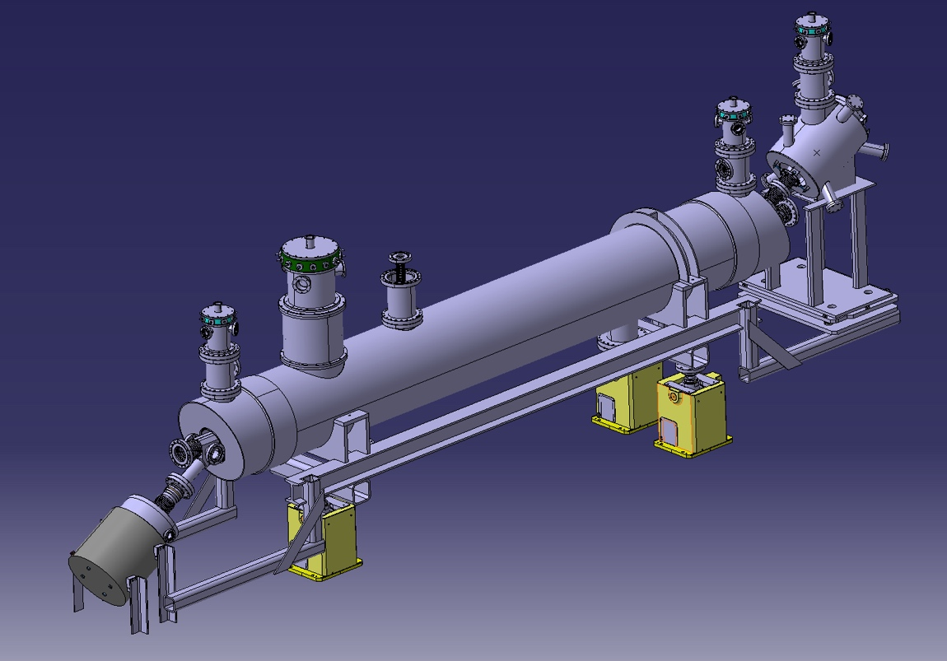
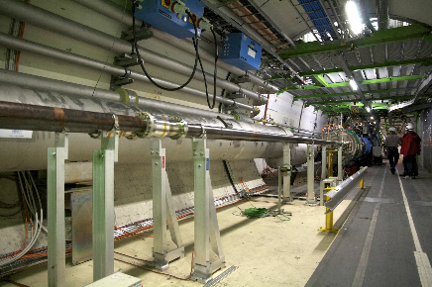
Technical design
S-shaped to compensate for the asymmetric electron beam distributions seen by the main beam
Gun and collector stick out in vertical plane to fit in LHC tunnel
Proton beam ~ round
D. Perini et al.
BGC
e-gun
Hollow electron beam
Proton beam
Candidate locations for the electron lenses are RB-44 and RB-46 at Point 4, on each side of the interaction region IR4.
The beam to beam distance is 420 mm.
The longitudinal available space is limited
Collector
A. Rossi et al, Beam Gas Curtain Instrument Review – Cockcroft Institute – 27-28 June 2017

Slide 11
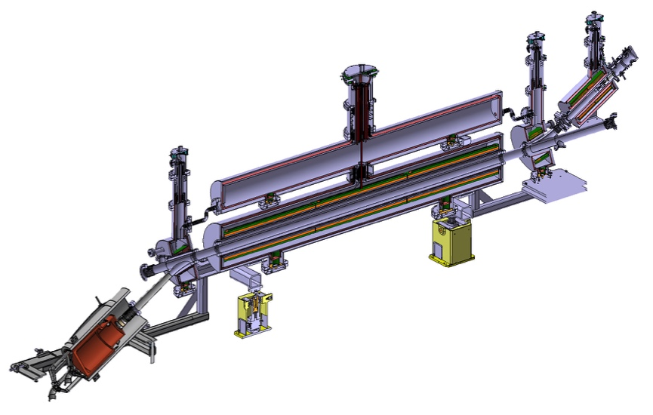
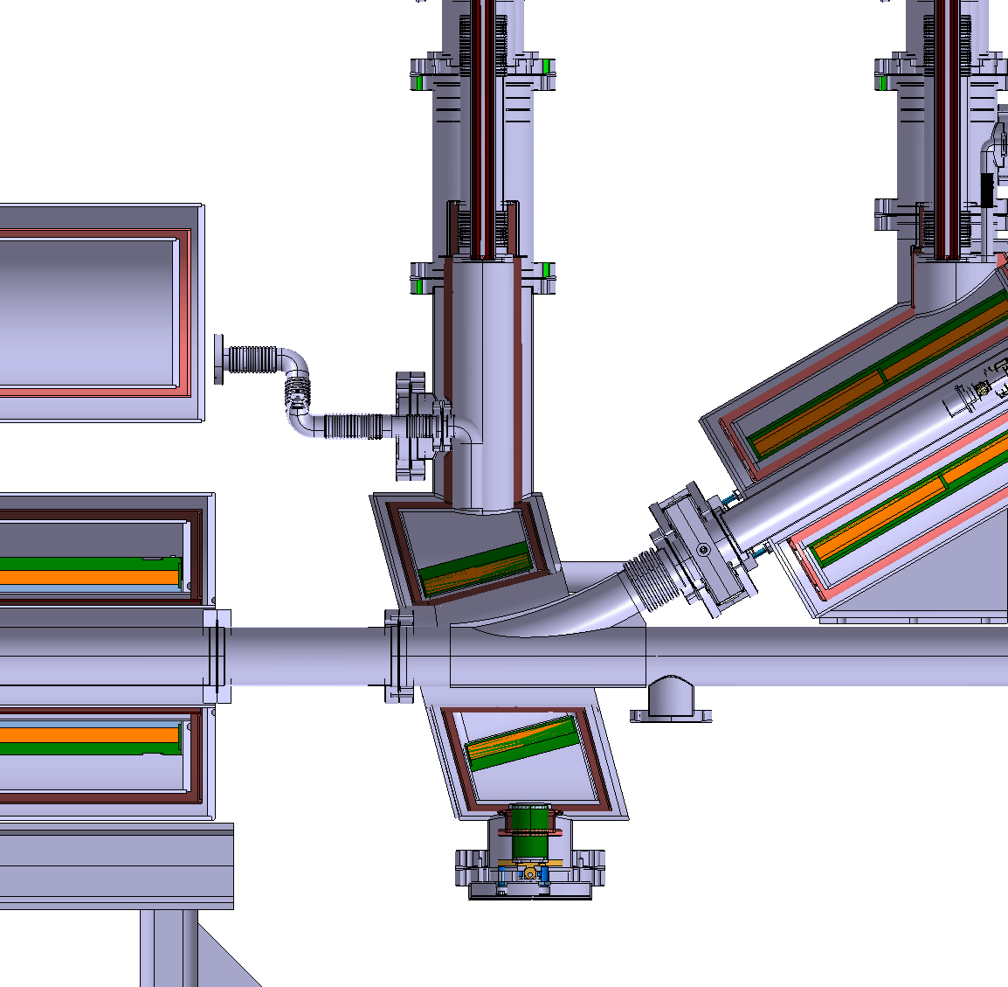
Technical design
Courtesy of A. Kolehmainen
Space reserved for BCG
A. Rossi et al, Beam Gas Curtain Instrument Review – Cockcroft Institute – 27-28 June 2017

Slide 12
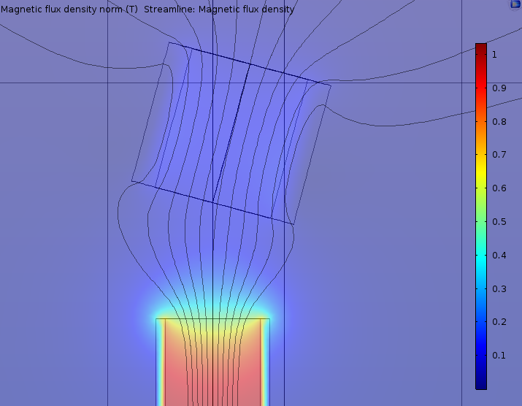
BGC requirements for HEL
Proton beam (±2σ) ~ 1.23 mm
  ~ 30 µm resolution (0.1 σ of proton beam)
Electron beam (from 4 to 6σ)
  d_{4σ}≈ 6.93 mm and d_{6σ}≈ 10.4 mm
  @ 0.5T in the gap
  ~ 48÷50µm resolution
Low impedance for p+ beam
As smooth as possible for e- beam (see later LRBB)
A. Rossi et al, Beam Gas Curtain Instrument Review – Cockcroft Institute – 27-28 June 2017

Slide 13
Timeline
October 2017: Conceptual readiness review
Test stand at CERN 2018?
LS2 (end 2018) Technical Design Report
LS3 (end 2023) Installation
A. Rossi et al, Beam Gas Curtain Instrument Review – Cockcroft Institute – 27-28 June 2017

Slide 14
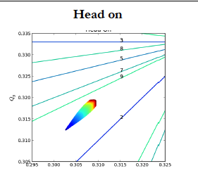
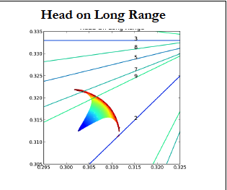
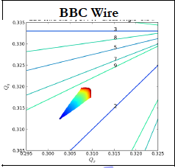
Long-Range Beam-Beam
LRBB interactions limit accelerator performance
  perturb motion at large betatron amplitudes, where particles come close to opposing beam
  produce beam blow-up and deterioration of beam lifetime
  causes amplitude dependent detuning
  limit closing crossing angle and therefore luminosity
Tune spread by T. Rijoff
A. Rossi et al, Beam Gas Curtain Instrument Review – Cockcroft Institute – 27-28 June 2017

Slide 15
LRBB Wire compensation
≈1
for large separation
Beam-beam (LR) kick
(round Gaussian beams +
crossing in both planes)
with (beam separation)
Can be approximated by
an “infinite” wire
wire separation
J.P.Koutchouk, LHC Note 223, 2000
Courtesy of
Y.Papaphilippou
A. Rossi et al, Beam Gas Curtain Instrument Review – Cockcroft Institute – 27-28 June 2017

Slide 16
LRBB compensation with e-lenses
Total electron beam current @ HL-LHC for LRBB compensation
  (I_{w}L_{w})_{eq}= 10.56Am per encounter ➔ ~ 200Am per IP side
  4 to 6
Current assumption 20A e-beam x 3m length
At an aspect beam ratio of 2 and ½.
S.Fartoukh in PhysRevSTAB.18.121001
A. Rossi et al, Beam Gas Curtain Instrument Review – Cockcroft Institute – 27-28 June 2017

Slide 17
Constraints from layout
~ optimal beam aspect ratio in matching section
Beam inter-axis 194 mm
Region getting shorter and crowded
Current layout (latest from HL-WP15)
5760m
4760m
187.44m 193.6m from IP

Slide 18
Assumptions for e-lens simulations so far
Proton beam dimension important only in the crossing plane
For HL IP5 (reverse plane for IP1) B2, symmetric for B1
In the simulations presented today by A. Levichev it was assumed an electron beam of Ø 2 mm given space available if electron beam wire placed at 10 σ_{x}
 |  | β_{x} (m) | σ_{x} (mm) | β_{y} (m) | σ_{y} (mm)
Round | left | 1000 | 0.58 | 2000 | 0.82
 | right | 2000 | 0.82 | 1000 | 0.58
Flat | left | 500 | 0.41 | 4000 | 1.16
 | right | 1000 | 0.58 | 2000 | 0.82

Slide 19
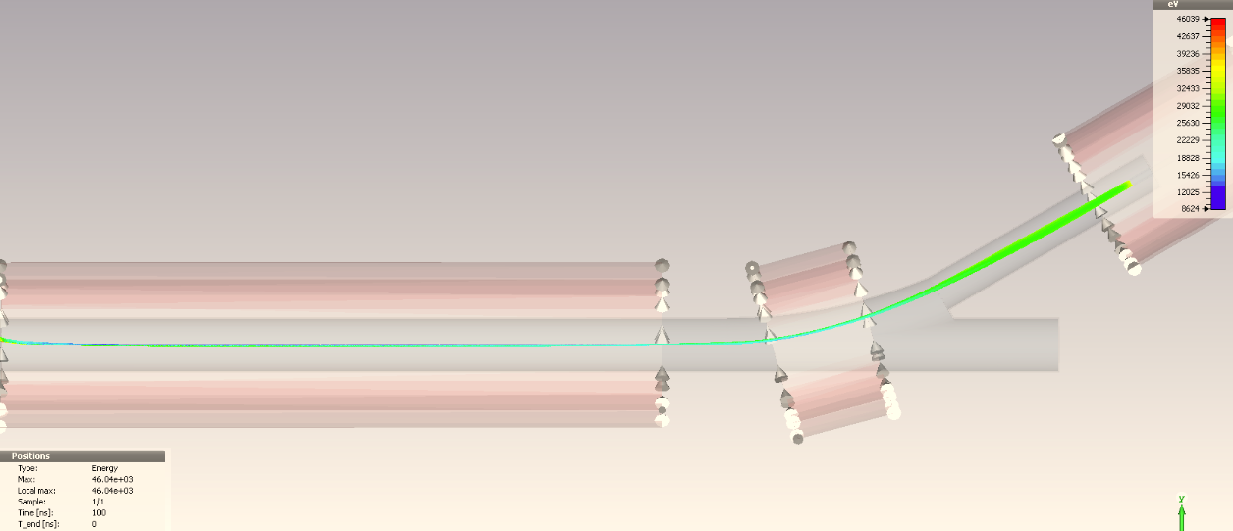
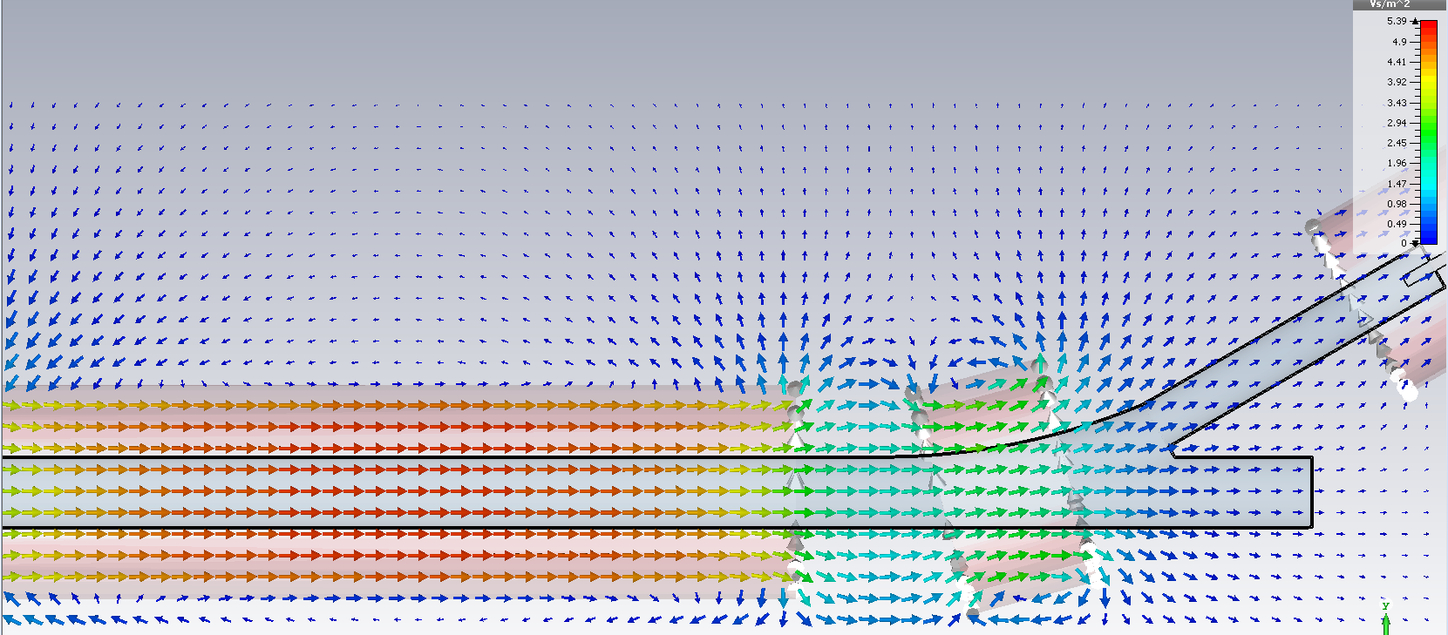
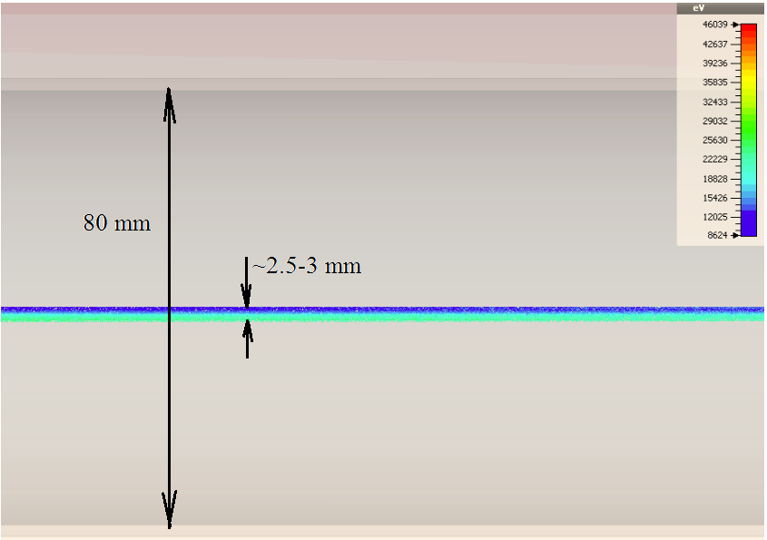
Beam dynamics I_{e}=20 A, V=35 kV
Courtesy of
A. Levishev (BINP)
0.2T
Ø 10mm
5T
3T
2-3 mm
@ 35kV, 20 A can propagates through the electron lens

Slide 20
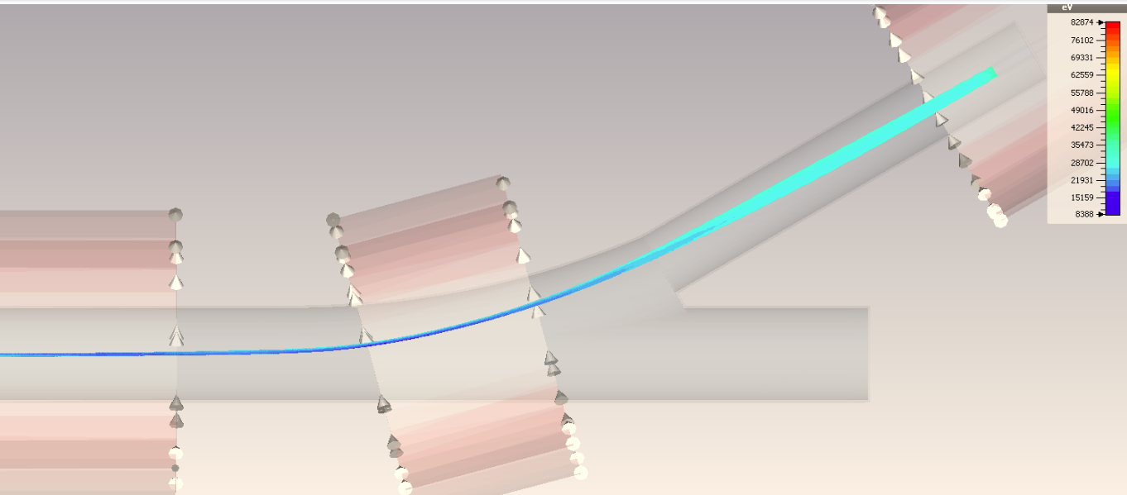
Beam dynamics I_{e}=20 A, V=35 kV
e-beam potential decreases when the beam is compressed and injected into the p-beam vacuum chamber with large aperture of the bending solenoid.
Due to the asymmetric vacuum chamber the beam potential becomes also asymmetric and particles get different velocities.

Slide 21
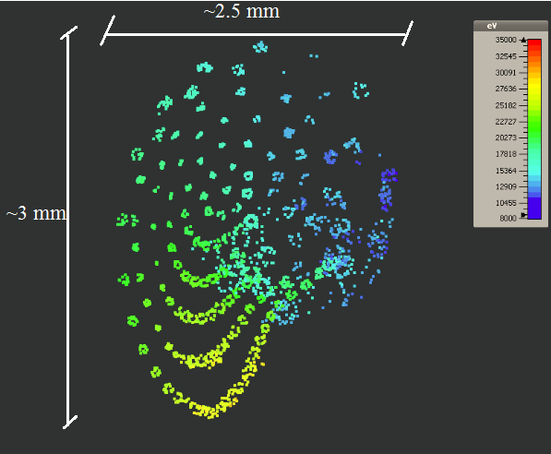
Beam dynamics I_{e}=20 A, V=35 kV: transverse beam space
e-beam profile results asymmetric, due to asymmetric vacuum chamber. For particles with different potential the Lorenz radius are differed. Besides the individual particle rotation, due to the magnetic field on the cathode the beam is rotated as a whole and therefore the potential distribution along the radius changes with time.

Slide 22
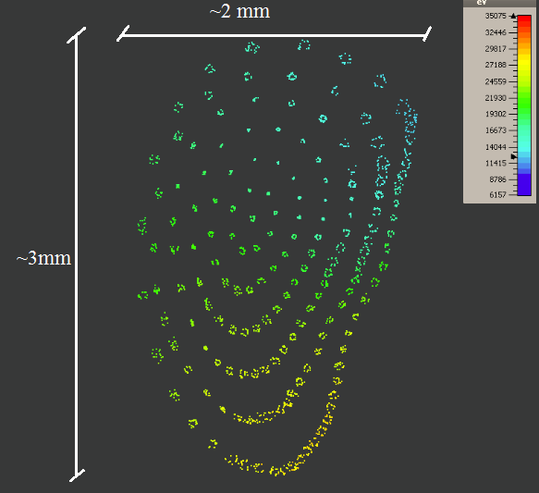
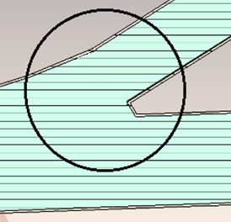
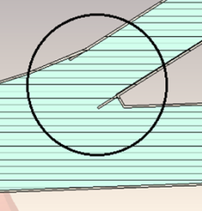
Beam dynamics I_{e}=20 A, V=35 kV
Attempt to symmetrized vacuum chamber
Transverse beam space

Slide 23
BGC requirements for LRBB
Proton beam (±2σ) ~ 2.8 mm
  ~ 50 µm resolution (0.1 σ of proton beam)
Electron beam smallest ~ 2mm,
  ~ 50µm resolution
Low impedance for p+ beam
As smooth as possible for e- beam (see later LRBB)
A. Rossi et al, Beam Gas Curtain Instrument Review – Cockcroft Institute – 27-28 June 2017

Slide 24
Timeline
HEL
October 2017: Conceptual readiness review
Test stand at CERN 2018?
LS2 (end 2018) Technical Design Report
LS3 (end 2023) Installation
BBLR
2017 first demonstration test with wire collimator
2018 new demonstration test
A. Rossi et al, Beam Gas Curtain Instrument Review – Cockcroft Institute – 27-28 June 2017

Slide 25
Conclusions
BGC can be used as profile and overlap monitor for electron lenses in HL-LHC
Design to be adapted for integration
To be taken into account in next iterations:
  Low impedance for proton beam
  High perveance for electron beam
A. Rossi et al, Beam Gas Curtain Instrument Review – Cockcroft Institute – 27-28 June 2017

Slide 26
Thank you for your attention

Slide 27
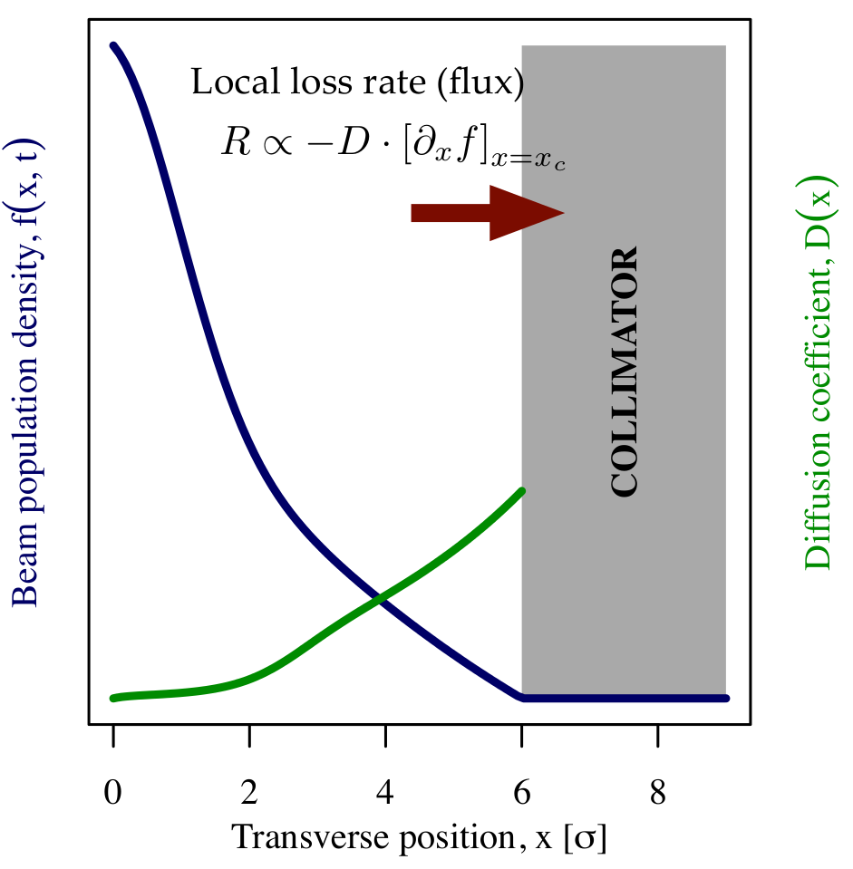
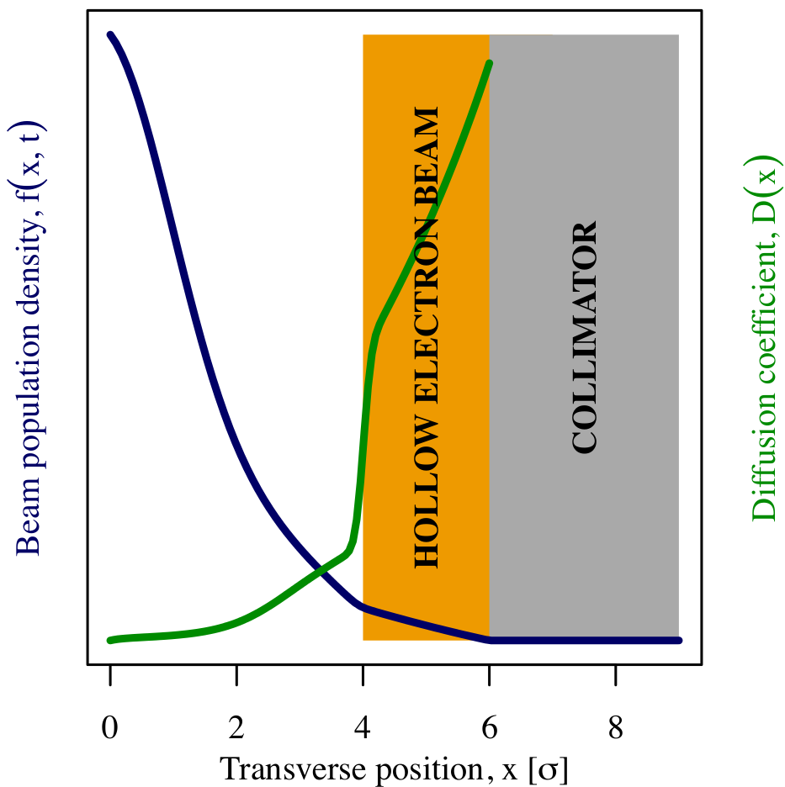
Effect on halo distribution
Controlled increase of diffusion speed of halo particles
Still need existing collimators to absorb the extracted halo particles
A. Rossi et al, Beam Gas Curtain Instrument Review – Cockcroft Institute – 27-28 June 2017

