Slide 2
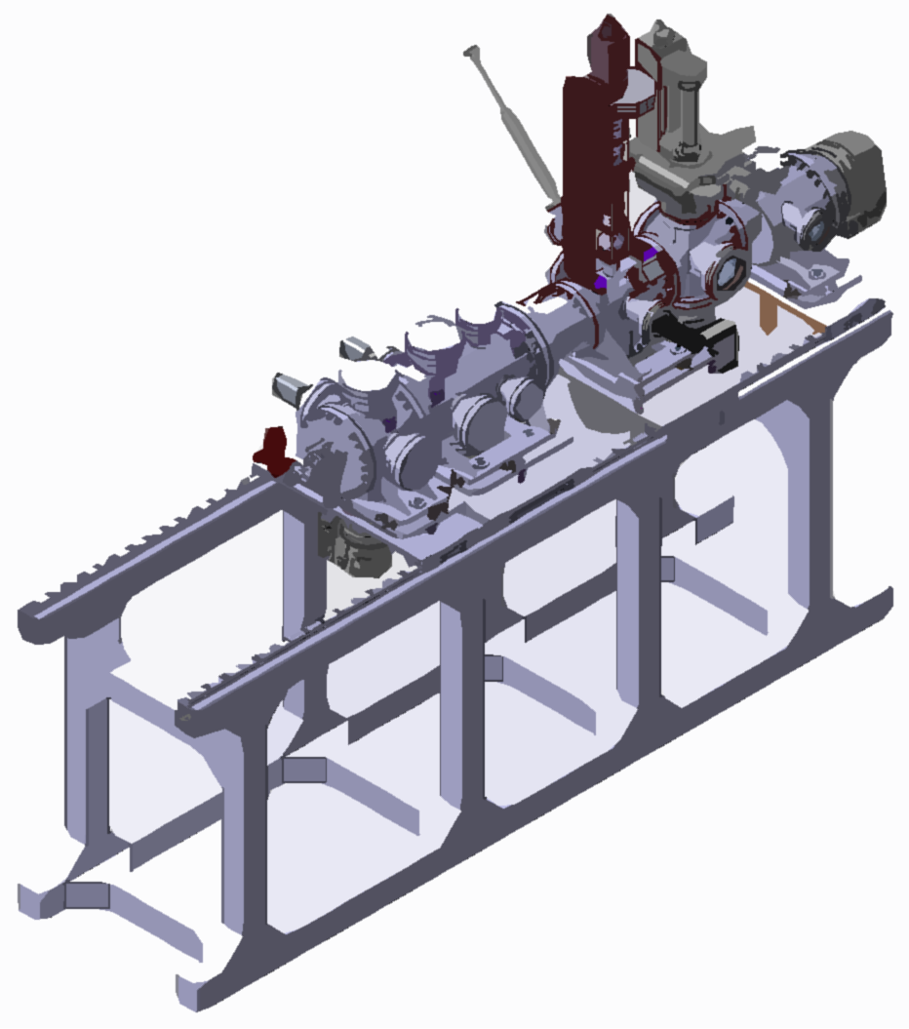
Design of the Beam Gas Curtain
Introduction of the Mechanical Design of the BGC

Slide 3
BGC: First prototype design
1. Elements of the BGC system
2. Changes to the existing system
3. Agreed interfaces between the systems
4. Alignment of the system
5. Vacuum system and expected pressures
6. Flexibility of the system
7. Integration of the system

Slide 4
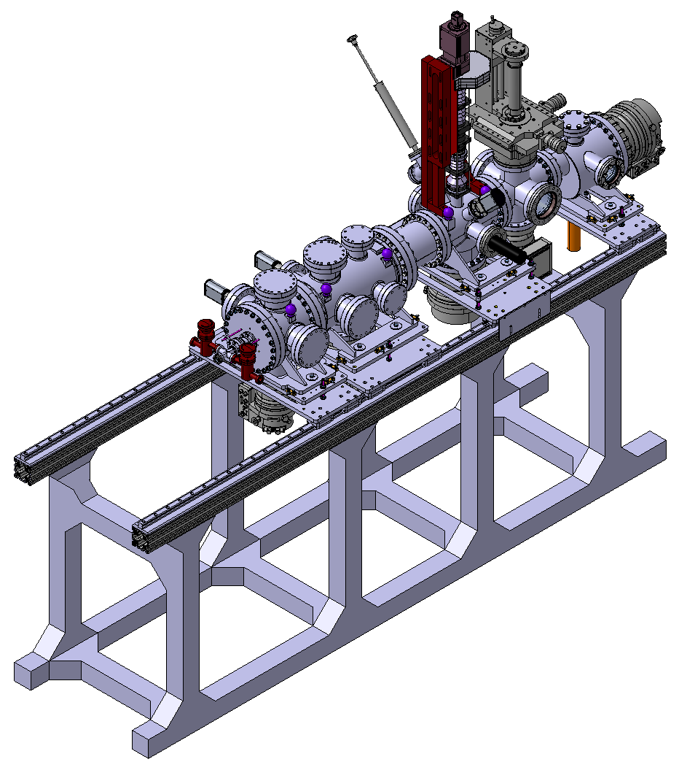
1. Elements of the BGC system
Electron beam
Nitrogen
gas jet

Slide 5
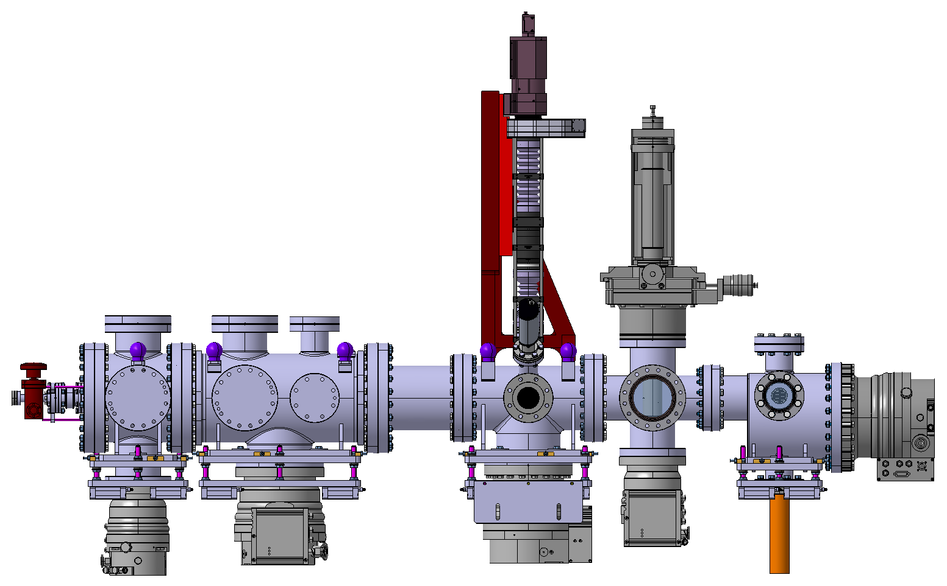
1. Elements of the BGC system
Expansion
section
Interaction
section
Dumping
section

Slide 6
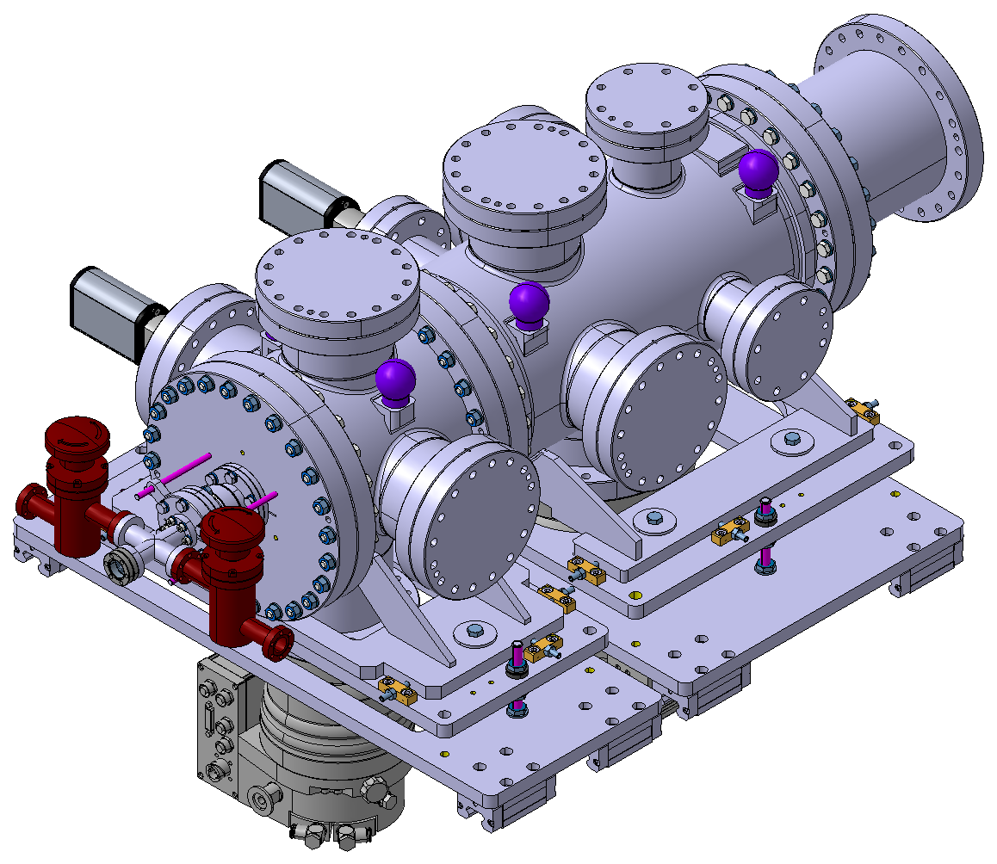
1. Elements of the BGC system
Nozzle chamber
Pressure sensors
Transition chamber
Gas inlet valve
Skimmers chamber
Turbopumps
Laser system viewport
Alignment tables
Nozzle pumping valve
Expansion section

Slide 7
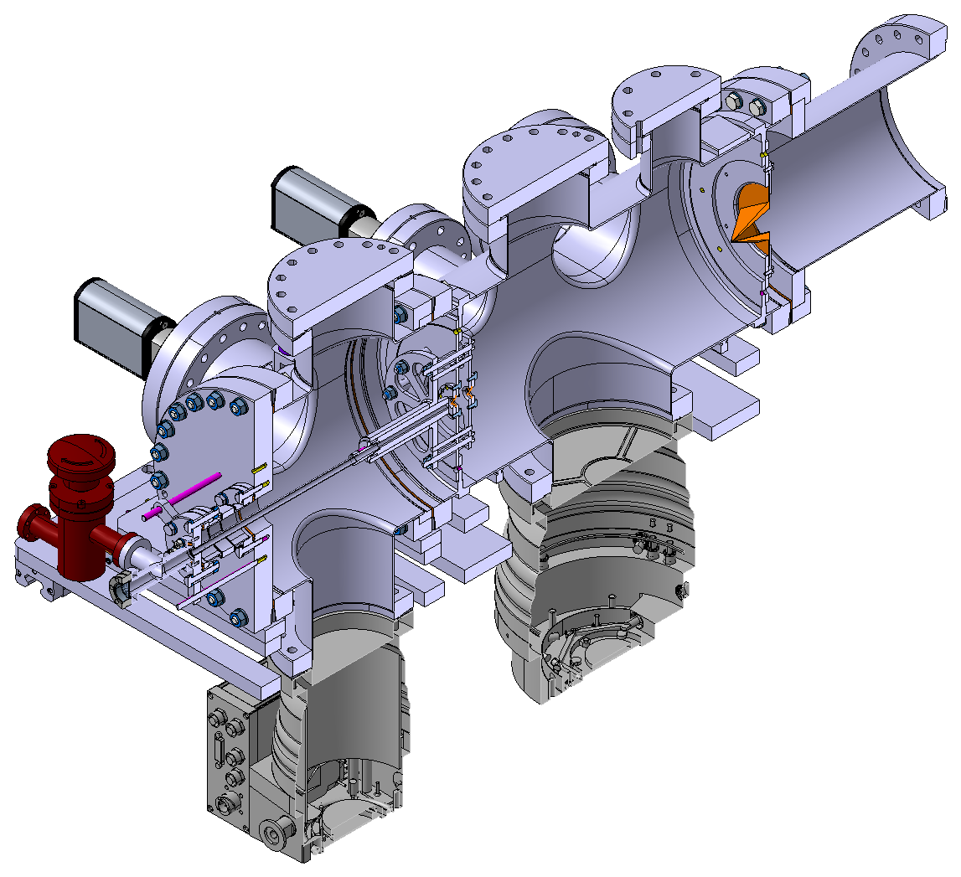
1. Elements of the BGC system
Expansion section

Slide 8
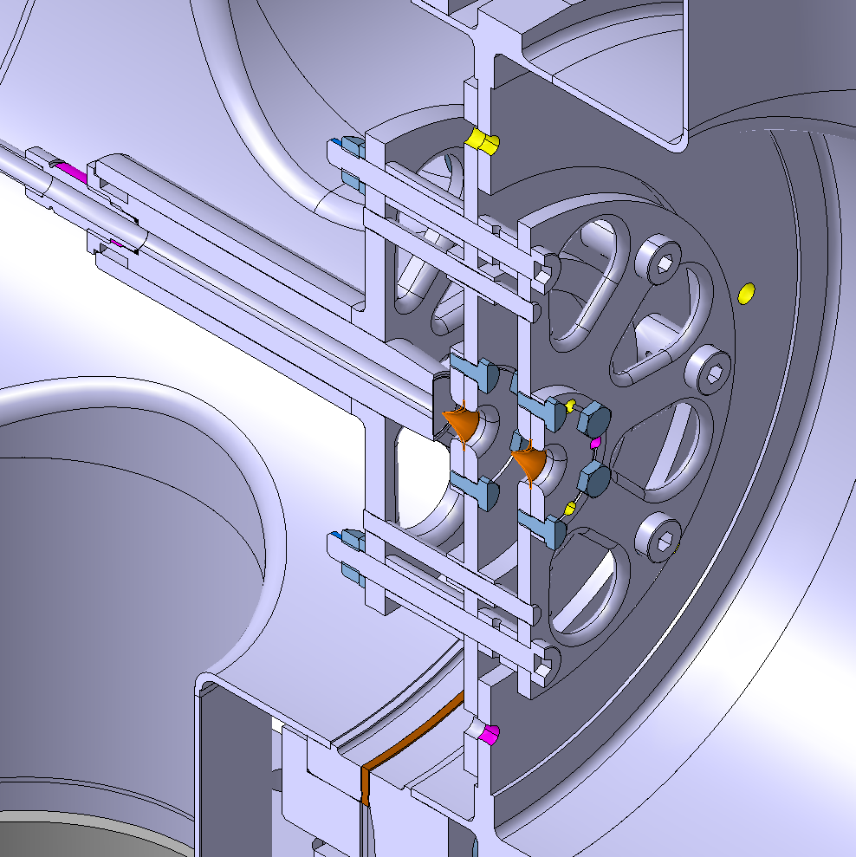
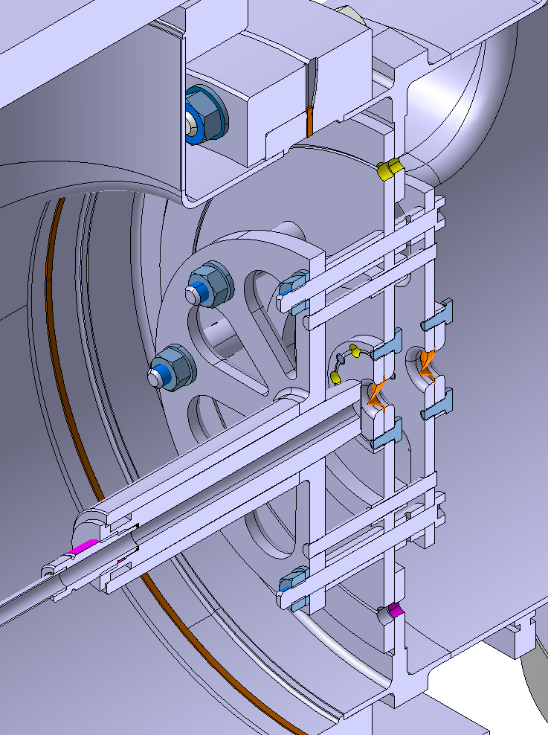
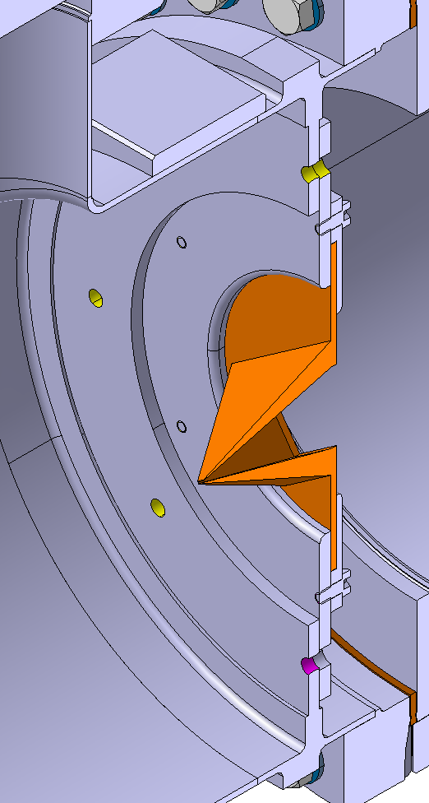
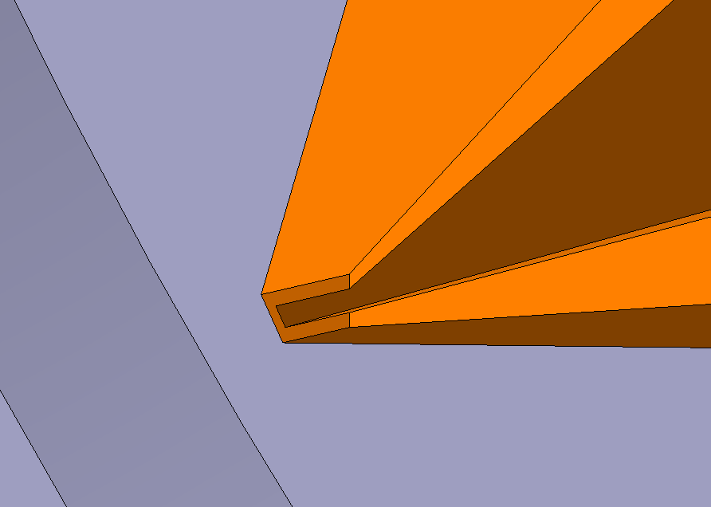
1. Elements of the BGC system
Front view
Back view
Ø = 30 μm
Ø = 180 μm
Nozzle
1st skimmer
Nozzle holder
Nozzle tube
2nd skimmer
Ø = 400 μm
3rd skimmer
□ = 4 x 0.4 mm
Expansion section

Slide 9
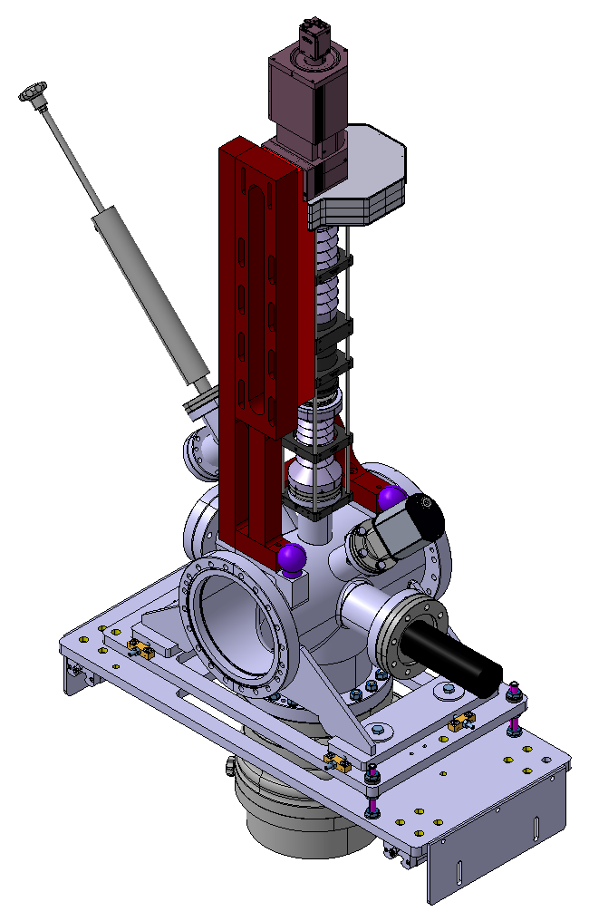
1. Elements of the BGC system
Optical system
Calibration LEDs
Electron collector
Pressure sensor
Electron gun
Turbopump
Interaction section

Slide 10
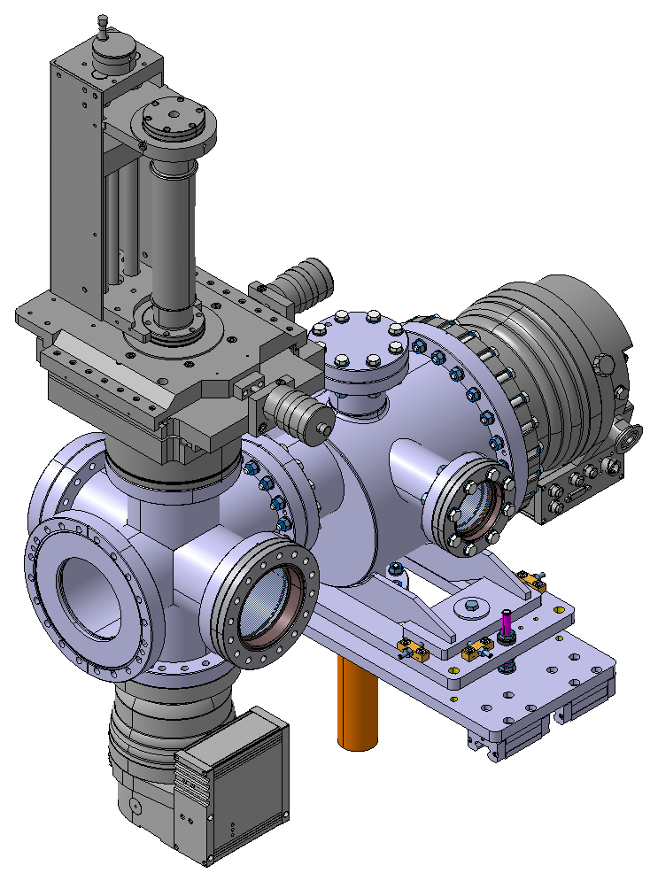
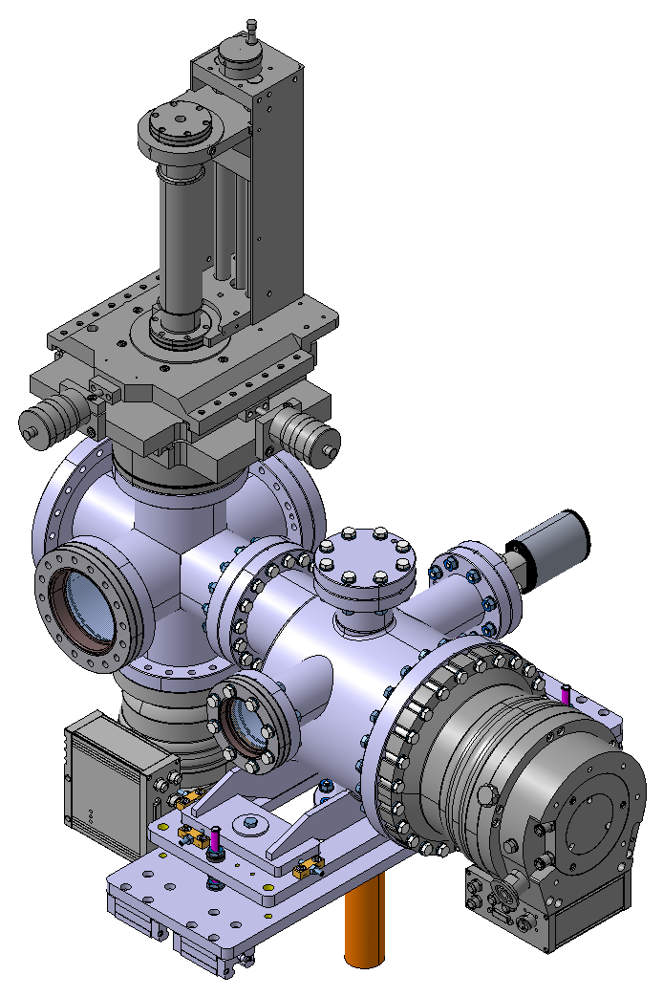
1. Elements of the BGC system
Front view
Back view
Turbopumps
3D movable gauge
Pressure sensor
Alignment table
Retractable mirror
Dumping section

Slide 11
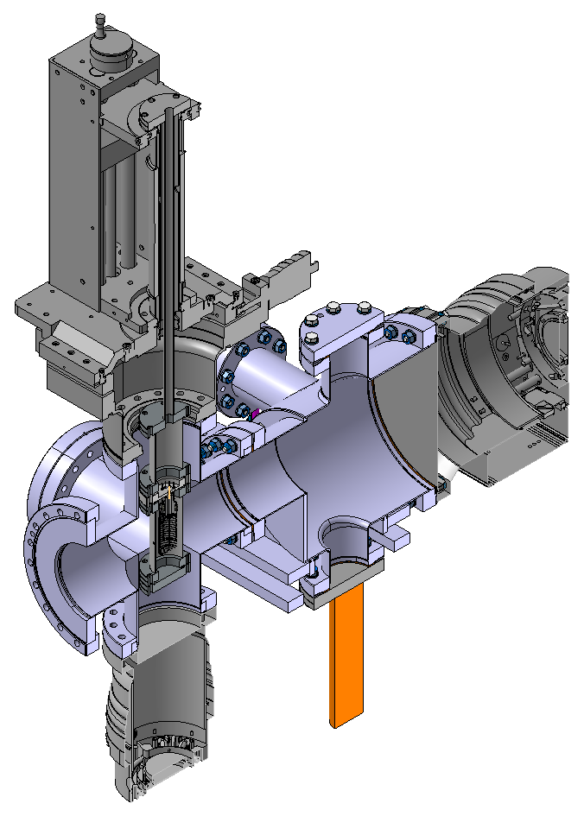
1. Elements of the BGC system
Nitrogen
gas jet
Dumping section

Slide 12
2. Changes to the existing system
Fully bakeable system up to a minimum of 200 °C
Alignment of the skimmers at metrology
Lower vacuum background pressure expected
Expected pressure of 10⁻⁹ mbar without gas jet
Fast pressure recovery after opening
Flexible system in case we want to change the skimmers
If we want to integrate the system in a setup with magnets, we would only need to change the interaction chamber

Slide 13
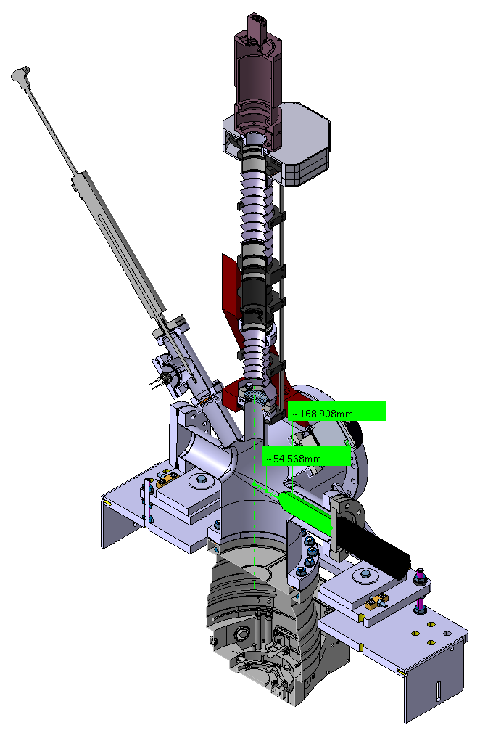
3. Agreed interfaces between the systems
*We would need to add a 115 mm extension vacuum pipe to cover the new electron gun's requirements
170 mm*
55 mm*
CF DN63
Electron gun

Slide 14
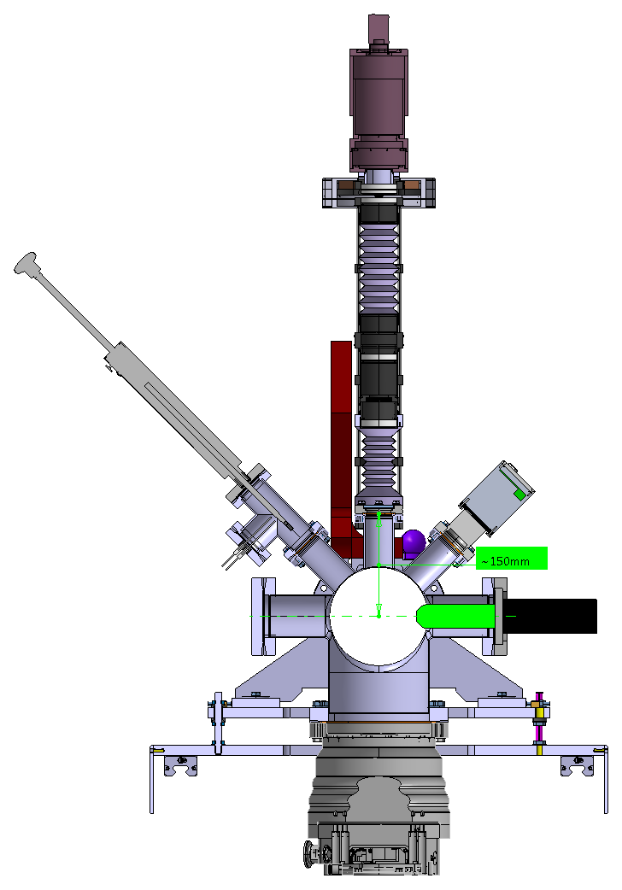
3. Agreed interfaces between the systems
CF DN40
150 mm
Optical system

Slide 15
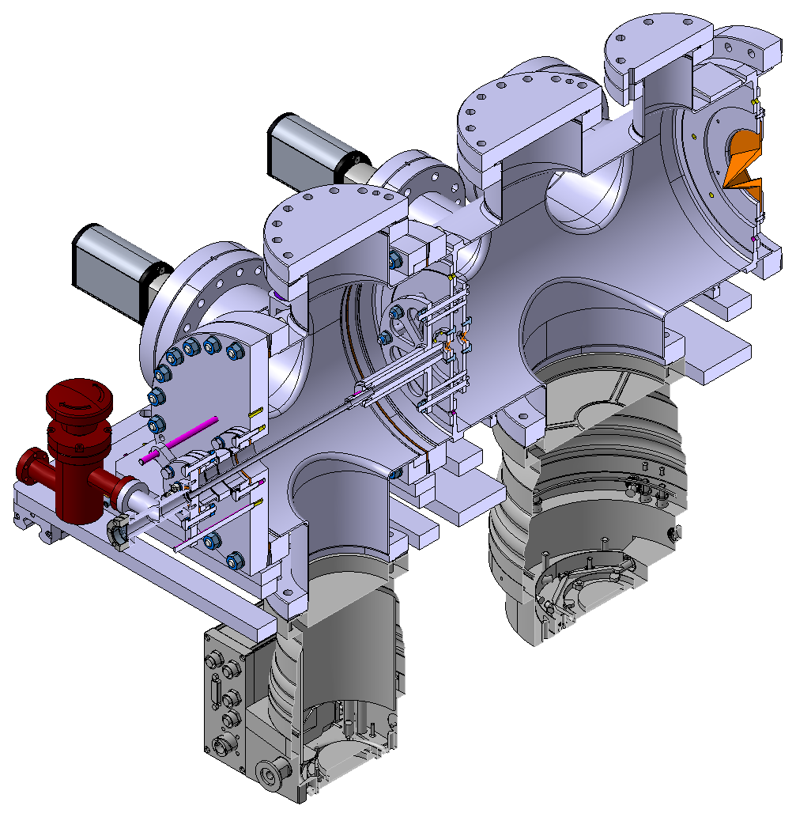
4. Alignment of the system
Ø = 180 μm
□ = 4 x 0.4 mm
1st skimmer
3rd skimmer
Ø = 30 μm
Nozzle
2nd skimmer
Ø = 400 μm

Slide 16
4. Alignment of the system
Ø = 180 μm
□ = 4 x 0.4 mm
1st skimmer
3rd skimmer
Ø = 30 μm
Nozzle
 | Distance
Nozzle – 1st skimmer | 2 – 20 mm
1st skimmer – 2nd skimmer | 20 mm
2nd skimmer – 3rd skimmer | 325 mm
2nd skimmer
Ø = 400 μm

Slide 17
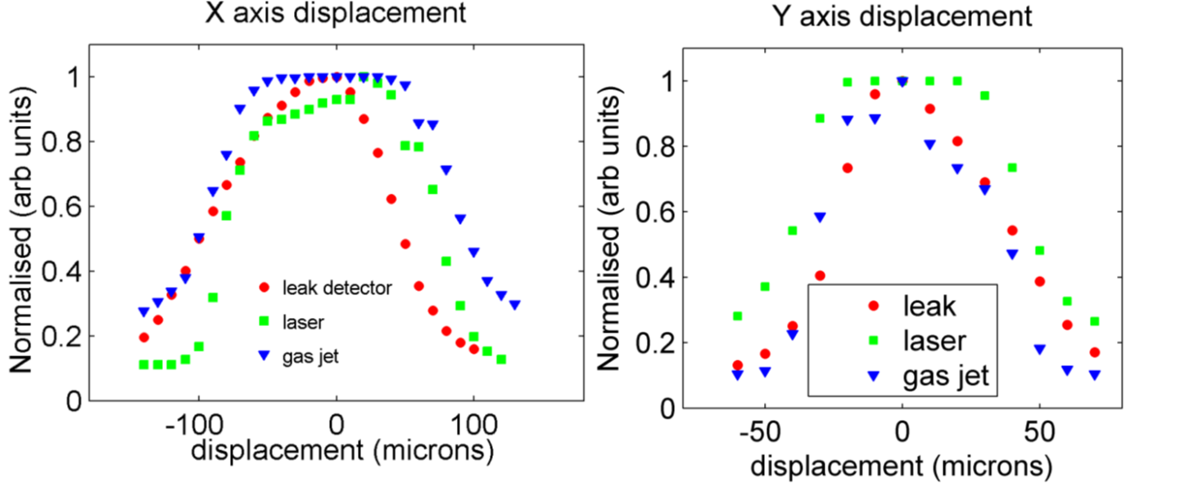
4. Alignment of the system
Source: V. Tzoganis

Slide 18
4. Alignment of the system
1. Align the nozzle holder to the 1st and the 2nd skimmer in a metrology environment
2. Mount the assembly to the skimmers chamber (possibility to note the internal centre line to external targets)
3. The nozzle tube must have a really good manufacturing concentricity

Slide 19
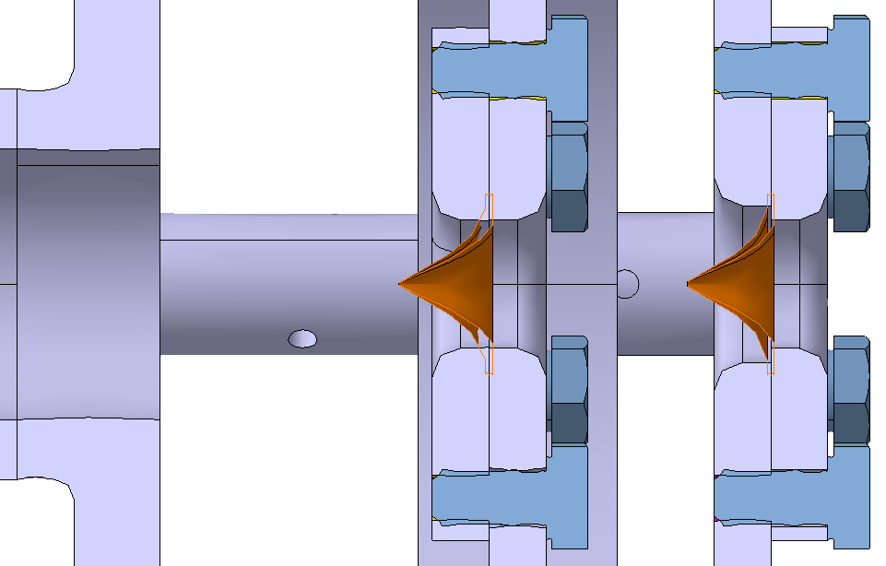
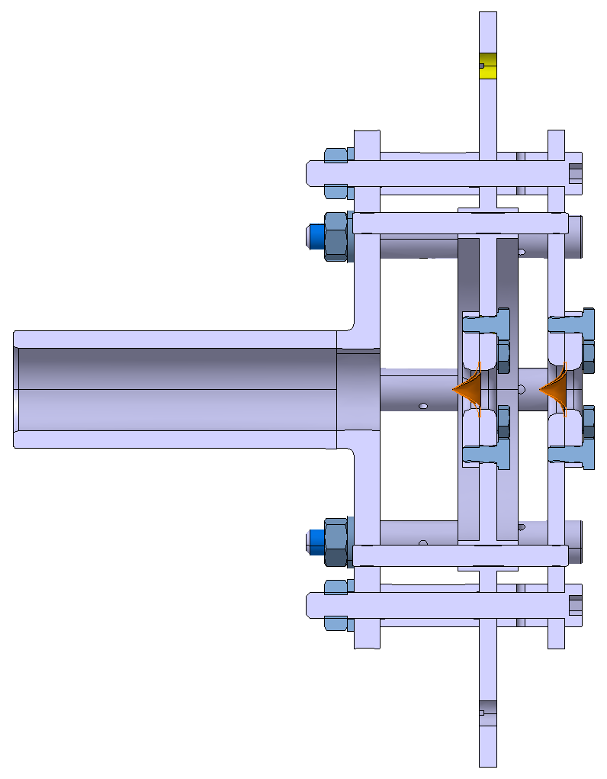
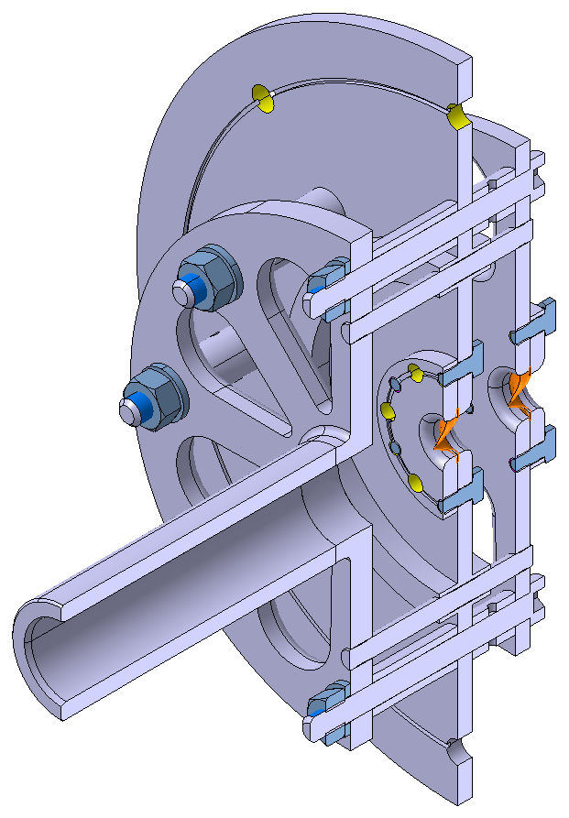
4. Alignment of the system
Nozzle holder
1st skimmer
Ø = 180 μm
2nd skimmer
Ø = 400 μm

Slide 20
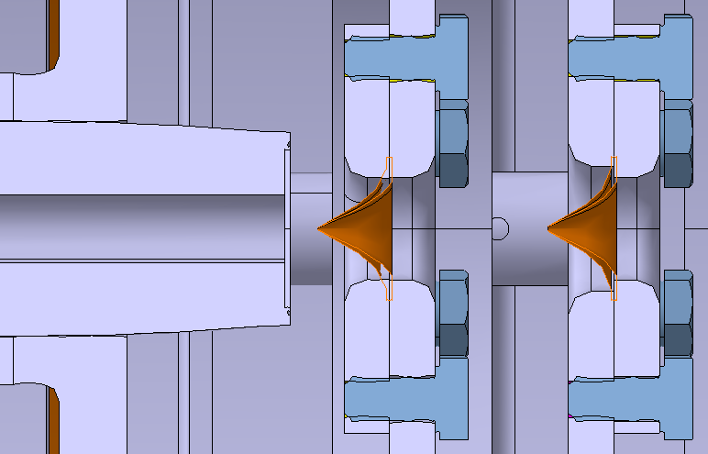
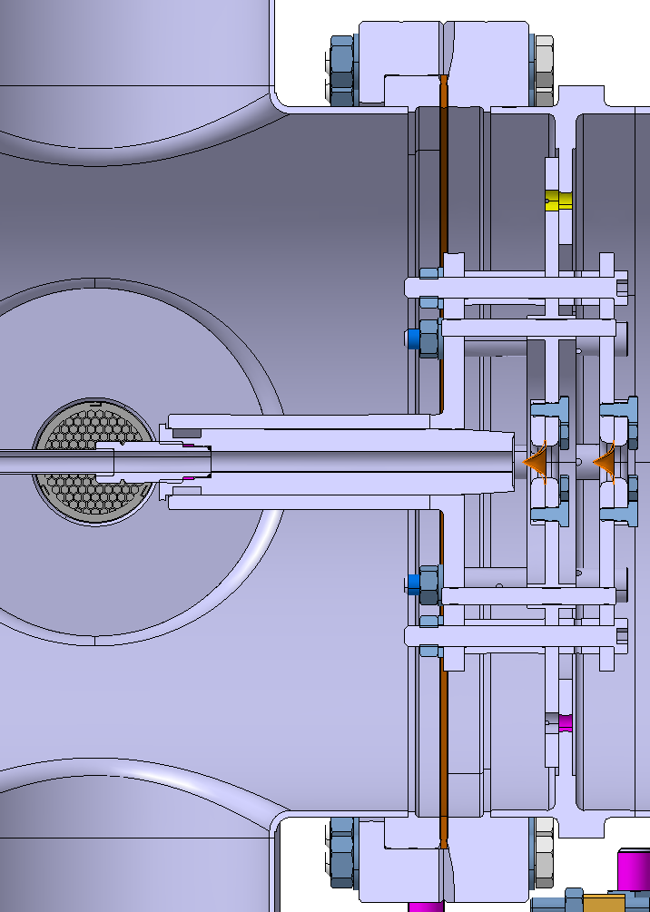
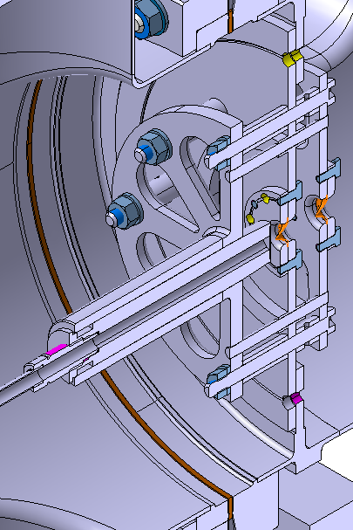
4. Alignment of the system
Nozzle
Ø = 30 μm

Slide 21
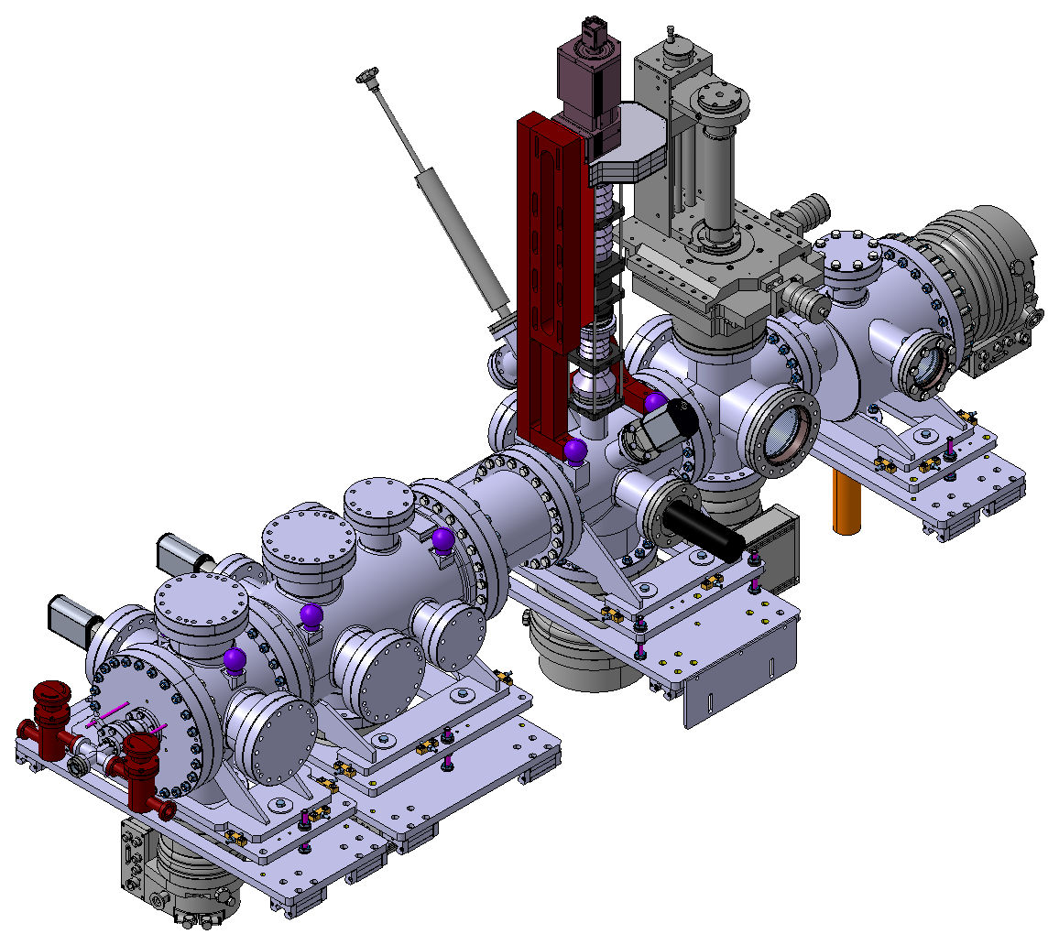
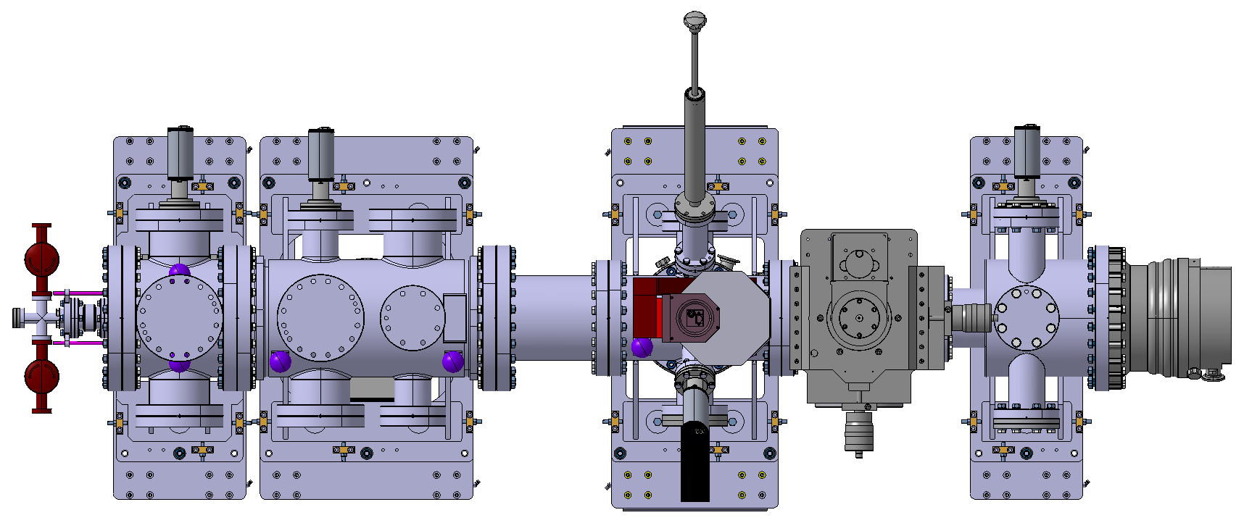
4. Alignment of the system
Top view
Nozzle chamber alignment targets
Interaction chamber alignment targets
Skimmers chamber alignment targets

Slide 22
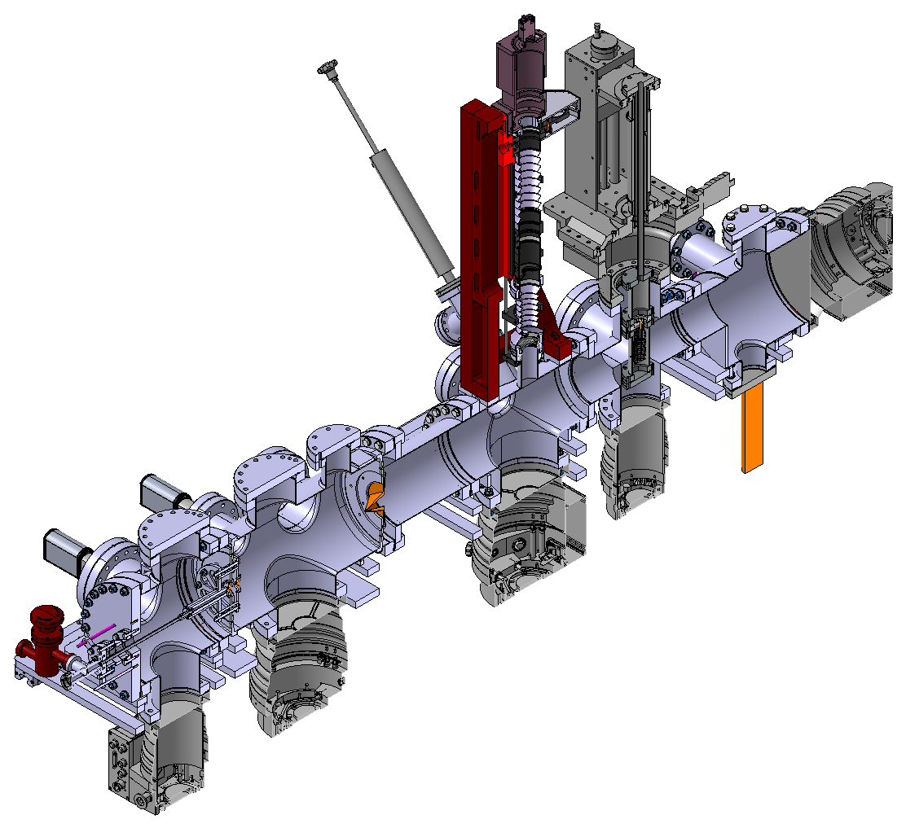
4. Alignment of the system
3D movable gauge
Laser system

Slide 23
4. Alignment of the system
3D printing is not an option
Alignment of Beam Gas Curtain (BGC) test plates
Starting investigation on how to align three
elements in the micron range
Analysis of Additive Manufacturing Technologies for the Beam Gas Curtain (BGC) instrument
EDMS 1708792 v.1
EDMS 1708789 v.1

Slide 24

5. Vacuum system and expected pressures
Baseline pumps
800 L/s
300 L/s
700 L/s
700 L/s
300 L/s

Slide 25
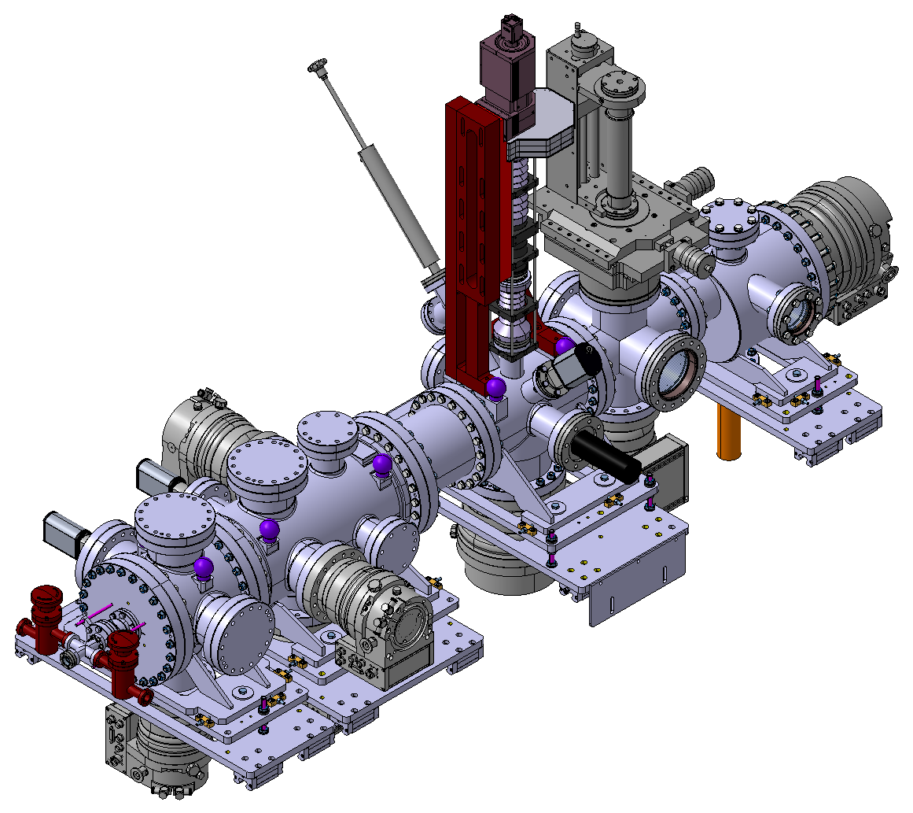
5. Vacuum system and expected pressures
Baseline and optional pumps
800 L/s
300 L/s
300 L/s
700 L/s
300 L/s
700 L/s
300 L/s

Slide 26
5. Vacuum system and expected pressures
Static pressure < 10⁻⁹ mbar
Dynamic pressure ranges (order of magnitude)
High
10⁻⁹ mbar
High
10⁻⁹ mbar
10⁻³ mbar
10⁻⁶ mbar

Slide 27
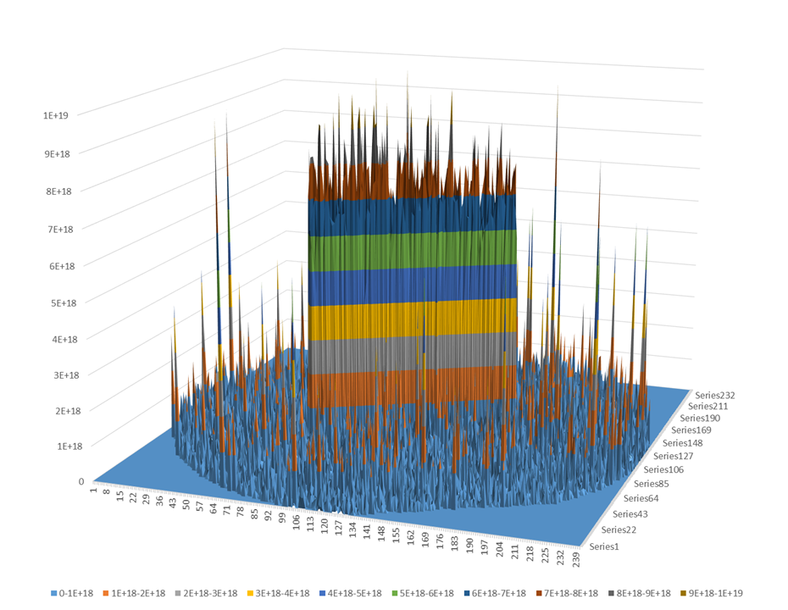
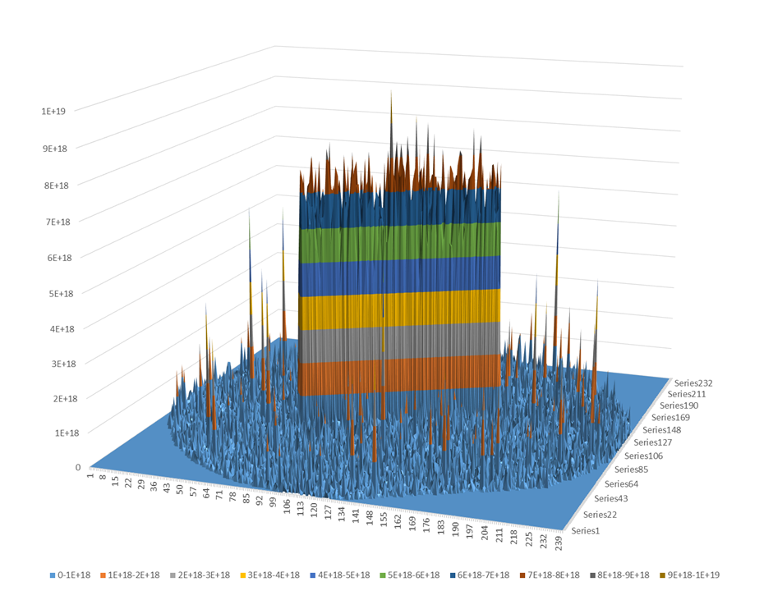
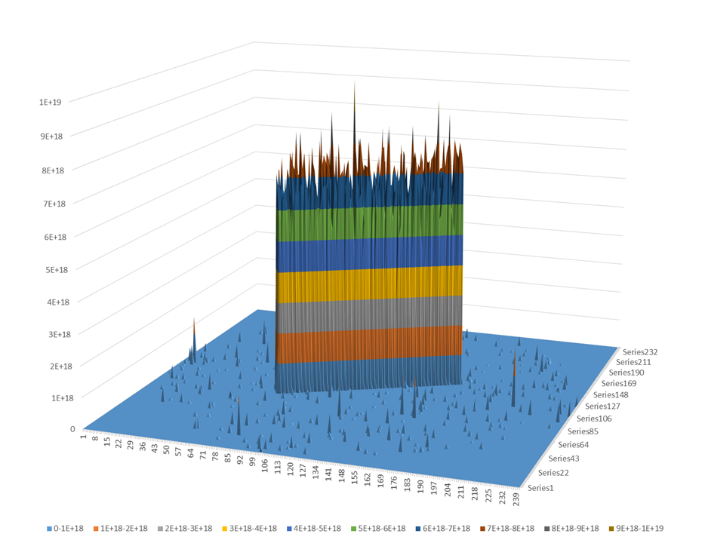
6. Flexibility of the system
700 L/s
pumping
1400 L/s
pumping
700 L/s
differential pumping
Source: M. Ady

Slide 28
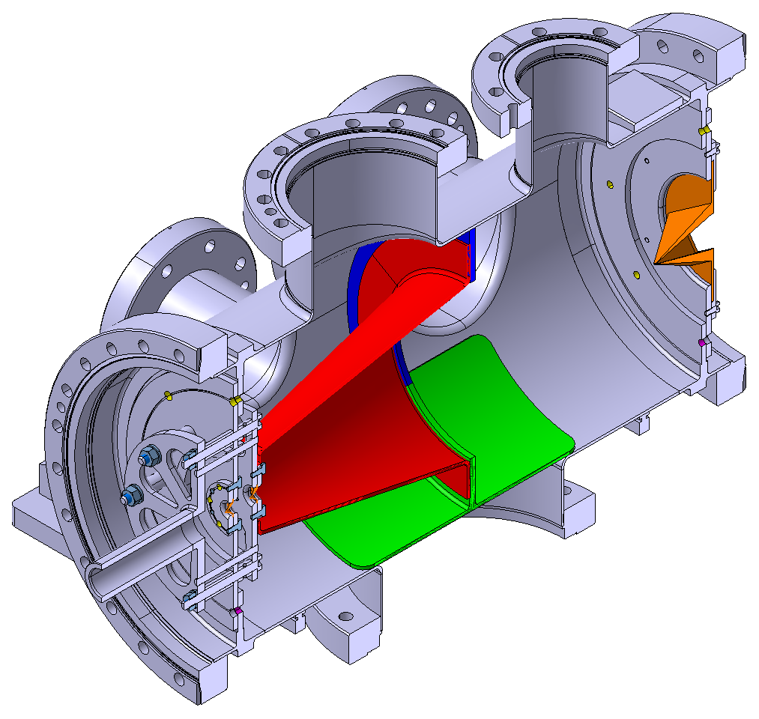
6. Flexibility of the system

Slide 29
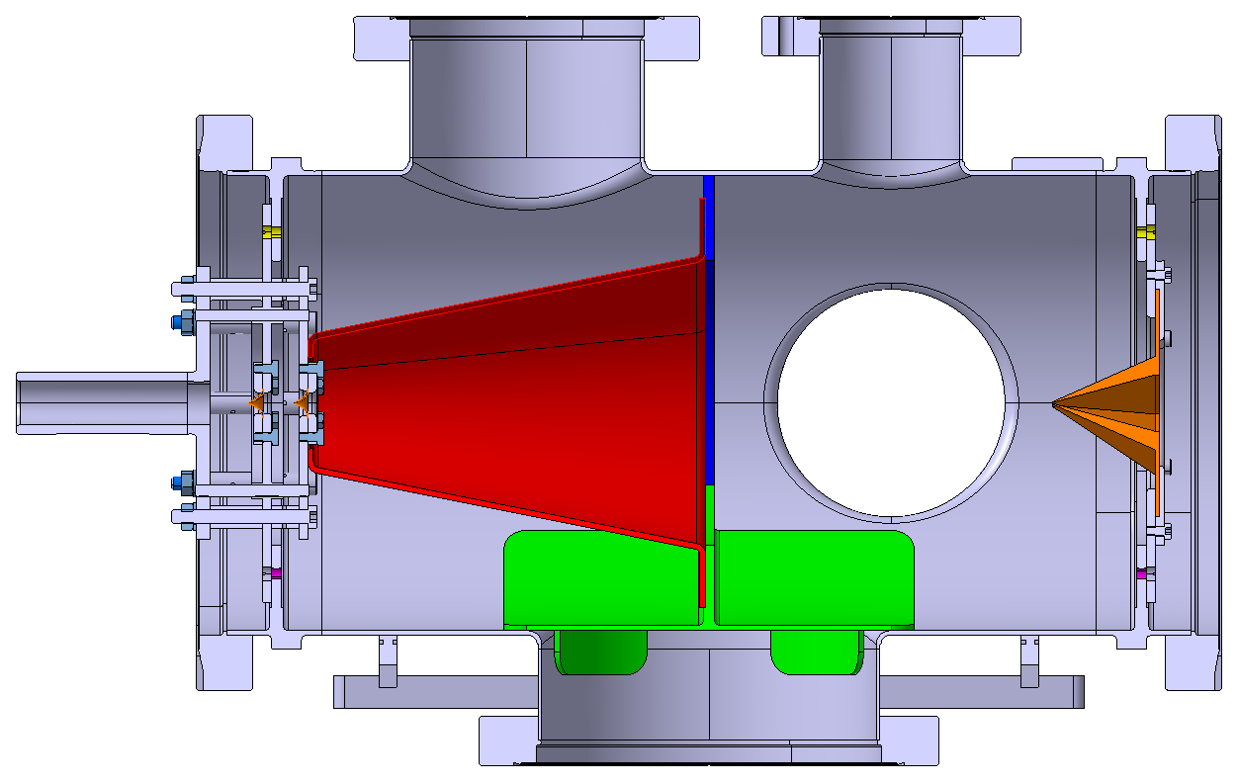
6. Flexibility of the system

Slide 30


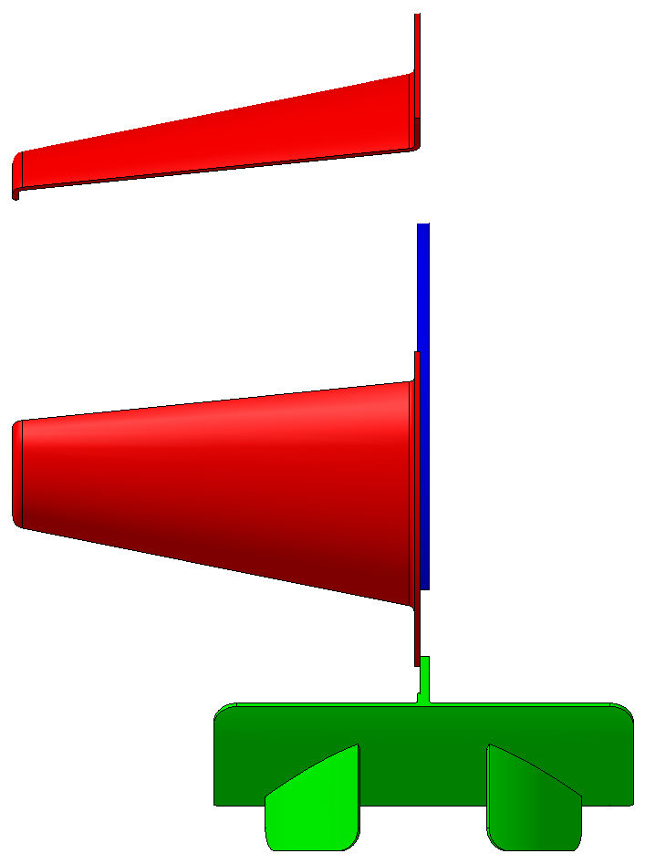
6. Flexibility of the system
SmarTeam code: ST0858286_01

Slide 31
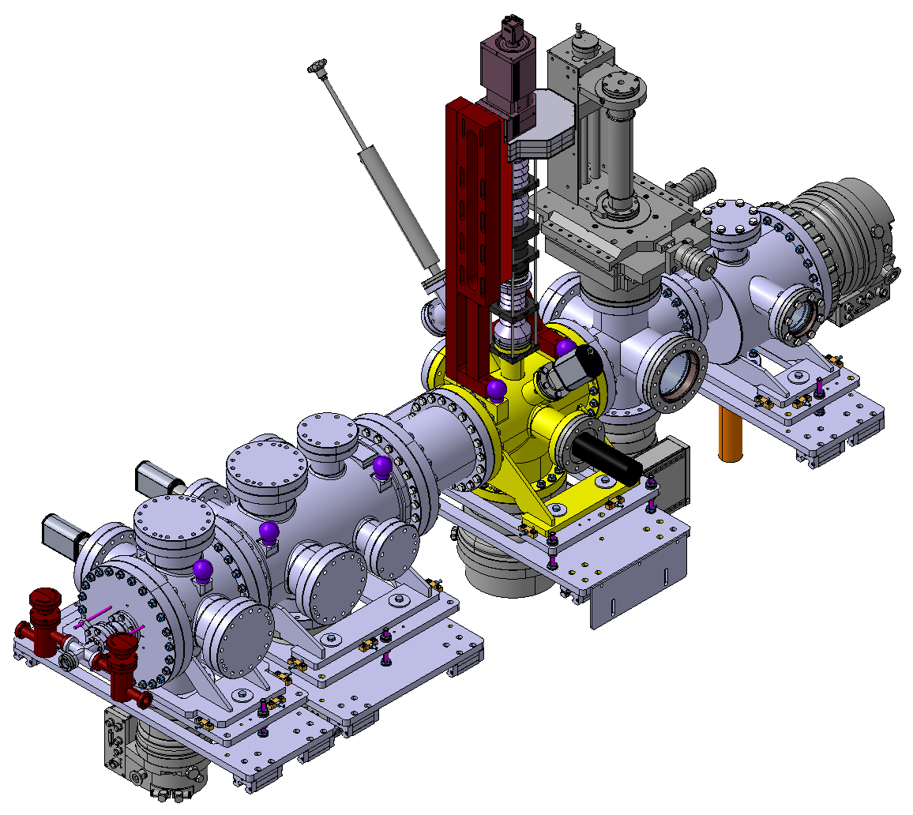
7. Integration of the system

Slide 32

Thank you!

