Slide 1
Manufacture and Alignment of the
BGC Skimmer and Nozzle Assembly
Tom Dodington
27 June 2017
BE-BI-ML

Slide 2
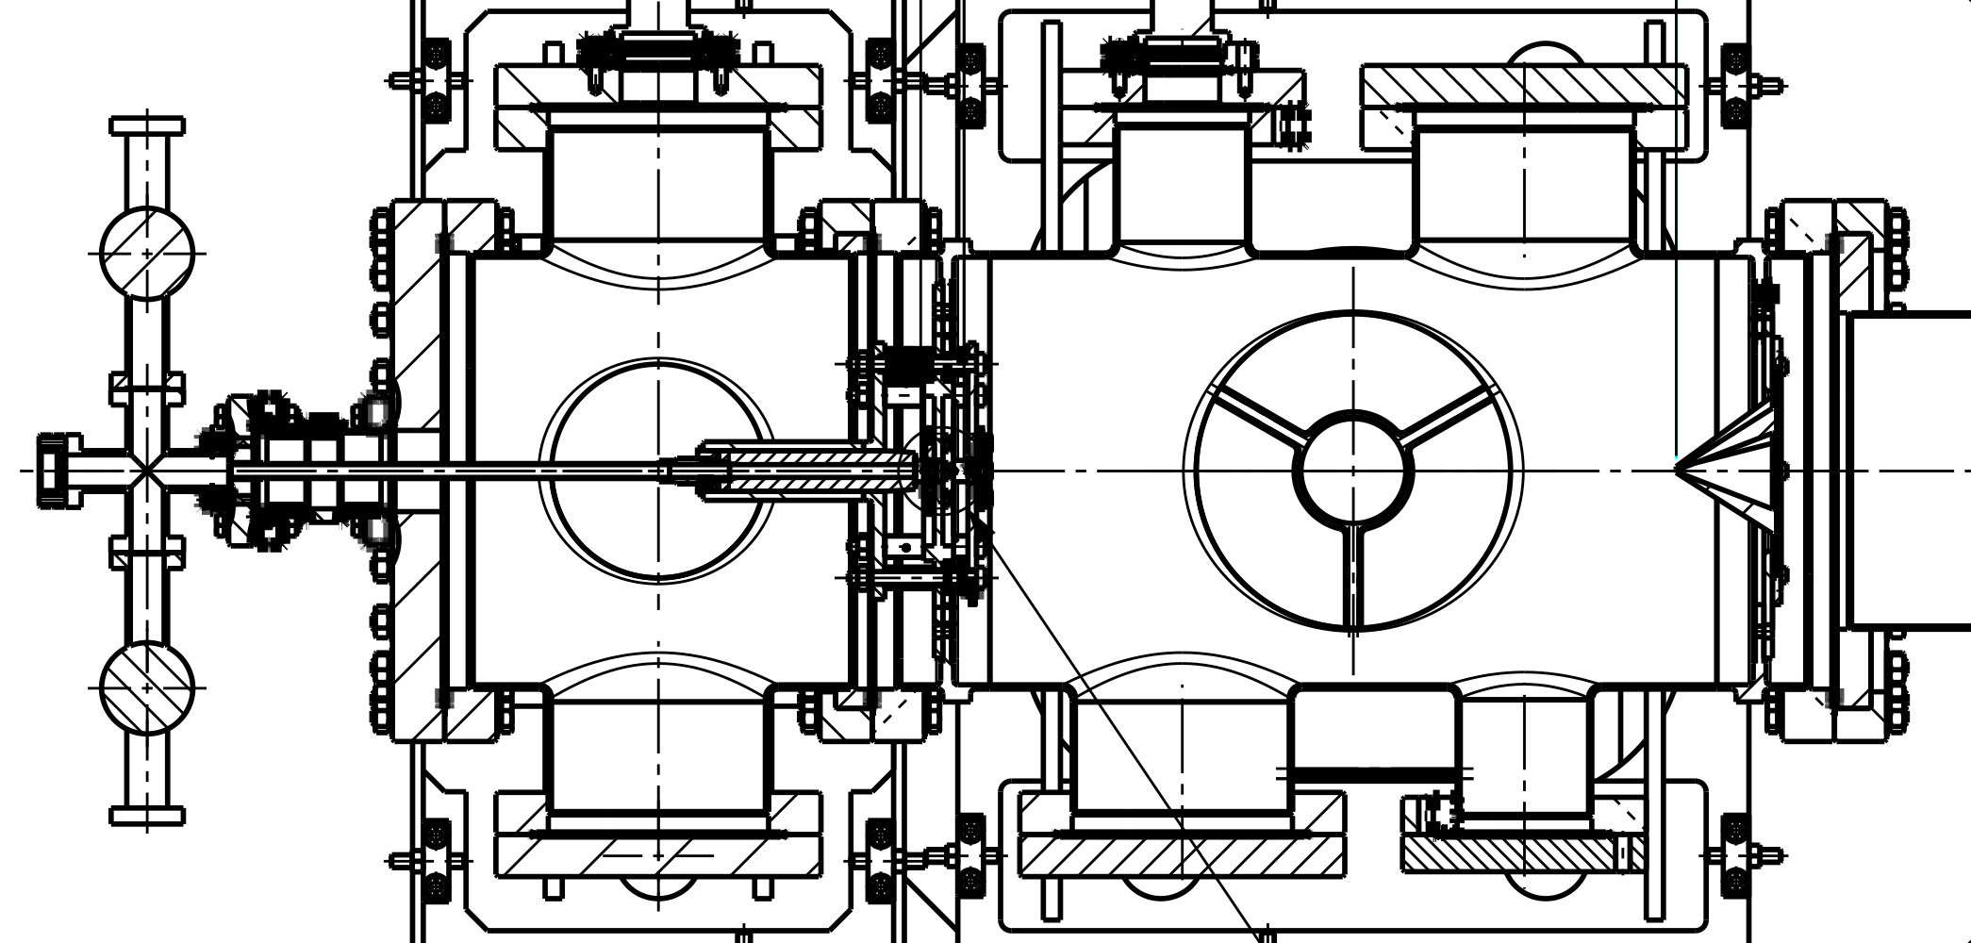
Nozzle and Skimmer Assembly
What do we want?- Concentric alignment of Skimmers and Nozzle.
Insert dimensions?

Slide 3

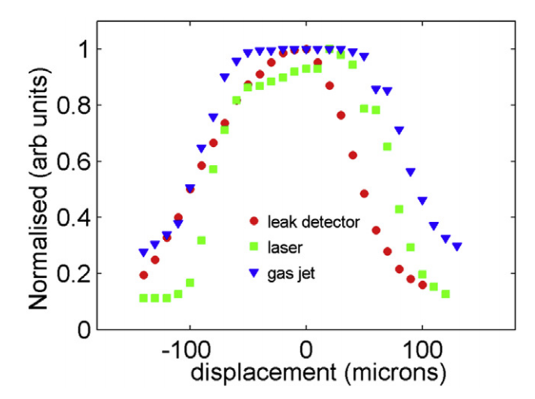
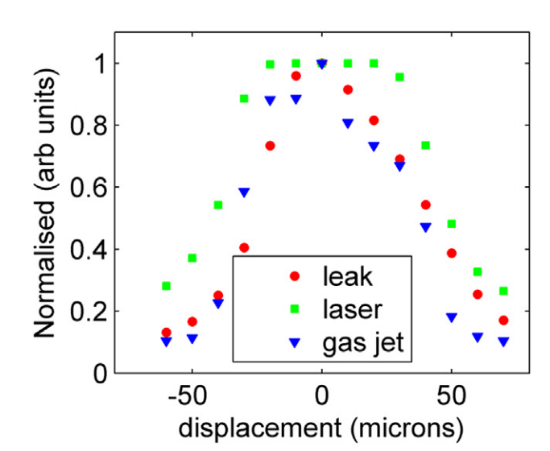
Central Assembly
Based on previous beam profile measurements, aiming within<50μm alignment range
Pins used to align the three critical parts
Central skimmer position fixed
X axis
Y axis
Notes:
The two main reasons for exploring additive manufacturing technologies in this case were due to the inherent flexibility of the process, where a dimension or feature is changed and the new 3D model is sent to the printer which, if available, can start to print immediately.
The second reason is to try and simplify the alignment process which currently involves several pieces of equipment and is altered once the instrument is pumped down. Additive manufacturing would allow us to print the part as one single piece, securing all the skimmers together

Slide 4
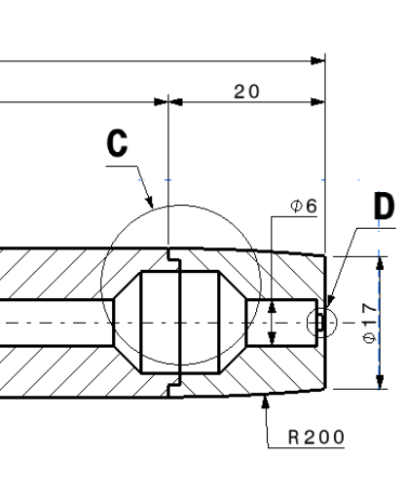
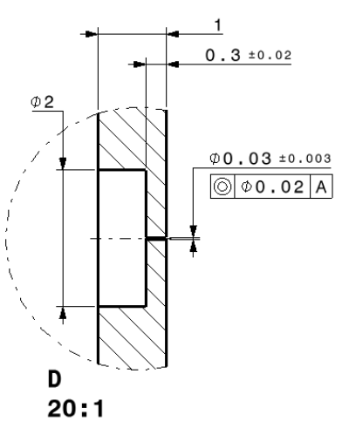
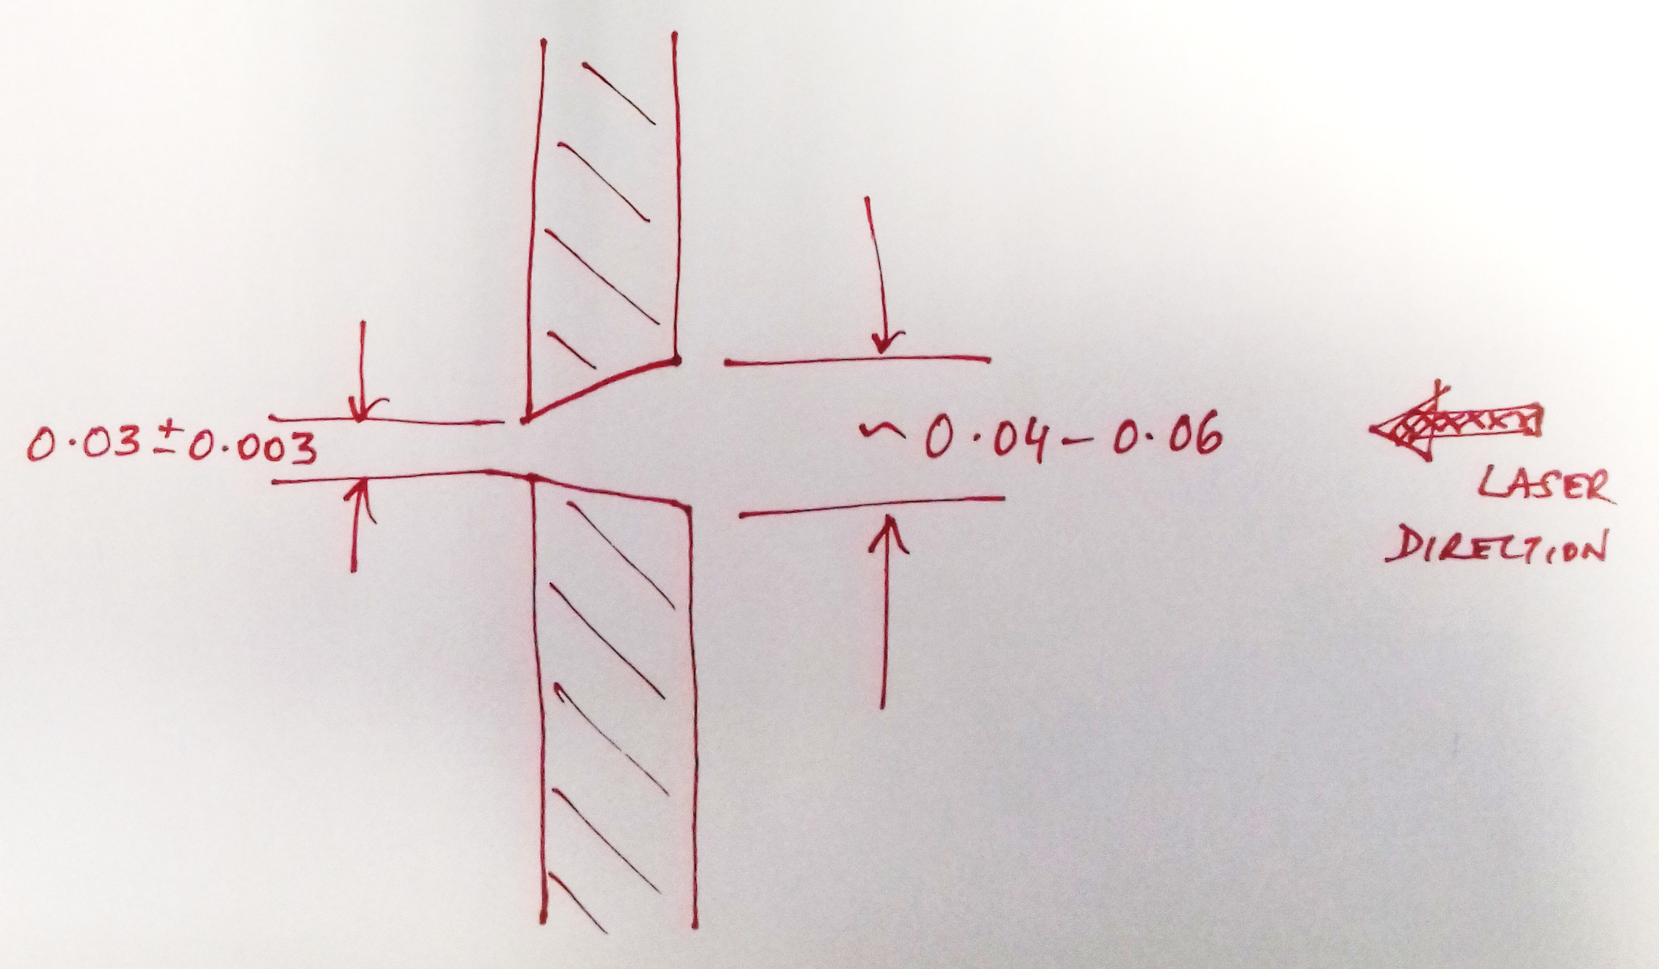
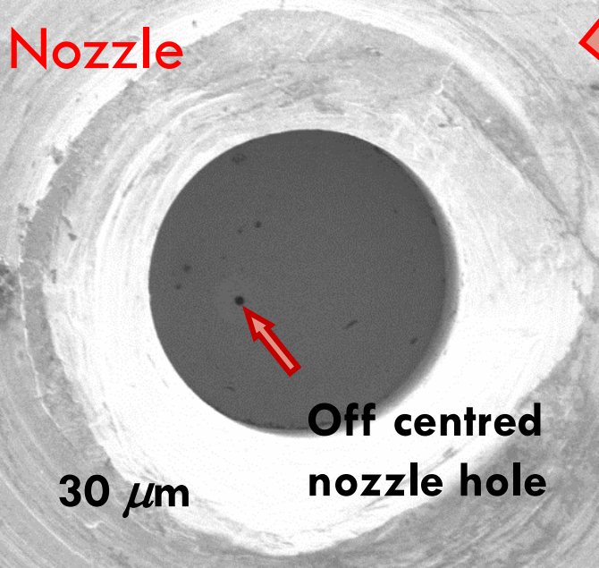
Nozzle Manufacture
To be machined in 2 parts at CERN
  Full depth weld to join parts
  Re-machined external diameter.
  30μm hole must be tightly concentric with external diameter.
Manufacture:
  Previously drilled in platinum foil, clamped between 2 Al plates.
  Precision, concentricity, internal angle unknown.
  Laser Micromachining, UK
  Contact at TU Darmstadt.
~2° angle
Notes:
Previous manufacturer unknown.
Concentricity of hole to external diameter

Slide 5
Skimmer 1 & 2
0.18 and 0.4mm diameter holes
  Sharp edges are essential
Previously manufactured by
  Beam Dynamics Inc, US
  Feedback welcome
  New skimmers have been purchased 10/06
Notes:
These are the three technologies that I will talk about in detail in a minute, although the heat sources and processes are slightly different, they are all based on the same concepts. A focused heat point melts the metal which is deposited onto a substrate and layers are placed on top of each other to build the object. The most common material is titanium with stainless steel and aluminium also available.

Slide 6
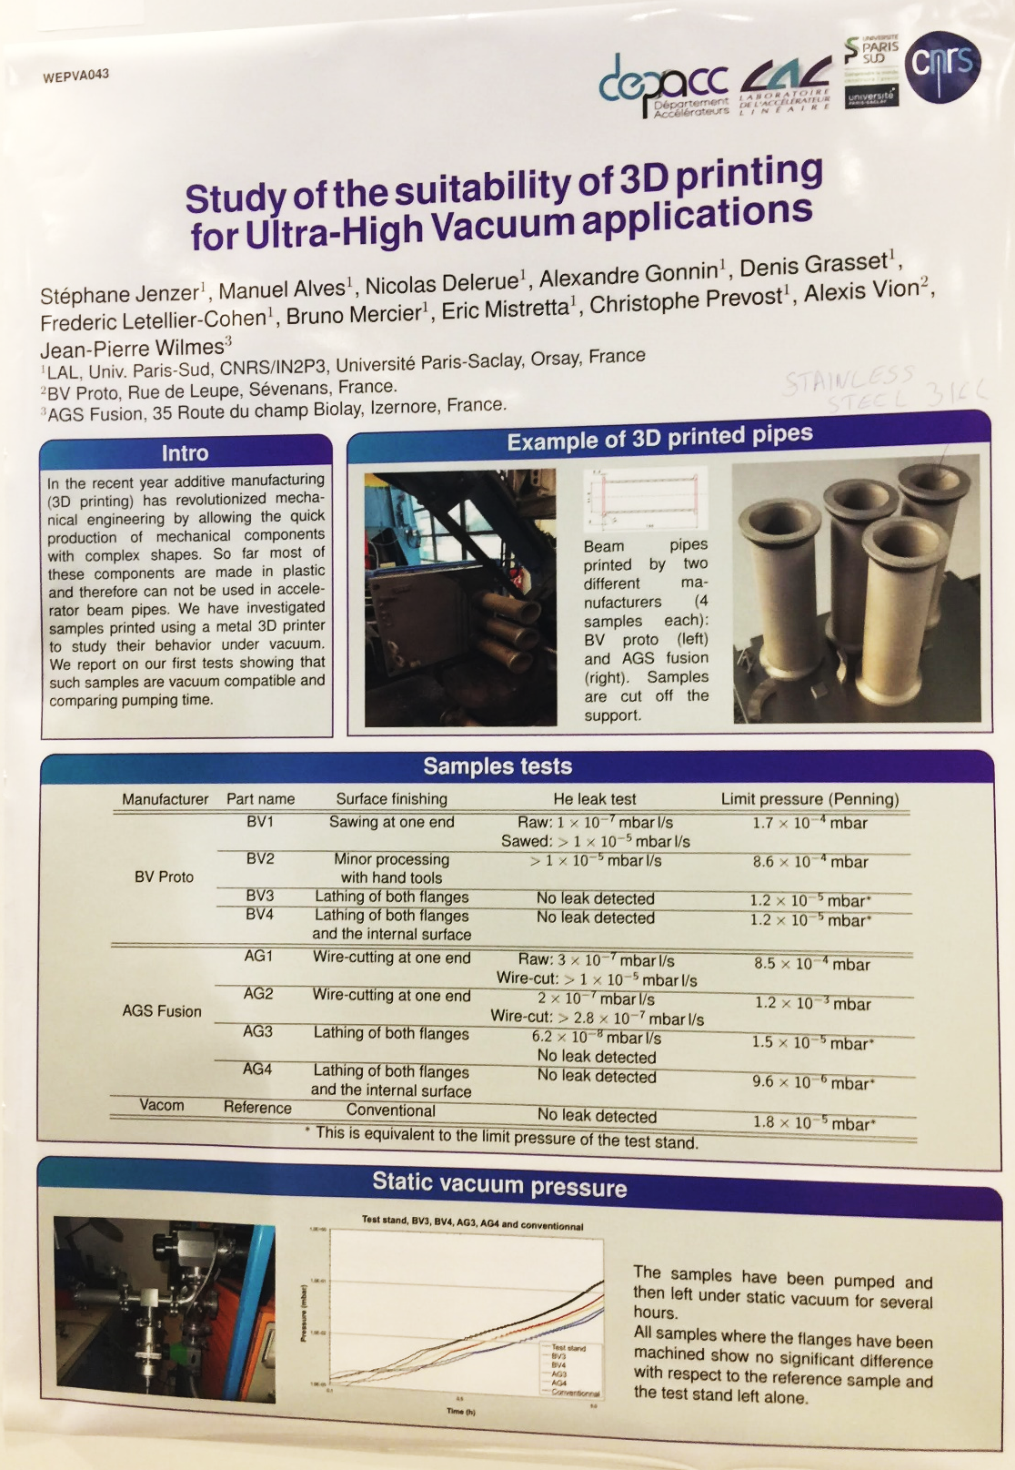
Skimmer 3
Rectangular, 0.4*4mm
Previously manufactured by
  CRDM rapid prototyping
  TJW polishing
New Skimmer
  IPAC poster about 3D metal printing
  Will contact manufacturers to discuss
Notes:
These are the three technologies that I will talk about in detail in a minute, although the heat sources and processes are slightly different, they are all based on the same concepts. A focused heat point melts the metal which is deposited onto a substrate and layers are placed on top of each other to build the object. The most common material is titanium with stainless steel and aluminium also available.

Slide 7
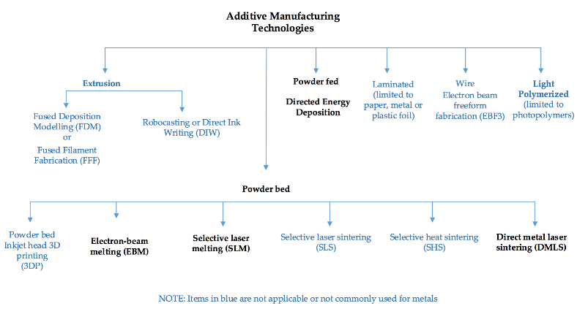
Additive Manufacturing Study
Review carried out by ML, Ana Miarnau.
Key issues:
Porosity and Lamination
Columnar grain structure
Orientation of the structure whilst printing
Print area and wall thickness limitations
General tolerance is ± 0.2 mm ± 1% of length
Surface roughness ∼ Ra 12μm. Post-processing required
Combination of additive manufacturing and CNC machining
Exciting potential, but technology not ready to provide desired tolerances.
Notes:
Key issues:
Porosity and lamination have been observed in many cases and most research papers are concerned about avoiding this and effects of different machine parameters and inputs
Not observed in the pieces printed or used by CERN. Parameters would be altered until the piece came out correctly.
The columnar orientation of the grain structure is not necessarily a bad feature, it can be desirable as the object will be stronger in one direction.
The orientation of the piece on the powder bed is important
X-Y plane has a better resolution than the z-axis
Overhangs (>45˚) and surfaces parallel to the powder bed require supports – must remove. Poor definition between the skimmers or use un-removable supports.
The print area is 250x250x200 mm (x, y, z)
1st and 2nd skimmer can be printed together but not the 3rd one
Minimum wall thickness is ∼ 150 μm
General tolerance is ± 0.2 mm ± 1% of length being considered
Best surface roughness that can be achieved without post-processing is ∼ R_{a} 12 μm
Post-processing is required → processes have improved but not enough
For clearly-defined skimmer geometry the opening must have sharp edge.
Hard to achieve. Could post-process skimmer 1, but not skimmer 2 (inaccessible).
Post processing required for final dimensions, flatness & dimensions and tolerances of holes.
Alternatives
Combine additive manufacturing with CNC machining
No guarantee skimmers align perfectly within tight tolerance. Could laser cut apertures.
Sharpness of skimmers edges will be lacking. Could cut or machine to final shape.
BUT skimmer 2 will be completely inaccessible:
Cannot improve geometry, surface roughness or dimensions of this skimmer
Could split into 2, machine and reassemble. Tolerances and alignment?
Conclusions
AM technologies are rapidly evolving and improving.
Relatively fast production times.
Complex geometries can be obtained – sacrifice accuracy compared to traditional manufacturing processes.
The skimmers could be 3D printed but they will not have the required dimensions and tolerances.
Machining of the skimmer 2 is impossible unless the piece is sliced and then put back together
Skimmer 3 would have to be manufactured separately due to print area constraints

Slide 8
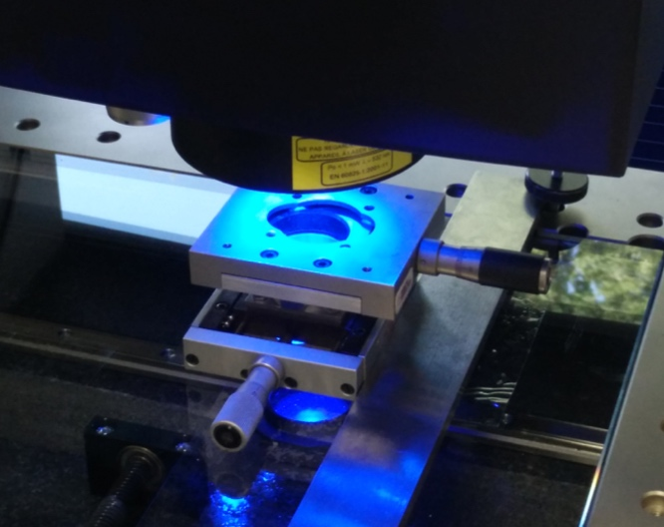
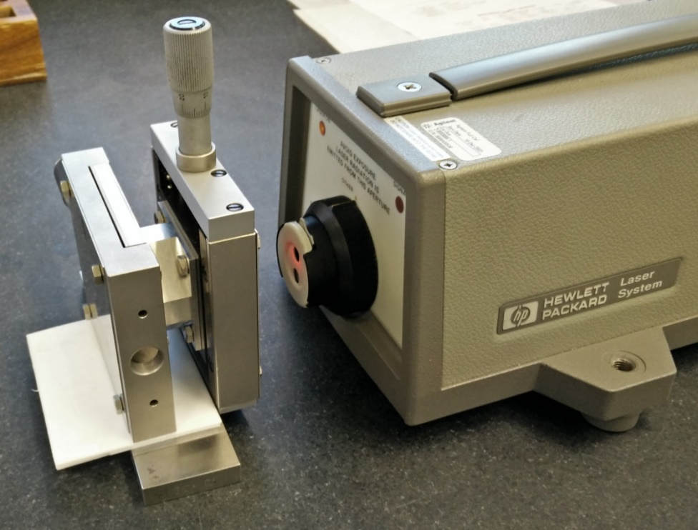
Alignment
What do we want?
Skimmer 1, 2 & 3 aligned to Nozzle hole within 50 μm.
Perfect solution would not require alignment:
3D print as one part. ❌
Perforate all holes with laser into assembled system. ❌
Previous study by Ana Miarnau.
  Alignment of two 50μm holes at CERN with metrology team
Notes:
Discussed feasibility of aligning all skimmers and nozzle and then drilling ‘single’ hole with a laser. Not possible.

Slide 9
Alignment
Option 1 | Option 2 | Option 3
Independent Skimmers. Adjust with micrometers. Laser & Target. | Independent Skimmers. Adjust with micrometers. Zeiss O-Inspect camera. | Assemble and fix nozzle & skimmers 1&2 without holes. Perforate holes in one operation, adjusting laser focus and diameter.

Slide 10
Alignment proposal
Build test rig at CERN for alignment preparation.
Central plate, holding skimmer 1, is fixed.
Nozzle housing and skimmer 2 plate adjustable with micrometer.
Alignment done manually using
Optical lasers or
Zeiss O-Inspect camera (CERN metrology)
Could manufacture part to hold laser in place
Once this system is aligned it can be installed in the
BGC and then checked.

Slide 11
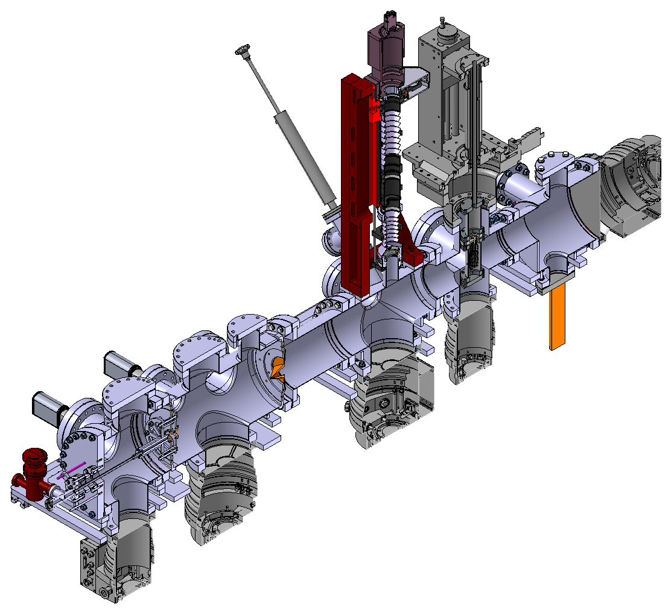
Laser Optical alignment
Mechanical fixation of the laser.
Adjust and focus of beam.
Laser
Laser system
E. Barrioz

Slide 12
Drawing approval
All drawings ready to be signed
  Have begun checking all the drawings
  Hope to have signed before design review
  Manufacture to begin ASAP
  Discuss with Cockcroft Institute

Slide 13
References
Slide 1: Gas dynamics considerations in a non-invasive profile monitor for charged particle beams Vasilis Tzoganis, Adam Jeff, Carsten P. Welsch
Slide 4: Poster at IPAC, provided by Hao Zhang
Slide 5: Alignment of Beam Gas Curtain (BGC) test plates Ana Miarnau

Slide 14
home.cern

