Slide 1
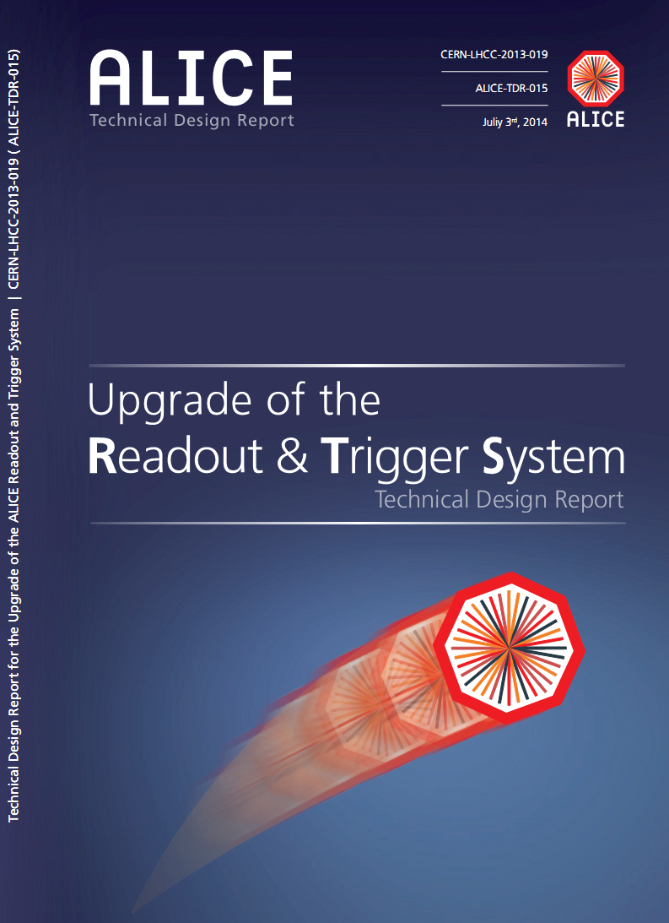


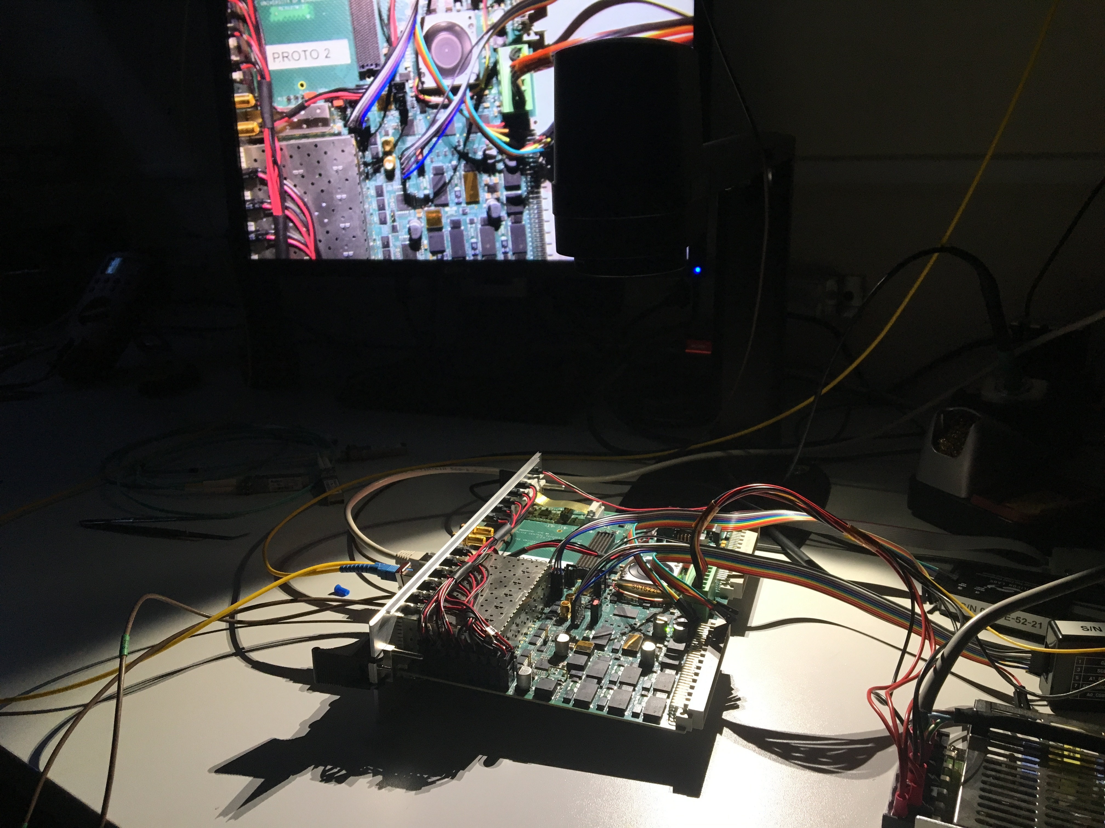
A Large Ion Collider Experiment
Benemérita Universidad Autónoma de Puebla
TTC-PON test (CTP/LTU-Board)
CTP – PRR - Meeting
July – 11th - 2017.
Luis Alberto Pérez Moreno (BUAP)
On behalf of the ALICE-CTP group

Slide 2



TTC-PON test (CTP/LTU-Board)
A Large Ion Collider Experiment
Outline
Introduction.
Evolution of the TTC_PON in ALICE CTP.
LTU_Firmware (Structure)
Experimental Setup 1 (CTP-LTU-Ev.Board)
Downstream latency measurements
BERT
Experimental Setup 2 (CTP-LTU-CRU)
Downstream latency measurements
BERT
1
CTP – PRR - Meeting
July – 11th - 2017.

Slide 3
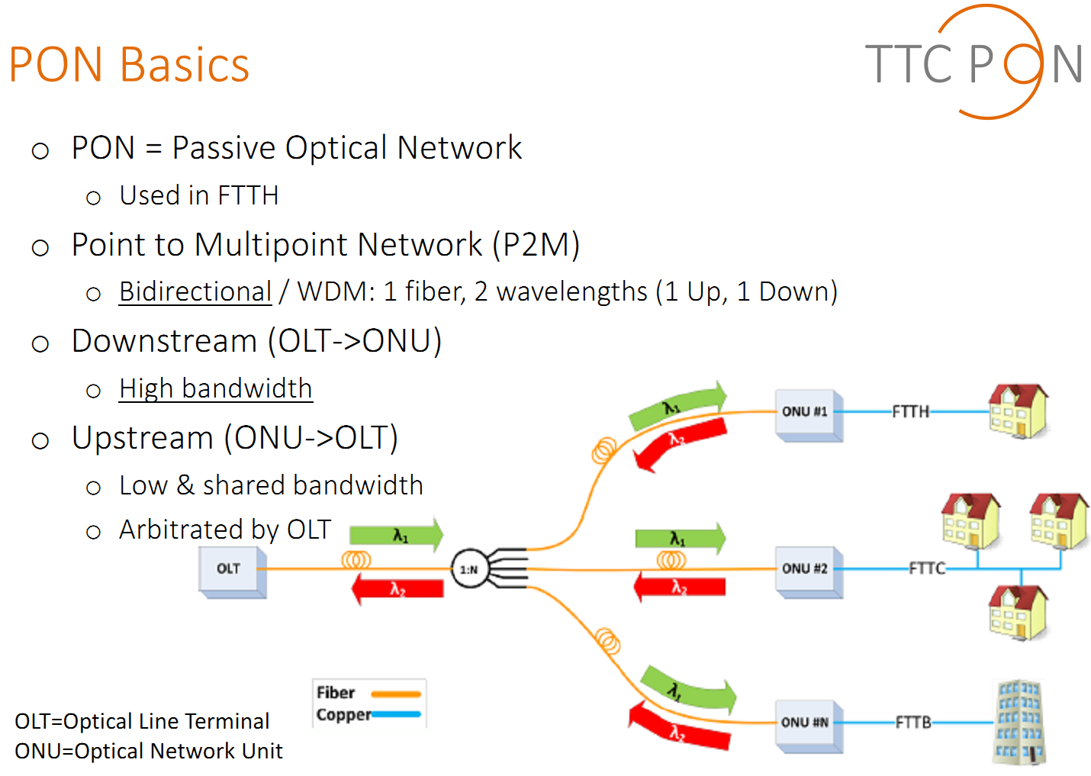
Introduction
A Large Ion Collider Experiment
Ref : The 10G TTC-PON :Challenges, solutions and performance (TTC.-PON team) , TWEPP 2016
2
CTP – PRR - Meeting
July – 11th - 2017.

Slide 4
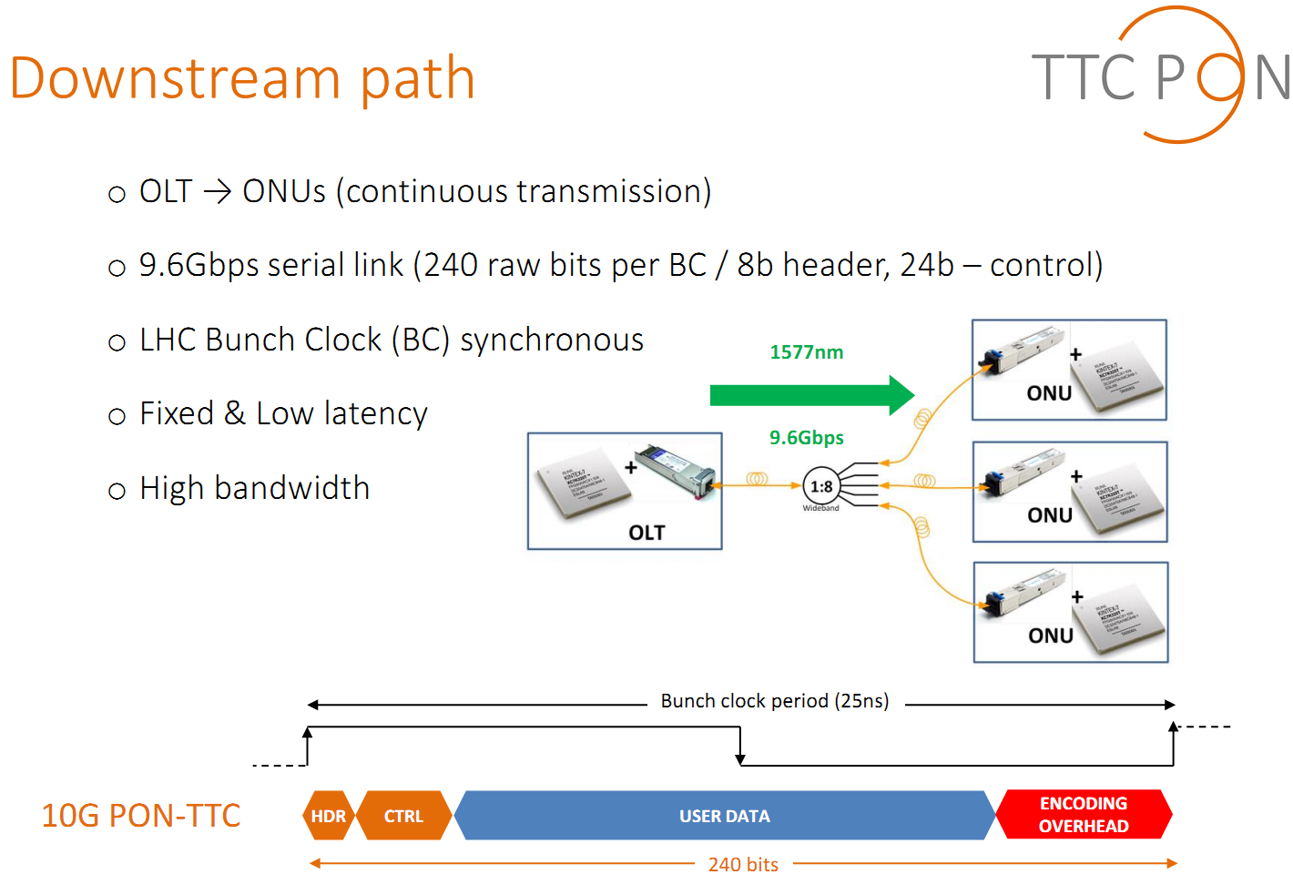
Introduction
A Large Ion Collider Experiment
Ref : The 10G TTC-PON :Challenges, solutions and performance (TTC.-PON team) , TWEPP 2016
    User Field: 20 bytes (160 bits)
  9.6Gbps, 6.4Gbps User Bandwidth maximum
3
CTP – PRR - Meeting
July – 11th - 2017.

Slide 5
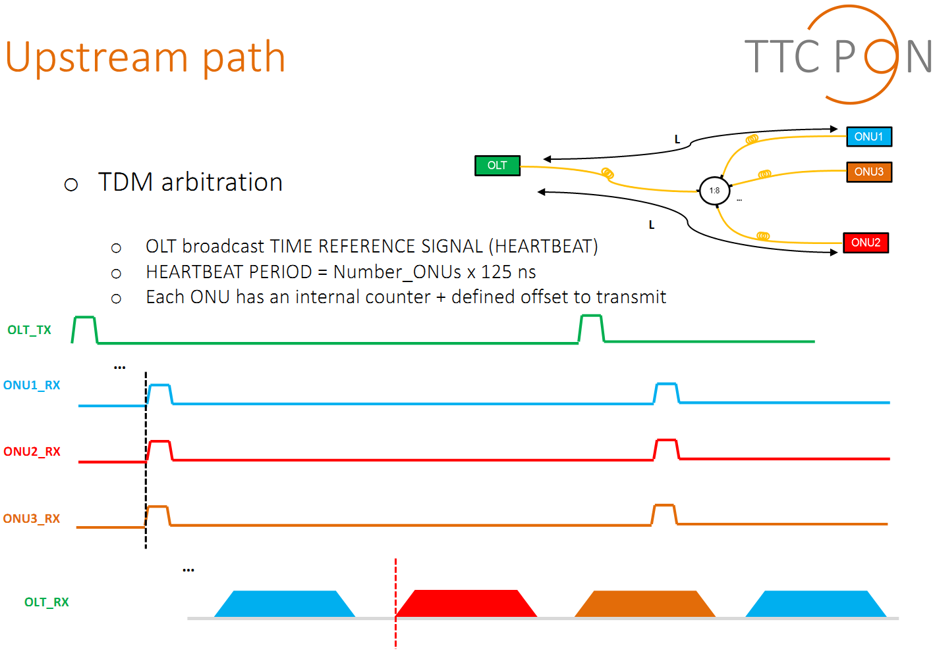
Introduction
A Large Ion Collider Experiment
Ref : The 10G TTC-PON :Challenges, solutions and performance (TTC.-PON team) , TWEPP 2016
4
CTP – PRR - Meeting
July – 11th - 2017.

Slide 6
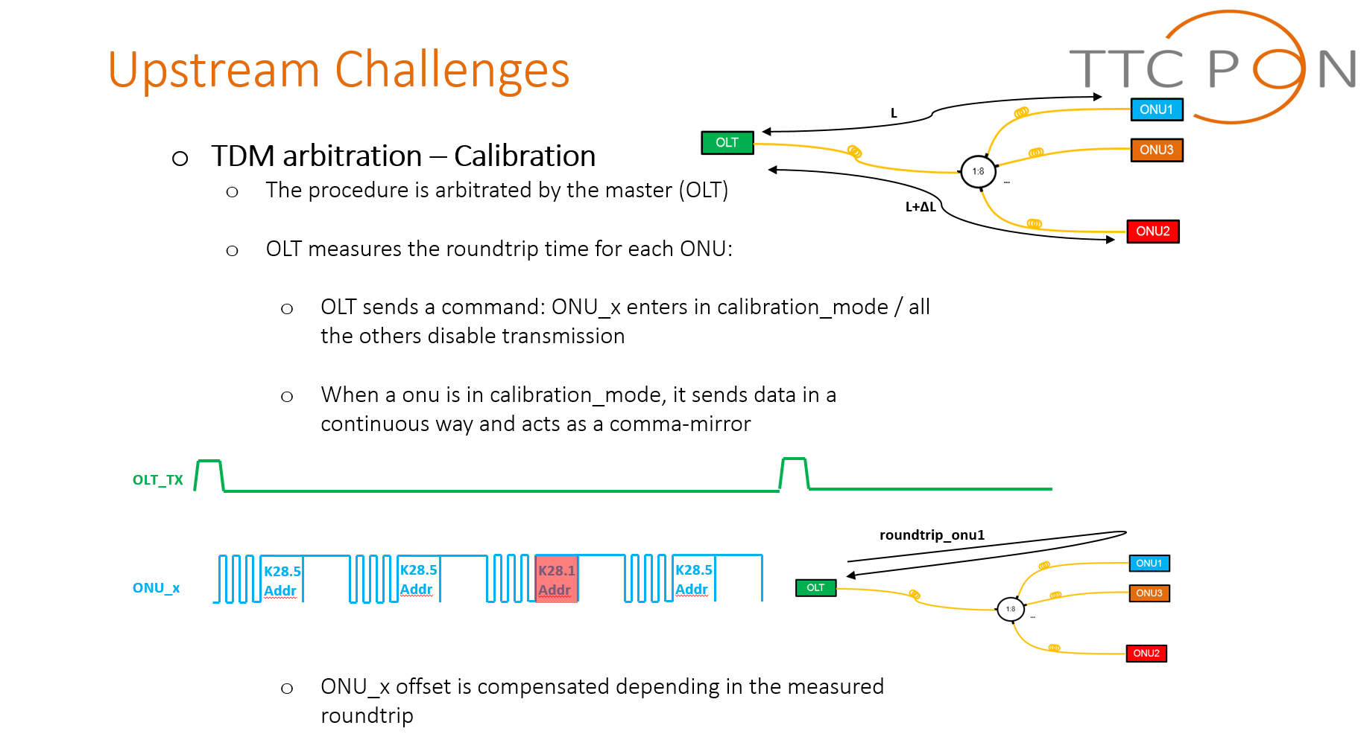
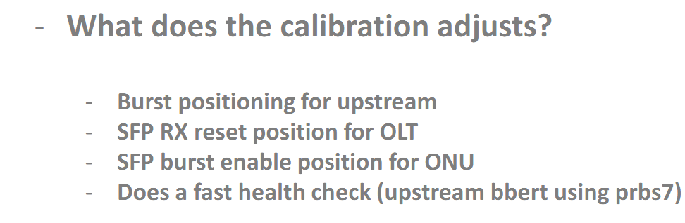
Introduction
A Large Ion Collider Experiment
Ref : The 10G TTC-PON :Challenges, solutions and performance (TTC.-PON team) , TWEPP 2016
5
CTP – PRR - Meeting
July – 11th - 2017.

Slide 7

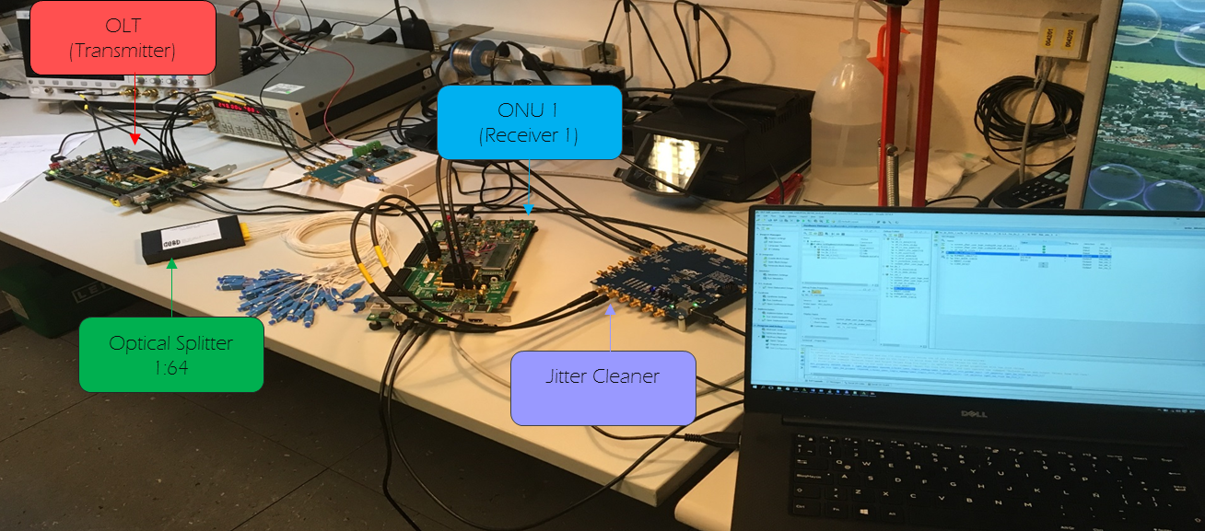
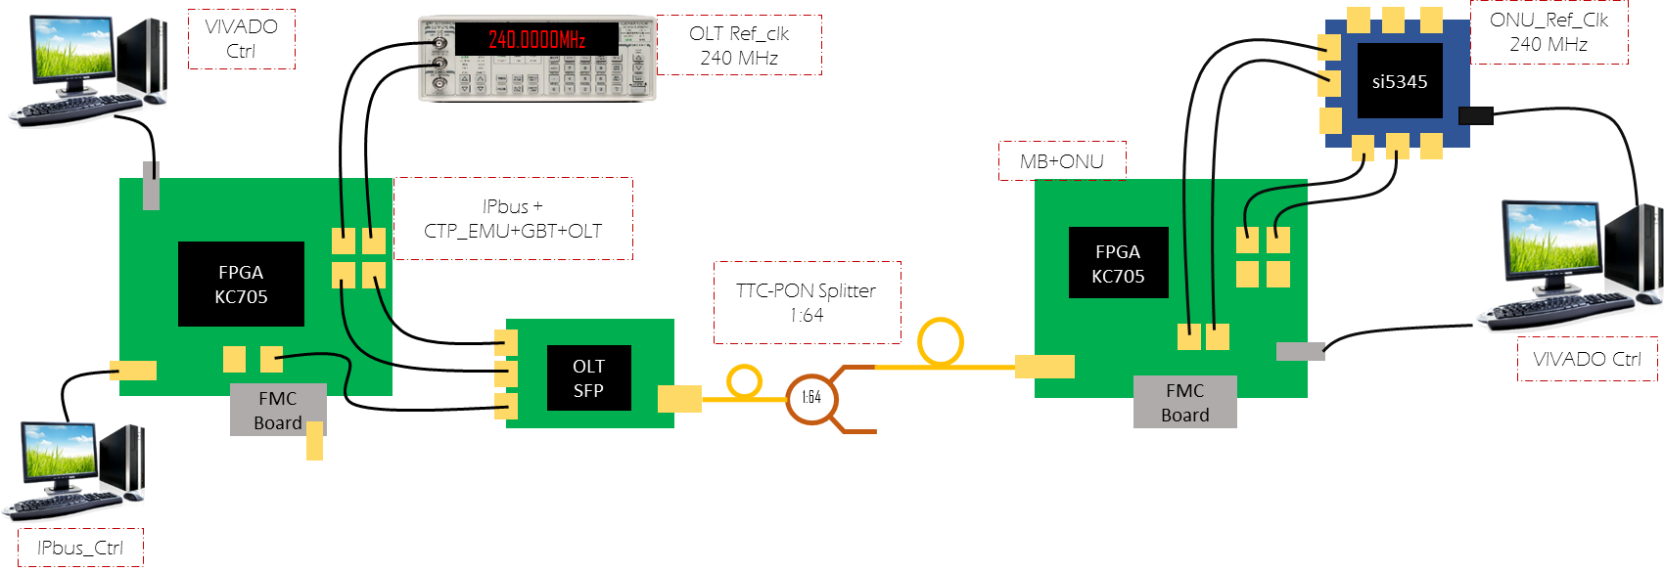
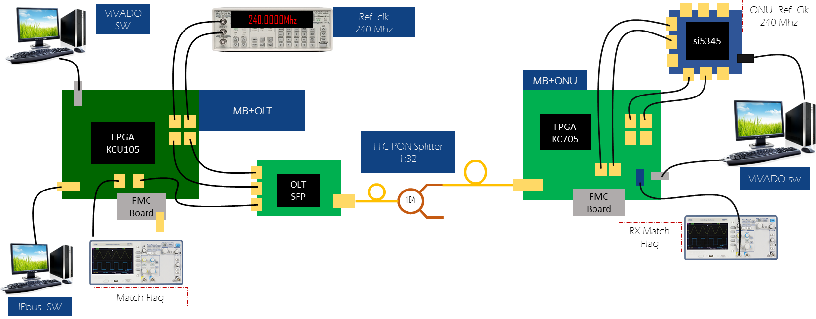

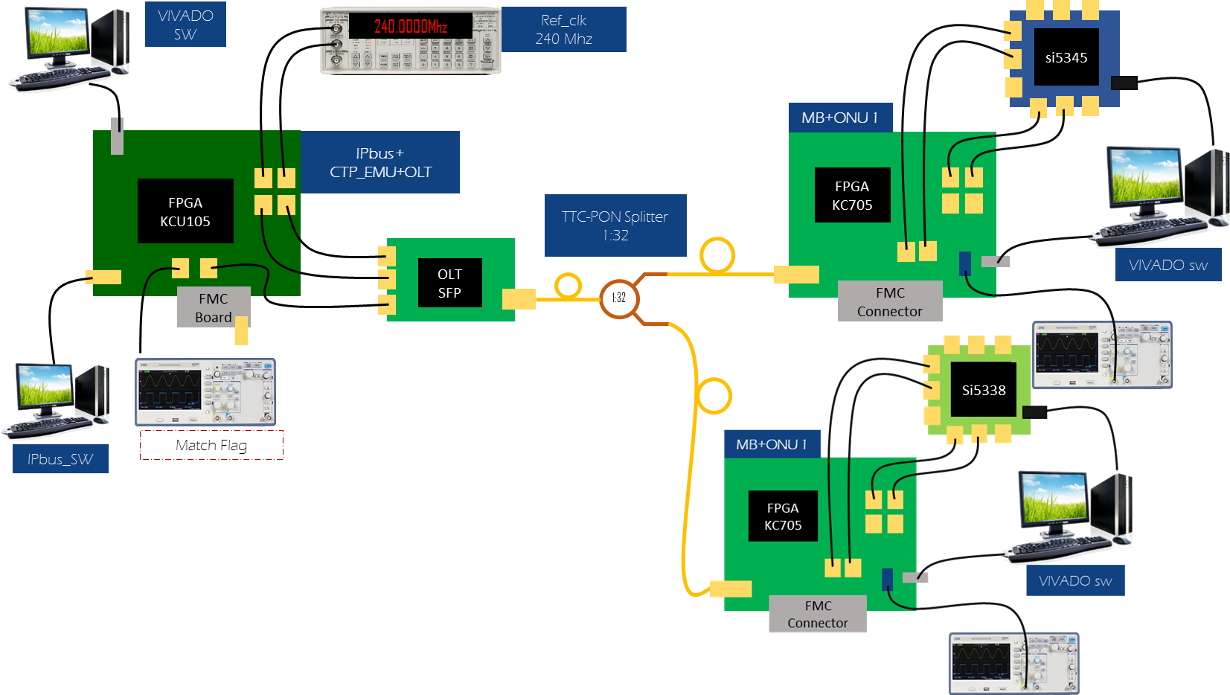
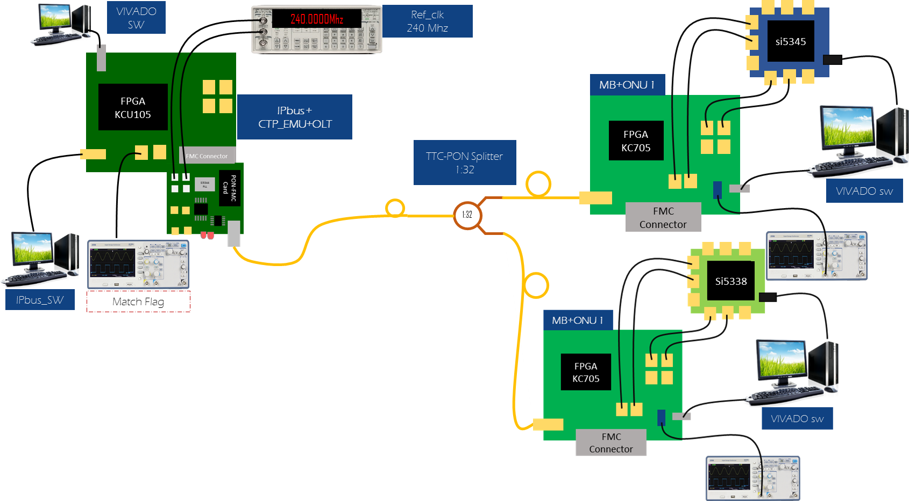
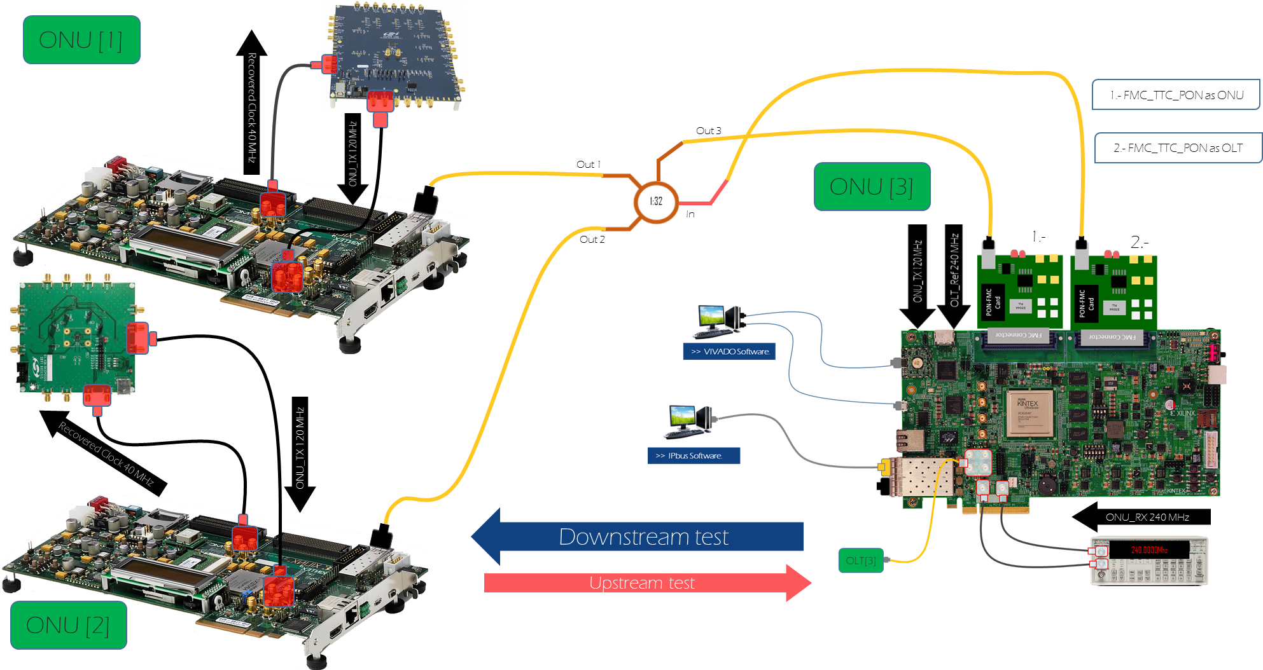
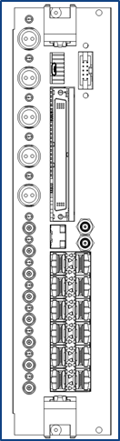
TTC_PON in ALICE CTP
A Large Ion Collider Experiment
TTC-PON ver_0_0 in KC705
1 OLT. Ctrl/Cfg: Microblaze, SDK
1 ONU. Ctrl/Cfg: Microblaze, SDK
Testability: Counter, PRBS7, PRBS23
Downstream
TTC-PON ver_0_1 in KC705
1 OLT. Ctrl/Cfg: IPbus
1 ONU. Ctrl/Cfg: Microblaze, SDK
Testability: CTP_EMU, Counter, PRBS7, PRBS23
Downstream.
TTC-PON ver_0_1
1 OLT (KCU105). Ctrl/Cfg: IPbus
1 ONU (KC705). Ctrl/Cfg: Microblaze, SDK
Testability: CTP_EMU, Counter, PRBS7, PRBS23
Downstream & Upstream.
TTC-PON ver_0_2
1 OLT (KCU105) Ctrl/Cfg: IPbus
2 ONUs (KC705). Ctrl/Cfg: Microblaze, SDK
Testability: CTP_EMU, Counter, PRBS7, PRBS23
Downstream/Upstream
Include calibration process
TTC-PON ver_0_3
1 OLT (KCU105) Ctrl/Cfg: IPbus
use the FMC_TTC_PON.
2 ONUs (KC705). Ctrl/Cfg: Microblaze, SDK
Testability: CTP_EMU, Counter, PRBS7, PRBS23
Downstream/Upstream
Include calibration process
TTC-PON ver_0_4
9 OLT (KCU105) Ctrl/Cfg: IPbus
1 ONU (KCU105) Ctrl/Cfg: Ipbus
2 FMC_TTC_PON (OLT/ONU).
2 ONUs (KC705). Ctrl/Cfg: Microblaze, SDK
Testability: CTP_EMU, Counter, PRBS7, PRBS23
Downstream/Upstream
Include calibration process
LTU Logic
6
CTP – PRR - Meeting
July – 11th - 2017.

Slide 8

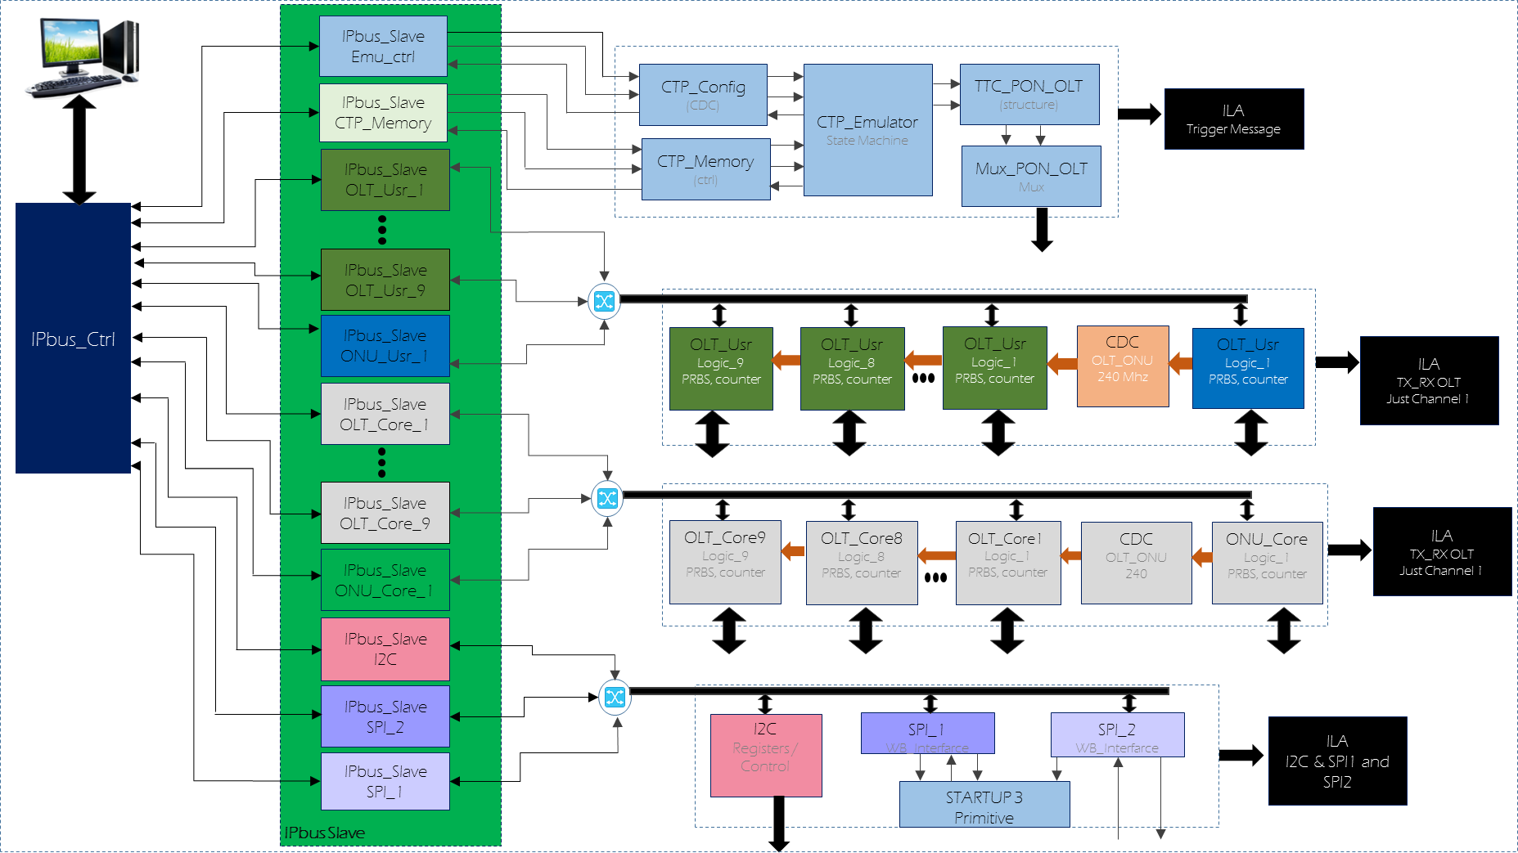
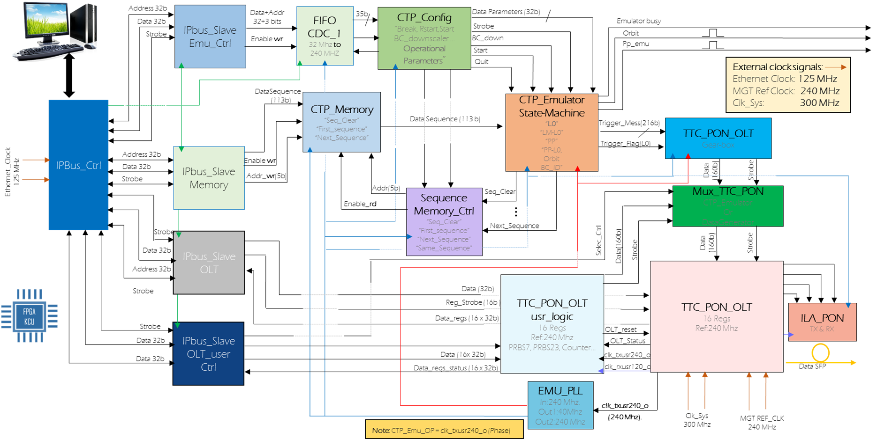

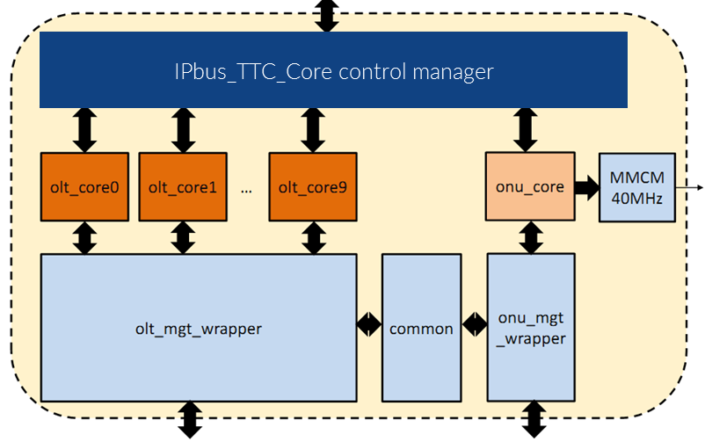
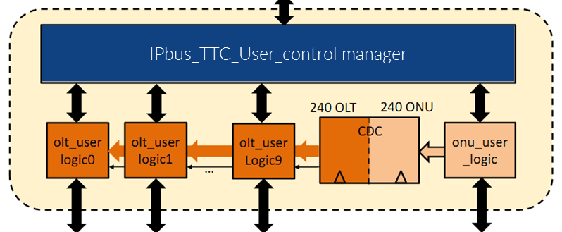


CTP_TTC-PON (Block-Diagram - Firmware)
A Large Ion Collider Experiment
Firmware V1
25 IPbus Slaves
1 ONU
1 I2C ctrl
8 ILAs (Logic Analyzer )
7
8 OLTs
2 SPI ctrl
1 CTP_ Emulator
“Thanks TTC-PON team for support”
CTP – PRR - Meeting
July – 11th - 2017.

Slide 9

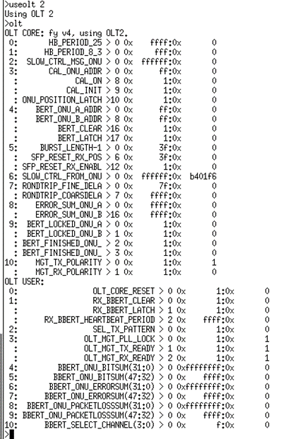
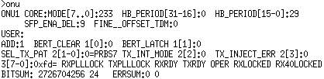
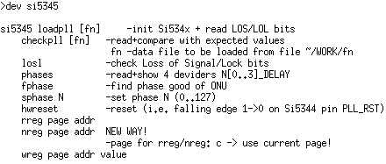
CTP_TTC-PON (Features of the TTC-PON system)
A Large Ion Collider Experiment
Ctrl & cfg. of all OLTs via IPbus
Ctrl & cfg. of the ONU via IPbus
TTC_PON test Menu (IPbus)
Full Calibration.
Light Calibration.
Network Init.
Network Health.
Network Presence.
BERT Config. (Down/Up)
BERT Read. (Down/Up)
Downstream Latency
Status ONU
Status OLT
Toggling (TX & RX)
OLT Reset loop
ONU_Ref_clock via IPbus (IPbus to I2C)
Firmware V1
25 IPbus Slaves
1 ONU
1 I2C ctrl
8 ILAs (Logic Analyzer )
8
8 OLTs
2 SPI ctrl
1 CTP_ Emulator
CTP – PRR - Meeting
July – 11th - 2017.

Slide 10

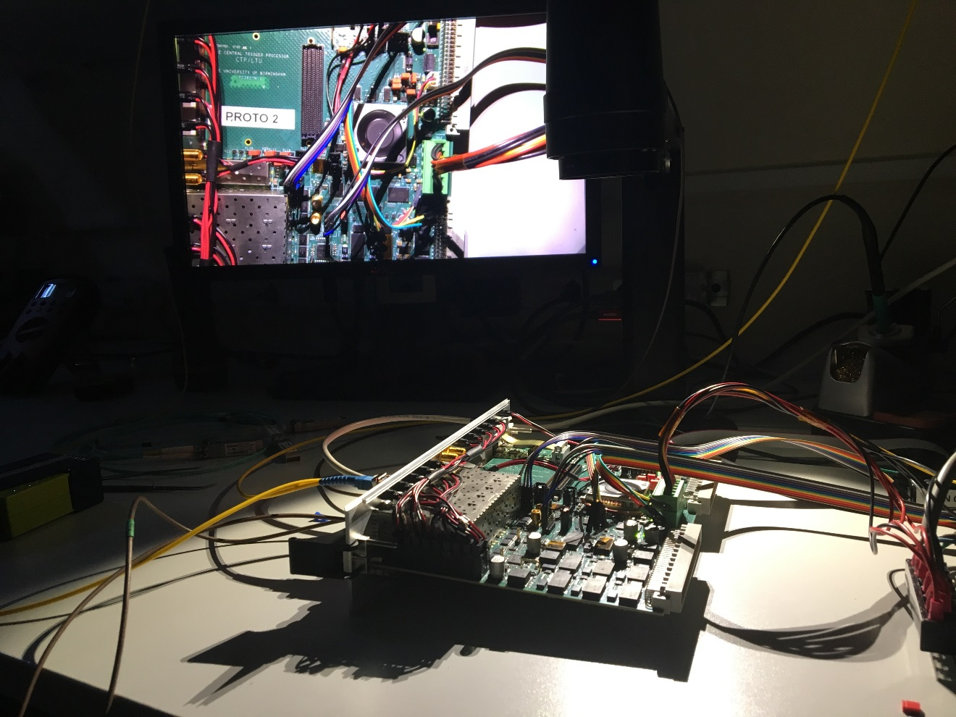
Experimental Setup 1 (CTP to LTU to 2 Ev.boards as CRU)
A Large Ion Collider Experiment
Experimental Setup 1
CTP
LTU
KC705
KCU105
9
CTP – PRR - Meeting
July – 11th - 2017.

Slide 11
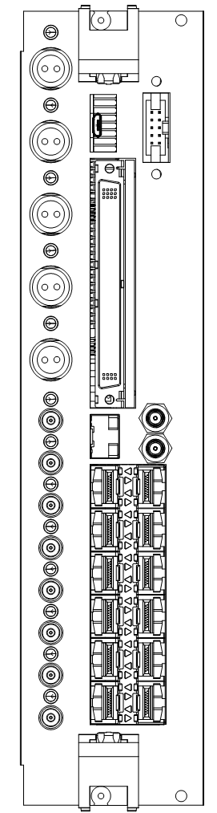

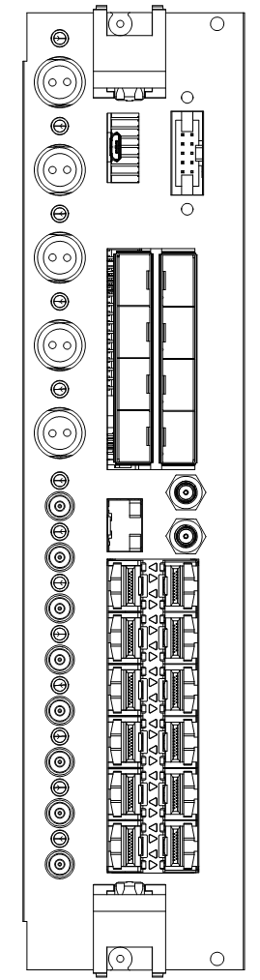






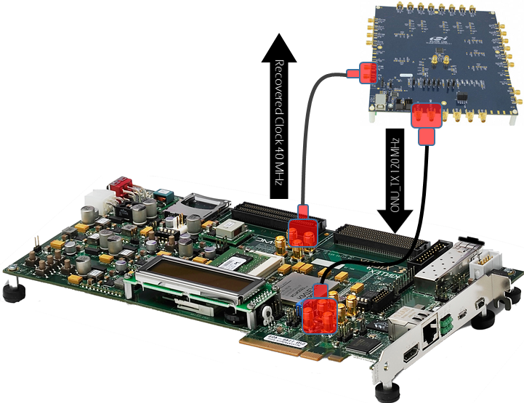
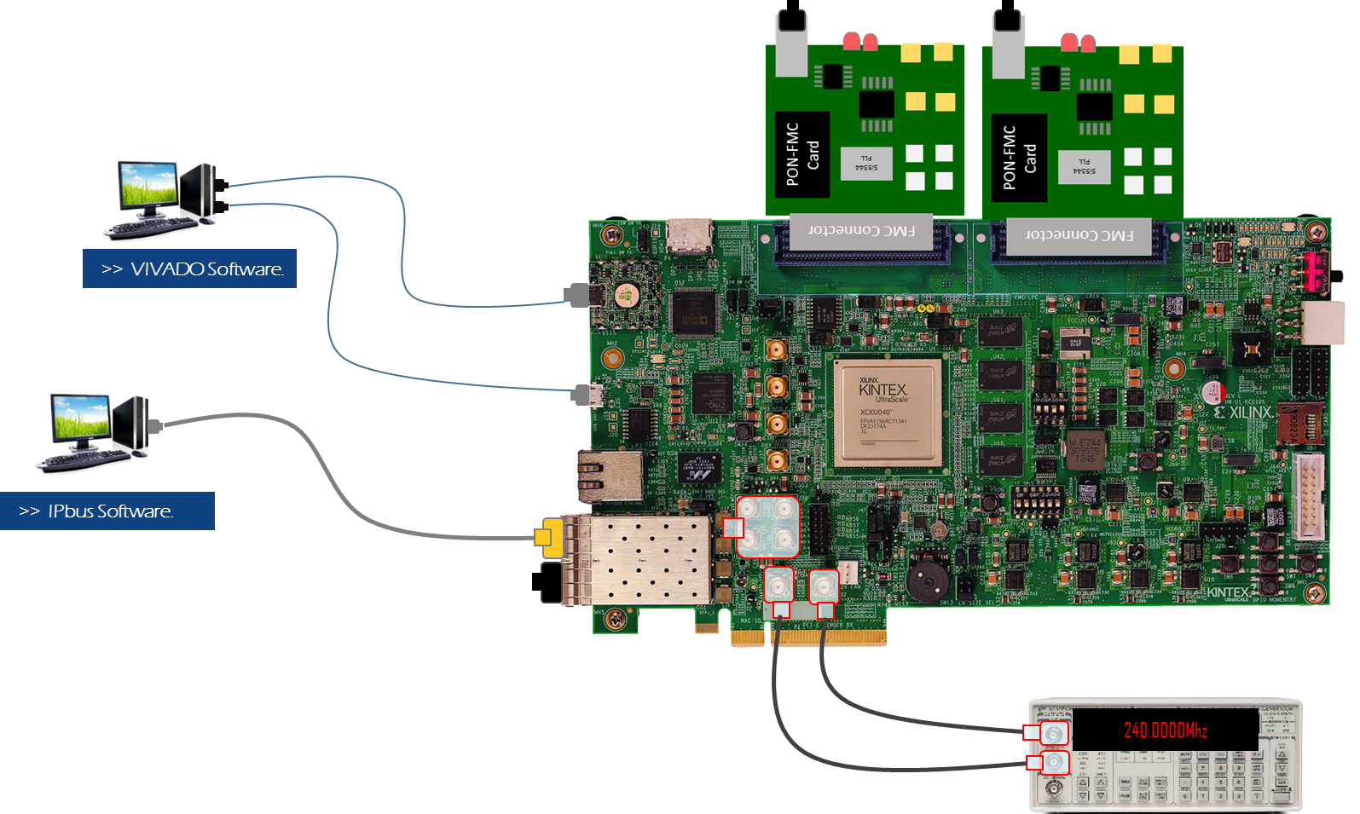

Experimental Setup (CTP to LTU to 2 Ev.boards as CRU)
A Large Ion Collider Experiment
LHC Clock
( LHC Machine Interface )
Optical Link
IPbus software
Electrical Link
Out
In
IPbus software
In
OLT & ONU
OLT
Out
Out
CTP/LTU board as LTU
CTP/LTU board as CTP
TTC-PON: Time & Trigger Control – Passive Optical Network
CTP: Central Trigger Processor
LTU: Local Trigger Unit
OLT: Optical Line Terminal
ONU: Optical Network Unit
CRU: Common Readout Unit
ONU
OLT & ONU
KC705
Microblaze software
10
KCU105
CTP – PRR - Meeting
July – 11th - 2017.

Slide 12
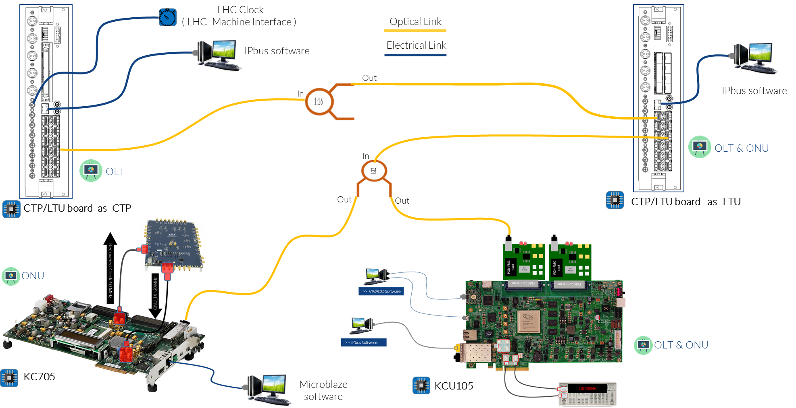
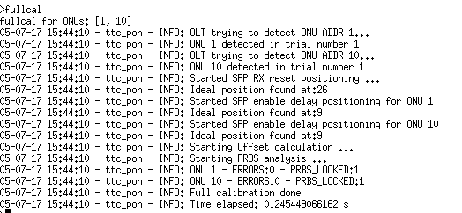
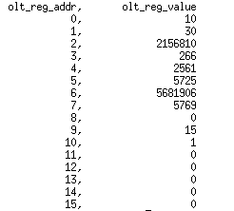

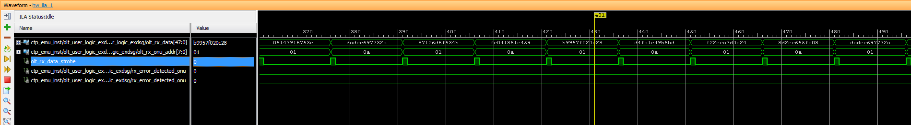
Experimental Setup (Calibration process)
A Large Ion Collider Experiment
Calibration Process (LTU to 2 Ev. Boards)
Result OLT Config.
Result ONU Config:
OLT_RX (ILA) After calibration.
11
CTP – PRR - Meeting
July – 11th - 2017.

Slide 13
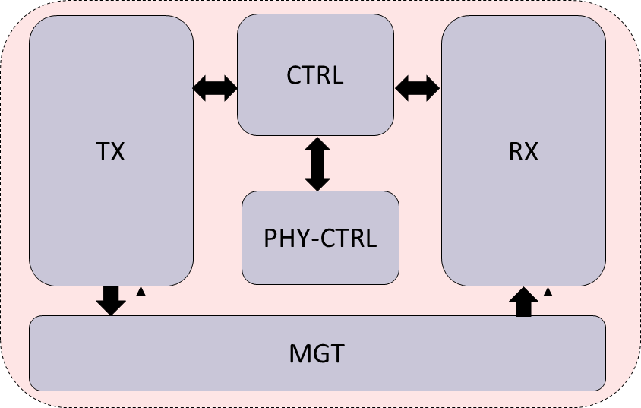

TTC_PON Downstream
A Large Ion Collider Experiment
The downstream latency must be constant, after reset process
Similar structure for OLT/ONU
*
OLT in counter mode
Match Flag
..01
..02
..f8
..f9
..00
..01
Match Flag
..01
..02
..f8
..f9
..00
..01
Start
End
OLT Match Flag
Downstream Latency
ONU Match Flag
OLT Core
ONU Core
Data_Gen
Data_check
bbert
bbert
Regbank
*
*
OLT User
ONU User
Regbank
FPGA
FPGA
12
CTP – PRR - Meeting
July – 11th - 2017.

Slide 14

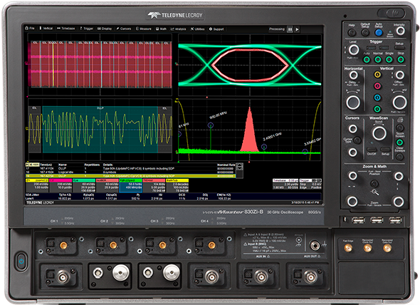
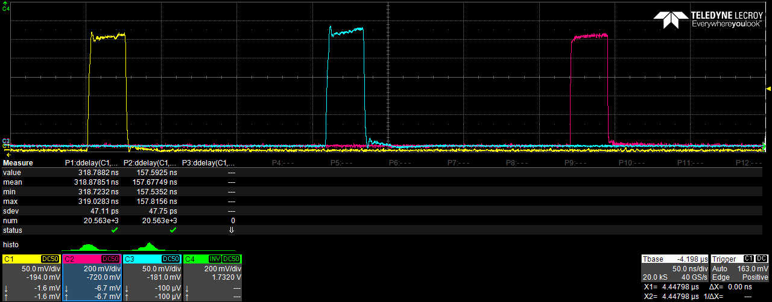

Experimental Setup ( Downstream Latency)
A Large Ion Collider Experiment
LHC Clock
( LHC Machine Interface )
2- Match Flag in ONU
IPbus software
IPbus software
OLT= Counter Mode
(LTU to Scope) = 1.5 m.
Out
In
Configuration Send data that is received from the ONU
“in the first PON layer”
(CTP to LTU) ~ 11 m.
1- Start in OLT
|
In
(CTP to Scope) = 1.5 m.
Downstream Latency .
CTP/LTU as LTU
CTP/LTU as CTP
Out
CTP to KCU
2
3
3 - Match Flag in ONU
CTP to LTU
1
(LTU to KCU) ~ 11 m.
LTU to KCU
(KCU to Scope) = 1.5 m.
1-2 ~ 157 ns (- 55ns of cables) ~ 102 ns
1-3 ~ 318 ns (-110ns of cables) ~ 208 ns
------------------------------------------------
2-3 ~ 161 ns (-55ns of cables) ~ 106 ns
KCU105
13
CTP – PRR - Meeting
July – 11th - 2017.

Slide 15
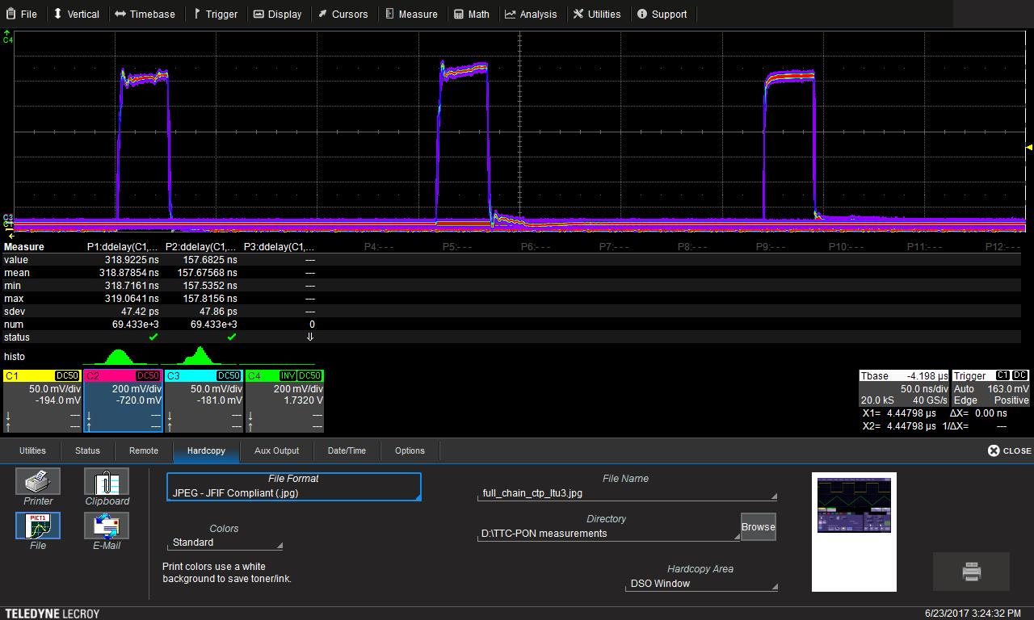
Experimental Setup ( Downstream Latency after several resets)
A Large Ion Collider Experiment
LHC Clock
( LHC Machine Interface )
2- Match Flag in ONU
IPbus software
IPbus software
OLT= Counter Mode
(LTU to Scope) = 1.5 m.
Out
In
Configuration Send data that is received from the ONU
“in the first PON layer”
(CTP to LTU) = 11 m.
|
1- Start in OLT
In
CTP/LTU board as CTP
CTP/LTU board as LTU
Stability of the latency.
Out
3 - Match Flag in ONU
(LTU to KCU) = 11 m.
1
2
3
(KCU to Scope) = 1.5 m.
1-2 ~ 157 ns (- 55ns of cables) ~ 102 ns
1-3 ~ 318 ns (-110ns of cables) ~ 208 ns
------------------------------------------------
After several resets in CTP_OLT, LTU_OLT
KCU105
14
CTP – PRR - Meeting
July – 11th - 2017.

Slide 16



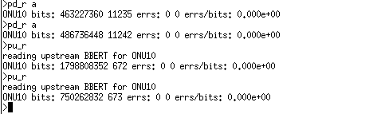
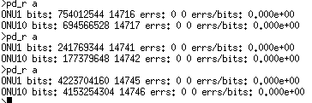
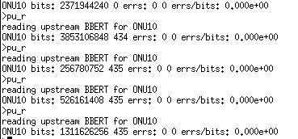
Experimental Setup ( BER Test after calibration process)
A Large Ion Collider Experiment
CTP
LTU
BERT Downstream (CTP to LTU). No Errors ~ 2hrs
LTU
BERT Upstream (LTU to CTP). No Errors ~ 2hrs
Downstream 9.6 Gbps
Upstream 2.4 Gbps
BER_Downstream ~ 10 ⁻¹⁴
BER_Upstream ~ 10 ⁻¹³
BERT Downstream (LTU to 2Ev.Board). No Errors ~ 2:30hrs
KCU & KC7
ONU_RX (ILA) PRBS lock and No errors.
BERT Upstream (KCU to LTU). No Errors ~ 2:30hrs
15
CTP – PRR - Meeting
July – 11th - 2017.

Slide 17
Experimental Setup (LTU standalone )
A Large Ion Collider Experiment
After Calibration process
Internal Clock
( Local Oscillator)
BERT Downstream (LTU to 2 ONUs). No Errors
Downstream 9.6 Gbps
NO LHC CLOCK
Upstream 2.4 Gbps
IPbus software
BERT Upstream (ONUs to LTU). No Errors
BER_Downstream ~ 10 ⁻¹⁴
BER_Upstream ~ 10 ⁻¹³
OLT & ONU
In
Out
Out
CTP/LTU board as LTU
ONU
KCU105
OLT & ONU
KC705
Microblaze software
16
CTP – PRR - Meeting
July – 11th - 2017.

Slide 18
Experimental Setup 2 (CTP to LTU to 2 Ev.boards as CRU)
A Large Ion Collider Experiment
Experimental Setup 2
CTP
KCU105
LTU
KC705
CRU 1
CRU 2
17
CTP – PRR - Meeting
July – 11th - 2017.

Slide 19
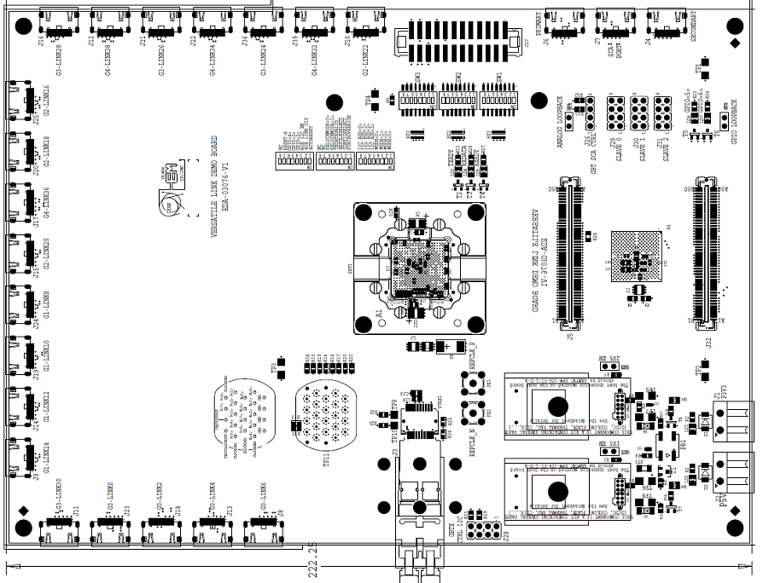
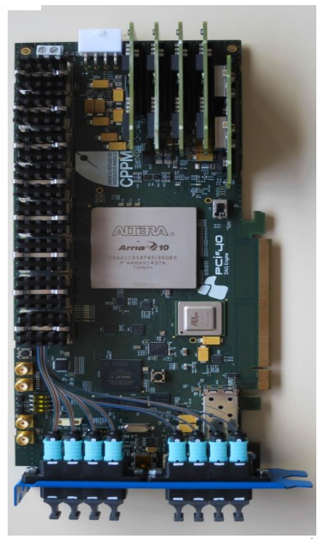

Experimental Setup (CTP-CRU)
A Large Ion Collider Experiment
LHC Clock
( LHC Machine Interface )
IPbus software
VLDB (GBTx)
IPbus software
Out
In
(CRU to VLDBs) = 11 m.
Out
OLT & ONU
Out
(CTP to LTU) = 1 m.
In
Out
Out
OLT
(LTU to CRUs) = 11 m.
CTP/LTU board as LTU
CRU
ONU
CTP/LTU board as CTP
Optical Link
(CTP to KCU) = 1 m.
LTU
to
KC705
=
1 m.
Electrical Link
CRU
ONU
TTC-PON: Time & Trigger Control – Passive Optical Network
CTP: Central Trigger Processor
LTU: Local Trigger Unit
OLT: Optical Line Terminal
ONU: Optical Network Unit
CRU: Common Readout Unit
Microblaze software
KCU105
ONU
18
OLT & ONU
KC705
CTP – PRR - Meeting
July – 11th - 2017.

Slide 20
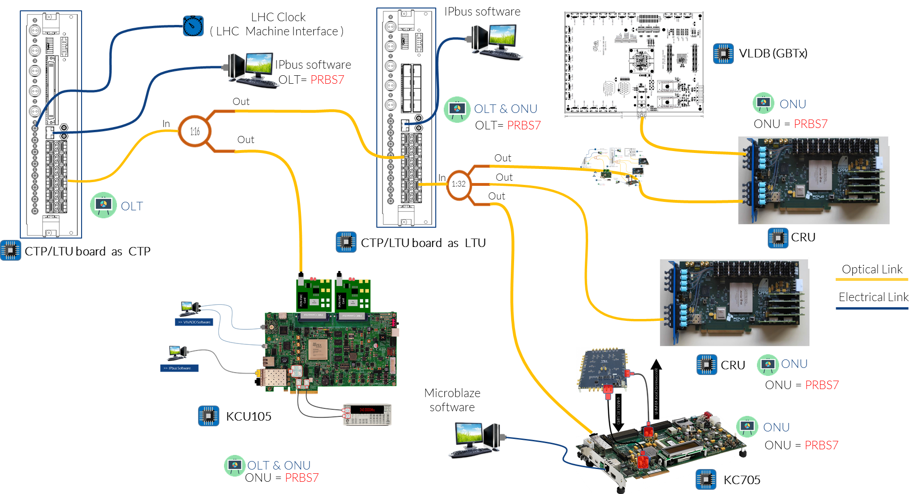
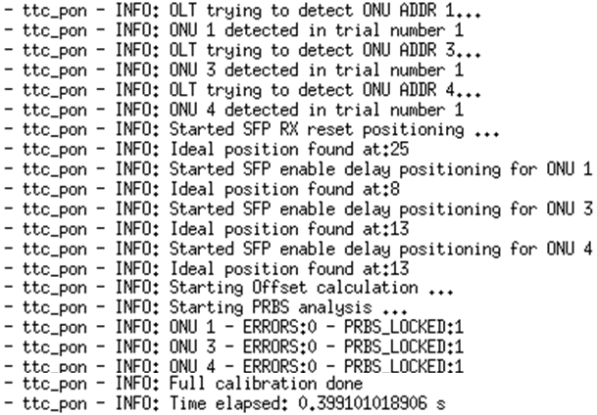
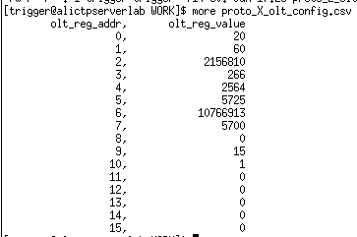
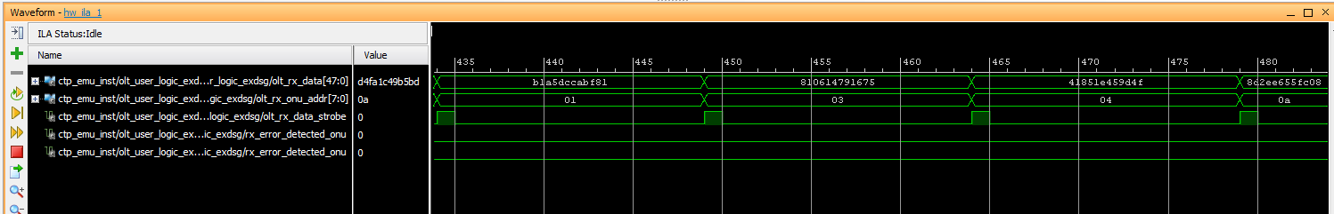
Experimental Setup (Calibration process)
A Large Ion Collider Experiment
Calibration Process (LTU to 2 CRUs and 1 KC705 )
KC705
CRUs
Result OLT Config:
Result ONU Config:
LTU(OLT_RX )(ILA) After calibration.
19
CTP – PRR - Meeting
July – 11th - 2017.

Slide 21

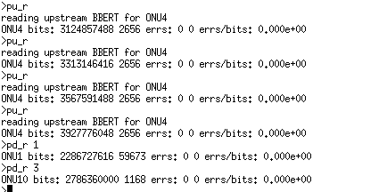
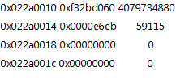
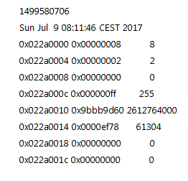
Experimental Setup (BERT Results )
A Large Ion Collider Experiment
CTP
LTU & KCU
BERT Upstream (CRUs to LTU). No Errors >22 hrs
CRU1
LTU
CRU2
BER_Downstream ~ 10 ⁻¹⁵
BER_Upstream ~ 10 ⁻¹⁴
Downstream 9.6 Gbps
Upstream 2.4 Gbps
BERT Downstream (LTU & 2CRUs & 1kc705 ). No Errors > 22hrs
CRUs
CRU1
CRU2
20
CTP – PRR - Meeting
July – 11th - 2017.

Slide 22
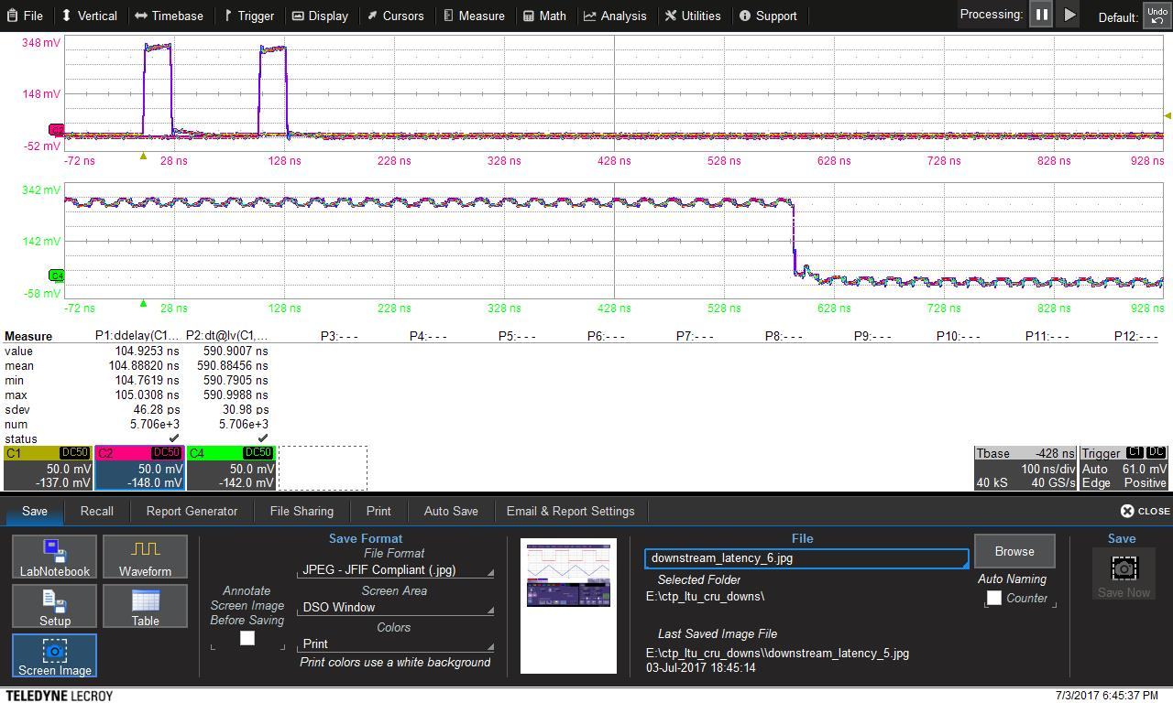
Experimental Setup (Downstream Latency After Several Resets)
A Large Ion Collider Experiment
LHC Clock
( LHC Machine Interface )
IPbus software
IPbus software
3- GBTx Match flag
OLT= Counter Mode
Out
VLDB (GBTx)
In
2- ONU Match flag
(CRU to VLDBs) ~ 11 m.
In
Out
OLT & ONU
Out
(CTP to LTU) ~ 1 m.
Out
(LTU to CRUs) ~ 11 m.
OLT
1- Start in OLT
CTP/LTU board as LTU
CRU
ONU
CTP/LTU board as CTP
Stability of the latency.
LTU
to
KC705
~
1 m.
Optical Link
CTP to LTU
1
2
Electrical Link
KC705
3
Microblaze software
CTP to eLink (VLDB)
ONU
1-2 ~ 105 ns (- 3 ns of cables) ~ 102 ns
1-3 ~ 590 ns (-120 ns of cables) ~ 365 ns (CRU + VLDB)
-----------------------------------------------------------------
After several resets in CTP_OLT, LTU_OLT
21
CTP – PRR - Meeting
July – 11th - 2017.

Slide 23

End
A Large Ion Collider Experiment
Summary
We tested the TTC-PON system on the CTP/LTU board.
First version of the LTU firmware well advanced
The consistence of the downstream latency between CTP-LTU-CRU-VLDB tested.
Downstream Latency CTP-LTU ~ 102 ns
Downstream Latency of the full chain ~ 590 ns
BER between LTU-CRU tested.
  BER downstream ~ 10⁻¹⁵
  BER upstream ~ 10⁻¹⁴
Next Steps:
Include the GBT in LTU firmware
Long BER test
Thank you !!
22
CTP – PRR - Meeting
July – 11th - 2017.

Slide 24


A Large Ion Collider Experiment
ALICE Central Tigger Processor (Upgrade)
Thank you !!
22
CTP – PRR - Meeting
July – 11th - 2017.

Slide 25
A Large Ion Collider Experiment
ALICE Central Tigger Processor (Upgrade)
Back Up!!
22
CTP - Upgrade - Meeting
June – 26th - 2017.

