Slide 1

Cooperation between
CERN and Ukrainian Industries
2017

Slide 2
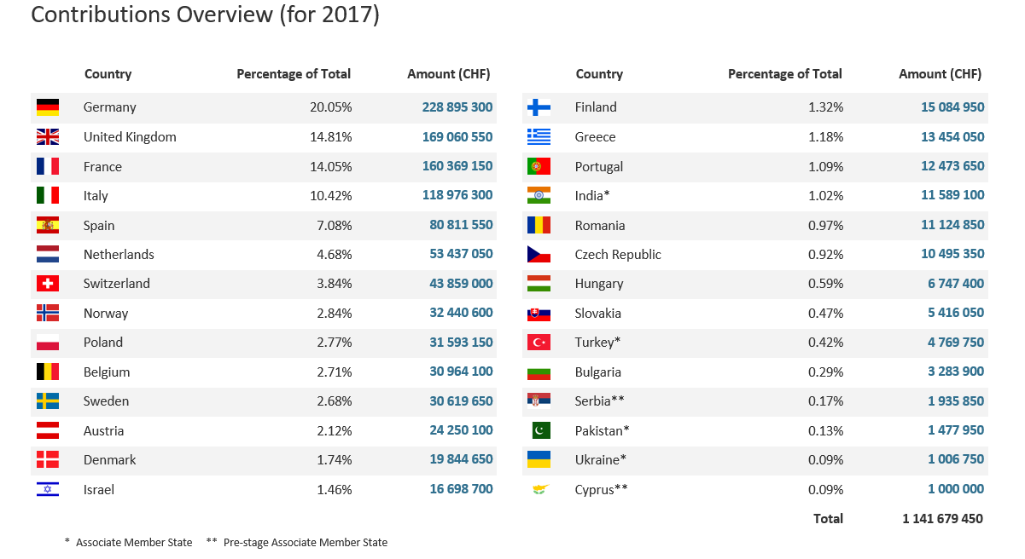
CONTRIBUTIONS FOR 2017 (CHF)
* Associate Member States

Slide 3

Legal framework
CERN, an Intergovernmental Organization, was established in July 1953, by the “Convention for the establishment of a European Organization for Nuclear Research”.
As an Intergovernmental Organization, CERN is not a legal entity under national law but governed by public international law.
CERN benefits from immunity from national jurisdiction and execution. Thus, legal disputes between CERN and its suppliers and contractors are not submitted to national courts but solved via international arbitration.
CERN is thus entitled to establish its own internal rules necessary for its proper functioning, such as the rules under which it purchases equipment and services.
3

Slide 4
Mission of Procurement and Industrial Services
The mission of the Procurement and Industrial Services group is to:
  procure all supplies and services for CERN;
  meeting all requirements;
  at the lowest possible overall cost, while;
  achieving balanced industrial return for the CERN Member States, and;
  respecting the CERN Procurement Rules.

Slide 5
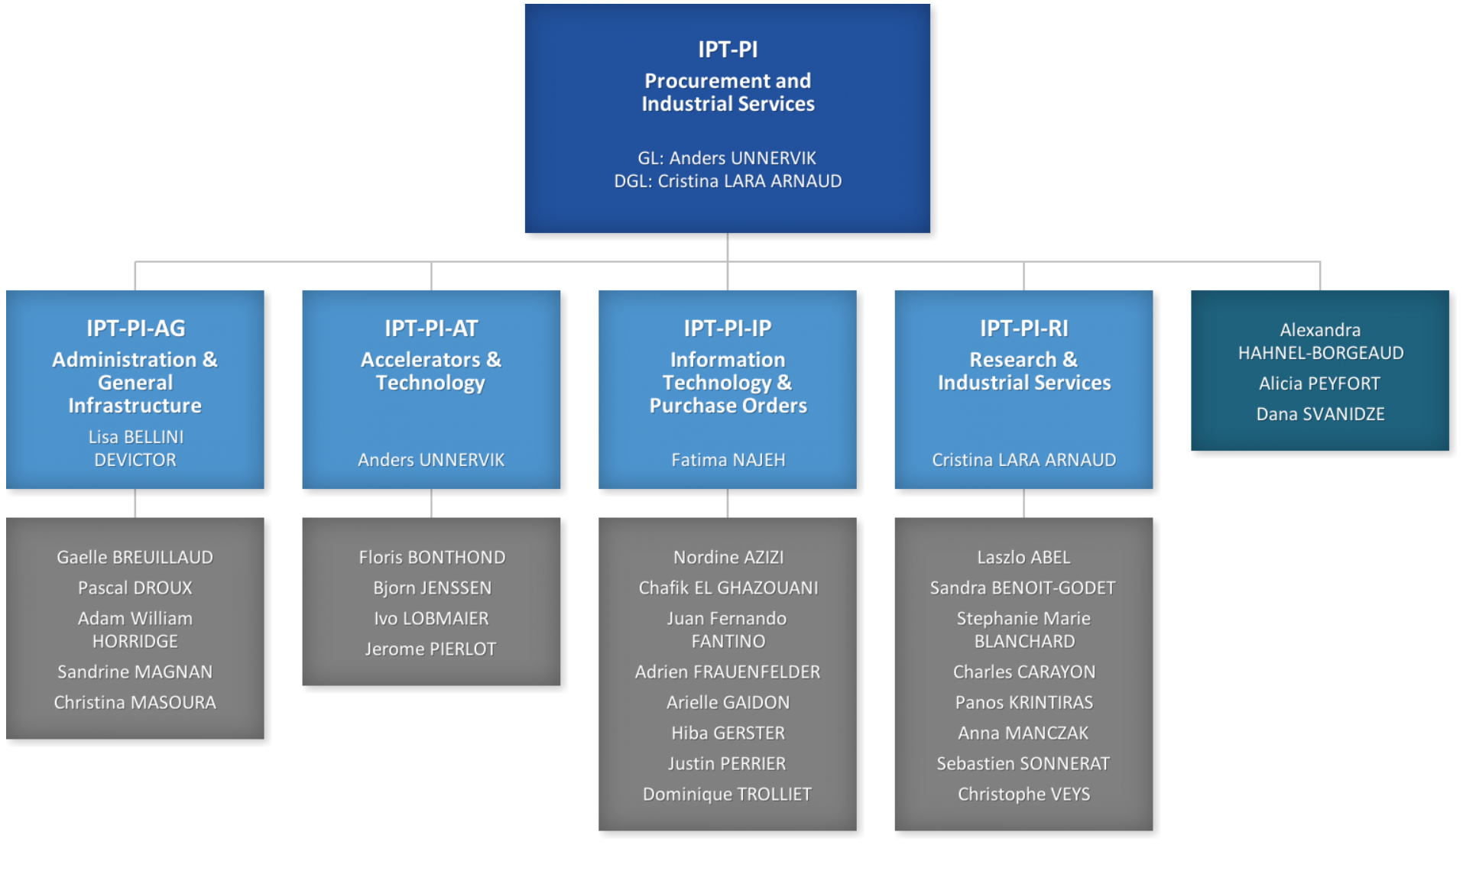
Organigramme

Slide 6

Procurement Principles
CERN purchases supplies and services and awards contracts in compliance with the principles of transparency and impartiality
Limited to firms established in the Member States.
Invitation to tender documents are drafted in an objective way so as to guarantee fair competition
As a rule, CERN’s tendering procedure is selective and does not take the form of open invitations to tender or price enquiries
The opening, negotiation and evaluation processes of the bids are strictly confidential
Is either the lowest; or
Represents the best value for money.

Slide 7

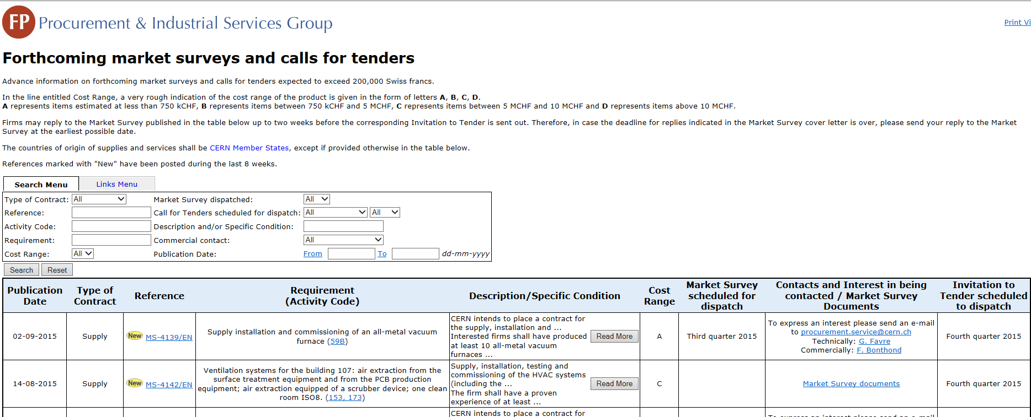
Procedures for obtaining offers
Requirements < 10’000 CHF
Users may issue enquiries directly provided CERN procurement
rules are followed
Requirements > 10’000 CHF and < 200’000 CHF
  Price Enquiries issued by Procurement Service
Requirements > 200’000 CHF
Announcement, Market Surveys & Calls for Tenders
7

Slide 8
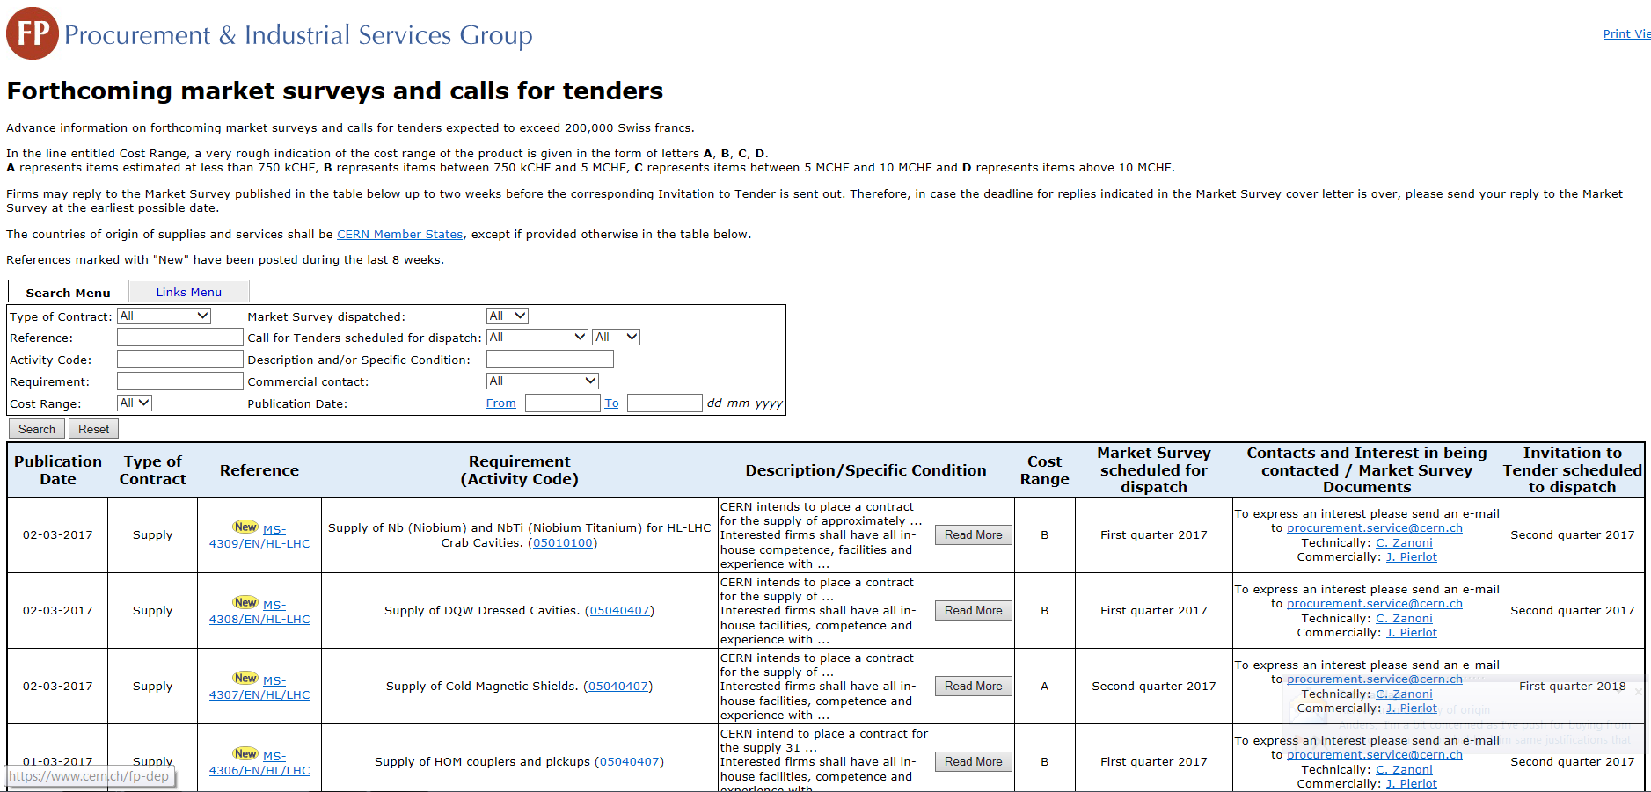
CERN “Shopping list”
https://found.cern.ch/java-ext/found/CFTSearch.do
8

Slide 9
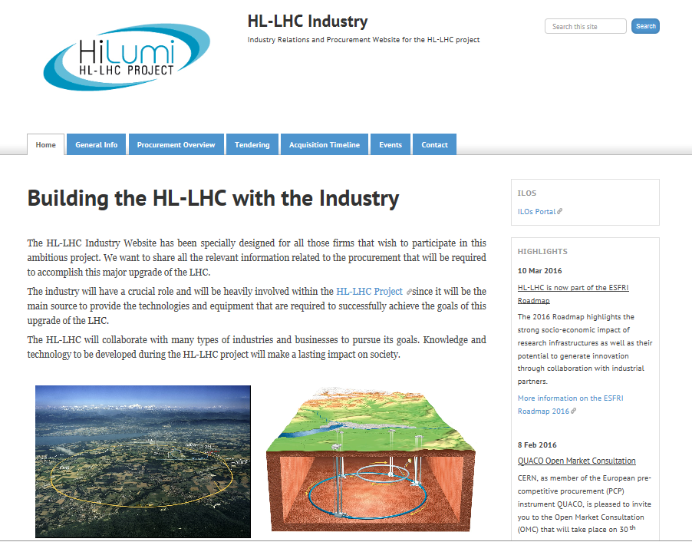
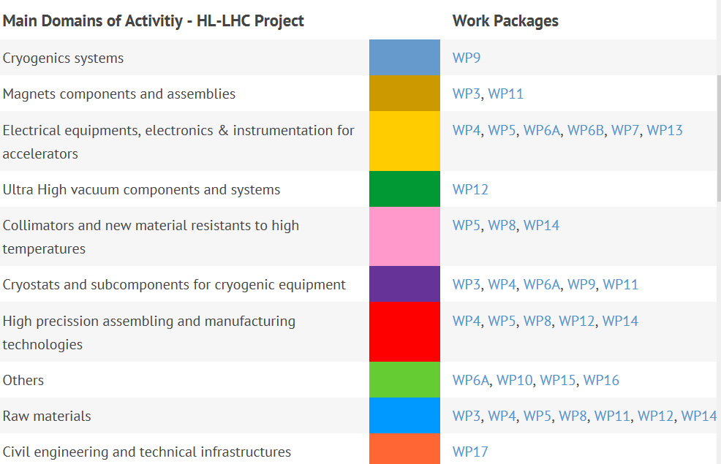
HL-LHC “Shopping list”
http://project-hl-lhc-industry.web.cern.ch/content/main-procurement-needs-hl-lhc
9

Slide 10
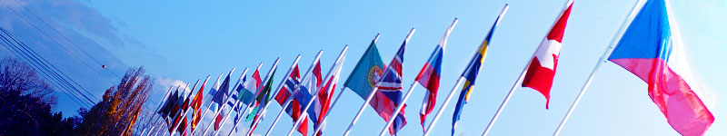
Country of origin
  Supply contract: country(ies) in which the goods are manufactured or where the last major modification will take place.
  Service contract: country(ies) in which the bidder is established.
10

Slide 11
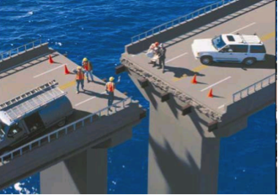
The alignment rule
For supply contracts to be awarded on the lowest compliant bid basis and exceeding 100’000 CHF in value
A bidder offering goods originating from poorly balanced Member States is offered to align his price, under certain conditions, to that of the lowest bidder and thereby be awarded the contract
The following countries are considered to be well-balanced in the period 01.03.2017 until 28.02.2018 for Supply contracts:
Bulgaria, Czech Republic, France, Hungary, Italy, Switzerland

Slide 12
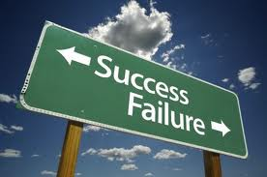
Successful bidders and contractors
Often small – medium sized and flexible firms
Ensure full understanding of specifications – exceeded specifications may be too expensive (adjudication to lowest compliant bid for supplies)
Communicate with CERN (problems, issues, alternatives, etc.)
Take into account test requirements and documentation
Make best offer directly
Ensure good working relationship with partners and sub-contractors
12

Slide 13

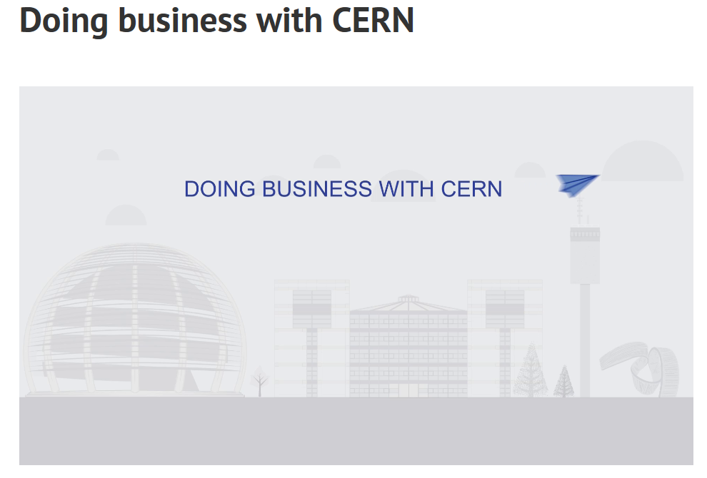
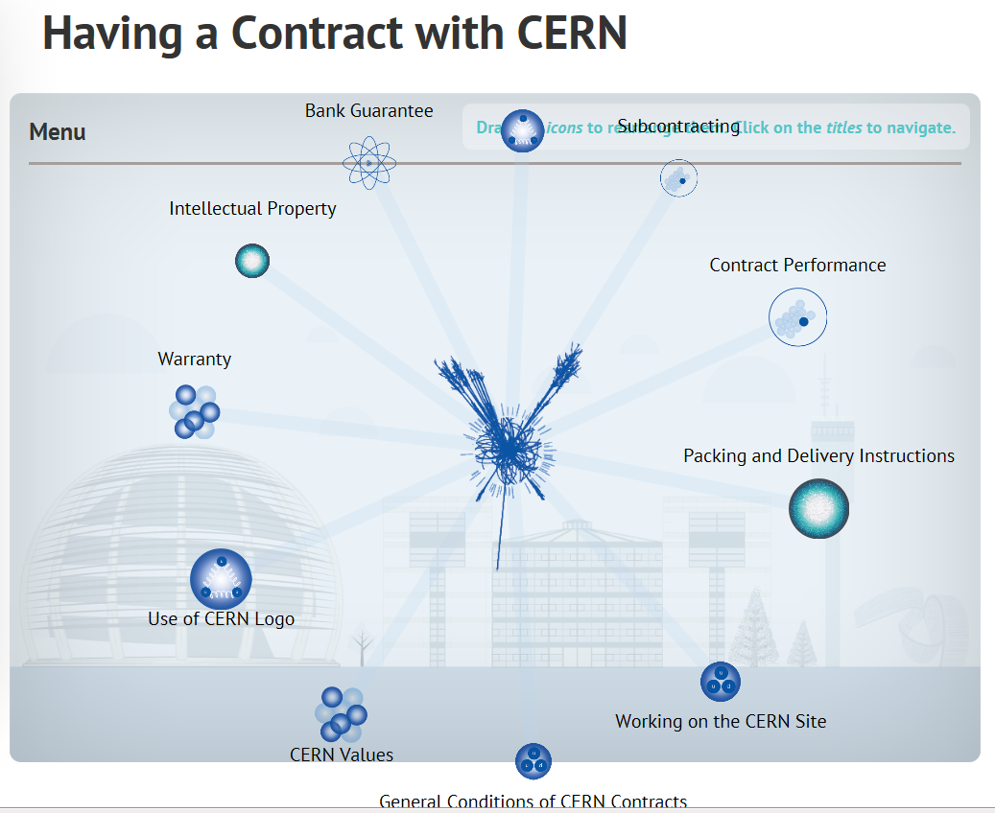
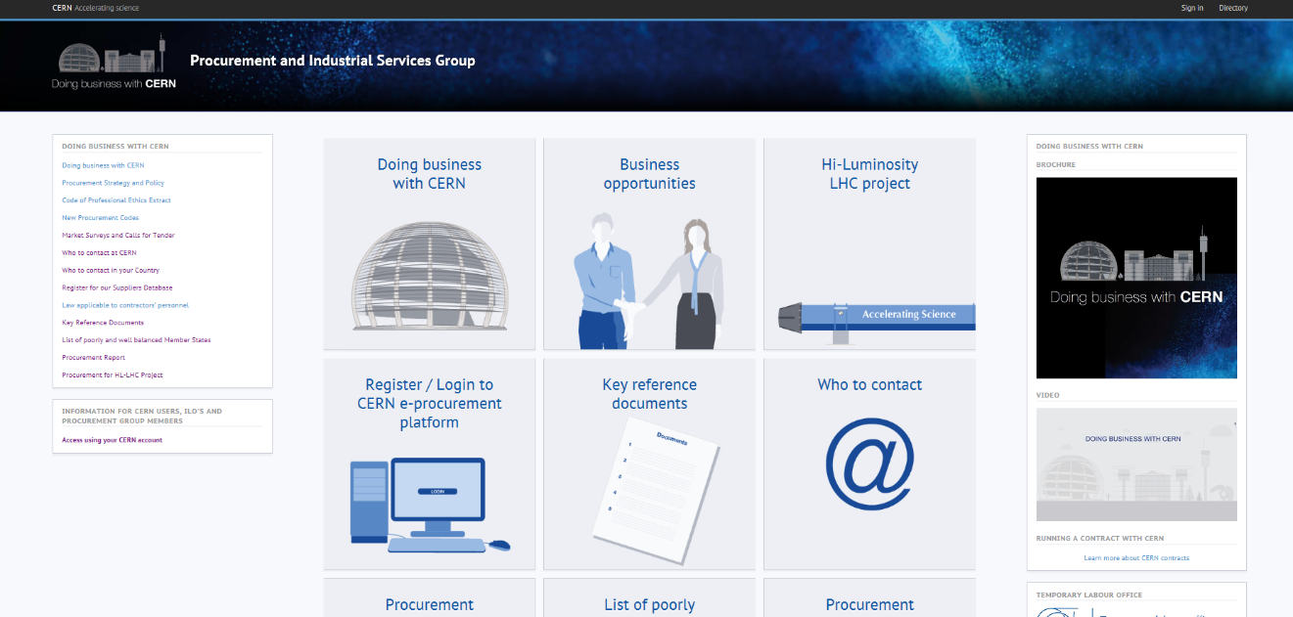
CERN Procurement web site
Procurement web page
http://procurement.web.cern.ch/

Slide 14
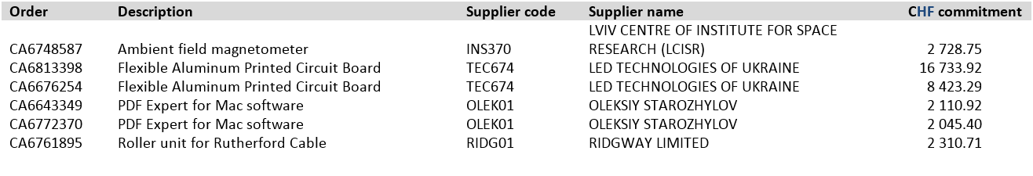
Orders placed in in 2017 (UA as the country of origin)
Orders place for 2018
Supplier name | Description | Country of origin | Amount
Institute for scintillation materials | 1000 bars of scintillator | UA | 360,000 USD

