Slide 2

Learning and working at CERN
Ukraine @ CERN
Anna Cook, HR Talent Acquisition Group
16th June 2017

Slide 3
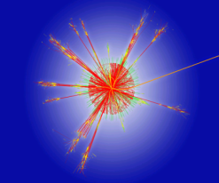
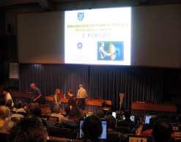

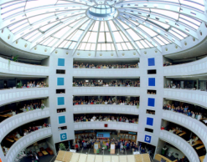
CERN’s Mission
To provide a unique range of particle accelerator facilities that enable research at the forefront of human knowledge
To perform world-class research in fundamental physics
To unite people from all over the world to push the frontiers of science and technology, for the benefit of all.
Research
Education
Technology
Collaboration

Slide 4
CERN’s Structure
DEPTS
Director General
HSE
BE
TE
Finance and Human Resources
EP
EN
FAP
HR
SMB
IT
IPT
TH
Research and Computing
International Relations
DG Units
Accelerators and Technology
GROUPS
SECTIONS
SECTORS

Slide 5
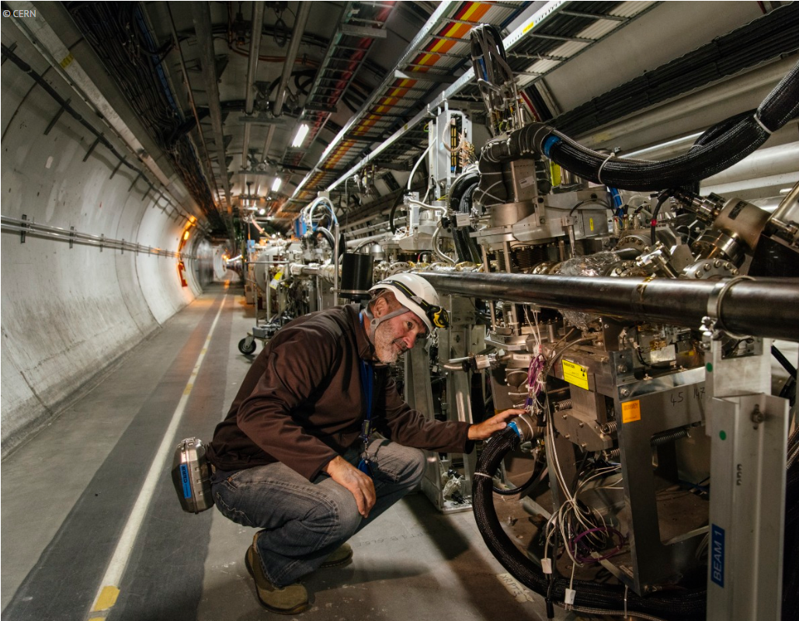
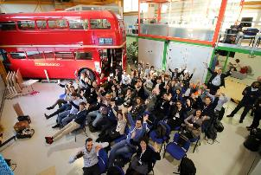
CERN’s Personnel
Employed
(MPE)
Staff members
Fellows
Associated
(MPA)
Associates for the purpose of:
International collaboration
Users
Exchange of scientists
Training
-Students
-Trainees
- Apprentices
Personnel

Slide 6
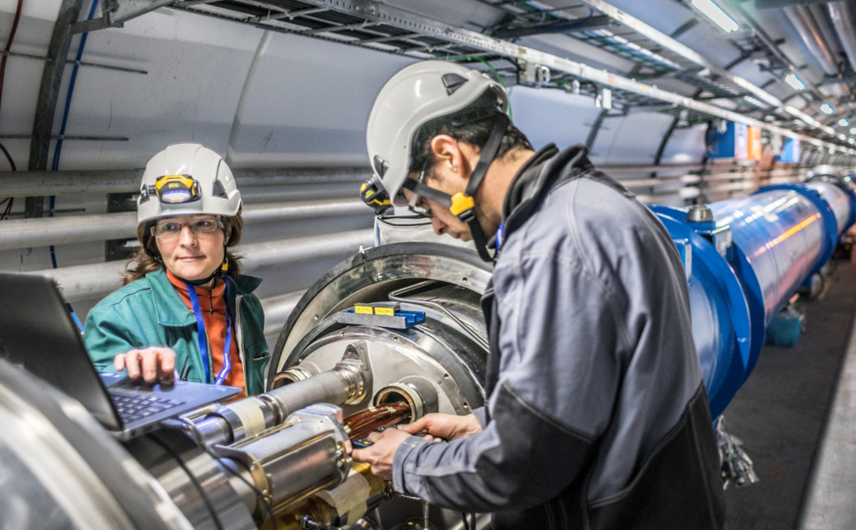
Working at CERN: Who?
790 FELLOWS
1100
ENGINEERS
416
STUDENTS
952
TECHNICIANS
Designed by engineers
For use by physicists the world over
Run by diverse support services
Built by technicians and engineers
3% !
2577
STAFF
239
ASSOCIATES
438
SUPPORT
FUNCTIONS
87
RESEARCH
PHYSICISTS
2577
staff
>11’000 USERS
Data: 1 May 2017

Slide 7
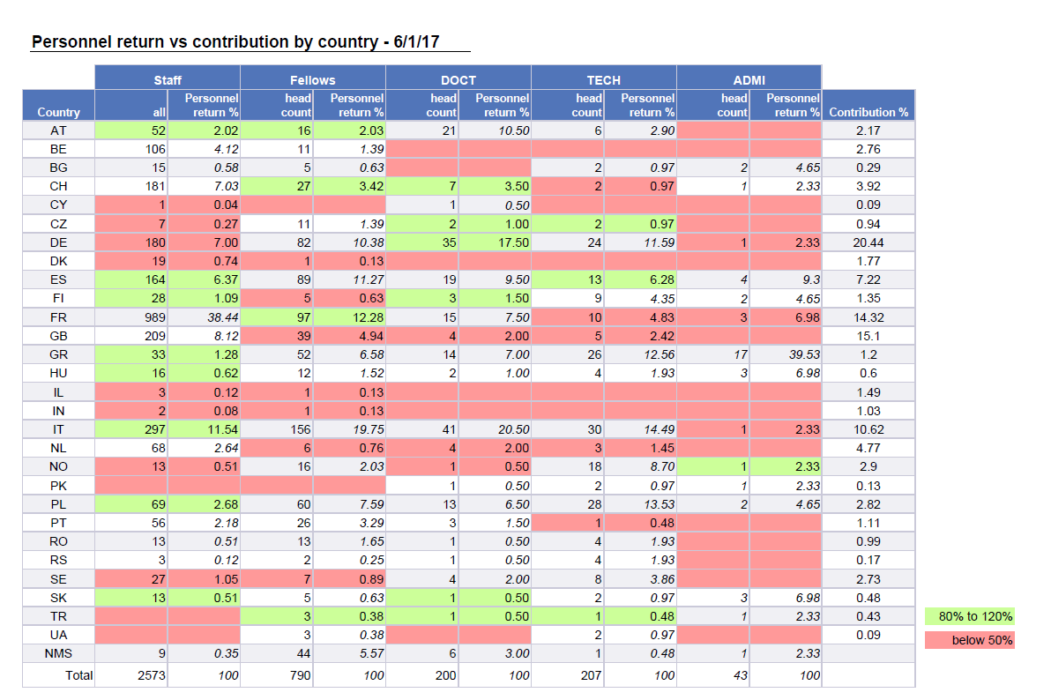
Ukraine @ CERN – a snapshot
AMS since October 2016, 0.09% of CERN’s budget: 1 006 750 CHF (ceiling Proc + Pers)
3 Fellows
2 Technical Students
& 3 Summer Students
Notes:
Not doing so badly for a new AMS
1 Doctoral student with UA as second nationality
Cooperation associates are physicists, engineers or technicians, or those responsible for providing them with administrative support, originating from the Member States, Associate Member States or non-Member States, who are admitted by CERN to contribute on behalf of their home institution to the execution of work under a collaboration agreement between CERN and their home institution. They may come to CERN on an individual basis or as a member of a team.
DOCT, 50k/annum, TECH and ADMIN 40k/annum, Fellows (PHD 120k, MSc, 100k, BSC 80k)
3 fellows and 2 techs = cca 380k – margin for more dep. On procurement

Slide 8
Ukraine @CERN: Building the talent pipeline
Oct. 2016: AMS
Ukrainian Members of FAS evolution over the past 5 years
 |  | 2012 |  |  | 2013 |  |  | 2014 |  |  | 2015 |  |  | 2016 |  |  | 2017
 |  | All | UA | % | All | UA | % | All | UA | % | All | UA | % | All | UA | % | All | UA | %
Associates | CASS | 4 |  |  | 3 |  |  | 7 |  |  | 5 |  |  | 2 |  |  | 8
 | PDAS | 62
 | PJAS | 178 | 1 | 0.5618 | 243 | 1 | 0.4115 | 169 | 1 | 0.5917 | 175 | 2 | 1.1429 | 188 | 2 | 1.0638 | 239 | 2 | 0.8368
 | UPAS | 777 | 4 | 0.5148 | 264 |  |  | 2
 | USAS | 126 |  |  | 74
Fellows | FELL | 540 | 1 | 0.1852 | 566 | 1 | 0.1767 | 617 | 1 | 0.1621 | 645 | 1 | 0.155 | 750 |  |  | 790 | 3 | 0.3797
Students | ADMI | 10 |  |  | 27 |  |  | 26 |  |  | 29 |  |  | 35 |  |  | 43
 | DOCT | 163 |  |  | 172 |  |  | 182 | 1 | 0.5495 | 201 | 1 | 0.4975 | 190 | 1 | 0.5263 | 200
 | TECH | 142 |  |  | 181 | 1 | 0.5525 | 204 |  |  | 176 |  |  | 193 |  |  | 207 | 2 | 0.9662
Total |  | 2002 | 6 | 0.2997 | 1530 | 3 | 0.1961 | 1207 | 3 | 0.2486 | 1231 | 4 | 0.3249 | 1358 | 3 | 0.2209 | 1487 | 7 | 0.4707
Ukrainian Staff applicants evolution over the past 5 years
 |  | 2013 |  |  | 2014 |  |  | 2015 |  |  | 2016 |  |  | 2017
 |  | All | UA | % | All | UA | % | All | UA | % | All | UA | % | All | UA | %
 | Application | 17197 | 34 | 0.2 | 19591 | 54 | 0.28 | 17101 | 40 | 0.23 | 17646 | 74 | 0.42 | 10690 | 65 | 0.61
 | Invited | 486 |  |  | 640 |  |  | 666 |  |  | 653 |  |  | 431
 | Not Attended | 31 |  |  | 25 |  |  | 35 |  |  | 17 |  |  | 16
 | Refused Offer | 3 |  |  | 18 |  |  | 8 |  |  | 9 |  |  | 6
 | Selected | 113 |  |  | 163 |  |  | 162 |  |  | 150 |  |  | 102
Starting to build the talent pipeline

Slide 9
Each year CERN welcomes….
Over 600 Students:
  300 Summer Students
  200 Technical Students
  80 Doctoral Students
  30 Administrative Students
Over 250 Fellows:
  Including 40 – 50 Technician Training Experience fellows
Over 150 Staff
And a number of associates

Slide 10
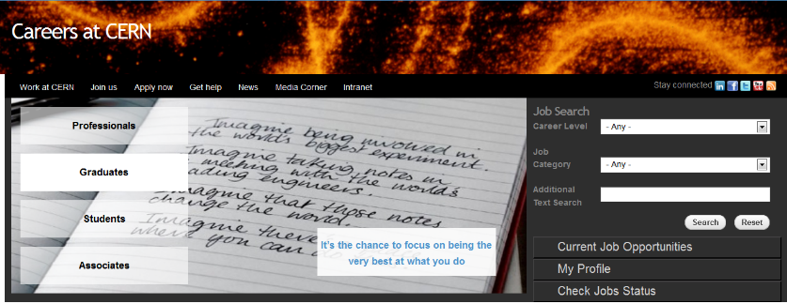
Working at CERN: How?
cern.ch/jobs

Slide 11


Technical Students programme
For students looking for a practical training assignment or who would like to write their bachelor or masters thesis at CERN
~ 200 positions/year
Fields Computing (~50% of the students)
Engineering
Physics (excl. theory and particle physics)
Length 4 to 14 months for technical students
Eligibility 18 months of technical undergraduate studies.
Registered student during stay at CERN
Features Technical project with a CERN supervisor
A living allowance of 3238 CHF
Health insurance provisions
“It’s a great place to start a career,
it’s a great place to learn new skills, make new friends…”
Committees in June and December

Slide 12

Admin Students programme
~ 30 positions/year
FIELDS : Translation, human resources, business administration, law, finance, librarianship, science communication, audiovisual, communication and public relations…
LENGTH : 4 to 12 months
ELIGIBILITY : 18 months of undergraduate studies
FEATURES : an administrative project with a CERN supervisor
a living allowance, incl. health insurance
“My Admin Studentship was a great experience – I had exposure to more activities than I could have imagined”
Committees in June and December

Slide 13

Doctoral Student programme
For students who would like to spend 3 years at CERN to work on their thesis
~80 positions/year
FIELDS : applied physics, engineering, computing
LENGTH : 6 mths -3 years
ELIGIBILITY : enrolled in a doctoral program in
a Member State university
FEATURES : a technical project, leading to a PhD thesis
co-supervised by the university thesis advisor and a CERN staff member
a living allowance incl. Health insurance
“Gave me the opportunity to meet important people, especially in the research fields”
Committees in June and December

Slide 14
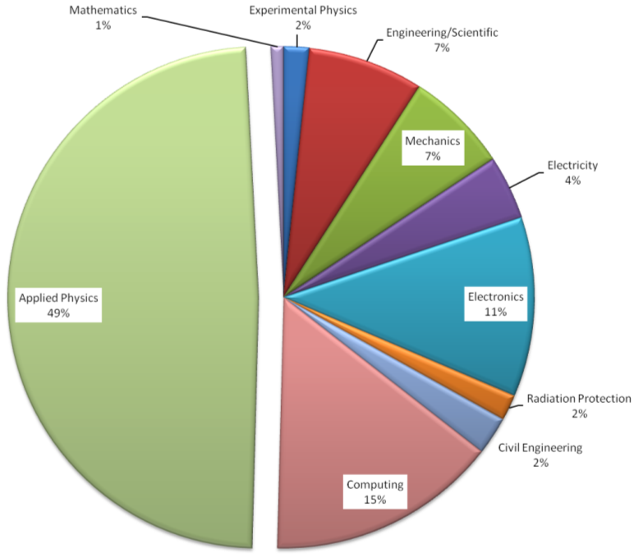
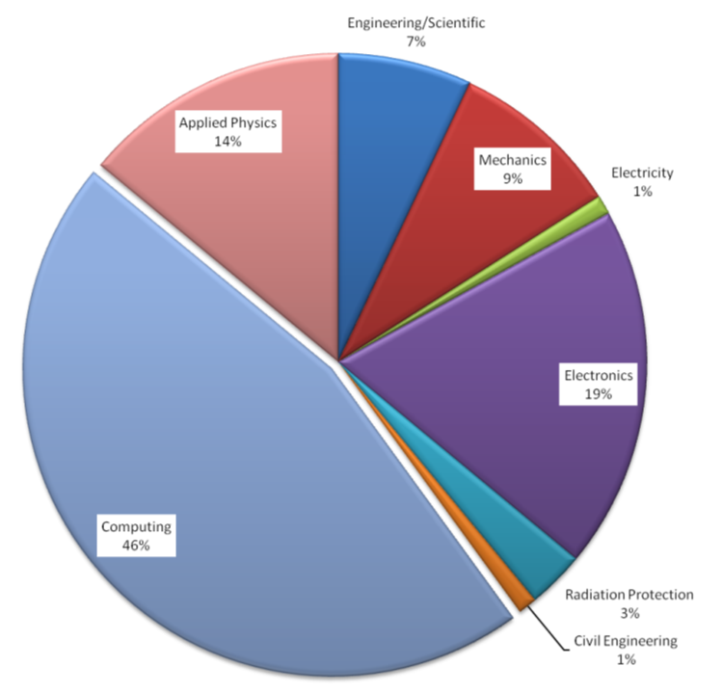

Students by Discipline
Applied Physics
49%
Engineering
40%
Computing
46%
Doctoral Students
Technical Students

Slide 15


Summer Students programme
Participate in the day to day life of a research team and follow lectures.
~300 positions/year (~ 150 for Member States and ~ 150 for Non Member States)
Fields Physics (incl. particle physics) =2/3 of students engineering, computing
Length 8 to 13 weeks, during the summer
Eligibility 3 years of full-time studies at university level
Features High-quality lecture programme over 6 weeks
Visits and workshops
Living allowance of 90 CHF p/d
Health insurance provisions
Accommodation in the CERN hostel
Application & Selection:
Deadline: end January
Web selection: Mid-March
First students arrive beginning June
“Can’t imagine a better way to spend my summer”
Over 6000 young scientists have benefitted to date…
Selection in February

Slide 16


Fellows
~250 positions/year
FIELDS : physics, engineering, computing – from junior engineers to posst-doc research physicists
LENGTH: 2-3 years
ELIGIBILITY : BSc, MSc or PhD
no more than 10 years relevant post-MSc experience
FEATURES : employment contract
attractive salary incl. social benefits
training and networking
Fellows are normally nationals of the Member States of CERN. There also exist a limited number of places for Fellows from non-Member States.
“An ideal place to follow
the most recent ideas in physics
and start new collaborations”
Committees in May and November

Slide 17

Marie Sklodowska-Curie
For university graduates
FIELDS : physics, engineering, computing
DURATION: up to 3 years
ELIGIBILITY : MSc or PhD
≤5 years post-degree experience
FEATURES : funded by the European Commission
an employment contract with CERN
specific Marie-Curie vacancies published on CERN web pages
an attractive salary, social benefits, allowances
international network

Slide 18


Technician Training Experience
~30-50 positions/year
FIELDS : Mechanics, electronics, electricity, etc.
ELIGIBILITY : Technical diploma
no more than 4 years relevant experience
SELECTION: All applications for TTE opportunities will be considered by a panel of CERN specialists.
FEATURES : An initial contract of one year renewable for a second year
Project with CERN supervisor
  Training and networking (on the job, formal, languages)
  Employment contract with attractive salary incl. social benefits
“I never imagined the possibilities CERN would offer me.”
Committees in June and December

Slide 19

Staff positions
~ 150 positions/year
(> 200 in 2017)
FIELDS : physics, engineering, computing, technicians, administrative staff
ELIGIBILITY : from apprenticeship to PhD
SELECTION: advertised on cern.ch/jobs
application via the website
Asynchronous video-screening (Sonru)
Interview at CERN (typically 4 invited)
FEATURES: up to 5 year initial limited duration contract
competitive salaries incl. social benefits
relocation expenses
training (language courses, technical training)
“It’s the chance to focus on being the very best at what you do.”

Slide 20
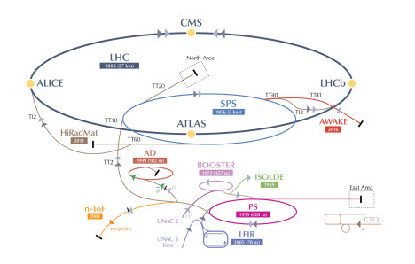
Associates
Scientific Associates
Experienced individuals on leave of absence
mainly in physics
Normally 12 months (24 months max)
Cooperation associates / Users
Scientists (including PhD students in physics)
Corresponding Associates
Experienced individuals from smaller Member States on
leave of absence mainly in physics
Up to 6 months
Project Associates
Physicists, engineers and technicians invited by
Departments (according to agreements)
Up to 3 years

Slide 21
PROJECT ASSOCIATES (PJAS)
  PJAS are scientists, engineers or technicians admitted by CERN to contribute their expertise on behalf of the Home Institution to the execution of project related activities
  They are invited directly by the Departments
  An Agreement is set up between CERN and the institute
  Departmental secretariat gathers all required documents and sends them to HR for verification and contract issuing.
  Conditions:
  PJAS must remain employed with the Home Institute (note: students cannot become PJAS)
  Duration of stay: 1 month to 36 months max.
  CERN pays a subsistence to cover costs in the area:
  CHF 4128 (supplement of CHF 1000 if family joins for at least 6 months)
  Social security to be provided by employer

Slide 22

Outreach
You can download our materials from our careers site, media corner

Slide 23
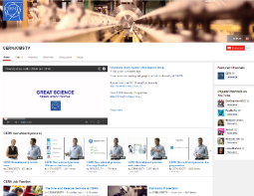

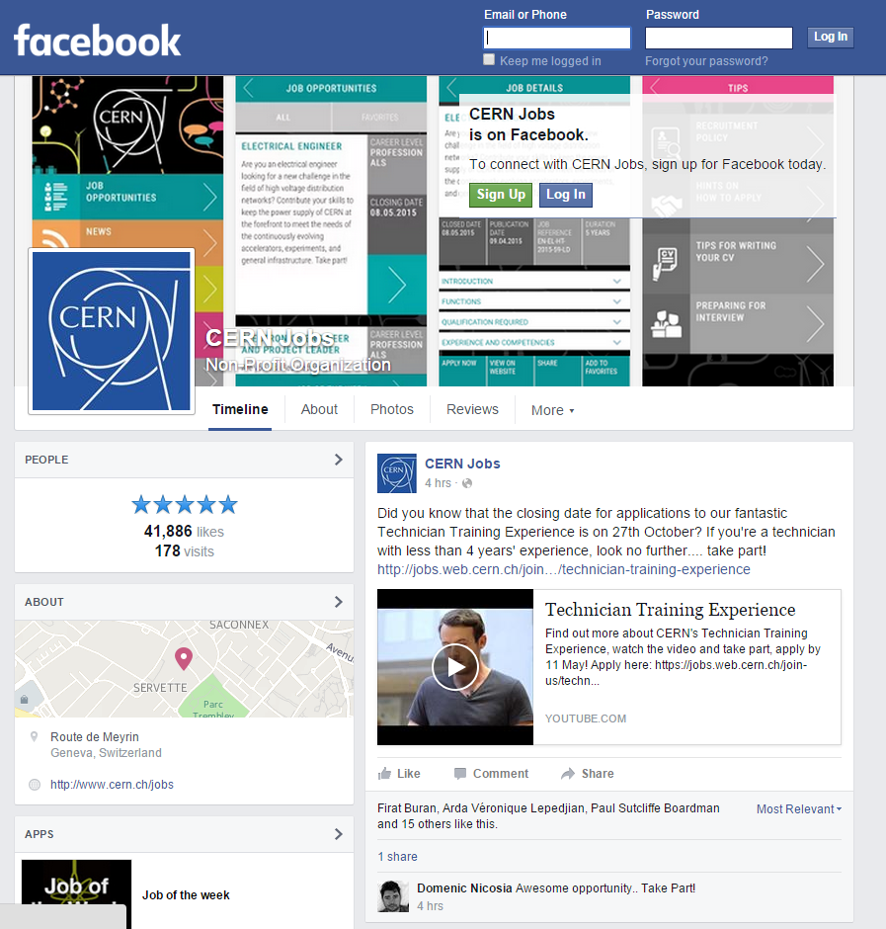

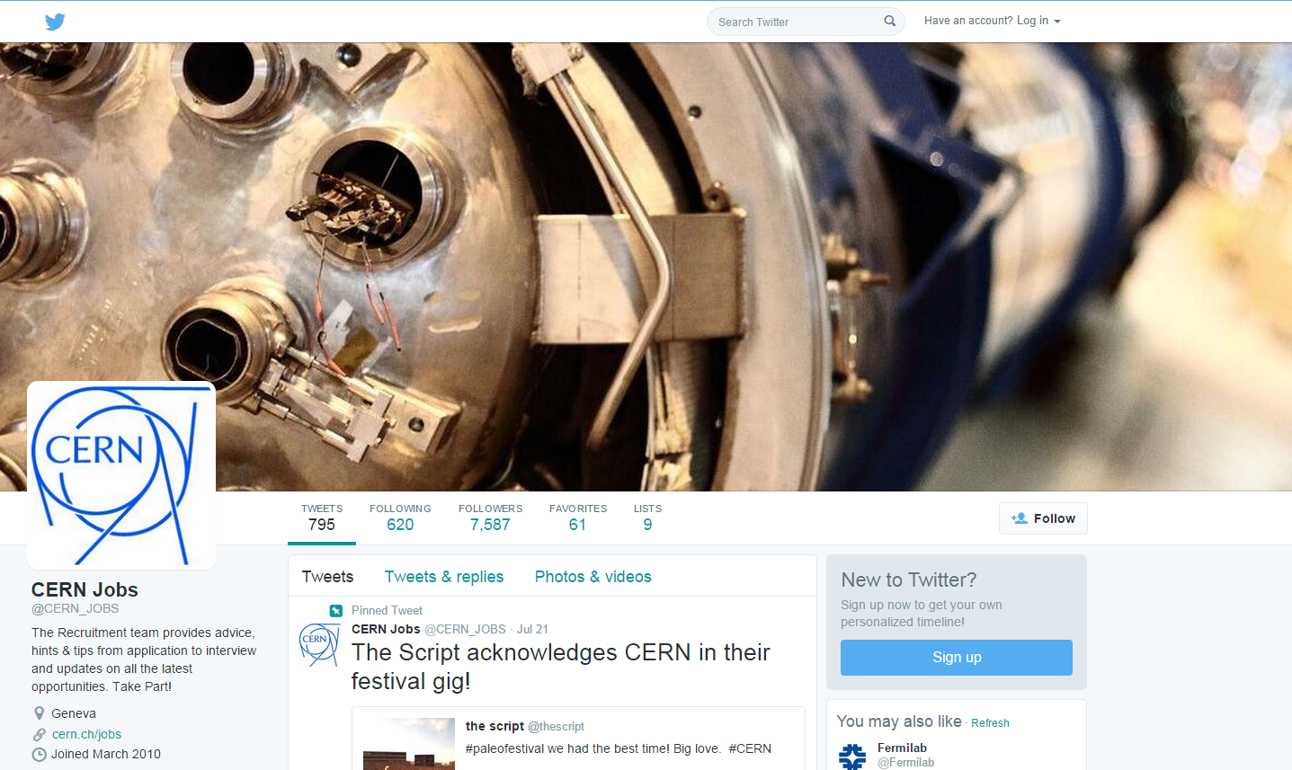



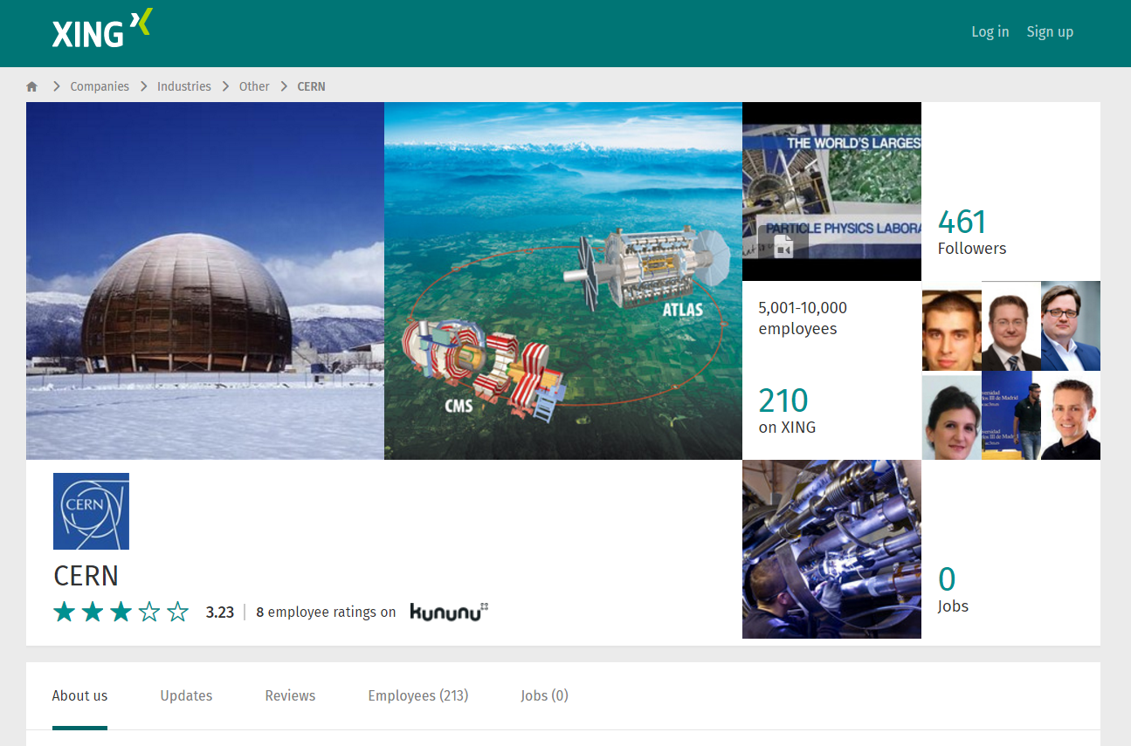
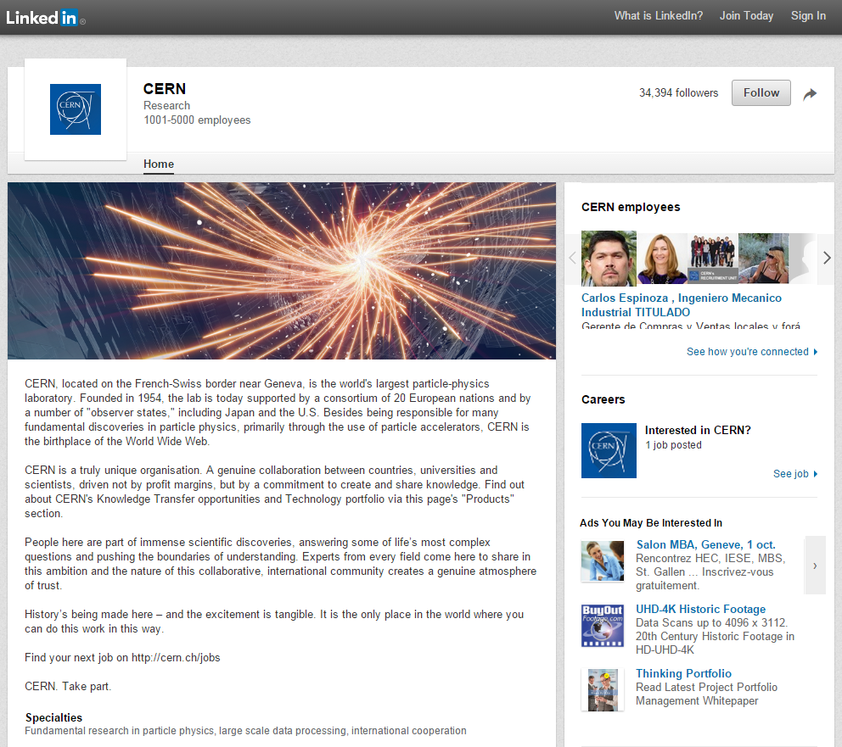
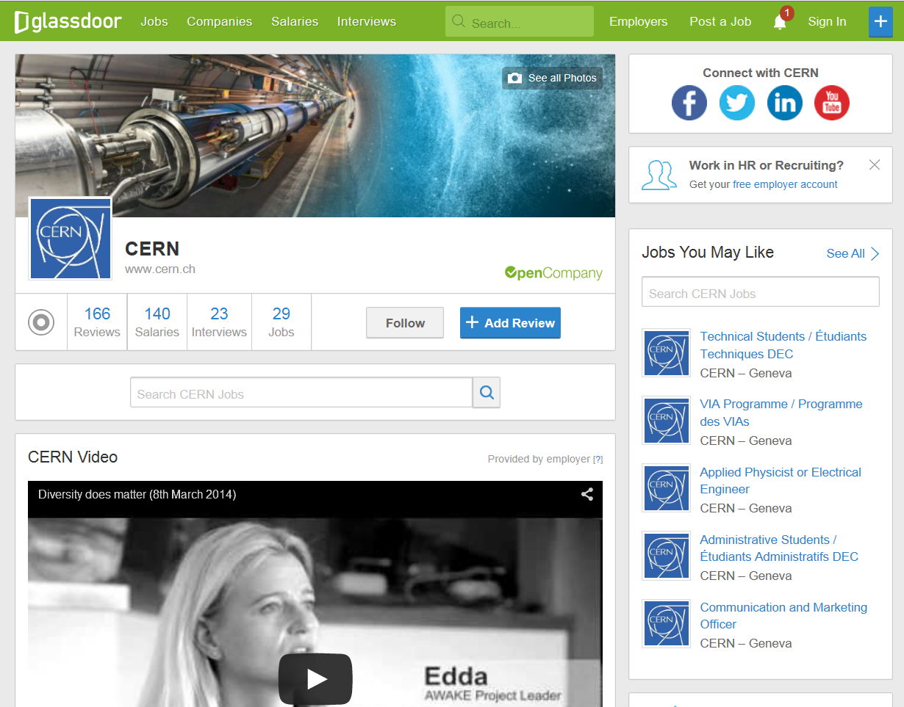

Follow us! “CERN Jobs”
@CERN_JOBS

Slide 24
Conclusion
CERN offers a multitude of first-class learning and working opportunities
in a high-tech, multi-cultural environment
providing
essential and world-class recognised capabilities for capacity building
equipping
the next generation of scientists, engineers and technicians
TAKE PART!

