Slide 1
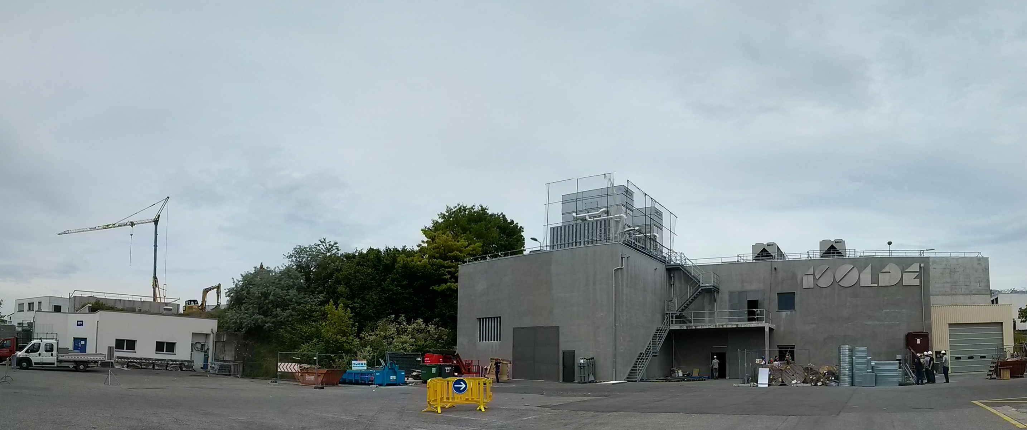

ISOLDE physics coordinator report: INTC 28th June 2017
Karl Johnston
Sebastian Rothe/Thierry Stora
(on behalf of Richard Catherall)
Technical developments/MEDICIS
Planning for 2017
Schedule so far: preparation for HIE-ISOLDE
Safety/collections

Slide 2
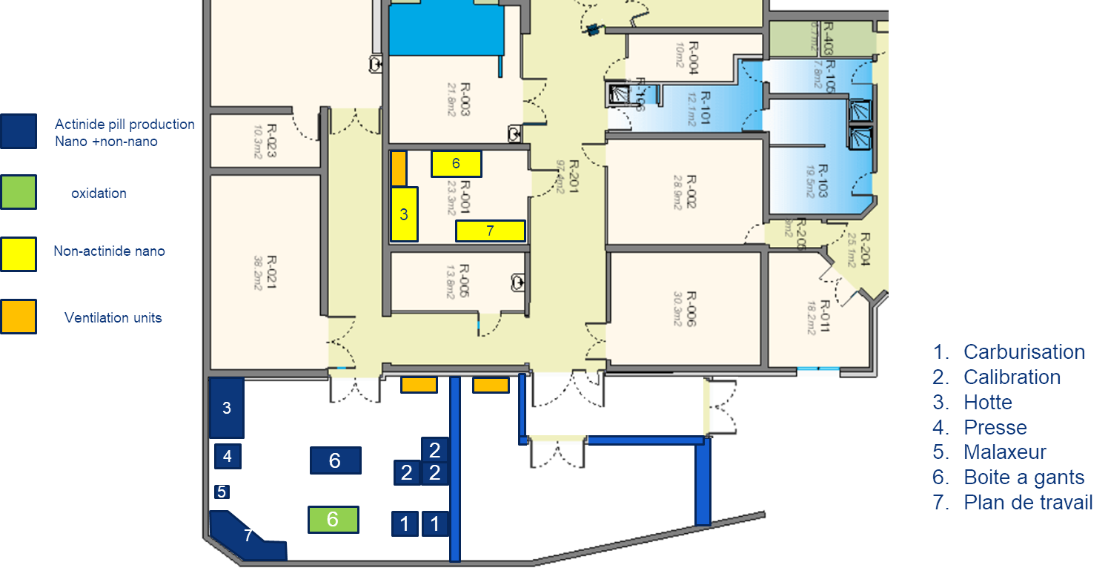
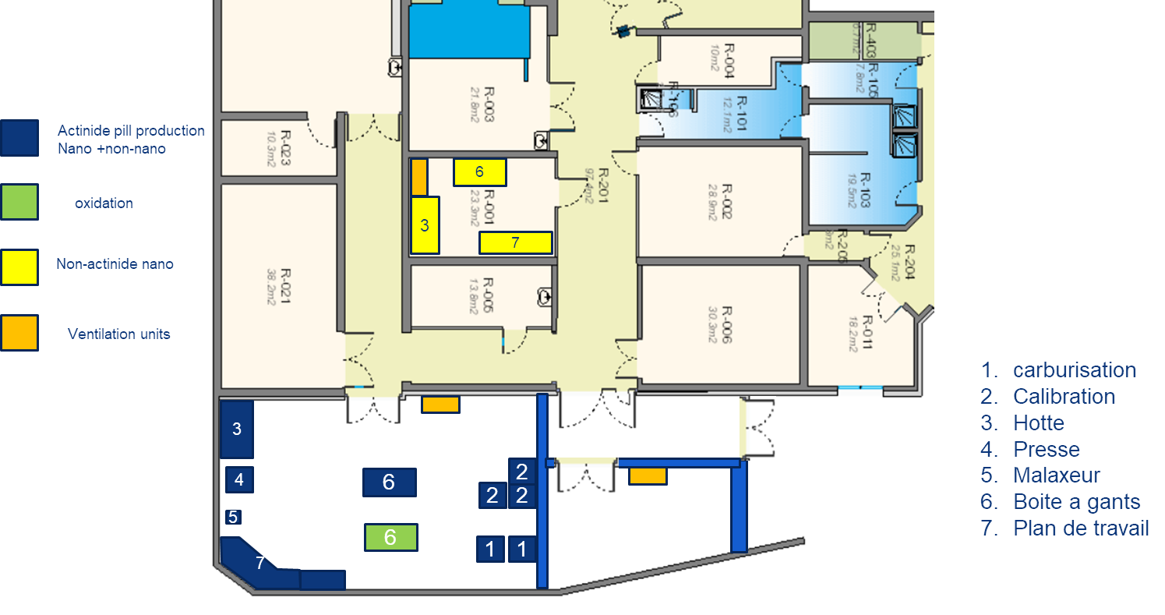
Nanolab
Option 1
Option 2
Funding secured for dedicated nanolab for production of nanostructured materials (including actinides)
Connection of ventilation foreseen in 2019

Slide 3
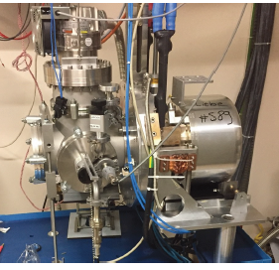
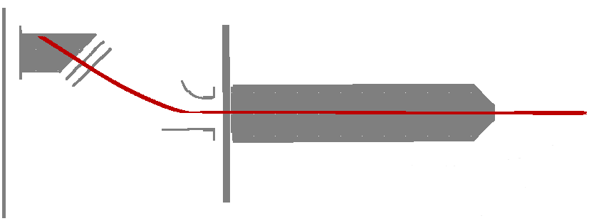
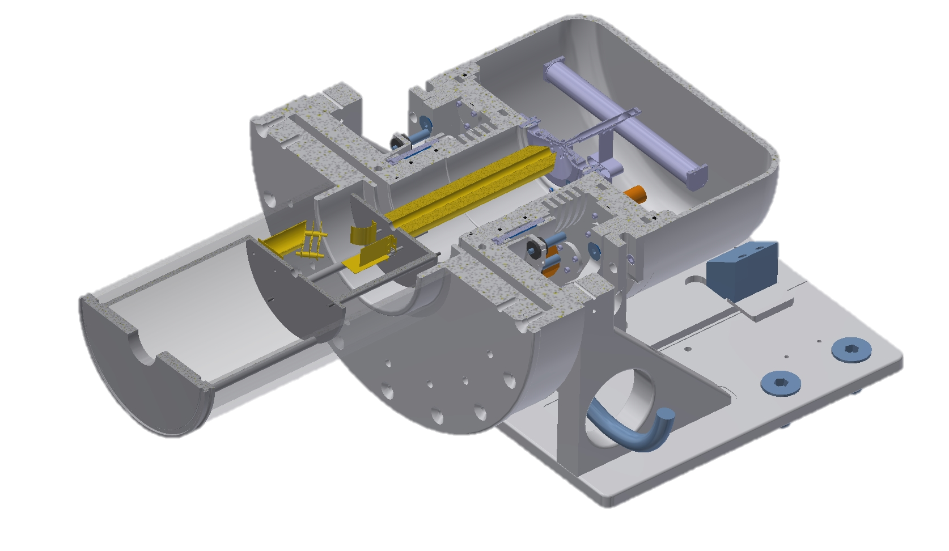
Dedicated test stand for ion source development
Main features:
ion beam extraction and detection
residual gas analyzer (RGA)
automated control and data recording
First application:
negative ion source development
investigation of source poisoning and regeneration
Future plans:
long-term performance studies
thermal stress tests
destructive tests -> operational limits & failure mode analysis
extraction electrode
deflector
Faraday cup
ISOLDE calibration stand
integration
David Leimbach

Slide 4
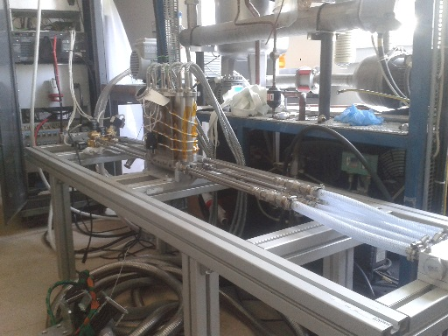
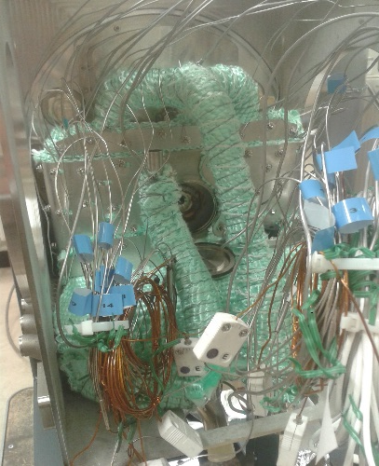
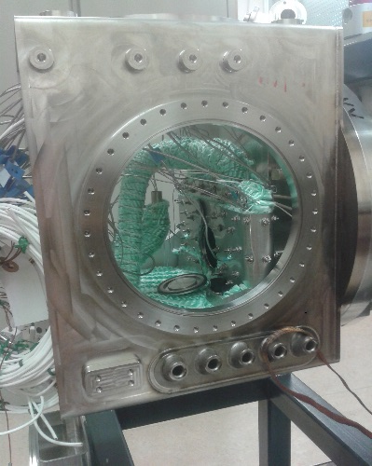
LIEBE Project
Present activities
Description
Schedule
Experimentally confirm the power extracted by the heat exchanger.
Under preparation,
starting 2nd week of July.
HEX test
Offline tests starting mid-August
LIEBE target ready to go online mid-November
Image of the installation to test the HEX
Ongoing:
Difficulties due to the geometry of the target.
Diffusion chamber vacuum test
Test to confirm good enclosement of the chamber.
Pump vibration tests at IPUL
Ongoing: finishing by end of July
Actual state of the LIEBE target ongoing vacuum tests
Slide curtesy of Ferran Boix Pamies

Slide 5
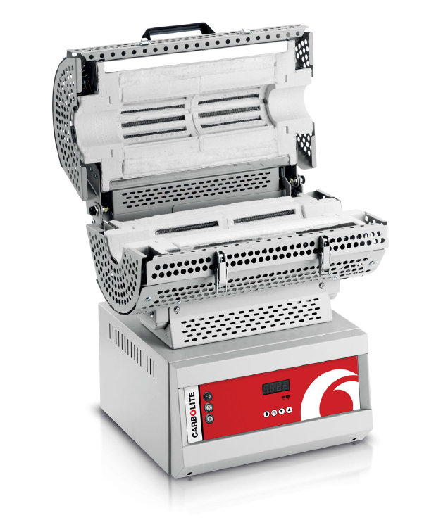
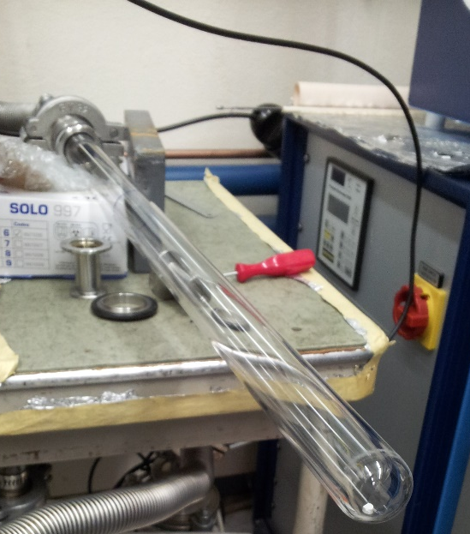
Dedicated oven for CaO production
Target unit building
Glove’s box for material transfer into unit (very sensitive to CO2 and H2O)
Calibration Target + Ion Source
Offline tests
ISOLDE
Material production
CaCO₃ → CaO + CO₂
About a week to produce material in pump stand
Current issues:
Thermocouple positioning difficult (can’t trust readout)
  Use pyrometer but readout is difficult in the 700 – 800 °C range
Thermal gradient in the container makes process much longer than should
CaO production unit difficult to handle in gloves box
Precise control of temperature
Temperature uniformity
Higher quality CaO
Quartz tube easy to handle in glovesbox
Production will be reduced to half-day.
J.P. Ramos, et al.

Slide 6
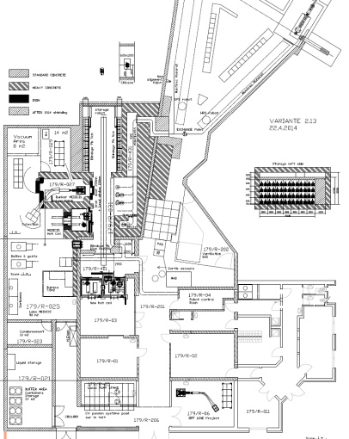
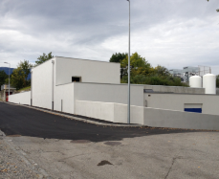
The facility today and the remaining Work Packages
Groundbreaking ceremony
3rd September 2013
MEDICIS
Target
Irradiation
Rail
Conveyor
System
Building reception
15th October 2014
MEDICIS
Laboratory
Installation of beamline and laboratory: ongoing
Commissioning & start-up end 2017 *
*Pending budget, management and safety clearance

Slide 7
Some MEDICIS milestones
Ventilation and cooling
Magnet from Leuven refurbished
Personal Protection System (PPS):
Commissioned last week
Remote handling : Robot + Rail Conveyor

Slide 8
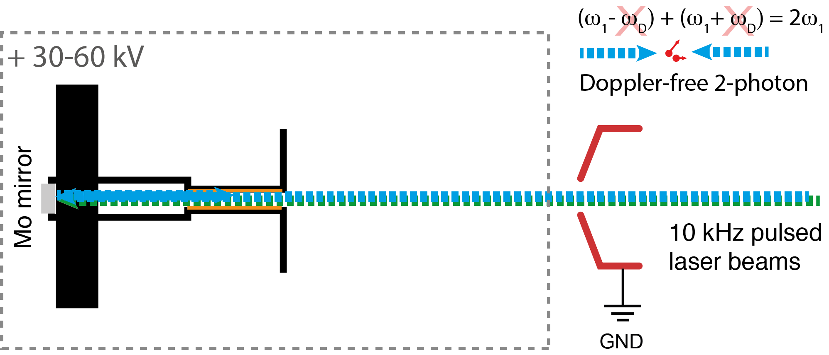
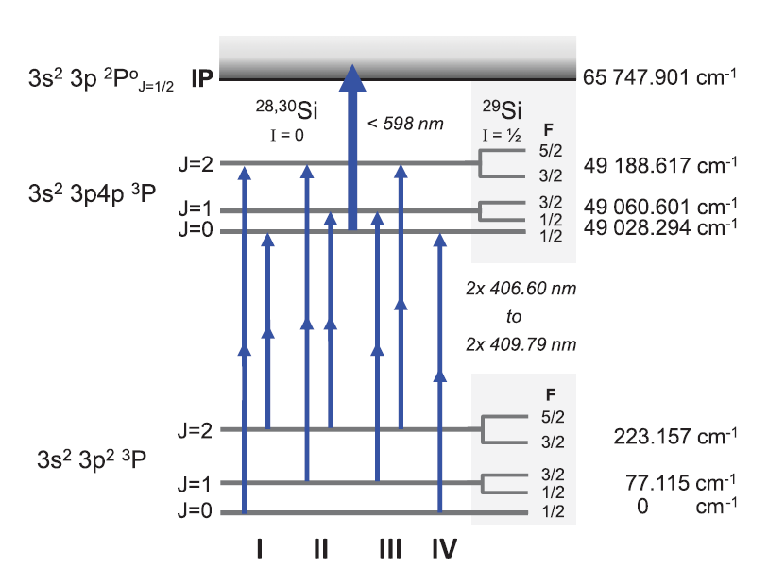
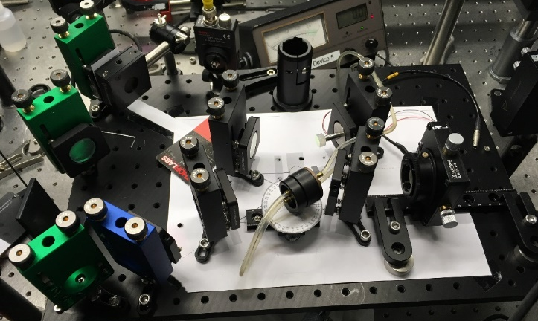
Towards high resolution 2-photon spectroscopy
Si 2-photon scheme
Status:
- Feasibility demonstrated in Mainz for Rb
- First broadband tests at ISOLDE:
1 and 2-photon schemes demonstrated
Seeded NB TiSa cavity constructed and under further development
Target unit was successfully operated with Mo ‘mirror’ installed at the back of the transfer line.
New TiSa bow-tie (ring) cavity for high resolution
Kati Chrysalidis – PhD work

Slide 9
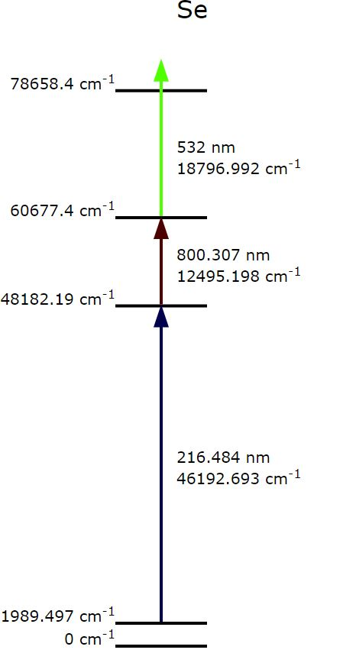
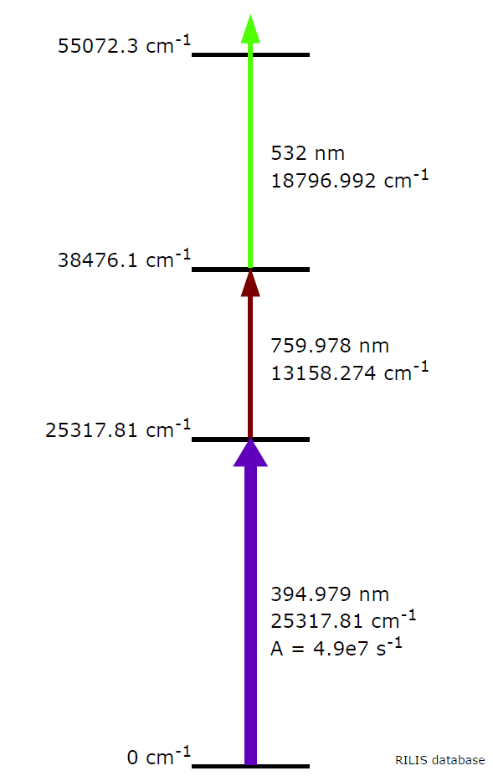
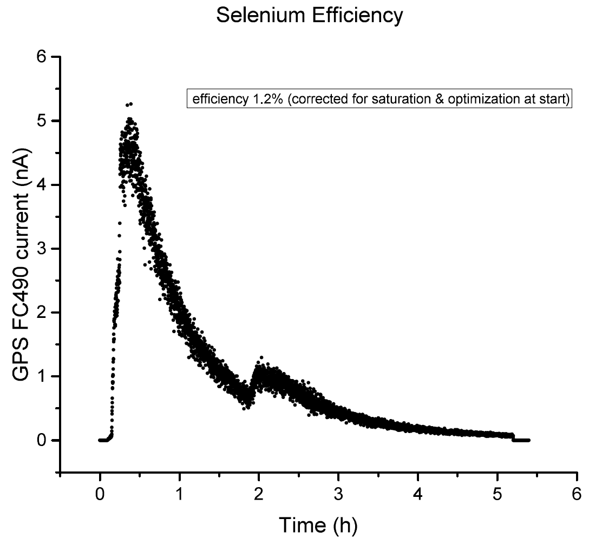
Scheme development 2017 (so far)
Selenium: first laser ionized Se at ISOLDE
→ Yield tests will be done during HIE-ISOLDE period
Titanium: new scheme tested successfully on stable Ti
UCx was not ideal target material for radioisotope production
More tests with other foil target to follow
>1.2 %
efficiency
Se
Ti
Kati Chrysalidis – PhD work

Slide 11
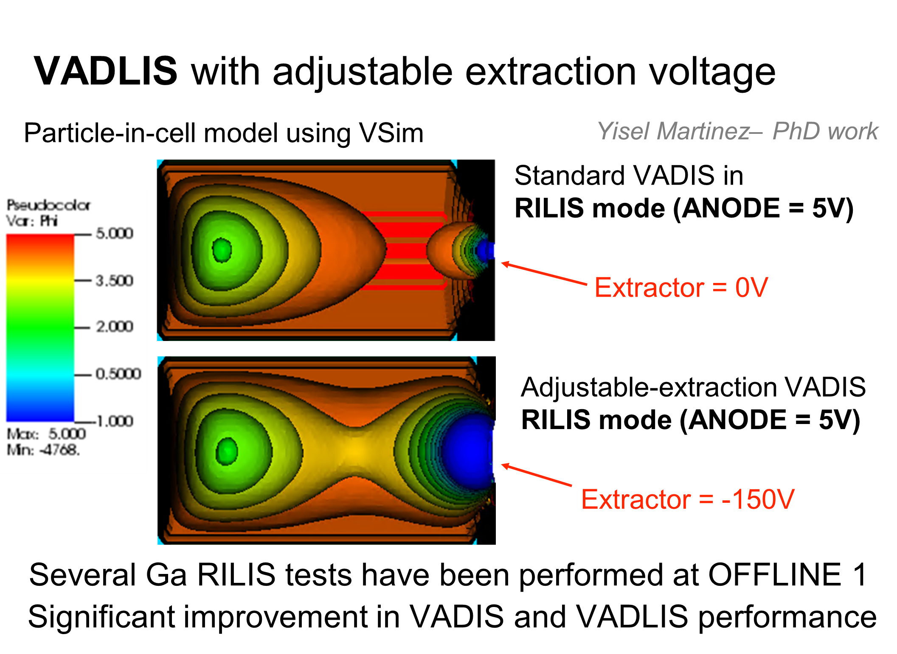

Slide 12
Row Labels | Sum of Requested shifts (summary)
Biophysics | 8
COLLAPS | 25
Collection | 7
CRIS | 50.5
GANDALPH | 9
HIE | 583
IDS | 49.001
ISOLTRAP | 41
LA1 | 22
Medical | 10.5
NICOLE | 8
SSP | 88
TISD | 17
VITO | 18
Windmill | 16
(blank) | 41
Grand Total | 993.001
49 HIE-ISOLDE Experiments; 27 requested beam in 2017

Slide 13









ISOLDE Schedule 2017: weeks 17 - 36
XT03
(Windmill)
Good runs for:
IDS: In and B
VITO: 35Ar (part I)
CRIS: In
SSP: Mg/Mn: RILIS was problematic
Windmill/IDS: Bi beams (booster problems)
*IS528: pending safety clearance
Difficult/cancelled runs for:
ISOTRAP: broken target
COLLAPS: Al HRS setup
CRIS: K isotopes target?
~ 100 shifts delivered so far
Need to check earlier re-used targets, allocate time in cold check-out.
New control room can lead to distance from machine…
We are here
IS617
Target change
CERN holiday
Setting up/proton scan/yield
Physics GPS
Physics HRS
RILIS run
KJ: 27.06.17

Slide 14
Some RILIS issues in 2017
TiSa chiller failure: Friday June 9th @ Midnight
Consequence:
Temporary loss of Tisa beam for Mn ionization
Solution:
Quick intervention from on-call RILIS member (Dima) who was able to replace the chiller and regain RILIS operation during the night
A replacement pump for the chiller will be installed in July
RILIS air conditioning failure
Consequence:
Extremely difficult to maintain stable RILIS conditions during the Mn/In run in June
Solution:
RILIS team provided round-the-clock on-site assistance during the weekend of 10 June
Technical operation team repaired the Air conditioning system during the weekend.

Slide 15
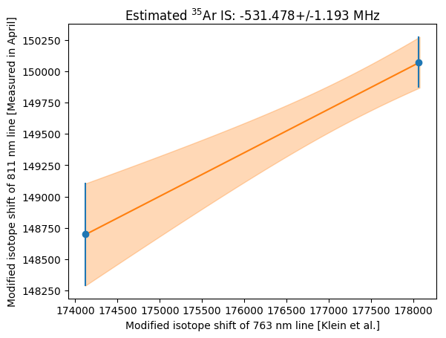
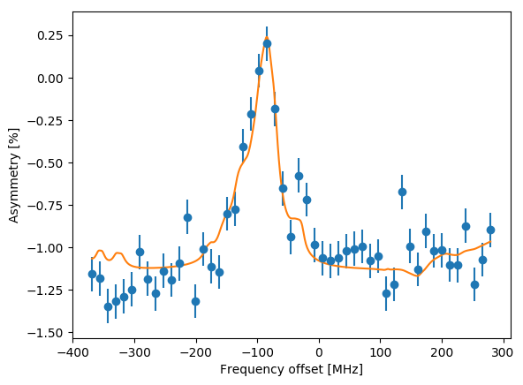
First run on ³⁵Ar at laser polarization beamline
Final aim of the experiment:
measure beta decay asymmetry parameter of 35Ar mirror decay using spin polarized beam
-> determine Fermi to Gamow-Teller ratio
-> contribute to determination of Vud CKM matrix element
Aim of May beamtime: identify host material with longest relaxation time for final experiment
Stable beam: bunched beam laser spectroscopy on ^{36,40}Ar
Radioactive beam: β-asymmetry scans, relaxation time and decoupling curve measurements for several crystals

Slide 16
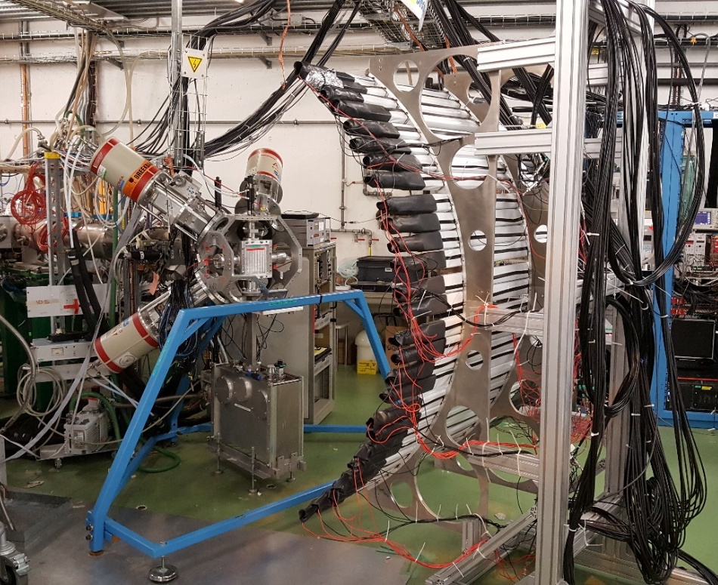
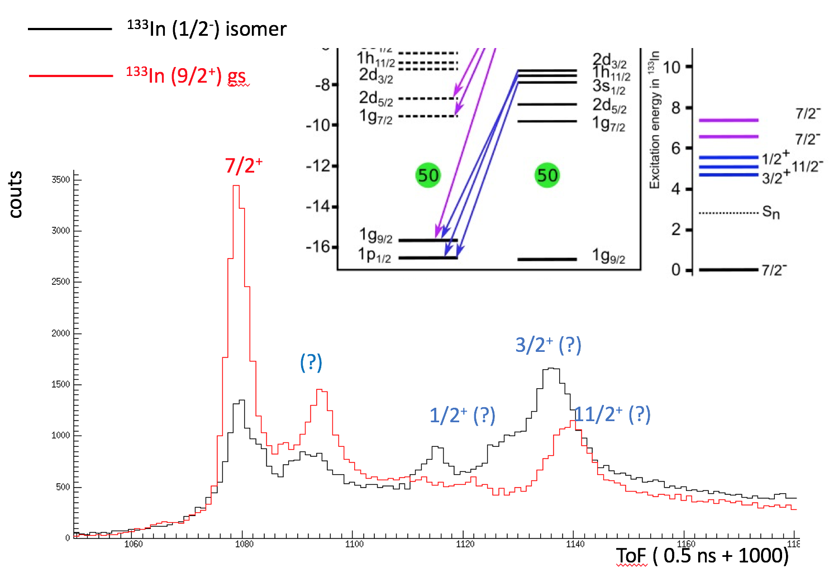
IS632 at IDS: Neutron unbound single particle states in ¹³³Sn from the beta decay of ¹³³In
The IDS Neutron Detector and HPGe Clovers were used
ToF calibrations with ¹⁷N from the HRS CaO target.
Production of ¹³³In ~ 900 ions/uC (~70% transmission from GPS)
Using RILIS, both isomer and gs in ¹³³In were selectively ionized
Clear resonances were observed, to be clarified in the offline analysis using neutron-gamma coincidences

Slide 17
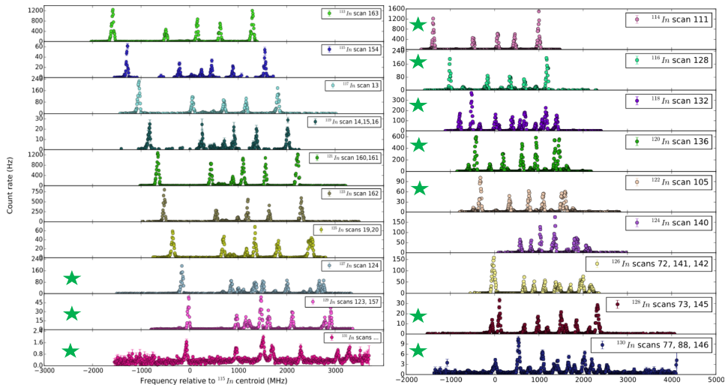
RESULTS CRIS Experiments on neutron-rich In
From ¹¹³In up to ¹³¹In
( New results )

Slide 18
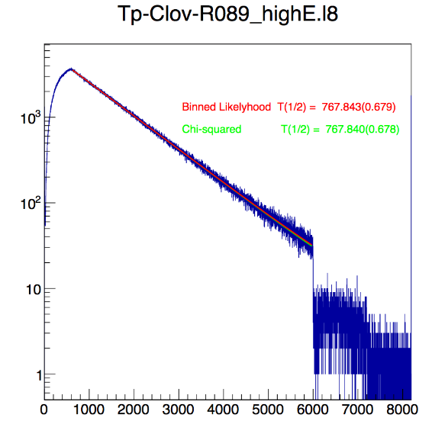
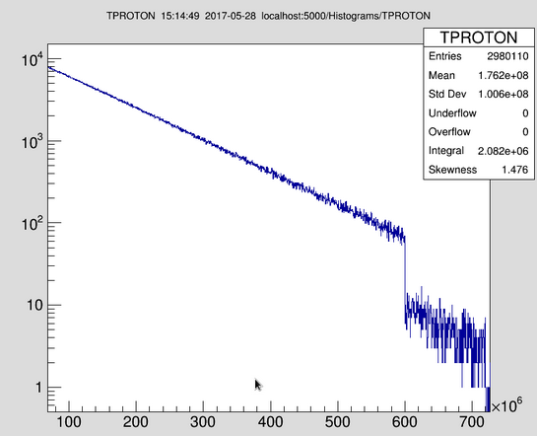
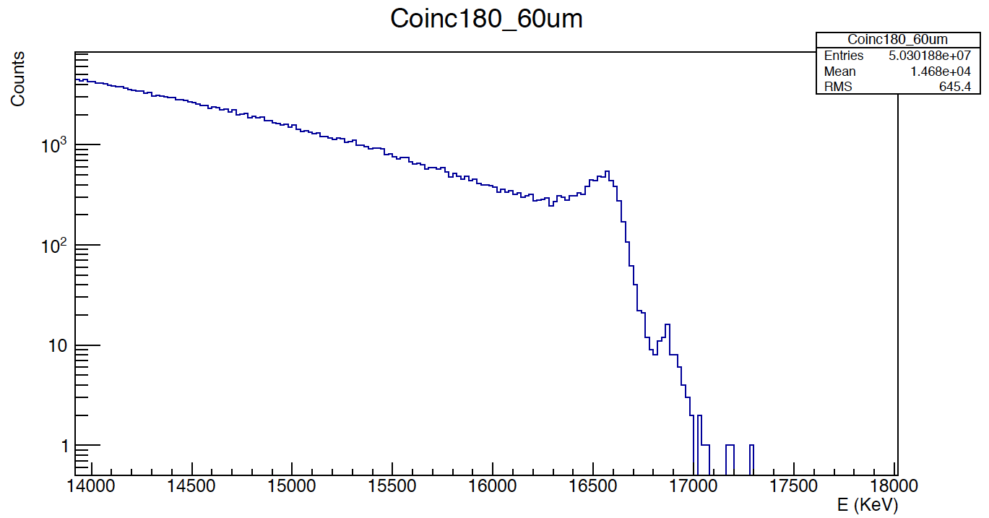
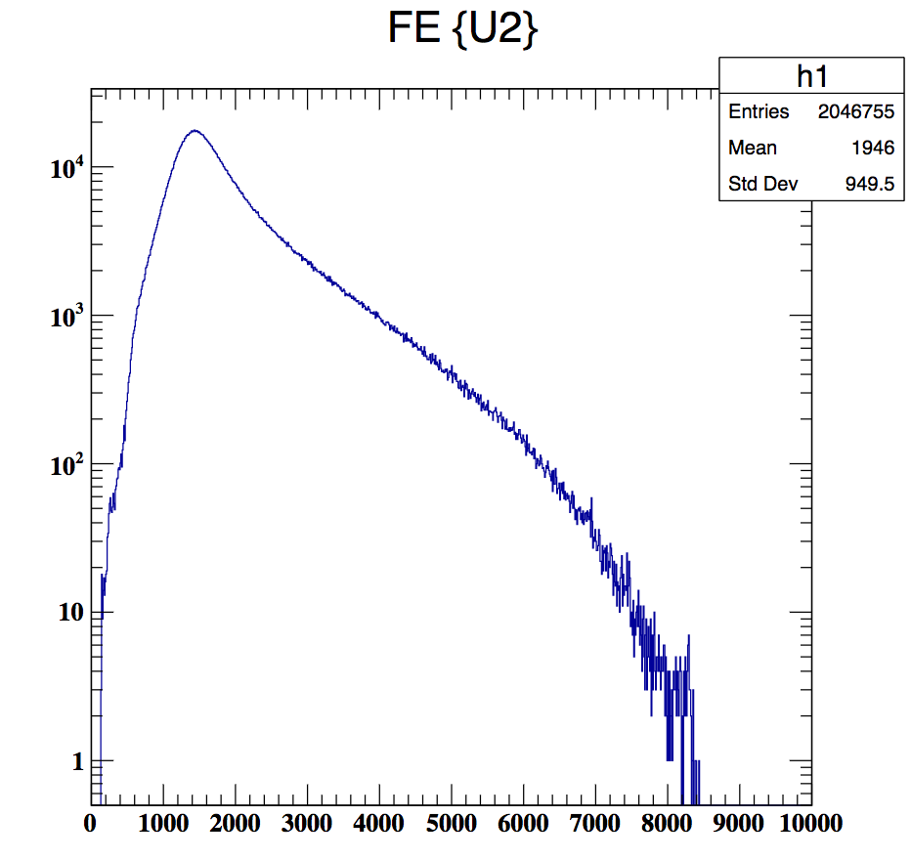
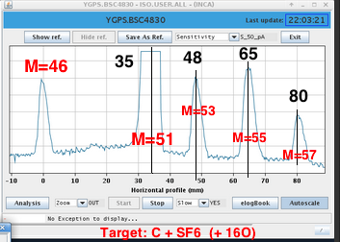
Electron capture of ⁸B into highly excited states in ⁸Be. IS633@IDS
9 shifts 26-29 May 2017
⁸B Half-life from 511 in glovers
⁸B Half-life from alphas
Half-life can be improved
to 0.1% level
alpha-alpha coincidence in 180 degrees in the 60 μm detectors. File83
→ 100 events in peak @ 16,9 MeV. → we got well the statistics promised i.e. > 500 events in this peak
⁸B β decay via 3.03 MeV
M46: BF₂ yield about 40k ⁸B/μC

Slide 19

IS634: Fluence dependence of interstitial ²⁷Mg in GaN
Complex balance of interstitial vs substitutional Mg as function of temperature, doping type and implanted fluence
reason: amphoteric character of Mg and its interaction with Ga vacancies
Mg_{i} + V_{Ga} → Mg_{Ga}
Impact: prospects for more efficient p-type doping of GaN
(high-power electronics, optoelectronics…)
Continuing our work initiated in
Phys. Rev. Lett. 118, 095501(2017)

Slide 20
K experiment at CRIS - IS620
Spectra from COLLAPS 2012
^{38g,m}K similar production yields
Goal of the experiment:
Measuring the hyperfine structure of ^{52,53}K
Investigating the proposed shell closers at N=32,34
Experiment could only access long-lived K isotopes ³⁸⁻⁴⁸K --due to the unusual performance of the target
However,
CRIS measured the hyperfine structure of ³⁸⁻⁴⁸K
  Using the new laser stabilization system
  With one spectrum of ⁴⁹K (only at the beginning of run)
Performed systematic studies – the effect of:
  Laser power
  Timing of laser pulses
  on the resolution/line shapes in hyperfine spectra
Spectra from CRIS 2016
^{38m}K was not released from target
^{38m}K ?

Slide 21
Break down of shift requests for 2017: HIE-ISOLDE

Slide 22

Draft planning 2017 (timetable no longer valid…but experiments essentially the same). Some limits on HIE…(manpower)
GPS
(1)
(2)
(4)
(3)
(5)
(7)
(11)
(13)
(9)
(10)
XT03
XT03
HRS
Te TISD has been performed. Experiment probably can’t run with Cs contamination. Require LIST/Molecular beam
(6)
(8)
(12)
Focus on GPS for HIE ISOLDE. Potentially good for laser spectroscopy
~ 13/27 experiments possible
~ 235 shifts for HIE ISOLDE
XT03
Setting up
HIE – ISOLDE physics
Low energy physics

Slide 23
HIE ISOLDE next week: 72Se followed by 70Se
Miniball took 22Ne last weekend
XT03 campaign in week 34

Slide 24
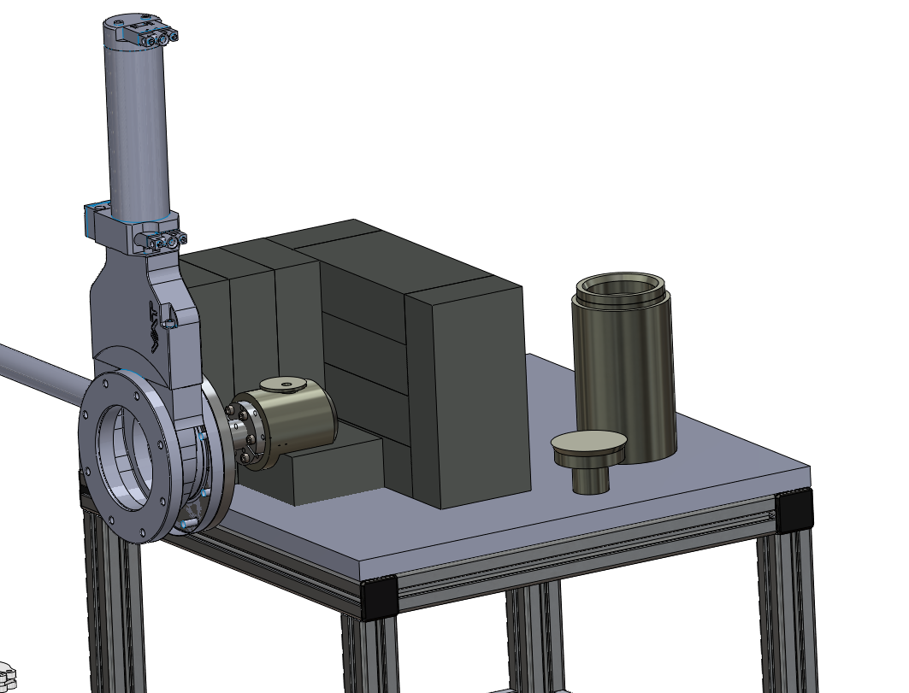
Collections at ISOLDE
2016, monthly finger dose threshold passed during collections of Tb isotopes for medicine
Visit and response from OFSP required improvements in how collections are planned at ISOLDE. (especially for extremity doses)
New chamber being finalised for medical isotopes.
Restrictions have also affected the solid state programme (even though the dose rates are far below medical collections).
Currently a very heavy load in terms of preparation, but also for RP.
Review of the situation may ease some of these issues.

Slide 25
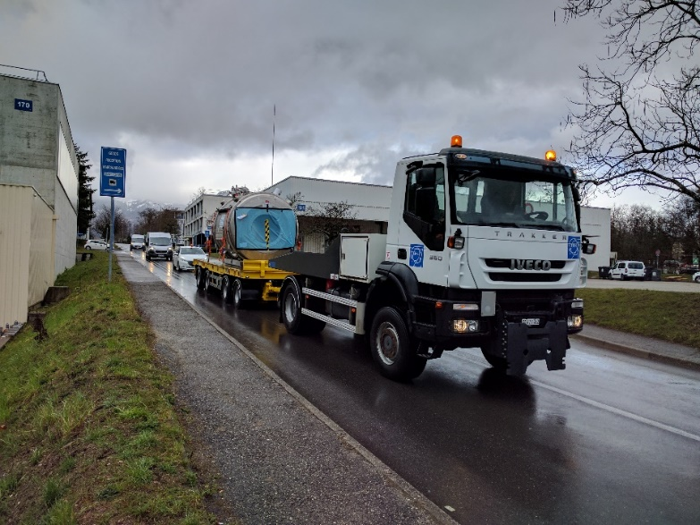
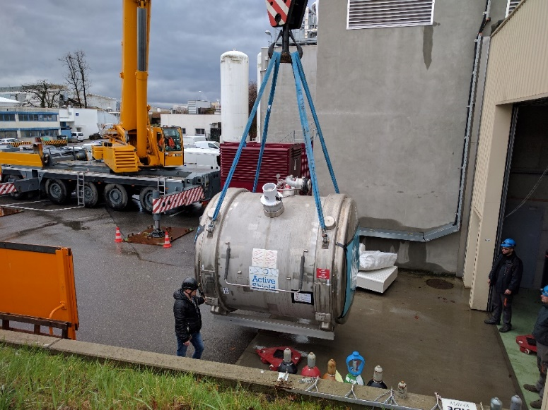
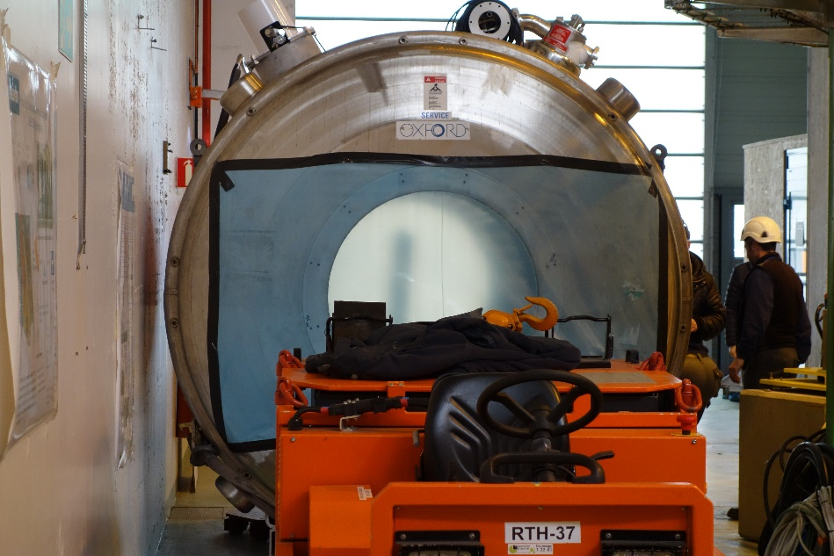
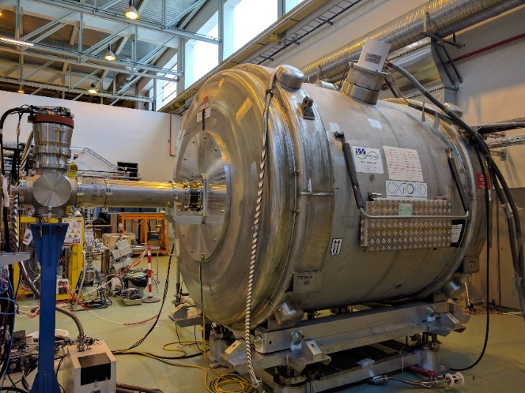
Arrival and installation of ISS: ready for stable beams late in the year?
Also, successful re-energising of the WISARD magnet to 9T….

Slide 26
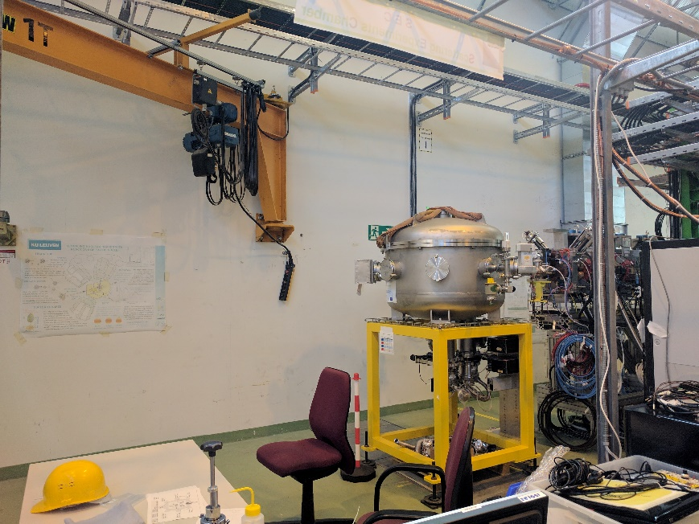
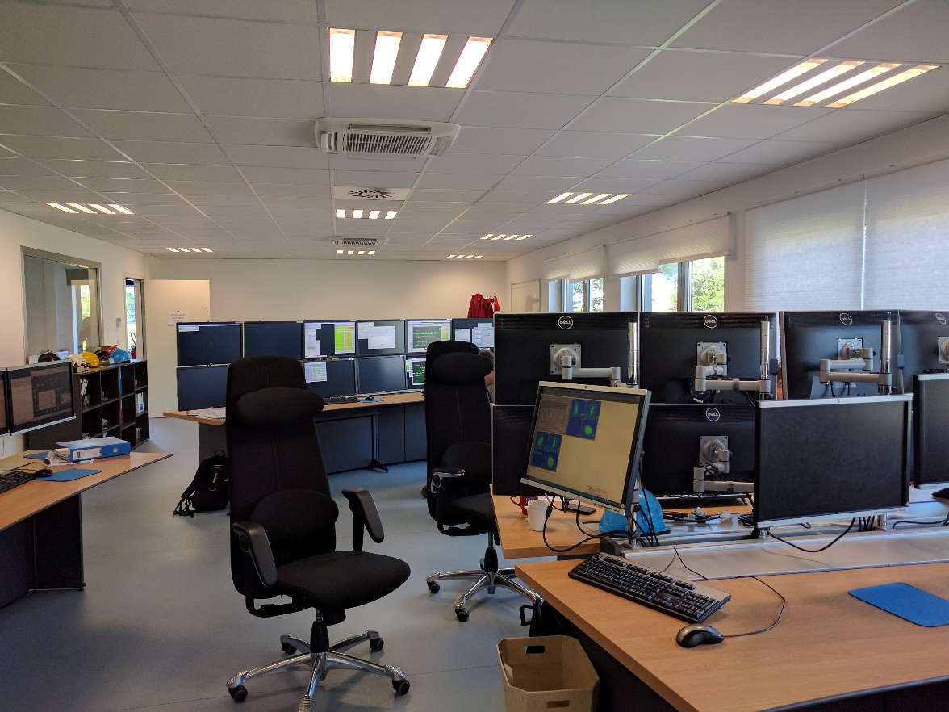
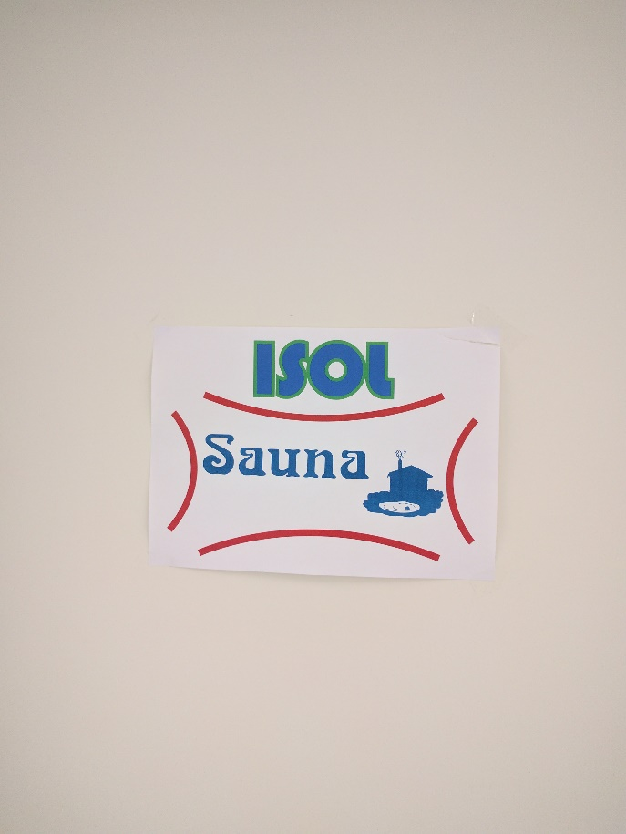
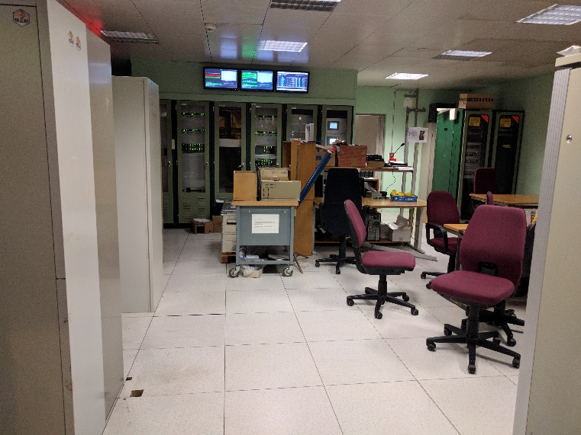
Installlation of XT03
Old control room: 22 new cabinets on order: re-arrangement in July

